Slide 1

WIT Diversity Talk with
John Ellis interviewed by
Sudeshna Datta- Cockerill

Slide 2
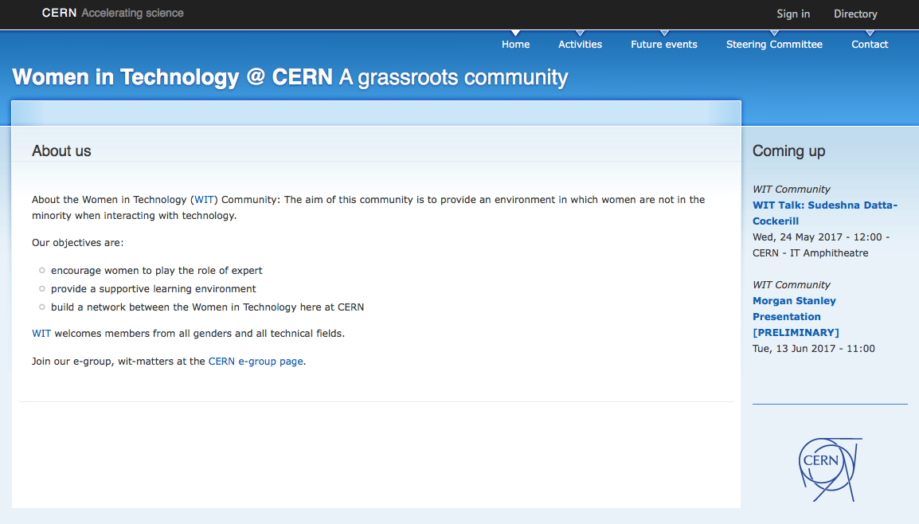
Want more information? Visit cern.ch/wit

Slide 3


Slide 4

CREDITS
Special thanks to all the people who made and released these awesome resources for free:
Presentation template by SlidesCarnival
Photographs by Death to the Stock Photo (license)

