Slide 1
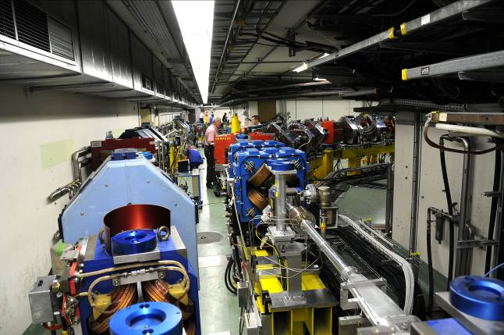
CTF3 commissioning status
& schedule update
Outline
Activities & achievements:
  Successful 4x recombination
  More than 5 A sent through the PETS
  Time to bunch length experiments
Setbacks:
  Lapp BPM
  Phase of MKS02
  Gun

Slide 2
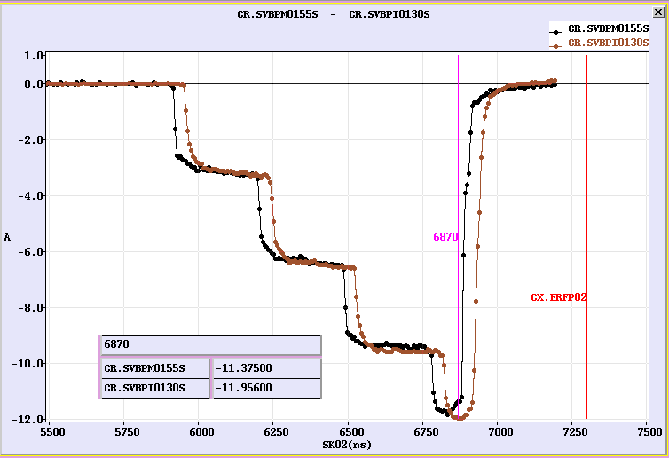
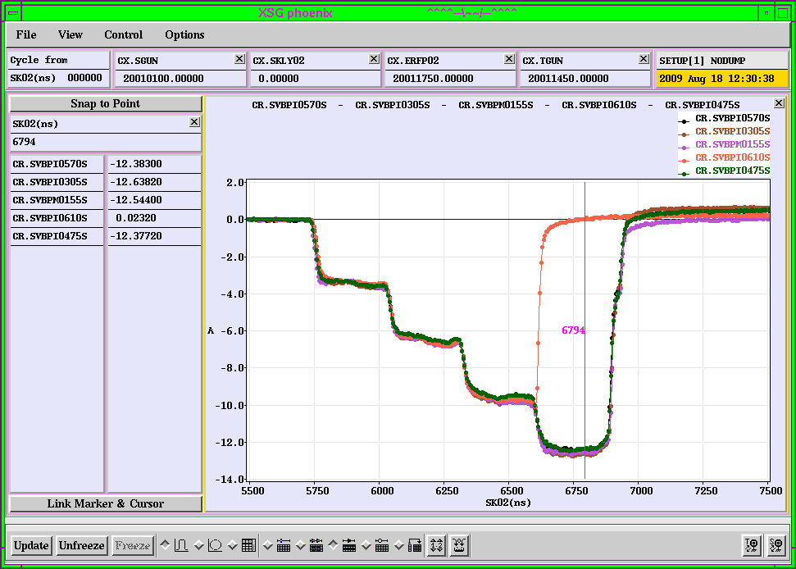
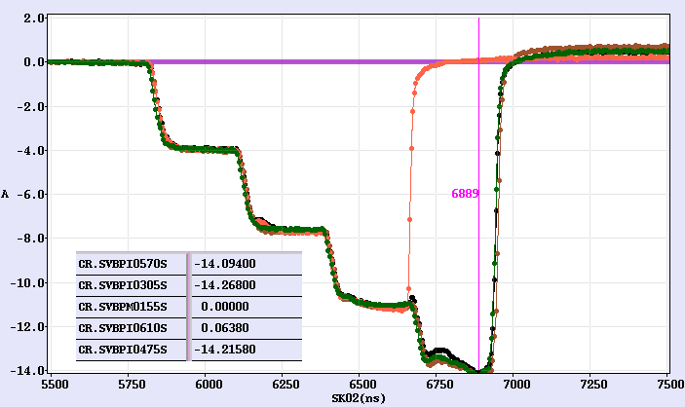
2008
Aug. 2009
13 A 280 ns recombined in the combiner ring

Slide 3
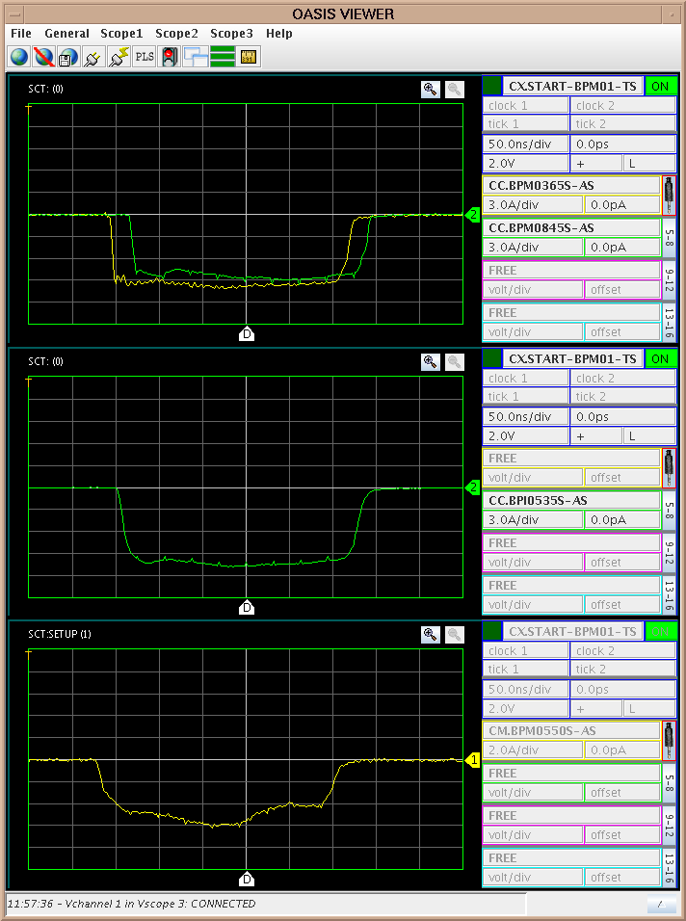
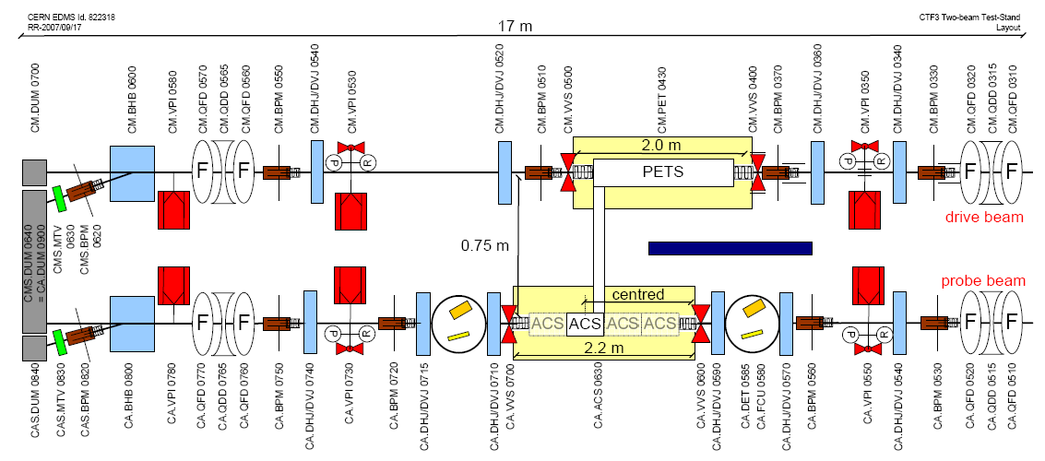
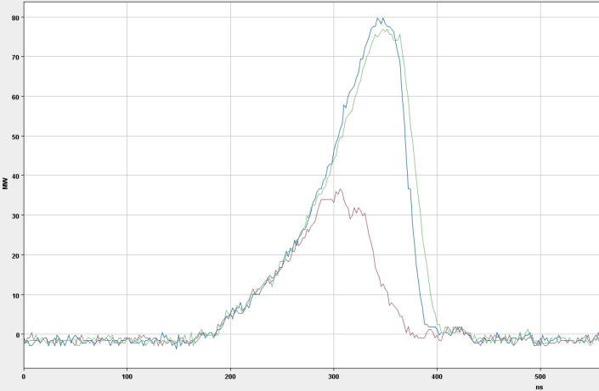
About 6 A after the PETS

Slide 4
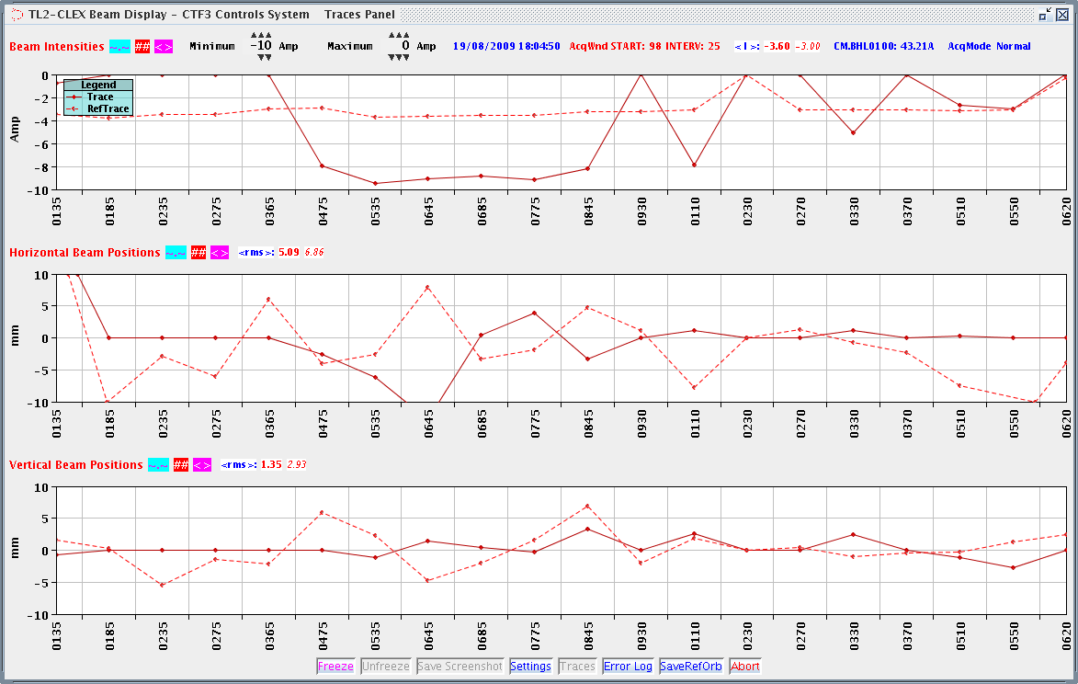
Other issues:
Lapp BPM:
  Frequent interventions are needed (also accesses in the machine)
  Almost constant contact with the LAPP people – local help from Franck Guillot (CERN)
  Annoying system (necessary to readjust all the timings one by one after each frequent reset)
  At the present we are blind for the majority of the line
Phase of MKS02 jumps of some degrees:
  Monitoring system installed
  At the moment the problem disappeared
Gun instability:
  Problem solved (for the moment…)

Slide 5
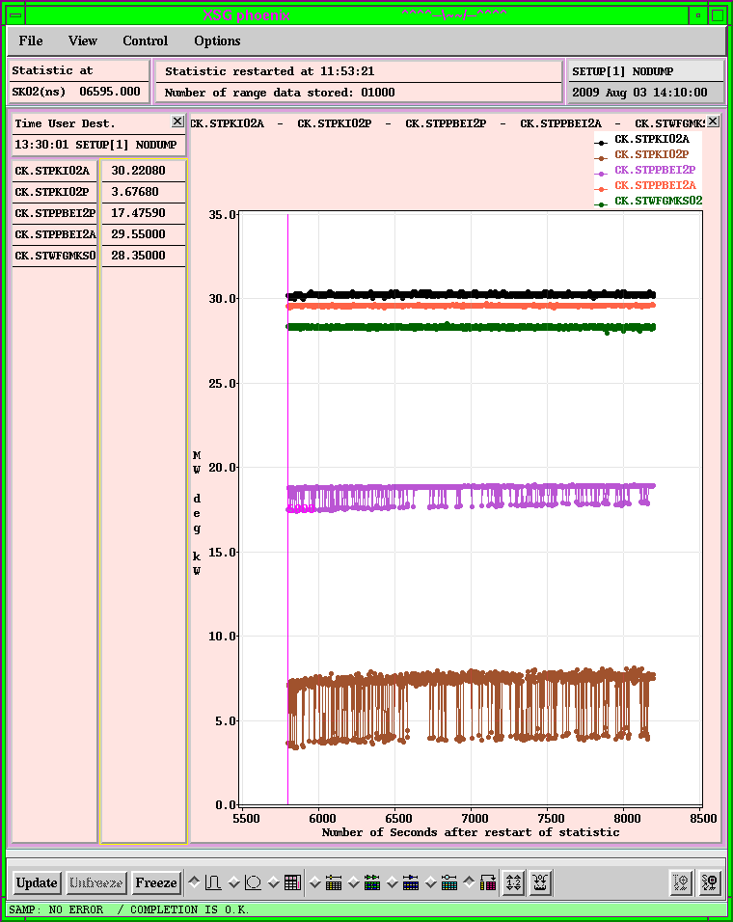
MKS02 phase jumps between 2 states

Slide 6
2009 CTF3 experimental program
Goals
30 GHz: One structure test (TM02) + breakdown studies
PHIN Beam characterization, reach ½ of nominal bunch charge ?
CALIFES Beam characterization, beam to TBTS (most likely still reduced current)
Delay Loop Back in operation, retrieve combination x 2 (~ 7 A)
Combiner Ring Final optics checks, isochronicity, put together with DL (> 24 A)
TL2 Complete commissioning (tail clipper), bunch length control, > 20 A to users
TBTS PETS to nominal power/pulse length (15 A, recirculation)
Beam commissioning of probe beam line
First accelerating structure tests (one structure ? – CLIC G)
Two-beam studies (deceleration/acceleration), initial breakdown kicks studies
TBL PETS validation (100 MW, need > 20 A), beam line studies (2-3 PETS ?)
Others CDR studies in CRM, beam dynamics benchmarking, stability studies, control of beam losses…

Slide 7
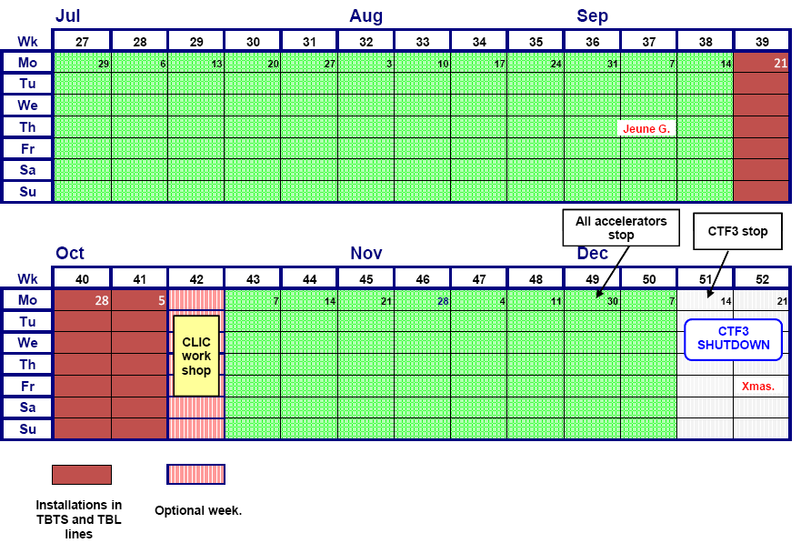
Today
Programme (updated end July)
wk 32+33:
- 1 day (Mo) CRM line or bunch length measurements
- 2 days (Tu+We) DL set-up with 2x 1.5GHz TWTs
- 2 days (Th+Fr) CR set-up for beam to TBTS (3x recombination),
when stable beam, it will be given to TBTS for measurements
wk 34:
- 1 day (Mo) bunch length measurements
- 4 days (Tu-Fr) CR beam to TBTS
wk 35+36+37
- DL+CR optics
- CALIFES to TBTS, for commissioning probe beam line
- 1 day CR to TBL
wk 38-40
- propably stop for installation work in CLEX:
TBTS accelerating structure, TBL continuation

