Slide 1
RD51- CERN 23-09-2009
Resistive spark protection and large MPGD production status

Slide 2
Summary
Resistive spark protection (PRC)
  Process
  Prototype in progress
Large size Bulk Micromegas
  Prototype in progress
  Sectorizing tests
Large single side GEM
  Prototype in progress
Conclusion

Slide 3
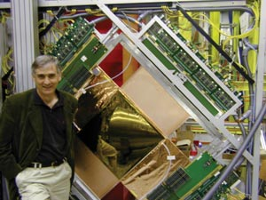
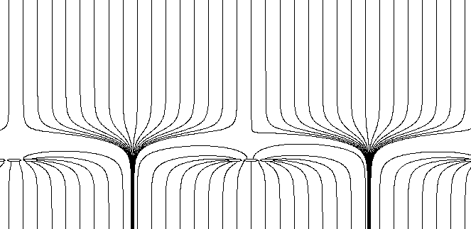
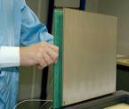
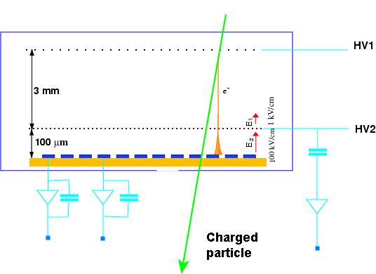
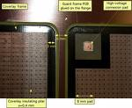
MICROMEGAS BULK resistive spark protection

Slide 4
Production steps
PCB
Bare PCB with strips
Lamination of one
Layer of photoimageable
coverlay
PCB
PCB
Pattern grooves
Fill with resistor paste
+ curing
PCB

Slide 5
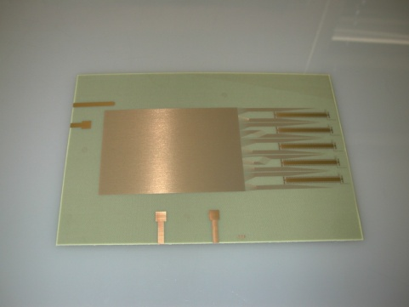
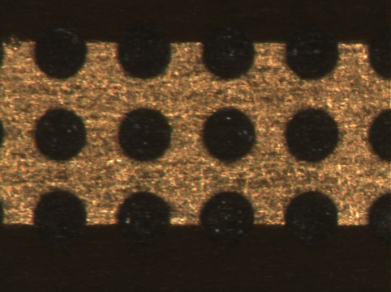
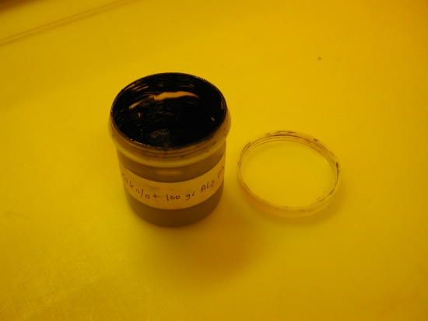
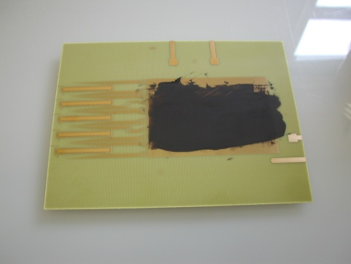
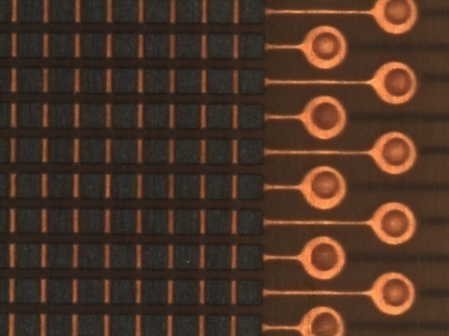
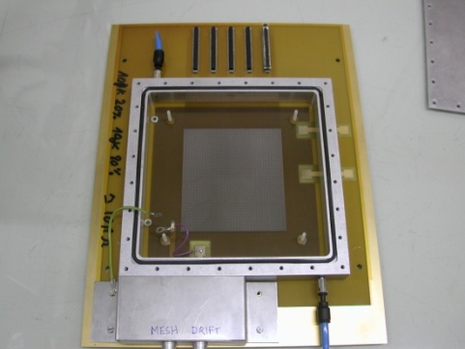
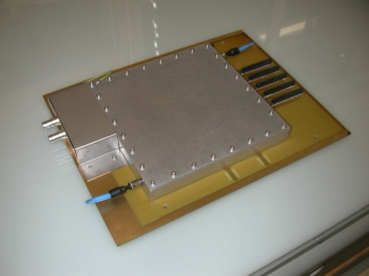
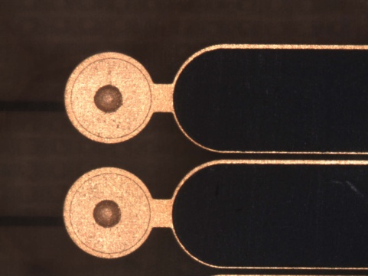
dots
Pads
Resistive paste from
ELECTRA
For 10Mohms vertical
Resistor: 80% 100k +20 %
10k
We have also added 50%
In weight of alumina powder
To reduce Z shrink during
polymerization
Strips

Slide 6
Values
150um
C
R
64um
PCB
PCB
=
For 1 mm2:
-C= 1pF (calculated)
-R= 10 Mohms (measured)
-RC=10us
-22us for C discharge
-Max rate before pileup :50Khz/mm2

Slide 7
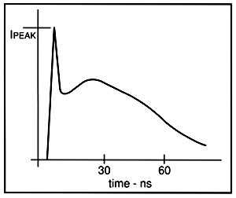
Trying to explain the effects
Spark signal
[Figure 1. IEC 801-2 ESD Curent Waveform]
“Fast signal“ 10nS (electrons)
In the range of 100 Mhz
“Slow signal” 100ns (Ions)
In the range of 10 Mhz

Slide 8
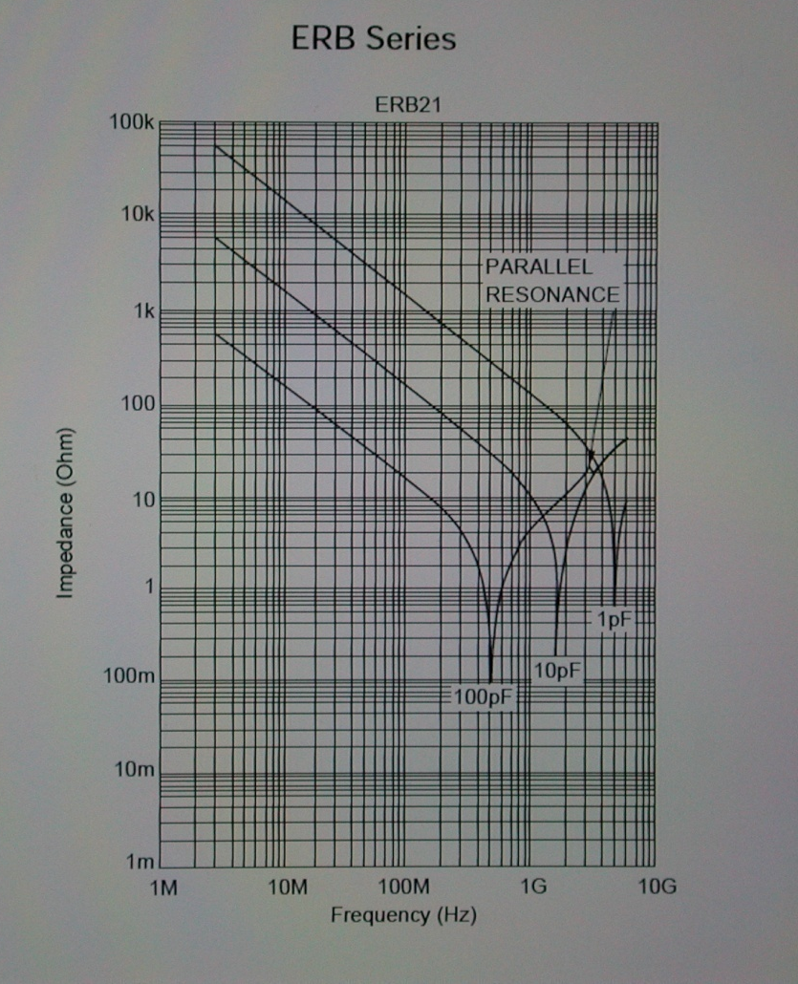
Capacitor impedance
Typical Capacitor impedance
at High frequencies
For 1pF
AT 100Mhz Impedance = 1.5 Kohms
At 10 Mhz impedance = 15 Kohms
Murata capacitor catalog

Slide 9
Filtering
After filtering a big part of the energy should be
removed but the resistor and capacitor should handle
this local power , creating a heat point

Slide 10
Summary
Theory
  The available energy during a spark should be reduced by pixelizing
  the input capacitors
  Most of the signal should be clamped by the capacitor if the value is properly define
  The max rate is define by the RC network
  The resistive material should have a high DC breakdown voltage and good thermal properties to evacuate the heat created by the spark
Reality
  Some good effects have been seen but we are still trying to understand the behaviour of these detectors
  BUT !Already 2 problems after first tests !!!
  And also lots of questions are still opened!
    Behaviour of the capacitor at these frequencies? Inductive effects?
    Value of the capacitor?
    Voltage breakdown of the capacitor?
    Heat spread of the resistor material compatible with smaller sparks?

Slide 11
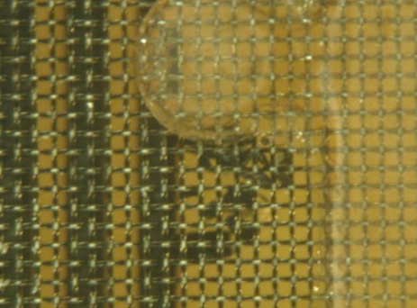
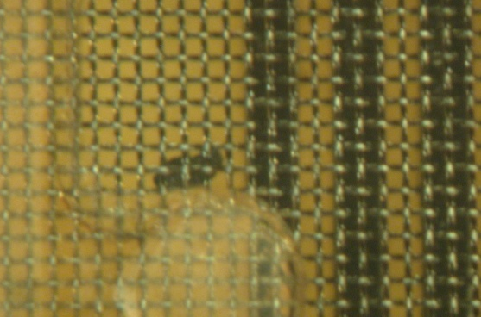
Problem 1 lateral spark
spark
PCB
PCB
Bits of resistive
material have
been pulled
away

Slide 12
Problem 2
HV breakdown
HV breakdown in the material
Creating channels of a few kohms
Applying 1 KV
directly to the resistor
At 250V OK
PCB
PCB

Slide 13
Solutions in progress
?
PCB
PCB
PCB
Reduce the strip width
Should solve the problem of
lateral sparks
Could save the problem of
HV break But it changes
the capacity!
Should we protect the
Resistor from a direct
Spark with a metal ?

Slide 14
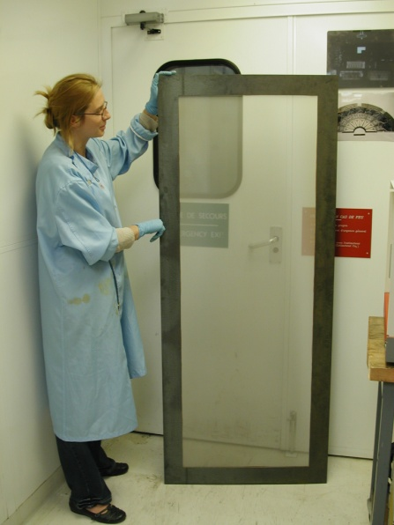
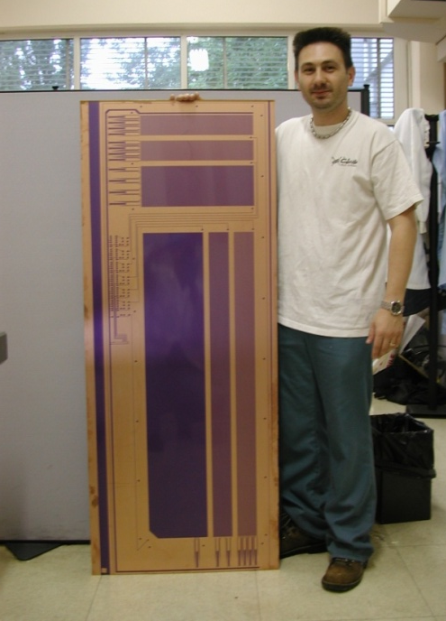
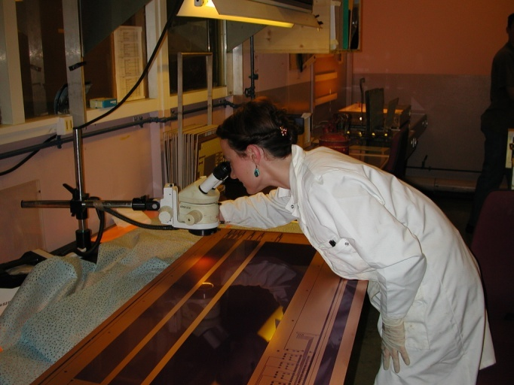
Large Micromegas situation
Inspection !!!
Mesh
Read-out
Atlas Muons detector upgrade project
1.5m x 0.5m processed area

Slide 15
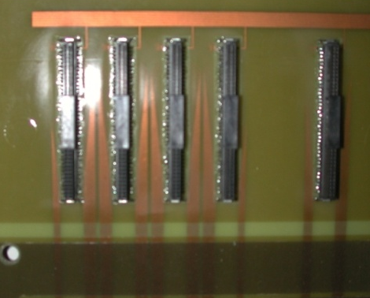
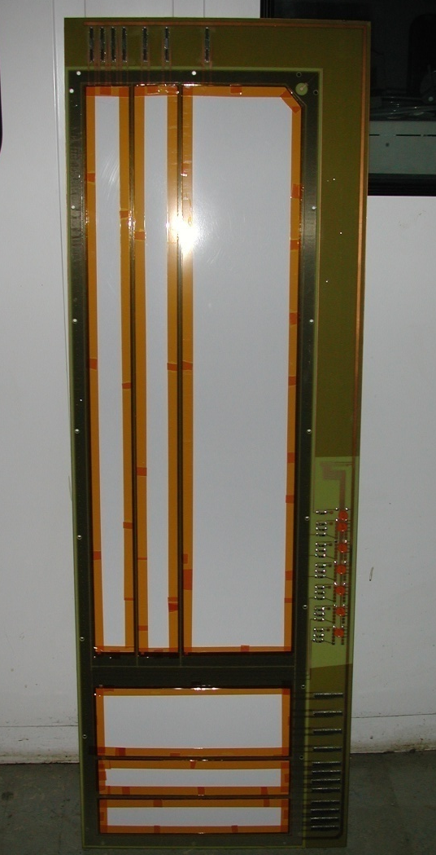
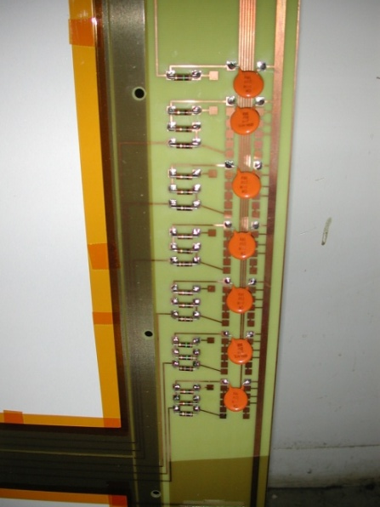
Signal output
HV distribution
The detector is completed all the
sectors have been tested at production
Level. Similar results compared to smaller ones
Biggest problem: laminator
pressure uniformity over the
50cm

Slide 16
New sectorizing method
Bulk detector not
segmented
melamine
adhesive
Applying a plate covered
with a pressure adhesive
tape
Conventional milling
The detecting area is
protected
0.8mm
0.4mm
0.8mm
After removing protection

Slide 17
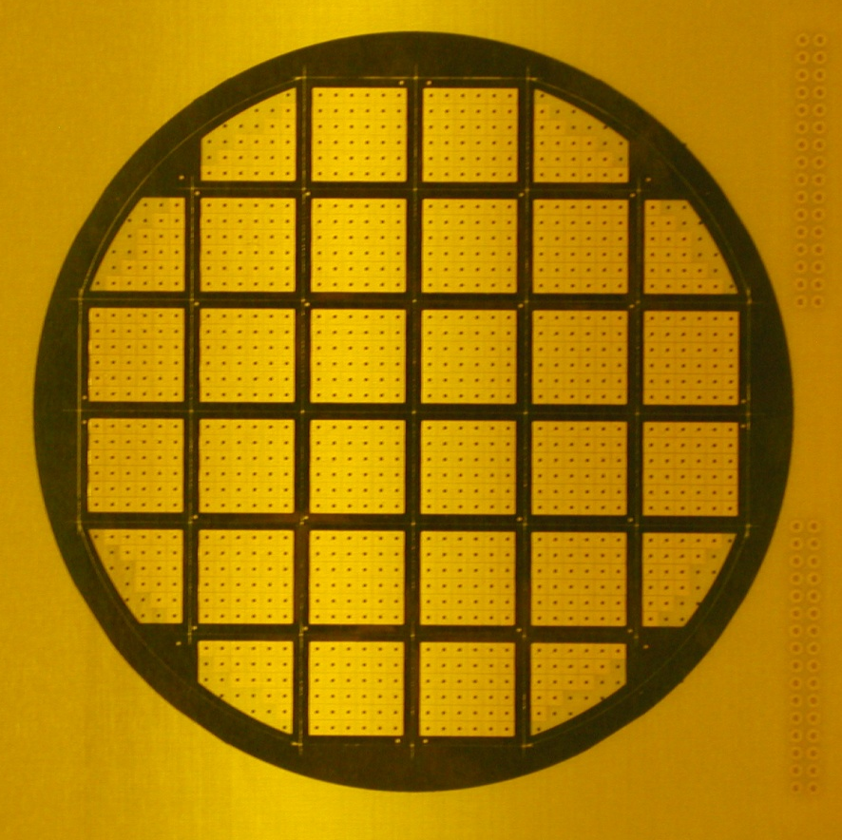
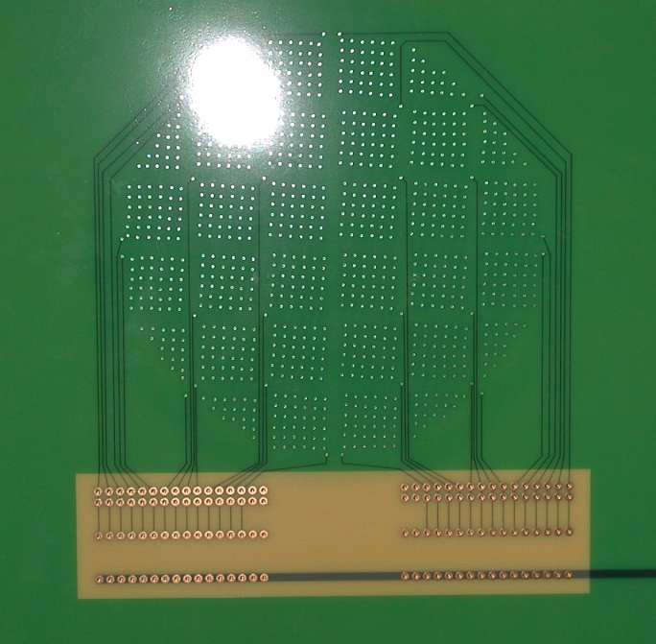
Sectorizing example
33 sectors , 12cm diameter detector
2.5mm dead space for sectorizing
1mm hole for HV connection
Bottom high voltage distribution
and HV read out

Slide 18
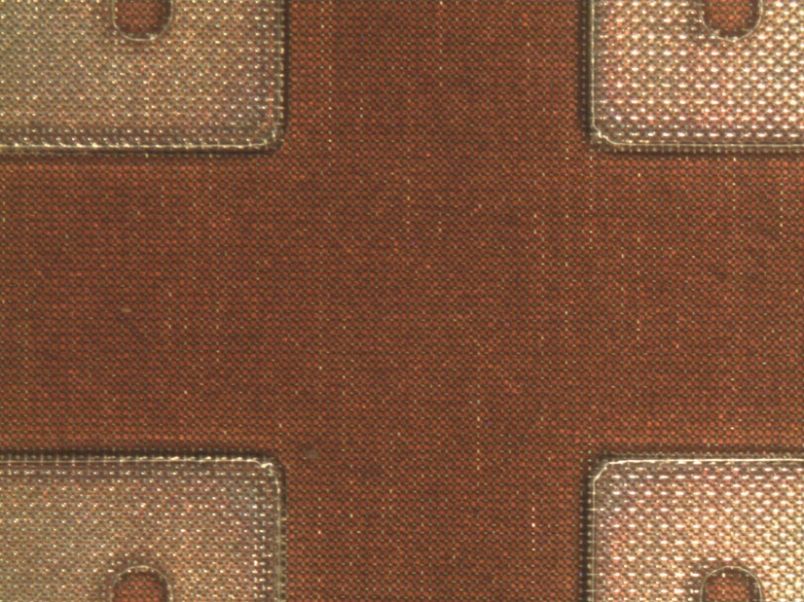
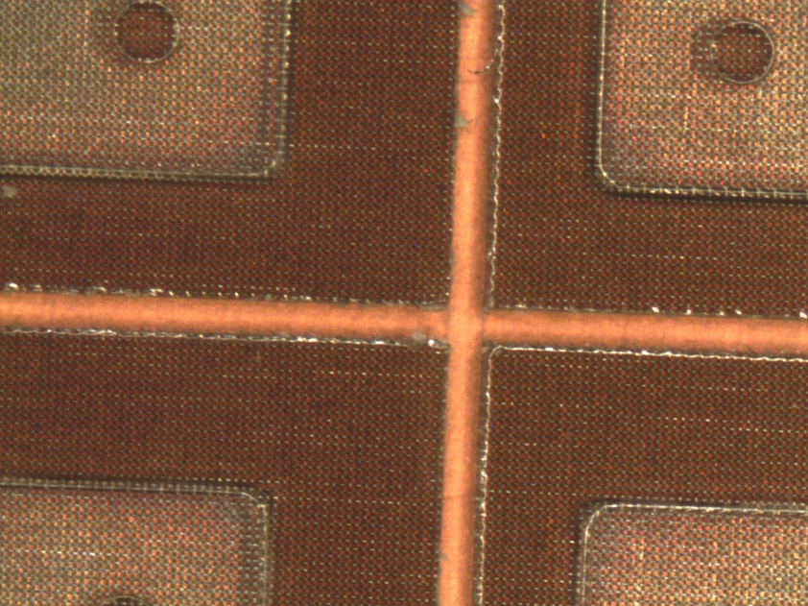
Before milling
After milling
No dust
But still need some
Improvement to avoid
any metal hair

Slide 19
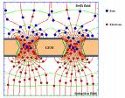
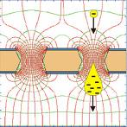


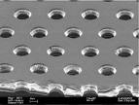
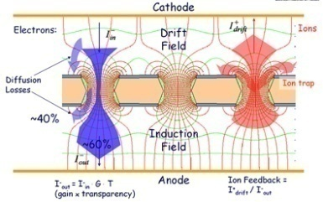
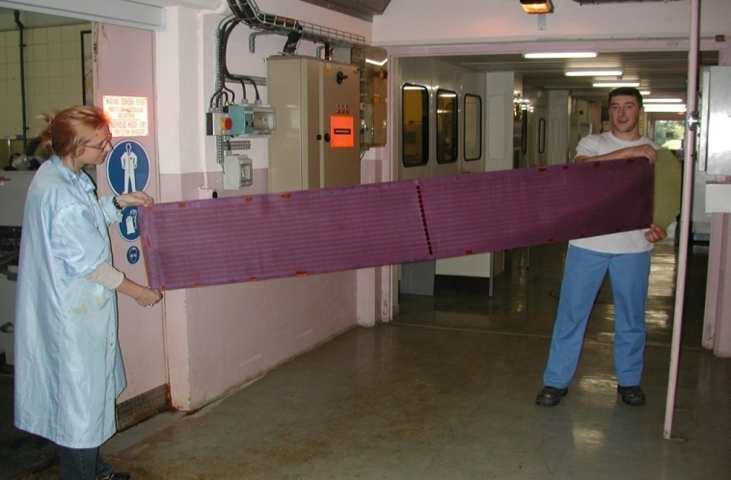
LARGE GEM

Slide 20
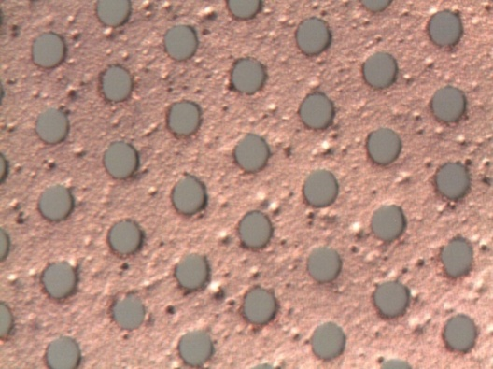
Single mask process
Chemical Polyimide etching
Sharper than std process
Etching of bottom electrode
by active corrosion protection
Stripping
Post Polyimide etching

Slide 21
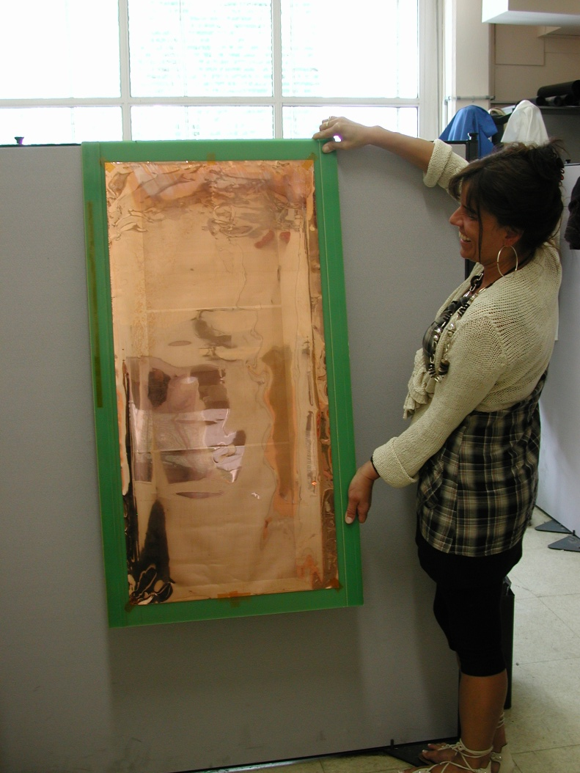
Large size single mask GEM in production
99cm x 33cm active area
105cm x 45cm foil
5um copper both sides
Prototype for test

Slide 22
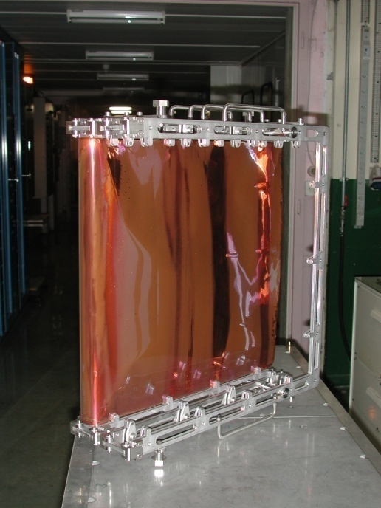
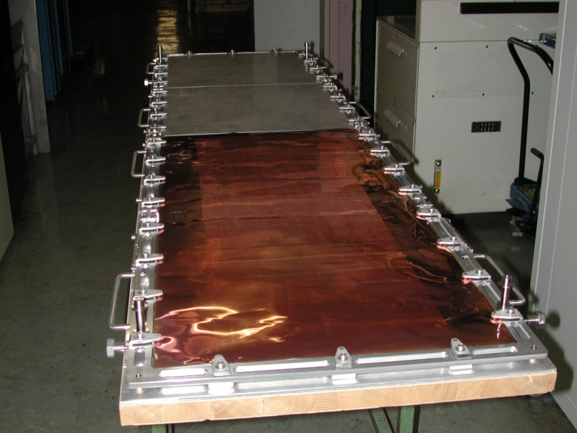
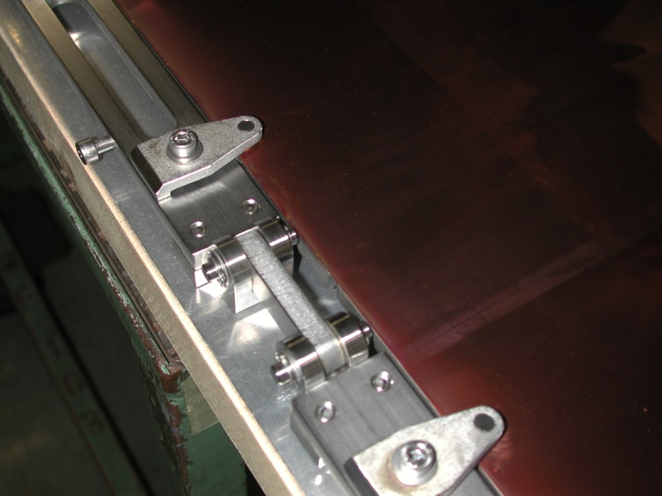
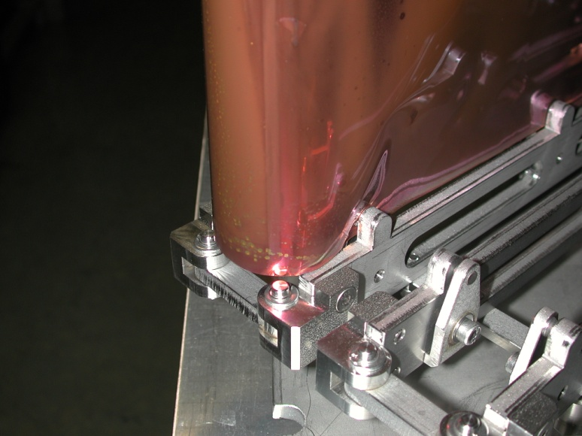
Tooling
2m x 0.45m
Possible size
1m GEM on the pictures

Slide 23
Large GEM production status
2 large foils are ready for Polyimide etch
Large bath are filled with new chemistries
Test on 10cm x 10cm have been performed
After characterisation we have seen a small difference on spark voltage compared to std GEMs
We have adjusted again the chemistry to remove this last imperfection.

Slide 24
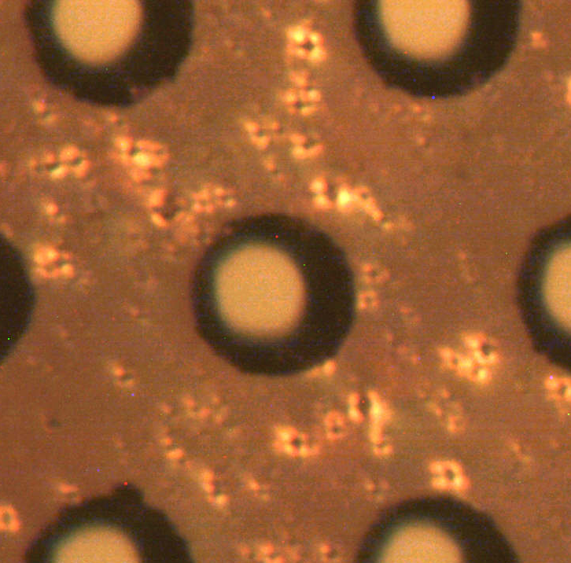
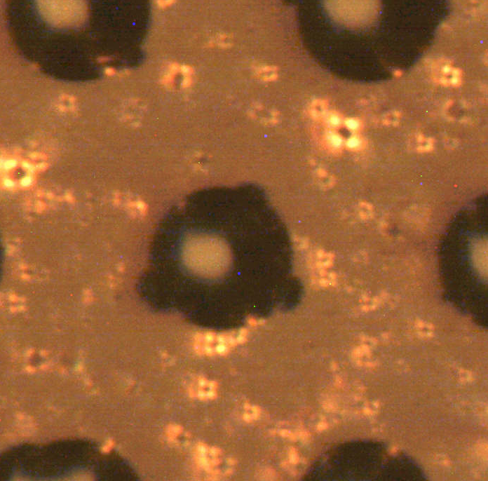
GEM without metal
Last tests
Previous productions
Better definition of the hole edge
at a micron level and better uniformity
Randomly distributed small
Imperfections probably causing the
lower sparking voltage

Slide 25
Conclusions
Resistive protection
  2 new detectors are in production with last improvements
  The 2 existing ones could probably be repared
Large Bulk
  The process seems to be under control (but only one piece produced!)
Large GEM
  Process and equipments ready for first trial of large size

