Slide 1
Update on CERN PC workshop

Slide 2
Project status
EN and TE Dept. agree to move out of bat 102
  EN PCB workshop, TE surface coating
  Main reason is safety
Preferred solution:
  Both in the same building
  Regroup with EN-ICE section for PCB design (bat 301, 160)
Some preliminary studies
  Go to location of bat 174
  No detailed price estimate yet
  No detailed time estimate yet
  No approval from top management yet

Slide 3
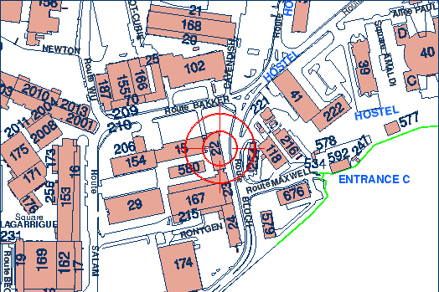
Water treatment plant
Present location
Possible new location

Slide 4
RD51 and PH attitude
PH Dept questioned timing, feasibility in industry
EN-ICE GL reluctant to include bigger machines
RD51 pushing for increased capabilities
RD51 institutes have to lobby

