Slide 1

A quick introduction to shell basics
Martin L. Purschke

Slide 2
Later in my RCDAQ presentation I will show you this
$ rcdaq_client load librcdaqplugin_drs.so
$ rcdaq_client create_device device_drs -- 1 1001 0x21 -150 negative 140 3
You will see that we are using commands typed in a terminal application ALL THE TIME.
A terminal application is what runs the shell
A shell is taking your commands and acts on them (it’s by far not the only program that does that)
I consider myself a master of the shell (and yet, I still learn things from others all the time)
The shell makes many repetitive tasks a breeze
And it is a lot faster to work with than a graphical environment

Slide 3
Why you need to know the shell.
You usually spend a lot of time using the shell
If not so far, then you will during the exercises!
The shell is the “face” of any Unix system, all attempts to make it like Windows aside
You can do magic with a few lines of script that would take hours otherwise
You can automate complex tasks with ease
You can even automate your job to a large extent
Let me show you in a few minutes.
If you are a physicist, an engineer, a professional in a technical field and do not use the shell, you are missing out!

Slide 4
You need to accomplish some really complex task on the computer…
… is there a ready-made tool that does exactly that?
Probably not!
But each task breaks down into small steps.
You already have a myriad of “small” tools available that do a particular thing really, really well.
Think: You want to build a table. Do you have a tool that makes a table? No. But you have a hammer, a saw, screwdrivers, a drill… You use those generic tools to make your table
You use them one by one and end up with something that does exactly what you wanted/needed
Sounds too abstract? Here is an example…

Slide 5
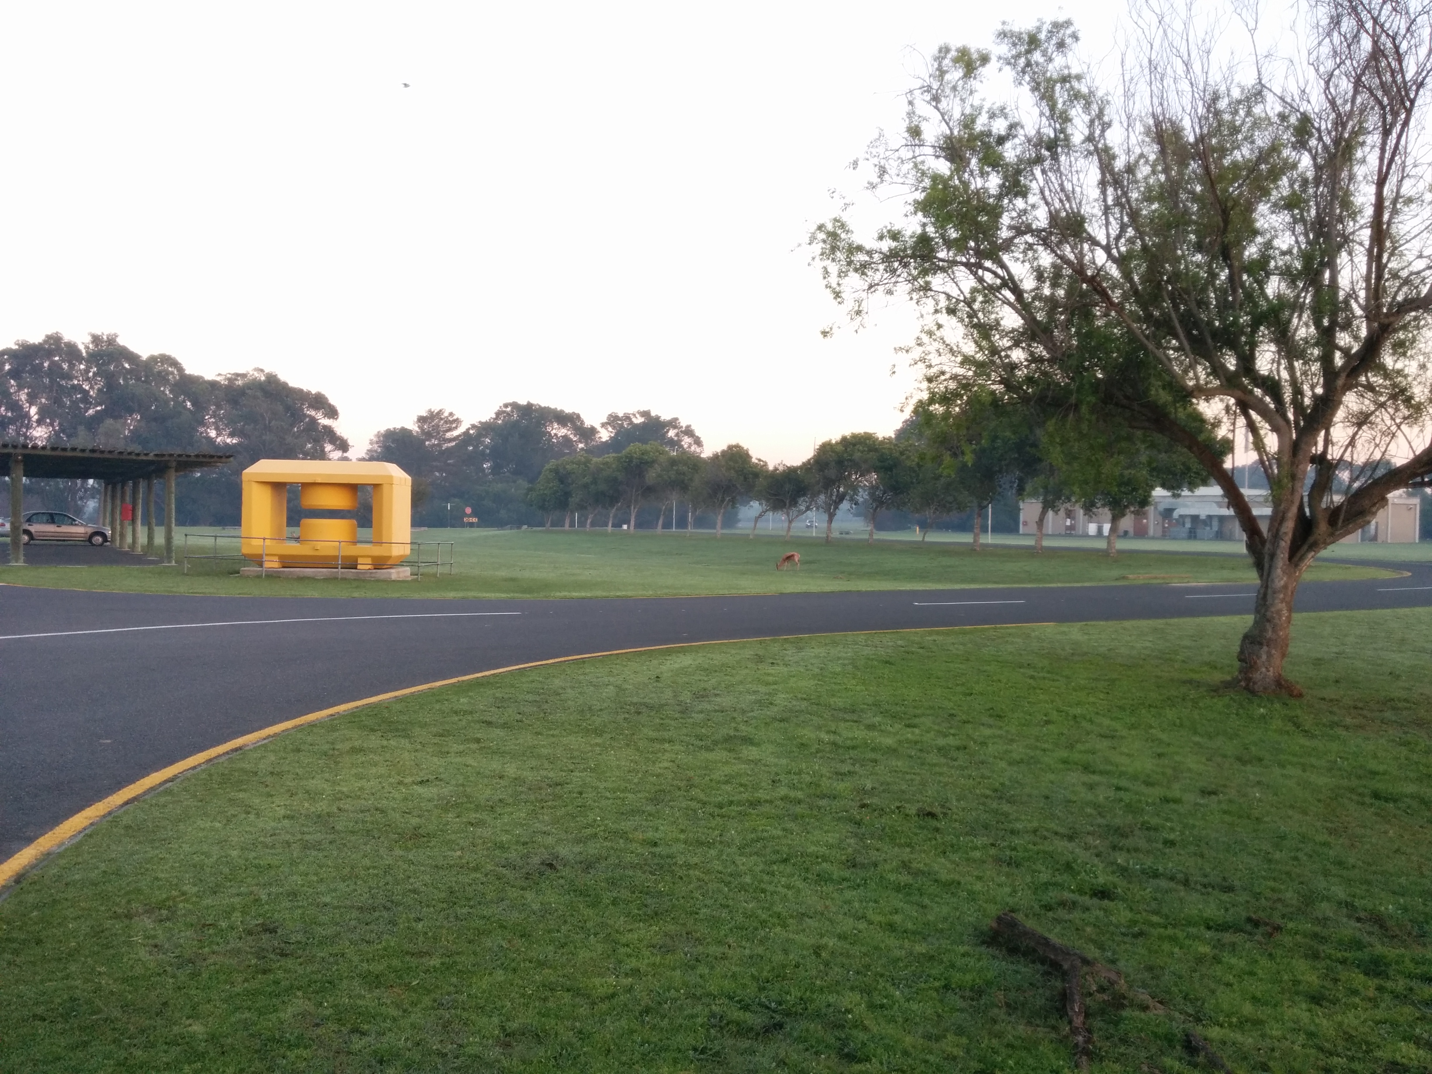
“I want to tag my pictures with the date they were taken!”
Figure out when a picture was taken and add some text on the right lower end:
That’s easy to do.
Right? Right?
Wait…
2018-07-07 08:01

Slide 6
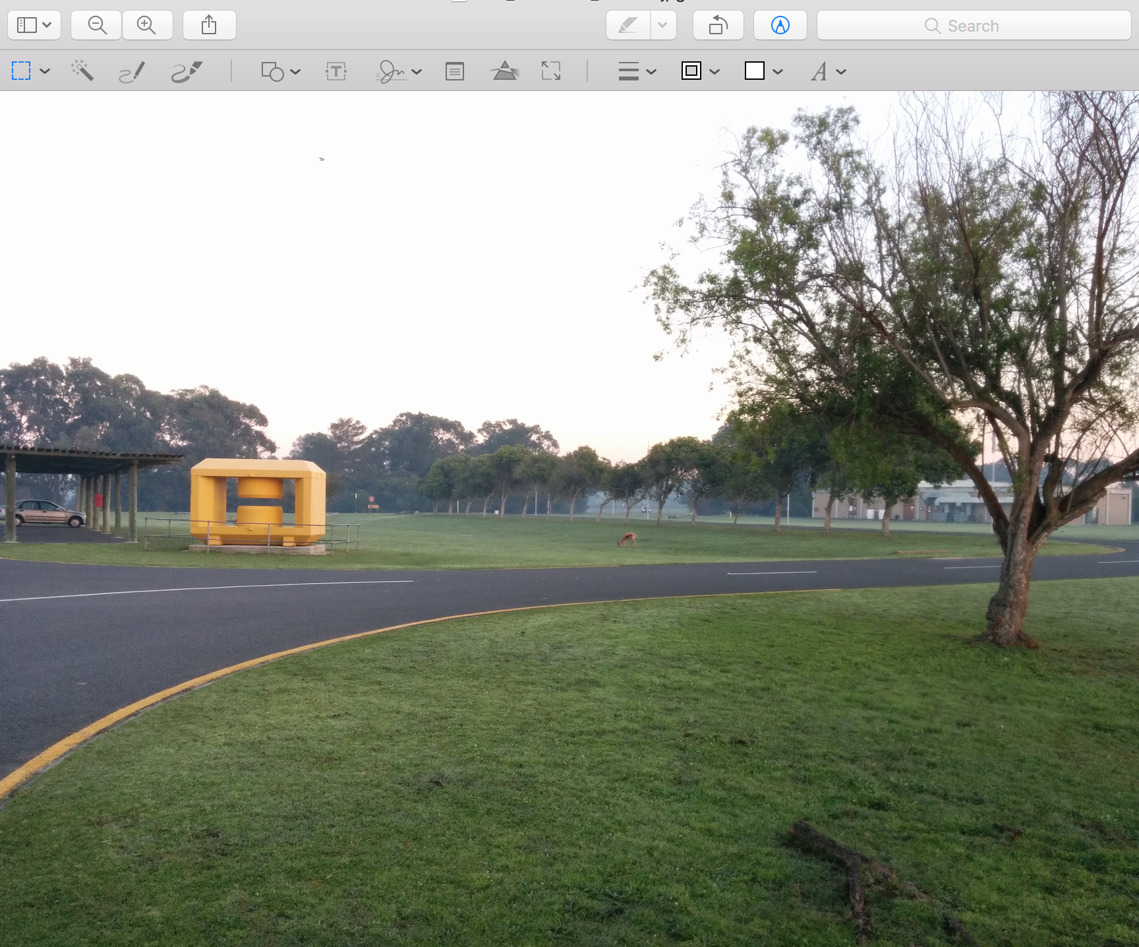
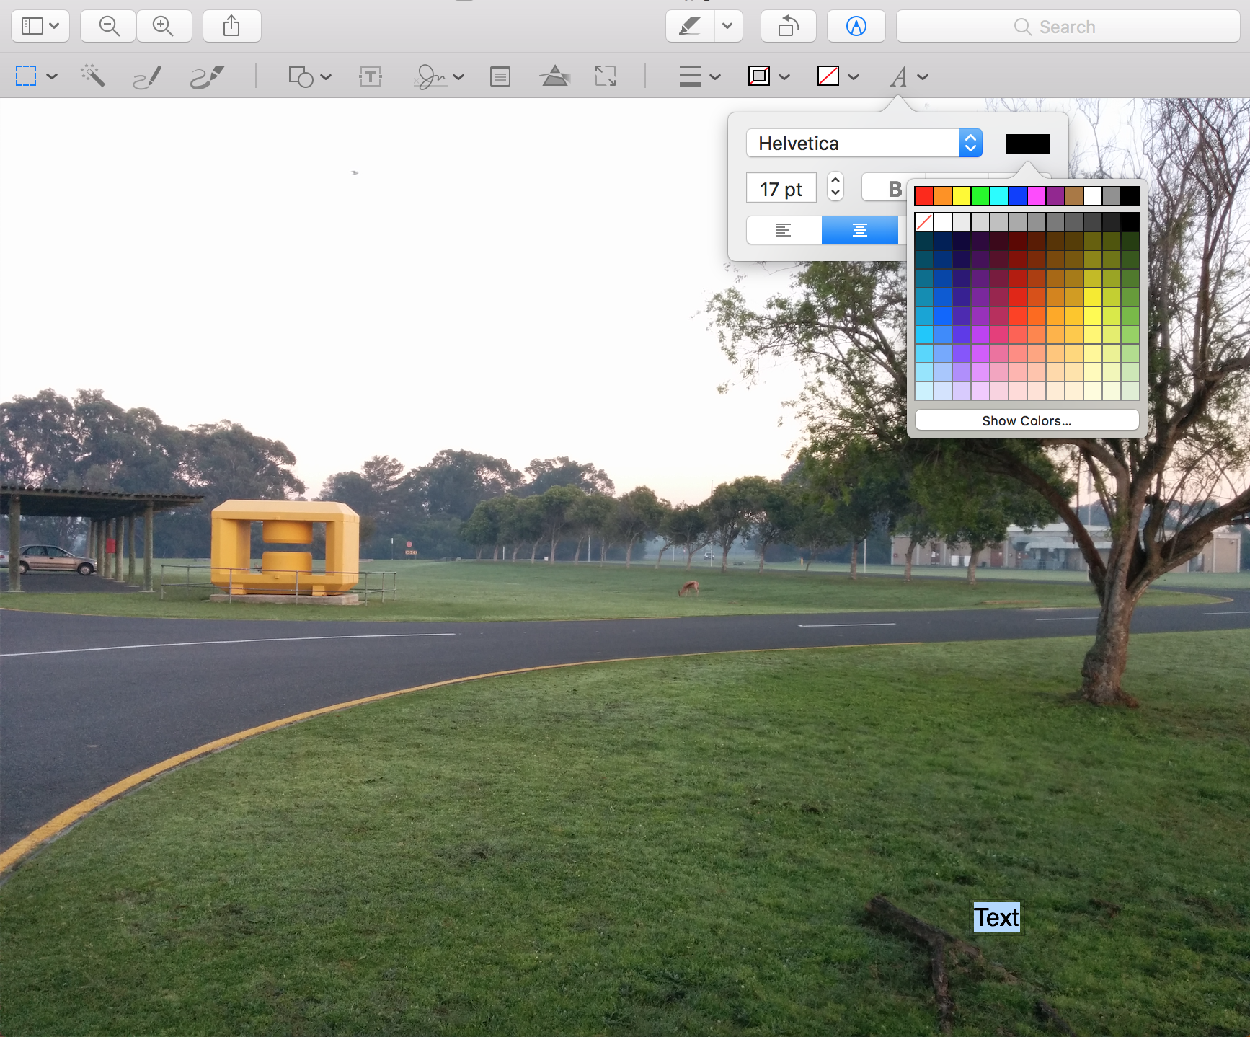
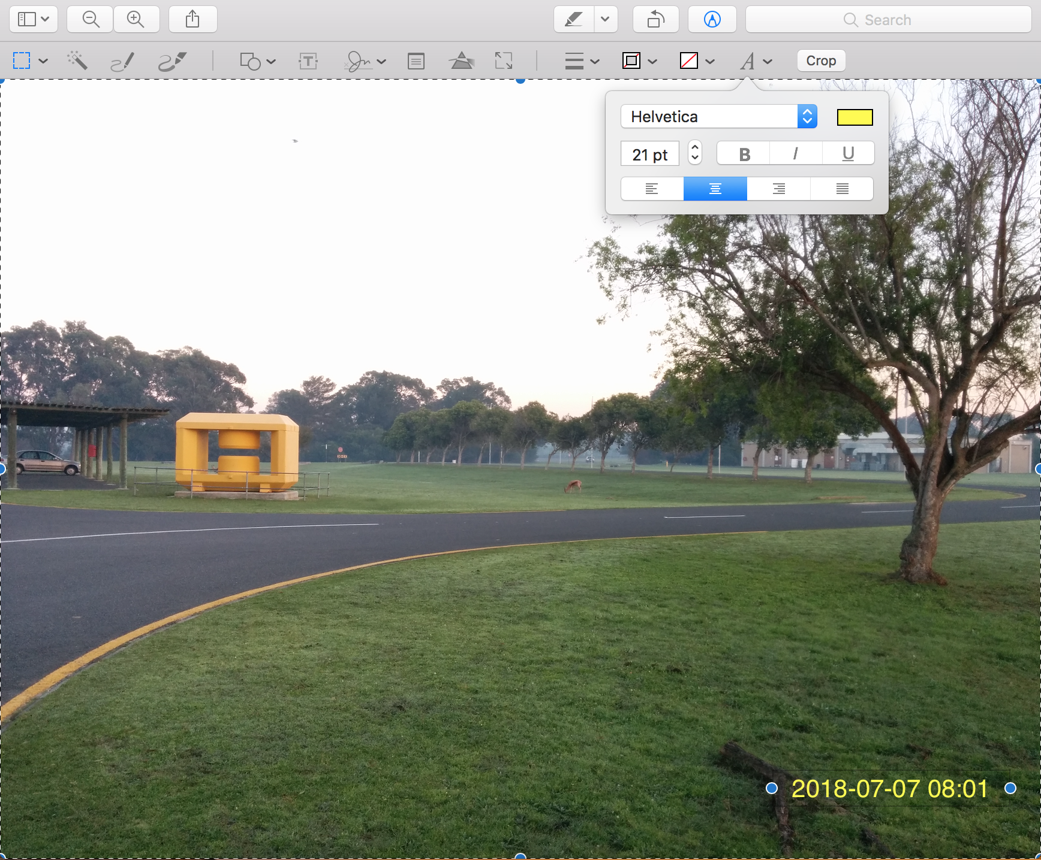
Is it easy? You decide…
That’s a lot of steps (I left several steps out)
But, yes, it gets the job done.
But wait! Now I have 1000 such pictures!
Does this really scale?
I’m going to be at it all week!
I’ll get (or buy) a program to do just that!

Slide 7
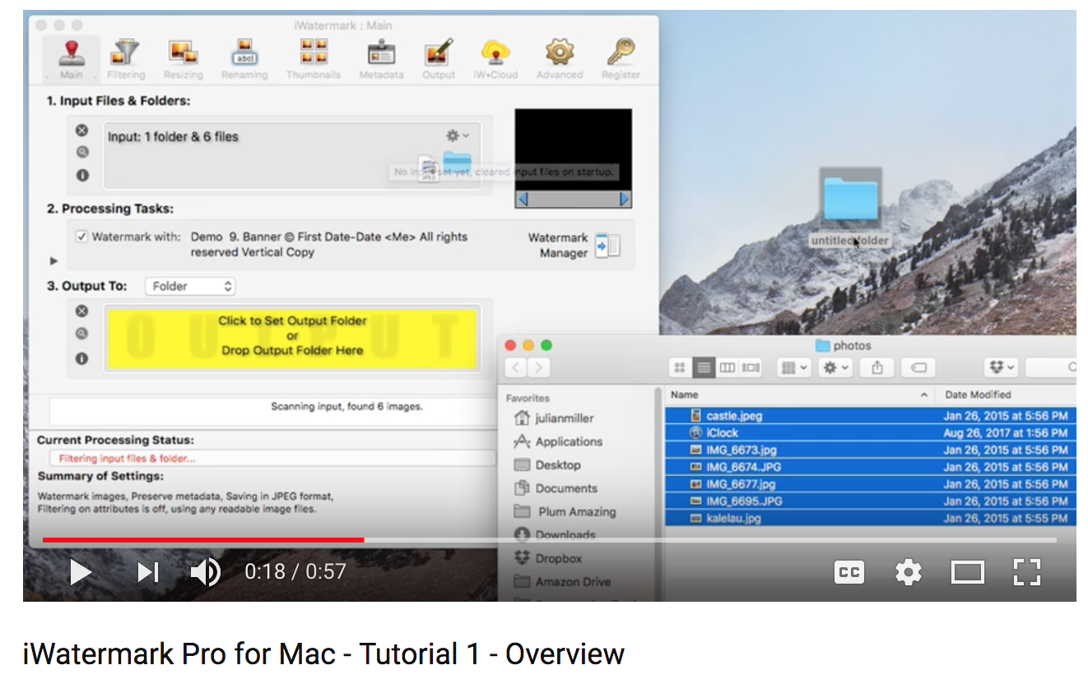
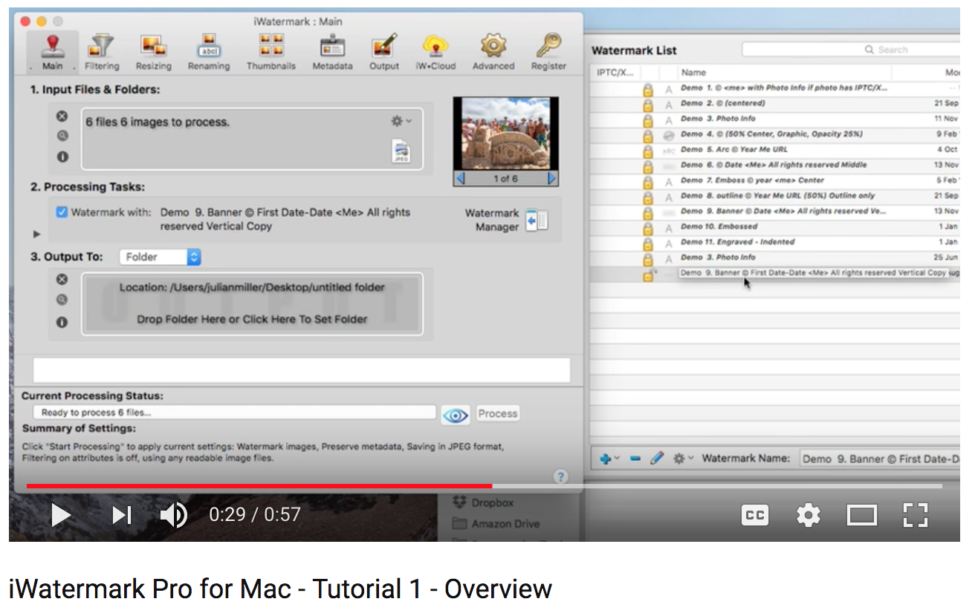
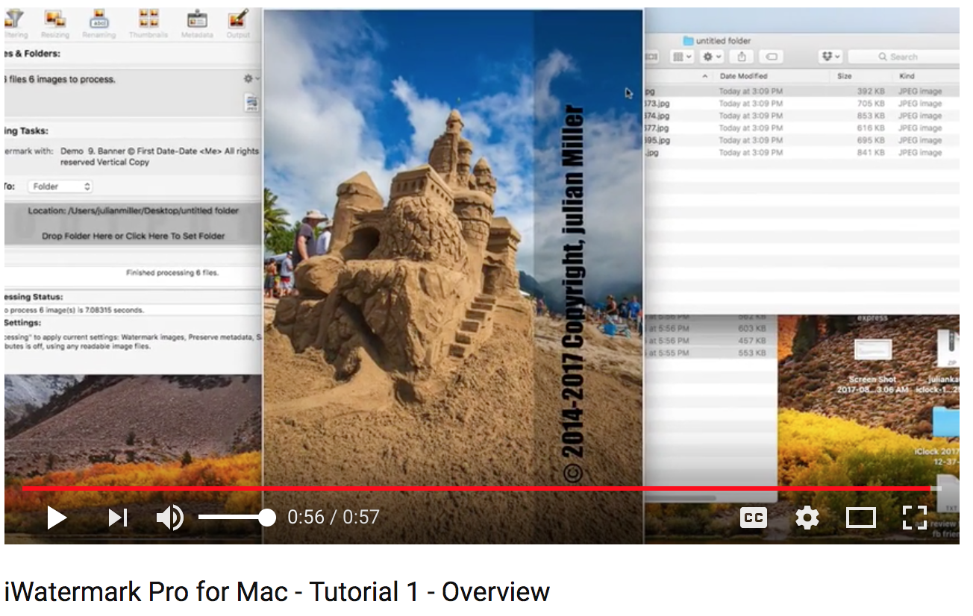

No shortage of programs you can get buy to do that…
It adds some information to the picture
Formats the appearance in 20 or so different styles to choose from
And it costs you $30!!!
And what happens if you want a different style?
A different font?
Maybe you want the text on the left side?
A date formatted in a particular way? US/European/???
Maybe you want to add something completely different?
No monolithic tool can foresee all possible use cases the user might want
Even the most advanced program is limited in the end (and the really good ones cost money!)
And that’s we are getting to the shell and the tools.

Slide 8
In the shell you are stringing together small tools…
No single “tool” needs to do all you want all on its own
Each small tool is really, really good at a particular thing, such as:
You have a tool to extract any information from a picture (data, geotags, lens info, ….)
You have a tool to format the information in whatever format you need
You have a tool to superimpose a ready-made string on a picture in whatever way you like ( position, size, color, transparency, font, background, ….)
You string together small individual tools that are great at one particular thing
No one utility needs to excel at all required tasks
And this buys you the ultimate flexibility to accomplish the most esoteric tasks
And not just what the designer of an all-integrated tool envisioned!
And most important: you can apply the same operation to thousands of images easily

Slide 9
We are getting way ahead of ourselves but I want to show you…
$ exiftool IMG_20180707_080137.jpg
ExifTool Version Number : 10.94
File Name : IMG_20180707_080137.jpg
Directory : .
File Size : 2.2 MB
File Modification Date/Time : 2018:07:07 03:06:05-04:00
File Type : JPEG
File Type Extension : jpg
MIME Type : image/jpeg
JFIF Version : 1.01
Exif Byte Order : Big-endian (Motorola, MM)
Make : LGE
Camera Model Name : Nexus 5
Orientation : Horizontal (normal)
. . .
Date/Time Original : 2018:07:07 08:01:37
Create Date : 2018:07:07 08:01:37
Shutter Speed Value : 59.7
Aperture Value : 2.4
Flash : No Flash
Focal Length : 4.0 mm
. . .
GPS Latitude : 34 deg 1' 29.08" S
GPS Longitude : 18 deg 42' 59.24" E
GPS Position : 34 deg 1' 29.08" S, 18 deg 42' 59.24" E
By the way: If you upload such a picture from your camera to, say, Facebook, you give away all this information!
Strip this out!
This is what we actually want!
$ exiftool -DateTimeOriginal -d "%Y-%m-%d %H:%M" -S IMG_20180707_080137.jpg | sed 's/DateTimeOriginal: //'
2018-07-07 08:01

Slide 10

This is what saved me $30 ☺
#! /bin/sh
PIC="$1"
[ -z "$PIC" ] && exit
DEST="$2"
[ -z "$DEST" ] && exit
DATE=$(exiftool -DateTimeOriginal -d "%Y-%m-%d %H:%M" -S "$PIC" | sed 's/DateTimeOriginal: //')
NAME=$(basename $PIC)
NAME="$DEST/$NAME"
echo "new image = $NAME"
convert $PIC -fill yellow -pointsize 80 -undercolor '#00000080' -annotate +2200+2200 "$DATE" $NAME

Slide 11
This was just to get you into the right mindset…
You don’t need to become a master at image processing, that was not the point…
I just wanted to show you that those tools act just like your hammer, saw, screwdriver, drill…
We will now do simple things with and in the shell.

Slide 12
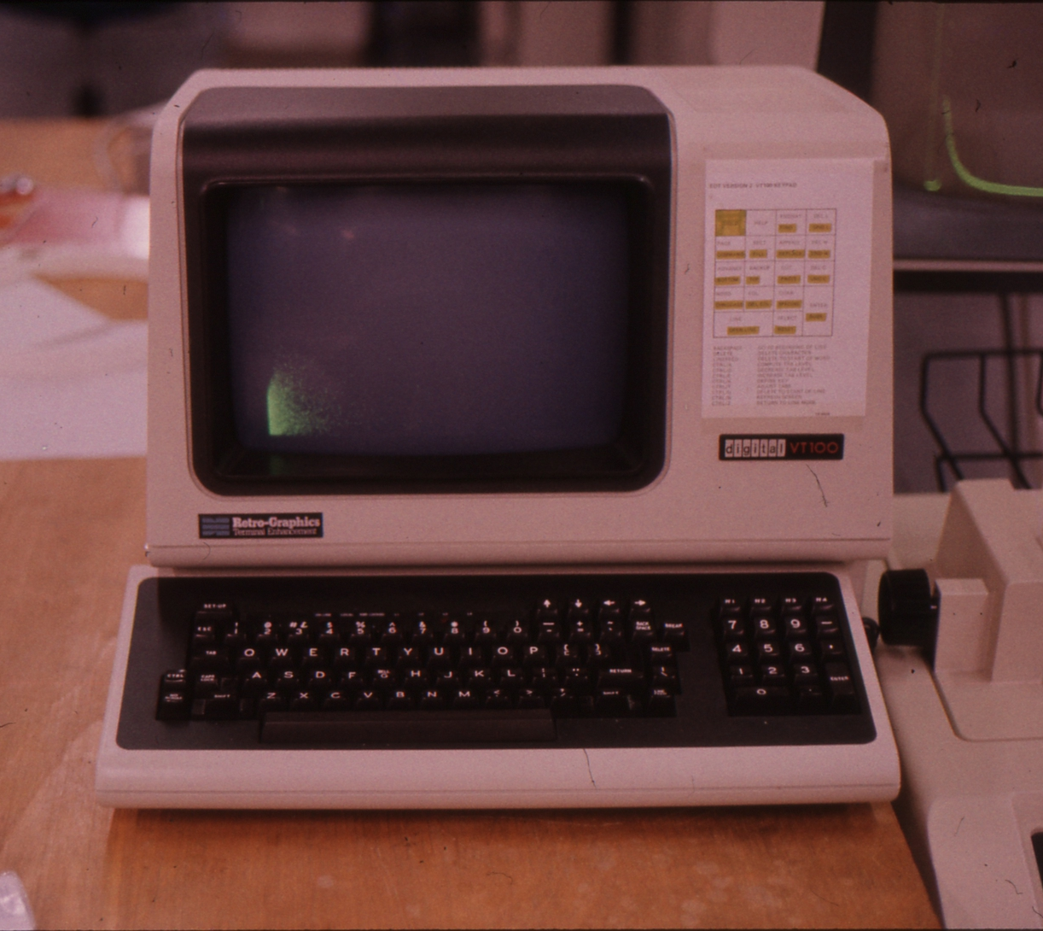
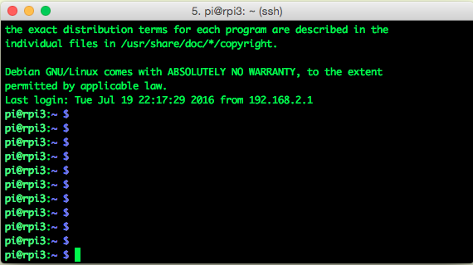
What the shell looks like
Normally you see a shell within a terminal window
In my younger days, a terminal was a big piece of hardware
Prompt Cursor (and here you can type things)

Slide 13
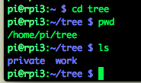

Directories and files
Directories == known as “folders” on other operating systems
We call them directories, sometimes also called “path”
Just a way to organize your work
Like “private” and “work”
Use cd to navigate directories (“change directory”)
Use pwd to show where you are (“print work directory”)
Certain commands only make sense if we stick with “directory”

Slide 14

Directories and files
Use pwd to show where you are (“print work directory”)
Most shell users picture the “pwd” as a physical place (“I am in the so-and-so directory”)
The current directory acts like it is prepended to a file path
I only typed “myfile”
The default directory acts as if it is prepended to the file name
myfile -> /home/pi/tree + myfile -> /home/pi/tree/myfile
It is an easy way to save a lot of typing
But you can still refer to the file by its full name /home/pi/tree/myfile

Slide 15


Commands Utilities Programs
On a Unix system, they all mean pretty much the same
For everything you do, you execute a new program that does what you tell the shell to do
All the shell does is to call up those programs based on what command you type
We have seen the pwd command – print work directory
We can use the which command to find out what happens
So if you type “pwd”, the shell executes a program /bin/pwd that prints the current directory

Slide 16
Navigating
The primary tool to “go to” a particular place in the directory structure is “cd”
“change directory”
You have absolute moves and relative moves
Being able to navigate the directories with ease saves lot of time
After working on a Linux / Unix system for a while you develop some sort of a “map” for that
In the rare occasions I work on Windows machines, I still try to visualize such a map

Slide 17
A directory tree
./
“up”
“down”
work
private
contracts
customers
letters
pictures
2014
2015
2016
customer1
customer2
customer3
customer4
customer5
invoices
offers
invoices
offers

Slide 18
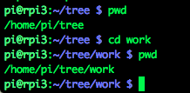
Navigating
We start out here
cd work
./
work

Slide 19
Navigating a directory tree
./
We are here
work
private
contracts
customers
letters
pictures
2014
2015
2016
customer1
customer2
customer3
customer4
customer5
invoices
offers
invoices
offers
And want to go here

Slide 20
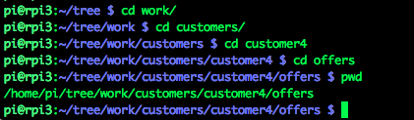

Navigating
We start out here
cd work
./
work
cd customers
private
contracts
customers
letters
pictures
cd customer4
2014
2015
2016
customer1
customer2
customer3
customer4
customer5
invoices
offers
invoices
offers
cd offers

Slide 21
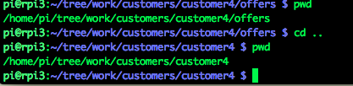
Navigating: . and ..
“.” is a shorthand for “here”
“..” is “one level up”
./
work
private
contracts
customers
letters
pictures
2014
2015
2016
customer1
customer2
customer3
customer4
customer5
invoices
offers
invoices
offers
You are here… and want to go here:
cd ..

Slide 22
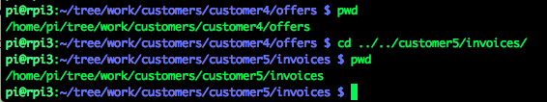
Navigating: combining “up” and “down”
./
work
private
contracts
customers
letters
pictures
2014
2015
2016
customer1
customer2
customer3
customer4
customer5
invoices
offers
invoices
offers
You are here… and want to go here:

Slide 23
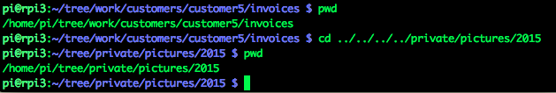
Navigating: combining “up” and “down”
./
You must think that this is really complicated, counting the number of “..” required. The shell makes this easy
work
private
contracts
customers
letters
pictures
2014
2015
2016
customer1
customer2
customer3
customer4
customer5
invoices
offers
invoices
offers
You are here… and want to go here:

Slide 24

The tab key is your best friend
When you type something, the tab key will expand this as
much as possible
It saves you tons of typing! And saves mistakes!
You will see seasoned shell users hit tab all the time
Let’s say you have a file called
Invoice_March27_2016_work_done_inFebruary_by_Martin_version7
Here I hit tab

Slide 25
ls –l
“ls” lists the files in a directory
ls –l adds more information “ls dash ell”
mlpmac:tree purschke$ ls
private work
mlpmac:tree purschke$ ls -l
total 0
drwxr-xr-x 3 purschke staff 102 Jul 17 22:49 private
drwxr-xr-x 5 purschke staff 170 Jul 17 23:24 work

Slide 26
Command options
Many commands have a large number of options that modify the behavior
As we have seen with ls –l
Commands can have “short” (one-letter) options and “long options”
For example ls –group-directories-first
Long options should start with two dashes, but many utilities don’t adhere to that

Slide 27
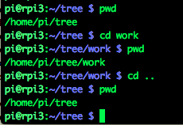

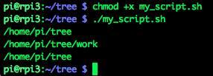
Scripts
We have so far executed each of our commands by typing it
Now I put those exact commands in a file, one line after the
other. I call this file my_script.sh
The file can have any name, but the .sh extension is a good
convention
Now I can execute those commands in one fell swoop:
pwd
cd work
pwd
cd ..
pwd
We add one more line
#! /bin/sh
pwd
cd work
pwd
cd ..
pwd

Slide 28
Before we go on – “the other kind of text processing”
On the following slides I will show you some concepts and commands that give you a jump-start with the shell.
This may not be obvious, but pretty much every command does some kind of text manipulation
Think of the Unix shell and the utilities as the
Most powerful text processor you can find
And a lot of work you do is text manipulation whether you realize this or not – that includes numbers
So this is orders of magnitude more powerful than any monolithic “text processor”.
Keep that in mind as we go along…

Slide 29
Some useful programs “wc” – “word count”
wc counts lines, words, and characters in a file
5 lines, 8 words, 41 characters
“Please explain what you liked about your experience (not more than 200 words)”
Useful to know home many words you actually used….
Just count the lines:
$ wc script.sh
5 8 41 script.sh
$ wc -l script.sh
5 script.sh

Slide 30
Shell variables
You can store values in “environmental variables”
You can then retrieve the stored value by $VARIABLE
They can have any name and case, but usually one writes then in all-uppercase
$ VARIABLE=value
$ printenv
TERM_PROGRAM=iTerm.app
TERM=xterm-256color
SHELL=/bin/bash
TMPDIR=/var/folders/7j/91pk1g_144b5y9vgy3gfy4gw0000gq/T/
Apple_PubSub_Socket_Render=/private/tmp/com.apple.launchd.s6dkLBBPc2/Render
TERM_PROGRAM_VERSION=3.1.6
OLDPWD=/Users/purschke/presentations/RealTimeSchool/2018/photoediting/copy1
TERM_SESSION_ID=w11t0p0:FFEA3644-74C7-4BEA-BB8E-C583B6227C06
USER=purschke

Slide 31
Echo! Echo!
The echo command simply prints the arguments to “stdout”
Ok, that’s pretty lame… we knew the answer beforehand!
But not always! This is a convenient way to see the value of a variable.
$ echo Martin
Martin
$ VARIABLE=Martin
$ echo $VARIABLE
Martin

Slide 32
Pipes
Whatever one command “prints to the screen” can be “piped” to another program with the | symbol
So, how many files/directories do I have here? As many as I have lines (ok, one less):
This is a fantastically powerful concept
$ ls -l
total 26184
-rw-r--r--@ 1 purschke staff 12092605 Jul 17 21:11 RCDAQ.pptx
drwxr-xr-x 16 purschke staff 544 Jul 17 21:57 pictures
drwxr-xr-x 21 purschke staff 714 Jul 17 22:18 pictures2
-rwxr-xr-x 1 purschke staff 41 Jul 17 20:57 script.sh
-rwxr-xr-x 1 purschke staff 154 Jul 17 21:00 script2.sh
-rw-r--r-- 1 purschke staff 41 Jul 17 20:58 script2.sh~
-rw-r--r--@ 1 purschke staff 1297508 Jul 17 23:57 shell.pptx
drwxr-xr-x 4 purschke staff 136 Jul 18 00:13 tree
$ ls -l | wc -l
9

Slide 33
Wildcards
Wildcards allow you to select files with common parts in their name (and may other things)
Here: Show me the PowerPoint files in this directory
It is important to understand that it is not “ls” that expands the wildcards but the shell – it gives the two names to ls, and ls does its thing
I can have more than one wildcard:
$ ls –l *.pptx
total 1231
-rw-r--r--@ 1 purschke staff 12092605 Jul 17 21:11 RCDAQ.pptx
-rw-r--r--@ 1 purschke staff 1297508 Jul 17 23:57 shell.pptx
$ ls –l *e*.pptx
total 988
-rw-r--r--@ 1 purschke staff 1297508 Jul 17 23:57 shell.pptx

Slide 34
“Pipe into”
Different people call it by different names – I like “pipe into” - the “bar” symbol |
So I would tell you to type
“ eles dash el pipe into wc dash el”
$ ls -l | wc -l
9

Slide 35
Standard in and standard out
You have already seen this with the “pipe into” –
Many programs have a concept of “stdin” and “stdout”
They take some input from “stdin” (usually from your terminal)
and write something out (usually to your terminal)
Here: the “cat” program (concatenate) – it can take its stdin (has other uses, hence my careful wording ☺ ) and puts stuff out to stdout. Here:
Ok, that’s a silly example, but you get the idea
You can think of such a program as a filter (ok, “cat” doesn’t actually do anything to the input, but just wait)
If a program doesn’t “do” stdout naturally, you can usually force it – we’ll see an example later
I type
It prints out
$ cat
1234
1234

Slide 36
Keep on piping …
“sed” is the “streamline editor”
It is an enormously powerful editor that takes the input, does something to it, outputs – that’s an actual filter! (you would not use it for editing some big thing….)
Remember echo? It takes the argument and prints it to stdout:
Here we go – we tell sed to substitute “a” for an “u”:
But sed again prints its output to stdout, so we can go on:
And we can go on like this – “tr” translates one group or characters to another one (here: make everything uppercase)
This is a fantastically powerful concept
$ echo Martin
Martin
$ echo Martin | sed 's/a/u/'
Murtin
$ echo Martin | sed 's/a/u/' | sed 's/i/e/'
Murten
$ echo Martin | sed 's/a/u/' | sed 's/i/e/' | tr a-z A-Z
MURTEN

Slide 37
A super-useful program: “awk” – but what does that even mean?
It is a utility named after the initials of the authors - Alfred Aho, Peter Weinberger, and Brian Kernighan
It is a swiss army knife for text parsing.
My full desktop at BNL is called “mlp.rhic.bnl.gov”. What if I want just the “mlp” name?
Sum something per-line up:
$ hostname
mlp.rhic.bnl.gov
$ hostname | awk -F. '{print $1}’
mlp
$ ls -l | awk '{sum+=$5} END {print sum}'
13391743

Slide 38
sort
We list our files sorted by file size ( numerically sort by the 5th column):
$ ls -l | sort -n -k 5
total 26184
-rw-r--r-- 1 purschke staff 41 Jul 17 20:58 script2.sh~
-rwxr-xr-x 1 purschke staff 41 Jul 17 20:57 script.sh
drwxr-xr-x 4 purschke staff 136 Jul 18 00:13 tree
-rwxr-xr-x 1 purschke staff 154 Jul 17 21:00 script2.sh
drwxr-xr-x 16 purschke staff 544 Jul 17 21:57 pictures
drwxr-xr-x 21 purschke staff 714 Jul 17 22:18 pictures2
-rw-r--r--@ 1 purschke staff 1297508 Jul 17 23:57 shell.pptx
-rw-r--r--@ 1 purschke staff 12092605 Jul 17 21:11 RCDAQ.pptx

Slide 39
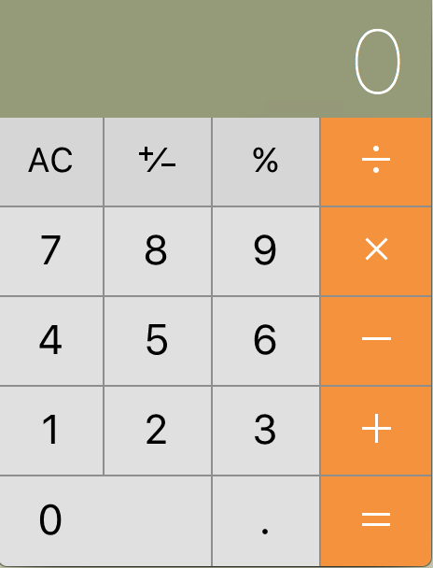
bc
Each computer and smartphone has a virtual pocket calculator these days
There is no slower way to calculate something… IMHO
Throw in “bc” - “binary calculator”
Arbitrary precision, text input, easy, takes stdin/out,….
$ bc -lq
1.234 * 2812894
3471111.196
3.78532 * 1276 / 9 * 15
8050.11386666666666666655
$ echo "1.234 * 2812894" | bc -lq
3471111.196

Slide 40
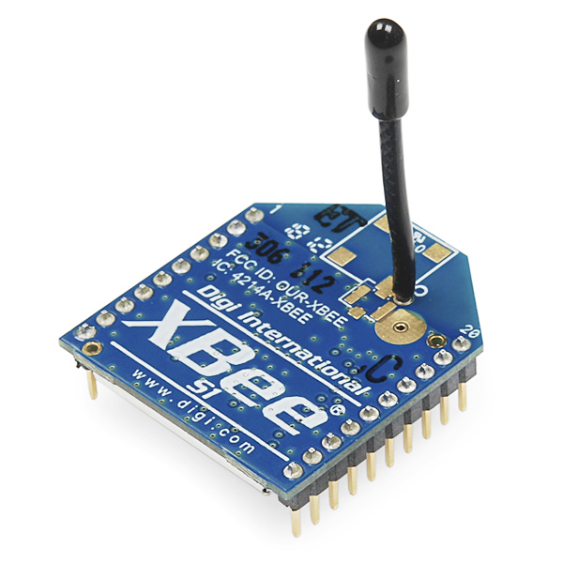
Where did I put that???? -- find is your friend
Let’s say I remember that I had at some point written a program in C++ and I vaguely remember its name (but not fully)
It was reading out a device called an Xbee. I would llke to copy–paste some code from it
But I have no idea where I put that. I have more then 1800 directories on my Mac…
Am I looking through 1800+ directories?
It is a good guess that the program had the word “xbee” in its name… so I go
See? I found not only one but 3… They are likely copies of the same file that I worked on
$ find . -name "*xbee*.cc"
./muell/heatserver/software/read_xbee.cc
./muell/software/read_xbee.cc
./softwarerepo/software/read_xbee.cc
$

Slide 41
find all files that were modified in the last day
Let’s see how busy I have been (ok, not all file modification represent work by me, there are mail files, web browser cache, etc etc)
You can see that I have been working on my presentations here. But how many files are that, total?
$ find . –type f –mtime -1
. . . Many lines deleted . . .
./presentations/RealTimeSchool/2018/photoediting/IMG_20180707_080137-6.jpg
./presentations/RealTimeSchool/2018/photoediting/IMG_20180707_080137-7.jpg
./presentations/RealTimeSchool/2018/photoediting/IMG_20180707_080137-8.jpg
./presentations/RealTimeSchool/2018/photoediting/IMG_20180707_080137-9.jpg
./presentations/RealTimeSchool/2018/raspberryPi_instructions.pptx
./presentations/RealTimeSchool/2018/RCDAQ.pptx
./presentations/RealTimeSchool/2018/scaledowns.pptx
$
$ find . -type f -mtime -1 | wc -l
1218

Slide 42
find all files that contain a certain string
Let’s say that I worry about files where I have inadvertently stored a password. Just making sure that I’m in the clear… My password is “secret1234” ( no it is not ☺ )
So I go through ALL files and look for the presence of that string. grep –l … prints the name of the string.
That was easy!
We look for all actual files (e.g. not directories)
-exec executes the command for each entry
The {} is replaced with each file
$ find . -type f -exec grep -l secret1234 {} \;
./muell/mypassword.txt
$
The ; (semicolon) terminates the command

Slide 43
bc - arbitrary precision. Printing 1000 digits of pi
Arctan(1) = pi/4
$ bc -lq
4*a(1)
3.14159265358979323844
scale=1000
4*a(1)
3.141592653589793238462643383279502884197169399375105820974944592307\
81640628620899862803482534211706798214808651328230664709384460955058\
22317253594081284811174502841027019385211055596446229489549303819644\
28810975665933446128475648233786783165271201909145648566923460348610\
45432664821339360726024914127372458700660631558817488152092096282925\
40917153643678925903600113305305488204665213841469519415116094330572\
70365759591953092186117381932611793105118548074462379962749567351885\
75272489122793818301194912983367336244065664308602139494639522473719\
07021798609437027705392171762931767523846748184676694051320005681271\
45263560827785771342757789609173637178721468440901224953430146549585\
37105079227968925892354201995611212902196086403441815981362977477130\
99605187072113499999983729780499510597317328160963185950244594553469\
08302642522308253344685035261931188171010003137838752886587533208381\
42061717766914730359825349042875546873115956286388235378759375195778\
18577805321712268066130019278766111959092164201988

Slide 44

Shamelessly Showing off!
This came up in the context of a super-sized physics simulation project
In the end, I ran a half-million jobs on the Computing Grid over the course of ~7 weeks
Every Friday, the OSG admins wanted a status report – “how much CPU time did you use”?
For each job on the grid you get a log file with the relevant CPU usage numbers – but how to extract them? Pocket calculator? Nah. Excel? Nah. But what is the most powerful text processing tool?
So in the end I had 500,000 log files that look like this:
So this job used
18h 27m 09s
But we have ~500,000
such files!
Can we do the calculation
on one line?
… lines deleted
005 (4972.000.000) 08/05 14:07:27 Job terminated.
(1) Normal termination (return value 1)
Usr 0 18:27:09, Sys 0 00:09:11 - Run Remote Usage
Usr 0 00:04:27, Sys 0 00:01:18 - Run Local Usage
Usr 0 18:27:09, Sys 0 00:09:11 - Total Remote Usage
Usr 0 00:04:27, Sys 0 00:01:18 - Total Local Usage
0 - Run Bytes Sent By Job
… lines deleted

Slide 45
Text processing…
First, find all log files ( I copied only 2 over here – remember we had 500,000)
Find the one line per file that we need by executing “grep” on each file:
We remove the commas (that would get in the way later) with sed:
# find . -name "*.log"
./condor_171878.log
./condor_171879.log
# find . -name "*.log" -exec grep 'Total Remote Usage' {} \;
Usr 0 22:11:04, Sys 0 00:11:11 - Total Remote Usage
Usr 0 18:27:09, Sys 0 00:09:11 - Total Remote Usage
# find . -name "*.log" -exec grep 'Total Remote Usage' {} \;
| sed 's/,//'
Usr 0 22:11:04 Sys 0 00:11:11 - Total Remote Usage
Usr 0 18:27:09 Sys 0 00:09:11 - Total Remote Usage

Slide 46
Text processing…
Now we extract the 3rd parameter which is the CPU time:
Now we are using awk again to get hours, minutes, seconds (we just print them here):
find . -name "*.log" -exec grep 'Total Remote Usage' {} \;
| sed 's/,//’
| awk '{print $3}'
22:11:04
18:27:09
find . -name "*.log" -exec grep 'Total Remote Usage' {} \;
| sed 's/,//’
| awk '{print $3}’
| find . -name "*.log" -exec grep 'Total Remote Usage' {} \;
| sed 's/,//' | awk '{print $3}’
| awk -F: '{print "hours:", $1, " Minutes:", $2, " seconds: ", $3}'
hours: 22 Minutes: 11 seconds: 04
hours: 18 Minutes: 27 seconds: 09

Slide 47
And finally we add it all up …
find . -name "*.log" -exec grep 'Total Remote Usage' {} \;
| sed 's/,//’
| awk '{print $3}’
| find . -name "*.log" -exec grep 'Total Remote Usage' {} \;
| sed 's/,//' | awk '{print $3}’
| awk -F: '{X += ($1 *3600 + $2*60 + $3)/3600} END {print X}’
40.6369
$ find log/ -name ``*.log'' -exec grep 'Total Remote Usage' {} \; | \
sed -e 's/,//g' | awk '{print $3}' | \
awk -F: '{X += ($1 *3600 + $2*60 + $3)/3600} END {print X}'
1.34523e06
$ bc -l
bc 1.06
Copyright 1991-1994, 1997, 1998, 2000 Free Software Foundation, Inc.
This is free software with ABSOLUTELY NO WARRANTY.
For details type `warranty'.
1345230 / 24
56051.25000000000000000000
1345230 / 24/365
153.56506849315068493150
1345230 hours
56051 days
153 years

Slide 48
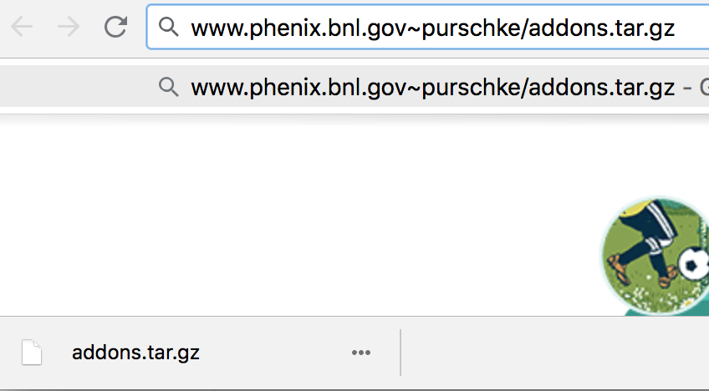
One last thing:
We will use the wget utility to download and unpack a
file from my web server
wget is like a command-line web browser: It downloads the content of a URL to your computer
But we don’t want to fire up the web browser
and we don’t want to store the file first but use pipes to extract the info right away
would download and store the file on your disk (but we don‘t want that!)
So we force wget to operate silently, AND force it to print out the contents to stdout (don’t do that, you’ll see a lot of gibberish – we don’t want that typed to the terminal!)
And we process the data from a pipe (this is one line):
wget http://www.phenix.bnl.gov/~purschke/addons.tar.gz
wget –q –O - http://www.phenix.bnl.gov/~purschke/addons.tar.gz
wget –q –O - http://www.phenix.bnl.gov/~purschke/addons.tar.gz
| tar xvz

Slide 49
The End

