Slide 1
Experimental results and studies on the
(HL-)LHC LRBB compensation
D. Pellegrini, A. Poyet, K. Skoufaris and G. Sterbini, with fundamental contributions from Y. Papaphilippou, S. Fartoukh and the BBLR compensation MD team.
WG2, 1st September 2017
Notes:
1

Slide 2
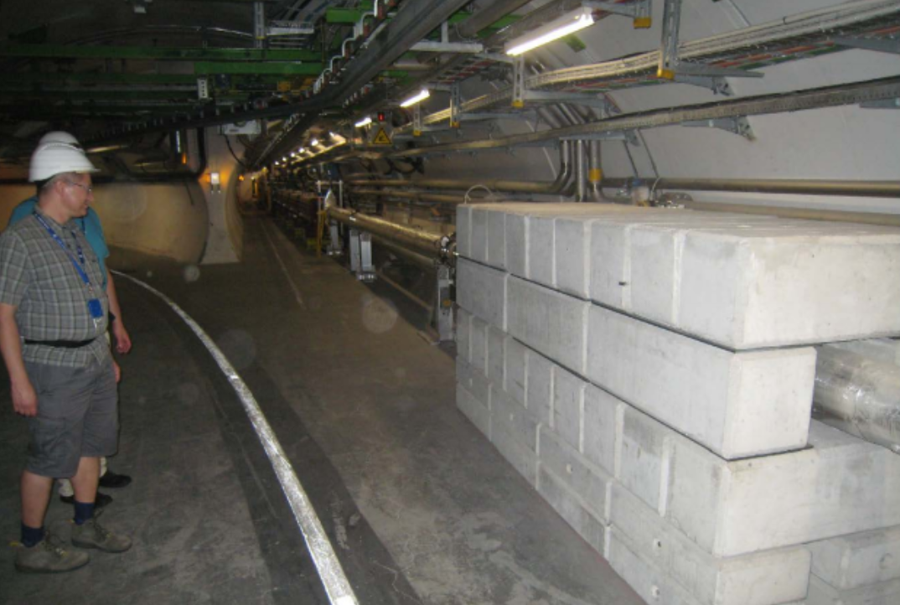
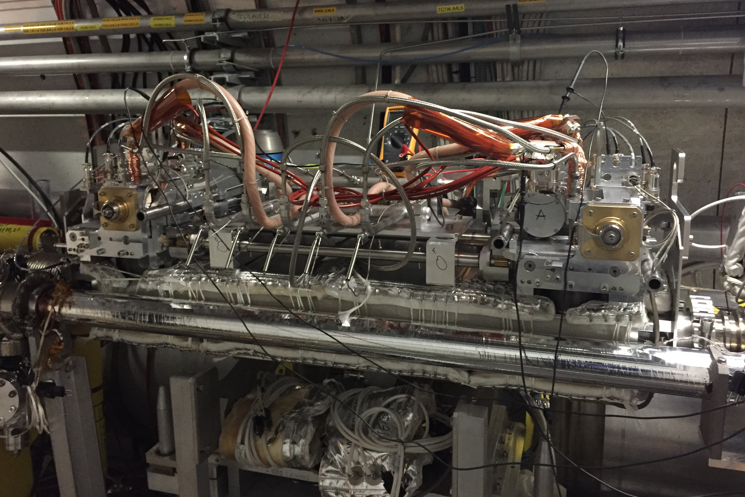
“On the shoulders” of >20 years of BBC studies
1996: V. Shiltsev et al., proposal to use electron beams to compensate BB tune spread in hadron machine
2001: J.-P. Koutchouk: proposal to use a DC wire
2004: J.-P. Koutchouk, F. Zimmermann, J. Wenninger: SPS wire experiments campaign (lasted >10 year and involving a lot of people)
2008: U. Dorda, PhD on wire compensation LHC (F. Zimmermann supervisor)
2012: T. Rijoff,MSc on wire compensation for the HL-LHC (F. Zimmermann supervisor)
2013: F. Zimmermann and R. Steinhagen: specification for the LHC wire prototypes
2015: S. Fartoukh et al.: Compensation of the long-range beam-beam interactions as a path towards new configurations for the high luminosity LHC
2016: F. Zimmermann and H. Schmickler, Long-range beam–beam compensation using wires
Synergic efforts of Collimation Team, BE-BI, EN-STI, EN-MME,TE-EPC…to transform an idea in HW!
From the idea to the BBCW prototype in LHC
2

Slide 3
Outline
Experimental results in MD1
Numerical results from the RDT
Tracking results for LHC and HL-LHC
Conclusions and plans
3
Notes:
3

Slide 4
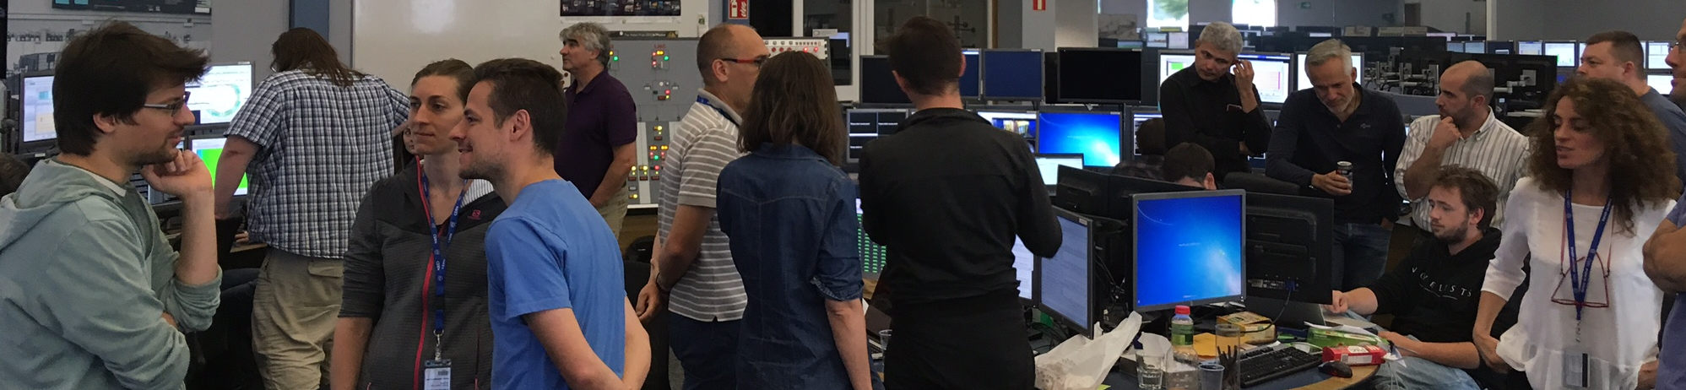
Experimental results of the BBCW MD1
MD2202 team (random order): K. Skoufaris, Y. Papaphilippou, A. Rossi, S. Fartoukh, D. Pellegrini, K. Karastatis, A. Poyet, A. Valishev, S. Kostoglou, G. Sterbini, S. Papadopoulou, M. Fitterer, M. Solfaroli, M. Pojer, M. Hostettler, B. Salvachua, L. Carver, X. Buffat, P. Zisopoulos, H. Bartosik, N. Fuster, S. Redaelli, R. Bruce, M. Gonzales, G. Trad, M. Gasior, C. Zamatzas, J. Olexa, T. Levens, C. Xu, A. Gorzawski, D. Valuch, D. Amorim, I. Lamas Garcia, G. Cattenoz, E. Effinger, L. Poncet, D. Mirarchi, R. Tomas, D. Kaltchev, R. Jones, F. Schmidt…and a many more.
LSWG, 17th August 2017

Slide 5
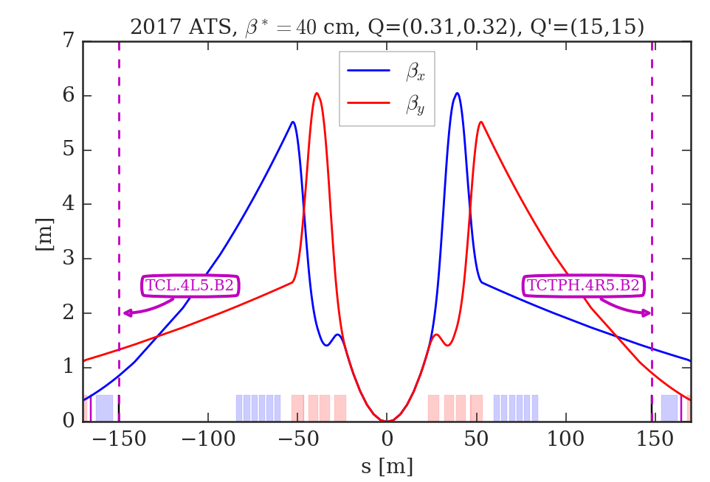
Introduction
After the installation of the BBCWs (prototypes of the beam-beam wire compensators) during last EYETS and parasitic tests at injections of top energy, an MD took place on the 1st July.
TCL.4L5.B2
TCTPH.4R5.B2
Layout of the BBCW compensation: 2 DC wires in IR5 to compensate the effect of the B1 on the B2 (in IR5).
5
Notes:
5

Slide 6
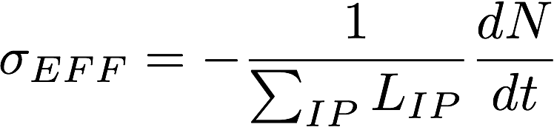
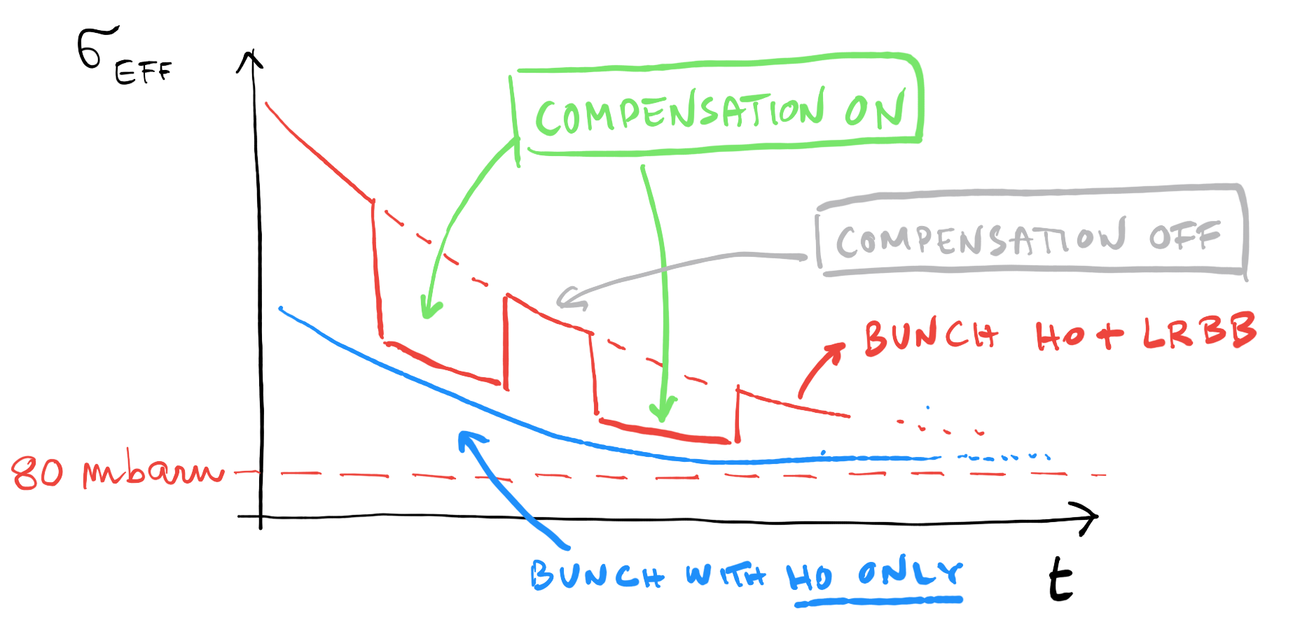
Objectives of the MD
Test with beam the different setting-up procedures (in particular the feedforwards on H-CO and tunes) and observables. Privileged observable: the effective total cross-section of the pp interaction (σ_{EFF})
Find the regime where the BBLR effect is visible.
Prove the beneficial effect of the wires.
The MD rationale
6
Notes:
6

Slide 7
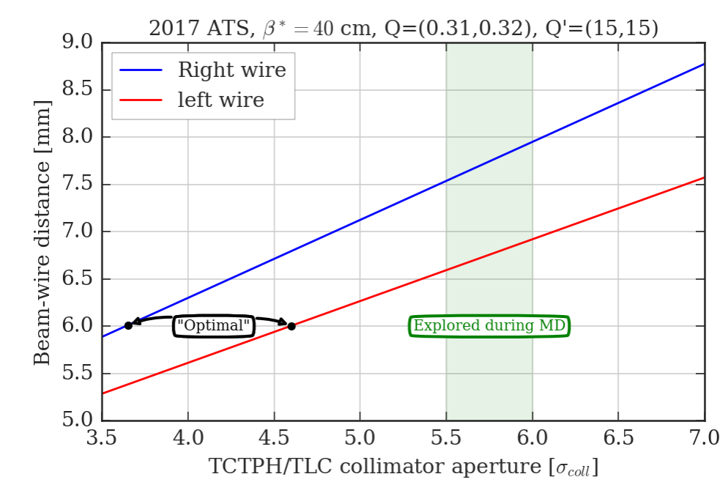
Constraint for the wire positioning
The wires are embedded in tertiary collimators. There are precise limits in the positioning of the wire with respect to the beams. Ideally we would need to put the wires at ~6 mm.
7
Notes:
7

Slide 8
MD2202
10 h MD.
The FILL5898 was dumped (RF on B1, not clear the reason, RF experts suggest a glitch on the interlock). Half-RF detuning.
The observations we report concern the FILL5900. Full-RF detuning.
8

Slide 9
Asymmetric filling scheme
To approach the wire to the beam the B2 has to be <3e11 p (safe limit).
We will main concentrate on the two bunches of B2 (Only HO and HO+BBLR).
9

Slide 10
STEP 1: Alignment of the two wires
Important vertical offset (up to 5 mm) to be corrected with the vertical alignment procedure. This is not a trivial procedure (no V PU).
It would be beneficial to have H+V PUs on the BBCW in HL-LHC.
10

Slide 11
STEP 2: H emittance blow-up
To increase the LRBB effect the B2 was blown-up to 5-6 mm mrad and the tunes were set to (0.31, 0.32).
11

Slide 12
STEP 3: Crossing angle reduction
To increase the BBLR the X-ing angle was reduced. Great synergy with the OP tools developed for the crossing angle anti-leveling.
12

Slide 13
Finally: powering the wires
During the powering of the wires the tunes of the beam (and its position) has to be controlled. The BBCW can move the Q of ~0.01: dipolar and quadrupolar contributions of the wires were compensated with feed-forward trims [backup slides].
13

Slide 14
Results on the compensation (I)
Compensation seen from the σ_{eff} [credit to N. Karastathis].
Clear effect on the BBCW when switching-off: signal compatible with a contraction of the DA.
We need a long integration time (very delicate observable).
14
Notes:
14

Slide 15
Result on the compensation (II)
Using dBLM signals to compute the cross-section [credit to A. Poyet].
Improved time resolution.
Further checks on calibration needed.
First results from LLRB MD
15
Notes:
15

Slide 16
Result on the compensation (III)
From the FBCT signals compensation on the losses [credit to M. Hostettler].
Clear effect of the BBCW.
16
Notes:
16

Slide 17
Summary of the experimental results of MD1
During the MD2202 it was observed for the first time in LHC the effect of a direct compensation of the BBCW. The setting-up procedures were tested and validated.
The HW (interlock, PCs, jaws temperature/cooling, collimators…) worked smoothly.
There is a lot of margin of improvement in the procedure: beta-beating/tune feedforward (Luis from Rogelio’s team is working on it) and a smoother orchestration of the feedforward trims (Matteo is working on it).
It is very important to explore the I_{w} and d_{w} parameter space and correlate it with the analytical model and the tracking results.
17
Notes:
17

Slide 18
Outline
Experimental results in MD1
Numerical results from the RDT
Tracking results for LHC and HL-LHC
Conclusions and plans
18
Notes:
18

Slide 19
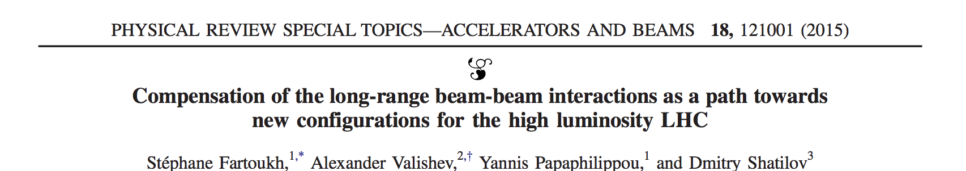
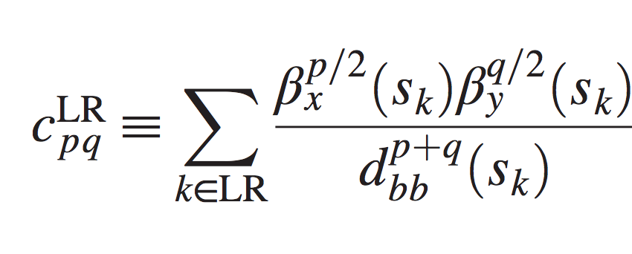
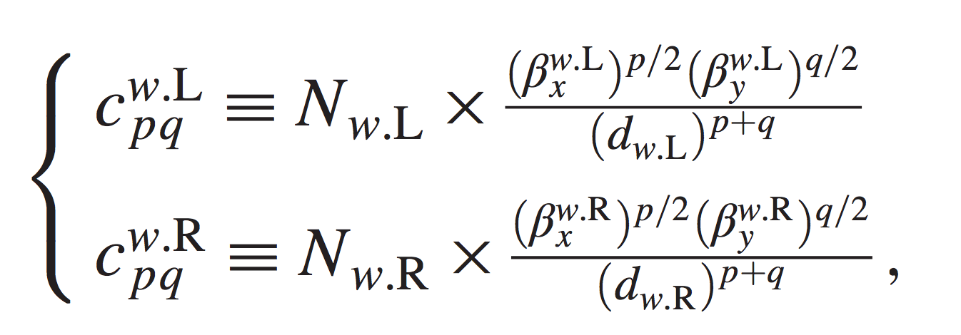
Numerical results from the RDT
We will use the RDT criterion presented and described in details in
Goal: compensate the BBLR RDTs by using 2 BBCs per IP.
Strong-beam driven RDTs
BBCW driven RDTs
Assuming
  the same N_{w} and d_{w} for both BBCWs,
  that the strong beam acts as a DC wire,
  that the phase advance between BBLRs and BBLRs/BBCW is 0 or 180 deg.
the paper gives N_{w} and d_{w} to compensate 4 RDTs (p1q1, q1p1, p2q2, q2p2) in closed form.
It is shown as a numerical evidence that by compensating 4 RDTs one can minimize ALL RDTs if the position of BBCW is conveniently chosen.
Using the paper’s formalism, we will show numerical results on the present LHC (2017 ATS).
19
Notes:
19

Slide 20
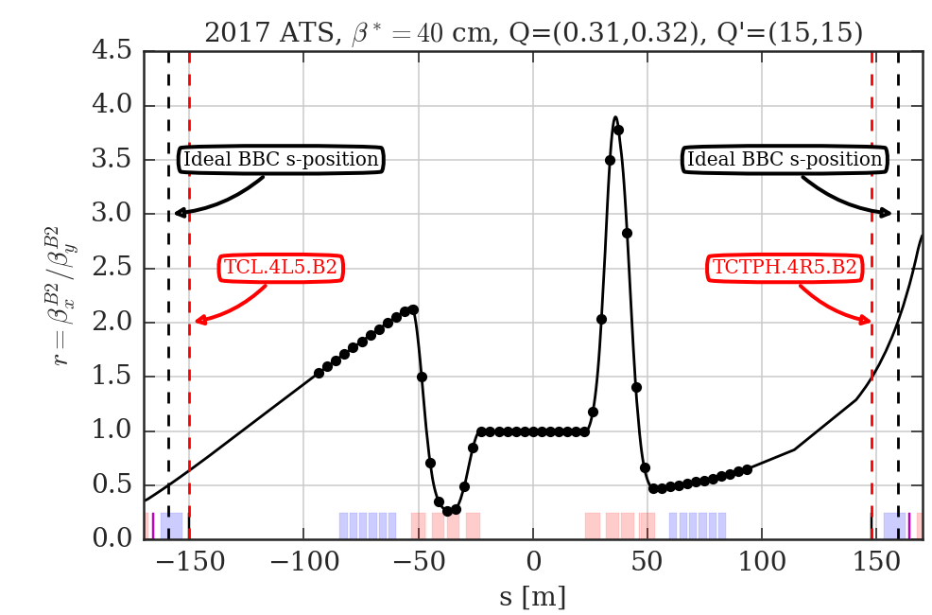
The ideal BBC position in 2017 ATS
The actual position of the BBC is ~10 m apart from the ideal one [backup slides].
We will first consider the ideal case and afterwards the real case per IP5.
First results from LLRB MD
20

Slide 21
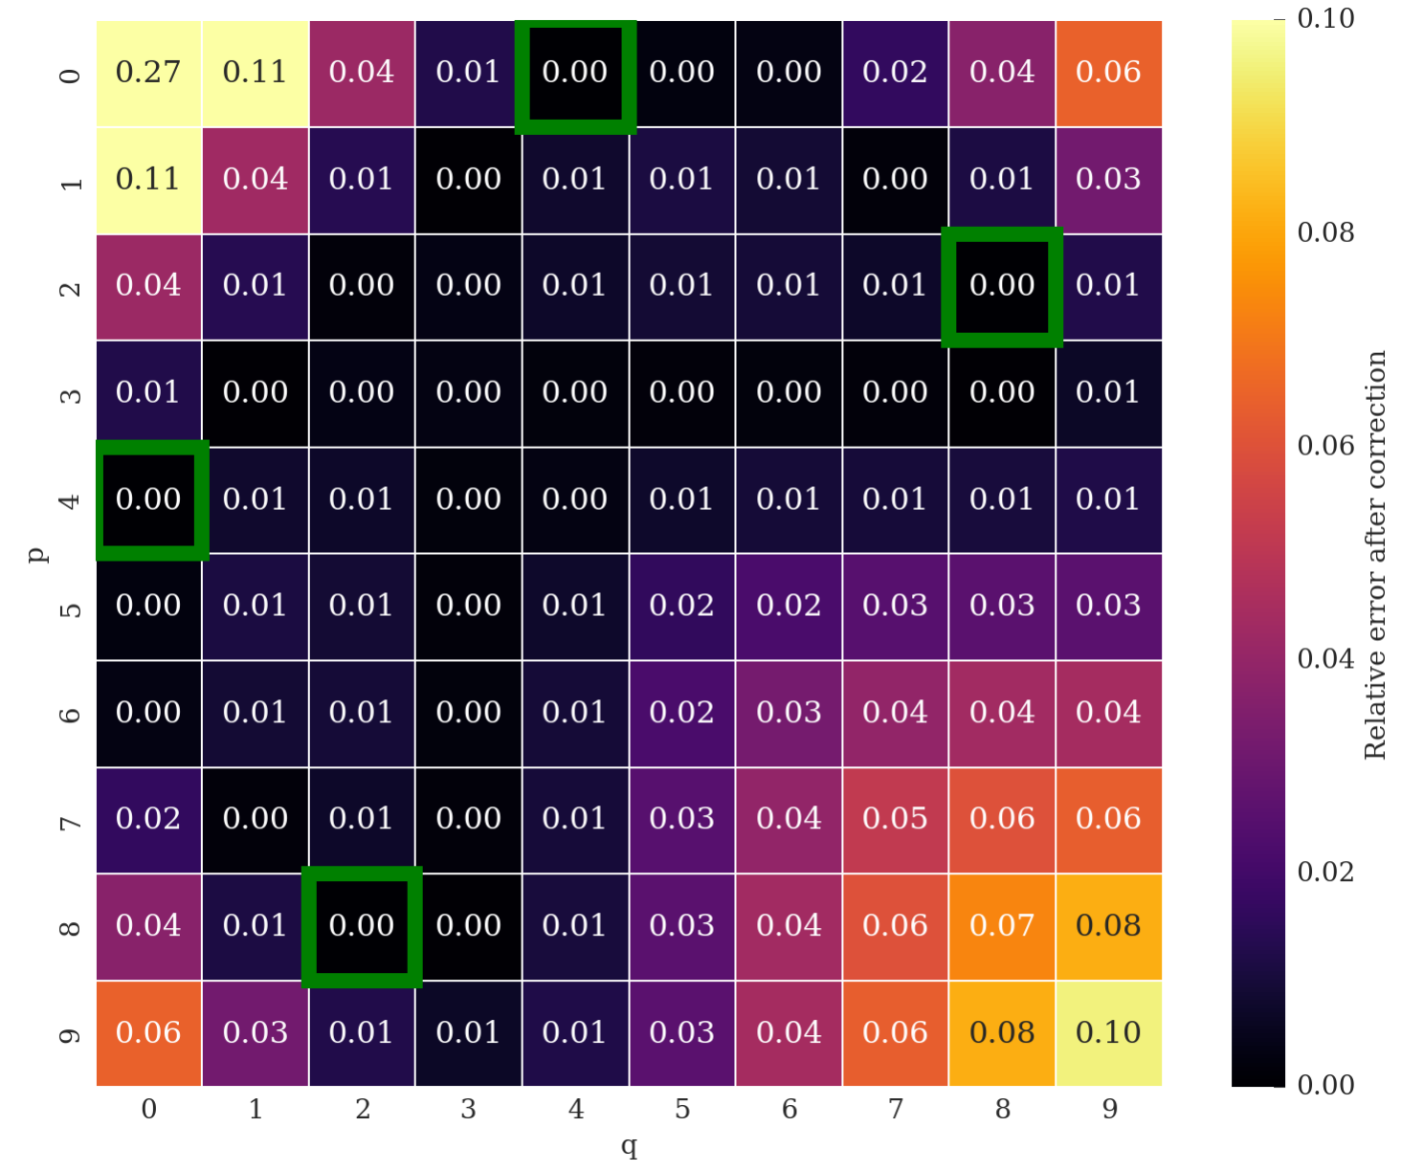
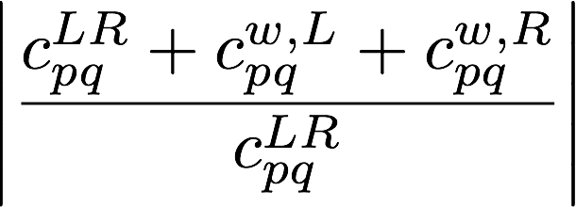
IDEAL CASE: 2 BBCW for IP at s_{opt}=+-159 m
RDT compensation map
dipole driven
quad driven
in color code
The green boxes are the 4 RDTs used to set N_{w} and d_{w}
As expected (under the mentioned assumptions) the compensation is covering many more RDTs than the 4 used to set the BBCWs (green boxes). The p+q=1 and p+q=2 could be addressed by using “local” linear magnets (Q4s and the Q4 correctors).
21
Notes:
21

Slide 22
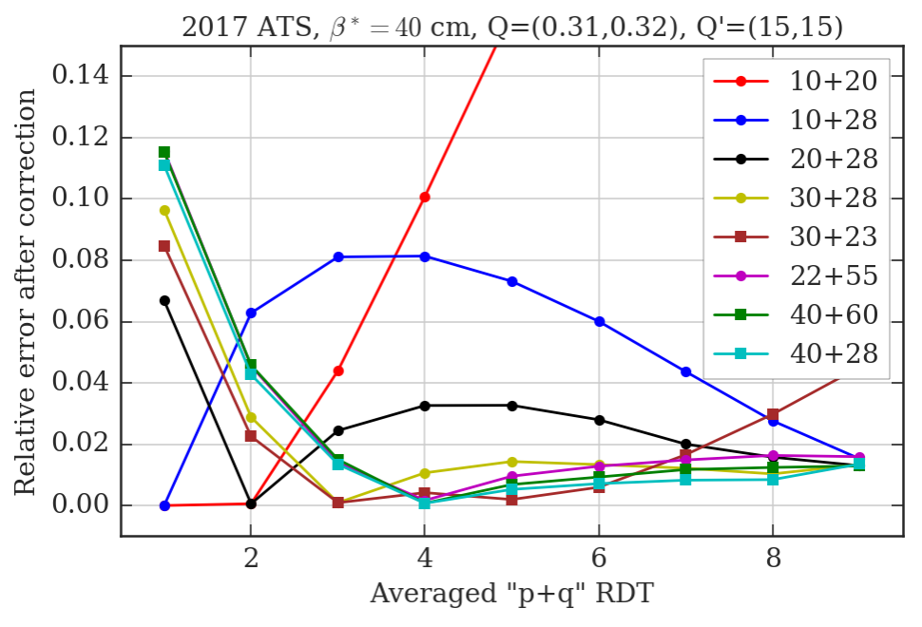
IDEAL CASE: 2 BBCW for IP at s_{opt}=+-159 m
Good performance
Averaging the anti-diagonal of the RDT map one can chose a convenient RDT minimization strategy. The minimization of 40+28+04+82 is the best among the considered cases.
22
Notes:
22

Slide 23
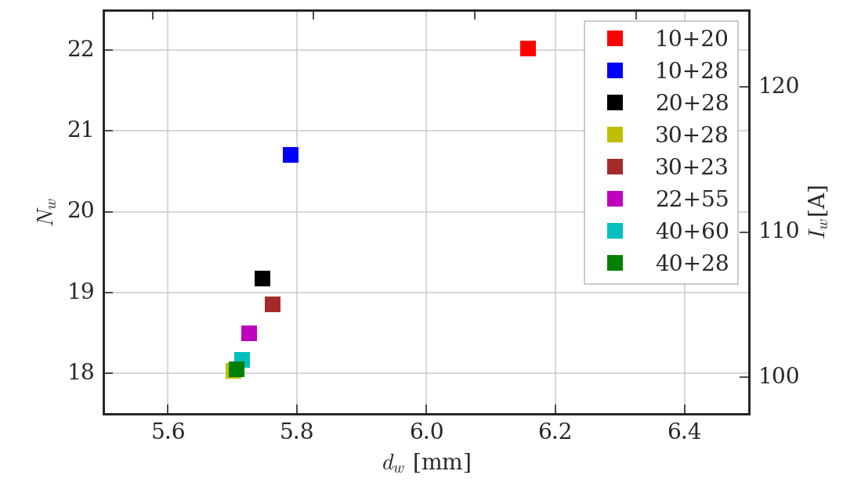
IDEAL CASE: from RDT to I_{w} and d_{w}.
Good performance
The d_{w} will depend on the crossing angle [back-up slides].
In the plot we assume a half-crossing of 150 urad.
This ideal case cannot be reached in MD (s and x-position limits).
23
Notes:
23

Slide 24
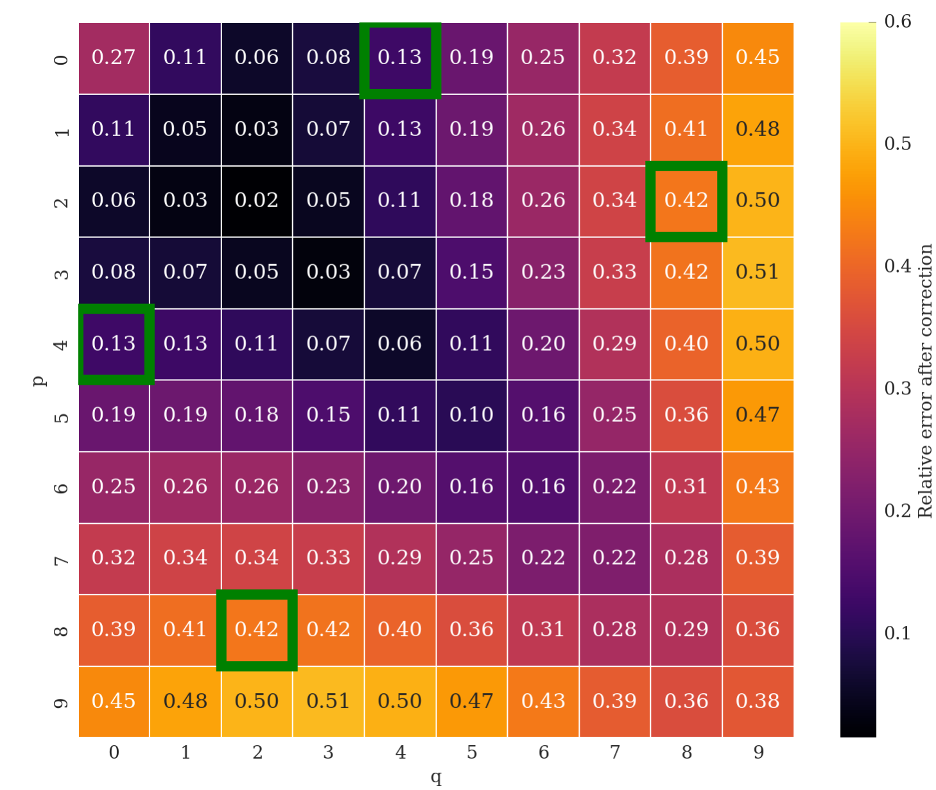
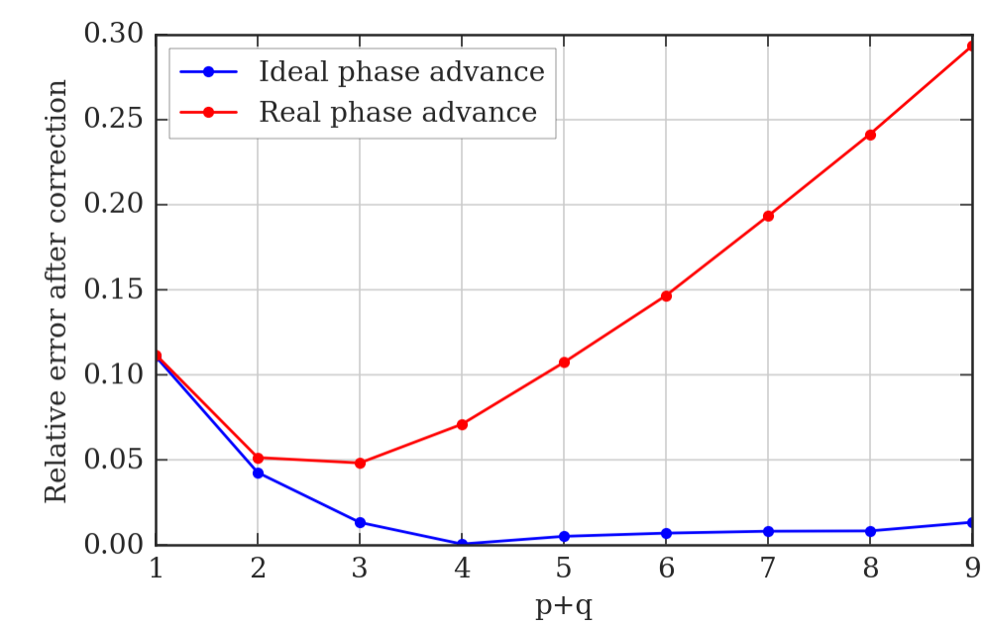
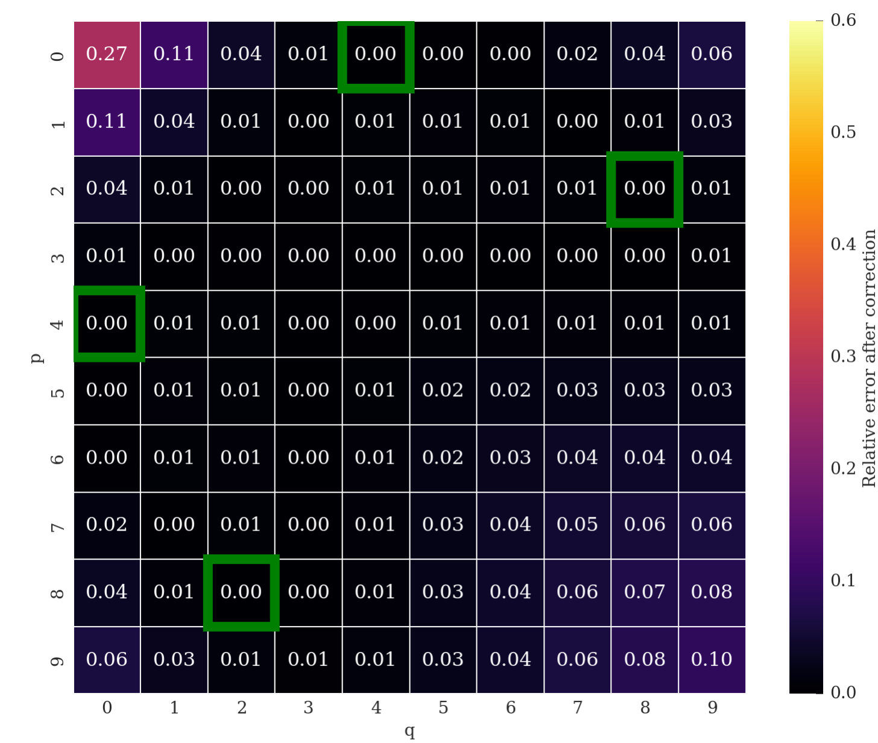
IDEAL CASE: considering the phase advance.
Real phase advance considered
Ideal phase advance considered (β*→0)
One can quantify a posteriori the effect of the phase advance.
The compensation of the RDT does degrade. The compensation of detuning terms (Q-footprint compression) is not affected.
24
Notes:
24

Slide 25
The MD results and the RDT
Very different from the ideal case:
The BBCWs are not in the optimal s-position.
The BBCWs are only in IP5.
The BBCWs are not positioned symmetrically with the IP5 (~2 m asymmetry).
The parameters adopted for the correction were I_{w}^{R}=I_{w}^{L}=350 A , d_{w}^{R}=7.95 mm, d_{w}^{L}=6.92 mm and θ_{c}=120 μrad).
25
Notes:
25

Slide 26
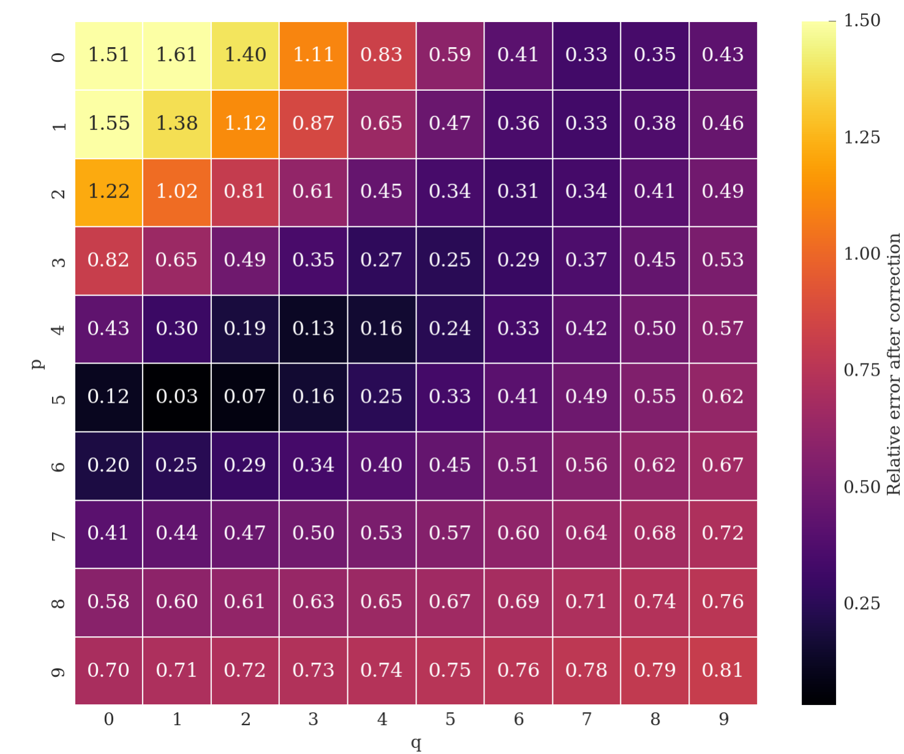
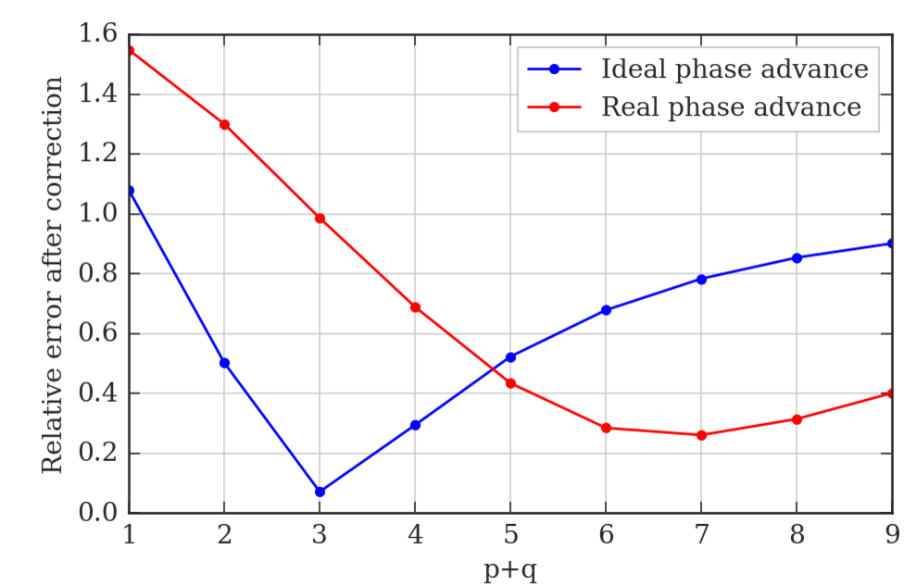
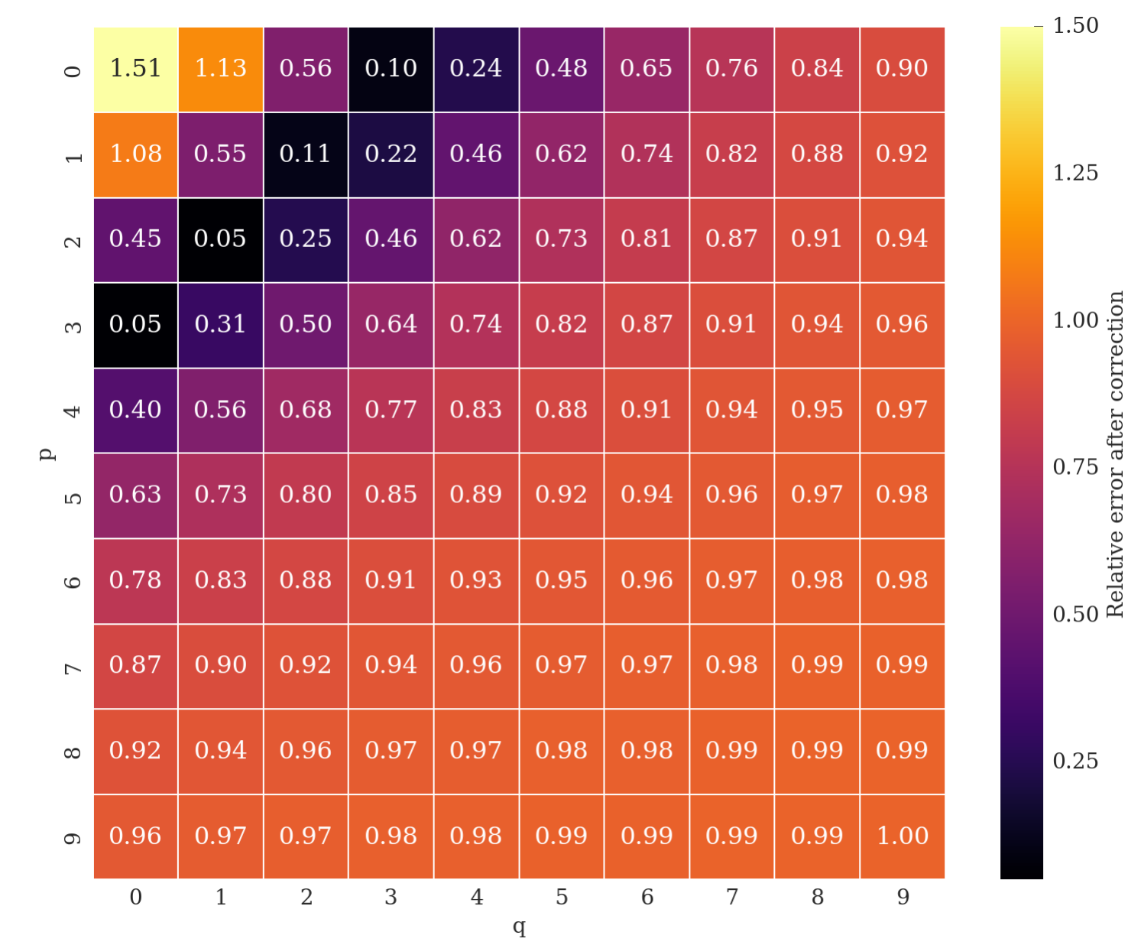
The MD results and the RDT
Real phase advance considered
Ideal phase advance considered (β*→0)
PRELIMINARY: the observed effect of the BBCW could be related to a partial compensation of the detuning terms.
26
Notes:
26

Slide 27
Outline
Experimental results in MD1
Numerical results from the RDT
Tracking results for LHC and HL-LHC
Conclusions and plans
27
Notes:
27

Slide 28
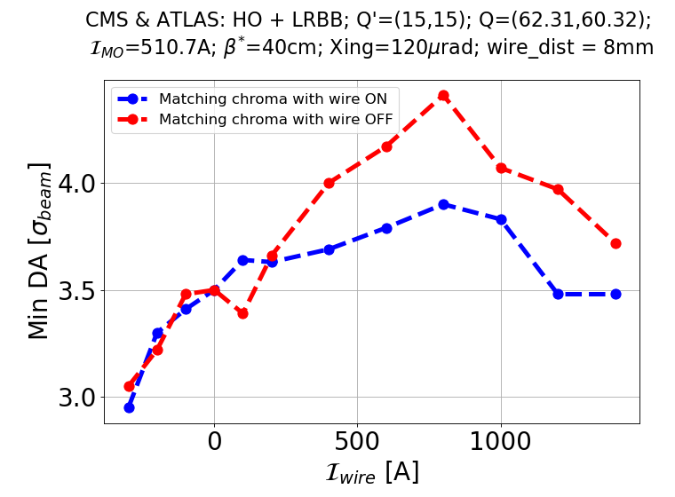
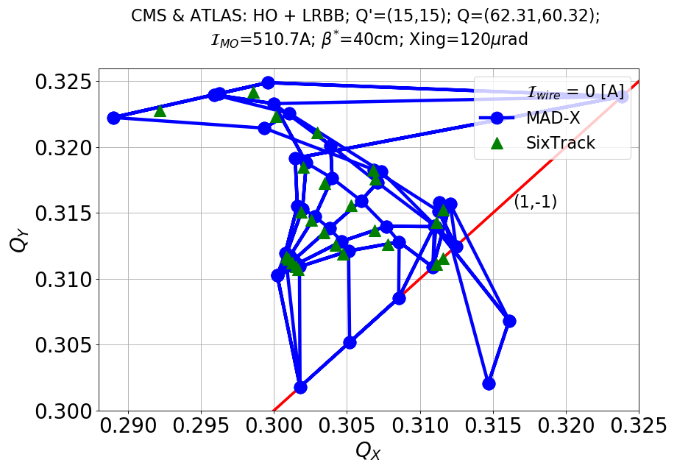
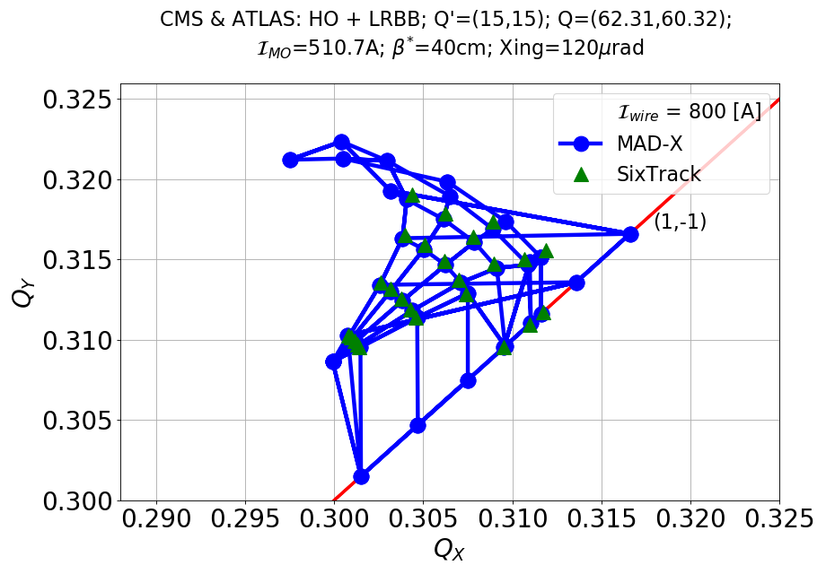
DA simulations with Wire in MD-like conditions I
MD-like conditions: d_{w}=8 mm. LR in IR1/5 but wire only in IR1, real aspect ratio at wire position, phase advances.
A modest gain of DA is observed for 8 mm wire-beam distance.
Optimal DA for 800 A.
With no rematch of the chromaticity (as in the MD), the gain of DA is improved.
Good agreement between footprints from MADX and Sixtrack.
Improvement observed but no clear identification of the optimum.
K. Skoufaris
First results from LLRB MD
28

Slide 29
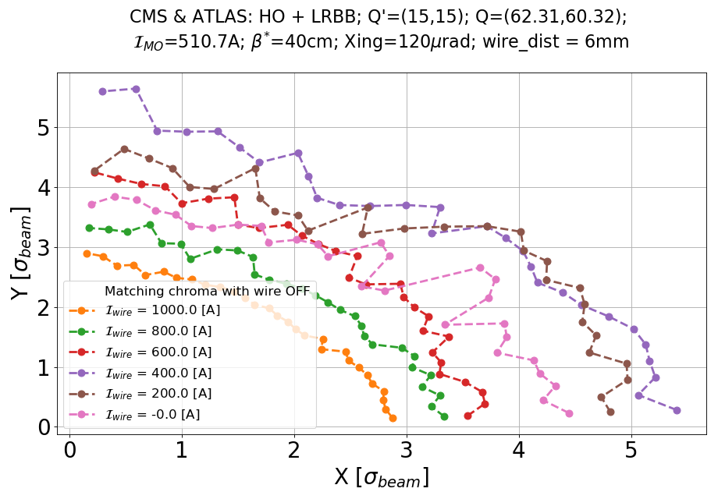
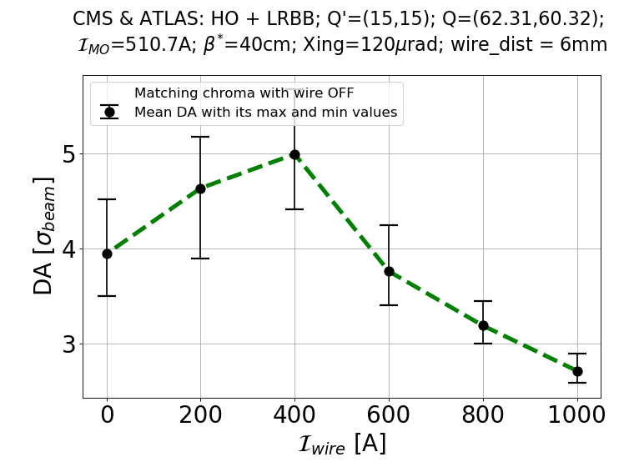
DA simulations with Wire in MD-like conditions II
Push d_{w} to 6 mm
Still not ideal conditions: LR in IR1/5 but wire only in IR1, aspect ratio at wire position, phase advances.
1σ (@2.5 μm) DA gained for an optimal wire current of ~400 A.
Clear improvement over all the angles.
400 A
0 A
K. Skoufaris
First results from LLRB MD
29

Slide 30
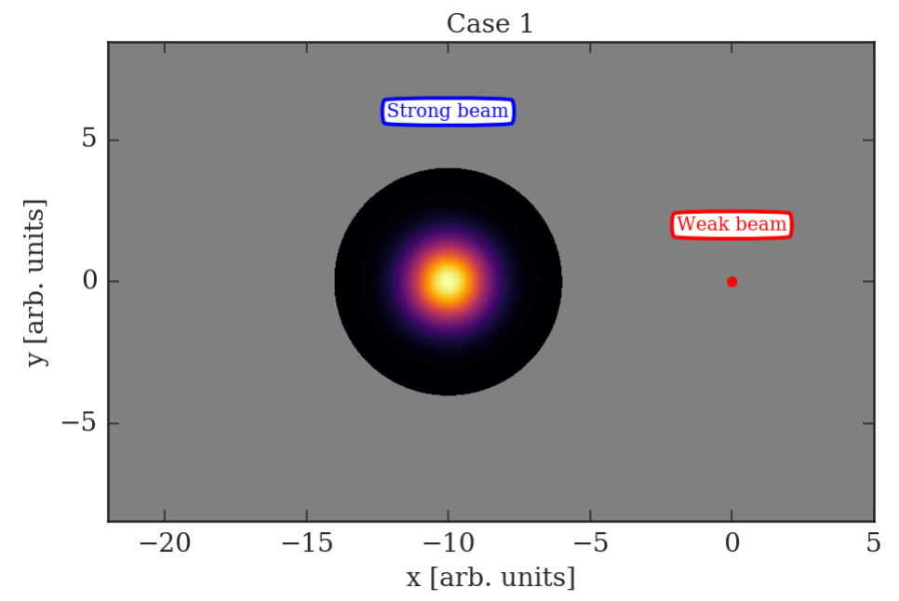
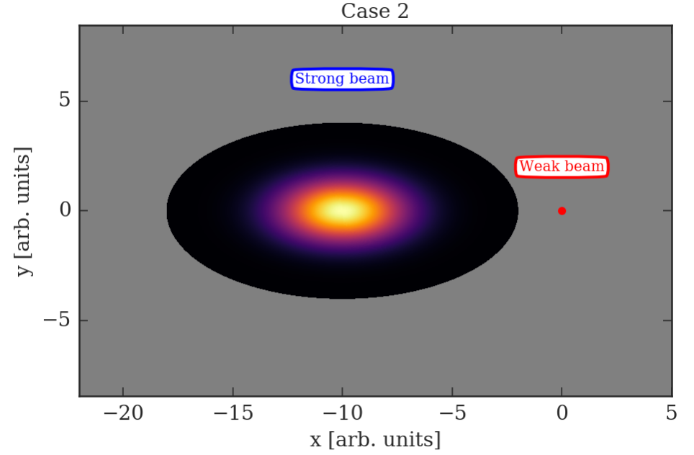
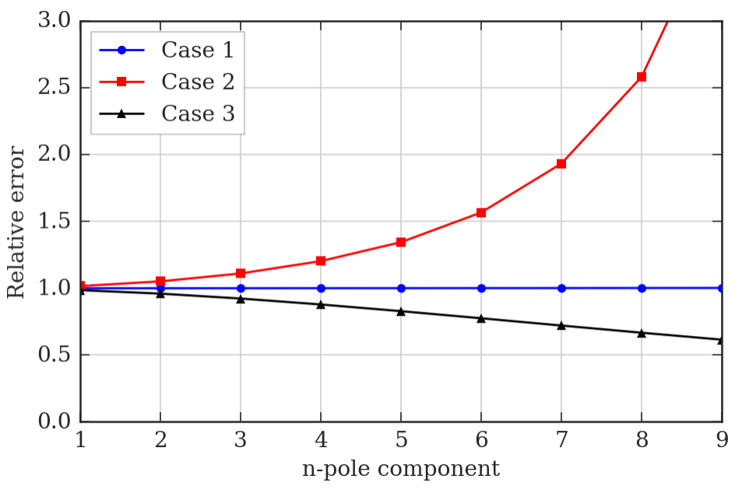
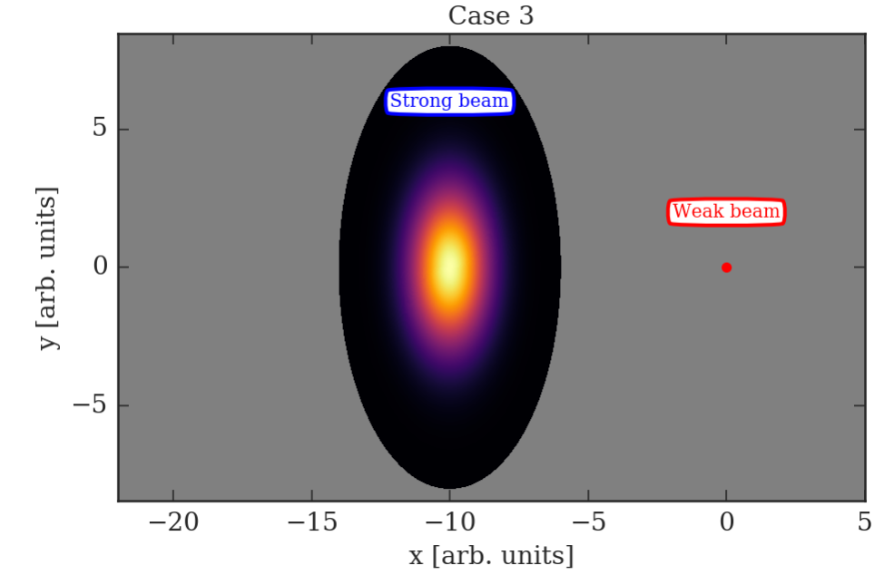
“Strong beam”-wire equivalence
For β_{x}≠β_{y} the “strong beam”-wire equivalence is not valid anymore
We compare the strong beam field and the wire field in terms of multipoles
Case 1: β_{x}=β_{y} , perfect equivalence
Case 2: β_{x}=4*β_{y} , see plot below
Case 2: β_{y}=4*β_{x} , plot below
We assume bi-Gaussian density (4 σ cut)
30

Slide 31
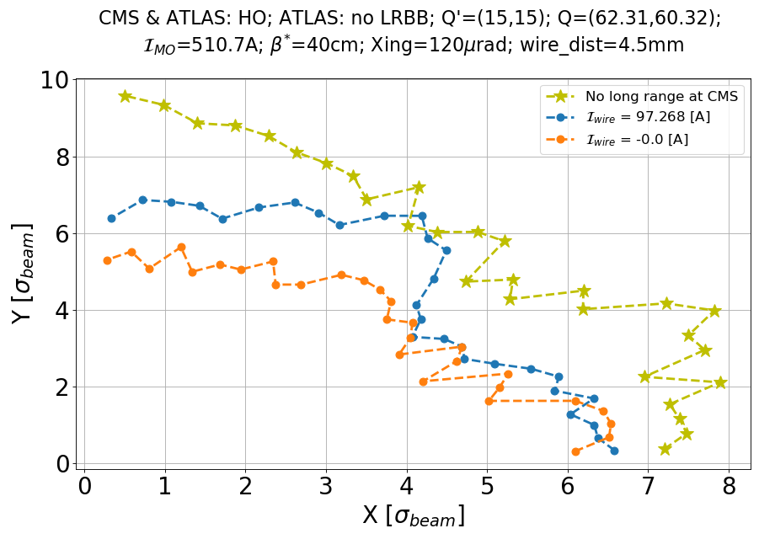
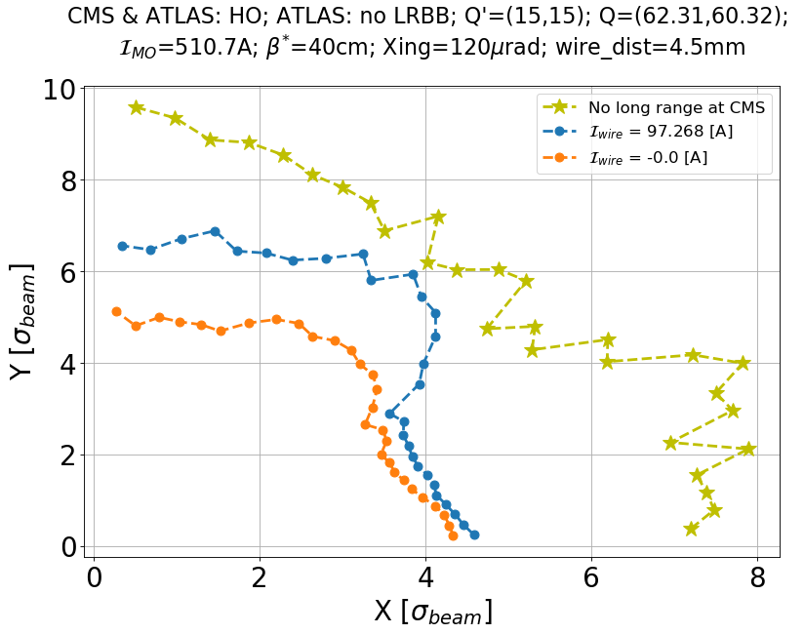
“Strong beam”-wire equivalence: tracking
Standard Strong Beam Zero-emittance-long-range Strong Beam
K. Skoufaris
The zero-emittance-LR strong beam does not show a better DA.
Effect of phase advance? Plans to test with the wire at ~70 m for better phases.

Slide 32
First attempts of BBCW in HLLHC1.3
B1 tracking with operational settings for emittance, tunes, chroma, octupoles.
4 wires (L/R IP1/5) installed in the crossing plane.
The wires are arbitrarily placed at +/-150m from the IPs.
The distance is tuned so that the beam-wire normalised separation is the same as the normalised crossing.
Likely a suboptimal configuration to be further refined.
β* = 60 cm | H Beta [m] | V Beta [m]
wire_l1.b1 | 1052 | 1181
wire_r1.b1 | 1178 | 1054
wire_l5.b1 | 1054 | 1182
wire_r5.b1 | 1181 | 1055
β* = 20 cm | H Beta [m] | V Beta [m]
wire_l1.b1 | 3006 | 3641
wire_r1.b1 | 3649 | 2999
wire_l5.b1 | 2995 | 3645
wire_r5.b1 | 3636 | 3003
First results from LLRB MD
32

Slide 33
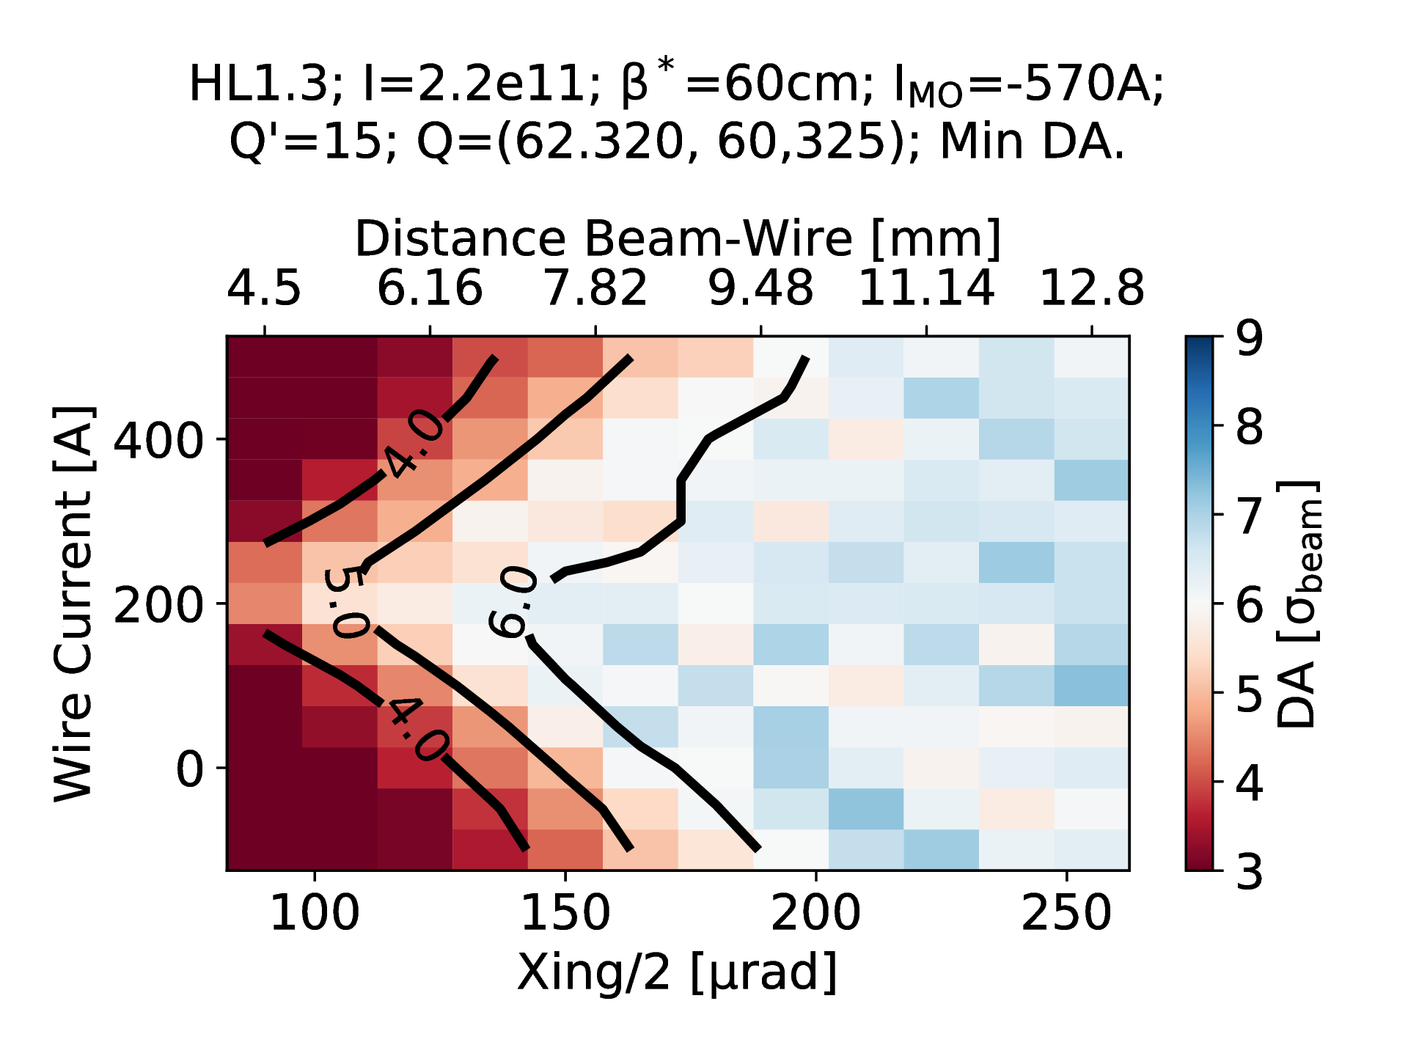
Wire Compensation at the beginning of the fill
Gain > 30 μrad
First results from LLRB MD
33

Slide 34
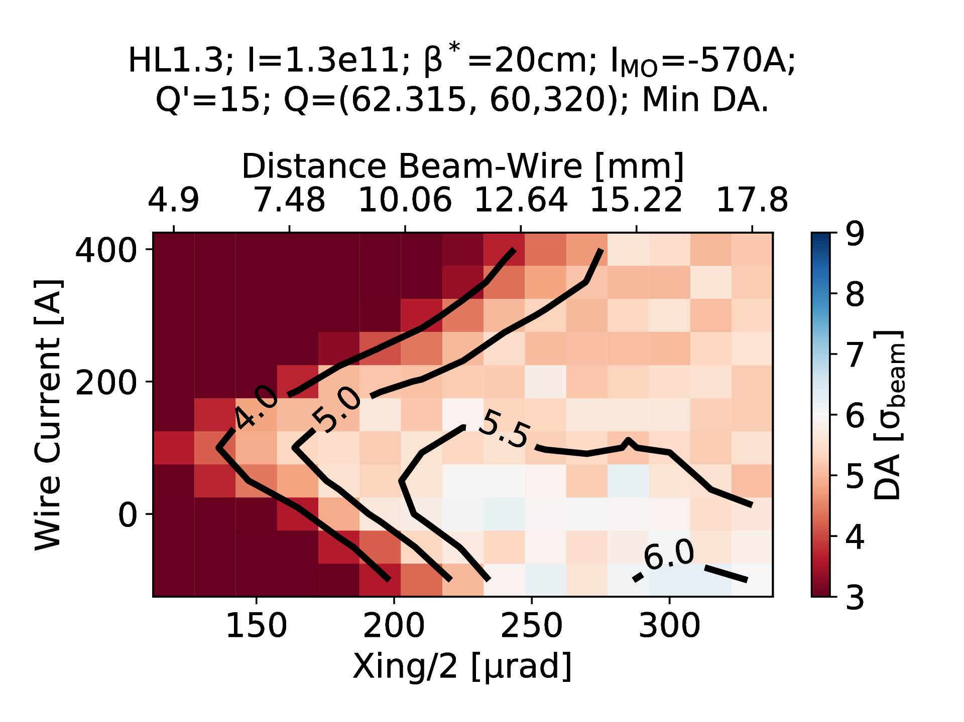
Wire Compensation at the end of levelling
Gain > 20 μrad
Wire attacking the extra octupole strength?
First results from LLRB MD
34

Slide 35
Outline
Experimental results in MD1
Numerical results from the RDT
Tracking results for LHC and HL-LHC
Conclusions and plans
35
Notes:
35

Slide 36
Conclusions and plans
During the MD2202 it was observed for the first time in LHC the effect of a direct compensation of the BBCW.
Given the constraint on the minimal d_{w} we used the maximum current. The analytical approach showed that the MD settings reduce by 75% the linear detuning due to the BBLR in IR5.The tracking studies showed the improvement of DA (with 400-800 A current with similar d_{w}).
The tracking for the HL-LHC shows a beneficial effect of the BBC also with sub-optimal positioning: iteration with the analytical model and the tracking will be the next step.
Presently working in the benchmarking of DA studies and analytical model with respects the phase and strong-beam assumptions.
In MD3 we plan to perform a systematic I_{w} scan with <=5.5 σ_{coll} and θ_{c}=120 μrad.
For HL-LHC, need to find a common strategy between BBLR octupoles/wires compensation and coherent effects.
36
Notes:
36

Slide 37
BACK-UP SLIDES
37

Slide 38
BBCW MD: sanity checks on H/V-position
The H-position of the beam is well under control.
The V-position and correctors behaviour confirm a very good V-alignment of the BBCW.
38

Slide 39
BBCW MD: sanity checks on tunes
The tunes feedback is off during collision. The Q-feedforward is working as expected allowing to keep constant the tune during the ON/OFF cycles of the BBCW.
39

Slide 40
BBCW MD: Q trims
The Q-trims are mostly due to the feedforward.
40

Slide 41
BBCW MD: dipolar trims
The correctors trims are mostly due to the crossing angle settings.
41

Slide 42
BBCW MD: optimizing HO collision
42

Slide 43
BBCW MD: wires H-positioning
The hectic activity on the BBCW positioning.
43

Slide 44
BBCW MD: instability of B1
During next MD we will use stronger octupole settings to avoid the instability of the non-colliding bunches in B1.
44

Slide 45
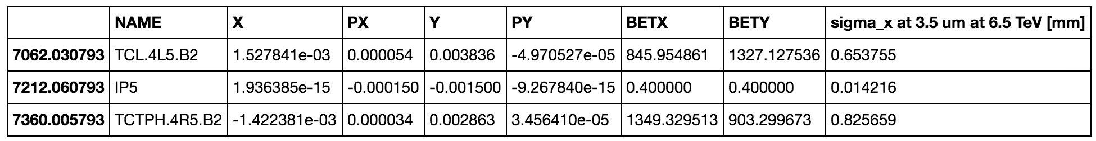
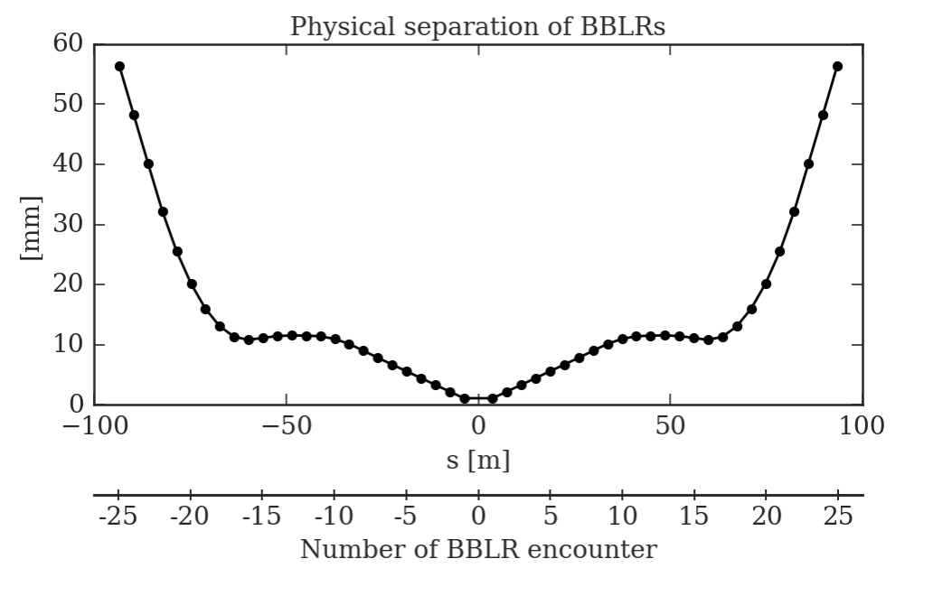
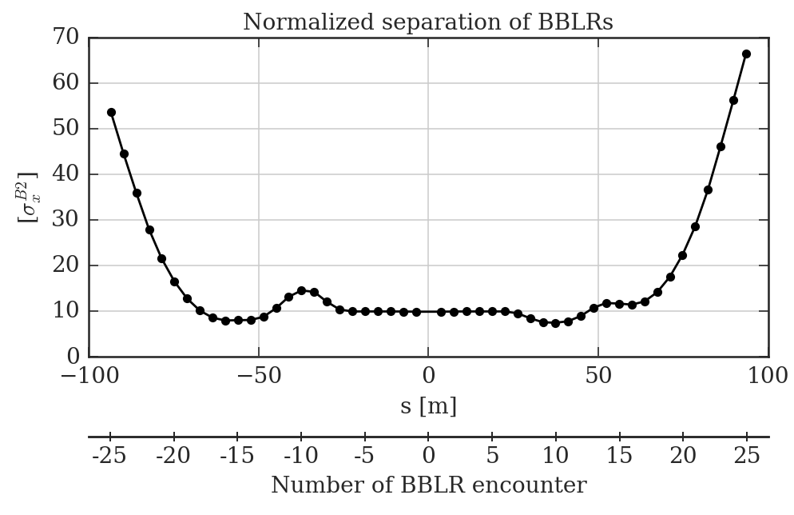
ATS 2017 optics
45

Slide 46
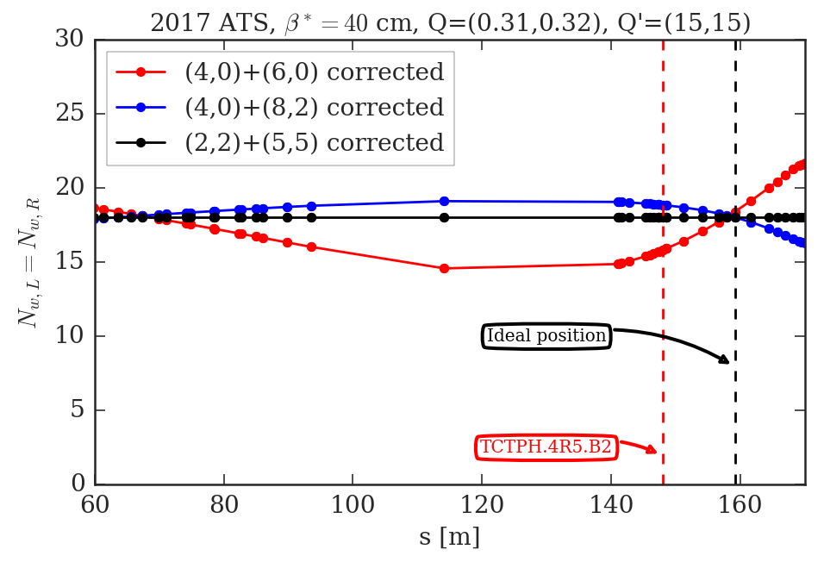
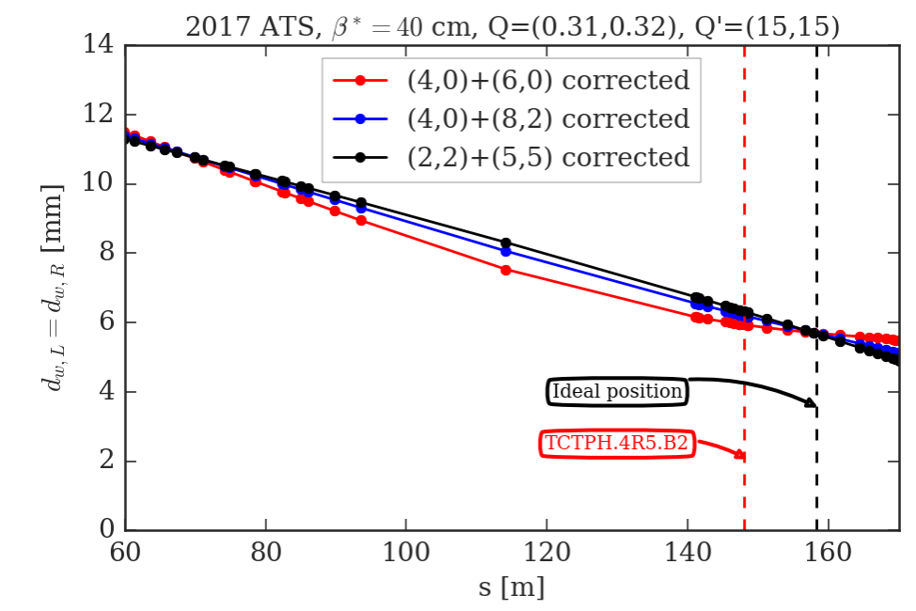
RDT criterion for ATS 2017 and θ_{c}=150 μm
By plotting the N_{w}(s) and d_{w}(s) for different RDT minimization strategy, one sees there are specific s-positions, s_{opt}, that minimizes more than the usual 4 RDTs.
The BBCW is positioned ~10 m apart with respect to the optimal position.
46
Notes:
46

Slide 47
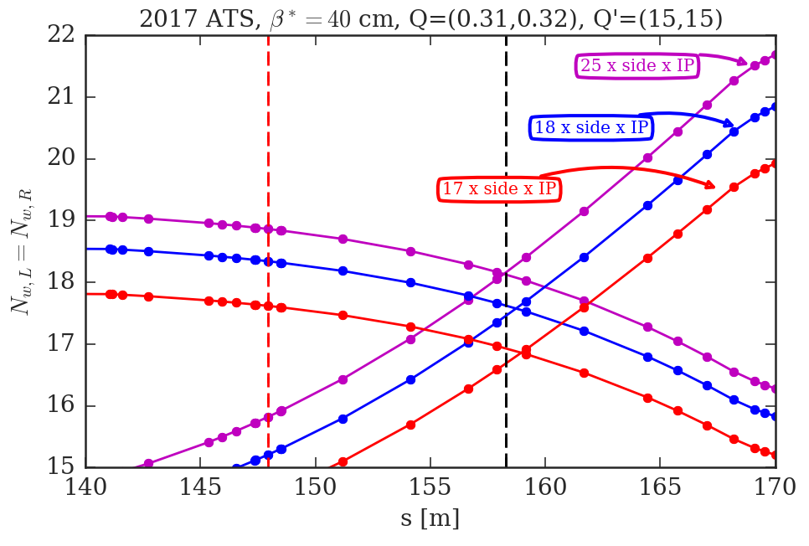
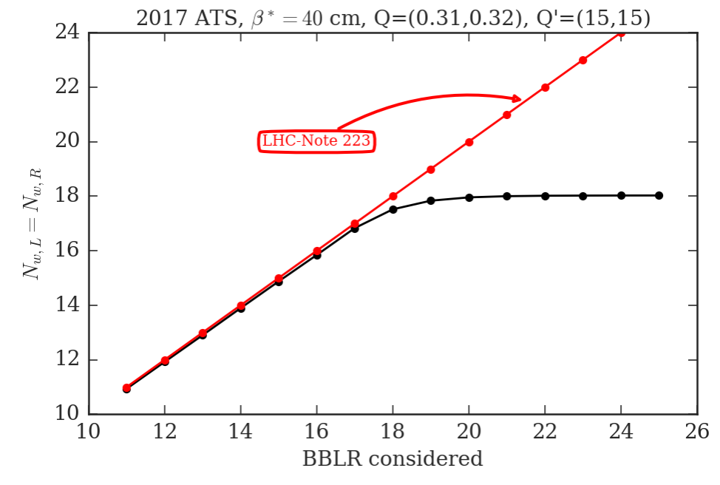
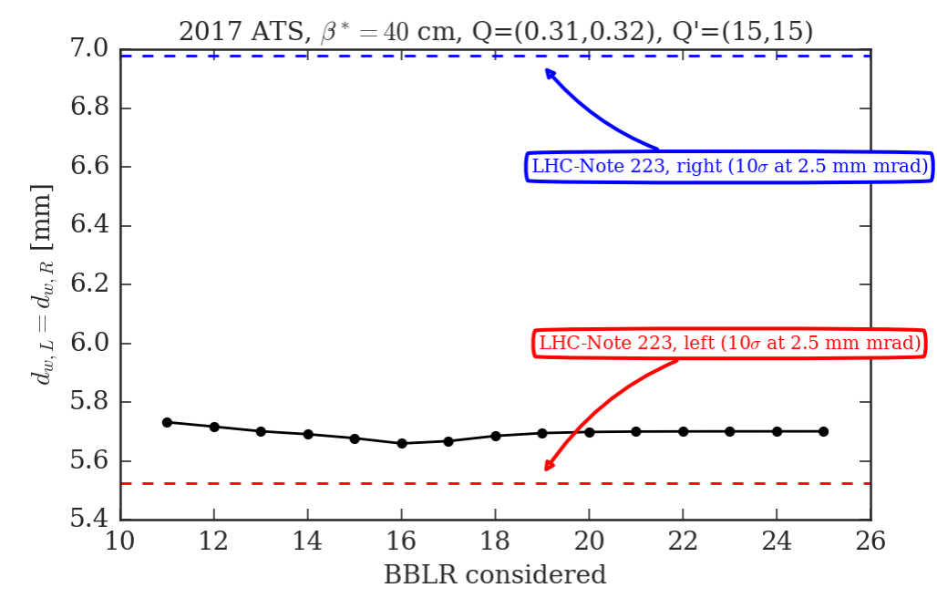
Convergence of BBLR with RDT criterion
Does s_{opt} depend on the BBLR considered?
How many BBLRs should be considered for its convergence?
What about the convergence of N_{w} and d_{w}?
47
Notes:
47

Slide 48
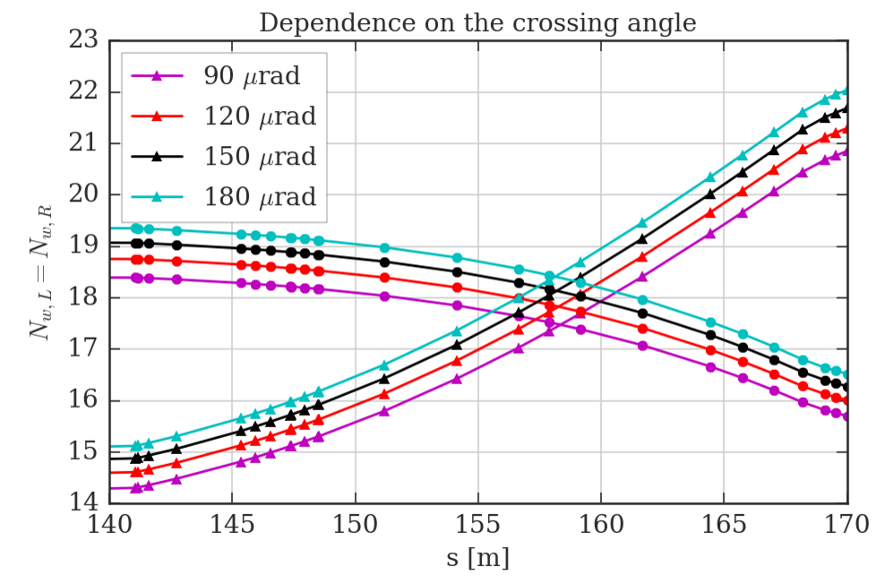
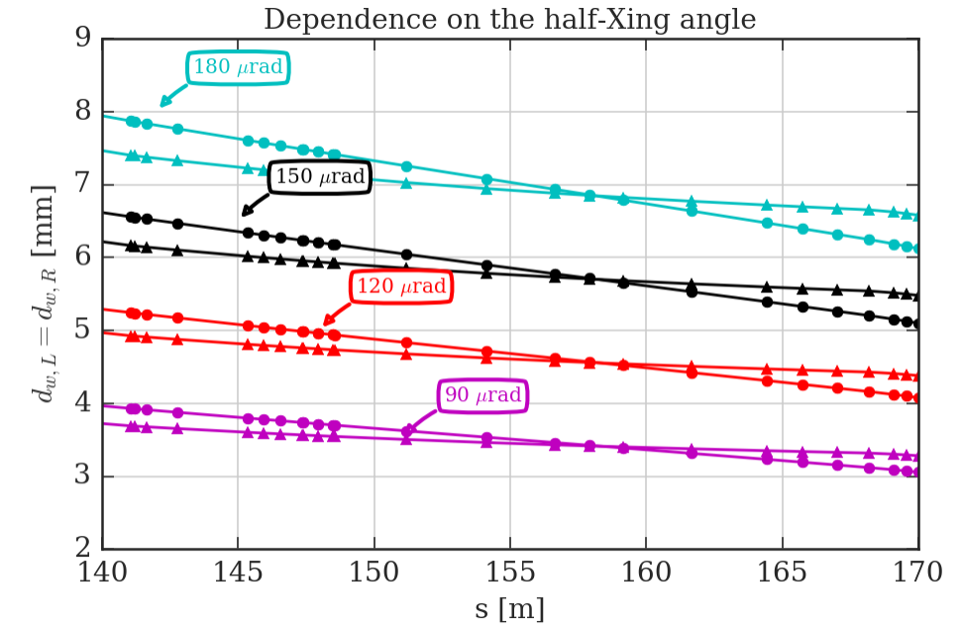
s_{opt}, N_{w} and d_{w} on crossing angle
There is no dependence of s_{opt} on the crossing angle.
N_{w} dependence on the crossing angle is marginal (smaller crossing angle, smaller N_{w}).
d_{w} is linearly dependent on the crossing angle.
48
Notes:
48

Slide 49
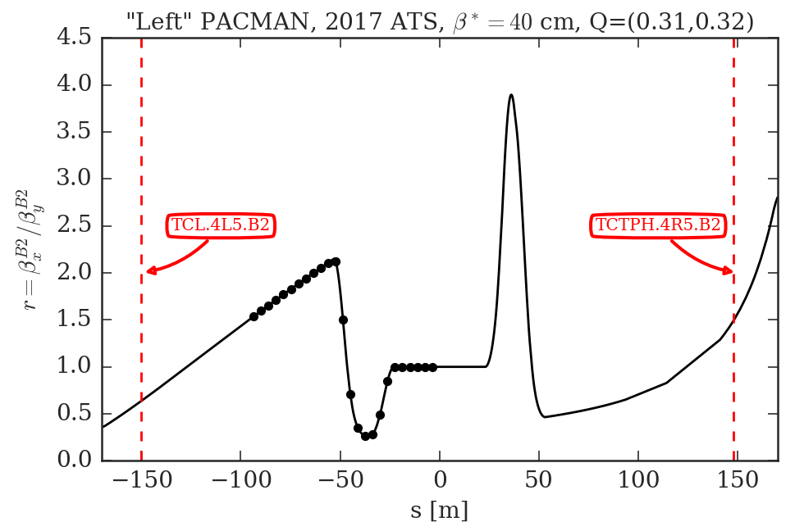
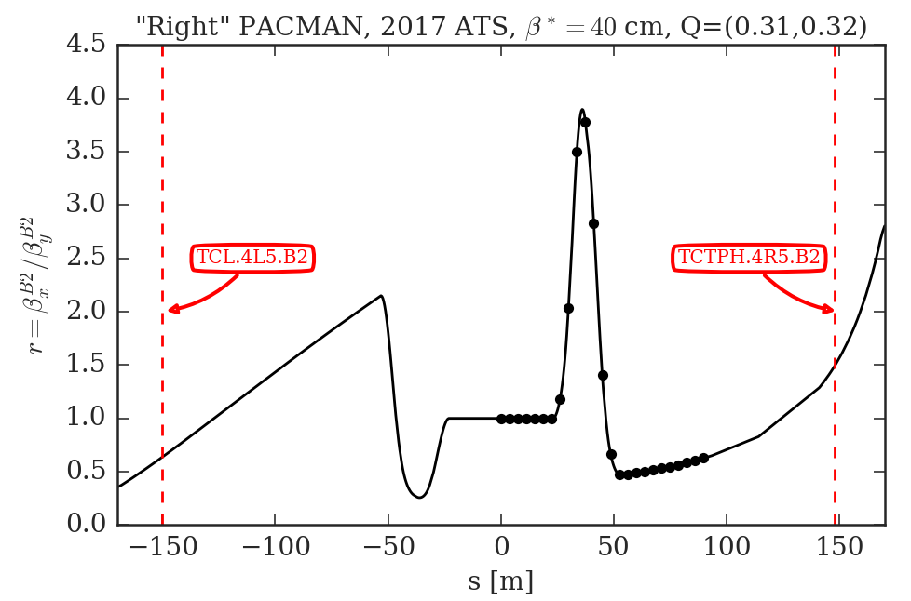
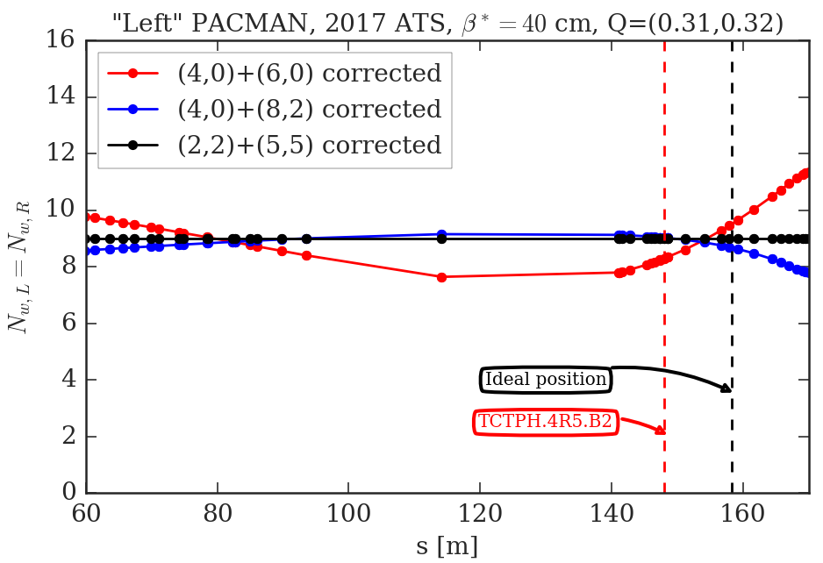
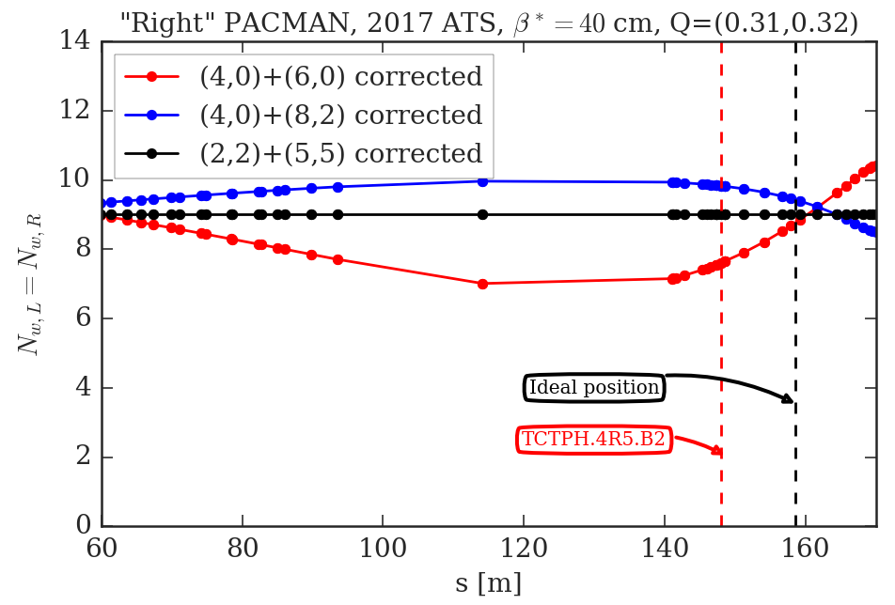
PACMAN bunches and s_{opt}
The s_{opt} depends on the PACMAN pattern.
49

Slide 50
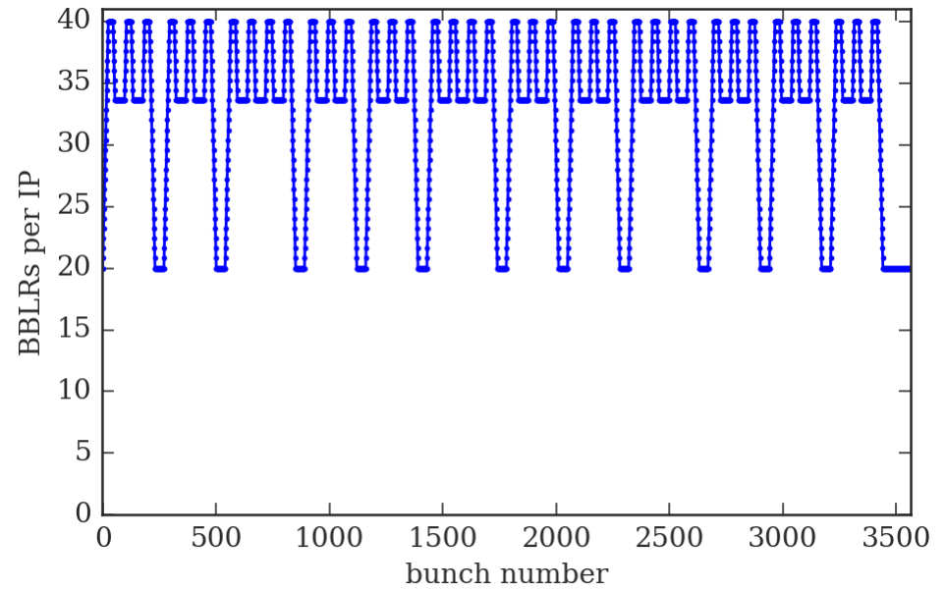
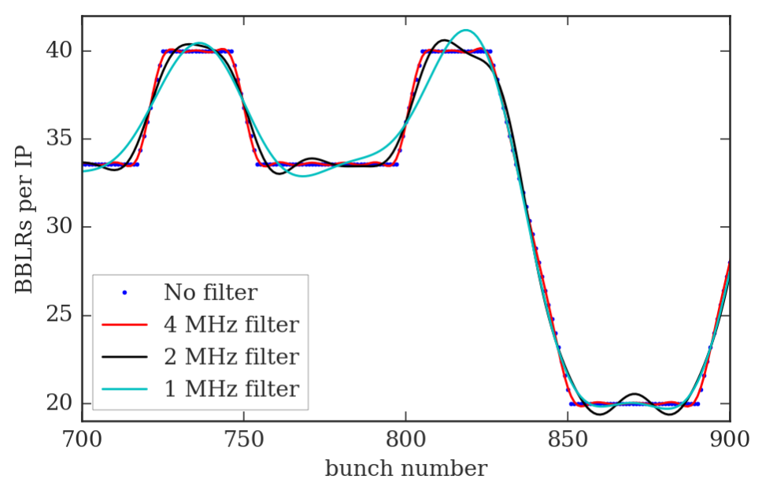
PACMAN bunches and I_{w} modulation
The needed I_{w} modulation BW is of the order of 4 MHz (x10 lower than the bunch frequency).
The wavelength in vacuum of a 4 MHz EM wave is ~75 m.
50

Slide 51


“Strong beam”-wire equivalence II
Case 2: what if the emittances of the strong beam increases by 20%?
51

Slide 52
What is the time constant of the CO feedback?
It depends of the gain/settings of the CO feedback. With nominal FT settings is of the order of ~1 minute.
52

Slide 53

BBCW impact of the beam profiles (I)
A very detailed presentation by Miriam and Stefania at https://indico.cern.ch/event/658908/
Longitudinal profiles
53

Slide 54

BBCW impact of the beam profiles (II)
A very detailed presentation by Miriam and Stefania at https://indico.cern.ch/event/658908/
Transverse profiles
54

Slide 55
HL1.3 Tune Optimisation
Beginning of fill
End of Levelling
N. Karastathis
First results from LLRB MD
55

