Slide 1
TAGS in the Analysis Model
Jack Cranshaw, Argonne National Lab
September 10, 2009

Slide 2
Objectives for this Talk
This is not a tutorial, that would take several hours.
What you should take from this presentation:
  Know how to check the content of TAGS.
  How to construct a query on the TAGS.
  Understand the general changes needed to use TAGS with athena.
  Understand plans for TAGS in real physics analyses.

Slide 3
Event Selection
Observations
  ATLAS operates at a hadron collider where signal to noise is almost always low.
  ATLAS will run for multiple years.
  ATLAS event rates and data sizes impose limitations on the amount of data which can be hosted on any particular site.
  Although running over a 1% subset of a large data sample will take more than 1% of time for the full data sample, it will take less than 100%.
  Having multiple people run over the same data (RAW, ESD, AOD, …) to make similar selections or make similar rejections is a waste of resources.
Consequences
  Event selection activities such as skimming, thinning, etc. are important and necessary activities.
  Maximizing the information than can be used for these activities can have large leverage effects on computing and physicist resources.

Slide 4
Event-level Metadata
Information about data is called metadata.
In ATLAS, metadata exists at many levels (dataset, run, lumiblock, event, …)
The TAGS are event-level metadata.
  TAGS must work with metadata at the other levels as well. You will learn more about this in the following talk.
TAGS contain
  Event identification
  Trigger information
  Stream information
  Detector status
  Physics quantities
    Photon, Electron, Jet, Muon, Tau Jet
  Physics decisions
    BPhys, Exotic, Jet Tagging, …
  https://twiki.cern.ch/twiki/bin/view/AtlasProtected/TagForEventSelection

Slide 5
Are TAGS an ntuple?
TAGS look like an ntuple: a set of related quantities in rows by event.
  TAGS are stored in multiple formats (relational database and ROOT)
  The ROOT storage is via a TTree, and the contents can be viewed using standard ROOT tools.
Data in TAGS, though are designed for event selection, not data monitoring, and not physics analysis.
  Nevertheless, the storage in a TTree aids in doing simple validations, and there have been cases where errors in data processing have been found first by simple analyses of TAG content.
TAGS are more than an ntuple.
  TAGS contain navigational information which allow users
    To identify datasets and files
    To use them directly as input to athena jobs
Many time TAG queries can look exactly like ntuple selections
  “RunNumber<430000 && NLooseElectron>4 && triggers(EFmu_20)=1”
  Caveat: triggers and other bitmasks stored in the TAGS require decoding (sometimes time dependent).

Slide 6
Data processing and TAG building
ATLAS data goes through several stages of processing.
http://indico.cern.ch/materialDisplay.py?contribId=38&sessionId=3&materialId=slides&confId=50976
TIME
800 kB/ev
150-250
kB/ev
RAW ESD AOD

Slide 7
Data processing and TAG building
TAGS are built at the same time as AOD and contain navigation information for all previous stages.
TIME
RAW ESD AOD TAG

Slide 8
Data processing and TAG building
TAGS are built at the same time as AOD and contain navigation information for all previous stages.
TAG capabilities have been and will continue to evolve rapidly.
TIME
RAW ESD AOD TAG DPD streams

Slide 9
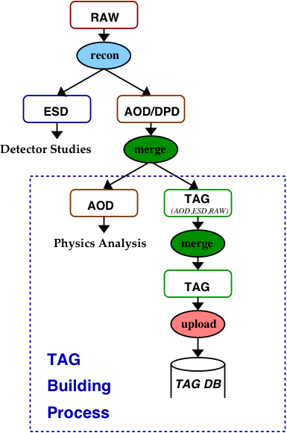
More on TAG Processing
TAG files are produced in ROOT files.
These ROOT files are grouped into datasets and made available through DQ2.
These files are also uploaded into relational database.
TAG data in the relational database is made available through various services which aid in event selection and metadata browsing.

Slide 10
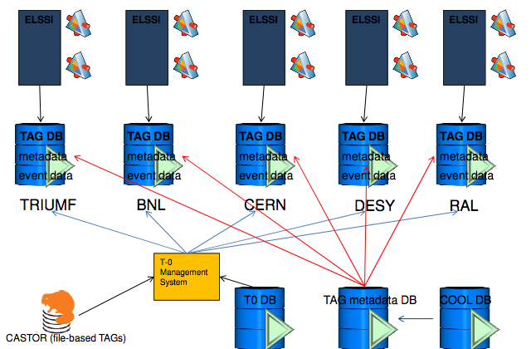
The TAG Database

Slide 11
Use Case I : Simple use by athena
As you’ve already learned, athena input is set using the EventSelector. This includes using TAGS as input.
Simple, circular example
  Take a POOL file and build a TAG file from it using
    athena.py –c “In=[‘yourPOOLFile.root’]; Out=myTAG.root” TagCollectionTest/MakeRunEventCollection.py
  This will create a TAG file myTAG.root with a TAG with only the run and event numbers. Go ahead and open it in root and take a look. Pick an event number.
  TAGS only contain file identifiers, so they need a catalog to find the files. So now do
    pool_insertFileToCatalog yourPOOLFile.root
  Take the job options you were using to analyze yourPOOLFile.root and change the EventSelector to have
    EventSelector.InputCollections = [“PFN:myTAG.root”]
    EventSelector.CollectionType = “ExplicitROOT”
    EventSelector.Query = “EventNumber==100”

Slide 12
Use Case II: Analyzing commission data
Put down your tricycle, it’s time to drive the big rig.
TAGS are meant as a tool for examining the cumulative ATLAS event store, so you will develop tools using the first use case, but the real work will occur on the grid.
Specific Example: The TAGS described previously have been developed for ATLAS physics running, but a specialized TAGCOMM has been developed and is being used for looking at commissioning data.
This is being used by users at CERN to pick out interesting and anomalous events that have shown up during cosmic data taking.
The US uses a grid job submission system called Panda, and a tool exists for running athena using Panda called pathena. The transition from using athena locally to using pathena has been made as simple as possible. Most cases involve the switch
  athena myJobOptions.py
  pathena –inDS=allTheATLASData myJobOptions.py
Now that you’re sold, here are the disclaimers. Many things are not automatic, and jobs will fail. There is a learning curve.
An example, https://twiki.cern.ch/twiki/bin/view/Atlas/PathenaTagComm09

Slide 13
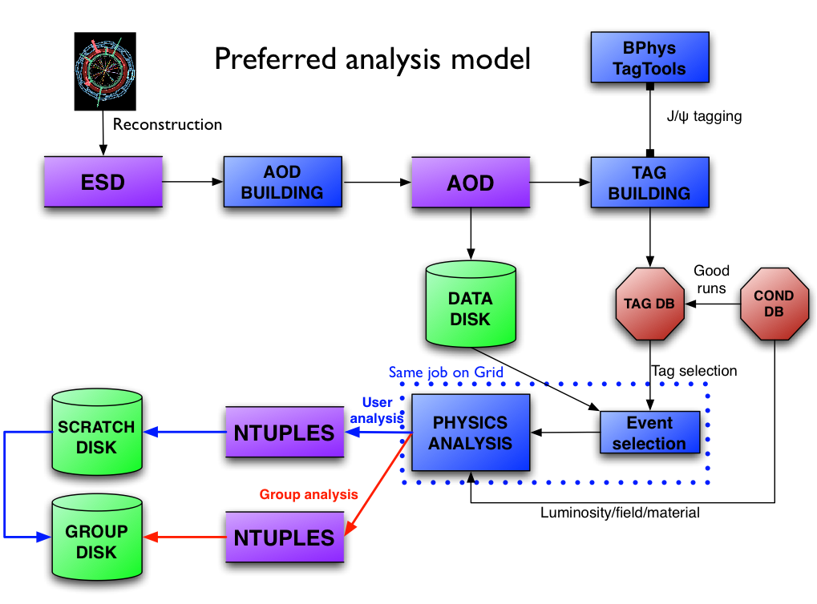
Use Case III: Plans for first data
Plans for usage of TAGS with first data are being developed by the physics and performance groups. Here is an example from J/Psi, Upsilon walkthrough last week.
http://indico.cern.ch/getFile.py/access?contribId=5&resId=0&materialId=slides&confId=67059

Slide 14
What isn’t in TAGS and Why
TAGS don’t contain data quality information.
  Data quality is assigned after TAGS are made and may be analysis specific.
  Data quality is assigned at the run or lumiblock level.
  This information is entered into COOL and can be made available in an integrated metadata interface (see next talk).
TAGS don’t contain all physics objects in AOD.
  Space and other technical limitations.
Other Resources
ATLAS software tutorials
  http://indico.cern.ch/conferenceDisplay.py?confId=65526
Metadata mailing list
  atlas-event-metadata@cern.ch
Upcoming tutorial at CERN October 21-22

