Slide 1
ALICE Data Quality Monitoring
Introduction to shifter’s operations
Part 2
D. De Gruttola for the DQM core
CERN, 02nd August 2016

Slide 2
Introduction to DQM shifter’s operations
- Using the DQM framework -
Preliminary instructions
Start the DQM session
The InfoBrowser
The amoreAgentsManager window
AmoreVisualization window (the GUI)
  DQM histograms
  Histograms by trigger classes
  Quality flags
  GUI layout
  NOT TO DO

Slide 3
At the beginning of your shift…
Get a report from the previous shifter about the current activity
Check the blackboard in the TWiki for the pending and solved issues
Inspect the previous End-Of-Shift (EOS) report and take note of the open issues for your own report (→ see “Reporting” session of this training)
Open on the web browser the following pages :
  Shifter’s guide:
  https://twiki.cern.ch/twiki/bin/viewauth/ALICE/AliceDQM
  Blackboard:
  https://twiki.cern.ch/twiki/bin/viewauth/ALICE/DQMBlackboard
  ALICE logbook (Runs view)
Start the DQM framework if not already open

Slide 4
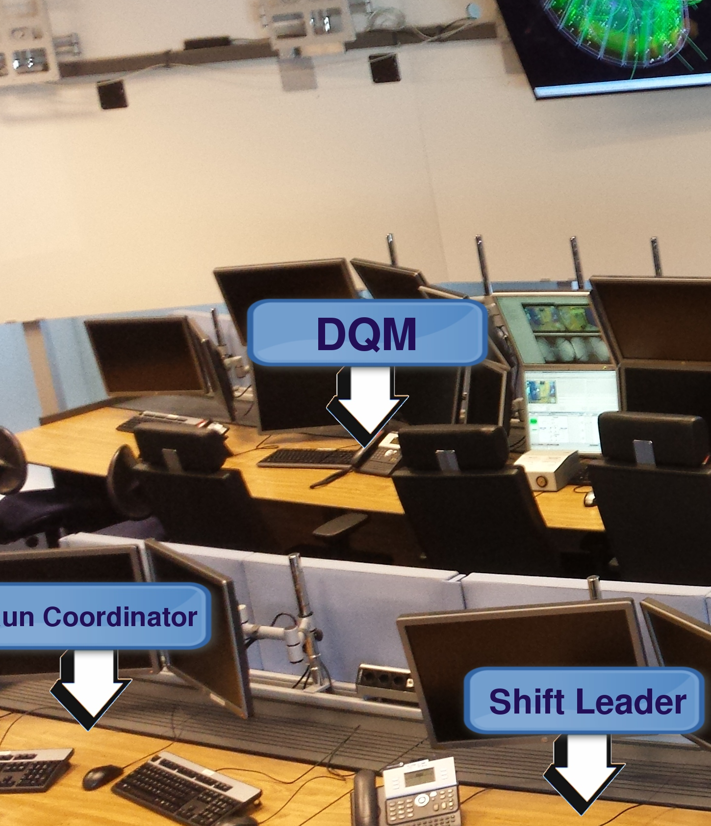
DQM station
first line on the left
as DQM shifter you have will use the DQM station (arcdqm) → autologin
this means you don’t need a password to login

Slide 5

Start the DQM session
alternatively you can do the following:
Open an xterm by clicking on the xterm icon in the menu bar and type:
The following windows will open automatically:
Amore Visualization Window 1 (event size plots for partitions PHYSICS1 and 2)
Amore Visualization Window 8 (ACO EMC FMD HMPID MCH PHOS PMD MTR)
Amore Visualization Window 9 (SDD SSD SPD TOF TRD V0 ZDC TPC T0 AD_Charge AD_Time T0_beam V0_trigger )
Amore Visualization Window 10 (SPD vertex and Global plots)
TRIGGER GUI
Please make sure that only one instance of every window is open at the time
If the run type changes (e.g. from beam to cosmics or viceversa) during a session, nothing has to be done, just wait the GUI(s) to refresh!
click on the button on the top left part of the tool bar
arcdqm> ./dqm-shifter-setup (in local/home/dqm/bin)
If you need to open only one of the windows:
arcdqm> amoreGui #
arcdqm> amore –d TRI –m Shifter

Slide 6
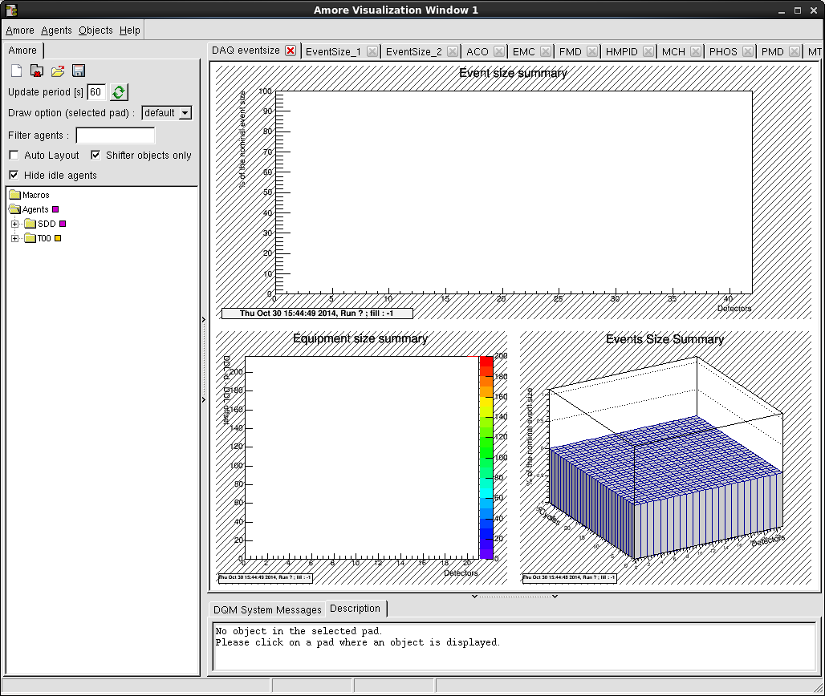
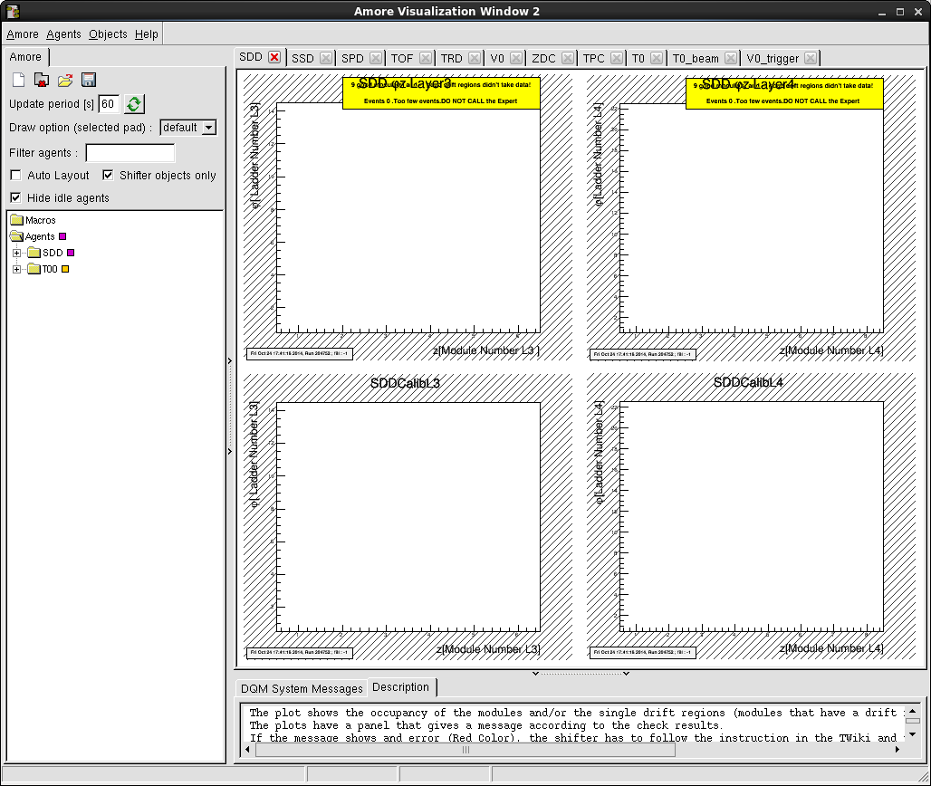
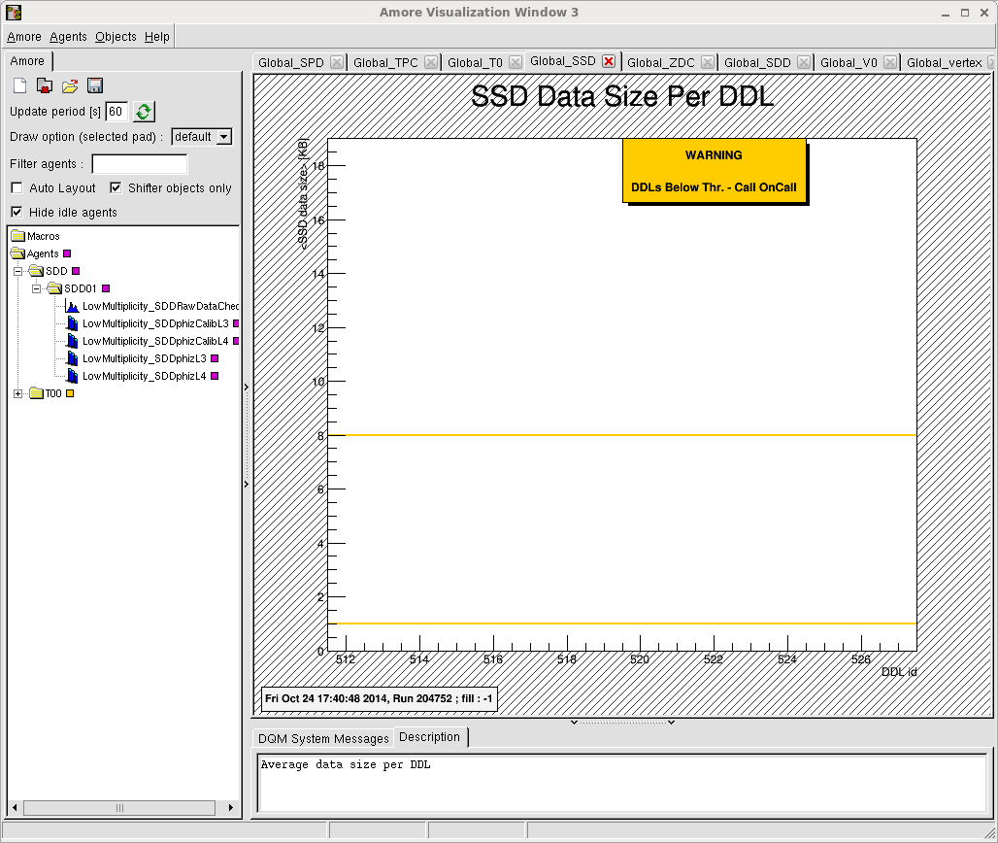
AMORE Visualisation Windows

Slide 7
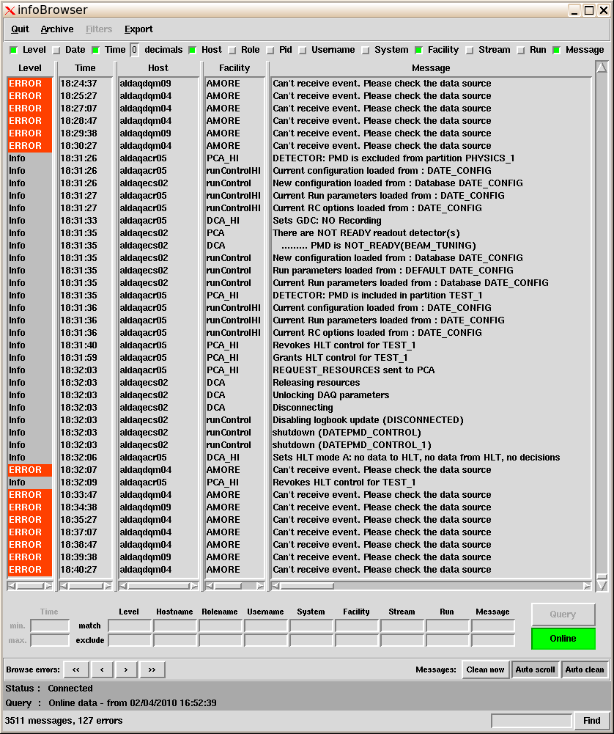
The InfoBrowser
It opens up automatically when the DQM session starts
The infoBrowser receives error messages from the Amore system.
It shows by default all messages from the current run, including SOR/EOR.
We filter only messages coming from AMORE

Slide 8
The InfoBrowser - details
Level: Debug/Info/Warning/Error/Fatal
Host: machines on which the agents run
Facility: DQM shifter has to be concerned only about facility “AMORE”
More fields to be displayed in the table can be selected from the first raw (e.g. run)

Slide 9
The InfoBrowser – Filter AMORE messages
To filter only messages coming from AMORE:
click the Online button (green -> gray)
type AMORE in the textbox marked Facility
click the Online button again (gray -> green).
1
2
AMORE
3
2b

Slide 10
The InfoBrowser – Retrieve previous messages
To retrieve previous messages coming from AMORE (eg. From the last 10 minutes):
click the Online button (green -> gray)
type AMORE in the textbox marked Facility
Write -10 min in the Time min. textbox
Click the Query button
3
1
4
-10 min
AMORE
2

Slide 11
amoreAgentsManager
The AMORE agents:
  are monitoring processes
  analyze raw data samples and produce monitoring histograms
  each of them receive data from a specific source
  produce expert and shifter histograms that can be displayed on the AMORE GUI (Graphical User Interface)
Production agents:
  Are marked with the flag Prod = 1 in the manager
  They have to run all the time

Slide 12
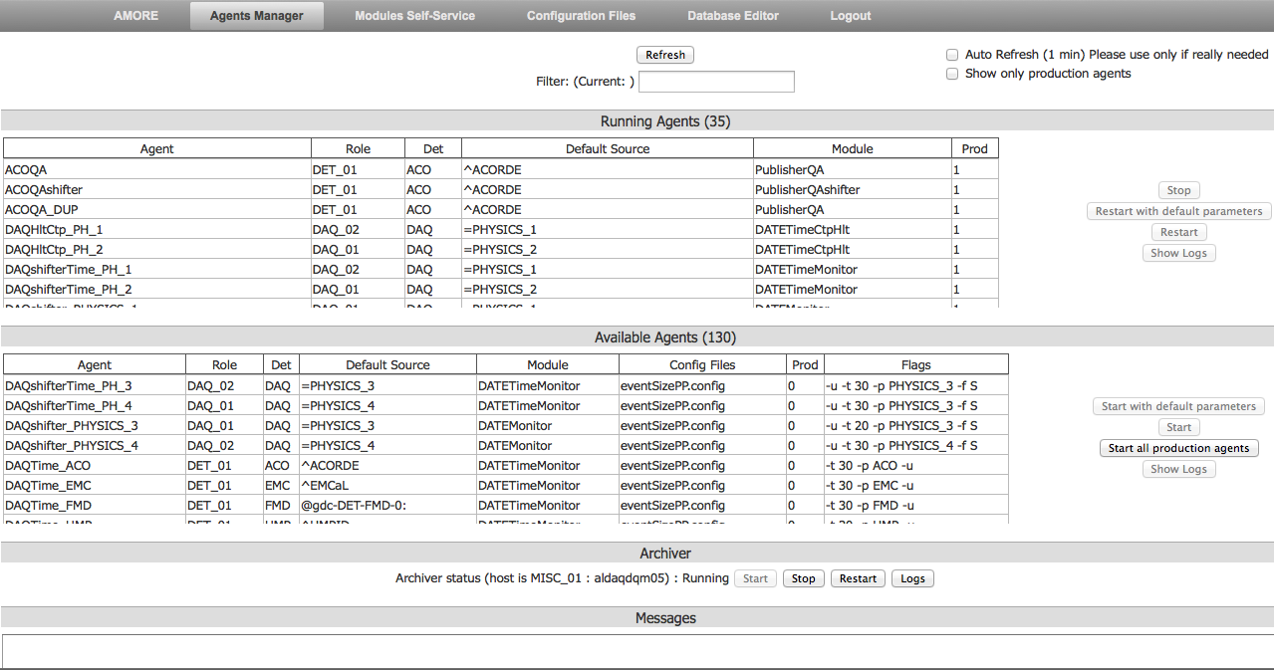
New amoreAgentsManager (by web tools)
  same features and layout as the old one, but provided a web tool

Slide 13
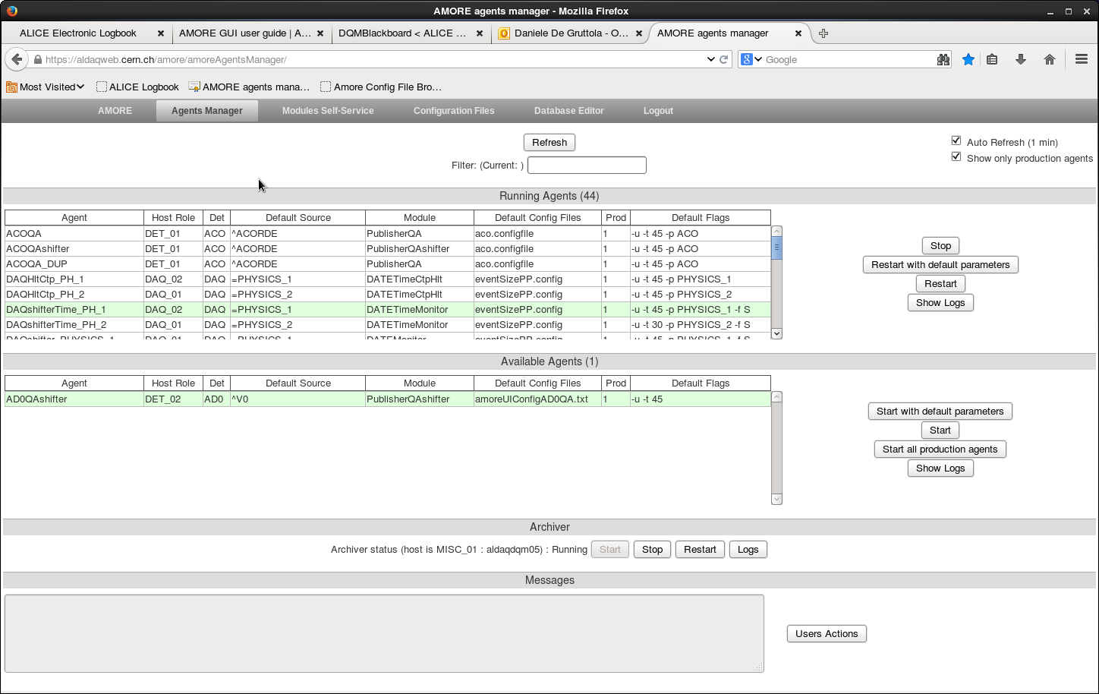
amoreAgentsManager – Filter agent name
Filter field:
filter here agent name
press “Enter” to apply filter
Press “Refresh” to update the list of running agents
You can filter also by detector or agent name
This will allow you to act only filtered agents

Slide 14
amoreAgentsManager – not running agents
Available agents table:
- see which agent are not running but available
- Verify agents options
Start agents
Inspect the logs of the agents

Slide 15
amoreAgentsManager – running agents
Running agents table:
- see which agent are running
Stop / restart agents
Inspect the logs of the agents

Slide 16
How to check if an agent is running?
If the agent appears in the “Running agents” table, it is running.
If the “auto-refresh” option is not selected, check the status in the amoreAgentsManager by clicking on the "Refresh" button.
Note that it is good to refresh especially after stop/restart/start of the agents.
  Also the background color of the detector’s histograms in the GUI can provide this info
  → see next slide.
  If it is white or hatched the agent is running.
  However, the best is checking from the Amore Agents Manager.

Slide 17
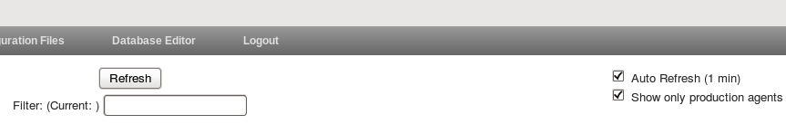
amoreAgentsManager – Default options
Auto-refresh:
Will refresh automatically every 1 minute the lists of running and available agents
Keep it selected, unless different instructions
Show only production agents
Allow to display only agents marked as production
Keep it selected, unless the experts ask for inspection of the other agents

Slide 18
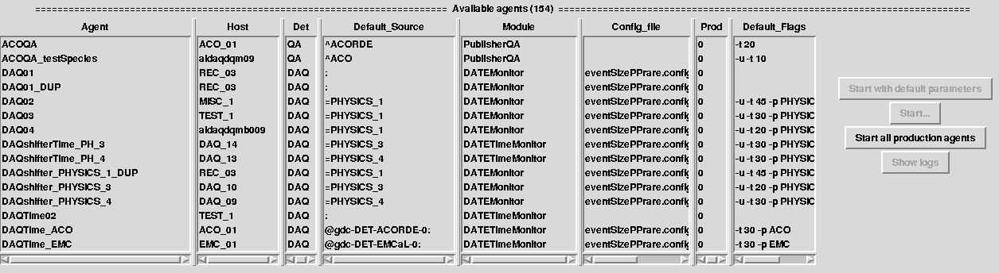
amoreAgentsManager - details
Agent name:
<det>QAshifter/<det>QA: common agents producing plots for the shifter/expert
<agentName>_DUP: created time by time and used by DQM experts for testing
Host: name of the machine on which the agents run
Default source: data source
Config file: configuration file that can be edited by detector experts
Production flag: agents marked as Prod=“1” must be running all the time
Default flag: options for running the agents (you cannot change them!)

Slide 19
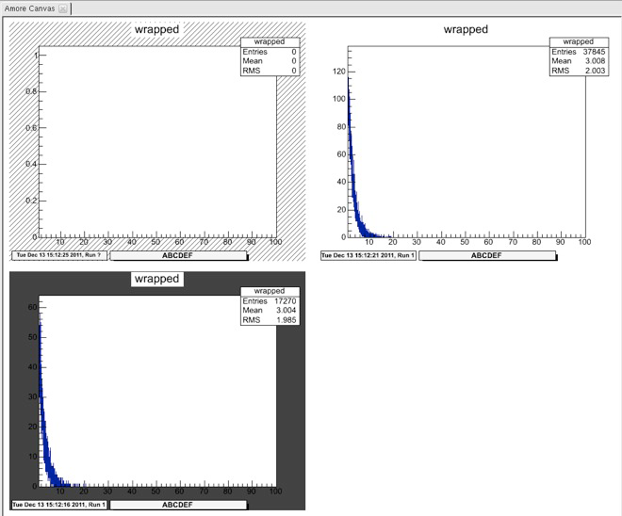
The GUI: histograms background color
The background color around the histograms is meaningful:
Black: agent is not running
Hatched: agent is “idle”, i.e. running but not processing data (i.e. detector not included in the running partition or low rate)
White: agent is running and processing data
So, if it is white or hatched the agent is running.
However, the best way to find out if an agent is running is checking from the Amore Agents Manager.
1 2 3

Slide 20
How to stop/restart an agent?
Select it from the running agents list
Click on the “Stop” or “Restart with default parameters” buttons.
Click on “Refresh” if the auto-refresh option is disabled
if the agent is still running, hold the Ctrl key down and click again on “Force Stop” or “Force Restart”
3
2
1

Slide 21
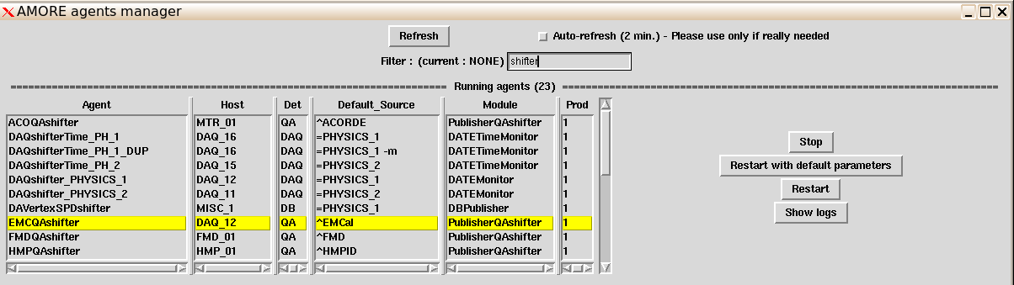
How to inspect the logs for an agent?
Select it from the corresponding agent list
Click on the “Show logs” button and a window will pop-up.
You will send the log to the detector expert, by adding it to the EOS report
1
2

Slide 22
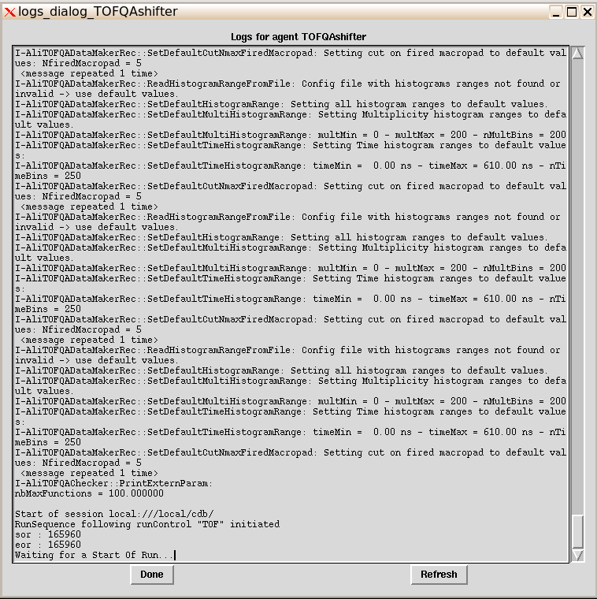
How to inspect the logs for an agent?
this should be done by experts
if needed see back up slides

Slide 23
AMORE Visualization window: the GUI

Slide 24
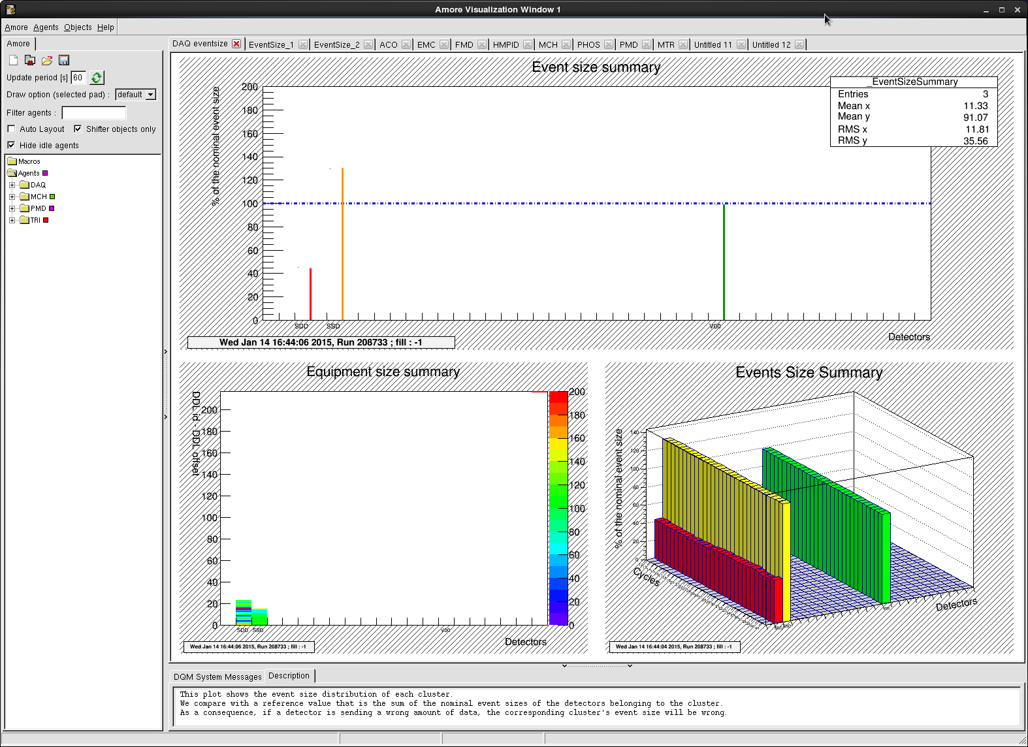
The GUI: tabs & histograms
Detector tabs
Histograms
Timestamp of last update of the histogram + run n.

Slide 25
The GUI: tools and agents tree
Menu bar
Tools panel
AMORE Agents Tree
Histograms description

Slide 26
The GUI: the menu bar and tools panel
Amore menu:
open/close tabs
Create new tab
Load/Save layouts
Objects menu:
- Toggle statistics
Open / close layout
(not used by the
shifter anymore)
Refresh agents tree
Open/close tab
Filter field:
type “shifter” or the name of agents/detector that you want to display in the AMORE agents tree

Slide 27
The GUI: the menu bar and tools panel
Amore menu:
open/close tabs
Create new tab
Load/Save layouts
Objects menu:
- Toggle statistics
Show only shifter’s objects
(as default it is checked)
Hide idle agents
(as default it is checked)

Slide 28
DQM shifter histograms
3 categories of plots with different priorities:
global conditions plots
detector main histograms
detector “backup” histograms
All plots are produced by production agents (Prod = 1)
All plots have an automatic check
Depending on the result of the check, a quality flag/color box is set in the agent’s tree per event specie
All plots appear in the summary image in the logbook, under the corresponding detector’s agent tab

Slide 29
DQM shifter histograms
global conditions plots
  Monitor depend from beam and/or running conditions (beams, trigger configuration, …)
  Have highest priority
  Have to be monitored continuously during each run by the DQM shifter and the Shift Leader (SL)
  if problem, the SL is informed and run can be stopped immediately if necessary
detector main histograms
  Monitor detector behavior and data
  Have high priority (help with quality flags)
  If problem, the detector on-call is informed
  Not mandatory to stop the run, but still quick action to be taken
detector “backup” histograms
  Available in the amore Agents tree but not in the GUI tabs
  To be looked at only if requested by detector expert

Slide 30
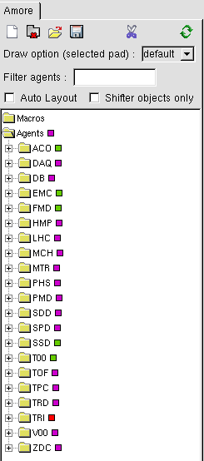
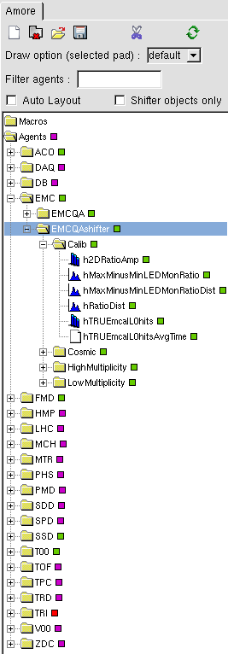
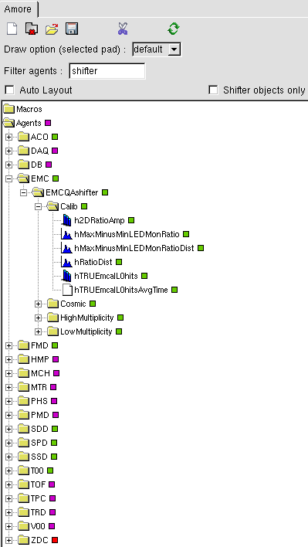
The GUI: the AMORE agents tree
Color boxes on the right of the name of the agents/ plots are quality flags set automatically by QAchecker algorithms (next slides)

Slide 31

Quality flags
Quality flags are the small boxes that appear in the AMORE agents tree
They are set by automatic checks of the content of the plots
If Yellow/Red/Purple it means that at least one of the plots produced by that agent exhibits a problem
If green all plots are ok
Always rely on alarms if present
Always check the Twiki
  Notice: if empty not necessarily a problem…see dedicated troubleshooting section of the Twiki!
Meaning:
red = error -> look at these plots first
Yellow = warning
Green = ok
Purple = fatal or empty (then you have to understand why…)

Slide 32
backup

Slide 33
How to refresh histograms manually?
If the timestamp of the plot is not up-to-date (older than 5 minutes) or if the troubleshooting section suggests to refresh manually the histograms:
Go to the detector tab in the GUI
Expand the Detector’s folder from the AMORE agents tree
Expand the agent’s folder
Expand the folder of the default or specific event specie
Click on the plot to be updated from the tab
Double-click on the histogram’s name from the tree
2
3
4
Please note that if the agent had just been restarted before trying the manual refresh, it might take up to a couple of minutes to load the histogram…

Slide 34
How to kill manually an agent?
If you cannot stop/start/restart an agent from the amoreAgentsManager, check the trobleshooting section of the Twiki.
Most likely you will have to kill the agent manually.
The agent <agentname> is running on a different machines and can be killed via terminal.
Open xterm and type:
Alternatively this gives the same result:
Where, in both cases, processID is referred to the process which contains "amoreAgent -a <agentname>”
$ sshdqm <agentname>
$ ps aux | grep <agentname>
$ kill processID
$ sshdqm <agentname>
$ ps -ef | grep amore
$ kill processID

Slide 35
How to inspect the logs for an agent?
The logs contain:
Command used to launch the agent
Info about SOR & Run number
List of requests for duplication by trigger classes of the plots
Info about monitoring cycle (MC)
Logs from the detector’s code
Error messages and crash stack trace
Monitoring cycle = time interval during which data are collected and processed by the agents. Typically 1 MC = 60 s
Monitoring cycle must increase in order to update the histograms.
If it does not, see troubleshooting section in the Twiki.

Slide 36
Logs: Example 1
Start of session local:///local/cdb/
RunSequence following runControl "EMC" initiated
sor : 165037
eor : 165034
Start of run received : 165037
created run 0x1edef9a0
PublisherQA : Start of run : 165037
Doing a reset in the PublisherQA : call ResetDetector of AliQADataMakerRec
Get the beam type
user: dateLogbook, pwd: 2PIY5guw, host: 10.161.36.8, dbname: LOGBOOK
Beam type found : NULL
Beam type transformed : -
beamType : -
runType : STANDALONE_BC
retrieve the name of the classes active for this run
Get the cosmic trigger list
cosmic trigger list found !
MonitorCycle 0 (Tue Oct 25 12:27:10 2011)
W-AliQADataMaker::SetEventTrigClasses: The string for event triggers is empty
<message repeated 3 times>
W-AliCaloRawStreamV3::NextBunch: Too long bunch detected @ 0 in Address=0xb2a (DDL=005) ! Expected <= 12 10-bit words, found 14 !
W-AliQADataMaker::SetEventTrigClasses: The string for event triggers is empty
<message repeated 3 times>
W-AliCaloRawStreamV3::NextBunch: Too long bunch detected @ 0 in Address=0xb2a (DDL=005) ! Expected <= 12 10-bit words, found 14 !
W-AliQADataMaker::SetEventTrigClasses: The string for event triggers is empty
<message repeated 3 times>

Slide 37
Logs: Example 2
>>>>>> Tue Oct 25 05:21:52 CEST 2011 <<<<<<
Launched with : amoreAgent -a T00QAshifter
Warning in <TClassTable::Add>: class AliQAThresholds already in TClassTable
Default storage set to '0x2aaab0000f30'
I-AliQAv1::SetQARefStorage: AliQAv1::SetQARefDir: QA references are in local://$ALICE_ROOT/QAref
Loading class AliT0QADataMakerRec
Aliroot det name : T0
I-AliQADataMaker::SetCloningRequest: Aliases for trigger classes:
I-AliQADataMaker::SetCloningRequest: 0VHN -> C0VHN-B-NOPF-CENTNOTRD
I-AliQADataMaker::SetCloningRequest: 0VHO -> C0VH0-B-NOPF-CENTNOTRD
I-AliQADataMaker::SetCloningRequest: 0VLN -> C0VLN-B-NOPF-CENTNOTRD
I-AliQADataMaker::SetCloningRequest: Histograms to clone:
I-AliQADataMaker::SetCloningRequest: VZERO/Raws/H1D_Trigger_Type -> 0VHN 0VLN 0VHO *
I-AliQADataMaker::SetCloningRequest: VZERO/Raws/H2D_CentrChargeV0A_V0C -> 0VHN 0VLN 0VHO *
I-AliQADataMaker::SetCloningRequest: VZERO/Raws/H2D_TimeV0A_V0C -> 0VHN 0VLN 0VHO *
Downloading macro t0DQMMacroLoader.C
Downloading macro t0DQMMacro.C
Loading macro t0DQMMacro.C
*** Break *** segmentation violation
===========================================================
There was a crash (kSigSegmentationViolation).
This is the entire stack trace of all threads:
===========================================================
Thread 3 (Thread 0x40da2940 (LWP 18032)):
#0 0x00002b38cb99b372 in select () from /lib64/libc.so.6
#1 0x00002b38c45713f6 in dim_usleep (usecs=100000) at ./src/dtq.c:291
#2 0x00002b38c4571504 in dtq_task (dummy=0x2b38c47a1d80) at ./src/dtq.c:325
#3 0x00002b38c457279c in dim_dtq_thread (tag=0x0) at ./src/dim_thr.c:99
#4 0x00002b38ca8f173d in start_thread () from /lib64/libpthread.so.0
#5 0x00002b38cb9a20cd in clone () from /lib64/libc.so.6

