Slide 1
10 MHz cavities amplifier upgrade and 2017 measurement plans
G. Favia
Y. Cuvet, H. Damerau, V. Desquiens, S. Energico, M. Morvillo, M. Paoluzzi, C. Rossi
LIU-PS Beam Dynamics Working Group MEETING
31/08/2017

Slide 2

Outline
10 MHz amplifier after EYETS 2015-16
10 MHz amplifier after YETS 2017-18
Solid state upgrade strategy
2017-18 plan

Slide 3
Outline
10 MHz amplifier after EYETS 2015-16
10 MHz amplifier after YETS 2017-18
Solid state upgrade strategy
2017-18 plan

Slide 4
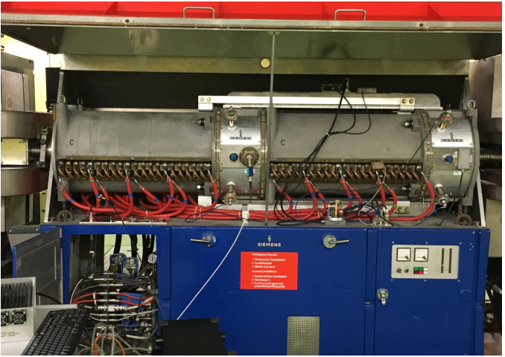
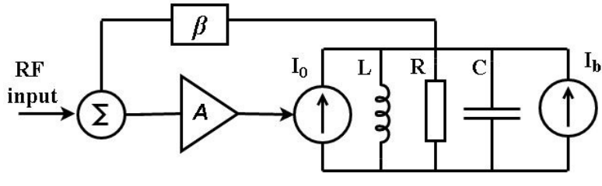
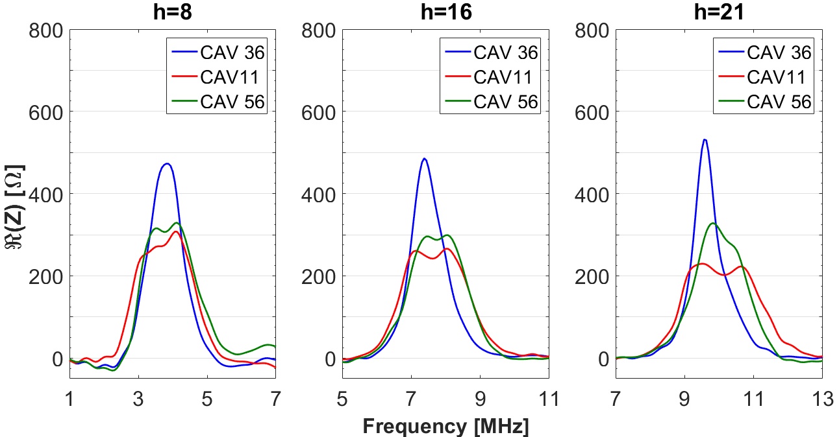
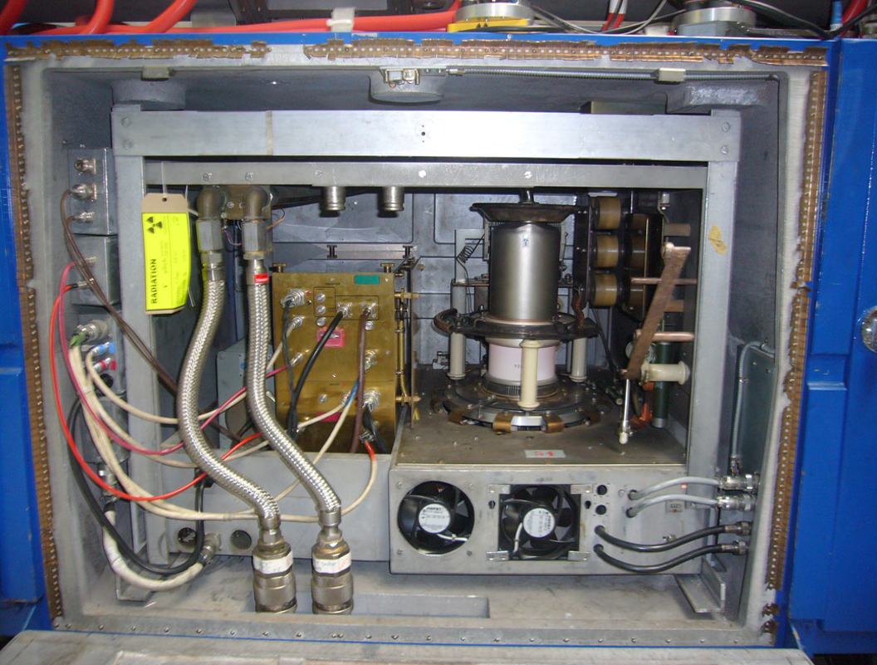
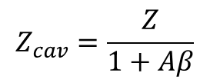
10 MHz amplifier upgrade
A new prototype amplifier has been built and installed in the PS ring during the winter technical stop in 2015
$$Z_{cav}=\frac{Z}{1+Aβ}$$
Loop gain
Higher loop gain
Improved stability
Limited re-design
Cavity featuring the highest impedance
Cavity featuring the lowest impedance
Cavity driven by the upgraded amplifier
Reduction of the impedance
up to a factor two

Slide 5
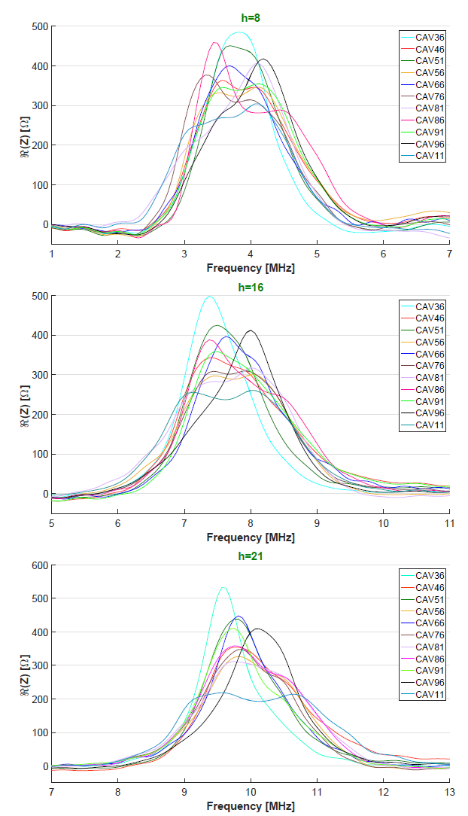
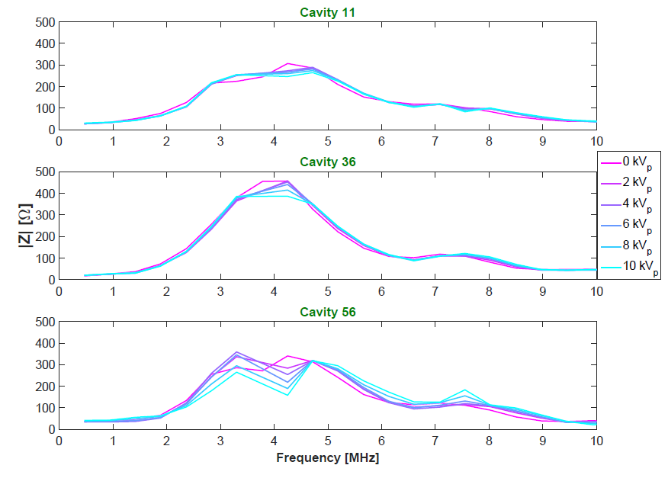



Evaluation of the PS 10 MHz cavities impedance
A measurement campaign has been performed for the evaluation of the contribution of the eleven 10 MHz cavities to the longitudinal impedance in the PS at h=8, 16 and 21.
Low accelerating field
High accelerating field
$$R(Z)[Ω]$$
Upgraded
amplifier
$$R(Z)[Ω]$$
Measurements available
at h=8 only

Slide 6
Outline
10 MHz amplifier after EYETS 2015-16
10 MHz amplifier after YETS 2017-18
Solid state upgrade strategy
2017-18 plan

Slide 7
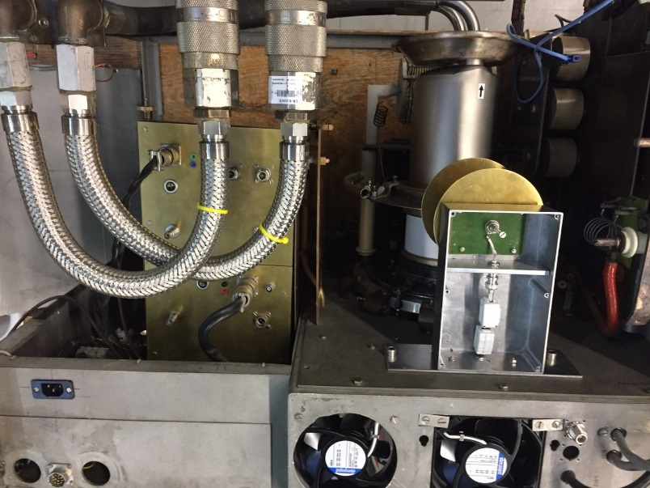
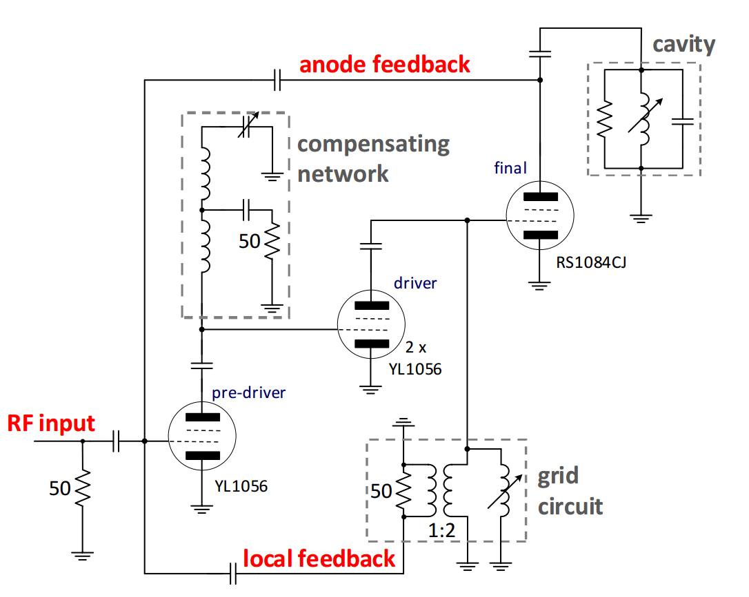
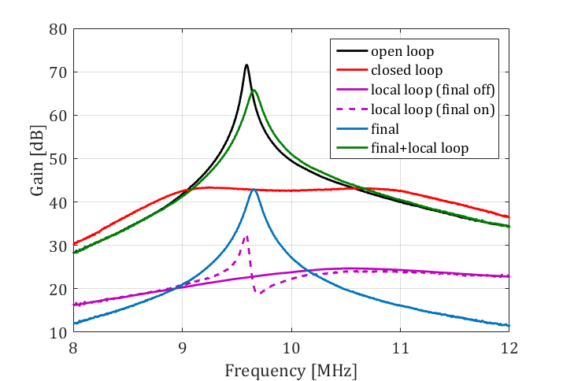

Further improvements
Other improvements are under development to optimize the present upgraded prototype
Neutralization circuit
Improves the stability of the amplifier
Helps clarifying loop gain measurements
C_{M}
z
Predriver
+
Driver
-C_{M}

Slide 8
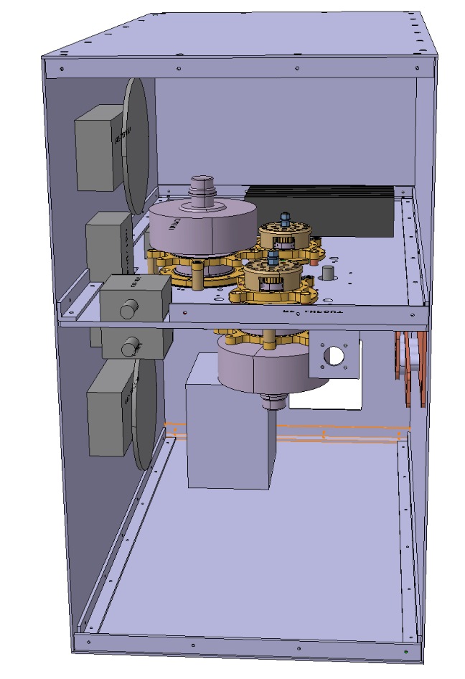
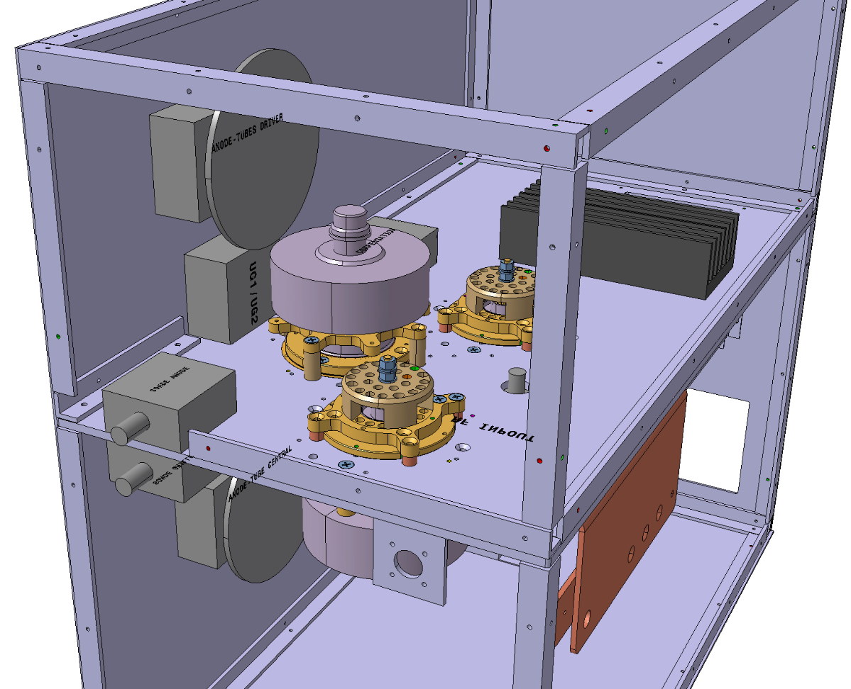
Further improvements
Other improvements are under development to optimize the present upgraded prototype
Mechanical improvements
Renovation of the mechanical layout ( last layout in 1989)

Slide 9
Outline
10 MHz amplifier after EYETS 2015-16
10 MHz amplifier after YETS 2017-18
Solid state upgrade strategy
2017-18 plan

Slide 10
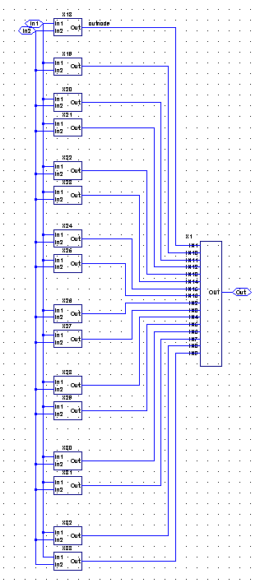
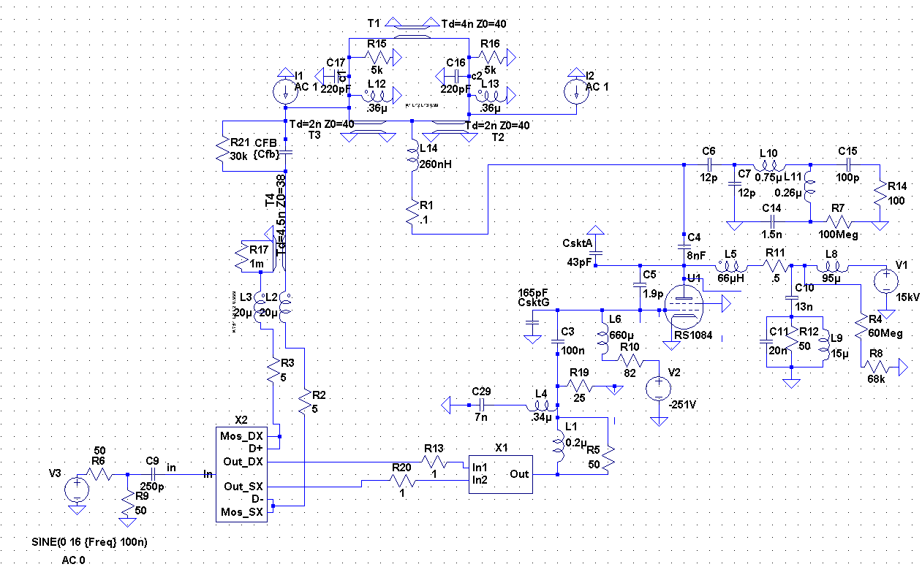
Solid state upgrade strategy
Predriver + driver replaced by a transistor-based stage + driver stage$→$ HIGHER FORWARD GAIN
Cavity
Power stage
Provides up to 300V to the final stage using several modules
Final stage
Driver stage
Takes the signal which is fed back from the cavity and provides the input to the power stage

Slide 11
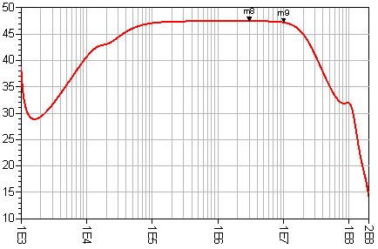
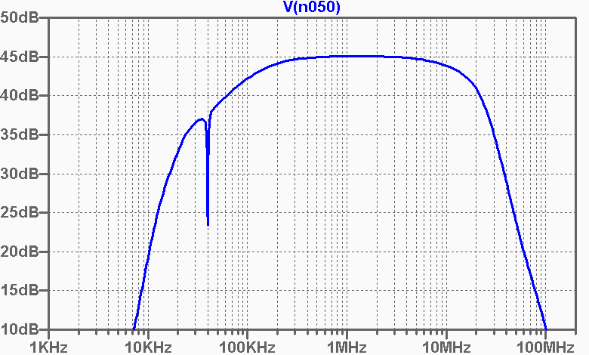
Solid state upgrade strategy
Two possible solutions investigated in parallel, developed and under construction:
Power stage implementing 8 modules using BLF574 power mosfet (500W, higher transconductance, tested performance with radiations)
Power stage implementing 16 modules using ARF479 power mosfet (900W)
Gain [dB]
Gain [dB]
Freq [Hz]
Freq
Gain=45-47 dB → 6 dB more compared to the vacuum tube solution
Group delay ≈ 20ns → < 37 ns (maximum allowable delay for the stability )

Slide 12
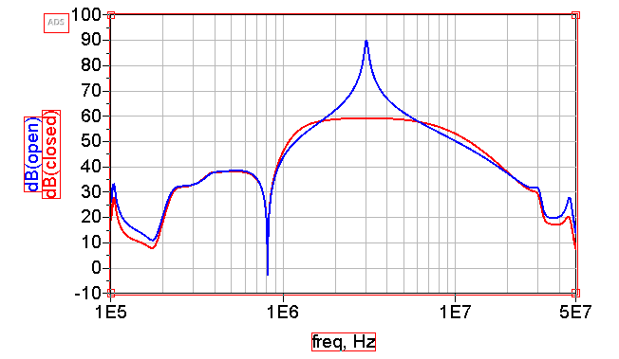
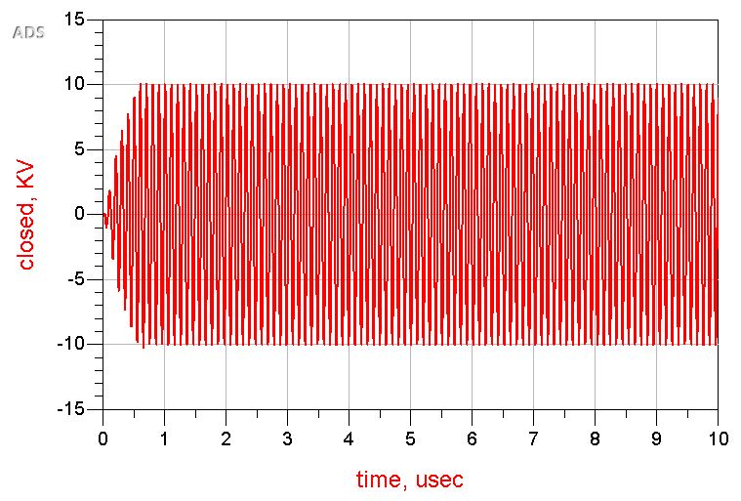
Solid state upgrade strategy
Solution implementing BLF574 mosfets:
3 MHz
10 MHz
Open loop
Open loop
Closed loop
Closed loop
Gain [dB]
Gain [dB]
Gap voltage [kV]
Gap voltage [kV]

Slide 13
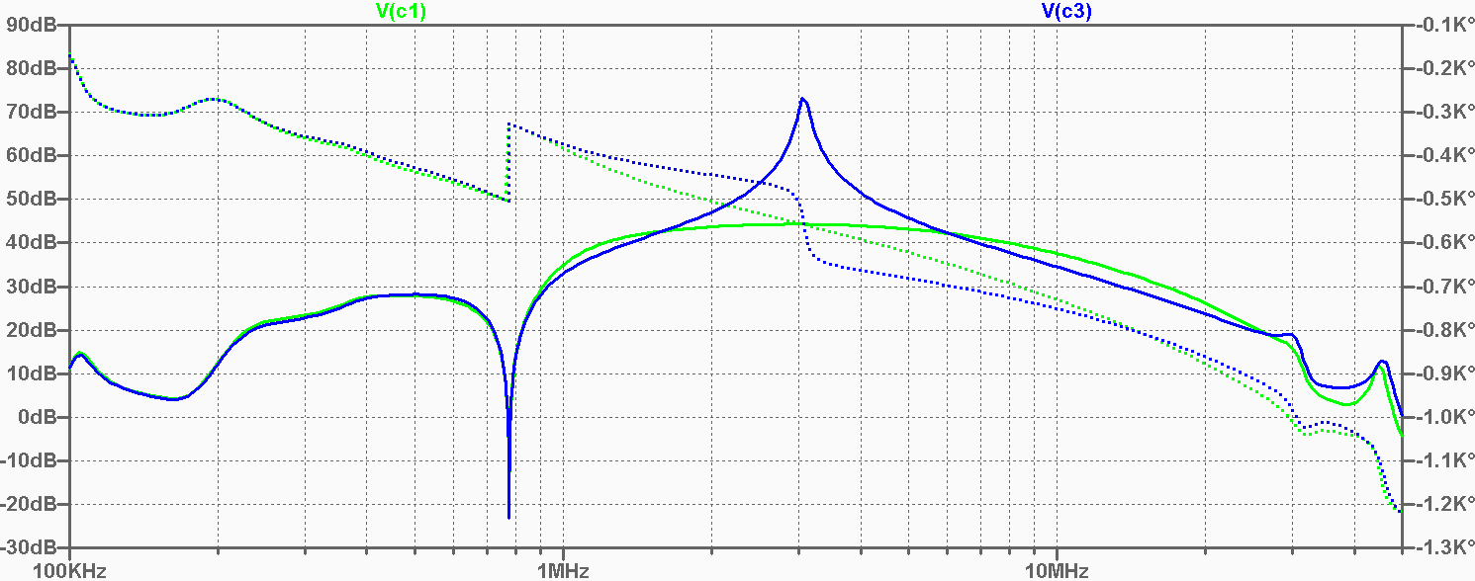
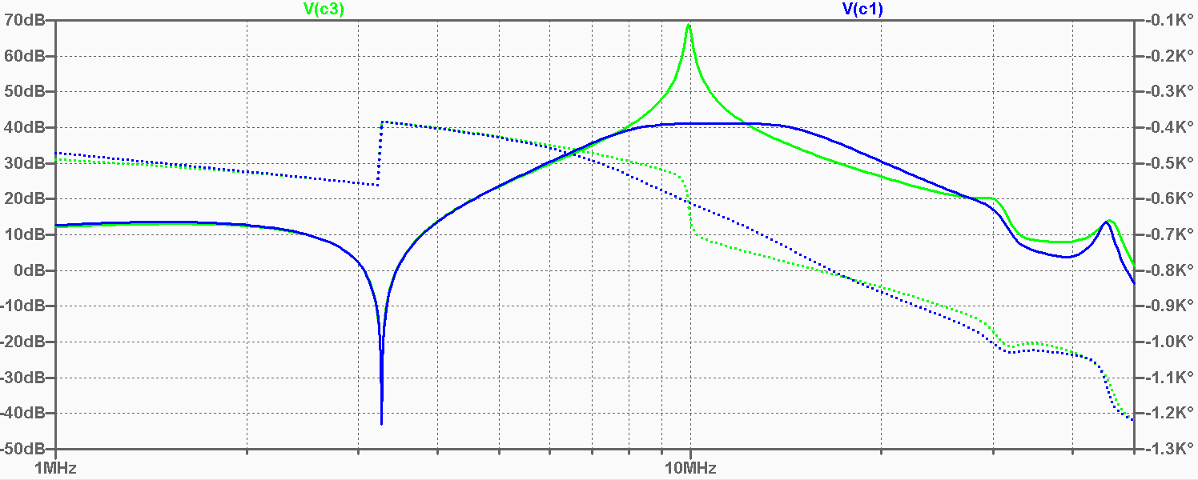
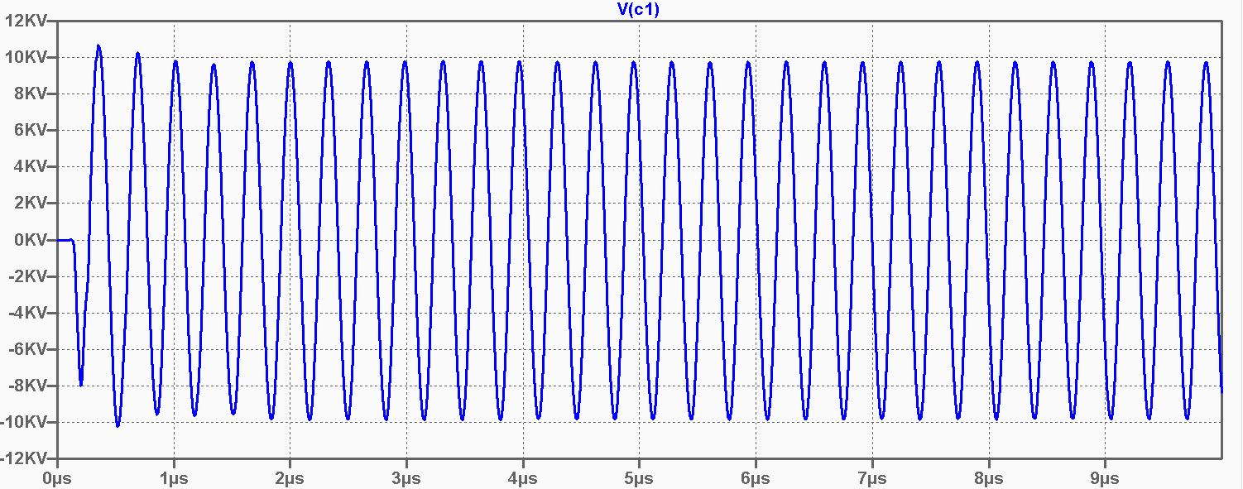
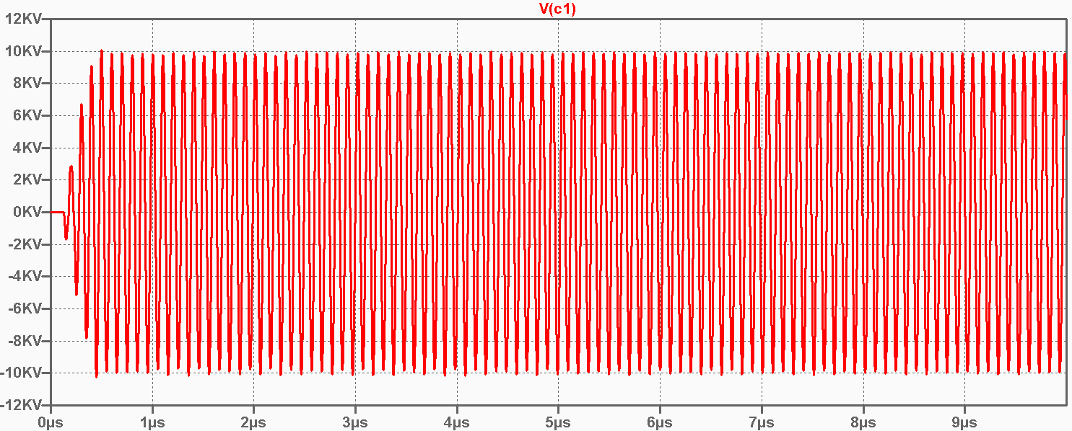
Solid state upgrade strategy
Solution implementing ARF479 mosfets:
3 MHz
10 MHz
Open loop
Open loop
Closed loop
Closed loop
Gain [dB]
Gain [dB]
Freq
Freq
Gap voltage [kV]
Gap voltage [kV]
Time
Time

Slide 14
Some numbers …
 | Loop gain 3 MHz | Loop gain 10 MHz | Gap impedance 10 MHz
Upgraded vacuum tube solution | 27 dB | 24 dB | ~200 Ω
Solid state solution (ARF479) | 32 dB | 30 dB | ~100 Ω
Solid state solution (BLF574) | 32.5 dB | 30 dB | ~100 Ω

Slide 15
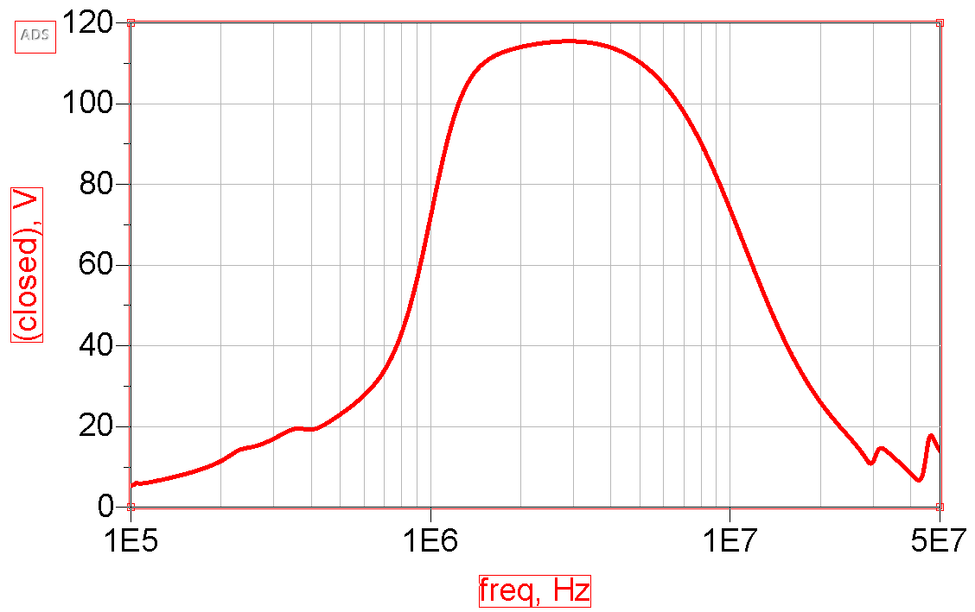
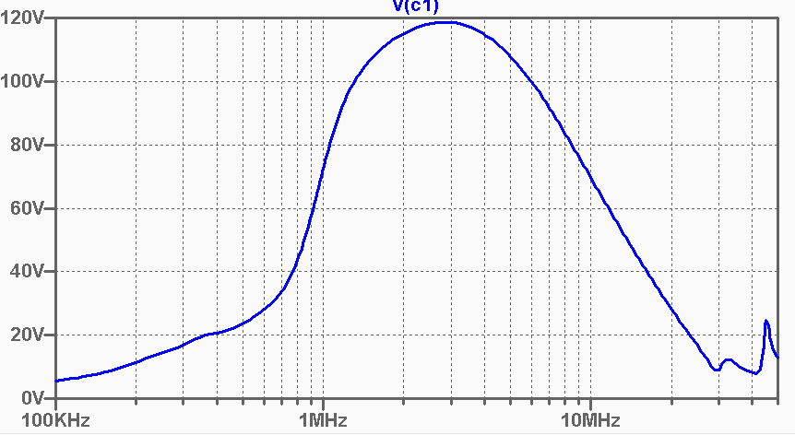
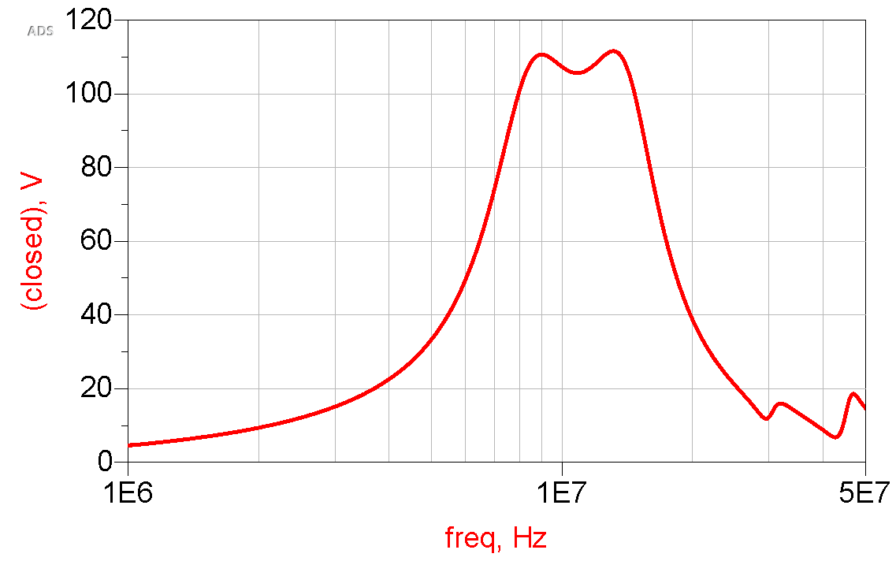
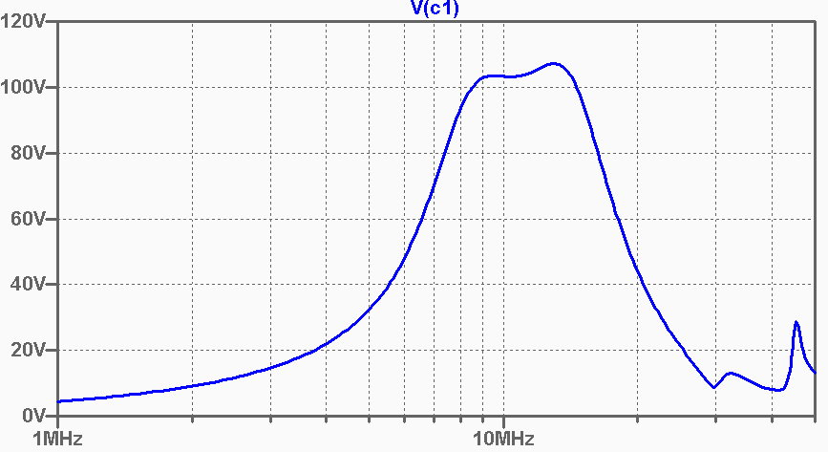
Solid state upgrade strategy
Impedance simulations:
Power stage implementing 8 modules using BLF574
Power stage implementing 16 modules using ARF479
3 MHz
3 MHz
Zgap [Ω]
Zgap [Ω]
Freq
10 MHz
10 MHz
Zgap [Ω]
Zgap [Ω]
Freq

Slide 16
Outline
10 MHz amplifier after EYETS 2015-16
10 MHz amplifier after YETS 2017-18
Solid state upgrade strategy
2017-18 plan

Slide 17
2017-18 plan
Amplifier upgrade
Finalization of the layout of the vacuum tube upgrade solution
  the final prototype should be ready to be installed during YETS 2017-18
  measurements with beam foreseen in 2018
Development of a solid state prototype (at least one of the possible solutions)
  the prototype should ready by the end of the year
  measurements in the test stand (driving test cavity) foreseen in 2018
Impedance measurements
Complete the measurements of the impedance of cavity 11
  measurements of the impedance with high voltage on the gap at h=21 still missing
Set-up prepared to perform measurements of the impedance of 80 MHz system

Slide 18
Thank you
for you attention

