Slide 1
Update on PS Longitudinal Impedance Model
B. Popovic
31/08/17

Slide 2
Motivation
Necessary to build a longitudinal impedance model of the PS machine
Build CST models for Wakefield & Eigenmode simulations
  From CATIA files (when available), otherwise 2D drawings
Confirm Wakefield & Eigenmode simulations with measurement (when possible and required)
  RF measurements
  MD’s
Provide Alex with confirmed results for BLonD codes

Slide 3
Overview of Models so Far
40 & 80 MHz Cavities
  CST Models of the bare cavities created
    No HOM couplers or frequency tuners
    No feedbacks
Transmission Line Kickers
  CST Models of the KFA45, KFA71 & KFA79 created
    Compare longitudinal impedances to previous CST models (S. Persichelli)
    Ferrite material from previous CST models (S. Persichelli)
UHV Gate Valves
  10 Valves in the PS
  CST model (including internal mechanisms) created
    Model confirmed via measurements
Standard Bellows

Slide 4
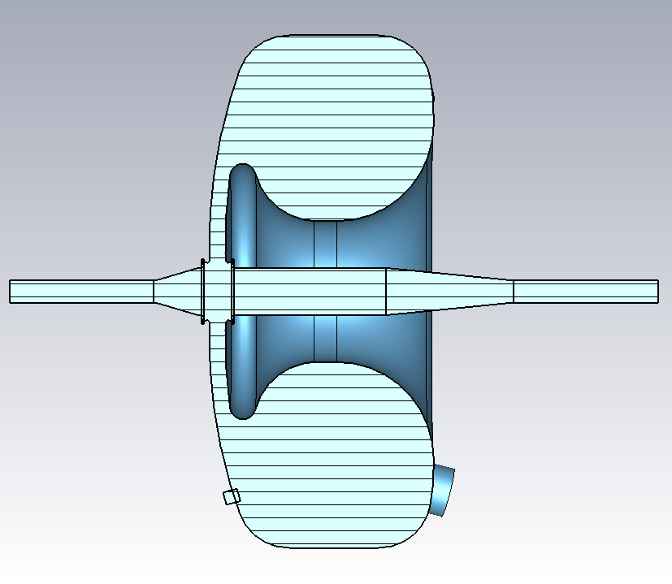
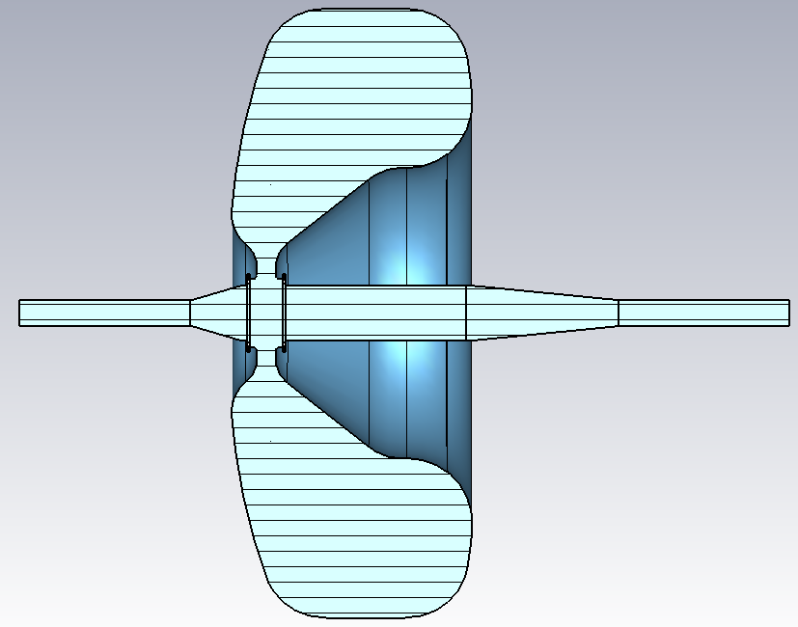
40/80 MHz Cavities: CST Models
*Models don’t include frequency tuners or HOM couplers
40 MHz cavity | Eigenmode | Measured
Res. Freq | 39.03 MHz | 40.06 MHz
Q | 25,795 | 13,352
R/Q | 33.7 | -
80 MHz cavity | Eigenmode | Measured
Res. Freq | 79.96 MHz | 80.11 MHz
Q | 37,246 | 19,300
R/Q | 57.4 | -
Notes:
40 MHz Cavity Measured by us on 040417
80 MHz Measured by CV (???) for tuner

Slide 5
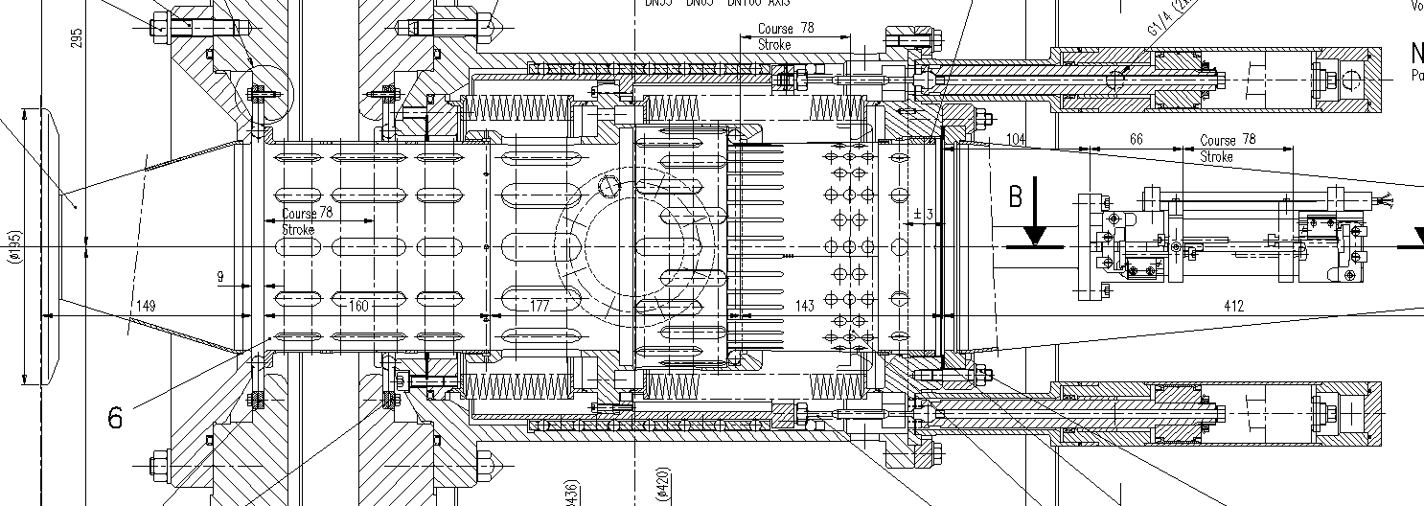
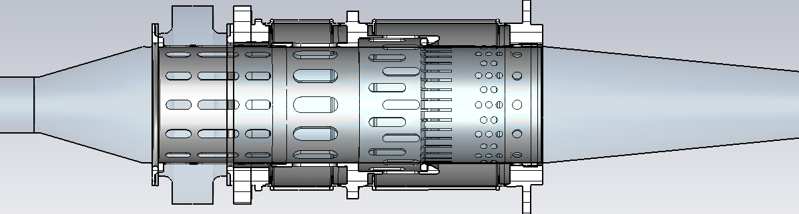
40/80 MHz Cavities: Mechanical Short CST Model
Current Model

Slide 6
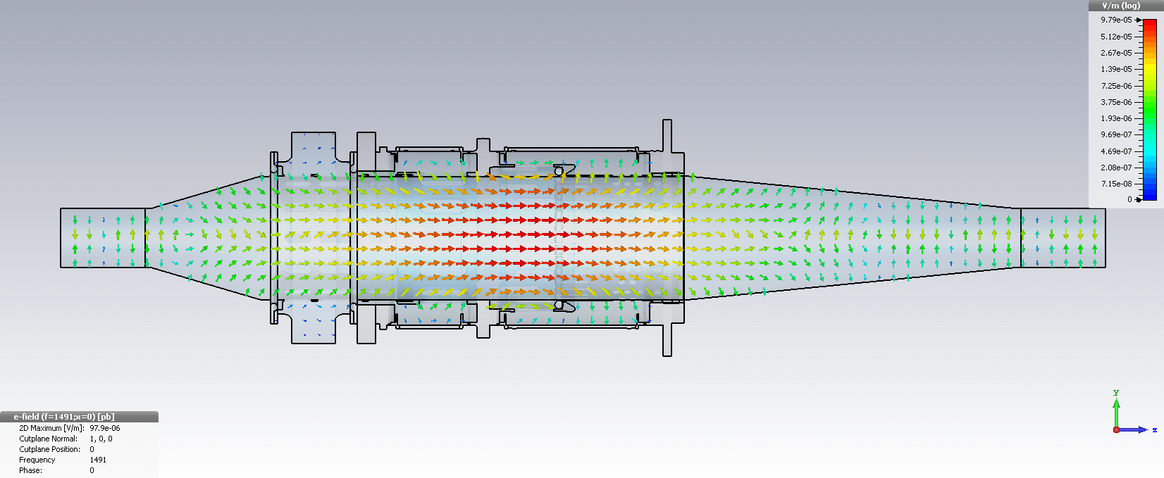
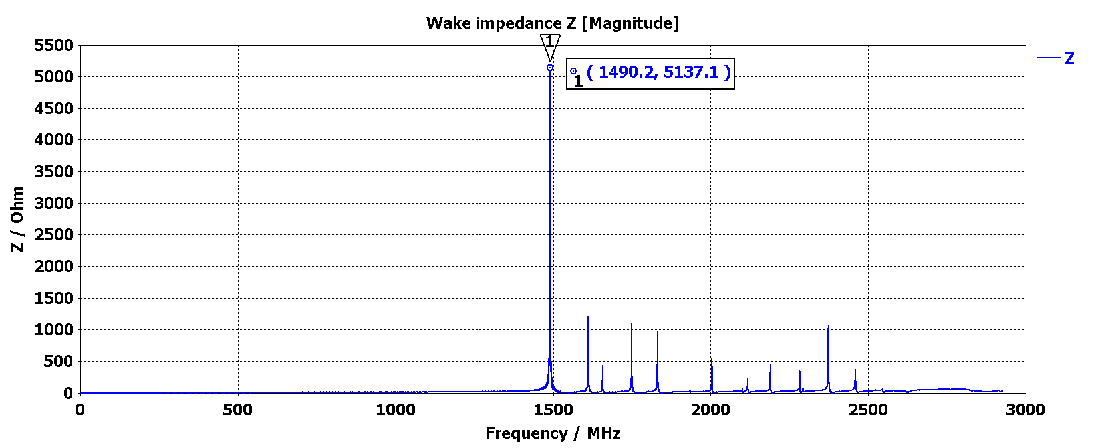
Wakefield Simulation of the Closed Mechanical Short
Mode at 1.49 GHz
Notes:
Cutoff of TM01 a=73 mm => 1.572 GHz (Simple Cav Model)
Cutoff of TM01 a=103 mm => 1.114 GHz (Simplified bellow inner Radius)
1.491 GHz, for cut off of TM01 => a =76.96 mm

Slide 7
40/80 MHz Cavities: Model Summary
Shape of mechanical short is included
  Separate model of the mechanical short has been created
Does not include tuners that adjust frequency
Does not include HOM dampers
  Need to see how to implement this in Wakefield Simulations
  Effect of feedback systems?
Options proposed for dealing with the feedback
  Model cavity together with feedback loops as was done with the PS 10 MHz cavity
  Obtain impedance of 80 MHz cavity using measurements of gap voltage instead of modeling the feedback loops

Slide 8
Transmission Line Kicker Models
Transverse impedance models available (S. Persichelli)
  Longitudinal models to build upon
  8C11 material definition
KFA4, KFA13, KFA21, KFA45, KFA71 & KFA79 employ 8C11 Ferrite Material
  Double check ferrite data via measurement
  Model of KFA71 requested for RF-measurement

Slide 9
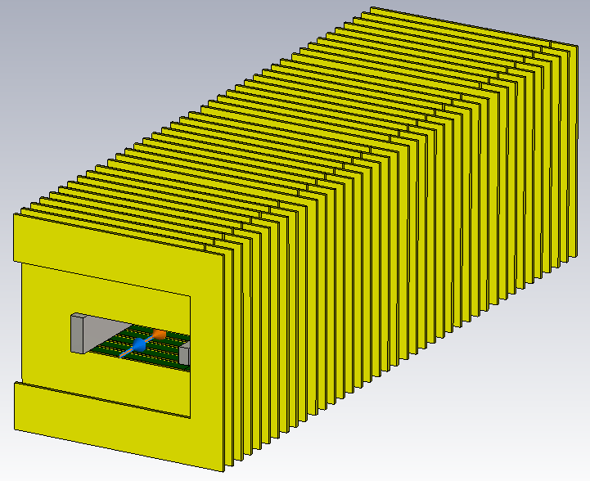
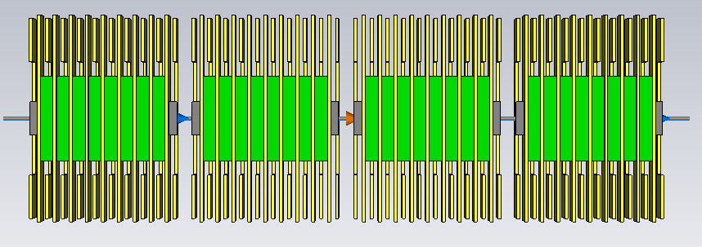
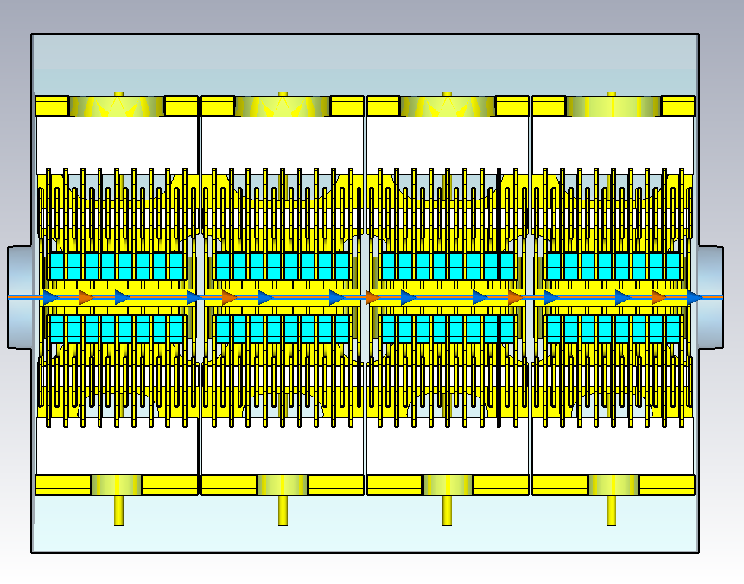
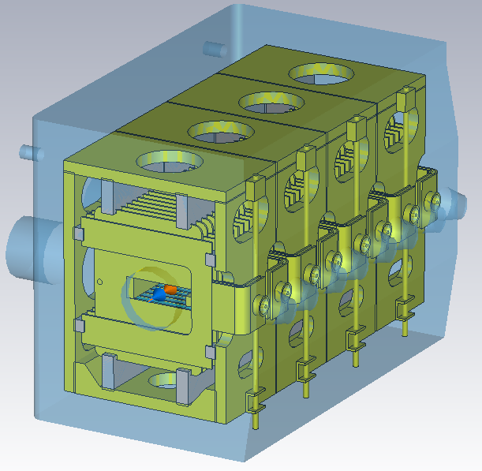
KFA45: Models
Previous Impedance Model
New Longitudinal Impedance Model

Slide 10
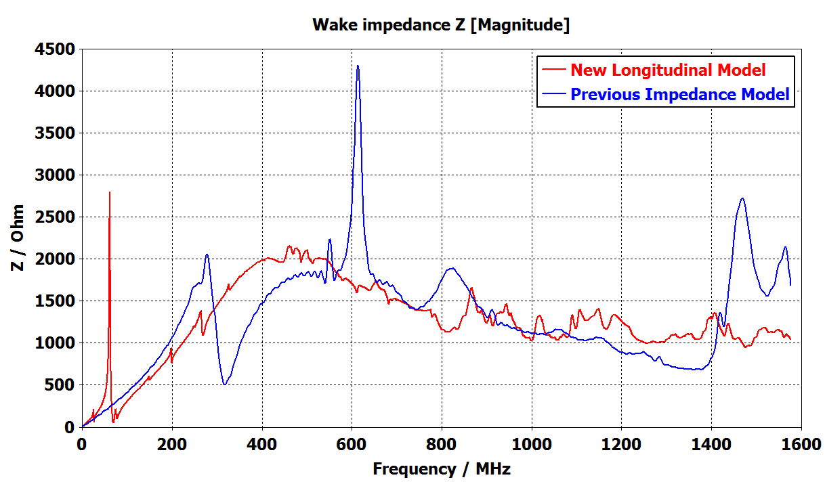
KFA45: Comparing Wakefield Simulation Results
Notes:
Show abs or (real & imaginary)…check with Alex

Slide 11
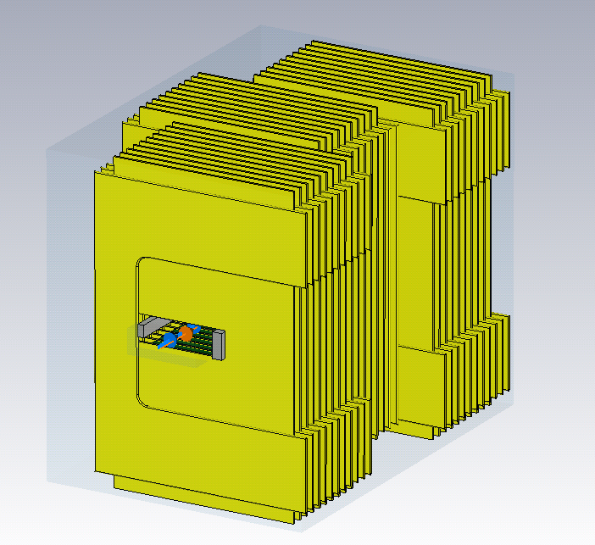
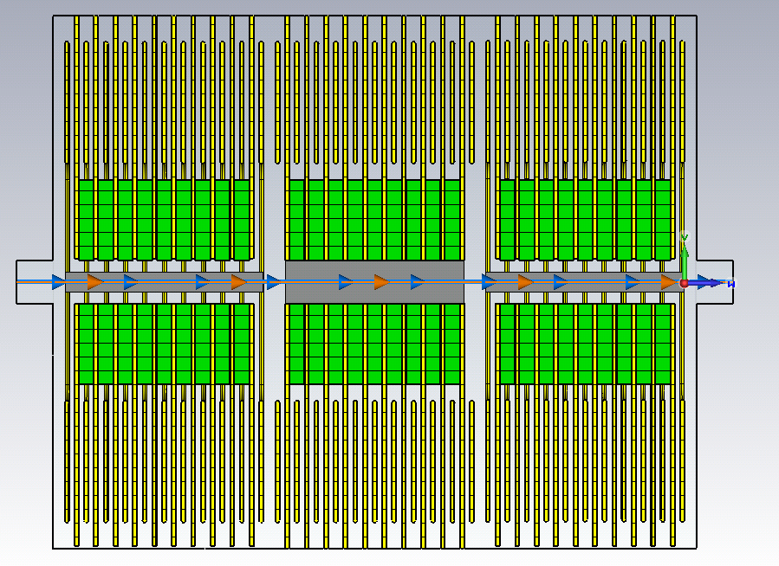
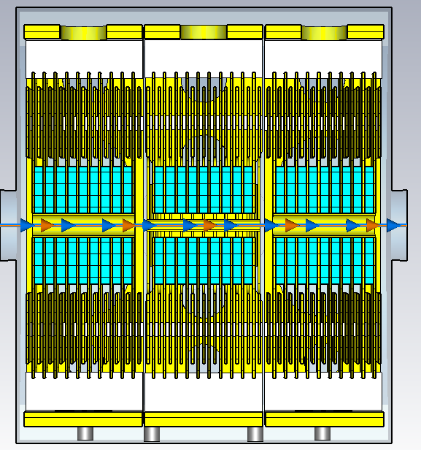
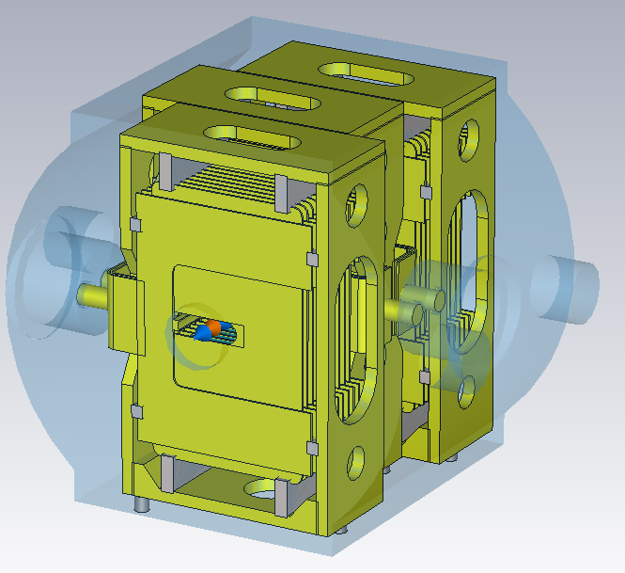
KFA79: Models
Previous Impedance Model
New Longitudinal Impedance Model

Slide 12
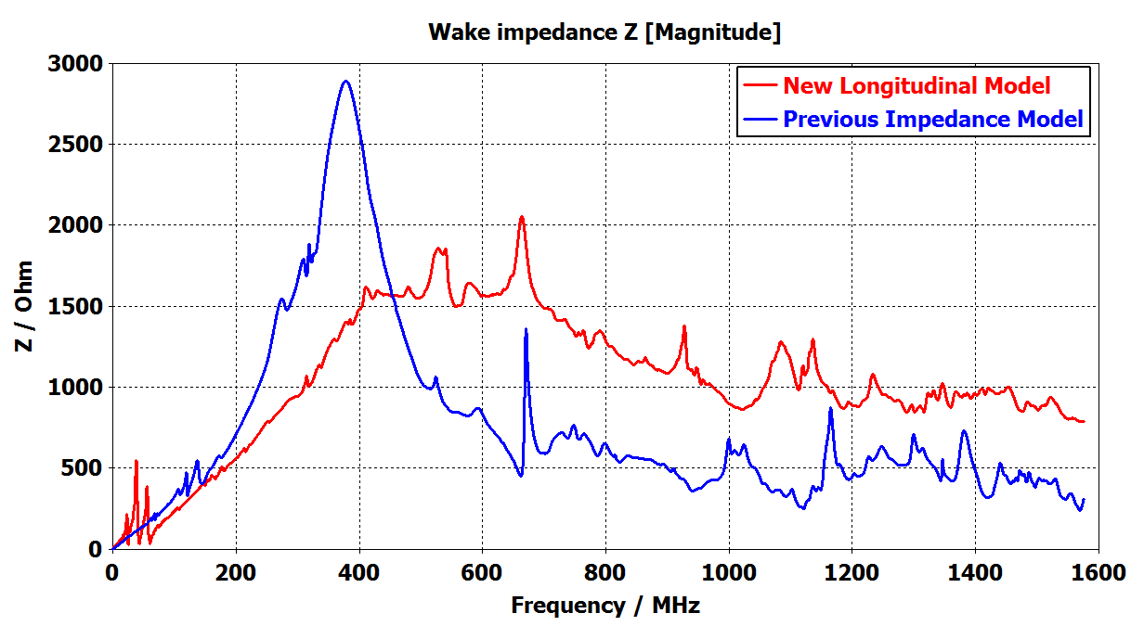
KFA79: Comparing Wakefield Simulation Results

Slide 13
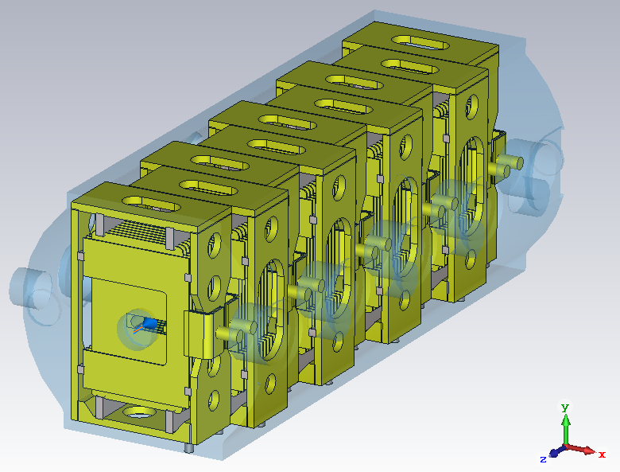
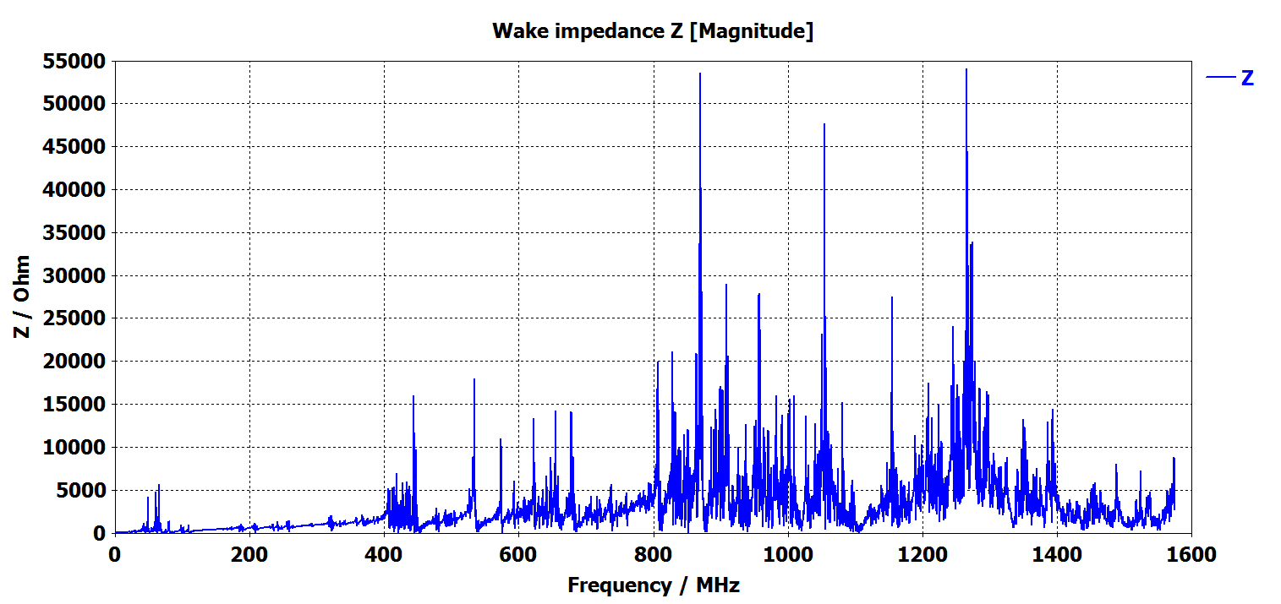
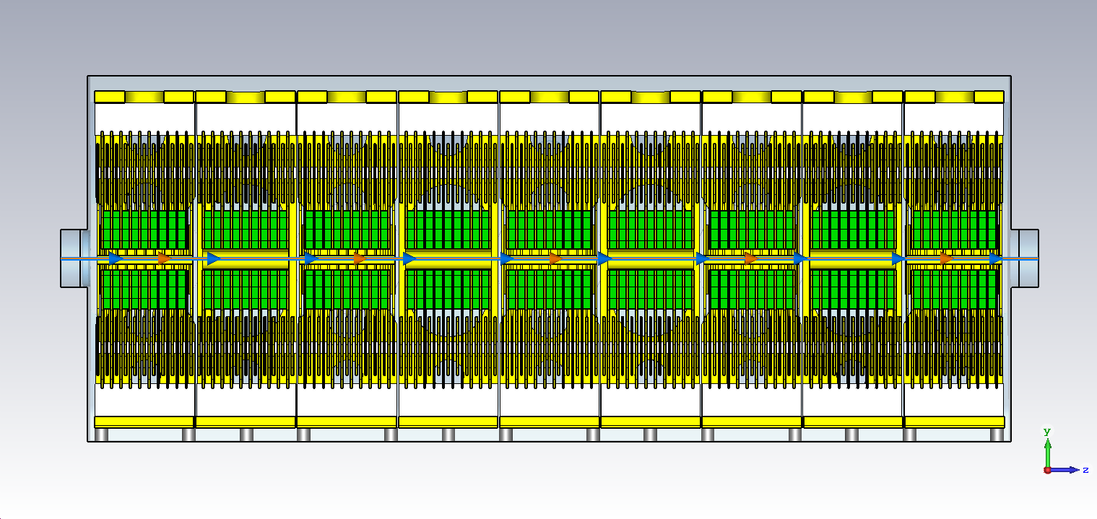
KFA71: Preliminary Wakefield Simulation Results
Preliminary Wakefield Results
  Need to run longer wakelength to further resolve peaks
Notes:
400 meter wakelength, decays down to -8.75 dB
2.370 meter long structure

Slide 14
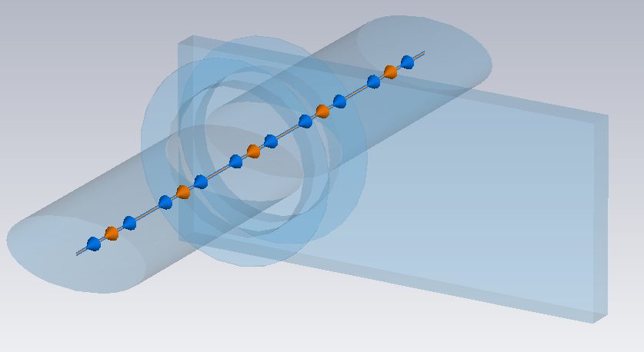
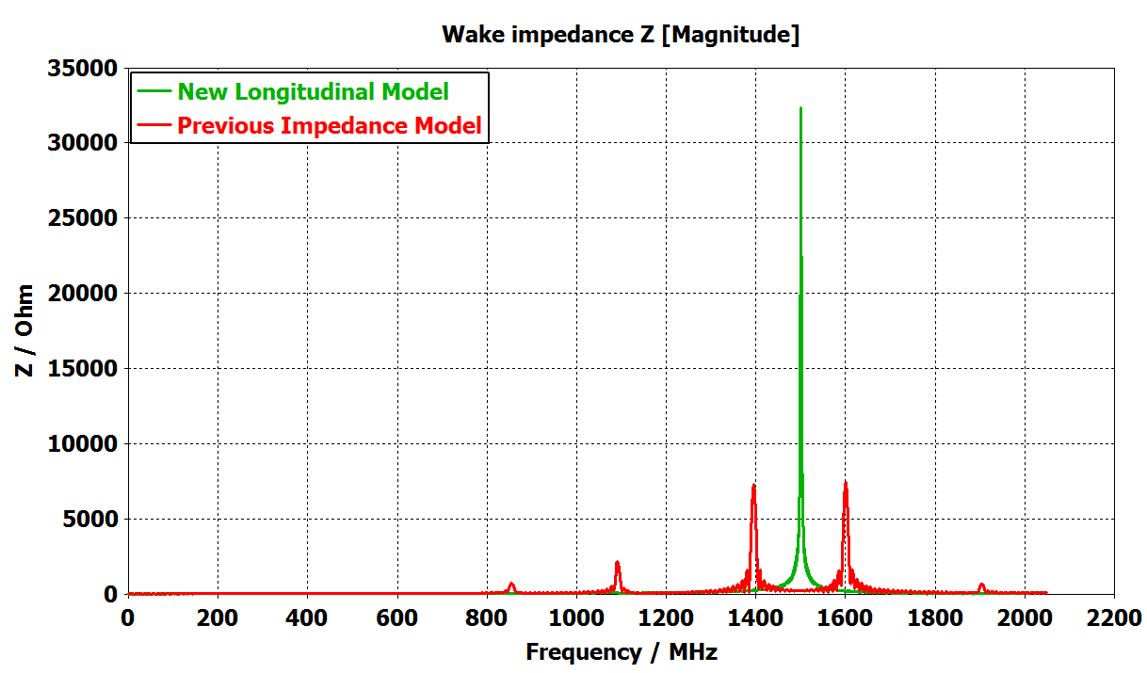
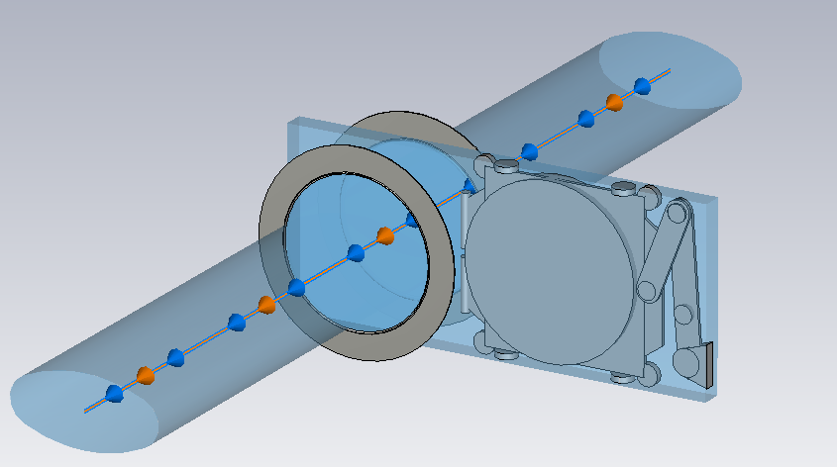
UHV Gate Valve: CST Models
Previous Impedance Model
10 Valves total
No internal model available
  Not included in previous model
  Proprietary
  Drawn using datasheet
  Measurements necessary
New Longitudinal Impedance Model

Slide 15
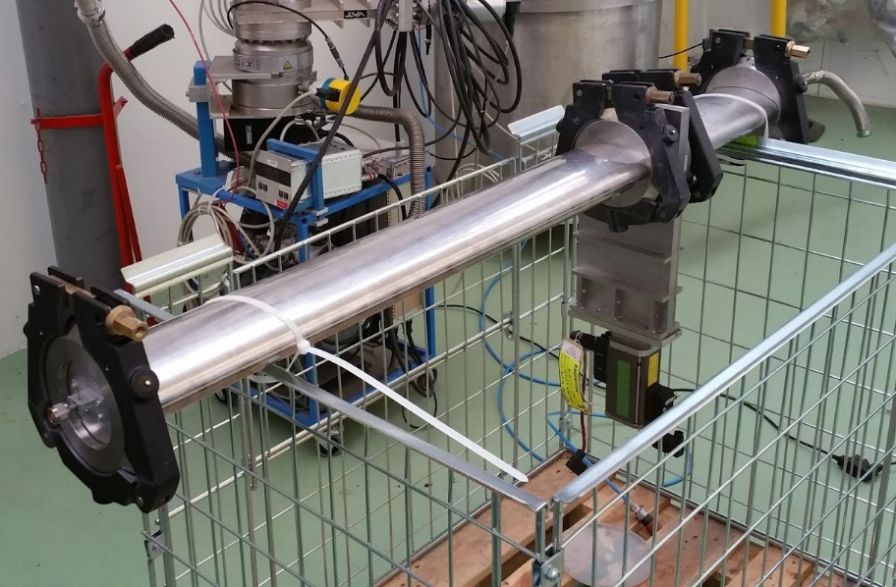
UHV Gate Valve: Measurement Setup
Measured using probe method
Setup closed at both ends
  Traps travelling wave modes
  TE_{11p}
Investigated resonances at
  1.2 GHz, 1.34 GHz & 1.5 GHz
10 Valves
Notes:
VAT UHV Gate Valve Series 108 Order No. 10844-Xe44-BIH1 DN 160 Flange X Dimensional Drawing 544734

Slide 16
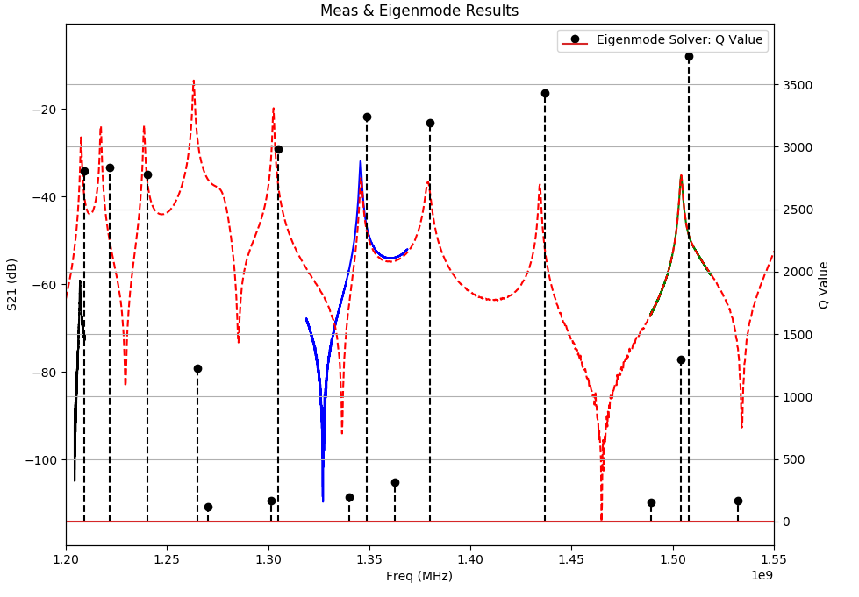
UHV Gate Valve: Comparing Measurement & Simulation Results
TE₁₁₉
TE₁₁₈
TE₁₁₁
TE₁₁₆
TE₁₁₇
TE₁₁₂
TE₁₁₅
TE₁₁₃
Cavity Mode
TM₀₁₀
1504.18
Q: 1184
TE₁₁₄
TE₁₁₆
1345.67 MHz
Q: 1442
TE₁₁₁
1207.04 MHz
Q: 2352

Slide 17
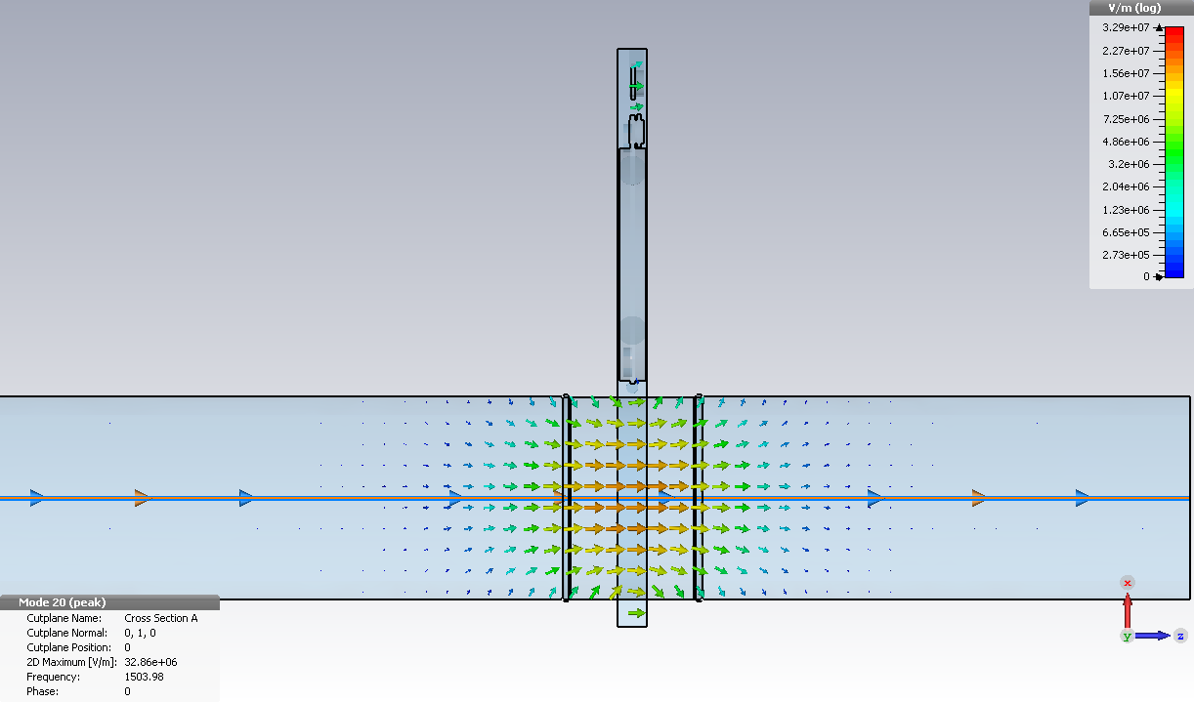
UHV Gate Valve: TM₀₁₀ Cavity Mode in the Valve
 | Eigenmode Simulation | Wakefield Simulation | Measured
Res. Freq | 1.503 GHz | 1.496 GHz | 1.504 GHz
Q | 1294 | 1206 | 1184
R Shunt | 39.0k Ohm | 36.2k Ohm | -

Slide 18
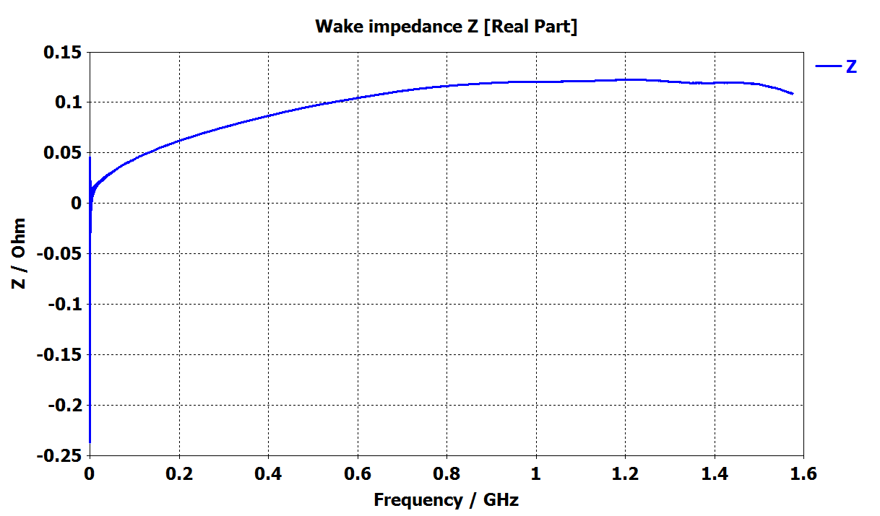
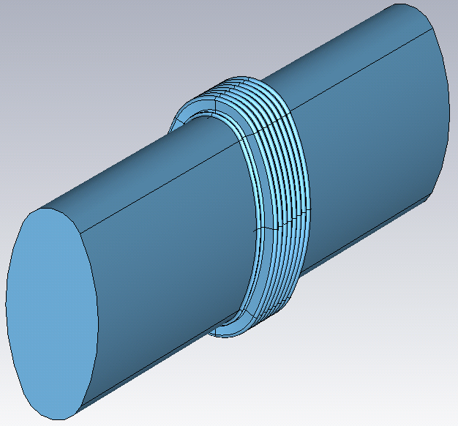
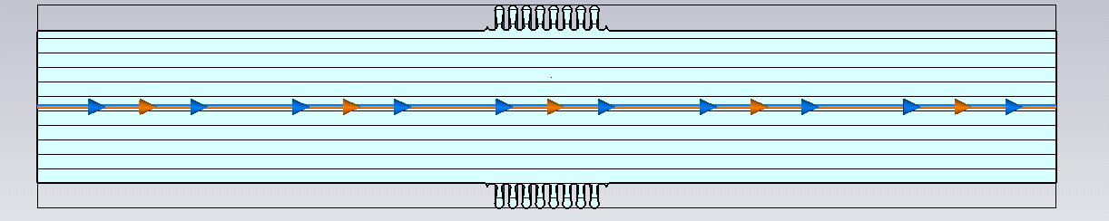
PS Bellows: Wakefield Simulations
ST0580970_01
ST0580970_01
Notes:
NEXT TO OBJECTS? => Extra Effects

Slide 19
Path Forward
RF Cavities major portion of the impedance budget
  How accurate is it to model them without feedback system?
  HOM couplers
    How important?
    How to simulate with Wakefield & Eigenmode?
Ferrite Kickers
  Need to confirm ferrite material parameters
    Sample measurement
  Measurement of the KFA71 spare
    Help to confirm ferrite material parameters
    Would confirm other kickers models as well
  Modeling and simulation of the other kickers
    KFA4, KFA13 & KFA21
Passive Elements
  PS Bellows
    Investigate other variations
    Investigate effects of its proximity to other objects
  Valves, transitions, etc.
    Machine survey to discover elements and their locations
    Start modeling the most numerous elements

Slide 20
Backups

Slide 21
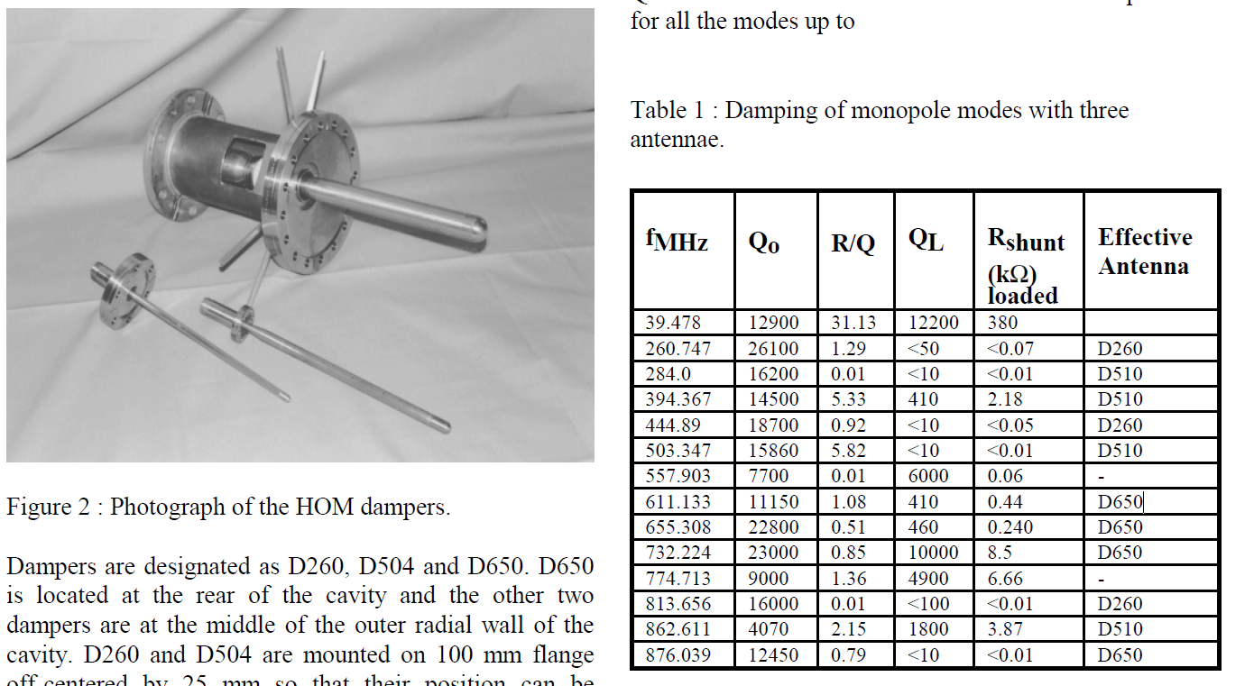
40 MHz HOM’s
E. Jensen, et. Al. “HIGHER ORDER MODE DAMPING OF THE CERN PS 40 MHZ CAVITY”

Slide 22
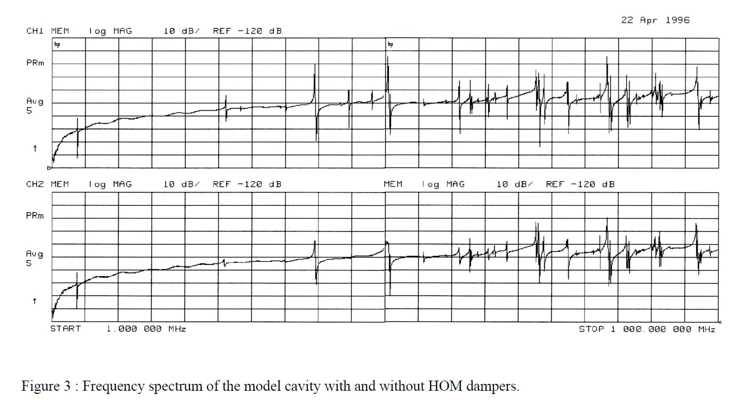
40 MHz Measurements
With & Without HOMs
E. Jensen, et. Al. “HIGHER ORDER MODE DAMPING OF THE CERN PS 40 MHZ CAVITY”

Slide 23
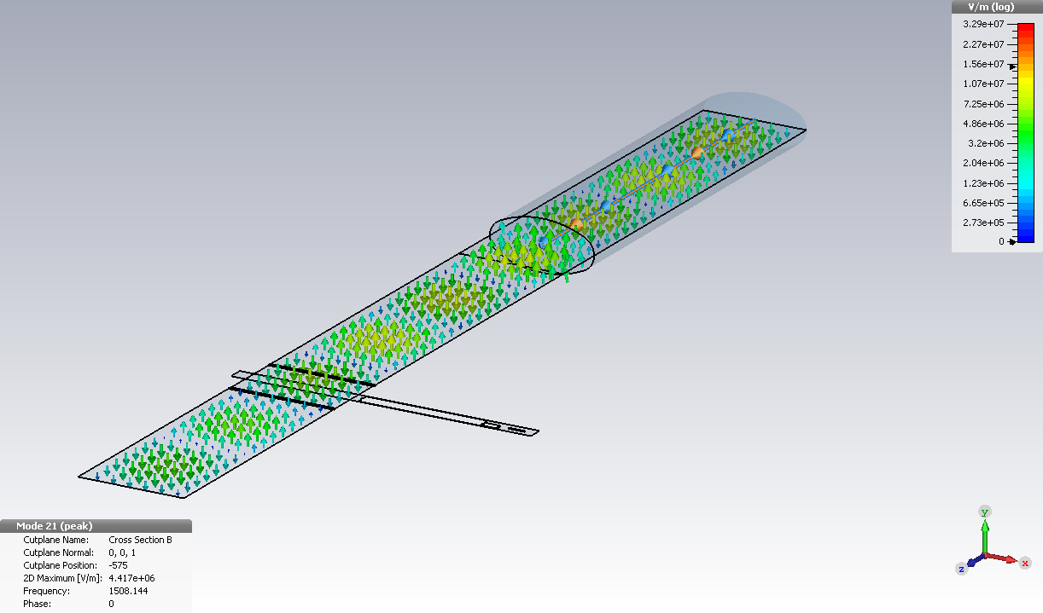

TE₁₁₉ Cavity Mode in the Valve
TE₁₁₉ Mode

Slide 24
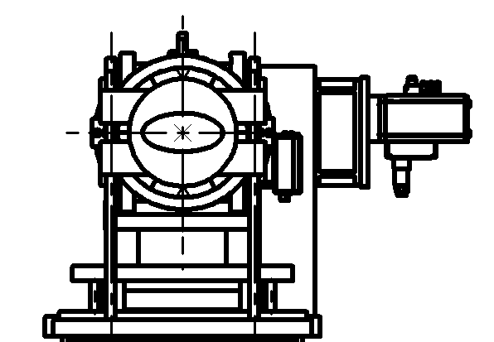
PS UHV Valve Locations

