Slide 1
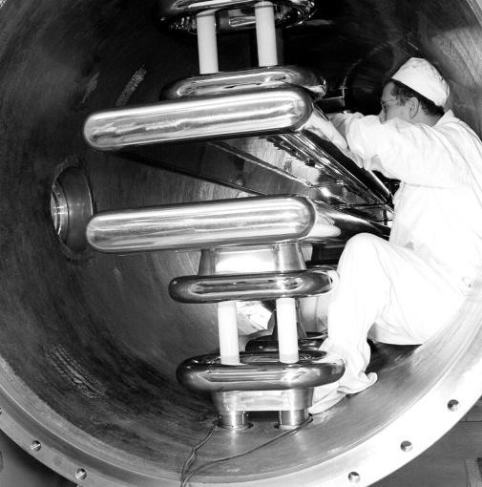
EDM main device parameters
J. Borburgh, with valuable input from
L. Allonneau, C. Carli and G. Guidoboni,
CERN, 1961

Slide 2
Outline
Reported separator experience
EDM layout review
EDM elements
Quads
Bends
Injection devices
1st Power converter building surface estimate
What next?

Slide 3
Some reported separator experience throughout the world
 | LESB II (1979) [1] | Tristan (1989) [2] | Tevatron (1992) [3] | SPS ZX (1982) [4] | LEP ZL (1996) | CESR (1999) [5] | BEPC II (2001) [6]
Nominal gap (mm) | 150 | 80 | 50 | 40 (20 – 160) | 100 (60 – 160) | 85 | 100
Operational field strength (MV/m) | < 5.2 | 3.0 | 5.0 max. | 5.0 | 2.5 (tested to 5.0) | 2.0 | 2.2
HV supply (kV) | +/-390 | +/- 120 | +/- 125 | 0/-200 | +/- 150 | +/- 85 | +/- 110
Electrode dimension (mm x mm) | n.a. | 4600 x 150 |  | 3000 x 160 | 4000 x 260 | 2700
Electrode material | Glass | Titanium |  | Titanium | Stainless steel
Device length (mm) | n.a. | 5105 | 3000 | 3380 | 4500
Working pressure (mbar) | 10⁻⁶ |  |  | 10⁻¹⁰ | 10⁻¹⁰
Operational spark rate (#/h) | <1 | <0.02 |  | < 0.03 | 0.2 | 0.04
Particle beam | p- | e- e+ 9mA 15GeV | p p- | p p- (270 GeV) | e- e+ (100 GeV) | e- e+ 150 mA | e- 576 mA

Slide 4
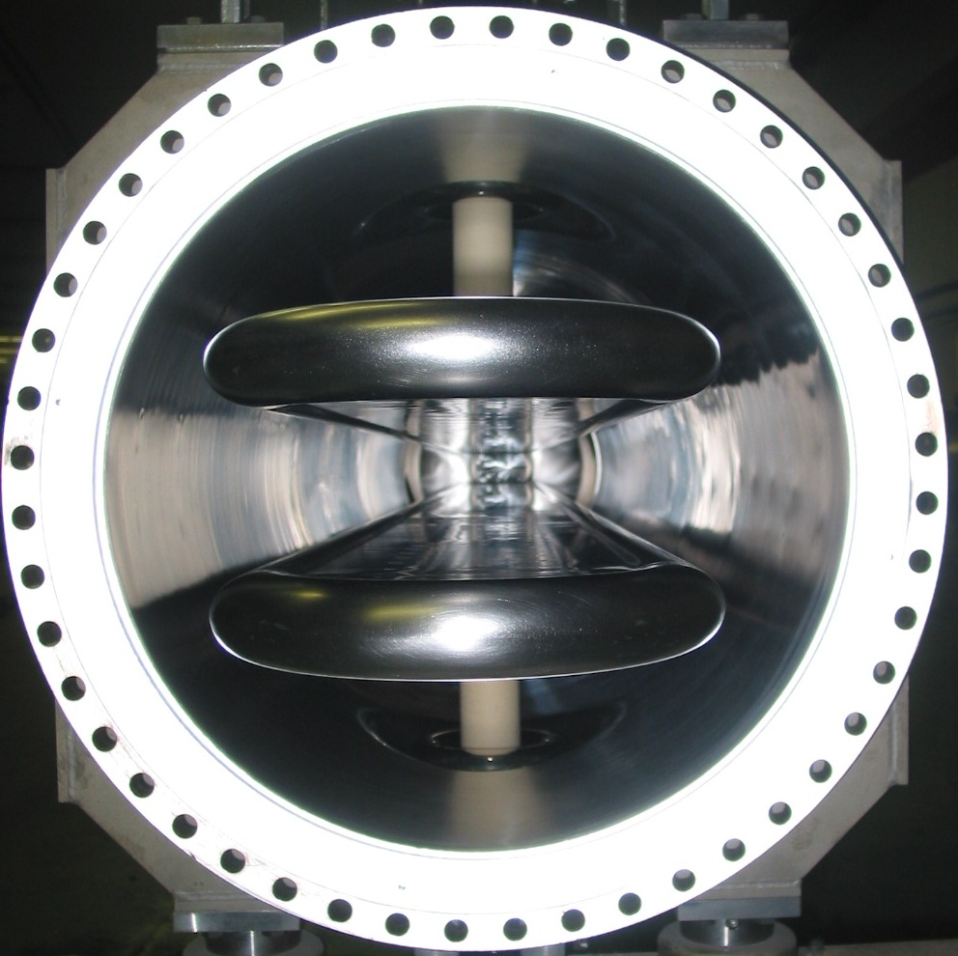
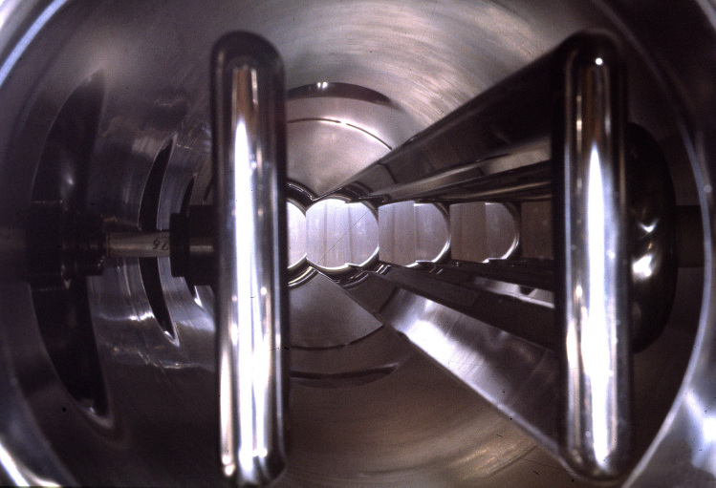
Electrode layouts
CESR separator
LEP ZL separator
SPS ZX separator

Slide 5
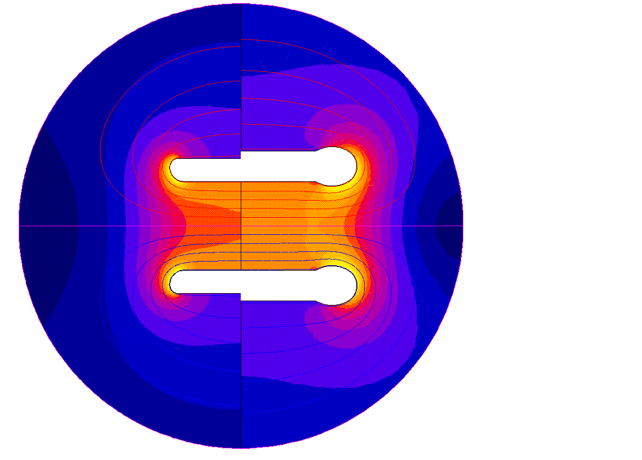
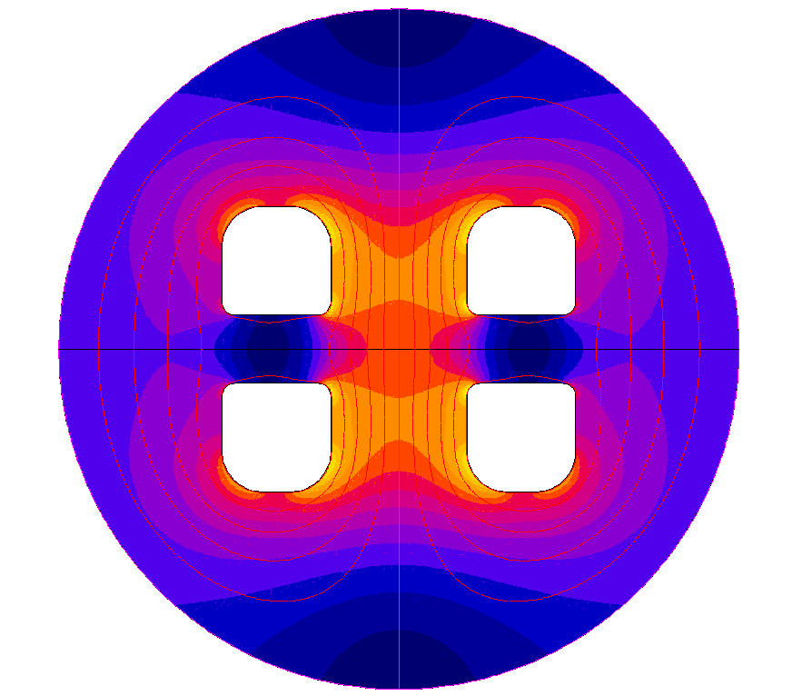
Field distributions
Split electrodes (50 mm)
ZX ZL

Slide 6
Installation length
In SPS ZS septa: 3000 mm active length at 870 mm spacing
LEP ZL: 4000 mm active length; 4500 mm device length; spacing > 650 mm
Note: Additional space would be needed for vacuum valves in case plug-in systems would be adopted to reduce down time in case of exchange due to failure

Slide 7
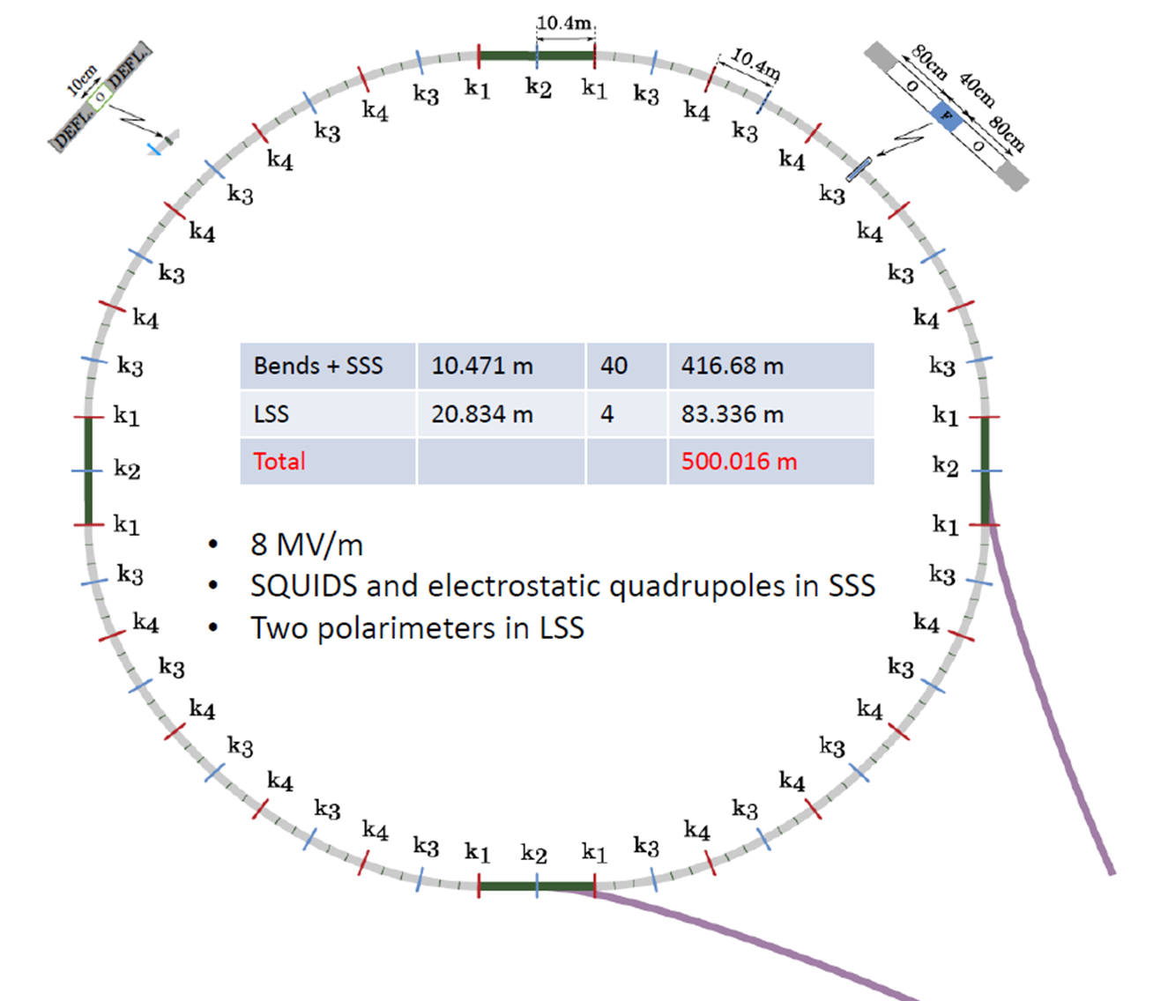
EDM layout review
 | # | l | l_{total}
LSS | 4 | 20.834 | 83.336 | m
Bends + SSS | 40 | 10.417 | 416.68 | m
EDM circumference |  |  | 500.016 | m
Cell
Drift before bend | 1 | 0.8 | 0.8 | m
Bend (flange2flange) | 2 | 4.1585 | 8.317 | m
active length/bend |  | 3.7985 |  | m
Drift between bends | 1 | 0.1 | 0.1 | m
Drift after bend | 1 | 0.8 | 0.8 | m
Quad | 1 | 0.4 | 0.4 | m
Bend+ sss |  |  | 10.417 | m
Injection
Fast deflector (f2f) | 1 | 3 | 3 | m
active length |  | 2.5 |  | m
Drift | 1 | 0.5 | 0.5 | m
Septum (f2f) | 1 | 3.5 | 3.5 | m
active length/septum |  | 3 |  | m
injection straight |  |  | 7 | m

Slide 8
Quadrupole
Assume 4 families
Field requirements not yet clarified (strength, quality)
Alignment very critical (value ?)
At cryo temperatures to reduce # warm/cold transitions ?
0.4 m length
In same sections as squids?
Ø 30 mm aperture (≡ bend) ?
Ø 20 mm good field region (≡ bend) ?

Slide 9
Bend proposal
4.16 m devices flange to flange, spaced at 0.1 m;
2 (baseline 3) bends per cell
Electrical field strength: 8.7 MV/m
Bipolar: +/- 130 kV,
all devices electrically in parallel, decoupled with > 5 MΩ resistors
Gap width: 30 mm.
Field homogeneity over Ø20 mm: 1 ppm still tbc.
Electrode shape: circular.
HV power supplies: ± 200 kV, 3 mA
To provide sufficient margin for conditioning and operation (U, I)
1 family needed in principle
Stability 10⁻⁴ tbc.

Slide 10
Open issues bends
Impact of magnetic shielding
Can stainless steel be used?
Vacuum issues
Bake out or cryogenic approach (mechanical design constraint)
Operational constraints: venting (grounding of electrodes)
Optimal electrodes
shape, cross section profile
Material and surface finish
Manufacturing techniques
Conditioning of the individual device when powered in //
Combined with fixed electrodes
System performance at 8.7 MV/m and beyond
Spark rate
Requirements vs. predictions

Slide 11
Required Bend related development
HV circuit
Recovery after sparking, HV resistors
Feedthroughs
Cables and connectors
H.V. generator:
voltage margin for conditioning,
current margin to cope with dark current
Feedthrough & insulator support design
Insulator treatments (ion implantation, ..), device glow discharge
Coupling in the event of sparking
Geometry effects (coupling of field, coupling via the beam / photons etc.)
Circuit effects
Recovery
Beam impedance
Problem to the separator (Parasitic mode damping needed?)
Beam loading

Slide 12
Injection devices
 | Injection septum | Fast deflector
L (f2f) [m] | 3.5 | 3.0
Active length [m] | 3.0 | 2.5
Deflection angle [mrad] | 57.34 | 10
Gap width [mm] | 30* | 42.5
Field [MV/m] | 8.0 | 1.674
Radius of curvature electrodes [m] | 52.32 | -
Nominal electrode voltage [kV] | - 240 | ± 35.6
T_{rise} and T_{fall} (2‰ - 998‰) [µs] | DC | 1.0
Capacitance per electrode (to gnd) [pF] | ~ 660 | < 500
* Assuming curved or segmented septum and electrode

Slide 13
Outstanding for injection devices
Segmented foil septum v.s. curved wire septum
Feasibility of Fast Deflector pulse generator:
Voltage switching
Rise and fall time
Alternative: stripline kicker to be studied

Slide 14
HV power supply space on the surface
 | Bends | Quads | Septum | Fast deflector
Power supplies | 4 (300 kV) | 10 (100 kV) | 4 (300 kV) | 4 (±40 kV)
Surface power supplies [m²] | 11 | 28 | 1 | 5
HV switches | 2 |  | 2
Surface / hv switch [m²] | 1.5 |  | 3
# HV resistors* | 8 | 20 | 8
Surface resistor [m²] | 5 | 8 | 5
Total equipment surface** | 19 | 36 | 20 | 5
* HV resistors in tunnel not included
** Space for operators and passages not included
First estimate power converters incl. corridors between racks: ~ 240 m²

Slide 15
What next?
Quad requirements to be clarified.
Is use of stainless steel in the machine acceptable?
Impact of magnetic shielding.
Requirements of quadrupoles to be clarified.
Power converter feasibility of fast deflector to be confirmed. Will need some R&D.
Vacuum approach bends to be determined: conventional approach: bake out before operation.
Cryo pumping could avoid many warm/cold transitions. More study required.

Slide 16
References
[1] V. Kovarik et al., “The modernization and improvement of the BNL short separators”, NIMB 158, 1979
[2] T. Shintake et al., “ electrostatic beam separation system of tristan main ring”, PAC 1989
[3] K.P Koepke, “Status of the low beta and separator projects”, EPAC 1992
[4] R. Bonvin et a;., “electrostatic deflectors for luminosity measurements at CERN pp collider”, 10th ISDEIV 1982
[5] J.J. Welch et al., “Commissioning and performance of low impedance electrostatic separators for high luminosity at CESR”, PAC 1999
[6] Y.D. Hao et al., “Design of low impedance electrostatic separators for BEPC II”, APAC 2001

Slide 17
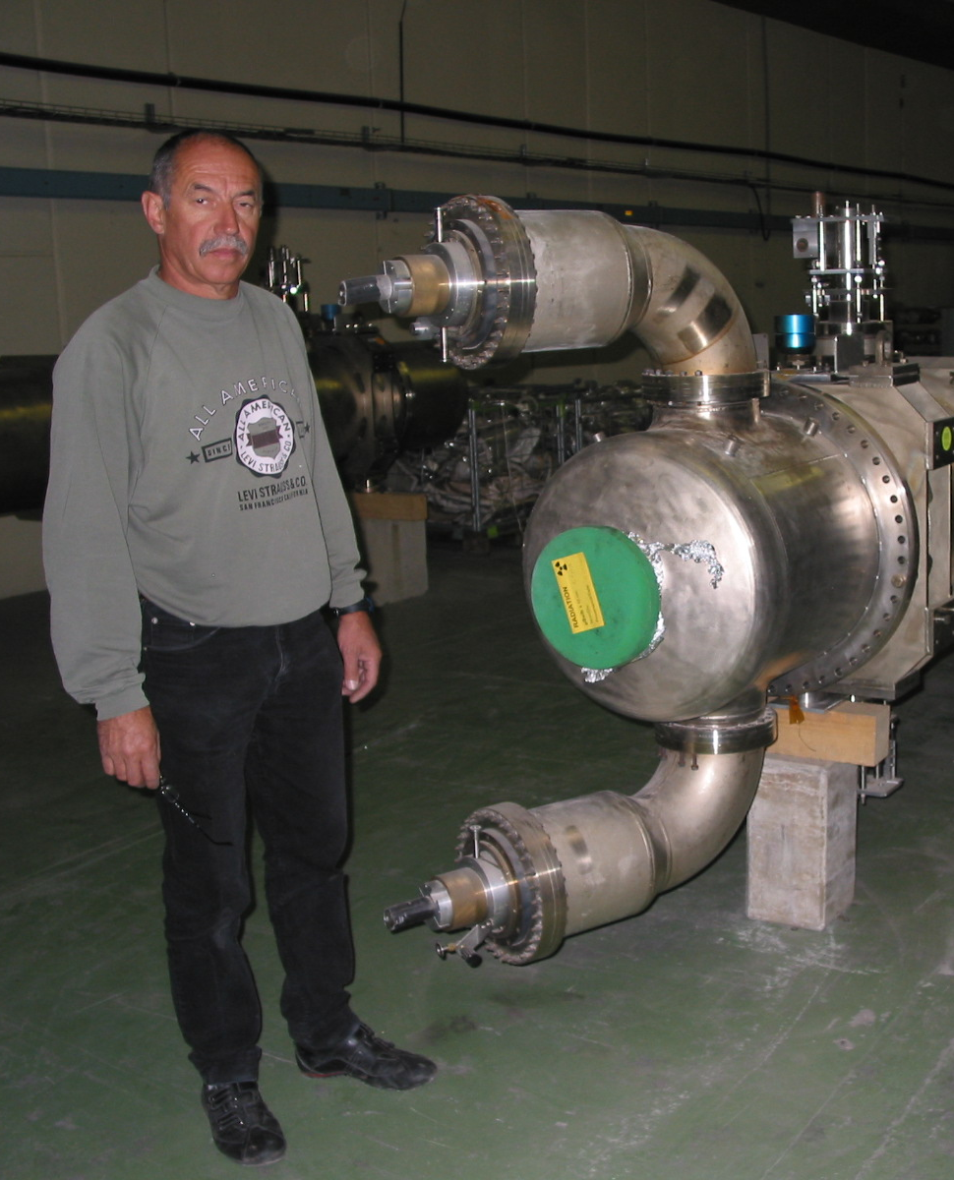
Feedthrough
Reliable design up to 300 kV available at CERN
Modular: can be exchanged in case of failure without removal of separator from beam line
Insulating liquid
3M Fluorinert FC-77 with continuous “regeneration”

Slide 18
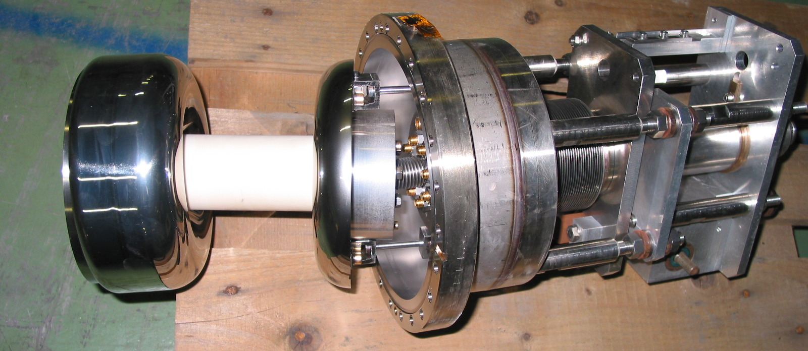
Electrode support
Choice of insulator material
Pure insulator / slightly conductive
Some work on insulator treatments available at CERN
Glow discharge experience at KEK
ZL electrode support mechanism:
Electrode cooling liquid channel
Remote displacement system

