Slide 1
CONS and HL-LHC day
Analysis of needs from EN-HE
R. Rinaldesi on behalf of EN-HE
26/09/2017

Slide 2
Equipment under HE responsibility vs HL-LHC
No specific consolidation budget needed for Hi-Lumi
Overhead cranes
Road transport vehicles
Lifts
Industrial trucks and electric tractors
Includes crucial equipment for transport of people and material and installation of magnets (LHC and HL-LHC

Slide 3
CONS and HL-CONS approved requests
(for HL-CONS except spares)
Item n. | Description | Approved Budget | Funding (CONS/HL-CONS) % | Budget to be allocated in the years
1 | Overhead cranes | 2.500 kCHF (2018-2020) | 100% CONS | Variable
2 | Lifts | 6.435 kCHF (2018-2023) | 100% CONS | Variable
3 | Road transport (>3.5t) | 600 kCHF (2018-2020) | 100% CONS | 200 kCHF/year
4 | Industrial trucks and electric tractors | 1.195 kCHF (2018-2020) | 100% CONS | ~400 kCHF/year

Slide 4
CONS and HL-CONS requests pending approval or refused (1/2)
Item n. | Description | Budget request | Budget to be allocated in the years | Pending | Refused
5 | Overhead cranes | 8.250 kCHF (2021-2025) | 1.500 kCHF/year (2.250 kCHF in 2022) | X
6 | Lifts | 600 kCHF (2024-2025) | 300 kCHF/year | X
7 | Road transport (>3.5t) | 1.050 kCHF (2021-2025) | 200 kCHF/year (250 kCHF in 2024) | X
8 | Industrial trucks and electric tractors | 2.000 kCHF (2021-2025) | 400 kCHF/year | X

Slide 5
CONS and HL-CONS requests pending approval or refused (2/2)
Item n. | Description | Budget request | Budget to be allocated in the years | Pending | Refused
9 | Support Consolidation | 1.600 kCHF (2018-2025) | 200 kCHF/year |  | X
10 | Heavy transport / aux. lifting equipment | 400 kCHF (2018-2025) | 50 kCHF/year |  | X
11 | Industrial trucks and electric tractors | 420 kCHF (2019-2025) | 60 kCHF/year |  | X

Slide 6
New requests in view of HL-LHC installation
(to meet HL-LHC goals)

Slide 7
New requests for conversion of LHC into HL-LHC
Item n. | Description | Budget request | Budget to be allocated in years (from-to) | Priority (1-3) 1 top 3 low
12 | Replacement of 2 Mafi trailers | 1.400 kCHF | 2021-2023 | 1
13 | Replacement of Mafi power feeding line in sectors 3-4 and complete repainting of guidance line | 600 kCHF | 300 kCHF/LS | 1
14 | Replacement of Kouba bogies | 1.000 kCHF | 2025 | 1
15 | Replacement of magnets transfer tables | 400 kCHF | Not known | 2

Slide 8
Description sheets for new requests

Slide 9
ITEM: Mafi trailers
Rational of the request
Total Budget request | 1.400 kCHF | Budget to be allocated in years (from-to) | 2021-2023
Material budget request | 100% | Personnel available [y/n] in addition to personnel budget request | Yes
Personnel budget request (M2P budget for MPAs and fellows) | 1 technical engineer (50%)
Consequences of suppression of request on HL performance
Impossibility to install and/or replace magnets
Consequences of delay of request to LS4 or later
Impossibility to install and/or replace magnets during LS2 and LS3

Slide 10
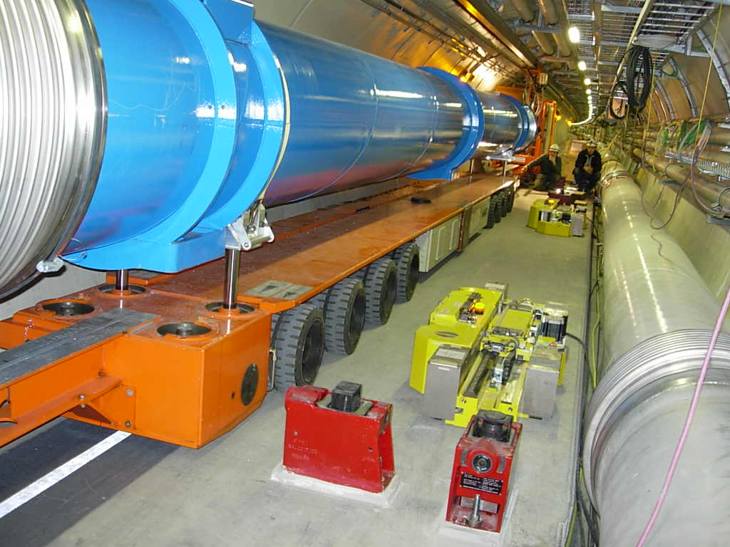
ITEM: Mafi trailers
Being a prototype, equipment life can be hardly estimated
Major consolidation interventions can’t be done due to the lack of support from the manufacturer
Reliability still sufficient for LS2 but not enough for LS3
Its proper functioning concerns both LHC and HL-LHC
Installation of TAN and inner triplets will be done with new specific machines (budget already requested)

Slide 11
ITEM: Mafi feeding line / guidance line
Rational of the request
Total Budget request | 600 kCHF | Budget to be allocated in years (from-to) | LS2, LS3
Material budget request | 100% | Personnel available [y/n] in addition to personnel budget request | Yes
Personnel budget request (M2P budget for MPAs and fellows) | 0
Consequences of suppression of request on HL performance
Impossibility to install and/or replace magnets
Consequences of delay of request to LS4 or later
Impossibility to install and/or replace magnets during LS2 and LS3

Slide 12
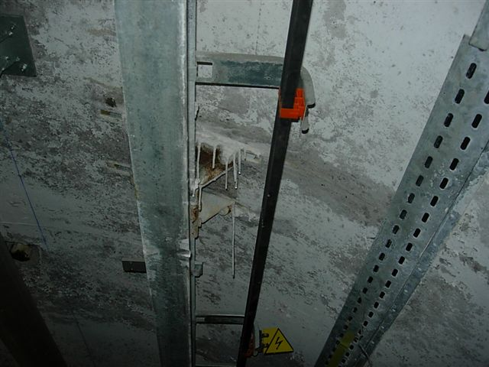
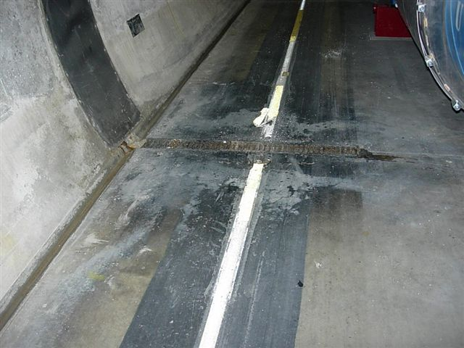
ITEM: Mafi feeding line / guidance line
Water infiltrations in sectors 3-4 require repair/replacement of power feeding line at every LS
Good line quality is required to correctly guide the convoy (only 10cm side clearance!): check and repairs on 27 km at every LS

Slide 13
ITEM: Kouba bogies
Rational of the request
Total Budget request | 1.000 kCHF | Budget to be allocated in years (from-to) | 2025
Material budget request | 100% | Personnel available [y/n] in addition to personnel budget request | Yes
Personnel budget request (M2P budget for MPAs and fellows) | 1 technical engineer (50%)
Consequences of suppression of request on HL performance
None
Consequences of delay of request to LS4 or later
Impossibility to replace warm magnets from LS4

Slide 14
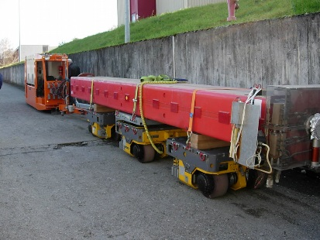
ITEM: Kouba bogies
Necessary for dismounting and installation of warm magnets
Proper functioning not guaranteed from LS4

Slide 15
ITEM: Magnets transfer tables
Rational of the request
Total Budget request | 400 kCHF | Budget to be allocated in years (from-to) | Not known, needed in case of major breakdown
Material budget request | 100% | Personnel available [y/n] in addition to personnel budget request | Yes
Personnel budget request (M2P budget for MPAs and fellows) | 0
Consequences of suppression of request on HL performance
Impossibility to install and/or replace magnets
Consequences of delay of request to LS4 or later
Impossibility to install and/or replace magnets during LS2 and LS3

Slide 16
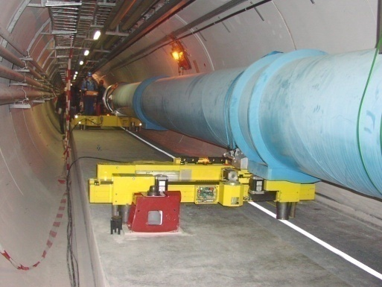
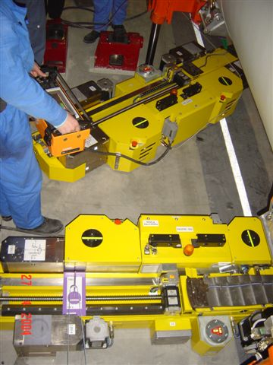
ITEM: Magnets transfer tables
Estimations are given for information only
5 sets available
In case of major breakdown, replacement is the only possible intervention
Manufacturer still available

Slide 17
Summary (1/3)
Priority (1-3) in decreasing order of importance | Item n. | Description | Approval Status: Approved by CONS Approved by HL-CONS Not Approved by CONS Not Approved by HL-CONS New
1 | 12 | Replacement of 2 Mafi trailers | New
1 | 13 | Replacement of Mafi power feeding line in sectors 3-4 and complete repainting of guidance line | New
1 | 14 | Replacement of Kouba bogies | New
1 | 4 | Industrial trucks and electric tractors (2018-2020) | Approved by CONS

Slide 18
Summary (2/3)
Priority (1-3) in decreasing order of importance | Item n. | Description | Approval Status: Approved by CONS Approved by HL-CONS Not Approved by CONS Not Approved by HL-CONS New
2 | 15 | Replacement of magnets transfer tables | New
2 | 8 | Industrial trucks and electric tractors (2021-2025) | Not Approved by CONS
3 | 5 | Overhead cranes (2021-2025) | Not Approved by CONS
3 | 6 | Lifts (2024-2025) | Not Approved by CONS
3 | 7 | Road transport (>3.5t) (2021-2025) | Not Approved by CONS

Slide 19
Summary (3/3)
Priority (1-3) in decreasing order of importance | Item n. | Description | Approval Status: Approved by CONS Approved by HL-CONS Not Approved by CONS Not Approved by HL-CONS New
3 | 1 | Overhead cranes (2018-2020) | Approved by CONS
3 | 2 | Lifts (2018-2023) | Approved by CONS
3 | 3 | Road transport (>3.5t) (2018-2020) | Approved by CONS
3 | 9 | Support Consolidation | Not Approved by CONS
3 | 10 | Heavy transport / aux. lifting equipment | Not Approved by CONS
3 | 11 | Industrial trucks and electric tractors | Not Approved by CONS

