Slide 1
PATH/TRAVEL : a multi-particle tracking code for linacs and transfer lines
Stefano Benedetti, Daniel Noll, Giulia Bellodi, Jean-Baptiste Lallement, Jimmy Garland, Vittorio Bencini, Silvia Schuh, Sharif Ghitan + everybody who has worked in linac beam dynamics in the last 10-15 years!
ABP-CWG meeting
Alessandra Lombardi

Slide 2
Points to be addressed (I)
Description of the physics and the modeling of the code
  What effects are included and what are not?
  What is the impact of the simulation tool for CERN studies?
Code implementation
  Programming language(s)
  Programming style (object oriented, procedural, …)
  Prerequisites to run the code (OS, compilers, libraries, other codes)
  Parallelisation technology (if any)
Example of typical application (use case)
  How many simulations for one study
  Where the code is run (lxplus, lxbatch, other clusters)
  Computing time

Slide 3
Points to be addressed (II)
Performance
  Is the performance in general adequate to the present needs?
Available documentation
Licensing policy
  Open source?
Future plans and needs
  Maintenance, extension and further development
    Include more physics to better model cases of interest for CERN?
    Performance improvement?
  Resource estimation for maintenance/development over next years
  What type of hardware resources would be best suited for the physics case?

Slide 4
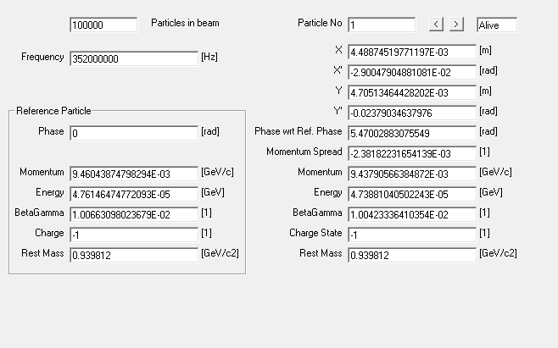
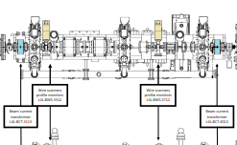
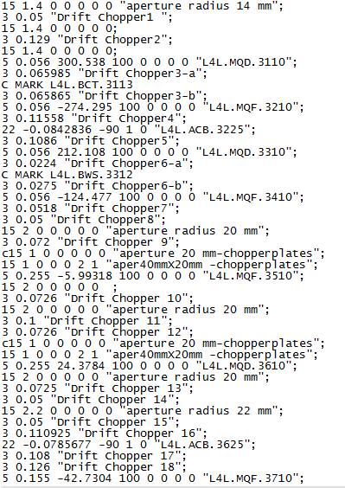
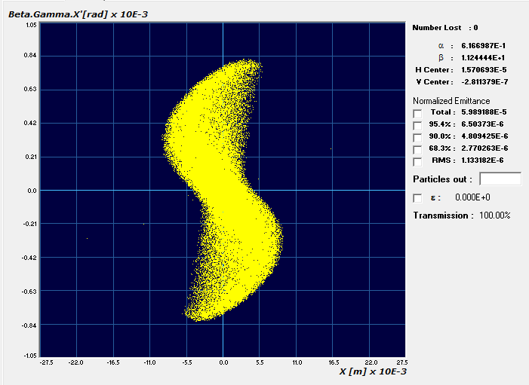
Description of the physics and the modeling of the code
Sequence of elements and instructions
Input beam up to 1M particles /run

Slide 5
Input beam
Each particle is represented by 9 coordinates :
          x,xp,y,yp,phase,energy, charge,mass,flag
  Possibility of beam with different species ( Eg LINAC3 source ) but also H- and co-extracted electrons
Input beam generator : built inside the code with several distribution
Compatible with other particle tracking codes : PARMILA/PARMTEQ/TRACEWIN/
Generate a particle beam from a measurement file (this is CERN specific and matched to the emittance measurement programs in house)

Slide 6
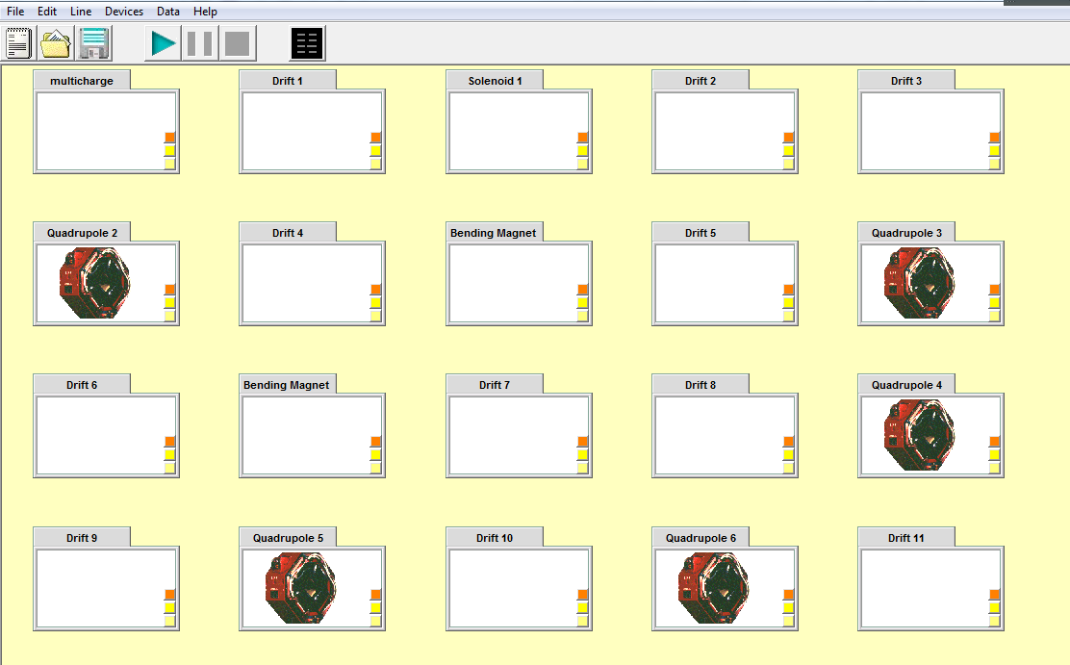
Layout deck
Sequence of lumped element and /or em field map
Includes switches on/off : aperture, second order effects, space charge, output at elements
Can be in GUI or standalone

Slide 7
List of available elements
OCTUPOLE
ACCELERATOR COLUMN
ND ELLIPSOID
(DE)ACTIVATE LINEAR ACCELERATOR MODE
ELLIPSE
(DE)ACTIVATE DECAY
REFERENCE PARTICLE VALUES OUTPUT
BEAM CENTER VALUES OUTPUT
ROOT-MEAN-SQUARED VALUES OUTPUT
SINGLE PARTICLE TRACKING OUTPUT
BEAM OUTPUT IN TABULATED TEXT FORMAT
BEAM OUTPUT IN TRAVEL FORMAT
BEAM OUTPUT IN PARMILAS FORMAT
BEAM OUTPUT IN STREAM FILE
MAPPED (r,z) FIELDS : STATIC ELECTRIC FIELD, STATIC MAGNETIC FIELD
MAPPED (r,z) FIELDS : RF ELECTRIC FIELD, STATIC MAGNETIC FIELD
MAPPED (r,z) FIELDS : STATIC ELECTRIC FIELD, RF MAGNETIC FIELD
MAPPED (r,z) FIELDS : RF ELECTRIC FIELD, RF MAGNETIC FIELD
MAPPED (r,z) FIELDS : STATIC ELECTRIC FIELD
MAPPED (r,z) FIELDS : RF ELECTRIC FIELD
MAPPED (r,z) FIELDS : STATIC MAGNETIC FIELD
MAPPED (r,z) FIELDS : RF MAGNETIC FIELD
MAPPED (r,z) FIELDS : STATIC ELECTRIC FIELD, RF ONLY B PHI
MAPPED (r,z) FIELDS : RF ELECTRIC FIELD, RF ONLY B PHI
MAPPED (x,y,z) FIELDS : STATIC ELECTRIC FIELD, STATIC MAGNETIC FIELD
RMS BEAM ADDITION
RF FREQUENCY
DRIFT
BENDING MAGNET
QUADRUPOLE
SLIT
BEAM SHIFT
BEAM SCALE
REPEAT LOOP
ABSORBER
REFERENCE PARTICLE DEFINITION
(DE)ACTIVATE APERTURE CONSTRAINTS
MATRIX TRANSFORMATION
APERTURE DEFINITION
RF PHASE COUPLER
(DE)ACTIVATE SECOND ORDER EFFECTS
SEXTUPOLE
HARD - EDGE SOLENOID
BEAM ROTATION
(DE)ACTIVATE RF PHASE CALCULATION
BUNCHER CAVITY
LENGTH PARTITION
SPACE CHARGE EFFECTS OPTIONS (UPDATED)
QUADRUPOLE OPTIONS

Slide 8
List of availiable elements
MAPPED (x,y,z) FIELDS : RF ELECTRIC FIELD, STATIC MAGNETIC FIELD
MAPPED (x,y,z) FIELDS : STATIC ELECTRIC FIELD, RF MAGNETIC FIELD
MAPPED (x,y,z) FIELDS : RF ELECTRIC FIELD, RF MAGNETIC FIELD
MAPPED (x,y,z) FIELDS : STATIC ELECTRIC FIELD
MAPPED (x,y,z) FIELDS : RF ELECTRIC FIELD
MAPPED (x,y,z) FIELDS : STATIC MAGNETIC FIELD
MAPPED (x,y,z) FIELDS : RF MAGNETIC FIELD
MAPPED (x,y,z) FIELDS : STATIC ELECTRIC FIELD, RF ONLY B PHI
MAPPED (x,y,z) FIELDS : RF ELECTRIC FIELD, RF ONLY B PHI
ABSORBER + STATIC E, STATIC B FIELD
ABSORBER + RF E, STATIC B FIELD
ABSORBER + STATIC E, RF B FIELD
ABSORBER + RF E, RF B FIELD
ABSORBER + STATIC E FIELD
ABSORBER + RF E FIELD
ABSORBER + STATIC B FIELD
ABSORBER + RF B FIELD
ABSORBER + STATIC E FIELD, RF ONLY B PHI
ABSORBER + RF E FIELD, RF ONLY B PHI
Acceptance
FILTER
SPECTRUM
ND emittance display
ELLIPSE TRANSFORMATION
WANTED EMITTANCE
TRAVEL INPUT
SIGMA MATRIX INPUT
GEOMETRICAL BENDING
START OF R-MATRIX CALCULATIONS
R-MATRIX DISPLAY
RMS TRACKING ACTIVATION
EXPORT RMS TRACK
EXPORT R-MATRIX TRACKING
END OF R-MATRIX CALCULATION
96 SET AVERAGE X, Y, X’ AND Y’ TO ZERO

Slide 9
Physics-external field
The effect of Magnetic and electric elements can be calculated with a linear transfer matrix or with integration through a field map.
E.g. solenoid
HARD EDGE SOLENOID
Type code 19
Effective length [m]
The field [KGauss]
Divide the solenoid in xx steps
Matrix transfer over each step
MAGNETIC FIELD
Scaling factor
Field map (2d or 3d)
Integration of equation of motion – time steps

Slide 10
Linac2 solenoids
R=0-3 cm
NB Emittance in the solenoid is NOT calculated in the Larmour frame when using field map, very important feature.

Slide 11
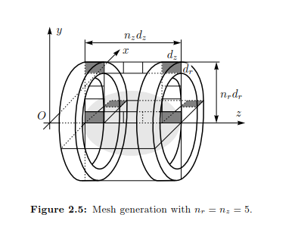
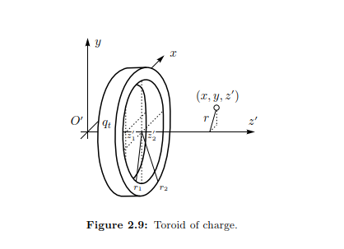
Physics – self fields (space charge) 1/2
2d space charge effects based on SCHEFF – sketch of how it works
Evaluate elliptic integrals – assuming uniform distribution in thetoroid
Apply the field on each charge
Math details in “space charge modelling in PATH manager” T. Muetze,2006

Slide 12
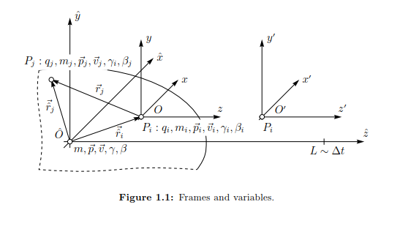
Physics – self fields (space charge) 2/2
3d space charge effects based on point-to-point
Calculate the field generated by each particle in the moving frame
Apply the kick in the laboratory frame

Slide 13
Physics-not used in a long time -
Decay
Absorbers : Bethe Block + energy struggling

Slide 14
Other important features
Statistic error studies
Steering algorithm
Emittance reconstruction algorithm
Back-tracing
Interfaced with MADX and survey data for survey team and database

Slide 15
Statistical error studies example: beam size at SMV with beam from linac 4 under energy, quad gradient and bending field jitter
Jitter in energy (gaussian 1σ= 30KeV) // bending field stability at 10⁻⁴ // Jitter on quadrupoles (±0.5%)

Slide 16
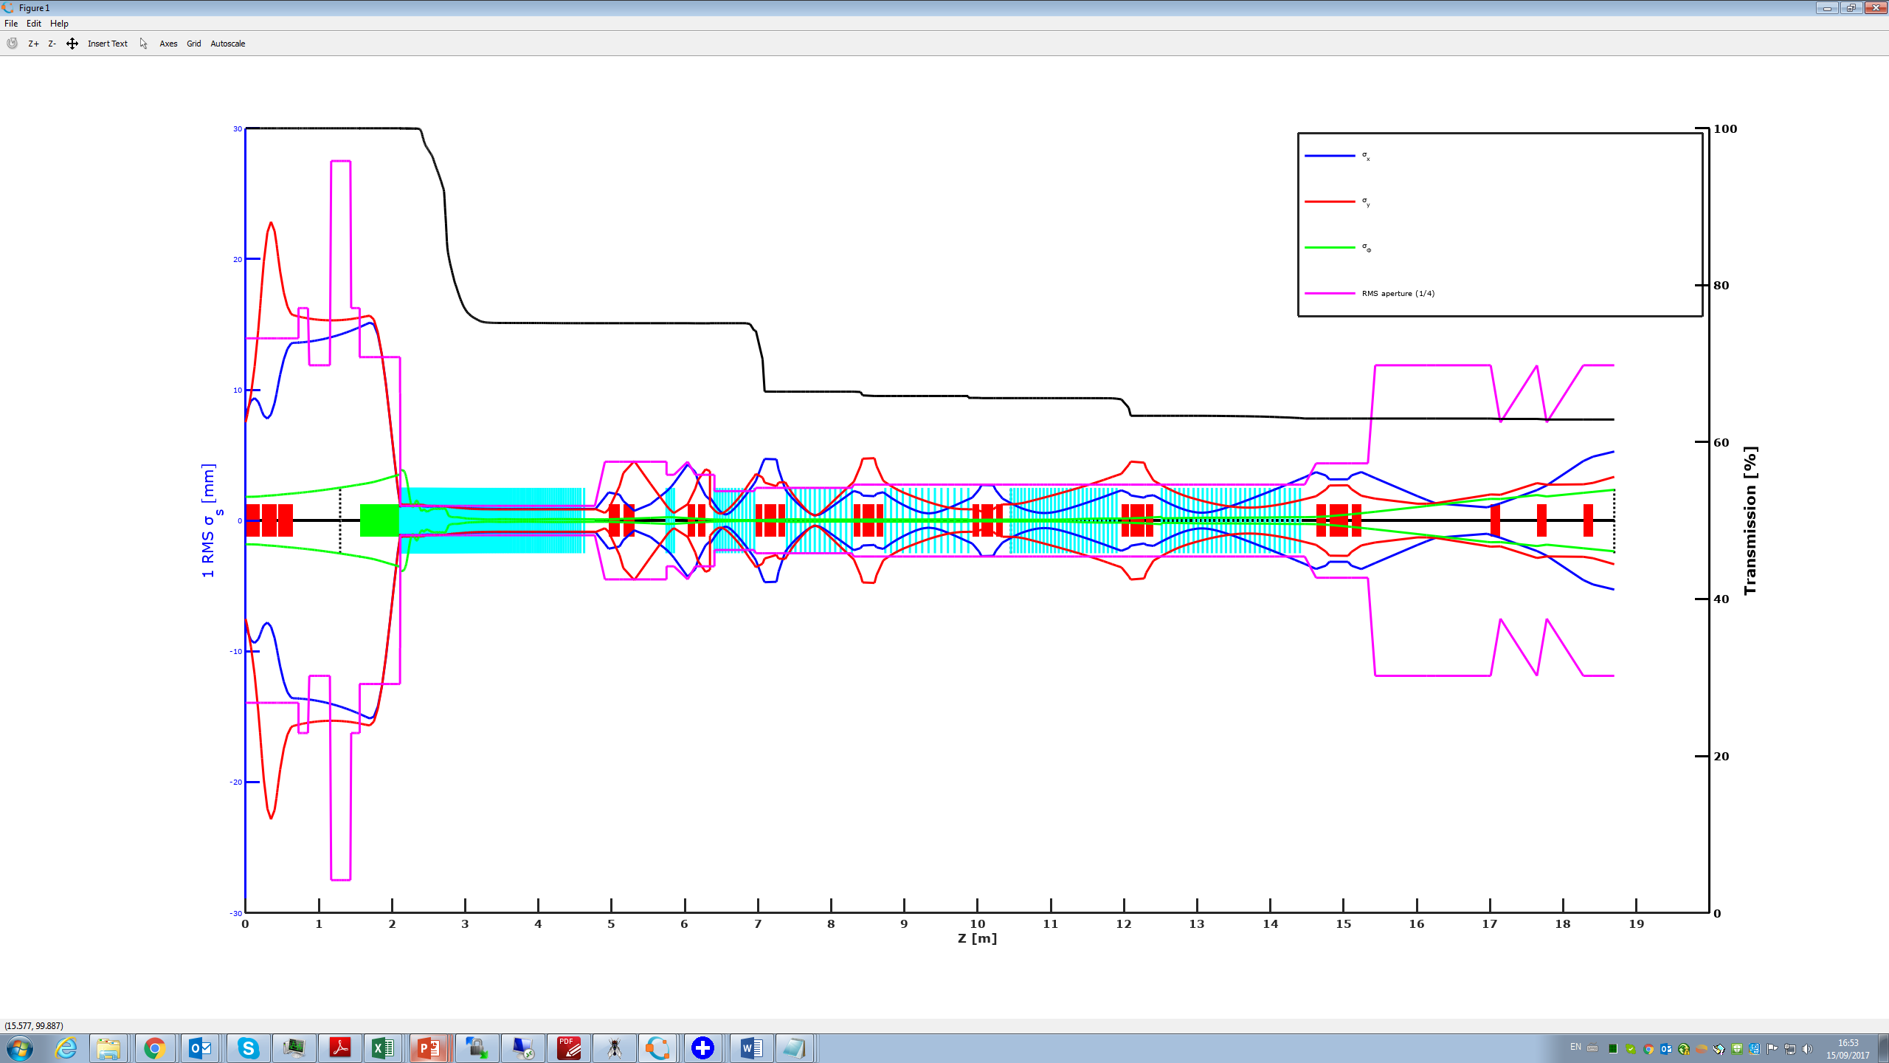
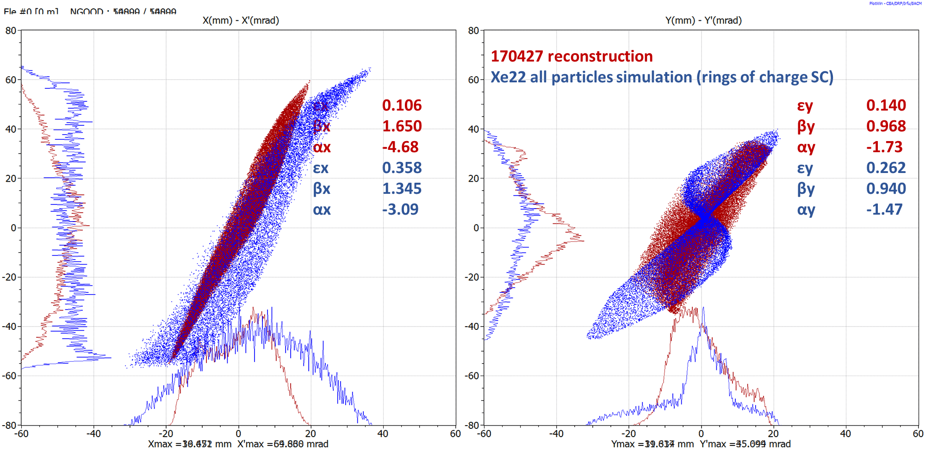
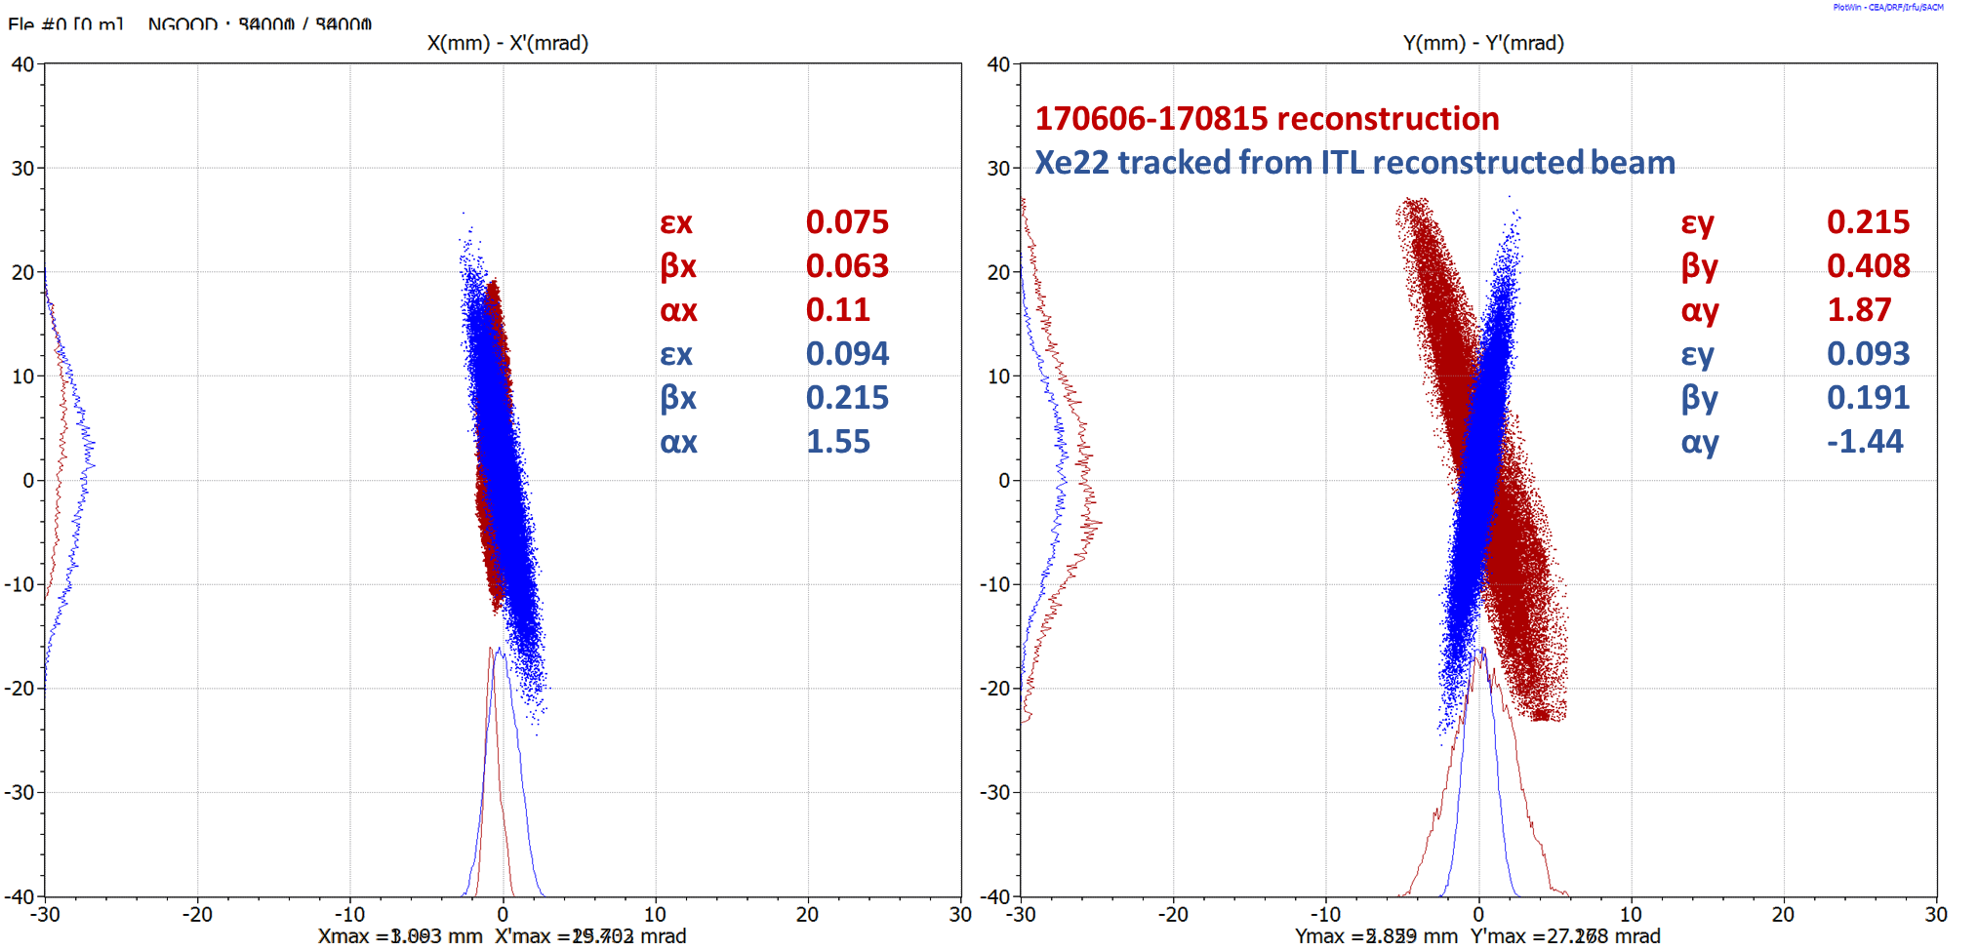
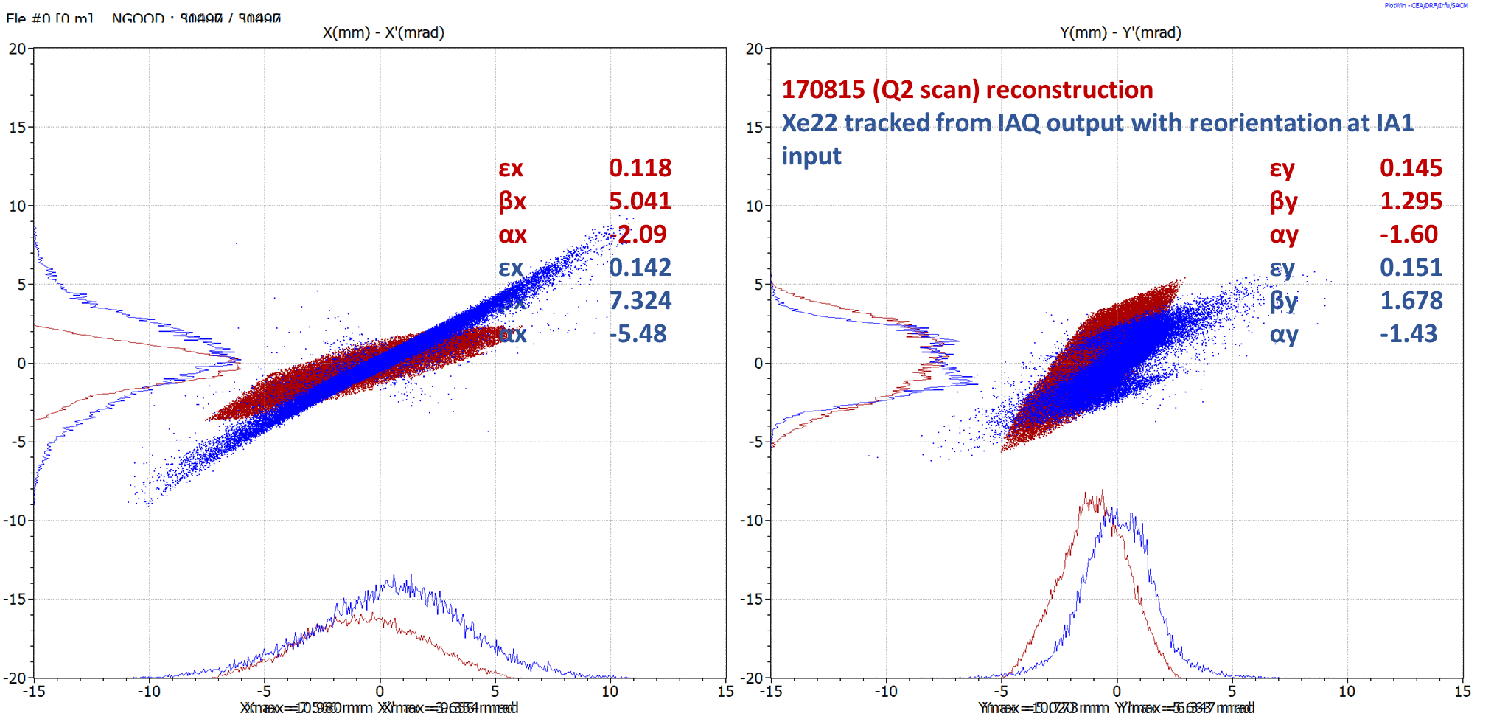
Linac3 BD studies
Emittance reconstruction and envelope tracking in LINAC3
S. Benedetti

Slide 17
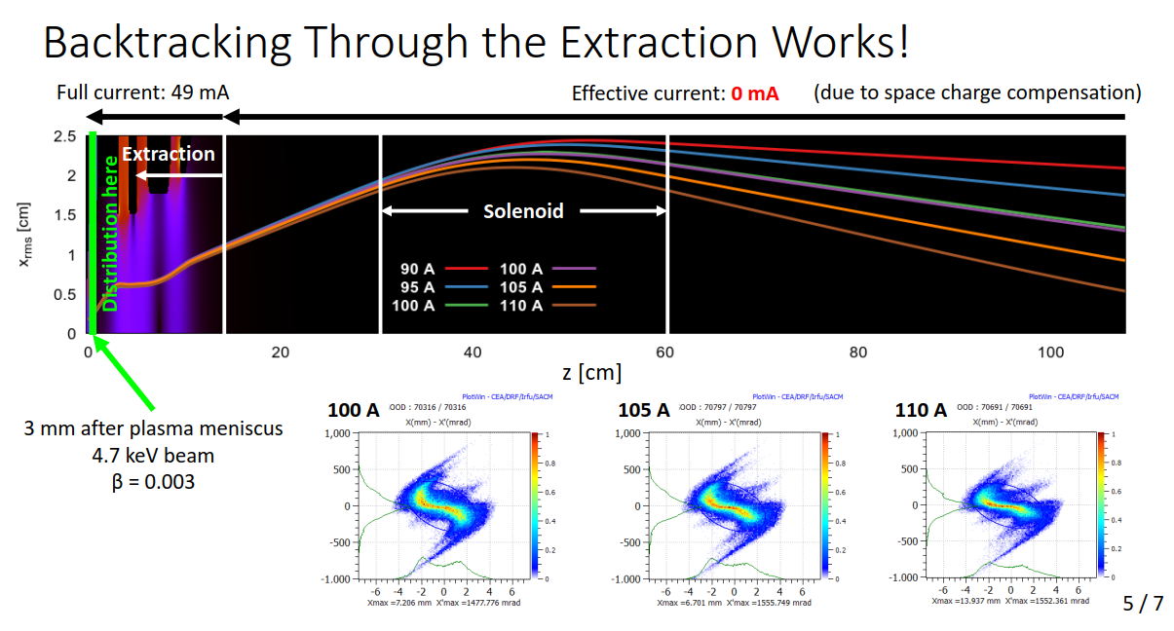
Back-tracing : slide from the information meeting

Slide 18
Example for time of calculations – LINAC4
End-to-end : 24 minutes with 50k particles, 1mm step size for the first 10meters and 1 cm step size for the rest (70m), output only at diagnostics elements and end of structures (14 +4)
Typical error studies involves 1000-5000 runs
Number of particles : limit on losses is 1W/m , at PSB duty cycle the beam power is 2.5 kW , so 100k particle is adequate. For higher rep rate and energy (e.g. SPL) 1M particles is necessary

Slide 19
Impact of the tool
Design stage :
  Verify the solidity of a design –
  find weak spots and bottlenecks
  Define the manufacturing / alignment / field tolerance
  Define the corrector strategy
Construction/installation stage :
  Interface with manufacturing for error budget and acceptance tests
  Optimise the installation and give direction on aligb=nment /realignment necessity
Commissioning:
  Backbone tool
  Complements information from the diagnostics
  Identify problems (e.g. quad inversion in linac4)
Operation :
  Crucial for MDs and for explaining empirical observation
  Post mortem

Slide 20
Points to be addressed (I)
Description of the physics and the modeling of the code
  What effects are included and what are not?
  What is the impact of the simulation tool for CERN studies?
Code implementation
  Programming language(s)
  Programming style (object oriented, procedural, …)
  Prerequisites to run the code (OS, compilers, libraries, other codes)
  Parallelisation technology (if any)
Example of typical application (use case)
  How many simulations for one study
  Where the code is run (lxplus, lxbatch, other clusters)
  Computing time

Slide 21
Code implementation
  Programming language(s) : fortran for the standalone code + Visual basic for the GUI
  Programming style (object oriented, procedural, …) : random!
  Prerequisites to run the code (OS, compilers, libraries, other codes) : Lahey fortran (commercial product)
  Parallelisation technology (if any) : attempted with a project with Canadian university, didn’t go that far

Slide 22
Points to be addressed (II)
The performance is adequate to the present needs in HSL , but a modernization of the codes would speed up and make it more user friendly.
Some documentation available. We have several users around the world (Mexican university, India, ESS Sweden and Bilbao, ADAM +…most of them had contact with us before and used the code with us)
Licensing policy : not open source, we give for free the executable to anyone asking (differently from the equivalent CEA codes)
Future plans and needs
  Minimum maintenance due to lack of manpower
  Ideally 0.5 FTE should be devoted to programming and maintenance and testing

Slide 23
Concluding words
PATH is a very powerful code for linear accelerators and transfer line.
An equivalent code is licenced at a price
The code is key for the activities of HSL
It could be used “as is” for transfer lines and other linear accelerators
A minimum maintenance is guaranteed by HSL but this is not sufficient

