Slide 1
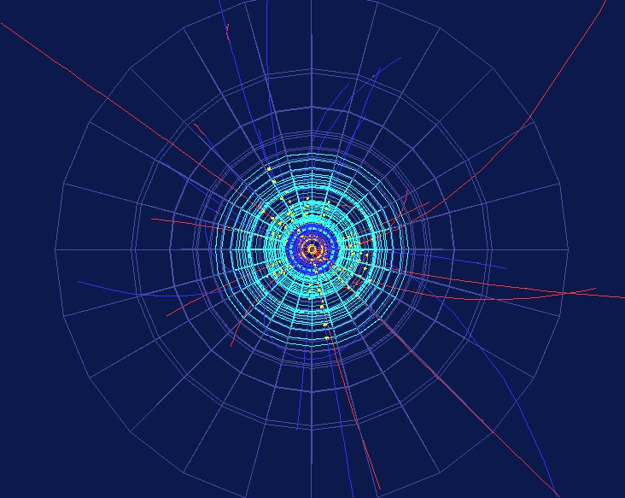

The Basics of Particle Detection
Christian Joram / CERN

Slide 2
Outline
Lecture 1 – Interaction of charged particles
  Introduction - Some historical examples
  Units, concept of cross-section, some numbers
  Particles and interactions
  Scattering, multiple scattering of charged particles
  Energy loss by ionization, Bethe-Bloch, Landau
  Cherenkov and Transition Radiation
Lecture 2 – Gaseous and solid state tracking detectors
Lecture 3 – Calorimetry, scintillation and photodetection

Slide 3
Literature
Text books (a selection)
  C. Grupen, B. Shwartz, Particle Detectors, 2nd ed., Cambridge University Press, 2008
  G. Knoll, Radiation Detection and Measurement, 3rd ed. Wiley, 2000
  W. R. Leo, Techniques for Nuclear and Particle Physics Experiments, Springer, 1994
  R.S. Gilmore, Single particle detection and measurement, Taylor&Francis, 1992
  K. Kleinknecht, Detectors for particle radiation , 2nd edition, Cambridge Univ. Press, 1998
  W. Blum, W. Riegler, L. Rolandi, Particle Detection with Drift Chambers, Springer, 2008
  R. Wigmans, Calorimetry, Oxford Science Publications, 2000
  G. Lutz, Semiconductor Radiation Detectors, Springer, 1999
Review Articles
  Experimental techniques in high energy physics, T. Ferbel (editor), World Scientific, 1991.
  Instrumentation in High Energy Physics, F. Sauli (editor), World Scientific, 1992.
  Many excellent articles can be found in Ann. Rev. Nucl. Part. Sci.
Other sources
  Particle Data Book, Chin. Phys. C, 40, 100001 (2016) http://pdg.lbl.gov/pdg.html
  R. Bock, A. Vasilescu, Particle Data Briefbook http://www.cern.ch/Physics/ParticleDetector/BriefBook/ (not updated since 1999)
  Proceedings of detector conferences (Vienna VCI, TIPP, Elba, IEEE, Como, NDIP)
  Journals: Nucl. Instr. Meth. A, Journal of Instrumentation

Slide 4
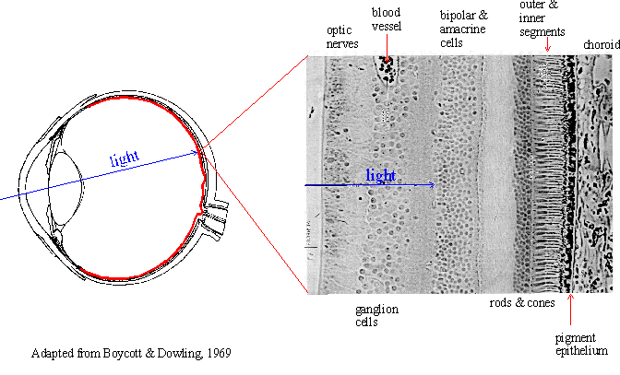
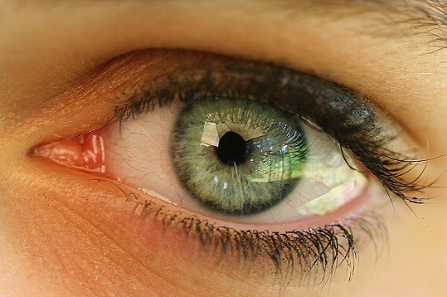
Historical examples
“The oldest particle (photon) detector”
(built many billion times)
Good spatial resolution
Very large dynamic range (1:10⁶)
+ automatic threshold adaptation
Energy (wavelength) discrimination
Modest sensitivity: 500 to 900 photons must arrive at the eye every second for our brain to register a conscious signal
Modest speed.
Data taking rate ~ 10Hz (incl. processing)
retina

Slide 5
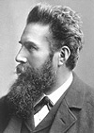
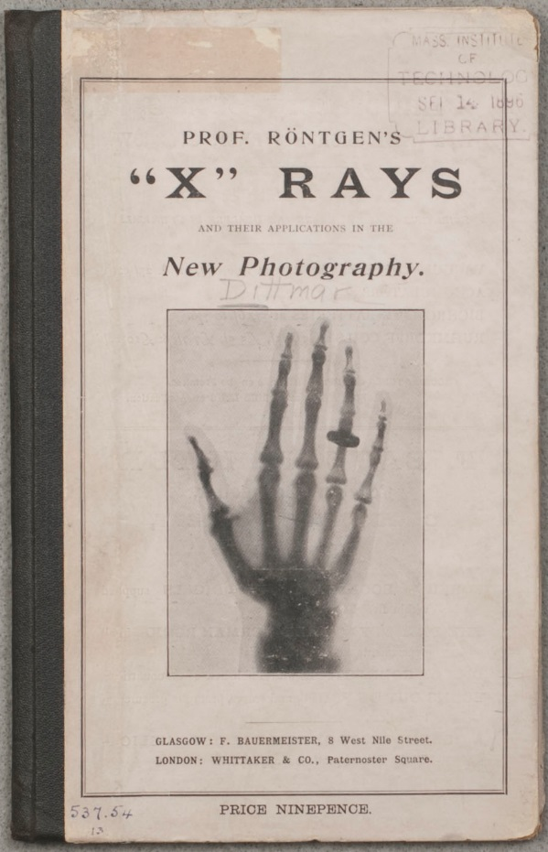
Historical examples
Use of photographic paper as detector
→ Detection of photons / x-rays
W. C. Röntgen, 1895: Discovery of the ‘X-Strahlen’
Photographic paper/film
e.g. AgBr / AgCl
AgBr + ‘energy’
→ metallic Ag (blackening)
+ Very good spatial resolution
+ Good dynamic range
- No online recording
- No time resolution

Slide 6
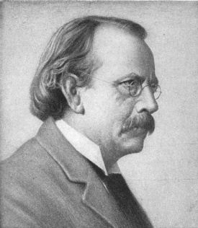
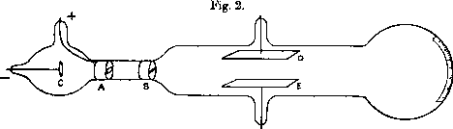
Historical examples
cathode ray tube
J. Plücker 1858 → J.J. Thomson 1897
Scintillation of glass
accelerator
manipulation
By E or B field
detector
From: J.J. Thomson: Cathode Rays.
Philosophical Magazine, 44, 293 (1897).
“… The rays from the cathode C pass through a slit in the anode A, which is a metal plug fitting tightly into the tube and connected with the earth; after passing through a second slit in another earth-connected metal plug B, they travel between two parallel aluminium plates about 5 cm long by 2 broad and at a distance of 1.5 cm apart; they then fall on the end of the tube and produce a narrow well-defined phosphorescent patch. A scale pasted on the outside of the tube serves to measure the deflexion of this patch….”

Slide 7
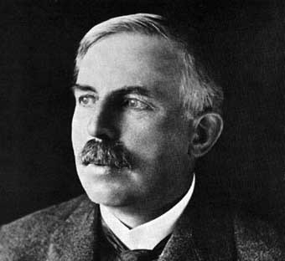
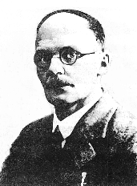
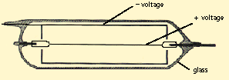
Historical examples
E. Rutherford
H. Geiger
1909
The Geiger counter, later (1928) further developed and then called
Geiger-Müller counter
pulse
First electrical signal from a particle

Slide 8
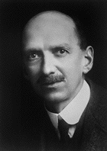
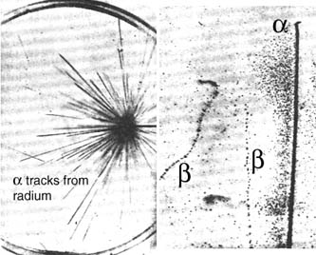
1912, Cloud chamber
First tracking
detector
C. T. R. Wilson
The general procedure was to allow water to evaporate in an enclosed container to the point of saturation and then lower the pressure, producing a super-saturated volume of air. Then the passage of a charged particle would condense the vapor into tiny droplets, producing a visible trail marking the particle's path.

Slide 9
Detection of particles (and photons) requires an interaction with matter.
The interaction leads to ionisation or excitation of matter.
Most detection interactions are of electromagnetic nature.
In the beginning there were slow “photographic” detectors or fast counting detectors.
New principles, electronics and computers allow us to build fast “photographic” detectors.

Slide 10

Some important definitions and units
energy E: measure in eV
momentum p: measure in eV/c
mass m_{o}: measure in eV/c²
1 eV is a tiny portion of energy. 1 eV = 1.6·10⁻¹⁹ J
m_{bee} = 1g = 5.8·10³² eV/c²
v_{bee}= 1m/s → E_{bee} = 10⁻³ J = 6.25·10¹⁵ eV
E_{LHC} = 14·10¹² eV
To rehabilitate LHC…
Total stored beam energy: E_{total} = 10¹⁴ protons · 7·10¹² eV ≈ 7·10²⁶ eV ≈ 1·10⁸ J
this corresponds to a
Stored energy in LHC magnets ~ 1 GJ
m_{truck} = 100 T
v_{truck} = 120 km/h
m₇₄₇ = 400 T
v₇₄₇ = 255 km/h

Slide 11
The concept of cross sections
Cross sections σ or differential cross sections dσ/dΩ are used to express the probability of interactions between elementary particles.
Example: 2 colliding particle beams
beam spot area A
What is the interaction rate R_{int.} ?
Φ₁ = N₁/t
Φ₂ = N₂/t
σ has dimension area !
Practical unit:
1 barn (b) = 10⁻²⁴ cm² = 10⁻²⁸ m²
R_{int} ∝ Ν₁Ν₂ / (Α · t) = σ · L
Luminosity L [cm⁻² s⁻¹]
Example: Scattering from target
scattered beam
solid angle element dΩ
target
N_{scat}(θ) ∝ N_{inc}· n_{A} · dΩ
= dσ/dΩ (θ) · N_{inc}·n_{A}· dΩ
θ
incident beam
.n_{A} = area density of scattering
centres in target
N_{A} = Avogadro’s number
A = mass number
d

Slide 12
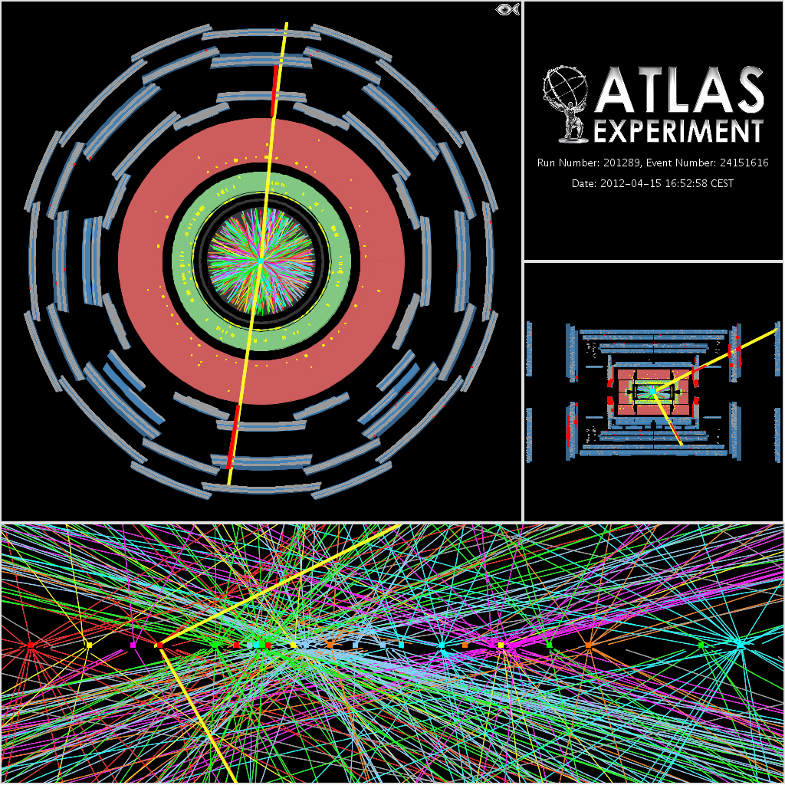
A real event in ATLAS
pp → x+Z → 2μ + lots of ‘background’
pp collision at √s = 14 TeV,
σ_{total} ≈ 100 mb ~ 10⁻²⁵ cm² = 10⁻²⁹ m²
Reminder: r_{p,charge} ~ 0.85 fm
Geometrical cross-section:
A = πr² = 7·10⁻²⁹ m²
We are however interested in processes with σ ≈ 10−100 fb (Higgs production, new physics).
We need an accelerator with very high luminosity
L_{LHC} ~ 5·10³³ cm⁻² s⁻¹,
R = L· σ_{total} = 5·10^{33 ·}10⁻²⁵ s⁻¹ = 5·10⁸ s⁻¹
×10⁻¹²
LHC bunch spacing = 50(25) ns
➔ 1 s = 20·10⁶ bunch crossings (BC)
➔ In every BC we have on average 5·10⁸/20·10⁶ = 25 overlapping pp events !

Slide 13
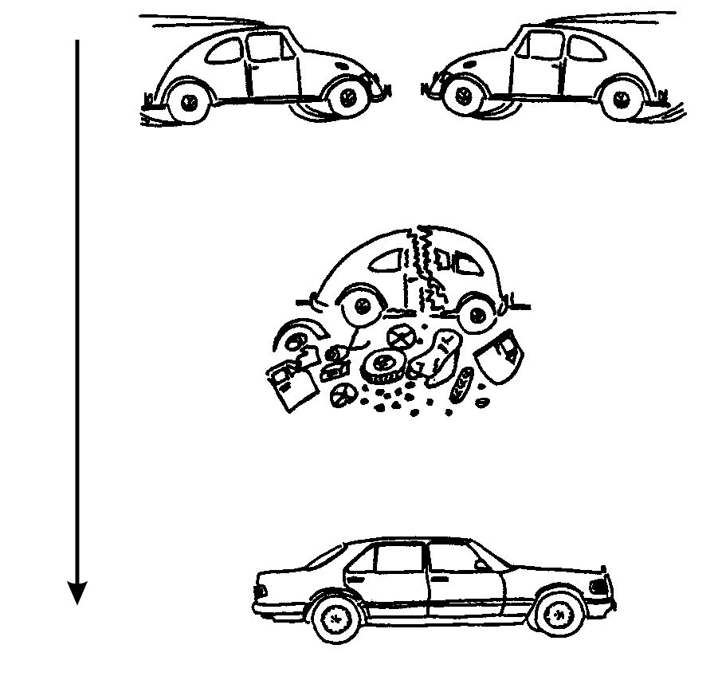
Introduction
Higgs production (in the macroscopic world)
Cartoon by Claus Grupen, University of Siegen
time
a rather rare event!

Slide 14
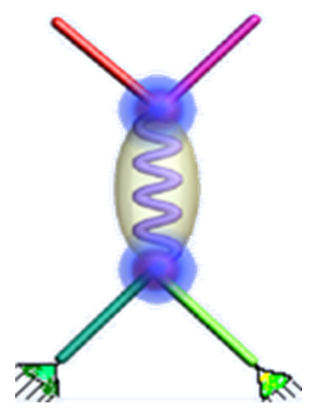
Introduction
Idealistic views of an
elementary particle reaction
e⁺
e⁻
Z
-
q
q
time
Usually we can not ‘see’ the reaction itself, but only the end products of the reaction.
In order to reconstruct the reaction mechanism and the properties of the involved particles, we want the maximum information about the end products !

Slide 15
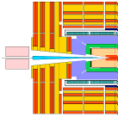
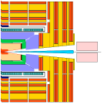
Introduction
The ‘ideal’ particle detector
should provide…
coverage of full solid angle (no cracks, fine segmentation)
detect, track and identify all particles (mass, charge)
measurement of momentum and/or energy
fast response, no dead time
But …. there are practical limitations (technology, space, budget) !
● charged particles
end products  neutral particles
● photons
Particles are detected via their interaction with matter.
Many different physical principles are involved (mainly of electromagnetic nature).
Finally we will always observe ionization and/or excitation of matter.

Slide 16
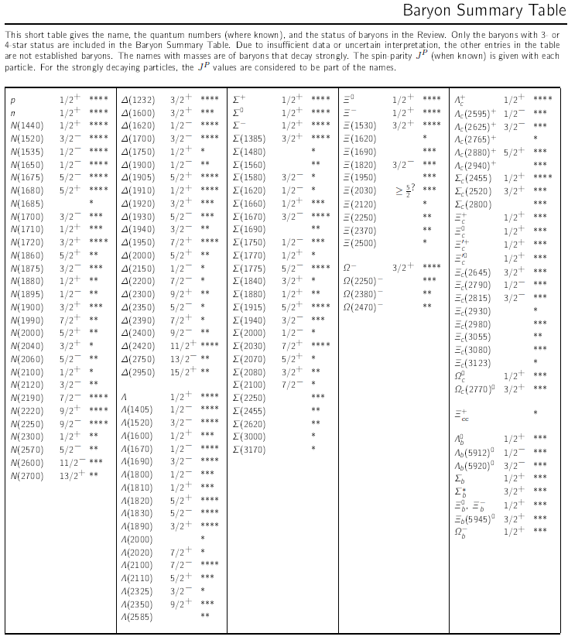
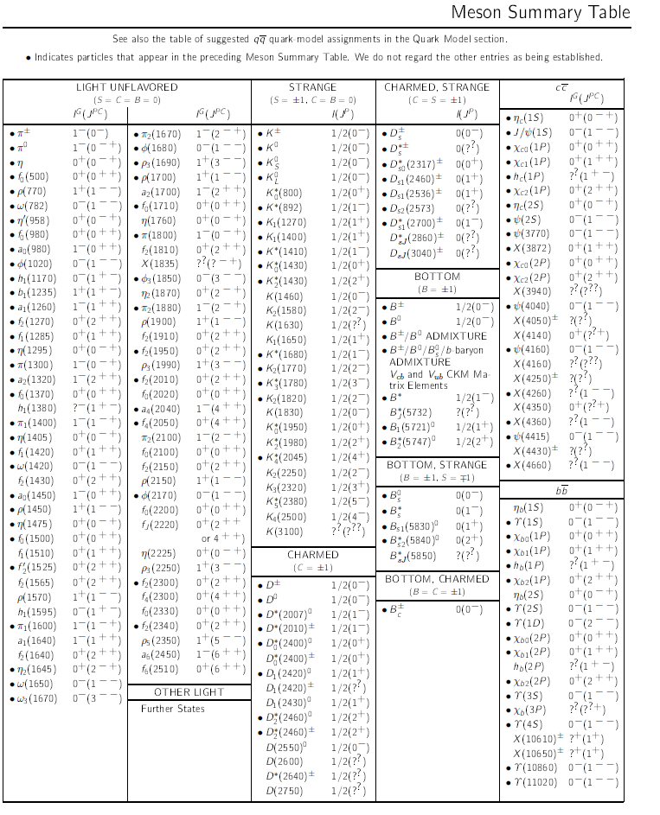
Introduction
Leptons
e
μ
τ
ν_{e}
ν_{μ}
ν_{τ}
There are hundreds of particles …
however most of them are so short-lived that we’ll never see them directly in our detectors.
Track length: l_{track} = vτ = cβγτ₀ with τ₀ being the lifetime at rest.
Only if l_{track} (at GeV scale) ≥ 1 mm, we have a chance to measure them.
Gauge bosons
γ
W^{+/−}
Z
g
Η
Which are left then? These 8 particles (and their antiparticles).
 | γ | p | n | e± | μ± | π± | K± | K₀ (K_{S}/K_{L})
τ₀ | ∞ | ∞ | ∞ | ∞ | 2.2μs | 26 ns | 12 ns | 89 ps / 51 ns
l_{track (p=1GeV)} | ∞ | ∞ | ∞ | ∞ | 6.1 km | 5.5 m | 6.4 m | 5 cm / 27.5 m

Slide 17
Interaction of charged particles
(Elastic) Scattering
An incoming particle with charge z interacts elastically
with a target of nuclear charge Z.
The cross-section for this e.m. process is
z
Rutherford formula
Approximation
  Non-relativistic
  No spins
Average scattering angle
Cross-section for infinite !
Scattering does not lead to significant energy loss (nuclei are heavy!)

Slide 18
Interaction of charged particles
In a sufficiently thick material layer a particle will undergo …
Multiple Scattering
The final displacement and direction are the result of many independent random scatterings
→ Central limit theorem
→ Gaussian distribution
Rutherford tails
θ₀
θ₀
Approximation
X₀ is radiation length of the medium (discuss later)
p
L

Slide 19
Interaction of charged particles
Detection of charged particles
Particles can only be detected if they deposit energy in matter.
How do they lose energy in matter ?
Discrete collisions with the atomic electrons of the absorber material.
Collisions with nuclei not important for energy loss (m_{N} >> m_{e})
If are in the right range ⇨ ionization.
e
W.W.M. Allison, J.H. Cobb,
Ann. Rev. Nucl. Part. Sci. 1980. 30: 253-98
-

Slide 20
Interaction of charged particles
Optical behaviour of medium is characterized by the complex dielectric constant ε
Refractive index
Absorption parameter
Instead of ionizing an atom or exciting the matter, under certain conditions the photon can also escape from the medium.
⇨ Emission of Cherenkov and Transition radiation. (See later). This emission of real photons contributes also to the energy loss.

Slide 21
Average differential energy loss
… making Bethe-Bloch plausible.
Interaction of charged particles
Energy loss at a single encounter with an electron
e⁻
b
v
z·e
2b
Introduced classical electron radius
How many encounters are there ?
Should be proportional to electron density in medium
The real Bethe-Bloch formula.

Slide 22
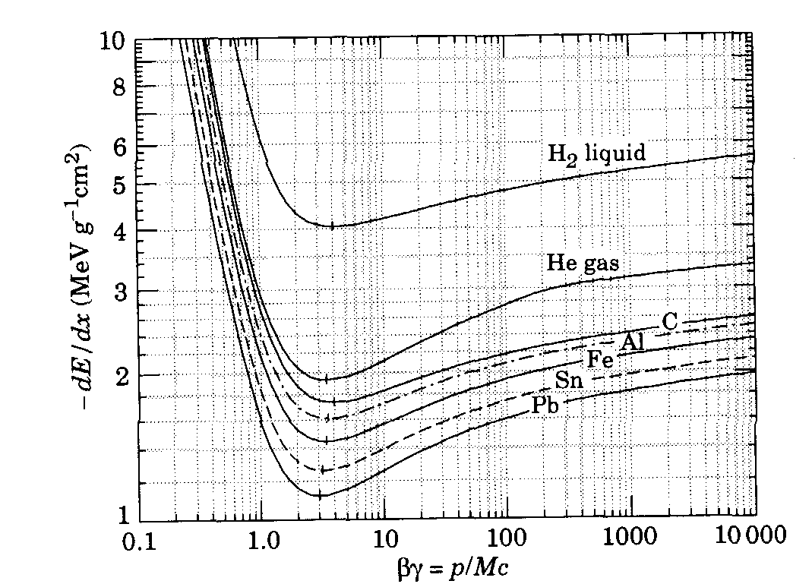
Interaction of charged particles
Energy loss by Ionisation only → Bethe - Bloch formula
dE/dx in [MeV g⁻¹ cm²]
Strictly valid for “heavy” particles (m≥m_{μ}) only.
For electrons, use Berger Seltzer formula
dE/dx depends only on β, independent of m !
First approximation: medium simply characterized by Z/A ~ electron density
Z/A = 1
“Fermi plateau”
Z/A~0.5
“relativistic rise”
βγ ≈ 3-4
minimum ionizing particles, MIPs
“kinematical term”
Useful link: http://www.nist.gov/pml/data/star/

Slide 23
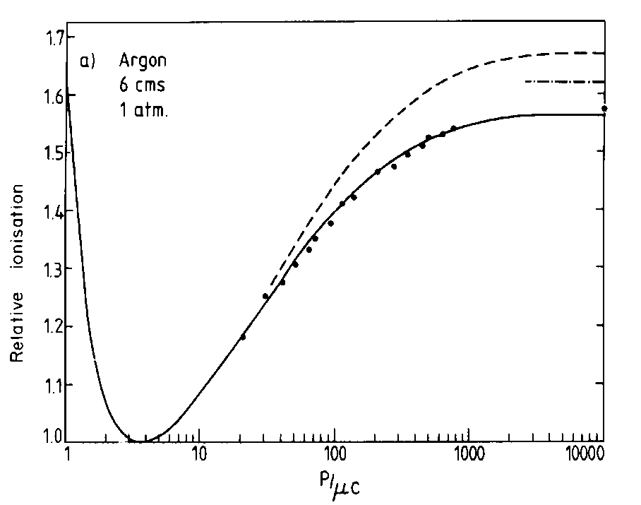
Interaction of charged particles
Bethe - Bloch formula cont’d
relativistic rise - ln γ² term - attributed to relativistic expansion of transverse E-field → contributions from more distant collisions.
relativistic rise cancelled at high γ by “density effect”, polarization of medium screens more distant atoms. Parameterized by δ (material dependent) → Fermi plateau
Formula takes into account energy transfers
I: mean ionization potential, measured (fitted) for each element.
solid line: Allison and Cobb, 1980
dashed line: Sternheimer (1954)
data from 1978 (Lehraus et al.)
Measured and calculated dE/dx

Slide 24
Interaction of charged particles
Real detector (limited granularity) can not measure <dE/dx> !
It measures the energy ΔE deposited in a layer of finite thickness δx.
For thin layers or low density materials:
→ Few collisions, some with high energy transfer.
→ Energy loss distributions show large
fluctuations towards high losses: ”Landau tails”
ΔE_{most probable} <ΔE>
e⁻
δ electron
ΔE
Example: Si sensor: 300 μm thick. ΔE_{most probable} ~ 82 keV <ΔE> ~ 115 keV
ΔE_{m.p.} ≈ <ΔE>
For thick layers and high density materials:
→ Many collisions.
→ Central Limit Theorem → Gaussian shaped distributions.
e⁻
ΔE

Slide 25
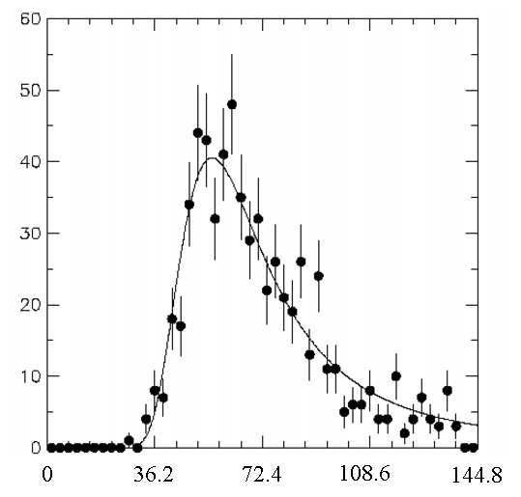
Interaction of charged particles
“Theory”
300 μm Si
ΔE_{m.p.} ~ 82 keV
<ΔE> ~ 115 keV
charge collection is not 100%
ξ = 26 keV
L. Alexander et al., CLEO III test beam results
300 μm Si
Includes a Gaussian electronics noise contribution of 2.3 keV
Landau’s theory J. Phys (USSR) 8, 201 (1944)
ΔE_{m.p.} ~ 56.5 keV
x (300 μm Si) = 69 mg/cm²
energy loss (keV)

Slide 26
… more interactions of charged particles
In addition to ionisation there are other ways of energy loss !
A photon in a medium has to follow the dispersion relation
θ
e
Assuming soft collisions + energy and momentum conservation
-
→ emission of real photons:
schematically !
Emission of photons if
A particle emits real photons in a dielectric medium if its speed v = β⋅c
is greater than the speed of light in the medium c/n

Slide 27
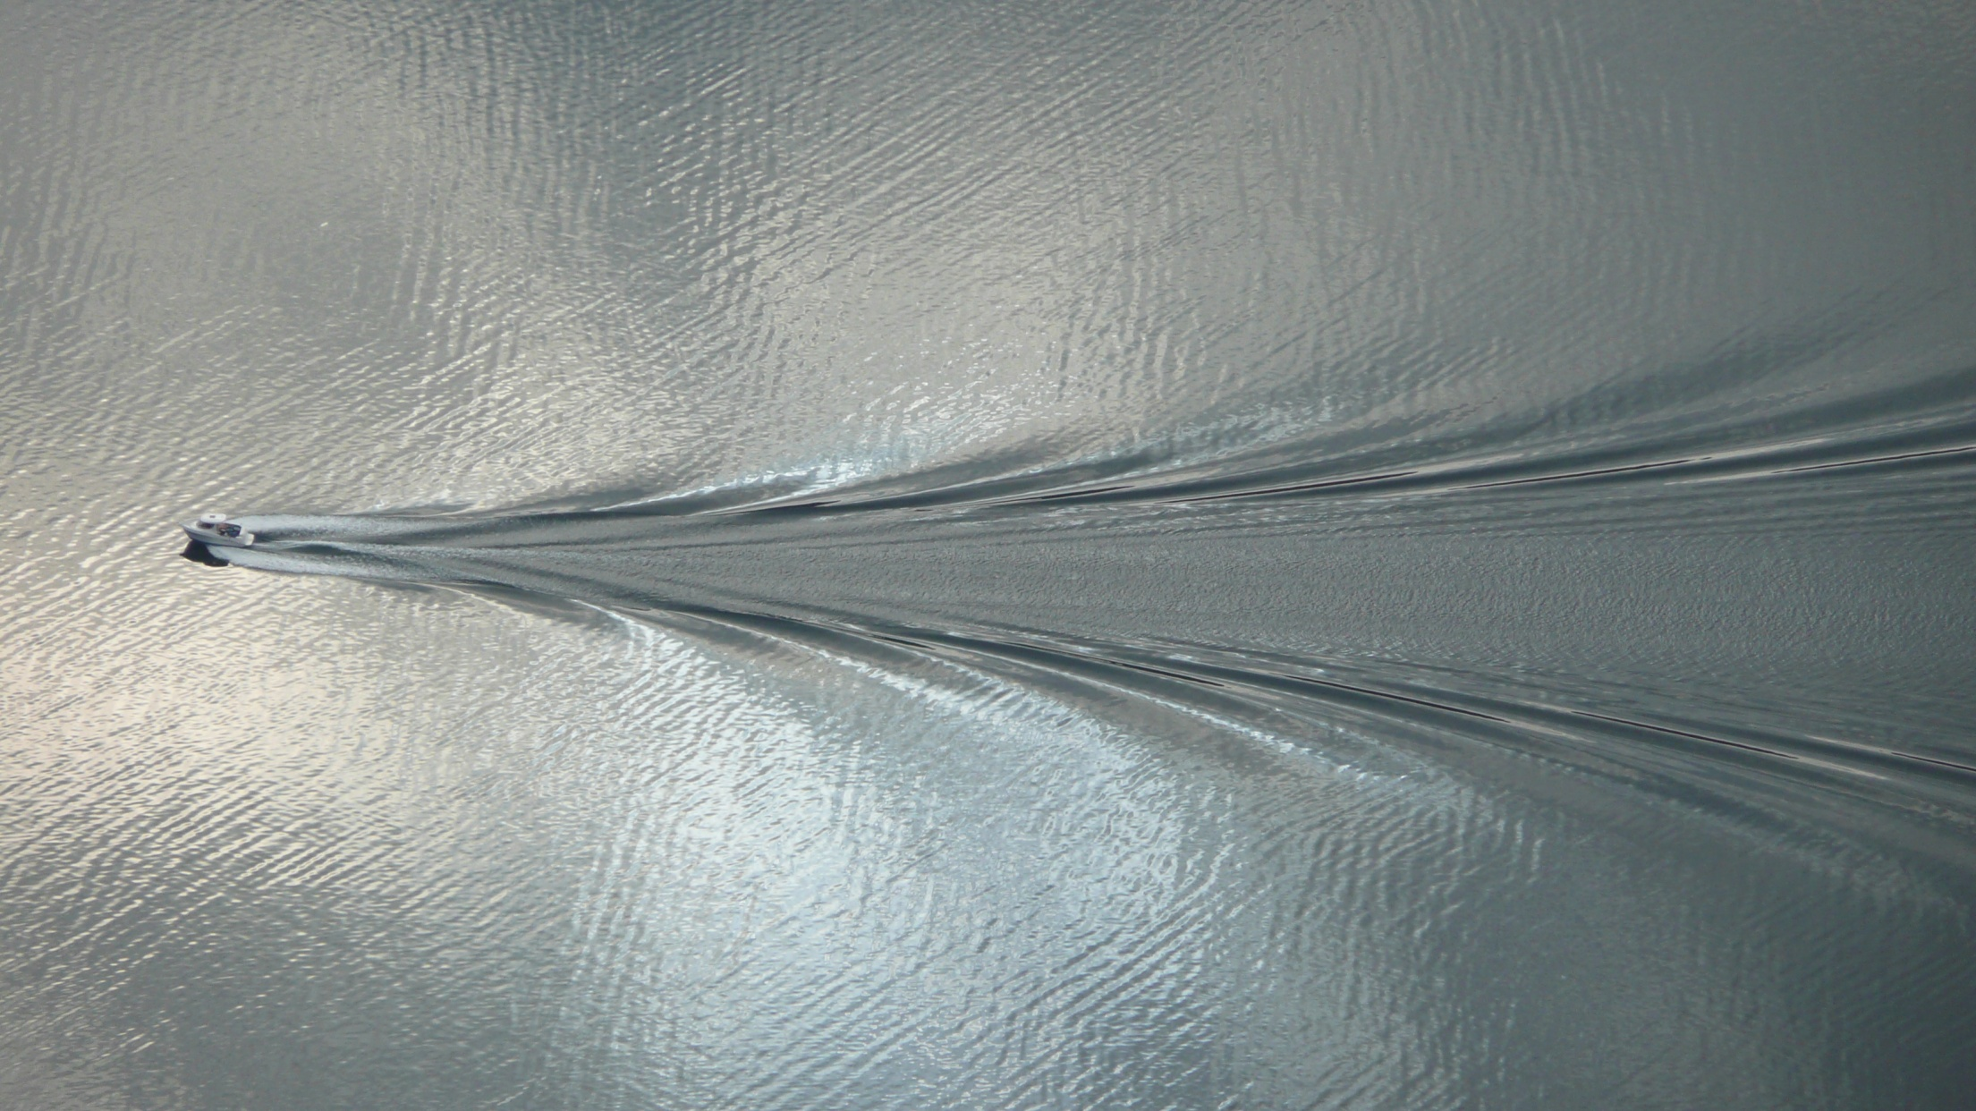
Cherenkov Radiation
A charged particle, moving though a medium at a speed which is greater than the speed of light in the medium, produces Cherenkov light.
Classical analogue: fast boat on water

Slide 28
Propagating waves
A stationary boat bobbing up and down on a lake, producing waves

Slide 29
Now the boat starts to move, but slower than the waves
No coherent wavefront is formed

Slide 30
Next the boat moves faster than the waves
A coherent wavefront is formed

Slide 31
Finally the boat moves even faster
θ
The angle of the coherent wavefront changes with the speed
cos θ = v_{wave} / v_{boat}

Slide 32
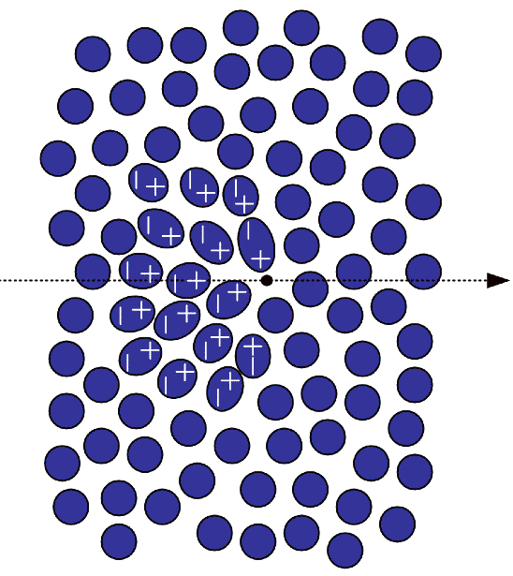
… back to Cherenkov radiation
The dielectric medium is polarized by the passing particle.
A coherent wave front forms if
“the radiator”
(n = refr. index)
v_{wave} = c/n
d·tanθ
d
θ_{C}
Cherenkov
cone
v_{particle} = βc
radiator of
limited thickness
Cherenkov
threshold
‘saturated’ angle (β=1)

Slide 33

Number of emitted photons per unit length and unit wavelength/energy interval
dN/dλ
UV cut-off
λ
dN/dΕ
Ε
0
UV cut-off
Cherenkov effect is a weak light source. There are only few photons produced.

Slide 34
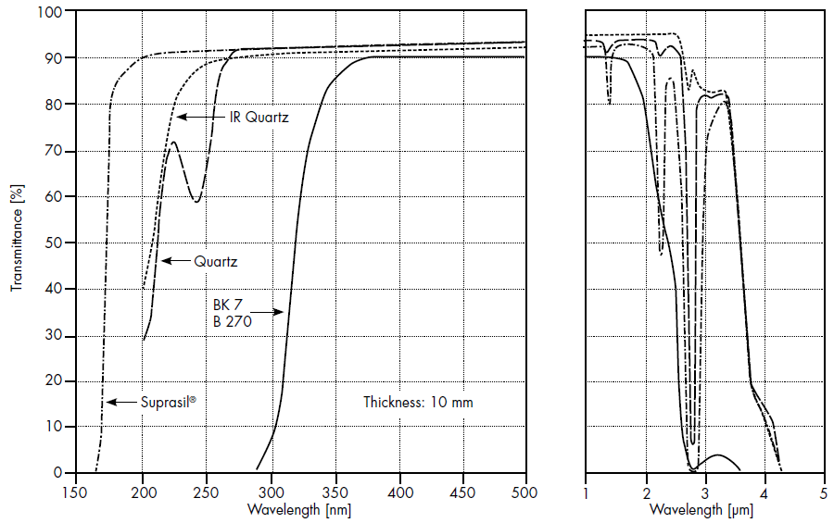
Cherenkov radiation
Estimate the energy loss by Cherenkov radiation in quartz
n_{quartz} ≈ 1.46
→ sin²θ = 1 - cos²θ = 1 - 1/n²= 0.53
λ_{min} = 160 nm → E_{max} ≈ 1234 / λ ≈ 7.7 eV
λ_{max} ≈ 3 μm = 3000 nm → E_{min} ≈ 0
ΔE = 7.7 eV
<E_{γ}> = ΔE/2 = 3.85 eV
Cherenkov effect is a weak but very useful light source.

Slide 35
Transition Radiation
TR is also called sub-threshold Cherenkov radiation
Transition Radiation was predicted by Ginzburg and Franck in 1946
Relativistic theory: G. Garibian, Sov. Phys. JETP63 (1958) 1079
TR is electromagnetic radiation emitted when a charged particle traverses a medium with a discontinuous refractive index, e.g. the boundaries between vacuum and a dielectric layer.
medium
vacuum
ε <1 !
A (too) simple picture
dipole
electron
Medium gets polarized. Electron density displaced from its equilibrium
→ Dipole, varying in time → radiation of energy.
Radiated energy per medium/vacuum boundary:

Slide 36
Transition Radiation
Radiated energy per medium/vacuum boundary:
only high energetic e± emit TR of detectable intensity.
→ particle ID
Lorentz transformation makes the dipole radiation extremely forward peaked → TR photons stay close to particle track
medium
vacuum
e±
Typical photon energy:
e± at E = 10 GeV; → γ ~ 2·10⁴
E_{γ} ~ 0.25 · 20 eV · 2·10⁴ ~ 10 keV → X-rays
Photons / boundary:
(TR detectors have many boundaries!)
Energy loss by TR

Slide 37
Detector resolution – some general observations
Energy deposition in detectors happens in small discrete and independent steps.
Even in the case of a well defined and constant amount of energy deposited in a detector , the achievable resolution in terms of energy, spatial coordinates or time is constrained by the statistical fluctuations in the number of charge carriers (electron-hole pairs, electron-ion pairs, scintillation photons) produced in the detector.
In most cases, the number of charge carriers n_{c} is well described by a Poisson distribution with mean μ = <n_{c}>
μ
The variance of the Poisson distribution is equal to its mean value.
Poisson distribution
for μ = 5.0
standard deviation
n_{c}

Slide 38
Detector resolution
For large μ values, (e.g. μ > 10) the Poisson distribution becomes reasonably well approximated by the symmetric and continuous Gauss distribution.
μ
σ
FWHM
Often used to characterize detector resolution: FWHM
n_{c}
The energy resolution of many detectors is found to scale like
Often, also time and spatial resolution improve with increasing <n_{c}>

Slide 39
Energy resolution – Fano factor
Case 1: particle traversing the detector
The measured energy deposition E is derived from the number of charge carriers (e.g. e-h or e-ion pairs)
(Poisson limit)
! We ignore here many effects which, in a real detector, will degrade the resolution beyond the Poisson limit !
Δx
In particular, depending on the thickness Δx and density, there may also be strong Landau tails.

Slide 40


Energy resolution – Fano factor
Case 2: Particle stops in the detector, or (x-ray) photon is fully absorbed
→ the energy deposition in the detector is fixed (but may vary from event to event).
E_{γ}
F = Fano factor
E_{p}
Ugo Fano,
Phys. Rev. 72 (1947),
26–29
For a formal derivation: See e.g. book by C. Grupen, pages 15-18.
For a physics motivated derivation: See e.g. H. Spieler, Heidelberg Lecture notes, ch. II, p25…
(1912 - 2001)
The fluctuation in the number of produced charge carriers n_{c} is constrained by energy conservation. The discrete steps are no longer fully independent. Their fluctuation can be smaller than the Poisson limit, i.e. F < 1.
F_{Si} = 0.12,
F_{diamond} = 0.08.
The detector resolution is (can be?) improved by a factor

Slide 41
Detector spatial resolution
Resolution of a discrete detector
x
0
x
w_{x}
w_{x}
Consider one strip only (for simplicity at x = x_{d} = 0):
For every recorded hit, we know that the strip at x = 0 was hit, i.e. the particle was in the interval
Assume a detector consisting of strips of width w_{x}, exposed to a beam of particles. The detector produces a (binary) signal if one of the strips was hit.
What is its resolution σ_{x} for the measurement of the x-coordinate?

Slide 42
Detector resolution
Resolution of a discrete detector (cont.)
We have tacitly assumed that the particles are uniformly distributed over the strip width.
More generally, a distribution function D(x) needs to be taken into account
D(x)
D(x)
1
1
-w_{x}/2
w_{x}/2
x
-w_{x}/2
w_{x}/2
x

Slide 43
Detector spatial resolution
Q = 0 20 80
Resolution of an analog detector
x
0
1
2
x / p_{x}
Centroid calculation
p_{x}
Assume a detector where the charge distribution is larger than its pitch p_{x}. Every hit cell produces an (analog) signal corresponding to the deposited charge.
What is its resolution σ_{x} for the measurement of the x-coordinate?
(Equivalent noise charge)
Depending on charge and noise, the resolution can be much better than in the discrete case.

Slide 44

Acknowledgements
Most of my slides are based on material I prepared in the last two decades for other courses (CERN academic training, various schools).
Some of the courses were given together with colleagues, from whom I ‘borrowed’ plots and figures
Leszek Ropelewski, Thierry Gys, Carmelo D’Ambrosio, Arnaud Foussat, Rob Veenhof, Michael Hauschild (list is certainly not complete!)
Many plots and ideas come from the excellent text books listed on the previous slide.
Lots of good material can nowadays be found by just Googling. The authors are then not always recognizable/acknowledgeable.

Slide 45
Back-up

