Slide 1

Scintillating Fibres – Tracking Particles With (a little) Light
The new Fibre Tracker for LHCb
Christian Joram
CERN, EP-DT
CBPF, Rio de Janeiro
01/09/2017

Slide 2
LHCb LS2 upgrade
What are scintillating fibres and how do they work?
How can we track particles with scintillating fibres ?
A bit of history
A few slides on Silicon Photomultipliers (SiPM)
The LHCb SciFi Tracker
What makes it difficult (and interesting)?
Outline

Slide 3
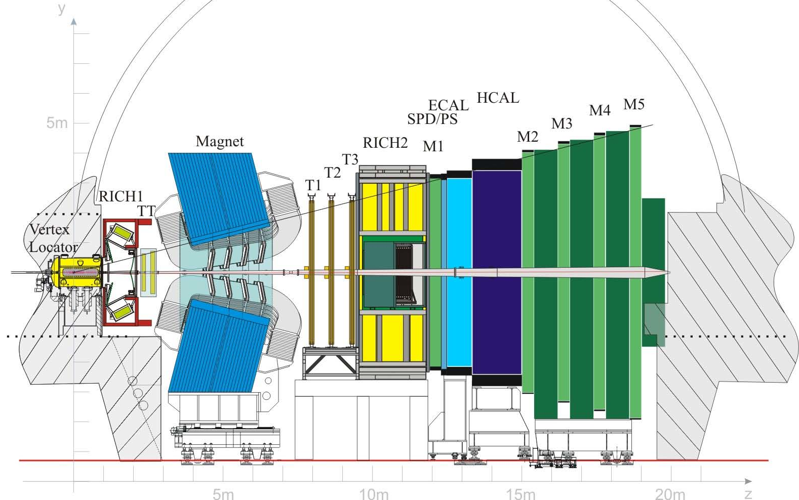
LHCb is an atypical collider experiment with classic fixed target geometry.
Its mission is to measure rare phenomena in the beauty and charm sector in particular CP violation, and to look for signs of new physics (beyond the standard model).
For this purpose it has powerful vertexing, tracking, calorimetry, particle identification
It’s in operation since 2010.
LHC pp
collision point

Slide 4
In 2019/2020 (during LHC Long Shutdown 2), LHCb will undergo a very major upgrade.
5x higher instantaneous luminosity. Aim for 50 /fb over 10 years.
Three detectors will be replaced. All other detectors obtain fast 40 MHz readout electronics.
Full software trigger for every bunch crossing.
New VELO, Si pixel based
New Upstream tracker (UT), Si-μstrip
SciFi Tracker, scintillating fibres

Slide 5
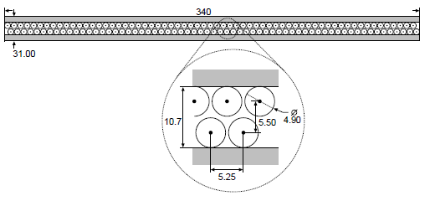
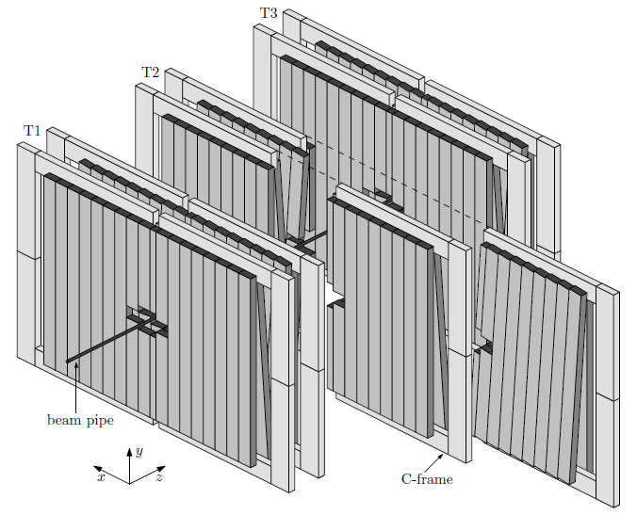

Why to replace the Outer Tracker?
OT technology: Straw tubes, i.e. cylindrical drift tubes
Ar/CO₂/O₂
Performance:
ε_{hit} = > 99%
σ_{x} = 180 μm
3% X₀ / station
Drift time ≤ 50 ns
6m
Issues when upgrading the luminosity at LHCb by a factor 5 and switching to 40 MHz readout:
drift time will spill over to next measurement
occupancy of straws will approach 100%
5m
OT

Slide 6
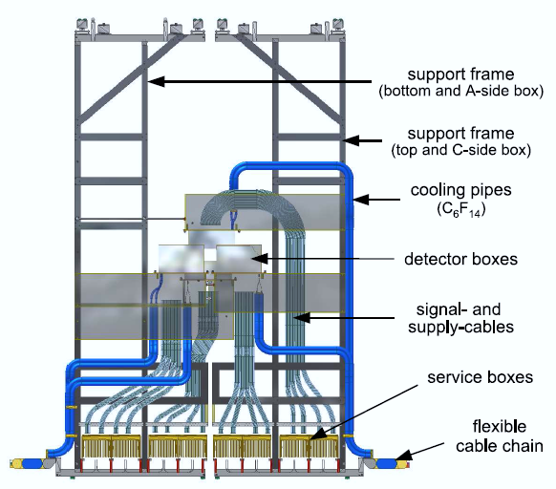
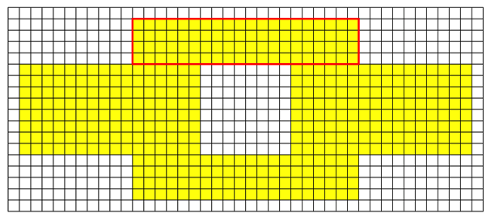
Why to replace also the Inner Tracker?
The region close to the beam pipe is complemented by the Inner Tracker (Si micro strip technology).
2% of the area
20% of the tracks
No intrinsic performance issue.
New 40 MHz readout needed
IT area would need to be enlarged
Integration of a Si tracker in the middle of another detector is a mess → up to 30% X₀ of material.
IT
0.4 m
1.08 m
→ Replace both IT and OT by a single technology

Slide 7
What are scintillating fibres and how do they work?

Slide 8
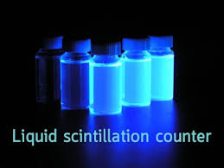
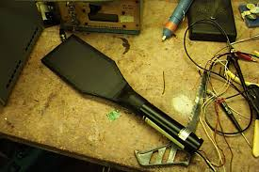
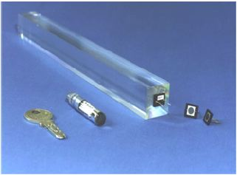
What is a scintillator ?
Energy deposition by an ionizing particle or photon (γ)
→ generation
transmission of scintillation light
detection
Light guide
particle
photodetector
scintillator

Slide 9
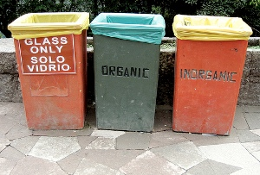
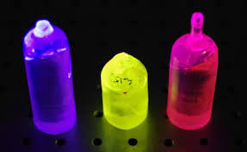
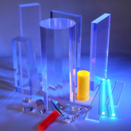
Two categories
Organic scintillators
(plastics or liquid solutions)
Polystyrene + some dopants
Little light (<10’000 photons / MeV)
Low density ρ ~ 1g/cm³
Fast (ns)
Cheap
Radiation “soft”
Can be used for fibres!
Inorganic (crystals)
More light (up to 70000 ph/MeV)
High density r ~ 5-10 g/cm³
Expensive
Don’t confuse scintillators with lead glass !
The light generation in lead glass is actually based on the Cherenkov effect. Lead glass is the poor man’s crystal. High density, but little light output.

Slide 10
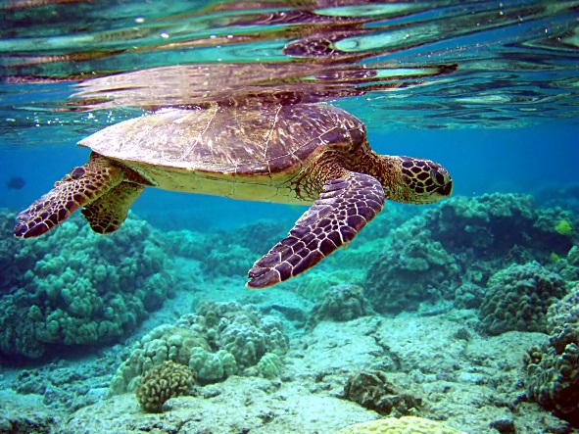
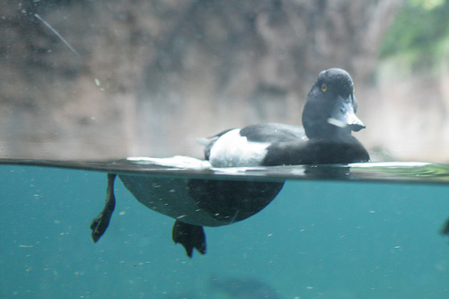
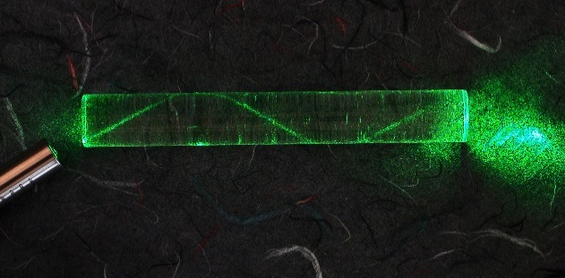
Refraction Total internal reflection
α_{out}
n_{lo}
α_{in}
n_{hi}
α_{in}
α_{out}
α_{crit =} asin(n_{lo}/n_{hi})
α_{in} > α_{crit} → α_{out} = α_{in} R = 100%
α_{crit}

Slide 11
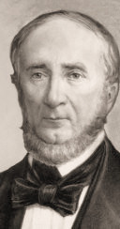
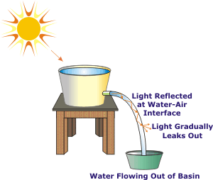
Jean-Daniel Colladon, a 38-year-old Swiss professor at University of Geneva, demonstrated (by accident) light guiding or total internal reflection for the first time in 1841.
He had actually studied law (!) and worked on speed of sound in water and water jets.

Slide 12
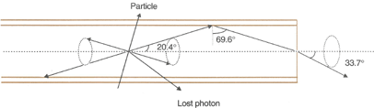

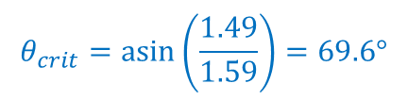

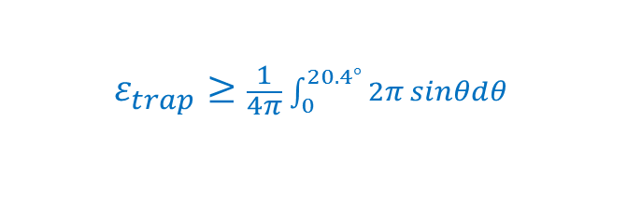
Basics of scintillating fibres
Scintillating fibre = Polystyrene (PS) core + plexiglass (PMMA) cladding
n ~ 1.59
n ~ 1.49
$$θ_{crit}=\operatorname{asin}\left(\frac{1.49}{1.59}\right)=69.6°$$
PMMA
$$ε_{trap}≥\frac{1}{4π}\int_{0}^{20.4°}{2π sinθdθ }$$
PS
$$≥3.1\%$$
(per side)
Why ≥ ?
There are also 'cladding rays' and helical paths. They usually survive only over short distances.

Slide 13
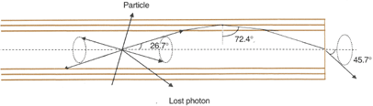
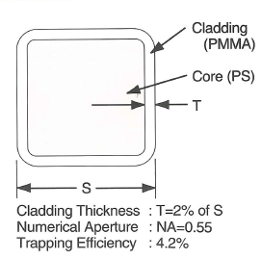
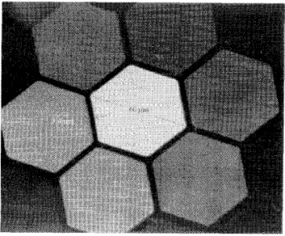
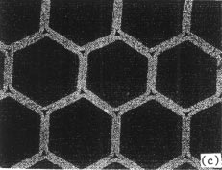
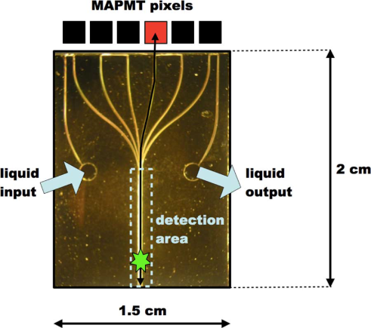

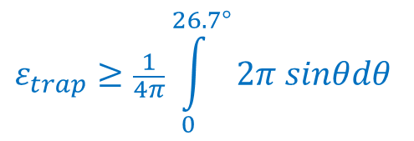
Double cladded fibres make use of an extra layer of a fluorinated polymer with lower refractive index (n = 1.42) (CERN RD7 / Kuraray 1990). This is still state-of-the art!
$$ε_{trap}≥\frac{1}{4π}\int_{0}^{26.7°}{2π sinθdθ }$$
63.3°
$$≥5.4\%$$
(per side)
Scintillating fibres exist also in other geometries and flavours
Square fibres
glass capillaries with
liquid scintillator
Micro-fluidic detector study
hexagonal fibres
60 μm
23 μm
C.D. Ambrosio et al.,
NIM A 325 (1993), 161
Annis P, et al. NIM A367
(1995) 377
A. Mapelli et al., IEEE TNS 58, NO. 3, JUNE 2011

Slide 14

Emission spectrum of Kuraray SCSF-78 fibre
(baseline for LHCb Tracker TDR)
as function of distance from excitation point
spectrometer
d
excitation
Non-irradiated
$$I=I_{0}{·e}^{−\frac{d}{Λ}}$$
Light is attenuated during propagation
Blue light is stronger absorbed than green and red
Λ(λ) attenuation length

Slide 15
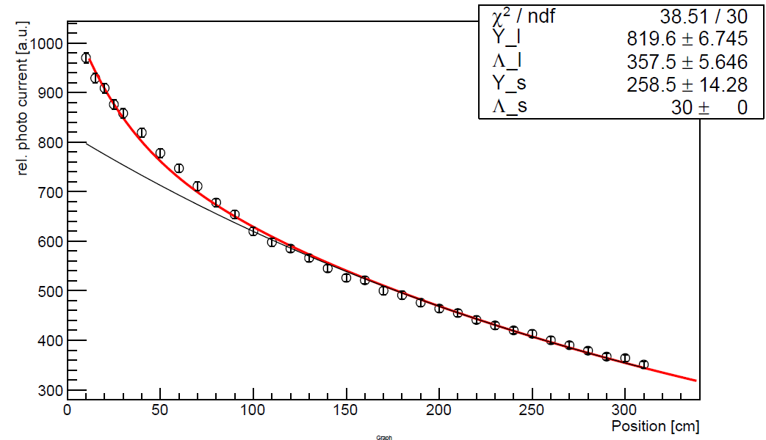

Attenuation in a 3.5 m long SCSF-78 fibre (Ø 0.25 mm) in air, averaged over emission spectrum
Short component: Λ ~ 0.3 m
helical paths, cladding light (depends on fibre environment (air, glue, …)
$$I=I_{0}\left(Yl{·e}^{−\frac{d}{Λ_{l}}}+{Ys·e}^{−\frac{d}{Λ_{s}}}\right)$$
Long component: Λ_{l} = 3.6 m
Rayleigh scattering, self absorption of WLS, imperfection of core/cladding interface

Slide 16
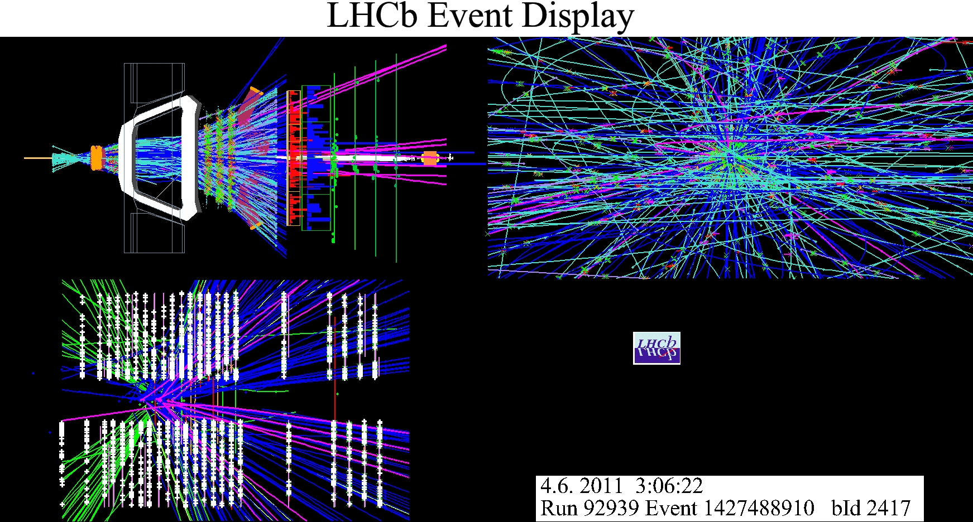
How can we track particles with scintillating fibres ?
Tracking = localising particles along their path
High resolution → use thin fibres
High efficiency → use thick fibres
Low background → low noise photodetectors
particle path
(in a magnetic field)
Future location of our SciFi tracker in LHCb

Slide 17
Trackers based on scintillating fibres
Fibres give lots of geometrical flexibility
They have low mass and are (almost) self supporting
All non-active material can be at the end of the fibres
a)
b)
2D
stereo
cylindrical
+ ….
But …
Fibres give relatively little light
They are non very radiation hard
Building a fibre tracker is a lot of work (companies just deliver fibres)

Slide 18
Back-of-the-envelope estimate of photoelectric yield in a 0.25 mm double cladded fibre, 2 m from photodetector. Non-irradiated.
MIP → dE/dx = 2 MeV/cm (Bethe Bloch)
photodetector
dx = 0.022 cm (active) → dE = 0.04 MeV
(when passing through axis … optimistic!)
Scintillation yield: dY_{γ}/dE = 8000 ph / MeV → Y_{γ} = 320
Trapping inside fibre (1 hemisphere): 5.4% → Y_{γ} ∼ 16
Attenuation losses over 2 m: 50% → Y_{γ} ∼ 8
Efficiency of photodetector (typ. PMT): 20% → Y_{p.e.} ∼ 1−2
VERY little light !
➔ Need more traversed fibre thickness
➔ Need higher photodetector efficiency
➔ Need to recover light in the second hemisphere

Slide 19
A bit of SciFi history

Slide 20
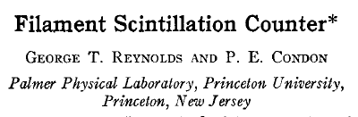
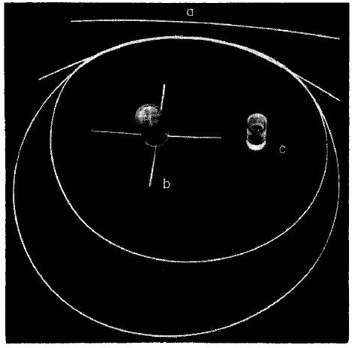


A bit of history
After the discovery of Colladon (1841), it took 116 years before scintillating fibres were used as particle detectors
Rev. Sci. Instrum. 28, 1098 (1957);
……
First (?) non-cladded scintillating plastic fibre.

Slide 21
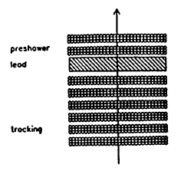
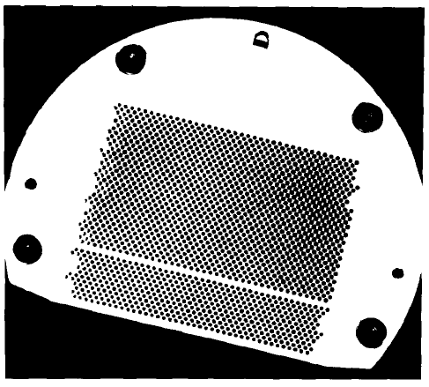
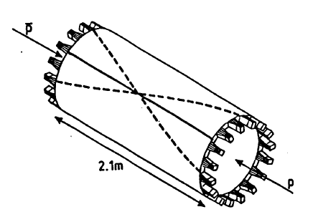
Upgrade of the UA2 experiment (1985-87).
J. Alitti et al. , NIM A 273 (1988) 135
The first major collider application of scintillating fibre tracking technology.
Outer tracking and pre-shower measurement for electron identification.
60,000 single-clad, blue-emitting scintillating fibres of 1 mm in diameter and 2.1 m long
developed and produced (!) at Saclay. Λ > 1.5 m.
Light propagates to 32 collector plates which are readout by 32 image-intensified CCDs (32000 pixels each).
collector plate

Slide 22
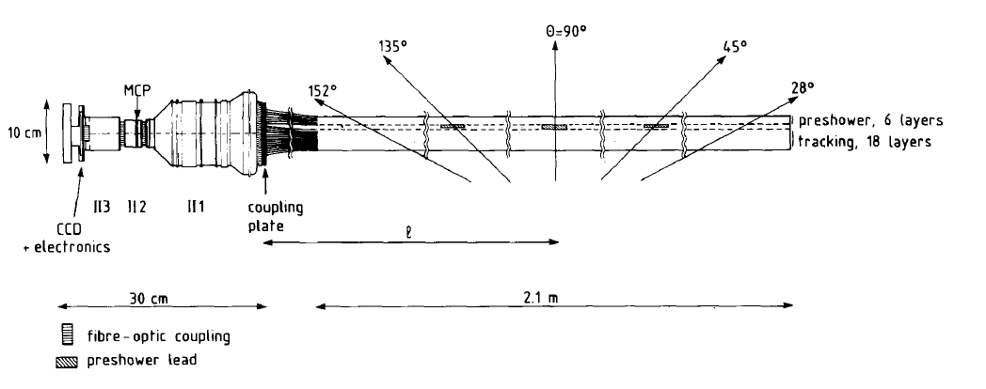
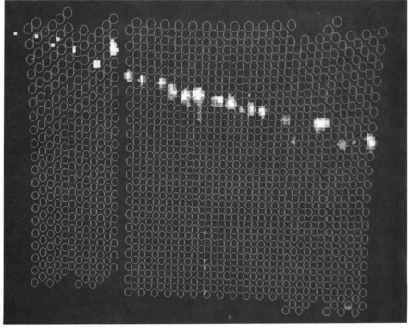
UA2 readout system
3-stage image intensifier (II)
R.E. Ansorge et al., NIM A265 (1988) 33-49
Performance
2.8 p.e. per fibre (1mm)
Single fibre efficiency: >91%
σ_{hit} = 0.35 mm, σ_{track} = 0.2 mm
Readout time ~10 ms
CCD image (circles show calculated fibre positions)

Slide 23
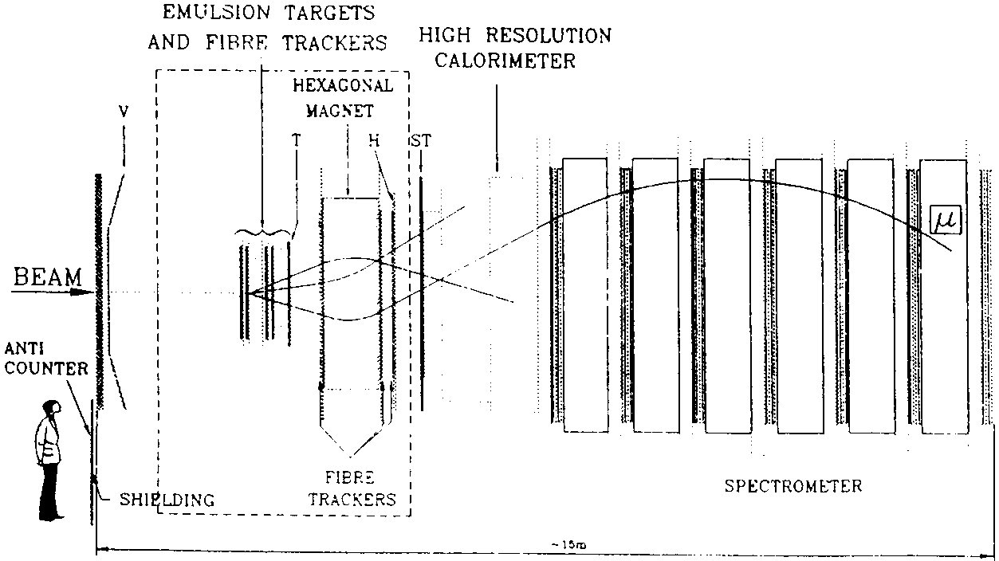
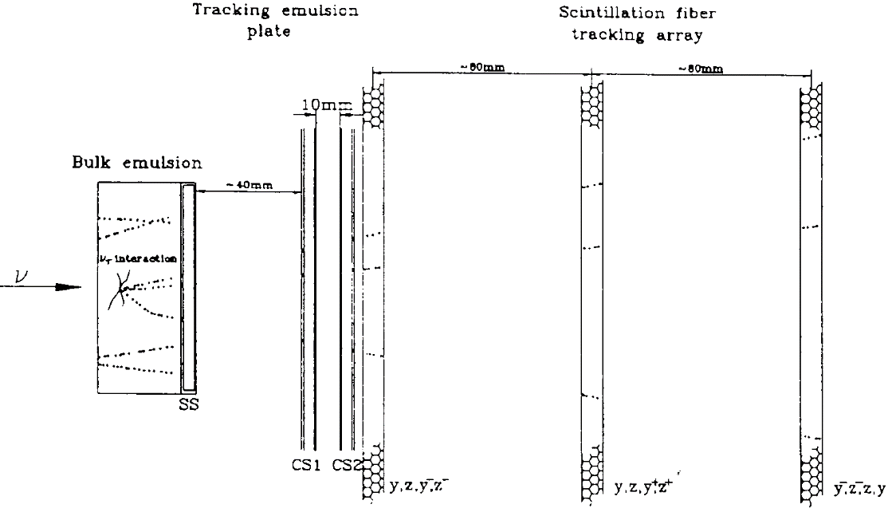
CHORUS
Annis P, et al. NIM A367 (1995) 367
10⁶ scintillating fibres of Ø 500 μm
58 image-intensifier chains + CCD,
similar to UA2.
The scintillating fibre-tracking layers provide pre-localisation of the regions to be scanned in the emulsion.
They also tested a micro-vertex tracker based on the liquid-in-capillary concept (see photo on slide 14).

Slide 24
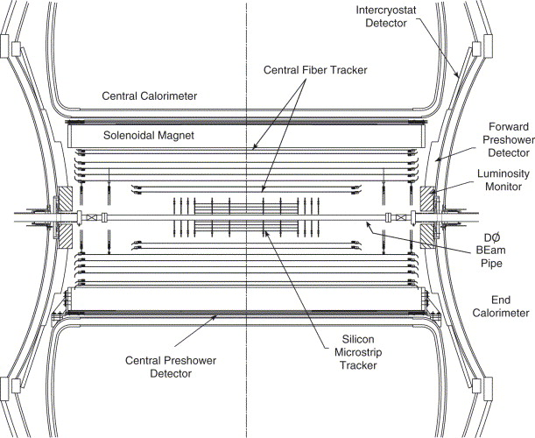
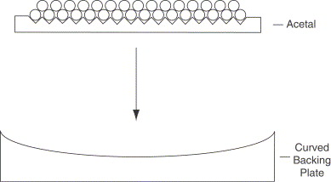
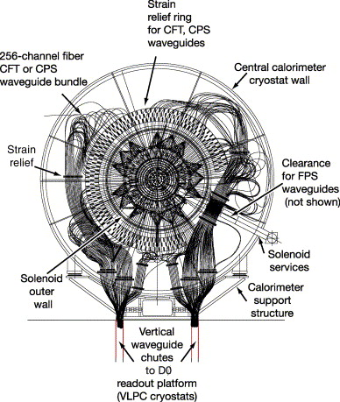
DØ The upgraded DØ detector comprises a 80,000-channel central fiber tracker (CFT).
V.M. Abazov et al, A 565 (2006) 463–537
Ø 835 μm fibres are arranged in 'Doublet' structure
~1 m
8 concentric layers (axial + stereo)
L_{fibre} ~ 2 m + O(10)m clear waveguide
Total = 200 km of scintillating and 800 km of clear fibres

Slide 25
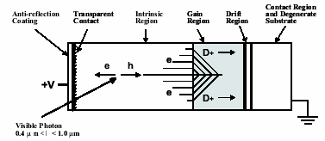
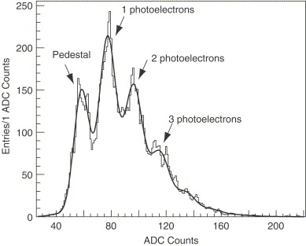
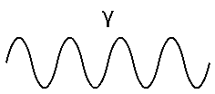
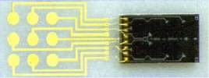
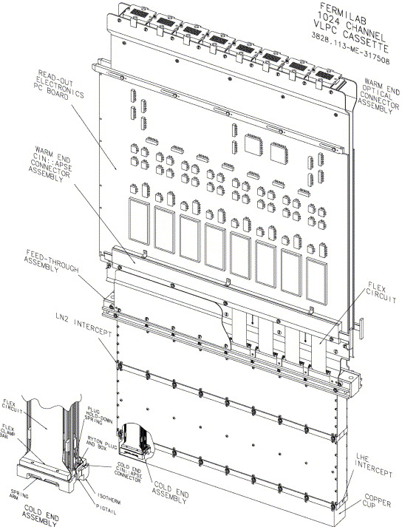
Very innovative readout in D0: Visible Light Photon Counters (VLPC)
LED calibration spectrum
Si:As avalanche photodetector
Very high QE: ~ 75%
High gain: ~40.000
! Needs to be operated at T=9K!
D0 used chips with 8 VLPCs (Ø 1mm).
128 chips fit in a cassette
Performance (partly from test stand)
Yield: ~10 pe / fibre
Hit efficiency: 99.5%
Doublet hit resolution: 100 μm
Fast readout: CFT contributes to the L1 trigger (every 132 ns)
B. Baumbaugh et al. IEEE TNS 43, NO. 3, JUNE 1996
88 cm
Same technology is also used in the MICE experiment http://mice.iit.edu/
Bundles of clear fibres

Slide 26
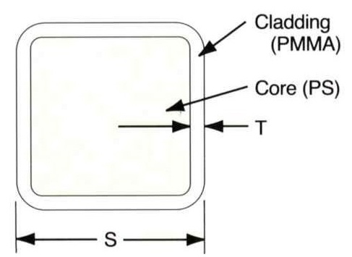
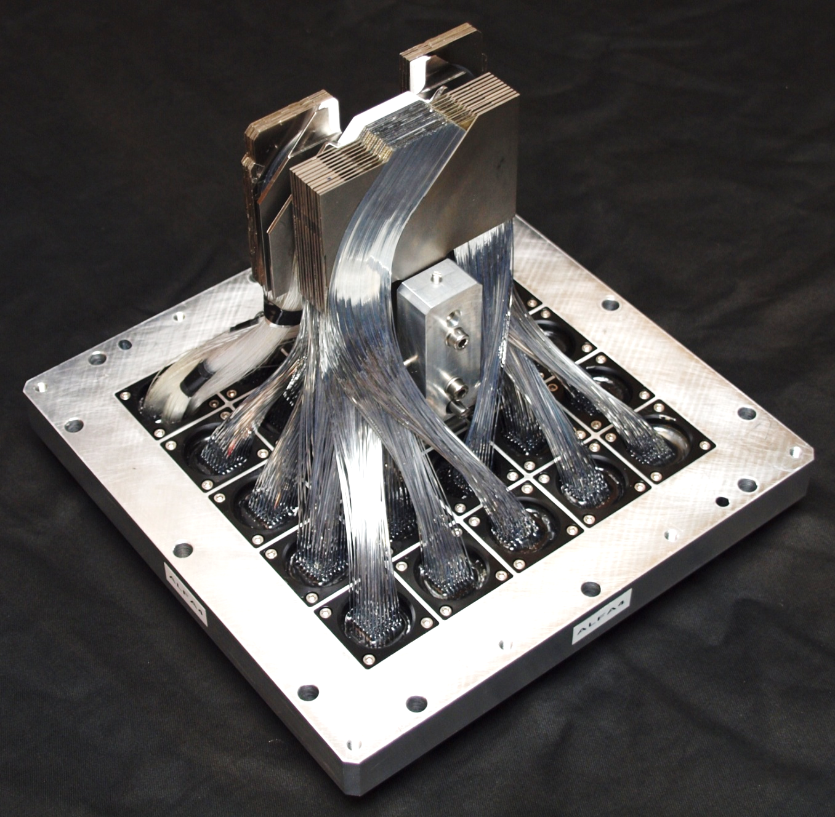
ATLAS ALFA
S. Ask et al., NIM A 568 (2006) 588–600
S. Abdel Khalek, 2016 JINST 11 P11013
Forward detector in Roman Pots for luminosity and σ_{tot}(pp) measurement
4 RP stations are located at ±240 m from ATLAS in LHC tunnel
Total ~11.000 fibres, 500 µm squared, ~35 cm long, aluminized for reduced cross-talk.
UV geometry with 2x10 staggered layers. Active area is only about 3 x 3 cm2.
Readout (at 40 MHz) by 184 Multi-anode (64 ch.) PMTs.
500 µm
LHC
Beam
Performance:
Yield: ~4 pe / fibre
Track resolution: ~25 μm

Slide 27
A short recap
of SiPM technology

Slide 28
Silicon Photomultipliers (SiPM) -
What makes them so attractive for SciFi ?
A photodetector for reading the scintillation light from a fibre requires
 | Image intens. CCD | (MA)PMT | SiPM
High sensitivity (PDE) | O | O | +
High charge amplification | + | + | +
High speed (multi-MHz) | - | + | +
Small size | O | - | +
Low cost (per channel) | - | - | +
Immunity to magnetic field | - | - | +
Radiation tolerant | O | 0 | -
~ 40%
~ 10⁷
~ mm²
few CHF

Slide 29
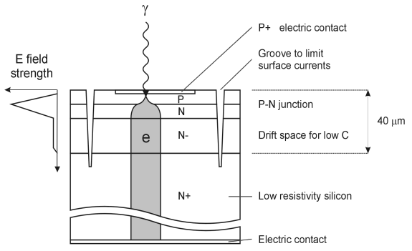
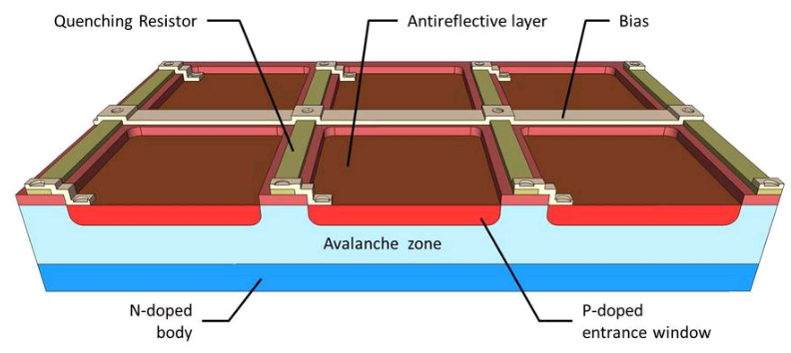
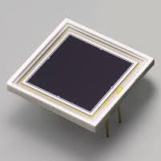

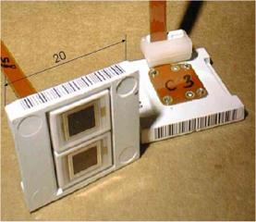
PIN photodiode
Avalanche Photodiode
(APD)
SiPM
γ
p⁺ i(n) n⁺
h e
γ
γ
High QE (~80%)
U_{bias} = small (or even 0)
No charge gain (G=1)
1 photon → 0 or 1 electron
Can’t detect single/few photons
High QE (~80%)
U_{bias} = few 100 V
‘small’ avalanche, self terminating
Charge gain G ~ few 100
Can’t detect single/few photons
γ
Multi-pixel array of APD
operated in Geiger mode, i.e. above break down
G ~ 10⁶ - 10⁷
forced quenching
Every pixel is just a binary detector (0/≥1)
Parallel connection of all pixels gives a quasi-analog detector
A = 1cm²
CMS ECAL

Slide 30



100 – several 10000 pix / mm²
1mm
Only part of surface is photosensitive!
Photon detection efficiency
PDE = QE · ε_{geom} · ε_{avalanche}
GM-APD
=f(OV)
Sizes up to 6×6 mm² now standard.
quench
resistor
−V_{bias}
bias bus
Quench
resistors
γ
1 pixel fired
…
2 pixels fired
20 x 20 pix
3 pixels fired
…
Q
Q
2Q
1 GM-APD is a binary device.
The operation of many GM-APDs in parallel leads to a quasi-analog detector with photon counting properties.

Slide 31
The LHCb
SciFi Tracker

Slide 32

General layout of the detector geometry:
3 stations with 4 planes each X-U-V-X (like the OT)
Requirements:
σ_{x} < 100μm (bending plane)
Low mass, 1% X₀ per layer
Readout every 25 ns
Radiation tolerant up to 35 kGy and 10¹² n/cm²

Slide 33

SciFi in numbers
Fibre mat
× 8
SciFi Module
× 12
1× SciFi Module
Detector Layer
SiPM
× 4 (stereo angles
0°, +5°, -5°, 0°)
Tracking Station
× 3
5m
mirror
Beam pipe
Scintillating Fibre Tracker
SiPM
6m
1024 mats, 128 modules
340 m² total area
almost 11,000 km of fibre
4096 SiPM arrays → 525’000 SiPM channels

Slide 34

QA on scintillating fibres (11’000 km, 880 spools)
Every mm of fibre is scanned for diameter anomalies (bumps)
Big bumps (ΔD > 100 μm) are shrunk / removed.
Every spool is characterised in terms of attenuation length and scintillation light yield.
A fraction of spools is checked for radiation hardness, decay time, bendability
Significant contribution from CBPF: A.B.R. Cavalcante 2014 – 2016 (PhD 08/2017)

Slide 35

Fibre mat &module production
Ø80 cm wheel with fine thread (p=0.275 mm)
D_{fibre} = 0.25 mm
6 layers + epoxy glue
40 mm
mirror
2.5 m
Winding machine, produced in industry

Slide 36



Principle of readout
32.59±0.10mm
128 channels
SiPM array
+
Kapton flex-PCB
single channel:
0.25×1.5mm²
96 pixels
single pixel

Slide 37

Principle of electronics
Hit fibres form clusters of 2-3 SiPM channels
Analog centroiding would give optimum spatial resolution.
Signal per channel up to ~20 pe → require 6 bits resolution.
Remember: 525 k channels × 40 MHz readout × 6 bits = 126 Tb/s → Not affordable
Second best solution: a 3-thresholds binary readout
4.5 pe
2.5 pe
1.5 pe
3 thresholds = 2 bits
Achieved in test beam:
σ_{x} ≤ 84 μm

Slide 38


Principle of electronics
Pacific(5) FE ASIC
Clusterisation
FPGA
GBT (data and controls)
64 channels
64 differential lines
V1 master & 4 cluster boards on cooling plate
Significant contribution from CBPF: PACIFIC emulator set-up (8x256 channels). A. Massafferri et al.

Slide 39

What makes LHCb SciFi challenging
(= interesting)?
Radiation
Large size
High precision
Complex integration

Slide 40
LHCb Radiation Environment
Ionization dose:
Neutron fluence
35 kGy in hottest region
at SiPMs: 6× 10¹¹ n_{eq} / cm²
decrease of fibre transparency
Increase of SiPM dark noise

Slide 41


Example: LHCb fibre irradiation test (CERN PS, 2012)
3 m long SCSF-78 fibres (Ø 0.25 mm), embedded in glue (EPOTEK H301-2)
irradiated at CERN PS with 24 GeV protons (+ background of 5·10¹² n/cm2)
before irradiation
after irradiation
Λ_{l} = 126 cm
Λ_{l} = 439 cm
Λ_{l} = 422 cm
Λ_{l} = 52 cm
0 kGy
3 kGy
at 6.25 Gy/s
22 kGy
at 1.4 Gy/s

Slide 42


Dose along fibre will be very non-uniform
SiPM position
~1 kGy
~35 kGy
Fluka
M. Karacson
beampipe level
Attenuation length Λ
Attenuation factor α = 1/Λ
α = α₀ + α_{irr}
α_{irr} ~ k· D
SciFi irradiation tests
Many radiation test → reasonably good understanding of radiation damage over full dose range.
α_{irr}
R. Ekelhof, PhD thesis

Slide 43
The (almost*) ultimate irradiation test
We irradiated two mirrored SciFi mats in the PS Irrad facility at CERN to the expected steep dose profile.
Only a 25 mm wide band along
the mat was irradiated.
From previous results, the expected signal loss at the mirror end of the mat was 40%.
Scan across the mat (13 cm), at 2 cm from mirror
~35%
10 pe
(* the ultimate test would be to irradiate at the correct (non-accelerated) dose date, which would have taken 5 years. However, we have so far no indications that rate matters).

Slide 44
Irradiated SiPM detectors become ‘noisy’
Dark counts from a single channel of an irradiated SiPM detectors,
operated at T = -40°C
As in every Si device, neutrons damage the Si lattice → leakage current.
In a SiPM the main effect is the increase of the dark count rate (DCR), linearly with the neutron fluence: DCR = a·Φ_{n,}
At room temperature, DCR can reach GHz per SiPM channel
Neutrons fluence is about the same for all SiPMs → All SiPMs are equally affected.
2 μs
3·10¹¹ n/cm²
~7 MHz
6·10¹¹ n/cm²
~14 MHz
12·10¹¹ n/cm²
~28 MHz
A. Kuonen et al. CERN-LHCb-INT-2015-004

Slide 45

Problem: noise hits have same amplitude as 1 pe signal hits. They can combine/pile up to signal-like noise clusters. → Noise Cluster Rate (NCR)
For efficient operation and reconstruction, NCR shall not exceed 50% of the smallest Signal Cluster Rate (SCR), which is 4 MHz.
Solutions:
  Cooling: Every 10 K reduction halves DCR. T = -40°C gives a factor 64 (2⁶) reduction.
  Clustering. Noise hits don’t form clusters, except accidentally!
  Optimise SiPM for low cross-talk and after pulses.
  Use preamp with short shaping time.
  Neutron shielding.
Noise cluster rate (NCR) for different Pacific settings and thresh.
‘Holy’ Olivier Callot limit: NCR < 2 MHz/SiPM array

Slide 46

Mechanics and services
2 x 6 C-frames
Hanging under existing bridge, new rail system needed.
Precise positioning of 2 x (5)6 modules
Supply of Novec fluid (@-50C)
Supply of cooling water
HV & LV cables
Signal and control fibres
~ 7 m
CF cables
Lower service bar has a translational DOF in y-direction

Slide 47




Very challenging and complex integration
roller
Novec manifold
Water cooling
Readout box
Flex cables
Cold box
A-side/C-side intersection
Fibre modules
Novec manifold, vacuum insulated
LHCC Review - 08 / 05 / 2017
47

Slide 48
Overall Status of Project
 | R&D | proto | pre-series | series | On schedule
Fibres |  |  |  |  | ☑
Mats |  |  |  |  | ☑→☑
Modules |  |  |  |  | ☑→☑
SiPM |  |  |  |  | ☑
Flex cable |  |  |  |  | ☑
Cold box |  |  |  |  | ☑→☑
Pacific ASIC |  |  |  |  | ☑
FEE |  |  |  |  | ☑
C-frames |  |  |  |  | ☑→☑
75%
45%
catching up
25%
catching up
ordered
ordered
still some issues
Fully
operational
tight
tight
tight
x
No but some tension in the planning.

Slide 49

CERN weekly bulletin (30/08/2017)

Slide 50
Summary and Outlook
Thanks to Silicon Photomultipliers (SiPM), there is new interest in scintillating fibres. One can build fast and light tracking detectors
LHCb SciFi tracker will be the largest and fastest fibre tracker ever built
Radiation levels pose major problems, but the chosen design is expected to cope with them (in Runs 3 & 4, 50 fb⁻¹)
The detector construction is in an advanced state. The schedule is tense but there is (justified) hope that we’ll be ready for installation in autumn 2019.
Not covered in this talk but perhaps of interest to the younger generation: A further LHCb upgrade (LS4, 2030) to 2×10³⁵ and 300 fb⁻¹ would require a modified SciFi and to complement it with an Si-based Inner Tracker, for R ~ 1-1.5 m around beam pipe.

Slide 51


SciFi Tracker: ~20 participating institutes
  Brazil (CBPF)
  China (Tsinghua)
  France (LPC, LAL, LPNHE)
  Germany (Aachen, Dortmund, Heidelberg, Rostock)
  Netherlands (Nikhef)
  Poland (Warsaw)
  Russia (PNPI, ITEP, INR, IHEP, NRC KI)
  Spain (Barcelona, Valencia)
  Switzerland (CERN, EPFL)

Slide 52



unwinding spool
tensioner 50 g
cleaner
LN
3015
AccuScan
6400
cladding
Test
NI 6009
Fast IO
6 m
CERN (built together with Aachen), which allows to scan fibres with 40 μm step size and <1 μm resolution. A 12.5 km fibre spool can be scanned in ~3.5 hours.
X and Y diameter
(look perfect on linear scale)
350 mu

Slide 53




290 μm
Projection x
Projection 1 (~ x)
Distance 295 μm
314 μm
298 μm
319 μm
Projection 2 (~y)
Projection y
Distance 562.0 μm
Distance 321.3 μm
Distance 306.7 μm
Distance 333.2μm
~1.1 mm
N.B. Correspondence between projections x,y and 1,2 is only approximate.

Slide 54




Manual set-up at CERN.
Set-up for measuring the light yield with ionising radiation (Sr-90 source)
Calibrated
in p.e.
Points at 60 cm are not included in fit

Slide 55

Complex irradiation of a 2.5 m long
fibre module in the new PS IRRAD zone
(Oct 2015)
Requested dose profile varies by a factor 1000 along the module

Slide 56
Find better fibres which give more light
LuminnoTech (Rus), Kuraray (JP) and CERN work on a new type of scintillating fibre.
Nanostructured Organo-silicon Luminophores (NOL)
On paper, it’s a little revolution. In practice, the quality isn’t good enough yet. Perhaps a solution for SciFi upgrade?
S. A. Ponomarenko et al., Nature Scientific Reports 4, Article number: 6549.
Spin-off company Luminnotech
Conventional scintillator
NOL scintillator

Slide 57


Slide 58


Geometrical precision
Fibre mats are produced by winding fibres, layer by layer, on a fine-pitch threaded wheel
addition of very fluid epoxy glue, TiO2 loaded
feeder
~ Ø 900mm
p = 270 μm
Fibre winding (at Univ. of Dortmund)
Dedicated machine, in-house production
Test winding (at Univ. of Aachen)
Use of a large CNC lathe.
~150 mm

Slide 59



Geometrical precision
Alternative technique: replace thread by a kapton film, structured with coverlay(© Dupont). PCB technique, R. de Oliveira.
p = 270 μm
3 m long and 16 cm wide Kapton film used
for a full-size 6 layer mat (march 2014).
~ Ø 900mm
~150 mm
Kapton film becomes part of fibre mat.
Allows use of precise alignment marks.
Inspection at CERN
After winding at Univ. Dortmund

Slide 60







Scan of fibre mat end faces (after cut with diamond tool)
1.5 mm
Optical 3D coordinate measurement machine (CMM) in PH/DT bond lab.
defect
defect
defect
RMS = 4-12 μm
layer 1 - layer 6

Slide 61
Get enough light → produce high quality mirror at non-read fibre end
50% of the scintillation light is emitted in the wrong hemisphere.
We studied three different mirror technologies
Aluminised mylar foil
3M Extended Specular Reflectance (ESR) foil
Aluminium thin film coating (TFC)
and measured the intensity gain (mirror/no mirror*)
20% gain
80% gain
It remains unclear why ESR results are so low. Would have expected ≥ Al. Mylar.
We checked for possible influence of angle of incidence as well as glue type. No change.

Slide 62

Get enough light → maximise fibre attenuation length
CERN set-up for measurement of attenuation length
fibre
UV-VIS-photodiode*
Teflon ‘cavity’ with 4 UV-LEDs
(+ PIN-diode for intensity monitoring)
Mechanical fixation
Optical rail, 3.5 m
AquaDAG (black paint)
Supresses cladding mode + rear reflection
*May be replaced by a SiPM, to have correct sensitivity characteristics.

Slide 63

Measurements of 8 spools + older Dortmund sample (unknown Lot no.)
KURARAY SCSF-78, 250 μm, double cladded)
<Λ_{att.} > = 293 cm
(Lot 1-8)
Λ_{att.} in cm
We are currently investigating with Kuraray whether lower or higher concentrations of dopants have a sizable impact on Λ or whether we have to live with Λ~3-4 m.
Side remark: We are also maintaining / building up relations to 2 other potential fibre producers: Saint-Gobain (Bicron), ELJEN Technologies (new in the SciFi market).

Slide 64

Scintillation in organic materials
The organic scintillation mechanism is based on the pi-electrons (molecular orbitals) of the benzene ring (C₆H₆).
Molecular states (pi orbitals)
singlet states
singlet states
S
ionization energy
S
3
ultra fast
3
10
-11
s
Organic scintillators exist as
Crystals (anthracene)
Liquids (solutions)
Plastics (polymerized solutions)
S
S
triplet states
2
triplet states
2
non-
T
T
2
S
radiative
2
S
1
1
T
1
fluorescence
phosphorescence
10
-8
- 10
-9
s
>10
s
fast
-
4
slow
S
S
0
0
Organic scintillators are fast. Scintillation light decay time ~ few ns.

Slide 65


Polyvinlyltoluene (PVT) ==> plastic scintillator tiles
In HEP, we use mainly
Polystyrene (PS) ==> scintillating fibres
In pure form, both PVT and PS, have a very low scintillation yield.
One adds therefore dopants in ‰ - % concentrations.
UV
(~300 nm)
Visible
( 400 nm)
>
~
Solvent
Scintillator
wavelength
shifter (‘fluor’)
ionizing particle
ΔE = dE/dx·Δx
fluorescence light
Typical yield
8000 ph/MeV
fast and local energy transfer via non-radiative dipole-dipole interactions. Förster transfer.
radiative transfer
A 'fluor' has non-overlapping absorption and emission spectra. The energy/wavelength difference is called Stokes shift
(Producers normally don't disclose the details about the additives and their concentrations.)

