Slide 1

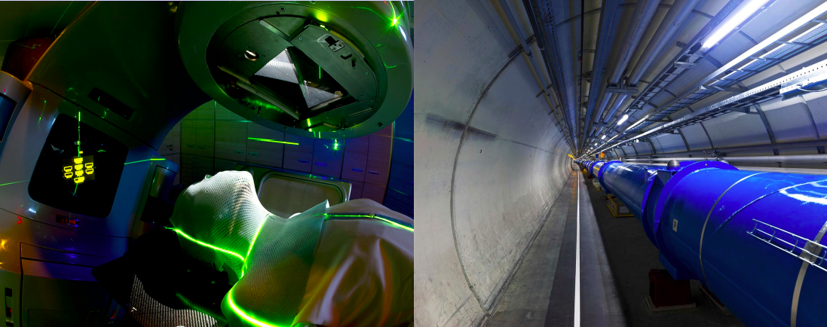

CERN: From Particle Physics to Medical Applications
Evangelos N. Gazis
Professor of Particle Physics
National Technical University of Athens
CERN High School Teachers, 26 Aug-01 Sep 2018

Slide 2
Outline
Medical Applications
From X-rays to Medical Physics
Natural Radioactivity
Synergy of sciences
CERN Collaboration for the deceases
Cancer: Diagnosis – Treatment
Medical Imaging
PET Imaging
Medical Imaging Collaborations: Crystal Clear & Medipix
Digital Imaging
Multimodality Imaging CT – PET
MRI
Accelerators for cancer : diagnosis - treatment
Hadron Therapy - Timeline
Carbon Ions – HIT
PIMMS – CNAO
ISOLDE – Isotopes Production

Slide 3
Medical Applications
• Fundamentals of Radiation Physics
• Medical Diagnostic Techniques
• Imaging technics (basic)
• Radiation Therapy
Not covered in this talk:
• Advanced Imaging
• Radiation Protection and Dosimetry
• Radiobiology
• Anatomy and Physiology
• Molecular and cellular oncology

Slide 4

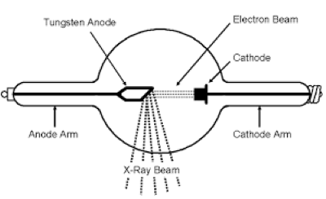
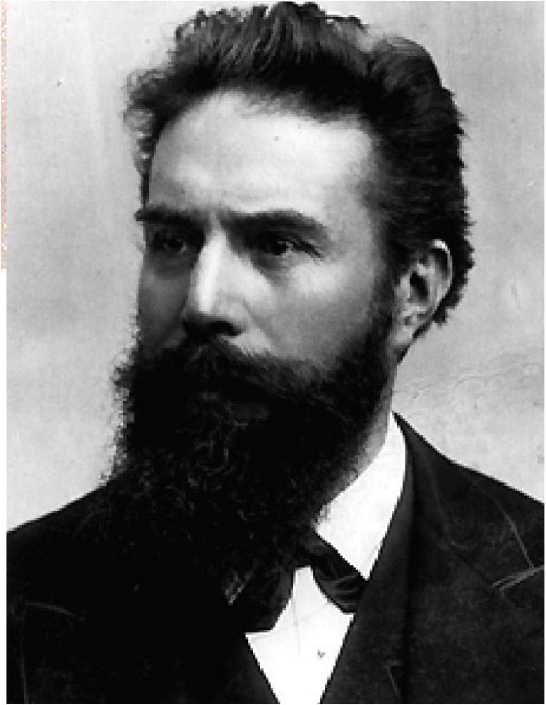
X-rays
Beginning of Modern Medical Physics
November 8, 1895 Wilhelm Röntgen discovered X-Rays
December 22, 1895 he takes the first image of his wife’s hand
Röntgen received the first Nobel prize in physics in 1901

Slide 5
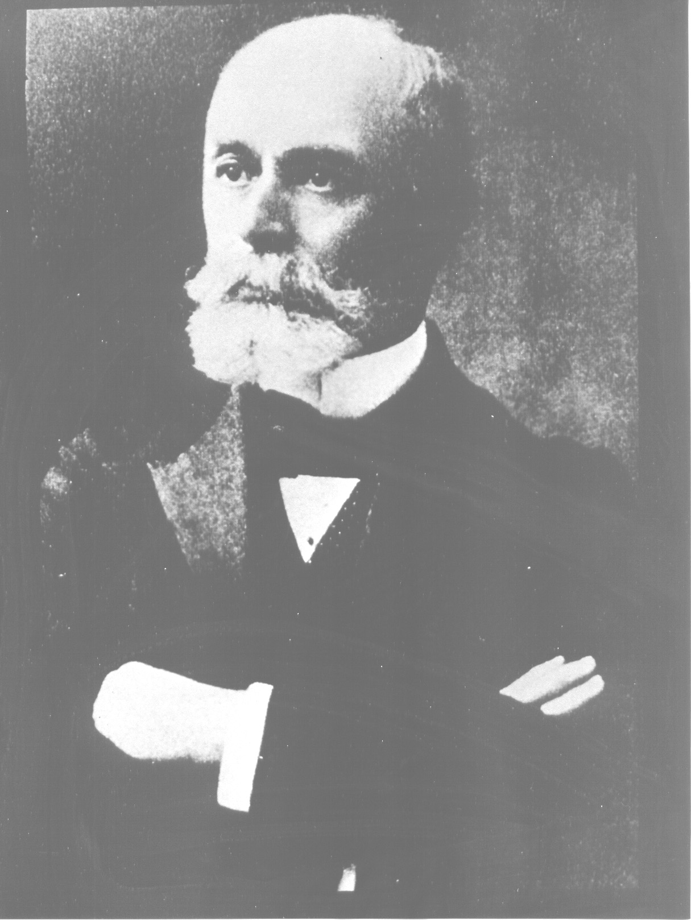
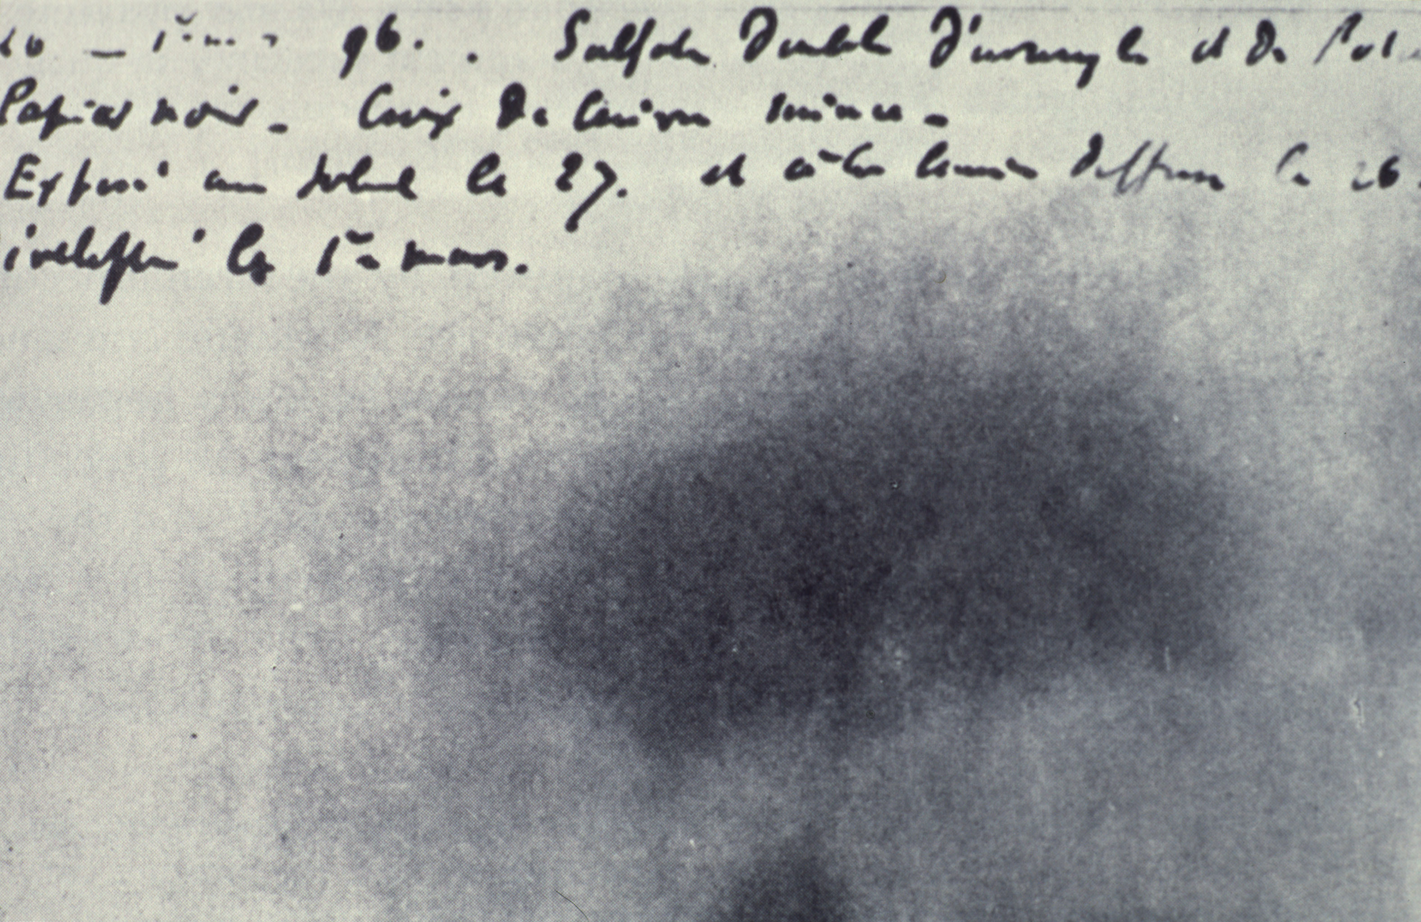
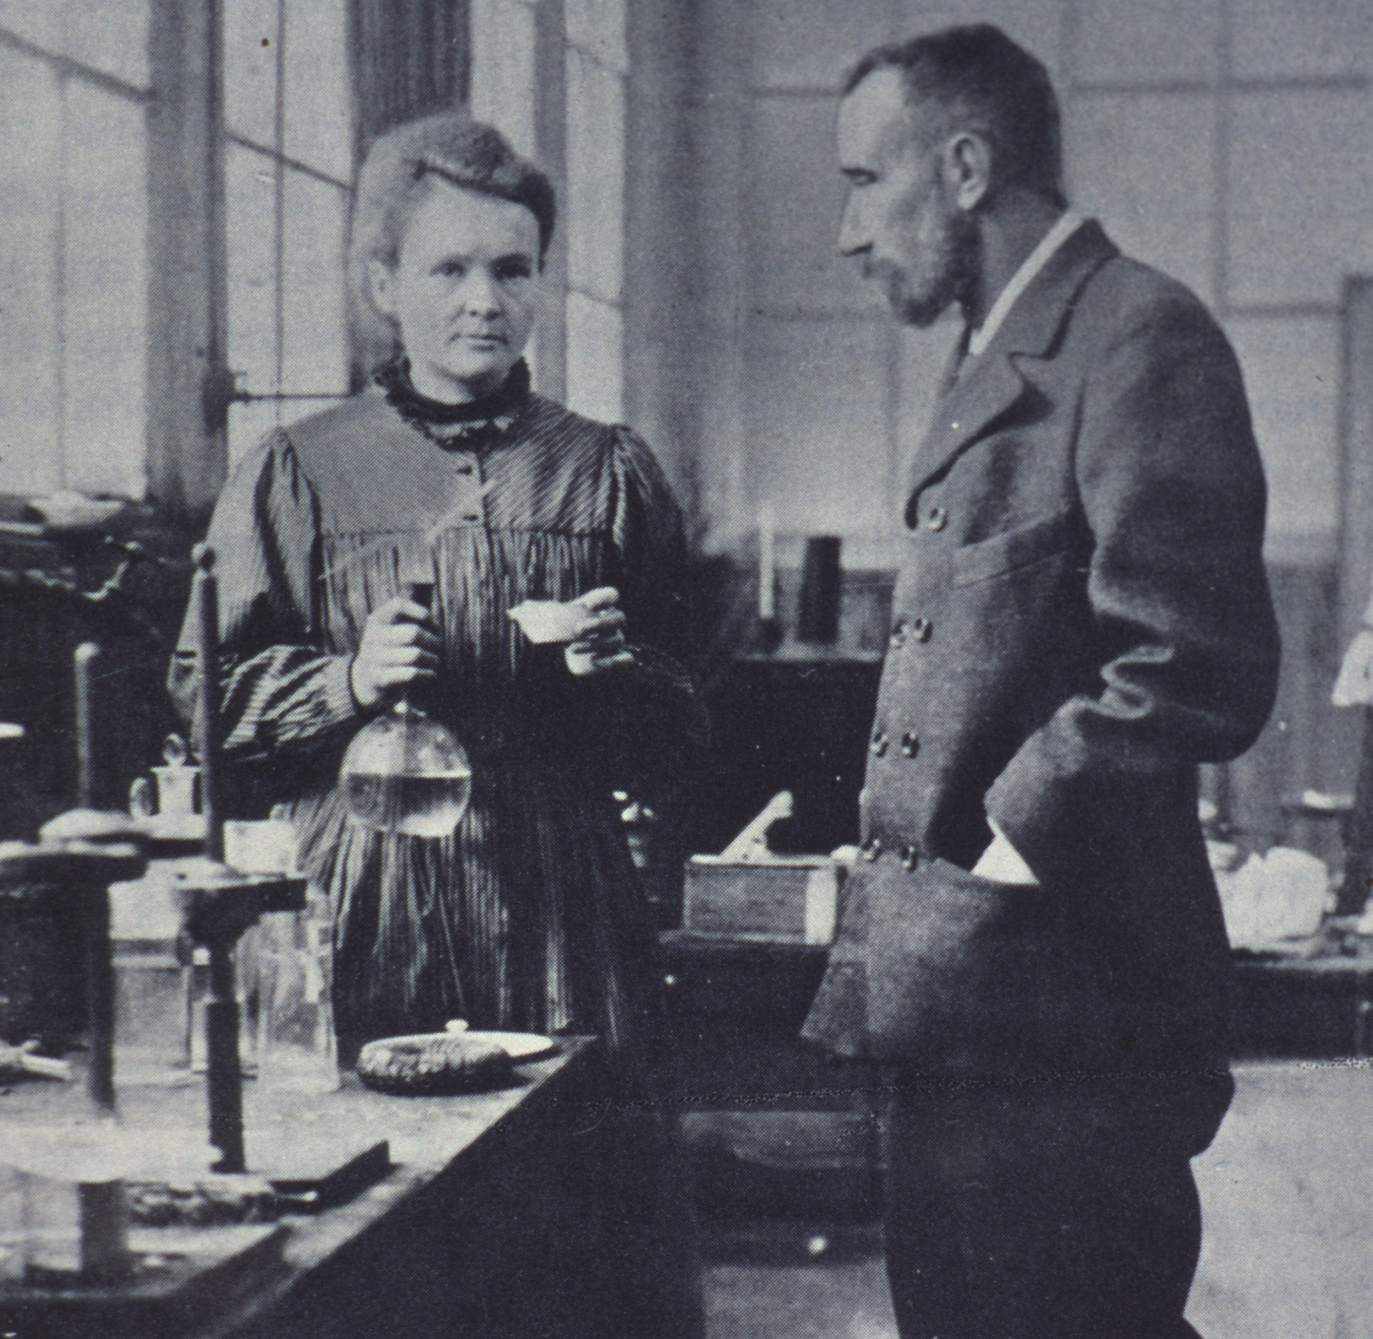
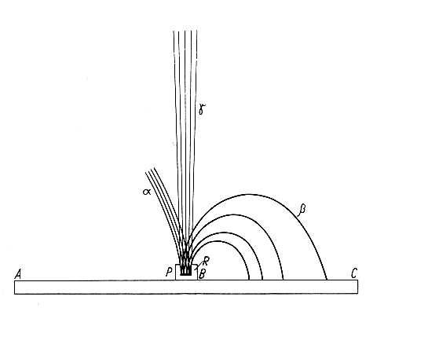
Natural Radioactivity
Beginning of Modern Medical Physics
1896: Discovery of natural radioactivity
1898: Discovery of radium used immediately for “Brachytherapy”
Henri Becquerel
Thesis of Mme. Curie – 1904
α, β, γ in magnetic field
Marie Curie Pierre Curie
(1867 – 1934) (1859 – 1906)

Slide 6
What is the added value of the Physics of Medicine?
….or why should YOU study medical physics?
…or why should senior physicists care about medical research?
…and why care medical researchers/industry about physics???

Slide 7
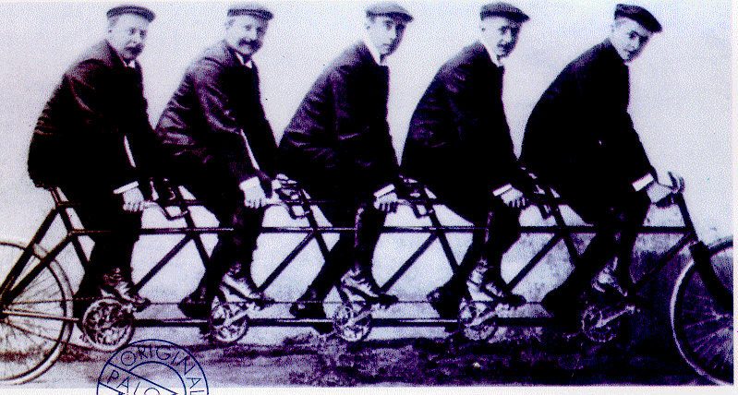
1st Answer: Synergy
X-.‐ray
source
physics
detector
physics
image
reconstruction
medical
doctors
Accelerator physics

Slide 8
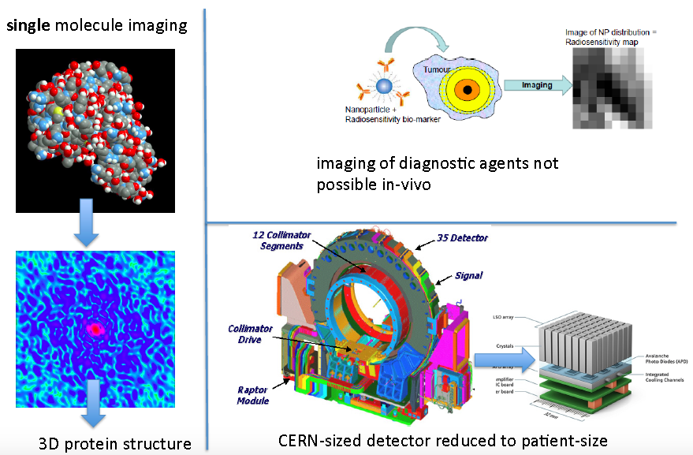
2nd Answer: Overcoming Limits!

Slide 9
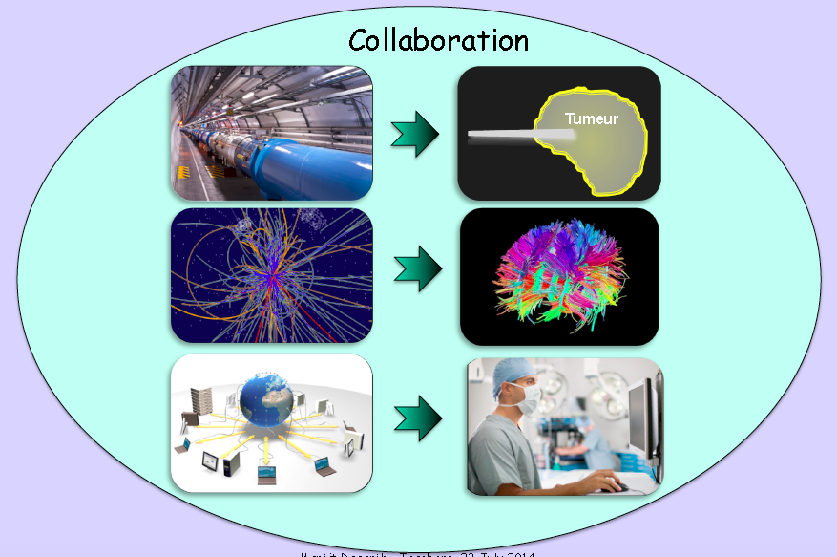
The 4th Pilar of Technology

Slide 10
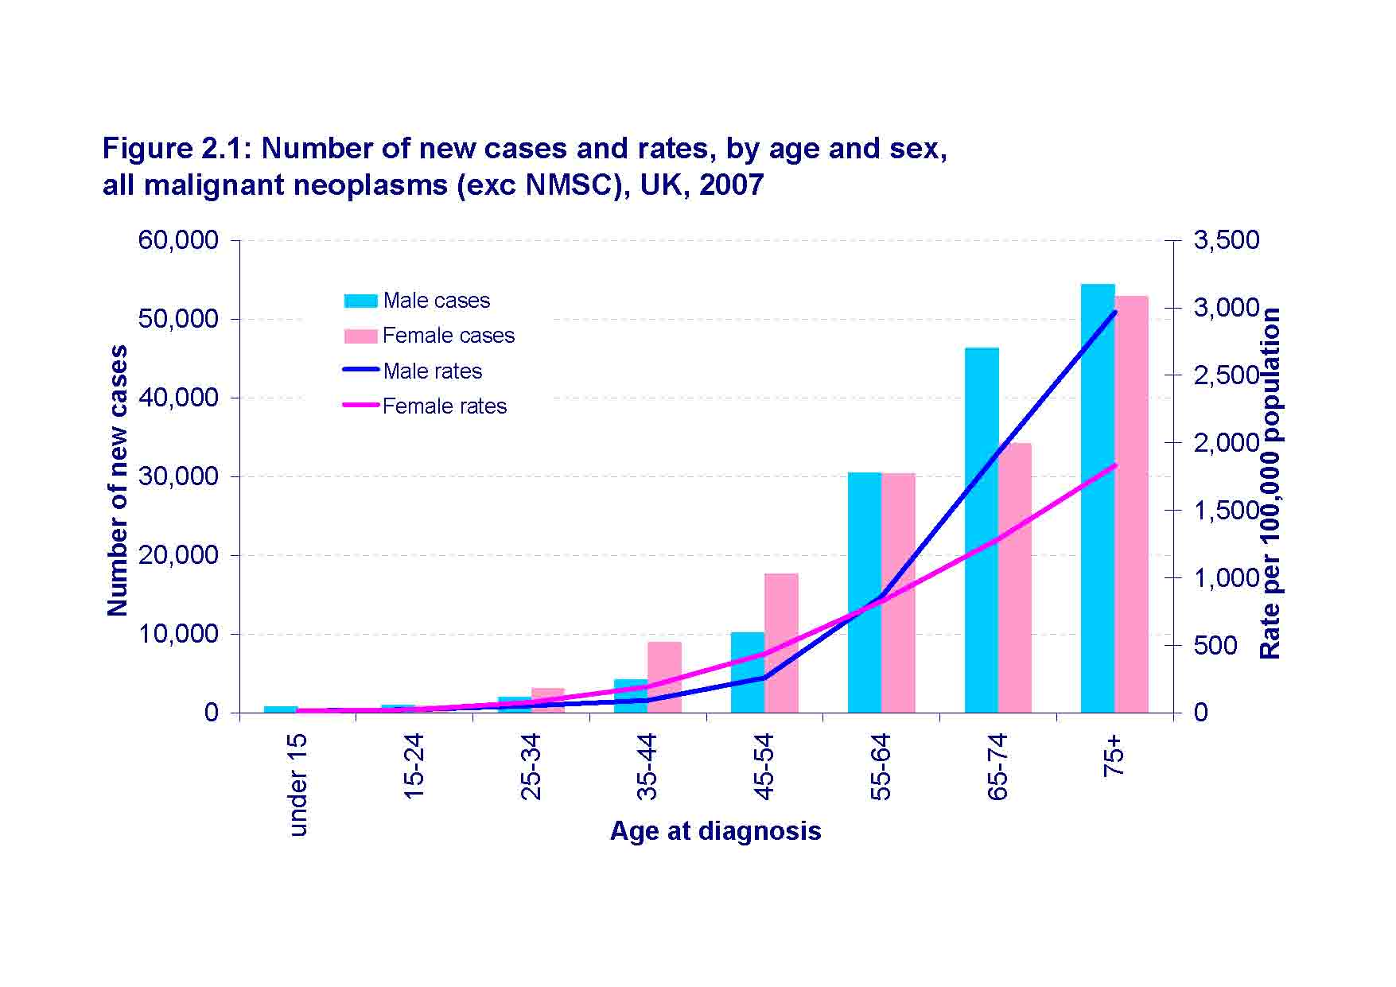
CANCER a growing challence
More than 3 million new cancer cases in Europe each year and 1.75 million associated deaths
Increase by 2030: 75% in developed countries and 90% in developing countries

Slide 11
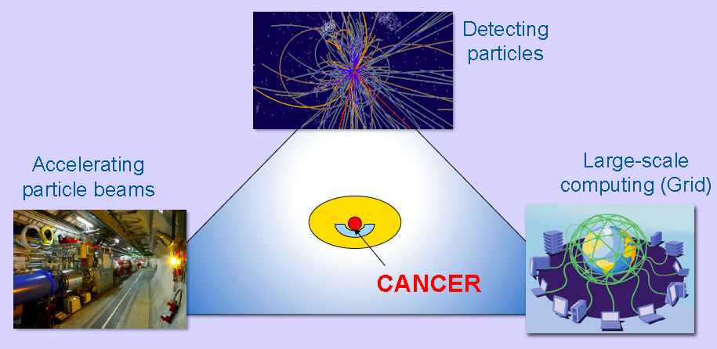
CERN Technologies & Innovation

Slide 12
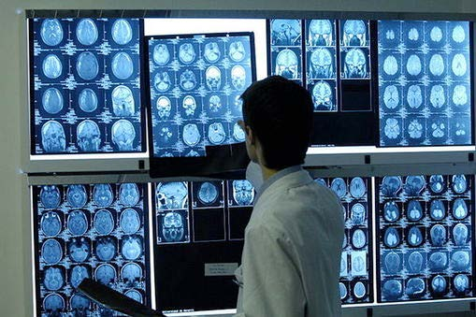
Medical Imaging

Slide 13
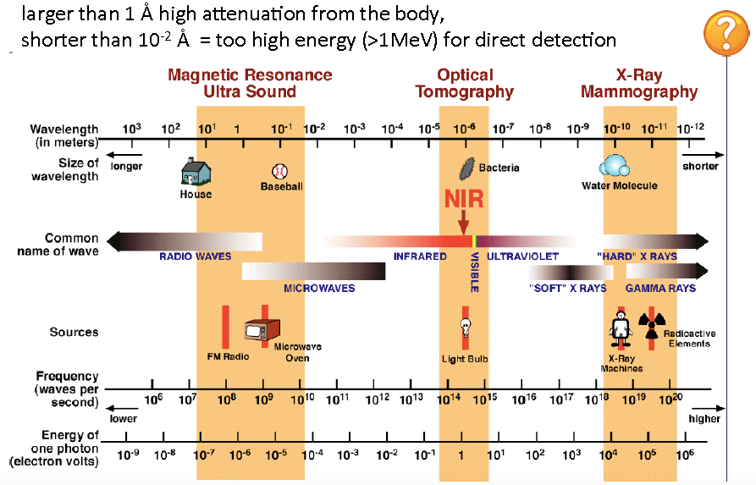
Electromagnetic Waves Used in Medical imaging

Slide 14
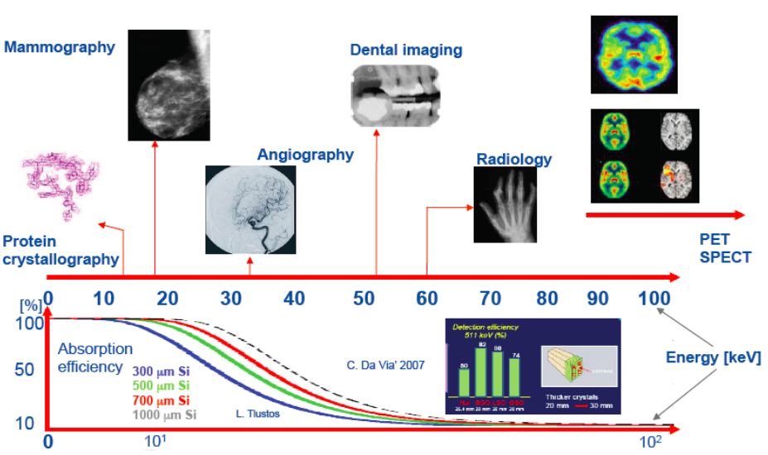
Medical Imaging

Slide 15
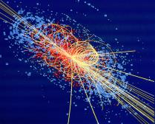
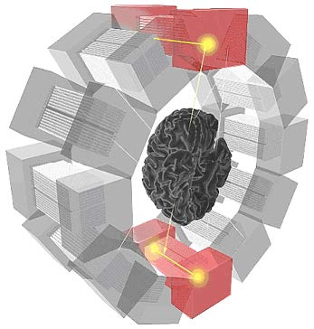
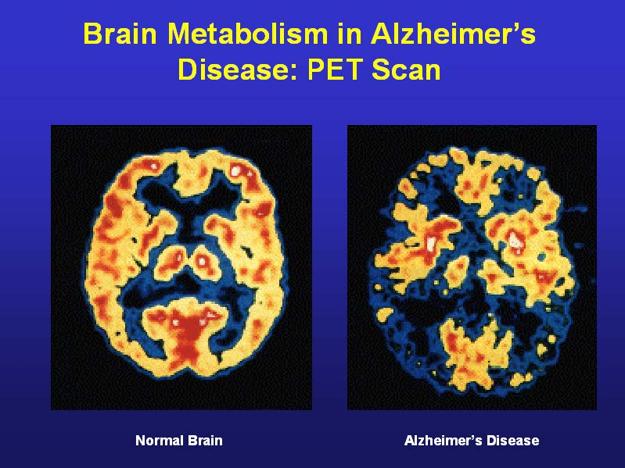
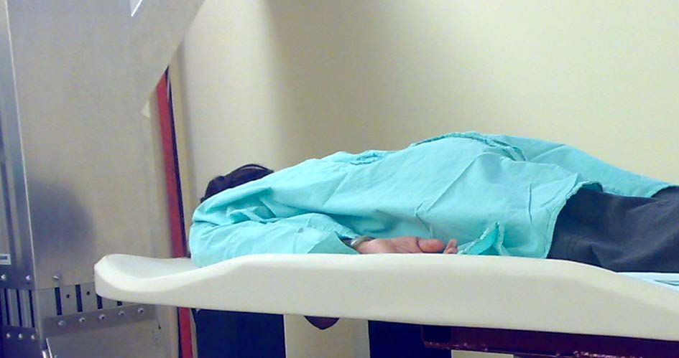
Medical Imaging then Treatment
Particle Detection
Imaging
PET Scanner
Breast imaging (Clear PEM)

Slide 16
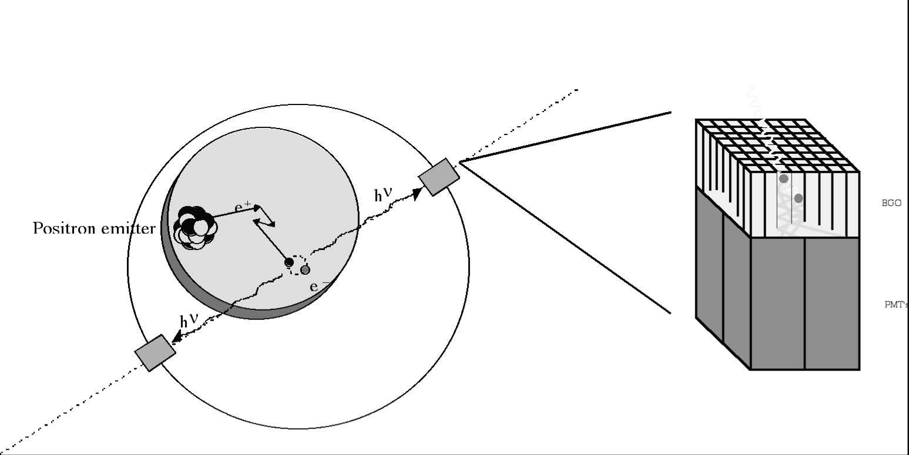
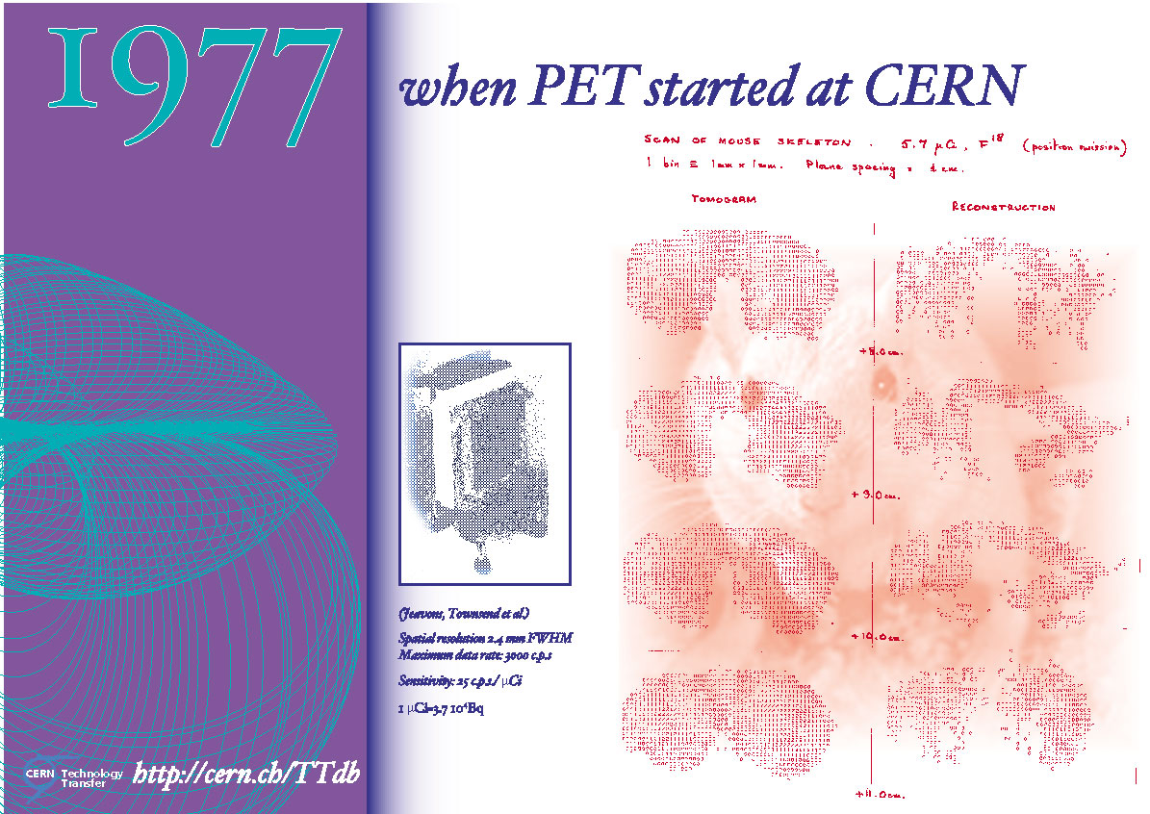
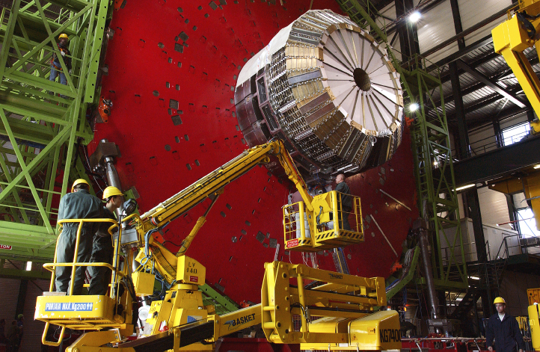
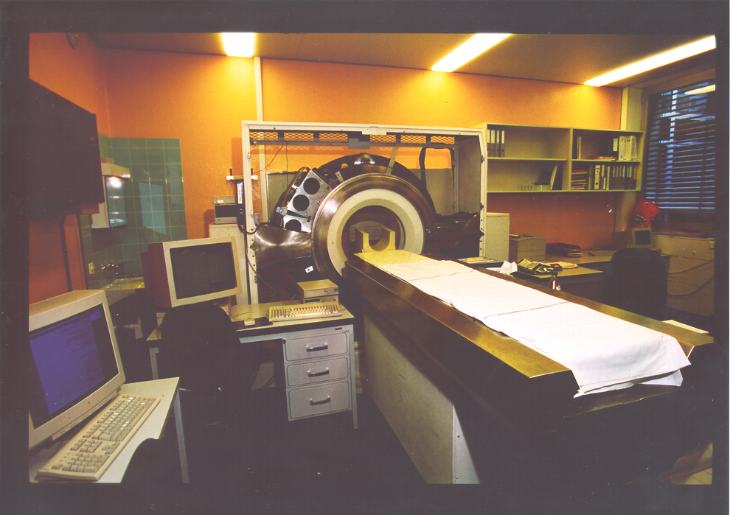
PET Imaging
Idea of PET

Slide 17
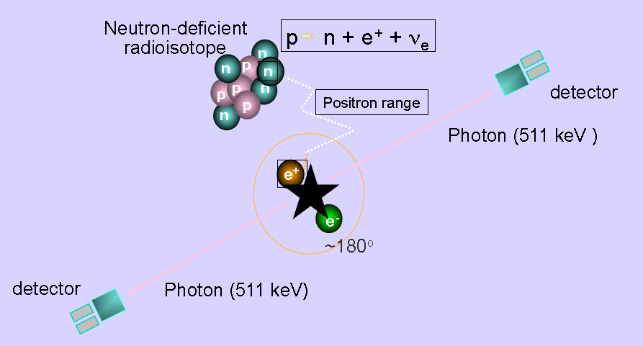
PET : Operation

Slide 18
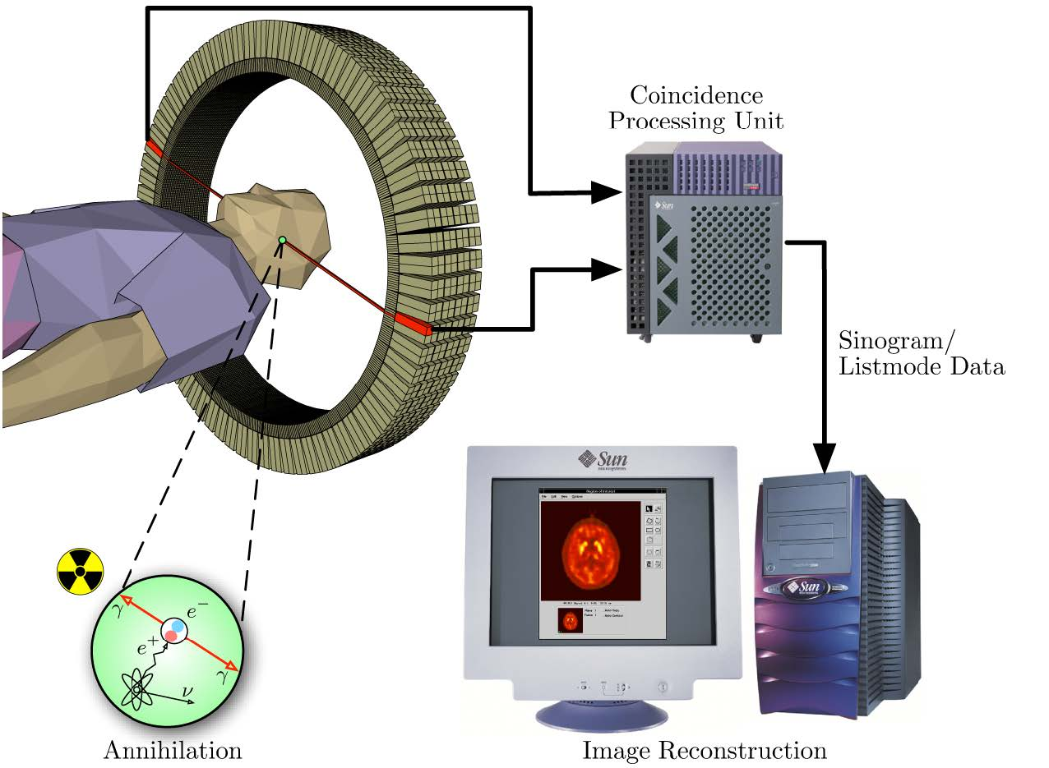

PET : Scan

Slide 19
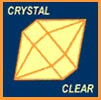
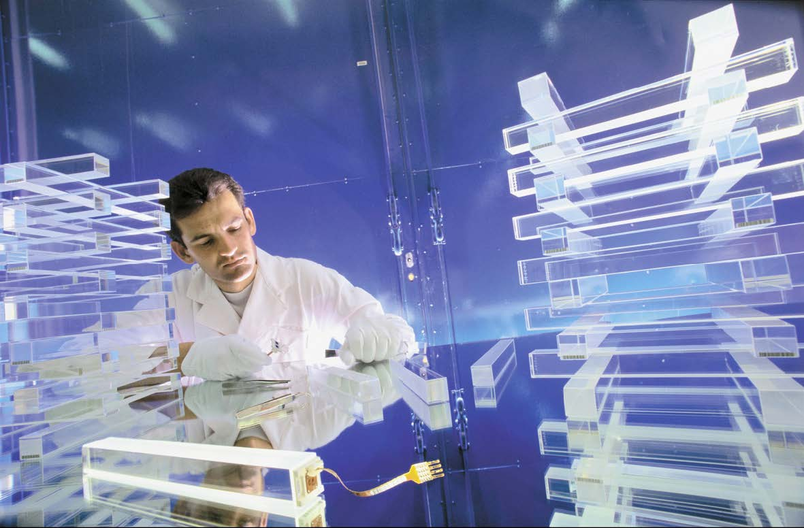
Crystal Clear Collaboration
• New scintillating materials
  – LuAP, phoswich LuAP-LSO (CERN patent)
  – Other crystals
• New photodetectors (Avalanche Photo-Diodes)
• New low noise electronics
New intelligent DAQ
systems with pipeline
and parallel architectures
better simulation GEANT 4
better reconstruction algorithms

Slide 20
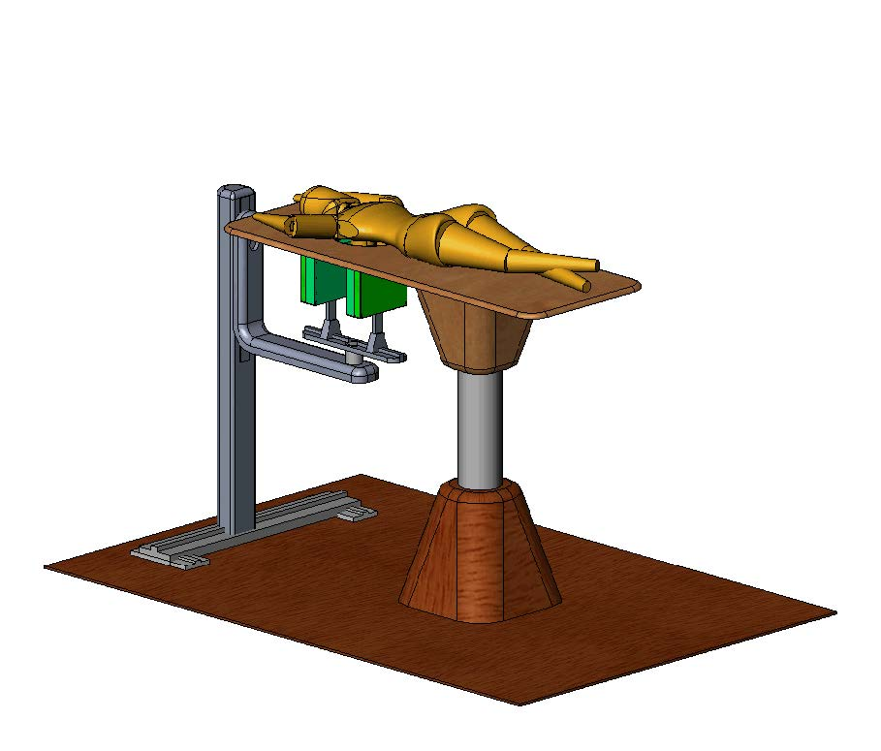
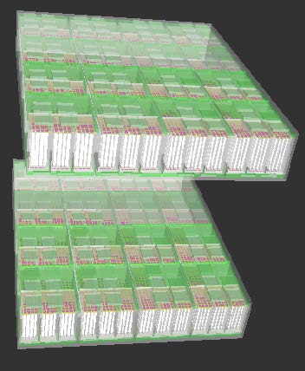
Crystal Clear Collaboration (PEM)
• PET dedicated to breast
cancer screening
– Extremely sensitive to small
tumor masses
• Spatial resolution (1-2mm)
• High counting sensitivity
• Short PET exam
• Coupled to ultrasound

Slide 21
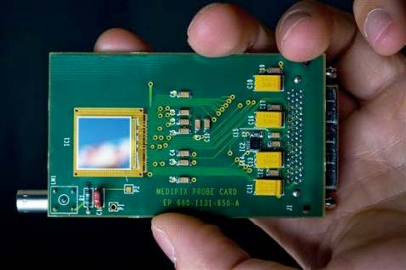
MEDIPIX
• High Energy Physics original development:
– Particle track detectors
• Allows counting of single photons in contrast to traditional charge integrating devices like film or CCD
• Main properties:
– Fully digital device
– Very high space resolution
– Very fast photon counting
– Good conversion efficiency of low energy X-rays

Slide 22
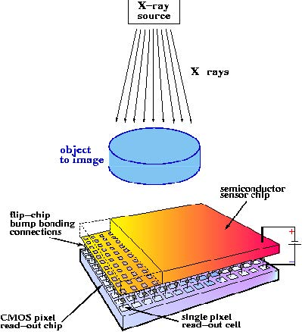
WHAT IS MEDIPIX ?
• an electronic chip similar to the electronic imaging chip in a digital camera
  – sensitive to x-rays instead of visible light
• it can create the first true color images with x-rays.
  – it permits us to move from black and white x-ray images to full color x-ray images
• can be read out very rapidly.
  – allows the use of the chip for color x-ray digital movies or for fast color x-ray CT scans

Slide 23
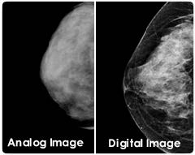
Digital Imaging
Current
– Limited contrast
– High dose
• Restricted screening
• Limited access to preventive health care
Digital
– High contrast
– Lower dose
• Opportunity for screening
• Access to preventive health care

Slide 24
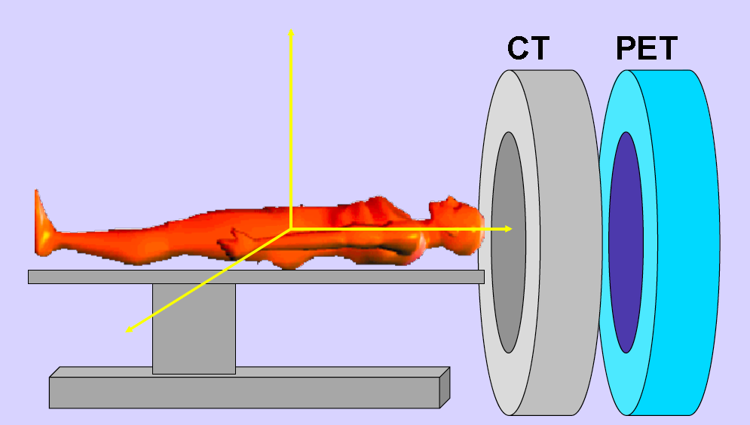
Multimodality Imaging
PET – CT David Townsend

Slide 25
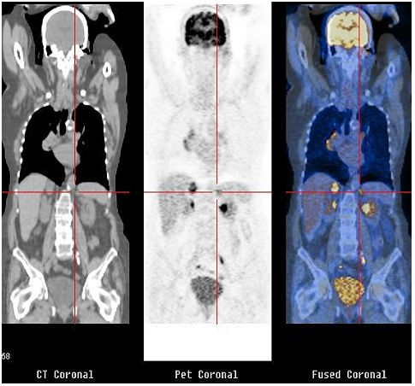
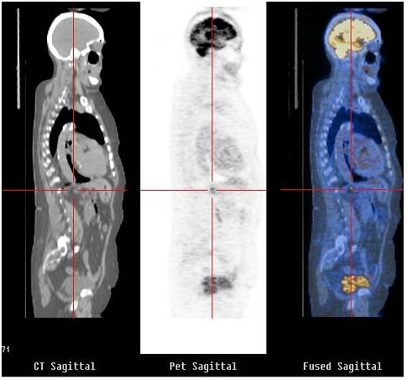
Multimodality Imaging : PET - CT
Morphology Metabolism

Slide 26
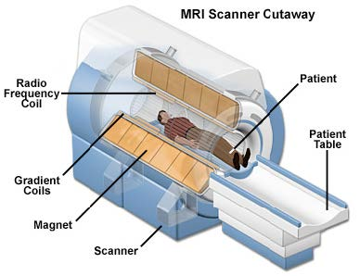
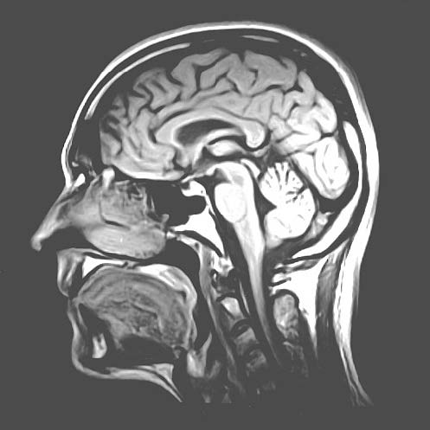
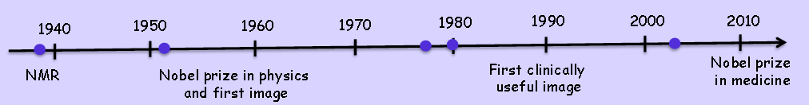
Magnetic Resonance Imaging - MRI
First human body scan

Slide 27
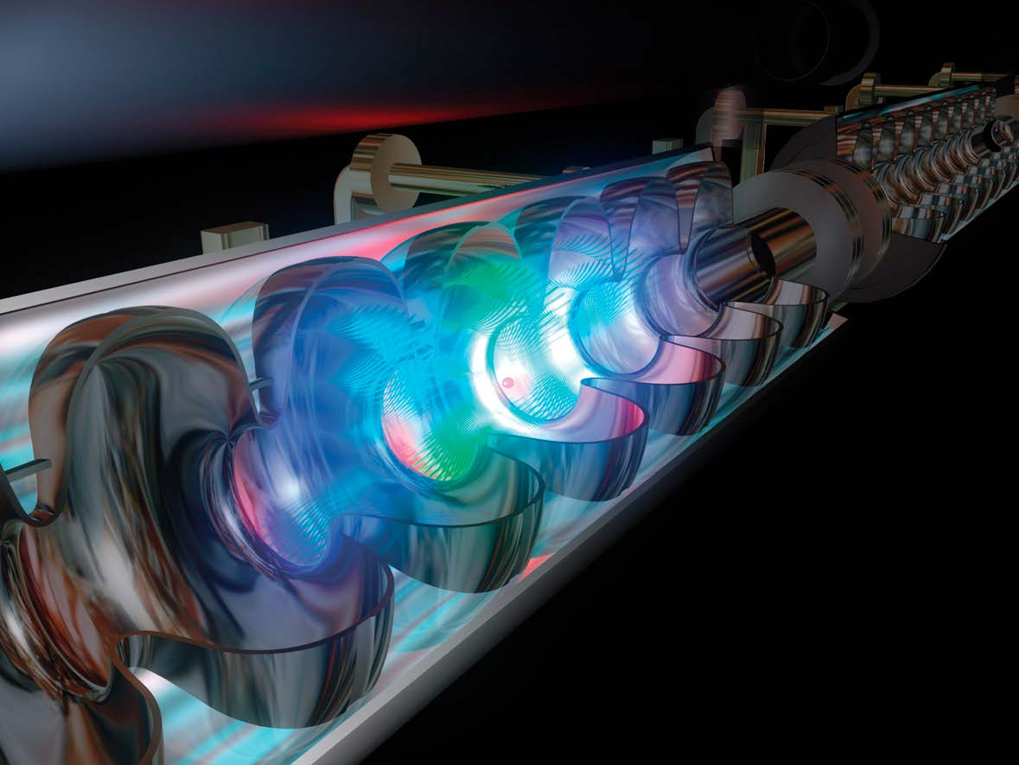
Accelerators for Cancer Treatment

Slide 28
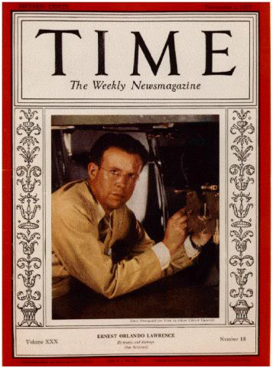
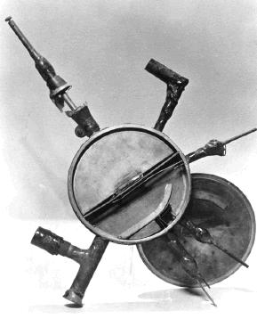
The 1st Cyslotron
E. O. Lawrence is awarded Nobel Prize in 1939
Ffor inventing the cyclotron 1937

Slide 29
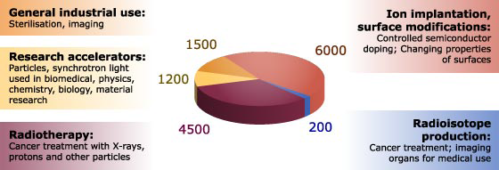
Use of Accelerators Today

Slide 30
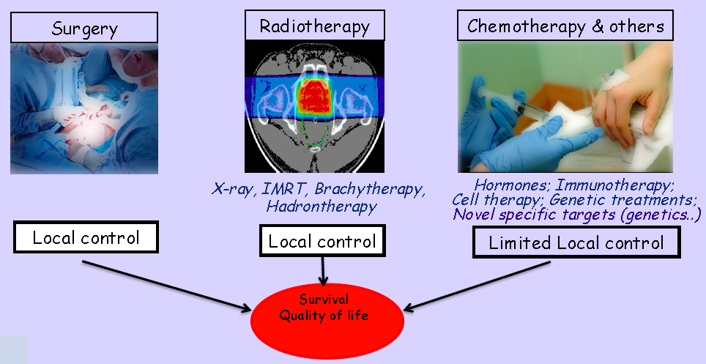
Cancer a growing societal challenge !
Over 3 million cancer cases in Europe each year

Slide 31
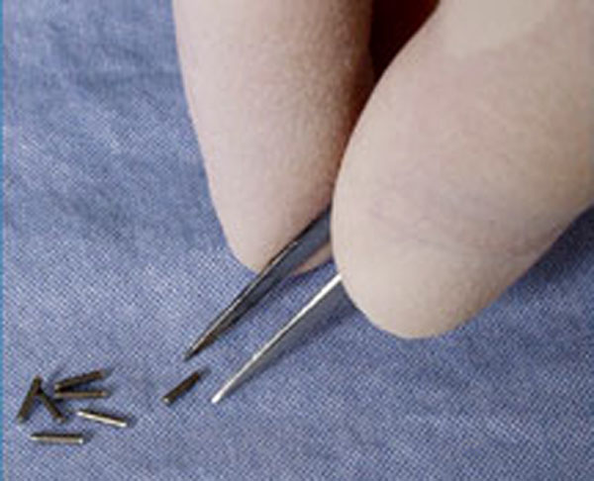
Radiotherapy
After diagnosis some diseases like hyperthyroidism, cancer, blood disorders, etc… can be treated using radiotherapy
Three main methods:
• Unsealed source radiotherapy
• Brachytherapy (sealed source therapy)
• External beam: x-‐rays, electrons, p, n, heavy ions
Stages in the radiotherapy process:
QA, Imaging, Planning, Simulation,
Treatment, Verifikation, Modelling Outcome
Physics, engineering, imaging, technology based
"seeds”‐ small radioactive rods implanted directly into the tumor

Slide 32
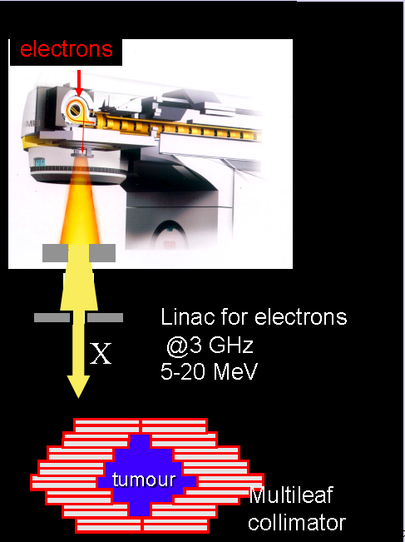
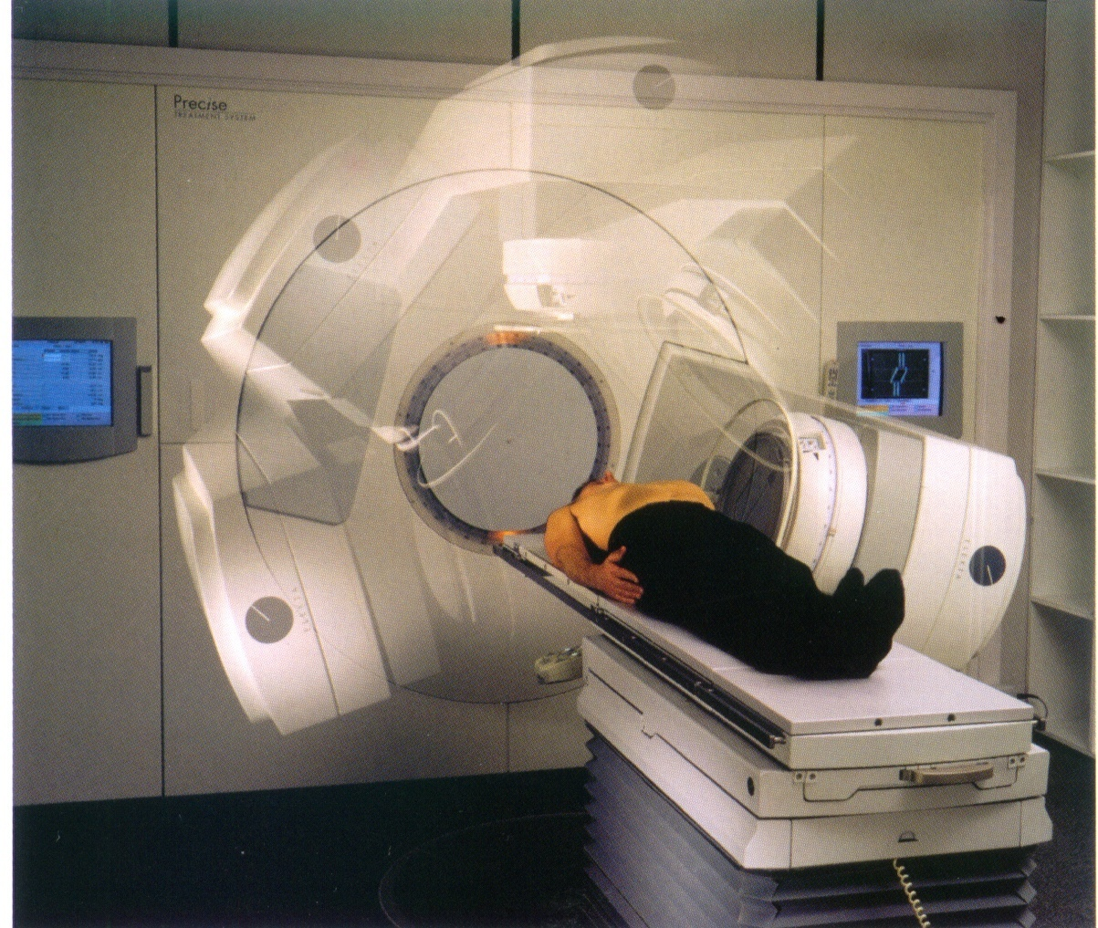
Conventional Radiotherapy
20 000 patients per year every
10 tumor million inhabitants
1 linac every <250,000 inhabitants
More than 7000 linacs in the world for radiotherapy

Slide 33
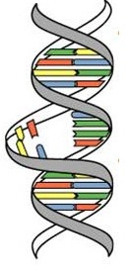
Radiotherapy in the 21st Century
3 "Cs" of Radiation
Cure (~ 45% cancer cases are cured)
Conservative (non-invasive, few side effects)
Cheap (~ 5% of total cost of cancer on radiation)
There is no substitute for RT in the near future
The rate of patients treated with RT is increasing
Present Limitation of RT:
~30% of patients treatment fails locally

Slide 34
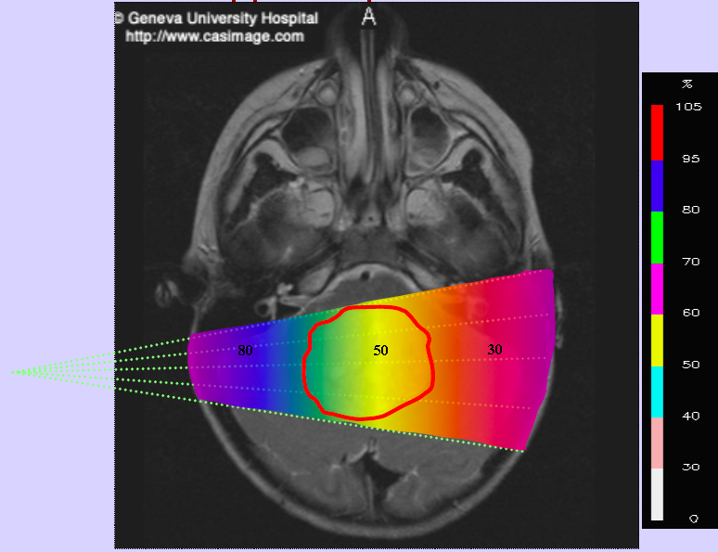
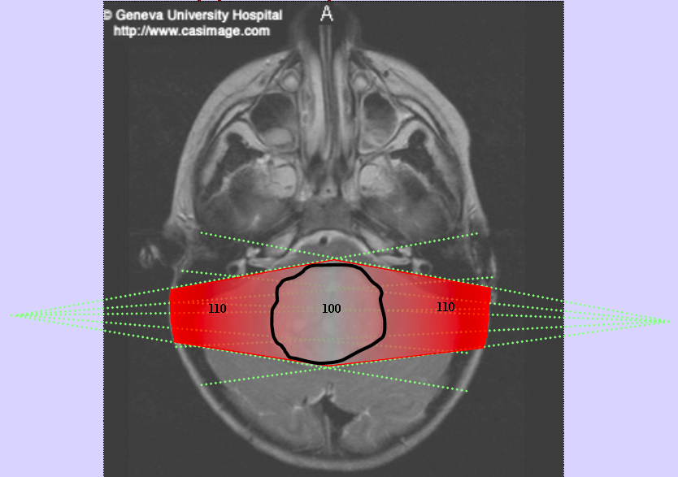
Two Opposite Photon Beams

Slide 35
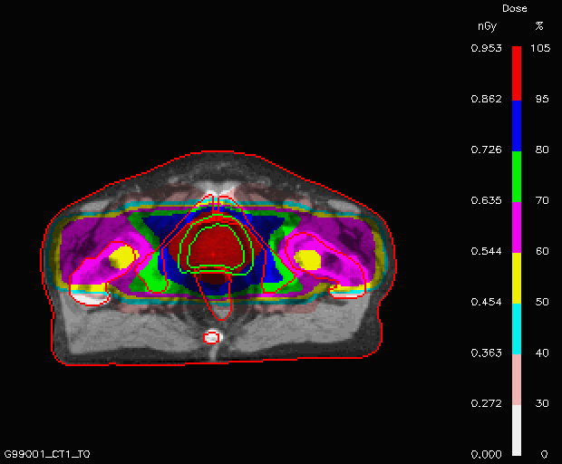
Two Opposite Photon Beams

Slide 36
How to decrease the failure rate?
• Accelerator technologies to improve treatment : higher dose
• Detectors/imaging: accuracy, multimodality, real-time, organ motion
• Biology: fractionation, radio-resistance, radio-sensitization
• Data: storage, analysis and sharing
• Collaboration in this multidisciplinary field is key
Raymond Miralbell, HUG

Slide 37



Hadron Therapy : All started in 1946
In 1946 Robert Wilson:
– Protons can be used clinically
– Accelerators are available
– Maximum radiation dose can be placed into the tumor
– Particle therapy provides sparing of normal tissues
- Tumors near critical organs
- Tumor in children
- Radio-resistant tumors
Conventional: X-Rays Ion Radiation

Slide 38


Hadron Therapy
Optimization of the natural distribution of dose

Slide 39

Hadron Therapy Timeline

Slide 40

Why Hadron Therapy
Tumors near critical organs
Tumors in children
Radio-resistant tumors

Slide 41

Photons vs Protons

Slide 42


Carbon Ions Project : pilot project in Europe
• GSI – Darmstadt (1997 – 2008)
• G. Kraft (GSI) & J. Debus (Heidelberg)
– 450 patients treated with carbon ions

Slide 43


HIT - Heidelberg
Beam transport line
Quality
control
Synchrotron
Ion source
Gantry
Treatment rooms
Siemens Medical

Slide 44

HIT - Heidelberg

Slide 45


Real time Monitoring
MC simulated
measured
On-line determination of the dose delivered
First time in 110 years !
Modeling of beta+ emitters:
        Cross section
        Fragmentation cross section
        Prompt photon imaging
        Advance Monte Carlo codes

Slide 46



PIMMS project at CERN (1996-2000)
Proton Ion Medical Machine Study

Slide 47


CNAO – Pavia Italy

Slide 48




ISOLDE
Isotopes for detection and treatment
1.4 GeV protons from PS-Booster
Beam lines
GPS
In collaboration with University Hospital Geneva
HRS Target station

Slide 49



Radio-Isotopes production
Nuclear
Reactions
Accelerators
          Circular
          Linacs

Slide 50

LINAC for Radio-Isotopes production

Slide 51

LINAC for Radio-Isotopes production

Slide 52

Radio-Isotopes for PET
Isotope
Half -time
Maximum
Energy (MeV)
Range in H₂O
(mm)

Slide 53

Thank you for your attention

