Slide 1
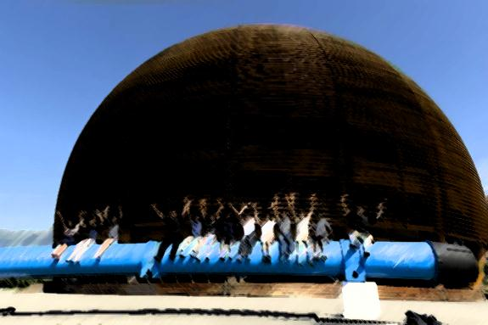

Introduction to Energy
& Power Conversion
Greek Teachers Programme 2018
Konstantinos Papastergiou | Technology Department
CERN – European Organisation for Nuclear Research

Slide 2
το CERN στα μάτια μας

Slide 3

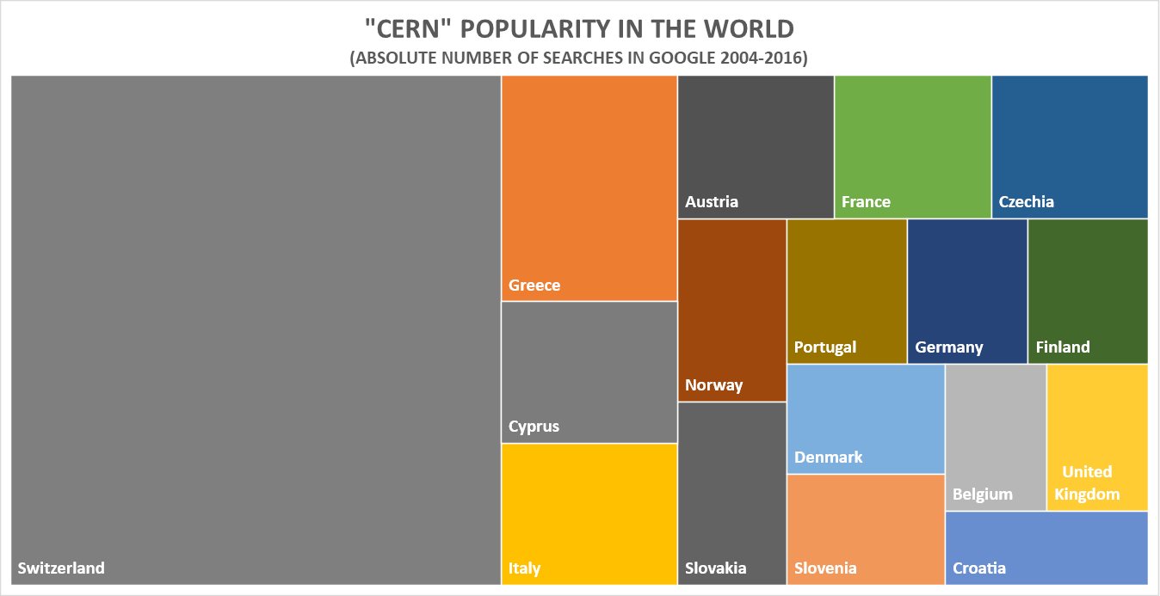
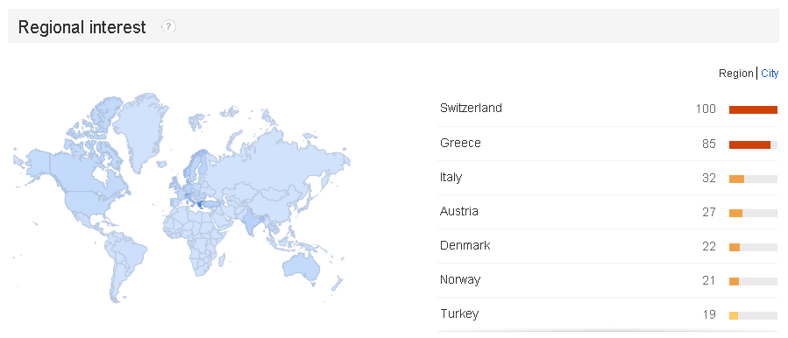
cern
2008 only
16
100 searches
10

Slide 4
1897
Ανακάλυψη ηλεκτρονίου
Nobel 1906, Joseph John Thomson, Cambridge Cavendish Laboratory

Slide 5
Summary
Energy consumption at CERN
  How is energy used?
  Electricity, Water and Gas
From Electrical to Kinetic Energy
  How is electricity converted to acceleration?
Key electrical consumers?
  Components with power requirements
Electronics and Power Electronics
  What is the difference
Power Conversion Principle
  Why and how is energy converted
Accelerator Power Electronics
  Real world systems – how do they look
Research Challenges
  The future in powering accelerators

Slide 6
CERN και ενέργεια

Slide 7
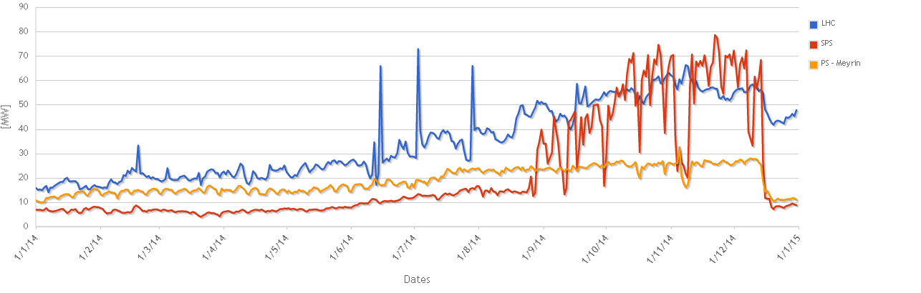
Electricity at CERN
Interconnections to both France and Switzerland
Approximately 80% of electricity from France
  French Energy mix: 75%Nuclear,16% Hydro, Thermal 9%
1000 high voltage circuit breakers in operation
Consumption
  as high as all households in Geneva area
  1/10th of the canton (11.3TWh).
2014: Preparations for Machine start-up

Slide 8
Energy Facts & Figures
Total consumption 1 230 000 000 kWh/yr (at home ~ 11 000kWh/yr)
  43% consumed by the LHC
    Up to 14% by superconductive magnet cooling
    Up to 9% equipment cooling and tunnel ventilation
  11% by its Experiments
  30% by SPS
    7% at its Experiments
  3% PS-booster-Linac
  6% Data Centres
  7% in offices, restaurants etc.
Notes:
http://cds.cern.ch/record/1324541?ln=fr Francois Duval EN/EL
61TWh consumed in Greece

Slide 9
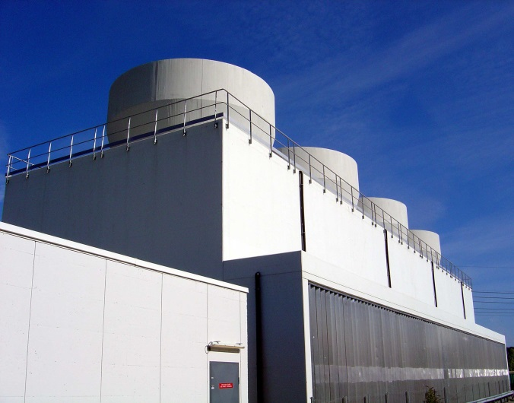
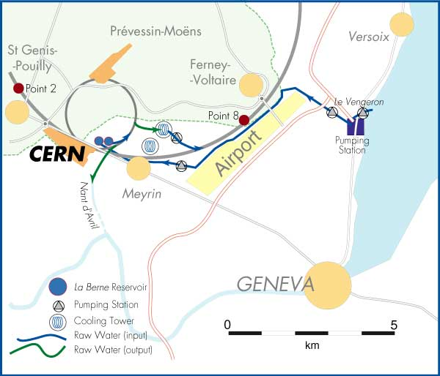
Water
5 million m³ of water mainly from the lake
Closed circuit of demineralised water and secondary circuit of raw water cooled in cooling towers.
Industrial process water
  Surface treatment
  Production of demineralised water

Slide 10
Natural Gas
Heating stations at Meyrin 8 million m³
Heating station at Prevessin – 1.5million m³
Operated by external companies
  Monitor dust, CO, CO2, nitrogen oxides and sulphur oxides

Slide 11
η ενέργεια στους επιταχυντές

Slide 12
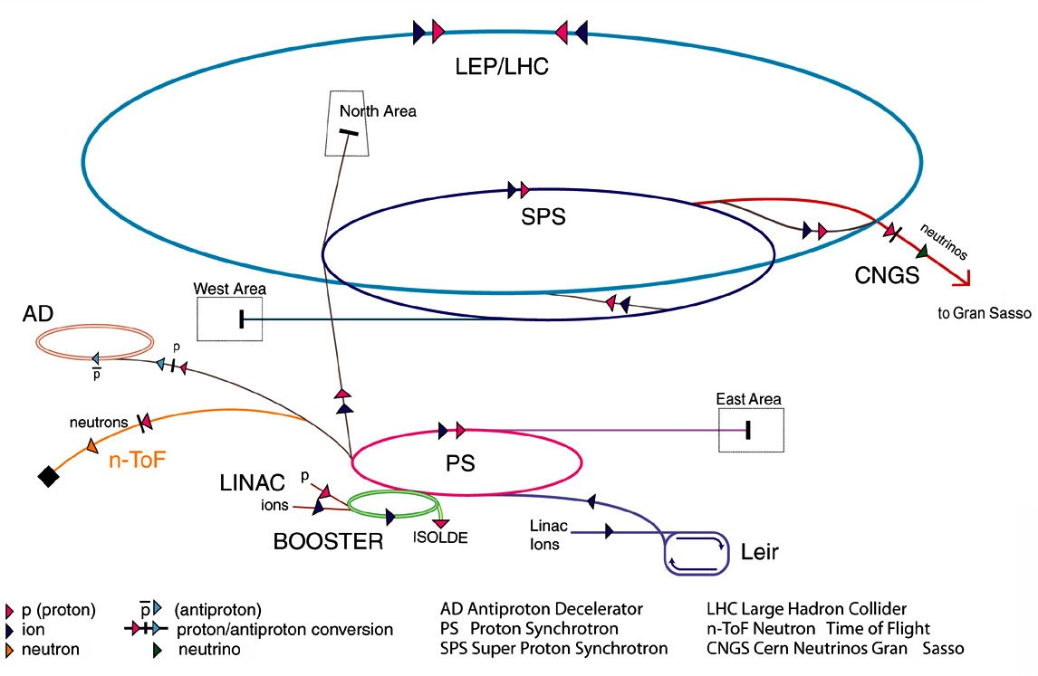
Accelerators at CERN
12

Slide 13
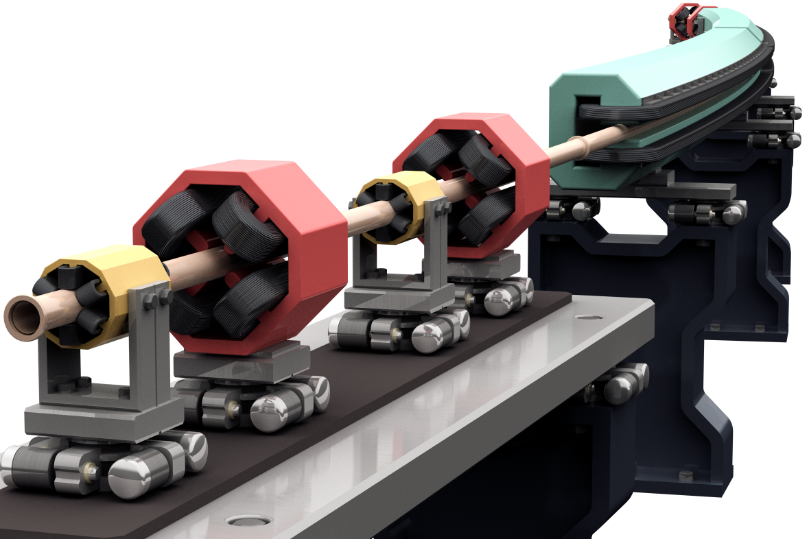
Key Energy Consumers
Direct Energy to the beam
  RF cavities - Klystron
  Magnets
Environmental Conditioning
  Cryogenics
  Systems cooling
  Tunnel air filtering
Data
  Measurements
  Processing
Infrastructure
Other
(c) Rey.Hori / KEK

Slide 14
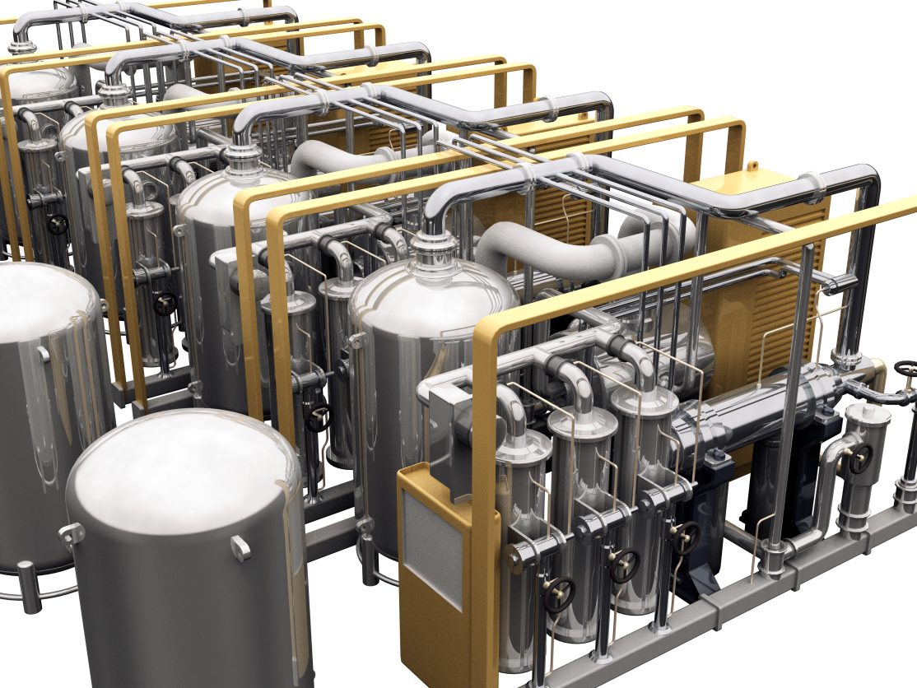
Cryogenics
Cryogenic pumps are the largest single electrical consumer at CERN
Peak power: 50MW
6 weeks to cool down Helium to 1.8K to 4.2K
(c) Rey Hori / KEK

Slide 15
Force on Charged Particle
The force on a charged particle is proportional to the charge, the electric field, and the cross product of the velocity vector and magnetic field:
Lorenz force:
Where q is the electrons’ (positrons’, protons’…) elementary charge:
For conservative forces (work done independent of the path) the work done by a force F along the path s₁->s₂ transversed by the particle is:
by differentiating:
Conclusion the magnetic field does not produce any work on the direction of the vector travelled by the charged particle. Energy (acceleration) is only gained under the effect of electric field.

Slide 16
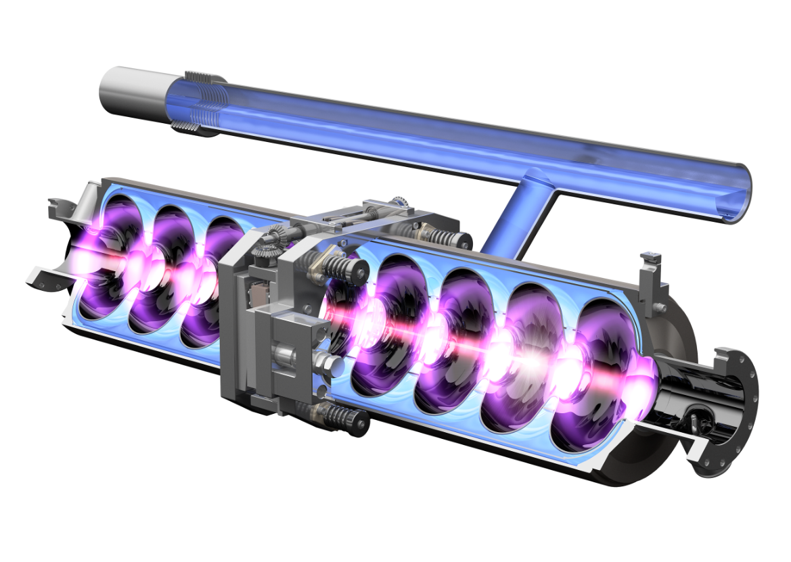
RF Cavities - Klystron
Functions:
Particle acceleration
* The rythm of energy build up depends on the particles’ charge and the electric field voltage
(c) Rey Hori / KEK
Particle arrives “early”
Particle arrives “late”
beam
+
-
t₀
t₁
t₂
Particles bunched”

Slide 17
Εlectro-magnets
Functions:
Beam steering
At first sight F is not dependent on mass
Since v on a circle of radius ρ-> F = centripetal force
* γ : lorenz factor (γ=1/(1-v²/c²)
Rearanging yields the beam rigidity i.e. a measure of the force needed to bend the charge direction
And the bending angle inside a magnet field
The integrated field is a magnet property also given by Amperes law:
*μ₀: magnetic permeability of the air

Slide 18
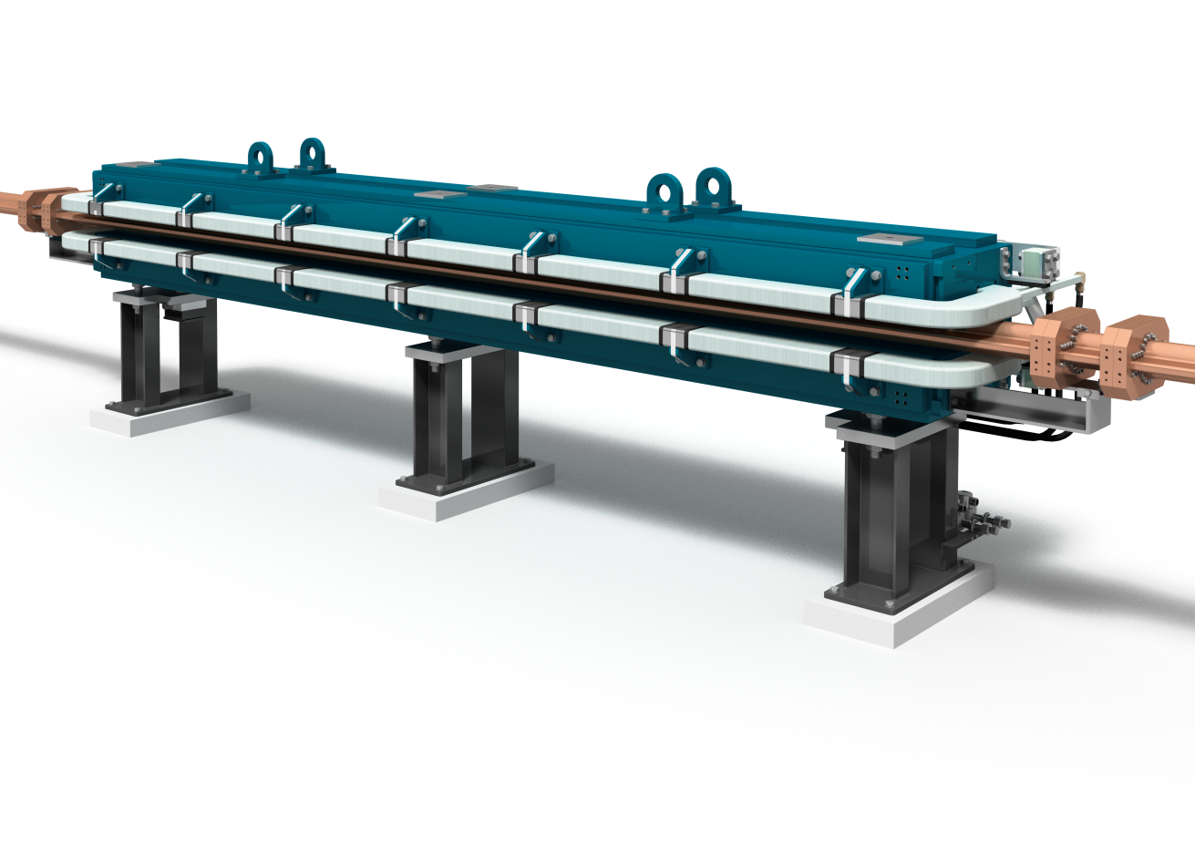
Dipole magnet
Functions:
Beam steering
Stores energy E=0.5 L I²
Consumes power P=I² R
(c) Rey Hori / KEK

Slide 19
Quadrupole magnets
Functions:
Focussing-defocusing
Two particles enter in the accelerator with different velocity vectors:
Betatron Oscillation
Particle on trajectory B
Particle on trajectory A (reference trajectory)

Slide 20
1880s
the war of currents

Slide 21
Thomas Edison VS George Westinghouse
Direct VS alternating current
AC has two key advantages
  Voltage/current can be transformed
  Current can be interrupted
Whereas DC is:
  Less dangerous* but
  May not be interrupted with standard switches
  Could not be transmitted in long distances due to the lack of dc transformers
Westinghouse won the battle!!!
  Alternating current is standard and can be transformed, transmitted to distances of several hundred kilometres and may be interrupted with standard mechanical breakers.
  It took us a century to develop technology for handling DC currents!
* If compared to a similar voltage level 50Hz alternating current of which the fluctuations can induce arrhythmia and eventually result in ventricular fibrillation of the heart

Slide 22
Edisson VS Westinghouse
Electrical power is P_{tot}=voltage (v) x current (i)
Using conductors to transmit power hence R_{copper}
Power is lost on the way P_{loss}=I²R
Hence useful power is P_{useful}=P_{tot}-P_{loss}
2 Solutions to save energy:
  Increase Voltage -> voltage transformation
  Decrease Resistance-> superconduction
Notice! Ploss is a function of I and R. Decreasing I by a factor of 2 decreases power loss by 4

Slide 23
In the LHC
designed for a momentum of p=7000GeV/c per beam
Aproximately 66% of space is allowed for dipole magnets ->17617.6m
LHC circumference 26658m-> radius=4242.9m
There are 1232 main dipoles -> α=360/1232=0.29 ̊
Field in the LHC=7Tesla -> I=… for protons charged at
Notice! High current is the objective
P_{loss}= I²R still valid! Cannot reduce I!! But can reduce R-> superconductivity!!!

Slide 24
Εισαγωγή στους
Μετατροπείς Ισχύος

Slide 25
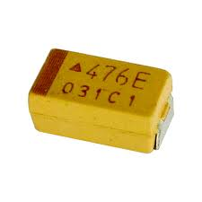
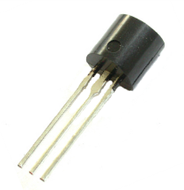
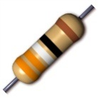
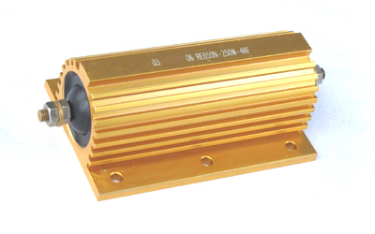
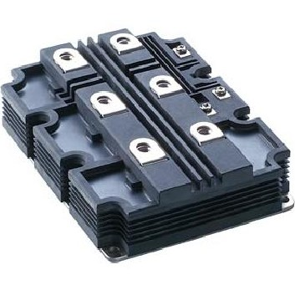
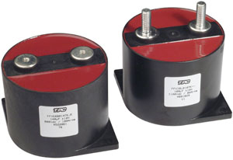
Electronics & Power Electronics
Electronics is the art of manipulating the flow of electrons to perform certain functions
  Receive, transmit and store information
  Generate electromagnetic waves (heat,light)
  Convert electricity to kinetic energy (motors
Analog &
Digital Electronics
Power Electronics

Slide 26
Power Conversion
Electrical voltage needs to be transformed
  From direct to alternating current and the opposite
  From one voltage to another
  From one frequency to another
DC
Choppers
DC
INPUT
Constant magnitude and frequency
inverters
OUTPUT
adjustable magnitude and frequency
rectifiers
AC
AC
Cycloconverters
Notes:
Similar to the mobile charger

Slide 27
Power Converter Structure

Slide 28


The basic power converter
Voltage regulator operation based on switching on and off the input source with a duty cycle D.
Inductor operates as averaging device
$$V_{out}=D.V_{in}$$
$$0<D<1$$

Slide 29
Power Semiconductors
Power Semiconductors
Diodes
Line-commutated
Self-commutated
Fast
Line-commutated
Avalache
Thyristors
Thyristors
Transistors
Turn-on
Bidirectional
Low losses
MOSFET
IGBT
BIGTs and other
GTO
IGCT
ON
OFF
ON
Ik
Ik
Ik
Vk
Vk
Vk
Based on slide by Frederick Bordry, CERN Accelerator school 2009

Slide 30
Modulation
Control of the fundamental frequency component (AC or DC) by varying the switch duty ratio

Slide 31
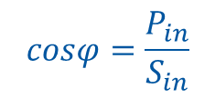
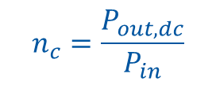
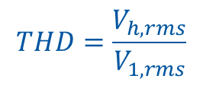
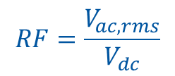
Figures of merit in PE
Power conversion efficiency
  Expresses the effective-ness of a converter in converting input power to useful output power (with less wasted power in the process)
Input Power factor
  A high power factor typically indicates a lower input current for delivering a certian output power level. (as usually input sources have a stiff voltage magnitude)
Ripple factor
  Is a measure of the voltage or current ripple magnitude in dc voltage or current waveform
Total Harmonic Distortion (THD)
  is a measure of its RMS power of the harmonic components in comparison with the RMS power of the fundamental component of a voltage or current waveform.
$$n_{c}=\frac{P_{out,dc}}{P_{in}}$$
$$cosφ=\frac{P_{in}}{S_{in}}$$
$$RF=\frac{V_{ac,rms}}{V_{dc}}$$
$$THD=\frac{V_{h,rms}}{V_{1,rms}}$$

Slide 32
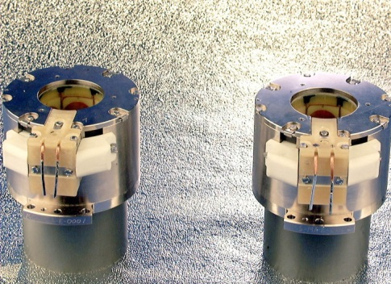
LHC – the Large Hadron collider
The beams are controlled by:
    1232 SC Main Dipole magnets to bend the beams
    392 SC Main Quadrupole magnets to focus the beams
    124 SC Quadrupole / Dipole Insertion magnets
    6340 SC Corrector magnets
    112 Warm magnets
    SC RF Cavities to accelerate and stabilize the beam
(in 196 circuits of ~ 6 kA)
(in 1460 circuits 60 to 600A)
(in 38 circuits 600 to 900A)
All ~8000 magnets need to be powered in a very controlled and precise manner

Slide 33
Converter operating modes
V
+
-
I
1 Quadrant mode
V
I
+
-
-
+
2 Quadrants mode
V
I
+
-
-
+
V
4 Quadrants mode
4
1
3
2
I
Slide by Frederick Bordry, CERN Accelerator school 2009

Slide 34
Current Regulation Precision
Current in a transfer line magnet
Precision components:
Current ripple
Short-term (dynamic behaviour)
Long term (reproducibility)
Typical requirements:
1-100ppm depending on application

Slide 35
LHC Powering Challenges
Installation (LEP infrastructure) and Operation
  volume (a lot of converter shall be back-to-back)
  weight (difficult access) => modular approach
  reparability and rapid exchange of different parts
  radiation for [±60A,±8V] converters
  losses extraction : high efficiency (>80%) , water cooling (90% of the losses)
  high reliability (MTBF > 100’000 h)
  EMC : very close to the other equipment ; system approach
Slide by Frederick Bordry, CERN Accelerator school 2009

Slide 36
LHC Power Converters
A- Elementary module [3.25 kA, 18V], [2kA,8V] :
  Switch Mode Converter (25-40 kHz, soft commutation)
  Modular approach : 4.0 kA (28) , 6.0 kA (160) , 8.0 kA (8) , 13 kA (18)
  Redundancy; small volume and weight
B- Unipolar and Bipolar converters 600A
  [± 600 A,± 10 V] : (~ 400)
  [± 600 A,± 40 V] : (~ 40)
  Energy dissipation SMPC : soft commutation ; 50-100 kHz
C- Bipolar converter [±60 A, ± 8 V] and [±120A,±10V]
  SMPC : soft commutation SMPC : soft commutation
  High reliability, radiation resistance (tunnel installation)
D- High voltage power converter [13 kA, ±180 V] (8)
  High power SCR converter and Topology studies
  Ramp (up and down) : [13 kA, ± 180 V] Flat bottom and flat top : [13 kA, 18 V]
  SCR converter : [13 kA, ± 180 V] with Active filter : ±600A,±12V

Slide 37
Power Converter topologies
Two Quadrant Phase Controlled Rectifiers for high current SC magnets:
- Used for booster of Main Bend and large warm magnets
Freewheel
circuit
+15º
3 Phase
50 Hz
Supply
-15º
Good Symmetry
-Voltage bandwidth < 70Hz
- Well proven
Inversion possible
Active filter (4% of the output voltage)
Slide by Frederick Bordry, CERN Accelerator school 2009

Slide 38
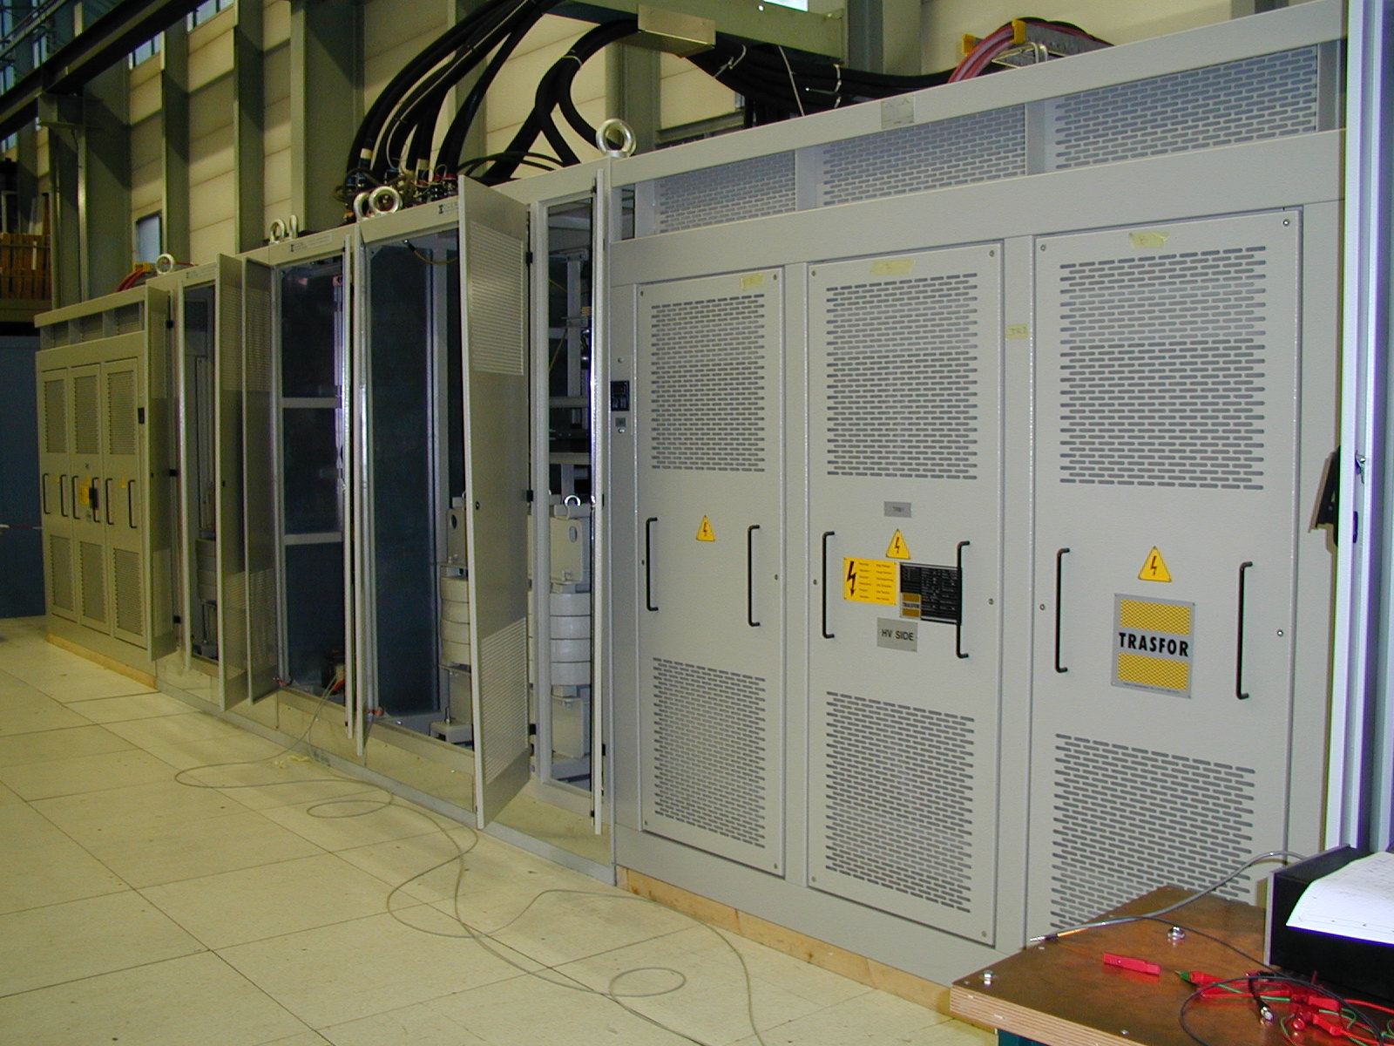
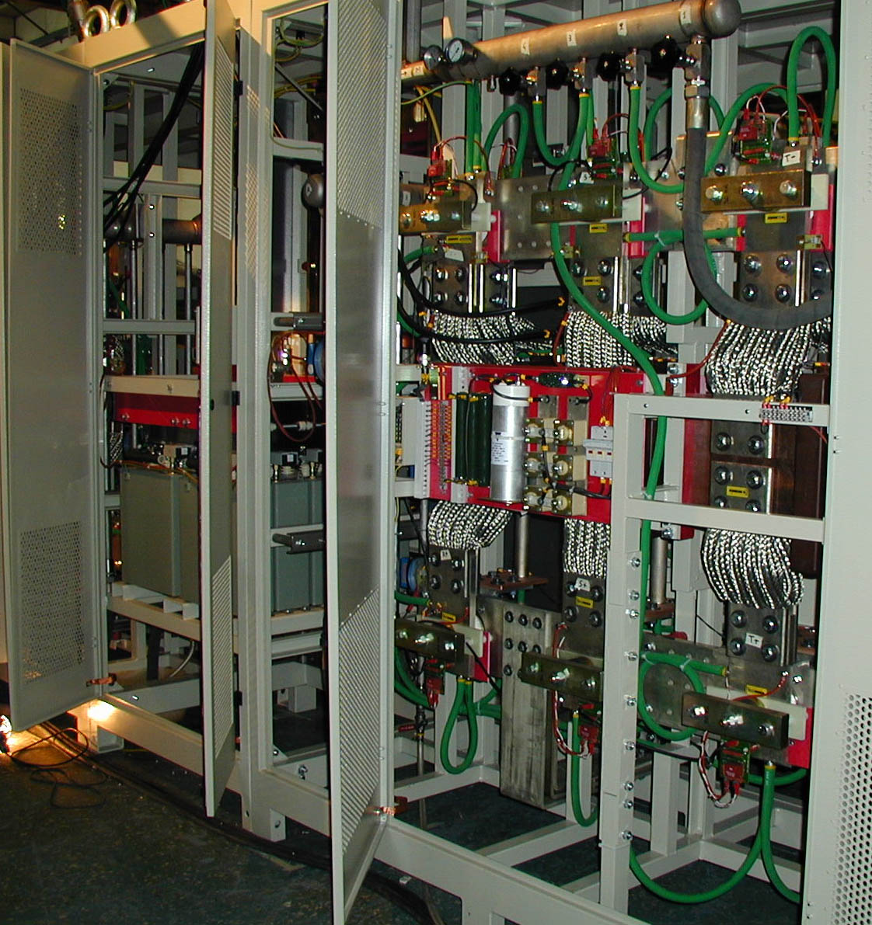
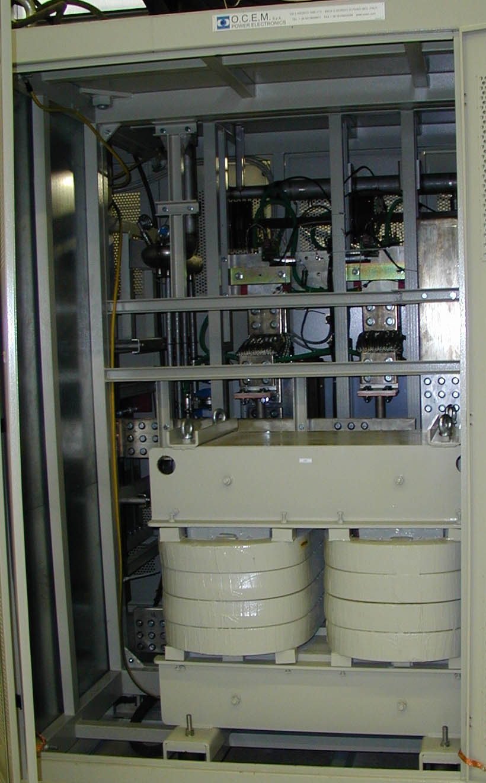


Slide 39
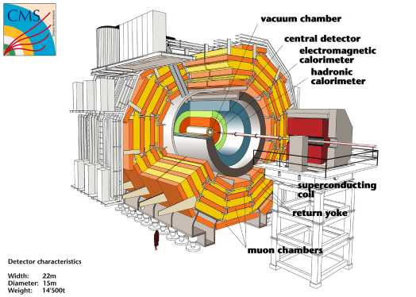
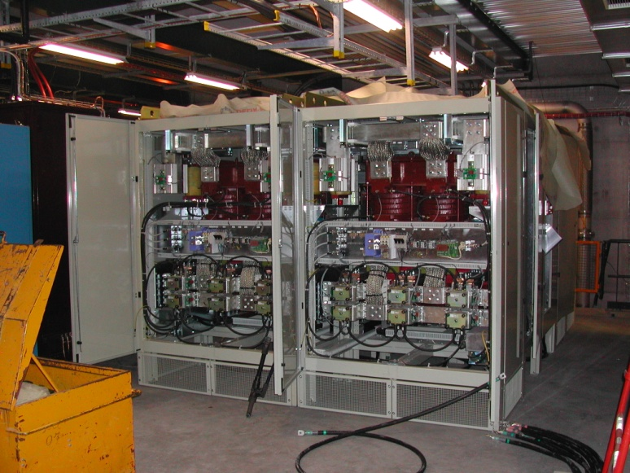
20kA power converter -CMS Solenoid
The load
Superconducting magnet: L= 14H
Nominal current: 20 kA
Stored energy: 2.8 GJ
Time constant: 39 hours
Time for current ramping up: 3h15m
Energy extraction system (resistor bank, not shown)
The power converter
Slide by Frederick Bordry, CERN Accelerator school 2009

Slide 40
Converter modularisation
3.25 kA , 18 V
3.25 kA , 18V
13 kA, 16V
3.25 kA , 18 V
Subconverter
(Current source)
3.25 kA , 18 V
3.25 kA , 18 V
+
-
Reactive network
3.25 kA , 18 V
n + 1 subconverters : redundancy, reliability
repairability
ease of handling underground
versatility (6.5kA, 9.75kA, 13kA, 21 kA)
Converter

Slide 41
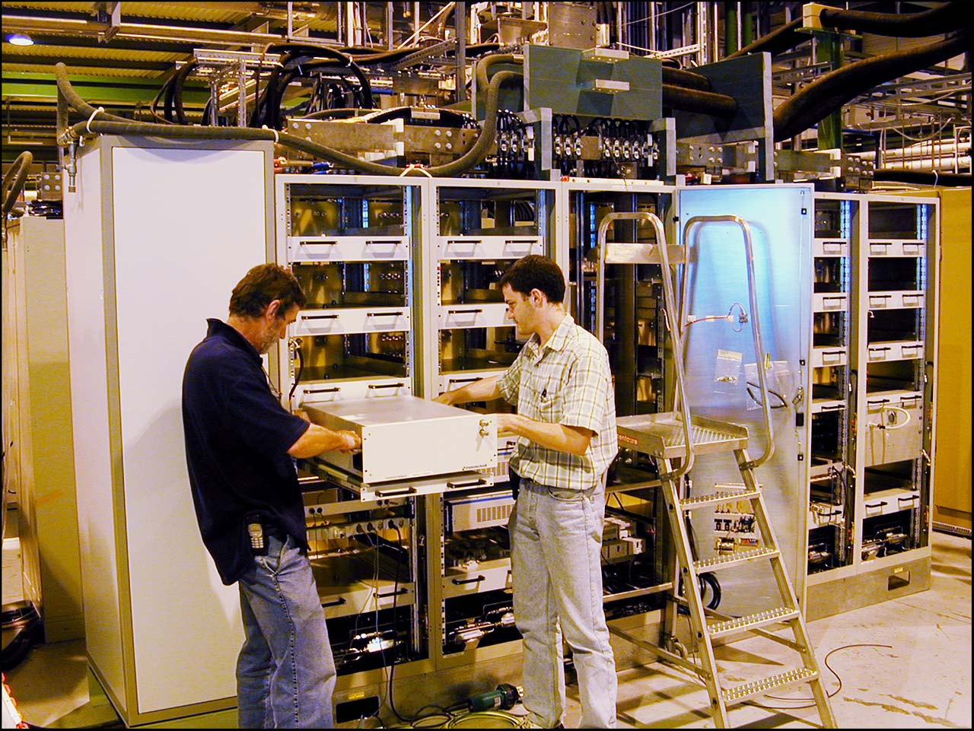

Slide 42
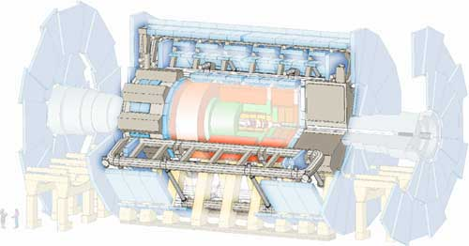
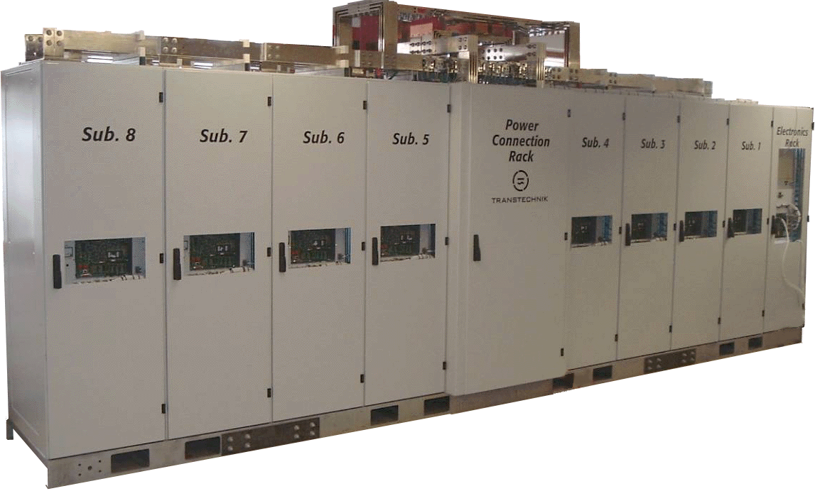

20.5kA power converter – ATLAS solenoid
The load
Superconducting magnet: L= 7.5 H
Nominal current: 20.5 kA
Stored energy: 1.6 GJ
Time constant: 37’500 s
The power converter : [20.5 kA, 18V] ; (7+1) x [3.25kA,18V]
Slide by Frederick Bordry, CERN Accelerator school 2009

Slide 43
Typical Converter topology (120A,10V)
BREAKER &
CONTACTOR
INPUT FILTER &
SOFT-START
SOFT COM. INVERTER,
50kHz..100kHz
ISOLATION &
RECTIFIER + FILTER
4Q.L.S.
Slide by Frederick Bordry, CERN Accelerator school 2009

Slide 44
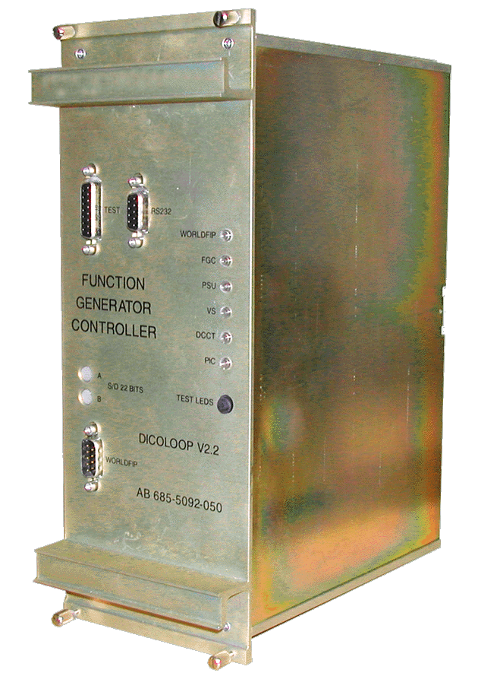


Digital control design
Tracking
Regulation
Tracking and Regulation with independent objectives
Ts
y(t)
yref(k)
T
1/S
Power Part
DAC
k.Ts
Digital controller
Digital
Filter
Anti
aliasing
filter
R
÷ k
ADC
Frequency
Divider
Over sampling
Slide by Frederick Bordry, CERN Accelerator school 2009

Slide 45
Έρευνα: πιο αποδοτικά συστήματα τροφοδοσίας

Slide 46
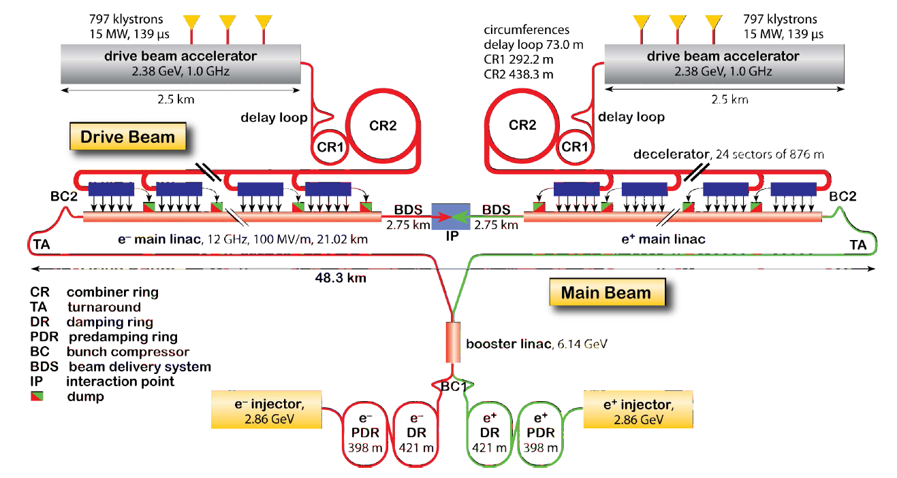
Compact Linear Collider (CLIC)
RF modulators are the primary electrical power consumer
Pulses of 139us 150kV and 160A resulting in bursts of 24MW per modulator
139µsec
Power 39GW
20000µsec
Notes:
Klystrons (RF power generation) are the main consumer of energy
Beams of high current (relatively low energy) are created in the combiner rings
Drive beam transferred to the Power Extraction and Transfer System (PETS)
Drive beam energy is extracted through the low impedance/high impedance transformer (this is what PETS effectively is)
Drive beam is dumped
Main beam is low current but high energy (low current obviously as there is no combiner rings).

Slide 47
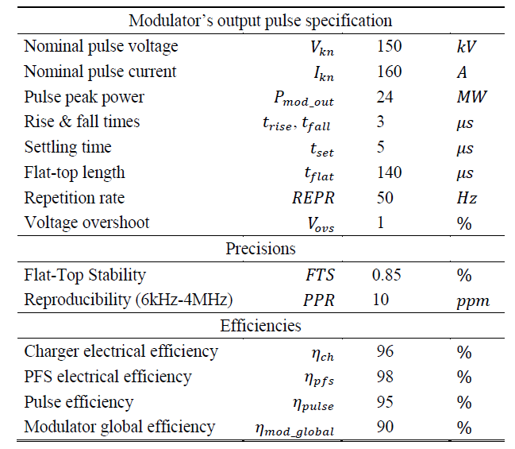
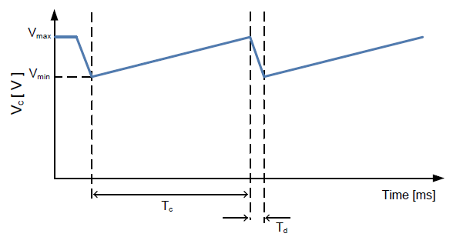
CLIC Specifications
Application parameters:
The load is 1638 Klystron tubes
150kV/160A 140µs flat-top required -> 24MW peak per Klystron -> 39.3GW peak load
Average power per klystron modulator 168kW
Accounting for a 90% efficiency (plug to drive beam) -> total average power 275MW

Slide 48

CLIC Grid interface
The network impedance limits the power that can be drawn.
At the rated power network impedance will be responsible for <10% voltage drop.
Drawing 39000MVA out of a 300MVA transformer would collapse the voltage (hence tripping the protections)

Slide 49
From 2Q to multilevel
Q1: V: positive
I: positive
Q2: V:positive
I:negative

Slide 50
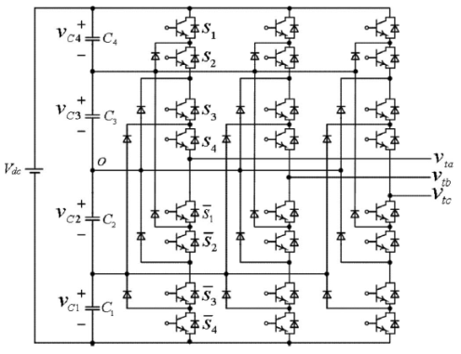
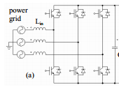
AFE Concepts
Topology comparison for:
high voltage (>20kV) and
high power (>20MW) applications
Three phase-bridge
Five level NPC
Modular-multilevel-converter (MMC)
AC Filter size | ◆ |  | 
Control system |  |  | 
Reliability  |  |  | 
Spares inventory |  | ◆ | 
Power range |  |  | 
Mechanical integration |  | ◆ | 
particularly interesting at higher voltage/power applications

Slide 51
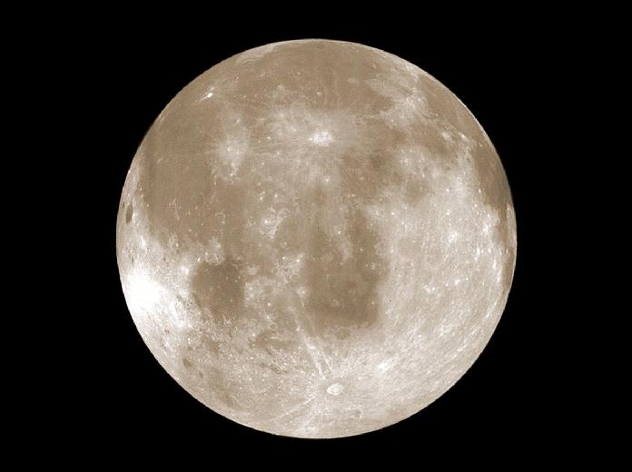
Ερωτήσεις;
http://www.cern.ch/aftervisit

Slide 52



Life at CERN

