Slide 1
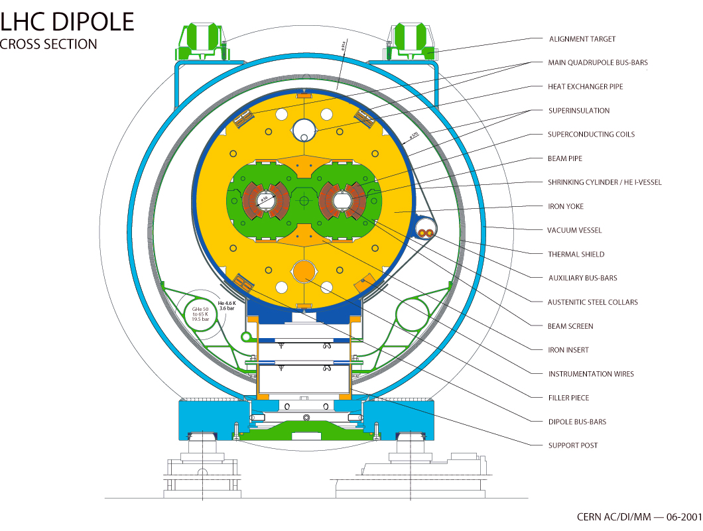
Cryostats: main features
LHC Main Cryostat
(Cross-Section)
Alignment targets
Super Insulation (MLI)
Vacuum Vessel
Thermal Shield
Bottom tray
(50-65 K feed line)
5-20 K support post
Heat intercept
Magnet Support Posts (GFRE)
External supports (jacks)

Slide 2
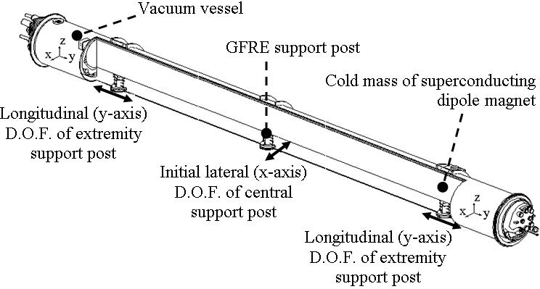
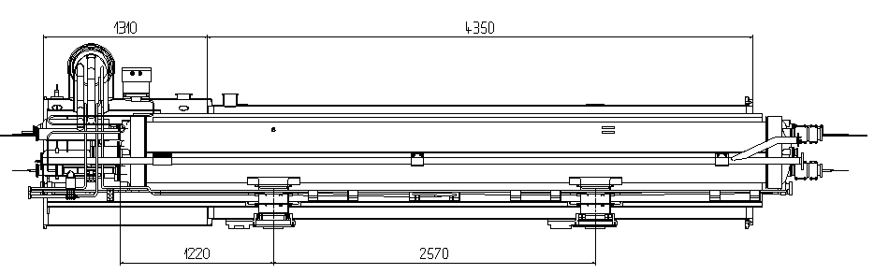
Magnet Supporting Systems
Cryo-dipole:
3 supports
central support fixed
- extremity supports slide
15 m
Arc SSS:
2 supports
left support fixed
- right support slides
~ 6 m
fixed
sliding
Longest SSS (in LSS):
3 supports
left support fixed
- other 2 slide
~ 14 m
fixed
sliding
sliding

Slide 3
External Supporting System
LHC arc half-cell
(top view)
SSS
Cryo-dipole
Cryo-dipole
Cryo-dipole
Jack
Central jack (“crutch” for vertical sag adjustment only)
SSS

Slide 4
Assembly interface (SSS)
Fixed support
longitudinal view
transversal view
Sliding support
longitudinal view
transversal view

Slide 5

Requirements
Main requirements¹:
Mechanical function:
  Supporting of heavy cold masses (100 kN per support)
  Accurate & stable positioning of cold mass in vacuum vessels
  Corollary: withstand load cases throughout life-cycle :
  assembly, handling & transport, cryo-magnet testing, LHC commissioning, LHC operation
Thermal insulation:
  Minimise overall heat loads
  Minimise 1.9 K heat loads in particular
Alignment targets
Vacuum Vessel
Bottom tray
(50-65 K feed line)
5-20 K support post
Heat intercept
Magnet Support Posts (GFRE)
External supports (jacks)
Design and choice of the material²:
Trade-off between stiffness and thermal conductivity
Glass-fiber/Epoxy
Fibre vol. fraction (Vf): 50% <Vf<60%
1 V. Parma et al. “Supporting systems from 293 K to 1.9 K for the Large Hadron Collider (LHC) cryo-magnets”,
Advances in Cryogenic Engineering, Vol. 43-A (427-434).
2 - V. Parma et al. “Thermal performance of the supporting system for the Large Hadrn Collider (LHC) super-conducting
magnets”, Advances in Cryogenic Engineering, Vol. 45-A (795-802).

Slide 6
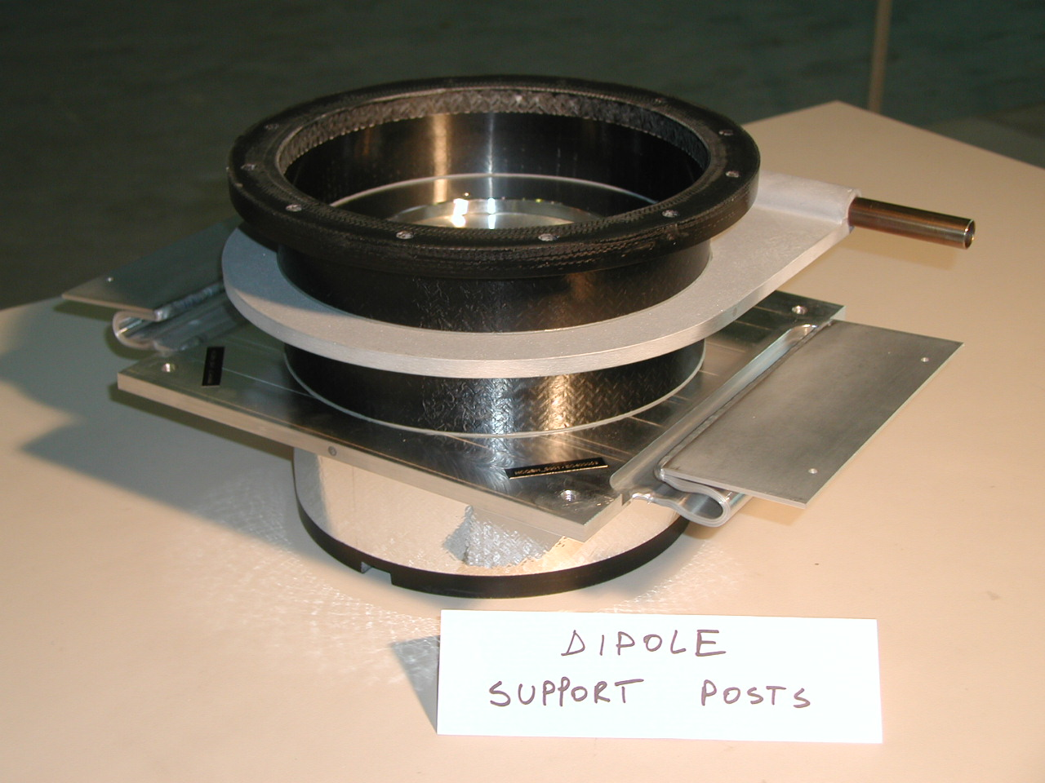
GFRE Support Posts
Cold mass interface flange: 2 K
5-10 K heat intercept
GFRE composite
column
50-65 K heat intercept
Vacuum vessel
Interface flange: 293 K
Features:
4-mm thickness, single-part composite column (integrating interface flanges)
Manufactured by Resin Transfer Moulding (RTM):
  Suited to a large-scale industrial production
  High reproducibility in quality
Limited machining at interface, for tight dimensional tolerances (H7/g6 at assembly) without undermining mechanical integrity
2 aluminum heat intercepts at 5-10 K and 50-75 K to enhance thermal performance

Slide 7
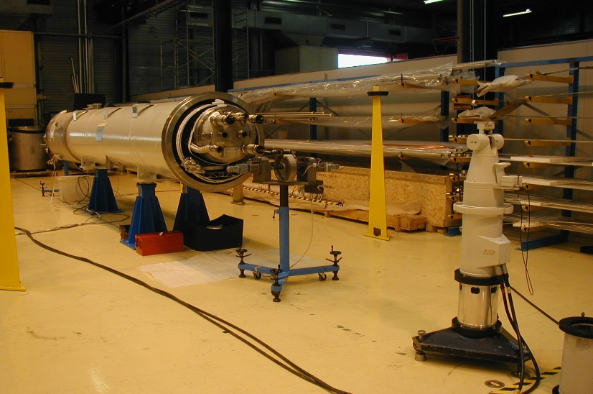
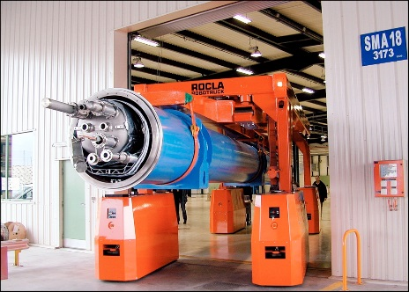
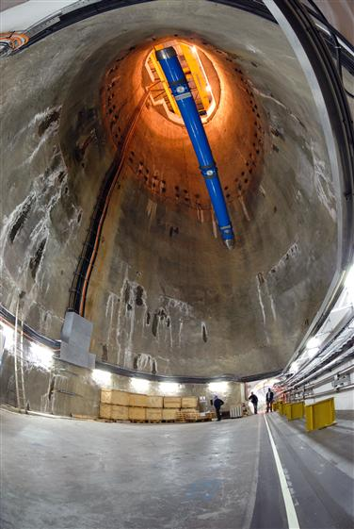
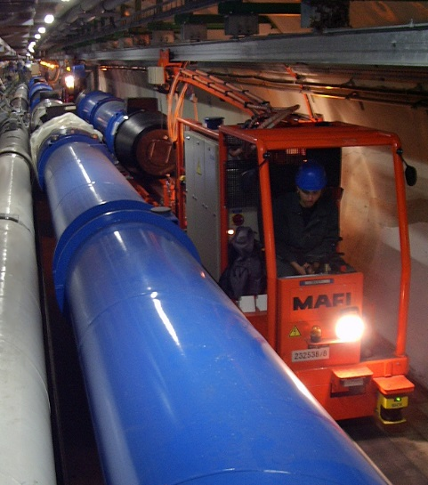
Geometrical Stability: survey measurements
SSS positional stability and reproducibility at cold
Cryo-dipole positional stability after transport to tunnel
Cold mass stability w.r.t. fiducials measurements on 20 cryo-dipoles
Survey measurements
with laser tracker
Transversal movements
Cryo-dipole
Mean: +0.1mm; St.dev.: 0.17mm
ROCLA vehicle
Vertical movements
Tunnel transportation
Cryo-dipole
100 m descent to the tunnel
Mean: +0.08mm; St.dev.: 0.11mm
Courtesy of CERN Survey (TS-SU)

