Slide 1
Deep Learning techniques to classify Scanning Electron Microscope (SEM) images at the nanoscale the NFFA case study
S. Cozzini, R. Aversa, C. De Nobili, A. Chiusole, G.B Brandino
CNR – IOM / eXact lab srl

Slide 2
Agenda
Introduction: NFFA-EUROPE project
Data Repository for NFFA-EUROPE project
Classify Scanning Electron Microscope (SEM) images at the nanoscale.
Conclusions & perspectives

Slide 3
EU funded project it provides the widest range of tools for research at the nanoscale
Free transnational access to academia & industry www.nffa.eu

Slide 4

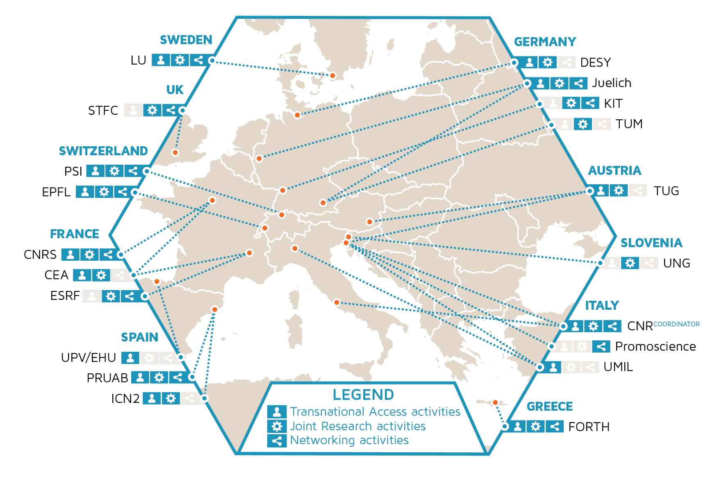
The consortium
Coordinated by CNR-IOM
20 partners of which 10 nanofoundries co-located with Analytical Large Scale facilities
Notes:
Giulia: modificare legenda qui
TA: transnational access
JRA: Joint Research Activity
NA: National Access

Slide 5
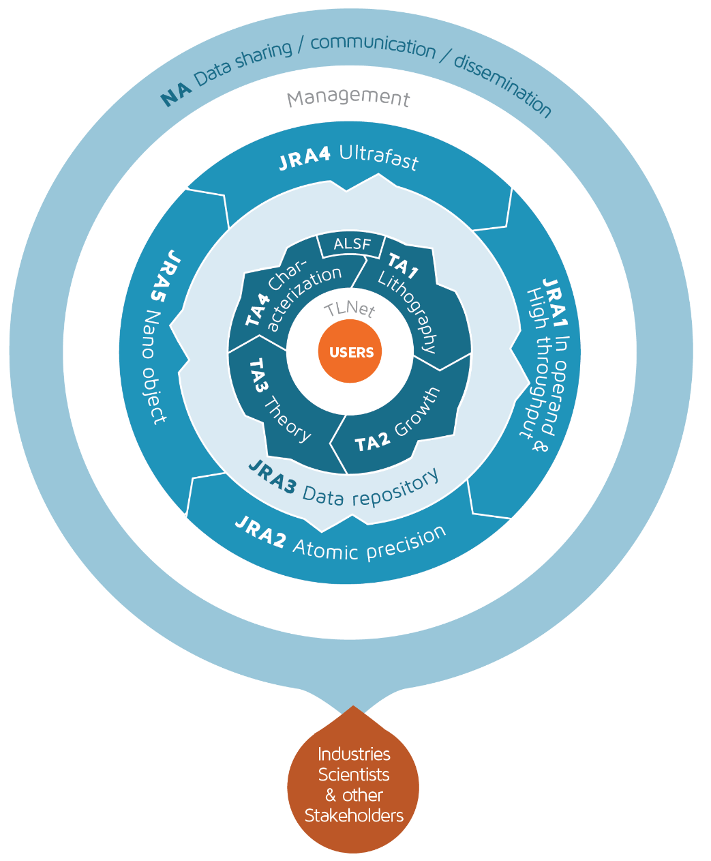
The offer
TA
Transnational Access activities
Multidisciplinary research at the nanoscale
performed at nano-laboratories and ALSFs
Integration of theory & numerical
analysis with advanced characterization
NA
Networking activities
Interface for different user communities
Industrial exploitation of experimental data
JRA
Joint Research activities
Methods & tools at the frontier in nanoscience research
Improved infrastructures for academic & industrial projects

Slide 6
NFFA Data management
JRA3:
e-Infrastructure for data and information management
A transversal activity devoted to the setup of the first Information and Data Repository Platform (IDRP) for Nano science
Definition of new metadata standards for data sharing in nanoscience
Automatic acquisition of key metadata and create a data repository for future data access
Data infrastructure is complemented by Data Analysis Services.

Slide 7
NFFA IDRP architecture
Easy data access from all facilities and via the NFFA portal for all NFFA users

Slide 8
NFFA IDRP deployment
B2SHARE EUDAT SERVICE
IDRP
KIT-DM@CNR
Materialcloud@EPFL

Slide 9
A case study: classifying SEM images by Neural network

Slide 10
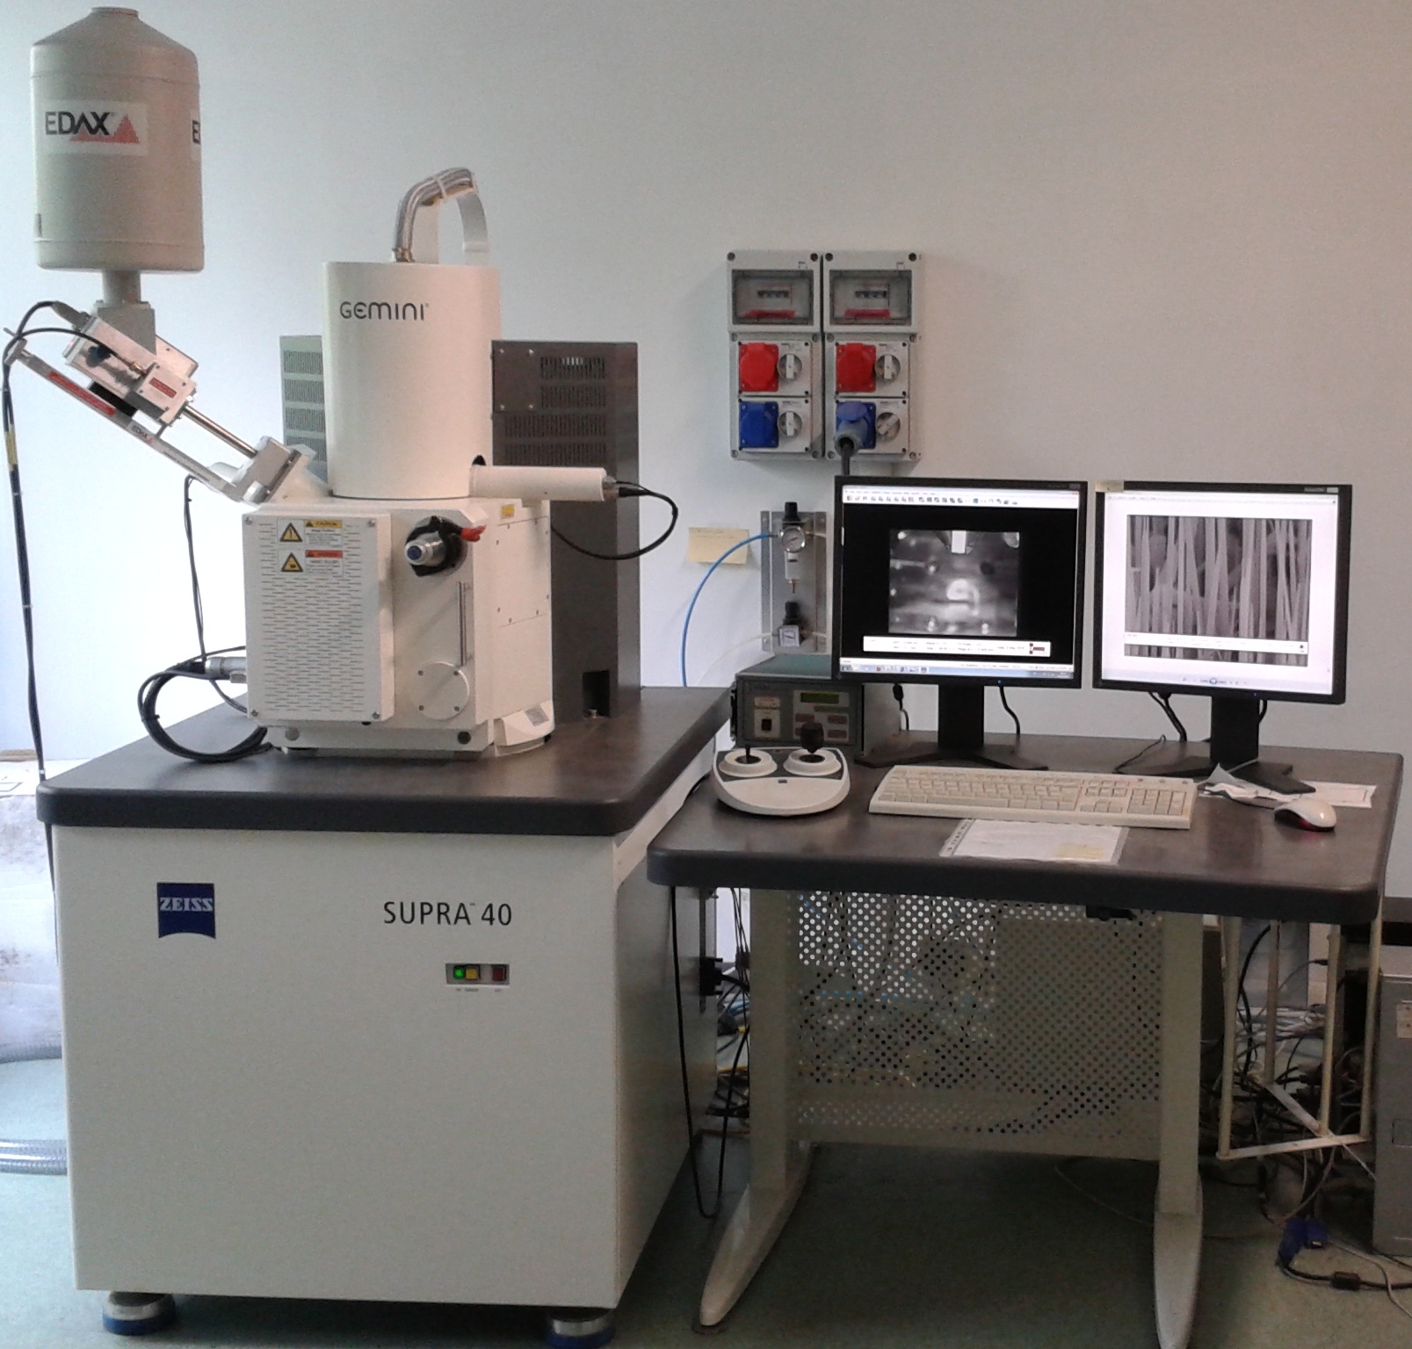
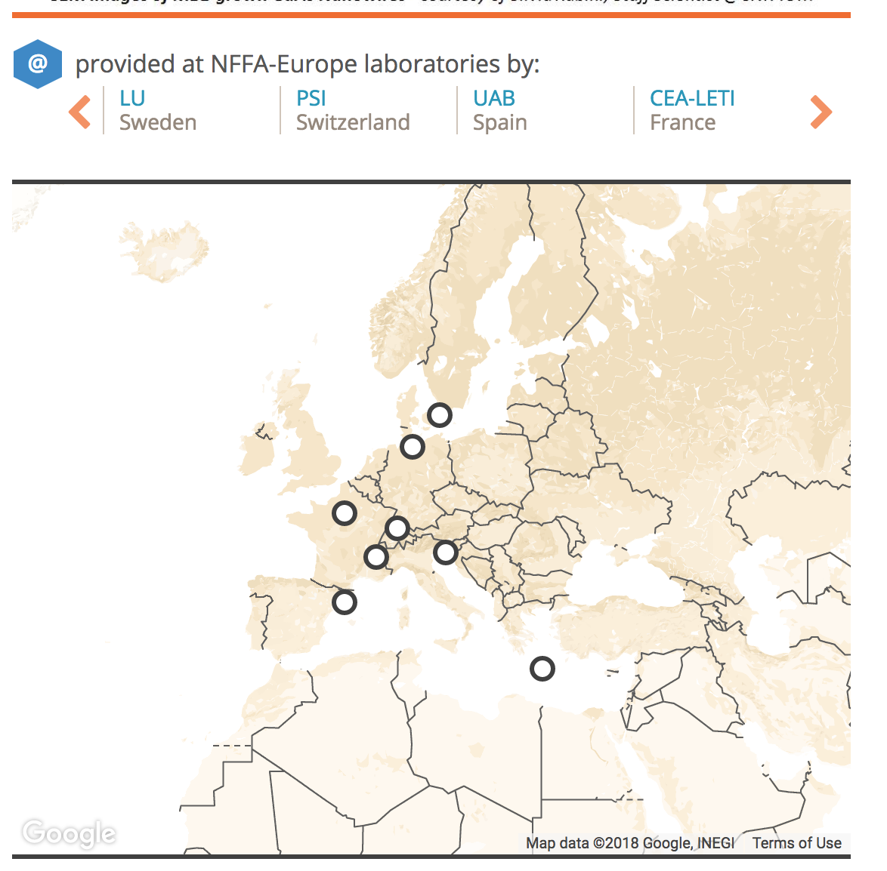
Our Issue: SEM images
One SEM Available at CNR-IOM Trieste with 150,000 images NOT classified
10 SEM across European partners: the work can be exported to a sizeable part of the community

Slide 11

Sharing images is nice..
A couple of million nano images can be of some help for some nanoscience..
But before doing that we need to start classifying them…

Slide 12
SEM images classification steps
STEP1: Classify images (scientific skills)
STEP2: Train a neural network (deep learning)
STEP 3: Use the network as classifier (inference)
  Semi - Automatic tool for SEM users
  Massive process of all the images
  Specific task in nano science: wires alignment

Slide 13
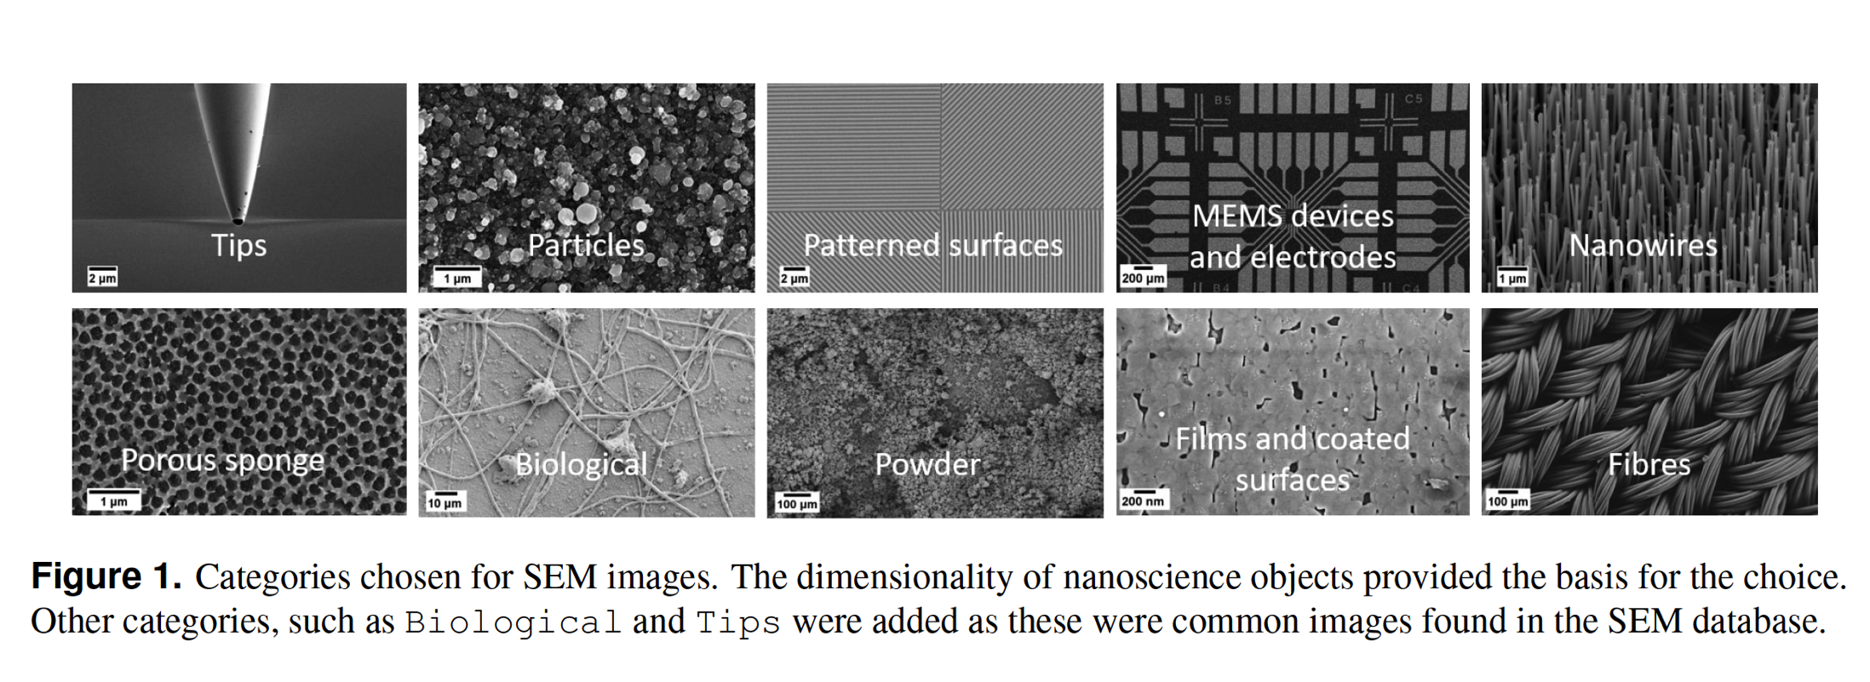
Step1: classify images..
We created and manually annotated the first dataset of classified SEM images (18,577 images).
Aversa et al., in preparation

Slide 14
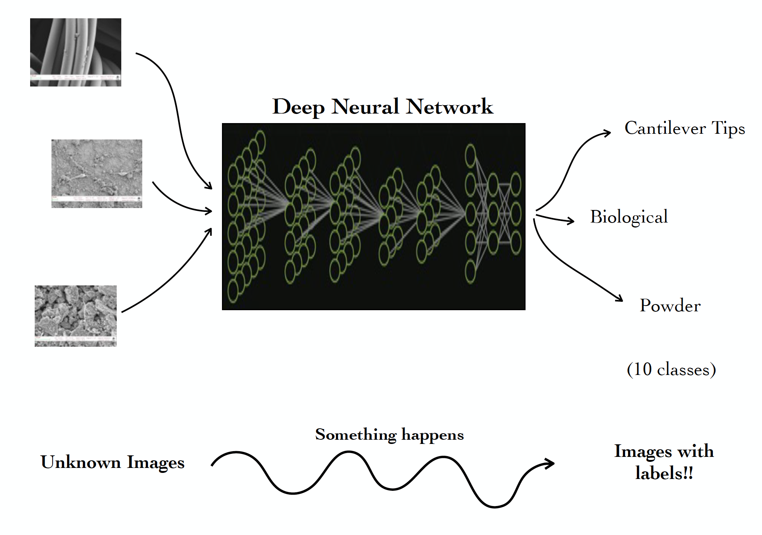
Step 2: train the network !

Slide 15
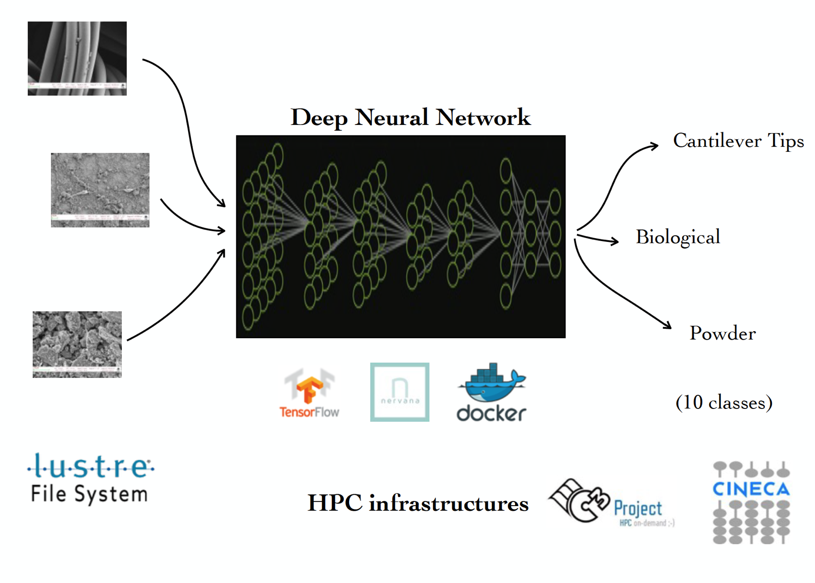
Step2 : the tools/infrastructure…

Slide 16
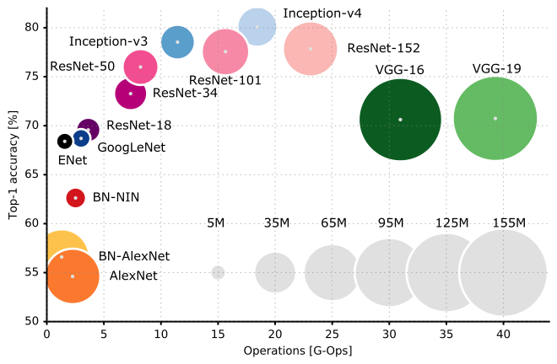


Step2: The deep Learning network..
Models:
  AlexNet
  Inception-v3/v4
  Densenet
Deep learning techniques:
  Training from scratch
  Transfer learning (Feature extraction, Fine Tuning)
Deep learning frameworks:
  TensorFlow
  Neon/Nervana

Slide 17
Glossary
Supervised learning: labelled examples
Transfer learning: applying knowledge of a trained network to a new domain
Check point: set of parameters saved at a certain point of the training
Feature Extraction: previous layers frozen to the check point + last layer(s) randomly initialized
Train from scratch: all the parameters of all the layers are randomly initialized
Fine tuning: all the parameters are initialized to the last check point and are allowed to vary

Slide 18
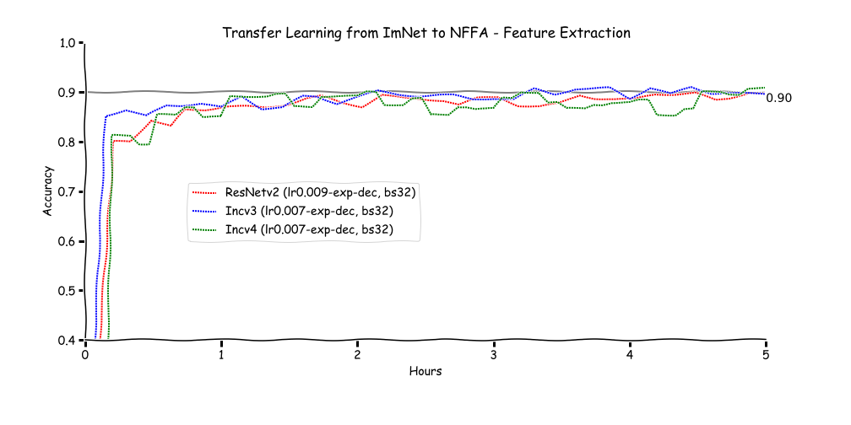
Feature extraction:
ImageNet Checkpoint

Slide 19
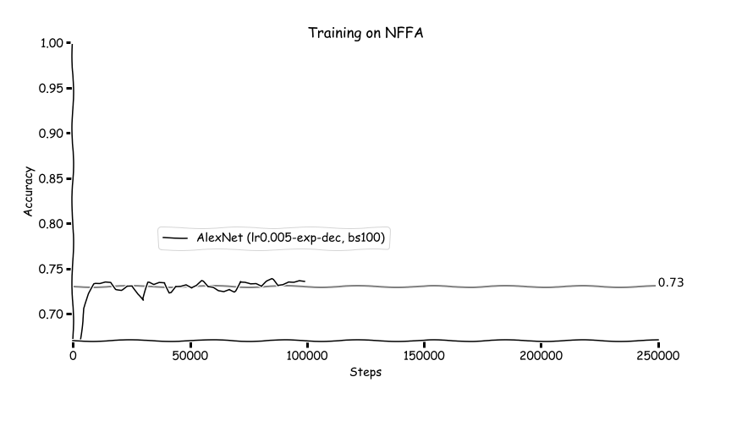
Training from Scratch: alexnet

Slide 20
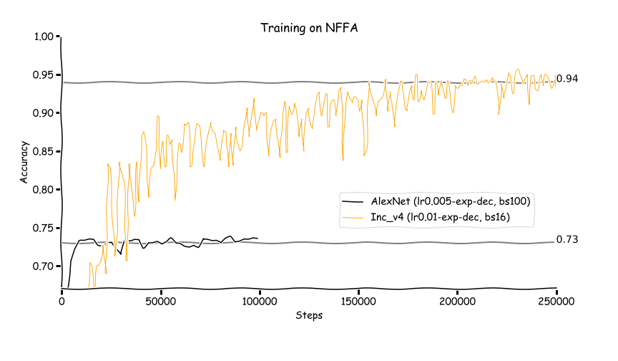
Training from Scratch: inc-v4

Slide 21
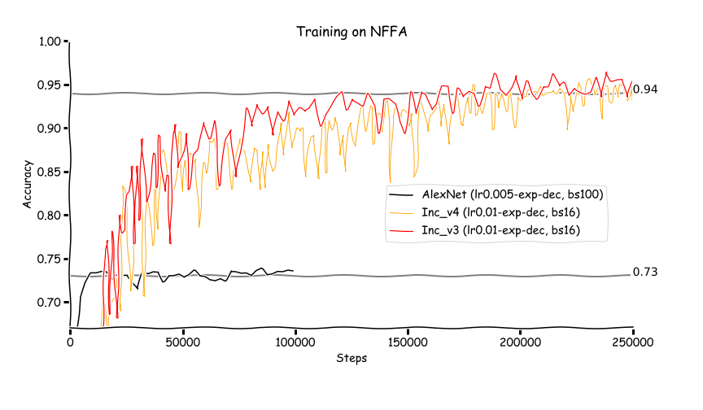
Training from Scratch: inc-v3

Slide 22
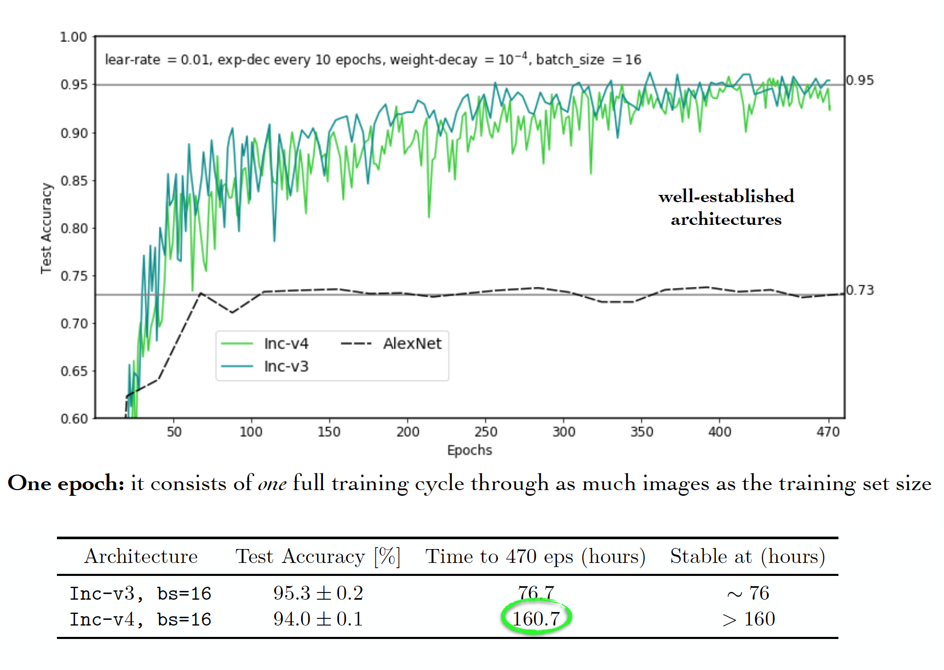
Which is the best ?

Slide 23
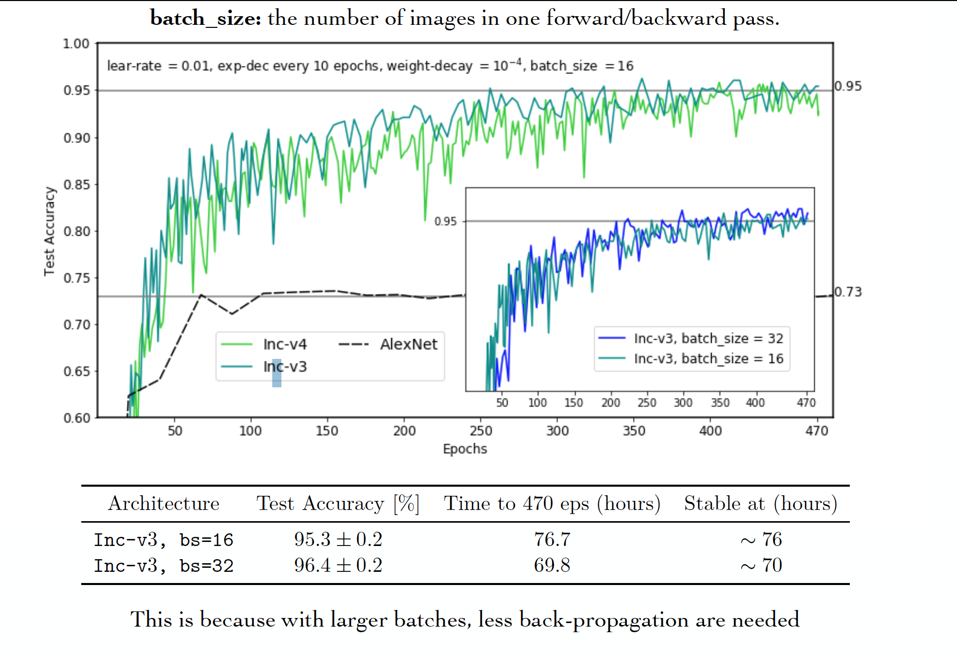
What about batch size ?

Slide 24
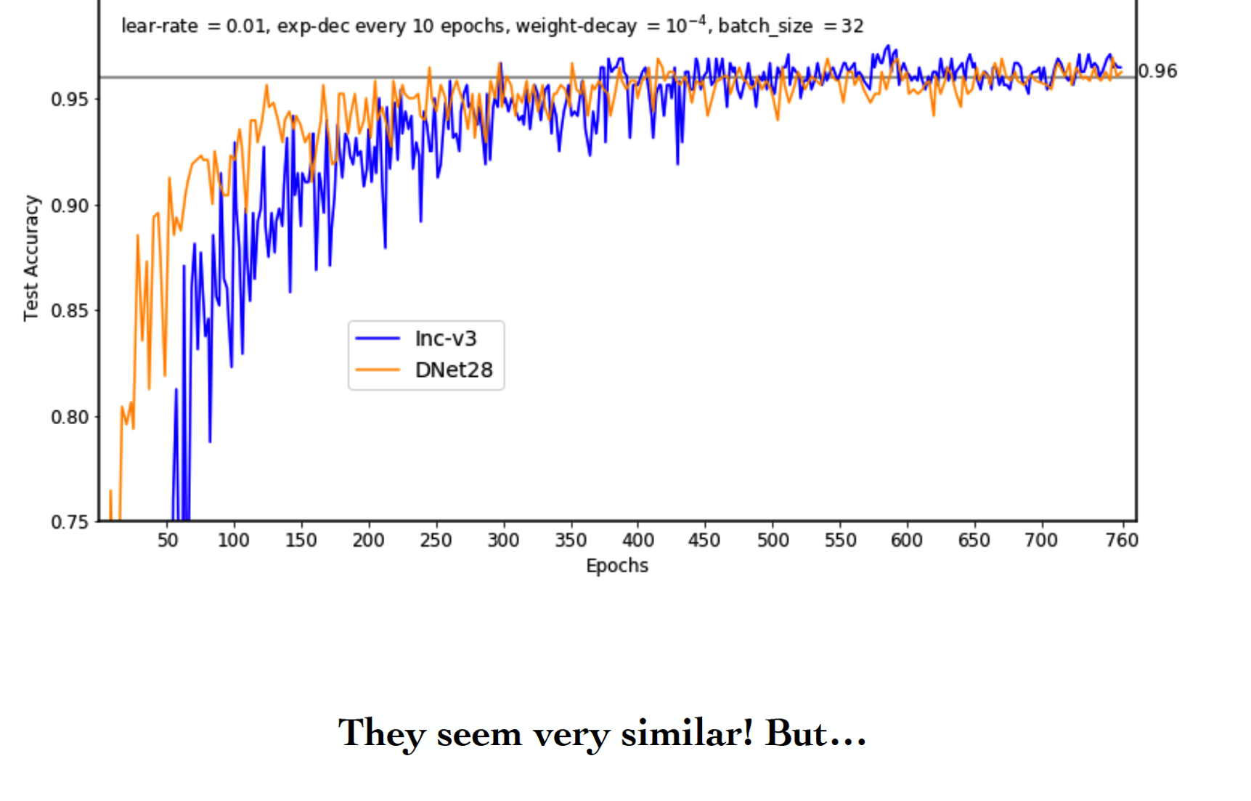
Densenet vs Inception..

Slide 25
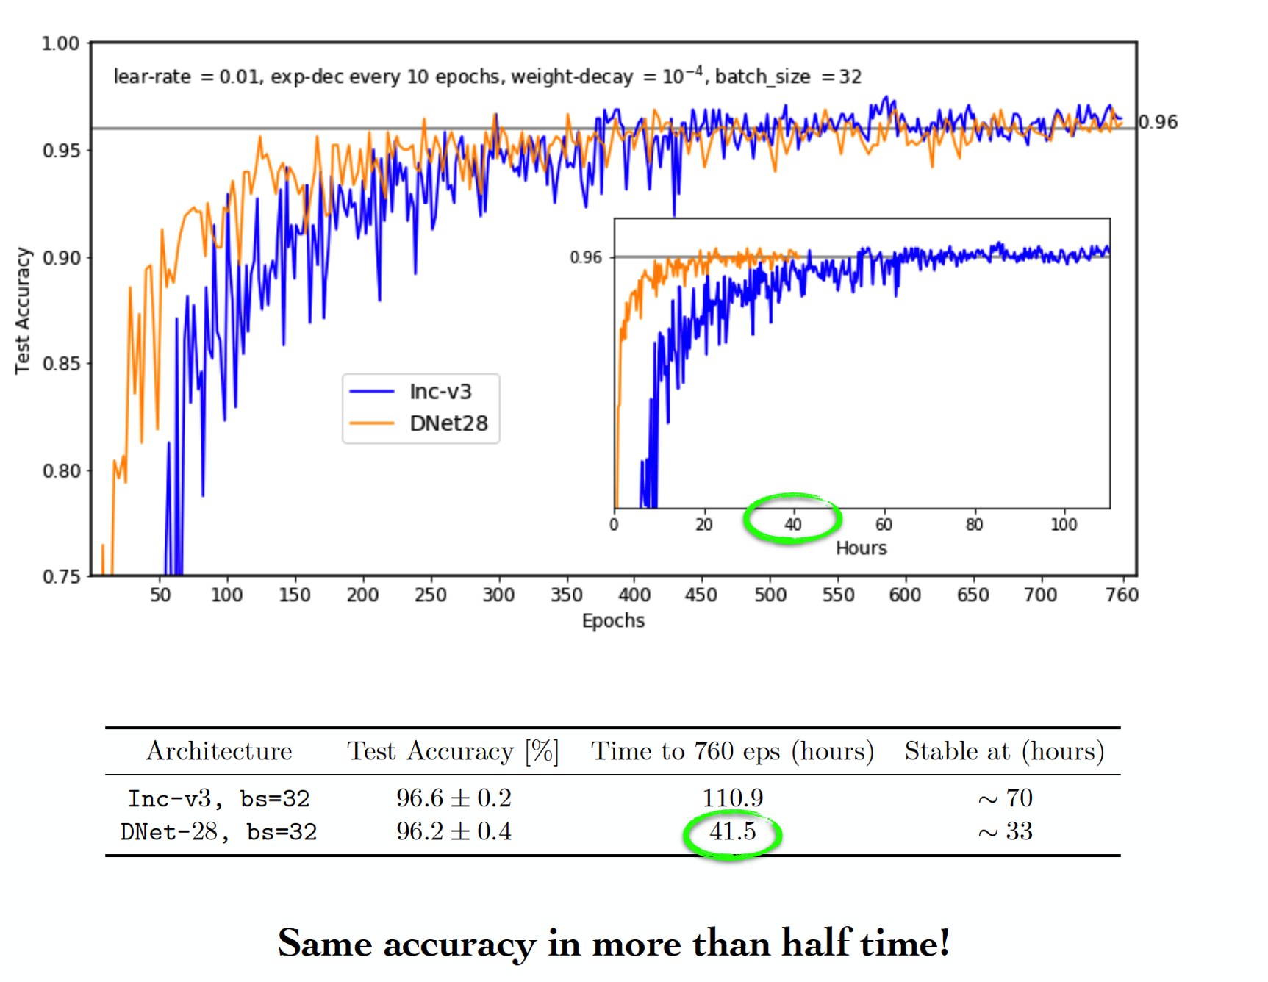
Densenet vs Inception

Slide 26
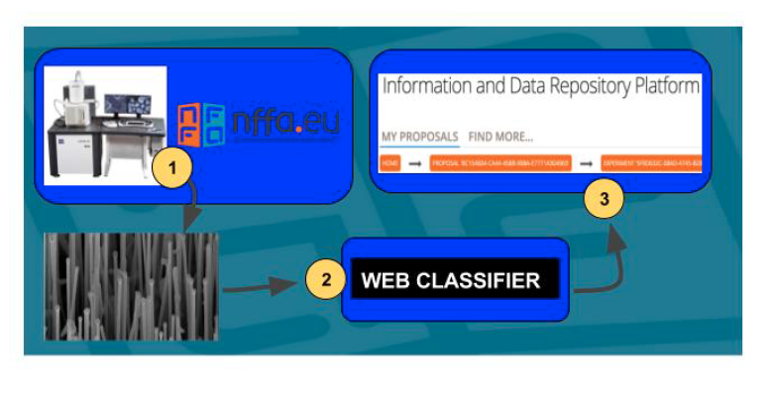
Step3: Data Analysis services:

Slide 27
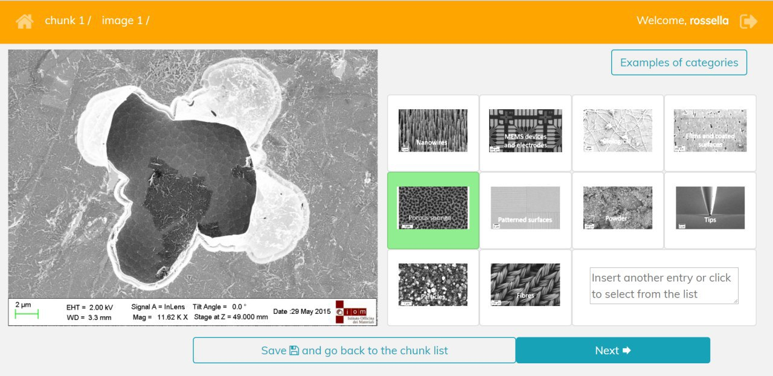
sem-classifier.nffa.ue

Slide 28
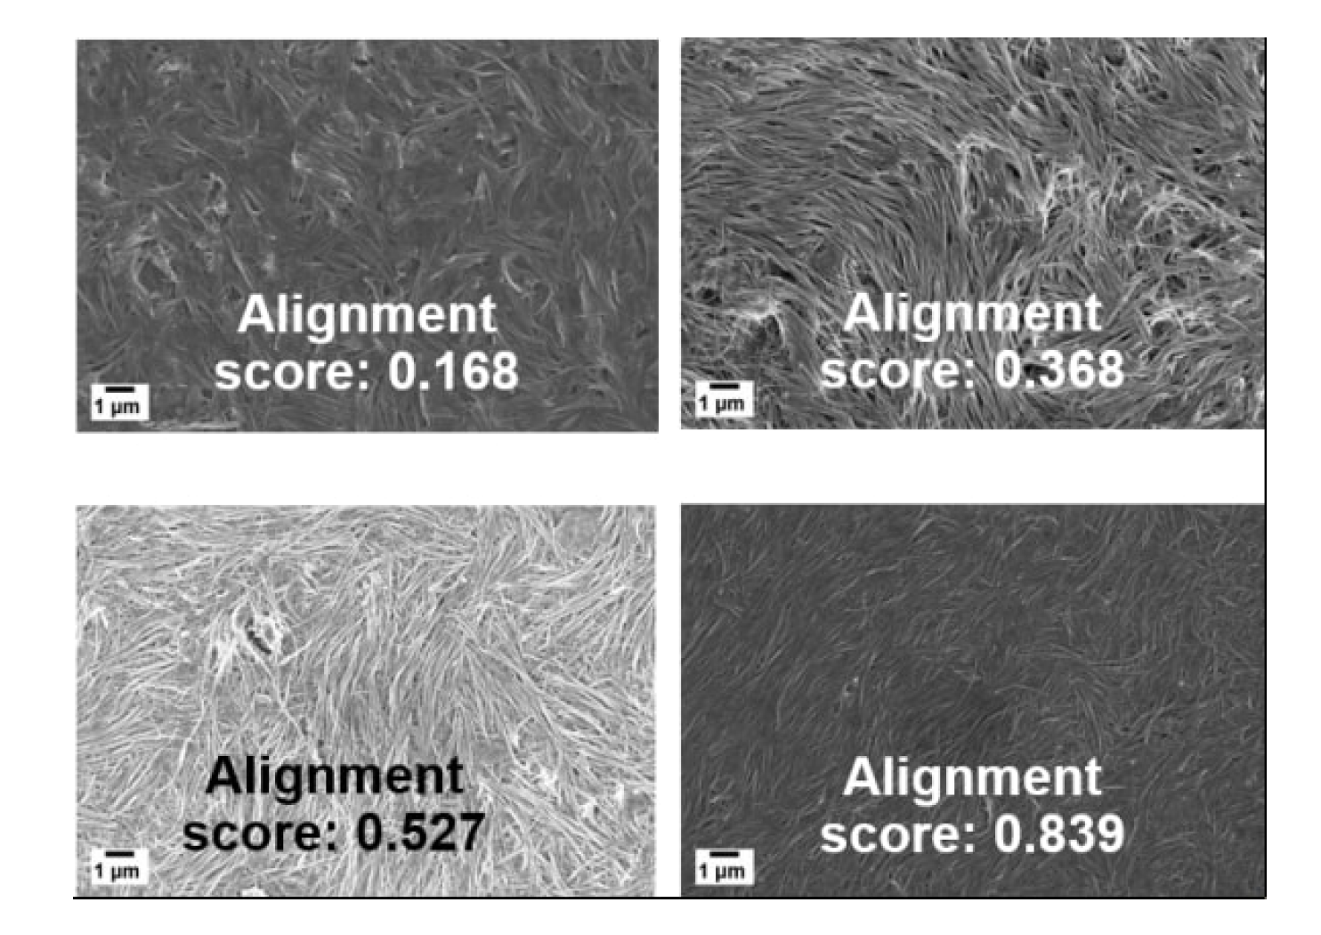
Data analysis service
A nanoscience task: mutually coherent alignment of nanowires
Alignments score comes by ML classification

Slide 29
Conclusions&perspective
A distributed Data management infrastructure for NFFA-EUROPE up&running
We applied the deep learning technique to train an automatic image classification engine for Nano images to provide Data Analysis services on the top of the infrastructure
A full automated procedure has been then setup to automatically annotate SEM images once user load them on the KTDM&IDRP..
  Metadata generated automatically thanks to ML
A pandora box was open for many different interesting nanoscience problems to be solved with the help of deep learning techniques to complement NFFA-EUROPE IDRP with data analysis services.

Slide 30
References
R. Aversa, “Scientific Image Processing within the NFFA-EUROPE Project”, MHPC thesis, 16-12-2016
C. De Nobili, “Deep Learning for Nanoscience Scanning Electron Microscope Image Recognition”, MHPC thesis, 18-12-2017
H.M. Modarres, R. Aversa, S. Cozzini, et al., “Neural Network for Nanoscience Scanning Electron Microscope Image Recognition”, Scientific Reports 7, 13282(2017)
R. Aversa, S. Cozzini, “The first annotated set of Scanning Electroscope Microscopy images”, in preparation
Web classifier: sem-classifier.nffa.eu

