Slide 1
Sync and share is dead
Long Live Sync and Share – A Contention
  30 January 2018, David Jericho, AARNet

Slide 2
Users don’t care
Pricing race to the bottom
The value of User Experience
Avoiding irrelevance

Slide 3
Users DON’t care
Fungible
1
Most users don’t have huge stores
2
Reliable enough
3
The top of the long tail has solved their problems themselves
4

Slide 4

Fungible
  Challenge
    How many sync clients are you running right this instant?
  Second challenge
    When is the last time you actually cared?
  Vendors ship automatically
    Google Drive
    Microsoft OneDrive
    Apple iCloud
  “It’s my platform” isn’t a justification

Slide 5

Not big data stores
  The sync and share story isn’t terabytes or petabytes
  Many users don’t sync all their data either
  A lot of idle data
  Even days to sync generally doesn’t bother users
  The archiving of big data sets is mostly a solved problem
  Therefore big data isn’t a justification

Slide 6

Reliable enough
  The User Experience (UX) of commercial solutions is far superior
  High throughput is mostly unimportant
    96% of CloudStor’s data is under 10MB per object
    92% is below 1MB per object
  Larger platforms can use their scale to hide failure – standard cloud computing paradigm
  Errors occur, users understand
    They self repair with no panic on their side
    Do many users actually notice data corruption?
  Therefore we can’t justify on reliability

Slide 7

The bottom of the long tail
  Simply put, big science and data does not use sync and share
    They’ve worked on their own tooling
  We’re chasing small users
    With increasingly smaller financial and data transactions
  And “because it’s research policy” doesn’t solve the problem of people going around policy
    Because going around policy only becomes a problem when there’s a fault
  Therefore “because we’re here” isn’t a justification

Slide 8
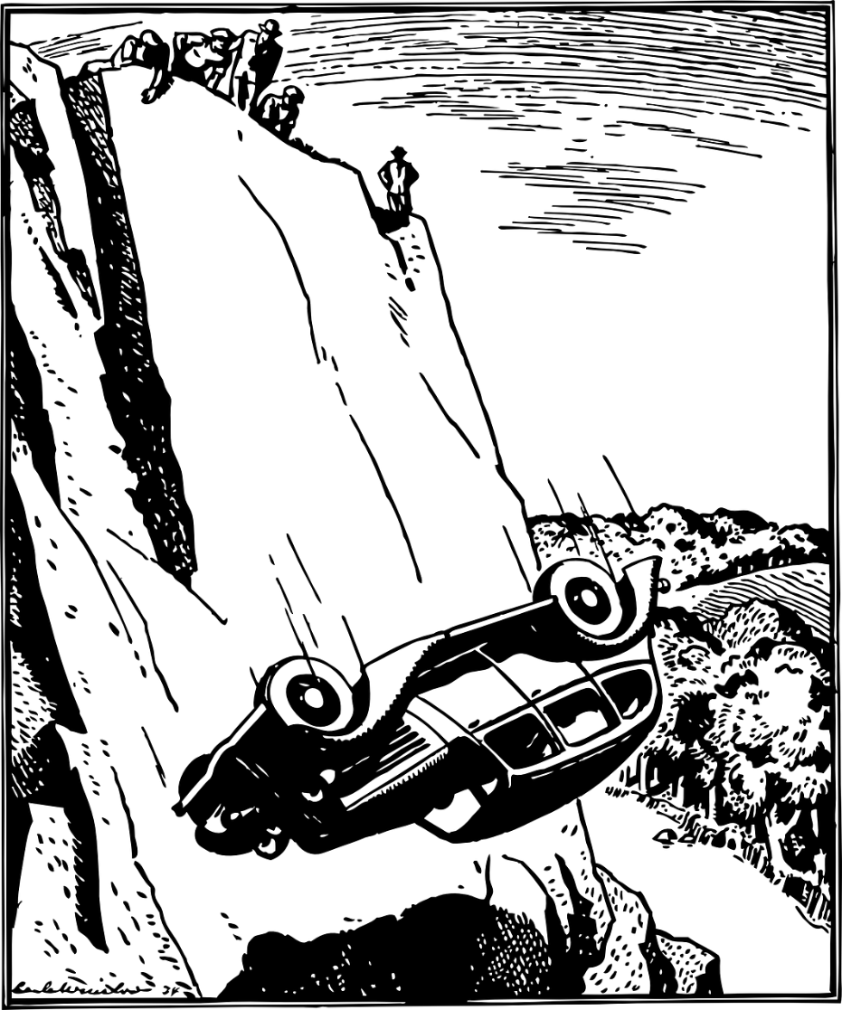
Race to the Pricing bottom
  We cannot win a pricing race to the bottom
    Even with global partnership with tier 0 hardware manufacturers
  Data points in AUD, from the published list price:
    DropBox Professional is $0.13/GB/year
    Google Drive is $0.124/GB/year
    Microsoft One Drive is $0.069/GB/year
    CloudStor TCO is > $0.60/GB/year
  Many of these companies are at a scale where they’re designing their own hardware
  We can never win a price race

Slide 9
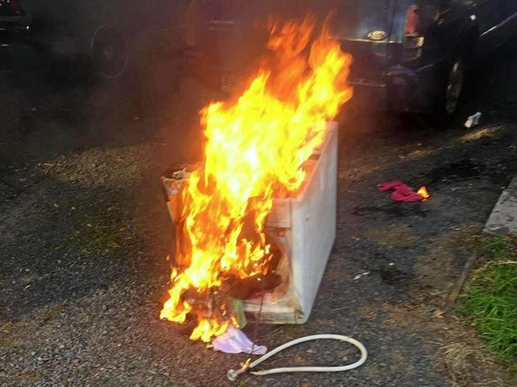
The value of user experience
  Users don’t like tools that don’t let them achieve
    Corollary: users prefer tools that give them a sense of achievement
    Example – A major manufacturer’s washing machines that caught fire, but the replacement didn’t play the notification tune of achievement, resulting in a low replacement rate
      Very literally, users preferred to run the risk of their house burning down, in return for the sense of achievement
  UX is a growing field
    Serifed yellow text on a black background isn’t accepted anymore
    It’s specialist knowledge
  Big providers know this and can deal with it
    Example, Google Drive reports a polite error that reassures
  Big red box of failure terrifies our ownCloud users
Image source: https://www.thechronicle.com.au/news/man-save-home-carries-burning-washing-machine-outs/3186435/

Slide 10

Avoiding the irrelevance
IT IS NOT THE END OF THE WORLD
(2 value adding things we can do)

Slide 11

ENABLe user specific tooling
  The big vendors can’t provide a unified face to discipline specific tools
    It’s not their money source
  Don’t reinvent the wheel
    Hijack commodity tooling where we can
    Example – Use Office365 for document editing
      Don’t write your own, really, please, don’t
    Can you make it an API?
      Make it an API
  METADATA!
    Indexed too!

Slide 12

Federate
  Sync and share is sticky
    Moving data can be effort
    Users hate effort
  Enable easy triple-A
    edugain is just one possible solution
  Think global collaboration
    Share code, and knowledge
    Be vocal
      Small sites often know things large sites haven’t thought of

Slide 13

Thankyou

