Slide 1
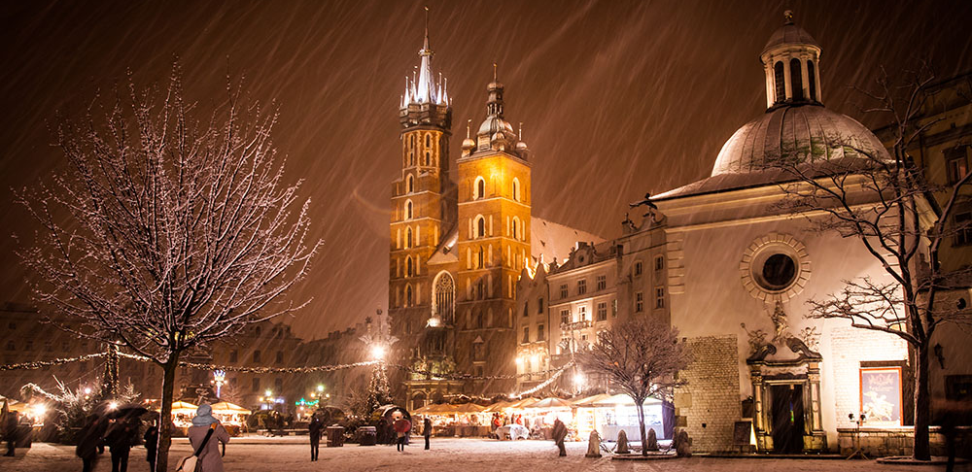

Container-based Service Deployment in Private and Public Clouds
Enrico Bocchi
CERN IT-ST
CS3 2018
Workshop on Cloud Services for Synchronisation and Sharing

Slide 2

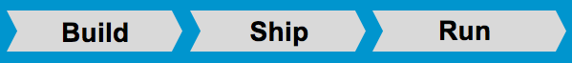
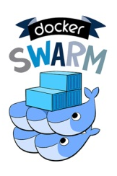
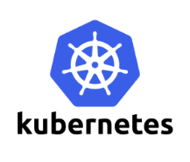


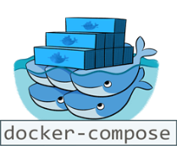
Container Technologies
Containers
Light-weight application-layer virtualization
Isolation: From other Apps and OS
Portability: Binary, Data, Config, Logs
Container Orchestration
  Deploy and manage complex services
  Scalability and high-availability
  Can we containerize and distribute CERN
  storage services and deploy them on any cloud?

Slide 3


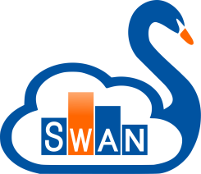
Containerized CERN Technology
Boxed – Self-contained, Docker-based package with:
EOS: Disk Storage for LHC+physics data, and CERNBox
CERNBox: Cloud Sync&Share for Science
SWAN: Platform for Interactive Data Analysis in the Cloud
EOS the CERN disk/cloud storage for science, Luca Mascetti | Tue@11:50
CERN IT-ST
CERNBox Service, Hugo Gonzalez Labrador | Today@18:45
CERN IT-ST
SWAN: Service for Web-based Analysis, Diogo Castro | Tue@10:00
CERN IT-ST + EP-SFT
Notes:
Scalable Storage Backend for Cloud and HPC
Site Reports
Software Stack for Data Science

Slide 4
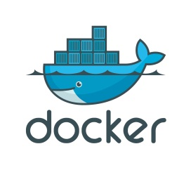
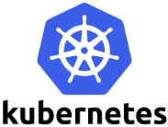



Containerized CERN Technology
Boxed – Self-contained, Docker-based package with:
+
+
One-Click Demo Deployment
Production-oriented Deployment
Single-box installation via docker-compose
No configuration required
Download and run services in 15 minutes
https://github.com/cernbox/uboxed
Container orchestration with Kubernetes
Scale-out storage and computing
Tolerant to node failure for high-availability
https://github.com/cernbox/kuboxed

Slide 5
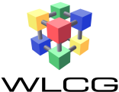

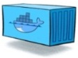
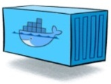




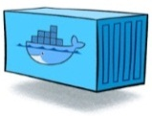





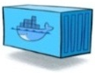
Boxed Architecture
CVMFS
Client
JupyterHub
EOS Fuse
Mount
SWAN
Interactive Notebooks
CERNBox
Backend
CERNBox
Gateway
Synchronization
and Sharing
CERNBox
File Storage
Servers
EOS
Management Node
Disk-based Storage

Slide 6
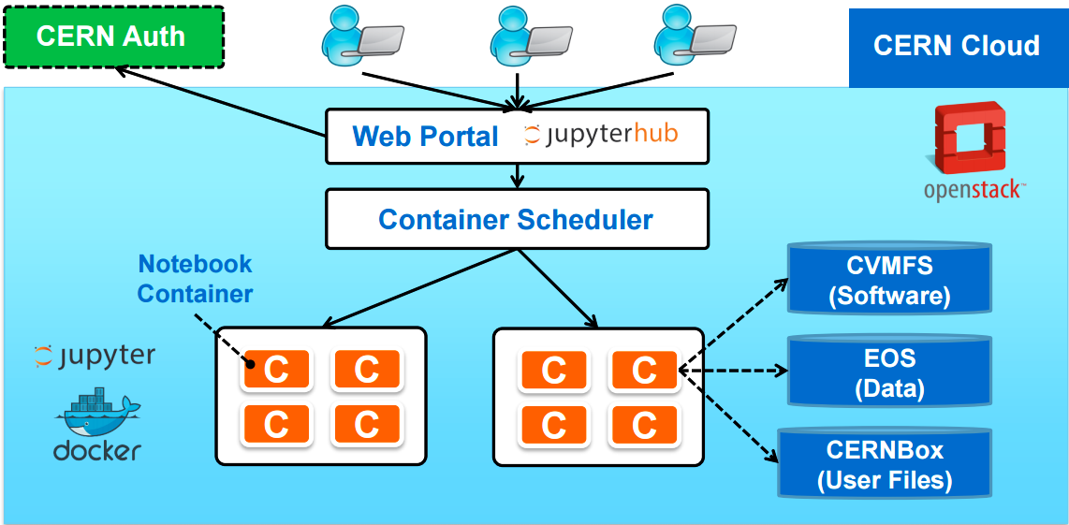

Boxed Architecture
CVMFS
Client
JupyterHub
EOS Fuse
Mount
SWAN
User
Sync Client
CERNBox
Backend
CERNBox
Gateway
CERNBox
File Storage
Servers
EOS
Management Node

Slide 7
Boxed Architecture
Single-user
Jupyter
Server
CVMFS
Client
JupyterHub
Start my session!
EOS Fuse
Mount
SWAN
User
Sync Client
CERNBox
Backend
CERNBox
Gateway
CERNBox

Slide 8
How to scale services
Single-user
Jupyter
Server
CVMFS
Client
JupyterHub
Start my session!
EOS Fuse
Mount
SWAN
User
Start ALL
our sessions!
Plenty of
Single-user
Jupyter
Servers
…
Plenty of users

Slide 9

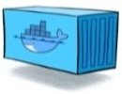
How to scale services
Kubernetes: Deploy, orchestrate, and manage containers in a cluster
It provides means to horizontally scale applications
  ReplicaSet, Deployment, StatefulSet, Horizontal Pod Autoscaler, LoadBalancer on Services, …
Storage – Extend EOS capacity
  Add machines with extra storage to the cluster
  Replicate File Storage Server containers
Computing – Sustain concurrent SWAN sessions
  Need of multiple cluster nodes where to spawn Single-user Jupyter Servers
  Add machines with computing power: Swan Workers
File Storage
Servers
…
Ability to scale-out storage

Slide 10
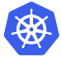

How to scale services
Start my session!
User
A closer look at SWAN
CVMFS
Client
JupyterHub
Ability to spawn single-user server on SWAN Workers
EOS Fuse
Mount
DaemonSet
CVMFS and EOS Fuse containers are replicated on any “Swan Worker” node
SWAN Workers
Single-user
Jupyter Server
Scale out
SWAN capacity
New SWAN Worker nodes

Slide 11
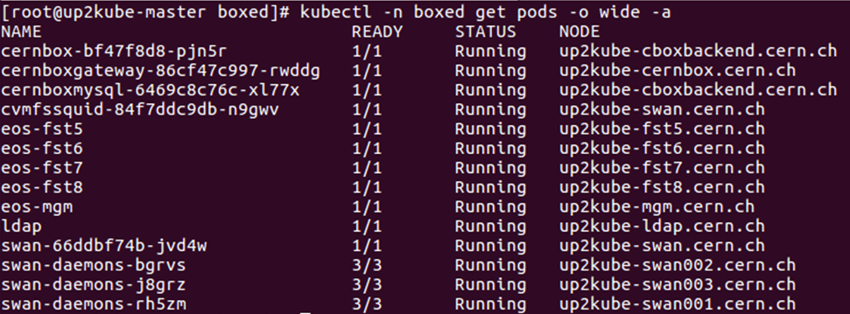
A Sample Deployment with Kubernetes
Development playground at CERN
Runs on OpenStack VMs
CERNBox
EOS
  1x Management Node
  4x File Storage Servers
SWAN
  1x JupyterHub
  3x EOS + CVMFS Daemons

Slide 12
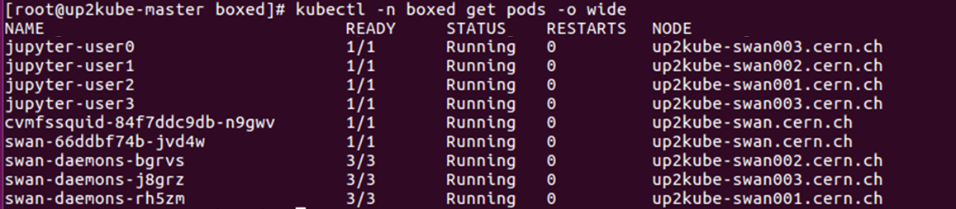
A Sample Deployment with Kubernetes
Computing – SWAN Workers
  Workers are (again) VMs with EOS + CVMFS daemons deployed
SWAN
Users
SWAN
Workers
DaemonSet running
on each SWAN Worker
EOS Fuse
Mount
CVMFS
Client

Slide 13





Use Cases for Boxed
EU Project Up to University (Up2U)
Simplified try-out and deployment for peers
  Australia's Academic and Research Network (AARNET)
  Joint Research Centre (JRC), Italy
  Saint Petersburg State University, Russia
  National Research Center “Kurchatov Institute”, Russia
  Academia Sinica Grid Computing Centre (ASGC), Taiwan
Disposable deployment for testing and development
within IT-ST and EP-SFT groups at CERN
Up2University: Educational Platform with Sync/Share, Peter Szegedi

Slide 14
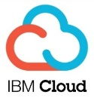




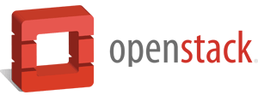
Deployment on Private and Public Clouds
Single-box deployment running on multiple clouds:
  Amazon Web Services
  Helix Nebula Cloud (IBM, RHEA, T-Systems)
  OpenStack Clouds (CERN, GRNet, PSNC)
  Your own laptop! (CentOS, Ubuntu)
Production-oriented deployment with Kubernetes
  OpenStack at CERN
  Poznań Supercomputing and Networking Center (PSNC)

Slide 15







The Helix Nebula Science Cloud
Helix Nebula Project: Move towards cloud-based scientific e-infrastructure
Hybrid cloud model – commercial providers + public-funded science clouds
Functional test Q4 2017
  Single-box automated deployment
Starting from Q2 2018
  Scalability Testing: Leverage on provided resources
  to run many SWAN user sessions
  End User Access: Interactive data analysis
  for High Energy Physics
10.000
cores
1PB
40Gbps

Slide 16




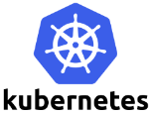

Conclusions
Boxed is a concrete example of CERN
core technologies running in containers
Delivers fully-fledged services on premises
Run your personal (tiny) datacenter in a box!
…or scale it out for a multi-user deployment
Help yourselves!
https://cernbox.cern.ch/cernbox/doc/boxed/

Slide 17
Thanks for your attention!

