Slide 2
Incoherent beam-beam effects and lifetime optimisation
8th Evian Workshop, 12-14 December 2017
D. Pellegrini
For: F. Antoniou, G. Arduini, S. Fartoukh,
G. Iadarola, N. Karastathis, S. Papadopoulou,
Y. Papaphilippou, G. Sterbini.

Slide 3
Outline
Recap of DA sensitivity from weak-strong beam-beam simulations (tune, chromaticity, octupoles) with sixtrack.
Predictions and effects on DA during 2017:
  30 cm beta*,
  8b4e filling scheme,
  crossing angle anti-levelling.
Correlation between DA and lifetime
Comments on computing and instrumentations

Slide 4
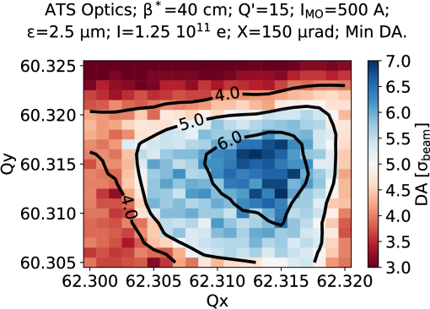
Impact of tunes
High sensitivity to tune adjustments, 1-2 σ DA lost within a few 1e-3 trims.
First test performed at the end of 2016, immediate lifetime improvement.
Tune optimisation routinely applied in 2017, e.g. after crossing angle steps.
Care not to excessively approach the diagonal to avoid instabilities.
Optimised tunes are now considered a “must” for lifetime and DA studies.

Slide 5
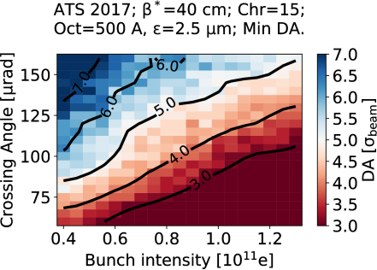
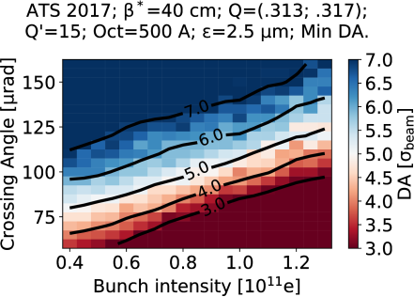
Impact of tunes (II)
Optimised tunes can allow as much as 30 μrad reduction of half crossing angle
(2 σ BB separation @ 40cm) → 10% increase in peak luminosity

Slide 6
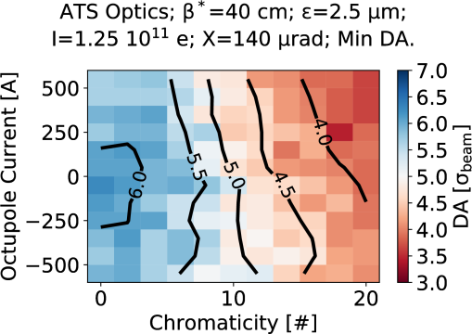
Chromaticity and Octupoles
1 σ DA for ~10 units of chromaticity.
Limited impact (< 0.5 σ) of octupoles in the range usually exploited: 300-500 A.
Demonstrated lifetime improvement for
telescope-enhanced negative octupoles (MD 2269, S. Fartoukh et al.)

Slide 7
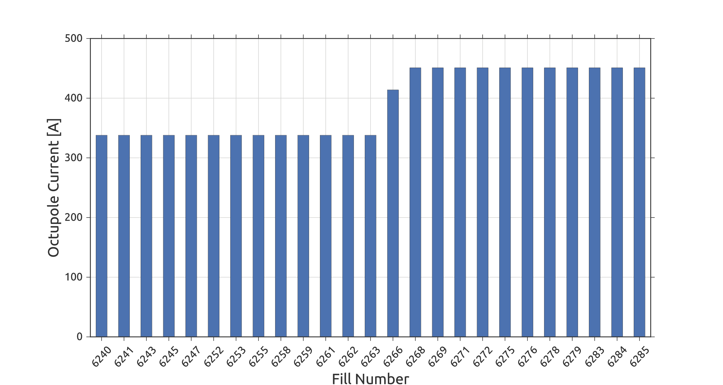
Octupole raise during the run
On Oct 2 octupoles where raised to improve beam stability.
Check the effective cross section (losses normalised to luminosity) on few fills before and after.

Slide 8
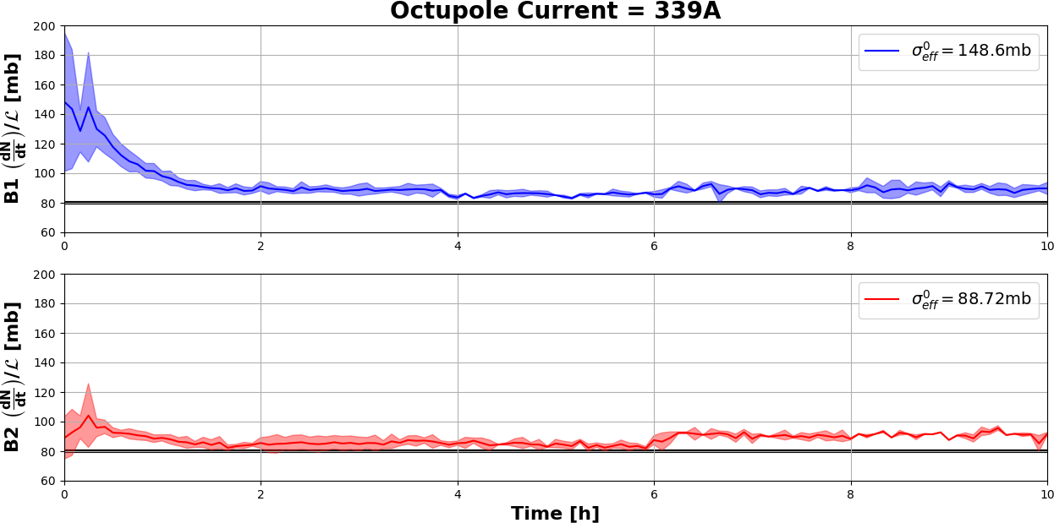
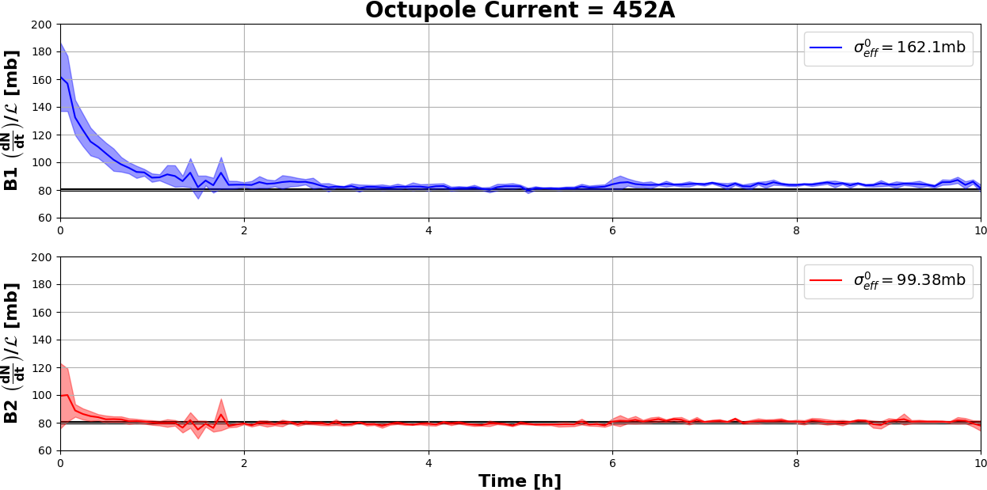
Octupole raise during the run
N. Karastathis
Small increase of losses at the beginning of the fill (within the uncertainty), compatibly with simulations.
No long term effect on losses.

Slide 9
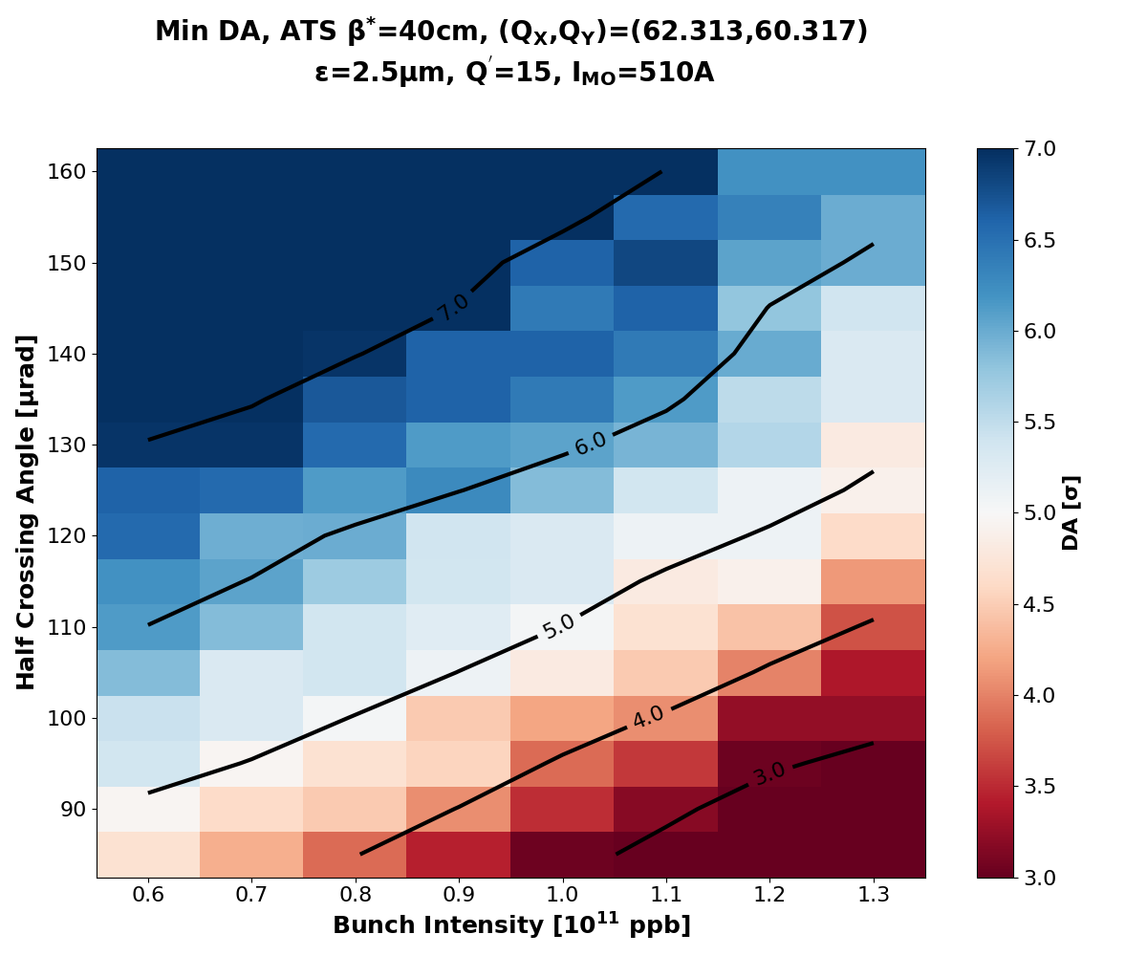
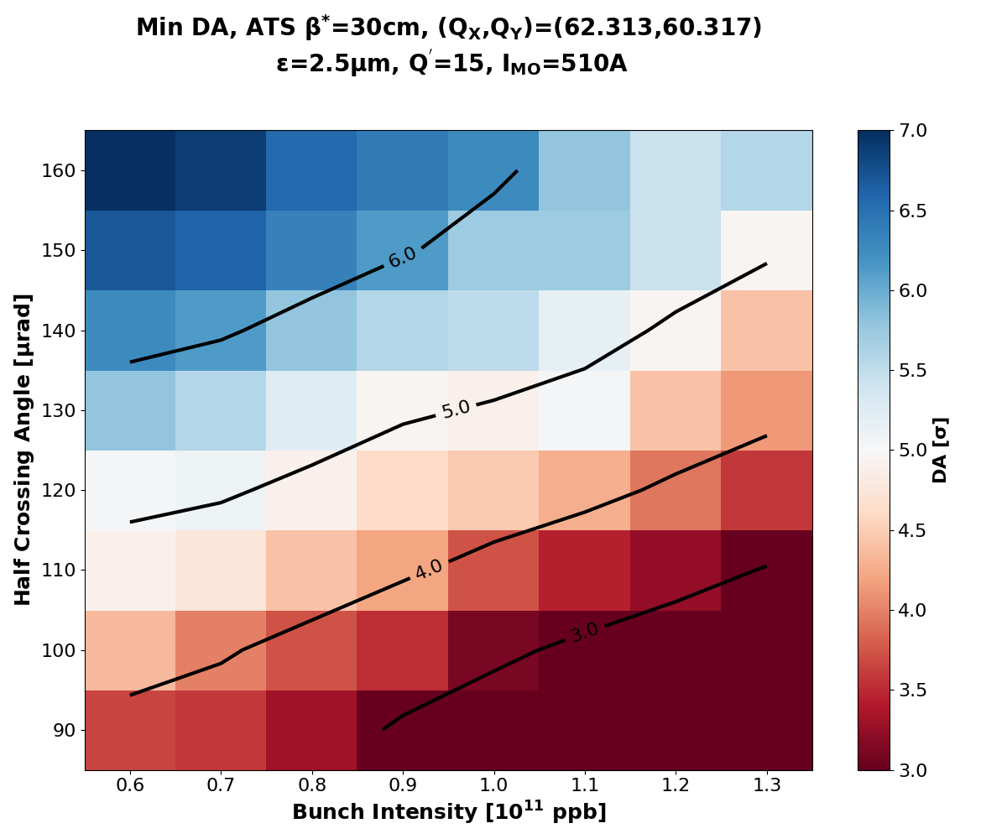
Reduction of β*
N. Karastathis
N. Karastathis
Xing maintained at 150 μrad levering on tune optimisations.
Beam-beam separation reduced from 10 to 8.5 σ.

Slide 10
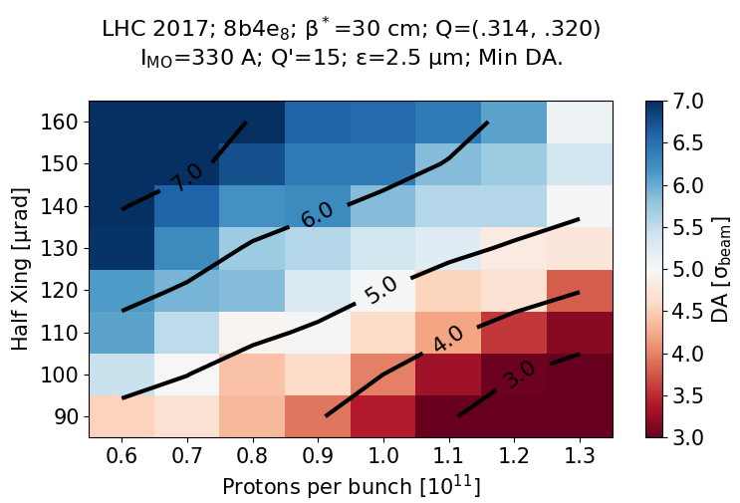
Beam-Beam with 8b4e
N. Karastathis
DA recovered also thanks to the 8b4e beam (worst case shown here), having less long range beam-beam encounters.

Slide 11
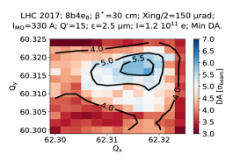
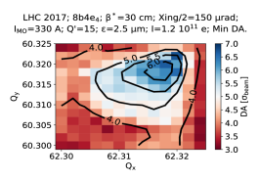
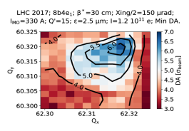
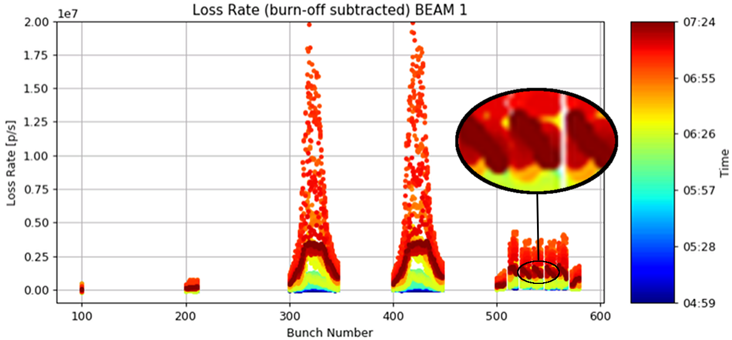
Different 8b4e classes
Precise predictions also for 8b4e trains.
The bunches in the front of the 8b mini-trains suffer more.
Observed both in MDs and simulations.
BCMS
8b4e
Courtesy M. Hostettler
From MD 2201 G. Sterbini et al.

Slide 12
Crossing angle anti-leveling
Idea: follow the intensity decay with the crossing angle along the iso-DA curve.
Act on the geometric reduction factor, for more luminosity.
Agreed on 10 μrad steps performed at 2, 4, 8 h into the fill.
Potential for introducing extra losses if not done properly (steps too aggressive or taken too early, unforeseen emittance blowup…)

Slide 13
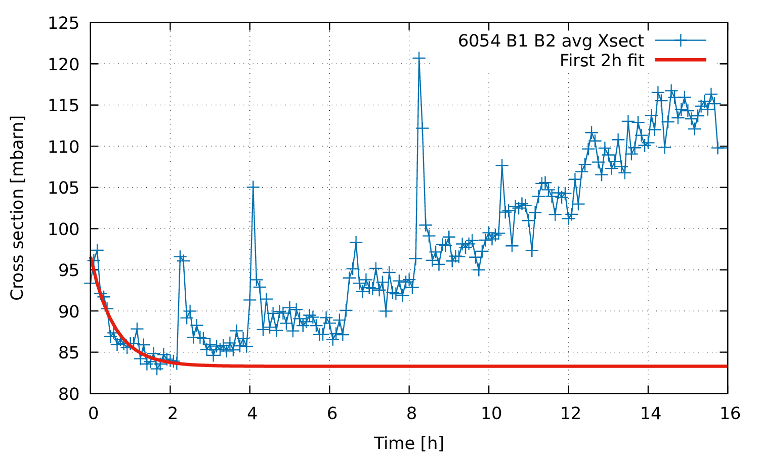
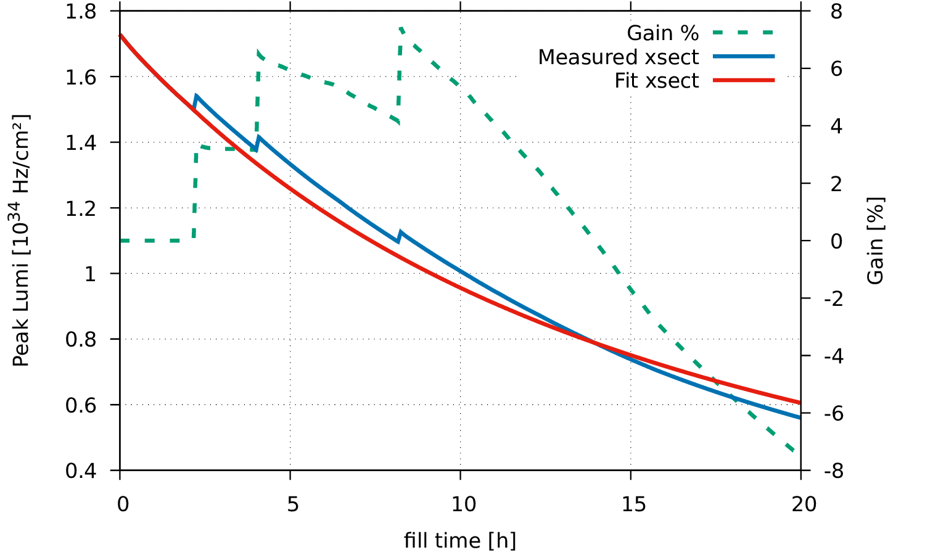
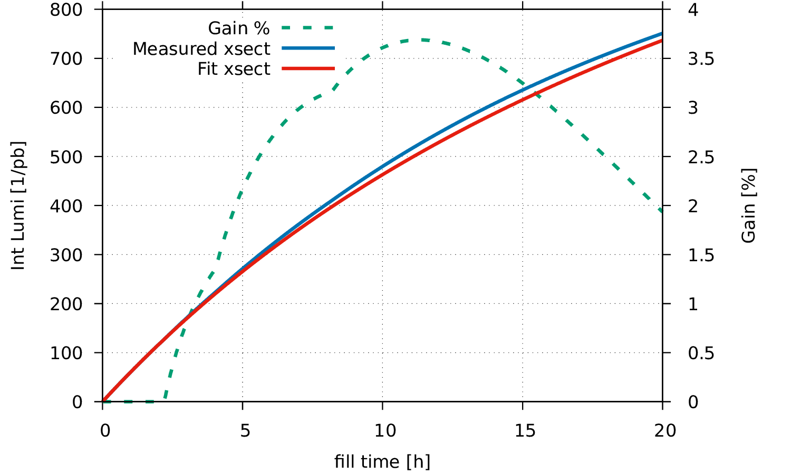
Anti-leveling with extra losses
Luminosity integrated with measured (fill 6054) or fitted cross section for intensity decay, with or without crossing angle steps.
Slightly aggressive crossing steps
~3% gain of integrated luminosity compared to ideal 5%.
120 µrad
130 µrad
150
140

Slide 14
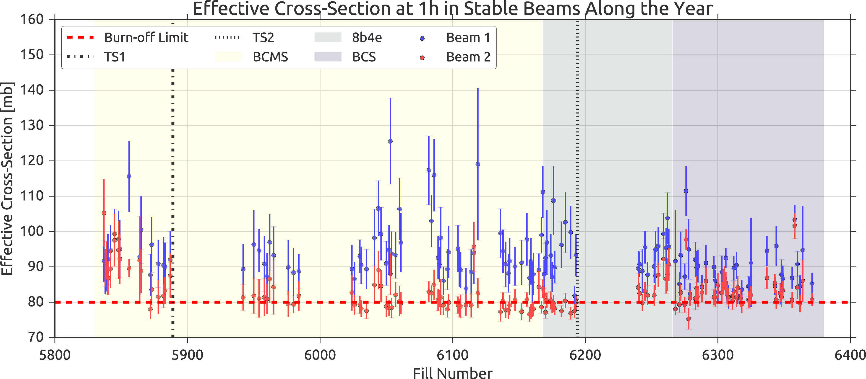
Observed cross section along the year
The effective cross section (loss rate normalised with luminosity) is kept constant over the year across the various configurations.
Difference between the two beams under investigation.
More in S. Papadopoulou’s talk.
N. Karastathis

Slide 15
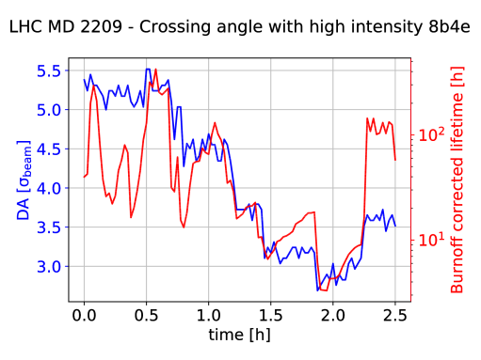
Lifetime vs DA with 8b4e
Idea: feed the machine settings and beam measurements along MDs with significant lifetime degradation to DA simulations.
Observe correlations between DA and lifetime.
Burnoff lifetime ≈ 25 h

Slide 16
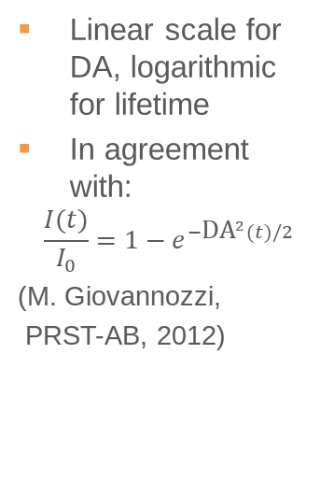
Lifetime vs DA with 8b4e
Linear scale for DA, logarithmic for lifetime
In agreement with:
$$\frac{I(t)}{I_{0}}=1−e^{−{\text{DA}}^{2}(t)/2}$$
(M. Giovannozzi,
PRST-AB, 2012)
Burnoff lifetime ≈ 25 h

Slide 17
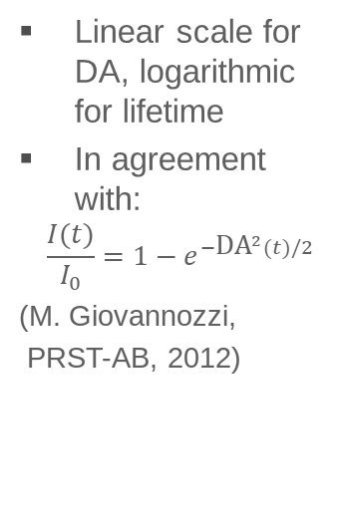
Lifetime vs DA with 8b4e
Linear scale for DA, logarithmic for lifetime
In agreement with:
$$\frac{I(t)}{I_{0}}=1−e^{−{\text{DA}}^{2}(t)/2}$$
(M. Giovannozzi,
PRST-AB, 2012)
Burnoff lifetime ≈ 25 h
Tune and Luminosity optimisation

Slide 18
Lifetime vs DA with 8b4e
Linear scale for DA, logarithmic for lifetime
In agreement with:
$$\frac{I(t)}{I_{0}}=1−e^{−{\text{DA}}^{2}(t)/2}$$
(M. Giovannozzi,
PRST-AB, 2012)
150
Crossing angle steps
130
Burnoff lifetime ≈ 25 h
110
100
100
90
Tune and Luminosity optimisation

Slide 19
Lifetime vs DA with 8b4e
Linear scale for DA, logarithmic for lifetime
In agreement with:
$$\frac{I(t)}{I_{0}}=1 \\ −e^{−{\text{DA}}^{2}(t)/2}$$
(M. Giovannozzi,
PRST-AB, 2012)
150
Crossing angle steps
130
Burnoff lifetime ≈ 25 h
110
100
100
90
Tune and Luminosity optimisation
Chromaticity and octupoles reduction

Slide 20
Lifetime vs DA with 8b4e
Crossing angle relaxation
Cannot well reproduce.
Need lifetime simulations taking into account particles lost previously.
Possible degradation of the core.
Linear scale for DA, logarithmic for lifetime
In agreement with:
$$\frac{I(t)}{I_{0}}=1−e^{−{\text{DA}}^{2}(t)/2}$$
(M. Giovannozzi,
PRST-AB, 2012)
150
Crossing angle steps
130
110
100
100
90
Tune and Luminosity optimisation
Chromaticity and octupoles reduction

Slide 21
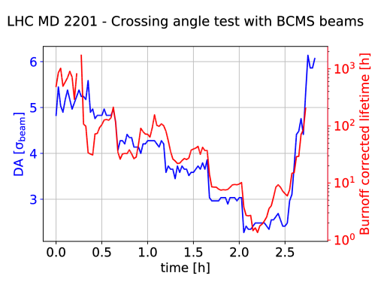
Lifetime vs DA with BCMS beams
Exercise repeated for MD 2201, observing BCMS beams.
Burnoff lifetime ≈ 25 h

Slide 22
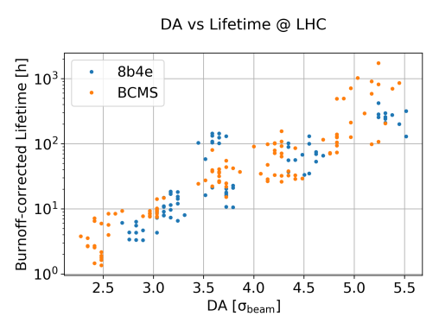
DA vs Lifetime
Good agreement between 8b4e and BCMS (non-pacman):
4 σ: give a lifetime equivalent to burnoff.
5 σ: grants lifetimes of ~100 h.
Minimum target for operation if well in control.
6 σ: suitable for studies further in the future in presence of larger uncertainties.

Slide 23
Summary
Assessed sensitivity to tunes, chromaticity and octupoles, with both operational experience and simulations.
Spot-on predictions of the crossing angle requirements in various scenarios, including anti-levelling.
Better understanding on DA and lifetime correlations and DA targets.

Slide 24
Comments on Computing
DA plots massively relying on the CERN computing resources (~1 year CPU time/plot).
Greatly suffered from the switch to HTCondor.
Follow up by ABP-CWG, slow improvements along 2017.
Ticket system not always effective, profited from having a direct line with IT specialists (thank you Ben Jones!).
Still some issues from time to time (authentication, scheduler reachability) being reported, but definitely bearable.

Slide 25
Comments on Instrumentation
Outstanding performance of the instrumentation:
Inputs from many instruments: fBCT, BSRT, Luminosity Monitor, BLM, BBQ, Schottky.
Relatively easy access with pyTimber and pjLSA.
But few wishes:
Tune determination in collision difficult, trims are often performed almost “blindly”.
Transverse profile tail knowledge (up to ~6 σ) would be desirable for guiding lifetime simulations (coronagraph?).

Slide 26
Thank you!

