Slide 1
Beam dynamics and levelling scenarios
December 12-14th, 2017
Y.Papaphilippou with input from
F. Antoniou, G. Arduini, H. Bartosik, J. Boyd, R. Bruce, X. Buffat, R. de Maria, M. Deile, I. Efthymiopoulos, S. Fartoukh, M. Giovannozzi, M. Hostettler, G. Iadarola, N. Karastathis, A. Mereghetti E. Metral, S. Papadopoulou, D. Pellegrini, B. Petersen, S. Redaelli, G. Rumolo, C. Schwick, M. Solfaroli Camillocci, G. Sterbini, R. Tomas, G. Trad, J. Wenninger

Slide 2
Content
  Injectors’ reach → Train composition, brightness
  Heat load → Filling schemes
  Emittance evolution until/during SB
  Aperture and collimation → Min β* choice
  Crossing angle → DA from incoherent beam-beam
  Instabilities and mitigations → Octupoles and larger telescope
  Experiments’ desiderata → Pile-Up, levelling approach
  Projected performance in 2018

Slide 3
Injectors performance
H.Bartosik
Beam type | Intensity [10¹¹ p/b] | Emittance [μm] | pattern
25 ns standard (2017-like) | 1.15 | 2.5 (2.4) | 1-4 x 72 → 288
25 ns standard (high intensity) | 1.30 | 2.8 (2.7) | 1-4 x 72 → 288
25 ns BCMS (2017-like) | 1.15 | 1.7 (1.4) | 1-3 x 48 → 144
25 ns BCMS (high intensity) | 1.30 | 1.9 (1.6) | 1-3 x 48 → 144
25ns BCS (2017-like) | 1.25 | 1.15 (1.0) | 1-4 x 32 → 128
25ns BCS (high intensity) | 1.30 | 1.20 (1.0) | 1-4 x 32 → 128
8b4e (2017-like) | 1.20 | 1.8 (1.6) | 1-3 x 56 → 168
8b4e (high intensity) | 1.60 | 2.4 (2.1) | 1-3 x 56 → 168
8b4e BCS (2017-like) | 1.25 | 1.15 (1.0) | 1-4 x 32 → 128
8b4e BCS (high intensity) | 1.60 | 1.55 (1.2) | 1-4 x 32 → 128
minimum batch spacing: 200 ns (shorter spacing being looked into)
emittances in parentheses to be demonstrated operationally

Slide 4
Injectors performance
H.Bartosik
Beam type | Intensity [10¹¹ p/b] | Emittance [μm] | pattern
25 ns standard (2017-like) | 1.15 | 2.5 (2.4) | 1-4 x 72 → 288
25 ns standard (high intensity) | 1.30 | 2.8 (2.7) | 1-4 x 72 → 288
25 ns BCMS (2017-like) | 1.15 | 1.7 (1.4) | 1-3 x 48 → 144
25 ns BCMS (high intensity) | 1.40 | 2.0 (1.6) | 1-3 x 48 → 144
25ns BCS (2017-like) | 1.25 | 1.15 (1.0) | 1-4 x 32 → 128
25ns BCS (high intensity) | 1.40 | 1.30 (1.0) | 1-3 x 32 → 98
8b4e (2017-like) | 1.20 | 1.8 (1.6) | 1-3 x 56 → 168
8b4e (high intensity) | 1.60 | 2.4 (2.1) | 1-3 x 56 → 168
8b4e BCS (2017-like) | 1.25 | 1.15 (1.0) | 1-4 x 32 → 128
8b4e BCS (high intensity) | 1.60 | 1.55 (1.2) | 1-4 x 32 → 128
minimum batch spacing: 200 ns (shorter spacing being looked into)
emittances in parentheses to be demonstrated operationally
Could try to push intensity to 1.4-1.45e11 p/b (longitudinal quality may be degraded)
BCS number of bunches/batch limited by TL collimators for high intensity
E. Shaposhnikova
F. Velotti

Slide 5
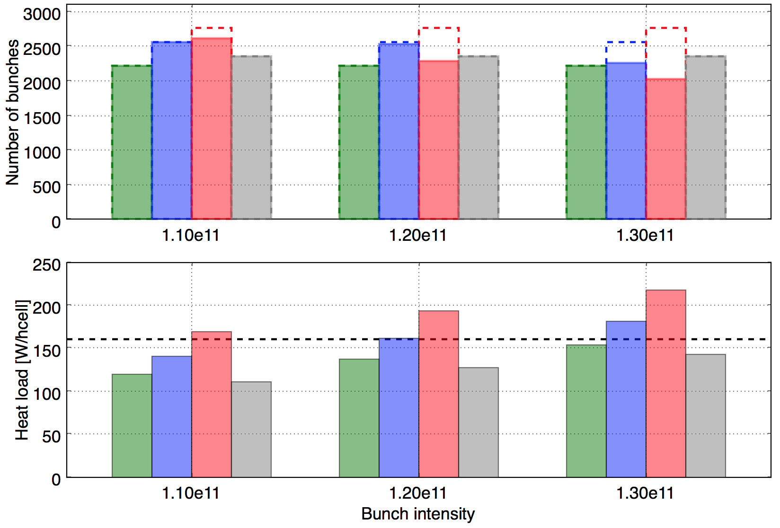
Heat load estimates
BCMS 2016
2x48b per injection
BCMS 2017
3x48b per injection
Standard 2017
4x72b per injection
G. Iadarola
Estimate for the sector with the highest heat load (S81)
  Cryo capacity found better than expected in high-load sectors
  Capacity of S12 still unknown, will need conditioning
  1.3-1.4x10¹¹ in BCMS could be within reach
Cryo limit (160 W/hcell)
BCMS_2016 2220b 1.10e11: 120.0(2220b) 1.20e11: 137.1(2220b) 1.30e11: 154.3(2220b)
BCMS_2017 2556b 1.10e11: 141.0(2556b) 1.20e11: 161.1(2538b) 1.30e11: 181.3(2256b)
STD_2017 2760b 1.10e11: 169.2(2610b) 1.20e11: 193.4(2283b) 1.30e11: 217.5(2030b)

Slide 6

Heat load estimates
BCMS 2016
2x48b per injection
BCMS 2017
3x48b per injection
Standard 2017
4x72b per injection
BCS 2018
4x32b per injection
G. Iadarola
Estimate for the sector with the highest heat load (S81)
  Cryo capacity found better than expected in high-load sectors
  Capacity of S12 still unknown, will need conditioning
  1.3-1.4x10¹¹ in BCMS could be within reach
  If limited by e-cloud (heat-load and/or emittance blow-up), BCS could be interesting alternative
Cryo limit (160 W/hcell)
BCMS_2016 2220b 1.10e11: 120.0(2220b) 1.20e11: 137.1(2220b) 1.30e11: 154.3(2220b)
BCMS_2017 2556b 1.10e11: 141.0(2556b) 1.20e11: 161.1(2538b) 1.30e11: 181.3(2256b)
STD_2017 2760b 1.10e11: 169.2(2610b) 1.20e11: 193.4(2283b) 1.30e11: 217.5(2030b)
BCS_2018 2348b 1.10e11: 111.0(2348b) 1.20e11: 126.9(2348b) 1.30e11: 142.8(2348b)

Slide 7
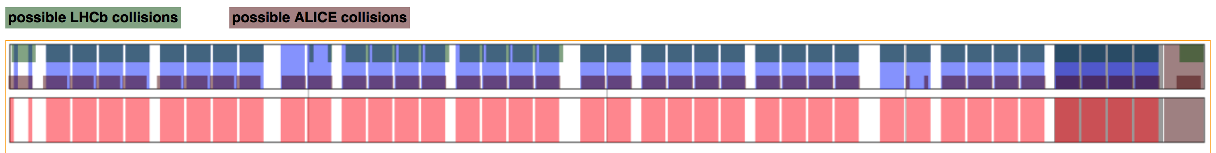
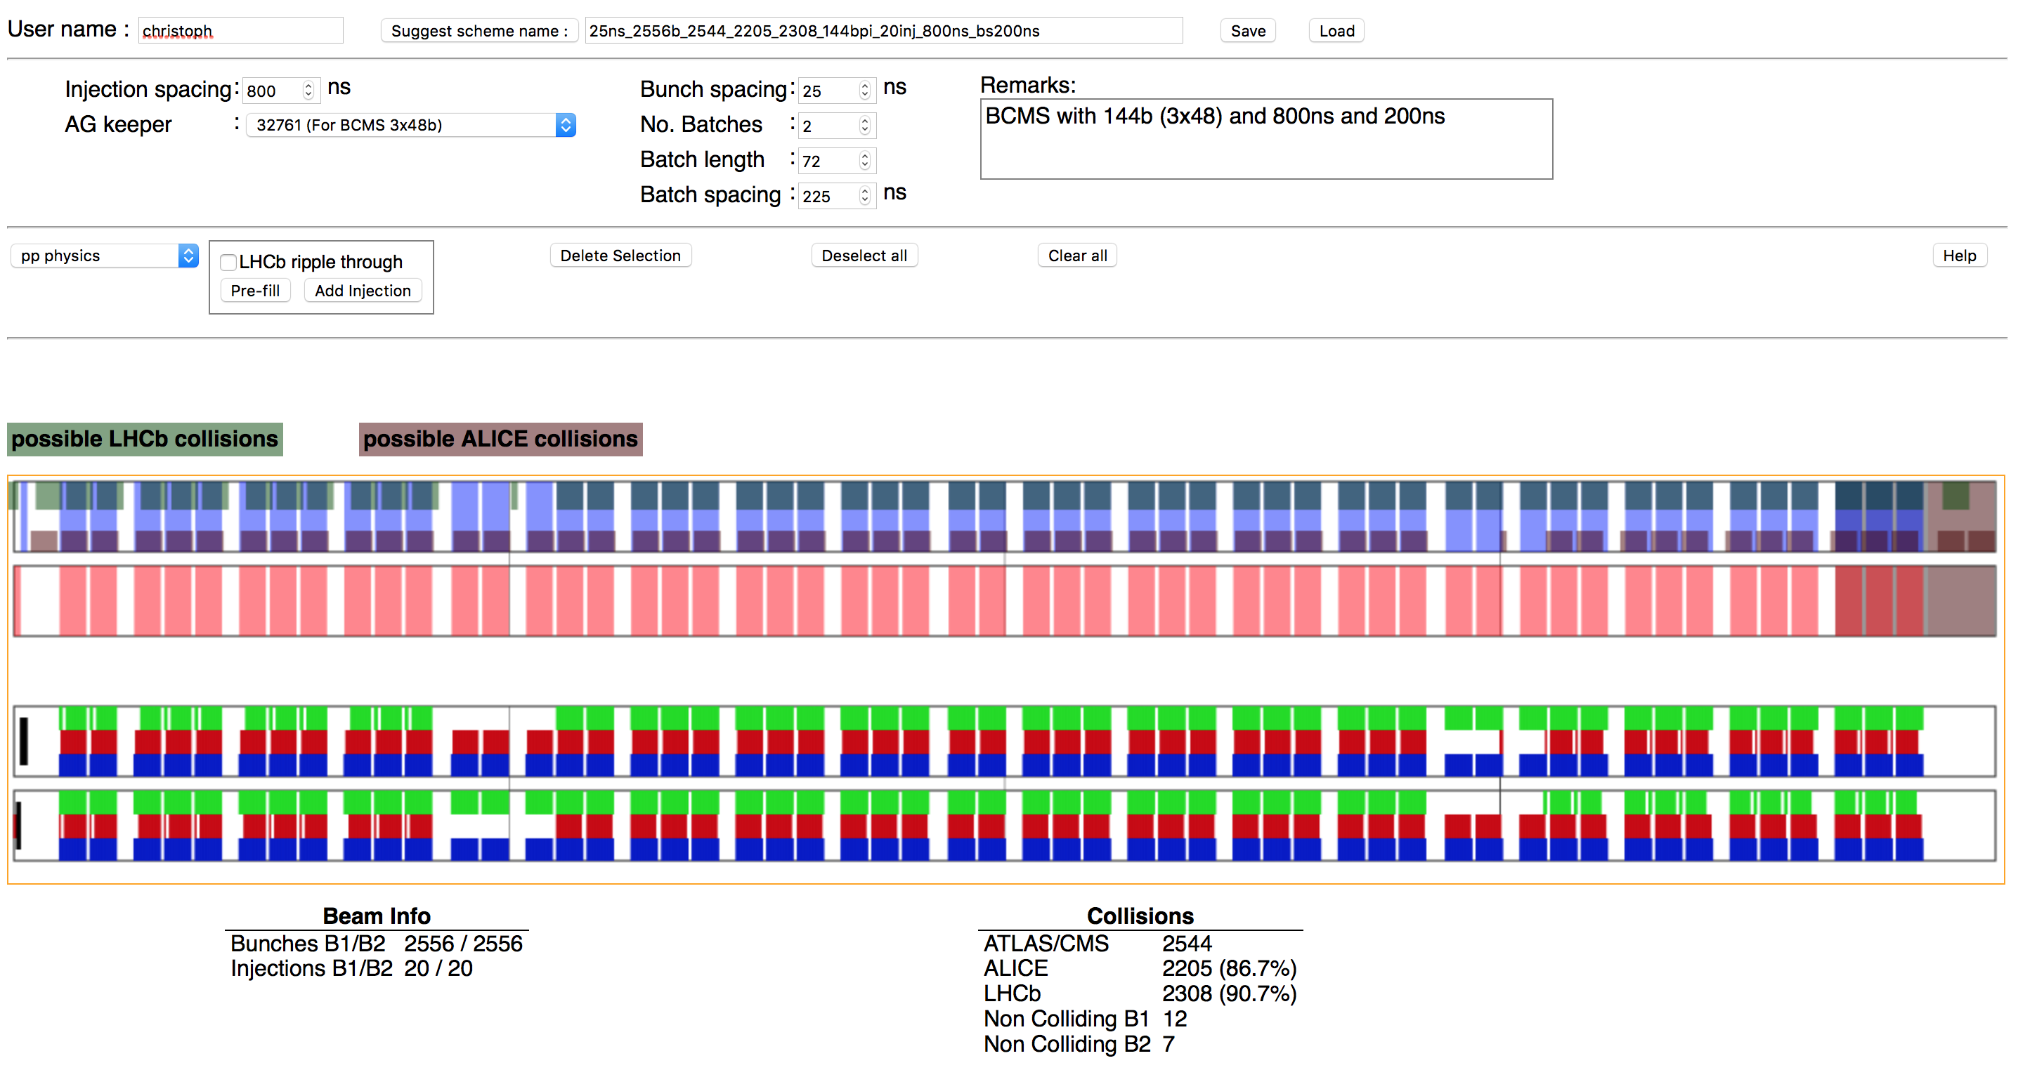
Filling schemes
Standard: 2760 b, 288 b/injection (4x72) T_{MKI} = 800 ns, T_{SPS} = 200 ns (N_{LHCb} = 2572 b)
40 % lower brightness than BCMS
BCMS: 2556 b, 144 b/injection (3x48) T_{MKI} = 800 ns, T_{SPS} = 200 ns (N_{LHCb} = 2332 b, 90% of total)
7 % less bunches than standard
BCS: 2348 b, 128 b/injection (4x32) T_{MKI} = 800 ns, T_{SPS} = 200 ns (N_{LHCb} = 2108 b, 90% of total)
8 % less bunches than BCMS, 30 % higher brightness than BCMS
G. Iadarola, C. Schwick

Slide 8
Filling schemes
Standard: 2760 b, 288 b/injection (4x72) T_{MKI} = 800 ns, T_{SPS} = 200 ns (N_{LHCb} = 2572 b)
40 % lower brightness than BCMS
BCMS: 2604 b, 144 b/injection (3x48) T_{MKI} = 750 ns, T_{SPS} = 200 ns (N_{LHCb} = 2402 b, 90% of total)
6 % less bunches than standard
BCS: 2444 b, 128 b/injection (4x32) T_{MKI} = 750 ns, T_{SPS} = 200 ns (N_{LHCb} = 2192 b, 90% of total)
6 % less bunches than BCMS, 30 % higher brightness than BCMS
  BCMS/BCS can accommodate 2604/2444 bunches with good IP8 ratio (90%) for MKIs rise time pushed to 750 ns or MKPs to 175 ns
  BCS is penalized for higher intensities of 1.4x10¹¹ p/b with 2220 bunches (15 % of BCMS) even for the pushed MKI/MKP settings
G. Iadarola, C. Schwick

Slide 9
Emittance evolution until SB in 2017
BCMS | H [%] | V [%]
flat bottom | 15 % 0.3 μm | 9 % 0.1 μm
ramp | 5 % 0.1 μm | 22 % 0.4 μm
total injection - collisions | 21 % 0.4 μm | 31 % 0.5 μm
  For 1.7 μm @ injection, reaching 2.2-2.3 μm @ SB
8b4e BCS | H [%] | V [%]
flat bottom | 17 % 0.2 μm | 15 % 0.15 μm
ramp | 43 % 0.6 μm | 45 % 0.6 μm
total injection - collisions | 68 % 0.8 μm | 68 % 0.7 μm
  For 1.0 μm @ injection, reaching 1.6-1.7 μm @ SB
M. Hostettler, N. Karastathis, S. Papadopoulou, and lumi team

Slide 10
Emittance evolution until SB in 2017
BCMS | H [%] | V [%]
flat bottom | 15 % 0.3 μm | 9 % 0.1 μm
ramp | 5 % 0.1 μm | 22 % 0.4 μm
total injection - collisions | 21 % 0.4 μm | 31 % 0.5 μm
  For 1.7 μm @ injection, reaching 2.2-2.3 μm @ SB
  2.5 μm
  Margin for
  intensity increase
8b4e BCS | H [%] | V [%]
flat bottom | 17 % 0.2 μm | 15 % 0.15 μm
ramp | 43 % 0.6 μm | 45 % 0.6 μm
total injection - collisions | 68 % 0.8 μm | 68 % 0.7 μm
  For 1.0 μm @ injection, reaching 1.6-1.7 μm @ SB
  1.8 μm
M. Hostettler, N. Karastathis, S. Papadopoulou, and lumi team

Slide 11
Collimation, aperture and β*
  With 2018a collimator settings, β* = 27 cm is possible
  If 2017-like aperture confirmed, β* = 25 cm is within reach in 2018
    With tighter 2018b collimators & 8.4 σ beam-beam separation (160 μrad half x-ing angle)
    Or 2018a collimators AND & 7.9 σ beam-beam separation (150 μrad half x-ing angle)
    Same x-ing angle polarity as in 2017
Collimator | 2017 | 2018a | 2018b
TCP IR7 | 5.0 | 5.0 | 5.0
TCSG IR7 | 6.5 | 6.5 | 6.0
TCLA IR7 | 10.0 | 10.0 | 9.5
TCP IR3 | 15.0 | 15.0 | 15.0
TCSG IR3 | 18.0 | 18.0 | 18.0
TCLA IR3 | 20.0 | 20.0 | 20.0
TCSG IR6 | 7.3 | 7.3 | 6.8
TCDQ IR6 | 7.3 | 7.3 | 6.8
TCT IR1/5 | 8.5 | 7.5 | 7.0
Aperture 1/5 | 9.5+0.5 | 8.5+0.5 | 8.0+0.5
TCT IR2 | 37.0 | 37.0 | 37.0
TCT IR8 | 15.0 | 15.0 | 15.0
R. Bruce and the collimation team

Slide 12
Collimation, aperture and β*
  With 2018a collimator settings, β* = 27 cm is possible
  If 2017-like aperture confirmed, β* = 25 cm is within reach in 2018
    With tighter 2018b collimators & 8.4 σ beam-beam separation (160 μrad half x-ing angle)
    Or 2018a collimators AND & 7.9 σ beam-beam separation (150 μrad half x-ing angle)
    Same x-ing angle polarity as in 2017
  Assumptions
    Good control of orbit and optics as for 2017
    No impact of larger CMS bump (-2 mm)
    Confirmation of MD results for hierarchy preservation (1 σ retraction) for tighter settings
Collimator | 2017 | 2018a | 2018b
TCP IR7 | 5.0 | 5.0 | 5.0
TCSG IR7 | 6.5 | 6.5 | 6.0
TCLA IR7 | 10.0 | 10.0 | 9.5
TCP IR3 | 15.0 | 15.0 | 15.0
TCSG IR3 | 18.0 | 18.0 | 18.0
TCLA IR3 | 20.0 | 20.0 | 20.0
TCSG IR6 | 7.3 | 7.3 | 6.8
TCDQ IR6 | 7.3 | 7.3 | 6.8
TCT IR1/5 | 8.5 | 7.5 | 7.0
Aperture 1/5 | 9.5+0.5 | 8.5+0.5 | 8.0+0.5
TCT IR2 | 37.0 | 37.0 | 37.0
TCT IR8 | 15.0 | 15.0 | 15.0
R. Bruce and the collimation team

Slide 13
Collimation, aperture and β*
  With 2018a collimator settings, β* = 27 cm is possible
  If 2017-like aperture confirmed, β* = 25 cm is within reach in 2018
    With tighter 2018b collimators & 8.4 σ beam-beam separation (160 μrad half x-ing angle)
    Or 2018a collimators AND & 7.9 σ beam-beam separation (150 μrad half x-ing angle)
    Same x-ing angle polarity as in 2017
  Assumptions
    Good control of orbit and optics as for 2017
    No impact of larger CMS bump (-2 mm)
    Confirmation of MD results for hierarchy preservation (1 σ retraction) for tighter settings
  Proposal:
    Start with 2017 settings and move towards 2018a settings during the fill (closing TCTs) with lower x-ing angle, allowing β* levelling
    Later apply 2018a settings at the beginning of fill, and possibly push to 2018b
Collimator | 2017 | 2018a | 2018b
TCP IR7 | 5.0 | 5.0 | 5.0
TCSG IR7 | 6.5 | 6.5 | 6.0
TCLA IR7 | 10.0 | 10.0 | 9.5
TCP IR3 | 15.0 | 15.0 | 15.0
TCSG IR3 | 18.0 | 18.0 | 18.0
TCLA IR3 | 20.0 | 20.0 | 20.0
TCSG IR6 | 7.3 | 7.3 | 6.8
TCDQ IR6 | 7.3 | 7.3 | 6.8
TCT IR1/5 | 8.5 | 7.5 | 7.0
Aperture 1/5 | 9.5+0.5 | 8.5+0.5 | 8.0+0.5
TCT IR2 | 37.0 | 37.0 | 37.0
TCT IR8 | 15.0 | 15.0 | 15.0
R. Bruce and the collimation team

Slide 14
Crossing-angle
  Target of min DA @ 5 σ (emittance of 2.5 μm) to preserve lifetime after WP optimisation
  Simulations with high octupoles and chromaticity (could be reduced for colliding bunches)
N. Karastathis and D. Pellegrini

Slide 15
Crossing-angle
  Target of min DA @ 5 σ (emittance of 2.5 μm) to preserve lifetime after WP optimisation
  Simulations with high octupoles and chromaticity (could be reduced for colliding bunches)
  For β* = 30 cm
    For 1.3x10¹¹ p -> 150 μrad
    For 1.4x10¹¹ p -> 160 μrad
N. Karastathis and D. Pellegrini

Slide 16
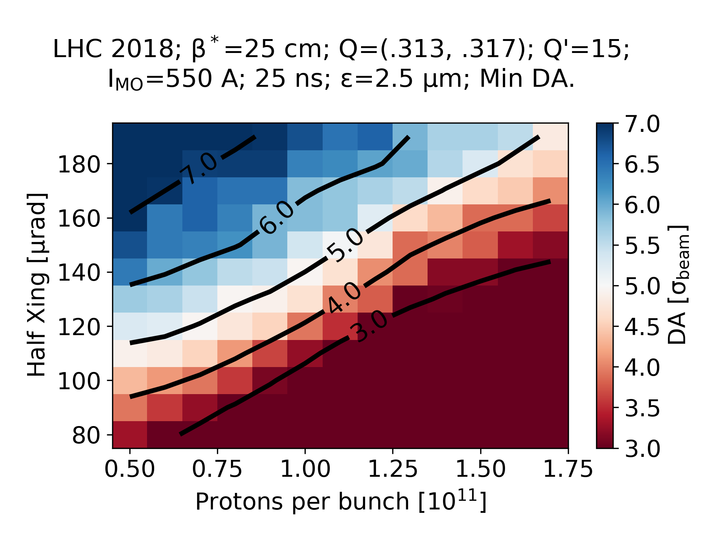
Crossing-angle
  Target of min DA @ 5 σ (emittance of 2.5 μm) to preserve lifetime after WP optimisation
  Simulations with high octupoles and chromaticity (could be reduced for colliding bunches)
  For β* = 30 cm
    For 1.3x10¹¹ p -> 150 μrad
    For 1.4x10¹¹ p -> 160 μrad
  For β* = 25 cm
    For 1.3x10¹¹ p -> 160 μrad
    For 1.4x10¹¹ p -> 170 μrad
  Proposal: 160 μrad allowing higher intensity and/or lower β*
N. Karastathis and D. Pellegrini

Slide 17
Crossing-angle
  Lower emittance of 1.8 μm for BCS (after WP optimisation)
  For β* = 25 cm
    For 1.3x10¹¹ p -> 140 μrad
    For 1.4x10¹¹ p -> 150 μrad
  Gain of 0.5 σ in beam-beam separation @ 25 cm
N. Karastathis and D. Pellegrini

Slide 18
Instabilities
  Instabilities mitigated with high octupoles (factor of 2 to the model), chromaticity and ADT gain (need well-corrected coupling)
  Octupole settings proposal (chromaticity of 15) based on measurements (conservative)
X. Buffat for the coherent instabilities team

Slide 19
Instabilities
  Instabilities mitigated with high octupoles (factor of 2 to the model), chromaticity and ADT gain (need well-corrected coupling)
  Octupole settings proposal (chromaticity of 15) based on measurements (conservative)
    Within reach for BCMS (even for tight collimator settings)
    Out of reach for BCS
  Need optimisation during operation
X. Buffat for the coherent instabilities team
Octupole current [A]
2017/2018a
2018b

Slide 20
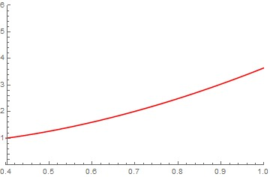
From ATS to ATS
  “Medium telescope”, stopping pre-squeeze @ 57-60 cm
    Tele index of 2.3-2.4 for 25 cm (1.6 for nominal scenario)
    50-60% more Landau damping, at flat top if small tele-squeeze (×1.5) in the ramp
MO tune spread amplification @ 25 cm vs.
β*_{pre-squeeze} ,relative to nominal scenario
S. Fartoukh
60 % @ β*_{pre-squeeze} =60cm
β*_{pre-squeeze} [m]

Slide 21
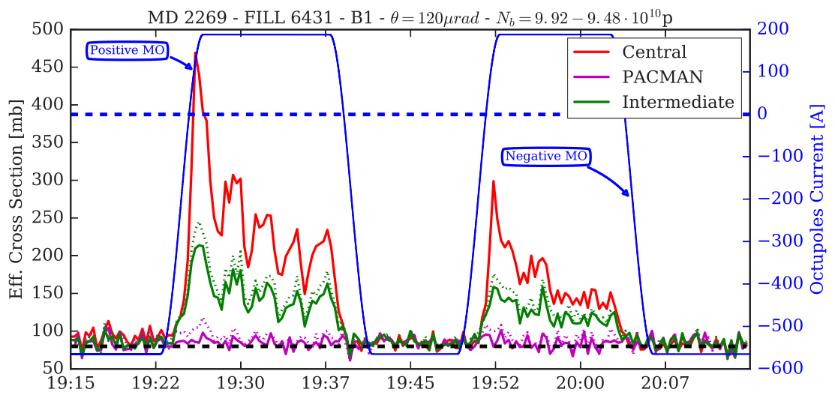
From ATS to ATS
  “Medium telescope”, stopping pre-squeeze @ 57-60 cm
    Tele index of 2.3-2.4 for 25 cm (1.6 for nominal scenario)
    50-60% more Landau damping, at flat top if small tele-squeeze (×1.5) in the ramp
MO tune spread amplification @ 25 cm vs.
β*_{pre-squeeze} ,relative to nominal scenario
S. Fartoukh
60 % @ β*_{pre-squeeze} =60cm
β*_{pre-squeeze} [m]
  “Large telescope”, stopping pre-squeeze @ 0.75 - 1 m
    Tele index of 3-4 for 25 cm
    BBLR mitigation, with margin for Landau damping
  Big potential but increased commissioning time
S. Fartoukh, A. Poyet, G. Sterbini and the BB team

Slide 22
Levelling considerations
  Experiments
    Total PU of 60 on average, with a PU width of the order of 10 % rms
    ATLAS and CMS may have different PU levelling targets
    Clear preference in levelling with separation but can accept β* levelling with three steps
    Ready for continuous x-ing angle anti-leveling
    Fills should be long enough to satisfy LHCb
C. Schwick, B. Petersen, J. Boyd

Slide 23
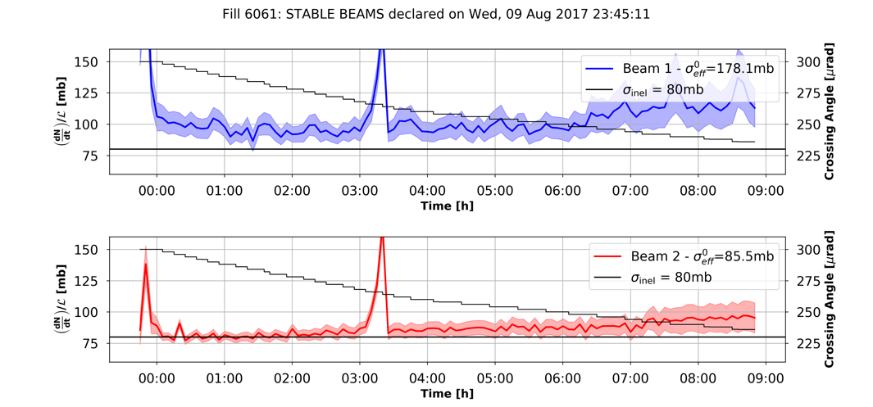
Levelling considerations
  Experiments
    Total PU of 60 on average, with a PU width of the order of 10 % rms
    ATLAS and CMS may have different PU levelling targets
    Clear preference in levelling with separation but can accept β* levelling with three steps
    Ready for continuous x-ing angle anti-leveling
    Fills should be long enough to satisfy LHCb
  Machine
    Deployed successfully separation and x-ing angle (anti-)levelling in 2017 operation
      No impact in emittance BU observed
    Tested successfully β* levelling mechanics in MD
C. Schwick, B. Petersen, J. Boyd

Slide 24
Performance projection in 2018
  General assumptions
    Levelling at average 60 PU event/crossing
    Emittance of 2.5 μrad for BCMS, 1.8 μrad for BCS
    Observed emittance blow-up on top of model
    Losses only from burn-off
    Turn-around time of 4 h, 100% availability
    Crossing angle anti-levelling keeping DA @ 5 σ
    Integrated luminosity/day projections based on optimal fill time (around 10 h)
      Can be lengthened to 12-14 h without major loss of integrated performance (LHCb performance enhanced)

Slide 25
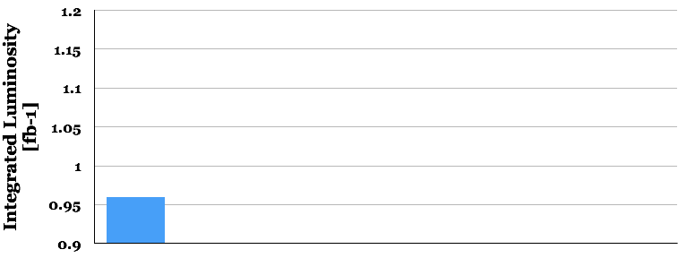
Performance projection in 2018
  Reach 2017 performance with BCMS beams
    1.25e11, 30 cm, 160 μrad, peak luminosity of 2.e34cm⁻²s⁻¹, peak pile-up of 55
    Apply x-ing angle anti-levelling from beginning of fill
    Already integrated luminosity 0.96 fb⁻¹/per day
[fb⁻¹]
BCMS
30 cm
1.25e11

Slide 26
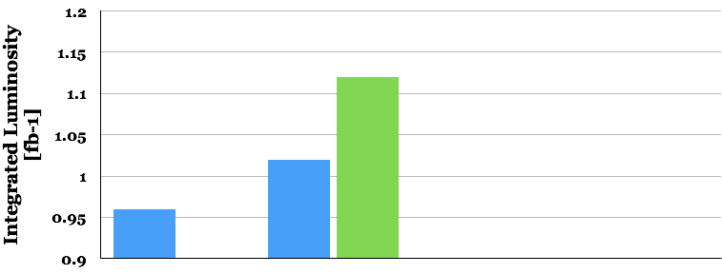
Performance projection in 2018
  Push intensity of BCMS beams
    1.3-1.4e11, 30 cm, 160 μrad, peak luminosity of 2.1/2.5e34 cm⁻²s⁻¹, peak pile-up of 59/69
    Start with separation levelling (0 to 2.6 h), beware of instabilities
    Apply x-ing angle anti-levelling after separation levelling
    Around 1.02 to 1.12 fb⁻¹/per day
BCMS
30 cm
+17%
[fb⁻¹]
BCMS
30 cm
+6%
1.25e11
1.3e11
1.4e11

Slide 27
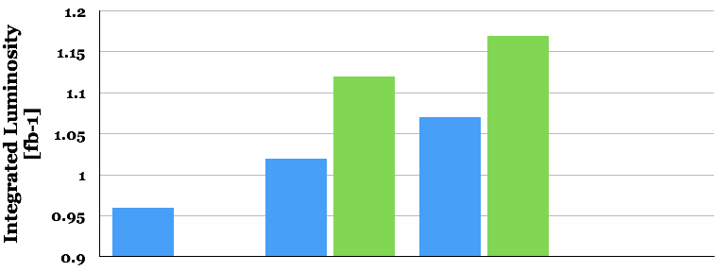
Performance projection in 2018
  Levelling to lower β* of BCMS beams
    1.3-1.4e11, 30 to 25 cm, 160 μrad, peak luminosity of 2.4/2.8e34 cm⁻² s⁻¹, peak pile-up of 66/77
    Start with separation, followed by β* levelling (1.3 to 3.4 h total) and then x-ing angle anti-levelling
    Integrated luminosity of 1.07-1.17 fb⁻¹/per day
BCMS
25 cm
BCMS
30 cm
+22%
+17%
[fb⁻¹]
+11%
BCMS
30 cm
+6%
1.25e11
1.3e11
1.4e11
1.3e11
1.4e11

Slide 28
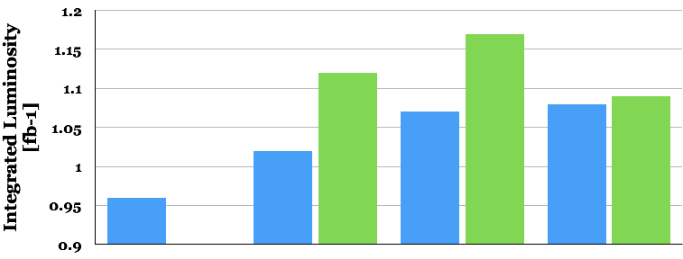
Performance projection in 2018
  Fallback scenario with BCS beams
    1.3-1.4e11, 30 to 25 cm, 150 μrad, peak lumi of 2.8/3.1e34 cm⁻² s⁻¹, peak pile-up of 86/100 (less bunches for higher intensity)
    Start with separation, followed by β* levelling (4.4 to 6 h) and then x-ing angle anti-levelling
    Integrated luminosity of 1.08-1.09 fb⁻¹/per day
BCMS
25 cm
BCMS
30 cm
+22%
BCS
25 cm
+17%
[fb⁻¹]
+14%
+11%
+13%
BCMS
30 cm
+6%
1.25e11
1.3e11
1.4e11
1.3e11
1.4e11
1.3e11
1.4e11

Slide 29
Summary
  BCMS beams is the baseline for luminosity production in 2018
    Excellent integrated luminosity performance projection even starting from 2017 conditions (limited by 16L2)
    Smooth x-ing angle anti-levelling from 160 μrad to further improve performance and mitigate any additional losses (take into account emittance BU)

Slide 30
Summary
  BCMS beams is the baseline for luminosity production in 2018
    Excellent integrated luminosity performance projection even starting from 2017 conditions (limited by 16L2)
    Smooth x-ing angle anti-levelling from 160 μrad to further improve performance and mitigate any additional losses (take into account emittance BU)
  Increasing the bunch current towards 1.4e11 in BCMS can enhance performance
    Levelling with separation for keeping average PU @ 60 events/crossing
  Slight increase in performance can be provided with lower β* (25 cm pending aperture/collimation verifications)
    Enable testing of separation, β* and x-ing angle (anti-)levelling consecutively in the same fill (HL-LHC scenarios)

Slide 31
Summary
  BCMS beams is the baseline for luminosity production in 2018
    Excellent integrated luminosity performance projection even starting from 2017 conditions (limited by 16L2)
    Smooth x-ing angle anti-levelling from 160 μrad to further improve performance and mitigate any additional losses (take into account emittance BU)
  Increasing the bunch current towards 1.4e11 in BCMS can enhance performance
    Levelling with separation for keeping average PU @ 60 events/crossing
  Slight increase in performance can be provided with lower β* (25 cm pending aperture/collimation verifications)
    Enable testing of separation, β* and x-ing angle (anti-)levelling consecutively in the same fill (HL-LHC scenarios)
  If BCMS limited by heat-load/e-cloud, BCS (high-brightness variant) can maintain performance to comparable levels
    Lower x-ing angle, longer levelling times
    Reduced number of bunches at highest bunch currents -> need to reduce the LHCb penalty with longer fills
    Octupole current may be limited for instability mitigation -> opens the route for the use of optics with larger telescope (commissioning time)

Slide 32
Summary
(levelling)

Slide 33
Extras

Slide 34
Comparison
Parameter. | BCMS – no levelling | BCMS sep. levelling | BCMS sep and β* levelling | BCS Sep and β* levelling
Particles per bunch, N [10¹¹] | 1.25 | 1.3/1.4 | 1.3/1.4 | 1.3/1.4
Number of collisions in IP1 and IP5/IP8 | 2544 | 2544 | 2544 | 2336/2208
Half x-ing angle in IP1/5 [μrad] | 160 | 160 | 160 | 150
Minimum β* [m] | 0.30 | 0.30 | 0.25 | 0.25
e_{n} [μm] | 2.5 | 2.5 | 2.5 | 1.8
R.M.S. bunch length [cm] | 8.3 | 8.3 | 8.3 | 8.3
Virtual peak luminosity L_{peak} [10³⁴ cm⁻² s⁻¹] | 2.0 | 2.1/2.5 | 2.4/2.8 | 2.8/3.1
Max pile-up | 55 | 59/69 | 66/77 | 86/100
Levelling time [h] | 0. | 0/2.6 | 1.3/3.4 | 4.4-6.0
Maximum number of bunches per injection | 144 | 144 | 144 | 128/96
L_{int} [fb⁻¹/day] | 0.96 | 1.02/1.12 | 1.07/1.17 | 1.08/1.09

Slide 35
Emittance evolution during SB in 2017
Beam 1
  Average emittance BU @ SB (beyond model)
    0.05 μm/h in H
    0.10 μm/h in V
  No visible impact of levelling
Beam 2
S. Papadopoulou, F. Antoniou et al., Evian 2017

Slide 36
Lifetime & Losses
  B2 very close to BO
  B1 slightly worse, improved with low emittance (relaxed x-ing angle for 8b4e)
  No visible impact of separation levelling
After 1.5h in SB | Lifetime [h] | Effective Cross-Section [mb]
B1 | 28.8 | 88.1
B2 | 32.2 | 80.51
N. Karastathis et al.

Slide 37
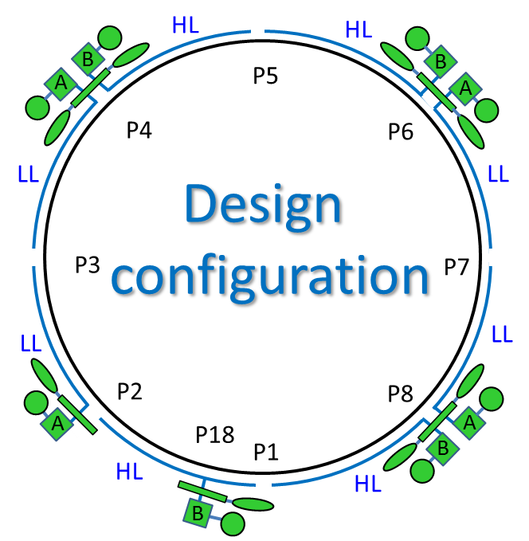
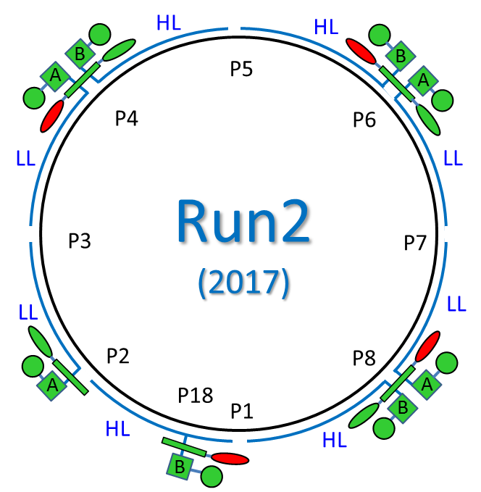
Beam Screen – refrigeration capacity summary 2017/expected 2018
Default estimated value of guaranteed refrigeration capacity is 160 W. Specific four sectors were tested in their design configuration. The values for their capacity limit for BS cooling is presented in table below.
G. Ferlin, Evian 2017
measured in:
?
2016
2017
2016
2017
Reconfiguration of the system for using of 1 cold pumping unit/cryo-island allows to spare about ~3 kW (~20 W/hc – estimated values) of capacity for BS but has an influence on equilibrium of capacity of about 10-15%.
Missing high load sector should be measured during YETS 2017/2018

