Slide 1
Electronics status September 2017

Slide 2
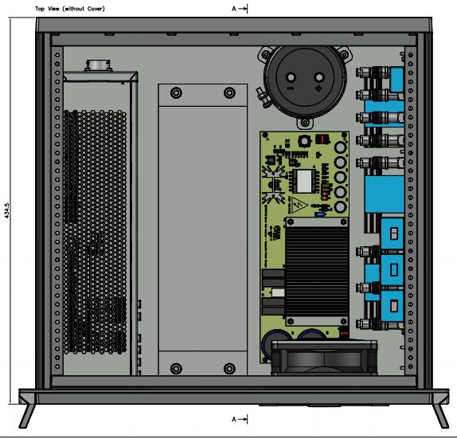
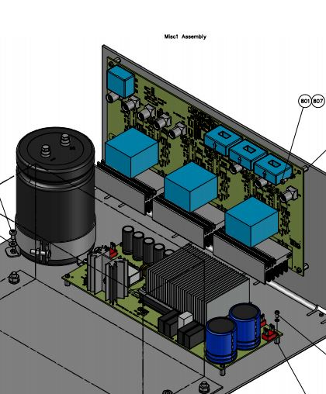
BWS

Slide 3
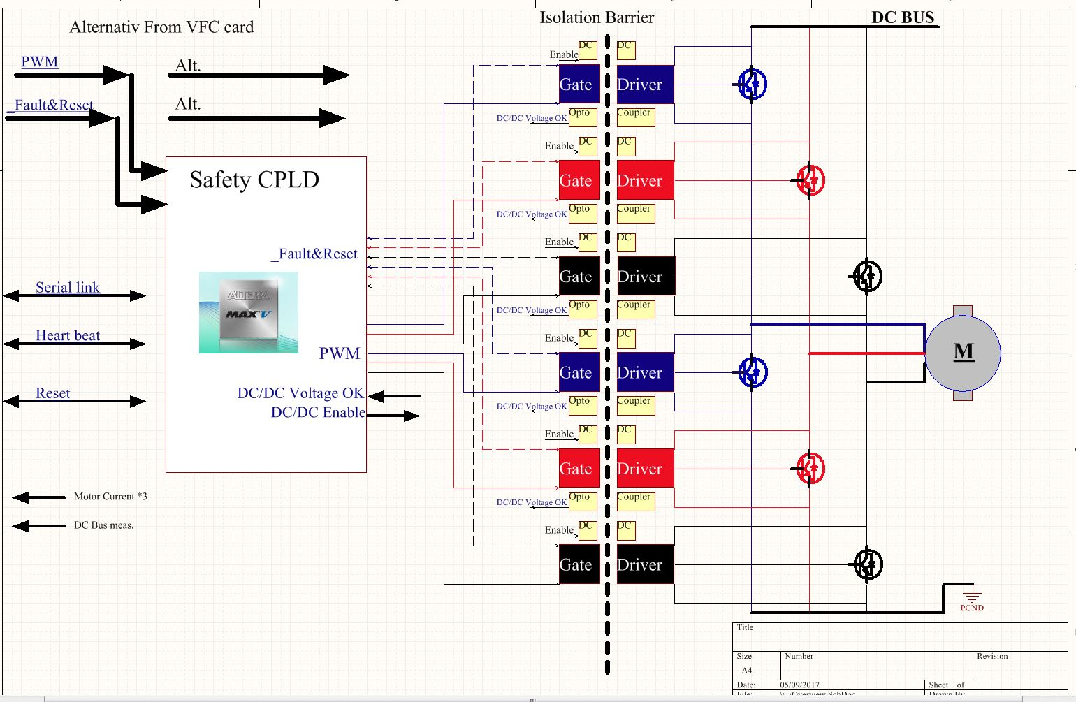
Inverter Overview
Key Features
600Vdc
48A continues
100A Peak
Safety CPLD
Current(100A) and
voltage measurement.

Slide 4
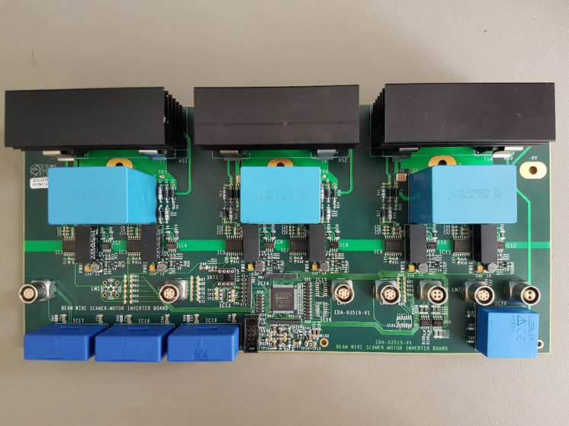
Motor Inverter.
Delivered May 2017.
Function Test
June 2017.
Temperature Test
August 2017(Dspace).

Slide 5
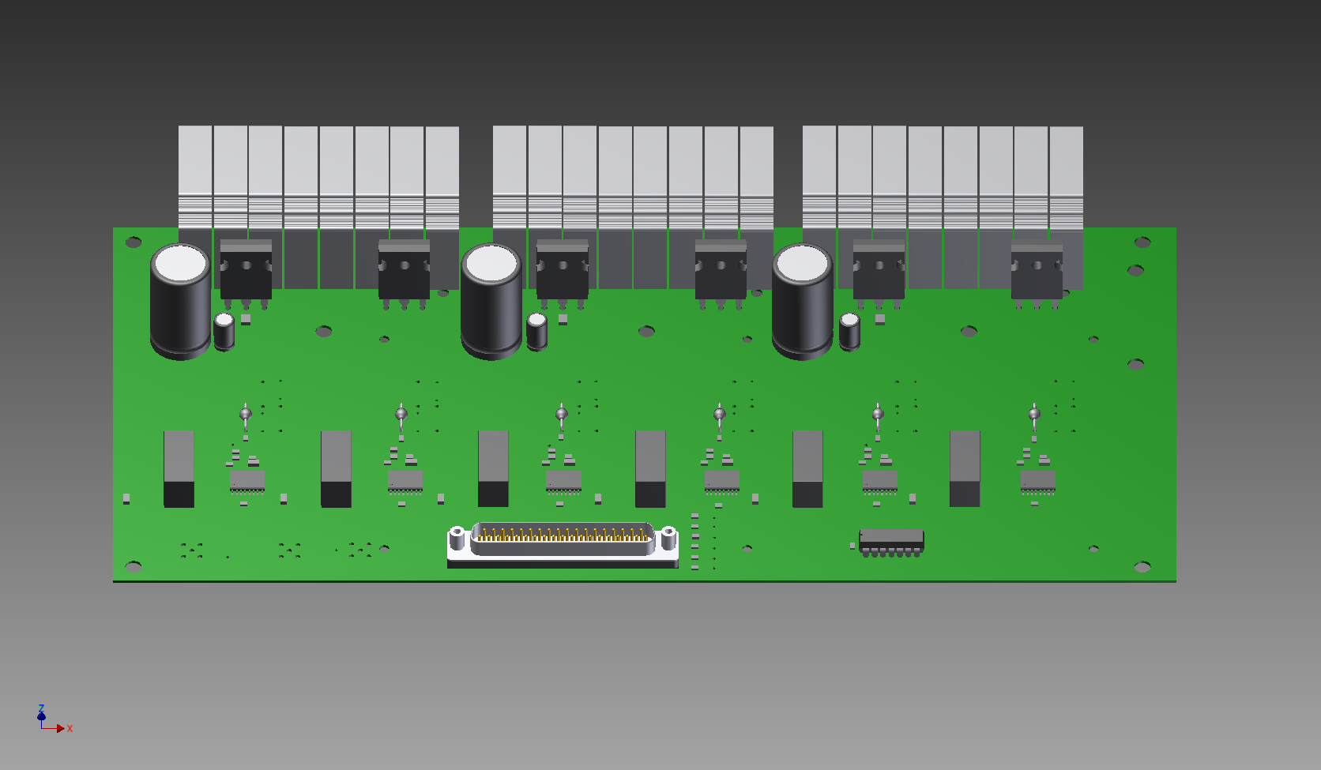
Temperature measure points
Orange dot =
Temperature
Sensor placement

Slide 6
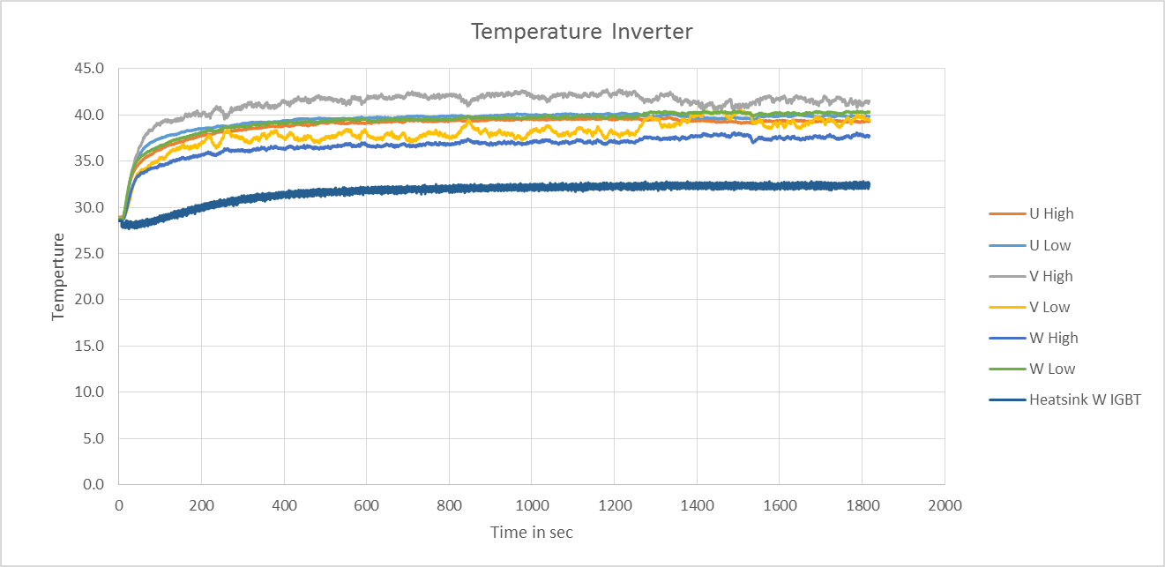
-133Rad/s
- 1 Scan every 3sec.
-309 Dc-Bus
-12mF Cond.
-100M Cable
-Filter 5040-10-83
-Air Temp 28C.

Slide 7
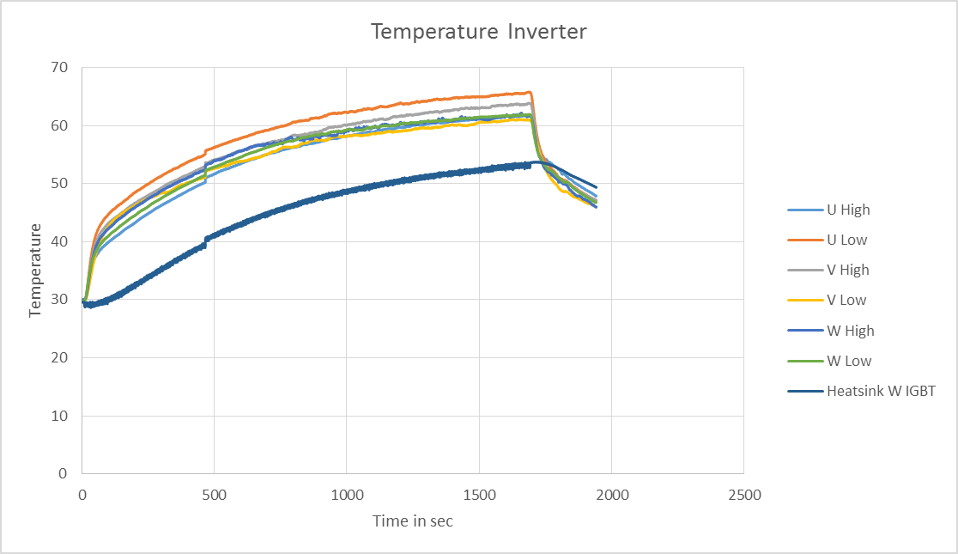
-133Rad/s
- 1 Scan every 3sec.
-309 Dc-Bus
-12mF Cond.
-100M Cable
-Filter 5040-10-83
-Air Temp 28C.
-No Fan
Labview restart

Slide 8
Conclusion Inverter
Working with the ALXION motor 145STK2M
EMC Radiation noise, Need to think about it when it is around other electronic equipment.
Need to change IGBT because they are now obsolete.

Slide 9
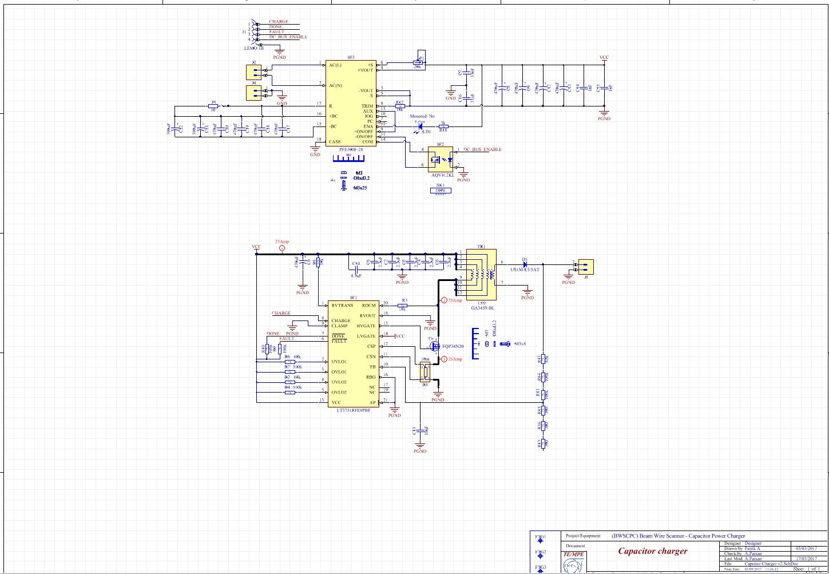
Capacitor charger (DC bus)
Key Features
Charge any size of capacitor
Up 500V
AC/DC, for 12V, 42A

Slide 10
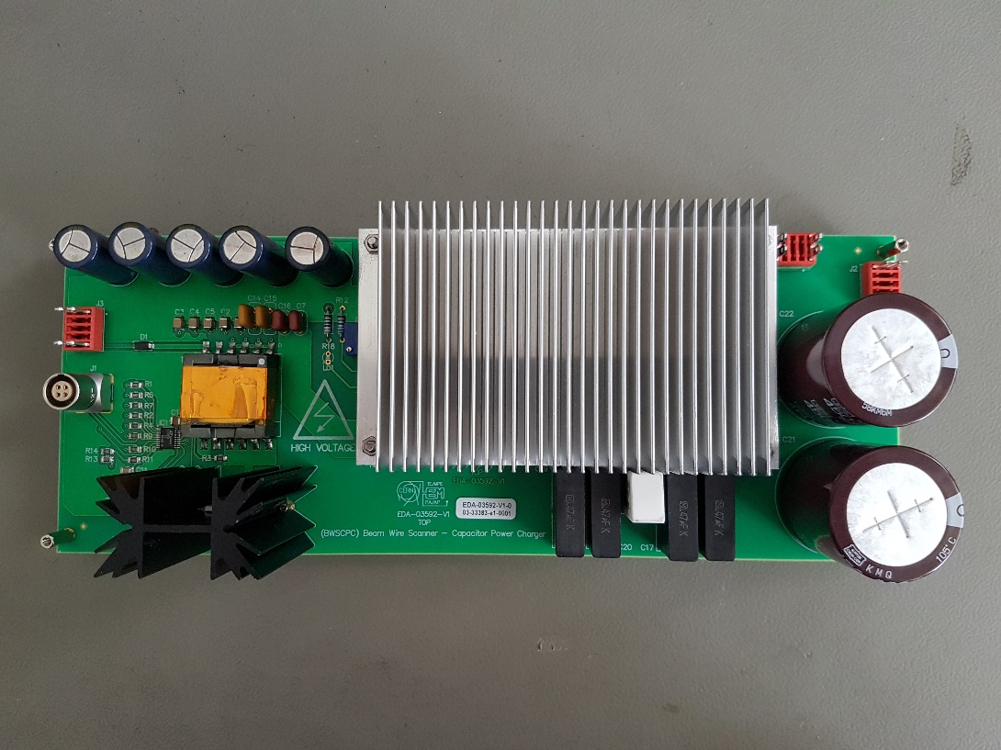
Capacitor Charger
Delivered June 2017.
Function Test
July 2017.

Slide 11
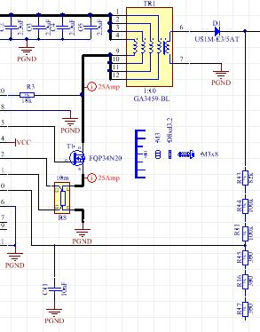
Conclusion Charger
Charging12mF to 310Vdc.
EMC Radiation noise.
Need to charge faster.
So change of Mosfet to improved
current tolerance and maybe
also change Transformer.

