Slide 1
Publishing data & software
Iulia Georgescu

Slide 2
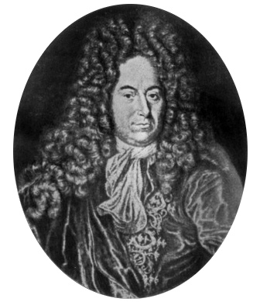
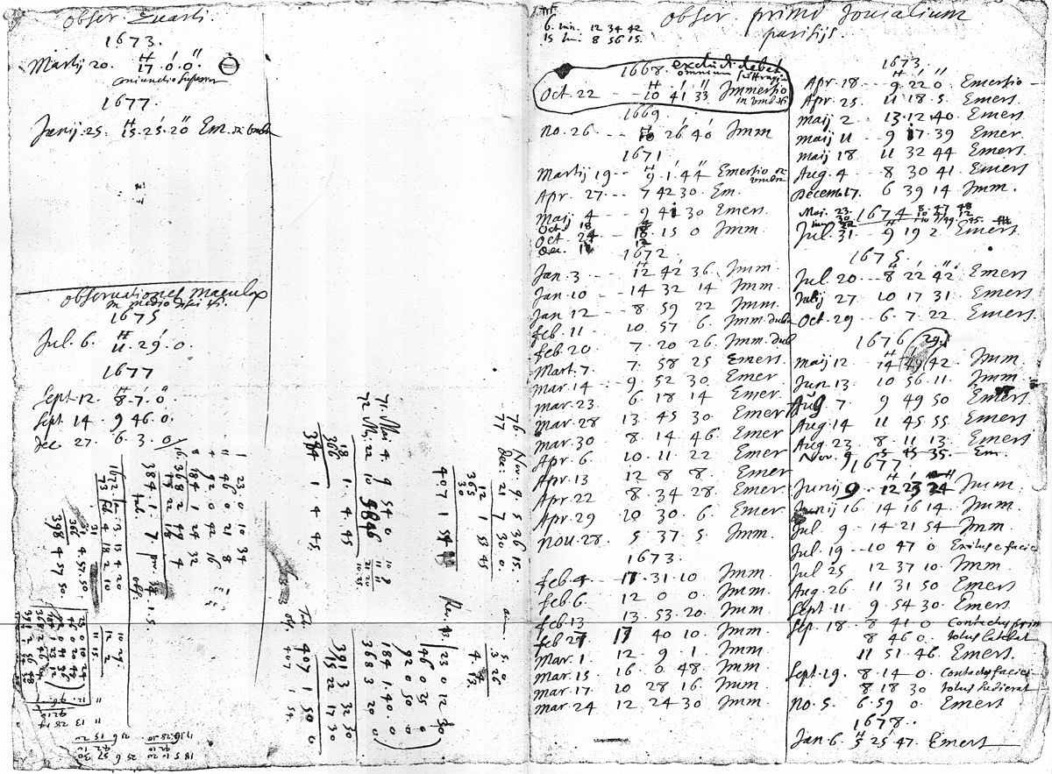
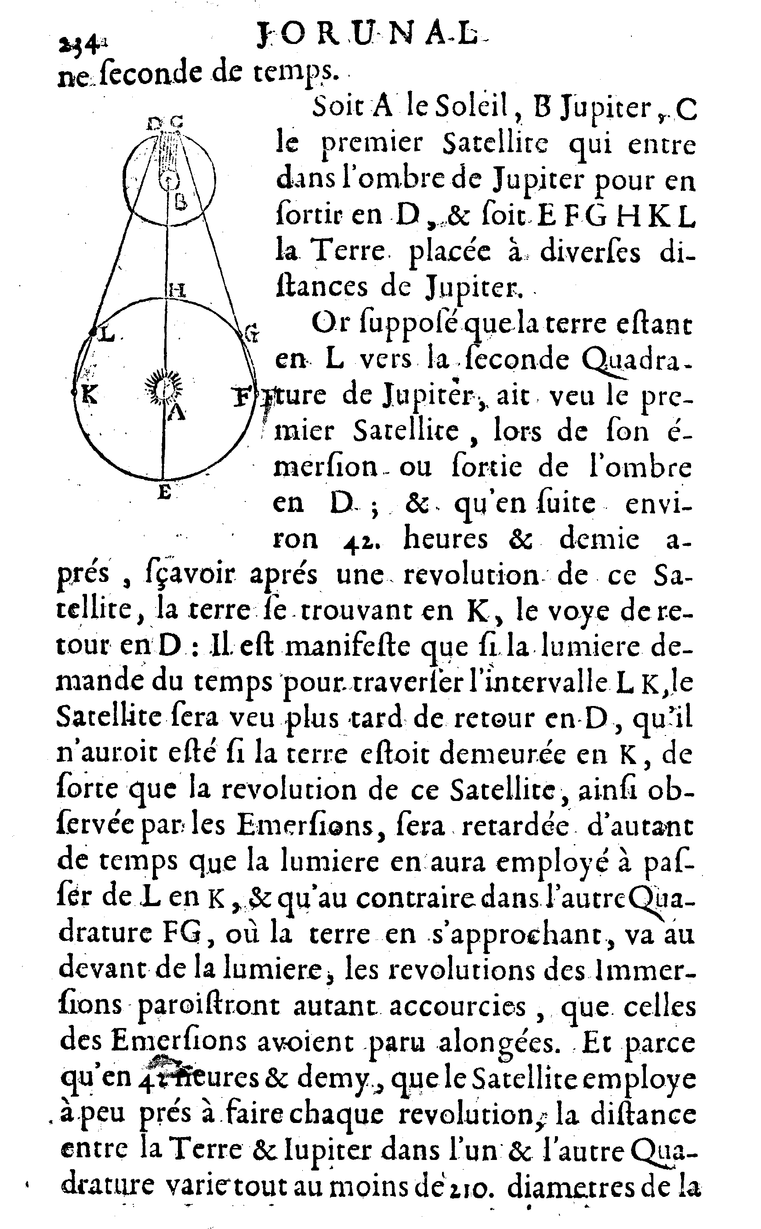
Determination of the speed of light
Ole Rømer (1644–1710)
Data
Story: 1676 Journal des sçavans

Slide 3
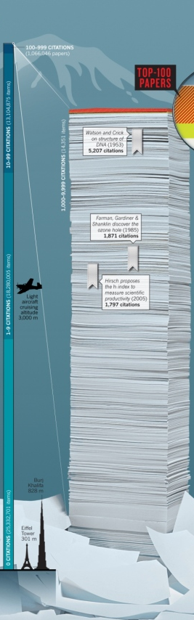
350 years of scientific publishing
1665
Philosophical Transactions of the Royal Society and Journal des sçavans (1665-1792)
2015
>14,000 ISI journals
~58 million papers in Web of Science

Slide 4
Jim Gray The Fourth Paradigm
Empirical (describing natural phenomena)
Theoretical (using models, generalizations)
Computational (simulating complex phenomena)
Data exploration (theory, experiment & simulation)
How has science publishing changed?

Slide 5
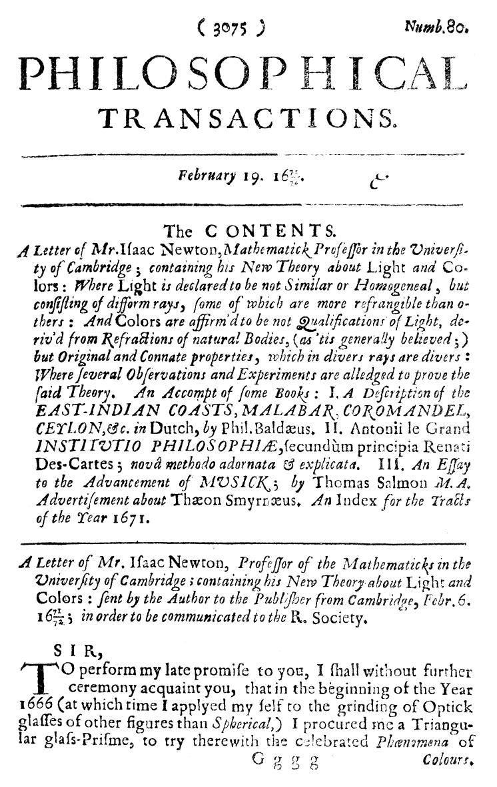
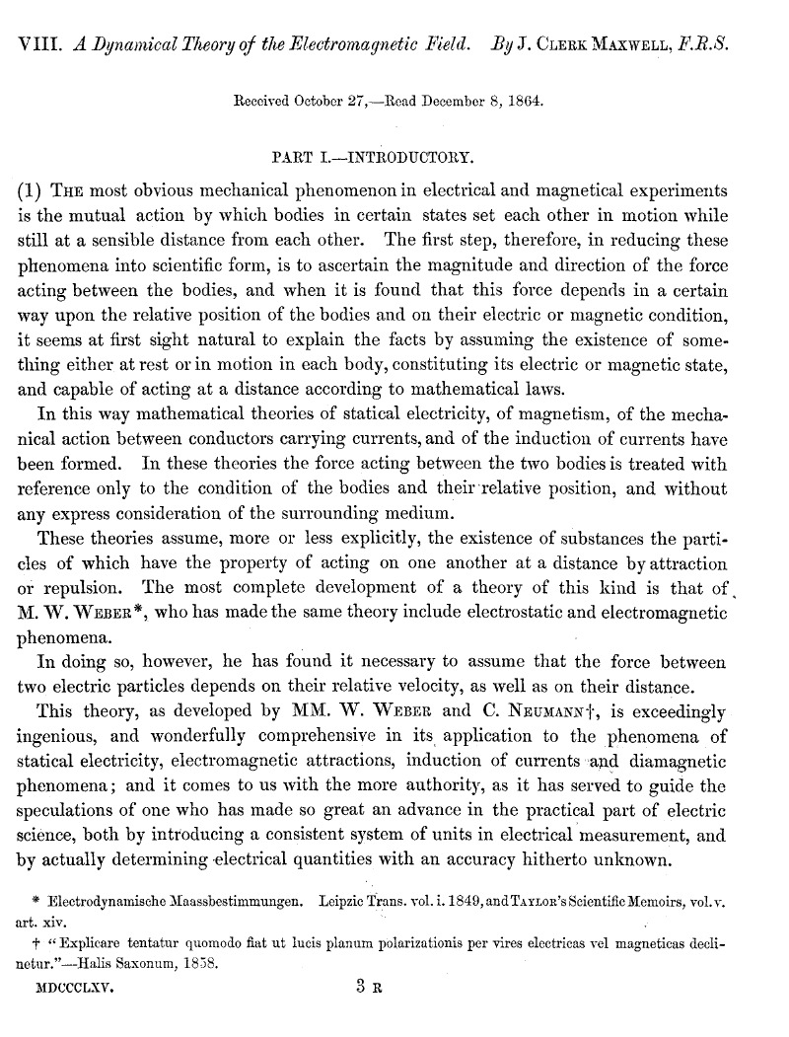
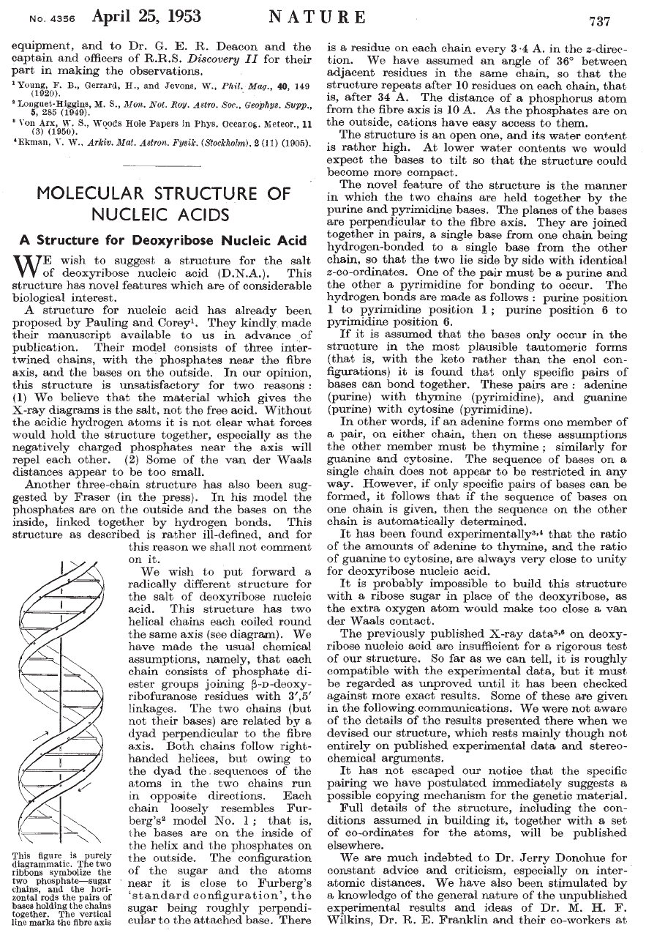
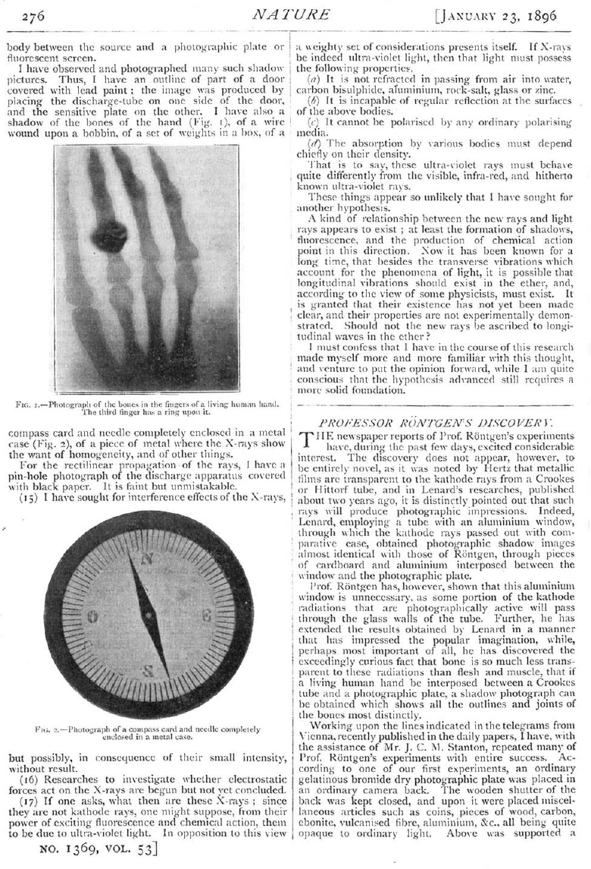
Isaac Newton 1671
James Clerk Maxwell 1864
Wilhelm Roentgen 1896
Watson & Crick 1953

Slide 6
Changing paradigm
The old type of narrative:
data to support a hypothesis
Data-intensive science:
Large amounts of data
Should be made accessible to others
Exploratory use
data interesting in itself

Slide 7
Filter and publish? or
Publish and filter?
Data
Story

Slide 8
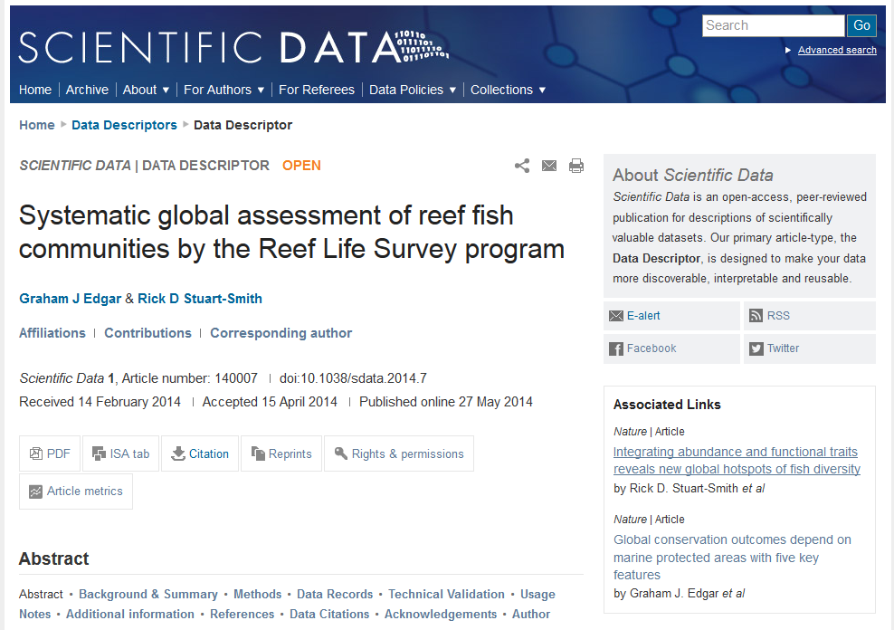
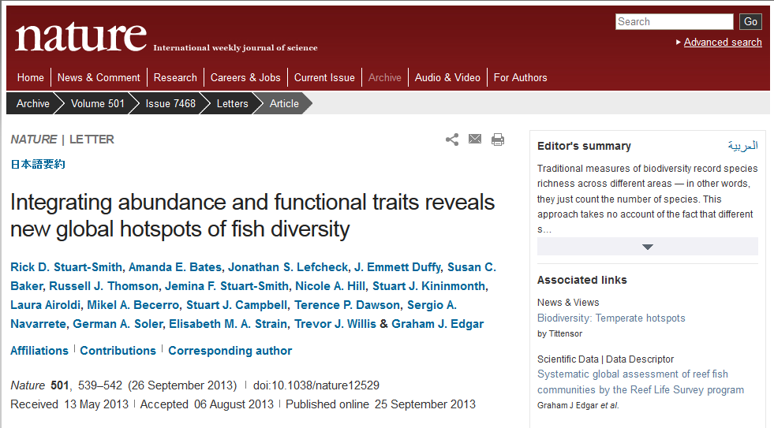
A possible answer: data journals
Scientific Data (NPG)
Data in Brief, Genomics Data (Elsevier)
Geoscience Data Journal (Wiley)

Slide 9
The concept of Data journals
Data must be well described before others can use it and benefit from it
Scientists who share data in a reusable manner deserve credit through citable publications
Data quality matters

Slide 10
How does it work?
Include methods and technical analyses supporting the quality of the data
Publish alongside a journal article
Describe standalone datasets that don’t fit in other publications
Release data used in previous research articles

Slide 11
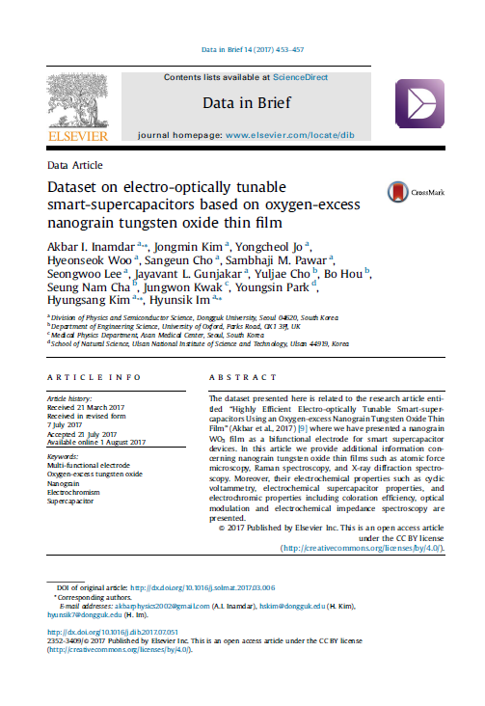
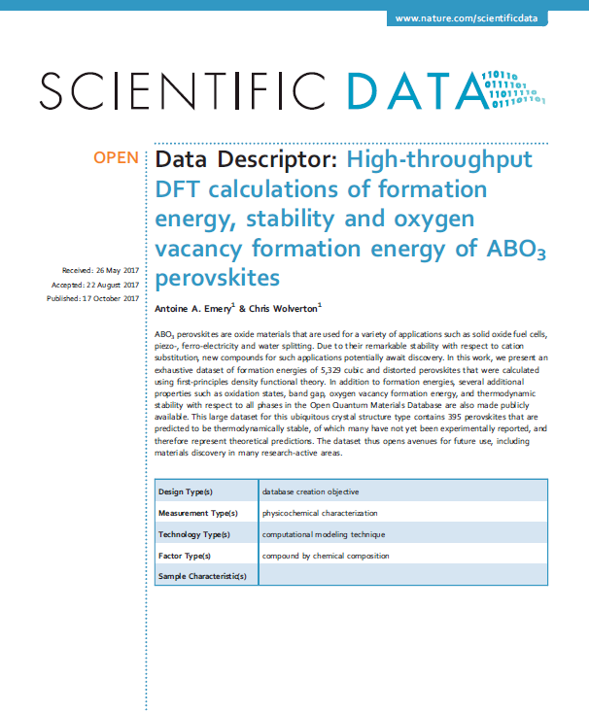
How to write a data descriptor?
Data descriptor
Title
Abstract
Background & Summary
Methods
Technical Validation
Data Records
Usage Notes
Figures & Tables
References
Data Citations
Research article
Title
Abstract
Introduction
Main results
Discussion
Outlook
Methods
Figures & Tables
References
Supplementary Info
No tests of new scientific hypotheses

Slide 12
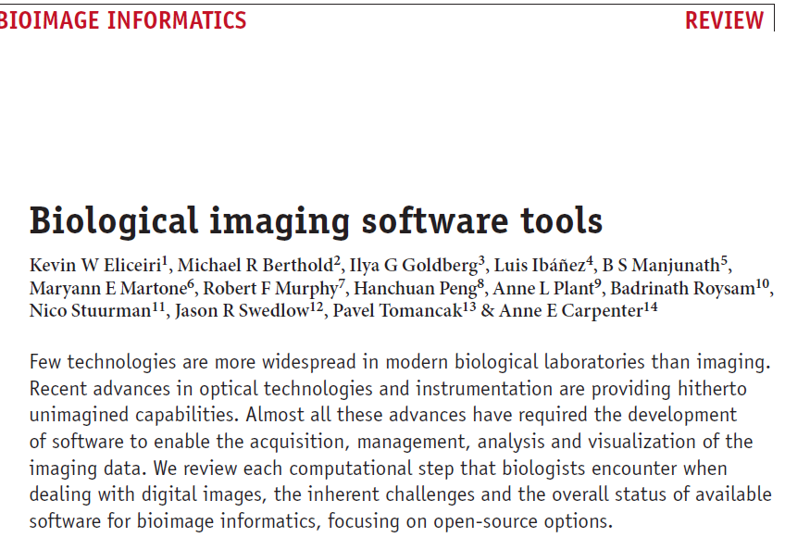
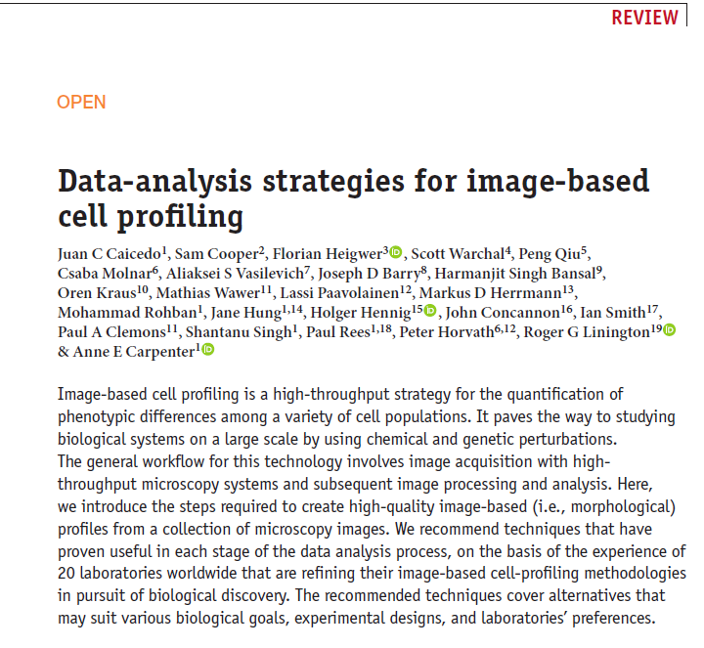
How about data & software reviews?
Coming up in Nature Reviews Physics in 2019

Slide 13
The future
Publishing data & software will become more widespread
Scientists and funders will come to appreciate these new articles on the same footing as primary research
Challenges: educating scientists to write and peer-review these new articles and establish guidelines for good scientific practice

