Slide 1
Publishing software and data
Dr. Chiara Farinelli – Publisher
CERN Workshop, 31 October 2017

Slide 2
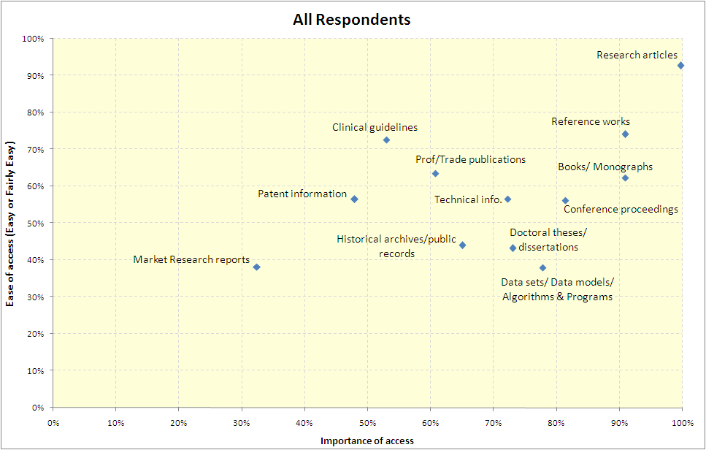
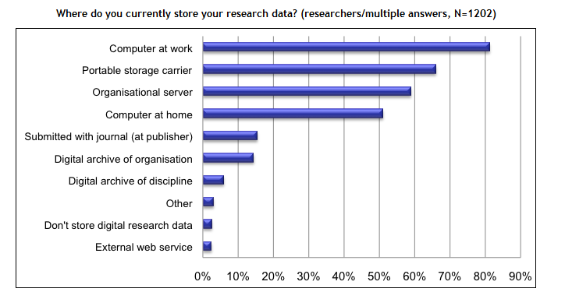
Why publish data and software?
move from down there to up here
Data and software are important, but hard to access
Storage of data and software is very fragmented

Slide 3
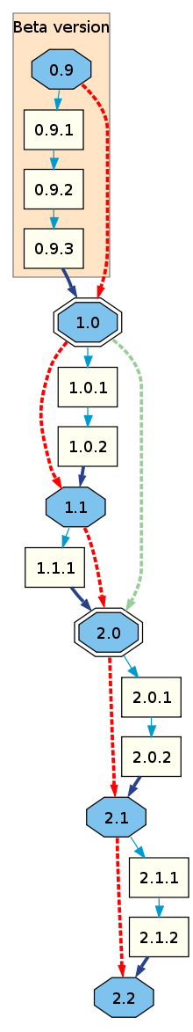

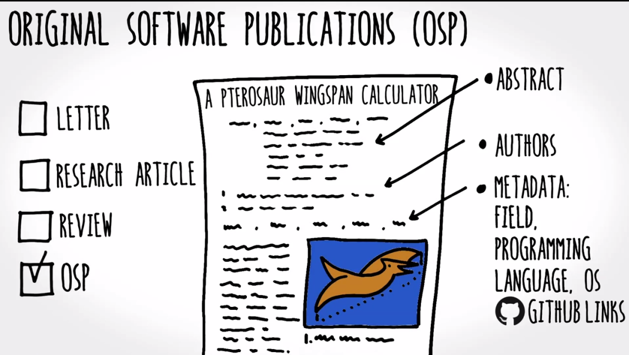


Original Software Publications
Every researcher uses software, a big fraction writes software
Distribution is not organized and authors don’t get credit for their work
It is often considered only a “support” and not part of publishable research.
1 ) Actual Software & code on developers platform use automated versioning systems we can persistently link to at scale…
2) Though OSP the Software & code can now be searched, indexed, discovered, archived, cite other work and be cited…
3) Creating a richer unified ecosystem for open science and discovery …
Title
doi
Authors
Abstract
Text
Metadata
Ref list
FLA
Title
doi
Authors
Abstract
Text
Metadata
Ref list
Software citing relevant theory
Addendum
V1.1
makes software indexed, peer reviewed and discoverable. Developers have the same credits of any other author and their work can be found and re-used by others
OSP
Title
doi
Authors
Abstract
Text
Metadata
Ref list
Software citing relevant earlier software work
FLA
Title
doi
Authors
Abstract
Text
Metadata
Ref list
New MAYOR release 2.0 considered new “body of work” and publishable as such
Addendum
V2.1
Experiment citing relevant software
Experiment citing relevant theory
Addendum
V2.2

Slide 4
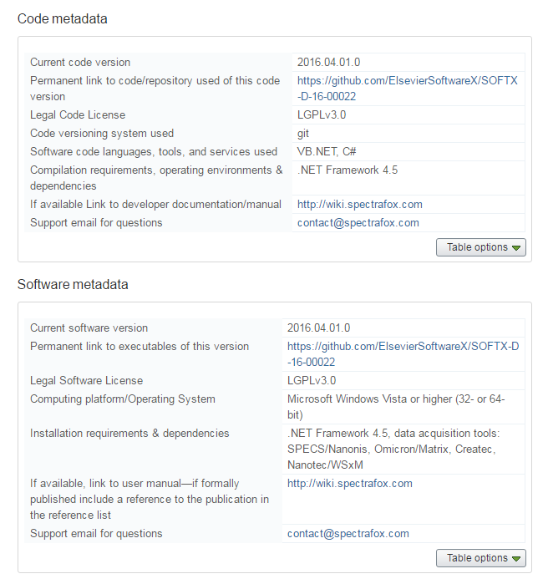
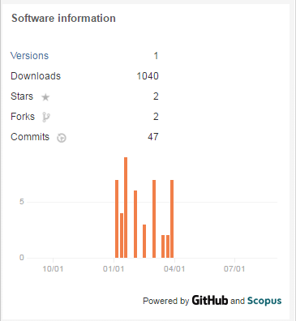

What is a article?
Submissions to SoftwareX are composed of:
  A short article describing the software, with particular focus on the impact of the software in the research community and its re-usability across disciplines
  A “metadata table” containing information about the software and software metrics
  A permanent link to a software repository (GitHub) where the software and code is stored and maintained by Elsevier and made freely available

Slide 5



How to review a Software Article?
Software articles are judged based mainly on their IMPACT on science and research
Reviewers are asked to answer a set of questions to simplify their job and assess the value of the submitted software
Reviewing criteria are public and authors are encouraged to keep them in mind when submitting their work. They can be found at: http://www.elsevier.com/data/assets/pdf_file/0010/97066/ReviewerForm.pdf (or via the Guide for Authors)
Reviewers are not expected to compile, run or debug the code, but they need to be convinced by the author that the software runs correctly. This can be done via videos, screencasts, examples or anything else the author can provide
Test the submitted software (current pilot with )
Accompany software with example data (on Mendeley Data) – because software and data must go together!
Introduce a star system to acknowledge the extra step
from authors besides peer review, eg.
Documentation!
Debugged!
Has example data!
Is portable!

Slide 6






Elsevier & research data
To help researchers store, share, discover and use data
MISSION & POLICY
“Raw research data should be made freely available to all researchers wherever possible” – STM Brussels Declaration 2007
Elsevier Research Data Policy
Data-linking program
Data Repository
Open Data
Data articles
(Data in Brief)
Standards bodies & working groups
PROGRAMS & PILOTS

Slide 7
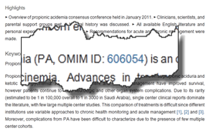
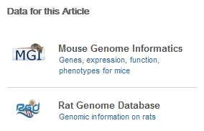
Data-linking
Elsevier has an extensive program with 90+ leading domain-specific data repositories to interlink articles and data
Makes it easier to find relevant data and place data into the right context
Linking through in-article accession numbers, data DOI’s, or data banners
Linking through in-article data accession numbers
Database banners shown next to the article on ScienceDirect
See http://www.elsevier.com/databaselinking

Slide 8

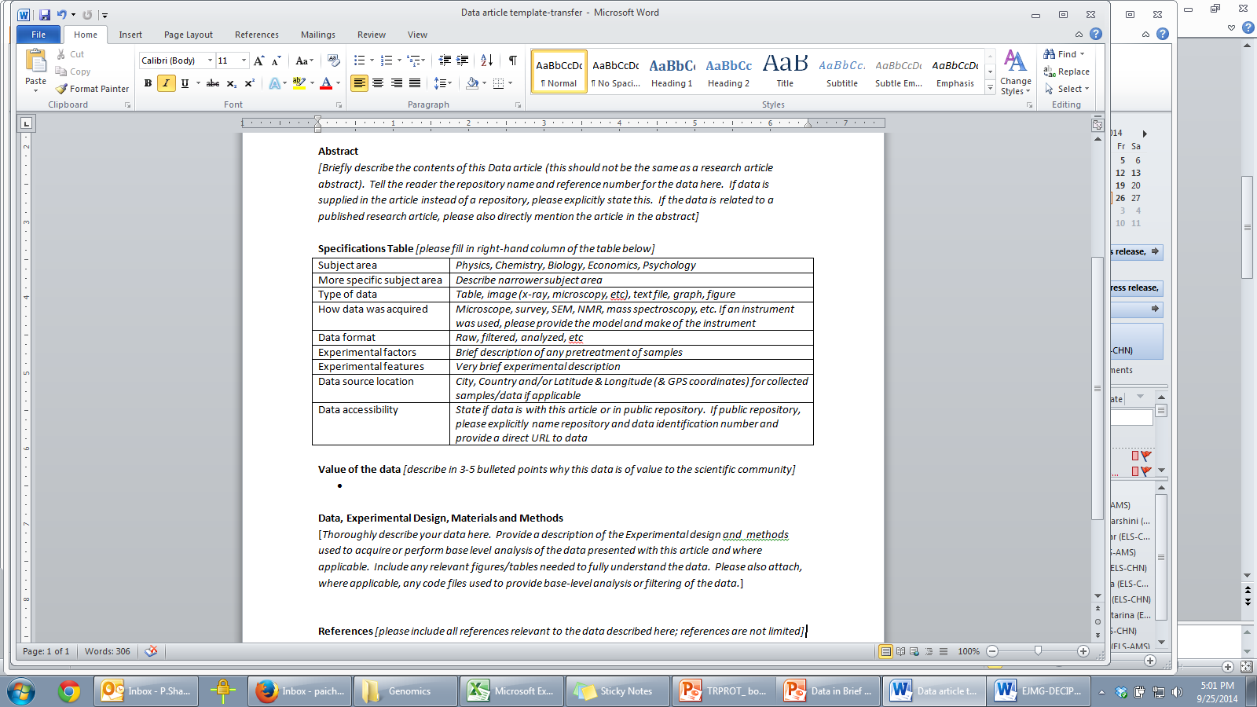

Place to describe datasets in any scientific discipline.
Data articles are purely descriptive and do not provide functional data nor interpretation.
Data articles are intended to facilitate data reuse and reproducibility
All data described must be made publicly available, either with the article or in a public repository
All authors fill in a standard data article template available at: https://www.elsevier.com/dib-template
Specifications table with direct link to data
  Value of the Data
  Materials and Methods
All Data in Brief articles have CC-BY license
Data in Brief
links back to related research article
Both articles cite each other in the reference list.

Slide 9

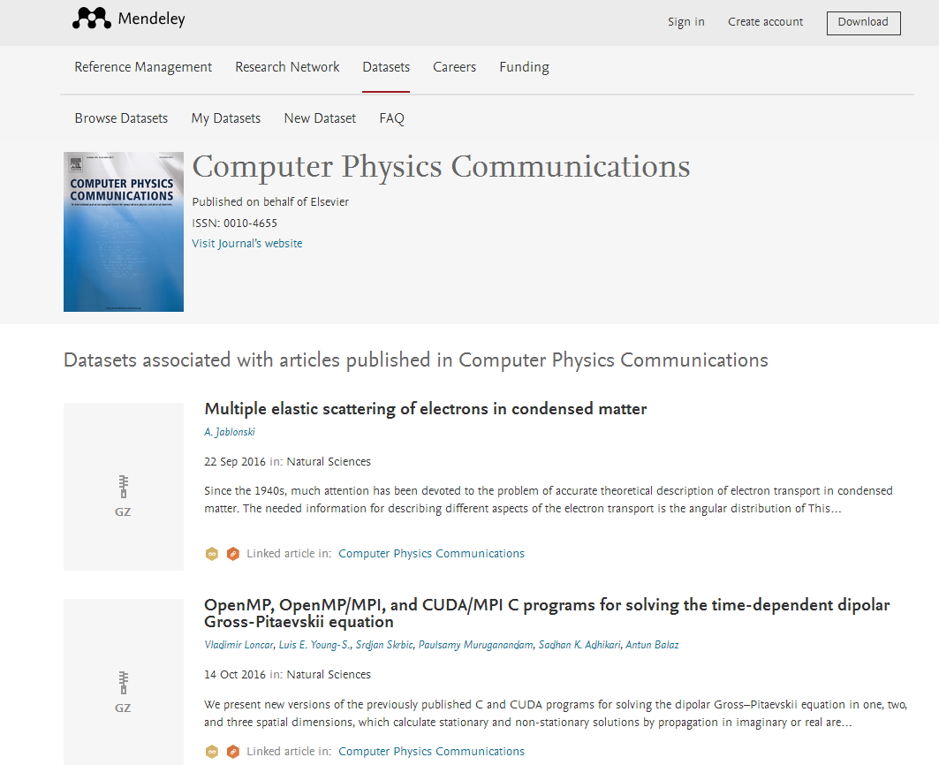

Mendeley Data: Elsevier’s data repository
Active ‘data share’ section at submission to directly upload datasets to Mendeley
Research data can be deposited, shared and cited
Link between dataset/program on Mendeley and journal article:
CPC programs on Mendeley are linked to the original research article on the CPC journal
a link to the program also appears next to the article on SD

Slide 10
Back-up slides

Slide 11
How to submit
Submissions to SoftwareX consist of two major parts:
  a short descriptive paper of max. 3000 words, max. 6 figures
  an open source software distribution with support material.
All articles are published Open Access with OA fee of 500$
Authors should include in their article:
Motivation and Significance – scientific background and motivation for developing software
Software Description – architecture and functionalities
Illustrative Examples – at least one example to demonstrate major functions
Impact - key factor; should include how widespread software is and citations of
results obtained using this software
5. Conclusions
https://www.journals.elsevier.com/softwarex/submit-your-software/you-can-now-submit-your-software-to-softwarex

Slide 12
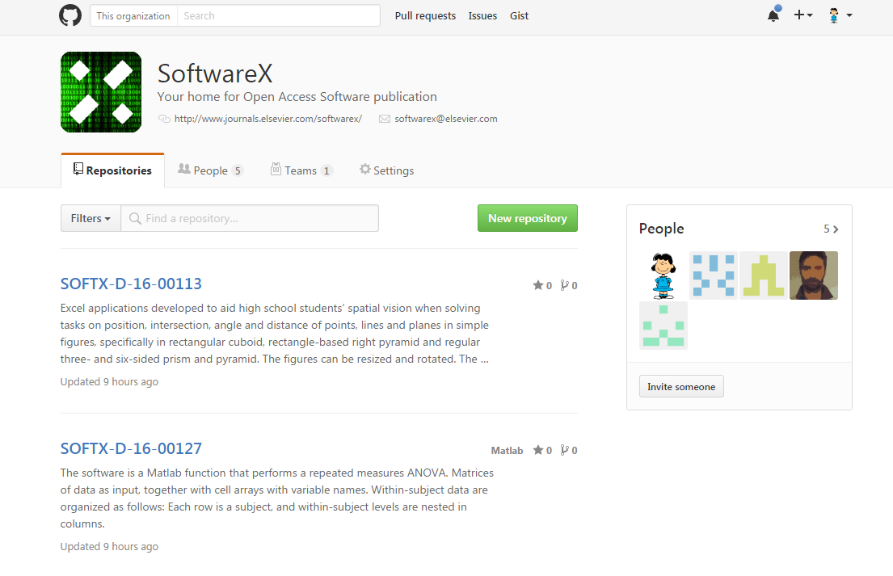
SoftwareX GitHub repository
SoftwareX is maintaining a curated GitHub repository
A dedicated person is in charge of branching or copying submitted software in the SoftwareX repository
Elsevier takes responsibility to maintain availability of the submitted software, even if the authors retract/delete their own repository
Versioning is done following GitHub method
Each deposited software is peer reviewed (for relevance, re-usability and research value) by independent reviewers
Whenever possible, documentation is included in the repository

