Slide 1
Future Collider Challenges
D. Schulte, CERN

Slide 2
Overview
Will cover the main high-energy future projects with a collaboration pushing forward
Circular colliders:
FCC (Future Circular Collider)
CEPC / SppC (Circular Electron-positron Collider/Super Proton-proton Collider)
Linear colliders
ILC (International Linear Collider)
CLIC (Compact Linear Collider)
Others will not be covered
Detectors, physics, …
Muon collider, effort strongly reduced but some recent progress with the source (MICE and novel idea)
Photon-photon collider
Gamma factory based on ions
…

Slide 3
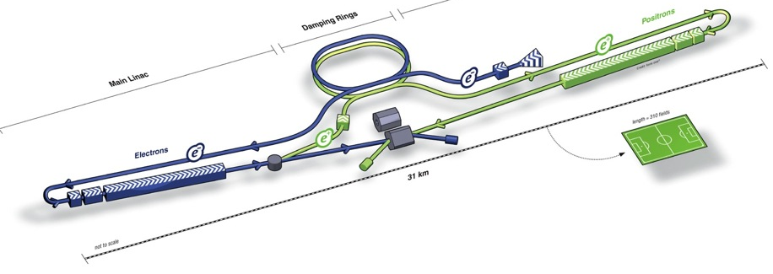

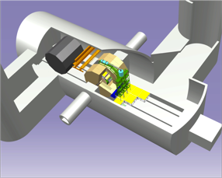
ILC
31km long
e+ Main Linac
e- Main Linac
Parameters | Value
C.M. Energy | 500 GeV
Peak luminosity | 1.8 x10³⁴ cm⁻²s⁻¹
Beam Rep. rate | 5 Hz
Pulse duration | 0.73 ms
Average current | 5.8 mA (in pulse)
E gradient in SCRF acc. cavity | 31.5 MV/m +/-20% Q₀ = 1E10
TDR exists
Aim for cost reduction
Political process in Japan ongoing

Slide 4
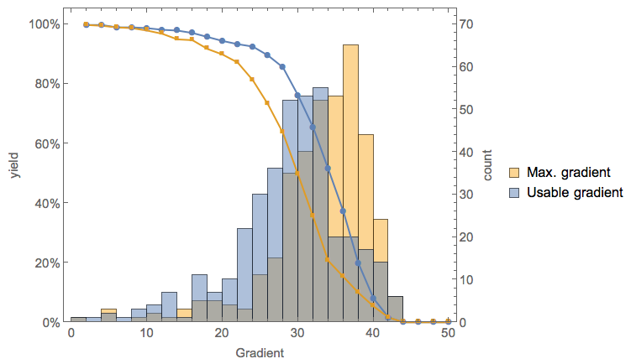
ILC Cavities
N. Walker, D. Reschke, SRF’15
Gradient goal is 31.5 MV/m in the module
800 cavities produced for European XFEL
Goal 24 MV/m
In vertical test stand (one Vendor):
Average gradient for Q₀ > 10¹⁰
G = 29.4 MV/m
ILC goal 31.5 MV/m installed
G-max
G-usable

Slide 5
ILC Development
L. Evans
A. Yamamoto
Nitrogen infusion appears very promising
Increase in gradient
Increase in Q₀
Cost saving studies, e.g.
Coupler design 1-2%
Cavity material 2-3%
No more hydrofluoric acid for chemical treatment 1-2%
Higher gradient and more efficient cavities 4-5%
…
A. Grassellino, S. Aderhold
Modified exposure to nitrogen (from FNAL)
Before: doping with few minutes at 800 °C
Now: a day or so at 120 °C

Slide 6
ILC Staging Scenarios
Example options
125GeV e-
Technical improvements can decrease cost by 10-20%
More seems to be required, so staging is being considered
Option C:
Option D:
125GeV e-
Baseline 500 GeV running example
Example: 250 GeV (F) and upgrade
Goal:
4 ab⁻¹ @ 500 GeV
100 fb⁻¹ @ 350 GeV
2 ab⁻¹ @ 250 GeV
Luminosity increase
2 x by increasing RF
2 x by increasing cryogenics and repetition rate

Slide 7
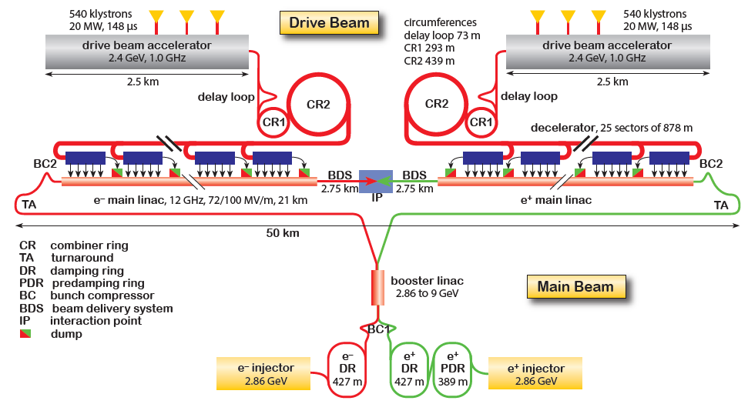
CLIC (3 TeV)
1.5 TeV / beam

Slide 8
CLIC (3 TeV)
Drive beam time structure - initial
Drive beam time structure - final
240 ns
240 ns
5.8 μs
140 μs train length - 24 × 24 sub-pulses
4.2 A - 2.4 GeV – 60 cm between bunches
24 pulses – 101 A – 2.5 cm between bunches
1.5 TeV / beam

Slide 9
CLIC (3 TeV)
Drive beam time structure - initial
Drive beam time structure - final
240 ns
240 ns
5.8 μs
140 μs train length - 24 × 24 sub-pulses
4.2 A - 2.4 GeV – 60 cm between bunches
24 pulses – 101 A – 2.5 cm between bunches
1.5 TeV / beam
100A drive beam
1.2A main beam

Slide 10
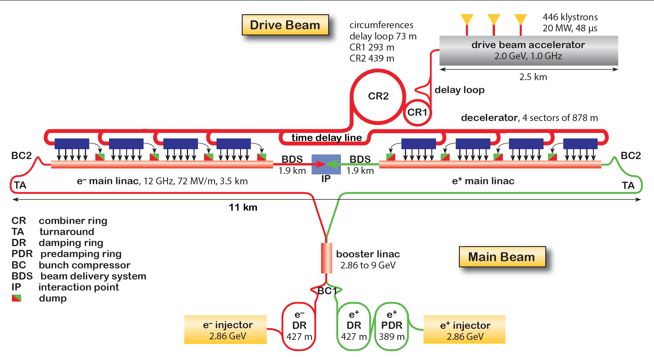
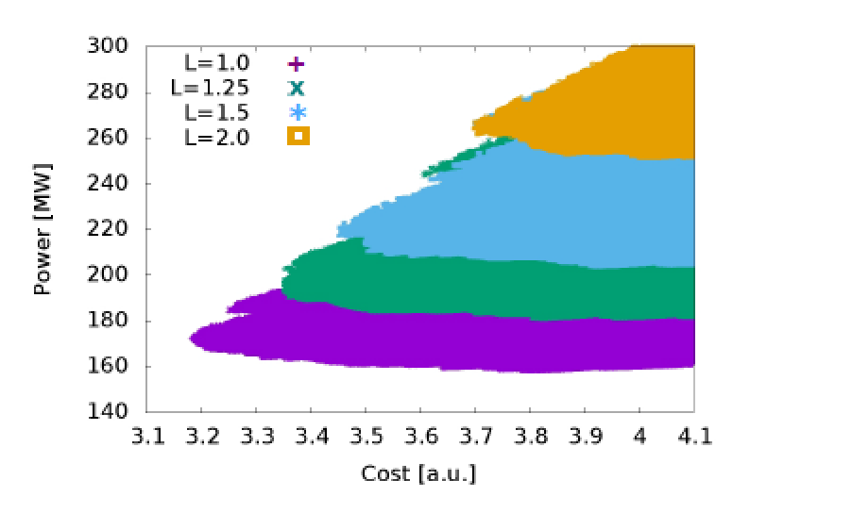
CLIC First Energy Stage
Plenty of good physics at lower energies
First stage at 380 GeV
  HZ, WW fusion, top asymmetry
Further stages re-use infrastructure and equipment
Preliminary value estimate 6.7 GCHF
Parameter | unit | 380 GeV | 3 TeV
L | 10³⁴ cm⁻²s⁻¹ | 1.5 | 5.9
G | MV/m | 72 | 72/100
Length | km | 11 | 50

Slide 11
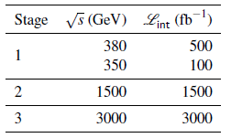
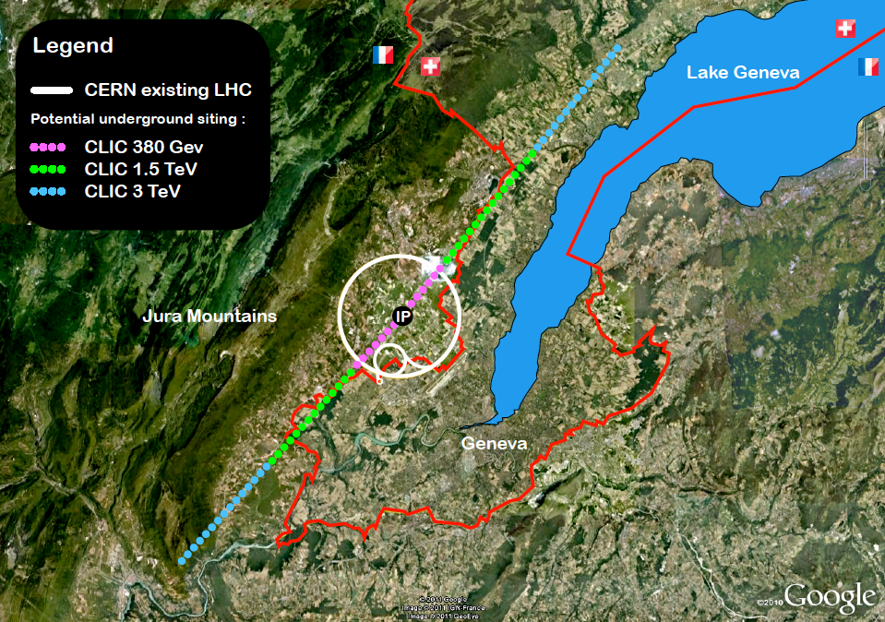
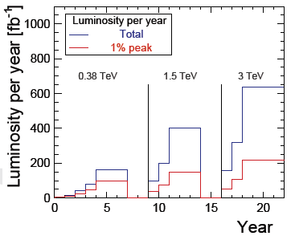
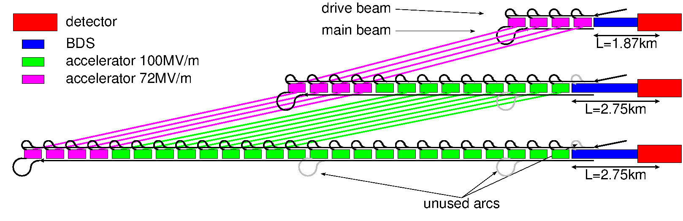
CLIC Staged Scenario
Luminosity targets from Physics Study group
Hopefully input from LHC
Central complex on Prevessin site
Luminosity evolution

Slide 12
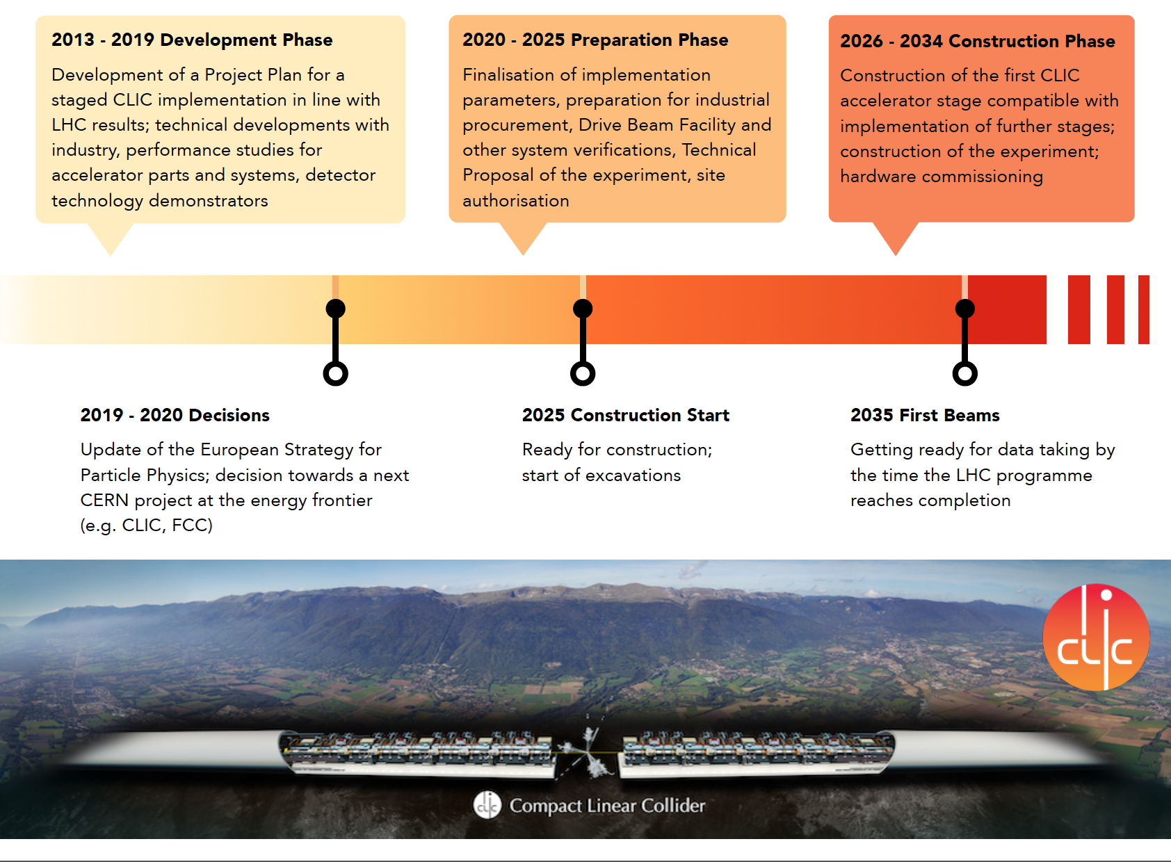
CLIC Roadmap
S. Stapnes

Slide 13
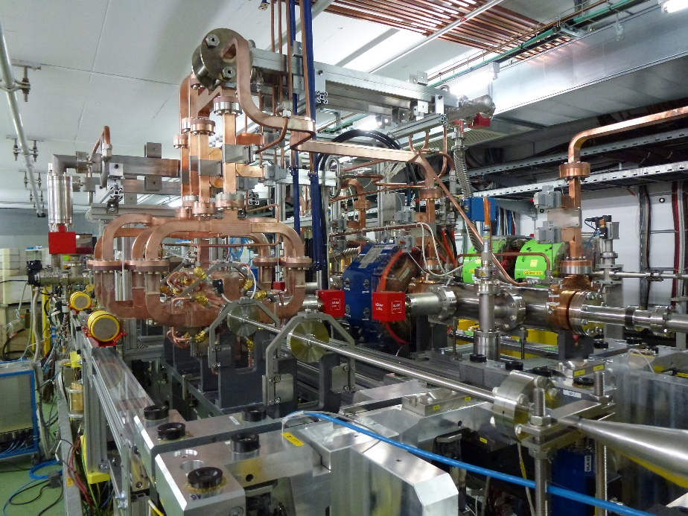
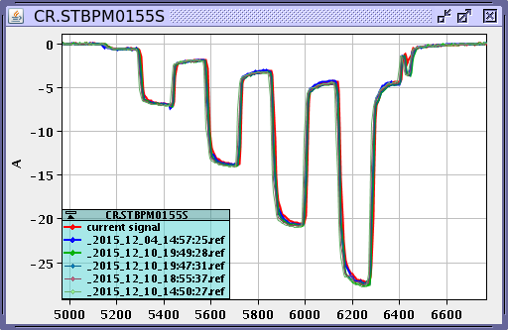
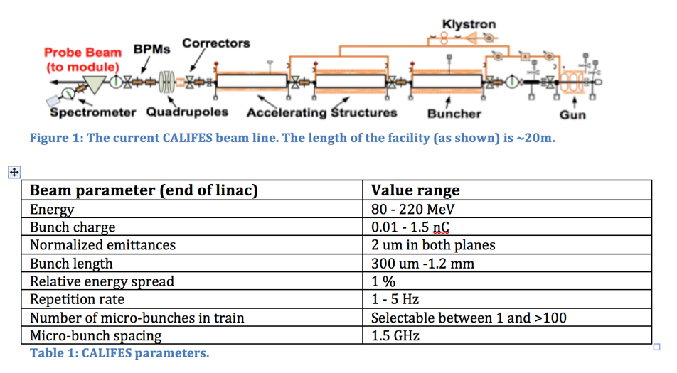
From CTF3 to CLEAR
CTF3 has demonstrated drive beam production
and main beam acceleration
Technology
Beam quality
Operation
Closed end 2016
New facility is coming online: CLEAR
CERN Linear Electron Accelerator for Research

Slide 14
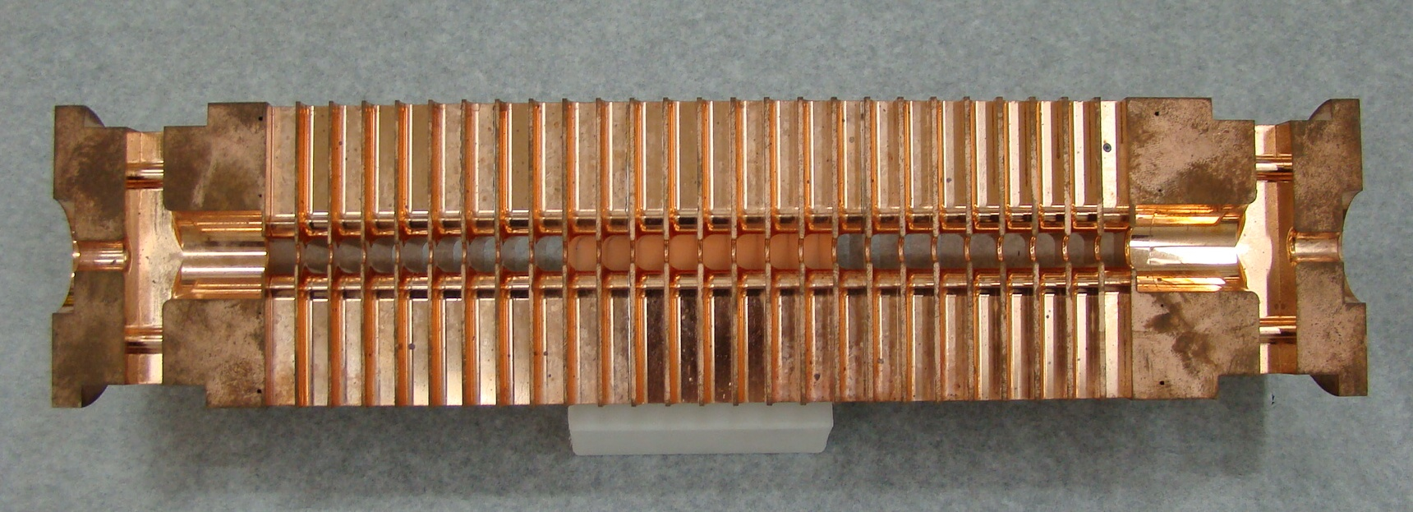
CLIC X-band Structure Development
Further development and industrialisation of accelerating structures is ongoing
Several klystron-based test stands exist that test structures (X-boxes)
Conditioning procedure is being optimised
40 G [MV/m] 80 100 120
Growing interest in X-band (FELs, novel technologies, …)
DESY, PSI, INFN, Cockcroft, …
CompactLight proposal to EU, 24 partners

Slide 15
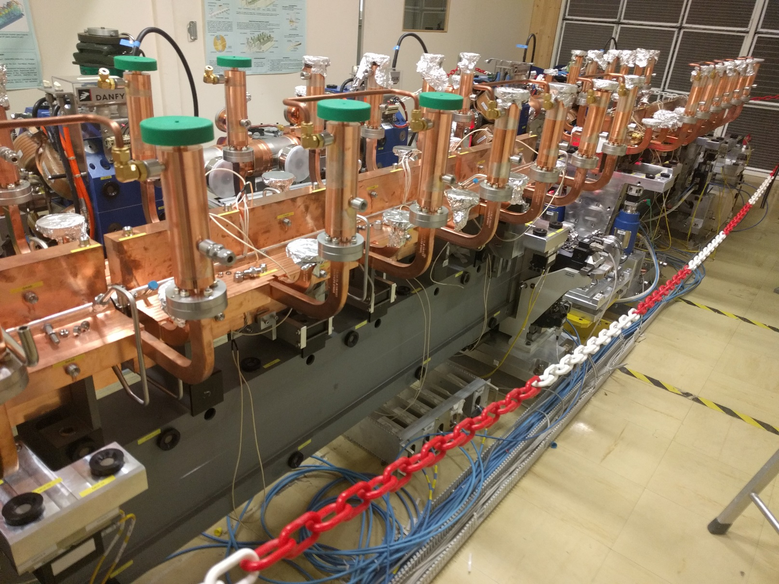
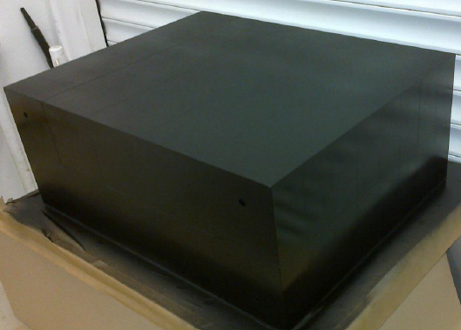
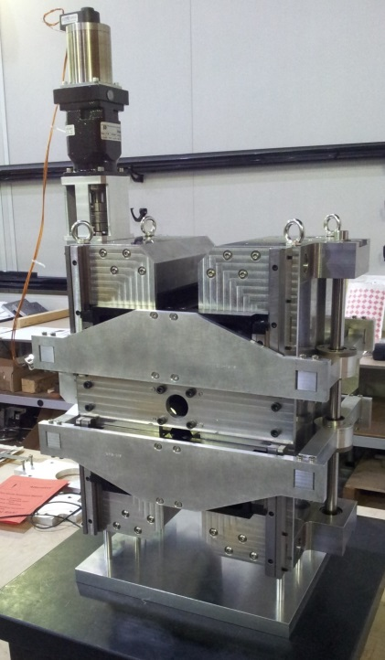
Other CLIC Technology Development
I. Syratchev et al.
C. Rossi et al.
Redesign CLIC modulators and klystrons
Increase efficiency from 62% to 90%
Reduce cost (low voltage, no oil)
A
New module design
Reduce cost of mechanical system and control
Permanent magnets
Use tunable permanent magnets where possible
Quadruoles in drive beam
Strongest permanent magnet developed in UK
Klystron-based first energy stage
As alternative
Main beam injector
e.g. halved power for positron production (C. Bayar, Ankara University)
J. Clarke et al.

Slide 16
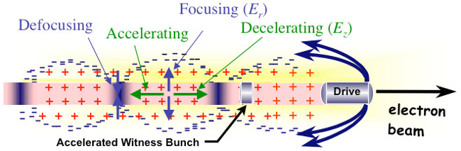
Plasma Acceleration as Upgrade Option?
Very high gradients of 50 GV/m demonstrated
Can use laser or particle beam to generate field
R&D programmes are ongoing
Require excellent beam quality and high efficiency
Preservation of beam quality during acceleration has to be studied in theory and experimentally
This is particularly tough for high efficiency
Application of novel technologies to colliders
Started a working group for CLIC to understand potential
Plasma community started a working group on colliders

Slide 17
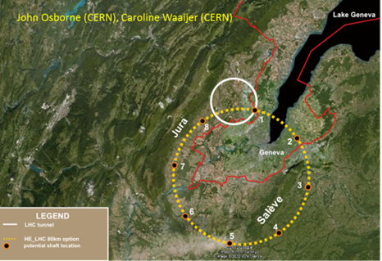
FCC and CEPC/SppC
Proposal for project at CERN
CDR for EU strategy end 2018
FCC-hh
pp collider with 100 TeV cms
Ion option
Defines infrastructure
FCC-ee
Potential e⁺e⁻ first stage
FCC-eh
additional option
HE-LHC
LHC with high field magnets
Proposal for project in China
CDRs exist but changes since
CEPC
e⁺e⁻ collider 90-240 GeV
focus on higgs
SppC
Hadron collider to later be installed in the same tunne
75 to O(150) TeV

Slide 18
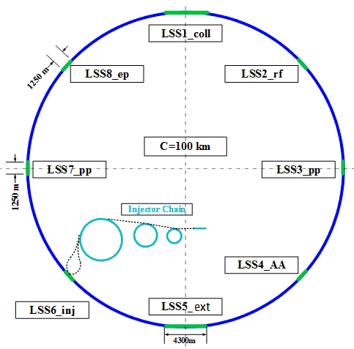
FCC-hh / SppC Layouts
FCC-hh layout
Optimised for Geneva site
Circumference 97.75 km
Can use LHC or SPS as injector
SppC layout
Recently adopted 100 km circumference
New injectors are required

Slide 19
Hadron Collider Parameters
 | LHC (HL-LHC) | HE-LHC (tentative) | FCC-hh Baseline Ultimate |  | SppC | SppC ultimate
Cms energy [TeV] | 14 | 27 | 100 | 100 | 75 | 150
Luminosity [10³⁴cm⁻²s⁻¹] | 1 (5) | 25 | 5 | < 30 | 10 | ?
Machine circumference | 27 | 27 | 97.75 | 97.75 | 100 | 100
Arc dipole field [T] | 8 | 16 | 16 | 16 | 12 | 24
Bunch distance [ns] | 25 | 25 (5) | 25 | 25 (5) | 25 (10/5) | ?
Background events/bx | 27 (135) | 800 (160) | 170 | < 1020 (< 202) | 490 (196/98) | ?
Bunch length [cm] | 7.5 | 7.5 | 8 | 8 | 7.55 | ?
FCC integrated luminosity goal is 17.5 ab⁻¹
L*= 40 m
5 ns to limit background, but more challenging and will lose some luminosity

Slide 20
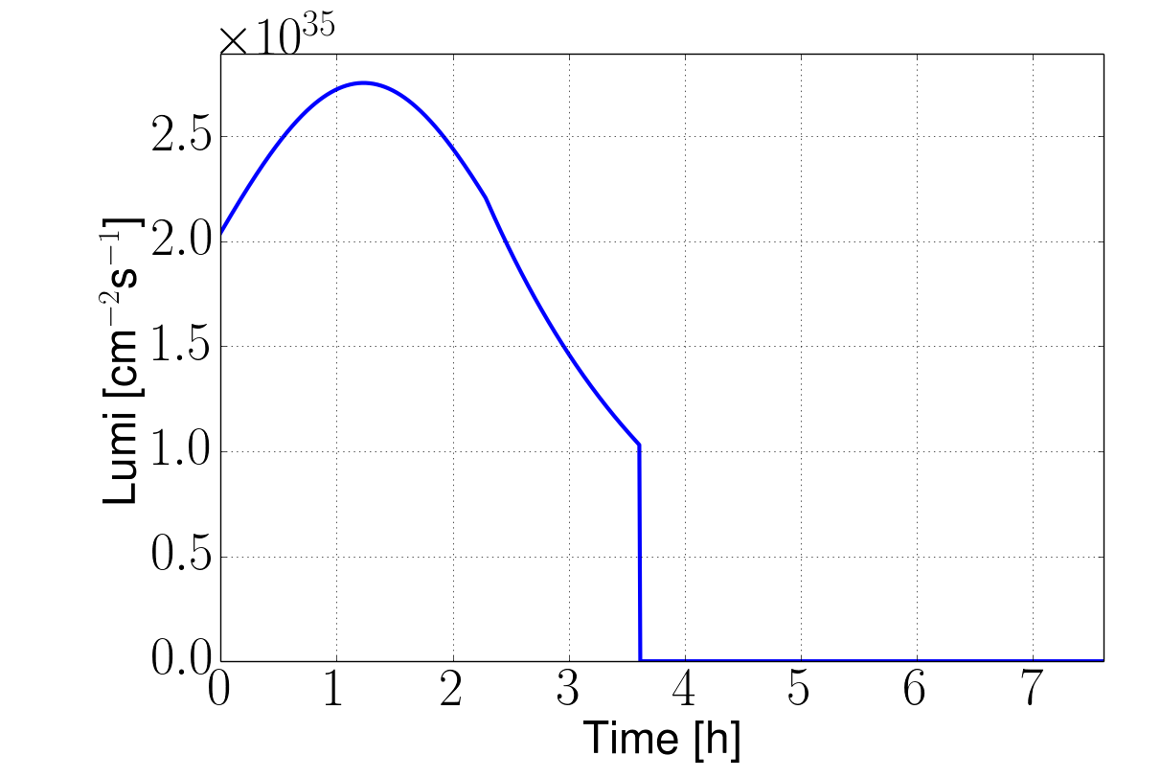
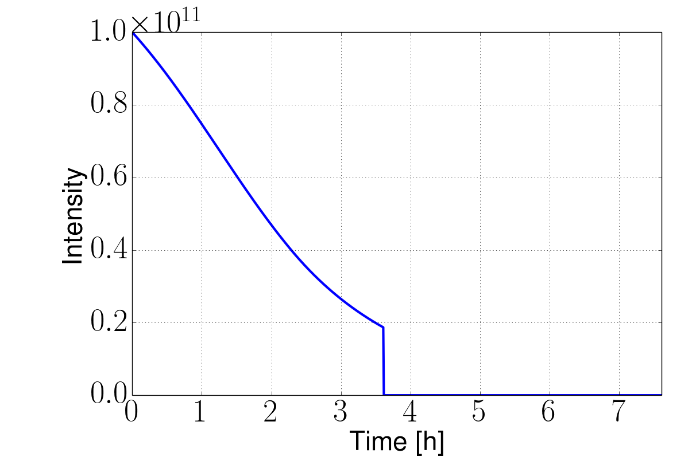
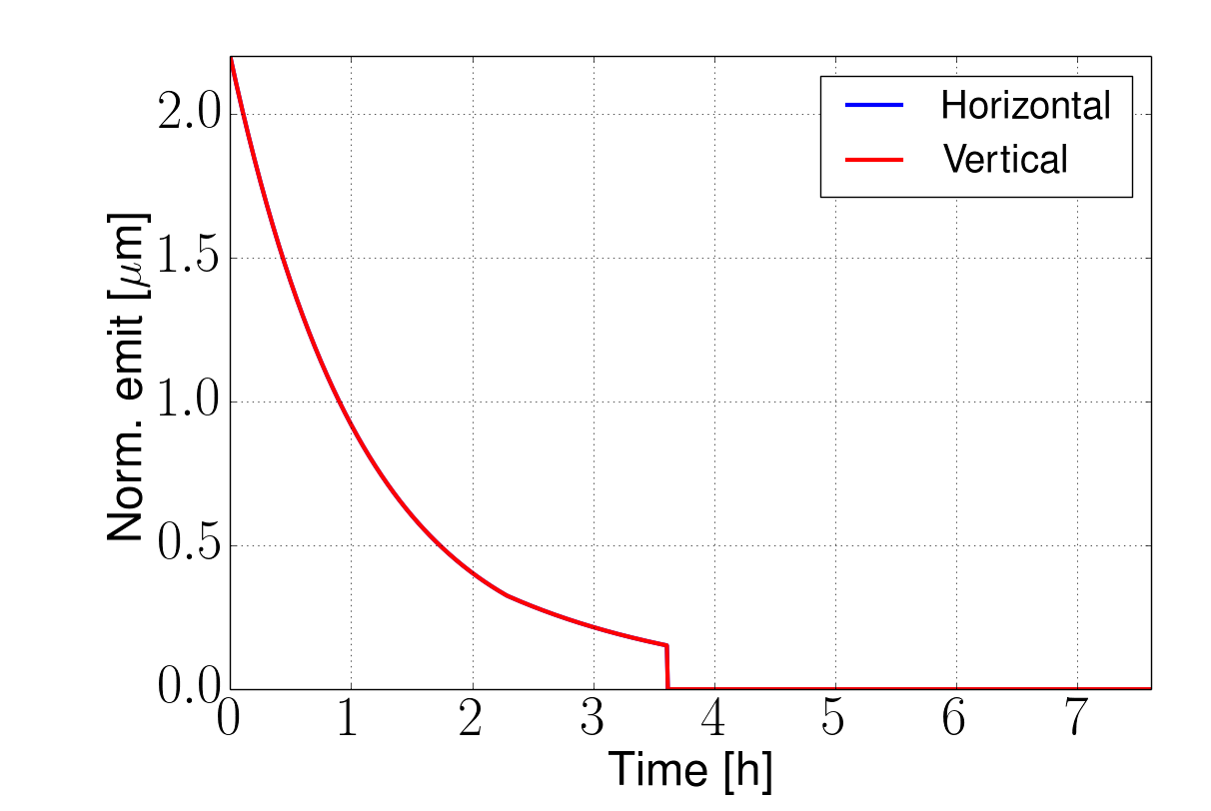
Luminosity Evolution (FCC-hh)
Beam is quickly damped
Beam burns quickly
Significant damping of the proton beam
Burn beam rapidly
Have to inject enough beam
Can consider luminosity levelling
Turn-around time
X. Buffat, D.S.

Slide 21
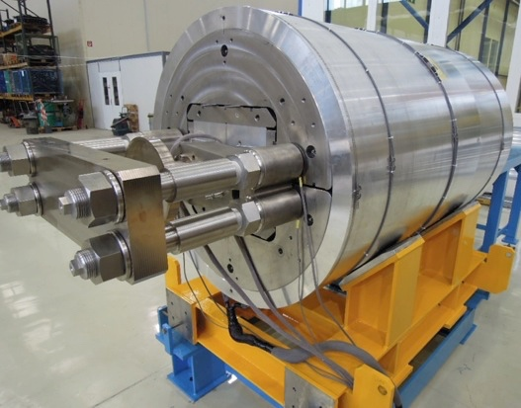
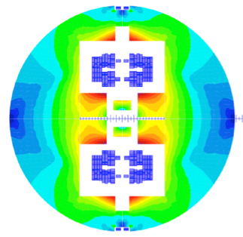
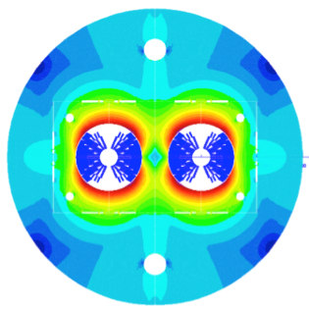
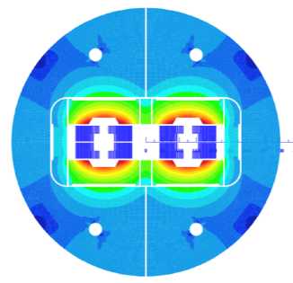
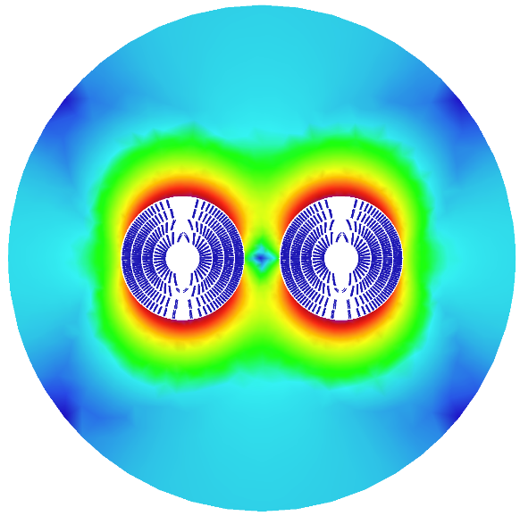

FCC-hh Magnet Development
FCC goal is 16 T operating field
Requires to use Nb₃Sn technology
At 11 T used for HL-LHC
Strong synergy with HL-LHC
Key cost driver
16 T demonstrated in coil
Hope for US model test early 2018: 14-15 T
Short magnet models in 2018 – 2023
12 T for HL-LHC
R&D on cables in test stand at CERN
Target: J_{C} > 2300 A/mm² at 1.9 K and 16 T (50% above HL-LHC)
Industrial fabrication:
Target cost: 3.4Euro/kAm
Magnet design to minimise material use and limit margins to essential level
D. Tommasini at al.
Blocks
Canted Coil
Common coils
Cos-theta
CIEMAT, CEA, INFN
Swiss contribution
via PSI
High-temperature superconductors (HTS) are also explored
Fields of 20+ T

Slide 22
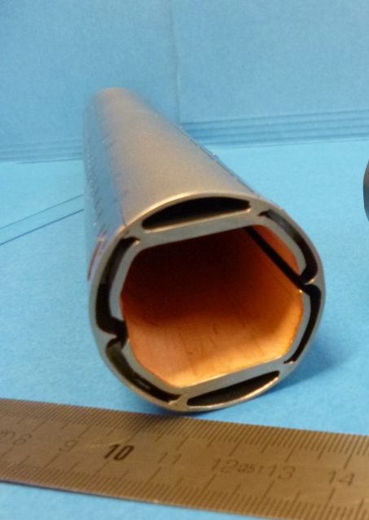
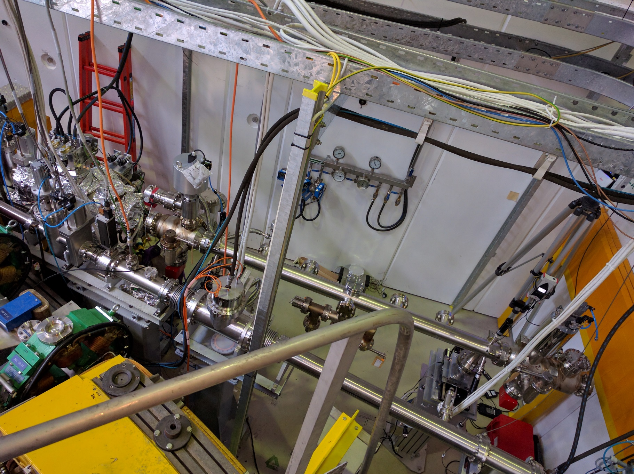
FCC-hh Technology Example
30 W/m synchrotron radiation (LHC: 1 W/m)
Make it small to make magnet cheap
Magnet aperture 50 mm (LHC 56 mm)
Prototype
P. Chiggiato at al.
Laser treatment / carbon coating against ecloud
Extract photons for great vacuum
Test station in ANKA
Strong to withstand quench
Hide pumping holes from beam for low impedance

Slide 23
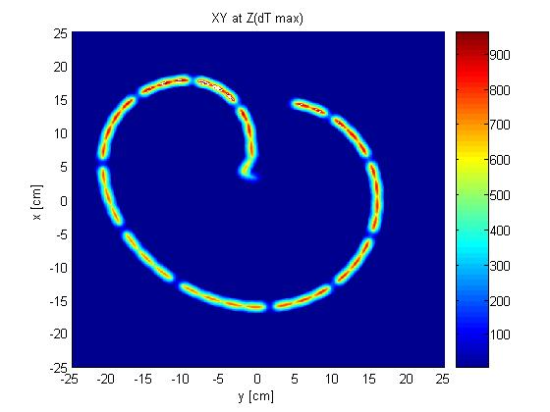
FCC-hh Beam Losses
8 GJ kinetic energy per beam
Airbus A380 at 720 km/h
2000 kg TNT
400 kg of chocolate
  Run 25,000 km to spent calories
O(20) times LHC
Up to 500 kW collision debris per experiment
Mainly lost in triplets, challenge for lifetime and quench
FCC-hh beam dilution pattern at dump
LHC beam dilution pattern at dump
Triplet design allows for thick shielding
Up to 1 of 300 atoms displaced in conductor
Can survive project lifetime
F. Cerutti et al.
Collimation system design ongoing
Identified hot spots
Will implement ideas to get rid of them
R. Bruce et al.
1m
B. Goddard al.

Slide 24
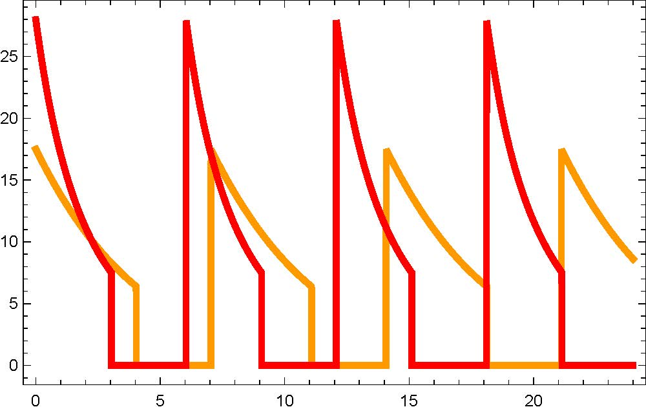
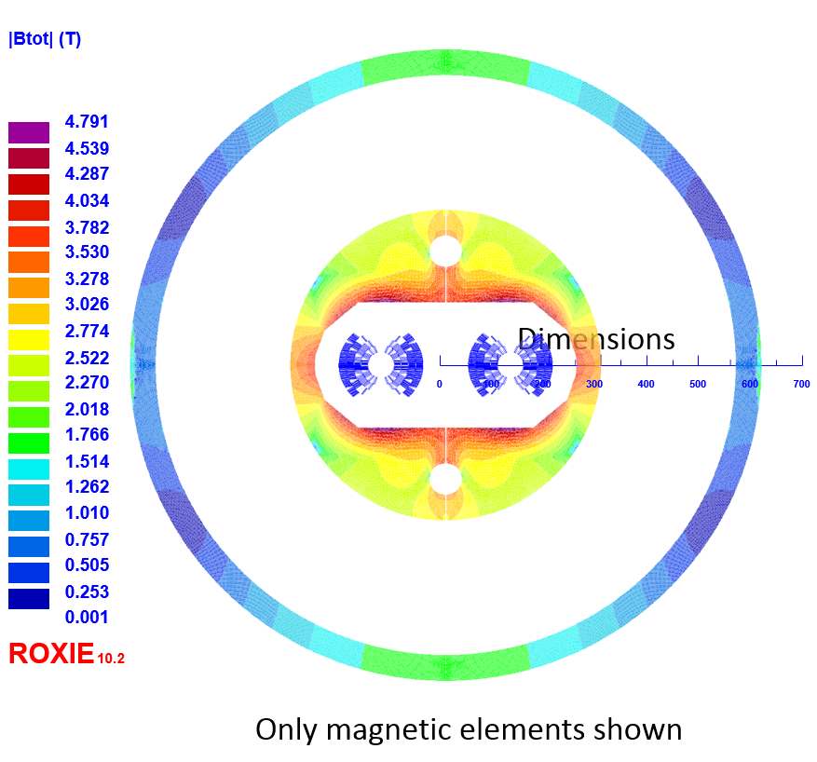
HE-LHC
Goal is 4 x HL-LHC luminosity
HL-LHC injectors
FCC-hh magnets and vacuum system
luminosity [10³⁴ cm⁻²s⁻¹]
F. Zimmermann et al.
25
β*=25 cm
25
β*=40 cm
Make FCC-hh magnets more compact to fit in LHC tunnel
Challenge is field leakage into tunnel
Use kryostat as partial return yoke
Active compensation
0
1 day
Cannot increase lengths of insertions
Currently beta-function around 0.4 m
  0.7ab⁻¹ per year
  Hope to improve
Beam extraction is a challenge
Collimation to be looked at

Slide 25
FCC-ee / CEPC Parameters
Energy | years | Int. Luminosity [ab⁻¹ ]
91.2 | 4 / 2 | 2 x 75 / 2 x 1.25
160 | 2 / not spec. | 2 x 5 / not specified
240 | 3 / 10 | 2 x 2.5 / 2 x 2.5
350 | 5 / --- | 2 x 1.5 / ----
Still moving targets
L. Wang et al. IHEP‐AC‐2017‐01
F. Zimmermann et al. priv. comm.
Parameter | Z | W | H | t | LEP2
Cms E [GeV] | 91.2 | 160 | 240 | 350 | 208
I [mA] | 1390 / 370-1450 | 147 / 51 | 29 / 11-30 | 6.4 / -- | 4
L [10³⁴ cm⁻²s⁻¹] | 200 / 18-71 | 25 / 4.1 | 7 / 2.1-5.4 | 1.3 / -- | 0.012

Slide 26
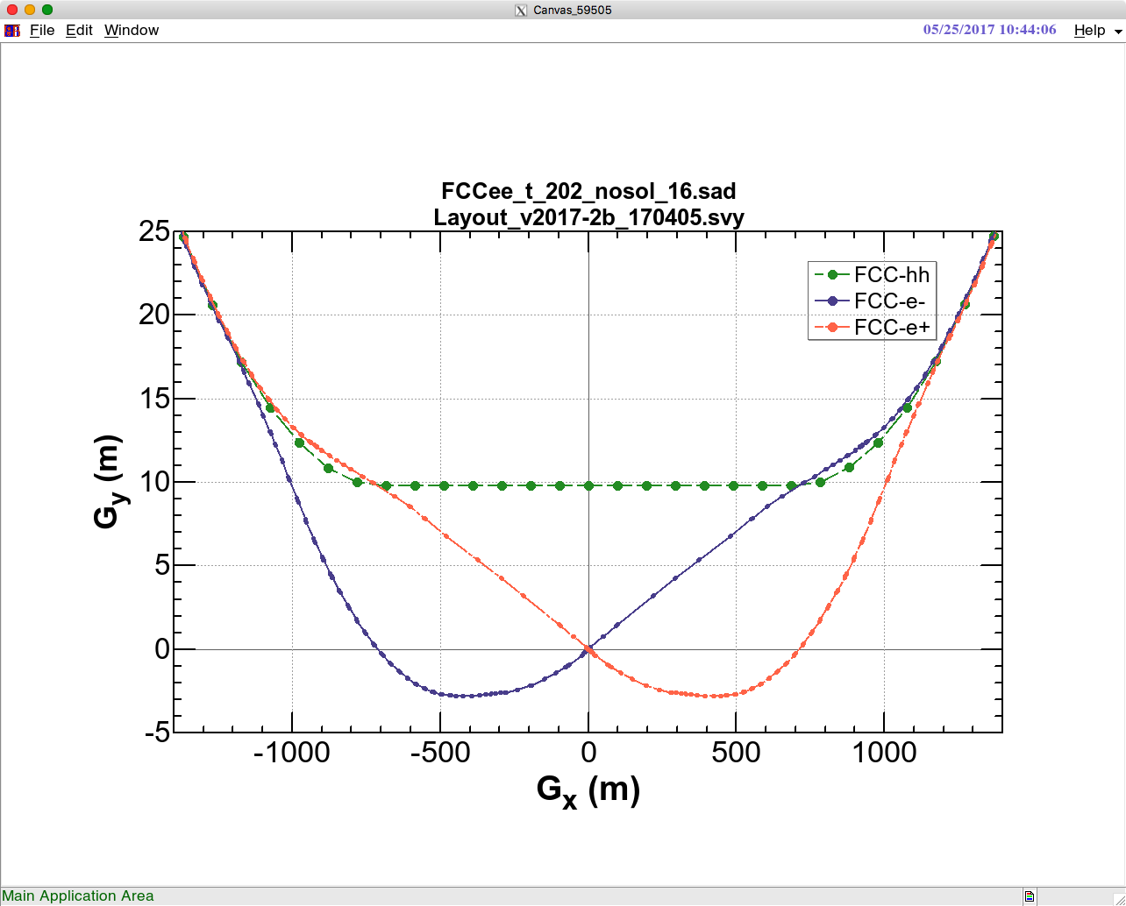
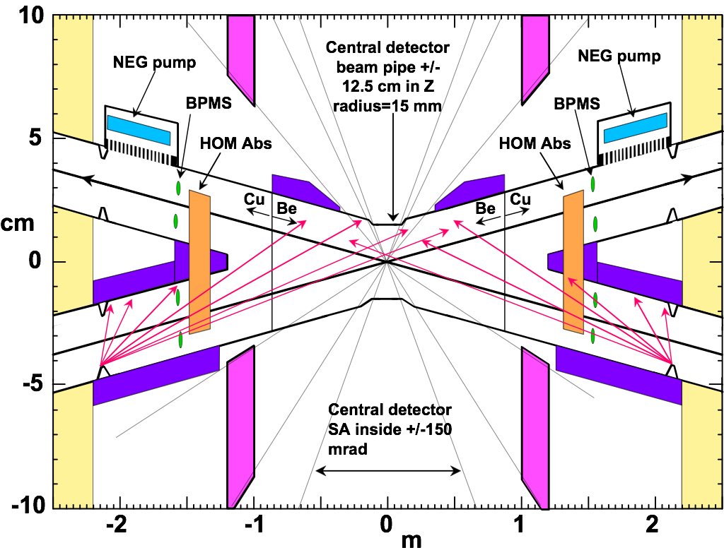

FCC-ee
Detailed MDI design ongoing
Large crossing angle requires additional tunnel
Short beam lifetime at high energy requires top-up scheme
K. Oide et al.

Slide 27
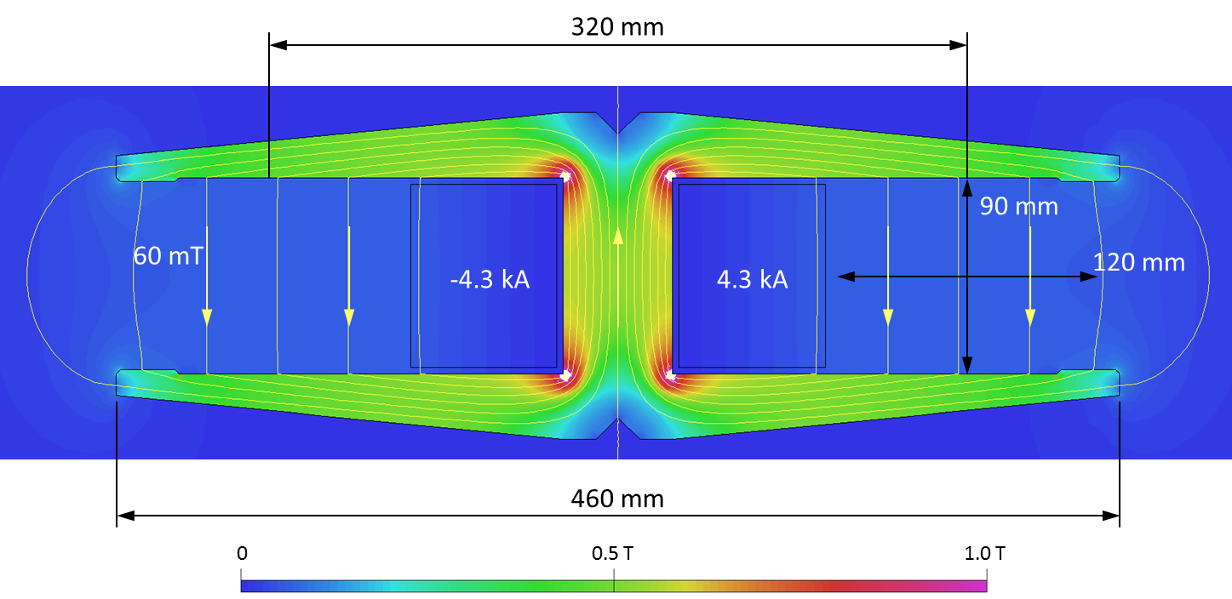
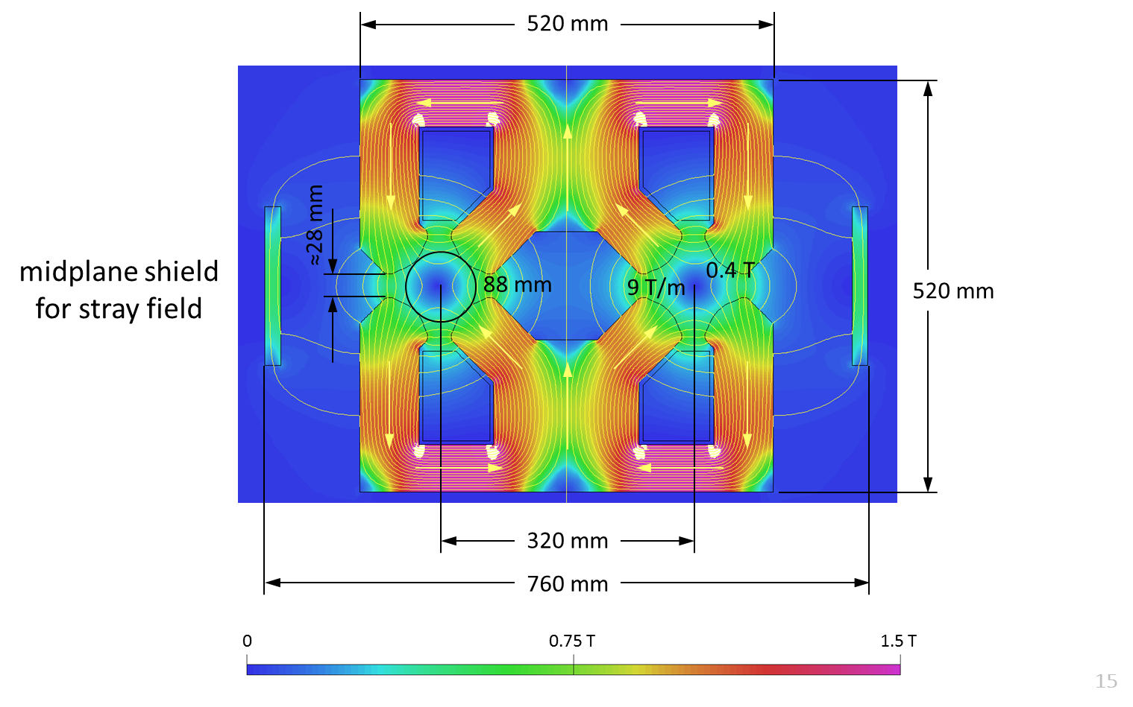
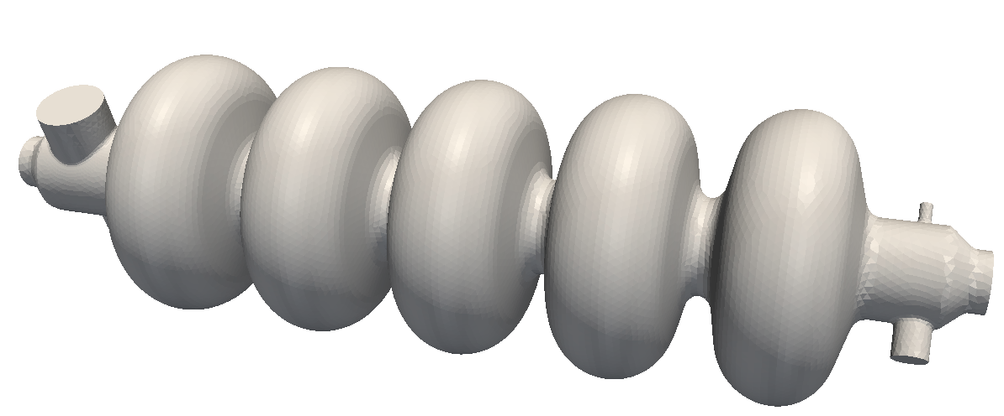
FCC-ee Technologies
Cost effective magnets
Two-in-one design of dipoles and quadrupoles
Optimised windings to reduce cost and power consumption
A: Milanese
O. Brunner et al
Optimised RF cavities
Single cells at low energy:
Low voltage but high current
Double cells at high energy:
Low current but high voltage
Efficient klystrons, based on design ideas for CLIC
I. Syratchev et al

Slide 28
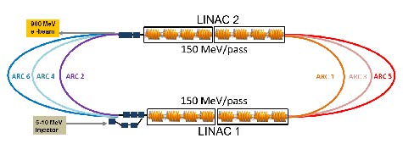
LHeC / FCC-he
 | LHeC CDR | HL-LHeC | HE-LHeC | FCC-he
E_{p} [TeV] | 7 | 7 | 12.5 | 50
E_{e} [GeV] | 60 | 60 | 60 | 60
L [10³³cm⁻²s⁻¹] | 1 | 8 | 12 | 15
Development of accelerator technology
E.g. RF power required to control cavities
Test facility (PERLE) planned in Orsay
Interaction region
design ongoing
M. Klein et al

Slide 29
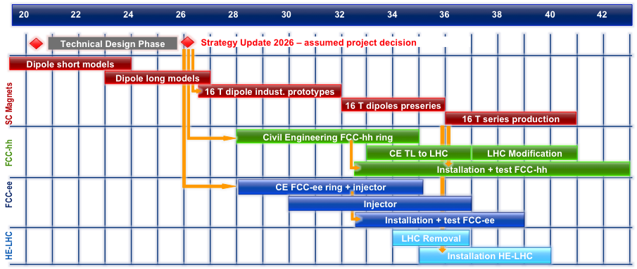
Preliminary FCC Draft Schedules
Technically limited schedule
M. Benedikt

Slide 30
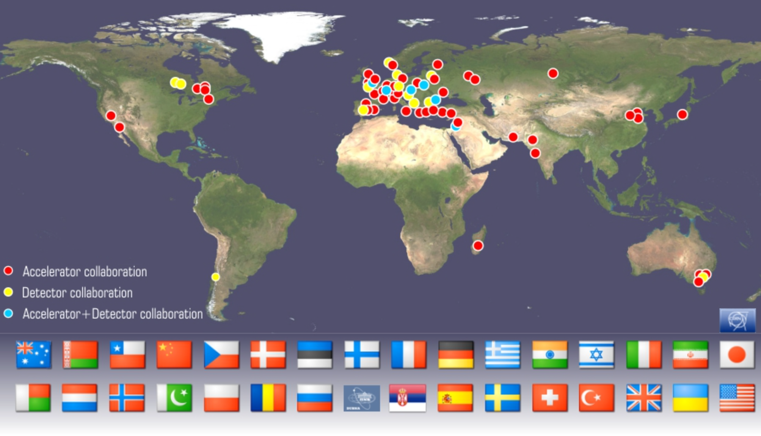
Current CLIC Collaboration
Notes:
The CLIC accelerator and detector&physics studies are already set up at international collaboraitons with wide participation from member and non-member states

Slide 31
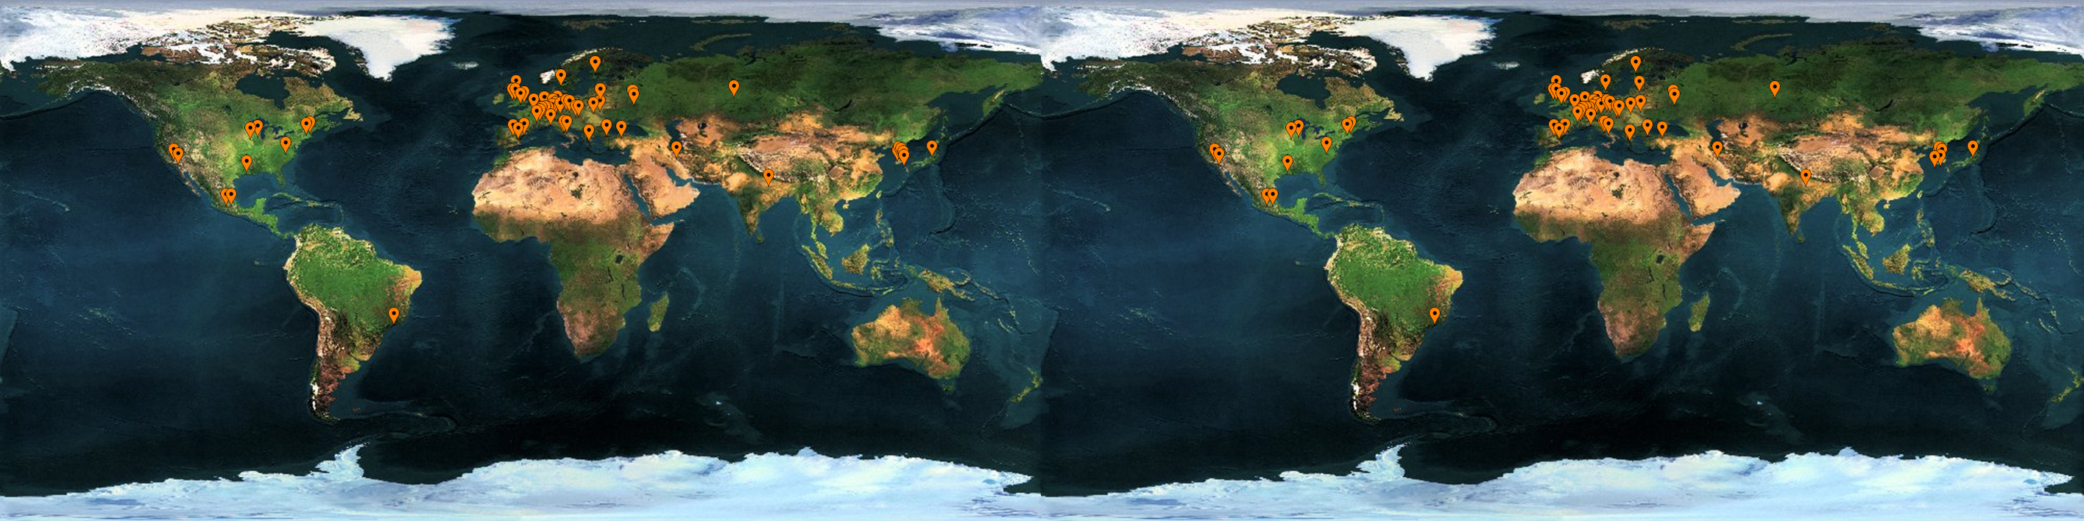



























FCC Collaboration
74 institutes
26 countries + EC
Status: April, 2016

Slide 32
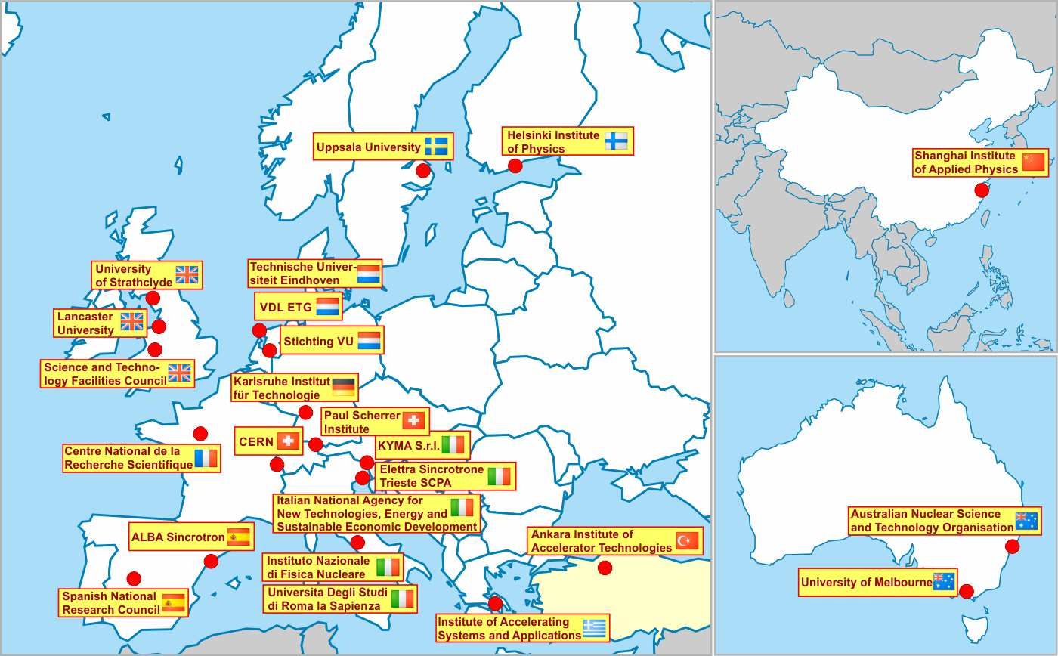
XLS
Recently approved EU co-funded design study to use CLIC technology for FELs
Workpackage on beam dynamics led by Avni Aksoy

Slide 33
Conclusion
Important progress toward the EU strategy
ILC
  Focus on cost reduction
  Political process
CLIC
  Further optimising 380 GeV first energy stage
  Work on further stages, including novel technologies
  Project Implementation Plan for 2018
SppC and CEPC
  CDRs available
FCC
  CDR end of 2018 for hh (with he) , ee and HE-LHC options
  Including R&D plan
Many thanks to L. Evans, S. Stapnes, W. Wuensch, Ph. Burrows, I. Syratchev, M. Benedikt, K. Oide, F. Zimmermann, M. Klein, …, the ILC, CLIC, FCC and SppC/CEPC teams

