Slide 1

Linear Imperfections
Jörg Wenninger
CERN Beams Department
Operation group
2 - 15 June, 2018
Tuusula, Finnland

Slide 2
Introduction
Orbit and dispersion
Tune and coupling
Chromaticity
Linear optics

Slide 3
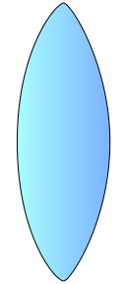
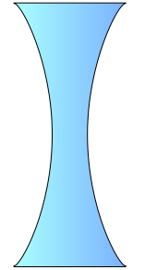
Accelerator lattice cell
An accelerator is usually build using a number of basic ‘cells’.
The cell layouts of an accelerator come in many subtle variants.
A simple FODO cell usually contains:
  Dipole magnets to bend the beams,
  Quadrupole magnets to focus the beams,
  Beam position monitors (BPM) to measure the beam position,
  Small dipole corrector magnets for beam steering.
  Sextupole magnets to control off-energy focussing.
Quadrupole
(focussing)
Quadrupole
(de-focussing)
Dipole corrector
Dipole
Dipole
Dipole corrector
beam
Beam position monitor
Beam position monitor
Schematic of a ½ cell

Slide 4
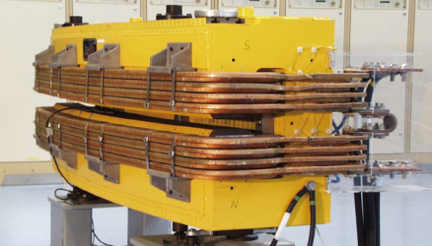
Dipole magnet
The dipole has two magnetic poles and generates a homogeneous field providing a constant force on all beam particles – used to deflect the beam.
  A dipole corrector is just a small version of such a magnet, dedicated to steer the beam as we will see later.
Lorentz force:
Horizontal deflection
Vertical deflection
B_{y}
y
x
F_{y}
orthogonal to the speed and magnetic field directions
F_{x}
x
x
B_{x}

Slide 5
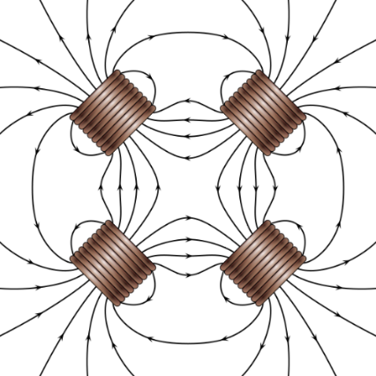
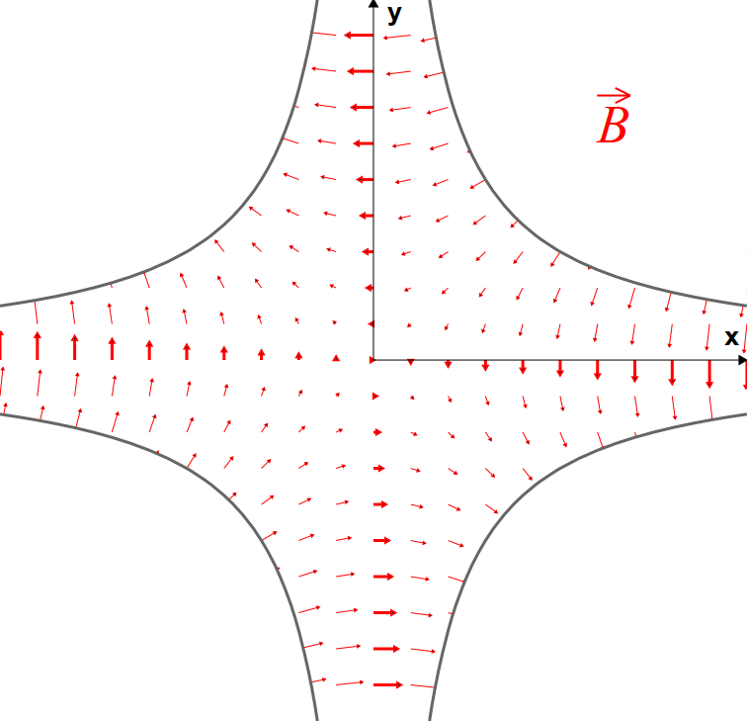
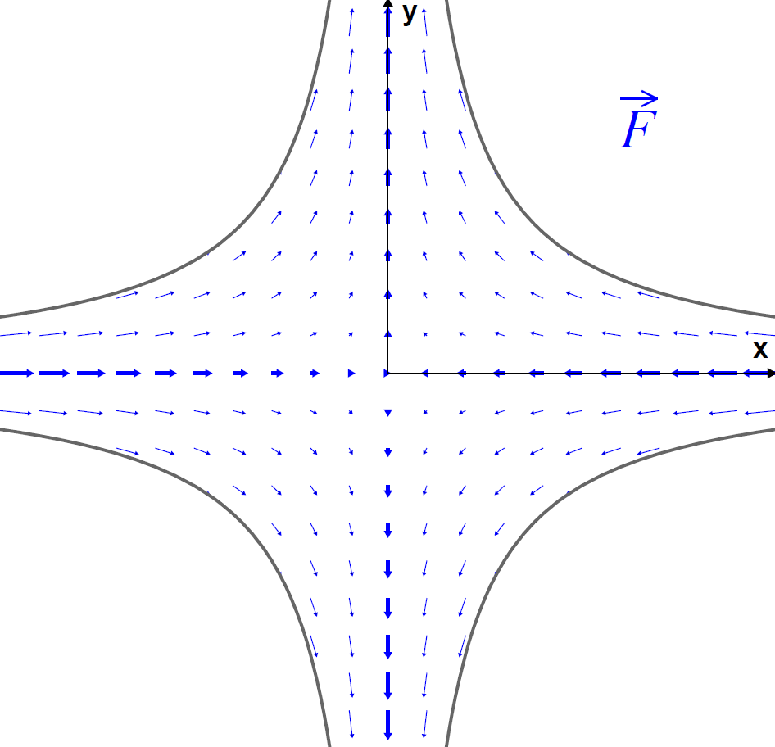
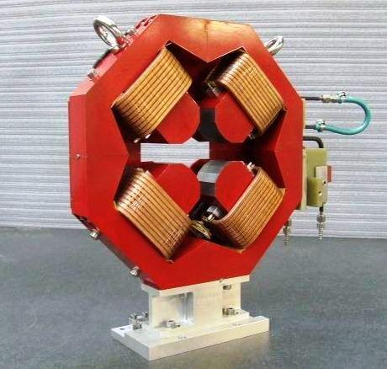


Quadrupole magnet
A quadrupole has 4 magnetic poles.
A quadrupole provides a field (force) that increases linearly with the distance to the quadrupole center – provides focussing of the beam.
  Similar to an optical lens, except that a quadrupole is focussing in one plane, defocussing in the other plane.
$$F_{y}=k y$$
$$F_{x}=−k x$$
Force pushes the particle away from the center → defocussing
Force pushes the particle towards the center → focussing

Slide 6
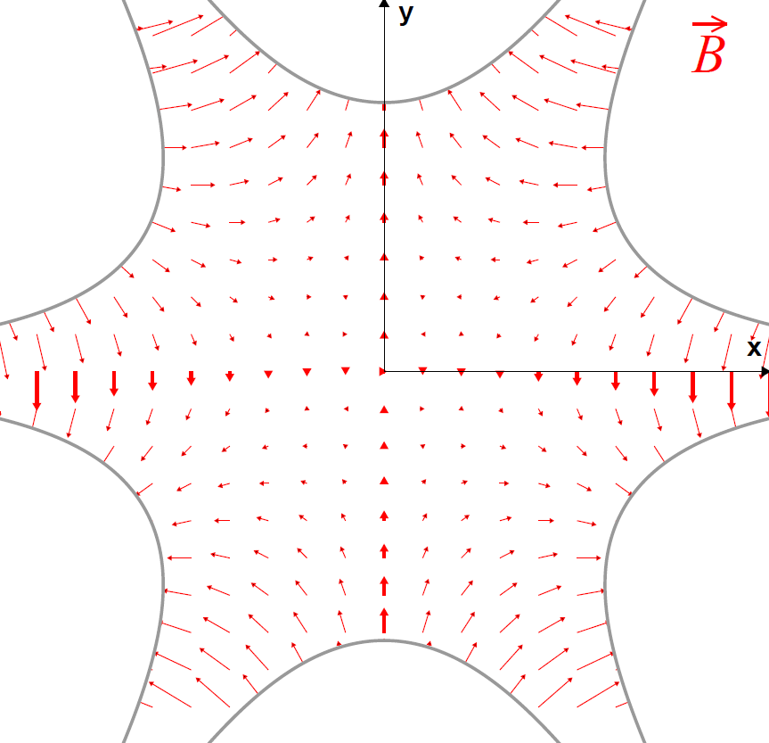
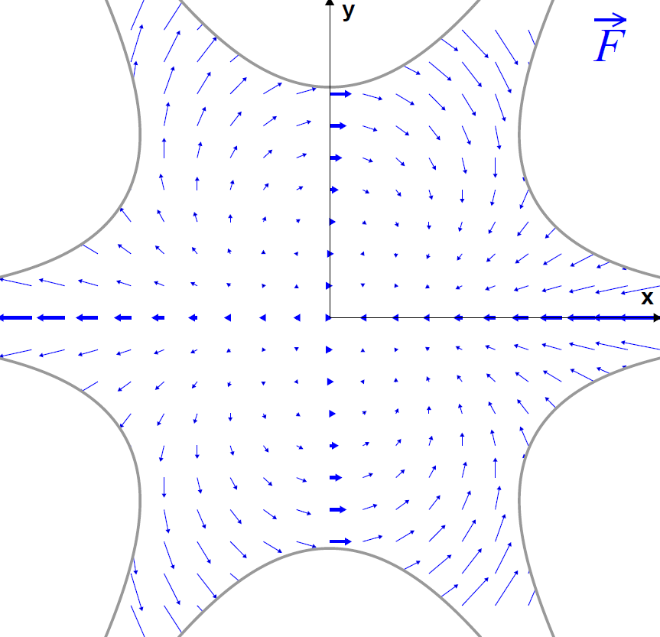


Sextupole
With sextupoles we are entering the regime of non-linear dynamics.
But sextupoles are also used to correct linear optics errors, for example the chromaticity (tune change with momentum).
  They may generate linear optics errors through misalignments.
  A sextupole is ≅ a quadrupole with gradient that increases with distance to centre.
$$F_{y} xy$$
$$F_{x} (y2−x2)$$

Slide 7
A realistic lattice - LHC
The LHC arc section are equipped with 107 m long F0D0 cells. Besides our 3 main elements the LHC cell is equipped with other correction (trim) magnets.
  In modern light sources multipoles are often combined inside the same magnet.
MB: main dipole
MQ: main quadrupole
MQT: trim quadrupole
MQS: skew trim quadrupole
MO: lattice octupole (Landau damping)
MSCB: sextupole + orbit corrector dipole
MCS: Spool piece sextupole
MCDO: Spool piece 8 / 10 pole
BPM: Beam position monitor

Slide 8
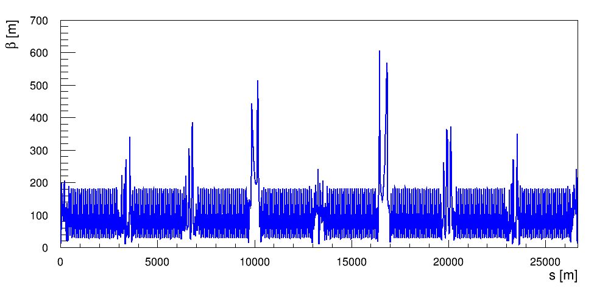
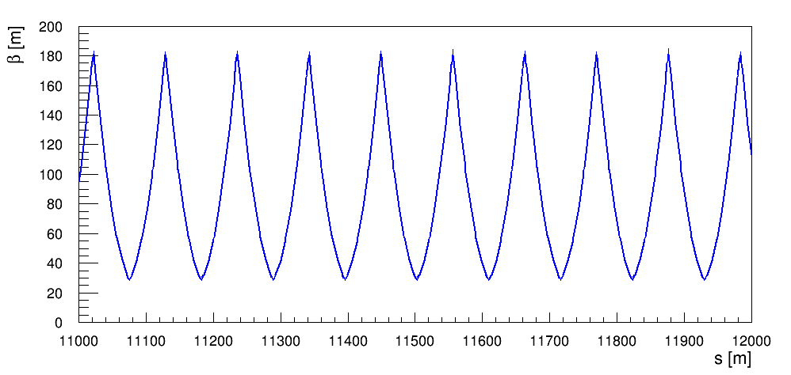
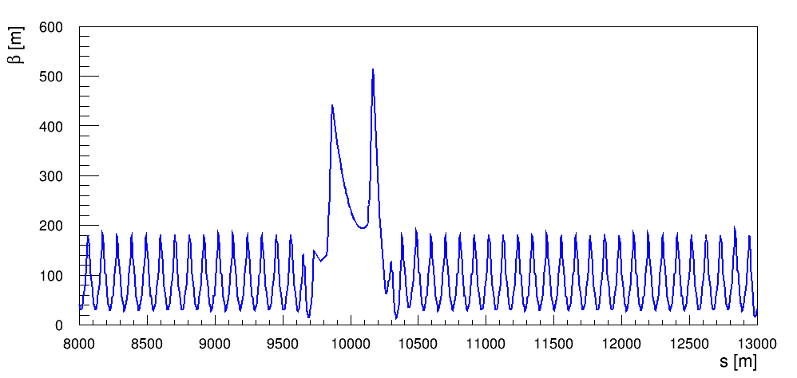
Recap on beam optics
There are a few quantities related to a beam optics in a circular accelerator that we will need for the lecture:
  The betatron function (β) that defines the beam envelope,
    Beam size / envelope is proportional to √β
  The betatron phase advance (μ) that defines the phase of an oscillation.
LHC optics at injection
one cell
zoom
zoom

Slide 9
Recap on beam optics
Consider a particle moving in a section of the accelerator lattice. The focussing elements make it bounce back and forth.
one cell
one cell
…
Another section of the accelerator
Another section of the accelerator
This periodic oscillation is called a betatron oscillation.

Slide 10
Recap on beam optics for pedestrians
The number of oscillation periods for one turn of the machine is called the machine tune (Q) or betatron tune.
  In this example Q is around 2.75 – 2 periods and ¾ of a period.
position
1 period
1 period
1 period
Longitudinal coord. s
It is possible to change the coordinates (from the longitudinal position in meters to the betatron phase advance in degrees) and transform this ‘rocky’ oscillation into a sinusoidal oscillation.
  Convenient (and simpler) way to analyse the beam motion.
position/√β
Betatron phase μ

Slide 11
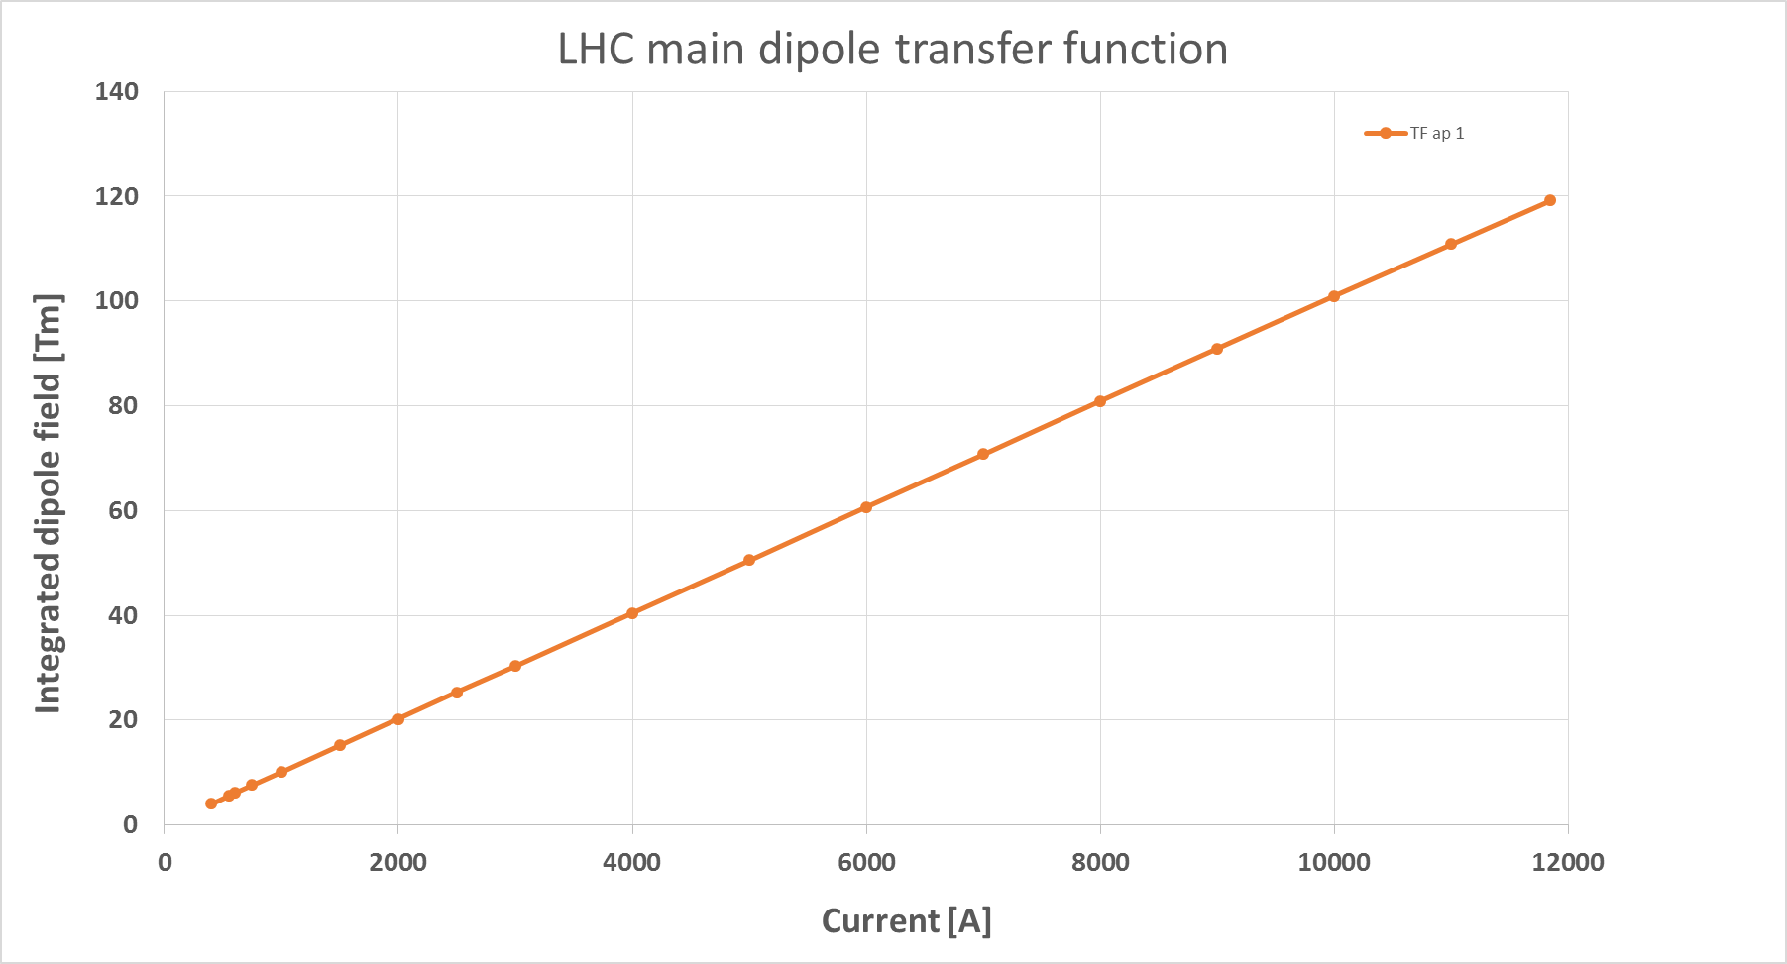
From model to reality - fields
The machine model defined by the accelerator designer must be converted into electromagnetic fields and eventually into currents for the power converters that feed the magnet circuits (for example).
Field imperfections are introduced when the model is transferred into the real machine. For magnetic fields for example the errors are due to:
  Beam momentum, magnet measurements and power converter regulation.
Magnet strength
Actual magnet current
Magnetic field (gradient)
Requested current
Beam momentum
Magnet
calibration curve (transfer function)
Power converter
Example of the LHC main dipole calibration curve

Slide 12
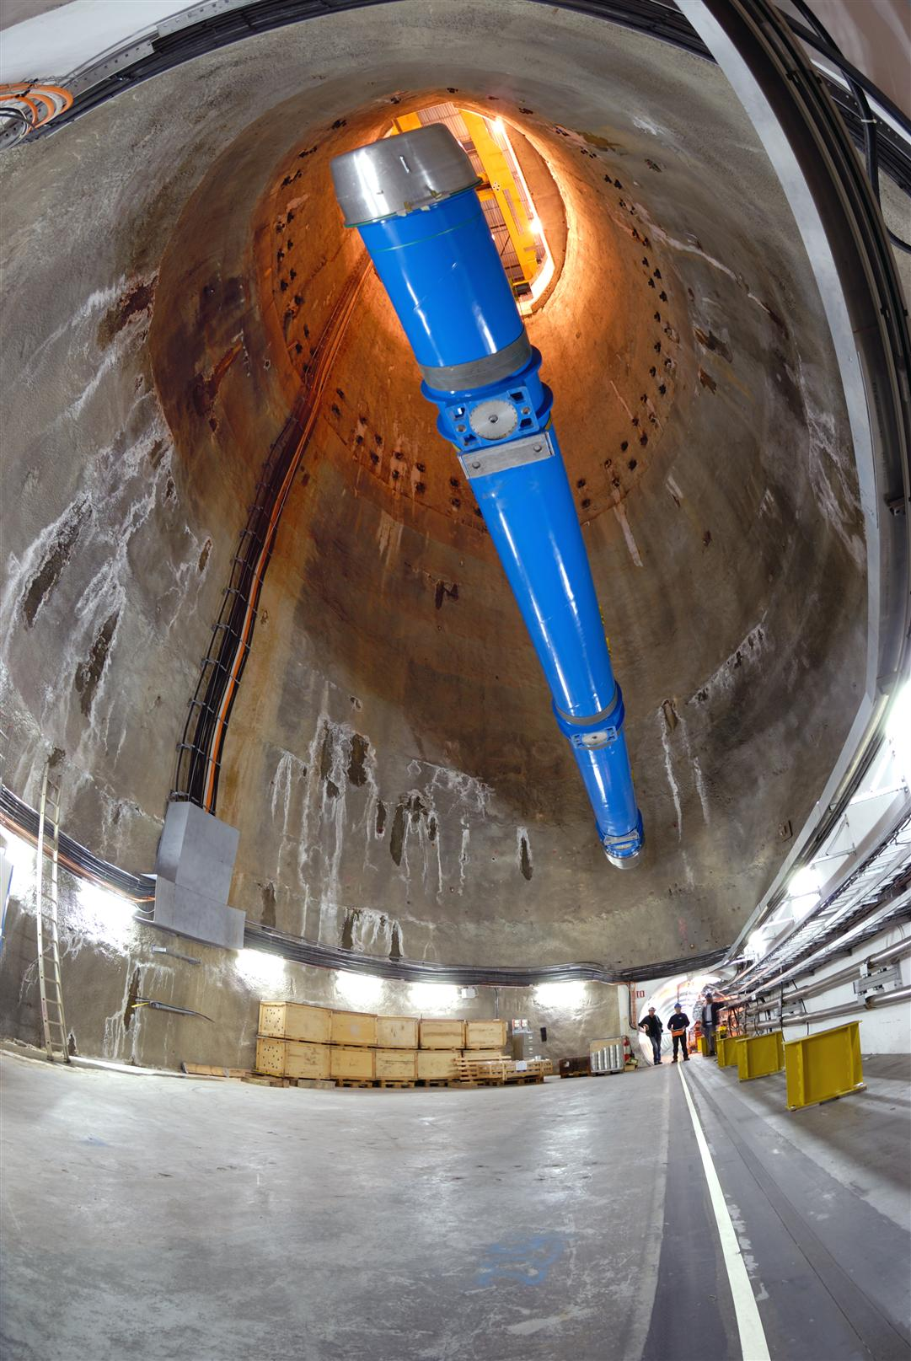
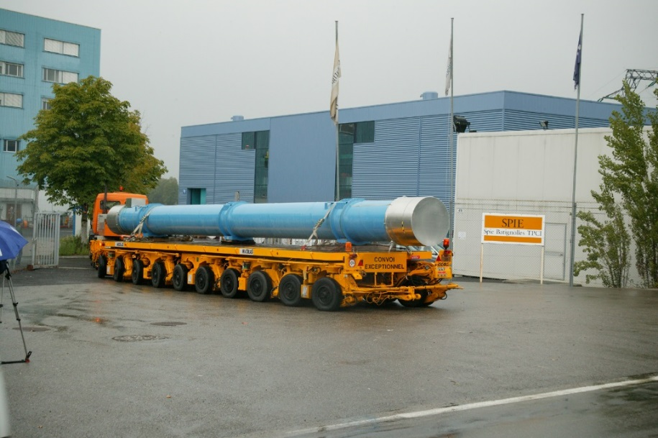
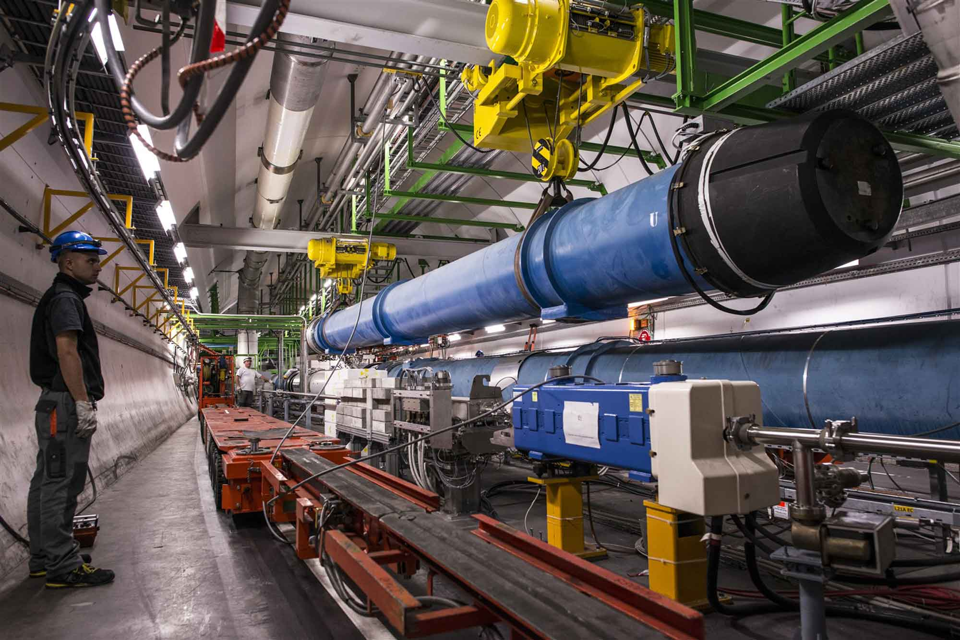
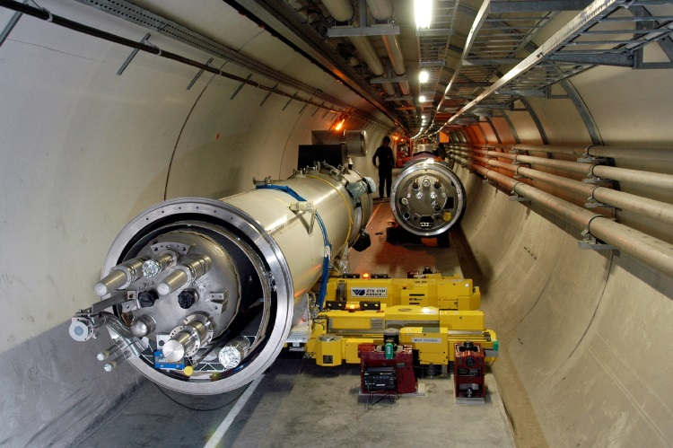
From the lab to the tunnel

Slide 13
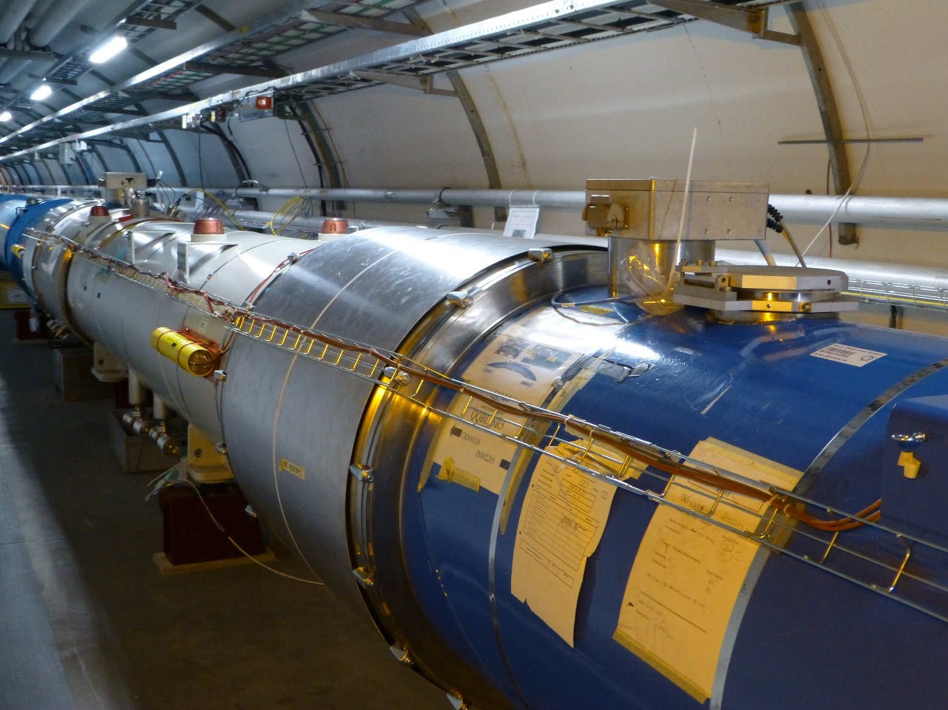
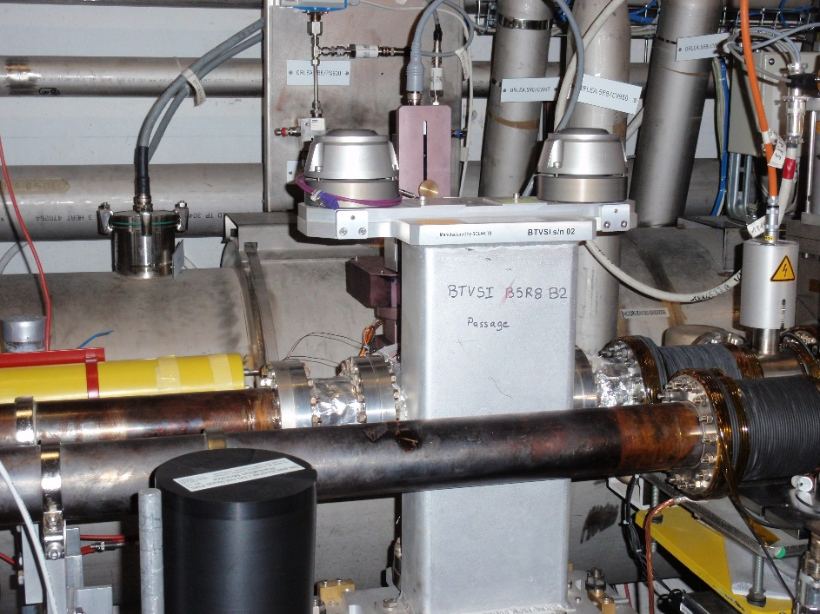
From model to reality - alignment
To ensure that the accelerator elements are in the correct position the alignment must be precise – to the sub-micrometre level for linear colliders !
The alignment process for a magnet implies:
  Precise measurements of the magnetic axis in the laboratory with reference to the element alignment markers used by survey teams.
  Precise in-situ alignment (position and angle) of the element in the tunnel.
Alignment errors are another common source of imperfections.

Slide 14
Restoring the model
As a consequence of imperfections, the actual accelerator may differ from the model to a point where the accelerator may not function well / at all.
  Beam does not circulate due to misalignments,
  Incorrect optics due to field errors and alignment errors,
  Missing beam aperture due to alignment errors,
  ….
Over the years many tools were developed to measure and correct accelerator parameters in control rooms and to restore design models or update the actual machine model.
  In many cases the tools are applied iteratively when an accelerator is bootstrapped and commissioned.
This presentation provides an overview of linear imperfections, how to measure and correct them.

Slide 15
Introduction
Orbit and dispersion
Tune and coupling
Chromaticity
Linear optics

Slide 16
Imperfection – undesired deflection
The presence of an unintended deflection along the path of the beam is a first category of imperfections.
This case is also in general the first one that is encountered when beam is first injected…
The dipole orbit corrector is added to the cell to compensate the effect of unintended deflections.
  With the orbit corrector we can generate a deflection of opposite sign and amplitude that compensates locally the imperfection.

Slide 17
Unintended deflection
The first source is a field error (deflection error) of a dipole magnet.
This can be due to an error in the magnet current or in the calibration table (measurement accuracy etc).
  The imperfect dipole can be expressed as a perfect one + a small error.
real dipole
ideal dipole
small dipole error
=
+
A small rotation (misalignment) of a dipole magnet has the same effect, but in the other plane.
real dipole
ideal dipole
small dipole error
=
+

Slide 18
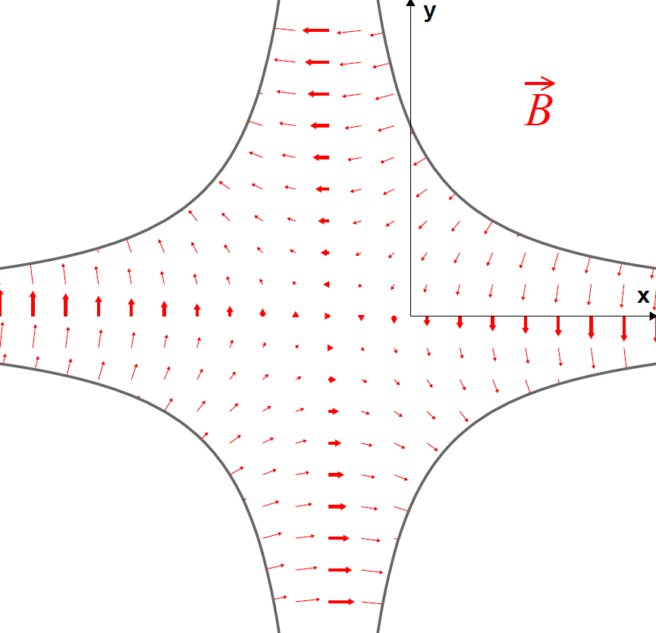
Unintended deflection
The second source is a misalignment of a quadupole magnet.
  The misaligned quadrupole can be represented as a perfectly aligned quadrupole plus a small deflection.
offset quadrupole
ideal quadrupole
small dipole error
=
+
Non-zero magnetic field on the beam axis !
No magnetic field on the beam axis

Slide 19
Linear imperfections table
Summary table of linear imperfections
Field type | Imperfection | Error type | Impact
Dipole | Field error | Dipole | Orbit / trajectory
Dipole | Tilt | Dipole | Orbit / trajectory
Quadrupole | Field error | Quadrupole | Tune / optics
Quadrupole | Offset | Dipole | Orbit / trajectory
Quadrupole | Tilt | Skew quadrupole | Coupling
Sextupole | Field error | Sextupole | Chromaticity
Sextupole | Offset horizontal | Quadrupole | Tune / optics
Sextupole | Offset vertical | Skew quadrupole | Coupling

Slide 20
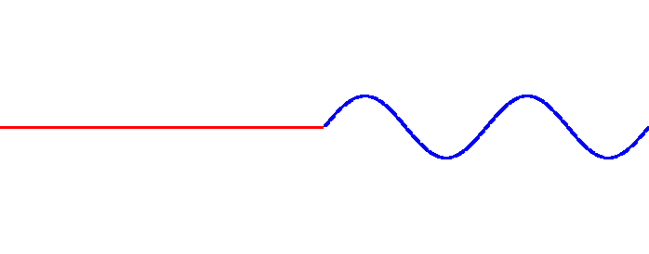
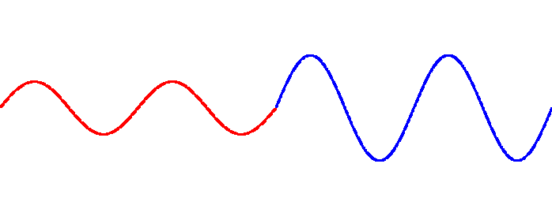
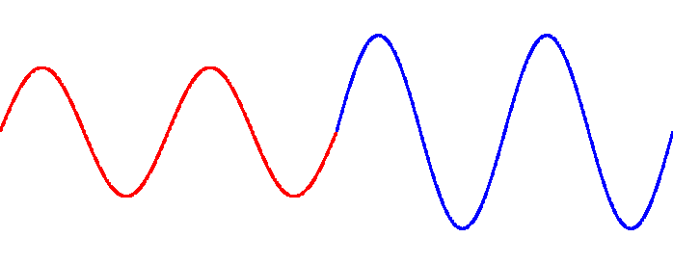
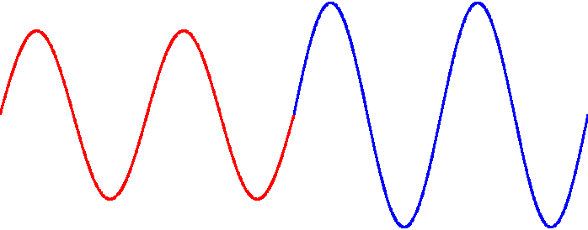
Effect of a deflection
Deflection
Particle direction
We set the machine tune to an integer value:
  Q = n ∈N
Turn no 1
When the tune is an integer number, the deflections add up on every turn !
  The amplitudes diverge, the particles do not stay within the accelerator vacuum chamber.
Turn no 2
Turn no 3
  We just encountered our first resonance – the integer resonance that occurs when Q = n ∈N
Turn no 4

Slide 21
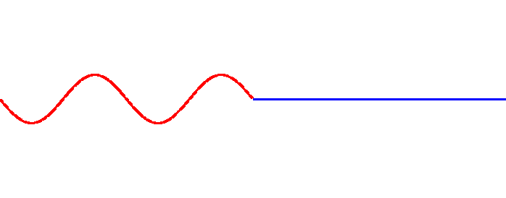
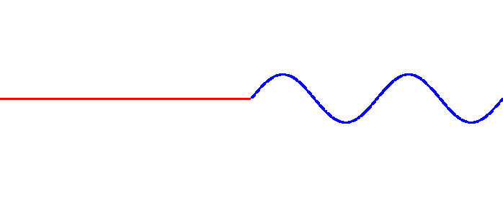
Effect of a deflection
Deflection
Particle direction
We set the machine tune to a half integer value:
  Q = n+0.5, n ∈N
Turn no 1
Turn no 2
For half integer tune values, the deflections compensate on every other turn !
  The amplitudes are stable.
Turn no 3
  This looks like a much better working point for Q!
Turn no 4

Slide 22
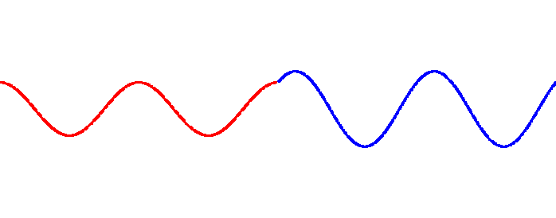
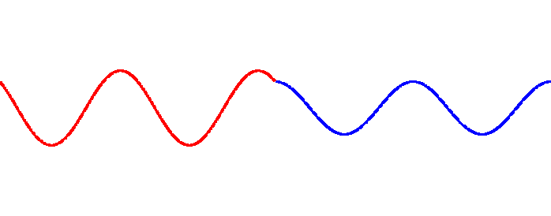
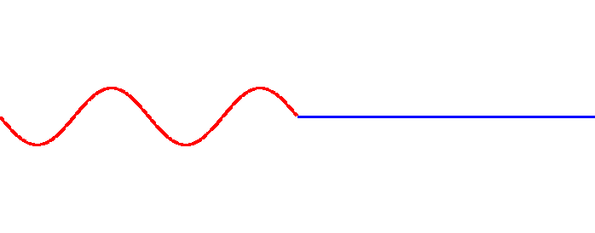
Effect of a deflection
Deflection
Particle direction
We set the machine tune to a quarter integer value:
  Q = n+0.25, n ∈N
Turn no 1
Turn no 2
For quarter tune values, the deflections compensate every four turns !
  The amplitudes are stable.
Turn no 3
  Also a reasonable working point for Q!
Turn no 4

Slide 23
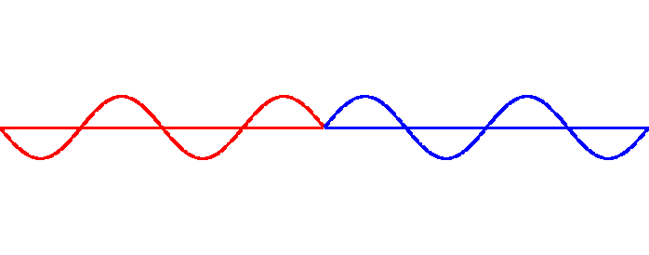
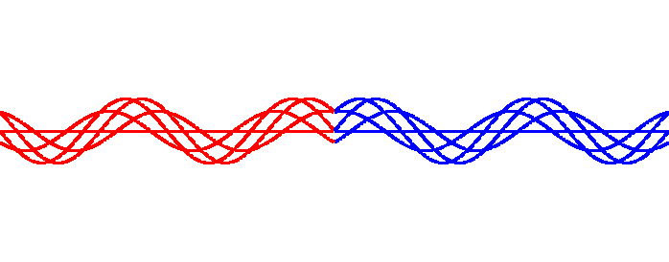

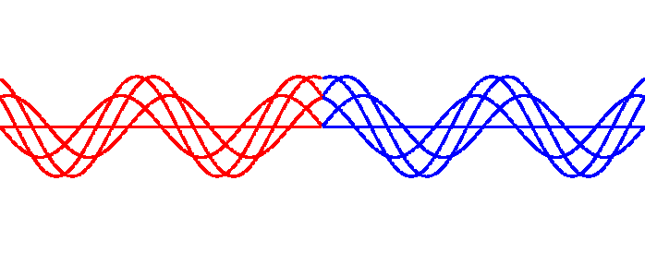
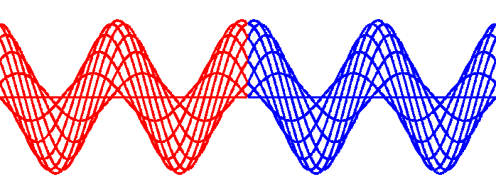
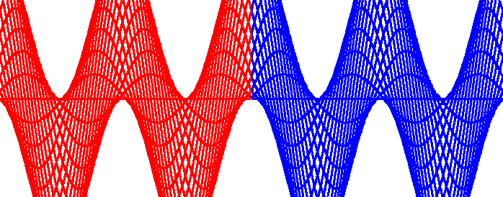
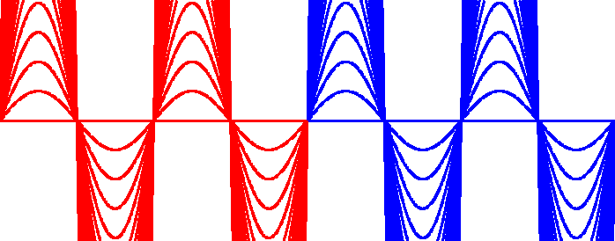
Many turns reveal something
Let’s plot the 50 first turns on top of each other and change Q.
  All plots are on the same scale
Q = n + 0.5
Q = n + 0.4
Q = n + 0.3
Q = n + 0.2
Q = n + 0.1
Q = n + 0.05
Q = n
The particles oscillate around a stable mean value (Q ≠ n)!
The amplitude diverges as we approach Q = n → integer resonance

Slide 24
The closed orbit
The stable mean value around which the particles oscillate is called the closed orbit.
  Every particle in the beam oscillates around the closed orbit.
  As we have seen the closed orbit ‘does not exist’ when the tune is an integer value.
The general expression of the closed orbit x(s) in the presence of a deflection θ is:
kink at the location of the deflection
amplitude modulated by the envelope β
oscillating term
divergence for Q = n

Slide 25
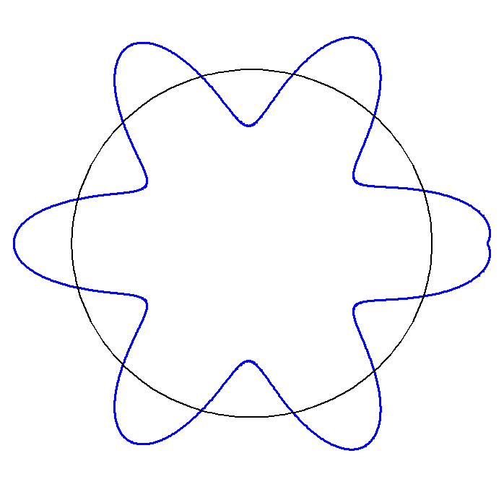
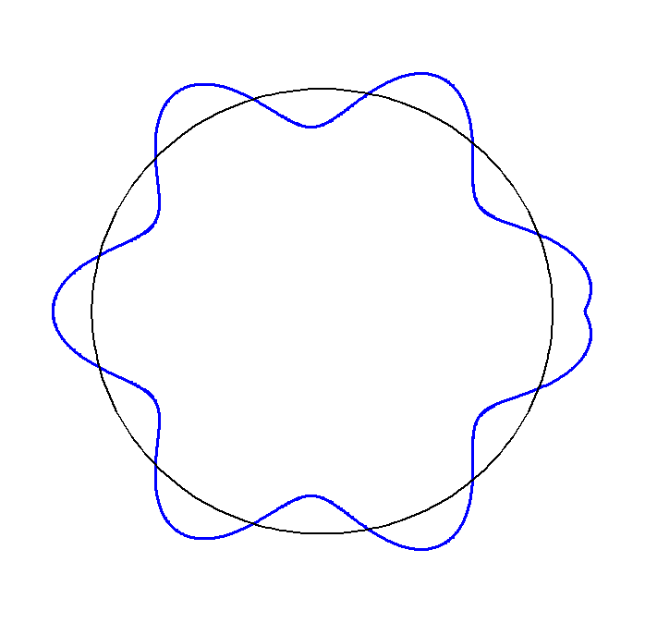
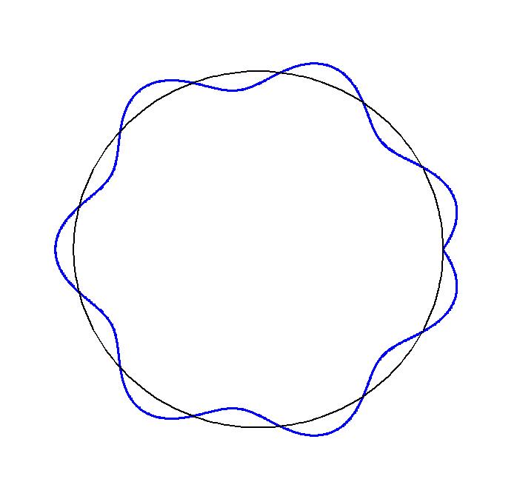
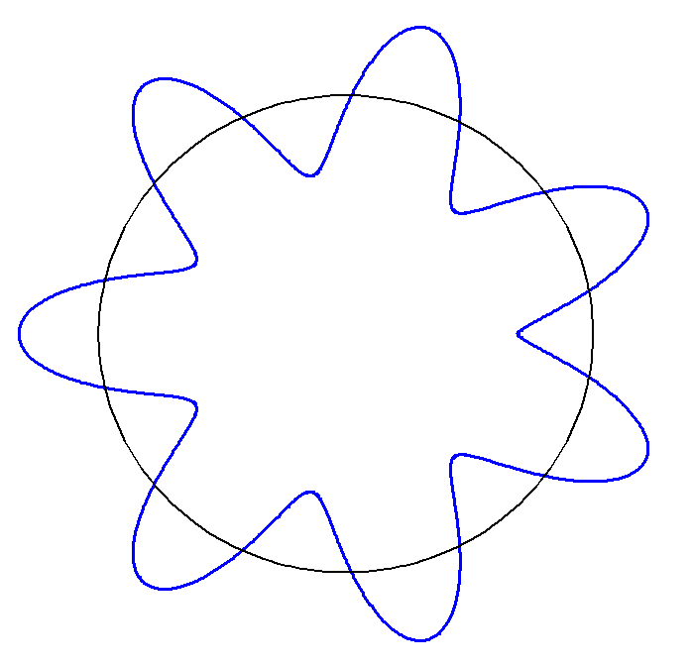
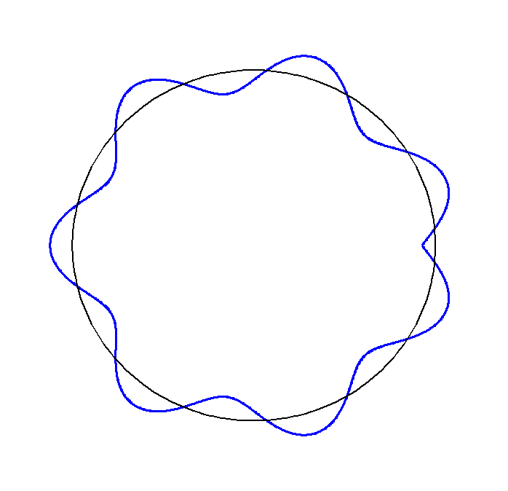
Closed orbit example
Example of the horizontal closed orbit for a machine with tune Q = 6 + q.
The kink at the location of the deflection (→) can be used to localize the deflection (if it is not known) → can be used for orbit correction.
Q = 6.1
Q = 6.2
Q = 6.5
Q = 6.9
Q = 6.7

Slide 26
Orbit & trajectory response
The position response Δu_{i} of the beam at position i due to a deflection Δθ_{j} at position j is given in linear approximation by:
where:
Closed orbit
Trajectory/Linac
To a first approximation we can limit the discussion to deflections generated by misaligned quadrupoles (gradient k, length l_{Q}) and by steering elements (orbit correctors).
  For quadrupoles with alignment error δ, the kick is

Slide 27
Orbit & trajectory correction
The relation between the positions measured at N BPMs (beam position monitors) and the deflections due to M steering elements (in general (N ≥ M) can be cast into a matrix format (R = response matrix):
To steer the beam deterministically this equation must be inverted, something like :
is in general a ‘pseudo’ inverse, a real inverse only exists if N=M.
Response matrix R obviously contains a lot of information on the machine optics – later we will see that they are tools to take advantage of that fact to determine and correct the lattice functions.

Slide 28
Orbit & trajectory correction II
In general the algorithms for beam steering aim to minimize the least square error:
  We assume here that we know the response matrix R well enough to apply a correction.
This equation is rather generic, problems of optics and dispersion correction can be cast in a similar form, and the algorithms used for steering are also used or adapted to those problems.

Slide 29
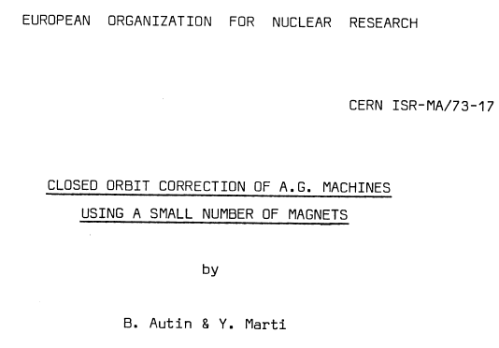
The early days of orbit correction
The problem of correcting the orbit deterministically came up a long time ago in the first machines.
B. Autin and Y. Marti of CERN published a note in 1973 describing an algorithm that is still in use today in many machines:
  MICADO*
  One of the first deterministic correction algorithms !
(Minimization of the quadratic orbit distortions)

Slide 30
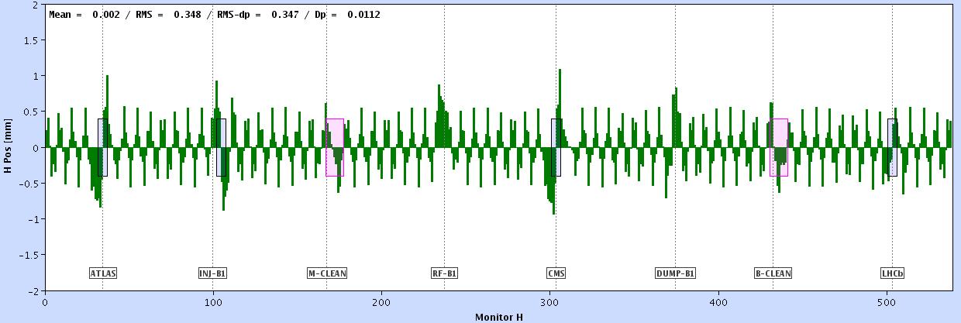
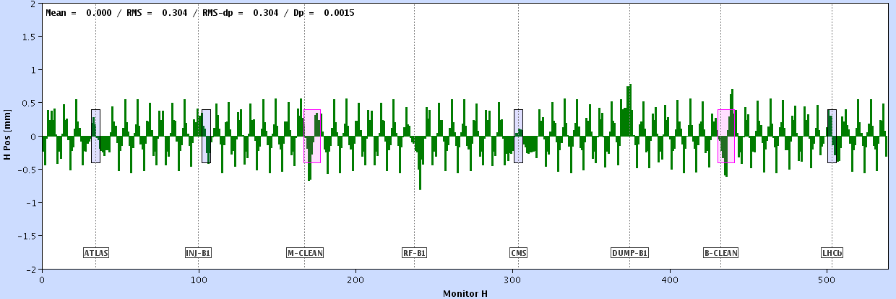
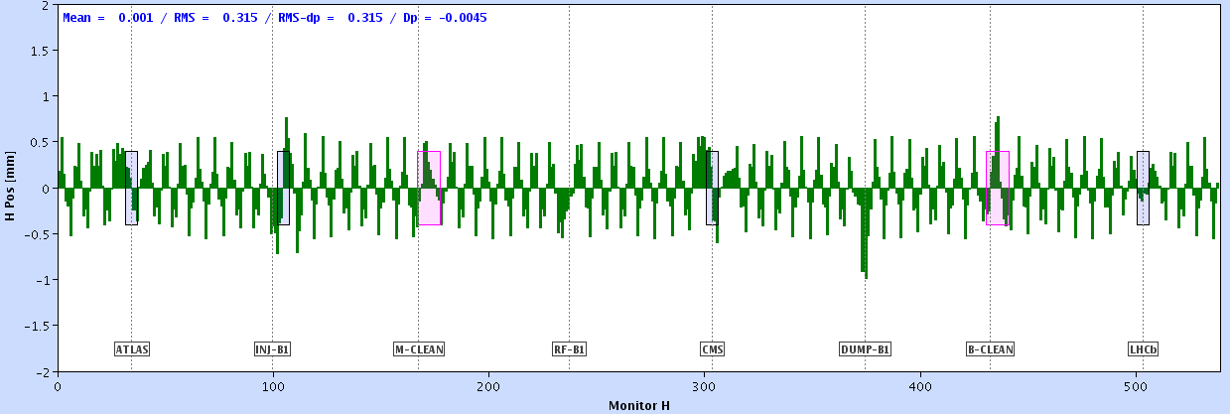
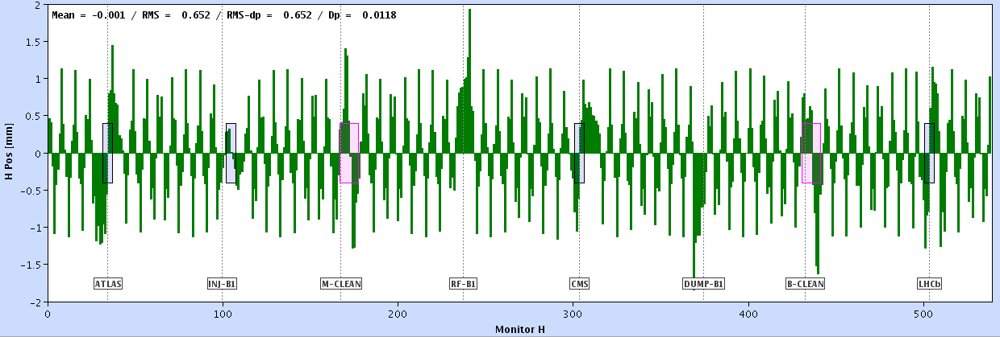
MICADO principle
The intuitive principle of MICADO is rather simple.
Preparation:
  The machine model must be used to build the R matrix,
  Each column of R correspond to the response of all N BPMs to one of the correctors.
Example of responses for LHC
Each orbit response corresponds to one column of R
...

Slide 31
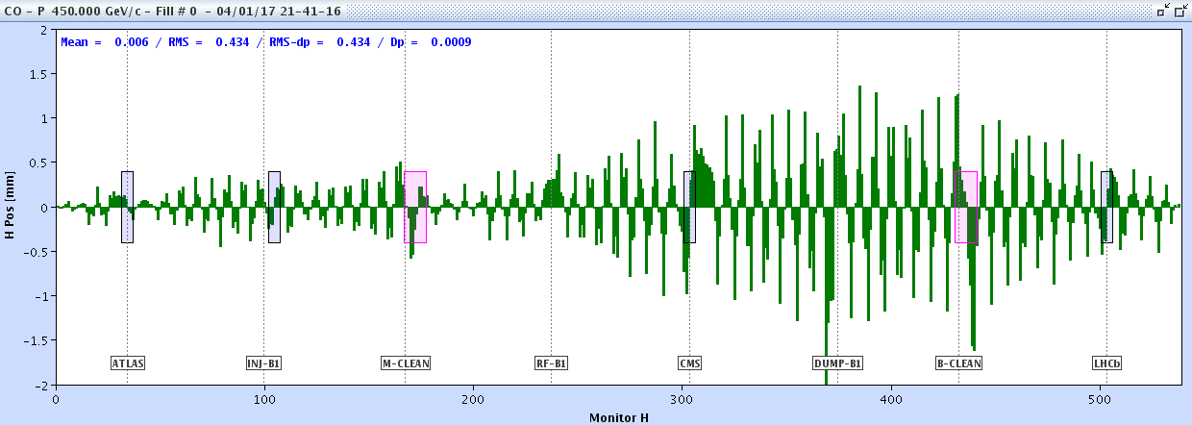
MICADO principle II
MICADO compares the response of every corrector with the raw orbit.
…
MICADO picks out the corrector that hast the best match with the orbit, and that will give the largest reduction of
The procedure can be iterated using the remaining correctors until the orbit is good enough (stop after K steps using K correctors) or as good as it can be by using all available correctors.

Slide 32
Singular Value Decomposition
Singular Value Decomposition (SVD) is a generic operation applicable to any matrix R that is decomposed into 3 matrices Z, W and V:
P2
P3
W is a diagonal ‘eigenvalue’ matrix while V is a square matrix that is also ortho-normal:
The columns (vectors) of V are related to the columns (vectors) of Z by the eigenvalues:
The vectors form an ortho-normal basis of the ‘corrector space’
⋅ = scalar product

Slide 33
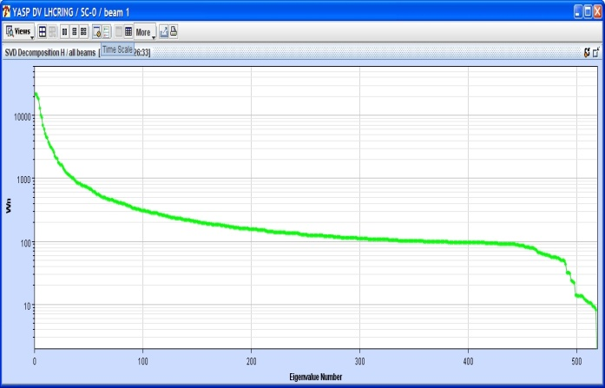
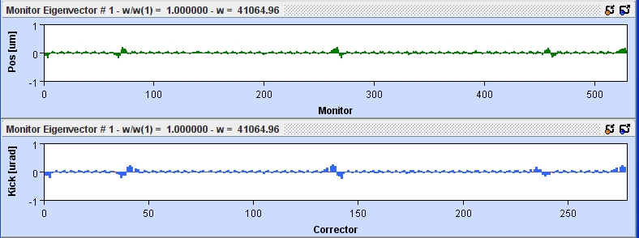
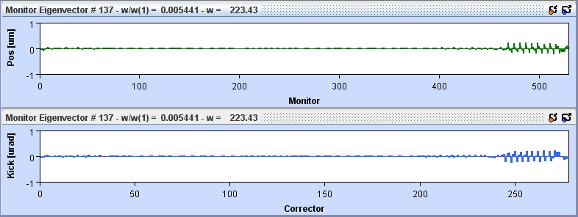
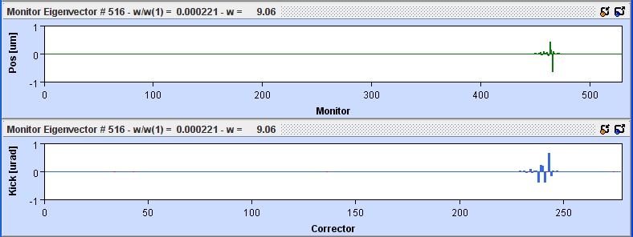
Eigenvectors examples for LHC
Eigenvalues
No. 1
No. 137
As the eigenvalues decrease, the associated eigenvectors correspond to increasingly local ‘structures’
No. 516

Slide 34
Meaning of eigenvectors
What are those eigenvectors and what is the useful ‘trick’ behind an SVD decomposition?
The response matrix R maps points in ‘corrector space’ to point in ‘beam position’ space.
  The natural basis vectors of those spaces are physical monitors and correctors.
u₂
R
θ₂
Corrector Setting
Beam Position
monitor₂
corrector₂
monitor₁
u₁
corrector₁
θ₁
The problem is that R maps orthogonal vectors (=correctors) into non-orthogonal responses in monitor space.
R
monitor₂
corrector₂
R
monitor₁
corrector₁

Slide 35
Meaning of eigenvectors II
The SVD decomposition identifies a new orthonormal basis of the orbit corrector space such that their responses are also orthogonal !
M vectors for a N×N dimensional space
M vectors for a M×M dimensional space
R
monitor₂
corrector₂
monitor₁
R
corrector₁
Every corrector setting can be decomposed into the v vectors.
Every orbit can be decomposed into the z vectors plus a residual un-correctable remainder:

Slide 36
Singular Value Decomposition ||
SVD can be used to solve the determine a correction using k out of M eigenvalues.
  The eigenvalues w_{j} are typically sorted in descending order: w_{j+1} ≤ w_{j}.
This operation corresponds intuitively to decompose the measured orbit into the orbit eigenvectors z_{i} – unique ! – and then to correct the effect of the k largest eigenvectors (since z_{i} is associated to v_{i}).

Slide 37
SVD - MICADO
MICADO picks out individual correctors.
  With a perfect match of model and machine it will help localize local sources.
  Well suited in case of clean measurements to identify a single / dominant source.
  MICADO can be in trouble if the R matrix presents singularities, associated to poor BPM or corrector layout (poor phase conditions…).
SVD will always use all correctors.
  With few eigenvalues for the correction, even a local perturbation will be corrected with many elements.
    Can be a pro if the strength of correctors is limited.
  The number of eigenvalues controls the locality /quality of the correction. With more eigenvalues local structures will be corrected better.
  By limiting the number of eigenvalues it is possible to avoid correcting on noise, in particular with eigenvectors that drive large strength and provide little position change.
    See also later the MIA technique.
  Since the SVD correction can be cast into a simple matrix operation, it is well suited (and always used) for real-time orbit feedbacks.

Slide 38


Orbit & trajectory – first steps
The first problem encountered during machine commissioning is to bring the beam to the end of the linac, respectively circulate it in the storage ring.
  Level of difficulty depends on the alignment errors and the length of the machine.
For small accelerators it is usually not a too serious issue as the number of undesired deflections encountered over the length of the accelerator is not too large, but for many km long machines this is far for guaranteed.
  Trajectory excursion build up randomly along the path of the beam s.
  For random errors the trajectory amplitudes scale roughly ~ √s.
LHC during first turn steering
Beam stopped on a collimator

Slide 39

Alignment and initial orbit errors
For a typical rms alignment error σ_{a} it is possible to estimate the resulting rms orbit error σ_{orb} for a machine (length L) build with a homogenous lattice consisting of N_{c} FODO cells:
LHC vacuum chamber
  Example: for the LHC injection optics κ ≅ 20-30. For σ_{a} ~ 0.3 mm, the expected orbit rms σ_{orb} is 6-9 mm. Excursions of ±2σ_{orb} already exceed the mechanical aperture of the vacuum chamber.
  The situation is likely become worse at FCC-hh !
34 mm
44 mm
  Example: for the 100 km long FCC-ee with N_{c} ~ 1500, κ ≅ 45. For σ_{a} ~ 0.1 mm, the expected orbit rms σ_{orb} is ~5 mm. This does not look too bad, but the FCC-ee lattice is so non-linear (strong focussing) that the beam does not make it around, although the vacuum chamber height is ~ twice as large than LHC.

Slide 40



LHC orbit correction example
The raw orbit at the LHC can have large errors (in this example the correctons were unfolded !), but proper correction bring the deviations down by more than a factor 20.
Uncorrected horizontal orbit of ring 1
50 mm
MICADO & SVD
Corrected horizontal orbit of ring 1
LHC vacuum chamber
50 mm
34 mm
44 mm

Slide 41



BPM errors
The quality of the BPM measurements used for measurements and corrections are affected by:
  Offsets,
  Scale errors and non-linearities,
  Intensity and beam pattern effects.
Non-linearities and beam/intensity systematics must be simulated or obtained from laboratory measurements.
  Non-linearities are due to electrode geometries and to the electronics.
  Improper correction of such effect can bias beam based measurements.
LHC button BPM
Black points: real beam position,
Red points: distorted positions based on a position reconstruction with a linear assumption:
BPM-NL

Slide 42


K-modulation
BPM offsets, an important nuisance for orbit corrections, can be measured by a technique called k-modulation:
  The gradient of a selected quadrupole is modulated slightly at a frequency f_{mod},
  The beam position is varied inside the quadrupole using orbit bumps.
The beam orbit is modulated at f_{mod}, the modulation amplitude vanishes when the beam is centred in the quadrupole.
P1
K-modulation at LEP
Oscillation amplitude as a function of the orbit bump amplitude

Slide 43
Dispersion
The bending of charged particles by magnetic fields depends on the momentum (Lorentz force).
As a consequence for a beam that is subject to a dipole deflection, the trajectories of the particles will be sorted by energy: dispersion !
  In a circular accelerator there is always some dispersion.
The dispersion measures the position difference per unit of energy deviation

Slide 44



Dispersion
Closely associated to the orbit is the dispersion, which is the derivative of the orbit wrt energy (u=x,y) :
slope
Dispersion in a ring (SPS)
Dispersion in a transfer line
Model dispersion is purely horizontal due to the flat ring
Model dispersion also present in the vertical plane due to vertical bending

Slide 45
Dispersion errors
In a storage ring there is always non-zero horizontal dispersion (bending!). For flat machines the vertical dispersion is usually ‘0’ by design.
  For hadron machines the dispersion is in general not critical. Controlling and correcting it follows similar lines to optics correction.
  At e⁺e⁻ machines the vertical dispersion can lead to significant vertical emittance ε_{y} growth, and to important luminosity performance loss.
Dispersion errors may be driven by:
  Optics errors → handled together with the general optics correction,
  Coupling → mainly from the horizontal to the vertical plane,
  Steering and alignment errors → mainly an issue at e⁺e⁻ machines where the emittances may be spoiled – storage rings and linacs !
Optics and coupling correction will be discussed later, for the moment we focus on the third point, namely steering driven dispersion.

Slide 46
Dispersion free steering
A technique combining regular steering and dispersion correction was used at SLC and LEP – dispersion free steering (DFS) – will be outlined here.
The principle of DFS relies on the extension of the orbit response matrix to dispersion including the dispersion response S and a weight factor α between orbit and dispersion:
P3
  The dispersion response may be estimated analytically or from a simulation program like MAD etc.
The combined orbit and dispersion correction system can be solved in exactly the same way than the ‘normal’ steering.
  This does however not apply to all sources of dispersion (due to coupling between planes for example).
DISP-RES

Slide 47


Dispersion free steering II
DFS at LEP
DFS convergence at LEP
Before
After
orbit
dispersion
kicks
P3
Observe that the orbit rms is degraded while the dispersion rms is improved !
DFS provides controlled correction of the orbit and the dispersion with the dispersion is dominated by deflection (errors).

Slide 48
Introduction
Orbit and dispersion
Tune and coupling
Chromaticity
Linear optics

Slide 49


Tune measurement
The tune (number of betatron oscillations per turn):
Uncorrected orbit at the LHC
The integer tune N is obtained from a poor closed orbit or a kick on the orbit.
  In large machine N may be wrong before correction !
The fractional tune q is obtained from the turn-by-turn data (TbT) of a single position monitor is the beam is given a kick or is oscillating naturally.
  Fast Fourier Transform (FFT) of oscillation data provides the resonant frequency q.

Slide 50


Excitations for tune measurements
Two common beam excitation methods:
The single kick method followed by a free oscillation, damped by decoherence (tune spread due to non-linearities),
The AC dipole forced excitation at a fixed frequency, usually close to the tune.
  Emittance growth free excitation for hadrons (if distance to tunes sufficient large),
  Long excitation duration (accuracy thanks to many turns).
  As this is a forced oscillation it does not provide the tune – but can be used for coupling and optics measurements.
Forced AC dipole oscillation (LHC)
Single kick and free oscillation (LHC)
Excitation
Excitation

Slide 51


Excitations for tune measurements (II)
Phased locking an excitation-measurement system provides a means to track tunes continuously.
  An exciter shakes the beam on the tune, it remains locked on the tune using the phase of the beam response wrt excitation.
  ‘Ideal’ for e⁺e⁻ rings where damping will erase the effect of the excitation.
  Problematic for hadrons as this technique tends to produce emittance blowup.
    Used at RHIC, but not at LHC (too strong transverse feedback).
Q-FB-RHIC
Phased locked tune and coupling (RHIC ramp)
Phased locked tune (and chromaticity) measurement at LEP

Slide 52

Shottky spectra
A direct and non-invasive technique to measure the tunes is based the Shottky spectrum of the beam.
  Relies on noise in the beam, no excitation is required – ideal for hadrons.
    But small signals: detection electrodes must be close to the beam, or the beam must have large charge Z (Shottky signal amplitude ~ Z²).
  Can be problematic for bunched beams due to large coherent signals,
  This devices is also able to provide chromaticity and emittance.
Shottky signals at the LHC
Q-SHOT-LHC
Tune

Slide 53

Tune working points
Collider tune working points.
  Hadron machines work usually very close to the diagonal (tune space).
    De-coupling of the planes is important.
  The tune value may depend on the number of IPs. For example for e⁺e⁻ the tune increment from one IP to the next is often chosen to be close to 0.5.

Slide 54
Quadrupole gradient errors
What is the impact of a quadrupole gradient error?
  Let us consider a particle oscillating in the lattice.
Too strong gradient / lens
The oscillation period is affected → change of tune, here Q increases !

Slide 55
Tune change by quadrupole
The tune change ΔQ_{u} (u = x,y) induced by a small quadrupole strength change Δk is given to first order by:
L_{Q} is the quadrupole length,
β_{u} is the betatron function inside the quarupole
In general the vertical and horizontal betatron functions differ at the quadrupole, therefore the tune changes are different for H and V.
By combining two (groups of) quadrupoles with different β_{x} and β_{y}, it is possible to construct combinations that affect Q only in one plane.
  Provides a means for orthogonal corrections of the two planes.
  In larger machine there are often distributed trim quadrupoles grouped in two (or more) families to spread out the correction and reduce optics errors.
Quadrupole 1
Quadrupole 2
m_{ij} = f(β_{x,1},β_{y,1,} β_{x,2},β_{y,2})

Slide 56


Tilted quadrupole
If a quadrupole is rotated by 45º (‘skew quadrupole’) one obtains an element where the force (deflection) in x depends on y and vice-versa: the horizontal and vertical planes are coupled.
normal quadrupole
skew quadrupole
F_{x} = -k x
F_{x} = k y
No mixing of planes
Full mixing of planes
F_{y} = k y
F_{y} = -k x

Slide 57
Coupling (I)
Small quadrupole tilts lead to coupling of the x and y planes.
The coupling can be corrected by installing dedicated skew quadrupoles to compensate for alignment or skew quadrupolar field errors.
tilted quadrupole
ideal quadrupole
skew quadrupole
=
+

Slide 58


Coupling (II)
Causes of undesired coupling in machines:
  Element misalignments (for examples tilt angles of quadrupoles),
  Skew quadrupolar field errors,
  Solenoids (experiments, coolers etc),
  Vertical orbit offsets in sextupoles (or misaligned sextupoles)
    Vertical offsets → skew quadrupole → coupling
    Horizontal offset → normal quadrupole → tune, beta-beating
offset sextupole
ideal sextupole
quadrupole
=
+

Slide 59
Linear imperfections table
Summary table of linear imperfections
Field type | Imperfection | Error type | Impact
Dipole | Field error | Dipole | Orbit / trajectory
Dipole | Tilt | Dipole | Orbit / trajectory
Quadrupole | Field error | Quadrupole | Tune / optics
Quadrupole | Offset | Dipole | Orbit / trajectory
Quadrupole | Tilt | Skew quadrupole | Coupling
Sextupole | Field error | Sextupole | Chromaticity
Sextupole | Offset horizontal | Quadrupole | Tune / optics
Sextupole | Offset vertical | Skew quadrupole | Coupling

Slide 60
Linear imperfections table
Summary table of linear imperfections.
Alignment offsets generate field errors of lower order:
  Quadrupole → dipole,
  Sextupoles → quadrupole,
  Etc..
‘Feed-down’
Field type | Imperfection | Error type | Impact
Dipole | Field error | Dipole | Orbit / trajectory
Dipole | Tilt | Dipole | Orbit / trajectory
Quadrupole | Field error | Quadrupole | Tune / optics
Quadrupole | Offset | Dipole | Orbit / trajectory
Quadrupole | Tilt | Skew quadrupole | Coupling
Sextupole | Field error | Sextupole | Chromaticity
Sextupole | Offset horizontal | Quadrupole | Tune / optics
Sextupole | Offset vertical | Skew quadrupole | Coupling

Slide 61


Coupling measurement
In the presence of coupling the beam eigen-modes Q₁ and Q₂ no longer coincide with Q_{x} and Q_{y}.
Large coupling can be an issue for the tune working point (hadron collider) or for the vertical emittance (e+/e- machines).
A first technique to characterise the coupling coefficient C⁻ consists in measuring the crossed tune peak amplitudes:
  Vertical tune in horizontal spectrum and vice-versa.
  Simple measurement, but no phase information.
  Only the local coupling is obtained, which can differ from the global coupling.
Horizontal tune spectrum at the LHC
Horizontal eigenmode Q1,
amplitude A_{1,x}
Vertical eigenmode Q2,
amplitude A_{1,y}

Slide 62



Coupling measurement II
The global machine coupling can be also determined directly using the closest tune approach.
  Requires to move the tunes close to / across each other.
  Provides global coupling information from a single location.
LEP-PERF
The closest distance of approach ΔQ_{min} corresponds to the coupling parameter C⁻:
Closest tune measurement at LEP
Q-COUP-KEKB
Closest tune measurements at superKEKB
ΔQ_{min}

Slide 63

Coupling measurement III
The coupling can also be determined along the machine using multi-turn beam position data (with e.g. AC dipole excitation) using pairs or groups of BPMs to reconstruct the coupling locally.
  Provides detailed local coupling information, including phase.
  Global coupling is obtained by integration of the local coupling.
  Provides excellent deterministic corrections, but kicking the beam is required.
Local coupling measurement at LHC
Q-COUP-LHC
O-NL-LHC

Slide 64
Correction of coupling
The coupling correction scheme depends on machine design.
Ideally experimental solenoids should be compensated by local anti-solenoids to correct the coupling source locally.
  At high energy hadron colliders like LHC, the solenoids of the 4 experiments contribute very little to he machine coupling (due to the high momentum).
The global machine coupling is usually corrected with distributed skew quadrupoles, either using 2 orthogonal knobs (similar to a tune correction) or with more refined local corrections.
  For measurements that do not provide phase information (only global coupling), the two orthogonal knobs must be scanned by trial and error to determine a correction.
As an alternative, orbit bumps in sextupoles may also be used for coupling corrections, but this can lead to problems with dispersion etc. Requires a careful combined correction of both parameters.

Slide 65
Introduction
Orbit and dispersion
Tune and coupling
Chromaticity
Linear optics

Slide 66

Chromaticity measurement
The linear chromaticity defines the tune dependence on momentum:
For a lattice Q’ is usually negative unless Q’ is corrected with sextupoles. The typical operation range of Q’ is ~ +1 to +20 above transition, slightly negative below transition energy – due to collective effects.
The chromaticity is measured by changing / modulating the energy offset dp/p through the RF frequency while recording the tune change ΔQ.
Q’ measurement by RF frequency modulation at LHC
At high energy machines, γ >> 1

Slide 67


Chromaticity measurement II
Q’ measurement along a ramp by RF frequency modulation at LHC
RF frequency
Vertical tunes
Horizontal tunes
Frequency continuously modulated,
Tune continuously measured,
Q’ reconstructed offline from the tune modulation amplitude.

Slide 68

Chromaticity from Shottky
A Shottky monitor can be used to determine Q’ for hadron beams without the need for a radial modulation.
  Completely non-invasive measurement.
Q’ is related to the difference in width of the upper and lower Shottky side-bands:
Shottky signal at the LHC
Q-SHOT-LHC
At LHC for example, the Shottky provides reasonable Q’ data at injection for protons, and at ~ all energies for ions (due to Z² sensitivity).

Slide 69
Chromaticity and field errors
In superconducting machines like Tevatron, LHC or FCC-hh the sextupolar field errors (b₃) play an important role and may generate huge chromaticity errors.
The field errors are usually generated in the dipoles and due to the important integrated length of the dipoles, the b₃ errors can add up to hundred’s of units of Q’.
Furthermore superconducting machine are affected by decay and snapback phenomena:
  Decay: while the machine ‘sits’ at injection for filling, persistent currents (~ eddy currents) flow between the cable strands and may induced large field errors, in particular b₃ components. This leads to a drift of the chromaticity over time.
  Snapback: At the start of the energy ramp, the persistent currents ‘snap back’ to their initial value before decay over a very narrow energy range, leading to large dynamic swings of Q’.

Slide 70

b3 errors at LHC
The b3 errors for the LHC dipole magnets were measured on test benches and on the series production magnets.
  Higher order field errors were also measured (up to b7).
Evolution of b3 during the LHC dipole cycle
During injection b₃ decays by ~1 unit ≅ 38 units of Q’.
  1 unit = relative field (error) of 10⁻⁴ at a radius of 17 mm.
Over the full cycle the swing of b3 is ~7 units ≅ 270 units of Q’.
Typically one would like to control Q’ to a few units (±1-2).
(dipole)
Start of ramp
Ramp
Injection plateau
CHROM-B3-LHC

Slide 71

b3 errors at LHC II
To control the LHC chromaticity at injection it is not possible to modulate the frequency for continuous measurements, a model must therefore be available to stabilize Q’.
Evolution of the H chromaticity at injection for LHC
Continuous Q’ measurements over many hours are used to establish models of the decay.
  Parameters depend on the flat top energy etc
A decay model is used to stabilize Q’ during injection.
  In general correct within ~ ±2.
For the snapback a model is used to correct Q’ during this short phase.
  Lasts ~ 30 s at LHC.
Q’
Measured Q’
Model compensation
Corrected Q’
Time (min)

Slide 72

Chromaticity correction
The chromaticity is usually corrected with the lattice sextupoles. The corrections are usually distributed over all / many sextupoles in the form of orthogonal knobs for the two planes.
For systematic field errors as they appear in large super-conducting machines, a correction with the lattice sextupoles may lead to poor dynamic aperture due to strong non-linear fields.
A better compensation of field errors is obtained using dedicated b3 correctors (~small sextupoles) that are installed next to the dipoles and distributed over the entire machine – local corrections.
LHC arc cell magnet layout
beam 2
beam 1
quadruple
dipole
dipole
dipole
b3 corrector

Slide 73
Introduction
Orbit and dispersion
Tune and coupling
Chromaticity
Linear optics

Slide 74
Quadrupole gradient errors - recap
What is the impact of a quadrupole gradient error?
Too strong gradient / lens
The oscillation period is affected, leading to a change of tune,
The focussing error also affects the beam envelope (β function).

Slide 75


Optics perturbation
The focussing error affects not only the tune, but also the beam optics and envelope (size) over the entire ring !
Example for LHC: one quadrupole gradient is incorrect
Nominal optics
Perturbed optics
Zoom into a subsection

Slide 76
Optics perturbation
The beam optics perturbation exhibits an oscillating pattern.
Nominal optics
Perturbed optics

Slide 77

Optics perturbation
The error is easier to analyse and diagnose if one considers the ratio of the betatron function perturbed/nominal.
The ratio reveals an oscillating pattern called the betatron function beating (‘beta-beating’). The amplitude of the perturbation is the same all over the ring !

Slide 78

Optics perturbation
The beta-beating pattern comes out even more clearly if we replace the longitudinal coordinate with the betatron phase advance.
The result is very similar to the case of the closed orbit kick, the error reveals itself by a kink !
  If you watch closely you will observe that there are two oscillation periods per 2π (360 deg) phase. The beta-beating frequency is twice the frequency of the orbit !

Slide 79
Optics errors
The knowledge of the beam optics is essential for the good performance of an accelerator. Tools to measure and correct the optics towards a design model are essential at any modern facility.
The betatron function error (beta-beating) at an observation point j due to a number of strength errors Δk_{i} is given to first order by:
Contrary to the case of orbit kicks, gradient errors have a non-linear effect on the betatron function. A correct treatment must be self-consistent, the equation above is only an approximation.
  The problem may however be linearized using the matrix elements B_{ji} and solved iteratively using the SVD / MICADO algorithms based on measurements of Δβ_{j}. After each correction iteration the matrix elements B_{ji} must be revaluated.

Slide 80
Optics measurements
There are three main technique to measure and reconstruct the machine optics, and they may be used in combination.
K-modulation: the strength of individual quadrupoles is modulated to determine the local optics function.
Orbit (trajectory) response: the orbit or trajectory response matrix is measured with orbit corrector kicks (→ see orbit correction), a fit to the response is used to reconstruct and correct the machine model.
Multi-turn beam position data: the beam is excited and mutli-turn beam position data is recorded to determine the betatron phase advance between beam position monitors. The betatron function is reconstructed from the phase advance information.

Slide 81



K-modulation
K-modulation was already described as a means to determine BPM offsets wrt quadrupole magnetic centres.
This technique can also be used to determine the average betatron function inside the modulated quadrupole since the tune change ΔQ due to a gradient change Δk is given by:
O-KMOD-LHC
(integral over the quadrupole length l)
O-MT-LHC2
K-modulation at LHC
The betatron function in the quadrupole is then given by:
This technique is powerful and simple but requires quadrupoles to be powered individually which is often the case on synchrotron light sources but applies only to a subset of quadrupoles in large storage rings!
  Large collider arc quadrupoles are generally powered in series.

Slide 82
Orbit (trajectory) response
The concept of orbit / trajectory response is to exploit the large amount of information that is encoded in the steering response matrix (ORM).
The principle, available in the popular LOCO code, is to excite all / many steering elements in a ring / line and record the BPM response. This provides a measurement of the response matrix folded with BPM calibration factors b_{i} and orbit corrector deflection calibration factors c_{j}:
O-LOCO-BDYN
All the elements of R_{M} are observables for a model fit, fit variables include:
  BPM and orbit corrector calibration factors (b_{i,} , c_{j}),
  BPM and orbit corrector roll angles as they generate measurement ‘coupling’,
  Any selection of quadrupole gradient to fit for β, μ,
  Skew quadrupoles for coupling.
  …

Slide 83
Orbit (trajectory) response II
The ORM matrix is linearized in the form of a vector :
  The vector size = the number of elements of R_{M} .
The fit parameter vector is composed of (for example):
  BPM calibrations and roll angles,
  Steering elements calibrations and roll angles,
  Quadrupole gradients (skew and normal),
  …
A response matrix G ist constructed with the dependence of each r_{i} on any c_{j}.
  Some elements are obtained analytically, others need a simulation tool (like MAD, PTC, ELEGANT…).

Slide 84
Orbit (trajectory) response III
The response analysis is coupled to an accelerator design tool like MAD, PTC etc in order to determine the sensitivity wrt to the quadrupole gradients etc.
Once the system is cast in matrix form, it is solved by SVD inversion –structurally equivalent to an orbit correction.
  The tricks to filter noise by eliminating small eigenvalues as discussed for beam steering can be employed here !
  A few iteration may be required to converge. At each iteration G must be re-evaluated.
Note that the size of matrix G grows rapidly !
  For a machine with 100 BPMs and 100 steering elements, there are 10’000 lines and over 200 columns !

Slide 85



Orbit (trajectory) response III
Orbit response example after fit at SPS
Horizontal orbit corrector calibrations at SPS
histogram = data
Some correctors are damaged by radiation (from the time when SPS was a lepton injector for LEP !)
Trajectory response for CNGS line at CERN
O-LOCO-SPS
O-LOCO-CNGS

Slide 86


Trajectory response
Example of am inverted BPM plane captured by a response measurement in a transfer line.
  The BPM clearly appears for both horizontal and vertical plane measurements.
  Data in green, model in magenta.

Slide 87

Orbit (trajectory) response IV
Orbit response has been used with a lot of success at synchrotron light sources where it is a standard tool.
  Typically ~ 100 BPMs, steerers and quadrupoles.
At very large machines like LHC and FCC-hh, the data volumes are immense and multi-turn methods are faster, therefore the response techniques are mainly useful to calibrate BPMs and steerers.
Beta-beating correction with LOCO at SOLEIL
O-LOCO-SOLEIL

Slide 88

Multi-turn optics measurements
Multi-turn optics measurements rely on a beam excitation for a certain number of turns, typically few x 1000 to obtains sufficient resolution.
The beam oscillation phase is extracted for each BPM, this phase corresponds to the betatron phase μ at each BPM.
  The betatron phase advance Δμ between BPMs can therefore be extracted in a straightforward way.
  The phase measurement does not depend on the BPM calibration (but is sensitive to BPM non-linearities).
O-REV
Exciting the beam with a single kick is often limited by the decoherence of the oscillation (or by radiation damping).
  Limited no of turns → measurement error.
Excitation by an AC-dipole is more favourable since the number of turns can be increased if necessary.

Slide 89



Phase advance and beam oscillations
The betatron phase advance is directly obtained from the phase of the oscillation between adjacent BPMs.
  The BPMs must be correctly synchronized to the same turn.
Δφ = 39.1°
Turn by turn positions
Δφ = 50.9°

Slide 90


Multi-turn optics measurements II
The betatron function can be reconstructed from the phases measured for 3 BPMs – assuming that they are no sources of errors between the 3 BPMs – but a model is required:
The raw turn data is often filtered for noise by SVD (→ see later) before the phase is extracted, and multi-BPM interpolation techniques have been developed to improve the accuracy of this technique.
  Improved accuracy when the phase advances to neighbouring BPMs are unfavourable.
O-REV
O-MULTI-BPM

Slide 91
Multi-turn optics measurements III
The advantage of the MT technique is that the optics for both planes is obtained with two measurements – which can be very fast – and for large machines the data size is not as immense as with ORM.
  In addition this method is not sensitive to BPM calibrations.
The disadvantage of the MT technique is that a fast kicker is required, and the beam must be excited to sufficiently large amplitude compared to the BPM turn-by-turn resolution.
  Can be an issue when the free aperture for kicking the beam is limited.
  For ORM the BPM noise is in general not an issue (average over many turns).
Once the data is prepared an optics modelling tool (MAD, PTC etc) must to used to fit machine errors to data, respectively establish corrections.
  Alternatively SVD correction can be applied iteratively from the phase or betatron function response matrix.
O-REV

Slide 92


Multi-turn optics measurements IV
In a collider with a low-beta section where the peak β is >> than the ring average, the local optics errors may dominate completely the beta-beating.
In such a configuration it is favourable to first correct the local errors before trying to flatten the beta-beating in the rest of the machine.
O-MT-LHC2
Local beta-beating correction at LHC
Final beta-beating correction at LHC
Raw β-beating ~ 100%
β-beating with local correction ~10-15%
Final β-beating ~ 1-2%

Slide 93
From optics measurements to corrections
K-modulation and multi-turn techniques provide measurements of the real optics (phases, β-functions).
  To restore the design optics (or at least reduce the deviations), corrections must be evaluated in a second step using directly an optics modelling program or using correction techniques based on response matrices with SVD (or even MICADO) type of algorithms.
The response matrix technique (LOCO) can directly provide errors on gradients etc in the fitting procedure if the appropriate variables are used in the procedure.
  To restore the design model it is sufficient to apply the errors as corrections to the real machine.
In all cases, due to measurement uncertainties and to the non-linear response of optical functions to gradient changes, iterations may be required to converge to a satisfactory situation.

Slide 94
Introduction
Orbit and dispersion
Tune and coupling
Chromaticity
Linear optics
Appendix: model independent analysis

Slide 95

Model Independent Analysis
The properties of the SVD decomposition find an interesting application in Model Independent Analysis (MIA) and noise filtering.
The idea behind MIA is to identify ‘patterns’ in data, in particular in time series, without using a model (at least not initially).
  SVD is able to find main components in data series.
Consider for example of a series of position measurements that are repeated at a certain time interval, not necessarily periodic.
  For each measurement the beam position at N BPMs is recorded,
  The data is stored in a matrix that is decomposed by SVD.
O-MIA-SLAC
Measurement no.

Slide 96



Model Independent Analysis II
We are interested in matrices W (eigenvalues) and V (special vectors):
  The columns of V^{T} contain orthogonal patterns that are characteristic for the data set (VV^{T} = V^{T}V = 1).
  The eigenvalues define the relative ‘importance’ of each pattern.
Example application to the SPS-LHC transfer line TI8.
MIA eigenvalues for trajectories
Largest MIA special eigenvector
O-MIA-TI8
A analysis of the spacial pattern with a model points to the extraction septum magnet as source (→ ripple)
BPM noise floor

Slide 97
Model Independent Analysis III
The example presented on the last slide highlights how a coherent pattern emerges from the data without need of applying a model.
The components of matrix V are by construction orthogonal.
  When there are multiple sources of patterns, the eigenvectors do not necessarily correspond to physical elements, but rather to linear combinations that form an orthogonal set.
  A model is required to identify and disentangle the real physical sources.
The same technique may also be used to apply noise reduction on a data set. For that purpose, after SVD, a filtered version A_{F} of matrix A is ‘reconstructed’ using only the dominant eigenvalues and vectors.
  This is a common technique to improve the quality of multi-turn data for optics measurements, keeping only the few dominant eigenvalues (~10) that contain the beam oscillation information.
0

Slide 98
References
Tune, coupling and chromaticity
[Q-SHOT-LHC] M. Betz et al, NIMA 874 (2017) 113–126.
[Q-FB-RHIC] R. Jones et al, TOWARDS A ROBUST PHASE LOCKED LOOP TUNE FEEDBACK SYSTEM, Proc. DIPAC 2005.
[LEP-PERF] D.Brandt et al, CERN-SL-2000-037 DI and Rep. Prog. Phys. 63 (2000) pp 939-1000.
[Q-COUP-KEKB] Y. Ohnishi , Optics Correction and Low Emittance Tuning at the Phase 1 Commissioning of SuperKEKB, eeFACT2016 workshop, Daresbury.
[Q-COUP-LHC] T. Persson et al, PRSTAB 17, 051004 (2014).
[CHROM-B3-LHC] N. J Sammut et al., PRSTAB 10, 082802 (2007).
Optics
[O-KMOD-LHC] M. Kuhn, CERN-THESIS-2016-149.
[O-BSTAR-LHC] F.S. Carlier, CERN-THESIS-2015-154.
[O-LOCO-BDYN] LOCO theme section in the Beam Dynamics Newsletter, 44, ICFA, December 2007
[O-LOCO-SPS] J. Wenninger, CERN-AB-2004-009.
[O-LOCO-CNGS] J. Wenninger et al, AB-Note-2007-008 OP.
[O-LOCO-SOLEIL] L. Nadolski, USE OF LOCO AT SYNCHROTRON SOLEIL, EPAC2008.
[O-MT-LHC1] R. Tomas et al, PRSTAB 15, 091001 (2012).
[O-REV] R. Tomas et al, PRAB 20, 054801 (2017).
[O-MULTI-BPM] A. Langner & R. Tomas PRSTAB 18, 031002 (2015).
[O-MT-LHC2] T. Persson et al, PRAB 20, 061002 (2017).
[O-MIA-SLAC] J. Irwin et al, Phys. Rev. Letters 82 (1999), 8.
[O-MIA-TI8] J. Wenninger et al, Beam Stability of the LHC Beam Transfer Line TI 8, PAC2005, Knoxville, Tn.
[O-CHROM-LEP] D. Brandt et al, MEASUREMENT OF CHROMATIC EFFECTS IN LEP, CERN SL-95-035 (1995)
[O-NL-LHC] E. Maclean, New optics correction approaches in 2017, LHC Evian Worskhop, https://indico.cern.ch/event/663598.

Slide 99
References
Beam position, steering and ground motion
[P1] B. Dehning et al, DYNAMIC BEAM BASED CALIBRATION OF BEAM POSITION MONITORS, EPAC96.
[P2] E. Bozoki and A. Friedman, NIM, Sect. A344, 269 (1994).
[P3] R. Assmann et al, Phys. Rev. ST Accel. Beams 3, 121001 (2000).
[BPM-NL] A. Nosych et al, OVERVIEW OF THE GEOMETRICAL NON-LINEAR EFFECTS OF BUTTON BPMS AND METHODOLOGY FOR THEIR EFFICIENT SUPPRESSION, IBIC2014, Montery, USA.
[OFB-LHC] R. Steinhagen, CERN-THESIS-2007-058.
[DISP-RES] J.Wenninger, LHC Performance Note 5 (2009).

Slide 101
Threading
At synchrotrons of very large dimension (10’s km) and/or with a very strong focussing optics, the beam may not necessary circulate without any corrections when it is injected the first time.
  Can also be the case for a corrected machine when the tunes are poorly set.
In such a case it is necessary to thread the beam around the ring segment by segment until a few turns are obtained.
  For superconducting machine one may have to operate at very low intensity / stop the beam at intermediate positions with collimators to avoid quenches.
Once a few turns are obtained:
  It may be possible to estimate (and correct) the tunes,
  The average of the N first turns may be used as estimate for the closed orbit, opening the option to correct directly this estimated closed orbit.
  To note after a few turns, the exact number depending on the machine, the beam may be debunched and no longer measureable by the BPMs, requiring the RF to be setup for capture for further progress.
    For example at the LHC the beam debunches over ~30-40 turns.

Slide 102



























Beam threading @ LHC
Very first LHC threading (arc) sector by sector (Sept 2008):
  One beam at the time & one hour per beam, correction with MICADO, 1-3 correctors.
  Collimators used to intercept the beam (1 bunch, 2×10⁹ p - 2% of nominal bunch).
  Beam through a sector (1/8 ring), correct trajectory, open collimator and move on.
Beam 2 threading
Beam direction

Slide 103

Impact of optics errors
In particular during the machine commissioning, significant optics errors may be present that could generate divergent orbit corrections.
  The orbit degrades with a correction instead of improving.
Typically up to 30-50% beta-beating there are no severe problems, but corrections may require iterations to converge well.
  Beyond that point corrections can diverge strongly, in particular if low beta sections are present.
  Errors on the tunes, and in particular wrong integer tunes, can generate strongly diverging corrections !
LHC orbit correction sensitivity to beta-beating
OFB-LHC
No. eigenvalues

Slide 104

Off-momentum optics
For lattices with low-beta section and / or very strong focusing measuring and correcting the on-momentum optics is generally not sufficient.
The optics / ORM must also be measured at different momentum offsets to ensure that the optics correction procedure does not degrade the off-momentum properties of the optics.
Montague W function at LHC beam 2
O-MT-LHC1

Slide 105


Higher order chromaticity
So far we discussed the linear chromaticity which corresponds to the regime of small dp/p:
Non-linear chromaticities Q’’, Q’’’ etc (higher order derivatives wrt dp/p) are however important for the machine dynamic aperture and for collective effects (‘Laudau damping’ through tune spread).
  Measurement of the tune versus dp/p.
  High order chromaticity gives insight into off-momentum behaviour of optics, feed-down from higher order fields (or field errors) etc.
NL chromaticity measurement at LHC injection
Q’’ < 0
Q’

Slide 106

β* from K-modulation
The knowledge of the betatron function β* at the interaction points (IPs) is important for the collider performance.
The IP is usually surrounded by (low-beta) quadrupoles that focus the beam at the IP, with a drift space between the IP and the first quadrupole.
  Due to errors, the betatron function waist β_{w} (minimum) may not coincide with the betatron function β* at the IP.
  The β-function in the surrounding quadrupoles can be obtained from k-modulation and interpolated to the IP to obtain β*.
  For e⁺e⁻ the experimental solenoid can have a large impact due to the lower beam energy → no longer a ‘drift’ between IP and low-beta quadrupole.
Example of an IP layout, here the LHC
O-BSTAR-LHC
Ideally:
β_{w}= β*
and
ω = 0

Slide 107

Off-momentum optics ||
Chromatic phase advance at LEP
MT phase advance measurements can also be used to probe the distribution of the sextupoles and the chromaticity correction.
As an alternative to the Montague functions, it is possible to determine the phase advance for different dp/p settings from which the chromatic phase advance change wrt dp/p can be reconstructed between BPMs:
O-CHROM-LEP

Slide 108

Non-linear optics correction
Higher order field errors may need to be corrected with non-linear (NL) optics corrections.
  The impact of low-beta quadrupole field errors may be boosted by the very large β-functions at those locations.
NL optics measurements usually rely on scanning local orbit bumps and recording the tune, or scanning the momentum offset.
Correction elements include sextupoles, octupoles and local NL correctors (low beta sections).
Local b3 correction for LHC low-beta section
O-NL-LHC

