Slide 1

BPM Systems
– A BPM Primer –
Manfred Wendt
CERN
BI CAS 2018

Slide 2
A Beam Position Monitoring System
BPM
pickup
BPM
pickup
BPM
pickup
BPM
pickup
beam orbit
(trajectory)
Part 1
BPM pickups
& 2
BPM
pickup
BPM
pickup
BPM
pickup
BPM
pickup
beam
bunch
Part 2
Read-out electronics,
BPM systems &
other aspects
pickup
signal
Read-out
electronics
BPM
data
required for
each BPM pickup

Slide 3
Learning Objectives
Introduction into BPM systems
  From an engineering perspective
    How to design and build a BPM system!?
  Focus on the principle of operation
    Often in graphical format
  Practical formulas as necessary, but no lengthy derivations
  Stick to the fundamentals
    Expert and exotic stuff: please study the related papers
Very personal selection of BPM topics
  Focus on popular BPM components and subsystems
    BPM pickups, such as buttons, stripline, cavity BPM, etc.
    BPM electronics, e.g. RF signal conditioning, digital signal processing
  Will not cover BPM applications and beam measurements
    Covered at the CAS introduction and advanced courses
Give the design basics for the key elements of a BPM system
  So lets start…

Slide 4
BPM Systems
are based on Beam Position Monitors (BPM),
which are beam detectors located along the accelerator
  BPM: Beam Position Monitor
    Beam pickup with signal processing (read-out) electronics
      Often colleagues just refer to the beam pickup as BPM
  BPMs are typically located near each quadrupole magnet
    Use 4 or more BPMs per betatron oscillation period
deliver beam orbit (trajectory) information
  Non-invasive monitoring based on the EM-field of the passing beam
  Synchronized BPMs deliver beam timing information
    Beam orbit measurement
      turn-by-turn, batch-by-batch, bunch-by-bunch, or averaged over many turns
    Beam phase or time-of-flight (TOF) information in linacs
are a powerful beam diagnostics tool
  Machine commissioning, characterization of the beam optics, measurement of beam parameters, trouble-shooting,…

Slide 5
BPM Systems Part 1
Principle of operation
  Wall currents and the electrostatic BPM pickup
Bunch Beam Signals
The image charge (current) model for BPMs
  Position characteristic in a circular beam pipe
  Numerical analysis and correction of non-linearities
BPM pickups
  Split-plane BPM
  Button BPM
  Stripline BPM
  Cavity BPM
Summary of part 1

Slide 6






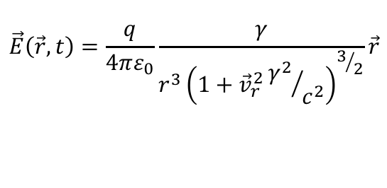
E-field of a moving point charge
Point charge
at rest
Moving
point charge
Relativistic moving
point charge
$$v=\text{const}$$
$$v≈c$$
+
+
+
$$\frac{1}{βγ}$$
$$∇\vec{E}=\frac{ρ}{ε} → \vec{E}\left(\vec{r}\right)=\frac{1}{4πε}\frac{q}{r^{2}}\hat{r}$$
$$\vec{E}\left(\vec{r},t\right)=\frac{q}{4πε_{0}}\frac{γ}{{r^{3}\left(1+{\vec{v}}_{r}^{2}{γ^{2}}/{c^{2}}\right)}^{3/2}}\vec{r}$$
A relativistic moving charge
has a “pancake”-like EM-field
  Only Transverse Electric Magnetic (TEM) field components
    almost no longitudinal field components
$$β=\frac{v}{c}≈1$$
$$E_{z}^{’}=γE_{z}$$

Slide 7
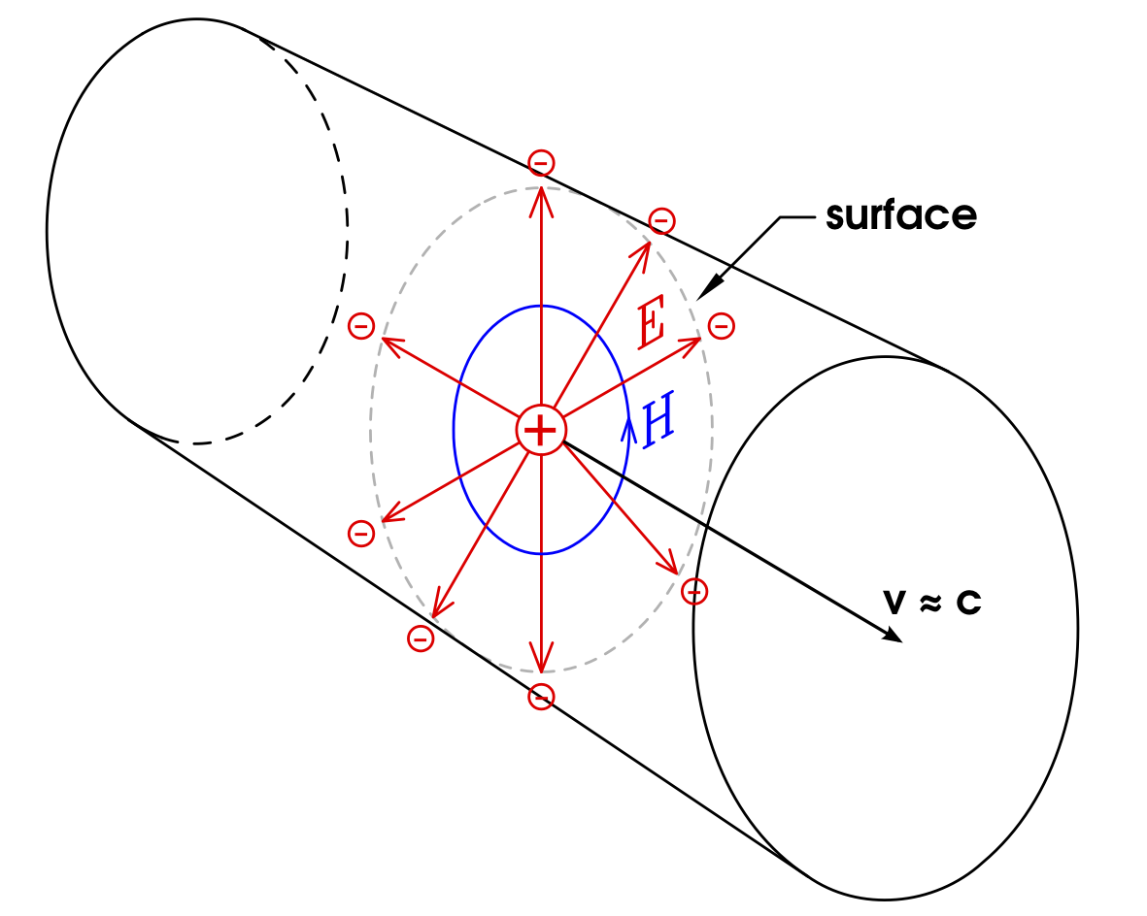

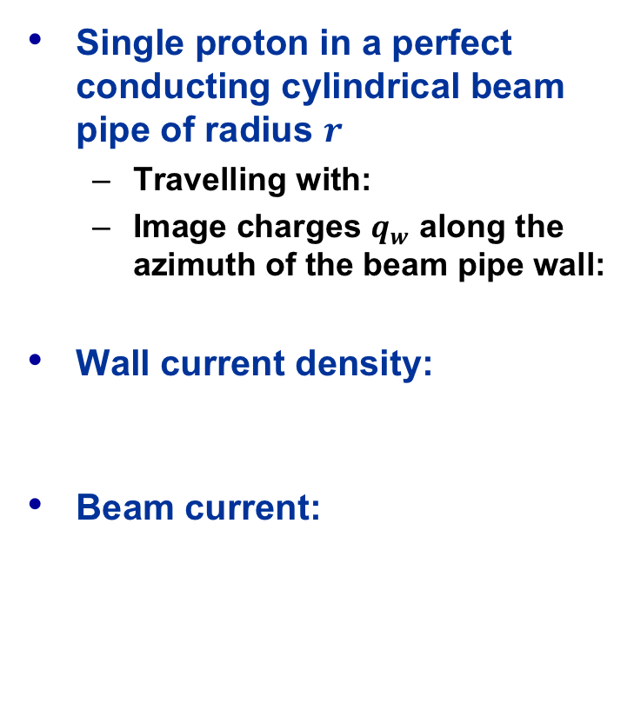
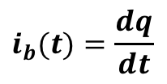
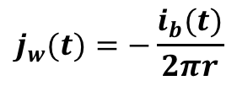




Wall current
Single proton in a perfect conducting cylindrical beam pipe of radius $r$
  Travelling with:
  Image charges $q_{w}$ along the azimuth of the beam pipe wall:
Wall current density:
Beam current:
$q_{w}$
$$β=\frac{v}{c}≈1$$
$q$
$$q=−q_{w}$$
$$j_{w}(t)=−\frac{i_{b}(t)}{2πr}$$
$$i_{b}(t)=\frac{dq}{dt}$$
$$q=Ne$$

Slide 8
Electrostatic Beam Monitor
courtesy O.R. Jones
R
V
+
-
+
-
-
+
-
+
-
+
-
-
+
-
+
-
+
-
+
-
-
+
-
+
-
+
-
+
-
+
-
+
-
-
-
+
+
-
-
+
+
-
-
-
-
+
-
+
-
+
-
-
+
-
+
-
+
-
-
+
-
-
-
-
-
+
-
+
-
+
-
-
+
-
+
-
+
-
+
-
+
+
+
+
-
+
-
-
+
-
+
+
+
+
+
+
+
+
+
+
+
+
+
+
+
+
+
+
+
+
+
+
+
+
+
+
+
+
+
+
+
+
+
+
+
+
+
+
+
+
+
+
+
+
+
+
+
+
+
+
+
+
+
+
+
+
+
+
+
+
+
+
+
+
+
+
+
+
+
+
+
+
+
+
+
+
+
+

Slide 9

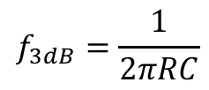
Beam response – High-pass
courtesy O.R. Jones
$$f_{3dB}=\frac{1}{2πRC}$$
Response (V)
C
0
0
Frequency (Hz)
R
V
$$v_{b}∝i_{b}$$
+
+
+
+
+
+
+
+
+
+
+
+
+
+
+
+
+
+
+
+
+
+
+
+
+
+
+
+
+
+
+
+
+
+
+
+
+
+
+
+
+
+
+
+
+
+
+
+
+
+
+
+
+
+
+
+
+
+
+
+
+
+
+
+
+
+
+
+
+
+
+
+
+
+
+
+
+

Slide 10
Electrostatic BPM
courtesy O.R. Jones
R
V
-
+
-
+
-
-
+
-
+
-
+
-
-
+
-
+
-
+
-
+
-
-
+
-
+
-
+
-
+
-
+
-
-
+
-
+
+
-
-
-
-
+
-
+
-
-
-
-
+
+
-
+
-
-
+
-
+
-
-
-
-
-
-
-
-
-
+
-
+
+
-
+
+
-
+
-
-
+
-
+
-
+
-
+
-
+
+
+
+
-
+
-
-
+
-
+
+
+
+
+
+
+
+
+
+
+
+
+
+
+
+
+
+
+
+
+
+
+
+
+
+
+
+
+
+
+
+
+
+
+
+
+
+
+
+
+
+
+
+
+
+
+
+
+
+
+
+
+
+
+
+
+
+
+
+
+
+
+
+
+
+
+
+
+
+
+
+
+
+
+
+
+
+
+
+
-
+
+
-
+
+
-
-
-
-
+
-
-
+
-
-
+
+
+
-
-
+
-
+
+
-
-
-
+
-
+
-
-
-
-
-
-
+
-
+
+
+
+
-
+
-
-
+

Slide 11
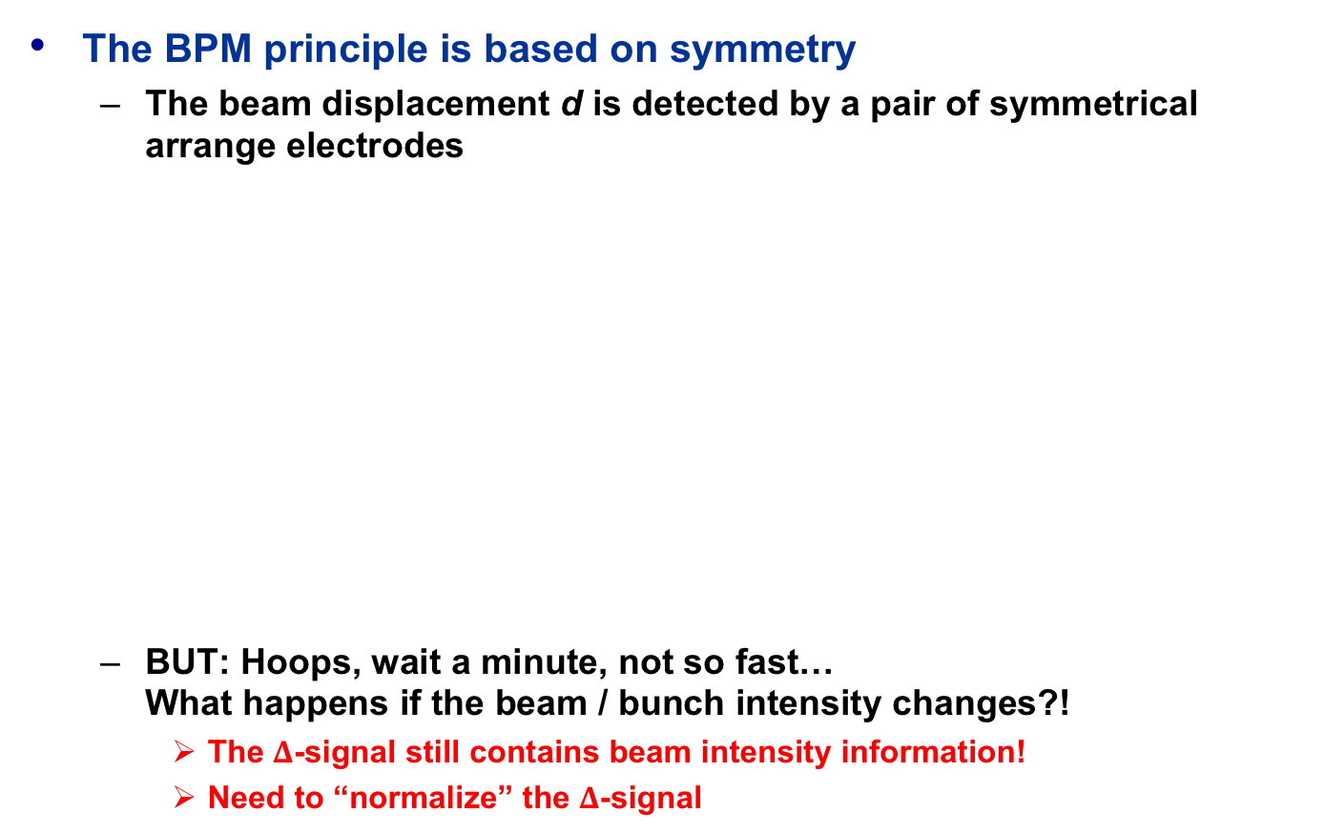

Beam Position Monitor Principle
The BPM principle is based on symmetry
  The beam displacement d is detected by a pair of symmetrical arrange electrodes
  BUT: Hoops, wait a minute, not so fast…
  What happens if the beam / bunch intensity changes?!
    The $Δ$-signal still contains beam intensity information!
    Need to “normalize” the $Δ$-signal
courtesy
O.R. Jones
$$Δ∝pos×int$$
d
–
=

Slide 12
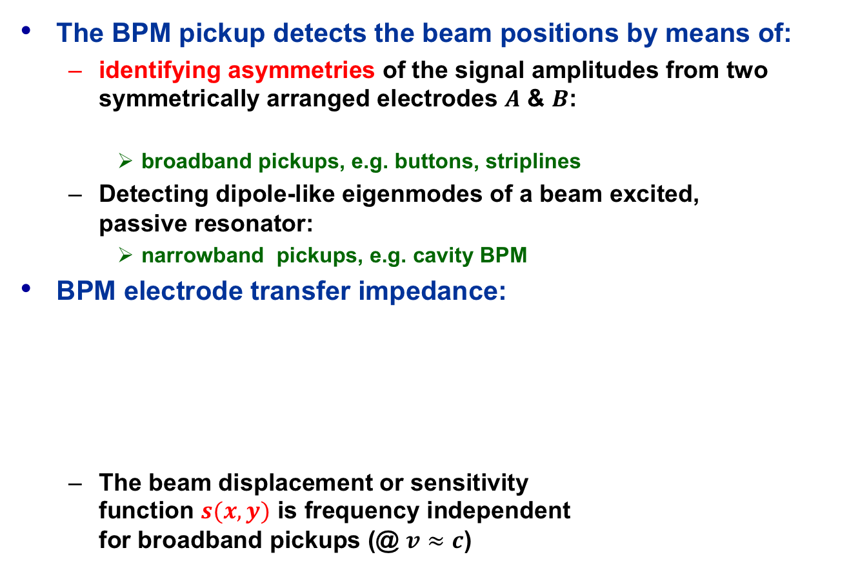


EM Pickup for Beam Position Measurements
The BPM pickup detects the beam positions by means of:
  identifying asymmetries of the signal amplitudes from two symmetrically arranged electrodes $A$ & $B$:
    broadband pickups, e.g. buttons, striplines
  Detecting dipole-like eigenmodes of a beam excited,
  passive resonator:
    narrowband pickups, e.g. cavity BPM
BPM electrode transfer impedance:
  The beam displacement or sensitivity
  function $s(x,y)$ is frequency independent
  for broadband pickups (@ $v≈c$)
$$\text{norm}\text{. }\text{beam} \text{pos}.∝\frac{A−B}{A+B}$$
$$V_{elec}\left(x,y,ω\right)=s\left(x,y,ω\right)Z(ω)I_{b}(ω)$$
beam position
beam intensity
applies only for
resonant pickups
frequency depending
transfer impedance
of the BPM electrode

Slide 13
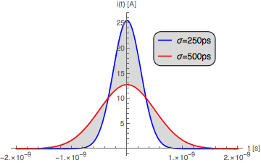




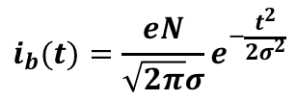


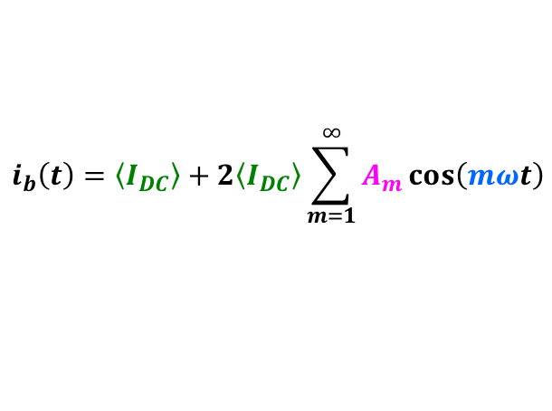



Beam Current Signals
$$i_{b}(t)=\frac{eN}{\sqrt{2π}σ}e^{−\frac{t^{2}}{2σ^{2}}}$$
Single bunch with Gaussian
distribution of the particles (long.)
  Number of particles:
  Bunch length (time):
Bunches spaced by an equidistant time $T$
  Fourier series expansion:
  Average beam current:
  Frequency harmonics
  spaced by:
  Time distance:
    Note: Understand the integration
    time of the BPM electronics
  Harmonic amplitude factor:
$$N$$
$$σ$$
$$i_{b}\left(t\right)=\left\langle I_{DC}\right\rangle +2\left\langle I_{DC}\right\rangle \sum_{m=1}^{∞}{A_{m}\cos\left(mωt\right)}$$
$$\left\langle I_{DC}\right\rangle =\frac{eN}{T}$$
$$i_{b}(t)$$
$$T$$
$$ω=2πf$$
amplitude
$$T=\frac{2π}{ω}$$
time
$$A_{m}=⋯$$

Slide 14
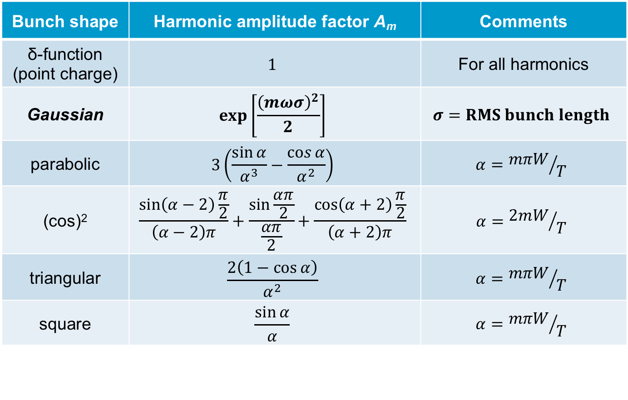
Beam Signals: Harmonic Amplitude Factors
Bunch shape | Harmonic amplitude factor A_{m} | Comments
δ-function (point charge) | $$1$$ | For all harmonics
Gaussian | $$\exp\left[\frac{{\left(mωσ\right)}^{2}}{2}\right]$$ | $$σ=RMS bunch length$$
parabolic | $$3\left(\frac{\sin{α}}{α^{3}}−\frac{\cos{α}}{α^{2}}\right)$$ | $$α={mπW}/T$$
(cos)² | $$\frac{\sin\left(α−2\right)\frac{π}{2}}{\left(α−2\right)π}+\frac{\sin{\frac{απ}{2}}}{\frac{απ}{2}}+\frac{\cos\left(α+2\right)\frac{π}{2}}{\left(α+2\right)π}$$ | $$α={2mW}/T$$
triangular | $$\frac{2\left(1−\cos{α}\right)}{α^{2}}$$ | $$α={mπW}/T$$
square | $$\frac{\sin{α}}{α}$$ | $$α={mπW}/T$$
$${\text{Normaization}: A}_{m}→1 \text{for} ω→0 T:\text{bunch} \text{period} W:\text{bunch} \text{lenght} \text{at} \text{base}$$

Slide 15
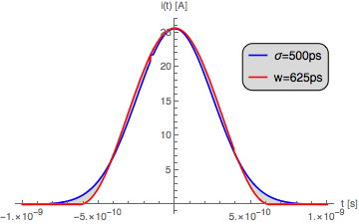
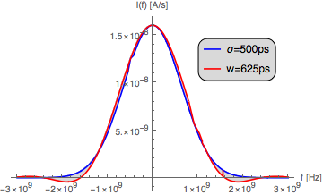
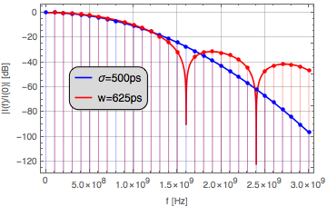
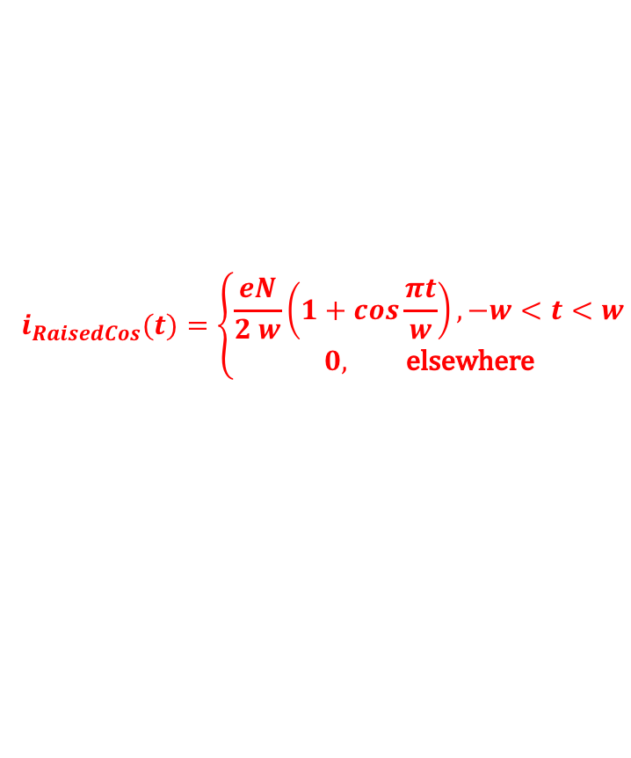

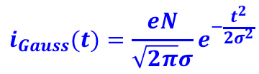
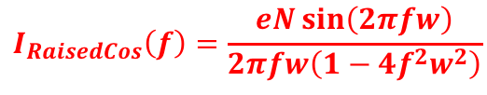
Beam Signal Frequency Response
Use Fourier transformation
  instead of Fourier series expansion with infinite sums
Examples: Gaussian and raised cosine (cos²) pulse
  Time domain
Frequency domain
$$i_{Gauss}(t)=\frac{eN}{\sqrt{2π}σ}e^{−\frac{t^{2}}{2σ^{2}}}$$
$$I_{Gauss}(f)={eN e}^{−2{\left(πfσ\right)}^{2}}$$
$$i_{RaisedCos}(t)=\left\{\begin{aligned}\frac{eN}{2 w}\left(1+\cos{\frac{πt}{w}}\right), −w<t<w \\ 0, \text{elsewhere}\end{aligned}\right.$$
$$I_{RaisedCos}\left(f\right)=\frac{eN\sin\left(2πfw\right)}{2πfw\left(1−4f^{2}w^{2}\right)}$$
Frequency domain
log₁₀[magn.(f))/log₁₀[magn.(0)]
Time domain (N=10¹¹)
Frequency domain

Slide 16
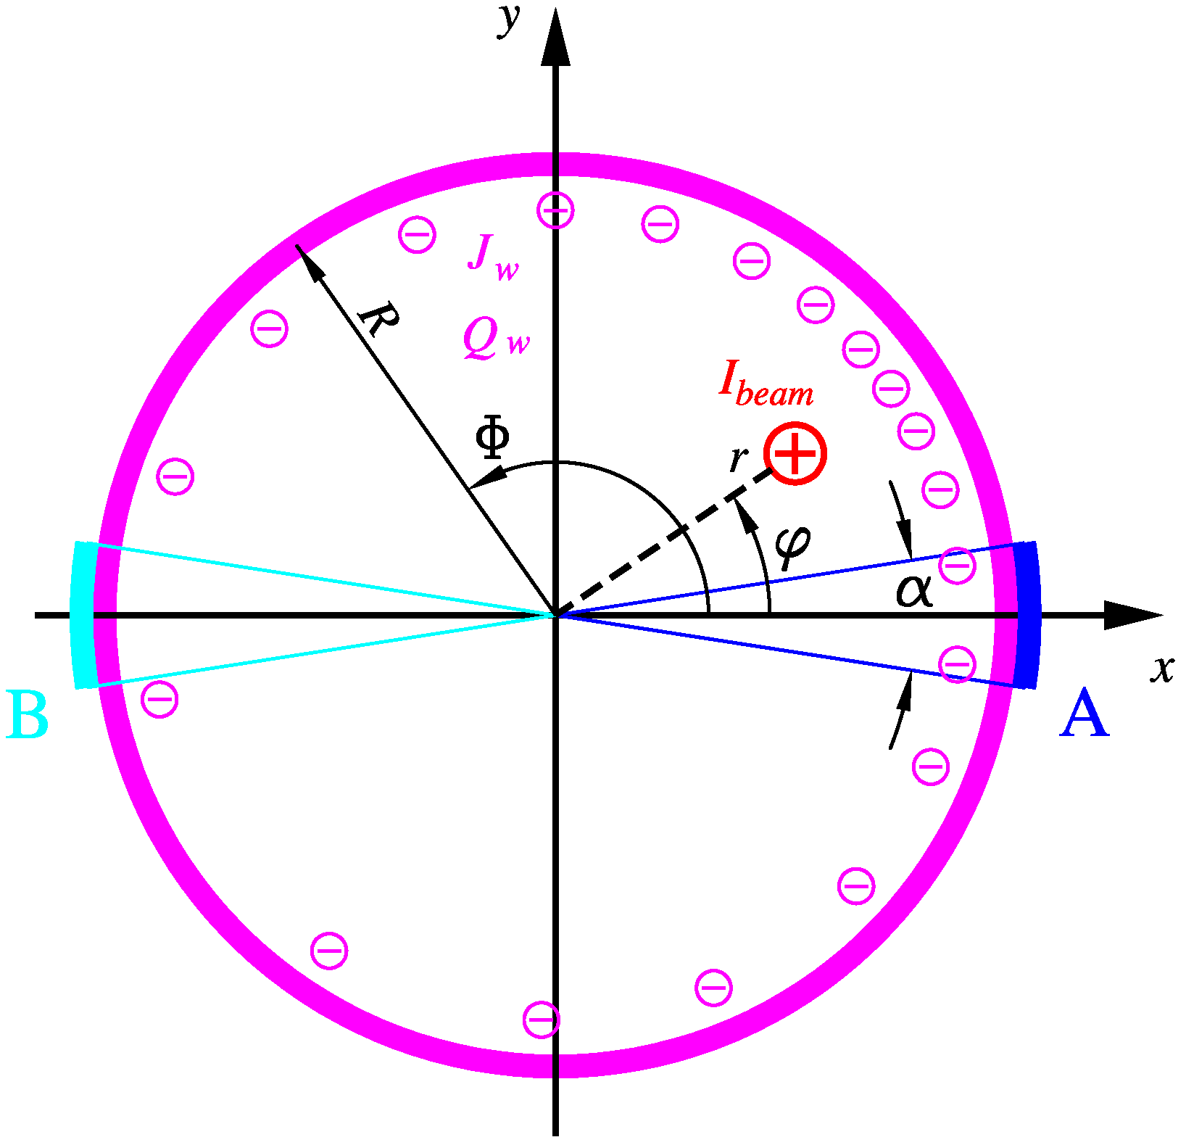
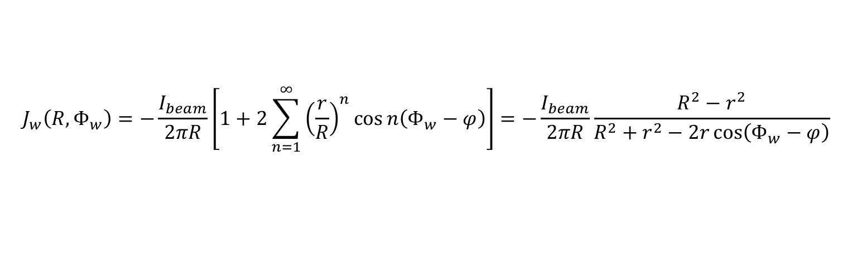
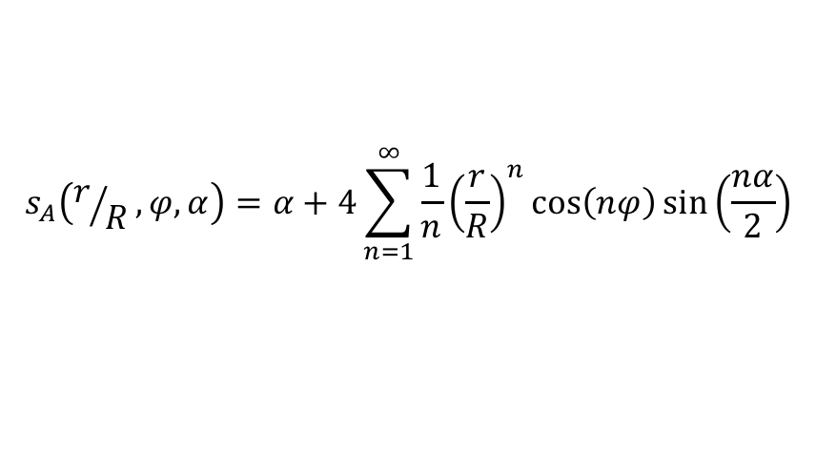
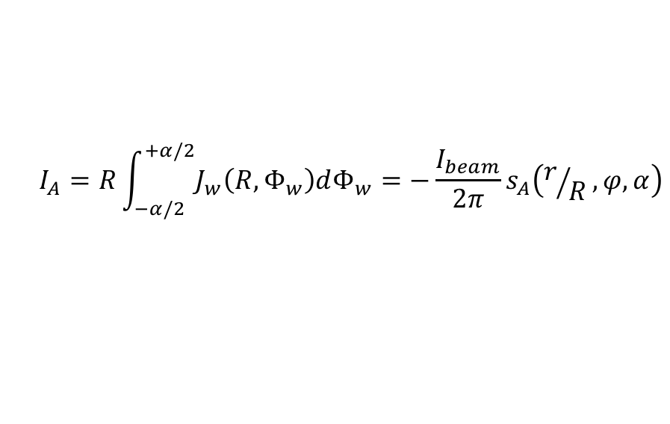
More on Image Charges and Image Currents
Relativistic beams v ≈ c:
  Electrostatic problem of a line charge in a conductive circular cylinder
Solution based on the image charge method:
  Image current density
  Image current integrated on BPM electrode A
  Similar solution for electrode B
  or for vertically arranged electrodes
$$J_{w}\left(R,Φ_{w}\right)=−\frac{I_{beam}}{2πR}\left[1+2\sum_{n=1}^{∞}{{\left(\frac{r}{R}\right)}^{n}\cos{n\left(Φ_{w}−φ\right)}}\right]=−\frac{I_{beam}}{2πR}\frac{R^{2}−r^{2}}{R^{2}+r^{2}−2r\cos\left(Φ_{w}−φ\right)}$$
$$I_{A}=R\int_{−α/2}^{+α/2}{J_{w}\left(R,Φ_{w}\right)dΦ_{w}}=−\frac{I_{beam}}{2π}s_{A}\left(r/R,φ,α\right)$$
$$s_{A}\left(r/R,φ,α\right)=α+4\sum_{n=1}^{∞}{\frac{1}{n}{\left(\frac{r}{R}\right)}^{n}\cos\left(nφ\right)\sin\left(\frac{nα}{2}\right)}$$

Slide 17

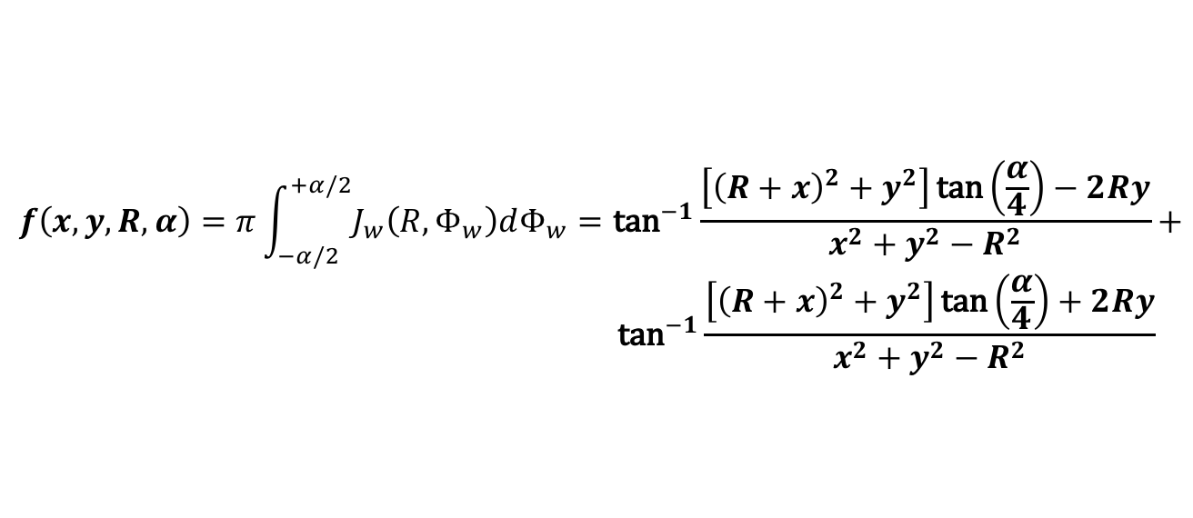



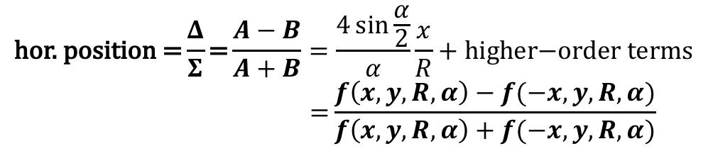
Normalized Beam Position Characteristic
Pair of symmetric horizontal electrodes:
  Horizontal and vertical beam position:
Normalized beam position characteristic Δ/Σ (horizontal):
  Approximation and closed form solution
$$A=I_{A} \text{(}\text{right} \text{electrode}\text{)}$$
$$B=I_{B} \text{(}\text{left} \text{electrode}\text{)}$$
$$x=r\cos{φ}$$
$$y=r\sin{φ}$$
$$\text{hor}\text{. }\text{position}\text{ =}\frac{Δ}{Σ}\text{=}\frac{A−B}{A+B}=\frac{4\sin{\frac{α}{2}}}{α}\frac{x}{R}+\text{higher}\text{−}\text{order} \text{terms} \\ \text{ =}\frac{f\left(x,y,R,α\right)−f(−x,y,R,α)}{f\left(x,y,R,α\right)+f(−x,y,R,α)}$$
$$f\left(x,y,R,α\right)=π\int_{−α/2}^{+α/2}{J_{w}\left(R,Φ_{w}\right)dΦ_{w}}={\text{tan}}^{−1}\frac{\left[{\left(R+x\right)}^{2}+y^{2}\right]\text{tan}\left(\frac{α}{4}\right)−2Ry}{x^{2}+y^{2}−R^{2}}+ \\ {\text{tan}}^{−1}{\frac{\left[{\left(R+x\right)}^{2}+y^{2}\right]\text{tan}\left(\frac{α}{4}\right)+2Ry}{x^{2}+y^{2}−R^{2}}}$$

Slide 18
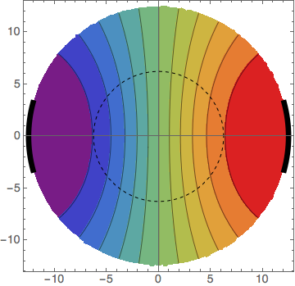
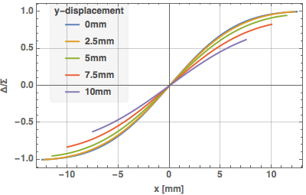
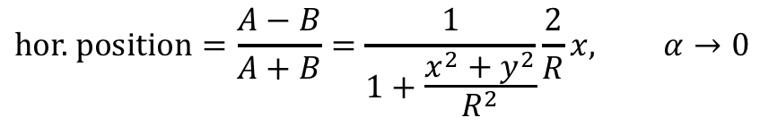
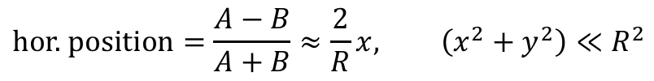
Example
Position characteristic for R = 12.5 mm, α = 30⁰:
Approximations
  Point-like electrodes:
  Small beam positions:
$$\text{hor}\text{. }\text{position}=\frac{A−B}{A+B}=\frac{1}{1+\frac{x^{2}+y^{2}}{R^{2}}}\frac{2}{R}x, α→0$$
$$\text{hor}\text{. }\text{position}=\frac{A−B}{A+B}≈\frac{2}{R}x, \left(x^{2}+y^{2}\right)≪R^{2}$$

Slide 19
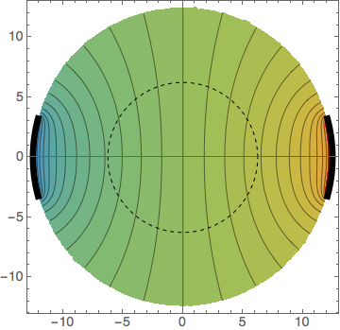
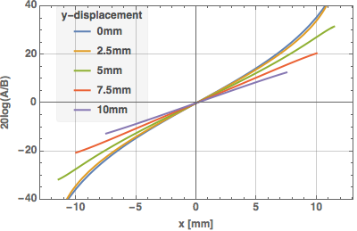
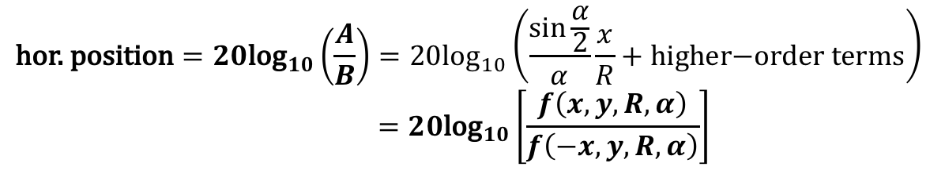
Logarithmic Ratio Normalization
Results in a more linear position characteristic
  The example for R = 12.5 mm, α = 30⁰
  gives a sensitivity of 2.75 dB/mm near the origin
$$\text{hor}\text{. }\text{position}=20{\text{log}}_{10}\left(\frac{A}{B}\right)=20{\text{log}}_{10}\left(\frac{\sin{\frac{α}{2}}}{α}\frac{x}{R}+\text{higher}\text{−}\text{order} \text{terms}\right) \\ =20{\text{log}}_{10}\left[\frac{f\left(x,y,R,α\right)}{f\left(−x,y,R,α\right)}\right]$$

Slide 20
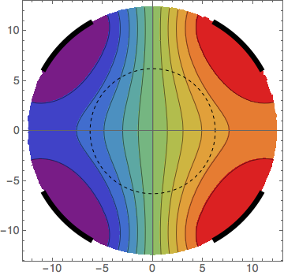
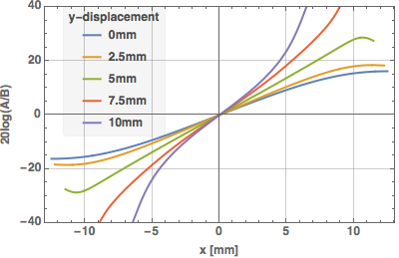
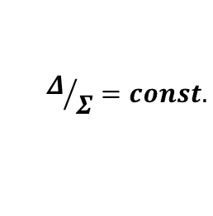
BPM with 45⁰ Rotated Electrodes
Popular in synchrotron light and damping rings, and in the LHC!
  Prevents that sync light, or collision debris, hits the electrodes
    More non-linear position behavior
    Reduced position sensitivity (this example: 1.94 dB/mm)
  Same mathematical procedure, but with coordinate rotation of 45⁰
$$Δ/Σ=const.$$

Slide 21
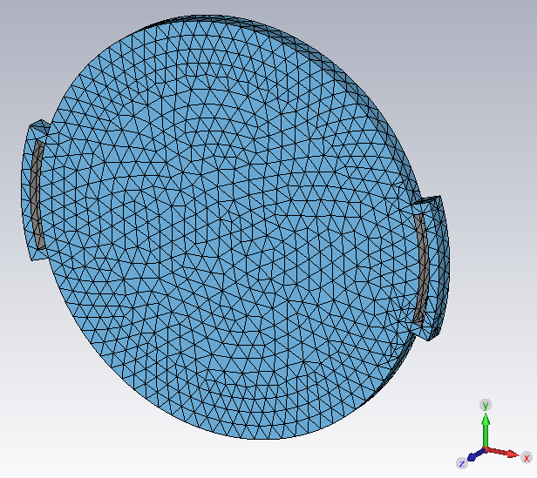
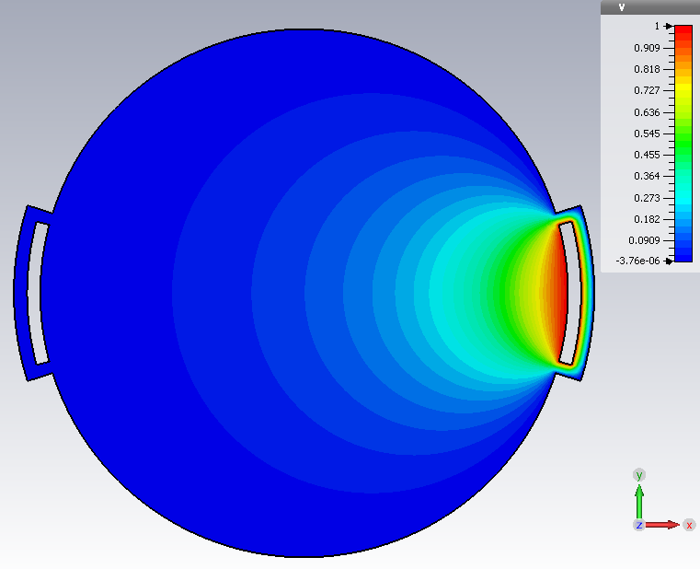


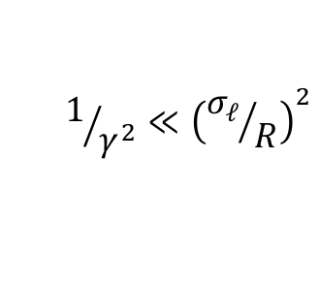


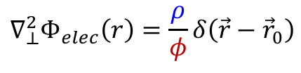
Numerical Analysis (1)
For most button or stripline type BPMs: 2D E-static analysis
  Relativistic beam long bunches
  Solve the 2D E-static potential problem
    BUT: without varying
    for many positions
  Apply Green’s reciprocity theorem
  and solve the Laplace equation in 2D:
$$1/{γ^{2}}≪{\left({σ_{ℓ}}/R\right)}^{2}$$
$$σ_{ℓ}≫R$$
line charge density
$$∇_{⊥}^{2}Φ_{elec}\left(r\right)=\frac{ρ}{φ}δ\left(\vec{r}−{\vec{r}}_{0}\right)$$
$$ρ$$
$$\vec{r}∈\left(x,y\right)$$
potential
$$∇_{⊥}^{2}Φ_{elec}\left(r\right)=0 →Φ_{elec}\left(x,y\right)$$
2D “slice”, prepared with tetrahedral mesh for the numerical analysis
Result of the quasi-2D numerical analysis: equipotentials of the right electrodes

Slide 22
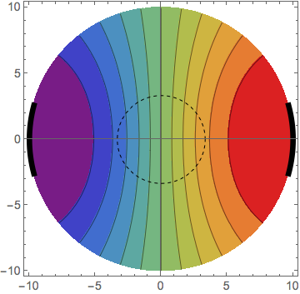
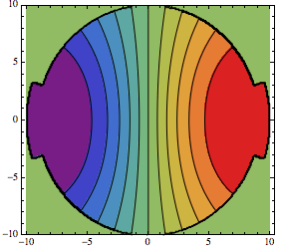
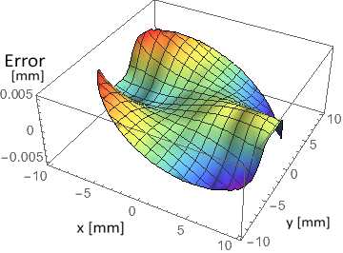
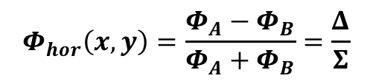

Numerical Analysis (2)
For a horizontal BPM
  Mirror the potential field
  And then combine the fields
    Can be performed for any symmetric arrangement of the electrodes
Comparison:
$${Φ_{elec}\left(x,y\right)=Φ}_{A}\left(x,y\right)=Φ_{B}\left(−x,y\right)$$
$$Φ_{hor}\left(x,y\right)=\frac{Φ_{A}−Φ_{B}}{Φ_{A}+Φ_{B}}=\frac{Δ}{Σ}$$
analytical analysis
numerical analysis
analytical - numerical

Slide 23
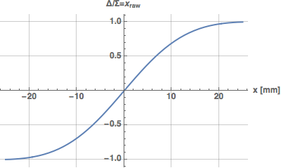
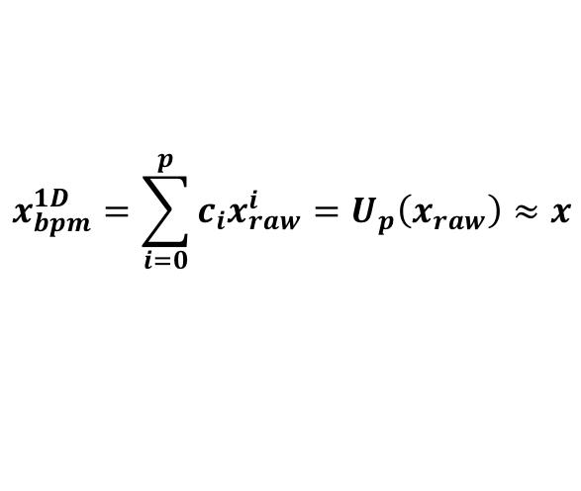
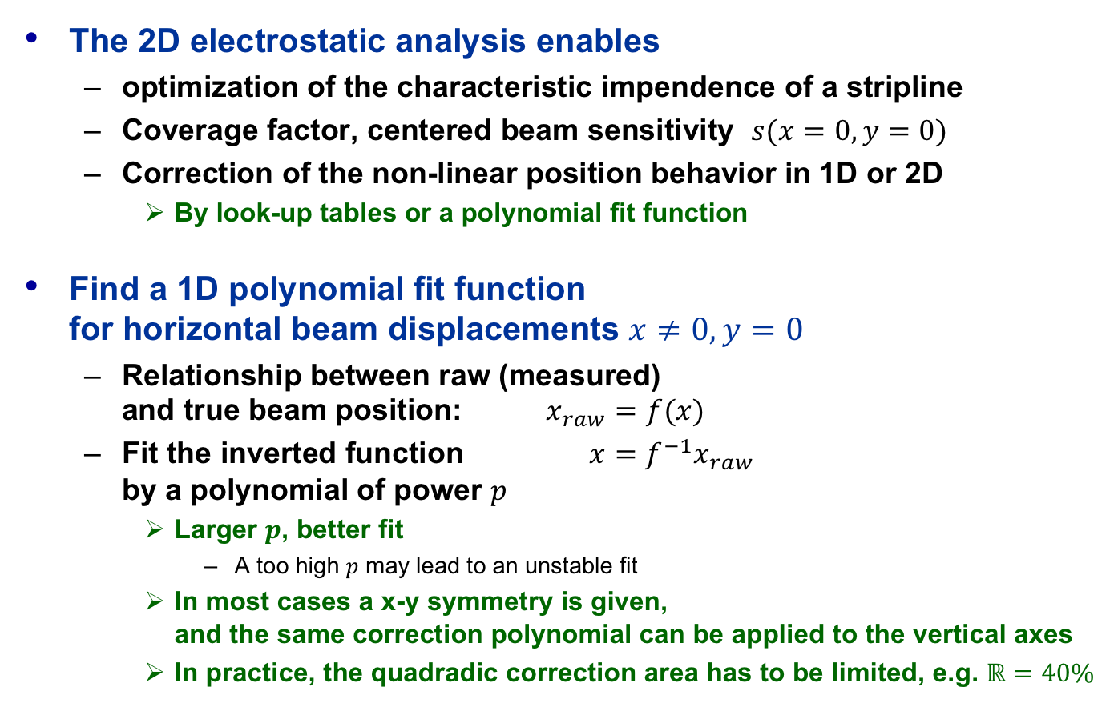
1D Non-linear Correction
The 2D electrostatic analysis enables
  optimization of the characteristic impendence of a stripline
  Coverage factor, centered beam sensitivity $s(x=0,y=0)$
  Correction of the non-linear position behavior in 1D or 2D
    By look-up tables or a polynomial fit function
Find a 1D polynomial fit function
for horizontal beam displacements $x≠0,y=0$
  Relationship between raw (measured)
  and true beam position: $x_{raw}=f(x)$
  Fit the inverted function $x=f^{−1}x_{raw}$
  by a polynomial of power $p$
    Larger $p$, better fit
      A too high $p$ may lead to an unstable fit
    In most cases a x-y symmetry is given,
    and the same correction polynomial can be applied to the vertical axes
    In practice, the quadradic correction area has to be limited, e.g. $ℝ=40\%$
LHC stripline BPM
$$x_{bpm}^{1D}=\sum_{i=0}^{p}{c_{i}x_{raw}^{i}}=U_{p}\left(x_{raw}\right)≈x$$

Slide 24
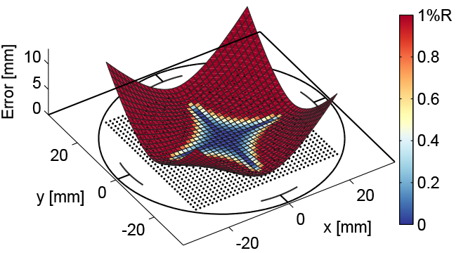
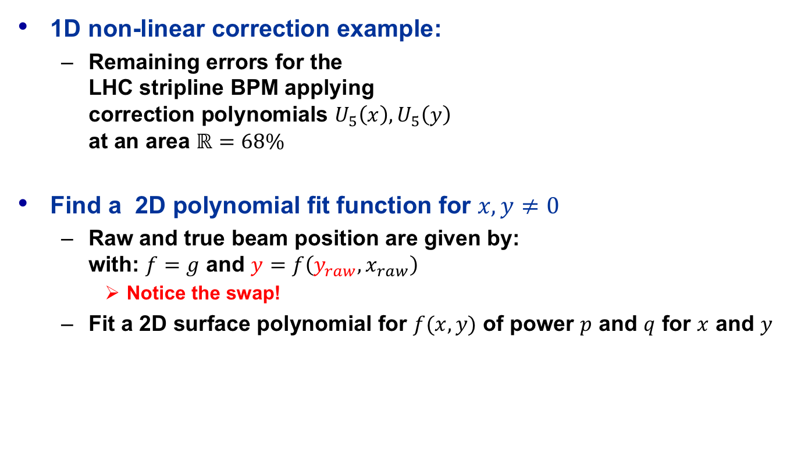
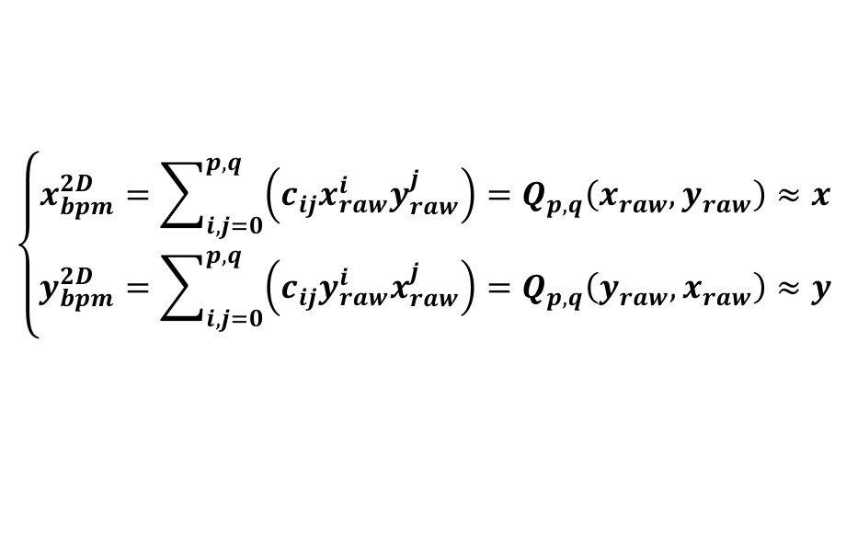
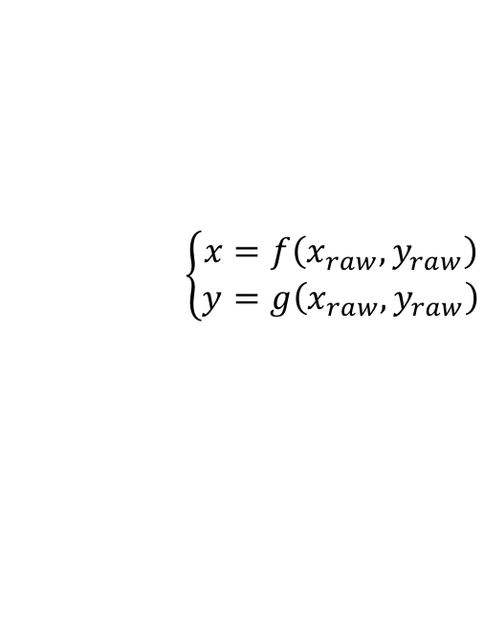
2D Non-linear Correction
1D non-linear correction example:
  Remaining errors for the
  LHC stripline BPM applying
  correction polynomials $U_{5}\left(x\right), U_{5}\left(y\right)$
  at an area $ℝ=68\%$
Find a 2D polynomial fit function for $x,y≠0$
  Raw and true beam position are given by:
  with: $f=g$ and $y=f\left(y_{raw},x_{raw}\right)$
    Notice the swap!
  Fit a 2D surface polynomial for $f(x,y)$ of power $p$ and $q$ for $x$ and $y$
$$\left\{\begin{aligned}x=f\left(x_{raw},y_{raw}\right) \\ y=g\left(x_{raw},y_{raw}\right)\end{aligned}\right.$$
$$\left\{\begin{aligned}x_{bpm}^{2D}=\sum_{i,j=0}^{p,q}{\left(c_{ij}x_{raw}^{i}y_{raw}^{j}\right)=Q_{p,q}\left(x_{raw},y_{raw}\right)≈x} \\ y_{bpm}^{2D}=\sum_{i,j=0}^{p,q}{\left(c_{ij}y_{raw}^{i}x_{raw}^{j}\right)=Q_{p,q}\left(y_{raw},x_{raw}\right)≈y}\end{aligned}\right.$$

Slide 25










Examples for 2D corrections
LHC stripline BPM
  Pin-cushion maps ($ℝ=40\%$)
    For symmetry reasons some cross-terms are 0, or very small (negligible)
  Remaining errors:
$$Q_{3,2}\left(x,y\right),Q_{3,2}(y,x)$$
$$Q_{5,4}\left(x,y\right),Q_{5,4}(y,x)$$
$$Q_{7,6}\left(x,y\right),Q_{5,4}(y,x)$$

Slide 26














Higher Order Moments
Particle<->BPM EM-fields are linear and time-invariant
  Superposition principles apply
  Many particles -> BPM detects (approximately) the center-of-charge
    Point charge $q=eN$
But: Non-linear effects allow the
detection of higher moments:
  Electrode A signal to N particles:
  After some math gym follows:
$$y$$
$$σ_{x},σ_{y}$$
$$y_{beam}$$
$$N$$
$$I_{A}=−\frac{I_{beam}}{2π}\left[α+4\sum_{i=1}^{N}{\sum_{n=1}^{∞}{\frac{1}{n}{\left(\frac{r_{i}}{R}\right)}^{n}\cos\left(nφ_{i}\right)\sin\left(\frac{nα}{2}\right)}}\right]$$
$$B$$
$$α$$
$$A$$
$$x_{beam}$$
$$x$$
$$R$$
monopole moment $∝$ intensity (common mode)
$$I_{A}=−\frac{I_{beam}}{π}\left[\frac{α}{2}+\frac{2}{R}\sin\left(\frac{α}{2}\right)x_{beam}+\frac{1}{R^{2}}\sin\left(α\right)\left(σ_{x}^{2}−σ_{y}^{2}+x_{beam}^{2}−y_{beam}^{2}\right)+⋯\right]$$
dipole moment $∝$ position/$R$
quadrupolar moment $∝$ ($Δsize$+$Δ$pos)/$R^{2}$

Slide 27

Effects of the Beam Size
courtesy M. Bozzolan

Slide 28










BPM with Linear Position Response
Split-plane tube electrode
  radius:
  length:
A beam of
  charge: , position:
induces an image charge
on the electrode:
  with a linear position response
$$R$$
$$ℓ\left(Φ_{w}\right)=ℓ(1+\cos{Φ_{w})}$$
A
electrode
$$q_{b}$$
$$(r, φ)$$
$$2R$$
B
electrode
$$Q_{elec}={−q}_{b}ℓ\int_{0}^{2π}{\frac{\left(1+\cos{Φ_{w}}\right)\left(R^{2}+r^{2}\right)}{R^{2}+r^{2}−2Rr\cos\left(Φ_{w}−φ\right)}dΦ_{w}}$$
$$2ℓ$$
$$Q_{elec}={−q}_{b}ℓ\left(1+\frac{r\cos{φ}}{R}\right)={−q}_{b}ℓ\left(1+\frac{x}{R}\right)$$
$$⟹ \text{hor}\text{. }\text{position}=\frac{Δ}{Σ}=\frac{A−B}{A+B}=\frac{x}{R}$$

Slide 29






“Shoe-box” BPM
Split-plane
(“shoe-box”) BPM
with ground-guards
  Improved sensitivity and
  reduced cross-talk
  Improved linearity
without
with
ground guards
courtesy P. Kowina
$$V_{left}=\left(a+x\right)\tan{α}$$
$$V_{right}=\left(a−x\right)\tan{α}$$
$$x=a\frac{V_{right}−V_{left}}{V_{right}+V_{left}}=\frac{Δ}{Σ}$$

Slide 30
Spit-Plane BPM
Pros
  Linear position response
    No correction for non-linearities required, simple analog read-out electronics without post-processing
  high transfer impedance at low frequencies
    Good match for long bunches, low-β beam
    High signal levels, allows operation at low frequencies with high load impedance
Cons
  Complicated mechanics, requires sufficient real-estate
  High capacitive source impedance, reflective
  Eigenmodes at low frequencies, high beam coupling impedance
    Limited to low frequency operation, typically <300 MHz

Slide 31


“Shoe-box” BPM Example
Technical realization at the HIT synchrotron of 46 m length for 7 MeV/u→ 440 MeV/u
BPM clearance: 180x70 mm², standard beam pipe diameter: 200 mm.

Slide 32
















Button BPM Equivalent Circuit
$$Z_{0}$$
$$R_{load}$$
$$w_{g}$$
$$t_{b}$$
$$I_{beam}$$
$$V_{button}$$
$$C_{button}$$
$$r_{pipe}$$
typically
50 Ω
$$Z_{button}\left(ω\right)=\frac{V_{button}(ω)}{s\left(x,y\right)I_{beam}(ω)}=φR_{load}\frac{ω_{1}}{ω_{2}}\frac{{jω}/{ω_{1}}}{1+{jω}/{ω_{1}}}$$
$$r_{b}$$
$$ω_{1}=\frac{1}{R_{load}C_{button}}$$
$$ω_{2}=\frac{c}{{2r}_{button}}$$
$$φ=\frac{r_{button}}{{4r}_{pipe}}=s(x=0, y=0)$$
coverage
factor
time constant
1/electrode transit time
Increase | Effect
d_{button} (larger area & C_{button}) | Higher signal level Lower resolution
t_{button} (larger volume) | Lower wake impedance Lower resolution, higher weight
w_{gap} (more trapped modes) | Higher resolution Higher wake impedance
button capacitance, very simplified
typically 2…15 pF
$$C_{button}≈\frac{2πε_{0}}{\ln\left(\frac{r_{button}+w_{gap}}{r_{button}}\right)}t_{button}+⋯$$

Slide 33

Button BPM
Pros
  Robust simple construction, cost effective, minimum real-estate
    RF UHV feedthrough and button is a single element
Cons
  High-pass characteristic with high cut-off frequency
    Typically >= 500 MHz,
    bad match to operate with long bunches, or at low frequencies
  Capacitive source impedance, reflective

Slide 34




Examples of Button BPMs
LHC Button BPM
(CERN)
ATF Button BPM (KEK)
NSLS-II Button BPM (BNL)
TTFII Button BPM (DESY)
located inside an undulator magnet

Slide 35



Stripline or Directional Coupler BPM
$$ℓ$$
beam
upstream
ports
$$w$$
Pair of symmetrical
arranged
strip-lines
upstream
ports

Slide 36

Stripline BPM
Strip transmission-line of characteristic impedance Z₀ = 50 Ω
No dielectric materials (ε_{r} = 1, vacuum)
  TEM fields of the signal, except near the transition at the ports
Coupling to the TEM field of the beam
  Electric and magnetic field coupling
Only the upstream port
delivers a beam signal!
  Directional coupler
Both ports are terminated
  Sometimes the downstream
  port is shorted to ground
    No directivity

Slide 37













Stripline BPM Principle (1)
+
$$v≈c$$
$$t=0$$
$$v_{s}≈c$$
$$v_{s}≈c$$
stripline $Z_{0}$
-
upstream
port
downstream
port
$$R_{load} \\ =Z_{0}$$
upstream line $Z_{0}$
$$ℓ$$
$$t=\frac{ℓ}{c}$$
+
$$v≈c$$
$$v_{s}≈c$$
-
$$v_{s}≈c$$
$$ℓ$$
$$ℓ$$

Slide 38







Stripline BPM Principle (2)
$$t=2\frac{ℓ}{c}$$
$$v_{s}≈c$$
$$ℓ$$
$$v_{s}≈c$$
$$2ℓ$$
annihilation
$$t$$
Stripline BPM response:
  δ-doublet pulse,
  space by $t=2ℓ/c$
$$2\frac{ℓ}{c}$$

Slide 39
Operational Principle: Beam from Left
+
+
+
+
+
Upstream Port (term.)
Downstream Port (term.)
Up
Down

Slide 40
Operational Principle: Beam from Right
+
+
+
+
+
Downstream Port (term.)
Upstream Port (term.)
Down
Up

Slide 41











Transfer Impedance
Time domain impulse response: δ-doublet pulse
Frequency domain transfer impedance
  Lobes at:
  3dB lobe bandwidth:
characteristic impedance
typically 50 Ω
$$z\left(t\right)=φ\frac{Z_{0}}{2}\left[δ\left(t\right)−δ\left(t−2\frac{ℓ}{c}\right)\right]$$
amplitude
$$δ(0)$$
coverage
factor
time
$$2\frac{ℓ}{c}$$
$$−δ\left(2\frac{ℓ}{c}\right)$$
$$Z\left(ω\right)=jφZ_{0}e^{j\frac{π}{2}}e^{−jω\frac{ℓ}{c}}\sin\left(ω\frac{ℓ}{c}\right)$$
$$Z_{0}=50Ω, ℓ=100 mm, φ=0.1$$
$$f_{c}=\left(2n−1\right)\frac{c}{4ℓ}$$
$$f_{lo}=\frac{f_{c}}{2}$$
$$f_{BW}=f_{hi}−f_{lo}=f_{c}$$
$$f_{hi}=3 f_{lo}$$

Slide 42
Stripline BPM
Pros
  Well defined, and high transfer impedance function
    For striplines with l >> w, TEM operation
    Can be “tuned” to match a dominant beam frequency
      Optimizing the length of the stripline
  Matched characteristic impedance with 50 Ω source
    Only for terminated ports
      Shorted downstream port: 0 Ω source, no directivity
    Reduced reflection effects between generator (stripline BPM)
    and read-out electronics!
  Directivity
    Separate beam position measurement of counter-rotating beams
      e.g. near the IP in a ring collider
Cons
  Complicated, fragile mechanics, high costs, requires sufficient real-estate
    More RF feedthroughts required, impedance control of the stripline, strip-electrode may require a support structure

Slide 43




Examples of Stripline BPMs
Stripline BPM
FLASH (DESY)
Stripline BPM
SNS (ORNL)
Ceramic posts
hold the electrode
Impedance Match
at the post
Inner-shielding bar
reduces electrode
to electrode
coupling
Stripline BPM
LHC (CERN)
Stripline BPM
inside a quad
FLASH (DESY)

Slide 44




Bunch Signals from broadband BPMs
Button BPM output signal to a Gaussian bunch
Stripline BPM output signal to a Gaussian bunch
  at the upstream port
$$v_{button}\left(t\right)≈\frac{A_{button}R_{load}}{πr_{pipe}βc}\frac{di_{beam}\left(t\right)}{dt}$$
$$=\frac{r_{button}^{2}R_{load}}{2r_{pipe}βc}\frac{eN}{\sqrt{2π}σ^{3}}te^{−\frac{t^{2}}{2σ^{2}}}$$
$$v_{{strip}_{up}}\left(t\right)≈\frac{φZ_{0}}{2}\frac{eN}{\sqrt{2π}σ}\left\{\text{exp}\left[−\frac{{\left(t+τ\right)}^{2}}{2σ^{2}}\right]−\text{exp}\left[−\frac{{\left(t−τ\right)}^{2}}{2σ^{2}}\right]\right\} \\ \text{with}: τ=\frac{ℓ}{2c}\left(\frac{1}{β}+\frac{1}{β_{strip}}\right) \\ { Z}_{0}=R_{load}=50 Ω$$

Slide 45


Limits of the Analytical Analysis
Stripline BPM response in the frequency domain
No closed form expression which includes important details
  high frequency effects a the feedthrough transition
  attenuation and dispersion of long coaxial cables
  effects of low-β beams
Numerical analysis of the EM problem
  With a beam field as stimulus signal
$$V_{strip_{up}}\left(ω\right)≈\sqrt{2}φZ_{0} \frac{eN}{T}A\left(ω\right)\sin\left[\frac{ωℓ}{2c}\left(\frac{1}{β}+\frac{1}{β_{strip}}\right)\right] \\ \text{with}:A\left(ω\right)=\text{exp}\left(−\frac{ω^{2}σ^{2}}{2}\right) \\ T=\frac{1}{f}=\frac{2π}{ω}$$

Slide 46








Numerically generated BPM Signals
$$r_{pipe}=12.5mm \\ r_{button}=5mm$$
Gaussian bunch:
  $N=6.24e8, σ_{s}=25mm, β=1$
  vertical beam offset=1mm
BPM sensitivity:
  e.g.: 2.7 dB / mm
Sensitivity:
2.7 dB/mm
$$r_{pipe}=12.5mm \\ ℓ_{strip}=100mm \\ φ=0.1$$

Slide 47








Resonant Cavity BPM
Based on a beam-excited, passive resonator
  Often a cylindrical “pillbox” cavity is used
  Operating on the TM110 dipole-eigenmode offers a higher resolution potential than comparable broadband BPMs (button, stripline).
    No common-mode $Σ$ signal, only a difference $Δ$ signal
    High transfer impedance, typically in the kΩ/mm range
courtesy
D. Lipka
TM010
(monopole)
TM110
(dipole)
TM020
(monopole)
$$v_{sig}∝i_{beam}$$
$$v_{sig}∝i_{beam}∙r$$
$$v_{sig}∝i_{beam}$$

Slide 48












Towards a Cavity BPM…
Eigenmodes in a brick-style resonator
  1st step towards a cavity BPM
  Unfortunately you need to go through the math
  of the modal expansion of the vector potential $Ψ$…😰
Laplace equation:
$$k_{0}^{2}=ω^{2}ε_{0}μ_{0}$$
$$k_{0}: free space wave number$$
$$ΔΨ+k_{0}^{2}ε_{r}μ_{r}Ψ=0$$
$$k_{0}={2π}/{λ_{0}}$$
$$λ_{0}: free space wave length$$
Product ansatz (Cartesian coordinates):
$$Ψ=X\left(x\right)Y\left(y\right)Z(z)$$
b
c
standing
waves
General solution (field components):
a
$$Ψ=\left\{\begin{aligned}A\cos\left(k_{x}x\right)+B\sin\left(k_{x}x\right) \\ \acute{A}e^{−jk_{x}x}+\acute{B}e^{−jk_{x}x}\end{aligned}\right\}\left\{\begin{aligned}C\cos\left(k_{y}y\right)+D\sin\left(k_{y}y\right) \\ \acute{C}e^{−jk_{y}y}+\acute{D}e^{−jk_{y}y}\end{aligned}\right\}\left\{\begin{aligned}E\cos\left(k_{z}z\right)+F\sin\left(k_{z}z\right) \\ \acute{E}e^{−jk_{z}z}+\acute{F}e^{−jk_{z}z}\end{aligned}\right\}$$
separation condition:
$$k_{x}=\frac{mπ}{a}$$
$$k_{y}=\frac{nπ}{b}$$
$$k_{z}=\frac{pπ}{c}$$
travelling
waves
$$k_{x}^{2}+k_{y}^{2}+k_{z}^{2}=k_{0}^{2}ε_{r}μ_{r}$$
$$f_{mnp}=\frac{c_{0}}{2πε_{r}μ_{r}}\sqrt{{\left(\frac{mπ}{a}\right)}^{2}+{\left(\frac{nπ}{b}\right)}^{2}+{\left(\frac{pπ}{c}\right)}^{2}}$$
Eigen frequencies:

Slide 49










Cylindrical “Pillbox” Cavity Resonator
Same procedure, but now with cylindrical functions 😢😢
Product ansatz (cylindrical coordinates):
$$Ψ=R\left(ρ\right)F\left(φ\right)Z(z)$$
$$φ$$
standing
waves
$$R$$
$$h$$
General solution (field components):
$$Ψ=\left\{\begin{aligned}A J_{m}\left(k_{r}ρ\right)+B N_{m}(k_{r}ρ) \\ \acute{A}H_{m}^{\left(2\right)}(k_{r}ρ)+\acute{B}H_{m}^{\left(2\right)}(k_{r}ρ)\end{aligned}\right\}\left\{\begin{aligned}C\cos\left(mφ\right)+D\sin\left(mφ\right) \\ \acute{C}e^{−jmφ}+\acute{D}e^{−jmφ}\end{aligned}\right\}\left\{\begin{aligned}E\cos\left(k_{z}z\right)+F\sin\left(k_{z}z\right) \\ \acute{E}e^{−jk_{z}z}+\acute{F}e^{−jk_{z}z}\end{aligned}\right\}$$
$J_{m}$, $N_{m}, H_{m}^{(1,2)}: cylindical functions \left(Bessel, Hankel, Neumann\right)$
^{(1,2)}see Abramowitz and Stegun
travelling
waves
separation condition:
Eigen frequencies:
$$k_{r}^{2}+k_{z}^{2}=k_{0}^{2}ε_{r}μ_{r}$$
$$f_{TMmnp}=\frac{c_{0}}{2πε_{r}μ_{r}}\sqrt{{\left(\frac{j_{mn}}{R}\right)}^{2}+{\left(\frac{pπ}{h}\right)}^{2}}$$
$$j_{mn} being the n^{th}root of J_{m}(x)$$
$$f_{TEmnp}=\frac{c_{0}}{2πε_{r}μ_{r}}\sqrt{{\left(\frac{j_{mn}^{′}}{R}\right)}^{2}+{\left(\frac{pπ}{h}\right)}^{2}}$$
$$j_{mn}^{′}being the n^{th}root of J_{m}^{′}(x)$$

Slide 50









Cavity BPM
Beam couples to:
dipole (TM₁₁₀) and
monopole (TM₀₁₀)
& other modes
Common mode (TM₀₁₀) frequency discrimination
Decaying RF signal response
  Position signal: TM₁₁₀
    Requires normalization and a phase reference
  Intensity signal: TM₀₁₀
$$E_{z}=C J_{1}\left(\frac{j_{11}r}{R}\right)e^{iωt}\cos{φ}$$
$$f_{010}$$
$$f_{110}$$
time domain
bunch response
$$r_{pipe}=12.5mm \\ r_{cav}=100mm \\ ℓ_{cav}=10mm$$

Slide 51





Common-mode free Cavity BPMs
monopole mode
dipole mode
courtesy
D. Lipka
Add slot-coupled waveguide TE₀₁-mode high-pass filter
between cavity and coaxial output port.
  Finite Q of TM₀₁₀ still leaks into TM₁₁₀!
The dipole mode has two polarizations
  which will orientate along imperfections, or as wanted along the coupling slots
    Requires tight tolerances to minimize
    x-y cross talk
$$f_{010} < f_{10}=\frac{1}{2a\sqrt{εμ}} < f_{110}$$

Slide 52
Cavity BPM
Pros
  No or minimum common mode signal contribution in the ∆-signal
    Frequency discrimination of dipole (TM110) and monopole (TM010) modes
  High resolution potential
    High shunt (transfer) impedance of the TM110 mode
      Even for lower Q tuning of the TM110 mode
    Sub-μm signal pass resolution potential
Cons
  High beam coupling impedance
    No free lunch: high impedance may cause beam break-up and/or instabilities
    No or very limited use in ring accelerators
  Requires a reference monopole mode (TM010) resonator
    Beam phase and intensity
  Limited position range
    ~half aperture
  Requires advanced RF read-out electronics
  High-Q resonator may not be suitable for single bunch position measurements

Slide 53






Examples of Cavity BPMs
Setup of several 15 GHz
cavity BPMs at the
CLIC Test Facility linac
DESY XFEL
3.3 GHz cavity BPM
Courtesy of D. Lipka & Y. Honda
KEK C-Band
Cavity BPM,
resolution <10 nm

Slide 54



Other Types of BPM Pickups
Less popular, but sometimes better suited for a specific application
  Stripline BPM with shorted downstream ports
  Exponentially tapered stripline BPM
  Re-entrant cavity BPM
  Resonant stripline of button BPM
  Inductive BPM, …
    In common: based on symmetry
exponential
stripline BPM
(CERN)
inductive
wall-current BPM
(CERN)
re-entrant
cavity BPM (KEK)

Slide 55
Summary Part 1
What have we learned?!
  It is hard to stay up on Sunday morning and to follow a BPM session…
What else have we learned,… about BPMs?!
  BPMs are based on symmetry
    Detect the asymmetric beam position by a pair of symmetrically arranged electrodes or by a symmetric resonant, beam driven cavity
  BPM pickups are non-invasive
    Detect the beam’s center-of-charge by electromagnetic coupling
  Broadband BPM electrode (stripline, button, etc.) signals
    contain information of the beam position and the beam intensity
      Need to “normalize” to extract a position signal
    May have a non-linear position characteristic
    Have a broad spectral response
  Resonant cavity BPMs
    Have a frequency selective beam response
    Have a high resolution potential
      No or only little “common mode” signal contribution in the dipole mode

