Slide 1

Overview of BSM physics at LHeC and FCC-eh
Monica D’Onofrio
(University of Liverpool)
Georges Azuelos
(University of Montreal)
LHeC/FCCeh workshop
September 11th 2017

Slide 2
Introduction
BSM physics is a broad topic!
We have already seen a lot in this workshop
  BSM Higgs physics, intended as new decays of the SM higgs boson or as production of new (usually heavy) additional higgs bosons
  BSM Top physics, e.g. FCNC in the top sector
In this session, we will see more on what LHeC and FCC-eh can do in the hunt for new physics
  Indirect complementarities with HL-LHC and FCC-hh
  Direct searches
    The “classic”: leptoquarks, contact interactions, RPV SUSY
    Anomalous couplings, instantons and more…
    New fronts: long-lived particles, EWK SUSY searches

Slide 3
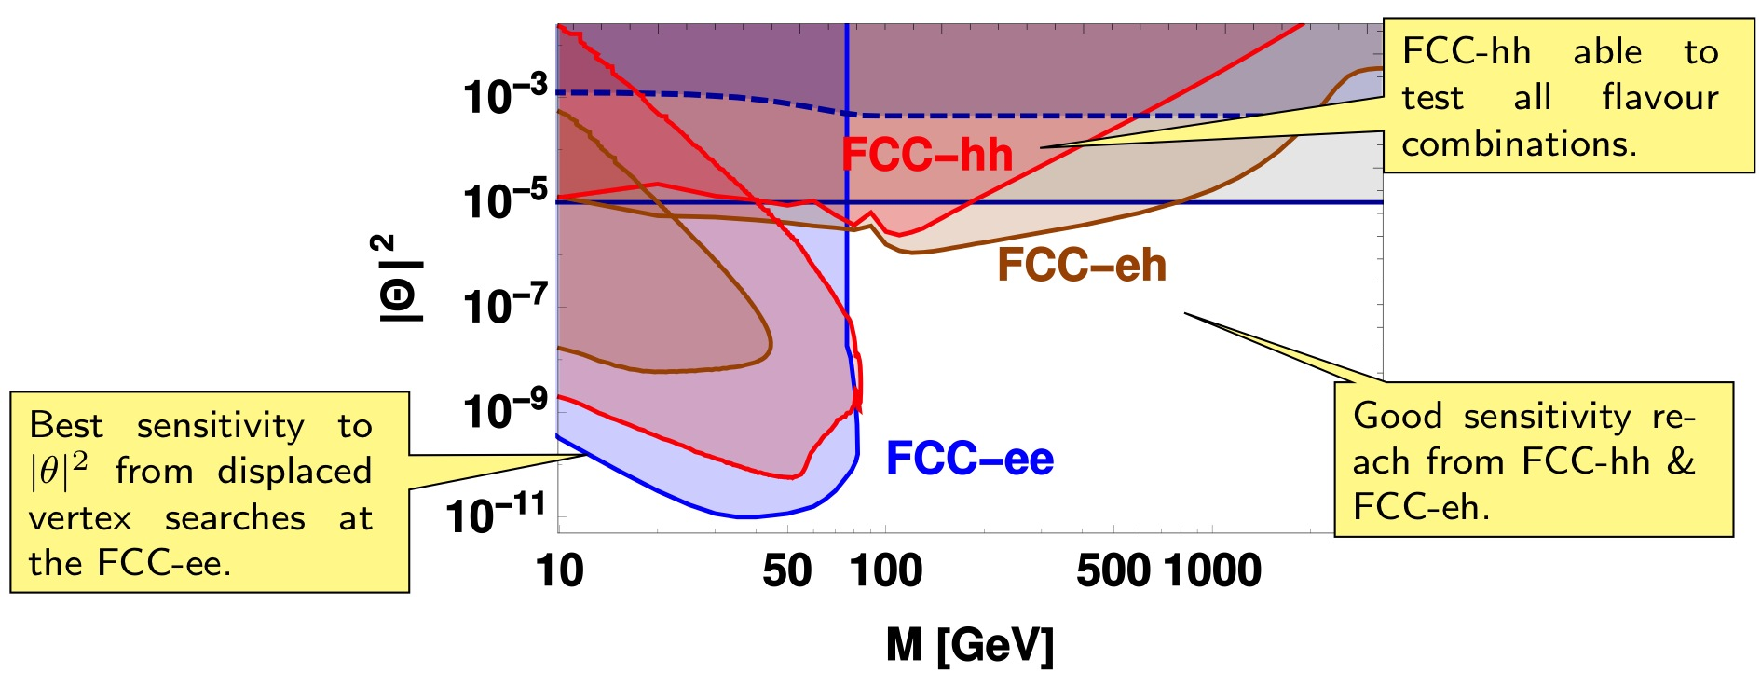
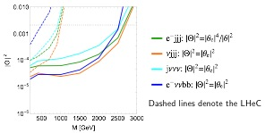
Some examples at this meeting
Heavy and sterile neutrinos (see Oliver Fischer’s talk today)
  @ LFV signatures and
  displaced vertex search
  → this is how it was in January …
lepton-flavor-conserving
signatures

Slide 4
Impact of PDF @ High x
large uncertainties in high x PDFs limit searches for NP
many interesting processes at LHC are gluon-gluon initiated: top, Higgs, … and BSM processes, such as gluino pair production
For HL-LHC → studied in detail impact of LHeC
prescription from J. Rojo to avoid negative x-section at at high masses for NNPDF30nlo → x-section calculation unstable
< x > ~ 0.4
Studies updated with modern PDF sets
  M(squark)=M(gluino)=μ_{R}=μ_{F}
  LHeC PDF uncertainties unchanged
  Normalized to MMHT14
Christoph Borschensky
Michael Kramer
Christoph Borschensky
Michael Kramer
Hopefully, we will update studies with LHeC PDF unc in performing studies for the HL-LHC Yellow Report
arXiv:1211.5102

Slide 5
Impact of PDF @ High x: FCC
FCC-hh reach up to 13(16) TeV for gluino pair production, 17(20) TeV for non-decoupled squark/gluino for 3(30)/ab⁻¹
Similar x range for the sensitive region
(<x> ~ 0.4) → ~40-50% uncertainties on the
prediction of gluon-gluon initiated processes
  Might be an issue also for central values
Other aspects might play a non-negligible role:
Top PDF: at the very high Q2, top becomes small and will have to be included as 6F PDFs
No doubts that having an e-p machine running in parallel with p-p will be very important

Slide 6
Impact of PDF: High mass Drell-Yan
Non resonant searches for ED (interference) sensitive to tails of DY distributions thus to PDF. Predominantly q-qbar
Uta Klein
VRAP 0.9 for NNLO QCD
“Troubles” at low and high x
FCCeh (and before, LHeC) can improve low and high M(ll) and M(lv) precision for standard candle measurements and searches for new physics
Notes:
at FCC (100 TeV) we have even 'trouble' to predict precisely W and Z cross sections, since the average x_1*x_2 is already 10-3.
Note, the sale are factors! so 3 means 300%.
Also our own newest ATLASPDf is not really of any help here.

Slide 7
Direct searches: Lepto-quarks
1st generation LQs → Current constraints almost
there with 3.2/fb @ 13 TeV
λ
λ
(λ_{LQ} = 0.03 = LHC ‘usual’ l)
L_{FCC-eh} = 500fb⁻¹
ep scenario:
sensitive to λ << e=√4πα=0.03
LHeC
Sensitivity of HL-LHC could go to ~2.8 – 2.9 TeV
Close to the reach for FCC-eh
Dependence on lambda
If deviations are found by the end of HL-LHC, FCC-hh will definitely see them, and FCC-eh can characterize those signals!
FCC-eh 60GeV
Current LHC
3000/fb @ 14 TeV ~ 2.9 TeV reach
(use http://collider-reach.web.cern.ch)

Slide 8
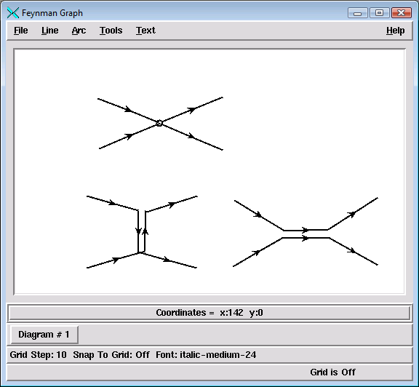
Contact interactions
if new physics enters at higher scales: Λ>> √s
such indirect signatures can be seen as effective 4-fermion interaction
may be applied very generally to new phenomena
LQ mass >> √s
Planck scale (Ms) of extra dimensional models
compositeness scale
…
Λ
Sensitivity to fermion radius recalculated with current expectations at the FCC-eh
R → 3(1.5) x 10⁻²⁰m
pessimistic(optimistic) calculations

Slide 9
Contact interactions (eeqq)
New currents or heavy bosons may produce indirect effect via new particle exchange interfering with γ/Z fields.
Reach for Λ (CI eeqq): VV: ~290 TeV; LL: ~160 TeV
VV: all couplings with +ve sign
LL: only LL couplings between q and e
~ equivalent sensitivity at the FCC-hh at least for some of the couplings (same as HL-LHC vs LHeC) but need more calculations!

Slide 10
E-p “specific” searches: Instantons
New physics as non-perturbative QCD effect at high energies
  Instantons → non-perturbative fluctuations of the gluon field
Photon-gluon fusion process
HERA recent results start probing interesting theoretical scenarios
Feasibility is now been considered → code to generate it with new Herwig7 being tested but still issues in compiling it (S. Amoroso)
Eur.Phys.J. C76 (2016) no.7, 381

Slide 11
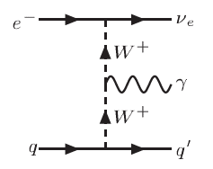
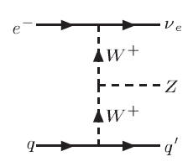
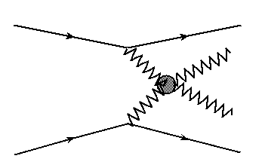
BSM in Vector Boson (VB) scattering
VB scattering at high mass:
  anomalous TGC, QGC couplings in VVV, VVVV ?
  New resonances possibly relevant for unitarity restoring
    expect below ~ 2-3 TeV → look for deviations from SM predictions:
    Challenging at p-p (high QCD bkg, pile-up), cleaner at FCC-eh

Slide 12
Anomalous couplings WWV
Triple gauge boson vertices WWV, V=γ,Z:
  Precisely defined in SM
  Parametrise possible new physics contributions to this vertex
  Current constraints (best from LEP) use various assumptions
http://arxiv.org/pdf/1405.6056v1.pdf
At the e-p:
can clearly distinguish between CC events e + p → νe + jet (W-exchange) and NC events e + p → e + jet (photon or Z boson exchange)
- triggering on a final state photon, can provide very clean bounds on the anomalous TGV’s!
https://arxiv.org/abs/1406.7696

Slide 13
FCC-eh Anomalous WW γ and WWZ Couplings
Study for FCC-eh
https://cds.cern.ch/record/2209389/?ln=en
  Report studies for Ee = 80 GeV
  Update here for Ee = 60 GeV
A. Senol, O. Cakir, I. Turk Cakirç
Cross section depending on anomalous λ_{γ} coupling of the
process ep→ν qγX for E_{e} = 60 GeV and E_{p}=50 TeV at FCC-ep.

Slide 14
Anomalous WWγ Couplings
A. Senol, O. Cakir, I. Turk Cakirç
Sensitivities to anomalous
couplings λ_{γ} ∼ 10⁻²
For comparison:
Two dimensional 95% C.L contour plot anomalous couplings in the λ_{γ}−Δκ_{γ} plane for the integrated luminosity of 10 fb-1 and 100 fb-1 at FCC-ep with electron beam energy E_{e} =60 GeV with polarization P =−0.8 .

Slide 15
Anomalous WWZ Couplings
analysis of the signal and backgrounds
for Z → ll’(l = e, μ)
A. Senol, O. Cakir, I. Turk Cakirç
Sensitivities to anomalous
couplings λ_{Ζ} ∼ 10⁻³
For comparison:
Two-dimensional 95% C.L contour plot of anomalous couplings in the λ_{Z} −Δκ_{Z} plane for the integrated luminosity of 10fb-1 and 100 fb⁻¹ at FCC-ep with electron beam energy Ee=60 GeV with polarization P=-0.8.

Slide 16
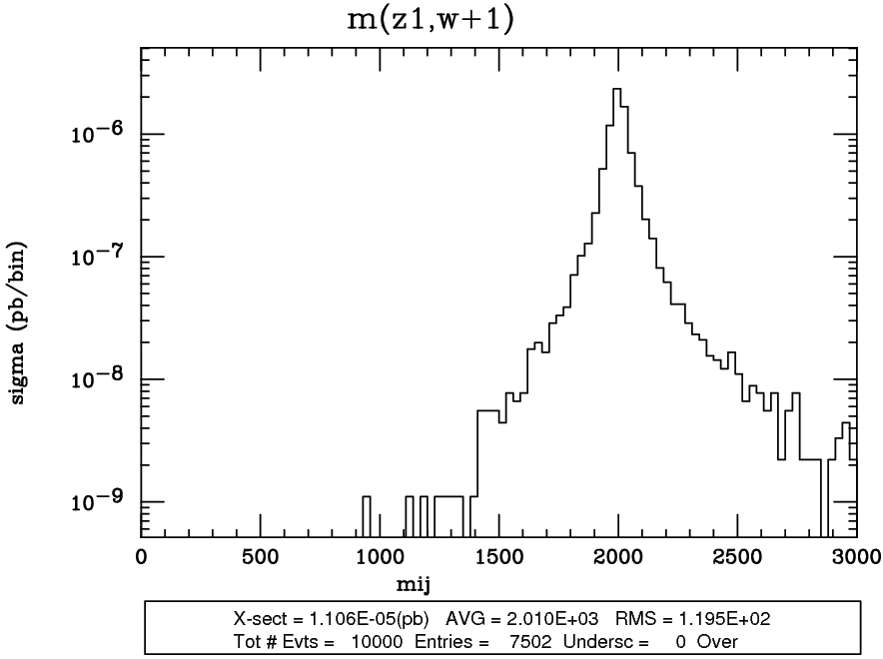
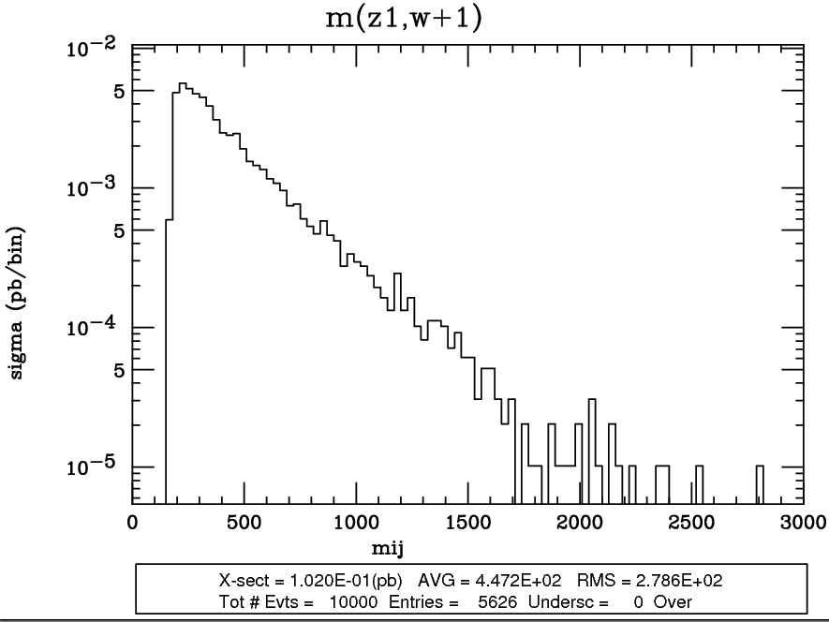
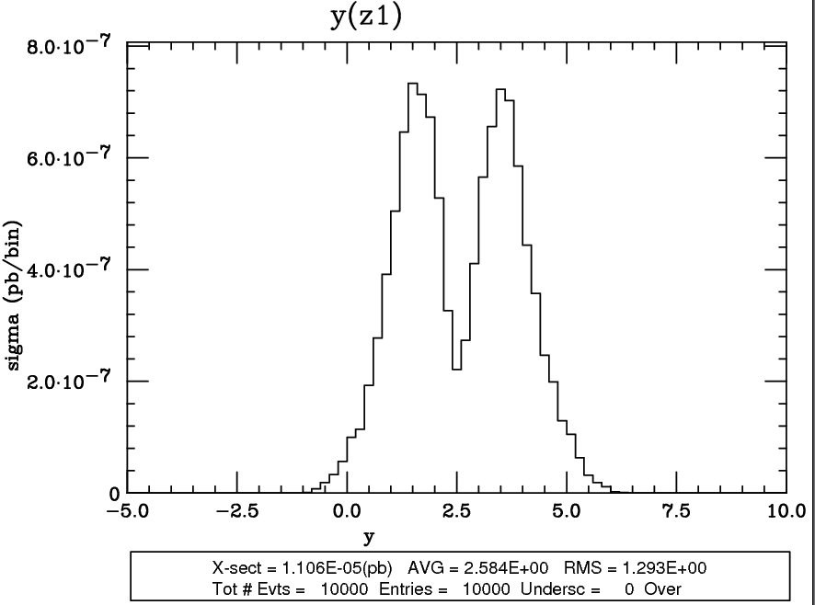
Vector Boson Scattering
Georges Azuelos
2 TeV resonance
m(WZ), background
Typical cross sections for 2 TeV resonance (c_{F}=0, c_{H}=1, g_{V}=3, 60 GeV x 50 TeV)
Heavy Vector Triplet model, D. Pappadopoulo et al., JHEP 1409 (2014) 060, 1402.4431
  highly dependent on acceptance and performance of detector
  FCC-eh (2 TeV resonance): S = 0.01 fb, B_{EW} = 100 fb
  (for comparison, LHC14: S = 0.12 fb B_{QCD} = 4.2 pb B_{EW} = 300 fb)
  low cross section, but kinematics of signal distinct from background
  (invariant mass, rapidity of the objects, can use W/Z boosted hadronic decays)
  Need very good detector performance

Slide 17
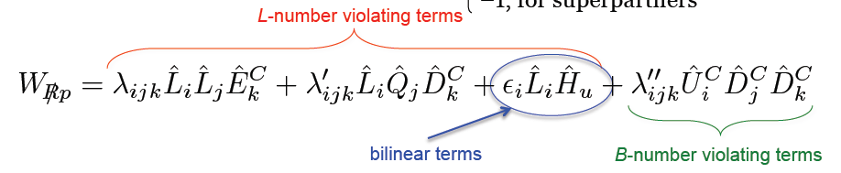
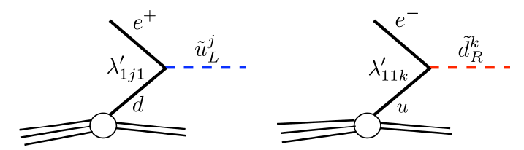
R-parity violating SUSY
Squarks in RPV models could be an example of ‘Leptoquarks’
ΔL =1, 9 λ couplings, 27 λ’ couplings
Plethora of new couplings, only partially constraints (m/100 GeV)
Various strong constraints already from LHC on λ and λ’’ (from multilepton and multijet searches)
Very recently, H. Dreiner et al. released an extremely comprehensive review of the current constraints on LLE, LQD and UUD couplings https://arxiv.org/abs/1706.09418
  Couplings with third gen quarks
  In e-p production rate depending on:
    e-d-t: λ’₁₃₁ (constraint: < 0.03)
    e-u-b: λ’₁₁₃ (constraint: < 0.02)

Slide 18
SUSY – R-parity violating
single sbottom/stop production (signal like leptoquarks, with generation mixing)
http://xxx.tau.ac.il/abs/1401.4266
sbottom
λ’₁₁₃
Ep=7000 GeV
λ’₁₁₃
Probe RPV LQD terms: (λ’₁₁₃)²
@FCC-eh: same analysis as for LQ → Sensitivity up to 2.5 TeV for λ’₁₁₃<0.02
λ’₁₁₃ can be more strongly constrained under certain assumptions. At the LHC, current constraints on other sparticles are tight but yet ‘reasonable’ and not on sbottom

Slide 19
Back-up

Slide 20
LHeC Prospects for WWγ
http://arxiv.org/pdf/1405.6056v1.pdf
Select on p_{T} of γ and jet
Sensitivity to Δφ (γ-jet)
Competitive constraints at LHeC already for ~ 100 fb⁻¹
Can access a space inaccessible for LEP
(Note: E(e)=100 GeV → expect slightly worse for 60 GeV, but not much)

Slide 21
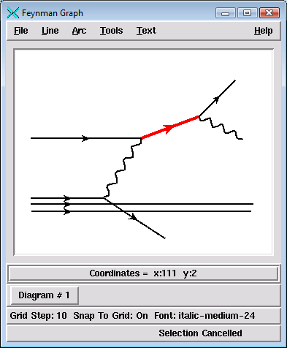
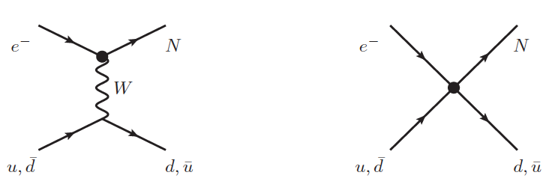
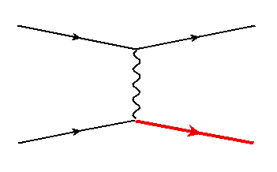
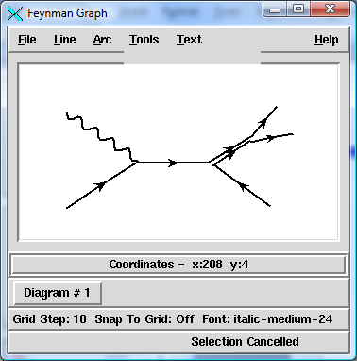
Heavy fermions/ colored bosons: covered in other talks
heavy leptons:
  vector-like leptons: left and right chiralities have same transformation properties
    predicted in GUT theories (E₆) or in Composite Higgs Models
    couplings:
  Majorana Neutrino Production in an Effective Approach
  (L. Duarte et al. 1412.1433)
  SM background from
  able to discover Majorana neutrinos up to 700 GeV (for E_{e} = 50 GeV)
vector-like quarks
  single production of top partners,
  sensitive to couplings:
(coupling to light quarks)
REMOVE ???
diquarks
  predicted in superstring inspired E6 and composite models
  could carry charge 1/3, 2/3, 4/3 and be scalar or vector
  in gp production
M Şahin and O. Çakir, arXiv:0911.0496
LHeC reach excluded
vector and scalar diquarks can be distinguished by the angular distribution of their decays

Slide 22
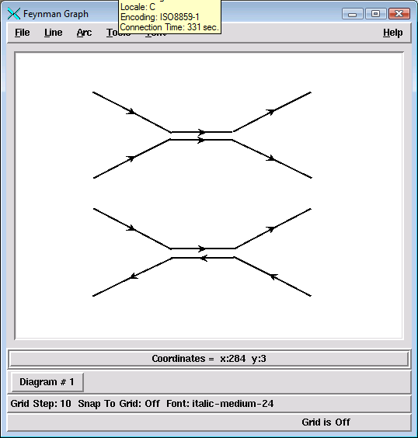
Measuring the LQ quantum numbers in e-p
Quantum numbers and couplings:
  Fermion number:
    can be obtained from asymmetry in single LQ production, since have higher than
    At pp: very poor asymmetry precision achievable in single LQ production
  spin
    At p-p, pair production of LQ-LQ leads to angular distributions which depend on the g-LQ-LQ coupling
    ➔ may need to look for spin correlations
    At e-p, cos θ* distribution is sensitive to the spin
    vector leptoquarks can have anomalous couplings
  couple chirally (i.e. to L or R but not both) ?
    could be probed by measuring sensitivity of cross sections to polarization of the electron beam
  generation mixing ?
    does LQ decay to 2nd generation?
  BR to neutrino, good S/B in νj channel

