Slide 1

BSM searches at FCC-eh
(selected topics)
Monica D’Onofrio
(University of Liverpool)
for the BSM ep team
[coord. MD, Georges Azuelos]
1st FCC Physics Week
January 19th 2017

Slide 2
Prelude
The HL-LHC results will be crucial to re-focus the BSM program at the FCC in terms of
  Characterization of hints for new physics if some excess or deviations from the SM are found
  Constraints of new physics models and complementary searches wrt the hh/ee cases
  Exploration of new scenarios
Not an easy task at the moment
Wish: engage the theory community!

Slide 3
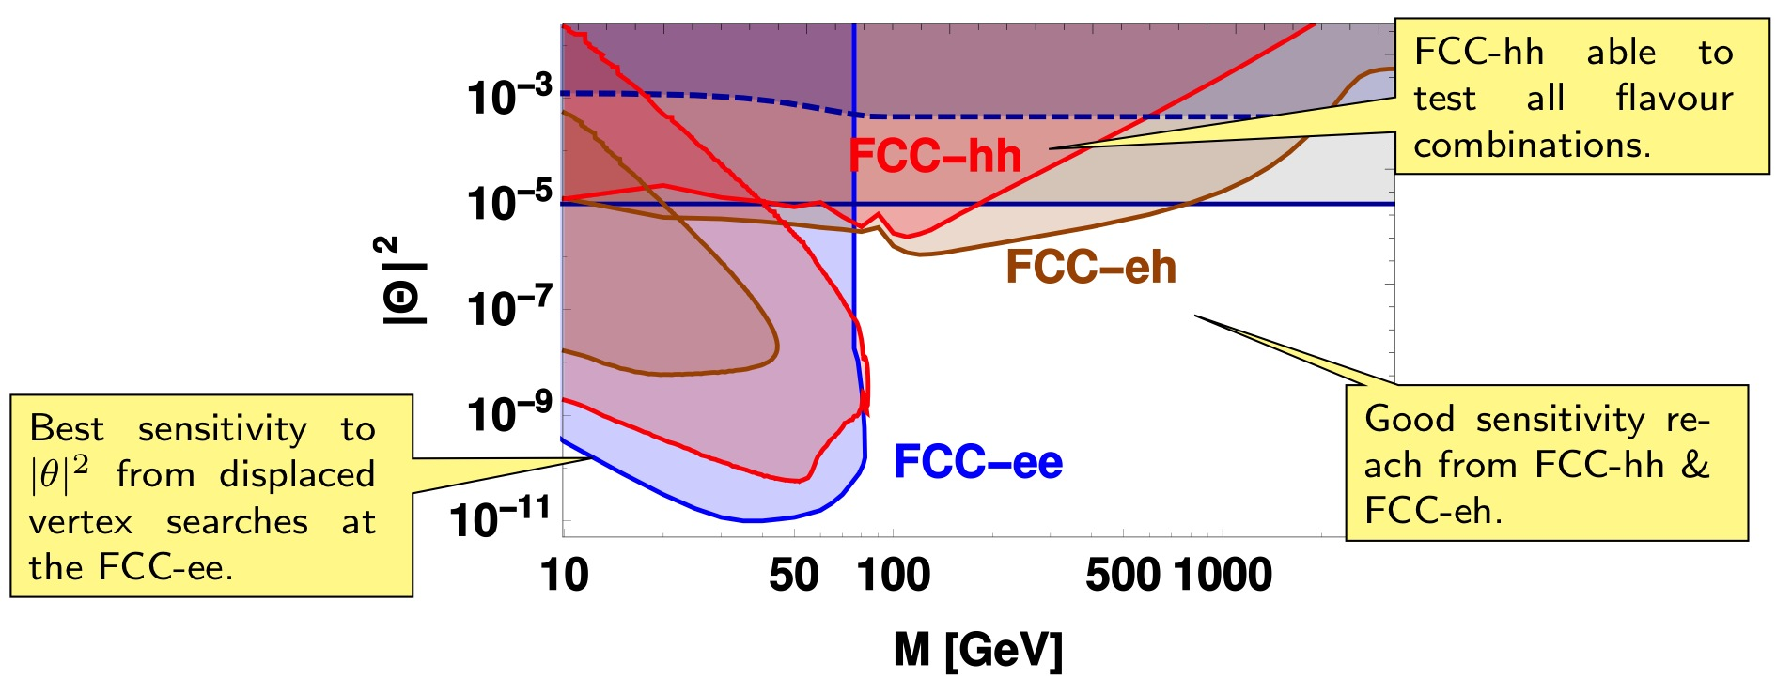
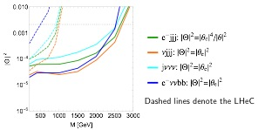
Some examples at this meeting
Heavy neutrinos (see Eros Cazzato’s and Oliver Fischer’s talks yesterday)
  @ FCC-eh: LFV signatures and
  displaced vertex search
lepton-flavor-conserving signatures
Top physics and FCNC
  See later this afternoon
  (Orhan Cakir’s talk)
  Poster on FCNC couplings of Higgs-top by B. Hacisahinoglu
Anomalous HVV couplings
  (see poster M. Altinli et al.)
Preonic models
  Saleh Sultansoy’s talk after this

Slide 4
Outline
Interesting BSM-eh cases made at this workshop
In this talk I will hint a few more topics
  Indirect impact on search potential for FCC-hh: improved PDF
  Direct searches for BSM
    Leptoquark
    contact interactions
    anomalous couplings (VVV)
    Vector Boson scattering
    SUSY: RPV and RPC
  Outlook and summary
HERA–LHeC–FCC-eh: finest microscopes, resolution as 1/Q
QCD
Parton Dynamics
100 years of lp scattering,
5 orders of magnitude deeper into matter
Higgs
LQ
continuing studies to get better precision on
potential discoveries and constraints on BSM models
Detector performance simulation in progress

Slide 5
Indirect impact on search potential for FCC-hh: improved PDF

Slide 6
Improving PDFs with the LHeC
FCC-eh: (Q²,x)max=10⁷ GeV², 0.8
no data
low-x: no current data to constrain x ≤ 10⁻⁴; better but not much after HL-LHC; rely purely on extrapolation non-linear equations, gluon saturation?
mid-x: need higher precision for Higgs
high-x: very poorly constrained – limits searches for new, heavy particles
FCC-eh: xmin ≤ 10⁻⁷
FCC-eh: access to much smaller x, larger Q²
Impact on PDF → also depends on whether LHeC is realized or not

Slide 7
Potential of FCCeh on PDFs
See Stefano and Voica’s presentation

Slide 8
Impact of PDF: High mass Drell-Yan
Non resonant searches for ED (interference) sensitive to tails of DY distributions thus to PDF. Predominantly q-qbar
Uta Klein
VRAP 0.9 for NNLO QCD
“Troubles” at low and high x
FCCeh (and before, LHeC) can improve low and high M(ll) and M(lv) precision for standard candle measurements and searches for new physics
Notes:
at FCC (100 TeV) we have even 'trouble' to predict precisely W and Z cross sections, since the average x_1*x_2 is already 10-3.
Note, the sale are factors! so 3 means 300%.
Also our own newest ATLASPDf is not really of any help here.

Slide 9
Impact of PDF @ High x
large uncertainties in high x PDFs limit searches for new physics at high scales
many interesting processes at LHC are gluon-gluon initiated: top, Higgs, … and BSM processes, such as gluino pair production
For HL-LHC → studied in detail impact of LHeC
< x > ~ 0.4
Studies updated with modern PDF sets!
  M(squark)=M(gluino)=μ_{R}=μ_{F}
  LHeC PDF uncertainties unchanged
  Normalized to MMHT14
Christoph Borschensky
Michael Kramer
NNPDF30nlo become negative at high masses despite positive constraints applied to the fitting procedure
arXiv:1211.5102

Slide 10
Impact of PDF @ High x
large uncertainties in high x PDFs limit searches for new physics at high scales
many interesting processes at LHC are gluon-gluon initiated: top, Higgs, … and BSM processes, such as gluino pair production
For HL-LHC → studied in detail impact of LHeC
< x > ~ 0.4
Studies updated with modern PDF sets!
  M(squark)=M(gluino)=μ_{R}=μ_{F}
  LHeC PDF uncertainties unchanged
  Normalized to MMHT14
Christoph Borschensky
Michael Kramer
Christoph Borschensky
Michael Kramer
Use prescription from J. Rojo to avoid negative x-section at at high masses for NNPDF30nlo → x-section calculation unstable
arXiv:1211.5102

Slide 11
Impact of PDF @ High x: FCC
FCC-hh reach up to 13(16) TeV for gluino pair production, 17(20) TeV for non-decoupled squark/gluino for 3(30)/ab⁻¹
Similar x range for the sensitive region
(<x> ~ 0.4) → ~40-50% uncertainties on the
prediction of gluon-gluon initiated processes
  Might be an issue also for central values
Other aspects might play a non-negligible role:
^{See also Stefano’s talk}
Top PDF: at the very high Q2, top becomes small and will have to be included as 6F PDFs
No doubts that having an e-p machine running in parallel with p-p will be very important

Slide 12
Direct searches at FCC-eh

Slide 13
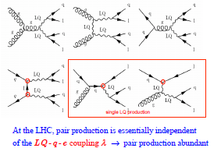
LQ production
Leptoquarks (LQs) appear in several extensions to SM: production σ ∼
can be scalar or vector, with fermion number 0 (e⁻qbar) or 2 (e⁻q)
At the p-p, mostly pair production (from gg or qq)
  if λ not too strong (0.3 or lower)
  cross section independent on λ
At the e-p: both baryon and lepton quantum numbers – ideally suited to search for and study properties of new particles coupling to both leptons and quarks
single, resonant production; sensitive to λ
λ
λ

Slide 14
LQ status and reach at FCC -eh
1st generation LQs → Current constraints almost there with 3.2/fb @ 13 TeV
(λ_{LQ} = 0.03 = LHC ‘usual’ l)
ep scenario:
sensitive to λ << e=√4πα=0.03
L_{FCC-eh} = 500fb⁻¹
LHeC
Sensitivity of HL-LHC could go to ~2.8 – 2.9 TeV
Close to the reach for FCC-eh
Dependence on lambda
If deviations are found by the end of HL-LHC, FCC-hh will definitely see them, and FCC-eh can characterize those signals!
FCC-eh 60GeV
Current LHC
3000/fb @ 14 TeV ~ 2.9 TeV reach
(use http://collider-reach.web.cern.ch)

Slide 15
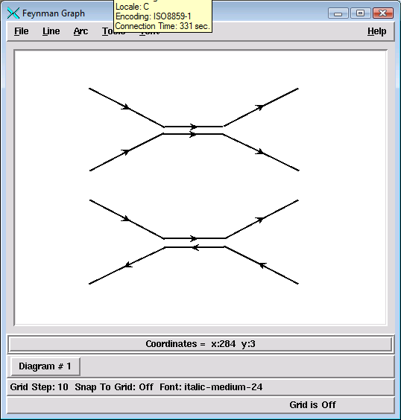
Measuring the LQ quantum numbers in e-p
Quantum numbers and couplings:
  Fermion number:
    can be obtained from asymmetry in single LQ production, since have higher than
    At pp: very poor asymmetry precision achievable in single LQ production
  spin
    At p-p, pair production of LQ-LQ leads to angular distributions which depend on the g-LQ-LQ coupling
    ➔ may need to look for spin correlations
    At e-p, cos θ* distribution is sensitive to the spin
    vector leptoquarks can have anomalous couplings
  couple chirally (i.e. to L or R but not both) ?
    could be probed by measuring sensitivity of cross sections to polarization of the electron beam
  generation mixing ?
    does LQ decay to 2nd generation?
  BR to neutrino, good S/B in νj channel

Slide 16
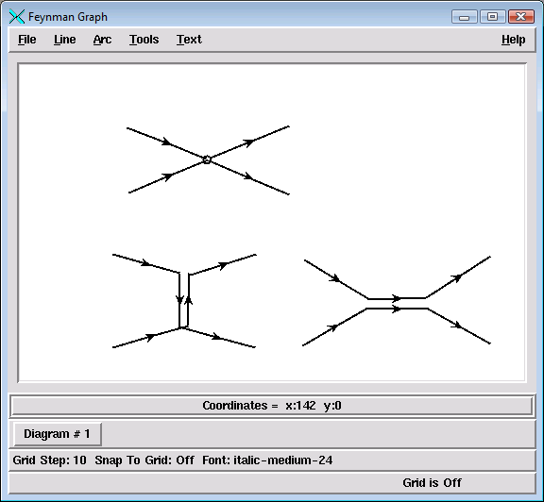
Contact interactions
if new physics enters at higher scales: Λ>> √s
such indirect signatures can be seen as effective 4-fermion interaction
may be applied very generally to new phenomena
LQ mass >> √s
Planck scale (Ms) of extra dimensional models
compositeness scale
…
Λ
Sensitivity to fermion radius recalculated with current expectations at the FCC-eh
R → 3(1.5) x 10⁻²⁰m
pessimistic(optimistic) calculations

Slide 17
Contact interactions (eeqq)
New currents or heavy bosons may produce indirect effect via new particle exchange interfering with γ/Z fields.
Reach for Λ (CI eeqq): VV: ~290 TeV; LL: ~160 TeV
VV: all couplings with +ve sign
LL: only LL couplings between q and e
~ equivalent sensitivity at the FCC-hh at least for some of the couplings (same as HL-LHC vs LHeC) but need more calculations!

Slide 18
E-p “specific” searches: Instantons
New physics as non-perturbative QCD effect at high energies
  Instantons → non-perturbative fluctuations of the gluon field
Photon-gluon fusion process
HERA recent results start probing interesting theoretical scenarios
Feasibility could / should be considered for the future
Eur.Phys.J. C76 (2016) no.7, 381

Slide 19
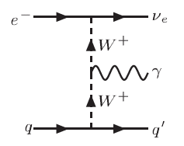
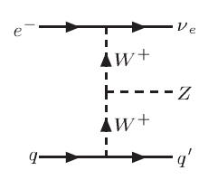
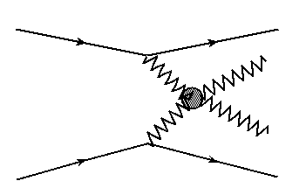
BSM in Vector Boson (VB) scattering
VB scattering at high mass:
  anomalous TGC, QGC couplings in VVV, VVVV ?
  New resonances possibly relevant for unitarity restoring
    expect below ~ 2-3 TeV → look for deviations from SM predictions:
    Challenging at p-p (high QCD bkg, pile-up), cleaner at FCC-eh

Slide 20
Anomalous couplings WWV
Triple gauge boson vertices WWV, V=γ,Z:
  Precisely defined in SM
  Parametrise possible new physics contributions to this vertex
  Current constraints (best from LEP) use various assumptions
http://arxiv.org/pdf/1405.6056v1.pdf
At the e-p:
can clearly distinguish between CC events e + p → νe + jet (W-exchange) and NC events e + p → e + jet (photon or Z boson exchange)
- triggering on a final state photon, can provide very clean bounds on the anomalous TGV’s!
https://arxiv.org/abs/1406.7696

Slide 21
FCC-eh Anomalous WW γ and WWZ Couplings
Study for FCC-eh
https://cds.cern.ch/record/2209389/?ln=en
  Report studies for Ee = 80 GeV
  Update here for Ee = 60 GeV
A. Senol, O. Cakir, I. Turk Cakirç
Cross section depending on anomalous λ_{γ} coupling of the
process ep→ν qγX for E_{e} = 60 GeV and E_{p}=50 TeV at FCC-ep.

Slide 22
Anomalous WWγ Couplings
A. Senol, O. Cakir, I. Turk Cakirç
Sensitivities to anomalous
couplings λ_{γ} ∼ 10⁻²
For comparison:
Two dimensional 95% C.L contour plot anomalous couplings in the λ_{γ}−Δκ_{γ} plane for the integrated luminosity of 10 fb-1 and 100 fb-1 at FCC-ep with electron beam energy E_{e} =60 GeV with polarization P =−0.8 .

Slide 23
Anomalous WWZ Couplings
analysis of the signal and backgrounds
for Z → ll’(l = e, μ)
A. Senol, O. Cakir, I. Turk Cakirç
Sensitivities to anomalous
couplings λ_{Ζ} ∼ 10⁻³
For comparison:
Two-dimensional 95% C.L contour plot of anomalous couplings in the λ_{Z} −Δκ_{Z} plane for the integrated luminosity of 10fb-1 and 100 fb⁻¹ at FCC-ep with electron beam energy Ee=60 GeV with polarization P=-0.8.

Slide 24
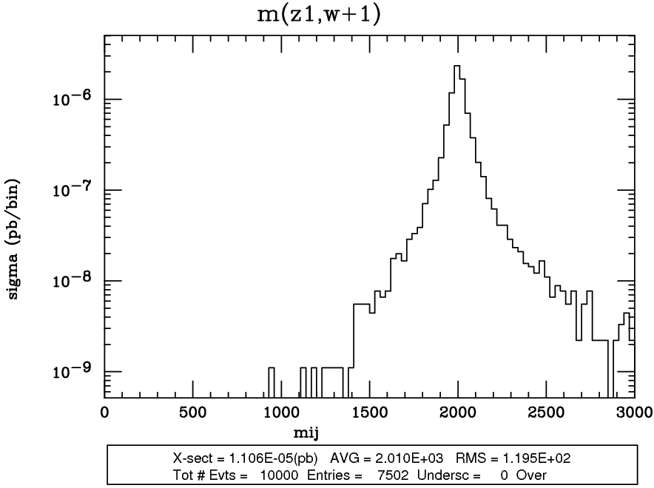
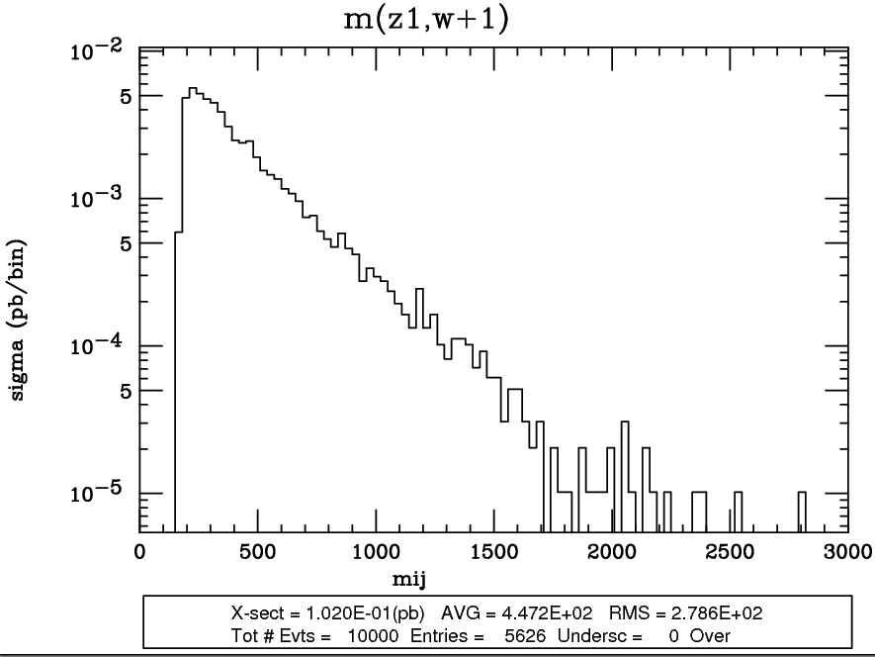
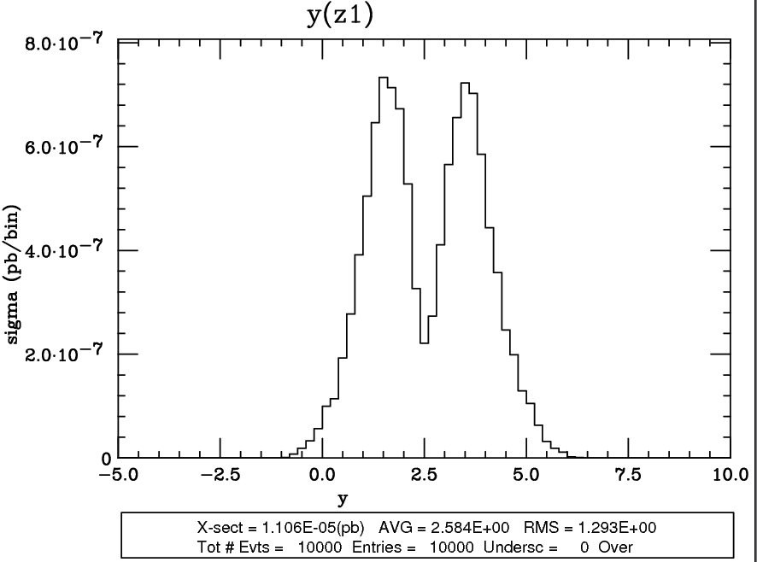
Vector Boson Scattering
Georges Azuelos
2 TeV resonance
m(WZ), background
Typical cross sections for 2 TeV resonance (c_{F}=0, c_{H}=1, g_{V}=3, 60 GeV x 50 TeV)
Heavy Vector Triplet model, D. Pappadopoulo et al., JHEP 1409 (2014) 060, 1402.4431
  highly dependent on acceptance and performance of detector
  FCC-eh (2 TeV resonance): S = 0.01 fb, B_{EW} = 100 fb
  (for comparison, LHC14: S = 0.12 fb B_{QCD} = 4.2 pb B_{EW} = 300 fb)
  low cross section, but kinematics of signal distinct from background
  (invariant mass, rapidity of the objects, can use W/Z boosted hadronic decays)
  Need very good detector performance

Slide 25
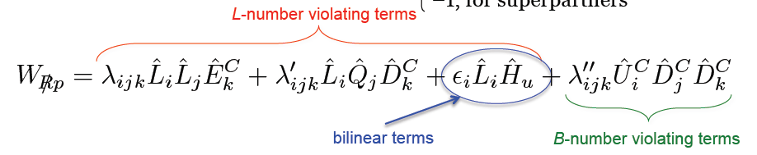
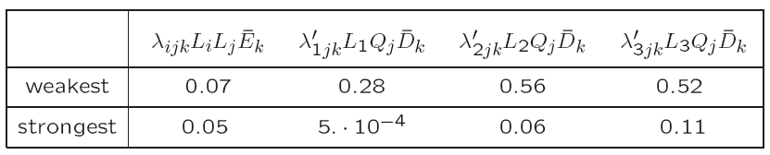
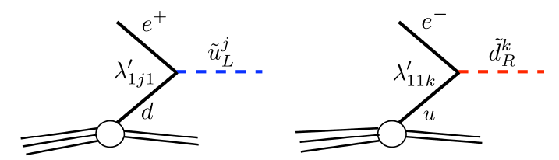
R-parity violating SUSY
Squarks in RPV models could be an example of ‘Leptoquarks’
ΔL =1, 9 λ couplings, 27 λ’ couplings
Plethora of new couplings, only partially constraints (m/100 GeV)
Various strong constraints already from LHC on λ and λ’’ (from multilepton and multijet searches)
  Couplings with third gen quarks
  In e-p production rate depending on:
    e-d-t: λ’₁₃₁ (constraint: < 0.03)
    e-u-b: λ’₁₁₃ (constraint: < 0.02)

Slide 26
SUSY – R-parity violating
single sbottom/stop production (signal like leptoquarks, with generation mixing)
http://xxx.tau.ac.il/abs/1401.4266
http://arxiv.org/pdf/1107.4461v2.pdf
sbottom
stop
Λ’₁₃₁< 0.03
also stronger bounds from ββ0ν
λ’₁₁₃
λ’₁₁₃
λ’ 131
Probe RPV LQD terms: (λ’₁₁₃)²
Probe RPV LQD terms:
In this case λ’₁₃₁ x λ ’₂₃₃
Ep=7000 GeV
requires good b-tagging
λ’₂₂₃ < 0.45 (constraints not sensitive to it down to ~ 0.05)
Dependency on λ’₁₃₁ :
  LHeC (1/fb): 300 GeV, λ’₁₃₁ = 0.005
  FCC-eh potential to be evaluated
@FCC-eh: same analysis as for LQ →
Sensitivity up to 2.5 TeV for λ’₁₁₃<0.02

Slide 27
A “different” SUSY RPV: Single-top + neutralino
Studies carried out in the past (for LHeC) shows potentially interesting signatures → resonant / non-resonant top+neutralino production
http://arxiv.org/pdf/1307.2308v2.pdf
Could lead to interesting discovery e.g. neutralinos decays in RPV scenarios

Slide 28
SUSY RPV in Higgs Sector
See also Uta Klein’s talk yesterday
In addition to the higgs to invisible and higgs to 4b, there are several other RPV cases to be considered. E.g.
  Neut1 might decay in 3 jets (UDD terms)
  Neut1 might decay also in lepton+neutrinos (LLE terms)
    Prompt or delayed: displaced vertex doable but not yet explored
  Some statistics: N_exp = L × σ(h) × BR(h→χ₁⁰χ₁⁰) × [BR(χ₁⁰ →X)]²
      In 1/ab, σ(h)=850 fb (CC), assuming BR(h→χ₁⁰χ₁⁰) = 10%
      N exp = 85000 × [BR(χ₁⁰ →X)]² → sizable dataset if BR not too small

Slide 29
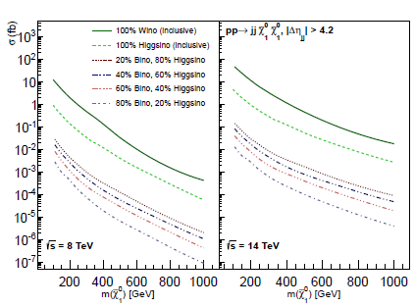

Hopes for RPC SUSY? EWK RPC
Charginos (C) and Neutralinos (N) fundamental for SUSY
  Expected to be light in most scenarios (C1, N1, N2 in particular)
  N1 is often the LSP and one of the preferred DM candidate
One of the most difficult scenarios for the p-p: medium-compressed N1, C1, N2 (DM few GeV)
  Not visible in direct searches, mono-photon and mono-jet searches possibly not sensitive because of systematic uncertatinties VS tiny xsect.
  VBF scenarios investigated for 14 TeV LHC
50 fb xsection for pure Wino-like N1
Promising for low N1, but possibly large bkg from SM
(ie Z,higgs production)

Slide 30
EWK RPC-SUSY production
Kechen Wang (and MD)
Question: can anything be done at the FCC-eh ?
Production of monojet-like signatures → not feasible
Production of the kind e+j+MET → possible
First look, using Madgraph:
  Example of diagram for C1C1. Production of N1N1 and C1N2 equivalent for almost degenerate masses
  Coupling strenghts depend on the Wino-Higgsino mixture
will use P=-0.8 for next round

Slide 31
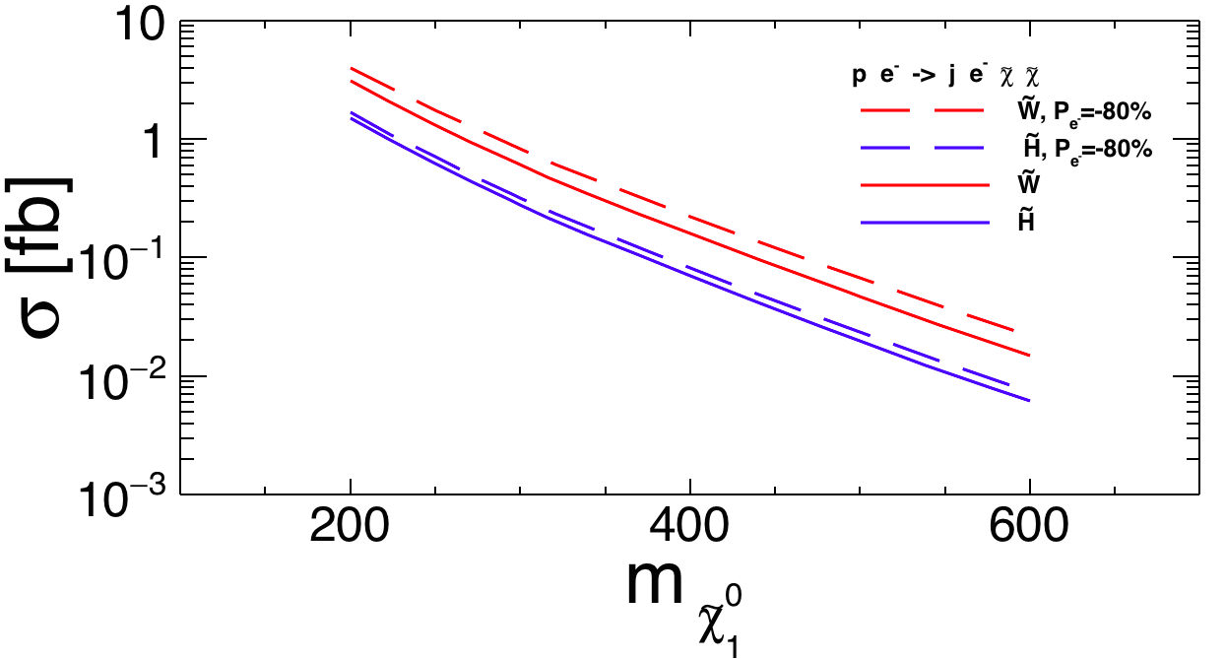
EWK RPC-SUSY production
Question: can anything be done at the FCC-eh ?
Production of monojet-like signatures → not feasible
Production of the kind e+j+MET → possible
Polarization -0.8 lead to a 30% increase in x-sections, which are anyway small:
Kechen Wang

Slide 32
SUSY EWK production
b
σ(Wino 200 GeV, P=0.0) = 3 fb
Bkg: j e MET including W/Z processes
Basic selections on pT jets, electron, eta range: signal and background ‘efficiency’
→ eff_S = 25%, eff_B = 0.04%
MET>100 GeV, MT(met, j)>150 GeV ,
Dphi(MET,jet)> 3, Dphi (e,j)<2, MT(MET, j+e) → eff_S = 15%, eff_B = 0.02%
Simple cut-and-count analysis based on ‘TRUTH’ studies lead to a signal significance >= 1 with 1000/fb (fake-MET bkg also missing)
MVA analyses would be beneficial (as in h→Inv case, see Uta’s talk)
Just started but worth investigating

Slide 33
Summary and outlook
FCC-eh offers a variety of opportunities for BSM searches
Crucial interplay in the context of PDF sets (@ high and low x)
Ideal to search and study properties of new particles with couplings to electron-quark
Nice prospects for “classic” searches on leptoquarks, contact interactions, anomalous couplings and RPV/RPC SUSY
    Some promising, some difficult
Physics potential yet to be fully exploited
    Engagement from theory community is really important → leading to very interesting results where it started!
    Detector-level studies crucial for next phase

Slide 34
Back-up

Slide 35
LHeC Prospects for WWγ
http://arxiv.org/pdf/1405.6056v1.pdf
Select on p_{T} of γ and jet
Sensitivity to Δφ (γ-jet)
Competitive constraints at LHeC already for ~ 100 fb⁻¹
Can access a space inaccessible for LEP
(Note: E(e)=100 GeV → expect slightly worse for 60 GeV, but not much)

Slide 36
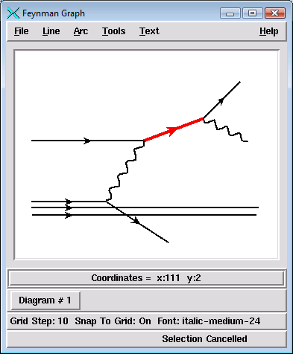
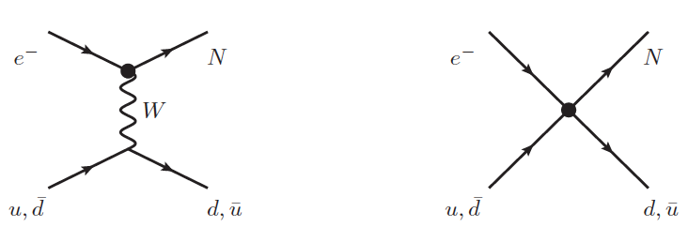
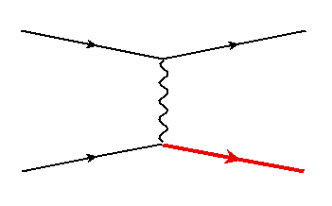
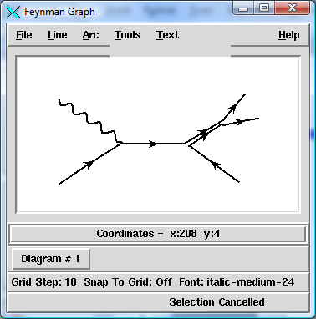
Heavy fermions/ colored bosons: covered in other talks
heavy leptons:
  vector-like leptons: left and right chiralities have same transformation properties
    predicted in GUT theories (E₆) or in Composite Higgs Models
    couplings:
  Majorana Neutrino Production in an Effective Approach
  (L. Duarte et al. 1412.1433)
  SM background from
  able to discover Majorana neutrinos up to 700 GeV (for E_{e} = 50 GeV)
vector-like quarks
  single production of top partners,
  sensitive to couplings:
(coupling to light quarks)
REMOVE ???
diquarks
  predicted in superstring inspired E6 and composite models
  could carry charge 1/3, 2/3, 4/3 and be scalar or vector
  in gp production
M Şahin and O. Çakir, arXiv:0911.0496
LHeC reach excluded
vector and scalar diquarks can be distinguished by the angular distribution of their decays

