Slide 1
BSM Physics @ ep Colliders
Co-author: Monica D’Onofrio & Georges Azuelos
Presenter: Kechen Wang (DESY)
on behalf of
the LHeC/FCC-eh BSM Physics Group
2nd FCC Physics Workshop, CERN
Jan. 17, 2018

Slide 2
Indirect Impact
Direct Searches
Singly Charged Higgs
Summary
Outline
Aim of this talk:
→ List promising topics
show progress of BSM studies @ ep;
focus on just updated one’s / recent studies;
→ Encourage more future studies
Indirect impact from improved PDF
Direct Searches
⬥ BSM Higgs: invisible decay; H->4b, H->multi-j, H⁺, H⁺⁺
⬥ SUSY: DM, sleptons
⬥ Anomalous gauge couplings: VVV, VVVV updated
⬥ Leptoquarks: RPV SUSY squarks, limits, quantum # & couplings; B anomaly (LHCb); 1-page
⬥ Contact interactions: eeqq (very heavy LQ, compositeness)
⬥ Vector boson scattering
⬥ BSM in the top sector
⬥ Sterile neutrinos
Outlook & Summary
More details,
see [Monica D’Onofrio’s talk “BSM searches at FCC-eh (selected topics)” in the 1st FCC Physics week,
https://indico.cern.ch/event/550509/contributions/2413829/attachments/1398547/2133088/FCCPhysics_BSMJan2017.pdf ]
& [Kechen Wang’s talk “BSM Physics at Energy-frontier Lepton-hadron Colliders” in the EPS-HEP Conference 2017, https://indico.cern.ch/event/466934/contributions/2583549/attachments/1489690/2314998/EPS-HEP_BSM_at_ep_colliders_2.pdf ]
2 / 20

Slide 3
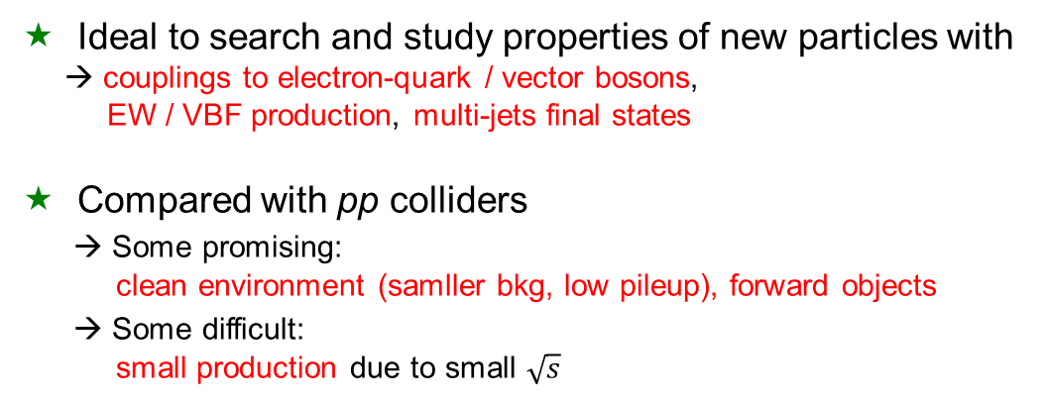
Indirect Impact
Direct Searches
Singly Charged Higgs
Summary
Outline
Indirect impact from improved PDF
Direct Searches
⬥ BSM Higgs: exotic (invisible) decay; H->4b, H⁺, H⁺⁺
⬥ RPC SUSY: DM, sleptons
⬥ RPV SUSY: neutralinos, squarks
⬥ Anomalous gauge couplings: VVV, VVVV updated
⬥ Leptoquarks: limits, quantum # & couplings;
⬥ Contact interactions: eeqq (very heavy LQ, compositeness)
⬥ Vector boson scattering
⬥ BSM in the top sector [Christian Schwanenberger, “Top physics in ep” ]
⬥ Sterile neutrinos [Oliver Fischer’s talk “Heavy neutrino discovery prospects at FCC”]
Outlook & Summary
Ideal to search and study properties of new particles with
→ couplings to electron-quark / vector bosons,
EW / VBF production, multi-jets final states
Compared with pp colliders
    → Some promising:
    clean environment (samller bkg, low pileup), forward objects
    → Some difficult:
    small production due to small $\sqrt{s}$
3 / 20

Slide 4
Indirect Impact on BSM from Improved PDF
  comment on [Claire Gwenlan’s talk “PDFs at the FCC-eh” ], before
Example: gluon-gluon initiated processes
→ large uncertainties in high-x PDFs limit searches for new physics at high scales
→ many interesting processes at LHC are gluon-gluon initiated: top, Higgs, … and BSM processes, such as gluino pair production
< x > ~ 0.4
At HL-LHC,
~ 40-50% uncertainties on the gluon-gluon initiated gluino production cross section in high-x region .
Christoph Borschensky
Michael Kramer
[arXiv:1211.5102]
At FCC-hh,
Similar x range for sensitive region
=> reducing PDF uncertainties by ep might be crucial to improve the pp limits.
Christoph Borschensky
Michael Kramer

Slide 5
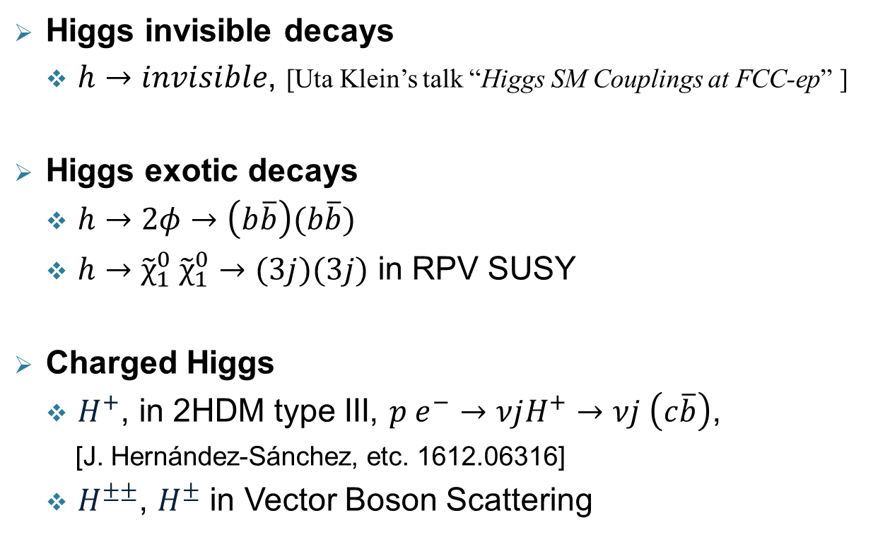
BSM Higgs
Higgs invisible decays
  $h→invisible$, [Uta Klein’s talk “Higgs SM Couplings at FCC-ep” ]
Higgs exotic decays
  $h→2φ→\left(b\overline{b}\right)(b\overline{b})$
  $h→{\tilde{χ}}_{1}^{0} {\tilde{χ}}_{1}^{0}→(3j)(3j)$ in RPV SUSY
Charged Higgs
  $H^{+}$, in 2HDM type III, $p e^{−}→νjH^{+}→νj \left(c\overline{b}\right)$,
  [J. Hernández-Sánchez, etc. 1612.06316]
  $H^{±±}$, $H^{±}$ in Vector Boson Scattering

Slide 6
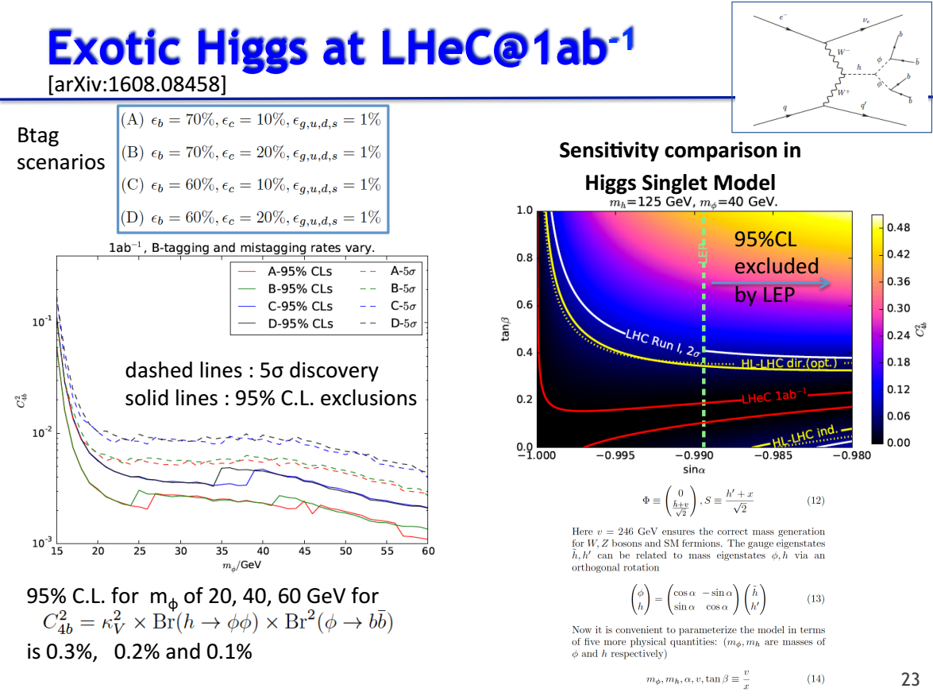

BSM Higgs
$$h→2φ→\left(b\overline{b}\right)(b\overline{b})$$
  [ Slide from Uta Klein ]

Slide 7
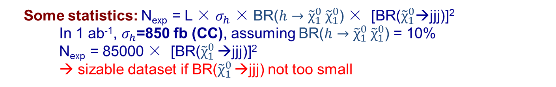

BSM Higgs
$h→{\tilde{χ}}_{1}^{0} {\tilde{χ}}_{1}^{0}→(3j)(3j)$ in RPV SUSY
In addition to the higgs to invisible and higgs to 4b,
there are several other RPV cases to be considered. E.g.
  Neutralino might decay in 3 jets (UDD terms)
  Some statistics: N_{exp} = L × $σ_{h}$ × BR($h→{\tilde{χ}}_{1}^{0} {\tilde{χ}}_{1}^{0}$) × [BR(${\tilde{χ}}_{1}^{0}$→jjj)]²
      In 1 ab⁻¹, $σ_{h}$=850 fb (CC), assuming BR($h→{\tilde{χ}}_{1}^{0} {\tilde{χ}}_{1}^{0}$) = 10%
      N_{exp} = 85000 × [BR(${\tilde{χ}}_{1}^{0}$ →jjj)]²
      → sizable dataset if BR(${\tilde{χ}}_{1}^{0}$ →jjj) not too small

Slide 8
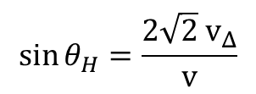

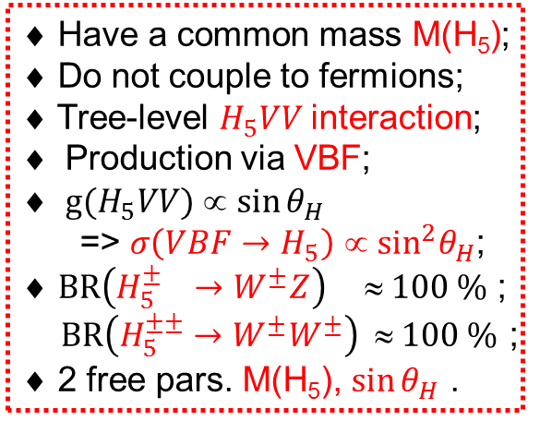
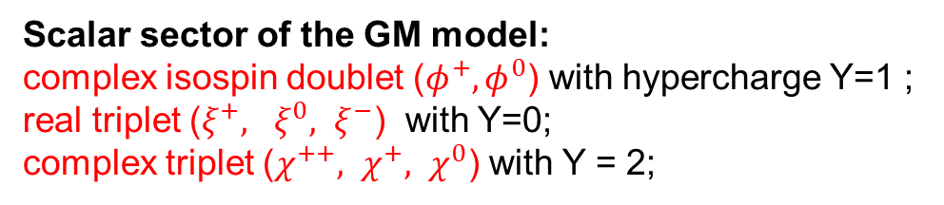

BSM Higgs
Georgi – Machacek (GM) Model
Scalar sector of the GM model:
complex isospin doublet ($φ^{+}, φ^{0}$) with hypercharge Y=1 ;
real triplet ($ξ^{+}, ξ^{0}, ξ^{−}$) with Y=0;
complex triplet ($χ^{++}, χ^{+}, χ^{0}$) with Y = 2;
Scalar potential is chosen to preserve a global SU(2)_{L} × SU(2)_{R} symmetry
Signatures of the five-plet in GM model:
[H. Logan, M. Zaro, LHCHXSWG-2015-001]
Physical fields under the custodial SU(2) symmetry
$$v^{2}=v_{Φ}^{2}+8v_{Δ}^{2}$$
$$\sin{θ_{H}=\frac{2\sqrt{2} v_{Δ}}{v}}$$
♦ Have a common mass M(H₅);
♦ Do not couple to fermions;
♦ Tree-level $H_{5}VV$interaction;
Production via VBF;
$g(H_{5}VV)$∝ $\sin{θ_{H}}$
=> $σ\left(VBF→H_{5}\right)$ ∝ ${\sin^{2}θ}_{H}$;
♦ $BR\left(H_{5}^{±} →W^{±}Z\right) ≈ 100 \%$ ;
$BR\left(H_{5}^{±±}→W^{±}W^{±}\right)$ $ 100 \%$ ;
♦ 2 free pars. M(H₅), $\sin{θ_{H}}$ .
$$\cos{θ_{H}=\frac{v_{Φ}}{v}}$$

Slide 9
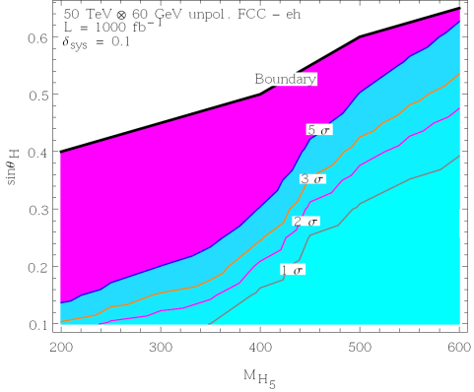
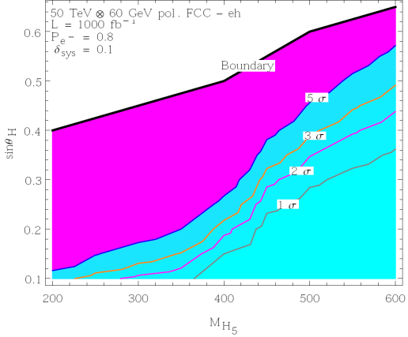
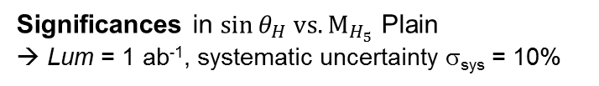


BSM Higgs
Double charged Higgs $H^{±±}$
Signal via WW-fusion in the Georgi-Machacek model
[study by H. Sun, X. Luo, W. Wei and T. Liu ]
$$p e^{−}→j ν_{e} {(H}_{5}^{−−}→W^{−} W^{−})→j ν_{e} (μ^{−} ν_{μ})(μ^{−} ν_{μ})$$
Significances in $\sin{θ_{H} vs. M_{H_{5}}}$ Plain
→ Lum = 1 ab⁻¹, systematic uncertainty σ_{sys} = 10%
Final state: ≥ 1 j + 2 $μ^{−}$ + MET
FCC-eh, unpol.
0.21
Simulation by "MadGraph + PYTHIA + Delphes".
Event selection:
Basic cut
FCC-eh, pol.
Basic selection
Optimized
0.18

Slide 10
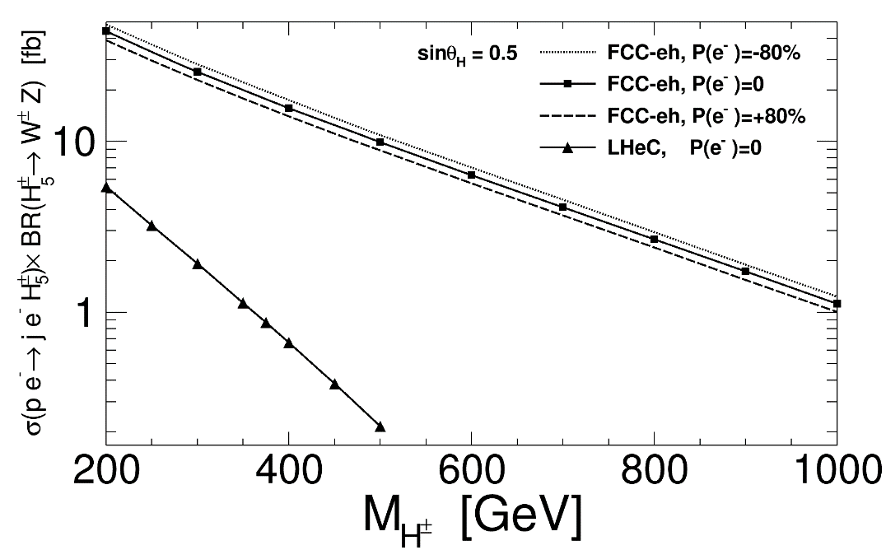
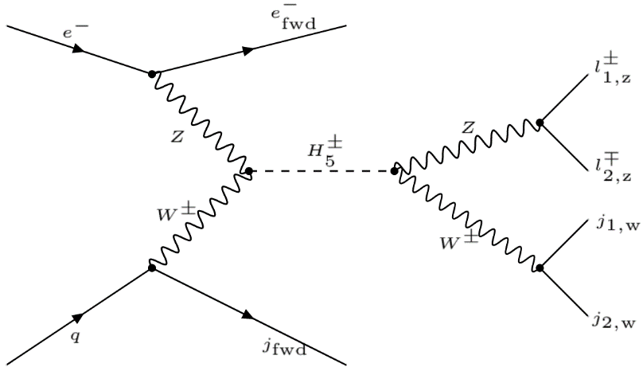
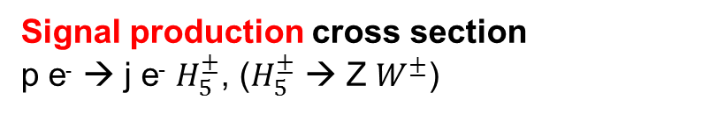

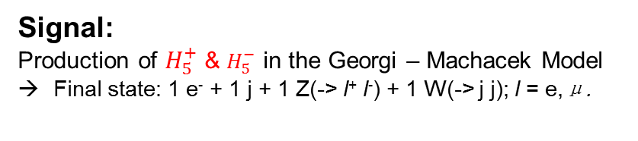
BSM Higgs
Signal Scenarios for $H_{5}^{±}$ Search
[Georges Azuelos, Hao Sun, and Kechen Wang, 1712.07505 ]
Collider: FCC-eh & LHeC
Signal production cross section
p e⁻ → j e⁻ $H_{5}^{±}$, ($H_{5}^{±}$ → Z $W^{±}$)
Signal:
Production of $H_{5}^{+}$& $H_{5}^{−}$ in the Georgi – Machacek Model
Final state: 1 e⁻ + 1 j + 1 Z(-> l⁺ l⁻) + 1 W(-> j j); l = e,μ.
SM Background
B1: p e⁻ > j e⁻ Z V, V → jj
B2: p e⁻ > j e⁻ Z jj, jets from QCD radiation

Slide 11
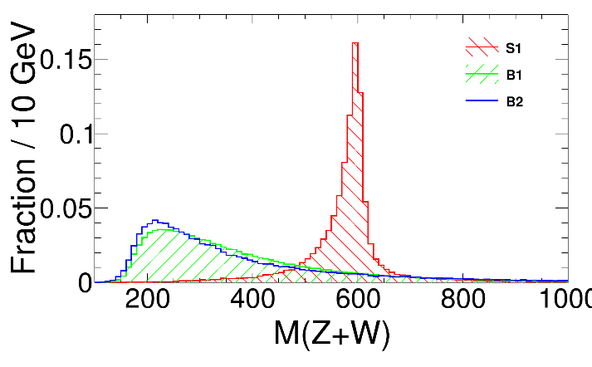
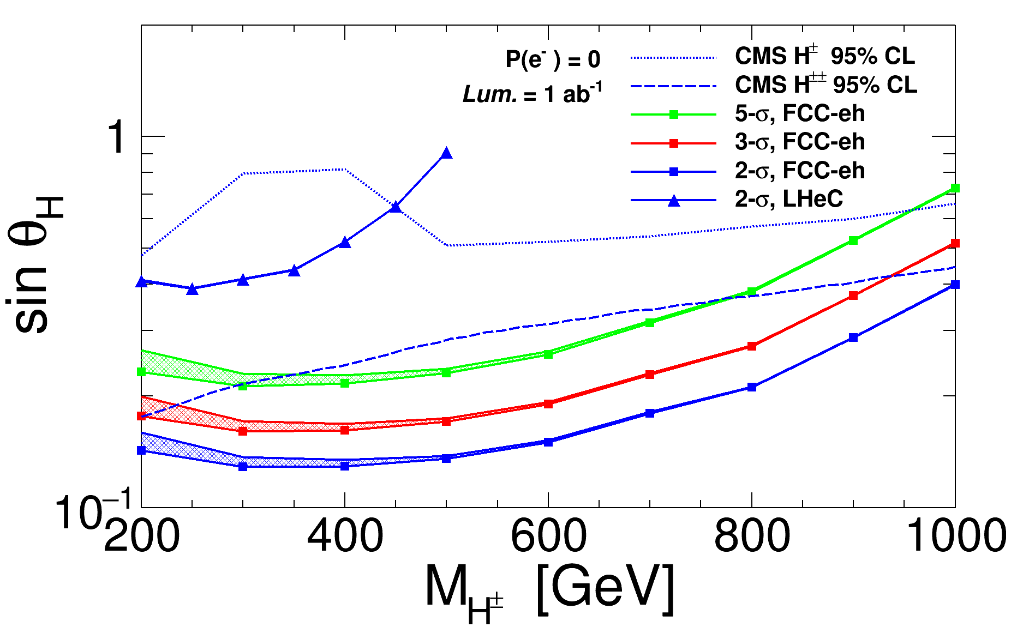
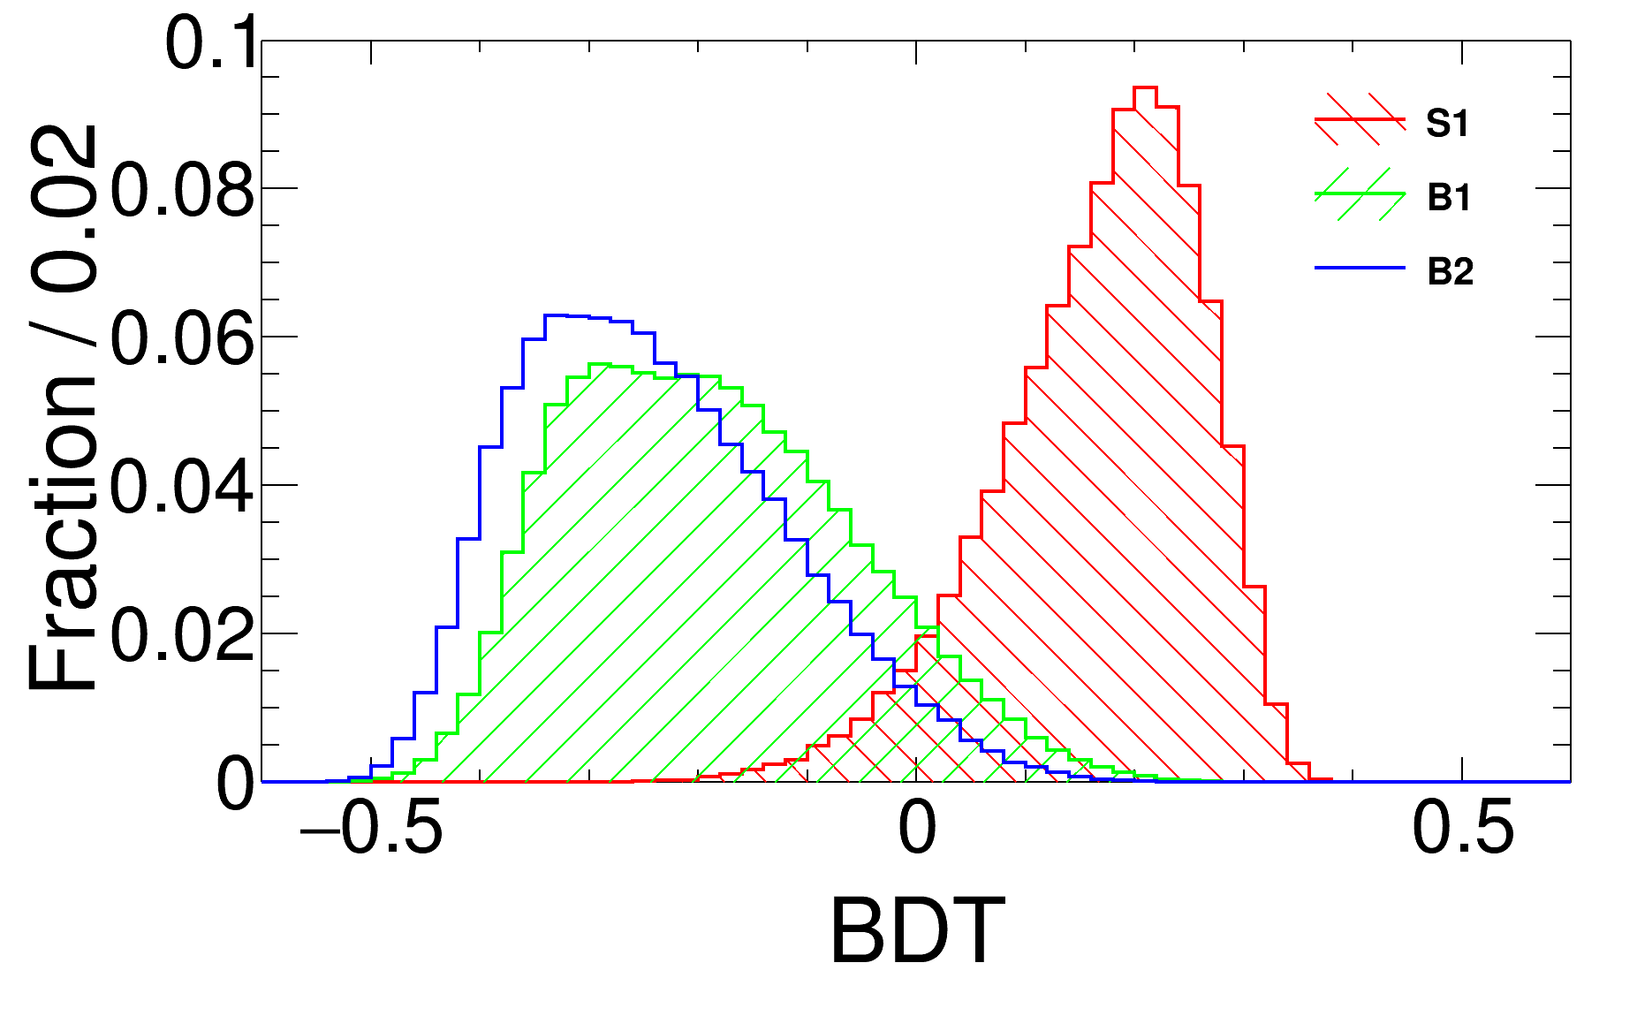

BSM Higgs
MVA-BDT analysis @ detector-level
Limits for $H_{5}^{±}$ Search
FCC-eh, unpol.
M(H₅) = 600 GeV
→ 10% systematic uncertainty on background included

Slide 12
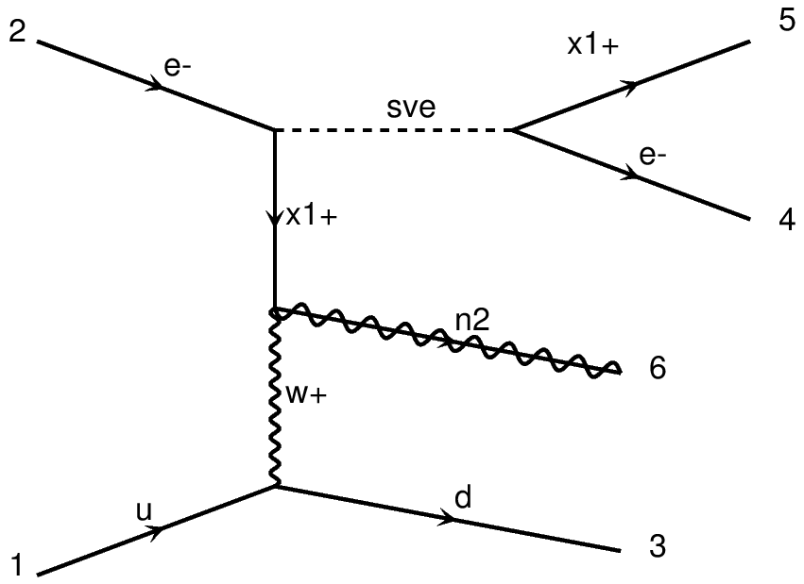
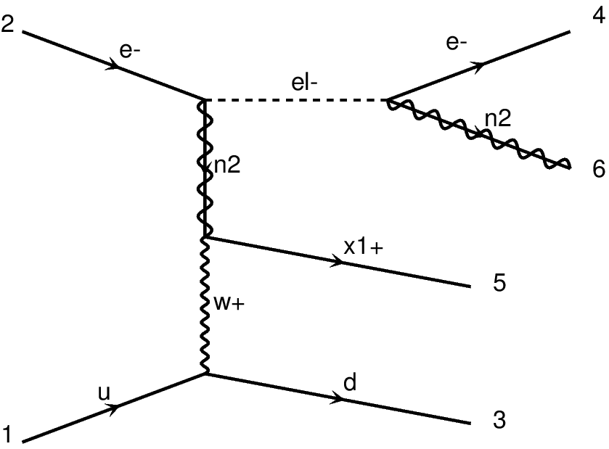
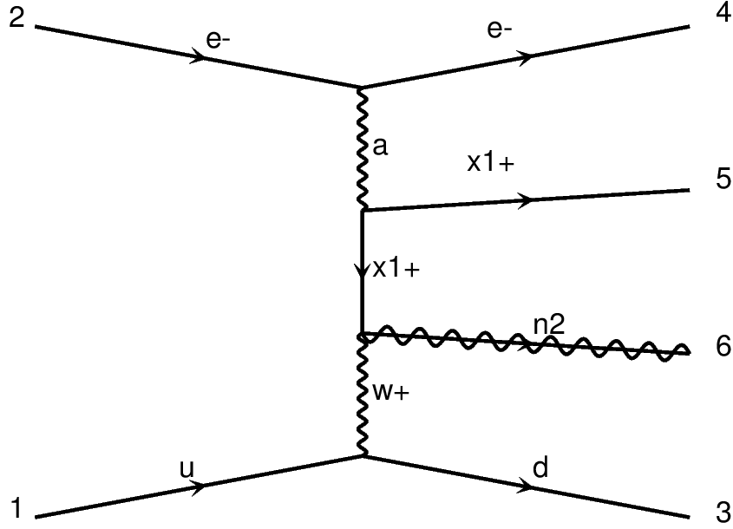
R-Parity Conserving SUSY
Dark matter via kinematical observables
Preliminary results from [Kechen Wang, Sho Iwamoto, Monica D’Onofrio, Georges Azuelos]
Collider:
FCC-eh ( Ep = 50 TeV, Ee = 60 GeV ).
Motivations:
(a) Compressed Scenarios:
decay products are very soft, challenging at pp colliders.
(b) Light sleptons:
Can be motivited by the "muon g-2"
DM production can be enhanced by the slepton decays.
Signal scenarios:
Bino: m_{neutralino1};
Wino: m_{chargino1} = m_{neutralino2} = m_{neutralino1} + 1 GeV;
(1) Light slepton scenario
Slepton: m_{slepton_L} = m_{chargino1} + 35 GeV;
Sneutrino: m_{sneutrino} ~ m{slepton_L} - 9 GeV (tanβ = 30)
BR( slepton -> neutralino2,1 e-): 40%
BR(sneutrino -> chargino1 e-): 60%
(2) Heavy slepton scenario
Slepton & Sneutrino: Heavy and decoupled.

Slide 13
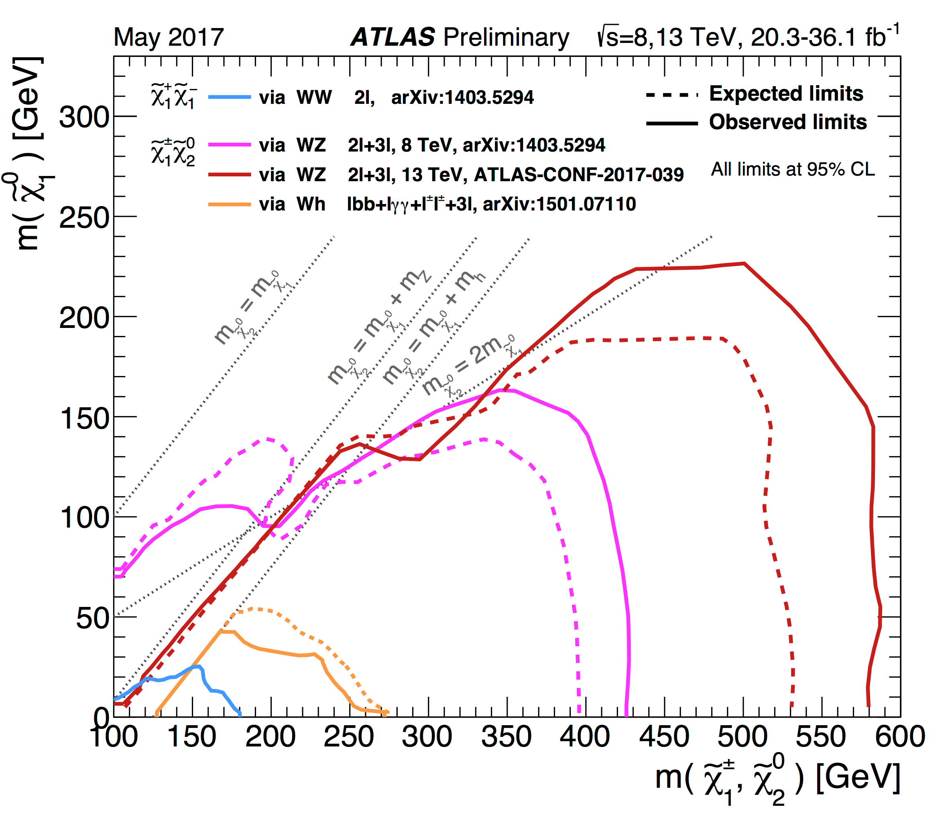
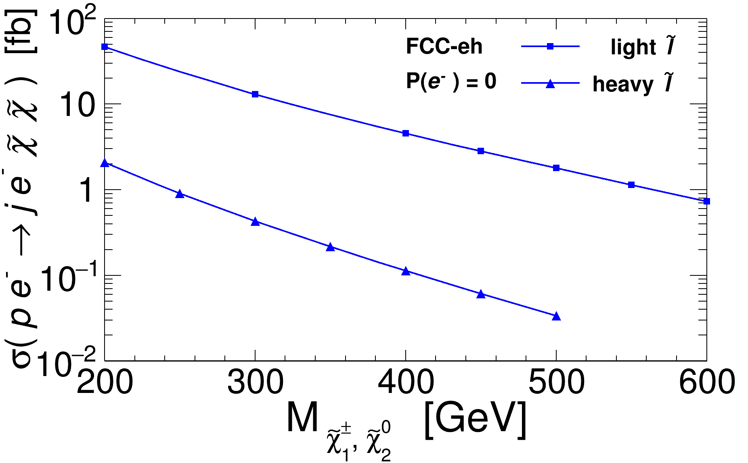
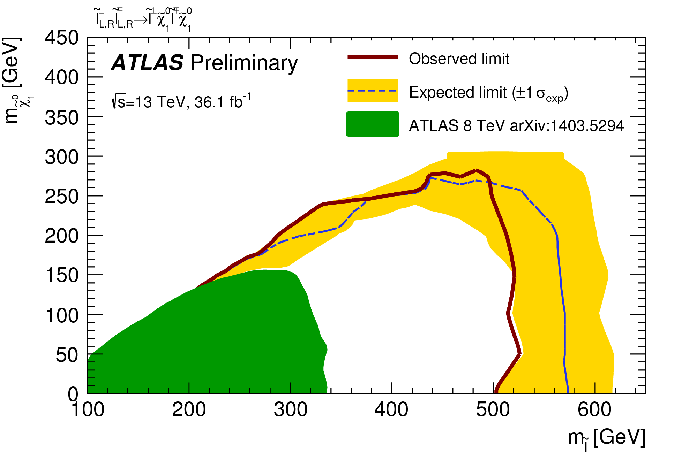
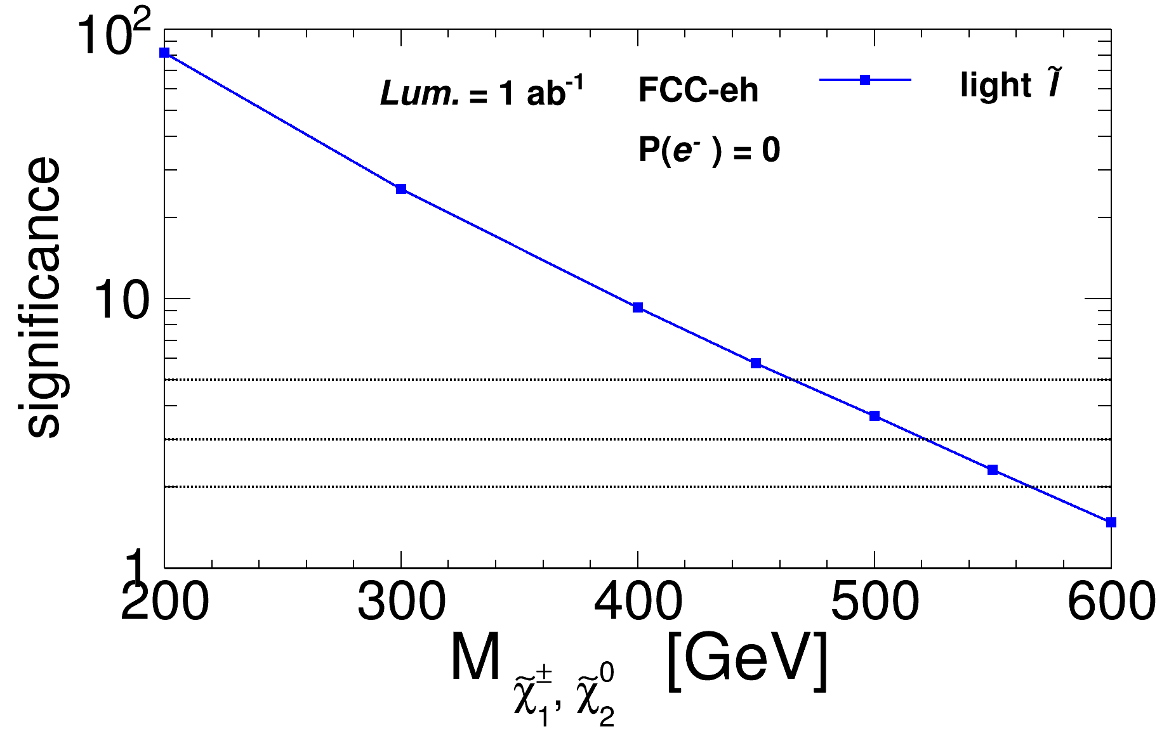
R-Parity Conserving SUSY
Dark matter via kinematical observables
Preliminary results from [K. Wang, S. Iwamoto, M. D’Onofrio, G. Azuelos], should be updated
Current LHC limits on SUSY DM:
Slepton is heavy [arXiv:1509.07152]:
Production cross sections
Current LHC limits on SUSY sleptons
Direct slepton pair production [ATLAS-CONF-2017-039]
Limits via MVA-BDT analysis @ detector-level

Slide 14
R-Parity Conserving SUSY
DM & Sleptons via disappearing tracks
Long-lived charged particles with cτ >~ 10mm
comment on [Kaustubh Deshpande’s talk “LLPs at FCC” ], before
based on [slide from Sho Iwamoto]
Simplest models at FCC-eh:
Simple efficiency analysis
→ Cross section enhanced
with “3-body production”
→ Requiring minimal detection length l_{min}
→ Charginos (Wino) with selectron
FCC-eh
→ More scenarios are in progress.
With no polarization;
9 GeV

Slide 15
Leptoquarks
Limits of Leptoquarks
B anomaly (LHCb); 1-page
(λ_{LQ} = 0.03 = LHC ‘usual’ λ)
ep collider: sensitive to λ < 0.03
L_{FCC-eh} = 500fb⁻¹
LHeC
Sensitivity @ HL-LHC ~ 2.9 TeV
Close to the reach for FCC-eh
If deviations are found by the end of HL-LHC, FCC-hh will definitely see them, and FCC-eh can characterize those signals !
FCC-eh 60GeV
Current LHC
3000/fb @ 14 TeV ~ 2.9 TeV reach
(use http://collider-reach.web.cern.ch)
=> LHeC / FCC-eh offer opportunity to evaluate quantum numbers & couplings
(fermion number, spin, couple chirally, ... )

Slide 16
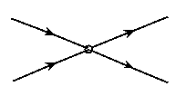
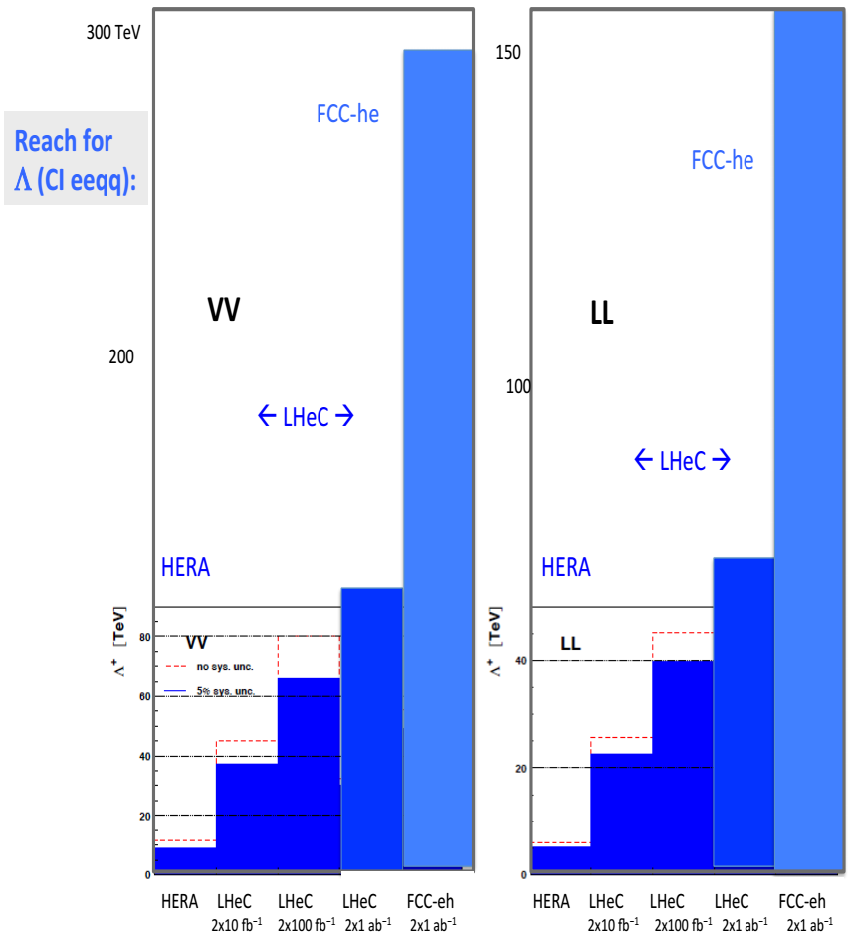
Contact Interactions
e
e
Contact interaction eeqq
q
q
if new physics enters at higher energy scales: Λ>> √s
such indirect signatures can be seen as effective 4-fermion interaction
VV: all couplings with +ve sign
LL: only LL couplings between q and e
New currents or heavy bosons may produce indirect effect via new particle exchange interfering with γ/Z fields.
Reach for Λ
→ VV: ~290 TeV; LL: ~160 TeV
[LHeC results: see CDR 2012]
→ comparable to FCC-hh for
some of the couplings
→ same as HL-LHC vs LHeC
→ need more calculations !

Slide 17
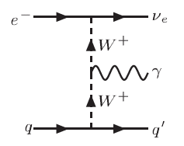
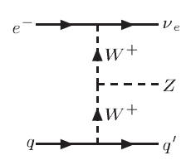
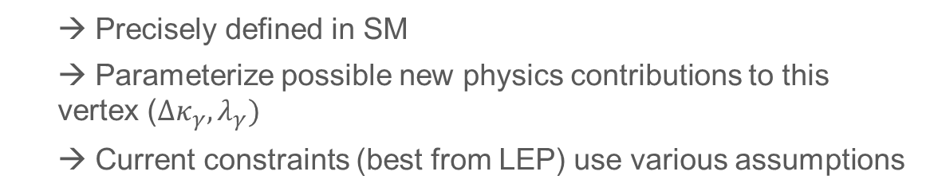
Anomalous Gauge Couplings
Comment on [Daniel Britzger’s talk “EW measurements in ep” ], before
Triple Gauge Couplings (WWV, V = γ, Z)
  → Precisely defined in SM
  → Parameterize possible new physics contributions to this vertex ($Δκ_{γ}, λ_{γ})$
  → Current constraints (best from LEP) use various assumptions
[http://arxiv.org/pdf/1405.6056v1.pdf ]
[https://arxiv.org/abs/1406.7696 ]
At the e-p:
→ can clearly distinguish between CC events e + p → ν_{e} + jet (W-exchange)
and NC events e + p → e + jet (photon or Z boson exchange)
→ triggering on a final state photon, can provide very clean bounds on the
anomalous TGC’s !

Slide 18
Anomalous Gauge Couplings
Triple Gauge Couplings (WWV, V = γ, Z)
[A. Senol, O. Cakir, I. Turk Cakir]
Analysis of the signal & backgrounds
for Z → ll’(l = e, μ)
For comparison:
FCC-eh
P(e⁻) = -0.8
Sensitivities to anomalous couplings λ_{Ζ} ~ 10⁻³

Slide 19
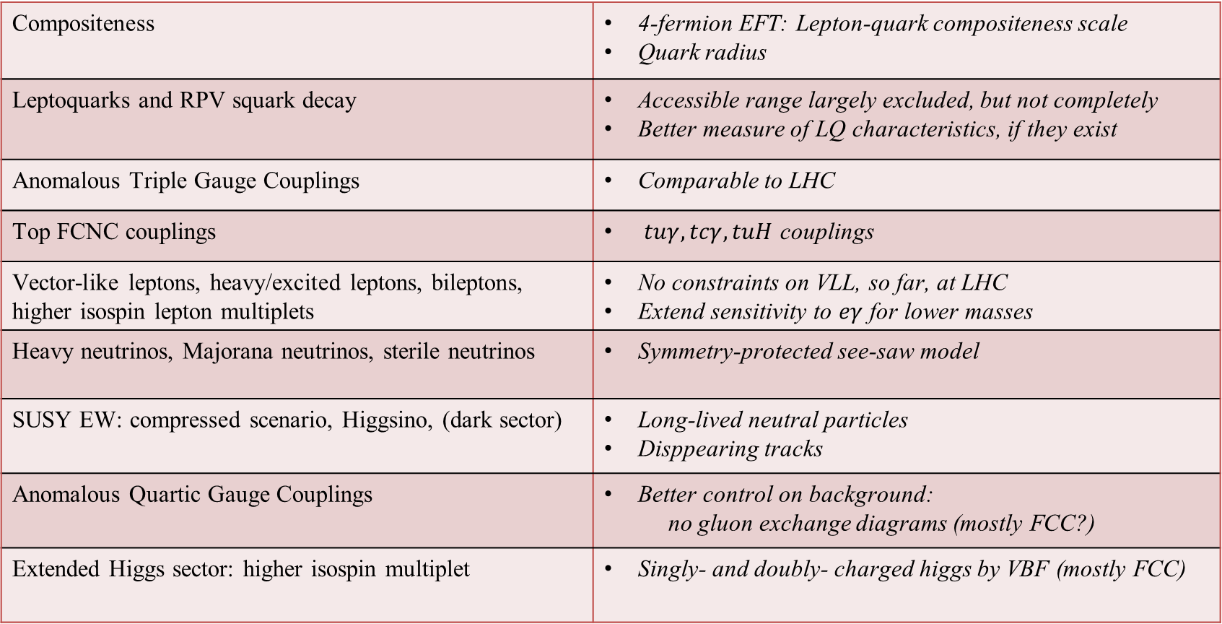
Complementary between ep and pp
  From [Georges Azuelos and Monica D’Onofrio ]
Compositeness | 4-fermion EFT: Lepton-quark compositeness scale Quark radius
Leptoquarks and RPV squark decay | Accessible range largely excluded, but not completely Better measure of LQ characteristics, if they exist
Anomalous Triple Gauge Couplings | Comparable to LHC
Top FCNC couplings | $tuγ, tcγ, tuH$ couplings
Vector-like leptons, heavy/excited leptons, bileptons, higher isospin lepton multiplets | No constraints on VLL, so far, at LHC Extend sensitivity to $eγ$ for lower masses
Heavy neutrinos, Majorana neutrinos, sterile neutrinos | Symmetry-protected see-saw model
SUSY EW: compressed scenario, Higgsino, (dark sector) | Long-lived neutral particles Disppearing tracks
Anomalous Quartic Gauge Couplings | Better control on background: no gluon exchange diagrams (mostly FCC?)
Extended Higgs sector: higher isospin multiplet | Singly- and doubly- charged higgs by VBF (mostly FCC)

Slide 20
Summary & Outlook
ep offers a variety of opportunities for BSM searches
→ precision measurements, complementary searches;
distinguishing & characterization new physics theories;
Improving pp limits indirectly by improved PDF (@ high and low x)
Fruitful BSM physics scenarios:
→ Leptoquarks, Contact interactions, Anomalous gauge couplings, Vector boson
scattering, BSM top physics, SUSY (RPV & RPC), BSM Higgs,
Sterile neutrinos...
Ideal to search and study properties of new particles with
→ couplings to electron-quark, EW production, multi-jets final states
Compare with pp colliders
    → Some promising: clean environment (samller bkg), forward objects
    → Some difficult: small production due to small sqrt(s)
Physics potential yet to be fully exploited
    → Detector-level studies crucial for next phase
    → You are welcome to join our team !!!

Slide 21
Backup Slides

Slide 22
Improved PDF Measurements @ LHeC & FCC-eh
→ low-x: no current data to constrain x ≤ 10⁻⁴;
better but not much after HL-LHC;
→ mid-x: need higher precision for Higgs
→ high-x: very poorly constrained;
limits searches for new, heavy particles
→ FCC-eh: access to much smaller x, larger Q²
→ important for the FCC-hh as it will probe much lower x regions for standard processes

Slide 23
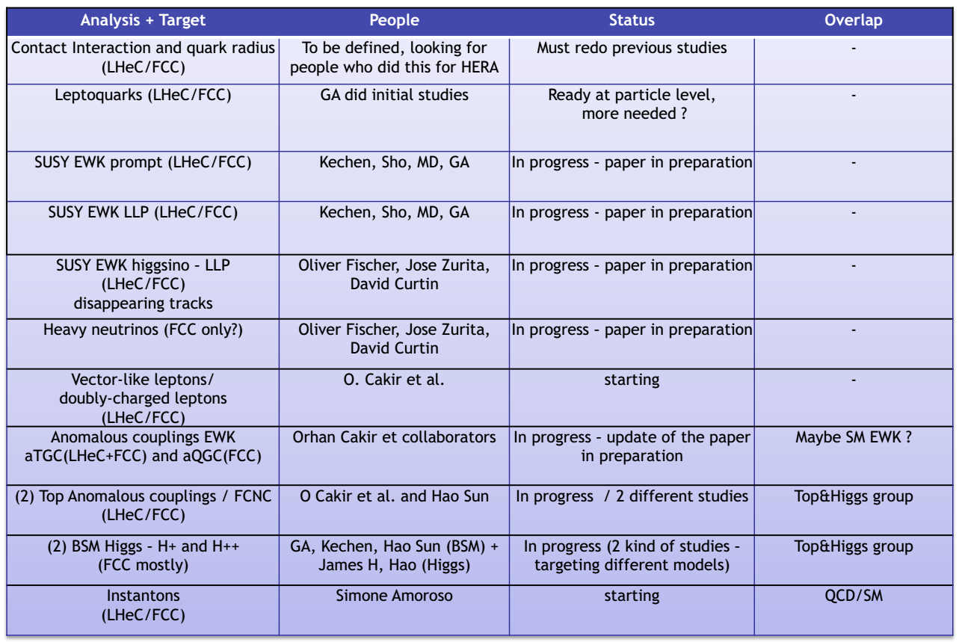
Searches to be followed in a nutshell
  From [Georges Azuelos and Monica D’Onofrio ]

Slide 24
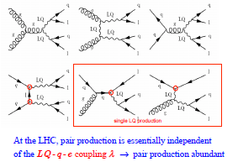
Leptoquarks
Leptoquarks (LQs)
→ appear in several extensions to SM: production s ~
→ can be scalar or vector, with fermion number 0 (e⁻ qbar) or 2 (e⁻ q)
At the e-p
→ both baryon & lepton quantum numbers
→ ideally suited to search for and study properties of new particles coupling to both leptons and quarks
At the p-p
λ
λ
→ mostly pair production (from gg or qq)
  → not sensitive to the LQ-q-l coupling λ
→ single, resonant production
→ sensitive to λ

Slide 25
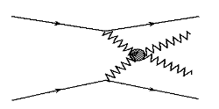
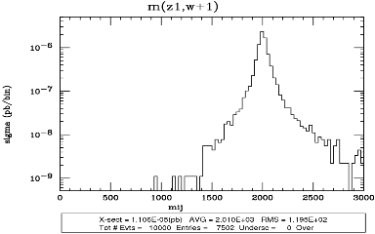
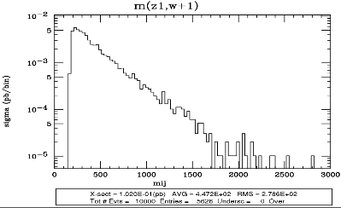
Vector Boson Scattering
New resonances possibly relevant for unitarity restoring
  → expect below ~ 2-3 TeV
  → look for deviations from SM predictions
→ Challenging at p-p (high QCD bkg, pile-up)
→ Cleaner at FCC-eh
Preliminary results from [Georges Azuelos’s study]
For a 2 TeV resonance
m(WZ), background
→ low cross section [1402.4431]
→ there is some potential to study
VBS at high mass
kinematics distinct between signal & background
cleaner, small background for masses ~ 2TeV
low pile-up

Slide 26
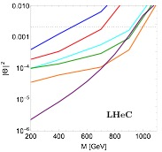
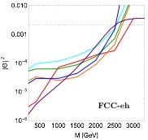

Sterile Neutrinos
Slide from [Oliver Fischer ]
Related articles considering electron-proton colliders
[“Polarized window for left-right symmetry and a right-handed neutrino at the Large Hadron-Electron Collider”, S. Mondal, S. K. Rai, Phys. Rev. D 93 (2016) no.1, 011702 ]
[“Probing the Heavy Neutrinos of Inverse Seesaw Model at the
LHeC”, S. Mondal, S. K. Rai; Phys. Rev. D 94 (2016) no.3, 033008 ]
[“Left-Right Symmetry and Lepton Number Violation at the Large Hadron Electron Collider”, M. Lindner, F. S. Queiroz, W. Rodejohann, C. E. Yaguna; JHEP 1606 (2016) 140 ]
limits for LNC signatures
[ S. Antusch, E. Cazzato, O. Fischer, 1612.02728 ]

Slide 27
Related previous talks at FCC week 2018
General introduction, physics, detector, CDR,
  see [Claire Gwenlan’s talk “PDFs at the FCC-eh” ], before
  see [Uta Klein’s talk “Higgs SM Couplings at FCC-ep” ], before
Sterile neutrinos,
see [Oliver Fischer’s talk “Heavy neutrino discovery prospects at FCC”], before
[Daniel Britzger, “EW measurements in ep” ], before
[Kaustubh Deshpande, “LLPs at FCC” ], before
After:
[Christian Schwanenberger, “Top physics in ep” ]

