Slide 1
The role of correlations in disentangling between heavy-flavor energy-loss Models
Winter Summer Workshop on Nuclear Dynamics
La Guadeloupe (Fr)
P.B. Gossiaux
SUBATECH, UMR 6457
Université de Nantes, IMT Atlantique, IN2P3/CNRS
In collaboration with J. Aichelin, B. Guiot, A. Mischke, M. Nahrgang, T. Pierog, L. Vermuunt, K. Werner
Notes:
Plan: 1) global motivation about correlations; 2) No NLO effect: back from PRC79 3) other correlations, spoiled by NLO 4) Tsidekalis and pp NLO 5) back to back in AA: AD from other groups 6) own results and 50-70% 7) combined analysis. …. WAS already presented at WWND 4 years ago.

Slide 2
(Short) Motivation
Nowadays, a large variety of models (most of them presented as “effective approaches”) are confronted with the data for the R_{AA} & v₂ single particle observables
For the purpose of making the contact with the fundamental theory, it is desirable to “constrain / pre-sort / rule out” some of the approaches
Very often, correlations are advocated to be useful in this respect (warning: main viewpoint adopted in this presentation)

Slide 3
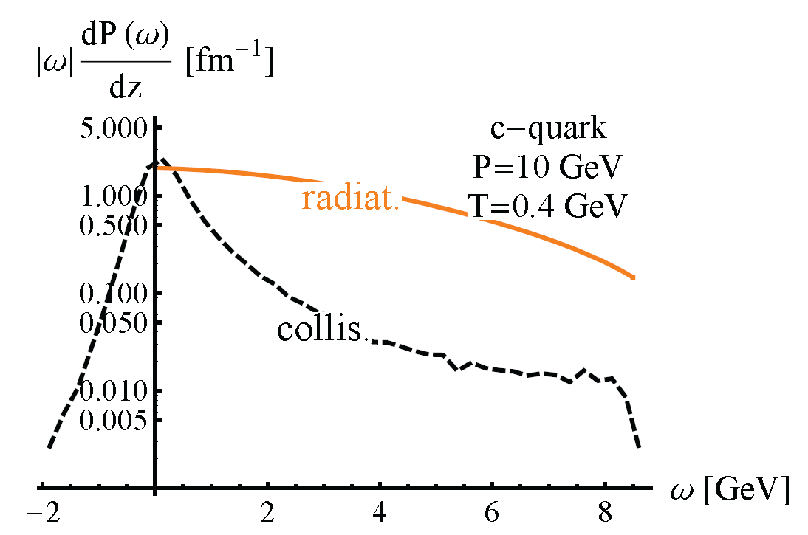


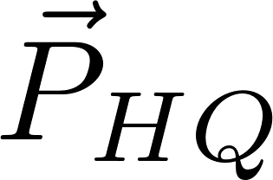
How does it help ? Best HF Correlation ever ?
γ – D/B/c jet /b jet:
In QGP: Longitudinal and transverse (qhat) fluctuations of the HQ, which crucially depend on the Eloss mechanism and cannot be measured in usual observables like R_{AA} or v₂
(II)
(I)
RADIAT
ELASTIC
No E loss => perfect probe of initial
differential probability to loose energy ω per unit time
Of course: NLO effect in the production mechanisms makes it not so trivial (not to speak about exp. Issues… RUN3 ? RUN4 ?)

Slide 4
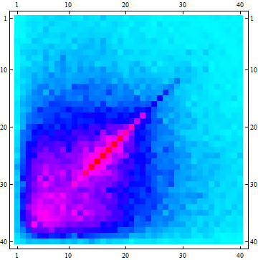
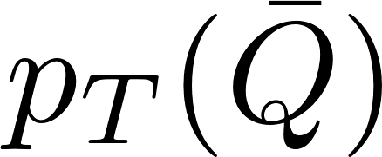

Next best thing: HF-HF correlations
Back to back D/Dbar or B/Bbar: As compared to γ-D/B: “triggering” itself is affected but symmetry between both particles could limitate the various effects:
Large number of c-cbar from various NN collisions => large uncorrelated background
Competing effects due to energy loss: …
p_{L}
Initial stage
Initial stage
decorrelation due to various path lengths + fluctuations: reduction
Strong correlation
Evolution in hot QGP medium
Notes:
Expectation: Initial correlations will be broadened more effectively in a purely collisional model.

Slide 5
Next best thing: HF-HF correlations
Back to back D/Dbar or B/Bbar: As compared to γ-D/B: “triggering” itself is affected but symmetry between both particles could limitate the various effects:
Large number of c-cbar from various NN collisions => large uncorrelated background
Competing effects due to energy loss: …
p_{L}
Initial stage
Initial stage
feeding from higher p_{T} (stronger) correlations: increase
Strong correlation
Evolution in hot QGP medium
Notes:
Expectation: Initial correlations will be broadened more effectively in a purely collisional model.

Slide 6
Once upon a time: momentum imbalance for hot core
Challenge: tagging on the “central” Q, i.e. getting closer to the ideal “penetrating probe” concept:
Reversing the argument: selecting might bias the data in favor of “central” pairs
≈ back to back
while
Possible caveat:
⇒ Need for a detailed study
≈
Gossiaux et al, PHYSICAL REVIEW C 79, 044906 (2009)

Slide 7

Once upon a time: momentum imbalance for hot core
Average transv.-dist. to center as a function of Δp_{T}^{fin} for various p_{T}^{in}
5fm
Indeed some (favorable) bias for init p_{T}^{in} > 5GeV/c and “small” Δp_{T}^{fin}
4fm
Hope to probe hotter regions of the QGP
3fm
However: No access to p_{T}^{in} !!!

Slide 8
Once upon a time: momentum imbalance for hot core
Best ansatz:
Average transv.-dist. to center as a function of Δp_{T}^{fin} for various p_{T}^{fin}
Central production:
Conclusion: Favorable bias for av. p_{T}^{fin} > 8 GeV/c and “small” Δp_{T}^{fin}
≈
Tangential production

Slide 9
momentum imbalance for hot core: back to r_{T} distributions
Glauber
p_{T}^{fin} > 5 GeV/c (singles)
p_{T}^{fin} > 5 GeV/c (double)
p_{T}^{fin} > 5 GeV/c AND Δp_{T}^{fin}<0.2 p_{T}^{fin}
Hyper-Corona
Final cuts lead to various distributions of initial position
One nearly recovers the Glauber profile for most severe cut
Glauber
p_{T}^{fin} > 10 GeV/c (singles)
p_{T}^{fin} > 10 GeV/c (double)
p_{T}^{fin} > 10 GeV/c AND Δp_{T}^{fin}<0.2 p_{T}^{fin}

Slide 10
momentum imbalance: increase R_{AA} sensitivity
Usual ratio: Nb(Au+Au)/ Nb_{coll}*Nb(pp)
Running α_{s}
Fixed α_{s}
Usual flat
2 part
Rise with p_{T} although no selection ! Different behaviors are due to fluctuations
More and more sensitive at large p_{T} for HQ from center
Close to experimental prediction but not yet (Hadronization, NLO at the time of production, background substraction,…)

Slide 11
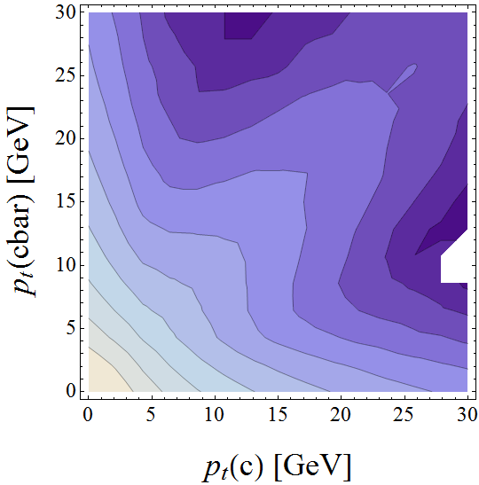
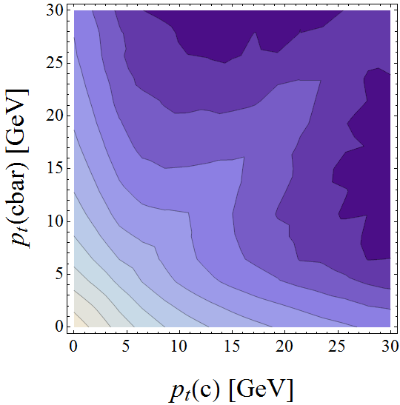
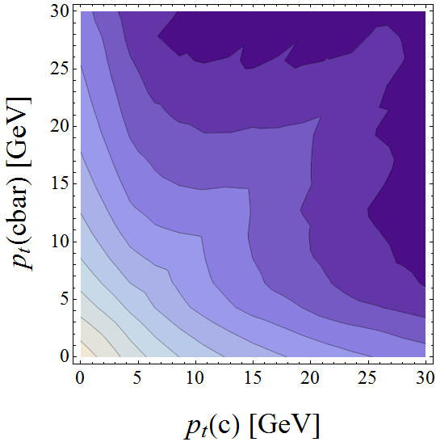
Consequences on the observables: p_{t}(c)-p_{t}(cbar) correlations
Pb-Pb @ 2.76 TeV; 40-60%. Toy study: back to back c-cbar (no NLO corrections)
El.
El. + LPM (Γ/Τ=0.75)
El. + LPM (Γ=0)
Background at small p_{t}
Tagging on 1 high p_{T} Qbar:
Residual correlation after evolution through QGP
(similar path length for most of HQ produced in the core of the reaction)
Notes:
Missing ingredient should moreover increase at high T

Slide 12
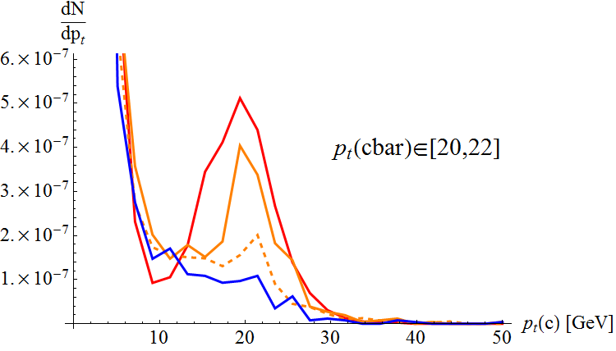
Consequences on the observables: p_{T}-p_{T}bar correlations
Pb-Pb @ 2.76 TeV; 40-60%. Toy study (proof of principle): back to back c-cbar
How does DGLAP evolution blur momentum imbalance ?
Significant residual correlation for the case of Elastic energy loss or LPM radiative + gluon damping
In the B2B region:
No significant residual correlation for the case of radiative GB or LPM radiative
WWND 2014 Galveston
Background at small p_{t}

Slide 13
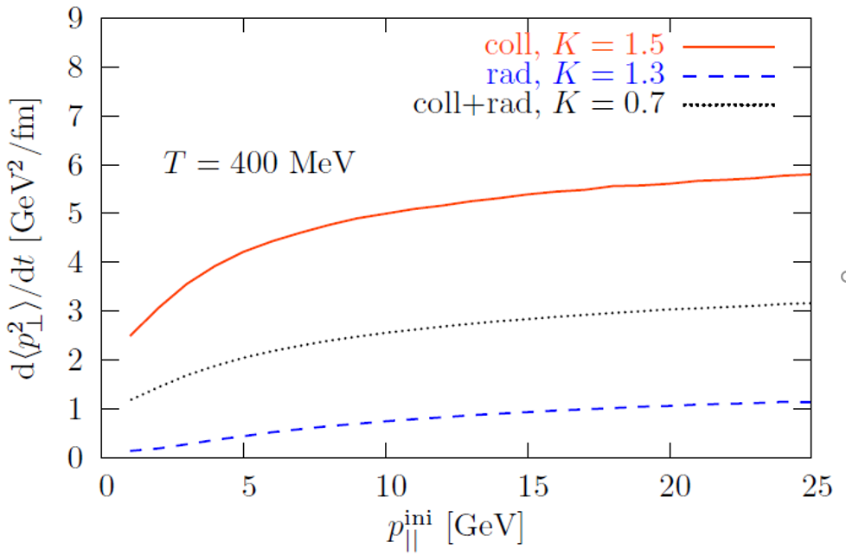
Next best thing: HF-HF correlations
Back to back D/Dbar or B/Bbar: As compared to γ-D/B: “trigger” itself is affected but symmetry between both particles limitates the various effects.
p⊥
Elastic Eloss vs radiative Eloss: The purely collisional scatterings lead to a larger average <p⊥²> then the radiative “corrections” (need for large scattering to be efficient)… although both types can give correct agreement with the data at intermediate p_{T}.
Expected consequences for azimuthal correlations (probe of B_{T}: good: complimentary to usual RAA and v2)
c quarks
Elastic
Radiative
x
Tuned to reproduce the R_{AA}
Notes:
Expectation: Initial correlations will be broadened more effectively in a purely collisional model.

Slide 14
Next best thing: azimuthal correlations
Assumption of back 2 back emission of initial QQbar (naïve LO…)
Nahrgang et al. Phys. Rev. C 90, 024907 (2014)
p_{T}
Indeed, rather large differences found for both b and c, and all kind of p_{T} cuts (… but good to see there is an effect though,…)
For the smallest p_{T} bin and elastic energy loss, we even find an inversion of the correlation (“hot partonic wind” push; v₀ bulk => v₁ correl; underlying event)
Notes:
V0 in the bulk => v1 in the correlations: I had a mathematical argument it cannot be true at some point. Probaby not for pT integrated, but ok in a given class of pT: put reference

Slide 15
Next best thing: azimuthal correlations
…but higher orders can have a significant impact:
LO; (a): back to back peak
(a)
(b)
NLO;
(c): “blurring” of B2B peak
(d): “flavor excitation”: no strong azimuthal correlation expected
(e): gluon splitting: strong peak around Δφ=0
(f): higher order FE; both Q and Qbar in the “remnant” region
(c)
(d)
(e)
(f)

Slide 16
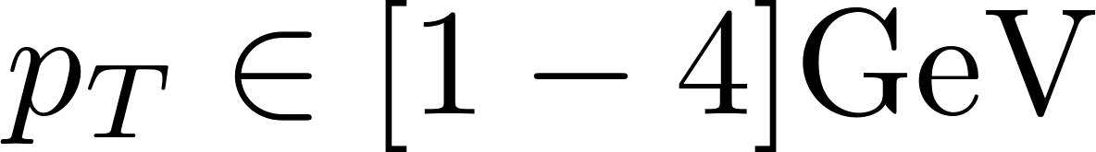
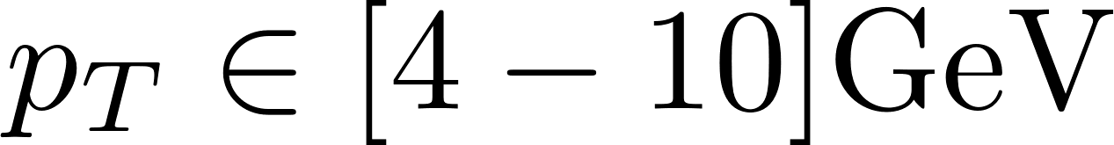
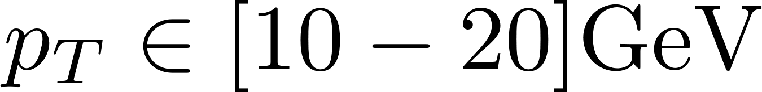
Next best thing: azimuthal correlations
NLO effect simulated with MC@NLO + HERWIG (parton shower)
Gluon splitting processes lead to an initial enhancement of the correlations around Δφ=0; Strong broadening of the Δφ=π peak (“vacuum” radiation is dominant)
For intermediate p_{T} : increase of the variances due to Eloss from 0.43 (initial NLO) to 0.51 (+20%) for the purely elastic mechanisms and to 0.47 (+10%) for the interaction including radiative corrections.
Correlations at large p_{T} seem to be dominated by the initial correlations. Nothing will be learned on the Eloss mechanisms in this region
Different NLO+parton shower approaches agree on bottom quark production, differences remain for charm quark production
Study by other groups (Duke, CCNU-LBL,PHSD,…)
Notes:
Exp CMS ?

Slide 17
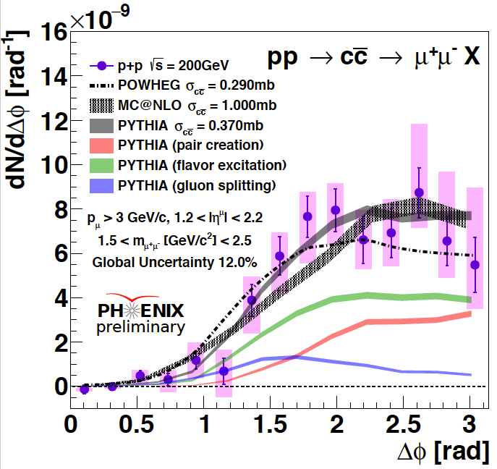
Azimuthal correlations from experimental viewpoint
PHENIX
Measured in pp both at RHIC and LHC (rising gluon splitting peak)
Not even sure one could resolve a 10% difference in the width for the pp !!!
A+A: expected after upgrades ?
LHCb
Notes:
Nothing in pA ?

Slide 18
Next best thing: HF-HF correlations
Back to back D/Dbar or B/Bbar: As compared to γ-D/B: “triggering” itself is affected but symmetry between both particles could limitate the various effects:
Large number of c-cbar from various NN collisions => large uncorrelated background
Competing effects due to energy loss
p_{L}
Of course: NLO effect in the production mechanisms makes it not so trivial (not to speak about exp. Issues… RUN 3 ? RUN 4 ?)
Notes:
Expectation: Initial correlations will be broadened more effectively in a purely collisional model.

Slide 19
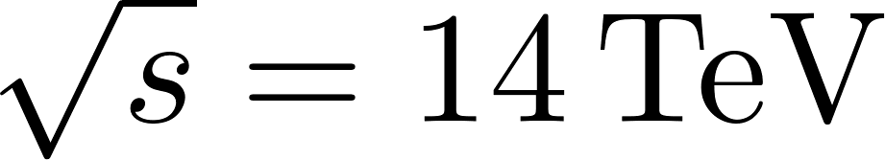
Not so naïve approach: Momentum imbalance in pp
… including “realistic” initial stage in pp (PYTHIA 6)
G. Tsiledakis et al., Nucl. Phys. A 858 (2011) 86.
Average auto-correlation:
In the back-to back region, NLO corrections (FSR) still preserve some degree of correlation

Slide 20
Not so naïve approach: Momentum imbalance in pp
… including “realistic” initial stage in pp (PYTHIA 6)
G. Tsiledakis et al., Nucl. Phys. A 858 (2011) 86.
Average relative auto-correlation:
Encouraging signs of significant finite (transverse) momentum correlation in pp, i.e. in the initial stage of A-A collisions
Going beyond average ?
Lessons from CMS: Pythia has problems to reproduce Q-Qbar azimuthal correlations
CMS-PASHIN-
16-005.

Slide 21
Momentum imbalance: not so naïve approach
Goal of the study: investigate whether p_{T}-p’_{T} correlations survive NLO effects
Method for “systematics”: use 2 event generators: PYTHIA (6.4) & EPOS3
L. Vermunt et al. arXiv:1710.09639
In pythia, those topologies are generated by coupling LO processes (implying 0,1 or 2 HQ) and ISR + FSR … This will be referred to as « LO + NLO ccbar » (strictly speaking, no NLO !)

Slide 22
Momentum imbalance: not so naïve approach
Goal of the study: investigate whether p_{T}-p’_{T} correlations survive NLO effects
Method for “systematics”: use 2 event generators: PYTHIA (6.4) & EPOS3
L. Vermunt et al. arXiv:1710.09639
In pythia, those topologies are generated by coupling LO processes (implying 0,1 or 2 HQ) and ISR + FSR … This will be referred to as « LO + NLO ccbar » (strictly speaking, no NLO !)
Same « strategy » in EPOS3, with « semi-hard pomeron » approach (with some soft evolution included), with various LO Born processes.
Space-like cascade
Born process
Time-like cascade

Slide 23
Momentum imbalance: not so naïve approach
Goal of the study: investigate whether p_{T}-p’_{T} correlations survive NLO effects
Method for “systematics”: use 2 event generators: PYTHIA (6.4) & EPOS3
L. Vermunt et al. arXiv:1710.09639
In pythia, those topologies are generated by coupling LO processes (implying 0,1 or 2 HQ) and ISR + FSR … This will be referred to as « LO + NLO ccbar » (strictly speaking, no NLO !)
Same « strategy » in EPOS3, with « semi-hard pomeron » approach (with some soft evolution included), with various LO Born processes.
In pythia, possibility to restrict to LO ccbar production processes with massive elements (MSEL=1 -> MSEL=4 flag), still switching on the … ISR + FSR … This will be referred to as « LO ccbar »

Slide 24
Momentum imbalance: not so naïve approach
Including NLO effects in the charm production (N.B. :beauty would be better for our purpose, but very low statistics)
L. Vermunt et al. arXiv:1710.09639
Not the same normalization
In the B2B region:
Good agreement in the normalization for EPOS3 vs PYTHIA « LO » (MSEL=4)
Large excess PYHTIA « NLO »; shown to be due to flavor excitation like process
B2B selection
N.B.: Pythia MSEL=4: at least 1 ccbar pair un each event => Normalized according to high-p_{T} LO charm creation in Pythia MSEL=1

Slide 25
Momentum imbalance: not so naïve approach
Including NLO effects in the charm production:
R.D. Field Phys.Rev.D 65 (2002)
Flavor excitation: very sensitive to the ccbar in the proton sea, i.e. to the gluon evolution -> large Q²
σ_{charm} (Pythia 6,) exceeds measured ALICE value by a factor 3-5. Mostly due to large FEX contribution.
Similar conclusion of sur-abundant FEX found by CMS (CMS-PAS-HIN-16-005) for beauty quarks

Slide 26
Momentum imbalance: not so naïve approach
EPOS3
PYTHIA LO ccbar
In the B2B region:
PYTHIA LO + « NLO » ccbar
Same process in the B2B => use the p_{T} correlations to investigate FSR

Slide 27
Momentum imbalance: not so naïve approach
EPOS3
PYTHIA LO ccbar
In the B2B region:
PYTHIA LO + « NLO » ccbar
Same process in the B2B => use the p_{T} correlations to investigate FSR
Use p_{T} correlations to resolve FEX contribution in the B2B region

Slide 28
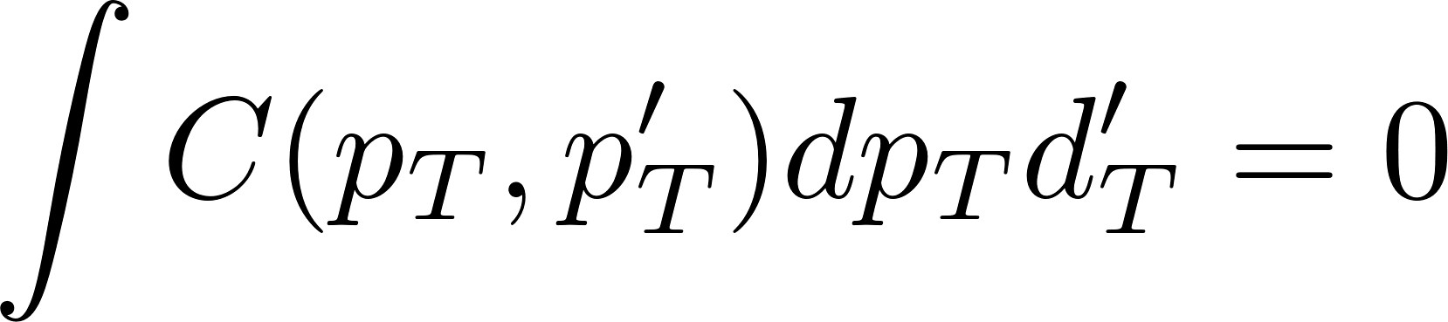
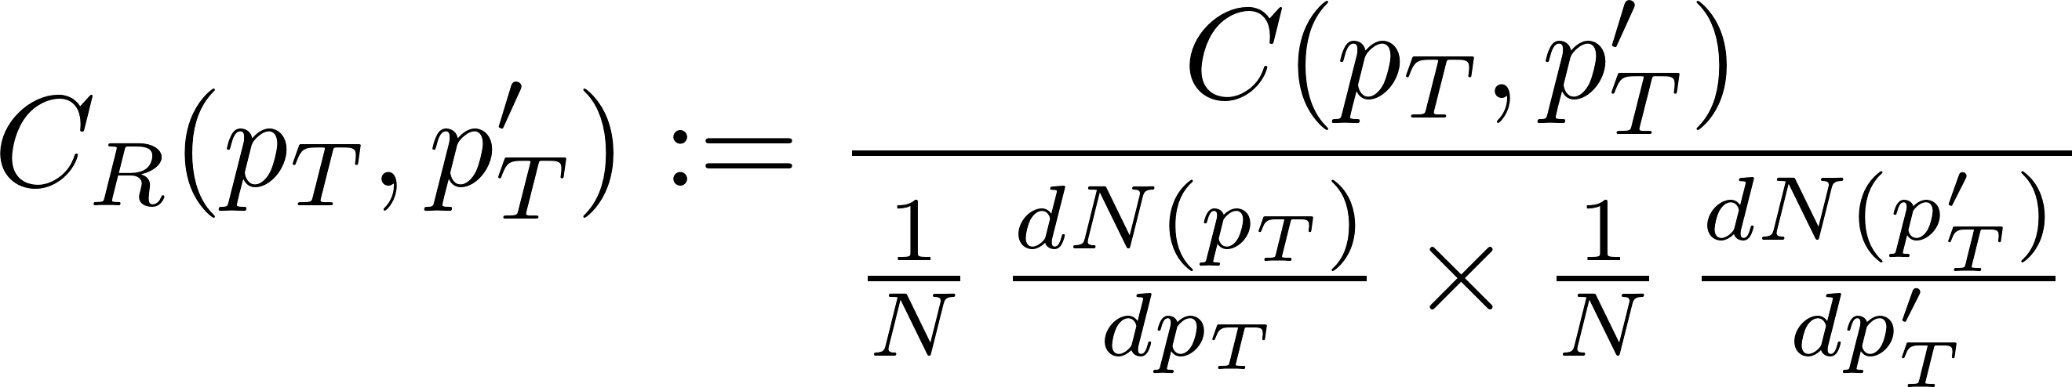
Momentum imbalance: not so naïve approach
Abolute correlation:
Vanishes if d²N factorizes (d²N(p,p’) = dN(p) x dN(p’))
Satisfies
Reveals correlation at finite p_{T}
PYTHIA LO ccbar
projection
Relative correlation:
B2B selection
Different p_{T} imbalance for 3 production models in pp
2 of them show that NLO effects does not completely destroy the perfect correlation found in LO production
Similar results for DDbar
Notes:
Mention the fact we are more differential

Slide 29
From the experimental viewpoint
No momentum imbalance so far in pp @ LHC (to my knowledge)…
But valuable data from LHCb on DD:
Under present investigation
LHCb, J. High Energy Phys. 06, 141 (2012)
Notes:
Mention FERMILAB

Slide 30
Momentum imbalance in A-A
Some recent works:
  J. Uphoff et al. (BAMPS): Phys. Rev. C 89 (2014), 064906
All including realistic c-cbar « initial » production

Slide 31
Momentum imbalance in A-A
J. Uphoff et al. (BAMPS): Phys. Rev. C 89 (2014), 064906:
Collisional Energy loss model calibrated on v₂(D) meson; lead to acceptable results for R_{AA} as well.
Chosen observable:
Back to back selection
Two selections for most central Pb-Pb collisions:
  “Intermediate”:
  “High”:
Leading D/Dbar
Sub- Leading D/Dbar

Slide 32
Momentum imbalance in A-A (BAMPS)
Intermediate p_{T} selection:
High p_{T} selection (focusing on PYTHIA IC):
“ Furthermore, it would be intriguing to include also radiative processes for charm quarks and investigate their effects on A_{D} »
Strong momentum imbalance resulting from c-quark interaction with QGP
Large fraction of c-cbar pairs stemming from disconnected NN interactions
Large fraction of c-cbar pairs stemming from single NN interactions Strong
Moderate momentum imbalance resulting from c-quark interaction with QGP (MI dominated by IC, as for azimuthal correlations)

Slide 33
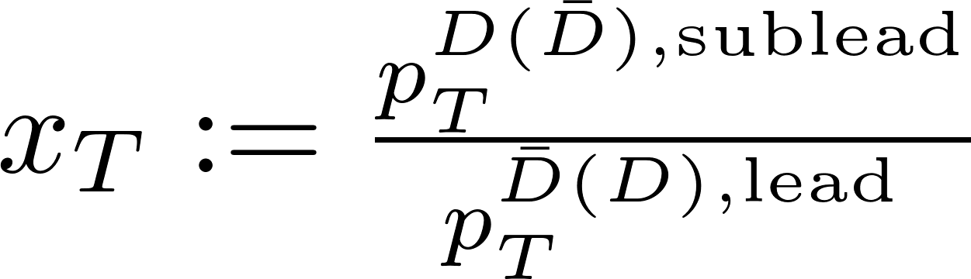
Momentum imbalance in A-A
Some recent works:
  S. Cao et al.: Phys. Rev. C 92 (2015), 054909 (focused on RHIC energies)
  T. Song et al. (PHSD): Phys. Rev. C 96 (2017), 014905 (azimuthal correlations)
All including realistic c-cbar « initial » production
Observable:
Moderate increase of momentum imbalance from pp → peripheral Au-Au → central Au-Au collisions
“…momentum imbalances … value does not strongly depend on the detailed energy loss mechanism as long as the transport coefficient is properly adjusted to describe the D meson RAA. »

Slide 34
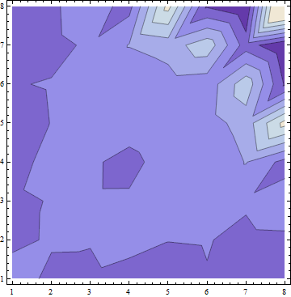
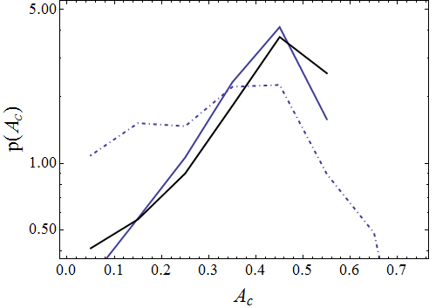
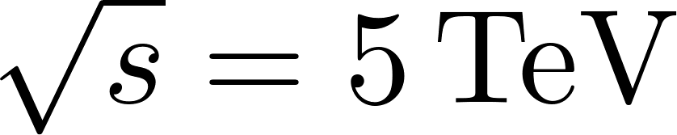

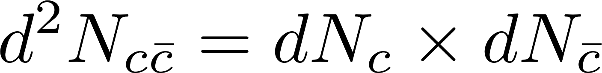
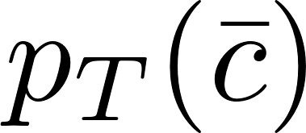
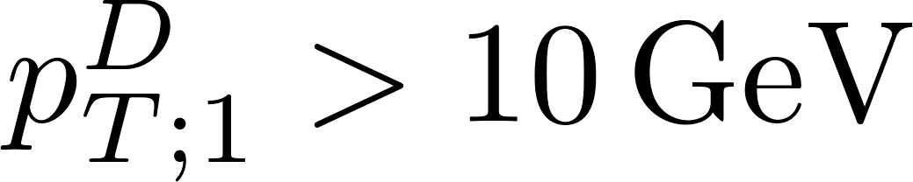
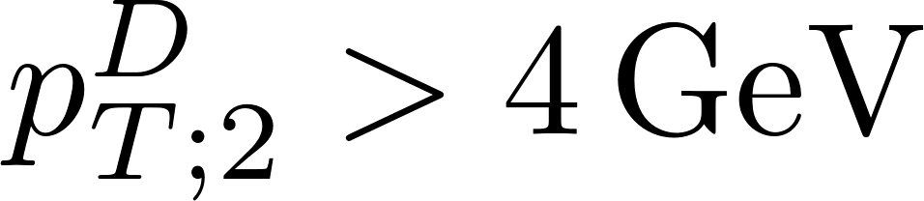

Momentum imbalance in central Pb-Pb (EPOSHQ)
All HQ produced according to EPOSHQ (V3210)
Final c-cbar:
Collisional Energy loss (K=1.5)
Pb-Pb (final)
PbPb (final), assuming
Final C_{R}
pp
16 GeV
≈ 100% memory loss of initial correlations
Very few remaining corre-lations in the final stage of the collision

Slide 35
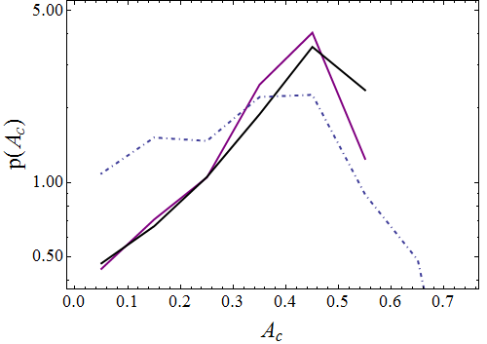
Momentum imbalance in central Pb-Pb (EPOSHQ)
All HQ produced according to EPOSHQ (V3210)
Final c-cbar:
Col + Rad Energy loss (K=0.8)
Pb-Pb (final)
PbPb (final), assuming
Final C_{R}
pp
16 GeV
≈ 100% memory loss of initial correlations, irrespective of E loss mechanism => no good discrimination (also for beauty)
Problem with A_{D}: no clear decorrelation limit
Very few remaining corre-lations in the final stage of the collision

Slide 36
Momentum imbalance: b-bar in Pb-Pb
“Initial” stage (before evolution with the medium)
projection
Very good correlation for intermediate p_{T}
Much less uncorrelated background than for c-cbar.

Slide 37
Momentum imbalance: b-bar in Pb-Pb
Elastic Energy loss
Elastic + Radiative Energy loss
Pb-Pb @ 5TeV, 50-70%

Slide 38
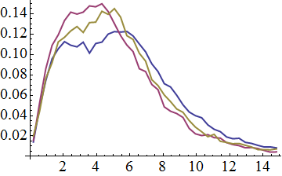
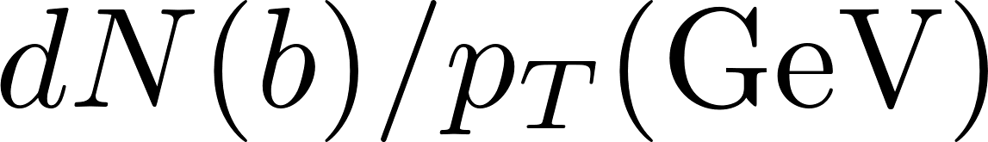
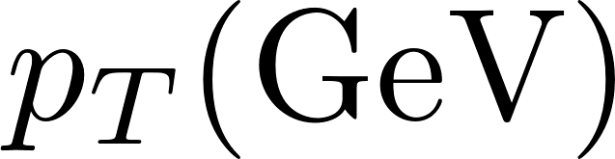



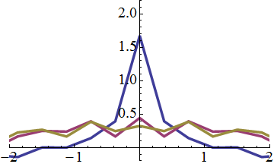
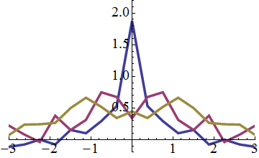
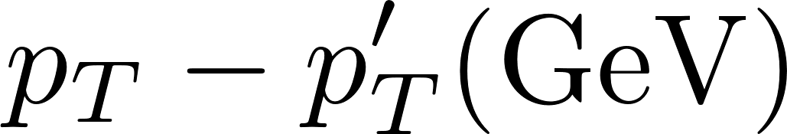
Momentum imbalance: b-bar in Pb-Pb
Pb+Pb; 5.02TeV; 50%-70%
Initial
Elastic Energy loss
Tuned to obtain similar quenching
Elastic + Radiative Energy loss
B2B selection
QGP partly washes away the correlation peak... Possible window to estimate the relative weights of elastic and radiative energy loss for bottom quarks
Notes:
For ccbar

Slide 39
Next best thing: HF-HF -> e-μ correlations
PHENIX: Phys. Rev. C. 89, 034915 (2014)
Puzzle in the picture:
“Such a suppression could arise due to nuclear PDF shadowing, saturation of the gluon wavefunction in the Au nucleus, or initial/final state energy loss and multiple scattering. »
Did not seem to have received enough attention from the community
d+Au
Notes:
E-mu data from LHC ? Confirmation from A. Mischke: no official plot from ALICE

Slide 40
Some words on D/B-h / e-h / … correlations
+ : less demanding in terms of statistics (already some experimental results at RHIC and at LHC after run 2 @ LHC)
+ : the near side can provide us new information about the “in medium” fragmentation.
- : Access to QQbar angular correlations is more indirect and “washed out“
- : More influenced by the “underlying event” than HF-HF correlations : maybe, HF also feel the influence of the bulk
- : New processes implied in the away side region:
Charged hadron
More involved from a theory / modelling view point; requires multi-component models

Slide 41
Some words on D-h … in pp
ALICE, Eur. Phys. J. C (2017) 77:245
Qualitative agreement between data and models, within the (large) uncertainties
EPOS3 predicts larger and wider peaks than the PYTHIA/POWHEG for Δφ correlations
Calibration ≈ ok
Notes:
D is already something

Slide 42
Some words on e-h / … in AA (at RHIC)
Notes:
In AA => degraded: e-h

Slide 43
Some words on e-h / … in AA (at LHC)

Slide 44
Some words on e-h / … in AA (at LHC)
ALICE concludes: “Going lower with p_{T}^{assoc}, hints of a hierarchy in NS yields: Pb-Pb 0-20% shows an enhancement w.r.t. p-Pb, despite very large total uncertainties” : priority 1
No conclusion for the away side peak after run 2. priority >1
Notes:
In AA => degraded: e-h

Slide 45
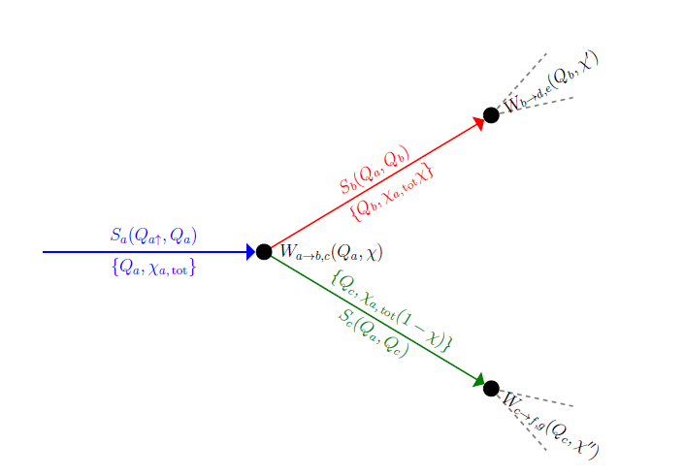

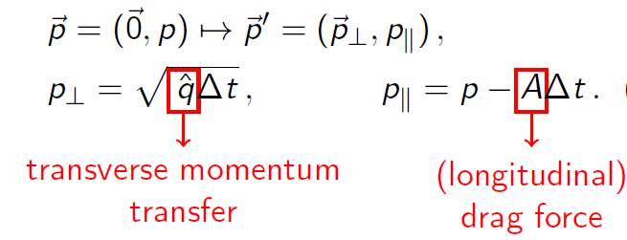
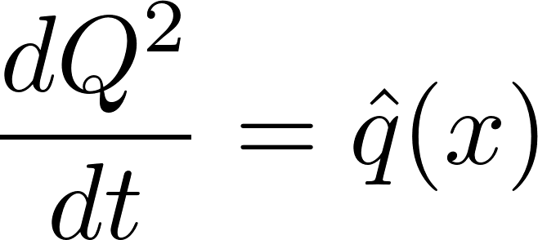

Modified DGLAP (Elastic + induced radiation)
Rescattering according to Langevin dynamics
YAJEM-like
[H. Berrehrah et al. PRC 90, 064906 (2014)]
increase of the virtuality => extra induced radiation.

Slide 46
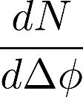
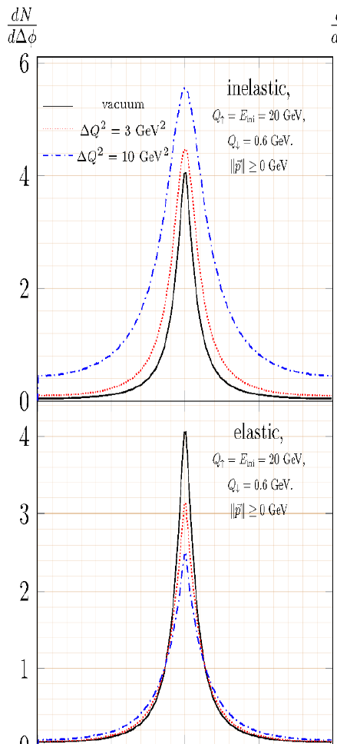
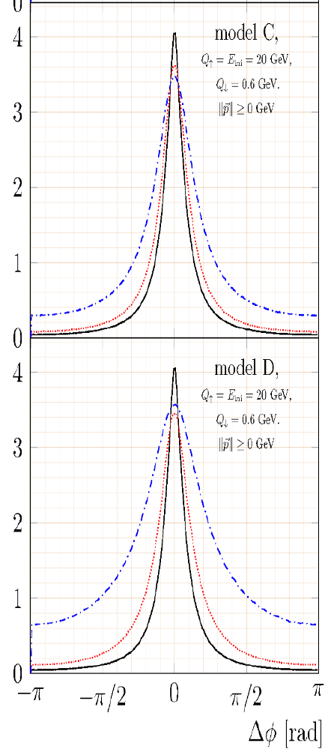
Near side study with a generic jet – medium model
M. Rohrmoser’s PhD thesis (2017)
Preliminary results in J.Phys. Conf. Ser. 779 (2017), 012032
…To be implemented in EPOSHQ with bulk back-reaction
Notes:
In AA => degraded: e-h

Slide 47
Conclusions
HF Correlations are for sure interesting per se and offers a bright future… but:
One should not expect huge effects ! Up to now, the best effects I am aware of in realistic calculations are of the order of 10 %
They often imply a much deeper understanding of the production mechanisms (one additional ingredient in the game !)
Brand new study on momentum imbalance : avoid central (and even semi-central) collisions in order to discriminate between Eloss mechanisms.
Too early to conclude; as a theorist, one has to get ready to deal with the improved precision data in the HF-HF or γ-HF sector
HF – hadrons correlations requires fully fledged models and simulators
By then, the most efficient “constrain” can be obtained by performing systematic multi-domain comparison of the traditional single particle observables…

Slide 48

Pentaquark state discovered at “La Guadeloupe”

Slide 49
Back up

Slide 50
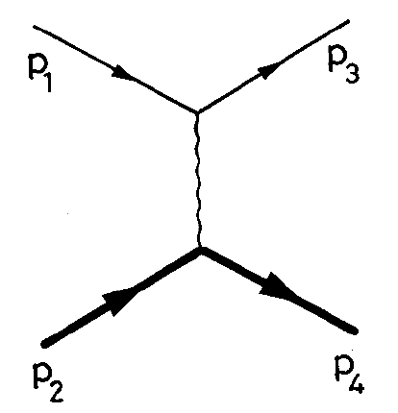


Our basic ingredients for HQ energy loss
Motivation: Even a fast parton with the largest momentum P will undergo collisions with moderate q exchange and large α_{s}(Q²). The running aspect of the coupling constant is often “forgotten/neglected” in some approaches
Elastic
Effective α_{s}(Q²) (Dokshitzer 95, Brodsky 02)
“Universality constrain” (Dokshitzer 02) helps reducing uncertainties:
m_{Dself}² (T) = (1+n_{f}/6) 4πα_{eff}(m_{Dself}²) T²
+ u and s channels
One gluon exchange effective propagator, designed in order to guarantee maximal insensitivity of dE/dx in Braaten-Thomas scheme
IR safe. Q² close to 0 does not contribute to Eloss
Large values for intermediate momentum-transfer => larger cross section

Slide 51
Induced Energy Loss
Generalized Gunion-Bertsch (NO COHERENCE) for finite HQ mass, dynamical light partons
Eikonal limit (large E, moderate q)
k’
Dominates as small x as one “just” has to scatter off the virtual gluon k’
with
Gluon thermal mass ~2T (phenomenological; not in BDMPS)
Quark mass
Both cures the collinear divergences and influence the radiation spectra (dead cone effect)
Notes:
Mention huge effet on the energy loss in the intermediate pT range

Slide 53
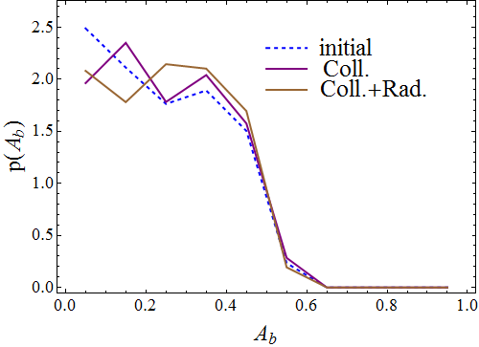
Momentum imbalance: b-bar in Pb-Pb
Pb-Pb @ 5TeV, 50-70%
Coll E. loss
Coll +rad E. loss

Slide 55
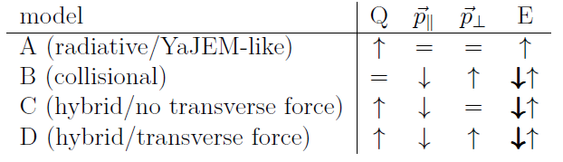
Modified DGLAP (“full”; model D)
« Full » : we combine ingredients from model A and model B:
Both induced radiation, rescattering of partons in the jet and energy loss -> medium
Motivation: Looking at various observables for these models may help us to better understand the role of induced energy loss
Medium evolution: For the time, we use a toy-model parametrization of the transport coefficient:
D & C vs A: role of the Energy transfer -> medium & medium response
Most questionable
Most « realistic »

Slide 56
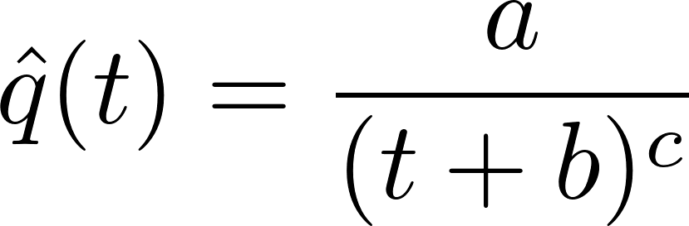
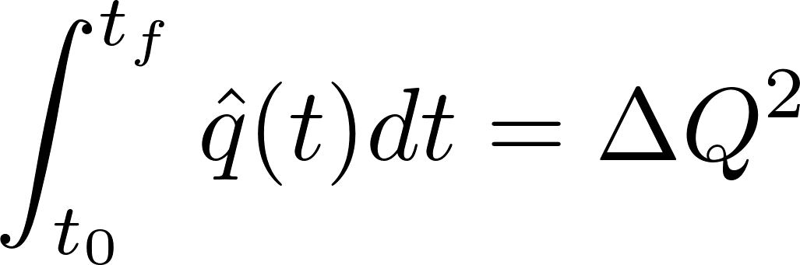
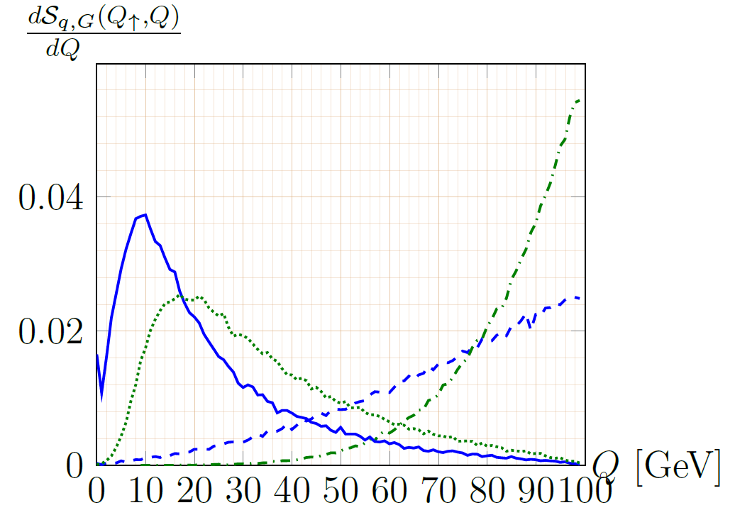
Further model ingredients
1. Medium evolution: For the time, we use a toy-model parametrization of the transport coefficient:
With b=1.5 fm/c, c=2.2
(jet emanating from the center of
the medium)
[Th. Renk: Phys.Rev.C 78, 034908 (2008)]
with
Parameter fixing the jet-medium coupling
2. Evolutions are initiated starting from a HQ with energy E_{ini} and a virtuality ranging from Q↑= E_{ini} down do Q₀≈1 GeV
3. For the following results: no further evolution in the
QGP once partons are on-shell
quark
Notes:
Initial configuraiton: initial HQ with Ein (no convolution on the PDF; to be done); no evolution for on shell HQ in medium

Slide 57
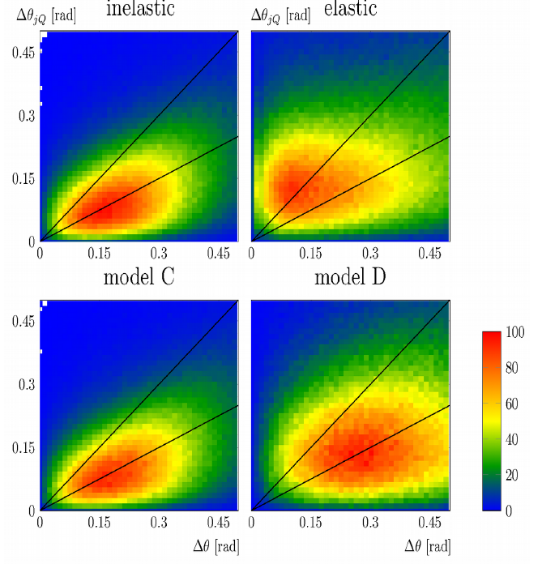
Double differential angular correlations
Angle between jet and HQ

