Slide 1
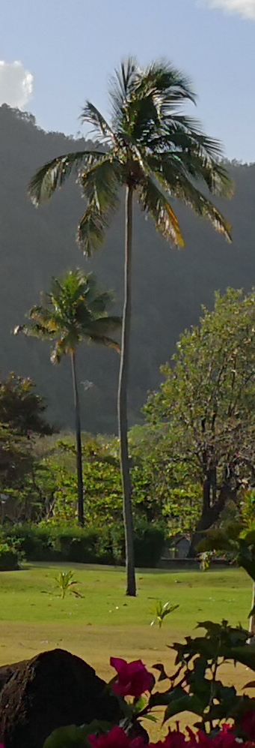


2- and 3-pion
Lévy femtoscopy
With PHENIX
Máté Csanád for PHENIX @ WWND 2018, March 30
Eötvös University, Budapest, Hungary

Slide 2
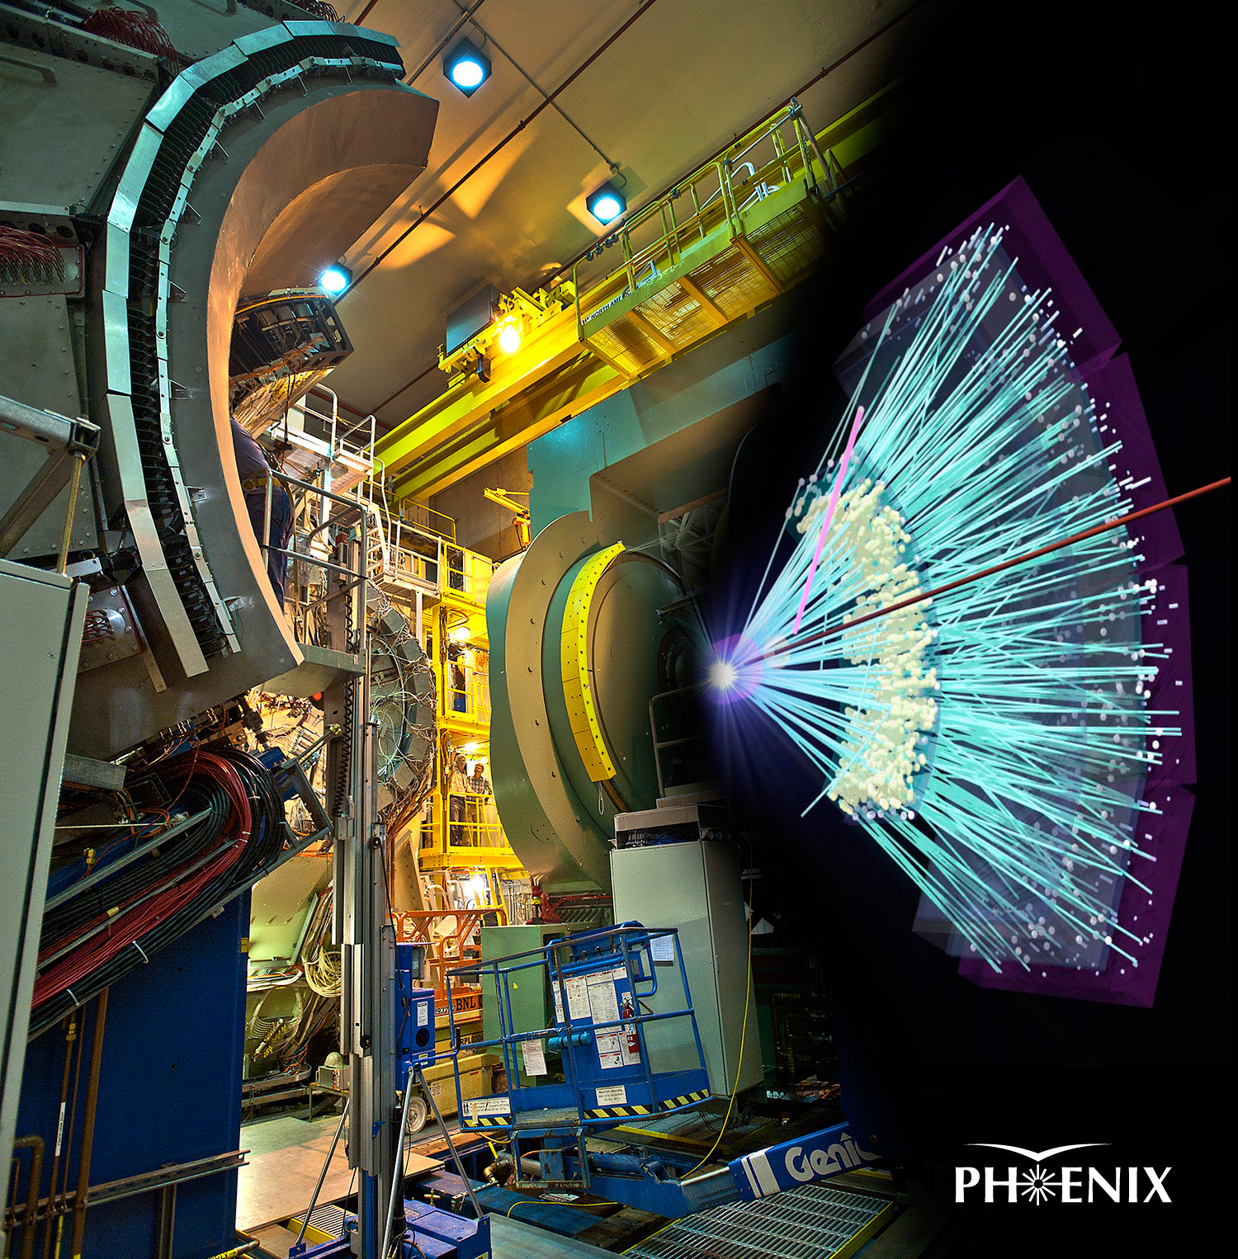
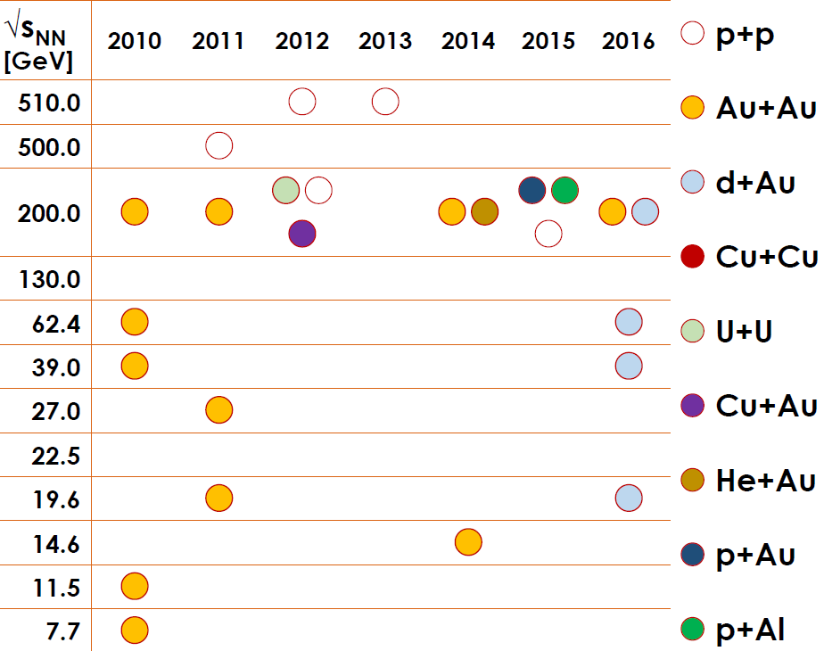

The PHENIX experiment and the BES
Collision energies: 7.7 to 200 GeV (20-400 MeV in $μ_{B}$, 140-170 MeV in $T$)
What changes with $\sqrt{s_{NN}} ?$

Slide 3
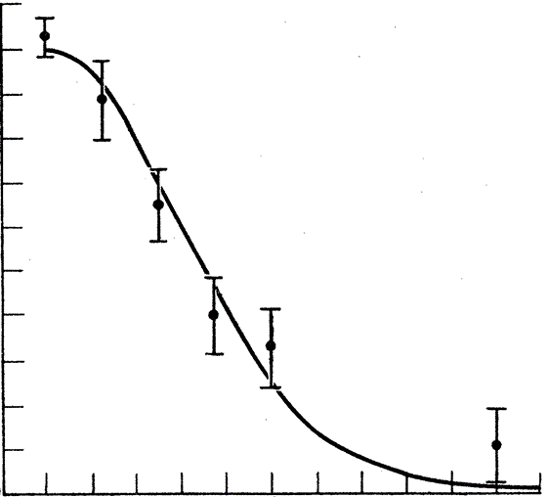
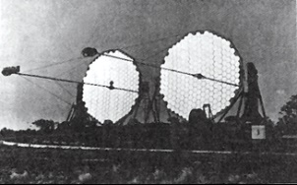
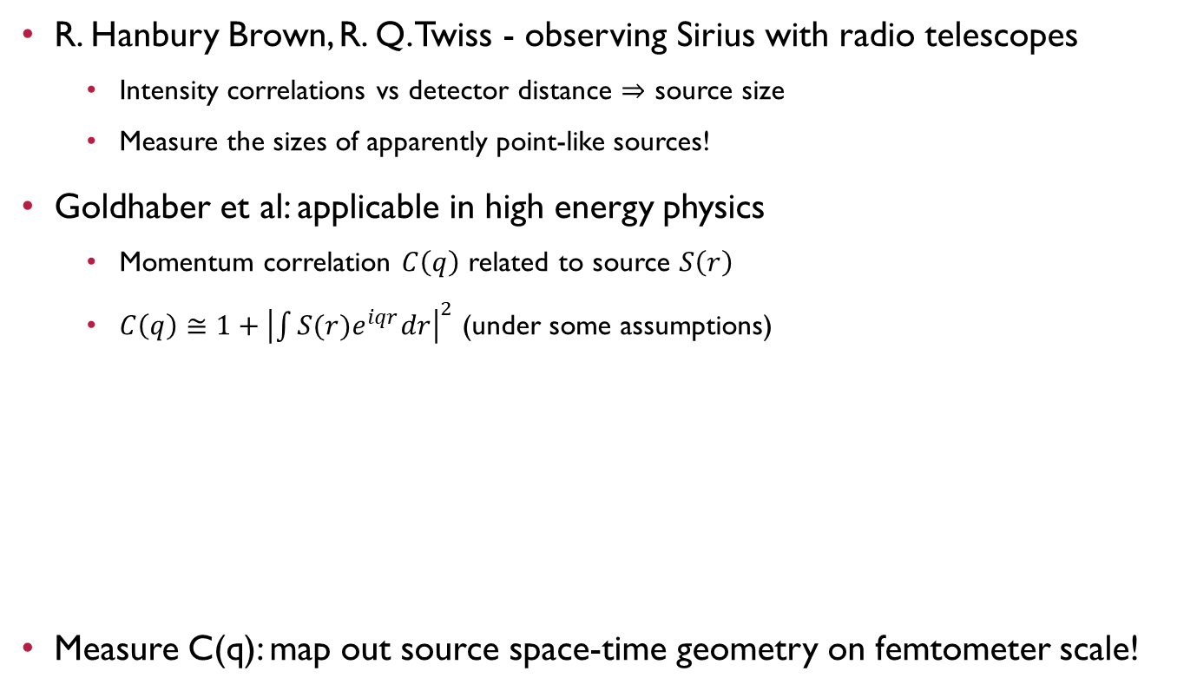
Femtoscopy: The HBT effect
R. Hanbury Brown, R. Q. Twiss - observing Sirius with radio telescopes
  Intensity correlations vs detector distance $⇒$ source size
  Measure the sizes of apparently point-like sources!
Goldhaber et al: applicable in high energy physics
  Momentum correlation $C\left(q\right)$ related to source $S\left(r\right)$
  $C\left(q\right)≅1+{\left|\int{S(r)e^{iqr}dr}\right|}^{2}$ (under some assumptions)
Measure C(q): map out source space-time geometry on femtometer scale!
Correlation strength
~1/R
Detector distance
R
1/R
source function S(r)
correlation function C(q)

Slide 4
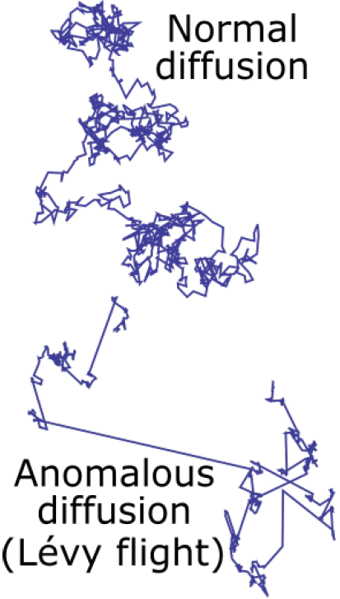

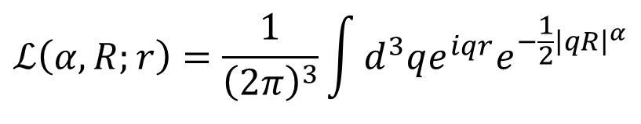
LÉvy distributions in heavy ion physics
Expanding medium, increasing mean free path: anomalous diffusion
Metzler, Klafter, Physics Reports 339 (2000) 1-77, Csanad, Csörgő, Nagy, Braz.J.Phys. 37 (2007) 1002
Lévy-stable distribution:
  Generalized Gaussian from generalized central limit theorem
  α = 2 Gaussian, α = 1 Cauchy
  Power-law in spatial correlations ~ r ^{–(1+α)}
Shape of the correlation functions with Levy source:
Critical spatial correlation ~ r ^{-(d-2-η)} → critical exponent
  α alpha can be associated with the critical exponent η?
Csörgő, Hegyi, Zajc, Eur.Phys.J. C36 (2004) 67, nucl-th/0310042
  How about dynamics?
$$ℒ\left(α,R;r\right)=\frac{1}{{\left(2π\right)}^{3}}\int{d^{3}qe^{iqr}e^{−\frac{1}{2}{\left|qR\right|}^{α}}}$$
$$C_{2}\left(q\right)=1+λ⋅e^{−{\left|qR\right|}^{α}} \begin{matrix}α=2:\text{Gaussian} \\ α=1:\text{Exponential}\end{matrix}$$

Slide 5



Lévy index as a critical exponent?
QCD universality class ↔ 3D Ising
  Halasz et al., Phys.Rev.D58 (1998) 096007
  Stephanov et al., Phys.Rev.Lett.81 (1998) 4816
At the critical point:
  Random field 3D Ising: η = 0.50±0.05
  Rieger, Phys.Rev.B52 (1995) 6659
  3D Ising: η = 0.03631(3)
  El-Showk et al., J.Stat.Phys.157 (4-5): 869
Motivation for precise Lévy HBT!
Change in α_{Levy} proximity of CEP?
Modulo finite size/time and non-equilibrium effects
$→$ what does power law exponent mean?
2.0
1.0
0.5
Lévy index of stability $α$
-0.5 0 0.5
$$(T−T_{c})/T_{c}$$

Slide 6
Levy HBT analysis
Dataset used for the analysis:
  Events: Run-10, Au+Au, √s_{NN} = 39 to 200 GeV, varying centrality, zvertex cut
  Particle identification:
    time-of-flight data from PbSc East/West, TOF East/West, momentum, flight length
    2σ cuts on m² distribution
  Single track cuts: 2 σ matching cuts in TOF & PbSc for pions
  Pair-cuts:
    A random member of pairs assoc. with hits on same tower were removed
    customary shaped cuts in Δφ - Δz plane for Drift Chamber, PbSc East/West, TOF East/West
1D(2π±) or 3D(3π±) corr. func. as a function of Q_{LCMS} in various m_{T} bins
  Q_{LCMS} is 3-momentum difference in longitudinal co-moving system
  Q₁₂, Q₂₃, Q₃₁ for the three-particle case
  Levy fits for 31 m_{T} bins (0.228 < m_{T} < 0.871 GeV/c) with Coulomb effect

Slide 7
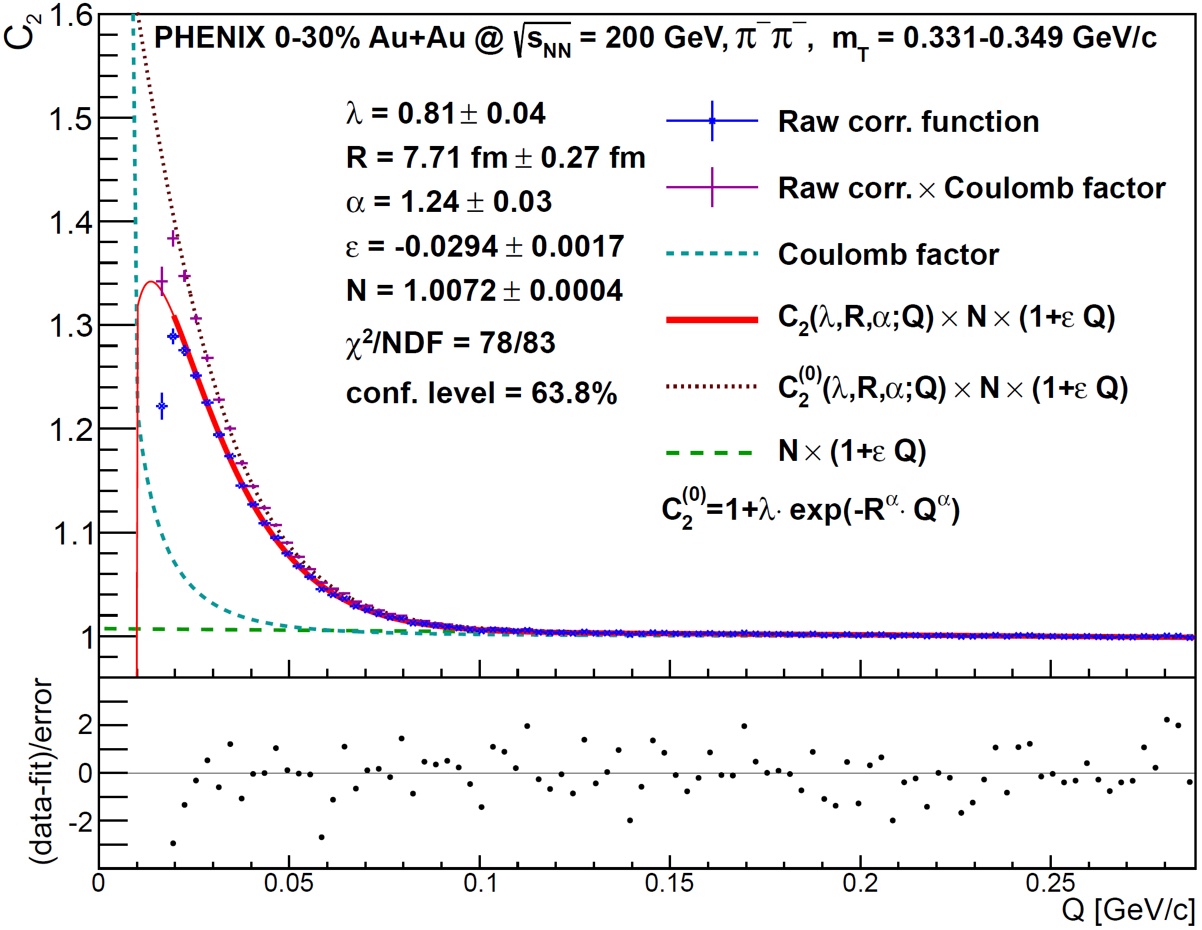



Example C₂(Q_{LCMS}) Correlation Function
Measured in 31 m_{T} bins
Fitted with Coulomb-
incorporated function
Coulomb-factor
displayed separately
All fits converged
Confidence levels
all acceptable
χ values scatter
around 0 properly
Physical parameters:
R, λ, α measured
versus pair m_{T}
$$λ$$
$$α$$
$$R$$
PHENIX, arXiv:1709.05649

Slide 8
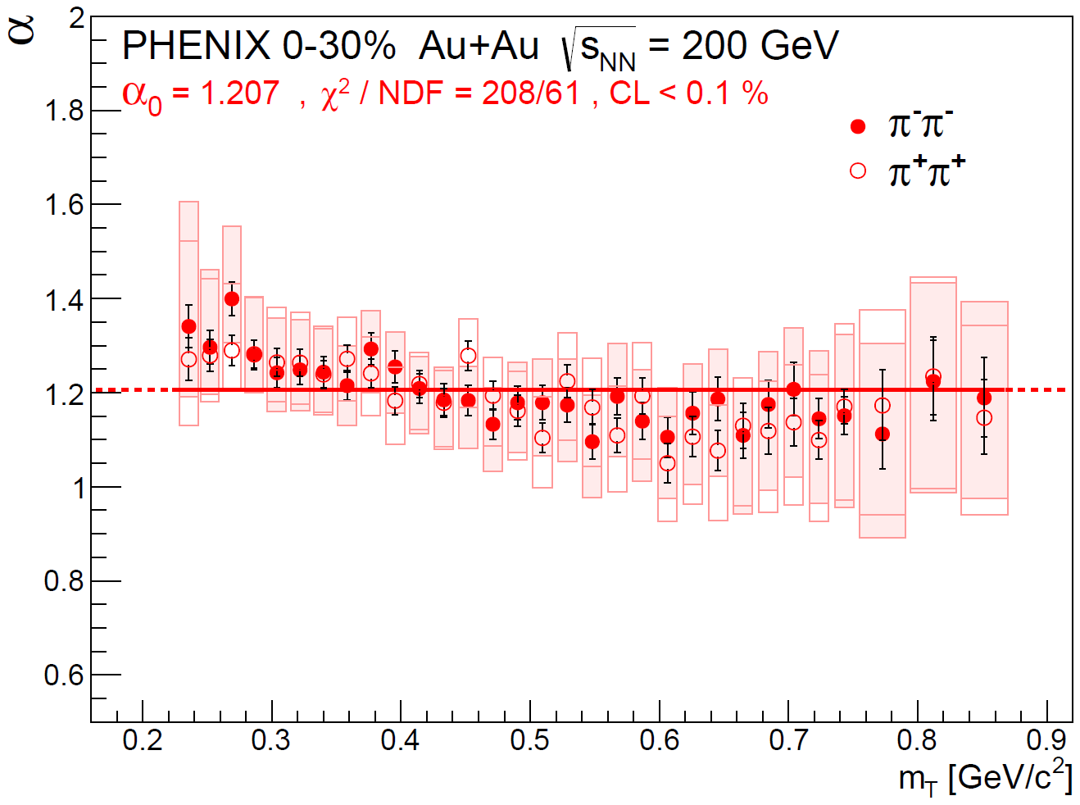



Lévy exponent (shape parameter) α
$α=2.0$ (Gauss)
$α=1.0$ (Cauchy)
PHENIX, arXiv:1709.05649
$α=0.5$ (rfd Ising CEP)
Measured value far from Gaussian (α = 2), inconsistent with expo. (α = 1)
Also far from the random field 3D Ising value at CEP (α = 0.5)
More or less constant (at least within systematic uncertainties)
What do models and calculations say?

Slide 9
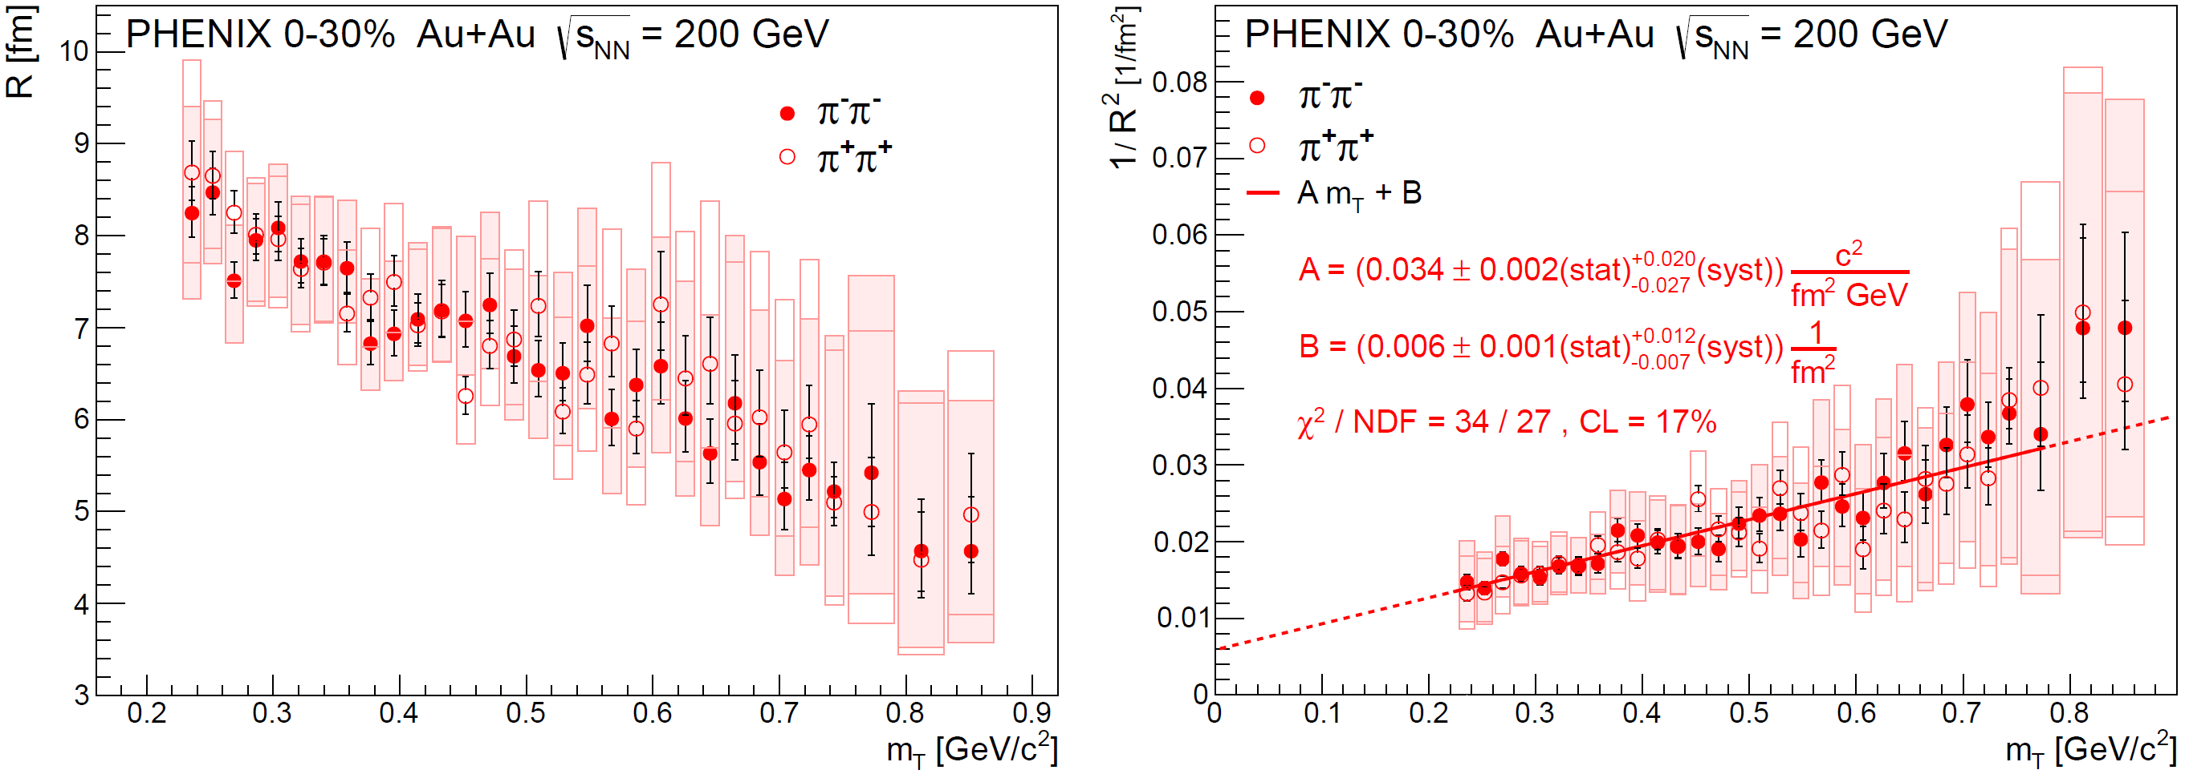
Lévy scale parameter R
Similar decreasing trend as Gaussian HBT radii, but it is not an RMS!
Hydro behavior not invalid
The linear scaling of 1/R², breaks for high m_{T}?
PHENIX, arXiv:1709.05649

Slide 10
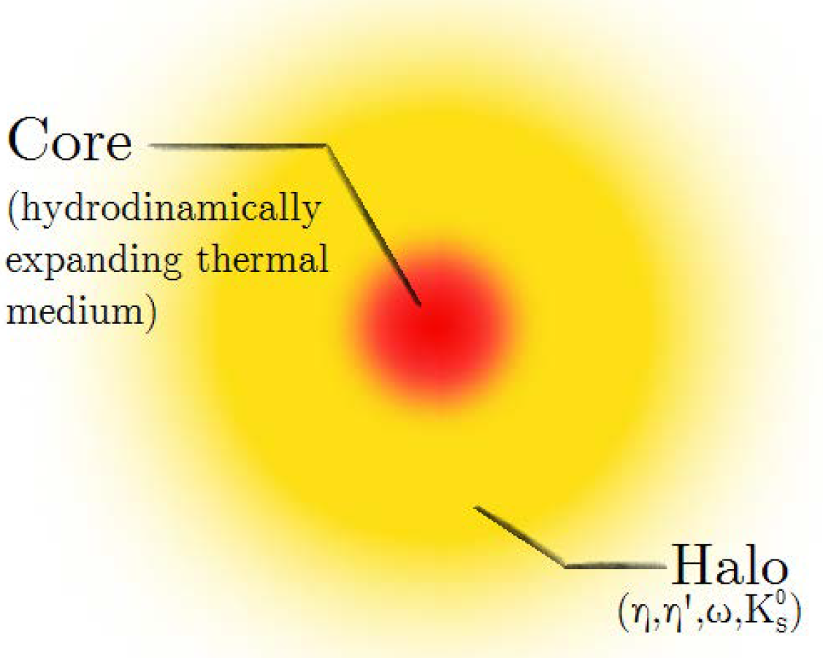
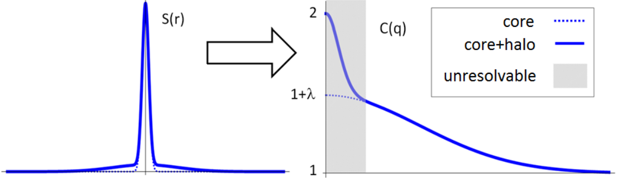

Correlation strength λ: Core/Halo
Two-component source
  Core: hydrodynamically expanding
  Halo: lived resonances ($≳$ 10 fm/c),
  unresolvable experimentally
  Define $f_{C}=N_{core}/N_{total}$
True $q→0$ limit: $C\left(0\right)=2$
Apparently $C\left(q→0\right)→1+λ$
$λ\left(m_{T}\right)=f_{C}^{2}\left(m_{T}\right)$
Bolz et al, Phys.Rev. D47 (1993) 3860-3870
Csörgő, Lörstad, Zimányi, Z.Phys. C71 (1996) 491-497

Slide 11
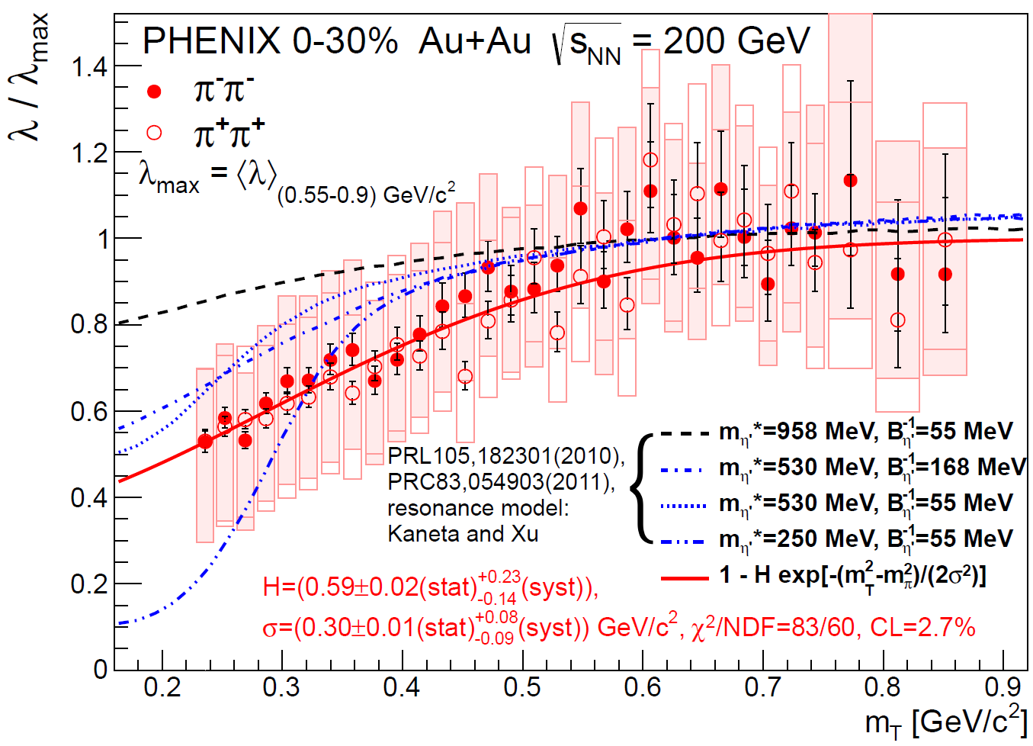

Correlation strength λ: IN-Medium mass?
Connection to chiral restoration
  Decreased η’ mass → η’ enhancement → halo enhancement
  Kinematics: η’ → ππππ with low m_{T} → decreased λ(m_{T}) at low m_{T}
  Dependence on in-medium η’ mass?
  Kapusta, Kharzeev, McLerran, PRD53 (1996) 5028
  Vance, Csörgő, Kharzeev, PRL 81 (1998) 2205
  Csörgő, Vértesi, Sziklai, PRL105 (2010) 182301
  Results compatible with modified mass!
η’
η’
η’
η’
η’
$$T < T^{∗}$$
$$m_{η′} > m_{η^{′}}^{∗}$$
$$N_{η′} < N_{η^{′}}^{∗}$$
$$λ > λ^{∗}$$
PHENIX, arXiv:1709.05649

Slide 12
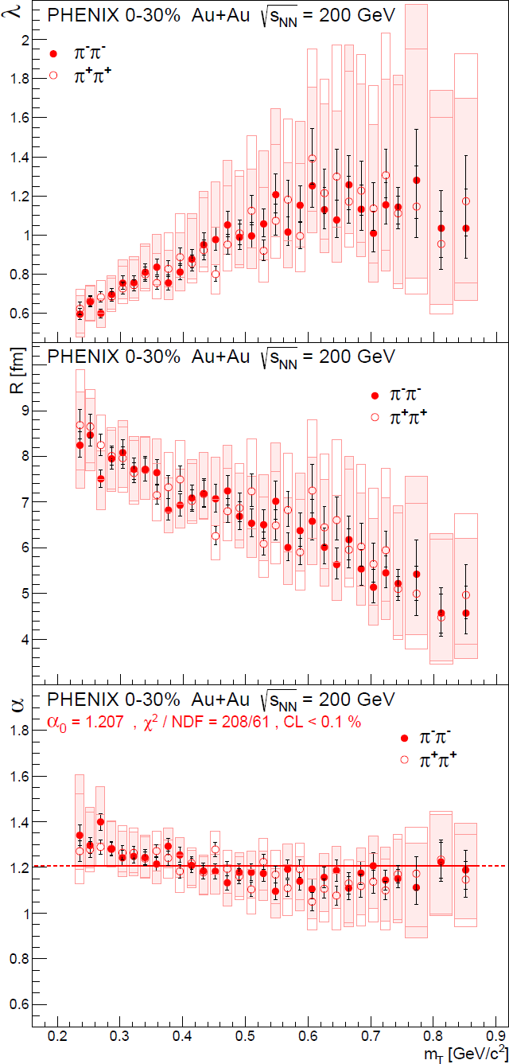
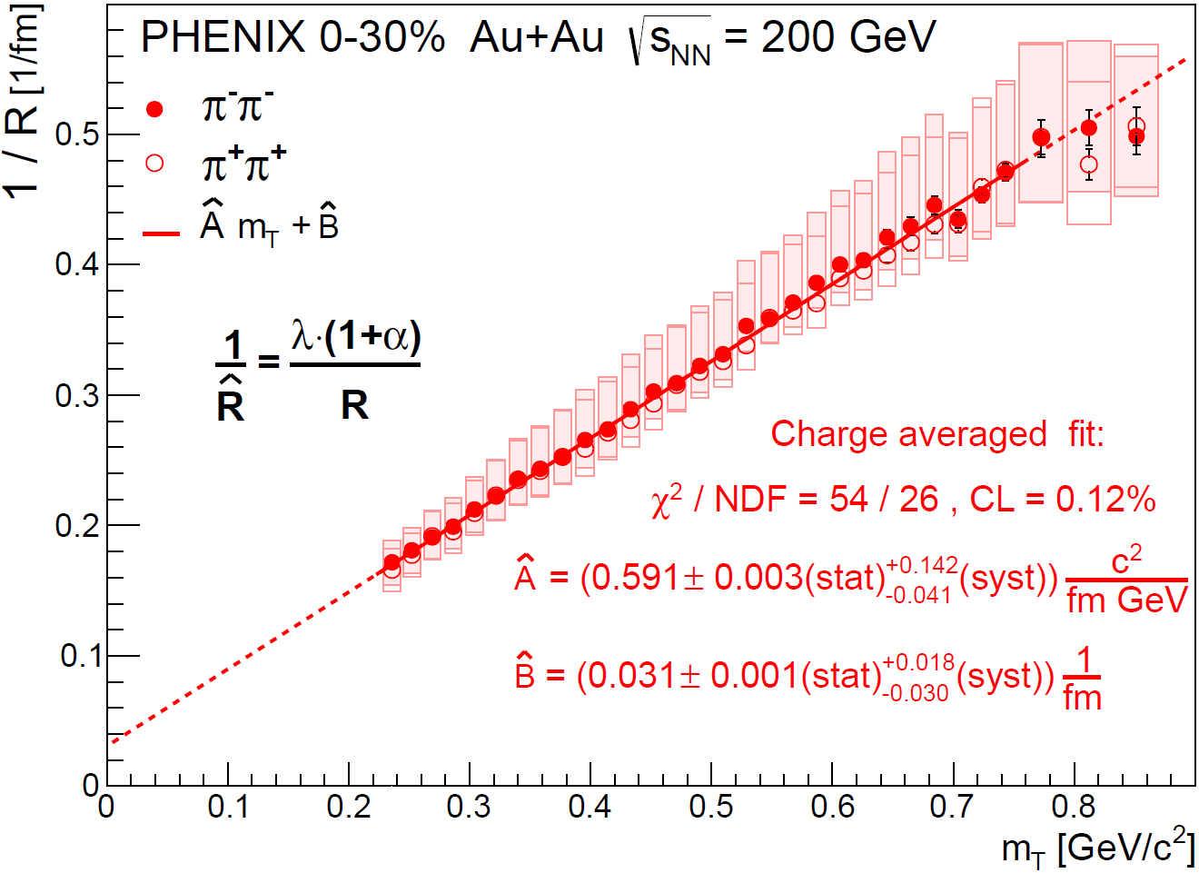



New scaling parameter $\hat{\text{R}}$
arXiv:1709.05649
$$λ(m_{T})$$
$$R(m_{T})$$
$$α(m_{T})$$
Empirically found scaling parameter
Linear in m_{T}
Physical interpretation: open question

Slide 13
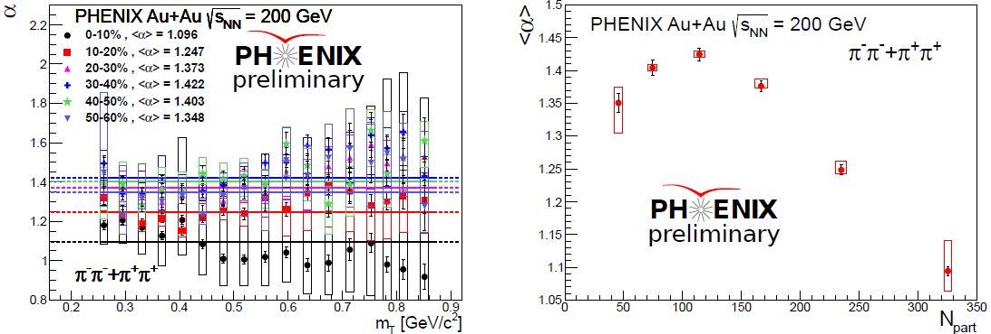
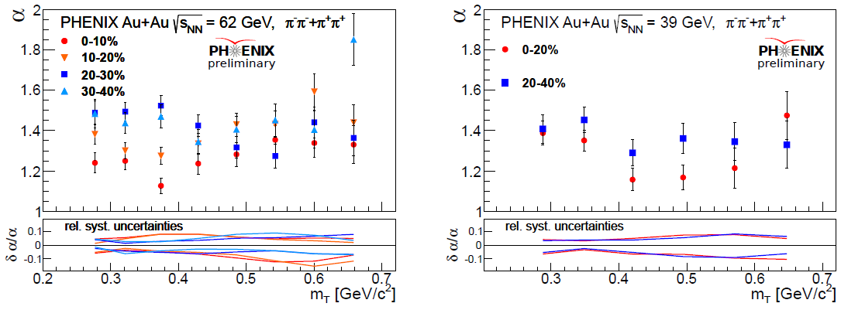
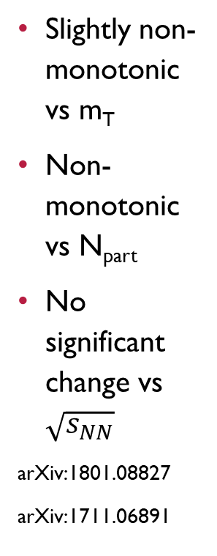
Lévy exponent $α$ VS Centrality and $\sqrt{s_{NN}}$
Slightly non-monotonic vs m_{T}
Non-monotonic vs N_{part}
No significant change vs $\sqrt{s_{NN}}$
arXiv:1801.08827
arXiv:1711.06891

Slide 14
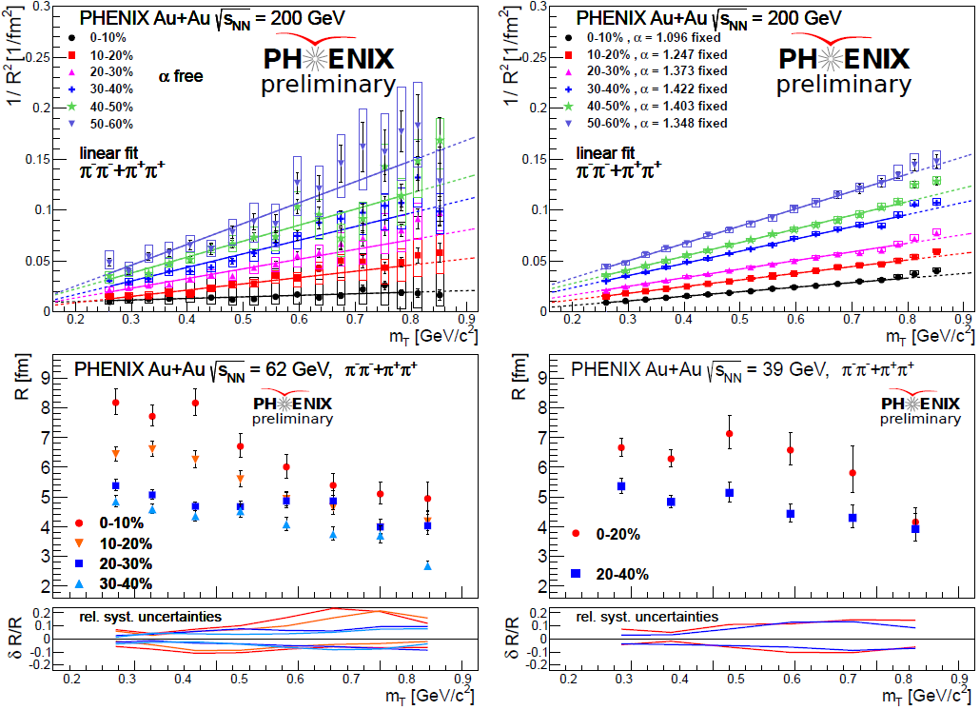




Levy R: similar hydro trends for all cases
$α$ free
$α$ fixed
arXiv:1801.08827
arXiv:1711.06891
$α$ free
$α$ free

Slide 15
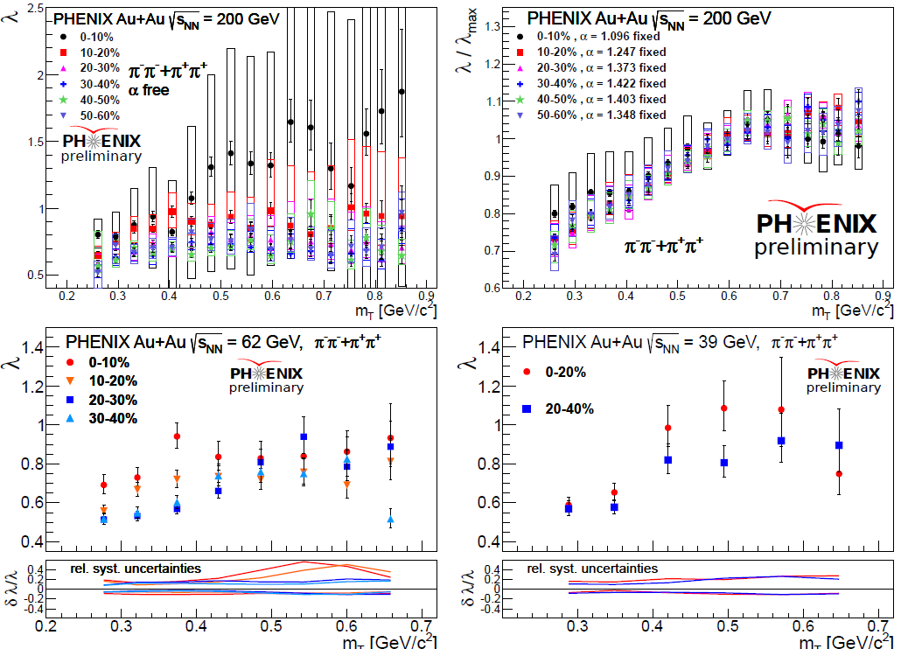




Hole in λ(m_{T}): all investigated energies
Hole apparent for $\sqrt{s_{NN}}≥39$ GeV, all centralities
Due to reduced
$η^{′}$ mass?
Sign for chiral
restoration?
To be cross-checked
with photons,
dileptons, etc.
No hole found at SPS
(Beker et al., PRL74)
arXiv:1801.08827
arXiv:1711.06891
$α$ fixed
$α$ free
$α$ free

Slide 16
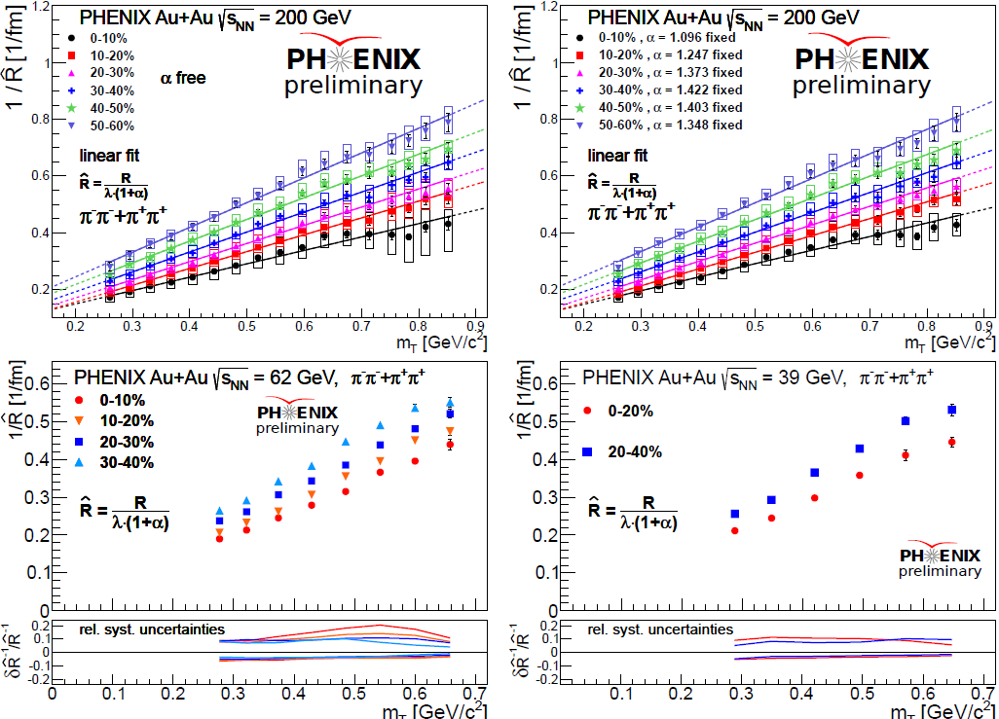




$\hat{\text{R}}$ scaling: all energies and centralities
$α$ free
$α$ fixed
arXiv:1801.08827
arXiv:1711.06891
$α$ free
$α$ free

Slide 17
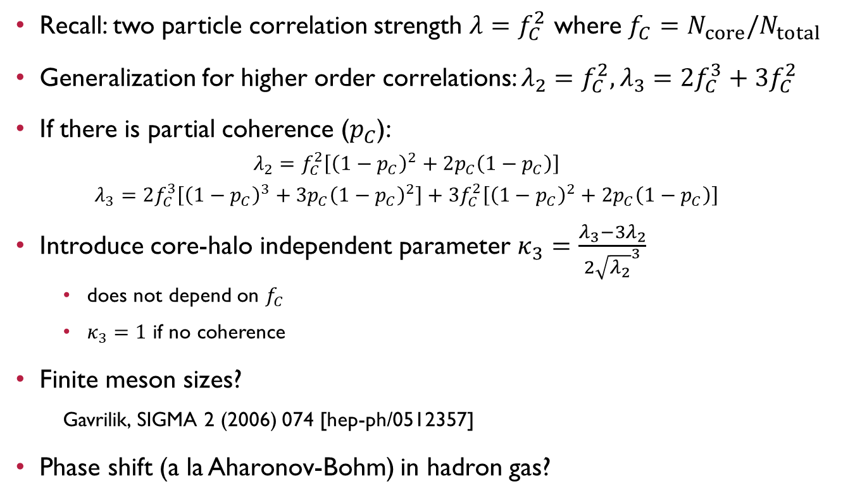
Three-pion correlations: Motivation
Recall: two particle correlation strength $λ=f_{C}^{2}$ where $f_{C}=N_{core}/N_{total}$
Generalization for higher order correlations: $λ_{2}=f_{C}^{2}, λ_{3}=2f_{C}^{3}+3f_{C}^{2}$
If there is partial coherence ($p_{C}$):
  $$λ_{2}=f_{C}^{2}\left[{\left(1−p_{C}\right)}^{2}+2p_{C}\left(1−p_{C}\right)\right]$$
  $$λ_{3}=2f_{C}^{3}\left[{\left(1−p_{C}\right)}^{3}+3p_{C}{\left(1−p_{C}\right)}^{2}\right]+3f_{C}^{2}\left[{\left(1−p_{C}\right)}^{2}+2p_{C}\left(1−p_{C}\right)\right]$$
Introduce core-halo independent parameter $κ_{3}=\frac{{λ_{3}−3λ}_{2}}{2{\sqrt{λ_{2}}}^{3}}$
  does not depend on $f_{C}$
  $κ_{3}=1$ if no coherence
Finite meson sizes?
  Gavrilik, SIGMA 2 (2006) 074 [hep-ph/0512357]
Phase shift (a la Aharonov-Bohm) in hadron gas?

Slide 18
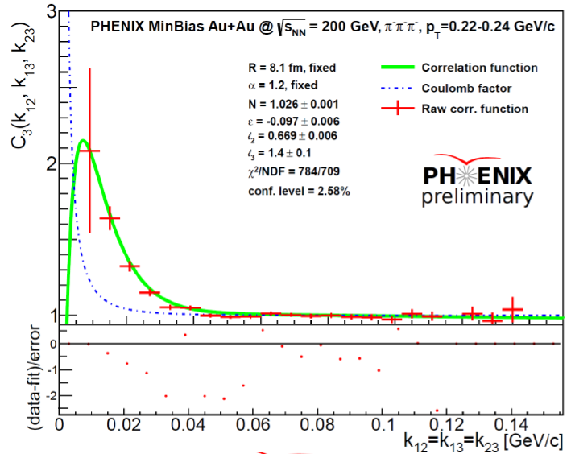
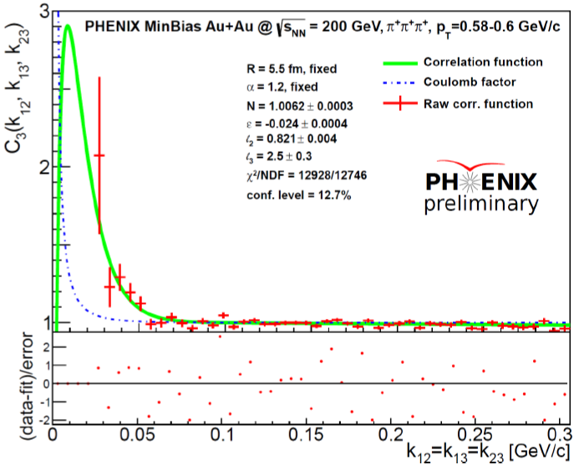
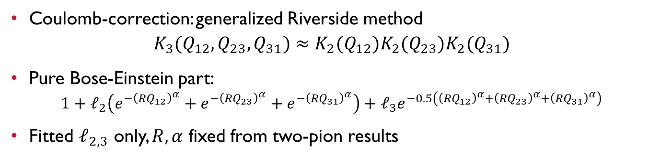
Example correlation function fits
Coulomb-correction: generalized Riverside method
$$K_{3}(Q_{12},Q_{23},Q_{31})≈K_{2}(Q_{12})K_{2}(Q_{23})K_{2}(Q_{31})$$
Pure Bose-Einstein part:
$1+ℓ_{2}\left(e^{{−\left({RQ}_{12}\right)}^{α}}+e^{−{\left({RQ}_{23}\right)}^{α}}+e^{−{\left({RQ}_{31}\right)}^{α}}\right)+ℓ_{3}e^{−0.5\left({\left({RQ}_{12}\right)}^{α}+{\left({RQ}_{23}\right)}^{α}+{\left({RQ}_{31}\right)}^{α}\right)}$
Fitted $ℓ_{2,3}$ only, $R,α$ fixed from two-pion results
arXiv:1801.03544
arXiv:1801.03544

Slide 19
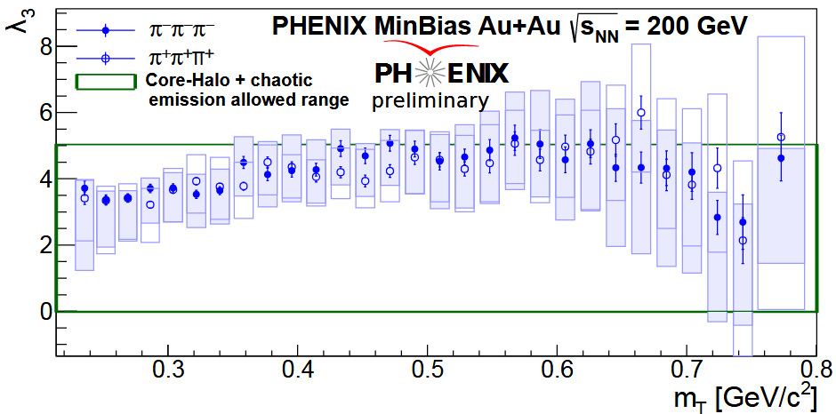

Three-pion correlation strength
Core-halo model, with or without coherence: ${0≤λ}_{3}≤5$
arXiv:1801.03544

Slide 20
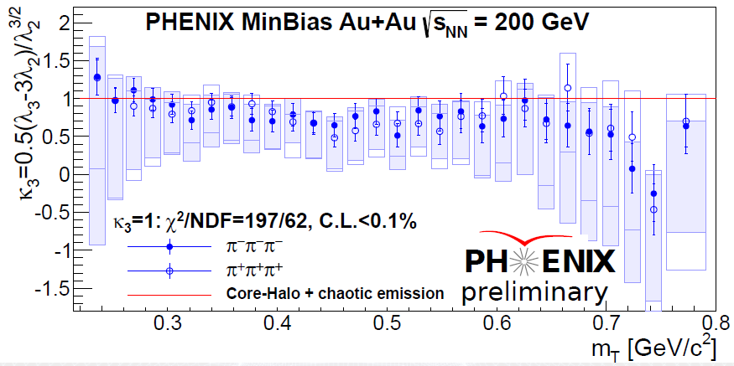

Test of core-halo model / coherence
Recall: $κ_{3}=1$ in pure core-halo model, $κ_{3}≠1$ if coherence
arXiv:1801.03544

Slide 21
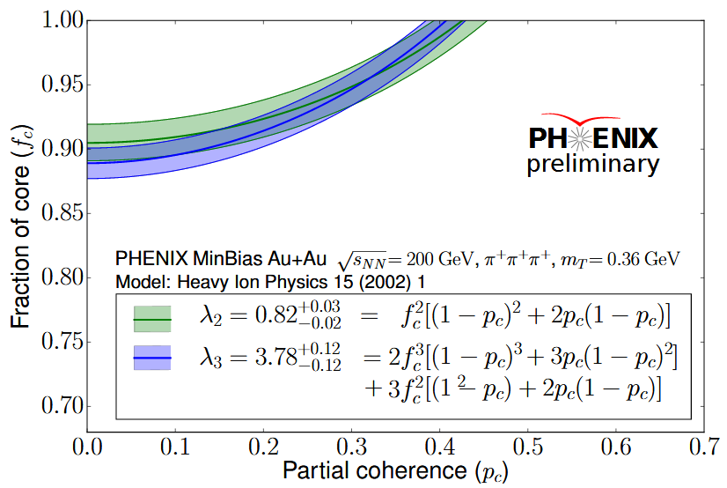

Determine core and coherence fraction
Recall:
$$λ_{2}=f_{C}^{2}\left[{\left(1−p_{C}\right)}^{2}+2p_{C}\left(1−p_{C}\right)\right]$$
$$λ_{3}=2f_{C}^{3}\left[{\left(1−p_{C}\right)}^{3}+3p_{C}{\left(1−p_{C}\right)}^{2}\right]+3f_{C}^{2}\left[{\left(1−p_{C}\right)}^{2}+2p_{C}\left(1−p_{C}\right)\right]$$
Calculate $f_{C}, p_{C}$ from $λ_{2,3}$ at given m_{T}
Strong correlation: test allowed
regions on $\left(f_{c},p_{C}\right)$ from $λ_{2,3}$
If indeed coherence:
should be centrality dependent!
Higher order correlations?
arXiv:1801.03544

Slide 22
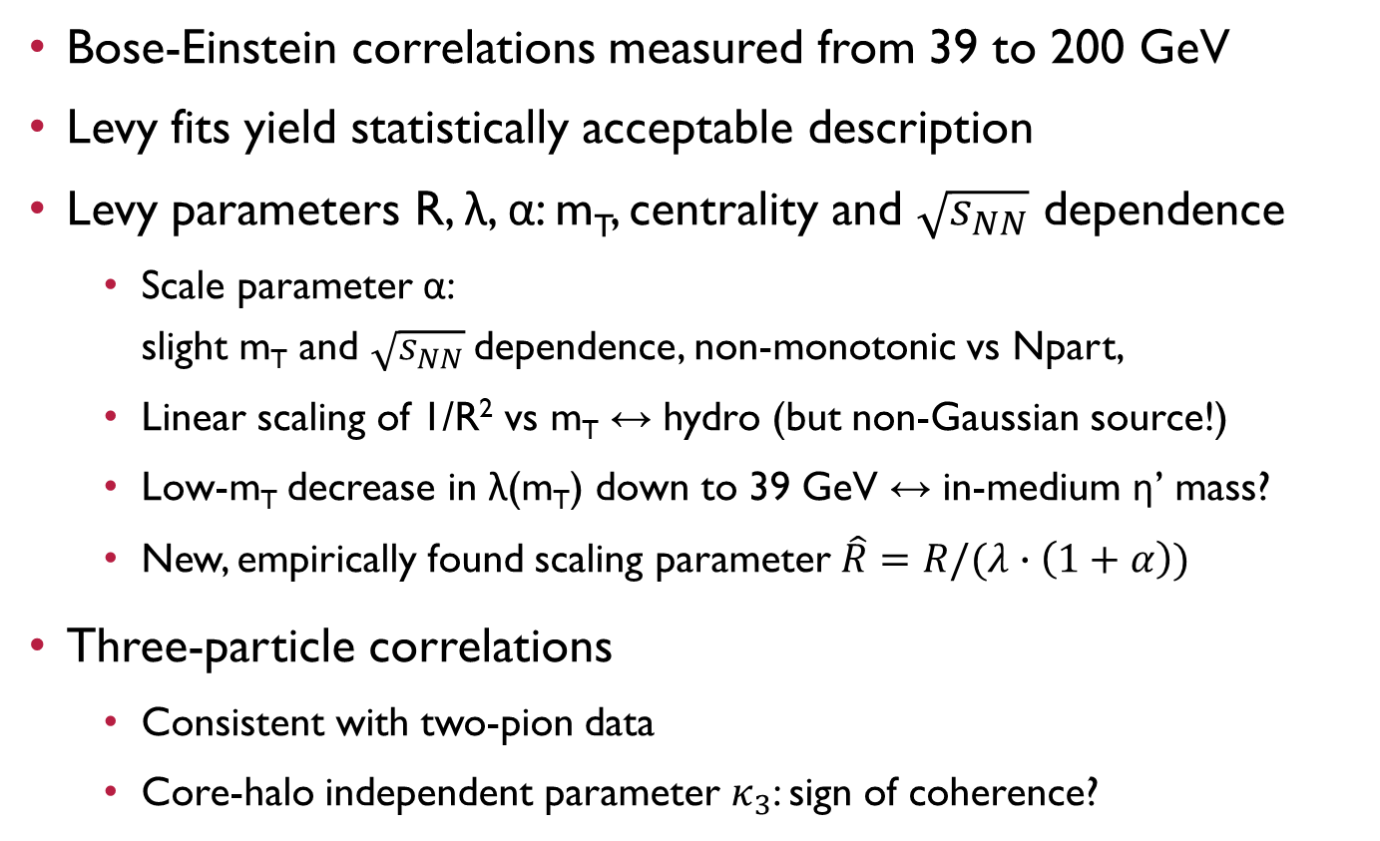
LÉVY HBT status from 39 to 200 GeV
Bose-Einstein correlations measured from 39 to 200 GeV
Levy fits yield statistically acceptable description
Levy parameters R, λ, α: m_{T}, centrality and $\sqrt{s_{NN}}$ dependence
  Scale parameter α:
  slight m_{T} and $\sqrt{s_{NN}}$dependence, non-monotonic vs Npart,
  Linear scaling of 1/R² vs m_{T} ↔ hydro (but non-Gaussian source!)
  Low-m_{T} decrease in λ(m_{T}) down to 39 GeV ↔ in-medium η’ mass?
  New, empirically found scaling parameter $\hat{R}=R/(λ∙\left(1+α\right))$
Three-particle correlations
  Consistent with two-pion data
  Core-halo independent parameter $κ_{3}$: sign of coherence?

Slide 23
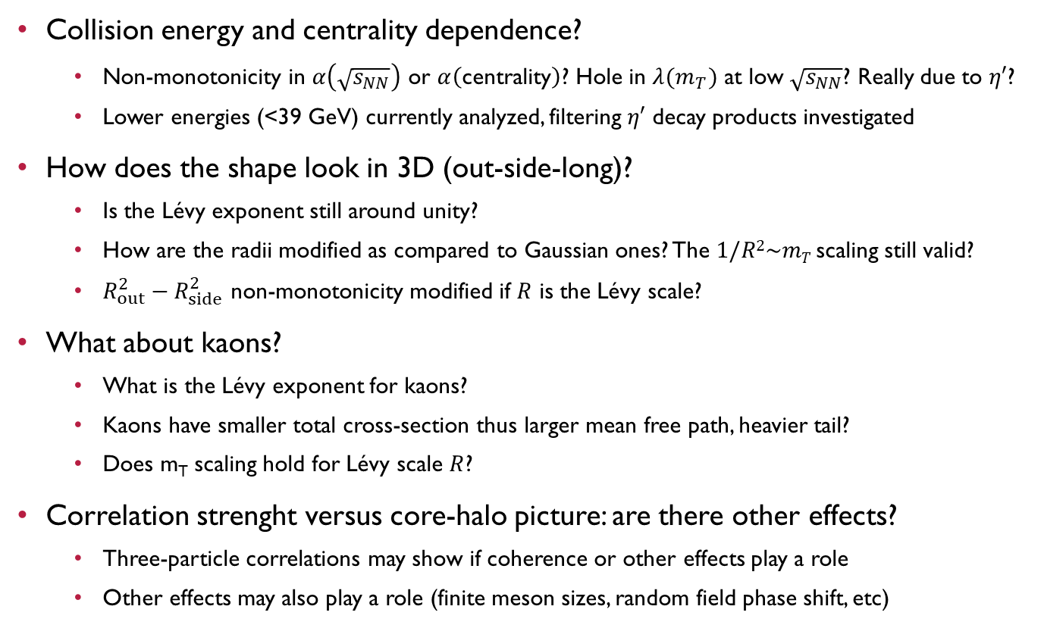
Open questions
Collision energy and centrality dependence?
  Non-monotonicity in $α\left(\sqrt{s_{NN}}\right)$ or $α\left(\text{centrality}\right)$? Hole in $λ(m_{T})$ at low $\sqrt{s_{NN}}$? Really due to $η′$?
  Lower energies (<39 GeV) currently analyzed, filtering $η′$ decay products investigated
How does the shape look in 3D (out-side-long)?
  Is the Lévy exponent still around unity?
  How are the radii modified as compared to Gaussian ones? The $1/R2\sim mT$scaling still valid?
  $R_{out}^{2}−R_{side}^{2}$ non-monotonicity modified if $R$ is the Lévy scale?
What about kaons?
  What is the Lévy exponent for kaons?
  Kaons have smaller total cross-section thus larger mean free path, heavier tail?
  Does m_{T} scaling hold for Lévy scale $R$?
Correlation strenght versus core-halo picture: are there other effects?
  Three-particle correlations may show if coherence or other effects play a role
  Other effects may also play a role (finite meson sizes, random field phase shift, etc)

Slide 24
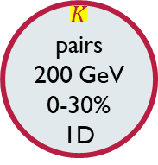
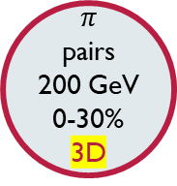
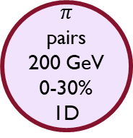
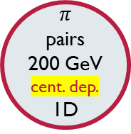
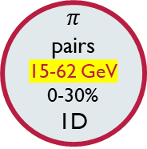
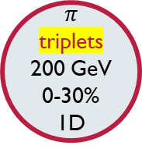
Lévy HBT with PHENIX
stay tuned
$$π$$
pairs
200 GeV
0-30%
3D
$$K$$
pairs
200 GeV
0-30%
1D
stay tuned
Final data
arXiv:
1709.05649
$$π$$
pairs
200 GeV
0-30%
1D
Preliminary
arXiv:
1801.08827
$$π$$
pairs
200 GeV
cent. dep.
1D
$$π$$
triplets
200 GeV
0-30%
1D
Preliminary
arXiv:
1801.03544
$$π$$
pairs
15-62 GeV
0-30%
1D
Partly preliminary
arXiv:1711.06891
+stay tuned

Slide 25


Thank you for your attention
If you are interested in these subjects, come to:
http://zimanyischool.kfki.hu/18
http://indico.ifj.edu.pl/event/199/

Slide 26
BACKUP

Slide 27
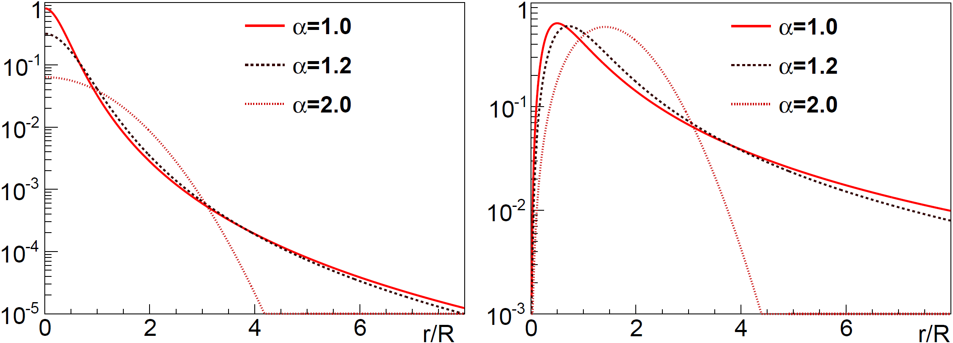



Lévy Versus Gauss versus exponential
No tail if $α=2$, power law if $α<2$
$$R^{3}S_{core}(r)$$
$$R4πr^{2}S_{core}(r)$$

Slide 28
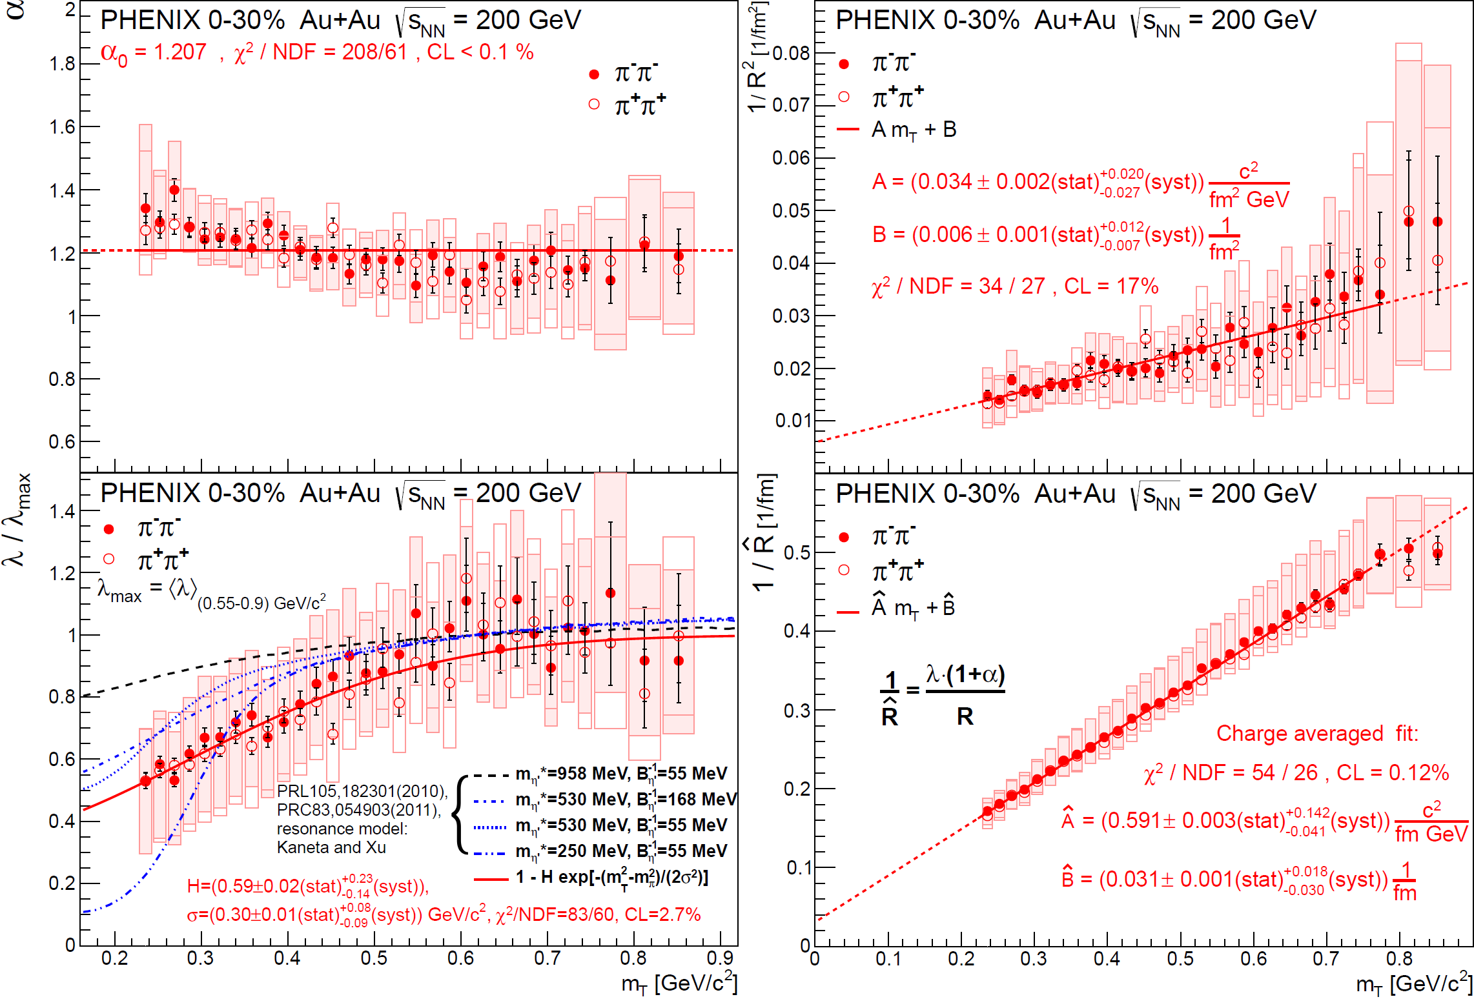
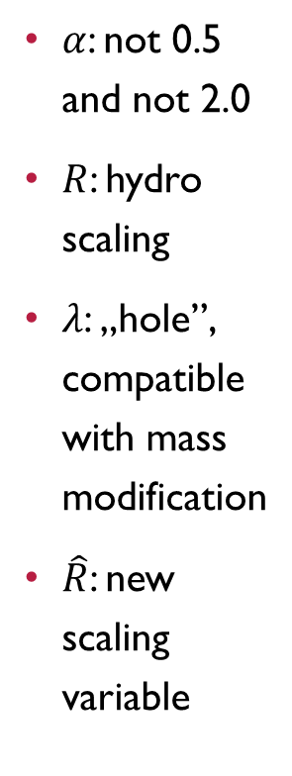
Physical fit parameter results
$α$: not 0.5 and not 2.0
$R$: hydro
scaling
$λ$: „hole”,
compatible
with mass
modification
$\hat{R}$: new
scaling
variable

Slide 29
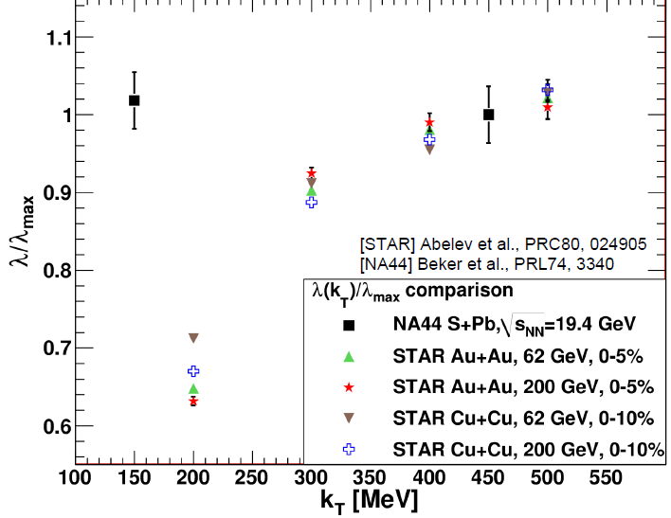
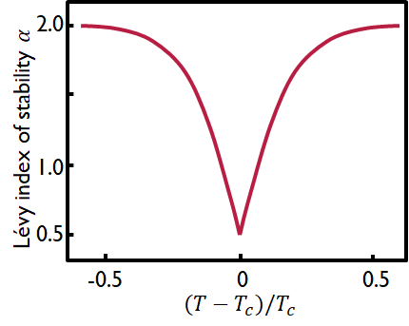

Coll. energy & Centrality dependence
Hole in $λ(m_{T})$ at lower energies?
  Filtering of $η′$ decay products to be investigated,
  based on Eur. Phys. J. A (2011) 47: 76
Non-monotonicity in $α$ vs centrality or $s_{NN}$?
New results on the way

Slide 30


3D analysis
B. Kurgyis, M. Csanád
Lévy radii at 200 GeV:
  $R_{out}≈R_{side}$ still true for Lévy scales?
  $1/R^{2}\sim m_{T}$ scaling still true?
How do Lévy radii change with energy?
  Non-monotonicity still there in $R_{out}^{2}−R_{side}^{2}$?
  $α$ versus energy in 3D: same as for 1D?
New results on the way

Slide 31


Kaon analysis
Kaon PID works well
Transverse mass scaling of Lévy HBT radii for kaons?
HRC prediction for kaons:
  Smaller cross-section, larger mean free path, heavier tail
New results on the way
ALICE Coll.
arXiv:1709.01731
Braz.J.Phys. 37(2007)1002

