Slide 1
Effect of Crab Cavity HOMs on the Couple-Bunch Stability of HL-LHC
S. Antipov
Many thanks to A. Burov (FNAL), N. Biancacci, E. Metral
9/11/17

Slide 2
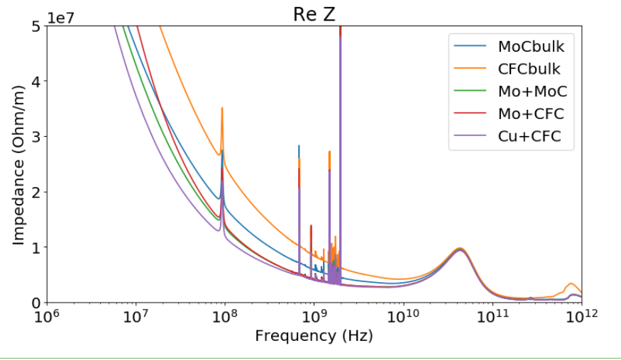
Some crab HOMs have a high shunt impedance.
They can drive a couple-bunch instability
f_{RF}
DQW design:
R_{s} = 2.7 MΩ/m
f = 1.96 GHz
Q = 31000
Crab HOMs
RW

Slide 3
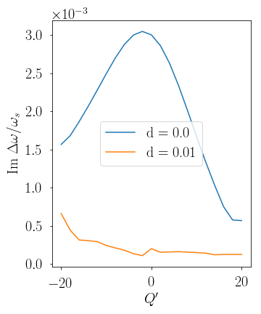
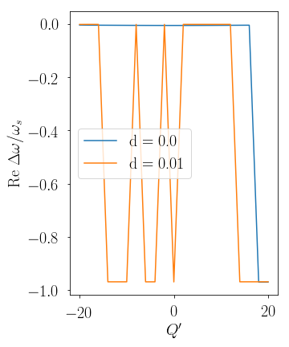
DELPHI shows that the l = 0 mode is the most critical
Impedance model – 1 HOM, no RW, low intensity
Growth rate
Tune shift

Slide 4
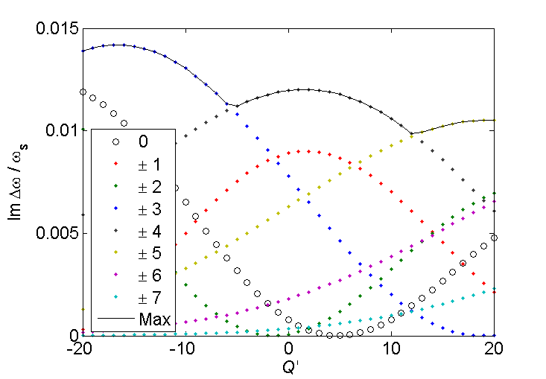
The most unstable couple-bunch mode excites many azimuthal intra-bunch modes
Low intensity:

Slide 5
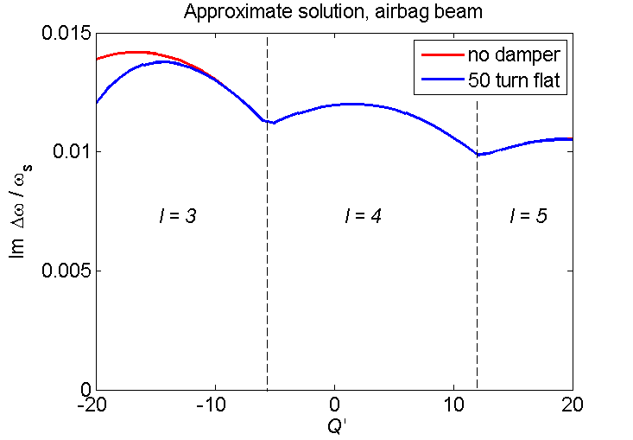
Neither chromaticity, nor flat damper can help
Flat damper:

Slide 6
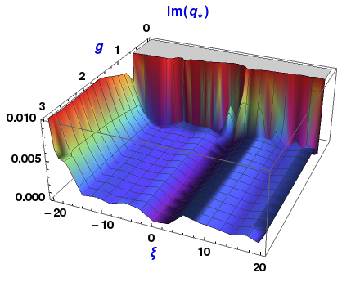
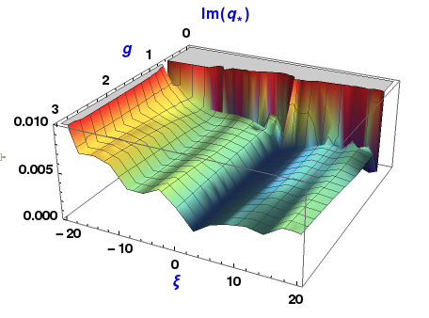
Crab HOMs significantly increase the instability growth rate for HL-LHC
Without the Crabs
With 1 dominant Crab HOM

Slide 7
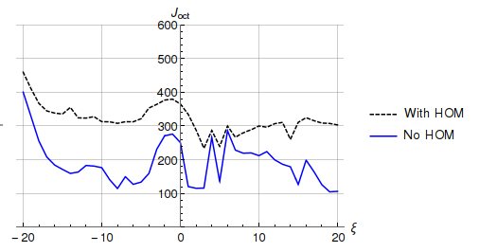
Need large additional octupole current to stabilize
ε_{n} = 2.0 μm, β* = 15 cm, negative oct., Gaussian,
Mo+MoGr coating in IR7
100 A

Slide 8
Summary
High-impedance HOMs can drive a CB instability in HL-LHC
They excite multiple azimuthal intra-bunch modes
  Thanks to their high frequency
  Flat resistive damper and Q’ are inefficient
Might need additional octupole current ~ 100 A
Possible ways to mitigate:
  Reducing mode impedance with new HOM couplers?
  Extra tune spread with an electron lens?
  Wideband feedback?
  Going to collision at a higher β*

Slide 9
Thank you
Back-up slides

Slide 10
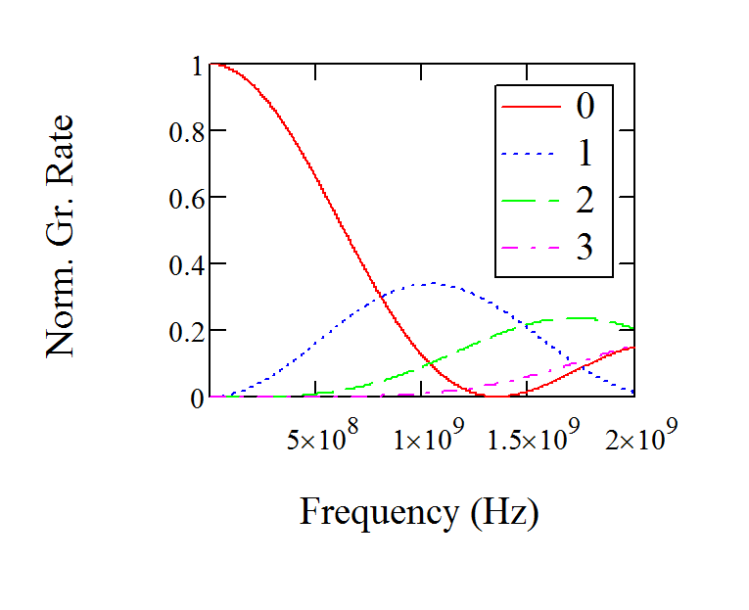
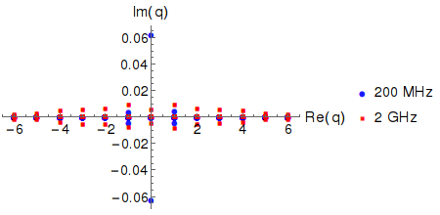
At large frequencies many azimuthal modes excited; at lower frequencies – only the low-l ones
Q’ = 0
NHT Simulation: 2.3x10¹¹ ppb, 1 HOM, Q’ = 0
Crab HOMs
are here
Comparison made keeping f/Q = const

Slide 11
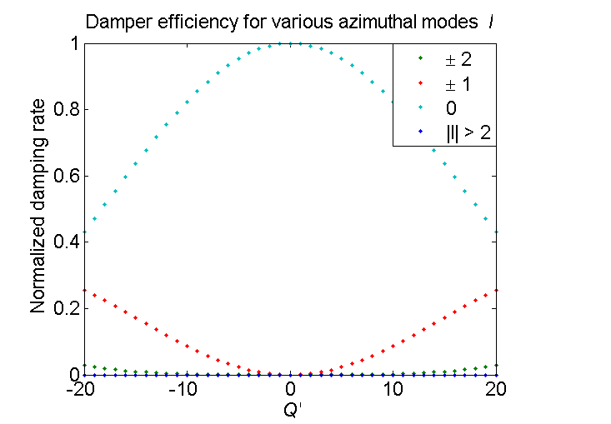
Damper is not efficient for high azimuthal mode numbers

Slide 12
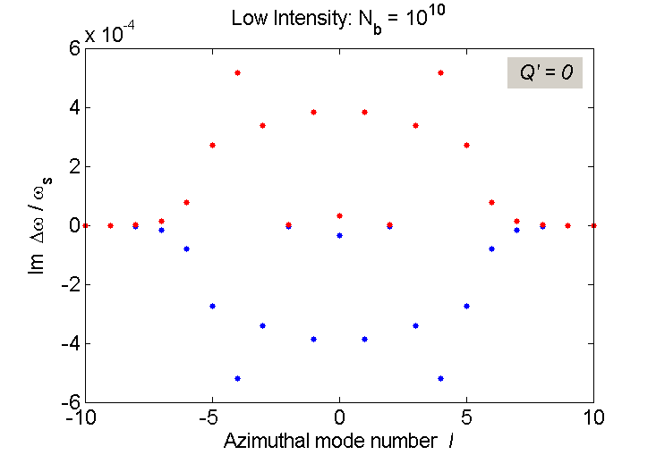
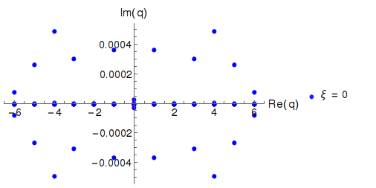
NHT agrees well with the approximate solution at low intensities: Q’ = 0, no damper
Approximate formula
NHT: 5 Radial rings

Slide 13
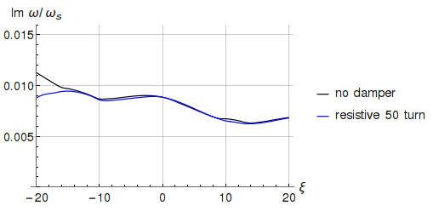
NHT agrees qualitatively with the approximate solution at higher intensities: 2.3x10¹¹ ppb
Approximate formula
NHT: 5 Radial rings

Slide 14
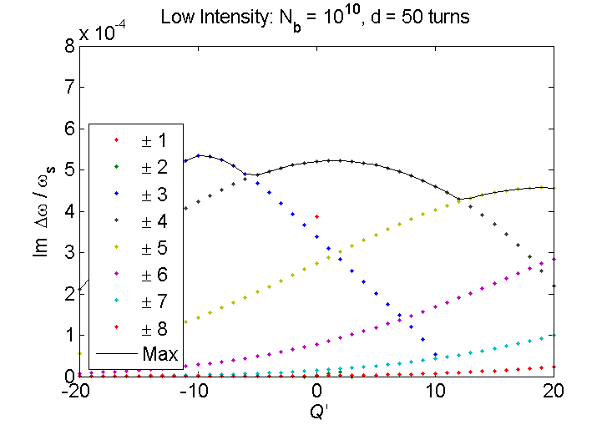
DELPHI shows that the l = 0 mode is the most critical
Approximate formula
DELPHI
Growth rate
Tune shift

