Slide 1
Crab cavity aperture and alignment
R. De Maria

Slide 2
Crab cavity
Cavity aperture: circle 84 mm
Parallel pipe: circle 84 mm
Separation: 194 mm
cryomodule
Crab cavity side
Parallel beam pipe
~ 2 m
Beam screen
needed in the parallel pipe

Slide 3
Crab Cavity Alignment
Cavities needs to be aligned on the closed orbit (potentially no margin left after alignment).
+1.06 mm
Crossing angle orbit is not zero in the in the center of the cavities.
D2
Q4
Crosssing +-295 murad
-0.69 mm
IP offset implemented with orbit corrector generate orbit at the cavities in the opposite direction
+3.31 mm
+0.47 mm
D2
Q4
Offset -2 mm
Parallel pipe will be will be misaligned with respect to the beam closed orbit.
Still margin (>5 mm in radius) to add a beam screen.

Slide 4
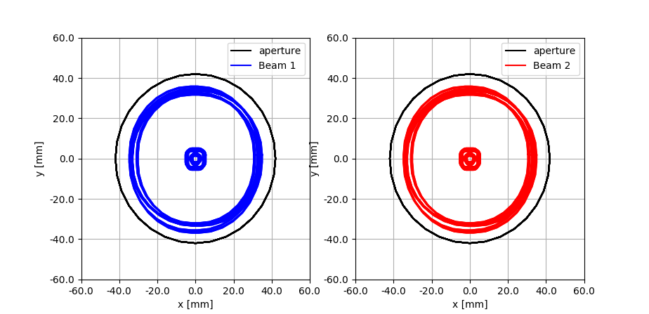
Crab Cavity Aperture
Parallel pipe without beam screen
beta*=7.5 cm, 14.2 sigma with usual tolerance

Slide 5
Protected Apertures
Δµ_{x} MKD-TCT [°] | Aperture [σ@2.5µm]
0-20 | 11.2
30 | 11.9
40 | 12.9
50 | 13.8
60 | 14.5
70-90 | 14.6
No TCT | 19.4
Injection | 12.6
Parameter | 7 TeV | 0.45 TeV
Radial CO [mm] | 2
Mom offset | 2 10⁻⁴
Dispersion | 0.1
Beam size | 1.1 | 1.025
R. Bruce et al. CERN-ACC-2017-0051

Slide 6
Aperture Margins: Round 15 cm, 12.5 σ
 | Bare | Mech | Beam | Crab | Offset
TAXS | 24.0 | 21.4 | 17.3 | 17.3 | 15.1
MQXFA.[AB]1 | 21.2 | 19.4 | 16.4 | 16.4 | 15.1
MQXF[AB]..[23] | 15.5 | 14.4 | 12.2 | 12.0 | 11.0
MBXF | 16.9 | 16.0 | 13.6 | 13.5 | 12.7
TAXN | 22.3 | 20.9 | 17.7 | 17.2 | 15.5
MBRD | 26.7 | 23.7 | 19.9 | 19.0 | 16.4
MCBRD | 29.2 | 26.3 | 22.1 | 21.2 | 18.3
TCLMB.4 | 24.9 | 23.3 | 19.0 | 18.0 | 14.7
MCBY[HV].[AB]?4 | 26.2 | 24.1 | 19.6 | 18.6 | 15.1
MQY.4 | 29.2 | 26.6 | 21.7 | 20.7 | 17.1
TCLMB.5 | 36.3 | 34.3 | 28.7 | 28.5 | 25.2
MCBY[HV].[AB]?5 | 37.5 | 35.3 | 29.4 | 29.4 | 26.2
MQY.5 | 39.4 | 37.1 | 31.0 | 31.0 | 27.9
TCLMC.6 | 37.0 | 34.4 | 28.1 | 28.1 | 25.6
MCBC[HV].6 | 38.2 | 35.9 | 29.4 | 29.4 | 27.2
MQML.6 | 38.6 | 35.8 | 29.3 | 29.3 | 27.1
θ_{c}= ± 295 μrad;
d_{sep}= ± 0.75 mm;
needs phase <=30° and slightly reduced margins
Aperture in σ at 2.5 μm/γ at 7 TeV

Slide 7
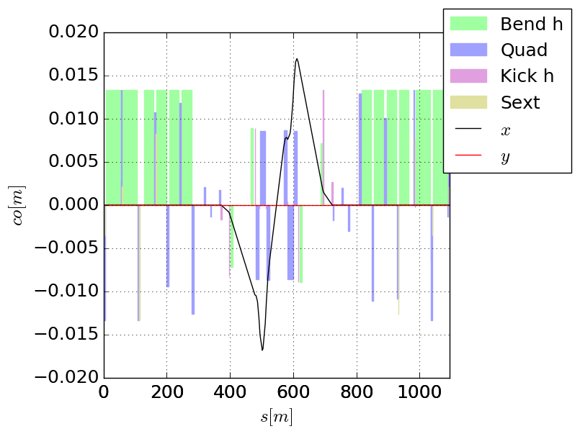
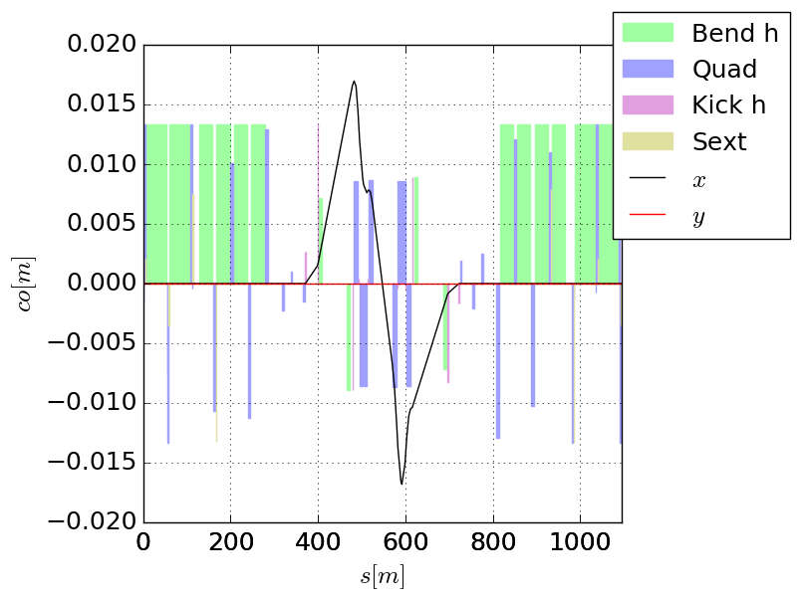
Nominal crossing bump
Baseline closed in MCBY.4 (acby.4=0.2 acbrd)
Beam 1
Beam 2
Impact on crab cavity alignment
D2
AB
CD
Q4
Crossing angle:
  x,y: ±1.15 mm (Beam 1, AB)
  x,y: ±(-0.5) mm (Beam 2, AB)
  For cryomodules:
  average offset 0.3 mm
  shear 1.65 mm
AB
CD

Slide 8
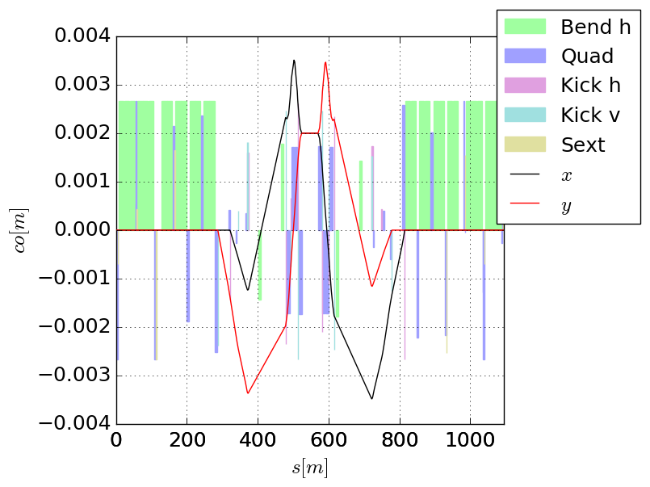
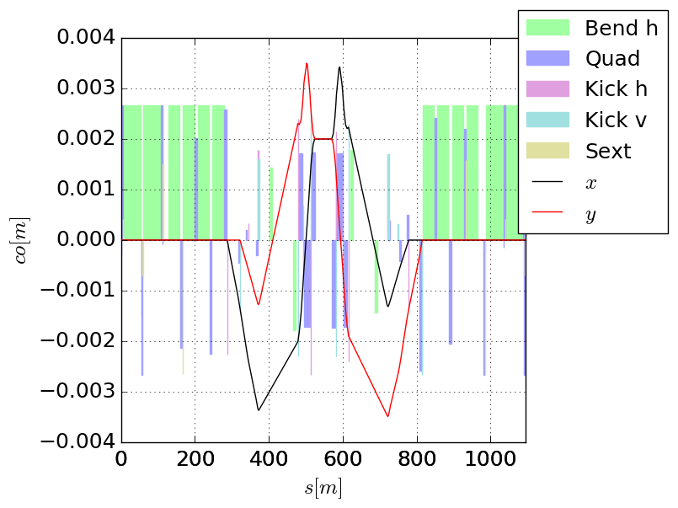
Orbit knobs - offset
Beam 1
Beam 2
IP Offset knob: x,y= ±2 mm same for the two beams to accommodate alignment needs of the experiments with machine realignment, besides crab cavities.
IP offset:
  x,y: ±3.4 mm (Beam 1, CD),
  x,y: ±1mm (Beam 2, CD),
  For cryomodules:
  avg. offset 2.2 mm
  shear 2.4 mm
D2
AB
CD
Q4
AB
CD

Slide 9
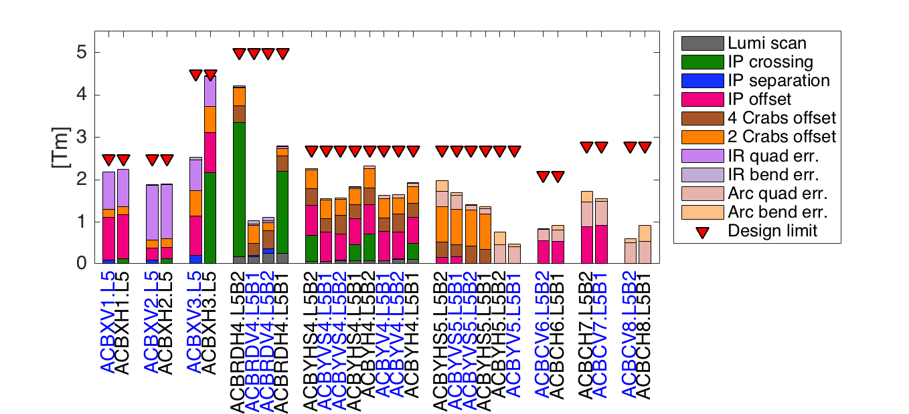
Correctors Budget requirements
For the Right and Point 1 symmetries apply:
Left B1 -> Right B2,
Left B2 -> Right B1
H Point 5 -> V Point 1
Correct quadrupole misalignments and dipole tilt and transfer function errors:
  uniformly distributed, uncorrelated error distribution (2 σ cut in the strengths):
    quadrupoles triplets and arc: 0.5 mm max transverse displacement, 1 mrad max roll
    dipoles D1, D2 and arcs: 10 mm max longitudinal displacement, 0.5 mrad max roll, 0.2% max field error
  Reduced estimates compared with LHC design (worst case) based on LHC experience
Adjust the IP position limiting the realignment of HW components (crab cavities only):
  offset in H/V planes: ±2.0 mm
Align beam in the crab cavities in both planes:
  Adjust for average offset and separation (±0.5 mm) between cavities in Beam 1 and Beam 2.
  Adjust for average offset between cavities of the same beam but in different cryomodules (±0.25 mm, relevant for 4 cavities per beam per plane per side).

