Slide 1

Forming simulations status
RFD bowl
Alexandre A. Carvalho
8.9.2017

Slide 2
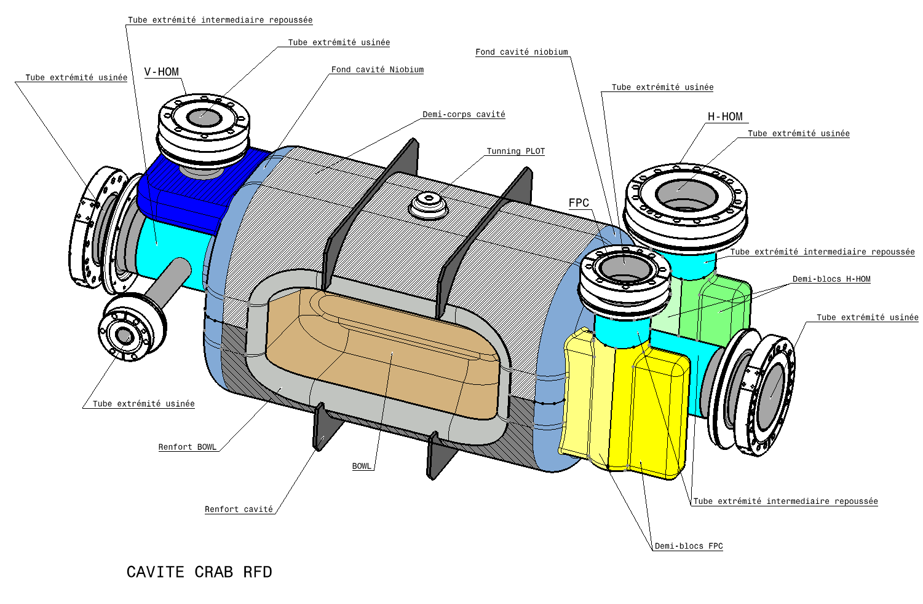
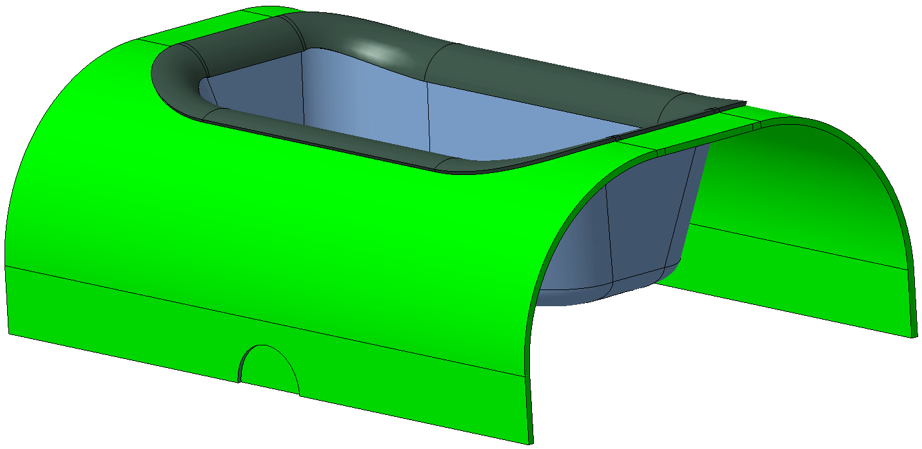
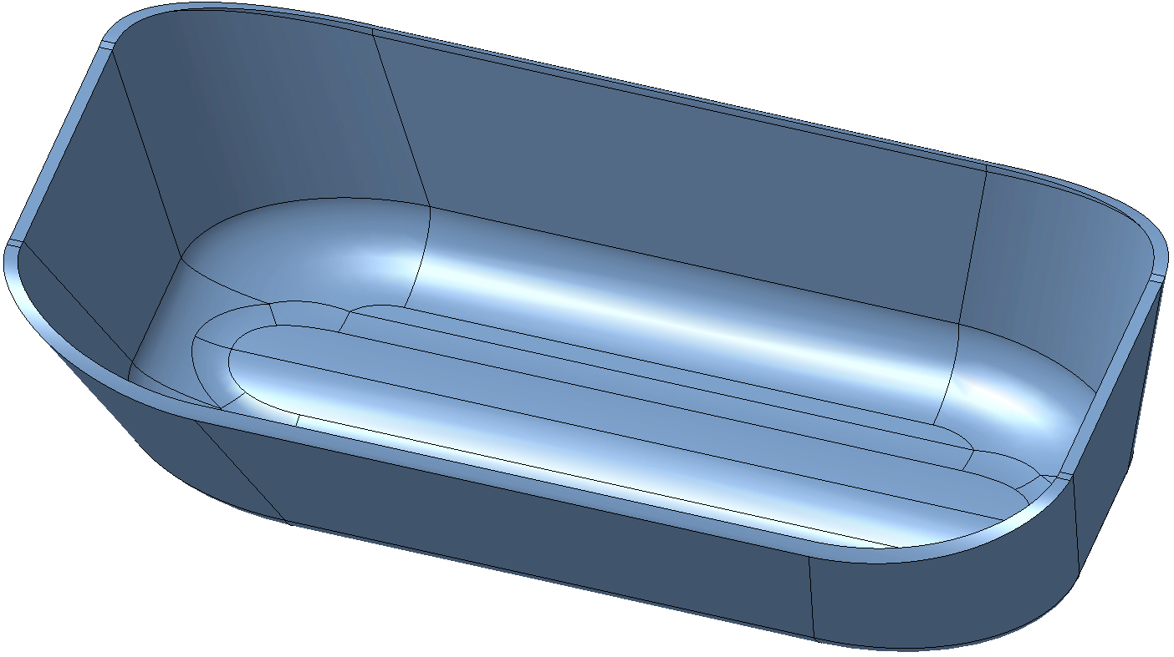
RFD bowl forming simulations
RFD Bowl
Objectives:
Optimize the shaping tools: mould, punch
Define an initial (forming) sheet cut-out shape;
Limitations:
Strain;
Thickness;
Springback;

Slide 3
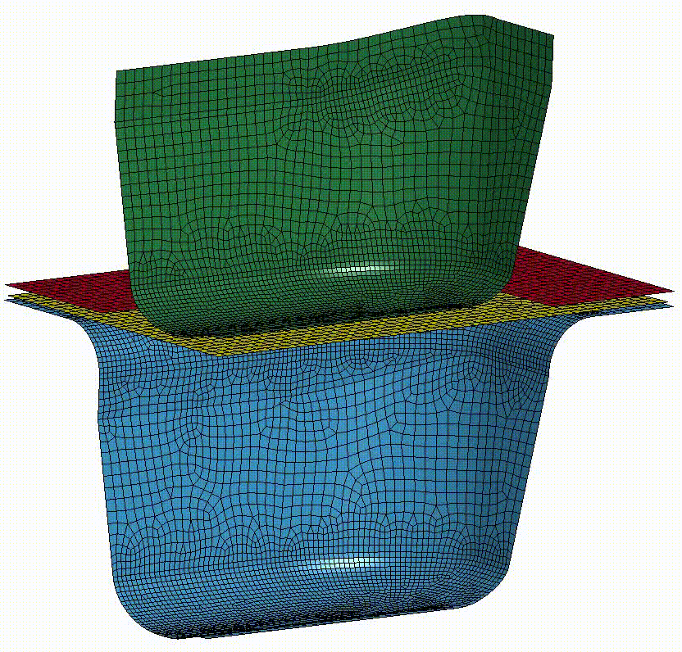
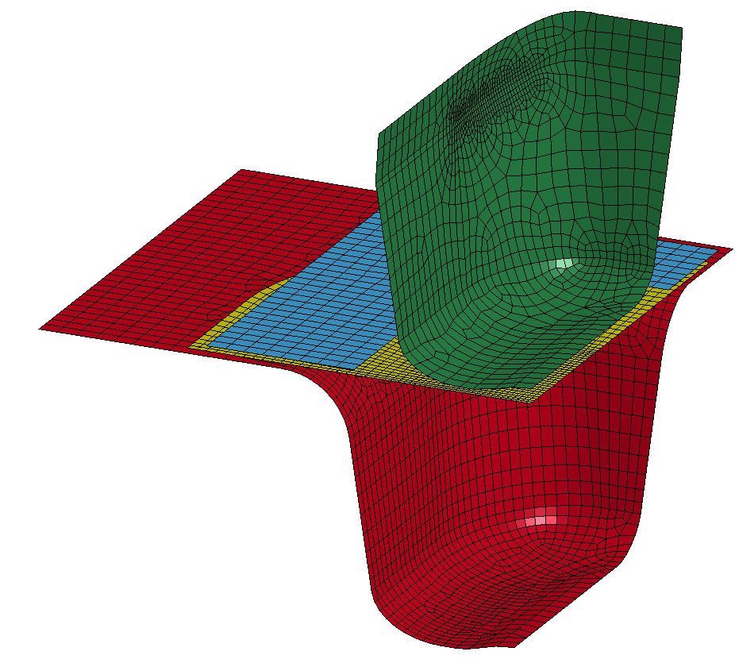
RFD bowl forming simulations
Full process:
Forming
Springback
Coining
Springback
Trimming
Springback
Process
Tools

Slide 4
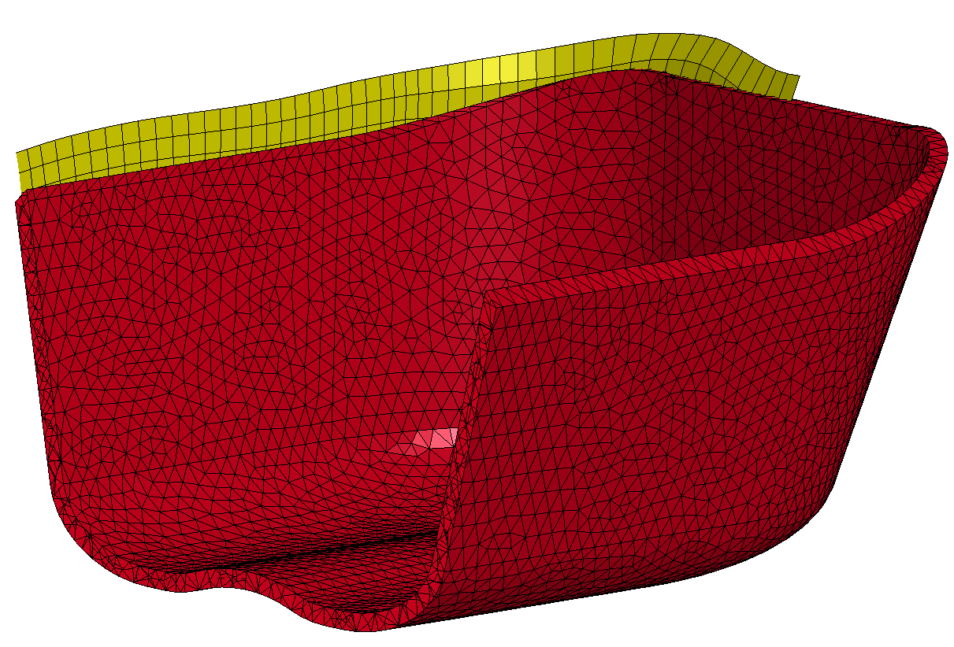
RFD bowl forming simulations
Bowl after forming
10mm
RFD Bowl as designed

