Slide 1
Infinite Derivative Gravity
James Edholm
Supervised by David Burton and Anupam Mazumdar, and collaborated on this work with Alexey Koshelev and Aindriu Conroy
arXiv:1604.01989, arXiv:1611.05062, arXiv:1705.02382, arXiv:1710.01366, arXiv:1801.00834
Notes:
Thank the organisers

Slide 2
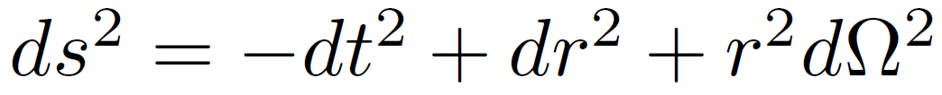
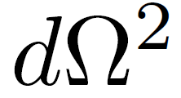
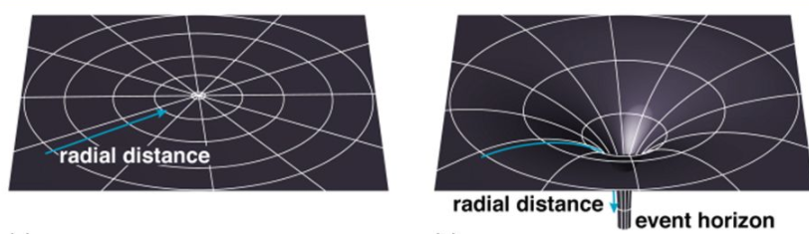
SPACETIME METRIC
Flat space:
Or in spherical coordinates:
where is the angular part

Slide 3


GENERAL RELATIVITY
Lagrangian:
Equations of motion:

Slide 4



SCHWARZSCHILD METRIC
Flat space:
Schwarzschild metric for a black hole of mass :

Slide 5
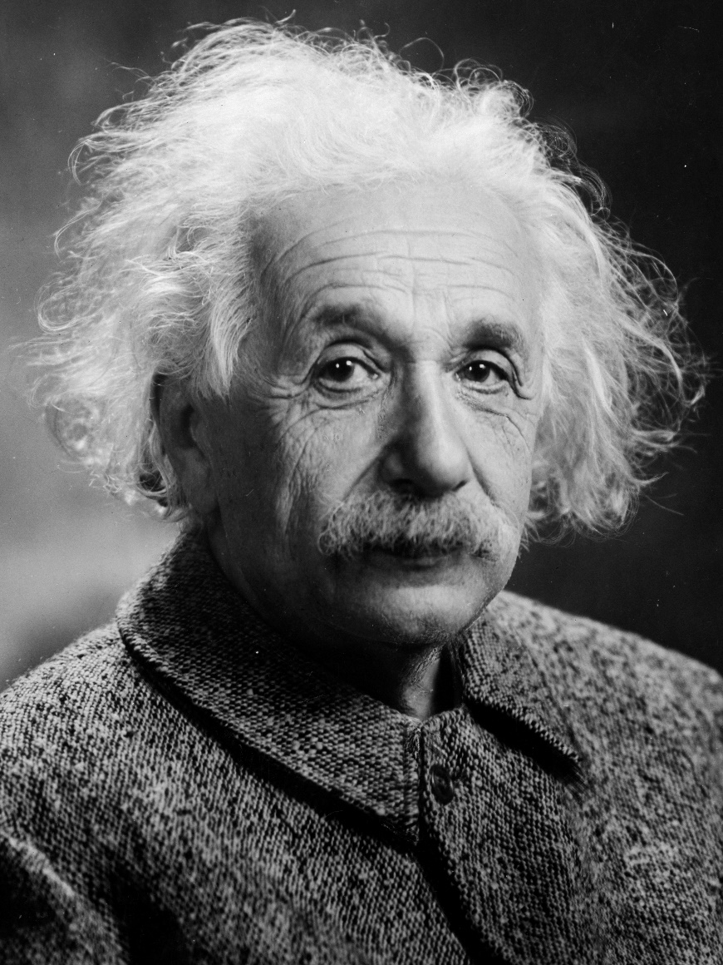
GENERAL RELATIVITY
Works well at large distances
Breaks down at short distances – produces singularities

Slide 6
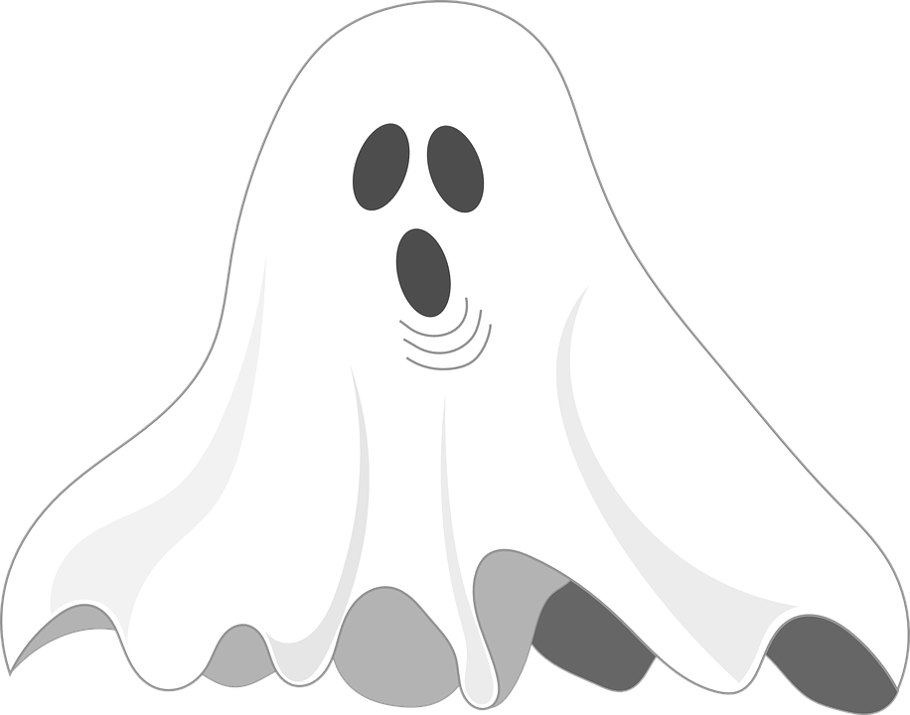


INFINITE DERIVATIVE GRAVITY (IDG)
Ghosts are physical excitations with negative kinetic energy
where

Slide 7


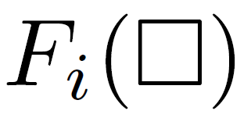

PROPAGATOR
IDG propagator around a flat background is
where in momentum space
is a combination of the s from earlier
To avoid ghosts, set
This has no zeroes
Therefore no poles in the propagator so no ghosts!

Slide 8

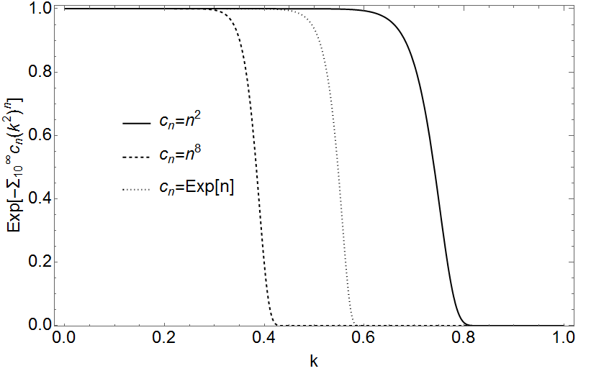
FUNCTIONAL FREEDOM
An entire function can be written as a polynomial
A priori, we have infinite freedom to set coefficients
Turns out that exponential of larger coefficients can be described by a rectangle function of a single parameter
Reduced DOF down from infinity to ~10

Slide 9
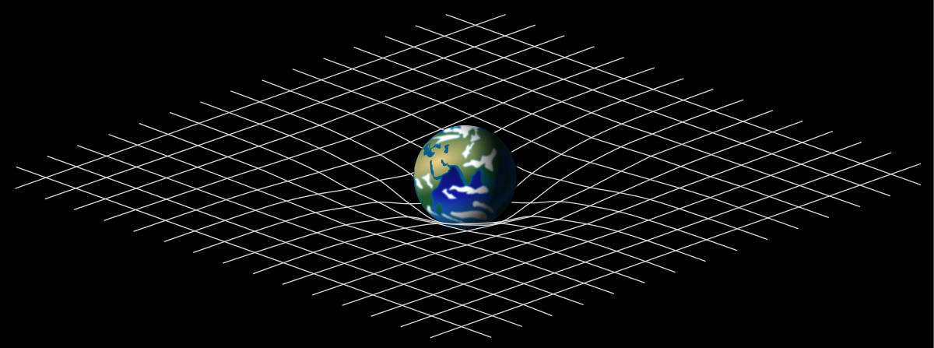
LINEARISED GRAVITY
Static point mass added to flat background

Slide 10
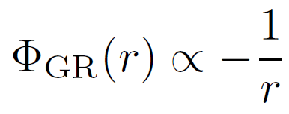
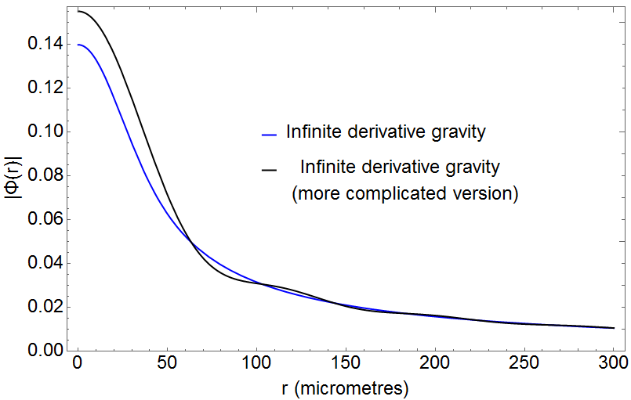
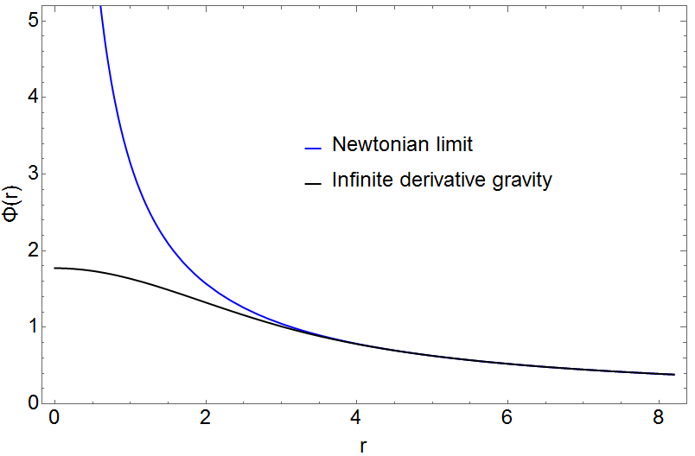
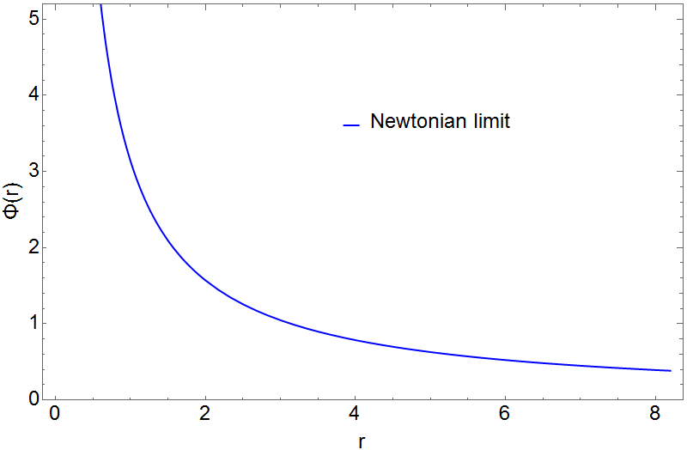
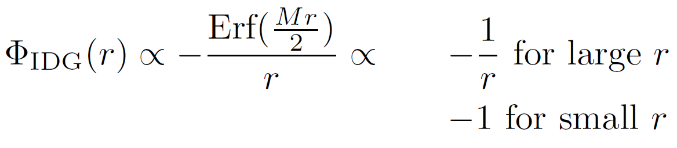
NEWTONIAN POTENTIAL
arXiv:1604.01989

Slide 11
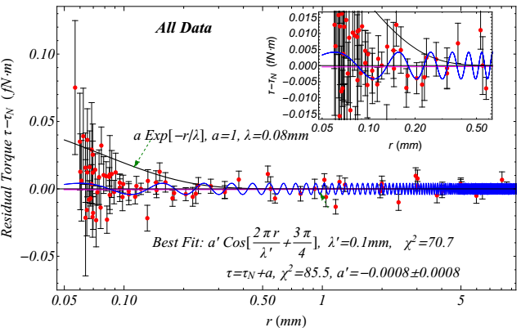
COMPARISON TO DATA
Credit: Leandros Perivolaropoulos “Submillimeter spatial oscillations of Newton’s constant: Theoretical models and laboratory tests” arXiv:1611.07293

Slide 12
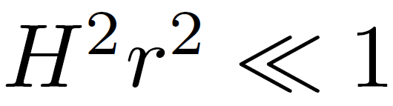
POTENTIAL AROUND A CURVED BACKGROUND
Used approximation
Found full equation for potential
At any distance where IDG makes a difference, curved background has negligible effect and vice-versa
arXiv:1801.00834

Slide 13
HAWKING-PENROSE SINGULARITIES
Hawking-Penrose singularities are produced in GR
IDG can avoid these singularities under certain conditions
Avoiding singularities for perturbations around flat background requires extra degree of freedom in propagator
Even with extra DOF, still avoid singularity in the potential from earlier
Extra DOF is not necessary around a curved background
arXiv:1705.02382, arXiv:1710.01366

Slide 14

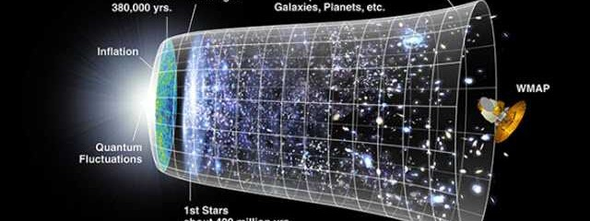
INFLATION
IDG contains R+R² (Starobinsky gravity)+ extra terms
1
0
0

Slide 15



EFFECT ON INFLATIONARY VARIABLES
IDG does not affect scalar perturbations
Spectral tilt of scalar perturbations is unaffected
It does affect tensor perturbations
So the ratio between them is

Slide 16
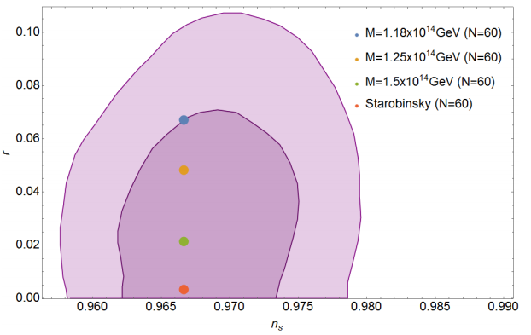
COMPARISON TO DATA
Tensor-scalar ratio against spectral tilt of scalar perturbations (from Planck satellite)
arXiv:1611.05062

Slide 17
CONCLUSION
IDG can help resolve singularities
Conforms well to experimental results
Can be constrained using inflation data

Slide 18
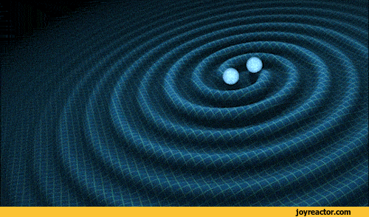
Thanks for listening!
Any questions?

Slide 19
Collabor8 conference
14th-15th May 2018 in Lancaster
www.collabor8research.com
Cosmology, strings, gravity and related topics
Aimed at PhDs and postdocs
Keynote speaker: Ruth Gregory
Abstract submission deadline: 5 April

