Slide 1
Status EuPRAXIA Project (WP1)
Ralph Aßmann (DESY)
Coordinator EuPRAXIA collaboration
Yearly Meeting 2017
November 20th, 2017, Lissabon, Portugal
http://eupraxia-project.eu

Slide 2
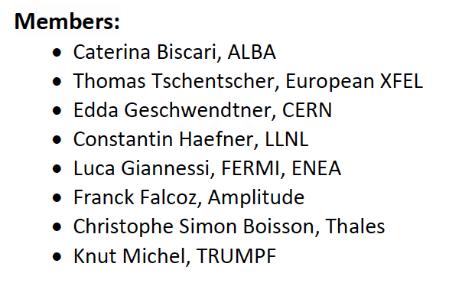
Welcome SAB
SAB = Scientific Advisory Board
Will advise on project status
Thank you for our help and glad to have you here!
All aspects
covered...
Focus 2017:
laser design
RF injectors
2018: overall project
with focus accelerator
2019: Advise on overall
project with focus
application and implementation
(nominated chair)
*
*excused

Slide 3
Outline
EuPRAXIA overview
Technical directions and status
Layout, site options and cost estimate
General developments

Slide 4
Outline
EuPRAXIA overview
Technical directions and status
Layout, site options and cost estimate
General developments

Slide 5

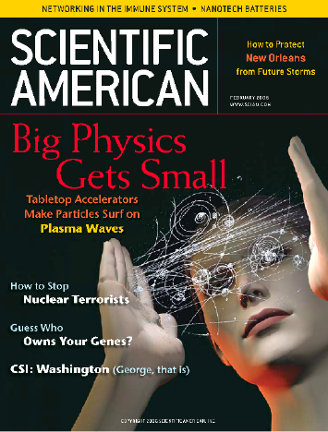
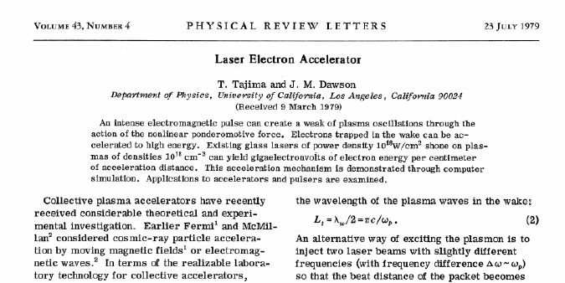


1979 paper by Tajima and Dawson. Invention of laser CPA by Mourou and Strickland.
Horizon 2020

Slide 6
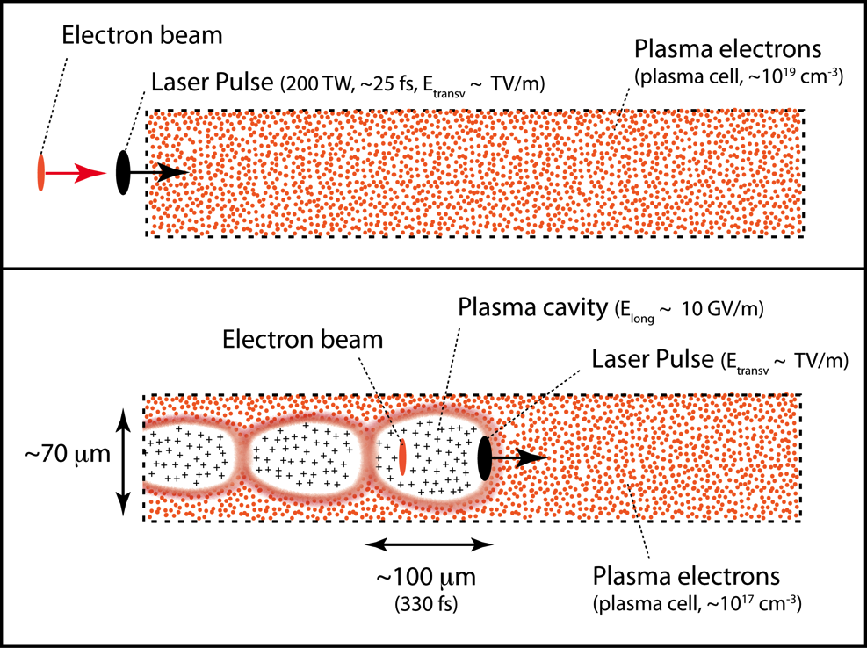

Horizon 2020

Slide 7
Why a European project?
Horizon 2020

Slide 8
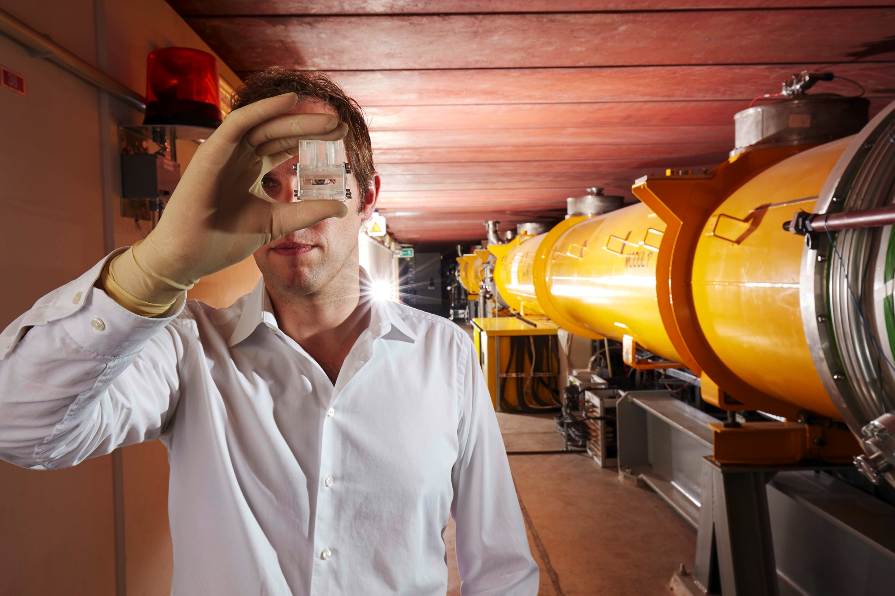
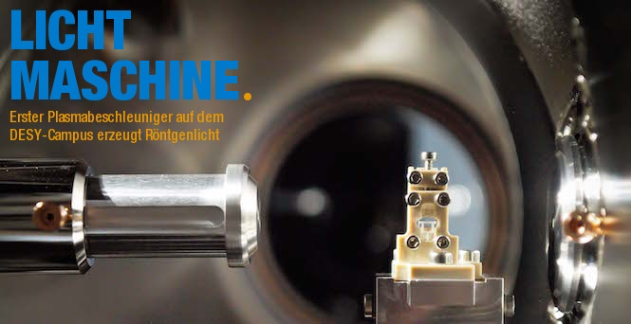
(4) Last not least, Europe has a world-leading laser industry for high power
Horizon 2020
(1) Europe has excellent accelerators, FEL’s (here FLASH at DESY) and HEP colliders
(2) Europe has highly competitive plasma accelerator R&D (invention bubble regime)
(3) European R&D faciities: e.g. laser plasma beams produce photons in FEL-type undulators

Slide 9
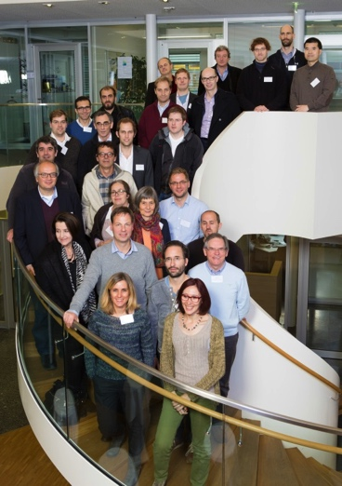
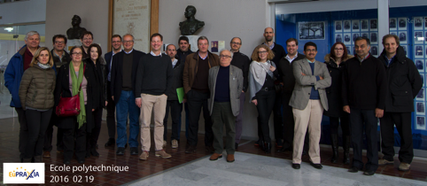
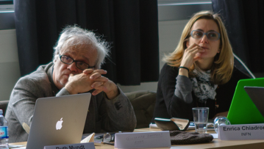
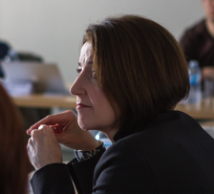
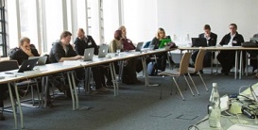
A European Strategy for
Accelerator Innovation
PRESENT EXPERIMENTS
Demonstrating
100 GV/m routinely
Demonstrating GeV electron beams
Demonstrating basic quality
EuPRAXIA INFRASTRUCTURE
Engineering a high quality, compact plasma accelerator
5 GeV electron beam for the 2020’s
Demonstrating user readiness
Pilot users from FEL, HEP, medicine, ...
PRODUCTION FACILITIES
Plasma-based linear collider in 2040’s
Plasma-based FEL in 2030’s
Medical, industrial
applications soon

Slide 10
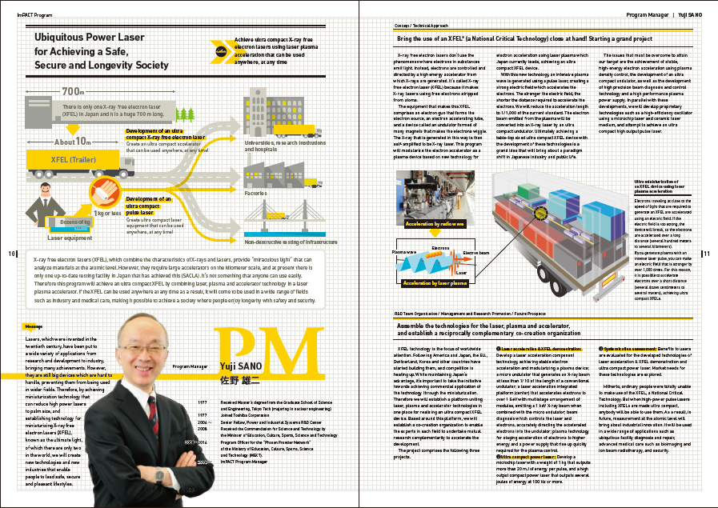
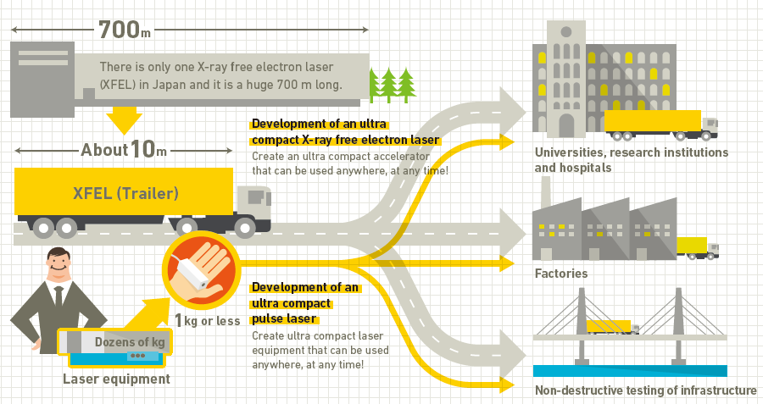
Vision of Japanese Friends
(ImPACT program in Japan)
500 M$ ImPACT program for novel technologies in Japan
About 30 M$ investment into laser plasma FEL + 60 M$ follow-up program (NEW)
Being constructed at SPRING-8/SACLA

Slide 11
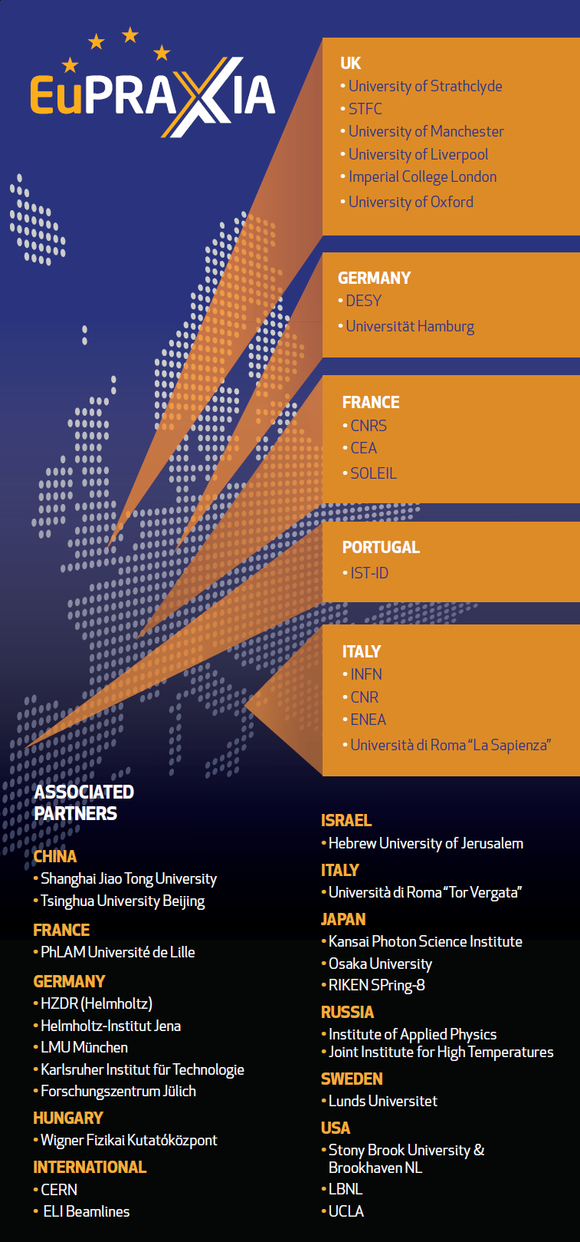
EuPRAXIA Consortium
Collaboration of 38 institutes
  16 EU laboratories are beneficiaries
  22 associated partners from EU, Europe, Asia and US contribute in-kind, 4 joined after 1st year:
  KIT (Germany), FZJ (Germany),
  University Jerusalem (Israel), IAP (Russia)
  2 candidate associate partners
Collaboration brings together:
  Big science labs: photon science, particle physics
  Laser laboratories: high power lasers
  International laboratories: CERN, ELI (associated)
  Universities: accelerator research, plasma, laser
Organized in 8 EU-funded work packages and 6 in-kind work packages
125 scientists in our work list

Slide 12
Project timeline
09.2014 Proposal submission
07.2015 Approval
11.2015 Start of EuPRAXIA project
11.2016 First common study version of EuPRAXIA design
  11.2017 Mid-term
  08.2019 Application to ESFRI roadmap for 2020 update
10.2019 Final conceptual design report and end design study
2020+ Construction decision
> 2021 – 2025 Construction
> 2025 – 2035 Operation
ESFRI =
European
Strategy for
Future Research
Infrastructures

Slide 13
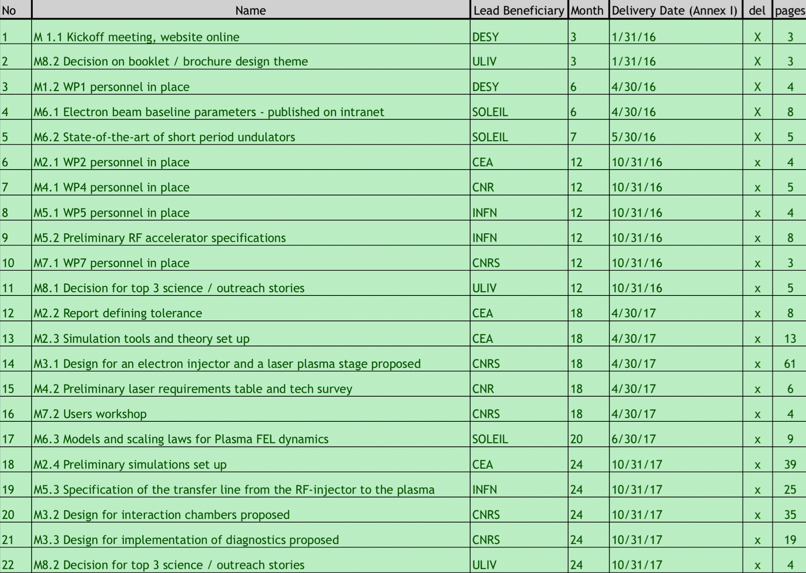
Milestones
275 pages

Slide 14
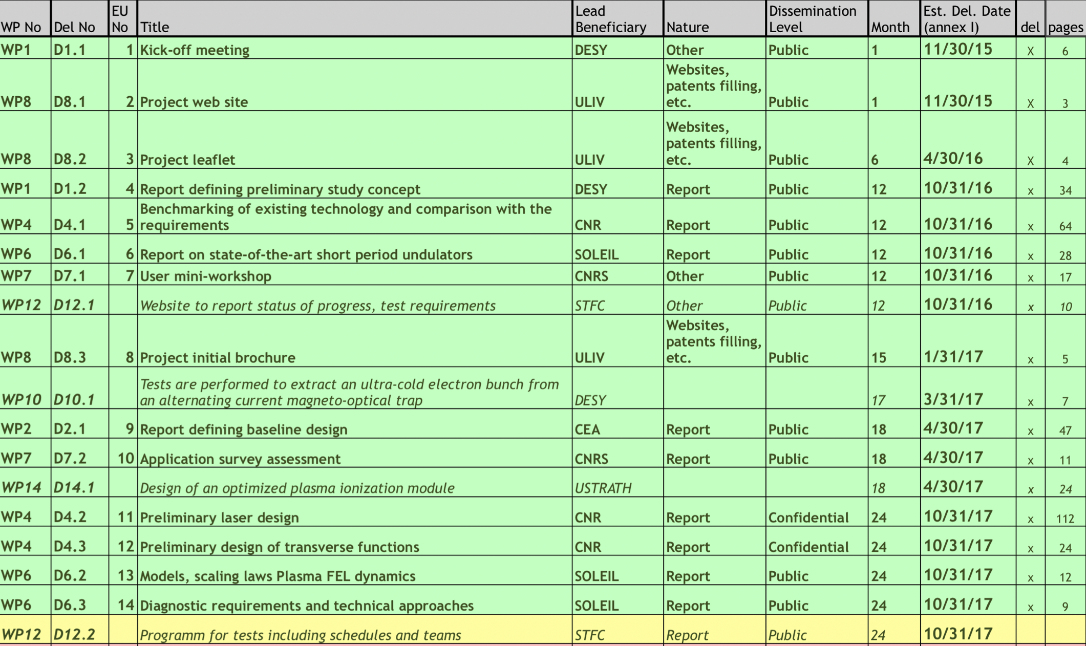
Deliverables
417 pages

Slide 15
Outline
EuPRAXIA overview
Technical directions and status
Layout, site options and cost estimate
General developments

Slide 16
EuPRAXIA Objectives
EuPRAXIA is a conceptual design study for a 5 GeV electron plasma accelerator as a European research infrastructure. Goals:
Address quality. Show plasma accelerator technology is usable:
  Incorporate established accelerator technology for optimal quality
  Combine expertise from accelerator, laser labs, industry, international partners
  Develop new technical solutions and a few use cases
Show benefit in size and cost versus established RF technology:
  Proposed solutions must offer a significant benefit, e.g. fitting constrained spaces (small labs, hospitals) and/or must be less effective.
  Cost benefits must include low operational costs (turn-key, industrial lasers at high repetition rate, cost-effective RF components, ...): small team, remote OP, ...
Note: EuPRAXIA will initially be low power and low wall-plug power efficiency
Baseline (10 Hz): 10s of Watt with ~ 1 mJ/photon pulse energy
Efforts with industry and laser institutes to improve rep. rate & efficiency (incorporate fiber-based lasers with 30 % efficiency)

Slide 17
Size versus Energy
electron linear accelerators
1 km
10 m
Size of Injector + Accelerator (m)
10 cm
Energy (GeV)

Slide 18
Size versus Energy electron linear accelerators
1 km
10 m
FEL territory
Size of Injector + Accelerator (m)
10 cm
Energy (GeV)

Slide 19
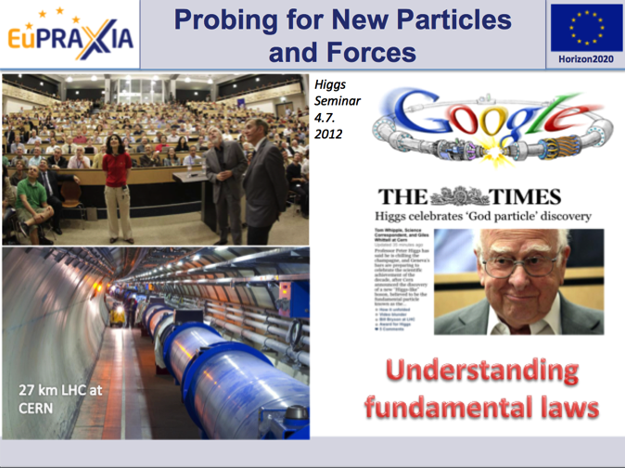
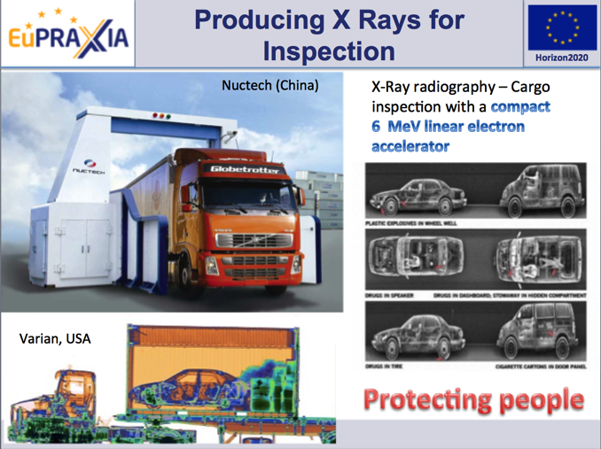
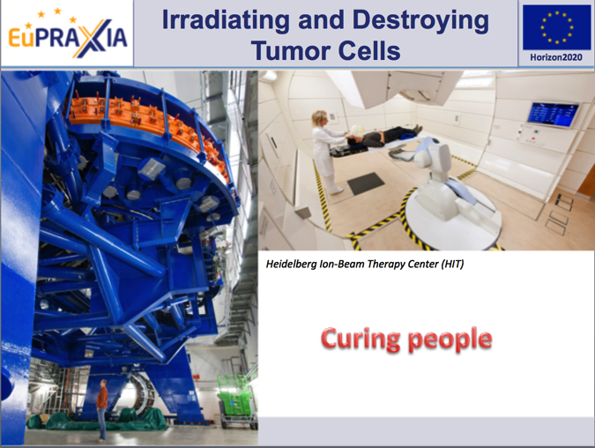
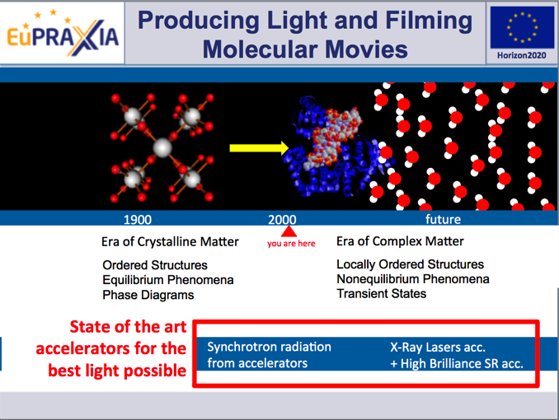
eXcellence
In Applications

Slide 20
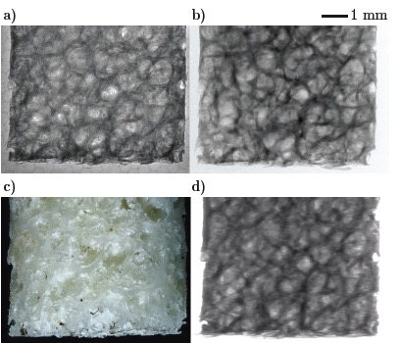
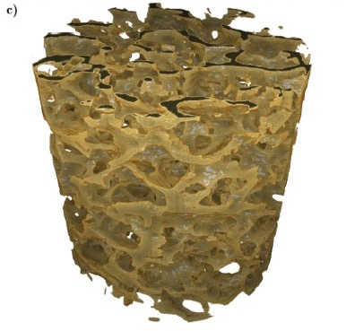
Today: Medical Imaging with Laser-Driven Plasma Accelerator
J.M. Cole et al, “Laser-wakefield accelerators as hard x-ray sources for 3D medical imaging of human bone”. Nature Scientific Reports 5, 13244 (2015)
Plasma Accelerator
μCT Scanner
3D tomography of a human bone
Flux density will be without competition
for advances in industrial laser
technology
Ultra-compact source of hard x rays for medical imaging in hospitals, universities, ...
Macro Photograhy
Radioactive Source
Results of John-Adams-Institute, UK (partner institite in EuPRAXIA)

Slide 21
Size versus Energy electron linear accelerators
TECHNICAL MASTERPIECES FOR SCIENCE
High quality beams, high power, bigger
1 km
10 m
FEL territory
Size of Injector + Accelerator (m)
10 cm
Energy (GeV)

Slide 22
Size versus Energy electron linear accelerators
TECHNICAL MASTERPIECES FOR SCIENCE
High quality beams, high power, bigger
1 km
10 m
FEL territory
Size of Injector + Accelerator (m)
10 cm
Lower quality beams, very low power, smaller
THE AMAZING PROGRESS OF A NEW TECHNOLOGY
Energy (GeV)

Slide 23
Size versus Energy electron linear accelerators
TECHNICAL MASTERPIECES FOR SCIENCE
High quality beams, high power, bigger
1 km
10 m
FEL territory
Size of Injector + Accelerator (m)
10 cm
Lower quality beams,
very low power, smaller
THE AMAZING PROGRESS OF A NEW TECHNOLOGY
Energy (GeV)

Slide 24
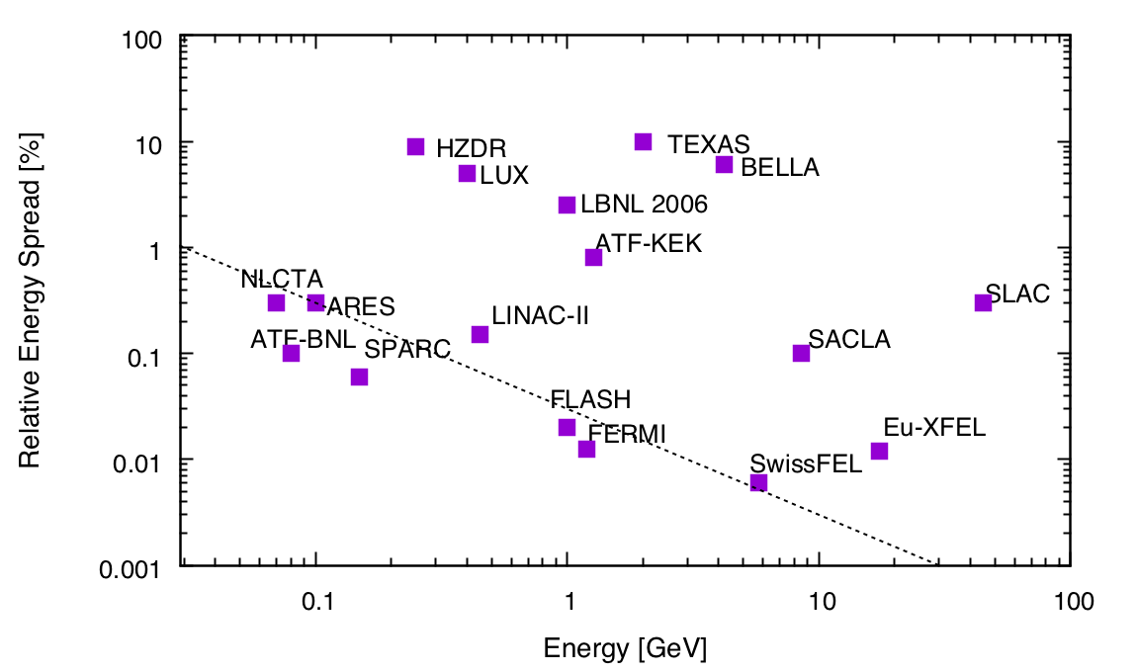
Quality: Example Energy Spread
Compact FEL’s?
Lower quality
FEL Territory
Higher quality
EuPRAXIA aims at addressing the quality problem.

Slide 25
Addressing Quality
Improve technical components and approaches in plasma accelerator concepts producing already GeV class beams:
  Improved laser technology
  Feedbacks
  New and old concepts for solutions in one stage all plasma facility
Start with a high quality beam from a small RF injector and boost it to high energy:
  Starting point quality is assured (start with FEL quality beam)
  Solve new issues, e.g. timing: new solutions needed
  Fully stageable → path to high energy
More resources will allow focused R&D
Complementary approach will bring in RF excellence

Slide 26
EuPRAXIA Development Paths towards high quality electron beams
FEL territory
1 km
10 m
Size of Injector + Accelerator (m)
10 cm
Energy (GeV)

Slide 27
EuPRAXIA Development Paths towards high quality electron beams
FEL territory
1 km
(a) EuPRAXIA
(RF + plasma)
10 m
Size of Injector + Accelerator (m)
10 cm
Energy (GeV)

Slide 28
EuPRAXIA Development Paths towards high quality electron beams
FEL territory
1 km
(a) EuPRAXIA
(RF + plasma)
10 m
Size of Injector + Accelerator (m)
10 cm
(b) EuPRAXIA (all plasma)
Energy (GeV)

Slide 29
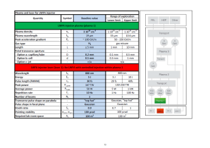
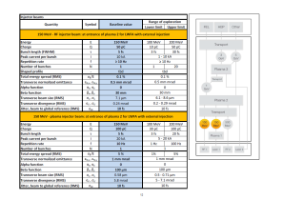
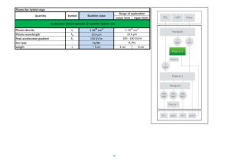
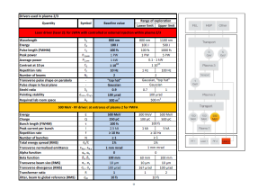
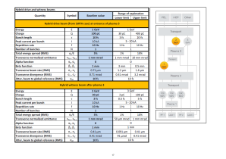
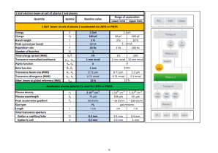
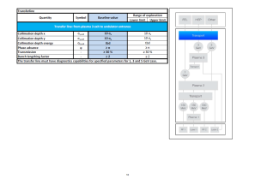
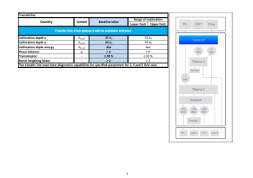
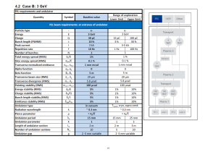
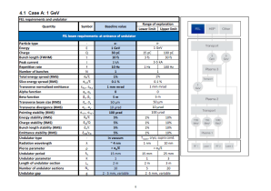
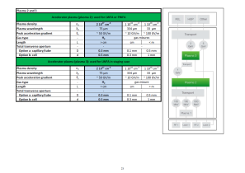
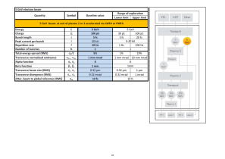
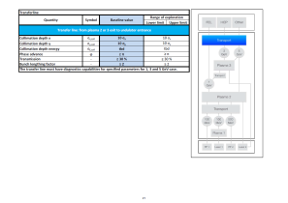

Parameter Tables
Study Version 2016
1 GeV
3 GeV
5 GeV

Slide 30
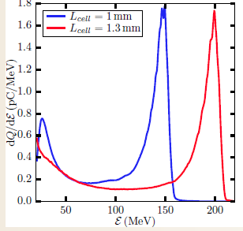
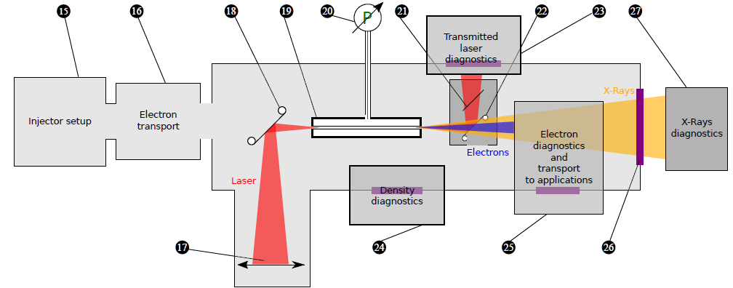
Path (b)...
Better parameters
Improved concepts (control plasma injection, plasma profiles, hybrid scheme, ...)
Multiple lasers?
See talks Brigitte Cros, Bernhard Hidding, ...

Slide 31

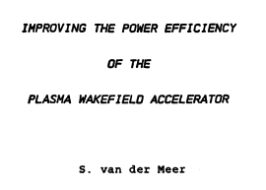
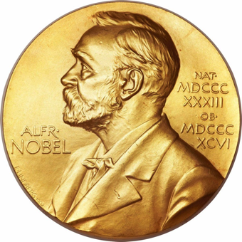
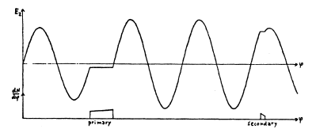
Path (a): Old Solutions
Beam loading, energy spread and efficiency
1985 van der Meer
van der Meer: Nobel Prize Physics for invention of stochastic cooling

Slide 32
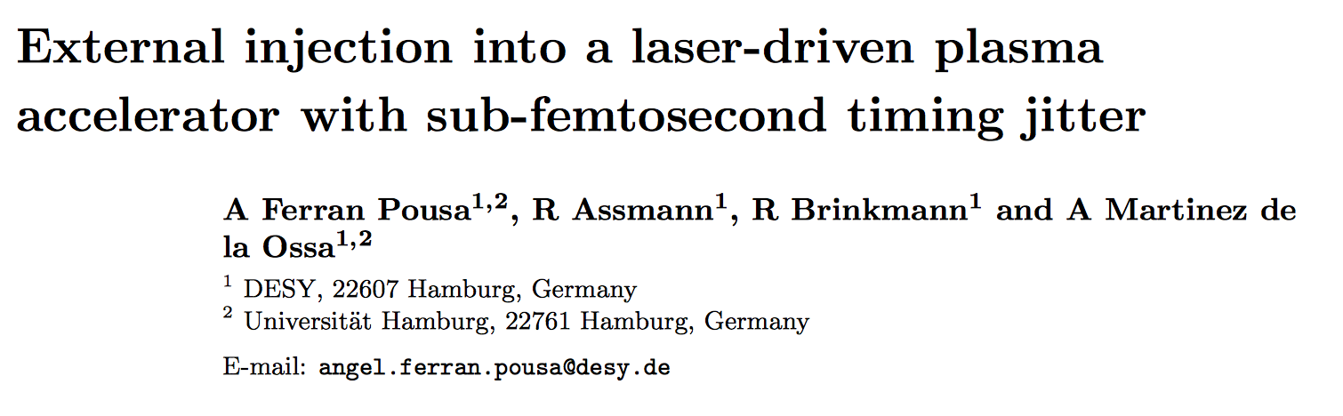
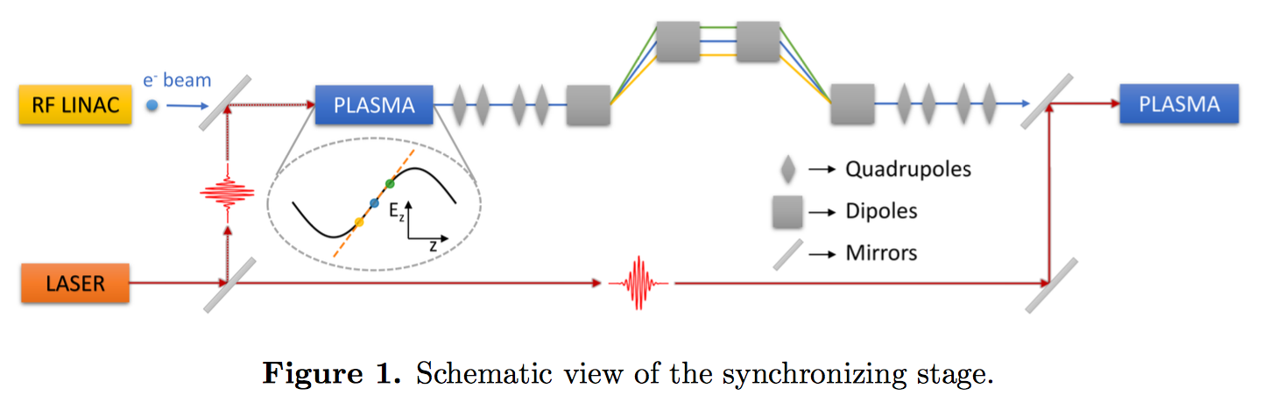
Path (a): New Solutions
External injection: timing

Slide 33
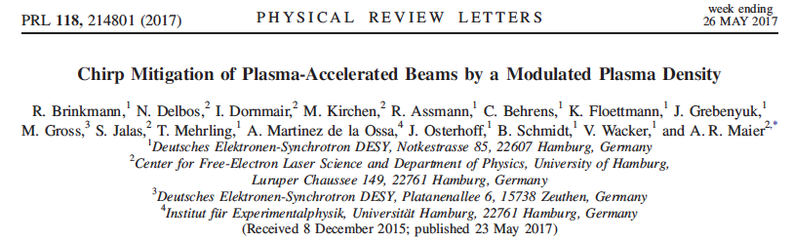
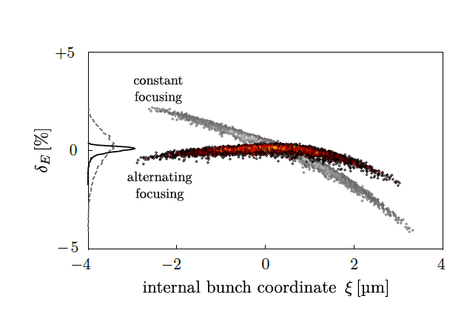
Path (a): New Solutions
Energy spread, focusing and defocusing stabilization

Slide 34
... and many more good ideas and concepts in- and outside of EuPRAXIA
kHz beams, long guiding, plasma lenses, high charge, improved quality, hybrid nano-emittance guns, application development, undulator radiation, novel undulators, theory advances, better and faster simulations, hollow plasmas, ...

Slide 35
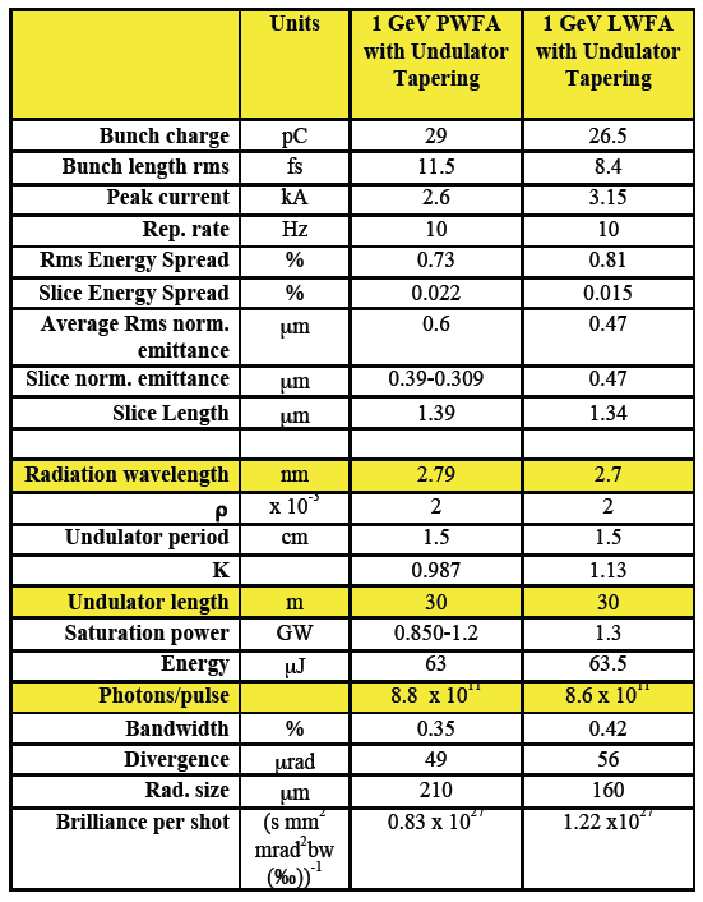
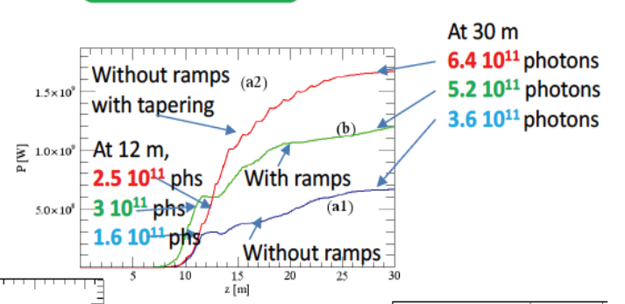

EuPRAXIA FEL Sim. Results
Putting it all together – start to end simulations. Results by INFN.
Lasing at 1 GeV predicted for several approaches!

Slide 36
Major Goals Ahead I
Define second study version of technical design and develop it further for CDR readiness (see talk Andreas Walker)
Further advance design work for lasers, RF injectors/drivers and plasma accelerators
Next iteration start to end simulation including newly published ideas for quality improvement.
  Can we reduce energy spread by factor 5 – 10
  Can we keep emittance growth small enough
  Can we open new territory: ultra short, nano-emittance, ...
  Include basic tolerance and sensitivity considerations (see timing idea)
Continue design work on FEL application but also strengthen work on HEP, medical and other applications: connect to users (even more talks, outreach, ...)
  Include seeding for reducing undulator length and improving light

Slide 37
Outline
EuPRAXIA overview
Technical directions and status
Layout, site options and cost estimate
General developments

Slide 38
Parameters, Layout, Sites
See talk by Andreas Walker

Slide 39
EuPRAXIA Implementation
Design study is site independent: 5 sites discussed so far
EuPRAXIA construction will be based on the facilities and expertise available at all supporting laboratories.
If construction budget would be obtained, it would go to the supporting labs/industry for agreed deliverables.
EuPRAXIA to be built similar to a big particle physics detector: all labs build and commission parts at local facilities, then assemble in one central site
Final site will to be decided at the political level: EuPRAXIA to provide options to decision makers at EU/national level

Slide 40
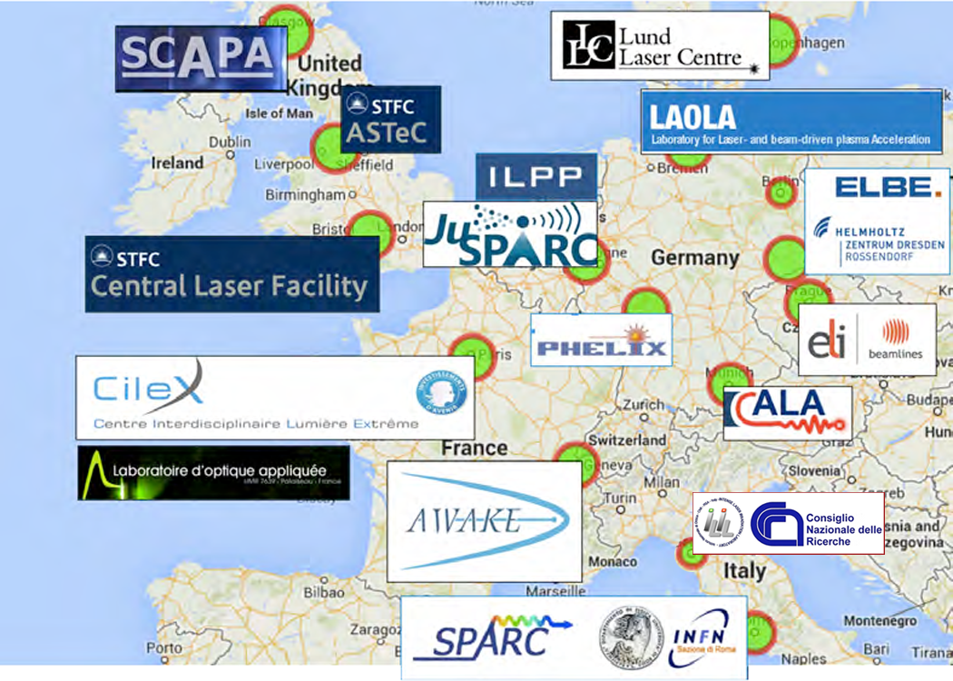

Slide 41
Major Goals ahead II
Next iteration of generic layout.
Start costing exercise
for facility construction.
Start costing exercise
for facility operation.
Work on ESFRI roadmap application, supported by external consultant (paid by DESY). Discuss with ministries.
Work out detailed implementation model.
Put it all together in the EuPRAXIA CDR with cost estimate, generic design and possible EU sites.
Advice from our SAB also very much welcome here. Bring industry expertise on board. R&D and budget required to arrive at easy to use, low OP cost lasers?

Slide 42
Decisions?
(for discussion in collaboration discussion)
Compact, cost-efficient plasma accelerator with usable beam
EuPRAXIA Idea and Goals
CDR
Solution 1
Solution 2
Solution 3
Layout 1
Cost 1
Layout 2
Cost 2
Layout 3
Cost 3
Cost – Size – Quality Matrix
Lowest cost solution
Most compact solution
Quantify for the first time benefits of novel accelerators
(should be less expensive, more compact than RF accelerators and offer usable quality)
Best quality for cost or size

Slide 43
Decisions?
(for discussion in collaboration discussion)
CDR
Compact, cost-efficient plasma accelerator with usable beam
EuPRAXIA Idea and Goals
CDR
Site 1
Existing equipment
Size constraints
Cost constraints
Special requirements
Solution 1
Solution 2
Solution 3
Layout 1
Cost 1
Layout 2
Cost 2
Layout 3
Cost 3
Site 2
Existing equipment
Size constraints
Cost constraints
Special requirements
Cost – Size – Quality Matrix
Lowest cost solution
Most compact solution
Quantify for the first time benefits of novel accelerators
(should be less expensive, more compact than RF accelerators and offer usable quality)
Best quality for cost or size

Slide 44
Decisions?
(for discussion in collaboration discussion)
Example:
Political decision for site 2. Very limited space.
CDR
Compact, cost-efficient plasma accelerator with usable beam
EuPRAXIA Idea and Goals
CDR
Site 1
Existing equipment
Size constraints
Cost constraints
Special requirements
Solution 1
Solution 2
Solution 3
Layout 1
Cost 1
Layout 2
Cost 2
Layout 3
Cost 3
Site 2
Existing equipment
Size constraints
Cost constraints
Special requirements
Cost – Size – Quality Matrix
Lowest cost solution
Most compact solution
Quantify for the first time benefits of novel accelerators
(should be less expensive, more compact than RF accelerators and offer usable quality)
Best quality for cost or size

Slide 45
Decisions?
(for discussion in collaboration discussion)
Example:
Political decision for site 2. Very limited space.
CDR
Compact, cost-efficient plasma accelerator with usable beam
EuPRAXIA Idea and Goals
CDR
Site 1
Existing equipment
Size constraints
Cost constraints
Special requirements
Solution 1
Solution 2
Solution 3
Layout 1
Cost 1
Layout 2
Cost 2
Layout 3
Cost 3
Site 2
Existing equipment
Size constraints
Cost constraints
Special requirements
Cost – Size – Quality Matrix
Lowest cost solution
Most compact solution
Quantify for the first time benefits of novel accelerators
(should be less expensive, more compact than RF accelerators and offer usable quality)
Best quality for cost or size

Slide 46
Decisions?
(for discussion in collaboration discussion)
Example:
Political decision for site 2. Very limited space.
CDR
Compact, cost-efficient plasma accelerator with usable beam
EuPRAXIA Idea and Goals
CDR
Site 1
Existing equipment
Size constraints
Cost constraints
Special requirements
Solution 1
Solution 2
Solution 3
Layout 1
Cost 1
Layout 2
Cost 2
Layout 3
Cost 3
Site 2
Existing equipment
Size constraints
Cost constraints
Special requirements
Cost – Size – Quality Matrix
Lowest cost solution
Most compact solution
Quantify for the first time benefits of novel accelerators
(should be less expensive, more compact than RF accelerators and offer usable quality)
Best quality for cost or size

Slide 47
Outline
EuPRAXIA overview
Technical directions and status
Layout, site options and cost estimate
General developments

Slide 48
General Landscape
The work on EuPRAXIA is communicated into the science funding bodies: positive and encouraging reactions!
See the examples of additional funding support obtained or under serious discussion in the national countries and EU:
  IuVF Plasma Accelerator (Helmholtz, coord. by HZDR, Germany): 7 M€
  ATHENA project (Helmholtz, coord. by DESY, Germany): 30 M€
  EuPRAXIA@SPARC (Frascati, Italy): 50 M€
  Projects in France, ideas in UK, ...
  LEAPS and TIARA activities on EU level, ELI project, ERC grants, ...
This makes us confident that we can in parallel prepare an application to the ESFRI roadmap (not required for CDR but profiting from the momentum we are getting with EuPRAXIA).
We are hiring an external consultant to keep us on track for this important goal (funded by DESY core budget).

Slide 49



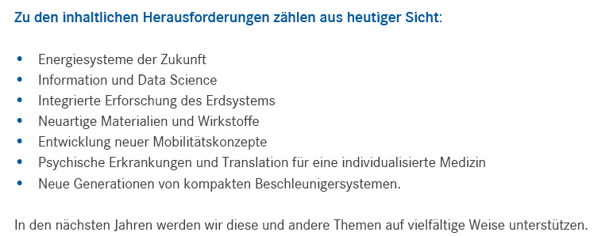
Political Landscape: Helmholtz Association in Germany
From today’s perspective the following challenges are identified
energy systems
information and data science
research earth system
new materials and agents
new mobility concepts
psych. disease
indiv. medicine
New generations of compact accelerators.
In the next years we will support these and other themes in multiple ways.

Slide 50
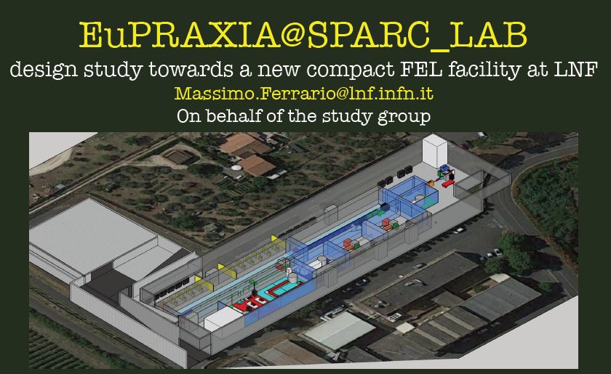


Political Landscape: INFN
Frascati in Italy
First start-to-end simulations plasma FEL
INFN strongly advancing scientific and political efforts towards an RF/plasma facility at Frascati that can host EuPRAXIA

Slide 51


LEAPS (last week kick-off event)
League of European Accelerator based-Photon Sources

Slide 52
Conclusion
EuPRAXIA is at mid term of project. All deliverables and milestones met, also the ones from in-kind resources.
Thanks to all WP leaders and WP members for great work!
We have simulations and concepts that promise indeed a higher quality, usable beam from plasma accelerators.
Now start addressing second part of our goal: show that it is indeed more compact and affordable than RF?
Feedback so far very positive: “There are not many projects like this in EU”. “EU needs these innovative projects”.
Still lot’s of work but on an excellent way: not risk free but with great benefits for science & society if we succeed.

Slide 53
























Thank you for your attention
The EuPRAXIA team
P. D. Alesini, A. S. Alexandrova, M. P. Anania, N. E. Andreev, R. W. Assmann, T. Audet, A. Bacci, I. F. Barna, A. Beaton, A. Beck, A. Beluze, A. Bernhard, S. Bielawski, F. G. Bisesto, J. Boedewadt, F. Brandi, O. Bringer, R. Brinkmann, E. Bründermann, M. Büscher, G. C. Bussolino, A. Chance, M. Chen, E. Chiadroni, A. Cianchi, J. Clarke, M. Croia, M. E. Couprie, B. Cros, J. Dale, G. Dattoli, N. Delerue, O. Delferriere, P. Delinikolas, J. Dias, U. Dorda, K. Ertel, Á. Ferran Pousa, M. Ferrario, F. Filippi, J. Fils, R. Fiorito, R. A. Fonseca, M. Galimberti, A. Gallo, D. Garzella, P. Gastinel, D. Giove, A. Giribono, L. A. Gizzi, F. J. Grüner, A. F. Habib, L. C. Haefner, T. Heinemann, B. Hidding, B. J. Holzer, S. M. Hooker, T. Hosokai, B. Imre, D. A. Jaroszynski, C. Joshi, M. Kaluza, O. S. Karger, S. Karsch, E. Khazanov, D. Khikhlukha, A. Knetsch, D. Kocon, P. Koester, O. Kononenko, G. Korn, I. Kostyukov, L. Labate, C. Lechner, W. P. Leemans, A. Lehrach, F. Y. Li, X. Li, A. Lifschitz, V. Litvinenko, W. Lu, A. R. Maier, V. Malka, G. G. Manahan, S. P. D. Mangles, B. Marchetti, A. Marocchino, A. Martinez de la Ossa, J. L. Martins, K. Masaki, F. Massimo, F. Mathieu, G. Maynard, T. J. Mehrling, A. Y. Molodozhentsev, A. Mosnier, A. Mostacci, A. S. Müller, Z. Najmudin, P. A. P. Nghiem, F. Nguyen, P. Niknejadi, J. Osterhoff, D. Papadopoulos, B. Patrizi, R. Pattathil, V. Petrillo, M. A. Pocsai, K. Poder, R. Pompili, L. Pribyl, D. Pugacheva, S. Romeo, A. R. Rossi, A. A. Sahai, Y. Sano, P. Scherkl, U. Schramm, C. B. Schroeder, J. Schwindling, J. Scifo, L. Serafini, Z. M. Sheng, L. O. Silva, C. Simon, U. Sinha, A. Specka, M. J. V. Streeter, E. N. Svystun, D. Symes, C. Szwaj, G. Tauscher, A. G. R. Thomas, N. Thompson, G. Toci, P. Tomassini, C. Vaccarezza, M. Vannini, J. M. Vieira, F. Villa, C.-G. Wahlström, R. Walczak, P. A. Walker, M. K. Weikum, C. P. Welsch, J. Wolfenden, G. Xia, M. Yabashi, L. Yu, J. Zhu, A. Zigler
www.eupraxia-project.eu

Slide 54
Additional Slides

Slide 55

Deliverables Ahead I

Slide 56

Deliverables Ahead II

Slide 57

Milestones Ahead

Slide 58
Schedule 2017 – 2018
2017 Date | Event | Place
06.11. 10:30-16:00 | mid-term-review | Brussels
20. – 24.11. | 2nd Annual Meeting 2nd Collaboration Board Meeting SAC 2nd Collaboration Week | Lisbon, Portugal (IST)
14.12. 9:00 – 12:00 | 8th Steering Meeting | remote
2018 Date | Event | Place
15.3. 9:00 – 12:00 | 9th Steering Meeting | remote
14.6. 9:00 – 12:00 | 10th Steering Meeting | remote
2. – 6.7. | 3rd Collaboration Week LIVERPOOL Symposium | Liverpool, UK
14.9. 9:00 – 12:00 | 11th Steering Meeting | remote
29.10. – 2.11. | 3rd Annual Meeting 3rd Collaboration Board Meeting SAC 4th Collaboration Week | TBC – Hamburg, Germany (DESY)
14.12. 9:00 – 12:00 | 12th Steering Meeting | remote

Slide 59
Schedule 2019
2019 Date | Event | Place
25.2. 14:00 - 1.3. 14:00 | Retreat (5th Collaboration Week) 13th Steering Meeting | TBD, Alps, Germany or Italy
19.6. 9:00 – 12:00 | 14th Steering Meeting | remote
TBD | 6th Collaboration Week SAB special meeting 15th Steering Meeting | TBD
29.10 9:00 - 31.10.16:00 | 4th Annual and Final Meeting 4th Collaboration Board Public outreach event | Hamburg, Germany (DESY)

Slide 60








Plasma LC
p/ion for medicine biology
Time-resolved plasma diagno-stics, material R&D
ATHENA Project
2018 – 2021, 30 M€
6 centers + 1 institute: Using infrastructures together
2 future technologies for the Helmholtz strategy
High relevance for applications in centers.
Expect funding to start in 2018 (final approval at highest level ongoing)
Plasma FEL
e- plasma
Injector
Hamburg, Dresden
n beams
Dresden
Pol. Beams
Medical imaging
Darmstadt, Jena
Karlsruhe
Jena
Jülich
Jülich
Hamburg, Karls-
ruhe, Jülich
Flagship
ATHENA_{e}
Flagship
ATHENA_{h}
HAMBURG
DRESDEN
p/ion plasma accelerator
e- plasma accelerator
BERLinPRO
FLUTE
SINBAD
LIGHT
ELBE
AMTF
PITZ
JENA
JUSPARC
ARD ST3
FLASHForward
REGAE
LUX

