Slide 1
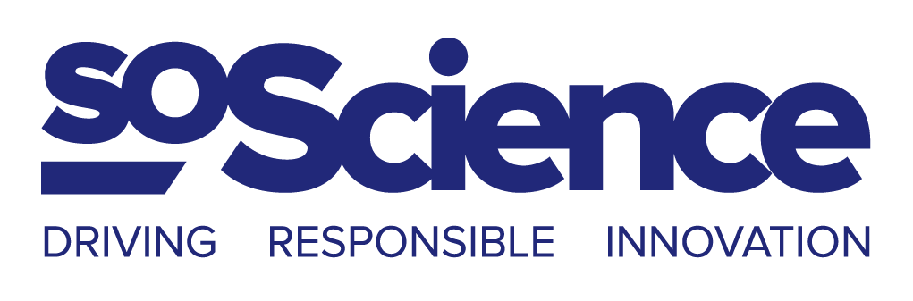

Slide 2
Responsible Research and Innovation: concepts and opportunities
14/09/2017
@SoScienceTweet / @Melanie_Marcel

Slide 3

Hi!
Mélanie Marcel
Engineer (wave physics + neurosciences)
Founder of SoScience
Ashoka Changemaker
Echoing Green Fellow
RRI expert for the EU
Notes:
Engineer, specialized in wave physics and neurosciences
Founder of SoScience

Slide 4
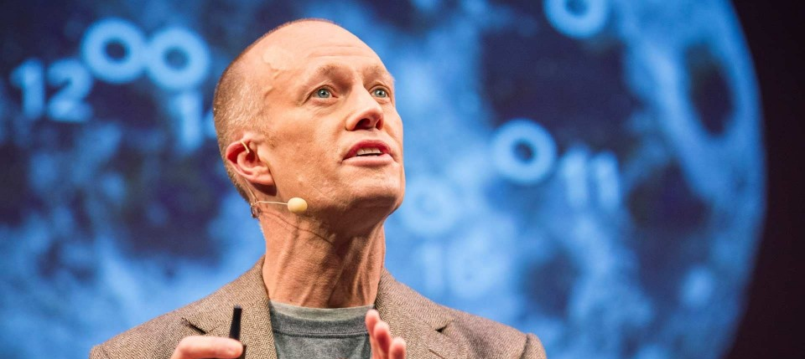
« Can technology solve our big problems? »
Notes:
Jason Pontin = chief redactor of the MIT Technology Review
TED conf février 2013
1.35 – 4.52
The first half of the 20th century produced the assembly line and the airplane,penicillin and a vaccine for tuberculosis. In the middle years of the century, polio was eradicated and smallpox eliminated.
[…] Blithe optimism about technology's powers has evaporated as big problems we had imagined technology would solve, such as going to Mars, creating clean energy, curing cancer, or feeding the world have come to seem intractably hard.
[…] It feels as if technologists have diverted us and enriched themselves with trivial toys, things like iPhones & apps. There's nothing wrong with these things […] but they don't solve humanity's big problems.

Slide 5
« Can technology solve our big problems? »
“The early 20th century produced the assembly line, the airplane, penicillin, a vaccine for tuberculosis. Polio was eradicated and smallpox eliminated.
Notes:
Jason Pontin = chief redactor of the MIT Technology Review
TED conf février 2013
1.35 – 4.52
[…] It feels as if technologists have diverted us and enriched themselves with trivial toys, things like iPhones & apps. There's nothing wrong with these things […] but they don't solve humanity's big problems.

Slide 6
« Can technology solve our big problems? »
“The early 20th century produced the assembly line, the airplane, penicillin, a vaccine for tuberculosis. Polio was eradicated and smallpox eliminated.
[…] Blithe optimism about technology's powers has evaporated as big problems we had imagined technology would solve (going to Mars, creating clean energy, curing cancer, or feeding the world) have come to seem intractably hard.
Notes:
Jason Pontin = chief redactor of the MIT Technology Review
TED conf février 2013
1.35 – 4.52
[…] It feels as if technologists have diverted us and enriched themselves with trivial toys, things like iPhones & apps. There's nothing wrong with these things […] but they don't solve humanity's big problems.

Slide 7
« Can technology solve our big problems? »
“The early 20th century produced the assembly line, the airplane, penicillin, a vaccine for tuberculosis. Polio was eradicated and smallpox eliminated.
[…] Blithe optimism about technology's powers has evaporated as big problems we had imagined technology would solve (going to Mars, creating clean energy, curing cancer, or feeding the world) have come to seem intractably hard.
[…] "Something happened to our capacity to solve big problems with technology" has become a commonplace.”
Notes:
Jason Pontin = chief redactor of the MIT Technology Review
TED conf février 2013
1.35 – 4.52
[…] It feels as if technologists have diverted us and enriched themselves with trivial toys, things like iPhones & apps. There's nothing wrong with these things […] but they don't solve humanity's big problems.

Slide 8
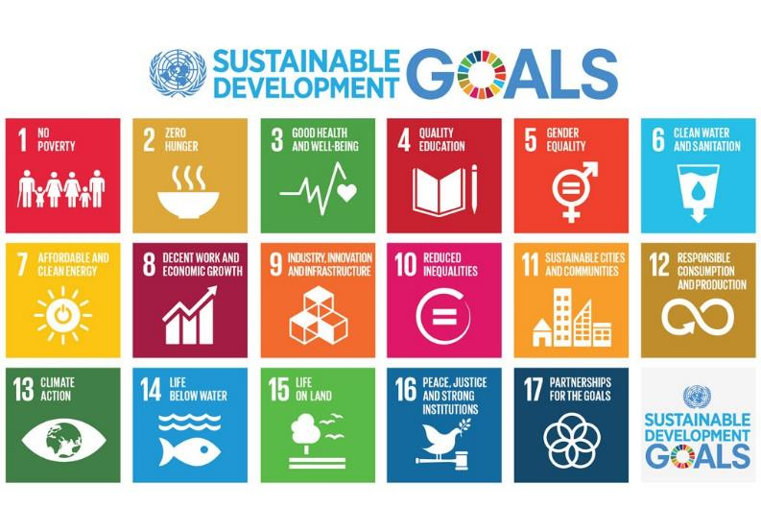
Responsible Research and Innovation
Context:
Notes:
Many problems are not resolved:
1/9 people in the world today (795 million) are undernourished
Of the 8,300 animal breeds known, 8% are extinct and 22% are at risk of extinction
Of the over 80,000 tree species, less than 1% have been studied for potential use
Man is polluting water faster than nature can recycle and purify water in rivers and lakes.
Energy use in OECD countries will grow another 35 per cent by 2020.

Slide 9
Responsible Research and Innovation
Context:
Clean drinking water
Climate Change
Overfishing
Food production
Urbanization
Internet Governance
Mobility and transport
Affordable healthcare
Cyber security
…
Deforestation
Sustainable Energy
Waste management
Poverty
Hunger
Child mortality
Orphan diseases

Slide 10
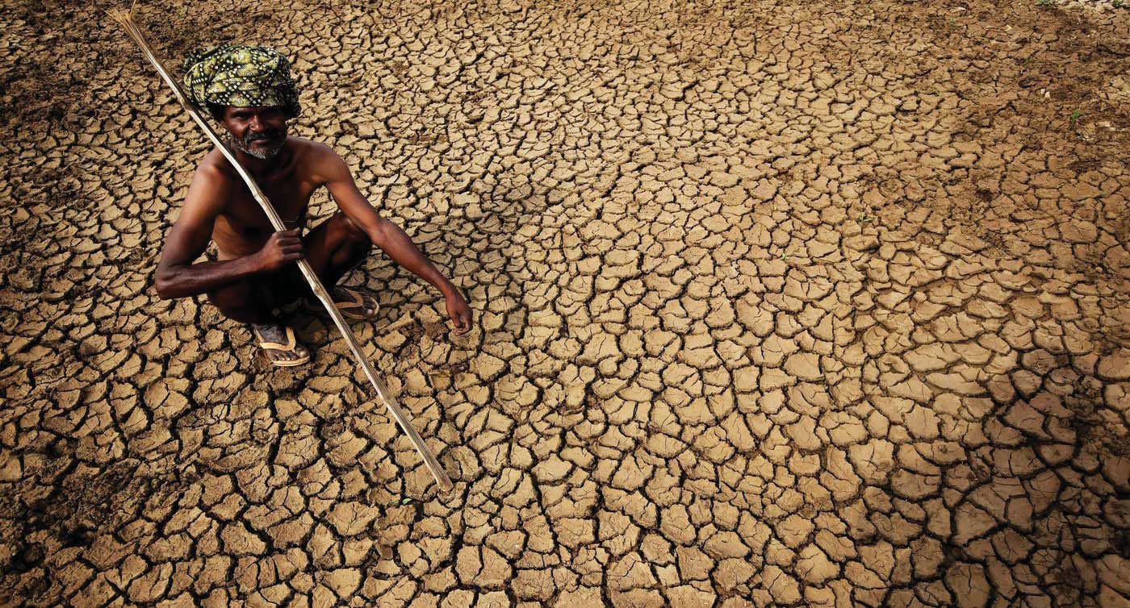
Water scarcity is impacting
40% of global population
(rising)
Notes:
2,6 milliards de personnes ont eu accès à des sources améliorées d’eau potable depuis 1990, mais 663 millions de personnes en sont encore privées
Au moins 1,8 milliard de personnes dans le monde utilisent une source d’eau potable qui est contaminée par des matières fécales
Entre 1990 et 2015, la proportion de la population mondiale utilisant une source d’eau potable améliorée a augmenté de 76% à 91%
Cependant, la pénurie d’eau affecte plus de 40% de la population mondiale et devrait augmenter. Plus de 1,7 milliard de personnes vivent actuellement dans des bassins fluviaux où l’utilisation de l’eau est supérieure à la quantité disponible
2,4 milliards de personnes manquent d’installations sanitaires de base, tels que des toilettes ou de latrines
Plus de 80% des eaux usées résultant des activités humaines sont déversées dans les rivières ou la mer sans aucune dépollution
Chaque jour, 1 000 enfants meurent de maladies faciles à prévenir en améliorant les conditions d’assainissement et d’hygiène
Environ 70% de toute l’eau prélevée dans les rivières, lacs et aquifères est utilisée pour l’irrigation
Les inondations représentent 70% des décès liés à des catastrophes causées par des aléas naturels

Slide 11
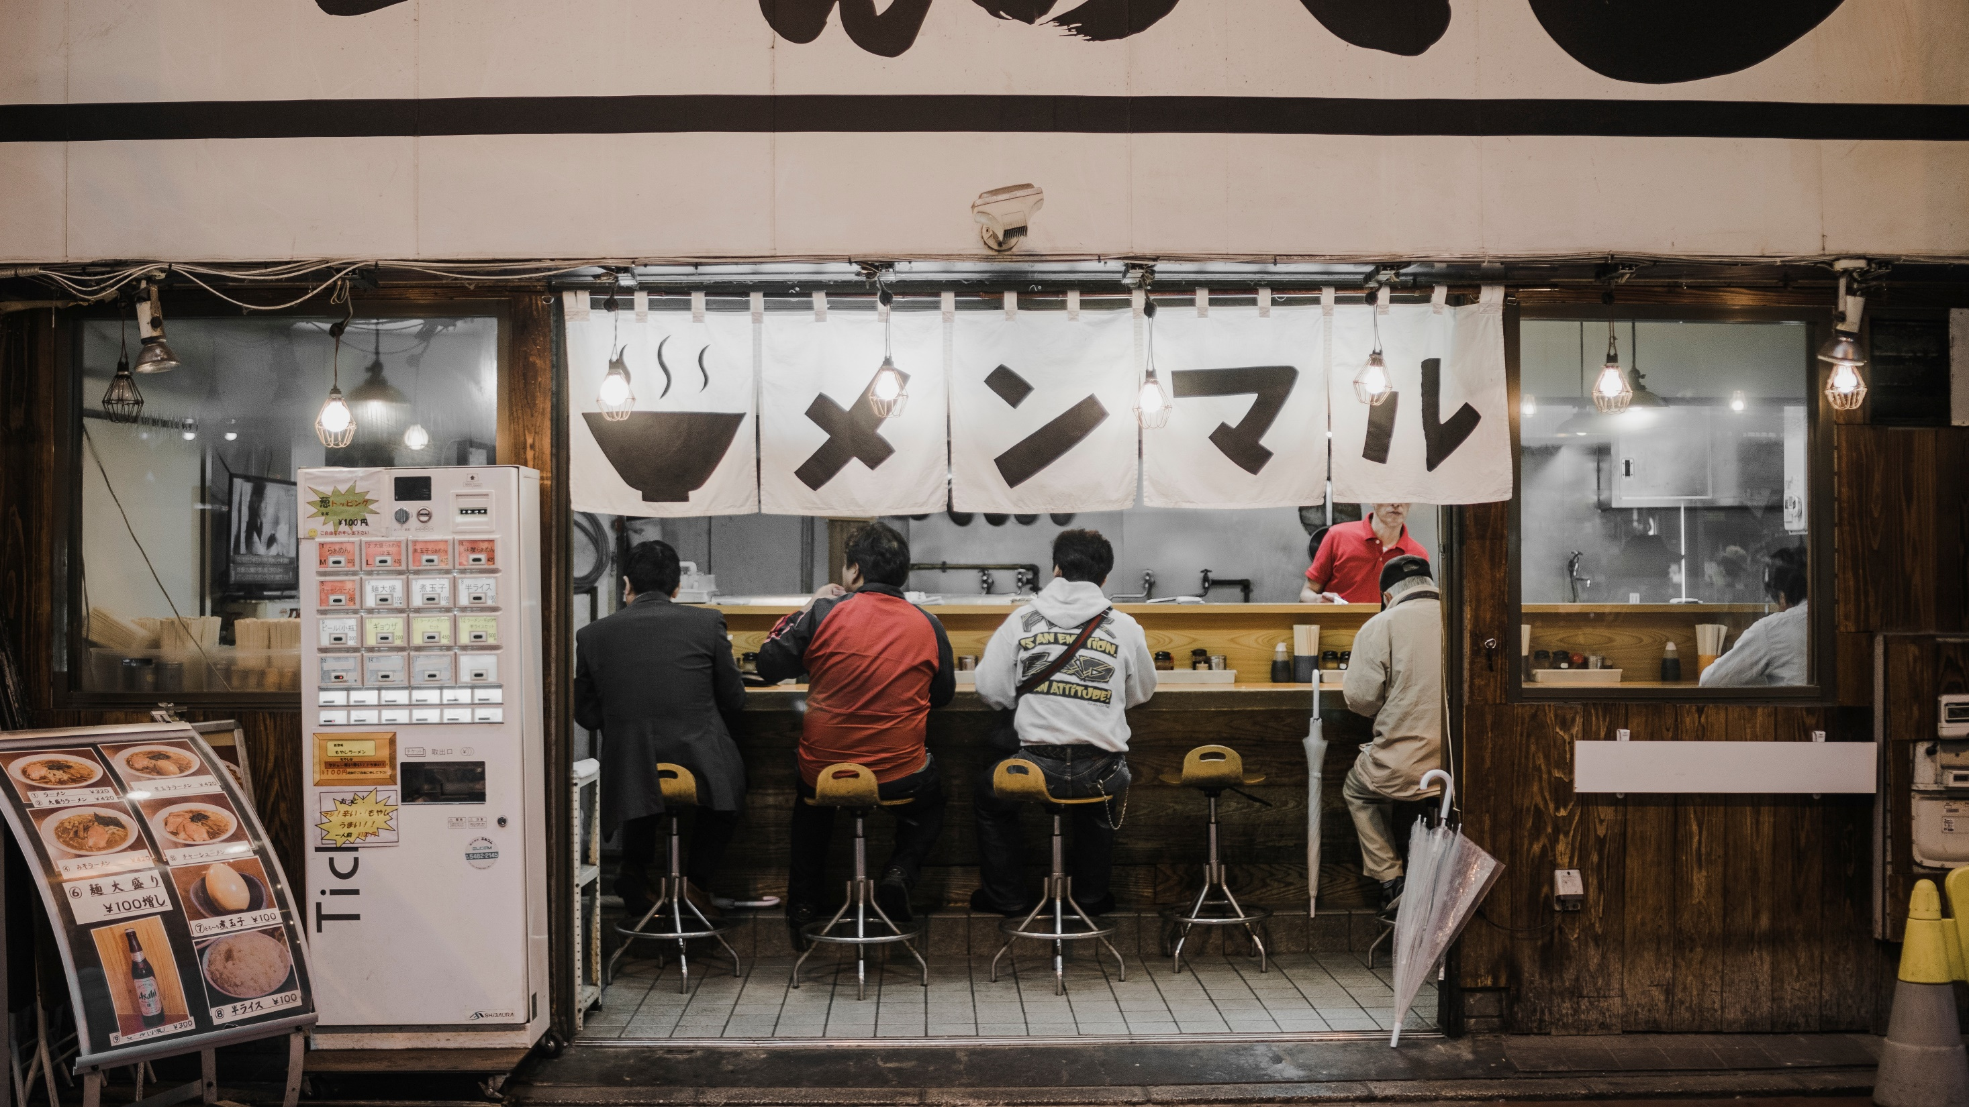
1/3 malnourished
1/3 overweighted
1/9 undernourished
Notes:
Aujourd’hui, 795 millions de personnes sont toujours victimes de sous-nutrition dont 780 millions vivent dans les pays en développement. Cela représente 12,9% de la population mondiale. Ainsi, 1 personne sur 9 aujourd’hui dans le monde n’a pas un accès satisfaisant à la nourriture.
La proportion de la population mondiale victime de sous nutrition soit sur une pente descendante avec une estimation de 5% en 2050 (13% aujourd’hui)
La « faim cachée » (hidden hunger) est une forme de malnutrition avec de fortes carences en micronutriments principalement en Asie du Sud et en Afrique sub-saharienne : 2 milliards de personnes, soit 30% de la population mondiale sont touchées.
Depuis les années 1980, le nombre de cas d’obésité a doublé à l’échelle mondiale.
En 2014, le surpoids concernait près de 2 milliards d’adultes soit 35% de la population mondiale et l’obésité, 600 millions d’entre eux.

Slide 12
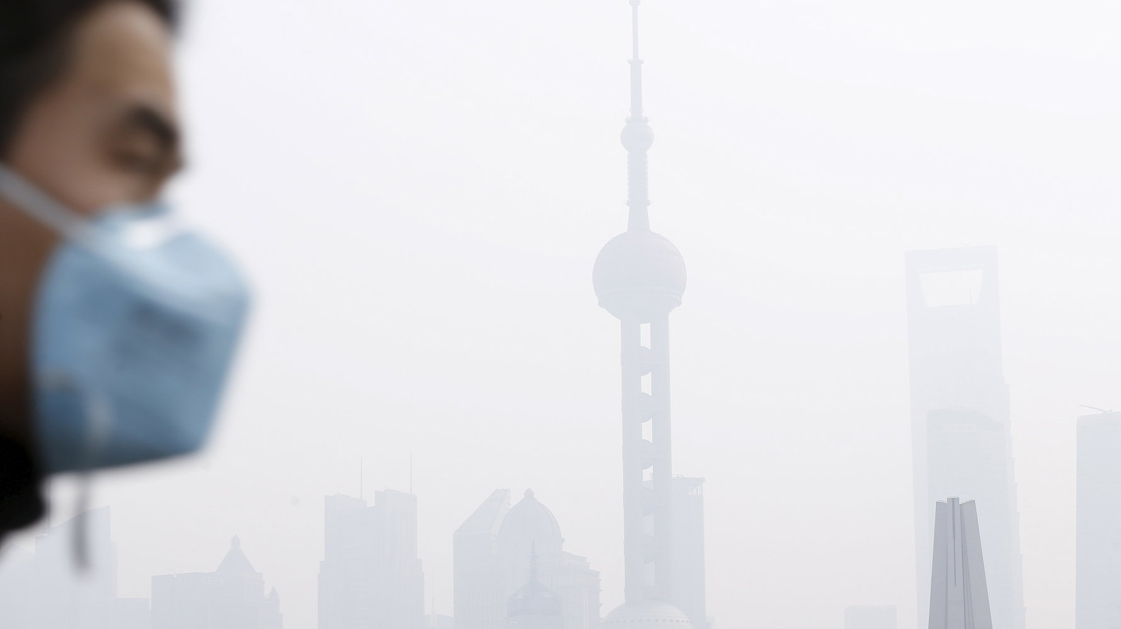
3,7 million death/year
7/8 urban citizens live with air quality
levels that exceed WHO safe levels
Notes:
Thus, seven of eight urban citizens breathe air that fails to meet WHO safe levels. [1]
Exposure to outdoor fine particulate matter (PM2.5) is estimated to cause 3.7 million premature deaths annually [2] and exposure to ozone is responsible for approximately 150 000 deaths annually from respiratory conditions [3].
This results in a cost of 3.5 trillion USD each year for OECD societies plus China and India.
In China, deaths due to outdoor air pollution from transport rose by 5 percent from 2005 to 2010, and, in India, this number increased by 12 percent.
Private cars are responsible up to 70 percent of urban air pollution even if they account for less than one-third of trips in cities worldwide. [1]
Between 1970 and 2010, global GHG emissions in the transport sector increased 2.5 times and were responsible for about 23% of total energy-related CO2 emissions [4]. Transport is the fastest growing consumer of fossil fuels and the fastest growing source of CO2 emissions. With 1 billion cars already on the road, the problem is now huge and growing. By 2050, it has been estimated that the global vehicle fleet could triple to 2 billion cars, with the number of trucks doubling [4].
Energy-related CO2 emissions are defined as emissions related to the combustion of fossil fuels (liquid fuels, natural gas, and coal).
The Human Development Index (HDI) was developed by the United Nations as a metric to assess the social and economic development levels of countries. Four principal areas of examination are used to rank countries: mean years of schooling, expected years of schooling, life expectancy at birth and gross national income per capita.
[1] The Global Opportunity Report, Global Opportunity Network 2016
[2] World Health Organization. Mortality from ambient air pollution for 2012, 2014
[3] REDUCING GLOBAL HEALTH RISKS Through mitigation of short-lived climate pollutants, WHO, 2015
[4] Climate change 2014: Mitigation of climate change contribution of Working Group 3 to the Fifth Assessment Report of the Intergovernmental Panel on Climate Change, Cambridge University Press, 2014

Slide 13
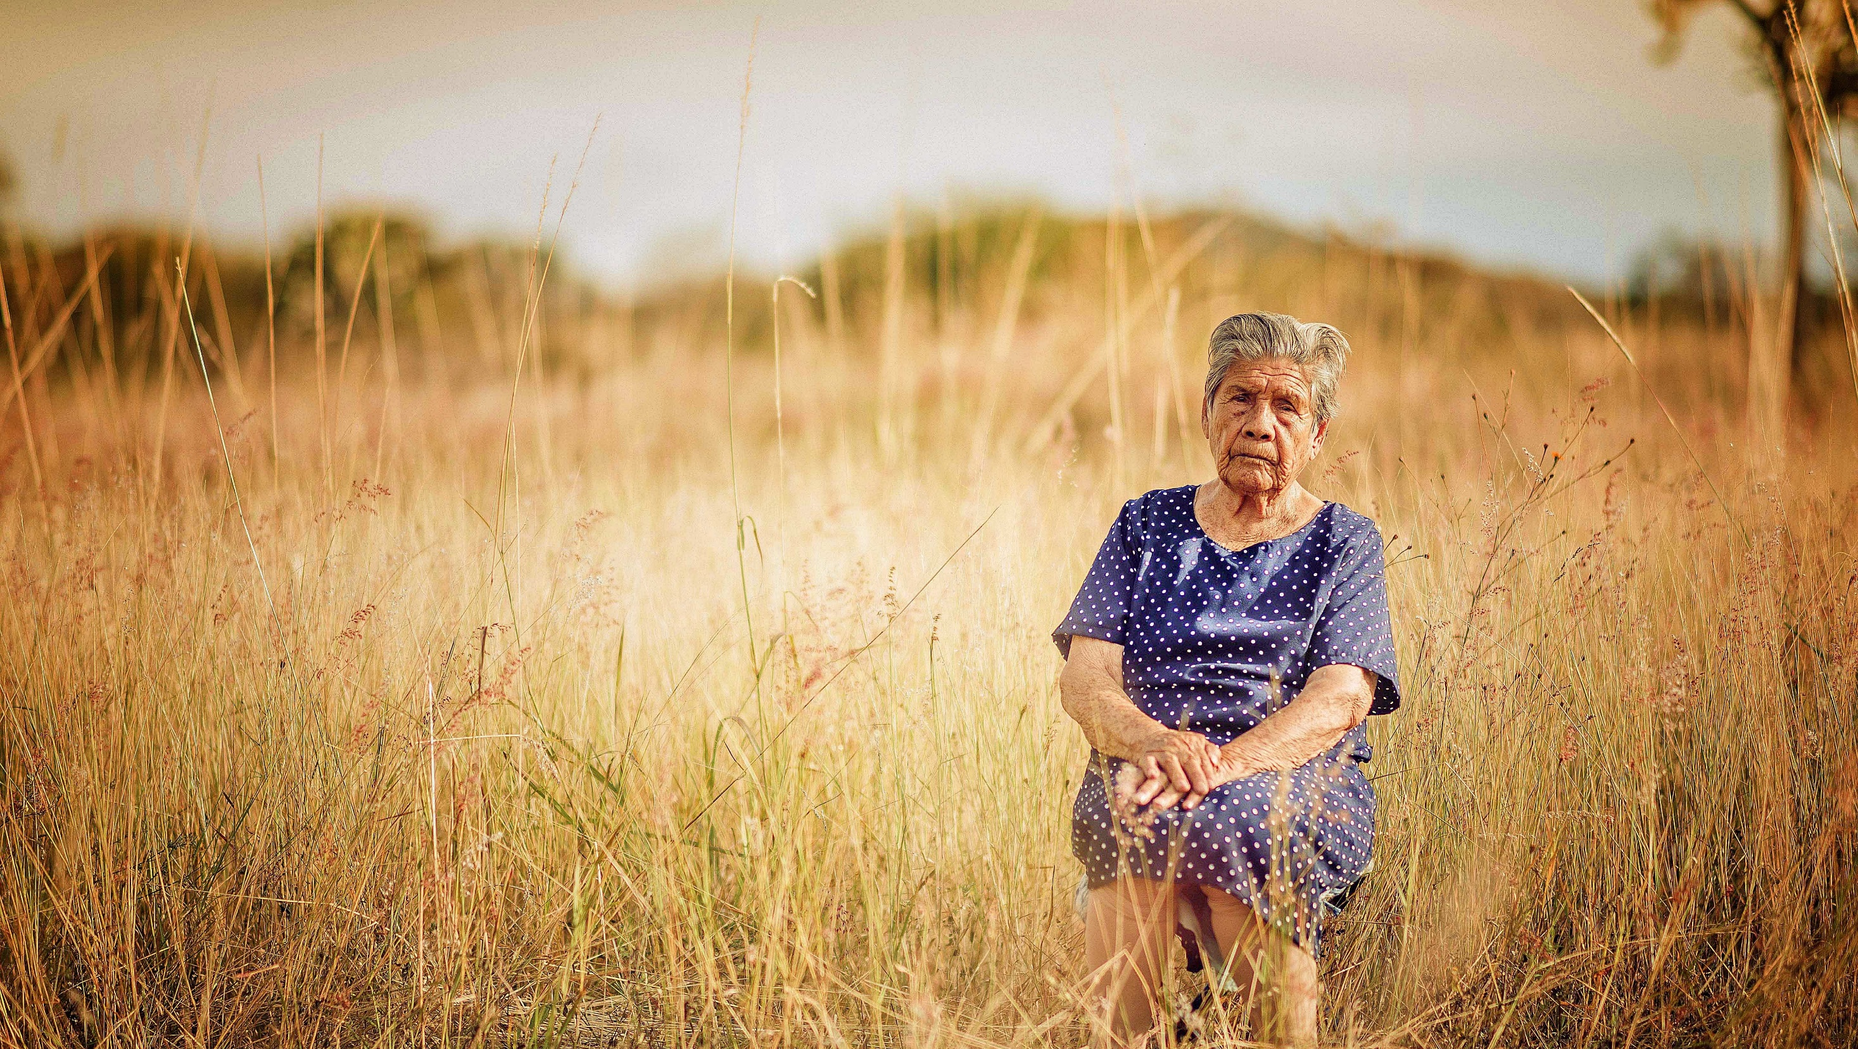
In 2030, 1/8 will be over 65+
Notes:
A major global demographic trend is global population growth. According to the United Nations, world population is projected to reach between 8 billion and 9.6 billion by 2050.
The second major demographic trend analysed in the literature is that the population of high-income countries (mainly in Europe, North America and Eastern Asia) will increasingly be an ageing population. The United Nations project that in high-income countries, by 2030, one in eight people will be 65 or above. [5] Facing this demographic change, some sectors are evolving to adapt to the needs of senior citizens. As the mobility sector is one that is core to their future level of dependency, it should be addressed consciously.
However, by 2050, developing countries will be ageing as fast as the West is now.
This phenomenon will have four consequences: a higher absolute number of elderly citizens, longer healthy life expectancies, a larger share of elderly people in the population, and lower numbers of working-age individuals. [4]
Owing to ageing populations worldwide, the dependency ratio (the ratio of the population aged 65 and above, as well as under 15, to the working-age population aged 15–64 required to support them) is set to rise in the European Union more than in the world as a whole over the next 25 years.
[4] Anderson & Hussey 2000; Bloom et al. 2011
[5] Beard et al. 2011; Chief of Force Development 2009

Slide 14
Responsible Research and Innovation
Definition
The first goal of Responsible Research and Innovation is the creation of positive impact.

Slide 15
Responsible Research and Innovation
Definition “positive impact”
Impact = all the consequences of an activity on both its direct and indirect stakeholders
individual well-being
Solving a public health problem
ability to create sustainable living conditions
Regenerating the environment
strengthening the inclusiveness of society
Maximizing social cohesion
Positive
Notes:
For example, a company that finds a solution to a social problem which it was previously foreign has a positive impact, conversely if it is the cause of the problem or participates and that it repaired the partially its impact remains negative.
“Impact” involves all the consequences (developments, inflections, changes, ruptures) of an activity on both its direct and indirect stakeholders, and on society and the environment in general. It can be positive when all these consequences are reflected in terms of individual well-being (eg. Solving a public health problem), ability to create sustainable living conditions (eg. Regenerating the environment) or strengthening the inclusiveness of society (eg. maximizing social cohesion).

Slide 16
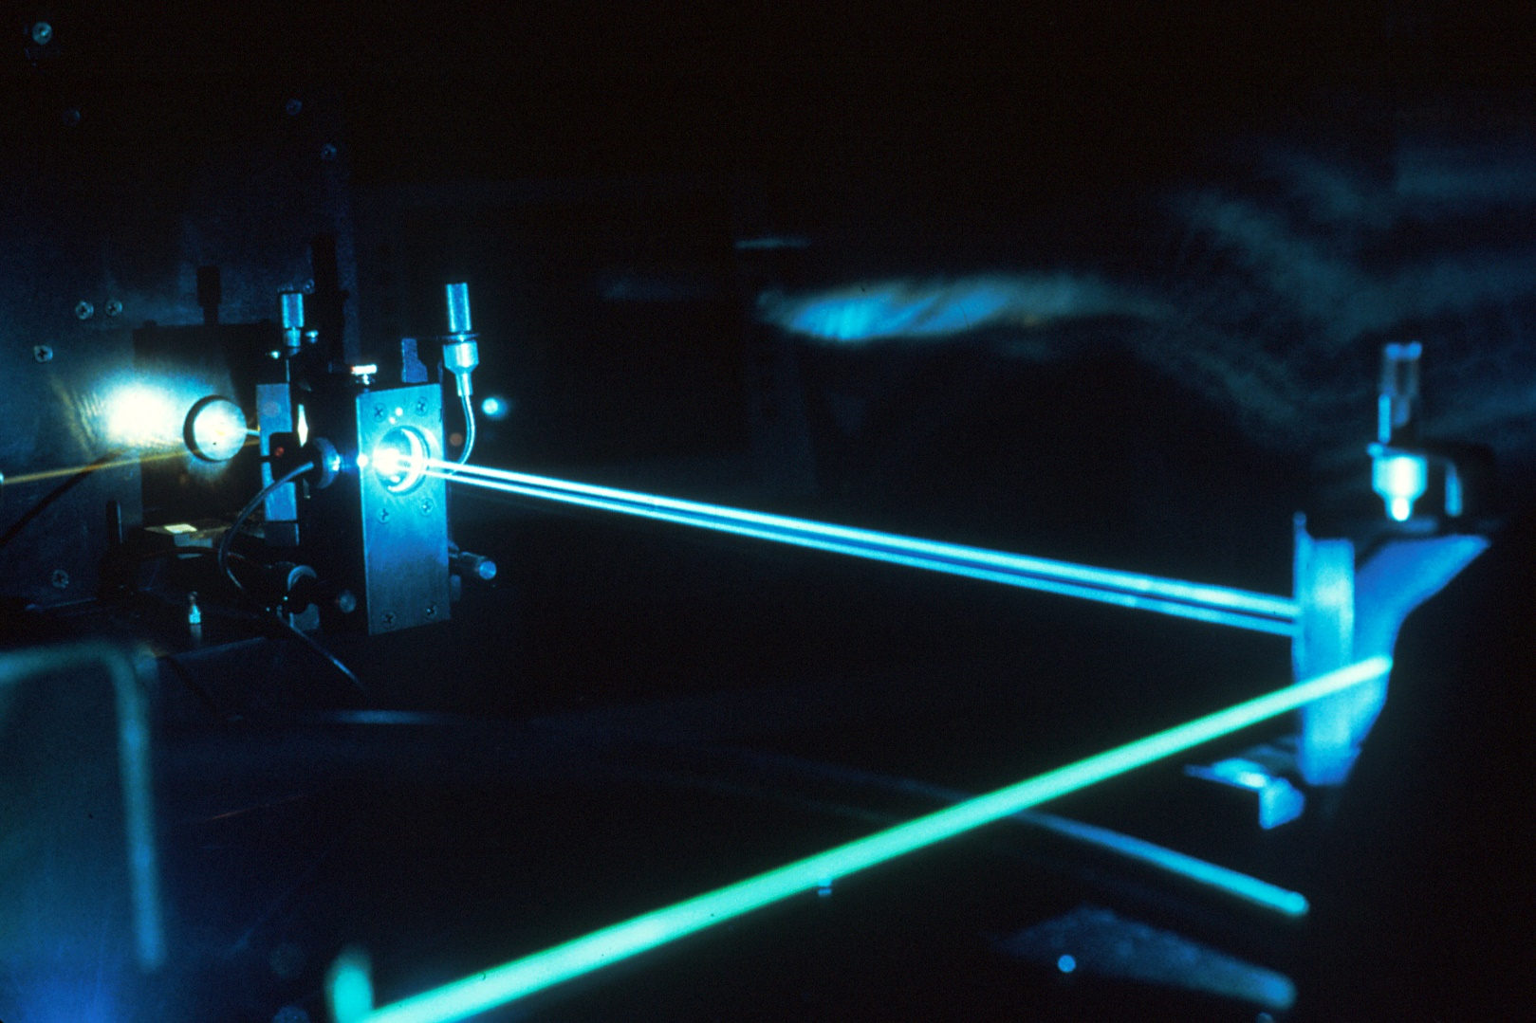
Responsible Research and Innovation
Notes:
Laser: En 1917, Albert Einstein prédit que le laser peut exister.
En 1960: creation du premier laser (43 ans plus tard)
1965: première application (percer un trou dans un diamant)
Applications: Information& Communication (printers, optic fiber), industry (cutting), medicine (microsurgery)…

Slide 17
Several actors and concepts

Slide 18


Several actors
Notes:
Mainly some labs of very large and reknowed american universities.

Slide 19




Several actors
Notes:
Mainly some labs of very large and reknowed american universities.

Slide 20


Several actors
Notes:
Mainly some labs of very large and reknowed american universities.

Slide 21

Several actors
Notes:
Mainly some labs of very large and reknowed american universities.

Slide 22
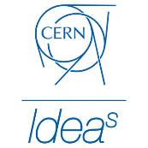
Several actors
Notes:
Mainly some labs of very large and reknowed american universities.

Slide 23


Several actors
European Commission
2013, Option for strengthening RRI
2013, RRI, Science and Technology
2012, Europe’s ability to respond to societal challenge
2011, A report on RRI
Notes:
Mainly some labs of very large and reknowed american universities.

Slide 24


Several actors
Notes:
Mainly some labs of very large and reknowed american universities.

Slide 25




Several actors
Notes:
Mainly some labs of very large and reknowed american universities.

Slide 26


Several actors
Notes:
Mainly some labs of very large and reknowed american universities.

Slide 27

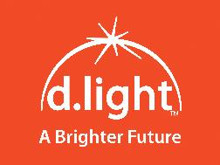


Several actors
Notes:
Mainly some labs of very large and reknowed american universities.

Slide 28




Several actors
Notes:
Mainly some labs of very large and reknowed american universities.

Slide 29
Inclusive innovation
Inclusive innovations often modify existing technologies, products or services to better meet the needs of lower-income and excluded groups. (OECD)
Notes:
Examples include the Tata Nano, a low-cost car produced in India based on a nofrills strategy, and the Narayana Hrudayalaya Cardiac Care Centre which provides heart surgery at a much lower price due to business process innovations. Scaling up requires initiatives that are built around: 1) financially sustainable business models; and 2) participation by lower-income and excluded groups.
A large part of the population has low income levels, hindering citizens’ ability to take advantage of innovation and new technologies.
Companies often lack adequate knowledge on the needs of poor populations.
Infrastructure is in many cases inadequate, making it costly for companies to distribute products to poorer customers

Slide 30
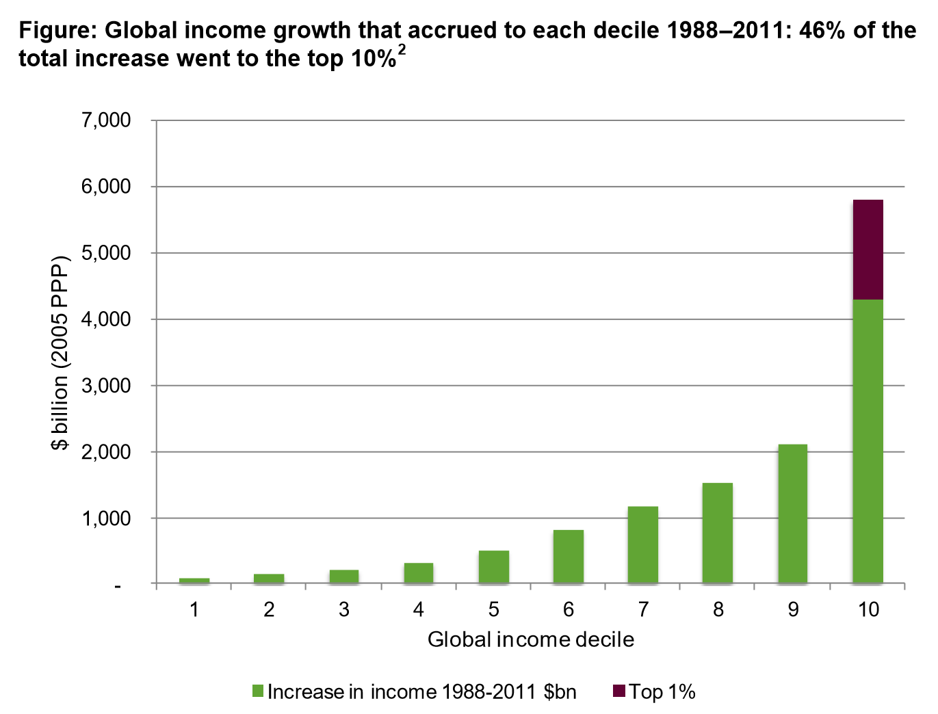
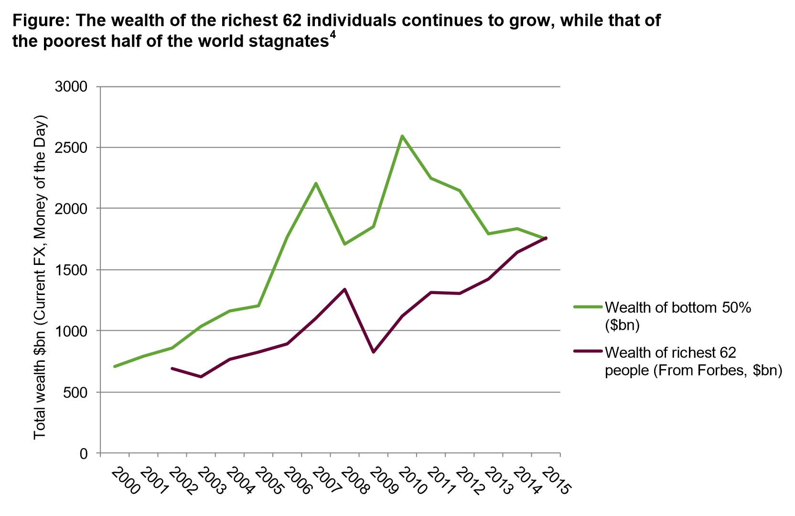
Inclusive innovation

Slide 31
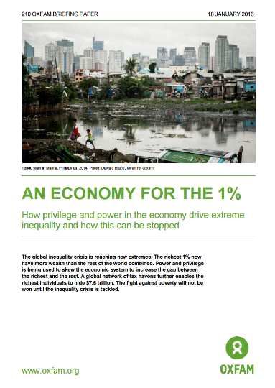
Inclusive innovation

Slide 32
Inclusive innovation EXEMPLE
Earthenable: https://vimeo.com/80867870
Notes:
Cette entreprise sociale issue du cours de Stanford « Design pour une Accessibilité Extrême » a eu l’idée de recouvrir le sol en terre battue d’une résine qui en rend la surface imperméable. Aux Etats-Unis, cette technique est utilisée en employant de l’huile de lin, un produit qui coûte malheureusement très cher. Earthenable a donc créé une nouvelle huile à base de matériaux locaux rwandais permettant de rendre les sols imperméables pour seulement 15% du coût de l’huile de lin ! Ainsi l’entreprise propose des sols au Rwanda pour environ 30$, soit dix fois moins cher que ses concurrents. Pour y parvenir, elle a adopté les principes de l’innovation frugale : être ingénieux à tous les niveaux afin de créer un produit bien plus abordable que les produits existants.
EarthEnable's (2013) mission is to provide healthy and affordable floors to the 80% of Rwandans who can only afford to have a dirt floor in their home. Concrete has been shown to reduce diarrhea by 49% and parasitic infections by 78% (Gertler et al., 2009), but a concrete floor costs $300-500 for a small Rwandan home. Meanwhile, EarthEnable's earthen floors cost only $30 dollars for the same area.
http://extreme.stanford.edu/projects/earthenable

Slide 33
Inclusive innovation
Issues:
4 billion people live with less than 5$ a day (BoP market)
Lack of knowledge from companies
Inadequate infrastructure
Notes:
Examples include the Tata Nano, a low-cost car produced in India based on a nofrills strategy, and the Narayana Hrudayalaya Cardiac Care Centre which provides heart surgery at a much lower price due to business process innovations. Scaling up requires initiatives that are built around: 1) financially sustainable business models; and 2) participation by lower-income and excluded groups.
A large part of the population has low income levels, hindering citizens’ ability to take advantage of innovation and new technologies.
Companies often lack adequate knowledge on the needs of poor populations.
Infrastructure is in many cases inadequate, making it costly for companies to distribute products to poorer customers

Slide 34
Frugal innovation
Definition
Frugal innovation or frugal engineering is the process of reducing the complexity and cost of a good and its production.
Notes:
Frugal innovation concentrate on the final product: it intends to do simple, cheap et robust product. Then it if often used in order to adress the BoP market however it is also a concept really interesting for other richer markets.

Slide 35

Frugal innovation EXAMPLE
Notes:
En 2005: les ingénieurs de GE Healthcare India se lancent un défi de recherche responsable
En 2007: nouveau produit, électrocardiogramme dont le prix a été divisé par 5
Aujourd’hui:
1) nouveau marché indien (75% de la population vit en zone rurale)
2) ce produit est vendu dans 90 pays !

Slide 36
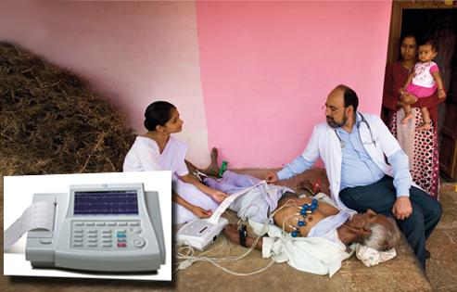
Frugal innovation EXAMPLE
2005 – 2007 : R&D program at GE Healthcare India
Notes:
En 2005: les ingénieurs de GE Healthcare India se lancent un défi de recherche responsable
En 2007: nouveau produit, électrocardiogramme dont le prix a été divisé par 5
Aujourd’hui:
1) nouveau marché indien (75% de la population vit en zone rurale)
2) ce produit est vendu dans 90 pays !

Slide 37
Frugal innovation EXAMPLE
2005 – 2007 : R&D program at GE Healthcare India
75% of the population in India lived in rural areas
Notes:
En 2005: les ingénieurs de GE Healthcare India se lancent un défi de recherche responsable
En 2007: nouveau produit, électrocardiogramme dont le prix a été divisé par 5
Aujourd’hui:
1) nouveau marché indien (75% de la population vit en zone rurale)
2) ce produit est vendu dans 90 pays !

Slide 38
Frugal innovation EXAMPLE
2005 – 2007 : R&D program at GE Healthcare India
75% of the population in India lived in rural areas
New product 5x less expensive
Notes:
En 2005: les ingénieurs de GE Healthcare India se lancent un défi de recherche responsable
En 2007: nouveau produit, électrocardiogramme dont le prix a été divisé par 5
Aujourd’hui:
1) nouveau marché indien (75% de la population vit en zone rurale)
2) ce produit est vendu dans 90 pays !

Slide 39
Frugal innovation EXAMPLE
2005 – 2007 : R&D program at GE Healthcare India
75% of the population in India lived in rural areas
New product 5x less expensive
Now used in more than 90 countries!
Mind shift: An innovative product thought for the BoP market can also be a huge commercial success.
Key point: Answer a social issue first, money will come later.
Notes:
En 2005: les ingénieurs de GE Healthcare India se lancent un défi de recherche responsable
En 2007: nouveau produit, électrocardiogramme dont le prix a été divisé par 5
Aujourd’hui:
1) nouveau marché indien (75% de la population vit en zone rurale)
2) ce produit est vendu dans 90 pays !

Slide 40

Responsible Innovation EXAMPLE
Notes:
Do you know Tarkett?
Floor solutions
12000 employees
They decided to launch responsible research. They chose a major public health problem.

Slide 41
Responsible Innovation EXAMPLE
Falls
Leading cause of death if you are >65+
In France (today) :
400 000 falls every year /
12 000 fatal falls
Notes:
FALLS.
In 2060:
En France 1/3 des habitants >60 ans en 2060
5 millions >85 ans (Today: 1,4 million aujourd’hui)
Public health problem La chute des personnes par exemple, devient un problème important. Aujourd’hui ces chutes sont la première cause de mortalité chez les plus de 65 ans en France : 400 000 personnes chutent chaque année et 12 000 personnes décèdent suite à celle-ci.

Slide 42

Responsible Innovation EXAMPLE
Falls
Leading cause of death if you are >65+
In France (today) :
400 000 falls every year /
12 000 fatal falls
Mind shift: A flooring expert innovated to answer a public health issue it was not responsible for.
Key point: Create a positive impact, not just reducing negative impact!
Notes:
Floor In Motion Care: 2 years of R&D & forced to developed a competence out of their knowledge.
Floor industry -> chemical industry // Connected Floor -> Electronics, Big data and Internet of Things

Slide 43
Why choosing this path in industry?
Opening new opportunities

Slide 44

Opportunity matrix

Slide 45
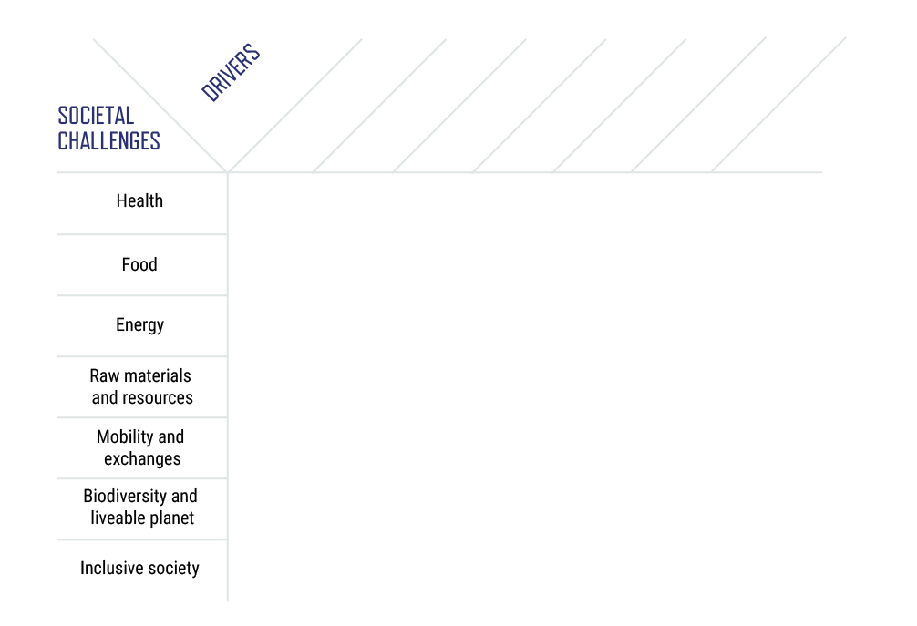
Opportunity matrix

Slide 46
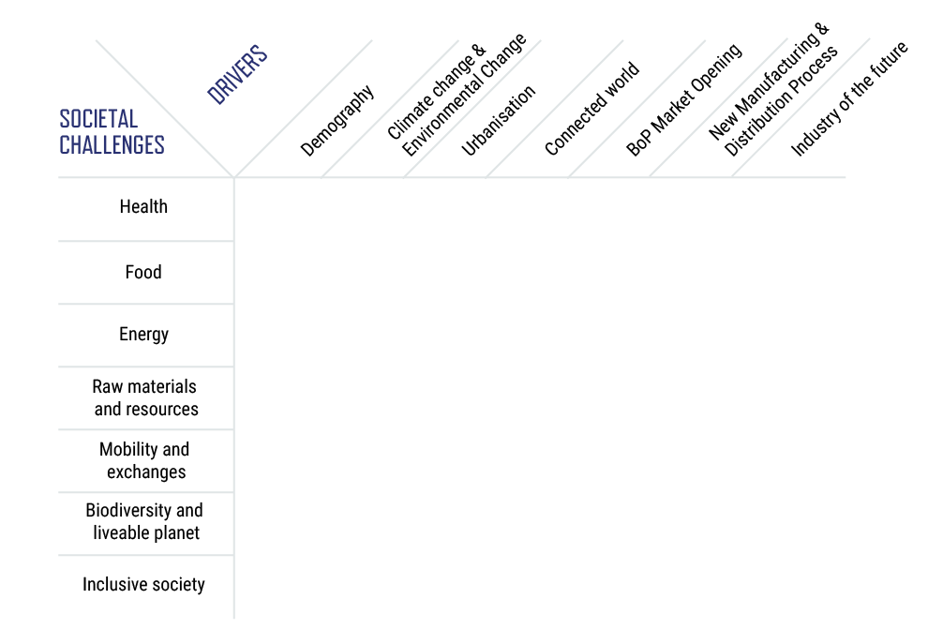
Opportunity matrix

Slide 47
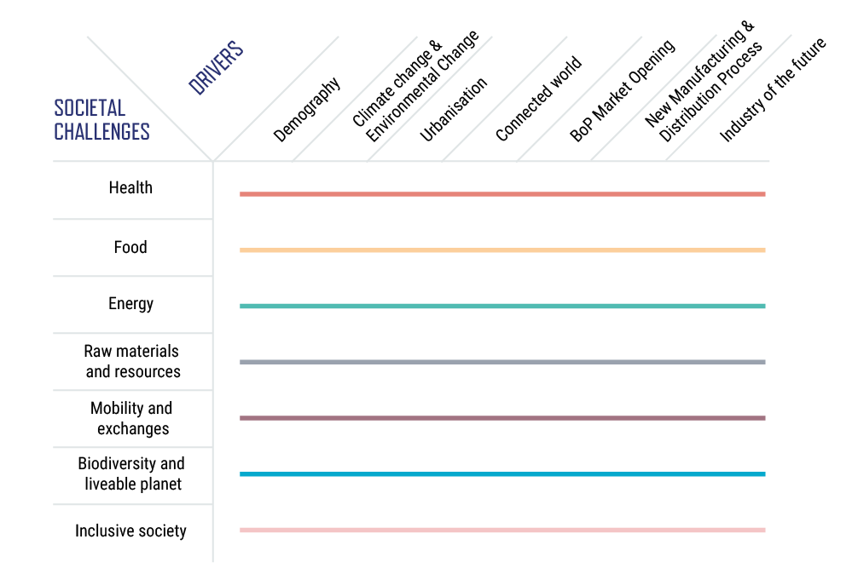
Opportunity matrix

Slide 48
Opportunity matrix
Health at work
Which health system for an ageing population
Personalized medicine
Health issue emergence due to pollution and environmental changes
What does healthcare for the Base of the Pyramid mean?
Health in the city and the countryside
Use data for health

Slide 49
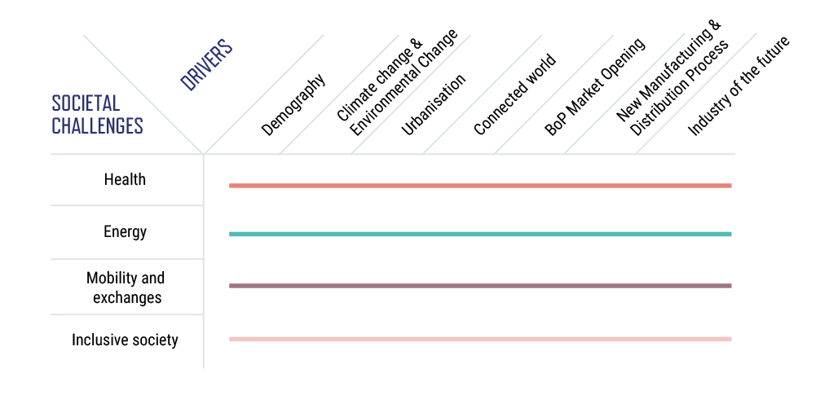
Why choosing this path in industry?
Your expertise
Opening new opportunities

Slide 50
Why choosing this path in industry?
Your expertise
Opening new opportunities
Your expertise

Slide 51
Car industry & Responsible Innovation
Absence of reliable, affordable refrigeration for transport causes 10-30% of production to be lost (Kitinoja & Kader, 2003)

Slide 52

Car industry & Responsible Innovation
Low-cost refrigerated utility vehicle targeting rural markets for edible goods transportation would be a game-changer
50BreakThroughs – Berkeley
Absence of reliable, affordable refrigeration for transport causes 10-30% of production to be lost (Kitinoja & Kader, 2003)

Slide 53
Car industry & Responsible Innovation
Low-cost refrigerated utility vehicle targeting rural markets for edible goods transportation would be a game-changer
50BreakThroughs – Berkeley
Absence of reliable, affordable refrigeration for transport causes 10-30% of production to be lost (Kitinoja & Kader, 2003)
Mind shift: A car maker can answer a food safety and waste issue through a new product (innovation + business opportunity).
Key point: Open your mind to unexpected or exotic fields!

Slide 54

Toto & Responsible Innovation
Notes:
Séquencer l’ADN, Human genome project: premier sequencage de 1990 à 2003, ça pris 13 ans et couté 2,7 milliards. En 2007: une entreprise le fait pour 350000$ et ça prend quelques mois. En 2014, ça ne coute plus que 1000$ et prends quelques heures (Illumina). Et le prix va continuer à baisser.

Slide 55
Toto & Responsible Innovation
Mind shift: A sanitary producer could take care of your health
Key point: Cutting-edge technologies are becoming cheaper
Notes:
Séquencer l’ADN, Human genome project: premier sequencage de 1990 à 2003, ça pris 13 ans et couté 2,7 milliards. En 2007: une entreprise le fait pour 350000$ et ça prend quelques mois. En 2014, ça ne coute plus que 1000$ et prends quelques heures (Illumina). Et le prix va continuer à baisser.

Slide 56
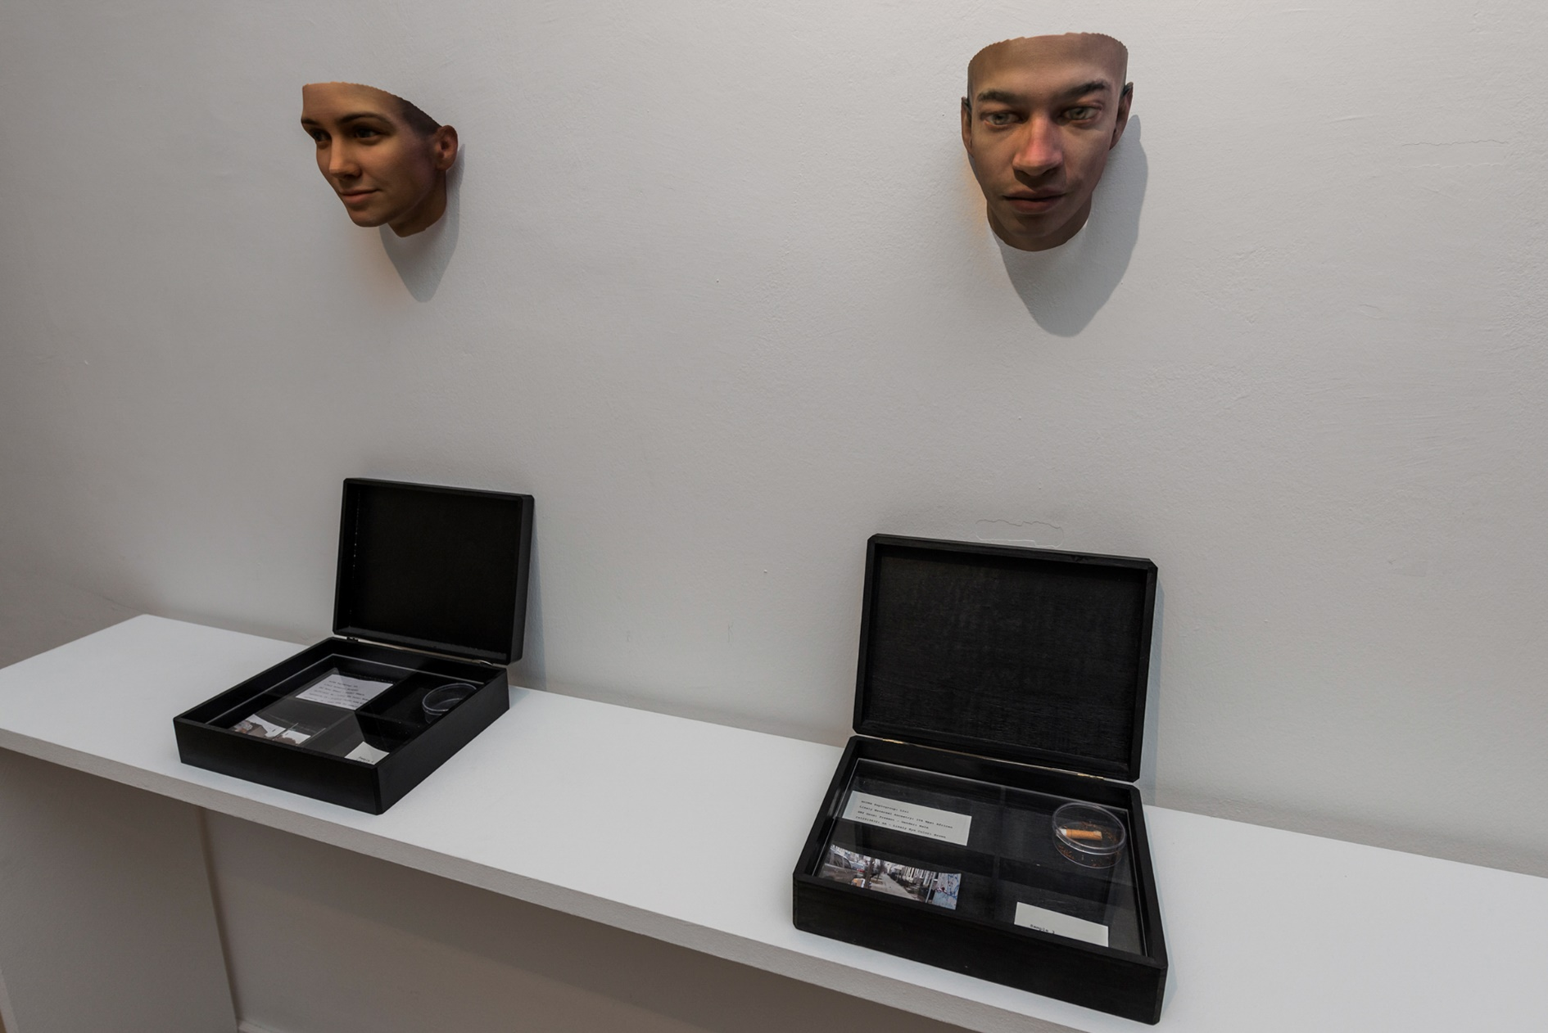
Stranger Visions
Mind shift: A toilet manufacturer is will take care of your Health
Key point: Advanced technology is becoming cheaper
Notes:
Séquencer l’ADN, Human genome project: premier sequencage de 1990 à 2003, ça pris 13 ans et couté 2,7 milliards. En 2007: une entreprise le fait pour 350000$ et ça prend quelques mois. En 2014, ça ne coute plus que 1000$ et prends quelques heures (Illumina). Et le prix va continuer à baisser.
« In Stranger Visions I collected hairs, chewed up gum, and cigarette butts from the streets, public bathrooms and waiting rooms of New York City. I extracted DNA from them and analyzed it to computationally generate 3d printed life size full color portraits representing what those individuals might look like, based on genomic research. Working with the traces strangers unwittingly left behind, the project was meant to call attention to the developing technology of forensic DNA phenotyping, the potential for a culture of biological surveillance, and the impulse towards genetic determinism.” Heather Dewey-Hagborg

Slide 57
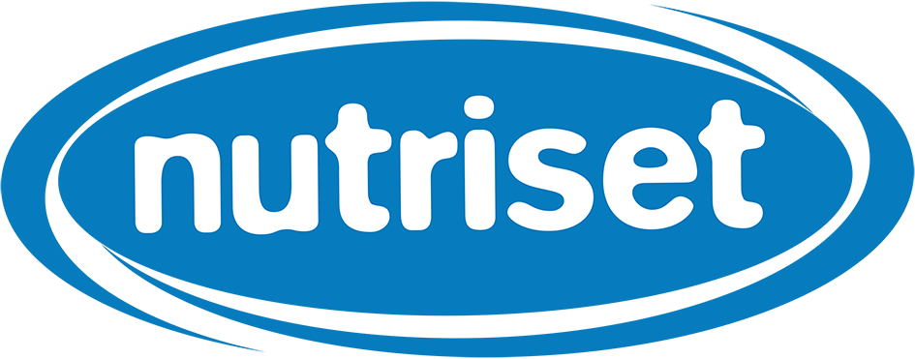
New actors
1986 – One mission: get rid of world hunger
Notes:
PROTECTION DE LA PROPRIETE INTELLECTUELLE BENEFICIANT AUX PLUS PAUVRES
Le programme de recherche « Intellectual Property Regimes for pro-poor innovation in agriculture » du programme néerlandais d’Innovation Responsable tente de résoudre le problème. Dirigé par Bram de Jonge, chercheur à la Wageningen University & Research Centre aux Pays-Bas, spécialiste en bioéthique, ce programme cherche à réunir l’ensemble des parties prenantes autour de cette question de la propriété intellectuelle pour influer sur les politiques africaines en la matière.
« The African seed sector needs a boost […] Without some form of intellectual property protection everything will remain just as it is and we will leave African farmers out in the cold, including the poorest and the most hungry. However the Western agricultural model as reflected by UPOV cannot simply be transferred lock, stock and barrel to Africa. We need to find a way to both encourage innovation and help those farmers who only own a small plot of land but are nevertheless responsible for 80 to 90 percent of food production in Africa. They cannot afford expensive seed. It would be absurd to forbid them from exchanging seeds, even if these contain genetic material from a variety protected under intellectual property law. »
Après un vrai travail de « recherche action » sur le terrain auprès des petits agriculteurs, des politiques, l’UPOV a revu son interprétation de l’ « exemption pour un usage privé et non commercial » de l’accord international. A l’avenir, les petits agriculteurs seront autorisés à garder et partager les semences collectées avec d’autres agriculteurs de leurs communautés, même si elles sont protégées par des droits de propriété intellectuelle.
Bram de Jonge préconise aussi l’usage de licences « humanitaires » qui permet de favoriser le transfert de technologies dans les pays pauvres ou en développement.
Cette stratégie a été adoptée par l’entreprise Nutriset qui utilise ses brevets comme un outil au service du développement. Cette gestion ouverte des brevets au profit des pays pauvres repose sur l’ « Accord d’usage en ligne », « un accord par lequel Nutriset autorise une entreprise ou une organisation à produire, commercialiser et distribuer des produits couverts par les brevets codétenus par Nutriset et l’IRD » sans aucune contrepartie.

Slide 58
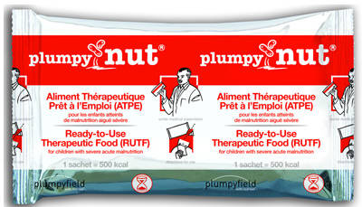
New actors
1986 – One mission: get rid of world hunger
1996 – Creation of Plumpy’Nut
2005 – A unique intellectual property strategy
Notes:
PROTECTION DE LA PROPRIETE INTELLECTUELLE BENEFICIANT AUX PLUS PAUVRES
Le programme de recherche « Intellectual Property Regimes for pro-poor innovation in agriculture » du programme néerlandais d’Innovation Responsable tente de résoudre le problème. Dirigé par Bram de Jonge, chercheur à la Wageningen University & Research Centre aux Pays-Bas, spécialiste en bioéthique, ce programme cherche à réunir l’ensemble des parties prenantes autour de cette question de la propriété intellectuelle pour influer sur les politiques africaines en la matière.
« The African seed sector needs a boost […] Without some form of intellectual property protection everything will remain just as it is and we will leave African farmers out in the cold, including the poorest and the most hungry. However the Western agricultural model as reflected by UPOV cannot simply be transferred lock, stock and barrel to Africa. We need to find a way to both encourage innovation and help those farmers who only own a small plot of land but are nevertheless responsible for 80 to 90 percent of food production in Africa. They cannot afford expensive seed. It would be absurd to forbid them from exchanging seeds, even if these contain genetic material from a variety protected under intellectual property law. »
Après un vrai travail de « recherche action » sur le terrain auprès des petits agriculteurs, des politiques, l’UPOV a revu son interprétation de l’ « exemption pour un usage privé et non commercial » de l’accord international. A l’avenir, les petits agriculteurs seront autorisés à garder et partager les semences collectées avec d’autres agriculteurs de leurs communautés, même si elles sont protégées par des droits de propriété intellectuelle.
Bram de Jonge préconise aussi l’usage de licences « humanitaires » qui permet de favoriser le transfert de technologies dans les pays pauvres ou en développement.
Cette stratégie a été adoptée par l’entreprise Nutriset qui utilise ses brevets comme un outil au service du développement. Cette gestion ouverte des brevets au profit des pays pauvres repose sur l’ « Accord d’usage en ligne », « un accord par lequel Nutriset autorise une entreprise ou une organisation à produire, commercialiser et distribuer des produits couverts par les brevets codétenus par Nutriset et l’IRD » sans aucune contrepartie.

Slide 59
New actors
1986 – One mission: get rid of world hunger
1996 – Creation of Plumpy’Nut
2005 – A unique intellectual property strategy
2015 – 105 millions euros of revenues and 6 millions beneficiaries
Mind shift: One company can be created only to answer a strong social mission.
Key point: Win the market through positive impact
Notes:
PROTECTION DE LA PROPRIETE INTELLECTUELLE BENEFICIANT AUX PLUS PAUVRES
Le programme de recherche « Intellectual Property Regimes for pro-poor innovation in agriculture » du programme néerlandais d’Innovation Responsable tente de résoudre le problème. Dirigé par Bram de Jonge, chercheur à la Wageningen University & Research Centre aux Pays-Bas, spécialiste en bioéthique, ce programme cherche à réunir l’ensemble des parties prenantes autour de cette question de la propriété intellectuelle pour influer sur les politiques africaines en la matière.
« The African seed sector needs a boost […] Without some form of intellectual property protection everything will remain just as it is and we will leave African farmers out in the cold, including the poorest and the most hungry. However the Western agricultural model as reflected by UPOV cannot simply be transferred lock, stock and barrel to Africa. We need to find a way to both encourage innovation and help those farmers who only own a small plot of land but are nevertheless responsible for 80 to 90 percent of food production in Africa. They cannot afford expensive seed. It would be absurd to forbid them from exchanging seeds, even if these contain genetic material from a variety protected under intellectual property law. »
Après un vrai travail de « recherche action » sur le terrain auprès des petits agriculteurs, des politiques, l’UPOV a revu son interprétation de l’ « exemption pour un usage privé et non commercial » de l’accord international. A l’avenir, les petits agriculteurs seront autorisés à garder et partager les semences collectées avec d’autres agriculteurs de leurs communautés, même si elles sont protégées par des droits de propriété intellectuelle.
Bram de Jonge préconise aussi l’usage de licences « humanitaires » qui permet de favoriser le transfert de technologies dans les pays pauvres ou en développement.
Cette stratégie a été adoptée par l’entreprise Nutriset qui utilise ses brevets comme un outil au service du développement. Cette gestion ouverte des brevets au profit des pays pauvres repose sur l’ « Accord d’usage en ligne », « un accord par lequel Nutriset autorise une entreprise ou une organisation à produire, commercialiser et distribuer des produits couverts par les brevets codétenus par Nutriset et l’IRD » sans aucune contrepartie.

Slide 60
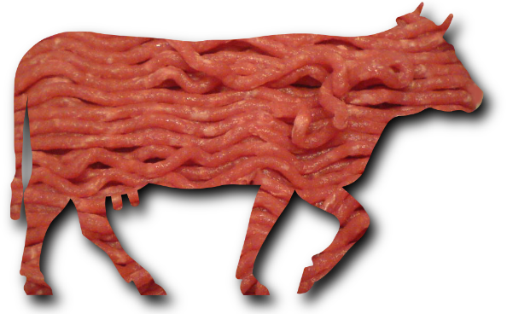
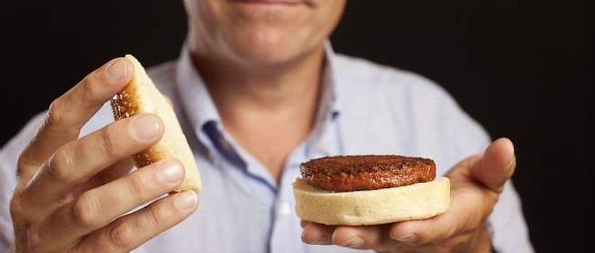
New actors
Mark Post: in-vitro meat
Notes:
Selon une étude de l’université d’Oxford, la culture en laboratoire par rapport à la production traditionnelle permet d’économiser, selon les produits comparés, 7 à 45% d’énergie, 82 à 96% d’eau et 99 % de surface agricole
L’élevage d’insectes a un très faible impact sur l'environnement. Il requiert considérablement moins de ressources que l’élevage du bétail. Le taux de conversion alimentaire des insectes est en effet favorable : en moyenne, 2 kg d'aliments sont nécessaires pour produire 1 kg d'insectes, tandis que les bovins exigent 8 kg d'aliments pour produire 1 kg d'augmentation de la masse corporelle animale (FAO). Les insectes peuvent être aussi élevés à partir des déchets organiques comme les déchets alimentaires.

Slide 61
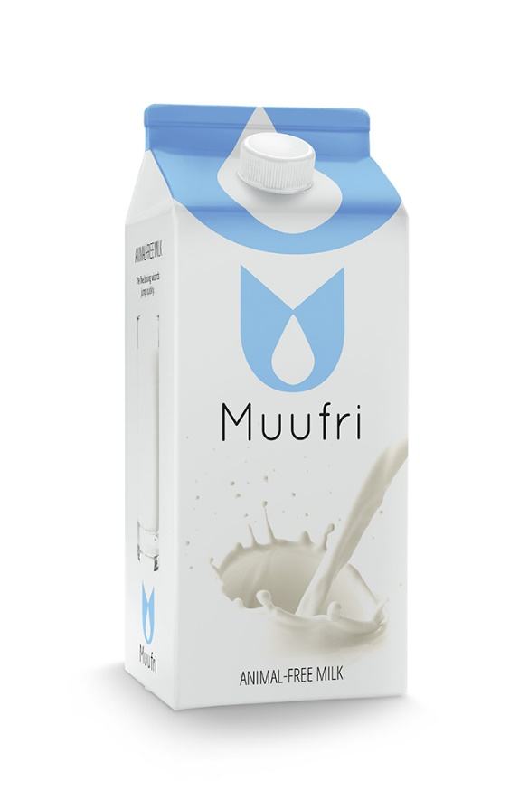
New actors
Mark Post: in-vitro meat
Notes:
Selon une étude de l’université d’Oxford, la culture en laboratoire par rapport à la production traditionnelle permet d’économiser, selon les produits comparés, 7 à 45% d’énergie, 82 à 96% d’eau et 99 % de surface agricole
L’élevage d’insectes a un très faible impact sur l'environnement. Il requiert considérablement moins de ressources que l’élevage du bétail. Le taux de conversion alimentaire des insectes est en effet favorable : en moyenne, 2 kg d'aliments sont nécessaires pour produire 1 kg d'insectes, tandis que les bovins exigent 8 kg d'aliments pour produire 1 kg d'augmentation de la masse corporelle animale (FAO). Les insectes peuvent être aussi élevés à partir des déchets organiques comme les déchets alimentaires.

Slide 62
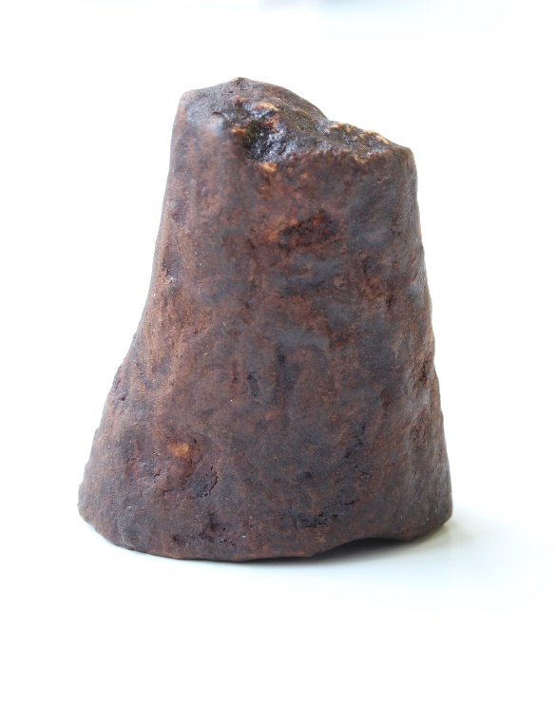
New actors
Mark Post: in-vitro meat
Notes:
Selon une étude de l’université d’Oxford, la culture en laboratoire par rapport à la production traditionnelle permet d’économiser, selon les produits comparés, 7 à 45% d’énergie, 82 à 96% d’eau et 99 % de surface agricole
L’élevage d’insectes a un très faible impact sur l'environnement. Il requiert considérablement moins de ressources que l’élevage du bétail. Le taux de conversion alimentaire des insectes est en effet favorable : en moyenne, 2 kg d'aliments sont nécessaires pour produire 1 kg d'insectes, tandis que les bovins exigent 8 kg d'aliments pour produire 1 kg d'augmentation de la masse corporelle animale (FAO). Les insectes peuvent être aussi élevés à partir des déchets organiques comme les déchets alimentaires.

Slide 63
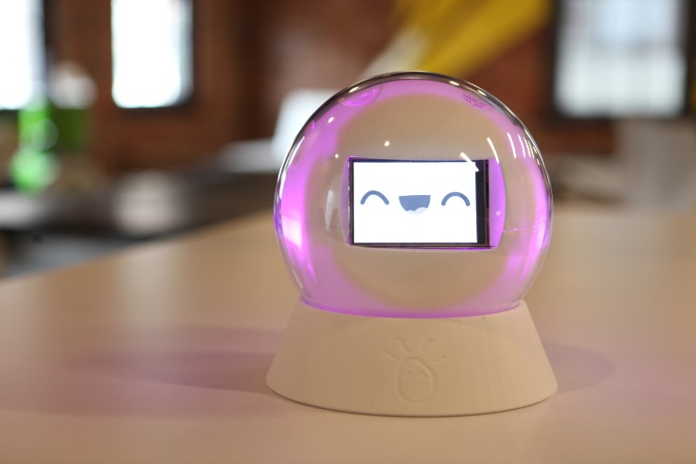
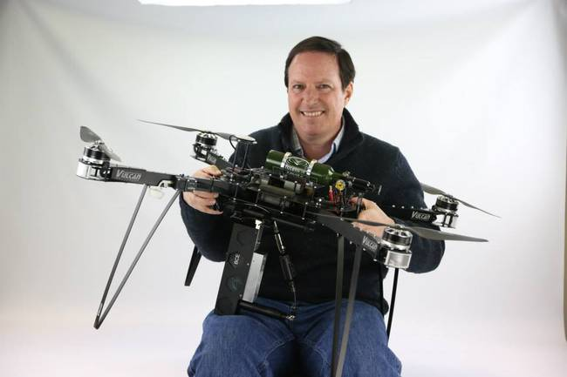
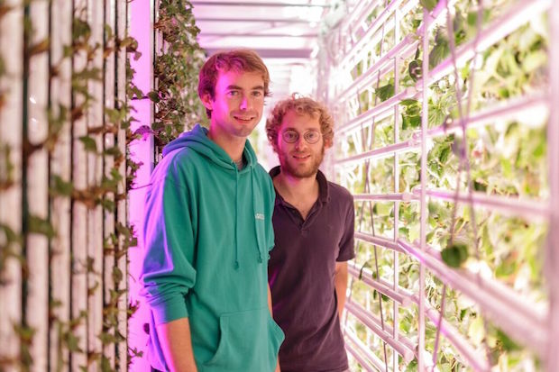

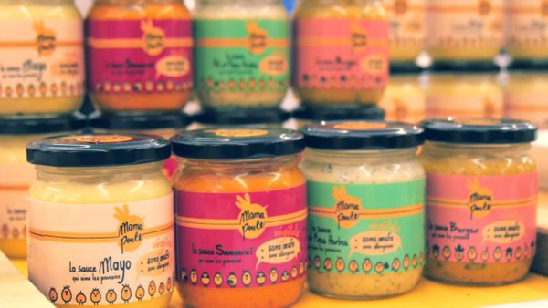
New actors
Notes:
Robotique pour aider l’intégration des enfants autistes, drone pour la reforestation, agriculture urbaine, lutte contre la pollution,

Slide 64
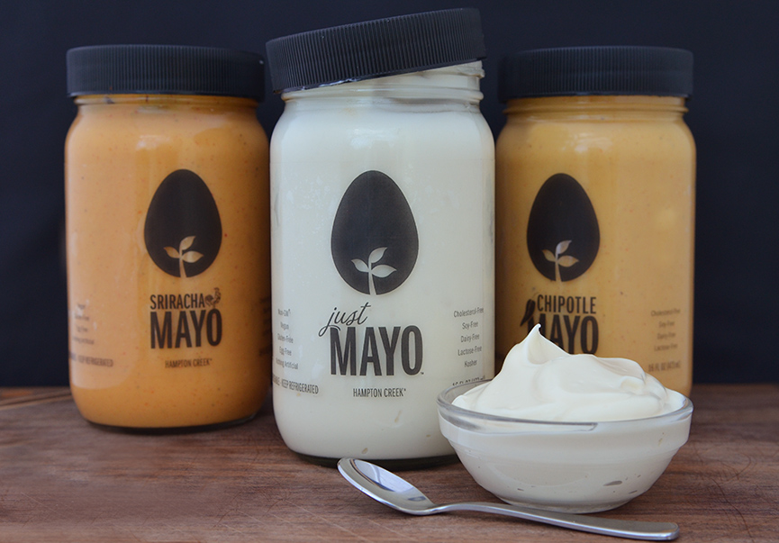
New actors
Notes:
Robotique pour aider l’intégration des enfants autistes, drone pour la reforestation, agriculture urbaine, lutte contre la pollution,
Hampton Creek: entreprise agroalimentaire avec la plus forte croissance en 2015. Just Mayo -> « mayonnaise » sans œufs, basée sur un travail scientifique sur les plantes pour créer de nouveaux produits agroalimentaires, moins grasse (meilleur pour la santé) et moins chère.

Slide 65

New actors
2015: Prêt à Pousser
Notes:
Mai 2015: Kickstarter de l’entreprise sociale Prêt à pousser, demandent 50 000€ et en recoivent prêt de 180 000€ par plus de 1800 contributeurs

Slide 66
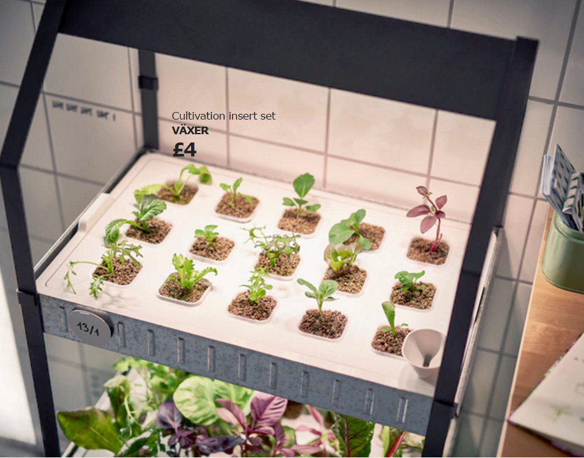
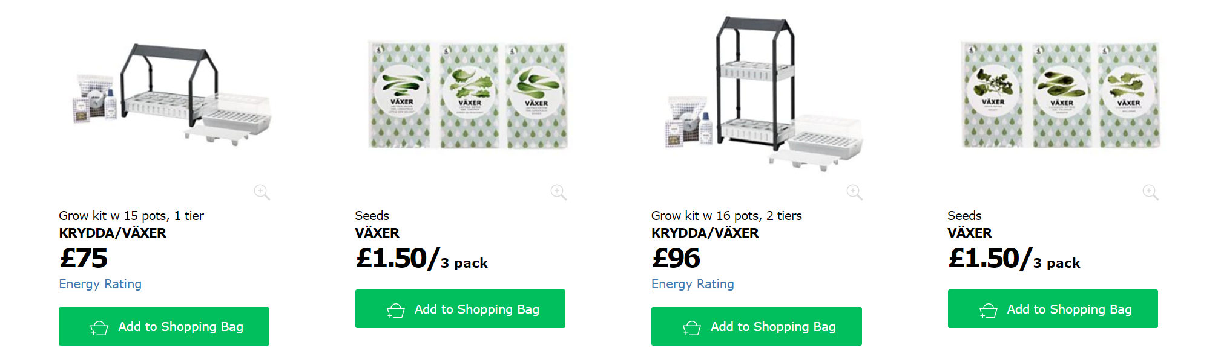
New actors
2015: Prêt à Pousser
2016: IKEA
Notes:
Mai 2015: Kickstarter de l’entreprise sociale Prêt à pousser, demandent 50 000€ et en recoivent prêt de 180 000€ par plus de 1800 contributeurs
En 2016: IKEA est sur le marché de l’hydroponie à la maison

Slide 67
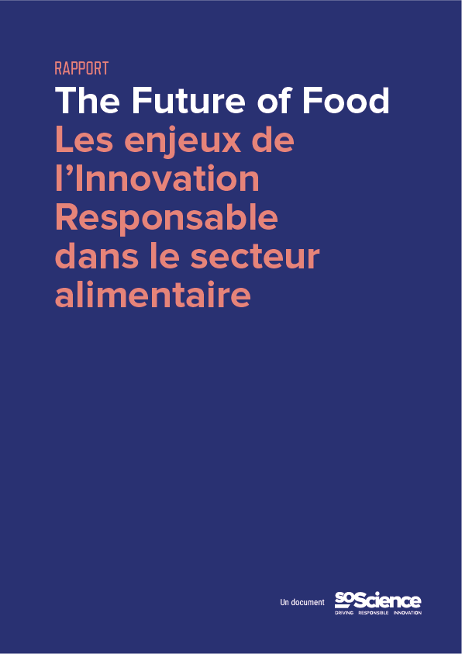
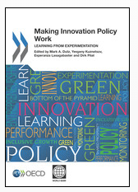
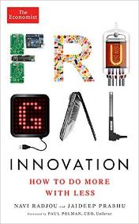
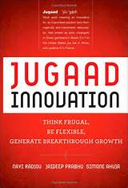
Bibliography
2014, Making Innovation Policy Work
Chapter 4

Slide 68

On the field since 2012
> 40 examples, case studies and experiences
9 interviews form France, Europe, United States, Africa
Around a few questions…
Which impact and role of the research system today?
Should it be revamped ?
Can technology answer our social and environmental issues?

Slide 69


Thank you for your attention!
SoScience! 5bis rue Jadin, 75017 Paris
+33 6 76 59 31 21 – melanie.marcel@soscience.org
@SoScienceTweet /SoScience

Slide 70




Named Ashoka Changemaker
Echoing Green Fellow 2017
Science and society expert for the European Commission
Positive Economy Award 2014
Notes:
On est expert de RRI
Engagé écouté et reconnu

Slide 71

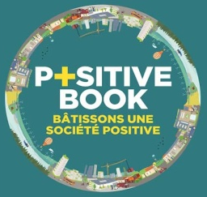
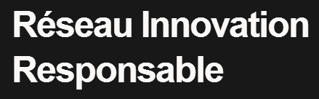

Our actions
First multi-actor thematic program centered on Responsible Innovation
Created by SoScience
Newsletter Réseau Innovation Responsable
Launched by SoScience
Think-tank « L’innovation Responsable en Industrie »
Launched by SoScience
« Science et impact social: vers une recherche responsable », Diateino, June 2017
Join us!

Slide 72



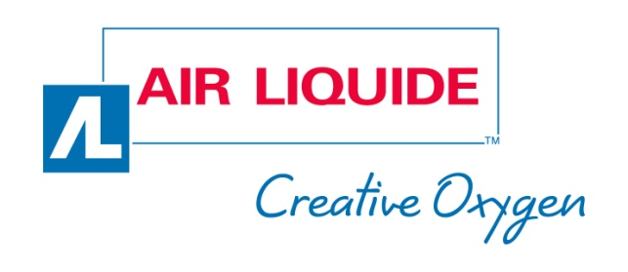


Clients and partners
Notes:
On accompagne des grands groupes , d’ailleurs on travaille en ce moment avec Air Liquide avec direction scientifique pour savoir qu’est ce que ca veut dire pour la r&d de airliquide de repondreà des grands enjeux societaux environnementaux, quels produits, enjeux legitimes, comment repondre. L’equipe de Soscience a bosser la dessus et il y a un rapport d’opportunité : un croisement entre les metiers d’AL, les grands enjeux sociaux (santé, securité, food) et les grand drivers (population viellissante, monde + connecté etc.)
C’est un travail qui commence et qu’on est en train de mené et si ça vous interesse n’hesitez pas de venir me voir a la fin pour voir comment vous associer pour la suite ou l’on compte lancer des projets, vous envoyer le rapport etc.
On est missionné par la Direction Scientifique (Maarianne Julien) paticulierement le m-Lab

Slide 73
SoScience! 5bis rue Jadin, 75017 Paris
+33 6 76 59 31 21 – melanie.marcel@soscience.org
@SoScienceTweet /SoScience

Slide 74

How to consider Responsible Innovation?
Sustainable innovation or how to reduce negative impacts
Notes:
Le 3ème et dernier étage de la fusée pousse la démarche encore plus loin : créer des impacts positifs, oui, mais qui ne bénéficient pas seulement à une minorité.
Les sols en terre battue sont vecteurs de maladies et ne favorisent pas des conditions d’hygiène optimales. Il a été démontré que passer d’un sol en terre battue à un sol en béton permettait de réduire les cas de diarrhées (deuxième cause de mortalité chez l’enfant de moins de cinq ans au niveau mondial) de 49% et les cas d’infections parasitaires de 78%. Mais la majeure partie de la population n’a pas les moyens de s’offrir un sol en béton : 4 milliards de personnes font partie de ce qu’on appelle les marchés BoP (Base of the Pyramid, le bas de la pyramide) et vivent avec moins de 5$ à 6$ par jour. Au Rwanda, par exemple, un sol en béton coûte au bas mot 300$. 80% des Rwandais ne peuvent pas se permettre un tel achat. Pour devenir accessible, le coût doit être divisé au moins par 10. Créer un sol hygiénique à un prix si faible est déjà une prouesse technique en soi et demande une vraie implication des équipes de recherche. Il faut ensuite répondre à des problèmes non moins complexes comme la distribution de ces sols et leur mise en place dans des endroits où les populations sont très dispersées. Il faut repenser le produit mais aussi la chaîne de distribution. Mettre sur le marché un produit rentable, bénéfique pour les plus pauvres et permettant de sauver des vies est le défi que s’est lancé Earthenable.
Cette entreprise sociale issue du cours de Stanford « Design pour une Accessibilité Extrême » a eu l’idée de recouvrir le sol en terre battue d’une résine qui en rend la surface imperméable. Aux Etats-Unis, cette technique est utilisée en employant de l’huile de lin, un produit qui coûte malheureusement très cher. Earthenable a donc créé une nouvelle huile à base de matériaux locaux rwandais permettant de rendre les sols imperméables pour seulement 15% du coût de l’huile de lin ! Ainsi l’entreprise propose des sols au Rwanda pour environ 30$, soit dix fois moins cher que ses concurrents. Pour y parvenir, elle a adopté les principes de l’innovation frugale : être ingénieux à tous les niveaux afin de créer un produit bien plus abordable que les produits existants.
Gertler et al., 2009
http://extreme.stanford.edu/projects/earthenable

Slide 75
How to consider Responsible Innovation?
Responsible innovation, or how to create positive impacts through core business activities
Sustainable innovation or how to reduce negative impacts
Notes:
Le 3ème et dernier étage de la fusée pousse la démarche encore plus loin : créer des impacts positifs, oui, mais qui ne bénéficient pas seulement à une minorité.
Les sols en terre battue sont vecteurs de maladies et ne favorisent pas des conditions d’hygiène optimales. Il a été démontré que passer d’un sol en terre battue à un sol en béton permettait de réduire les cas de diarrhées (deuxième cause de mortalité chez l’enfant de moins de cinq ans au niveau mondial) de 49% et les cas d’infections parasitaires de 78%. Mais la majeure partie de la population n’a pas les moyens de s’offrir un sol en béton : 4 milliards de personnes font partie de ce qu’on appelle les marchés BoP (Base of the Pyramid, le bas de la pyramide) et vivent avec moins de 5$ à 6$ par jour. Au Rwanda, par exemple, un sol en béton coûte au bas mot 300$. 80% des Rwandais ne peuvent pas se permettre un tel achat. Pour devenir accessible, le coût doit être divisé au moins par 10. Créer un sol hygiénique à un prix si faible est déjà une prouesse technique en soi et demande une vraie implication des équipes de recherche. Il faut ensuite répondre à des problèmes non moins complexes comme la distribution de ces sols et leur mise en place dans des endroits où les populations sont très dispersées. Il faut repenser le produit mais aussi la chaîne de distribution. Mettre sur le marché un produit rentable, bénéfique pour les plus pauvres et permettant de sauver des vies est le défi que s’est lancé Earthenable.
Cette entreprise sociale issue du cours de Stanford « Design pour une Accessibilité Extrême » a eu l’idée de recouvrir le sol en terre battue d’une résine qui en rend la surface imperméable. Aux Etats-Unis, cette technique est utilisée en employant de l’huile de lin, un produit qui coûte malheureusement très cher. Earthenable a donc créé une nouvelle huile à base de matériaux locaux rwandais permettant de rendre les sols imperméables pour seulement 15% du coût de l’huile de lin ! Ainsi l’entreprise propose des sols au Rwanda pour environ 30$, soit dix fois moins cher que ses concurrents. Pour y parvenir, elle a adopté les principes de l’innovation frugale : être ingénieux à tous les niveaux afin de créer un produit bien plus abordable que les produits existants.
Gertler et al., 2009
http://extreme.stanford.edu/projects/earthenable

Slide 76
How to consider Responsible Innovation?
Last step: create a positive impact for all
Responsible innovation, or how to create positive impacts through core business activities
Sustainable innovation or how to reduce negative impacts
Notes:
Le 3ème et dernier étage de la fusée pousse la démarche encore plus loin : créer des impacts positifs, oui, mais qui ne bénéficient pas seulement à une minorité.
Les sols en terre battue sont vecteurs de maladies et ne favorisent pas des conditions d’hygiène optimales. Il a été démontré que passer d’un sol en terre battue à un sol en béton permettait de réduire les cas de diarrhées (deuxième cause de mortalité chez l’enfant de moins de cinq ans au niveau mondial) de 49% et les cas d’infections parasitaires de 78%. Mais la majeure partie de la population n’a pas les moyens de s’offrir un sol en béton : 4 milliards de personnes font partie de ce qu’on appelle les marchés BoP (Base of the Pyramid, le bas de la pyramide) et vivent avec moins de 5$ à 6$ par jour. Au Rwanda, par exemple, un sol en béton coûte au bas mot 300$. 80% des Rwandais ne peuvent pas se permettre un tel achat. Pour devenir accessible, le coût doit être divisé au moins par 10. Créer un sol hygiénique à un prix si faible est déjà une prouesse technique en soi et demande une vraie implication des équipes de recherche. Il faut ensuite répondre à des problèmes non moins complexes comme la distribution de ces sols et leur mise en place dans des endroits où les populations sont très dispersées. Il faut repenser le produit mais aussi la chaîne de distribution. Mettre sur le marché un produit rentable, bénéfique pour les plus pauvres et permettant de sauver des vies est le défi que s’est lancé Earthenable.
Cette entreprise sociale issue du cours de Stanford « Design pour une Accessibilité Extrême » a eu l’idée de recouvrir le sol en terre battue d’une résine qui en rend la surface imperméable. Aux Etats-Unis, cette technique est utilisée en employant de l’huile de lin, un produit qui coûte malheureusement très cher. Earthenable a donc créé une nouvelle huile à base de matériaux locaux rwandais permettant de rendre les sols imperméables pour seulement 15% du coût de l’huile de lin ! Ainsi l’entreprise propose des sols au Rwanda pour environ 30$, soit dix fois moins cher que ses concurrents. Pour y parvenir, elle a adopté les principes de l’innovation frugale : être ingénieux à tous les niveaux afin de créer un produit bien plus abordable que les produits existants.
Gertler et al., 2009
http://extreme.stanford.edu/projects/earthenable

Slide 77
RRI - Criteria
Is the project :
Centered on a need
Turned towards beneficiaries
Simple
Accessible
Sustainable
Environmentally conscious

Slide 78

RRI - Criteria
Is it a lab technology pushed on people or a need being solved through innovation?
Is the project :
Centered on a need
Turned towards beneficiaries
Simple
Accessible
Sustainable
Environmentally conscious
Notes:
“Techno-push” vs “market-pull”
Beaucoup de produits développés aujourd’hui font partie de la 1e catégorie, et créent des besoins pour placer des technologies existantes.
Pour etre responsable, une innovation doit avant tout répondre à un besoin identifié dans une communauté.
Se concentrer sur le besoin, et développer la technologie nécessaire pour répondre à ce besoin de manière innovante.

Slide 79
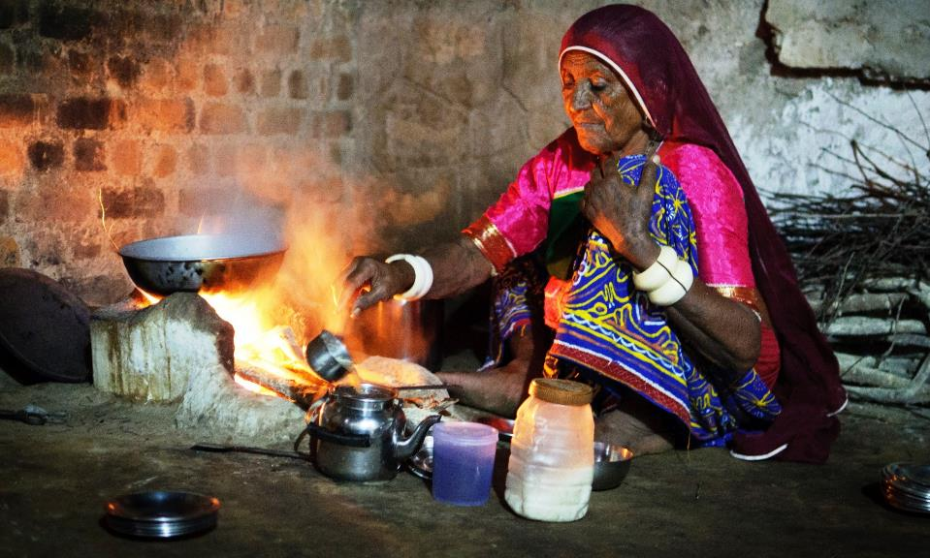
RRI - Criteria
To what extent was the population consulted? Involved?
Is the project :
Centered on a need
Turned towards beneficiaries
Simple
Accessible
Sustainable
Environmentally conscious
Notes:
Pour répondre à un besoin efficacement, il faut travailler avec les gens qui rencontrent ce besoin et qui vont devenir bénéficiaires, et possiblement clients.
One you’ve focused your work around a community, do you integrate them in the innovation process?
Impliquer les communautés visées tout au long du processus d’innovation pour assurer l’efficacité du produit et la cohérence avec le besoin et les attentes.
Ex : fours propres

Slide 80

RRI - Criteria
What is the R&D investment? The cost of the final product?
Is it the simplest solution?
Is the project :
Centered on a need
Turned towards beneficiaries
Simple
Accessible
Sustainable
Environmentally conscious
Notes:
Penser simple.
Pas cheap, mais simple. Certaines innovations auront besoin de développement et donc de ressources, et il faut leur donner les moyens d’etre développés.
Mais si l’idée elle-meme est simple et va directement au but sans artifice, ça augmente ses chances de succès. Pas de fonctionnalités inutiles, frugalité.
Ex : Faso Soap

Slide 81
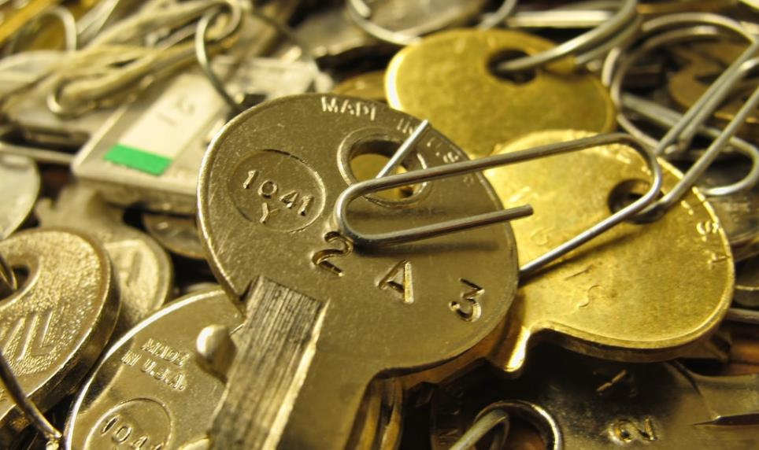
RRI - Criteria
Is it accessible? To who? In what kind of setting?
Is the project :
Centered on a need
Turned towards beneficiaries
Simple
Accessible
Sustainable
Environmentally conscious
Notes:
Etre sur que l’innovation va pouvoir atteindre ses bénéficiaires.
Plusieurs manières :
open acces, mais vérifier si les gens ont internet, parlent la langue etc
Distribution directe : mais les canaux de distribution doivent etre adaptés au contexte
Solutions intermédiaires

Slide 82
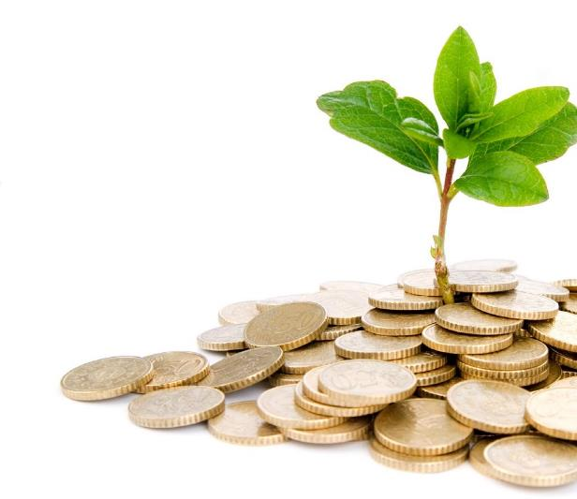
RRI - Criteria
Is it useful on the field? Could it be sell? How? Is is economically sustainable?
Is the project :
Centered on a need
Turned towards beneficiaries
Simple
Accessible
Sustainable
Environmentally conscious
Notes:
Durabilité économique pour exister sur le long terme.
Need to have a Business Model in order to maintain your impact.
Integrate market constraint in the innovation process. Ex: Faso Soap
Les problèmes sociaux ne sont pas uniquement l’affaire des gouvernements et des ONGs. Les communautés dont le besoin est adressé représentent un marché, parfois BoP.

Slide 83
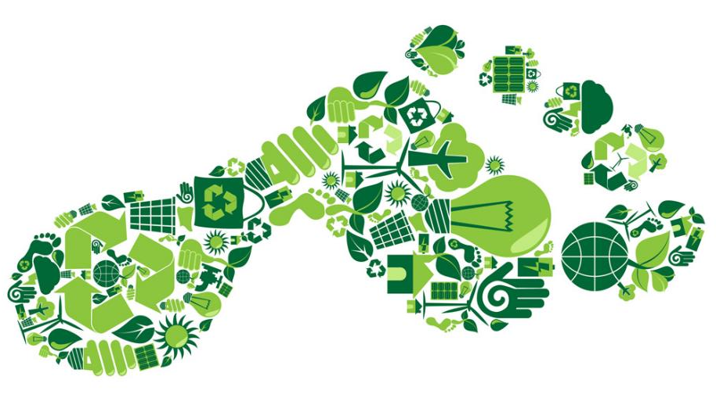
RRI - Criteria
How will the product be discarded? Could we imagine a circular model? Can we use other materials?
Is the project :
Centered on a need
Turned towards beneficiaries
Simple
Accessible
Sustainable
Environmentally conscious
Notes:
Il faut réfléchir à l’impact du produit : fabrication, vie, recyclage.
Evaluer cet impact pour le diminuer à chaque étape.
Ex : produits locaux, bio-sourcés, anticiper le recyclage, les utilisation des co-produits
Questions à poser dès le début

Slide 84
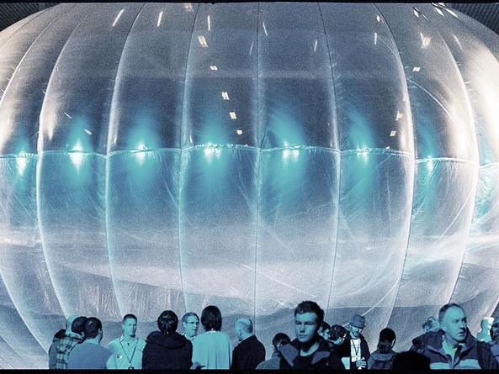
Responsible Innovation - Criterias: Case studies & discussion
1- Techno-push / Market-pull
2- People’s participation?
3- Simple / Frugal Innovation?
4- Accessibility?
5 – Economic sustainability/
6- Environmentally conscious?
Project loon
But: donner accès à internet à tout le monde
Fonctionnement : réseau de ballon à 20km (stratosphère) du sol, 15m de diamètre, Les ballons communiquent avec une antenne internet au sol. On filtre le signal pour que les antennes et ballons ne reçoivent que des signaux du project loon (grande bande passante sur longue distance). Les ballons marchent à l’énergie solaire.
Notes:
En partant de la science
Techno: réseau de ballon à 20km (stratosphère) du sol, 15m de diamètre, 10 premiers km = pluies, avions, montagnes. Les ballons communiquent avec une antenne internet spécialisée au sol. Les antennes et ballons ne recoivent que des signaux du project loon (grande bande passante sur longue distance). Solar power pour les ballons. PB: les antennes sont polarisées et les ballons tournent sur eux mêmes…
But: tout le monde accède à internet
Commentaires : financé par Google donc analyser les conflits d’intérêts. Est-ce vraiment le premier souci des populations concernées?

Slide 85
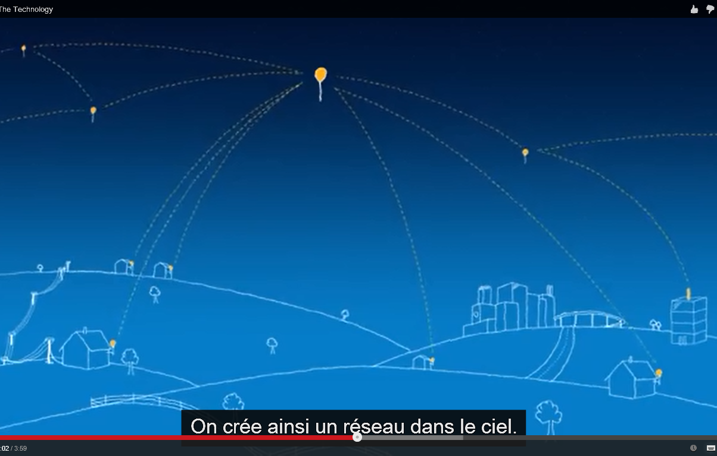

Slide 86
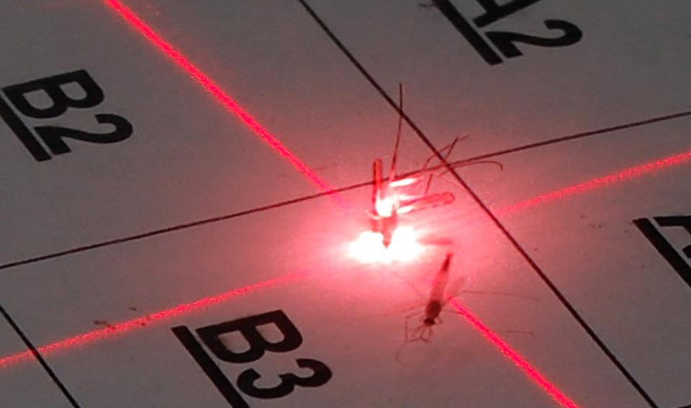
Responsible Innovation - Criterias: Case studies & discussion
1- Techno-push / Market-pull
2- People’s participation?
3- Simple / Frugal Innovation?
4- Accessibility?
5 – Economic sustainability/
6- Environmentally conscious?
Intellectual Ventures, Global Good
Ce projet vise à lutter contre la malaria en protégeant les zones les plus sensibles (hôpitaux) des moustiques en les shootant au laser
Un faisceau inoffensif permet de distinguer les espèces grâce au rythme de la lumière réfractée par le battement des ailes. Une fois le moustique repéré, on calcule sa trajectoire puis on lui tire dessus au laser concentré. Peut être fait pour 50$.
Notes:
En partant de la science
Lumière rétrofractée d’un laser non dangereux par les insectes permet de distinguer les espèces. Il faut deux poteaux pour réfléchir la lumière. Une fois le moustique repéré, calcul de la trajectoire du moustique puis laser concentré là où il est. Peut être fait pour 50$. Et le software?
Commentaires : Et le prix du software? Est-ce vraiment possible à mettre en place? Laser dangereux pour les gens. Un mur? Les moustiques passent dessus…

Slide 87
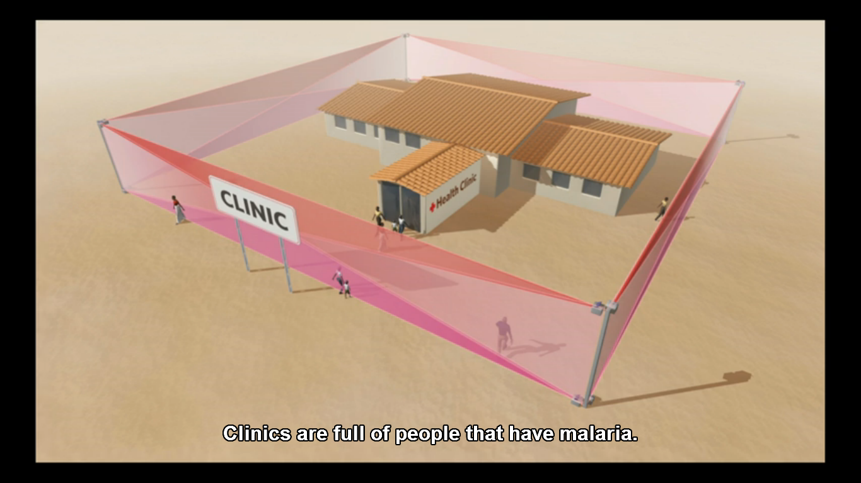

Slide 88
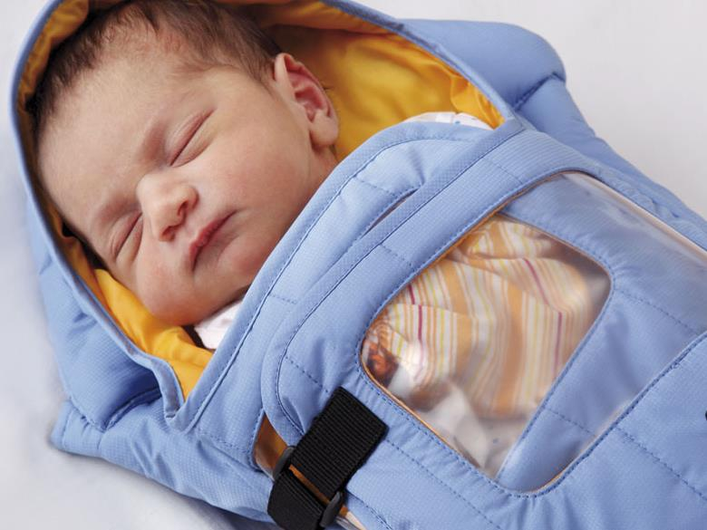
Responsible Innovation - Criterias: Case studies & discussion
1- Techno-push / Market-pull
2- People’s participation?
3- Simple / Frugal Innovation?
4- Accessibility?
5 – Economic sustainability/
6- Environmentally conscious?
Embrace
Le jour le plus dangereux pour un nourrisson est le jour de sa naissance: 1 millions de morts et 98% de ces morts dans le monde en voie de développement, principalement d’hypothermie (pas de couveuse, etc). Embrace a développé un « cocon » pour tenir le nourrisson à 37°C grâce à un matériau à changement de phase.
Notes:
En partant des besoins. Jour le plus dangereux pour un nourrisson: jour de sa naissance, 1 millions de morts et 98% de ces morts dans le monde en voie de développement. Ils utilisent un matériel à changement de phase à 37°C

Slide 89
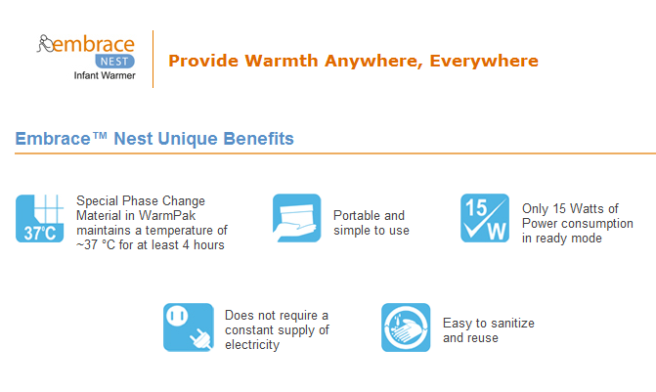

Slide 90
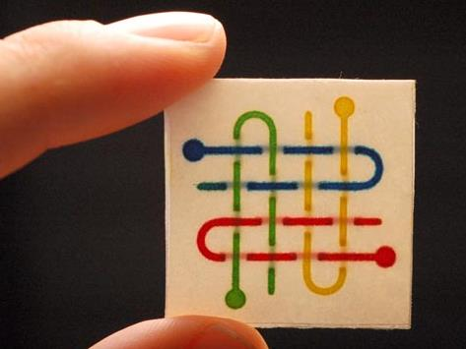
Responsible Innovation - Criterias: Case studies & discussion
1- Techno-push / Market-pull
2- People’s participation?
3- Simple / Frugal Innovation?
4- Accessibility?
5 – Economic sustainability/
6- Environmentally conscious?
Microfluidique sur papier
Le but est de construire des puces microfluidiques peu chères pour le diagnostic médical (même principe que le test de grossesse).
Voir les travaux réalisés à l’ESPCI ParisTech notamment.
Notes:
En partant de la science. Voir les travaux réalisés à l’ESPCI ParisTech notamment. Nous avons des reviews sur le sujet si cela vous intéresse.

Slide 91

Responsible Innovation - Criterias: Case studies & discussion
1- Techno-push / Market-pull
2- People’s participation?
3- Simple / Frugal Innovation?
4- Accessibility?
5 – Economic sustainability/
6- Environmentally conscious?
APOPO
Le but est d’entrainer des rats pour déminer des zones en Afrique.
L’odorat du rat étant très développé, ils sentent la TNT et sont trop léger pour faire exploser les mines. Projet annexe pour tester la tuberculose dans la salive.
Notes:
En partant des besoins: Rat = odorat. Ils sentent la TNT. Entrainement positif au click. /!\ les mines peuvent être chargées avec différentes charges TNT, Composite B (TNT + RDX) et RDX ou T4. Le poids du rat ne fait pas exploser la mine.
Tuberculose: ils sentent la salive des personnes.
Commentaires : les mines peuvent être chargées avec différentes charges: TNT uniquement, composite B (TNT + RDX) et RDX ou T4.

Slide 92

Responsible Innovation - Criterias: Case studies & discussion
1- Techno-push / Market-pull
2- People’s participation?
3- Simple / Frugal Innovation?
4- Accessibility?
5 – Economic sustainability/
6- Environmentally conscious?
Prakti Design
Pour la problématique de la cuisson sur foyers ouverts dans les pays en développement, voir le blog de SoScience, il y a un dossier.
Prakti Design est une entreprise sociale qui conçoit et vend des fours fermés, plus propres, plus efficaces. Ca marche en grande partie parce que le design des fours est fait en intégrant l’utilisateur, et qu’il est adapté aux habitudes et traditions.
Notes:
En partant des besoins.
Clean cookstoves: meilleur design, pas ouvert et avec cheminée et beaucoup plus efficace sur la combustion. Plus de chaleur.

Slide 93

Responsible Innovation - Criterias: Case studies & discussion
1- Techno-push / Market-pull
2- People’s participation?
3- Simple / Frugal Innovation?
4- Accessibility?
5 – Economic sustainability/
6- Environmentally conscious?
Lentilles PDMS
Innovation très frugale : faire des lentilles de microscope avec du PDMS. On dépose une goutte, on retourne le support et la gravité lui donne une forme parabolique parfaite. On cuit ensuite au four. Moins d’un centime pour une lentille qui grossit 160 fois avec une résolution de 4 micromètre. 2$ pour le device qu’ils ont fait autour (led) et 500$ pour l’i-phone. Pour comparaison, un dermascope coute environ 500$ pour voir des mélanomes.
Notes:
Solutions astucieuses: PDMS et loi de la gravité. Moins d’un centime pour une lentille qui grossit 160 fois avec une résolution de 4 micromètre. 2$ pour le device qu’ils ont fait autour (led) et 500$ pour l’i-phone. Un dermascope coute environ 500$ pour voir des mélanomes.

Slide 94


Slide 95

Responsible Innovation - Criterias: Case studies & discussion
1- Techno-push / Market-pull
2- People’s participation?
3- Simple / Frugal Innovation?
4- Accessibility?
5 – Economic sustainability/
6- Environmentally conscious?
Foldscope
But : faire un microscope très bon marché pour le diagnostic médical. Le foldscope est fait principalement en papier (plus une lentille bon marché, et quelques LED suivant le modèle), il est donc très peu cher à construire et distribuer. Il se monte sur le principe de l’origami et chacun peut le faire grâce à un code couleur très simple. Il y a plusieurs modèles afin de cibler différentes maladies.
Notes:
Solutions astucieuses : Foldscope

Slide 96

Responsible Innovation - Criterias: Case studies & discussion
1- Techno-push / Market-pull
2- People’s participation?
3- Simple / Frugal Innovation?
4- Accessibility?
5 – Economic sustainability/
6- Environmentally conscious?
Bouteilles comestibles
Nom du projet : OHOO. Le but est de réduire les déchets plastiques en créant une bouteille comestible (au moins biodégradable). Il s’agit d’une membrane faite grâce à de l’alginate de calcium, qui provient de l’algue brune et du chlorure de calcium . C’est un procédé de gélification (technique classique de sphérification utilisée en cuisine moléculaire).
Le résultat est simple, facilement réplicable et coûte 2 centimes.
Notes:
Solutions astucieuses: OHOO. Alginate de qui provient de l’algue brune et du chlorure de calcium qui permettent la gélification (technique classique de sphérification utilisée en cuisine moléculaire). Eau à l’intérieur du gel (surement de l’eau+calcium plongé dans un bain d’alginate)
The final package is simple, cheap (2ct/unit), resistant, hygienic, biodegradable and even eatable.
Discussion : hygiène?

Slide 97
Socratic Dialogue
Would you consider these examples a Responsible Research and Innovation?
Why?

Slide 98
Socratic Dialogue
Why does it mean for a research to be responsible? What does it mean for an innovation to be responsible?
Why?
Why do say that?
What are you implying?
What could we assume instead?
How does this relate to our discussion?

Slide 99
Socratic Dialogue
What type of values and human qualities are necessary to practice this mindset?
Why?
Why do say that?
What are you implying?
What could we assume instead?
How does this relate to our discussion?

Slide 100

BoP Market – Research context
Notes:
Normal map, showing the territory of each country
Worldmapper.com : Territory size shows the proportion of all scientific papers published in 2001 written by authors living there.

Slide 101

BoP Market – Research context
Notes:
Territory size shows the proportion of all scientific papers published in 2001 written by authors living there.
No wonder why our innovation and the technological path we chose is increasing inequalities.

Slide 102

BoP Market – Research context
Notes:
In a less graphic way

Slide 103

BoP Market – Research context
Notes:
In a less graphic way

Slide 104

Research for Bottom of the Pyramid contexts

Slide 105
Research for Bottom of the Pyramid contexts
A flawed system of innovation
2010, Journal of Clinical Oncology: aspirin 1x/week could reduce death by 50% in breast cancer
Holmes, M. and W. Chen (2014), “A cancer treatment in your medicine cabinet?”, The New York Times, 05 Mai 2014
Notes:
Un essai randomisé sur 3000 femmes aux Etats-Unis couterait 10 millions de dollars. Ce montant est élevé pour beaucoup de financements publics, mais c’est un montant faible pour une entreprise pharmaceutique.
Cependant Michelle Holmes et Wendy Chen, les deux membres de la Harvard Medical School à l’origine de la première étude, n’arrivent pas à faire financer ces recherches. Aucune entreprise n’a lancé de tests cliniques sur ce sujet. Pour les chercheuses de Harvard les raisons sont évidentes : personne ne peut espérer réaliser des profits avec l’aspirine. C’est un médicament générique depuis 1919 qui coûte moins de six dollars pour une année de réserve. Le potentiel est pourtant énorme : ce sont tous les ans 10 000 personnes aux Etats-Unis et 75 000 personnes dans les pays développés qui pourraient être sauvées.

Slide 106
Research for Bottom of the Pyramid contexts
A flawed system of innovation
2010, Journal of Clinical Oncology: aspirin 1x/week could reduce death by 50% in breast cancer
2014, Only one randomised test was launched; will be finished in 2025
Cost of such a trial: 10 million $
Holmes, M. and W. Chen (2014), “A cancer treatment in your medicine cabinet?”, The New York Times, 05 Mai 2014
Notes:
Un essai randomisé sur 3000 femmes aux Etats-Unis couterait 10 millions de dollars. Ce montant est élevé pour beaucoup de financements publics, mais c’est un montant faible pour une entreprise pharmaceutique.
Cependant Michelle Holmes et Wendy Chen, les deux membres de la Harvard Medical School à l’origine de la première étude, n’arrivent pas à faire financer ces recherches. Aucune entreprise n’a lancé de tests cliniques sur ce sujet. Pour les chercheuses de Harvard les raisons sont évidentes : personne ne peut espérer réaliser des profits avec l’aspirine. C’est un médicament générique depuis 1919 qui coûte moins de six dollars pour une année de réserve. Le potentiel est pourtant énorme : ce sont tous les ans 10 000 personnes aux Etats-Unis et 75 000 personnes dans les pays développés qui pourraient être sauvées.

Slide 107
Research for Bottom of the Pyramid contexts
A flawed system of innovation
2010, Journal of Clinical Oncology: aspirin 1x/week could reduce death by 50% in breast cancer
2014, Only one randomised test was launched; will be finished in 2025
Cost of such a trial: 10 million $
Why? -> No profit with aspirin
Which cost? -> Every year 10 000 people in the US
75 000 in developed countries
Holmes, M. and W. Chen (2014), “A cancer treatment in your medicine cabinet?”, The New York Times, 05 Mai 2014
Notes:
Un essai randomisé sur 3000 femmes aux Etats-Unis couterait 10 millions de dollars. Ce montant est élevé pour beaucoup de financements publics, mais c’est un montant faible pour une entreprise pharmaceutique.
Cependant Michelle Holmes et Wendy Chen, les deux membres de la Harvard Medical School à l’origine de la première étude, n’arrivent pas à faire financer ces recherches. Aucune entreprise n’a lancé de tests cliniques sur ce sujet. Pour les chercheuses de Harvard les raisons sont évidentes : personne ne peut espérer réaliser des profits avec l’aspirine. C’est un médicament générique depuis 1919 qui coûte moins de six dollars pour une année de réserve. Le potentiel est pourtant énorme : ce sont tous les ans 10 000 personnes aux Etats-Unis et 75 000 personnes dans les pays développés qui pourraient être sauvées.

Slide 108

Research for Bottom of the Pyramid contexts
A flawed system of innovation
2010, Journal of Clinical Oncology: aspirin 1x/week could reduce death by 50% in breast cancer
2014, Only one randomised test was launched; will be finished in 2025
Cost of such a trial: 10 million $
Why? -> No profit with aspirin
Which cost? -> Every year 10 000 people in the US
75 000 in developed countries
Holmes, M. and W. Chen (2014), “A cancer treatment in your medicine cabinet?”, The New York Times, 05 Mai 2014
Notes:
Un essai randomisé sur 3000 femmes aux Etats-Unis couterait 10 millions de dollars. Ce montant est élevé pour beaucoup de financements publics, mais c’est un montant faible pour une entreprise pharmaceutique.
Cependant Michelle Holmes et Wendy Chen, les deux membres de la Harvard Medical School à l’origine de la première étude, n’arrivent pas à faire financer ces recherches. Aucune entreprise n’a lancé de tests cliniques sur ce sujet. Pour les chercheuses de Harvard les raisons sont évidentes : personne ne peut espérer réaliser des profits avec l’aspirine. C’est un médicament générique depuis 1919 qui coûte moins de six dollars pour une année de réserve. Le potentiel est pourtant énorme : ce sont tous les ans 10 000 personnes aux Etats-Unis et 75 000 personnes dans les pays développés qui pourraient être sauvées.

