Slide 1
nuSTORM

Slide 2
What is nuSTORM?
nuSTORM

Slide 3
Neutrinos from stored muons
Scientific objectives:
  %-level (ν_{e}N)cross sections
    Double differential
  Sterile neutrino search
    Beyond Fermilab SBN
Precise neutrino flux:
  Normalisation: < 1%
  Energy (and flavour) precise
π ➔ μ injection pass:
  “Flash” of muon neutrinos

Slide 4
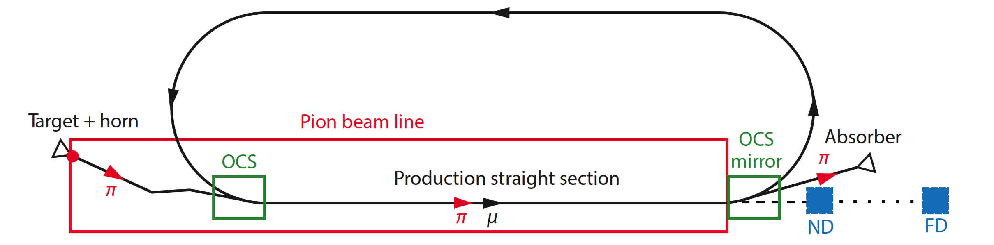
nuSTORM oveview
Fast extraction at >~ 100 GeV
Conventional pion production and capture (horn)
  Quadrupole pion-transport channel to decay ring

Slide 5
Neutrino flux
10.1146/annurev-nucl-102014-021930
ν_{μ} flash:
  Pion: 6.3 × 10¹⁶ m⁻² at 50m
  Kaon: 3.8 × 10¹⁴ m⁻² at 50m
    Well separated from pion neutrinos
ν_{e} and ν_{μ} from muon decay:
  ~10 times as many ν_{e} as, e.g. J-PARC beam
  Flavour composition, energy spectrum
    Use for energy calibration

Slide 6
Why study neutrino interactions?
nuSTORM

Slide 7
To understand the nucleus, nucleon and
contribute to nuclear physics
… but also …

Slide 8
Search for CPiV in lbl oscillations
Seek to measure asymmetry:
  P(ν_{μ}➤ν_{e}) – P(ν_{μ}➤ν_{e})
Event rates, convolution of:
  Flux, cross sections, detector mass, efficiency, E-scale
    Measurements at %-level required
  Theoretical description:
    Initial state momentum, nuclear excitations, final-state effects

Slide 9
Systematic uncertainty and/or bias
Phys.Rev. D89 (2014) no.7, 073015; Coloma et al
Uncertainty
(cross section
and ratio)
Event mis-classification
Phys.Rev. D92 (2015) no.9, 091301; Ankowski et al
Energy scale mis-calibration
Missing energy (neutrons)

Slide 10
Search for CPiV in lbl oscillations
Seek to measure asymmetry:
  P(ν_{μ}➤ν_{e}) – P(ν_{μ}➤ν_{e})
Event rates convolution of:
  Flux, cross sections, detector mass, efficiency, E-scale
    Measurements at %-level required
Lack of knowledge of cross-sections leads to:
  Systematic uncertainties; and
  Biases; pernicious if ν and ν differ

Slide 11
The benefit of nuSTORM
nuSTORM

Slide 12
ν_{e}N cross section measurements
Morfin

Slide 13
Systematic uncertainties
Morfin

Slide 14
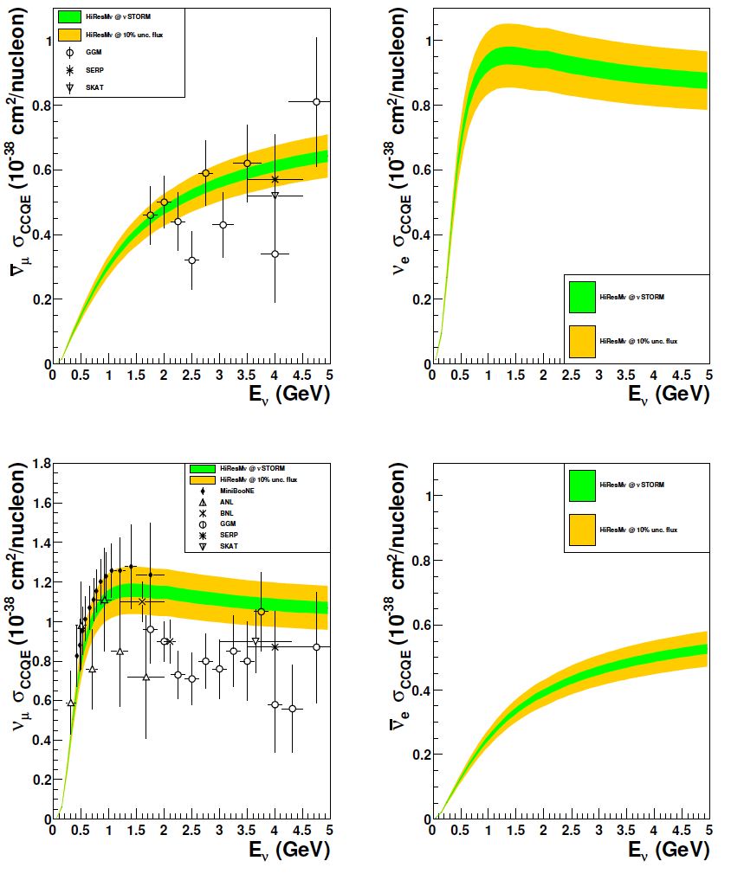
CCQE measurement at nuSTORM
CCQE at nuSTORM:
  Six-fold improvement in systematic uncertainty compared with “state of the art”
  Electron-neutrino cross section measurement unique
Require to demonstrate:
  ~<1% precision on flux
Individual ν_{e} measurements from T2K and MINERvA
[10.1103/PhysRevLett.113.241803, 10.1103/PhysRevLett.116.081802 ]
10.1103/PhysRevD.89.071301; arXiv:1305.1419

Slide 15
nuSTORM
& the CERN Physics Beyond Colliders
Study group
nuSTORM

Slide 16
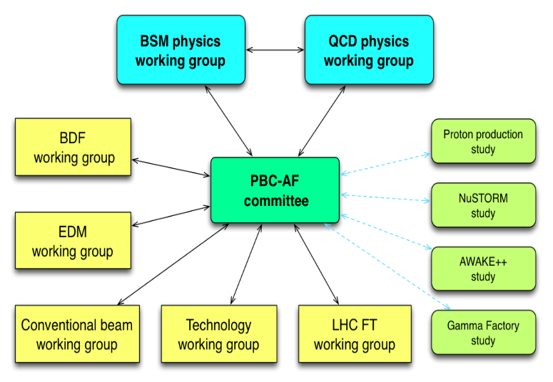
Physics Beyond Colliders study group
http://pbc.web.cern.ch

Slide 17
Elements of study
Physics case:
  Neutrino-scattering for:
    Oscillation
    Nuclear
Specification:
  Energy range:
    Long- and short-baseline neutrino
    Nuclear and particle physics
  Acceptance:
    Rate
    Neutrino-energy calibration
Accelerator:
  Full simulation that demonstrates <~1% flux precision
  Energy range (i.e. sweep down from max)
Implementation:
  Feasibility at CERN (see next slide)
Detector:
  Others are “on this”, so:
    Adopt performance of typical, or assumed, detector

Slide 18
Implementation @ CERN Exploratory study
A credible proposal for siting at CERN, including:
  SPS requirements
  Fast extraction, beam-line
  Target and target complex
  Horn
  Siting
  Civil engineering
  Radio-protection implications

Slide 19
I. Efthymiopoulos

Slide 20
Conclusions
nuSTORM

Slide 21
Conclusions
nuSTORM can deliver:
  nN scattering measurements with precision required to:
    Serve the long- and short-baseline neutrino programmes
    Provide a valuable probe for nuclear physics
CERN PBC study: opportunity to define innovative programme:
    nuSTORM:
      Delivers critical measurement: ν_{e}/ν_{μ} N scattering;
      Has discovery potential: sterile neutrinos;
      Potential for 6D ionization-cooling programme to follow MICE

Slide 22
Acknowledgements
nuSTORM collaboration and FNAL study of nuSTORM (A.Bross et al) and especially …

Slide 23
Event rates
10.1146/annurev-nucl-102014-021930
Per 10²¹ POT illuminating 100 Tonne LAr detector at 50m
ν_{μ} flash:
  Pion: 6.3 × 10¹⁶ m⁻² at 50m
  Kaon: 3.8 × 10¹⁴ m⁻² at 50m
    Well separated from pion neutrinos
ν_{e} and ν_{μ} from muon decay:
  ~10 times as many ν_{e} as, e.g. J-PARC beam
  Flavour composition, energy spectrum
    Use for energy calibration

