Slide 1
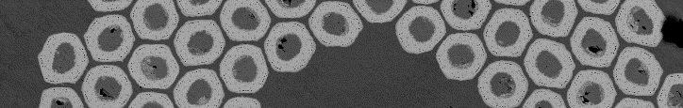


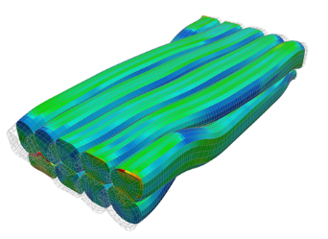
Workshop ^{#1}
Nb₃Sn Rutherford cable
characterization
for accelerator magnets
Pierre MANIL
CEA Paris-Saclay
15 November 2017

Slide 2
Outline
Why this workshop series?
Introduction to workshop ^{#1}
Next steps

Slide 3
Outline
Why this workshop series?
Introduction to workshop ^{#1}
Next steps

Slide 4
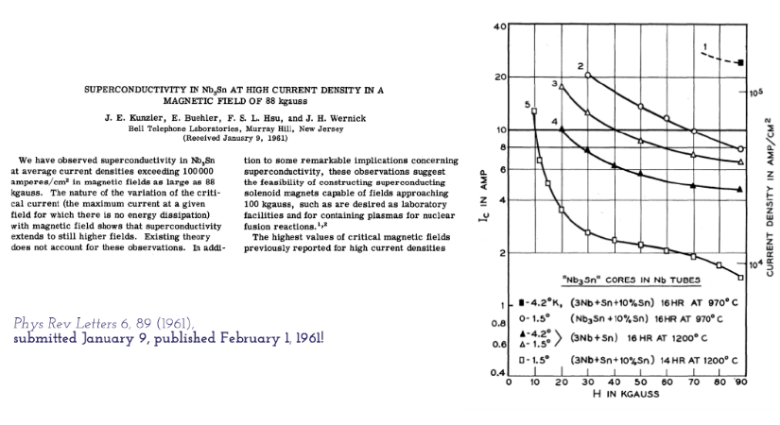
Strength and limitations of Nb₃Sn^{1/2}
1961: a promising observation…
… involving complex effects

Slide 5
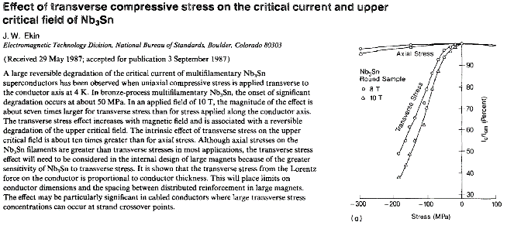
Strength and limitations of Nb₃Sn^{2/2}
Nb₃Sn performance is not only limited by the critical surface… but also by mechanical effects at the microstructure level

Slide 6
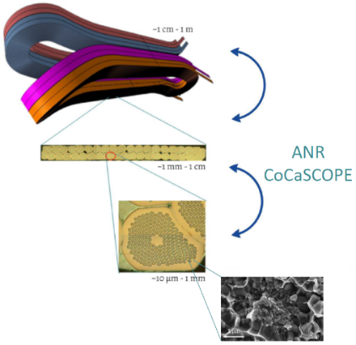
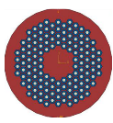
Nb₃Sn raises multiscale questions
Macroscopic behaviour of the magnet is controlled at the microstructure level
Magnet scale
Cable scale
Strand scale
Filament scale
This workshop

Slide 7
Questions encountered along the way
Possible showstoppers:
  Heat treatment optimization
  Brittleness: R&W vs W&R
  Series production of strand (unit lengths, procurement strategies)
  J_{c} optimization (production methods, Cu/nCu ratio, flux pinning…)
  Reversible/permanent effect of transverse/longitudinal stress/strain
  Electromagnetic stability (self-field instabilities…)
  Stress management at the magnet level (criterion?)
  Accounting for quench-back effects
  …
+ « side problems »
  Heat-treatment-proof tooling
  Test facilities (need for high field/high pressure)
  FEM model parameters
  Difficult in-situ observation of the reaction process

Slide 8
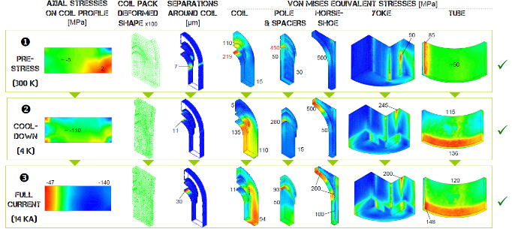
Some (old) ‘trauma’ of mine^{1/2}
Which Youg modulus in FEM for the insulated/impregnated cable?
How to measure it experimentally?
Which design critetion in terms of admissible stresses? σ_{VM} < 150 MPa??
SMC mechanical models (CAST3M)

Slide 9
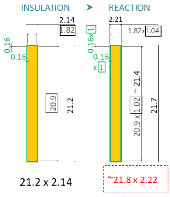
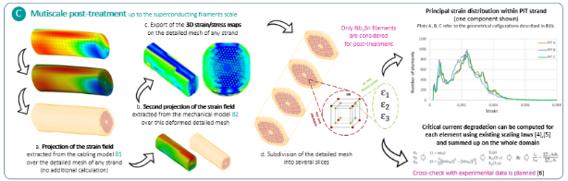
Some (old) ‘trauma’ of mine^{2/2}
What cable dimensions to consider in the CAD design?
What longitudinal contraction expected?
Which driving parameter(s) for the electromagnetic performance?
(scaling laws)
FRESCA2 cable sketch
FRESCA2 coil
CoCaSCOPE program

Slide 10
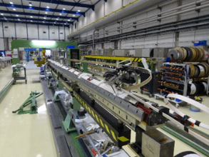
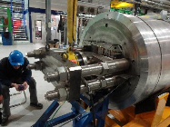
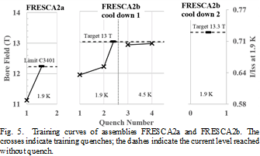
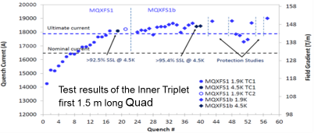
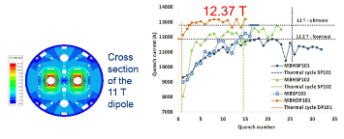
Why now?
Continuous progress + recent encouraging results
  LARP/US magnet development program: HD, HQ…
  NED/EuCARD: SMC, RMC, FRESCA2
  CERN HFM program: eRMX, RMM…
  HiLumi: 11 T dipole, 4m-long MQXF
  EuroCirCol, FCC: new design concepts
  Strong implication in China and Japon
  → 16 T Nb₃Sn magnets are credible…
4m-long MQXF
FRESCA2 structure
MQXFS
11T dipole

Slide 11
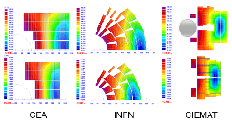

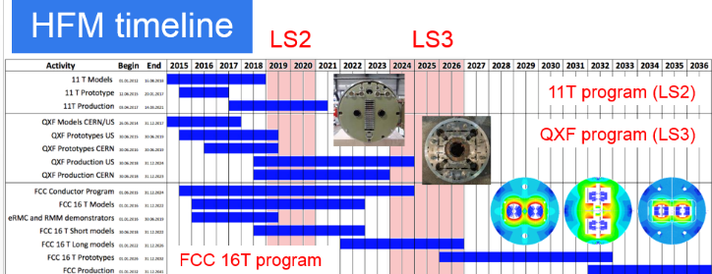
Why now?
FCC: a clear timeline proposal
  We are at the crossroads between
  R&D/demonstrator magnets
  and first Nb₃Sn magnets
  operating in accelerators
  → Perfect timing for consolidating
  the huge amount of R&D feeback
  acquired worldwide!
[courtesy of F. Bordry, L. Bottura, G. de Rijk]

Slide 12
Intention of the workshop series
This workshop series aims at sharing experience gained worldwide in the field of Nb₃Sn conductor characterization.
At the end of the series, the idea is to set-up a best practice manual resulting from the discussions having taken place all along the workshops.
From today, we can evaluate that 3 to 5 workshops could be necessary.

Slide 13
Outline
Why this workshop series?
Introduction to workshop ^{#1}
Next steps

Slide 14
Organizing committee
Organization
  Cecile Noels @ CERN
  Natacha Lomet @ CEA Paris-Saclay
Logistics/support
  Hi-Lumi collaboration
  Luis Garcia and Fernand Toral @ CIEMAT
  Pierre Védrine @ CEA Paris-Saclay
Scientific committee
  Bernardo Bordini, Paolo Ferracin, Friedrich Lackner @ CERN
  Maria Durante, Hélène Felice, Pierre Manil @ CEA Paris-Saclay

Slide 15
Useful documents
Agenda
Letter of intent
Guidelines for the presenters
List of participants
  Including affiliation, contact, background and interest

Slide 16

47 participants
CERN CEA INFN CIEMAT ENEA EFJ
15 9 5 4 2 1
38
3
3
1
2

Slide 17
Topics
Session #1 | Introduction to the workshop series
Session #2 | Mechanical characterization of impregnated conductor Session chairs: Paolo Ferracin, Friedrich Lackner
Session #3 | Dimensional changes during heat treatment
Session chairs: Hélène Felice, Bernardo Bordini
Session #4 | Wrap-up and close out

Slide 18
Guidelines to the presenters
Besides the scientific results that you wish to present, please keep significant time to present the experimental setups and procedures.
Do not hesitate to present negative or partial results if you think they can bring constructive input.
Please take some time at the end of your talk to conclude on the problems and success encountered and try to draw conclusions (even negative) that could serve the whole community rather than sticking to the specificities of a particular project.

Slide 19
Guidelines to the attendees
Ask questions ;-)

Slide 20
Outline
Why this workshop series?
Introduction to workshop ^{#1}
Next steps

Slide 21
Proceedings
The idea is to come out with proceedings highlighting the common/diverging conclusions arising from the presentations and discussions in each session.
These proceedings will not be a list of abstracts or papers.
They will be short (approx. 2 pages per session).
Following the workshop, the scientific committee and chairmen will edit the proceedings of each session.
The proceedings will be reviewed by all the presenters before being shared and open for comments.
Unless specific request, the proceedings will be made public.

Slide 22
Next worshop(s)?
Will be discussed in the wrap-up session:
  Next topics
  Workshop regularity/location
  Method to set a best practice manual
  Coordinated research programs?
So please stay with us for the last session (ending at 18:30)!

Slide 23
Thank you

