Slide 2
New Maven dependency updates & review of apps deployed using non-standard dependencies

Slide 3
Maven dependencies updates
Changed API in cmw-data (comm, fxcomm RDA)
Removed dependencies from artifactory
Removed versions from artifactory
https://deployments.cern.ch is not working properly (not all pro versions listed)

Slide 4
Why these changes? (as by CO)
So what happened: these were old libraries, and more importantly some of them were not even properly released artifacts with CBNG , but instead, they were released with CommonBuild and then got continuously migrated to Artifactory in the past few years. The problem was that they were anything, but not reliable artifacts. The binary was the same of course but the dependency set was different.
We always discouraged users from using these non-reliable, obsolete libraries, because we had several issues with them. So finally, we rather removed them from the repository.

Slide 5
Actions for CO library changes
Changes had to be done in :
  Configuration POM
  GUI Parent POM
  fxcomm
  comm
Changes still have to be done in some of the non-standard applications (!)

Slide 6
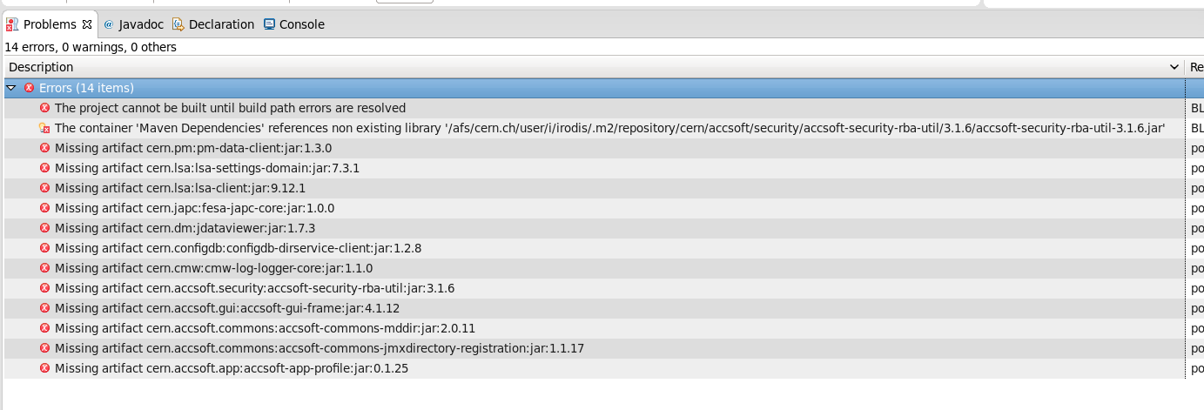
Libraries missing

Slide 7
Updated & new libraries
lsa-client-common
fesa-japc-core
accsoft-commons-mddir
pm-data-client
lsa-client
japc-ext-inca
japc
jdataviewer
configdb-dirservice-client
accsoft-gui-frame
accsoft-security-rba-util-gui
lsa-settings-domain
accsoft-app-profile
accsoft-commons-jmxdirectory-registration
cmw-log-logger-core
more details : https://goo.gl/qscpUC

Slide 8
Applauncher Statistics
In order to find out the standard and the non-standard applications of the section, appLauncherStatistics project can be used
Link can be found here :https://goo.gl/1dp6bS
Running the script it is possible to find the:
Standard applications
Non-standard applications
ExpertGui applications
ExpertGuiMaven applications
ExpertGuiArtifactory applications

Slide 9
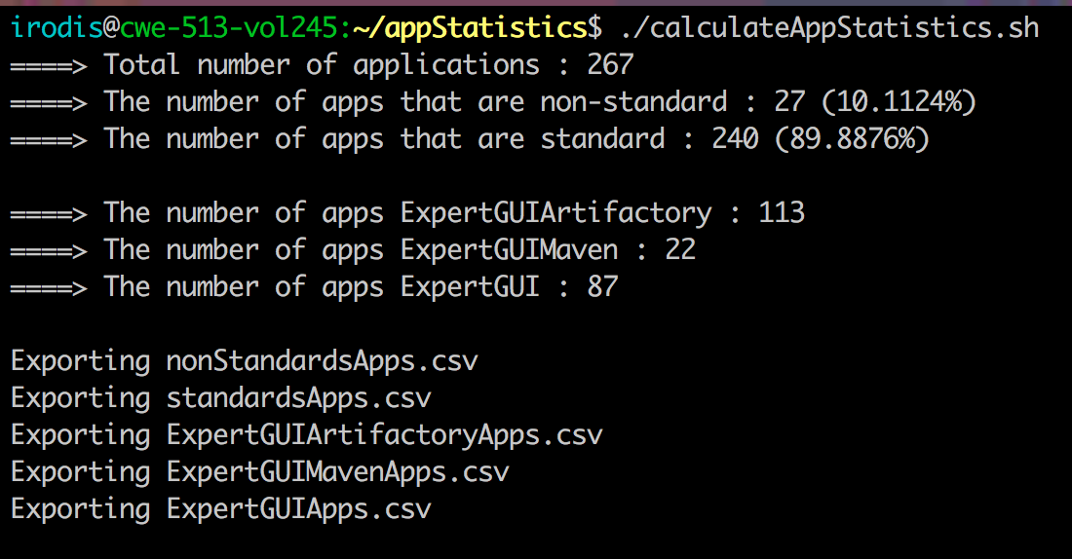
Example

Slide 10
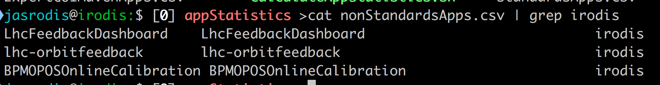
Usage
git clone https://:@gitlab.cern.ch:8443/bisw-java-fwk/appLauncherStatistics.git
./calculateAppStatistics.sh
Then in your project’s folder 4 .csv files will have been generated. You can find your non-standard applications simply using grep

