Slide 1
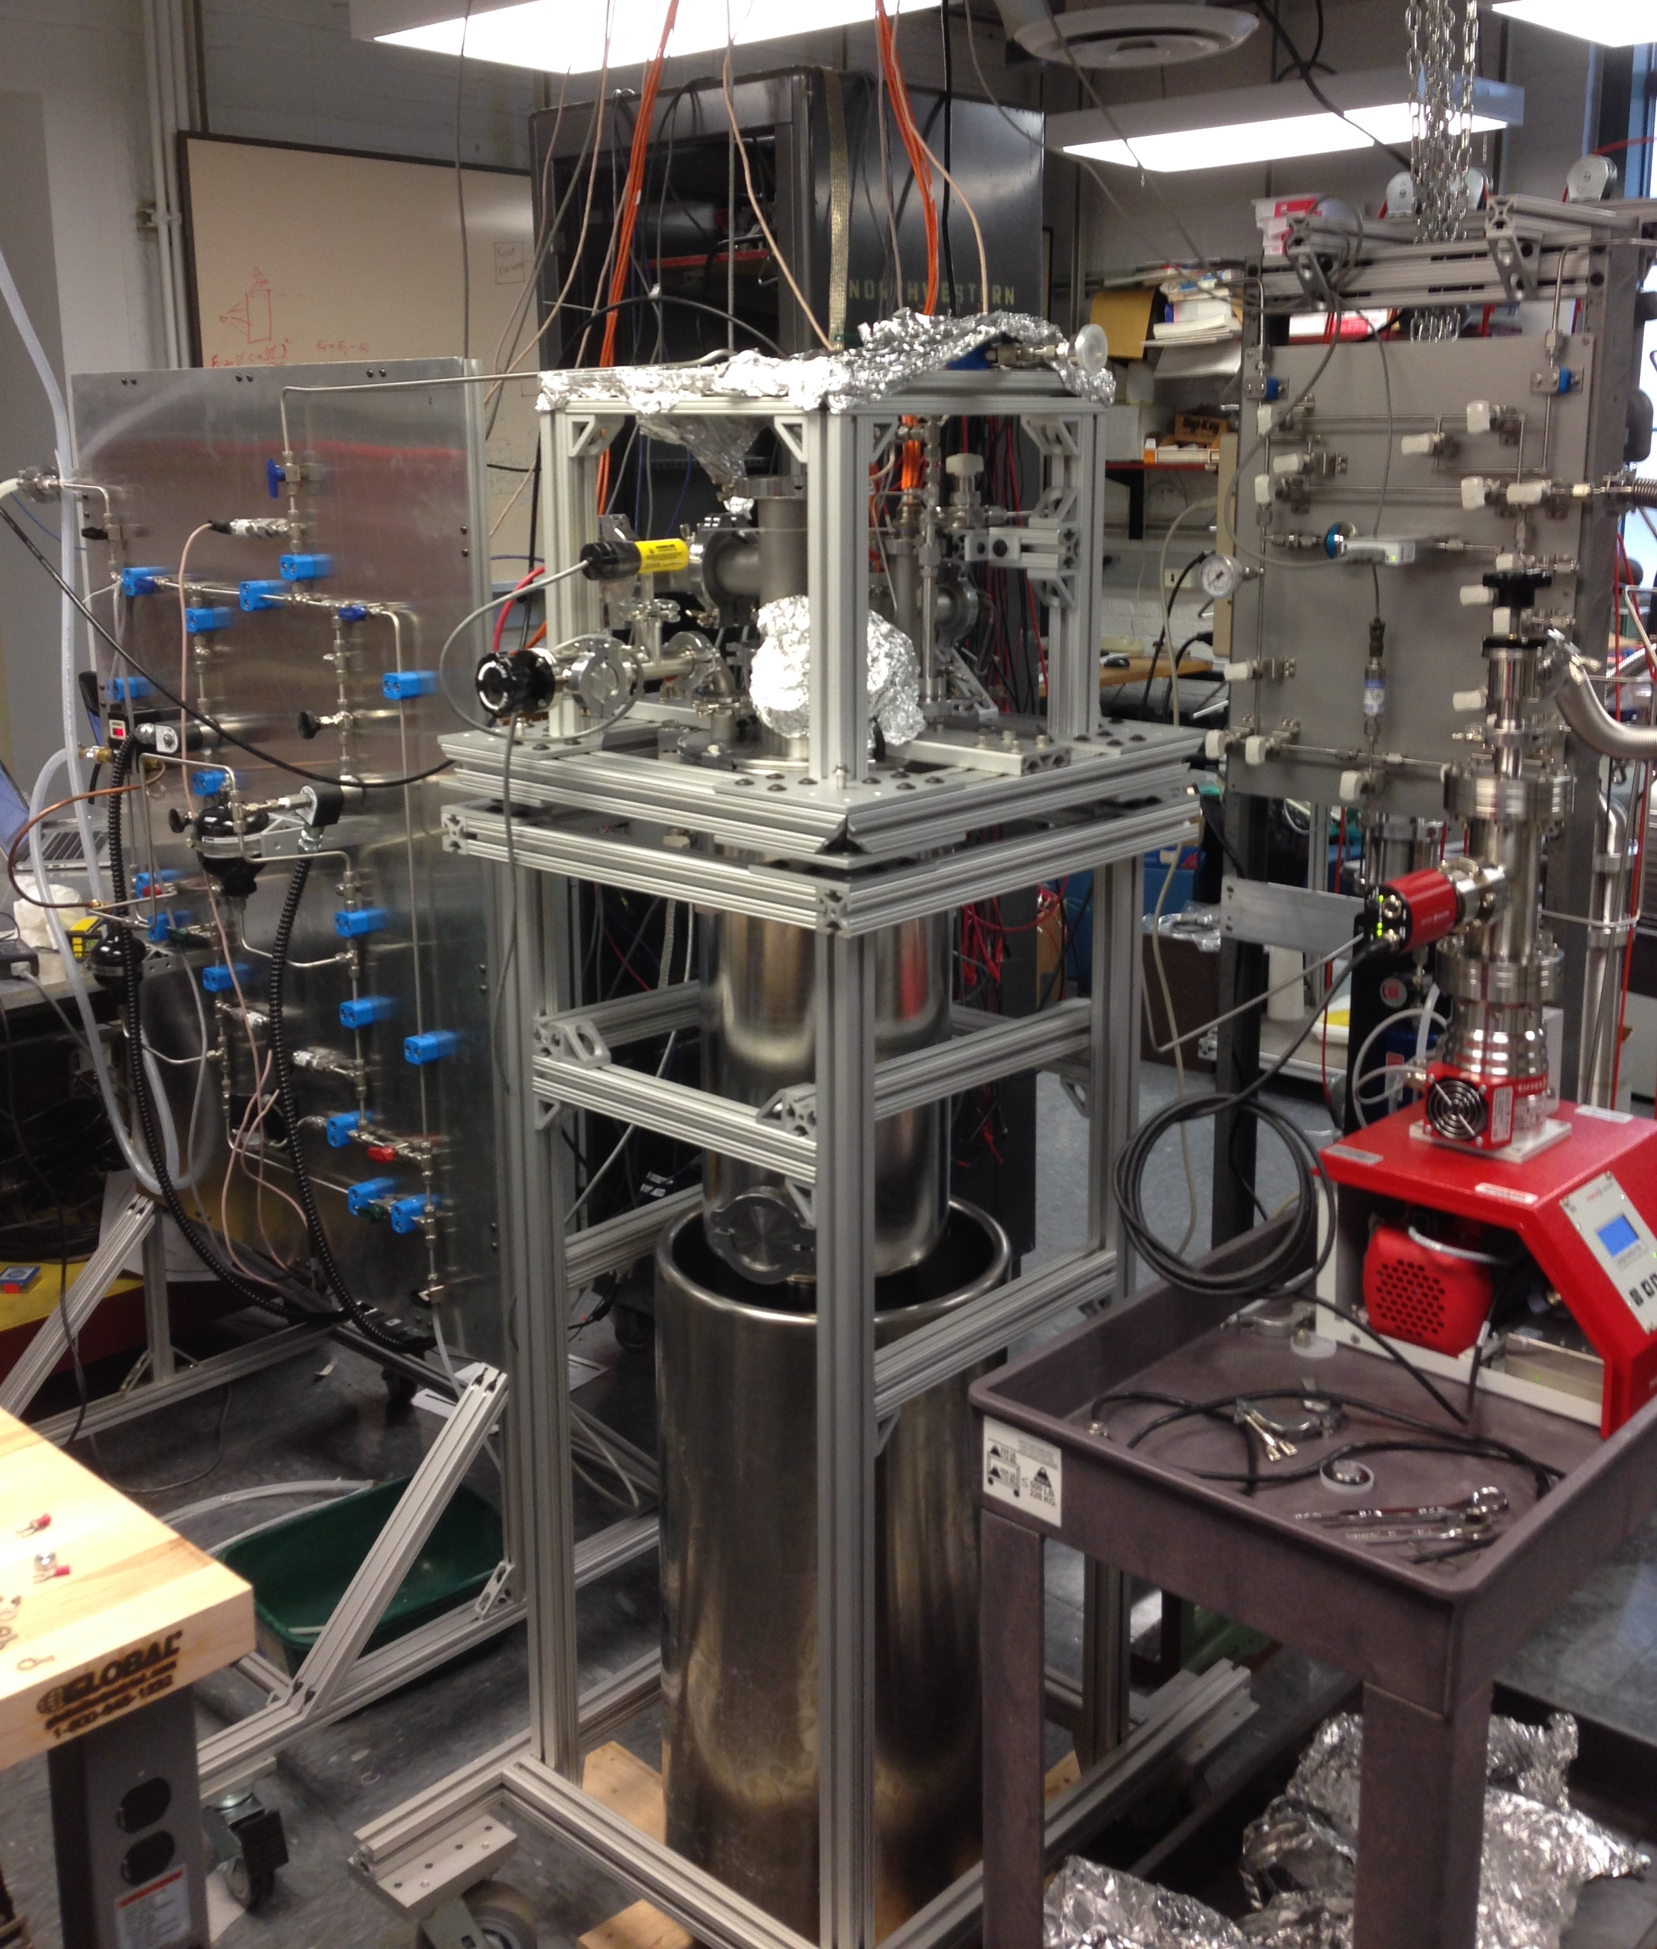
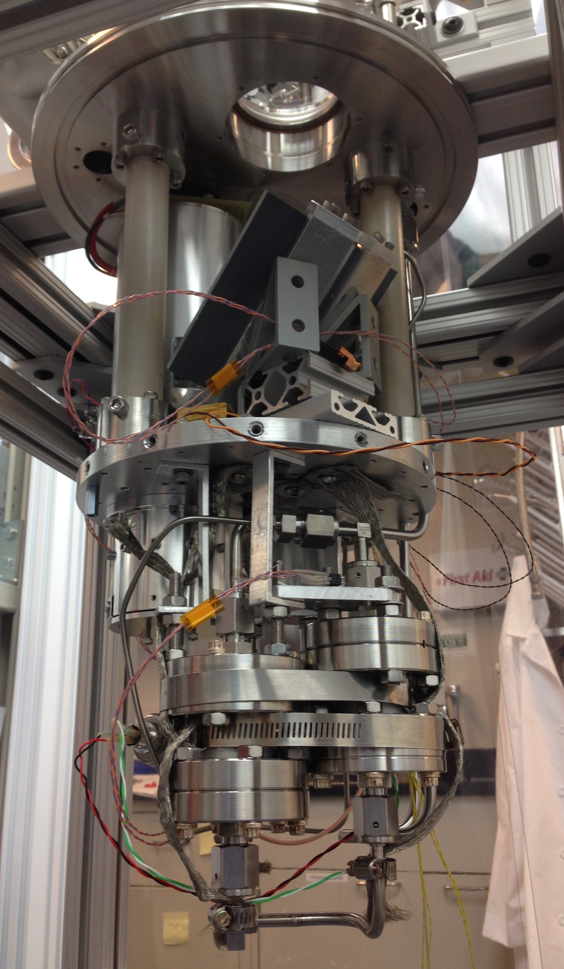
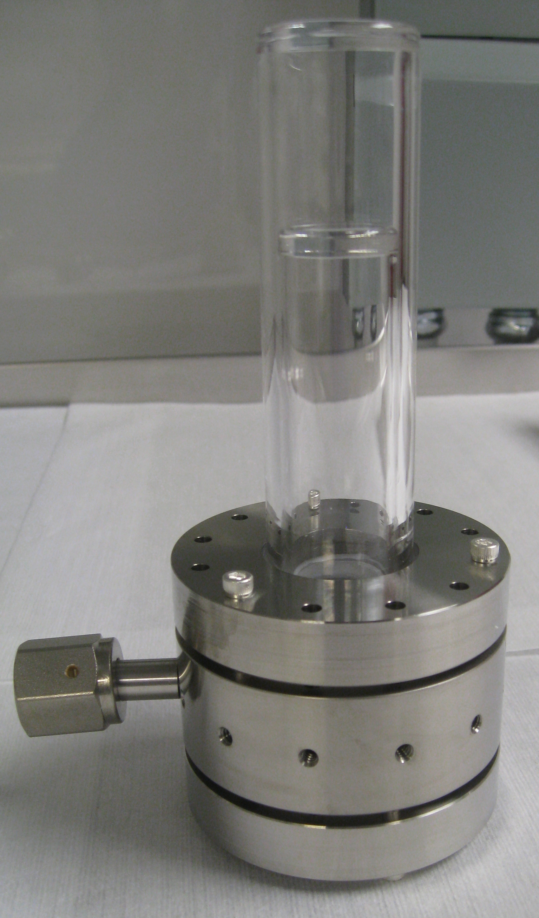
Liquid-Noble Bubble Chambers
Prospects for neutrino and WIMP detection
Eric Dahl, Northwestern University
COFI seminar
July 13, 2017

Slide 2
Outline
Motivation: GeV WIMPs and reactor neutrinos
The scintillating bubble chamber technique
  On Paper
  In Practice
First Results from a 30-gram xenon prototype
Lowering thresholds – current status
arXiv:1702.08861 [PRL 118, 231301]

Slide 3
What could you do with a liquid-noble bubble chamber?
Discriminating
  Only sensitive to nuclear recoils (neutrons, neutrinos, and WIMPs)
Scalable
  Largest bubble chamber to date: 35 m³ (BEBC)
  Ton-scale low-background bubble chamber in works (PICO)
Low threshold?
  Sub-keV recoil energy threshold is moving from “plausible” to “realistic”

Slide 4
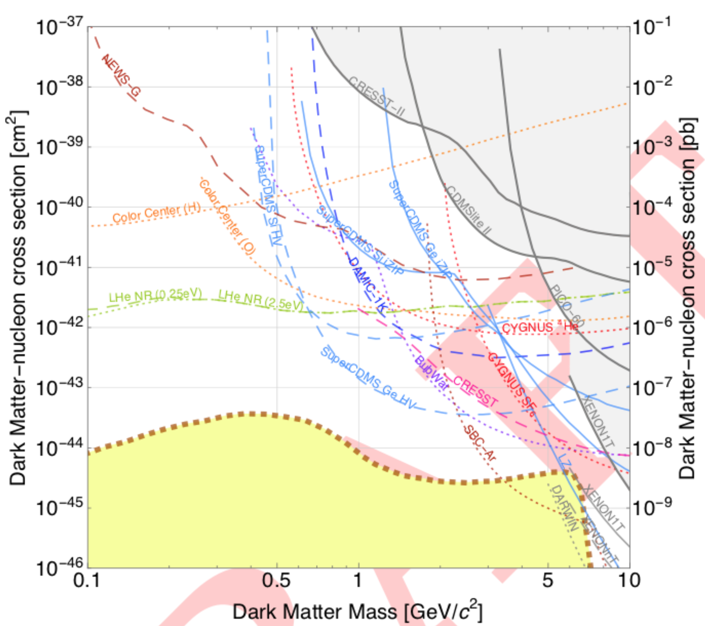
What could you do with an argon bubble chamber?
(DRAFT of upcoming Cosmic Visions white paper)
Up to an event-per-minute in a m³ target,
Only background is neutrons
1 ton-year at 1-keVr threshold
(76 ⁸B neutrino events expected)

Slide 5

Bubble Chambers
Superheated Target
  CF₃I, C₃F₈, …
Particle interactions
nucleate bubbles
Cameras and acoustic
sensors capture
bubbles
Chamber recompresses
after each event

Slide 6
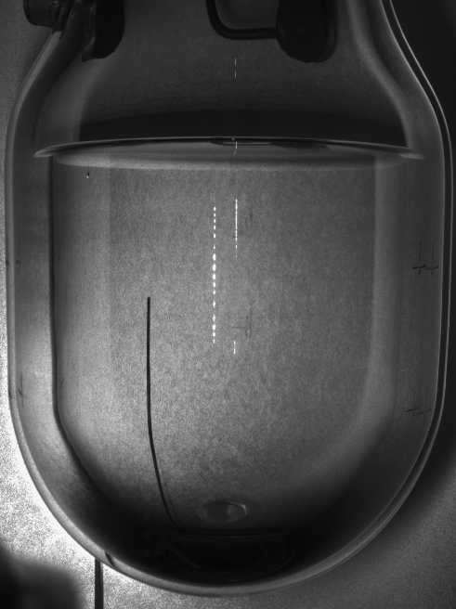










Bubble Chambers
Superheated Target
  CF₃I, C₃F₈, …
Particle interactions
nucleate bubbles
Cameras and acoustic
sensors capture
bubbles
Chamber recompresses
after each event

Slide 7
Scintillating Bubble Chambers
Superheated Scintillator
  Xe, Ar, C₆F₆, …
Particle interactions
nucleate bubbles
and produce scintillation
Cameras and acoustic
sensors capture bubbles
and photodetectors collect
scintillation light
Chamber recompresses
after each event
PMT
PMT
PMT
PMT

Slide 8
Bubble Chamber Thermodynamics
What is a meta-stable state?
Superheated Liquid

Slide 9
Bubble Chamber Thermodynamics
Consider a bubble with
  T_{l} = T_{b} (thermal equilibrium)
  μ_{l} = μ_{b} (chemical equilibrium)
Then P_{b} is (approx) the vapor
pressure at temperature T
P_{b} > P_{l} , so bubble should
grow… until we consider surface tension
P_{l}, T_{l}
P_{s}
P_{b}, T_{b}

Slide 10
Bubble Chamber Thermodynamics
Inward pressure from surface tension!
  P_{s} = 2σ/r
Bubble will grow if
  P_{b} > P_{l} + P_{s}
  r > r_{c} = 2σ / (P_{b} – P_{l})
Bubbles with r < r_{c}
collapse and re-condense
P_{l}, T_{l}
P_{s}
P_{b}, T_{b}

Slide 11
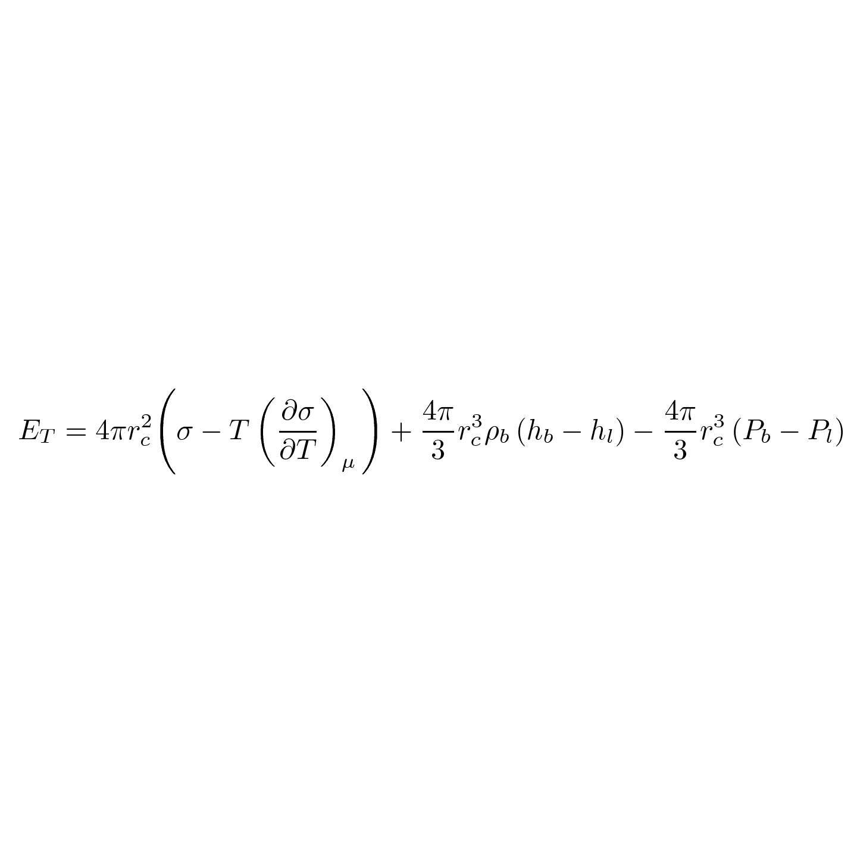
Bubble Chamber Thermodynamics
What does it take to produce critical bubble?
1.53 keV
P_{l}=30 psia, T_{l}=14ºC
1.81 keV
P_{b}= 89.7
psia
-0.15 keV
r_{c}=23.7nm
C₃F₈
= 3.19 keV total
Surface energy, Bulk energy, Reversible Work

Slide 12
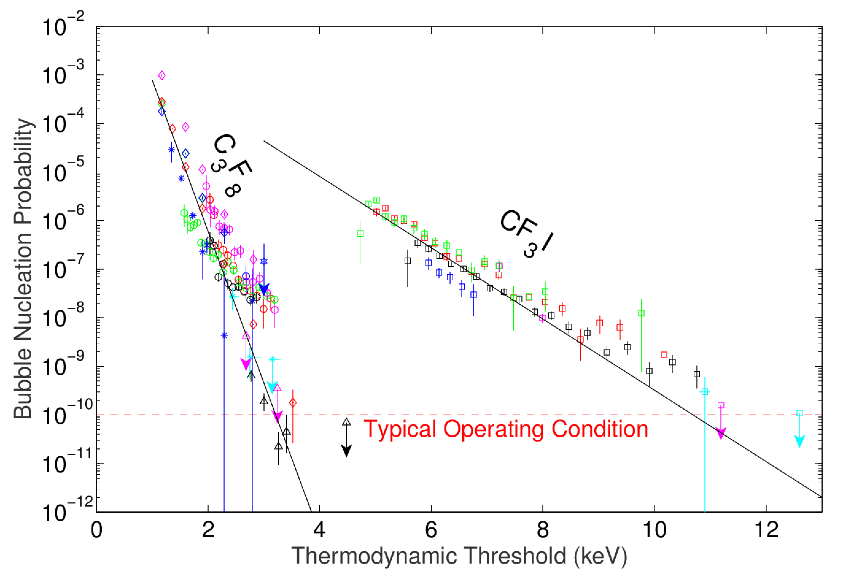
Bubble Chamber Discrimination
Electron recoil sensitivity in C₃F₈ and CF₃I from various PICO calibration and dark-matter chambers

Slide 13
Nuclear Recoil Threshold
Neutron Calibrations in C₃F₈ @ E_{T} = 3.2 keV

Slide 14
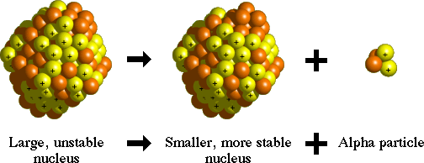
Bubble Chamber Backgrounds
All bubbles look the same!
  1-mm diameter bubble has drawn
  10 PeV from superheated fluid
  Nuclear recoil visually indistinguishable from alpha-decay
10 keV
6 MeV
Nuclear
Recoils
(3-500 keV)
~1-MeV energy resolution in acoustic channel
²²²Rn, ²¹⁸Po
(5.5, 6.0 MeV)
C. Amole et al. Phys. Rev. D 93, 061101(R) (2016) [arXiv:1601.03729]
²¹⁴Po
(7.7 MeV)

Slide 15
Bubble Chamber Backgrounds
6 MeV
1 MeV
100 eV
Eliminated via
Acoustics
Eliminated via particulate control measures,
removal of buffer fluid
ALL of these are easily identifiable with scintillation signal
More information always key to background discrimination
C. Amole et al. Phys. Rev. D 93, 061101(R) (2016) [arXiv:1601.03729]

Slide 16
Scintillating Bubble Chamber History
Glaser built a xenon bubble chamber in 1956 and found:
  No bubbles in pure xenon
  even at ~1 keV threshold
  (with gamma source)
  Normal bubble nucleation in
  98% xenon + 2% ethylene
  (scintillation completely quenched)
Phys.Rev. 102, 586 (1956)

Slide 17
Scintillating Bubble Chamber History
Scintillation suppresses bubble nucleation!
  Electrons should be even less likely to make bubbles than in freon chambers
  Greater superheat (lower thresholds) possible
  Nuclear Recoils should be largely unaffected, thanks to Lindhard Effect
Phys.Rev. 102, 586 (1956)
Experimental verification needed!

Slide 18
NU Xenon Bubble Chamber Schematic

Slide 19
NU Xenon Bubble Chamber Model
NU Prototype
  30-gram xenon target
  No buffer fluid
  30-psia, –50ºC superheated state
  IR illumination for cameras
  IR-blind PMT (R6834) for 175nm scintillation

Slide 20
NU Xenon Bubble Chamber
First Bubbles June 2016
April 2016
Feb 2016
Sept 2015
June 2015

Slide 21
Sample Nuclear Recoil Event
z
z

Slide 22
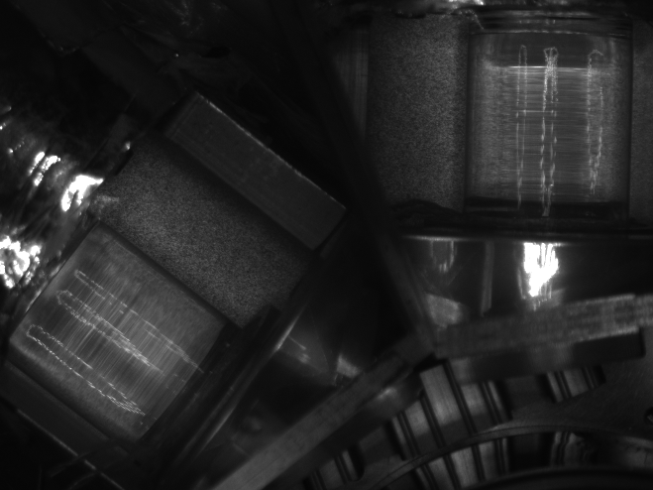
Annulus Boiling

Slide 23
NU Xenon
Bubble Chamber v 2.0
¼” Sapphire Window
(Blackbody absorber)
Minimum E_{T} decreased from 30 keV to 4 keV

Slide 24
Sample Nuclear Recoil Event
z
z
Δt

Slide 25
Acoustic – Scintillation Coincidence
< 1% accidental coincidence rate in calibration data
Slope = speed of sound in xenon (to 20%)

Slide 26
Light Collection
⁵⁷Co calibration
(122-keV photo-peak)
No bubbles over
background rate
Same signal in normal and superheated states
Poor resolution due to position dependence
Average 1 phe per 25 keVr
(0.4% photon detection efficiency)

Slide 27
Gamma Rejection
Xe
Without scintillation, xenon would be slightly worse than CF₃I

Slide 28
Nuclear Recoil Efficiency
Can determine nuclear recoil bubble nucleation threshold from bubble rate and multiplicity as before…
  ²⁵²Cf not the best source for this
  Not many multi-bubble events in small chamber
2 doubles, 160 singles at E_{T}=8.2 keV
  Recoil energy threshold 19 ± 6 keV
Check with scintillation channel!

Slide 29
Scintillation Spectrum for Bubble Events
E_{T} = 8.2 – 8.6 keV
E_{T} = 8.6 – 15 keV
No E_{T} dependence
observed in
other bins
*
*Simulation assumes
15-keV threshold for bubble nucleation
Bubbles with no PMT Trigger

Slide 30
NU Xenon
Bubble Chamber v 3.0
–43 ºC
Removed inner jar to eliminate narrow
(.5mm) annular region
Minimum E_{T} decreased from 4 keV to 0.8 keV
(and still falling…)

Slide 31
Gamma Rejection
PRELIMINARY
Xe
Turns out Glaser wasn’t kidding about gammas not making bubbles in xenon…

Slide 32
Nuclear recoil sensitivity
Threshold analysis ongoing at E_{T}=1.0 keV
  Much larger ²⁵²Cf exposure to work with
    Determine threshold from bubble multiplicity
    Position corrections for scintillation signal from 40-keV inelastic scatters -> higher resolution in scintillation channel
  ²⁰⁷Bi-⁹Be (γ,n) source
    97 keV neutrons (max 3.0 keV recoil)
    Source is weak, but may see rate over background (and over bare ²⁰⁷Bi gamma source)
  Will soon have higher-activity (γ,n) sources
  Meanwhile, just began data taking at E_{T}=0.8 keV

Slide 33
Next Steps
Low-threshold calibrations in xenon
(summer/fall)
  Easy reconfig to get to -40ºC (E_{T}=0.5 keV)
  New gamma-n sources coming
  Lots of analysis, simulation work coming to nail down recoil threshold
Switching to argon (fall/winter/spring)
  New thermal control scheme (same cryostat)
  Waveshifter deposition on jar (w/o obscuring images)
R&D for larger detectors (anytime…)
  Need pressure-resistant photo-detector system compatible with camera illumination and immersion in hydraulic fluid (e.g. CF₄)
  (SiPM’s very likely candidate…)
  Site selection and background sims for future proposals

Slide 34

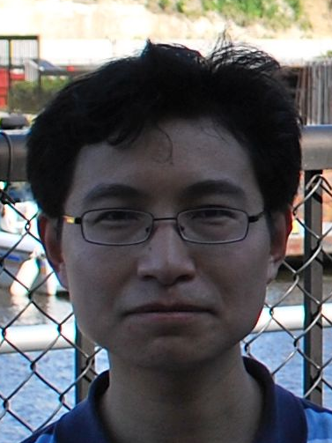
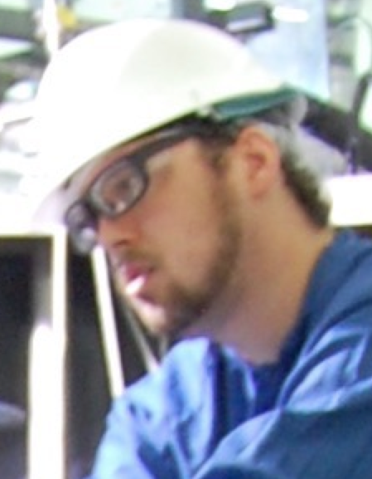
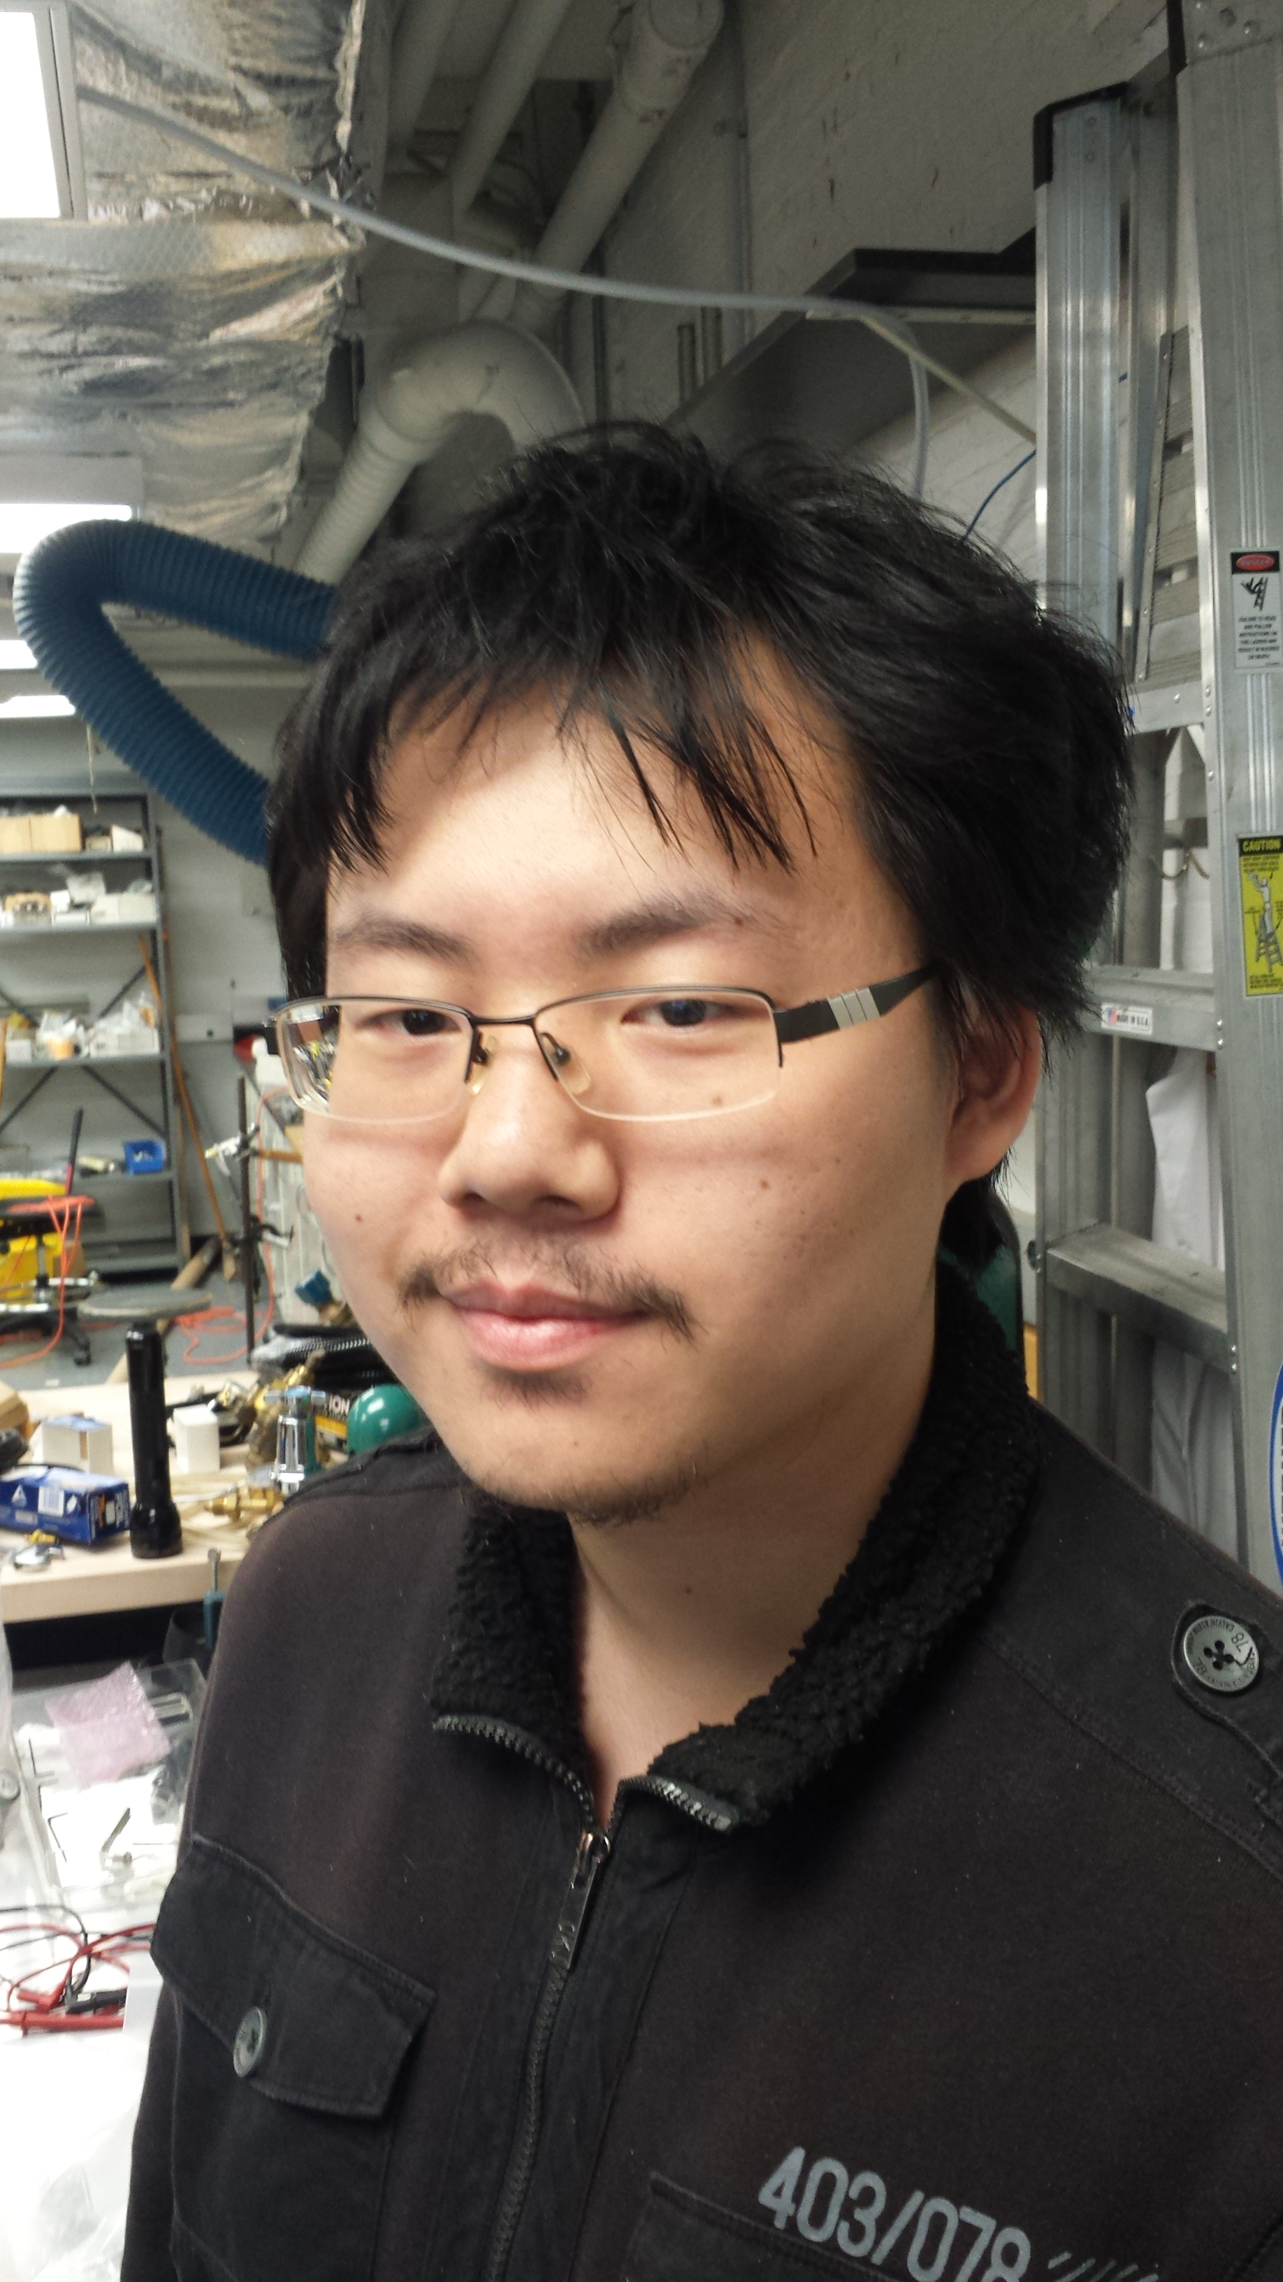
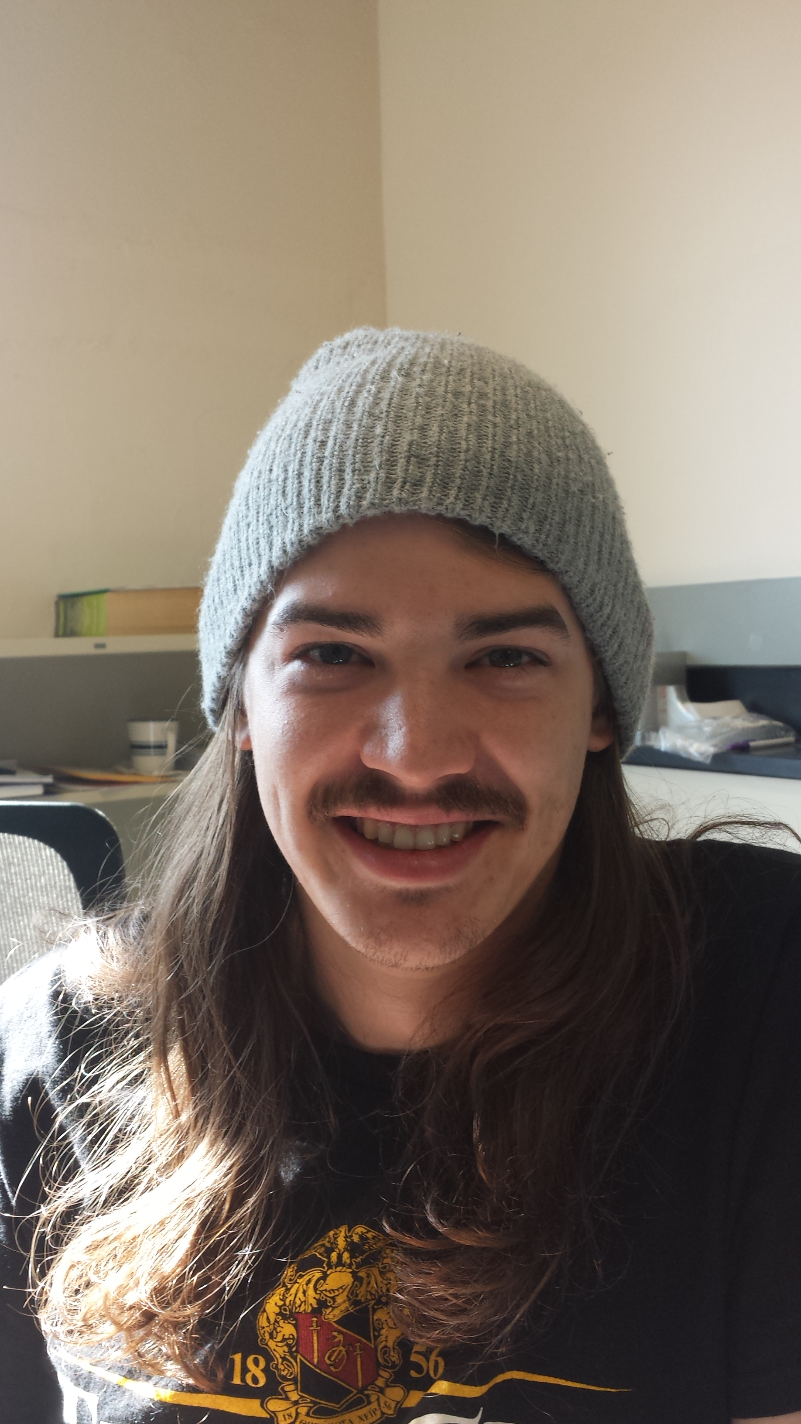
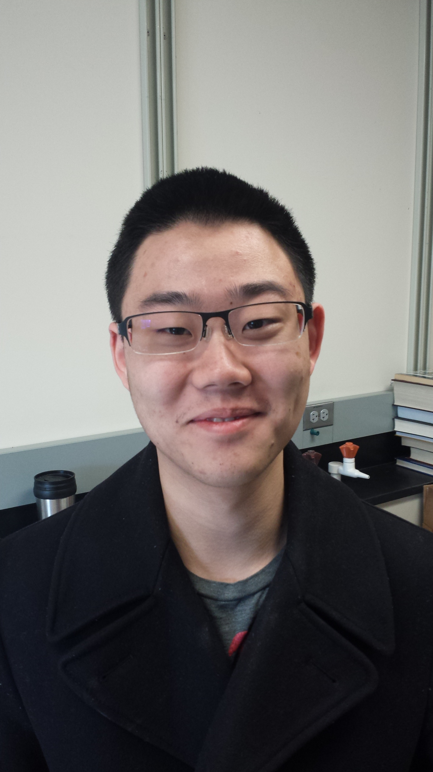
Our Group
Jianjie Zhang
Dan Baxter
Miaotianzi Jin
Dylan Temples
Jon Chen
Funding:
  Department of Energy Award DE-SC0012161
Paper:
  arXiv:1702.08861 [PRL 118, 231301]

Slide 35
Our Group
Jianjie Zhang
Dan Baxter
Miaotianzi Jin
Dylan Temples
Jon Chen
Funding:
  Department of Energy Award DE-SC0012161
Paper:
  arXiv:1702.08861 [PRL 118, 231301]

Slide 37
Summary
Scintillating bubble chambers work!
  Confirmed coincident scintillation and bubble nucleation by nuclear recoils
  Electron discrimination better than in freons
  (still finding out out how much better…)
  Low-threshold performance looking very promising, stay tuned (or jump in!)

Slide 38
Annulus Boiling

Slide 39
“Bright” event
(Muon track with nuclear recoil)
0.2 phe/keVee, from ⁵⁷Co 122-keV gamma calibration

Slide 40
“Medium Bright” Event
(alpha-decay candidate)
0.2 phe/keVee, from ⁵⁷Co 122-keV gamma calibration

Slide 41
“Dim” Event (nuclear recoil)
0.2 phe/keVee, from ⁵⁷Co 122-keV gamma calibration

Slide 42
Gamma Discrimination
Xenon (90% CL, no bubbles from gammas so far)
Without scintillation, we would expect poorer discrimination in xenon than CF₃I

Slide 43
Ongoing R&D
Lower thresholds (higher superheat)
  Look for gamma sensitivity
  Precision nuclear recoil calibrations
Alternate targets
  Argon
    Hydraulics -> pneumatics
    Expect better gamma-discrimination than xenon
  Organic scintillators
    Superheated fluid -> supersaturated gas+liquid solution
    Many light-nuclei available (C, F, H)

