Slide 2
Update: WP4
First Deliverables from INFN-LNL achieved:
  The tooling for spinning 400 MHz monocell cavities is ready
    First seamless Al test cell delivered to CERN
  The fabrication design of 800 MHz has been made
  The coatings and RF tests of 6 GHz cavities has been performed.
    Good results from 70 µm thick Nb coatings
  Samples of Nb-Cu films have been sent to STFC for analysis
    Reference samples from CERN had been sent as well

Slide 3
Update: WP4
Good progress at CERN for the EP system
  EP bench design is already well defined, entering into detail phase
  Main components defined, purchases to start soon.
  Strong interaction with EN/MME for mechanical integration, and VSC/ICM for controls
Coating system progress
  400 MHz is operational
  800 MHz: adaptation plate has been designed to make use of the 400 MHz bench

Slide 4


Slide 5
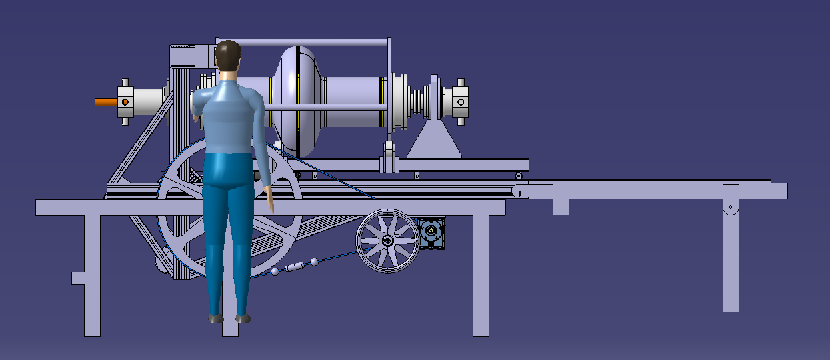

Slide 6
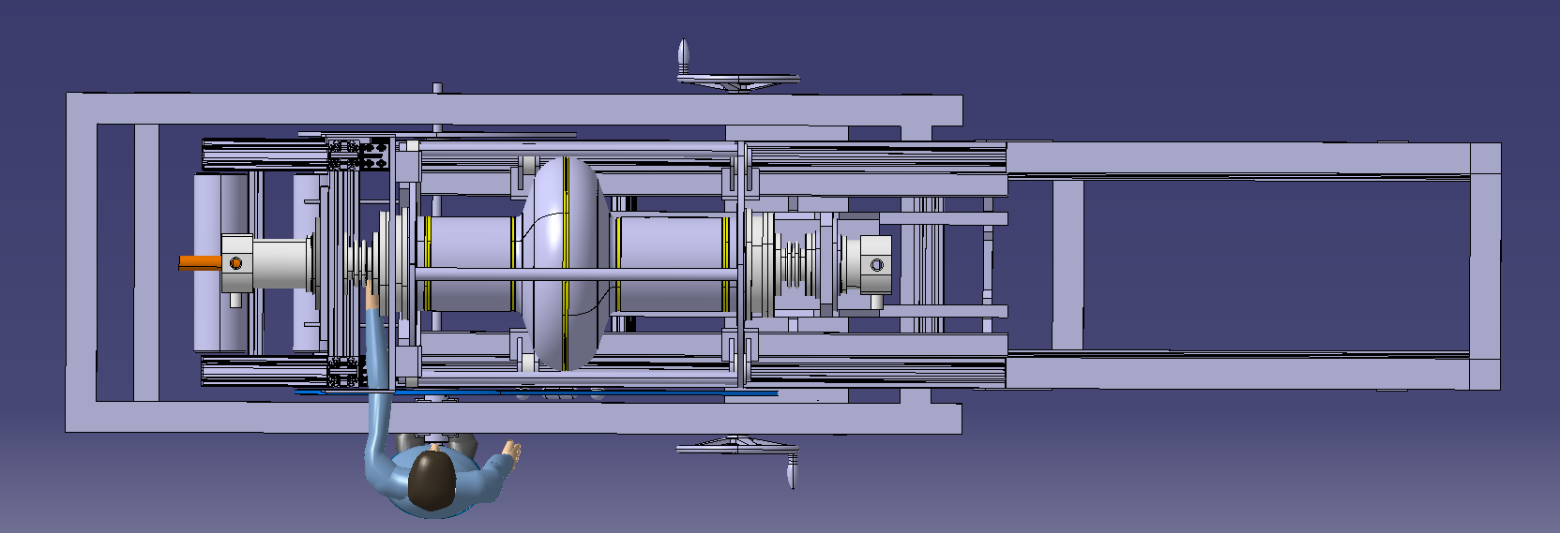

Slide 7
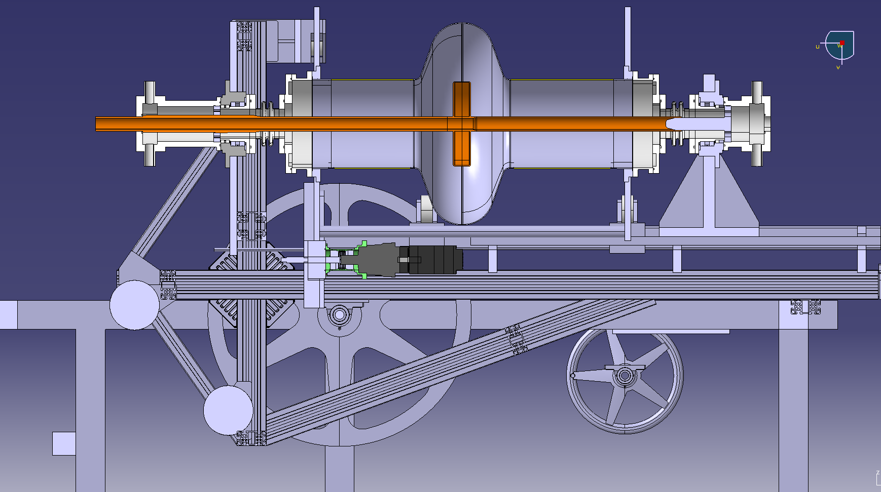

Slide 8
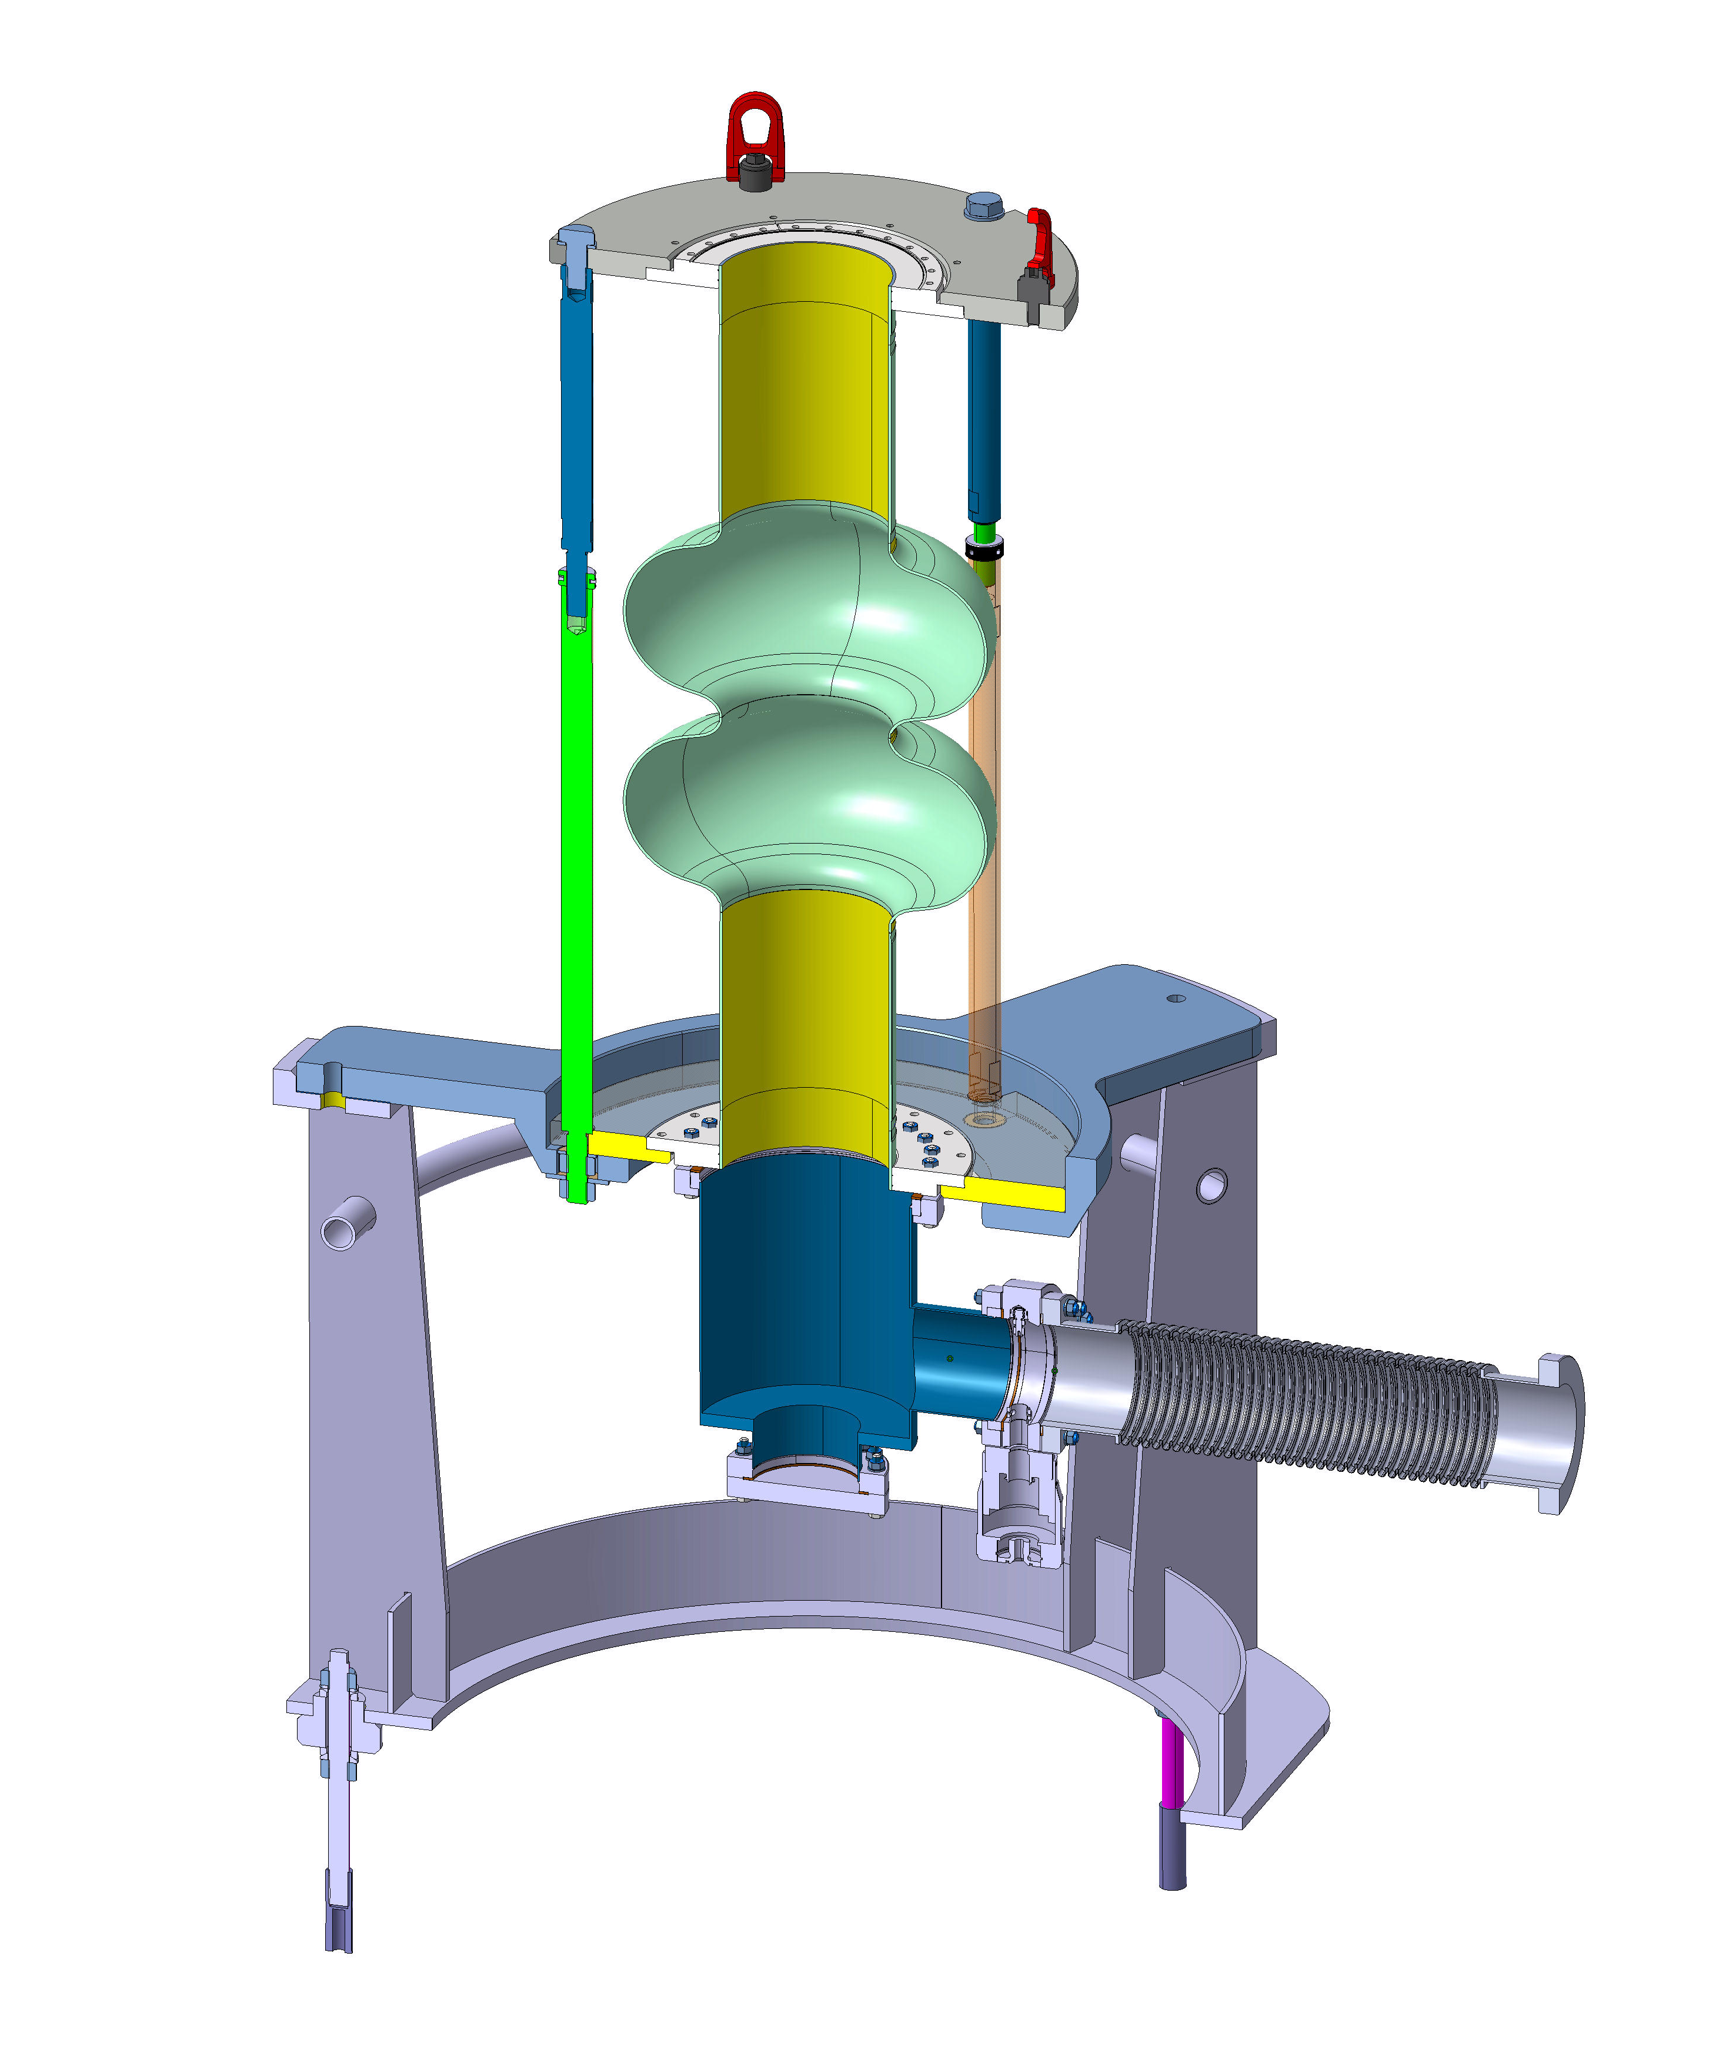

Slide 9
Update: WP4
New Annex 3 for revised scope with INFN (400 MHz 1-cell and 800 MHz 2-cell seamless, + 1 year, + extra €€€) drafted and under signature.
Unfortunately the full Collaboration agreement needs to be revised for legal reasons, and re-signed from all parties: CERN, INFN, STFC

