Slide 1
HOM power in RF cavities of FCC-ee rings
(old and new parameters)
Ivan Karpov
Acknowledgments: O. Brunner, A. Butterworth, R. Calaga, J. F. Esteban Müller, R. Rimmer, N. Schwerg, E. Shaposhnikova, D. Teytelman
FCC RF R&D coordination meeting 15 27.09.2017

Slide 2
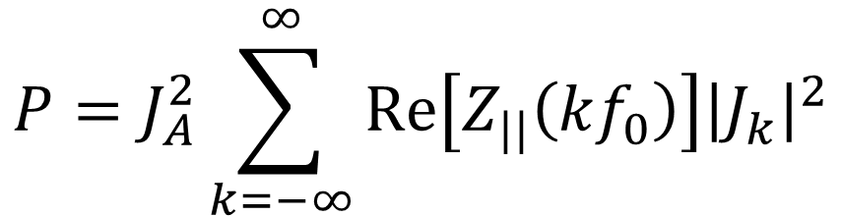
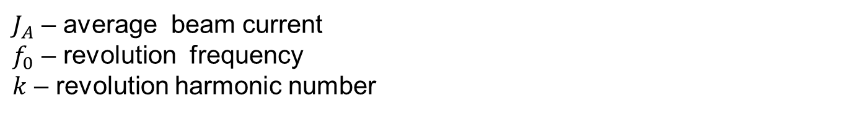
HOM power loss calculations
Normalized
Fourier harmonics
of beam current
Simulated cavity
impedance
$$P=J_{A}^{2}\sum_{k=−∞}^{∞}{Re\left[Z_{||}\left(kf_{0}\right)\right]{\left|J_{k}\right|}^{2}}$$
$J_{A}$ – average beam current
$f_{0}$ – revolution frequency
$k$ – revolution harmonic number
Estimations of the power loss are required to determine parameters for high order mode (HOM) absorbers.

Slide 3
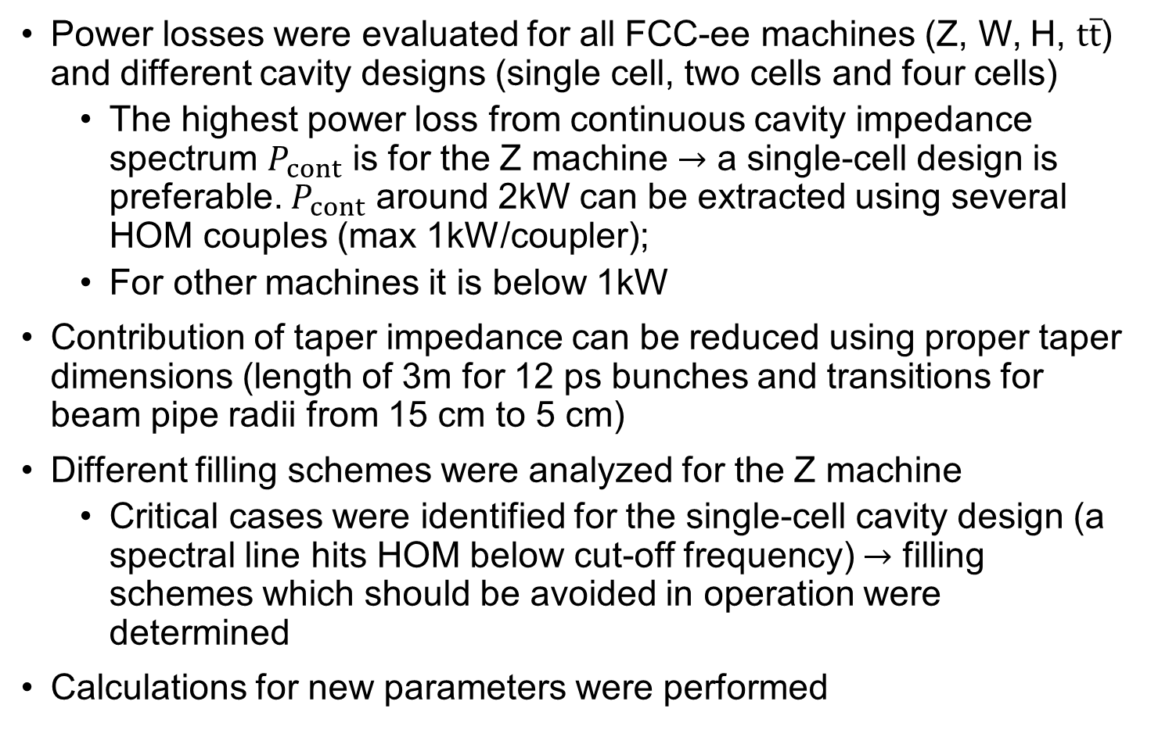
Recap on the progress
Power losses were evaluated for all FCC-ee machines (Z, W, H, $t\overline{t}$) and different cavity designs (single cell, two cells and four cells)
  The highest power loss from continuous cavity impedance spectrum $P_{cont}$ is for the Z machine $→$ a single-cell design is preferable. $P_{cont}$ around 2kW can be extracted using several HOM couples (max 1kW/coupler);
  For other machines it is below 1kW
Contribution of taper impedance can be reduced using proper taper dimensions (length of 3m for 12 ps bunches and transitions for beam pipe radii from 15 cm to 5 cm)
Different filling schemes were analyzed for the Z machine
  Critical cases were identified for the single-cell cavity design (a spectral line hits HOM below cut-off frequency) $→$ filling schemes which should be avoided in operation were determined
Calculations for new parameters were performed

Slide 4
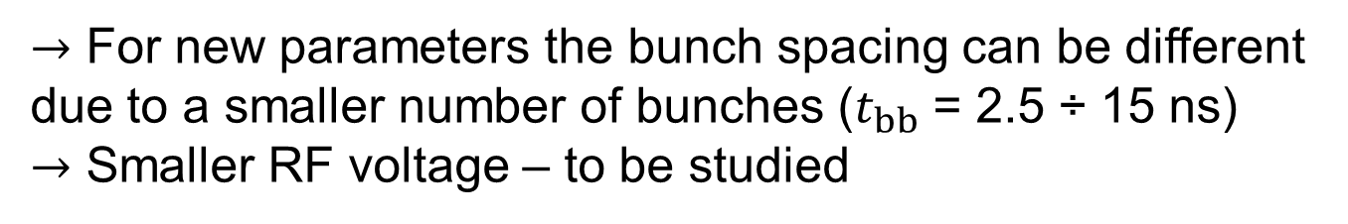
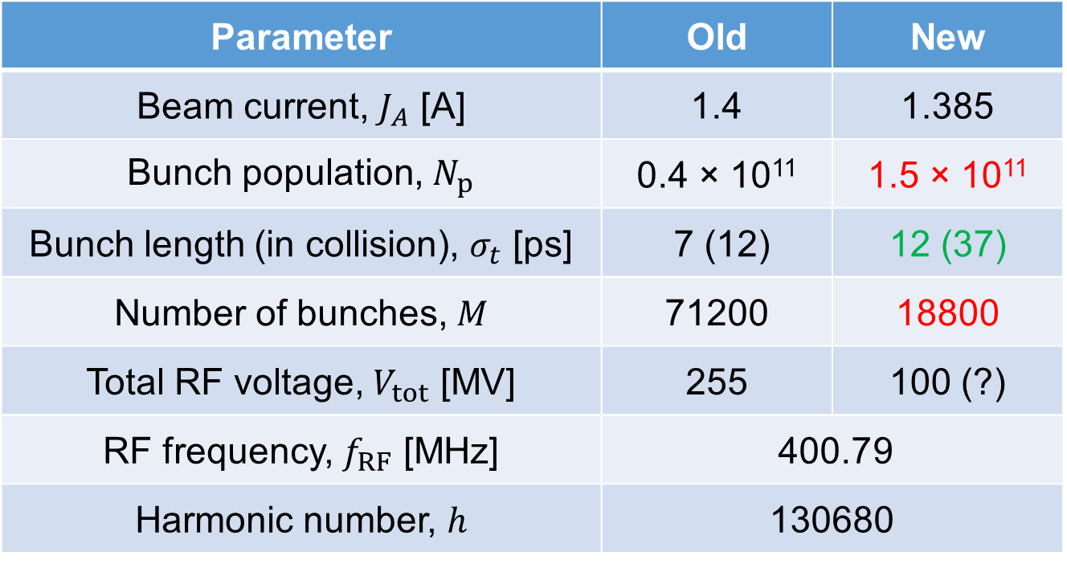
Parameters for Z machine
Parameter | Old | New
Beam current, $J_{A}$ [A] | 1.4 | 1.385
Bunch population, $N_{p}$ | 0.4 × 10¹¹ | 1.5 × 10¹¹
Bunch length (in collision), $σ_{t}$ [ps] | 7 (12) | 12 (37)
Number of bunches, $M$ | 71200 | 18800
Total RF voltage, $V_{tot}$ [MV] | 255 | 100 (?)
RF frequency, $f_{RF}$ [MHz] | 400.79
Harmonic number, $h$ | 130680
$→$ For new parameters the bunch spacing can be different due to a smaller number of bunches ($t_{bb}$ = 2.5 ÷ 15 ns)
$→$ Smaller RF voltage – to be studied

Slide 5
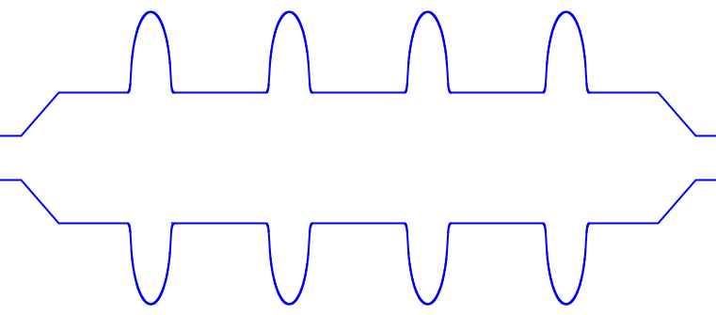




LHC-like layout of cryomodule
400 MHz LHC cavities with modified shape (input from R. Calaga)
Taper length, $L$
$$3λ/2$$
$b=50$ mm
$d=150$ mm
Taper-out
Taper-in
Impedance calculation using ABCI
Axisymmetric structure
+
Gaussian bunch
Wake potential
Impedance

Slide 6
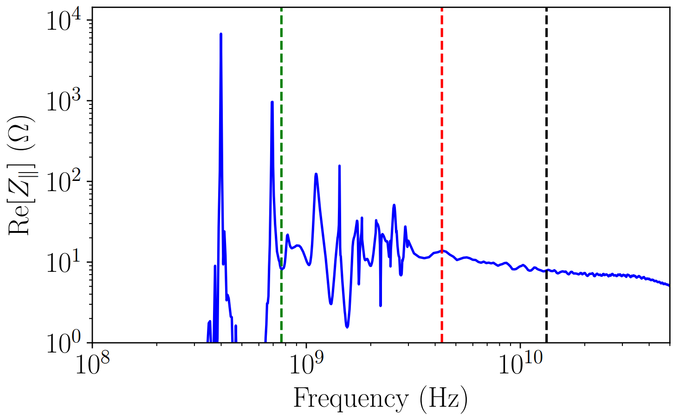
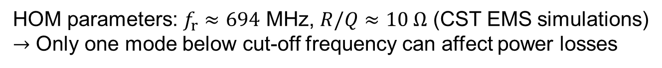
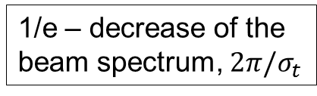
Single-cell cavity impedance
Cut-off frequency
1/e – decrease of the
beam spectrum, $2π/σ_{t}$
HOM
“Continuous”
spectrum
Fundamental mode
New (in collisions)
Old (in collisions)
HOM parameters: $f_{r}≈694$ MHz, $R/Q≈10 Ω$ (CST EMS simulations)
$→$ Only one mode below cut-off frequency can affect power losses

Slide 7
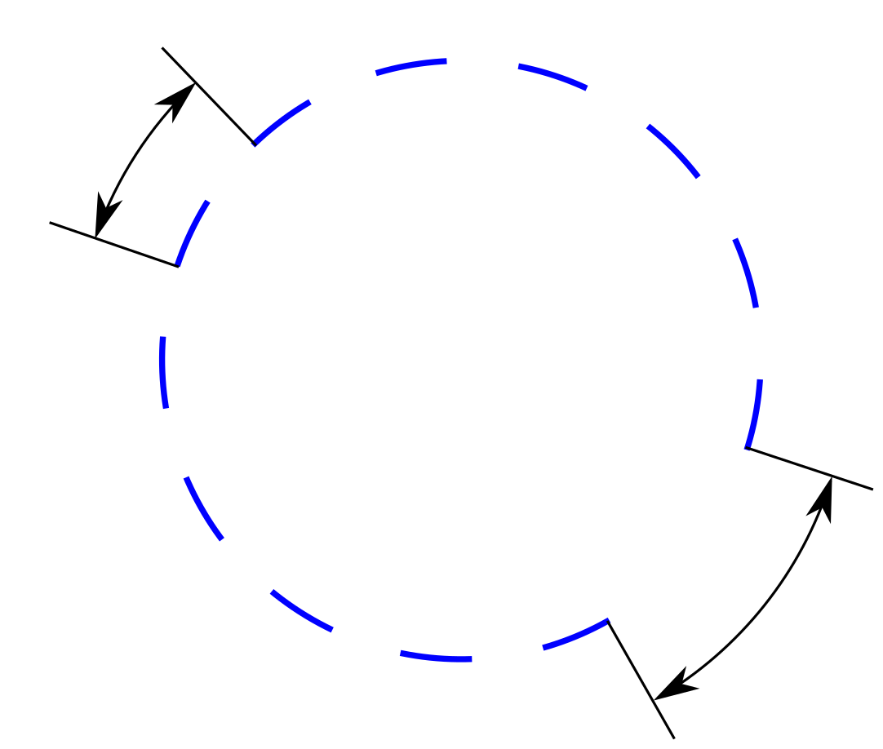
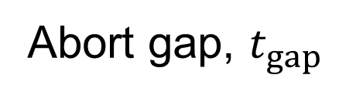
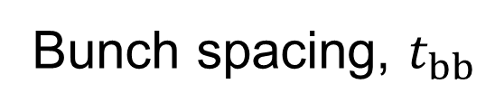
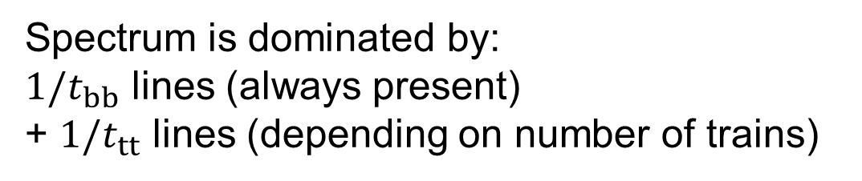
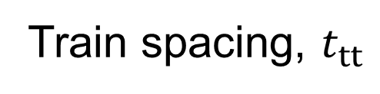
Beam spectrum for different filling schemes
Train spacing, $t_{tt}$
Bunch trains
Bunch spacing, $t_{bb}$
Abort gap, $t_{gap}$
Spectrum is dominated by:
$1/t_{bb}$ lines (always present)
+ $1/t_{tt}$ lines (depending on number of trains)

Slide 8
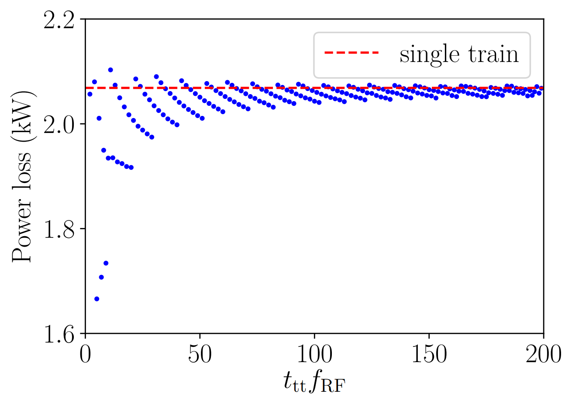
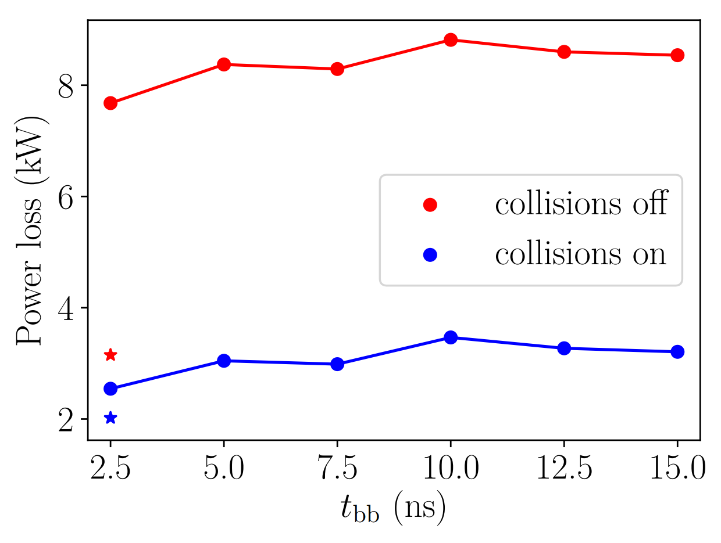
Power loss above cut-off frequency
Constant parameters: total current ≤ 1.4 A, abort gap length, bunch population
Variable parameters: number of bunches in the train, number of trains, train spacing
Old parameters + collisions on
Old parameters
Power loss is moderate for the present cavity design for bunches in collisions
There is a weak dependence on train spacing and bunch spacing

Slide 9
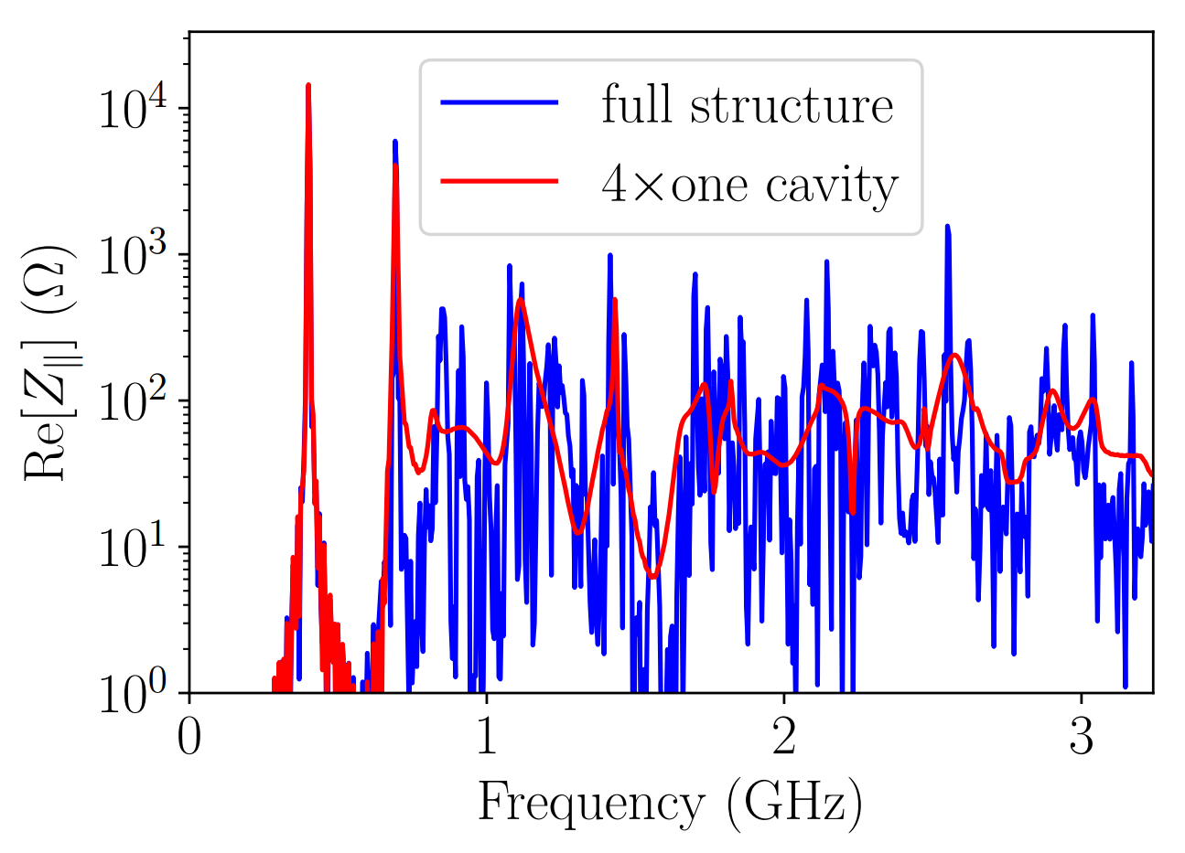
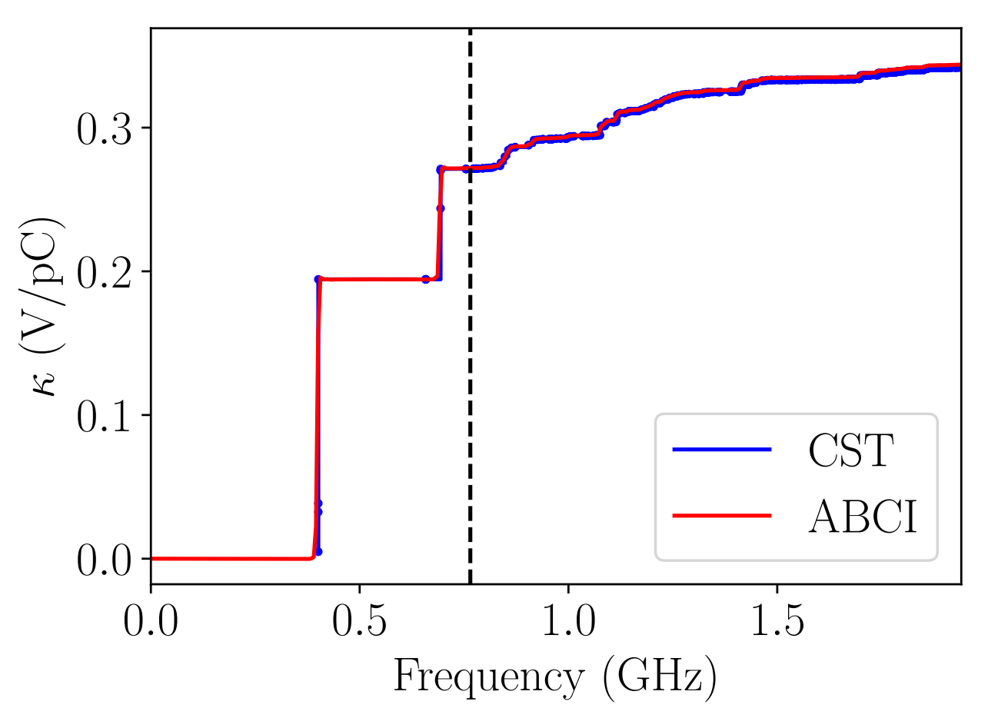
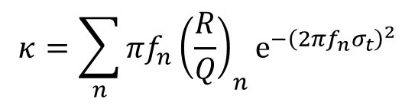
Impedance below 3 GHz
Four single-cell cavity displaced by 3λ/2 + 3 m long tapers from 15 cm to 5 cm
$$κ=\sum_{n}{{πf_{n}{\left(\frac{R}{Q}\right)}_{n}e}^{−{\left(2πf_{n}σ_{t}\right)}^{2}}}$$
For CST
There are still a few modes below cut-off frequency of the cavity with high R/Q.
Higher frequency HOMs have small R/Q values

Slide 10
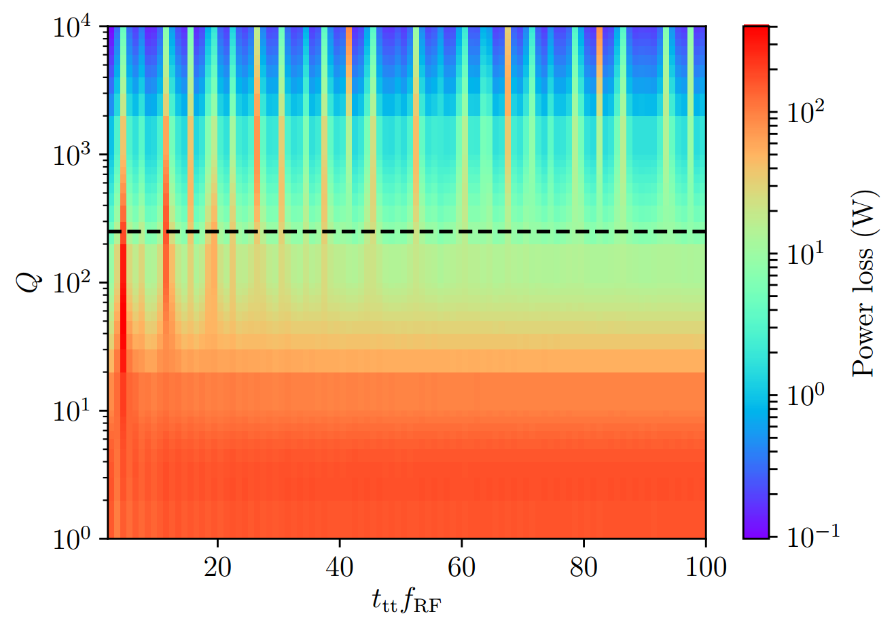

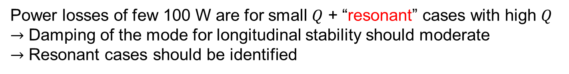
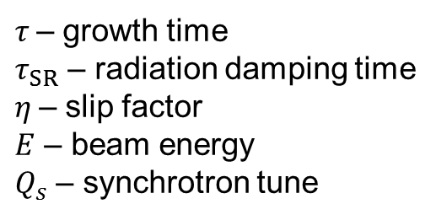


Power loss for HOM below cut-off frequency
For new parameters
Longitudinal coupled-bunch instability growth rate
$$\frac{1}{τ}=\frac{e\left|η\right|J_{A}}{2EQ_{s}}f_{r}R$$
If $τ>τ_{SR}$ $→$ stability
$τ$– growth time
$τ_{SR}$ – radiation damping time
$η$– slip factor
$E$ – beam energy
$Q_{s}$ – synchrotron tune
$f_{r}≈694$ MHz, $R/Q≈10 Ω$
Stability threshold for 1 MV/cavity accelerating gradient
Power losses of few 100 W are for small $Q$ + “resonant” cases with high $Q$
$→$ Damping of the mode for longitudinal stability should moderate
$→$ Resonant cases should be identified

Slide 11
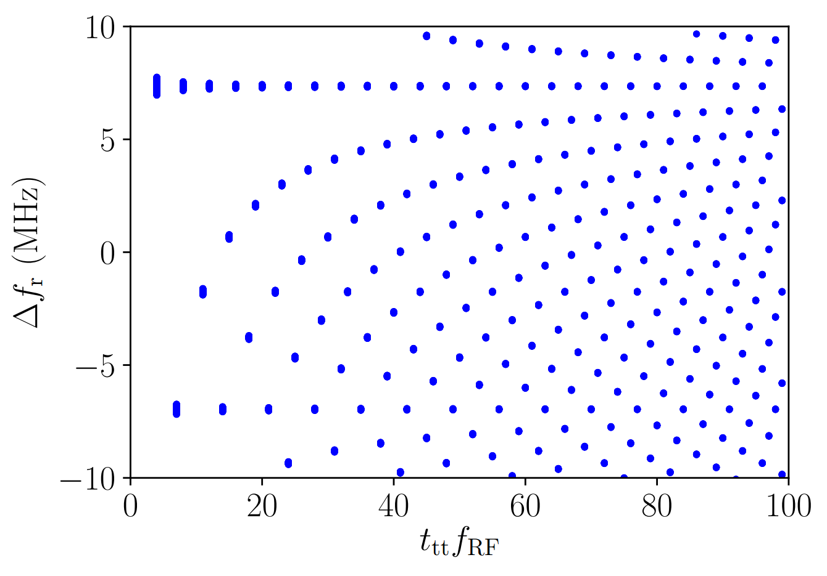

Shift of the resonant frequency
“Resonant” condition $\left|1−\frac{\left[f_{r}t_{tt}\right]}{f_{r}t_{tt}}\right|<\frac{1}{Q}$
→ There are many cases when the spectrum line hits the resonant line → Not all of them are dangerous

Slide 12
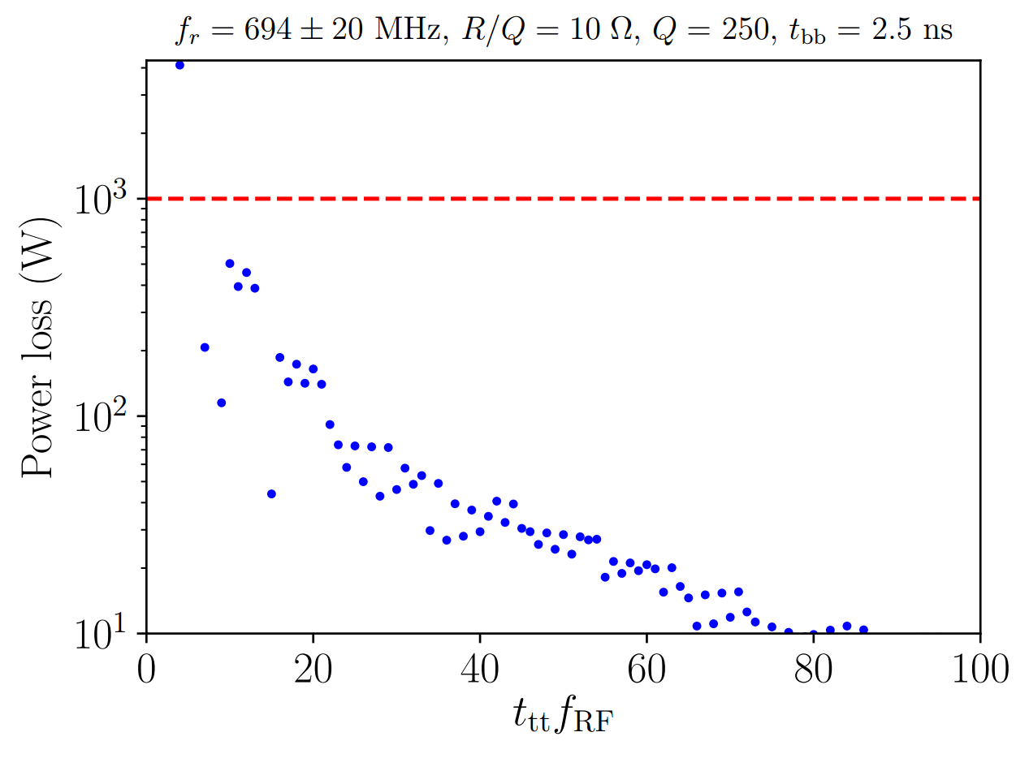
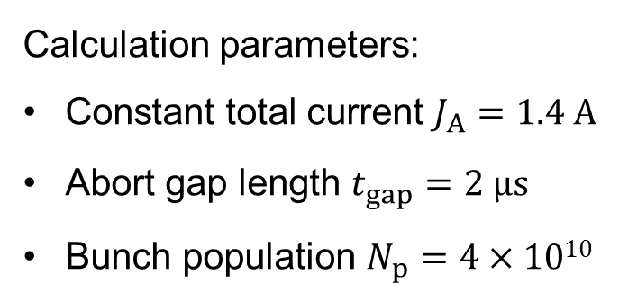
Power losses for old parameters
Calculation parameters:
Constant total current $J_{A}=1.4 A$
Abort gap length $t_{gap}=2 μs$
Bunch population $N_{p}=4×1010$
Max power extracted by a single HOM coupler
$→$ Damped HOM is not dangerous if ${t_{tt}f}_{RF}>4$

Slide 13
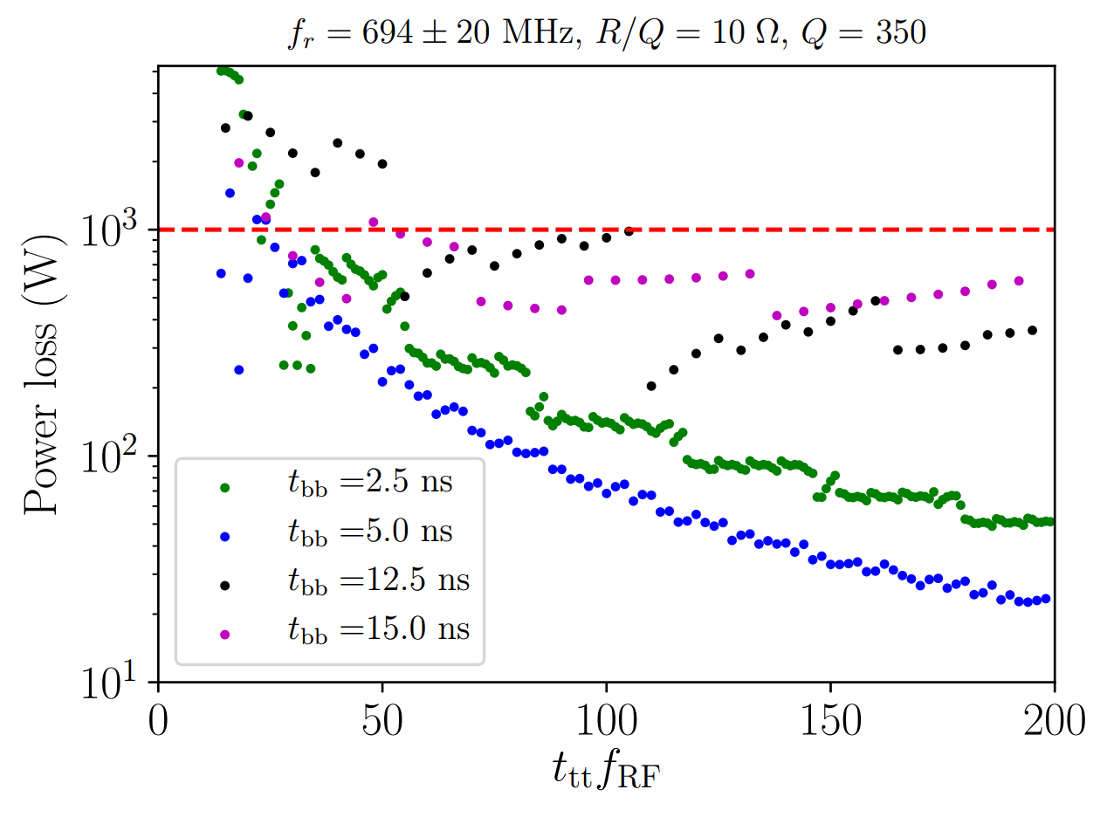
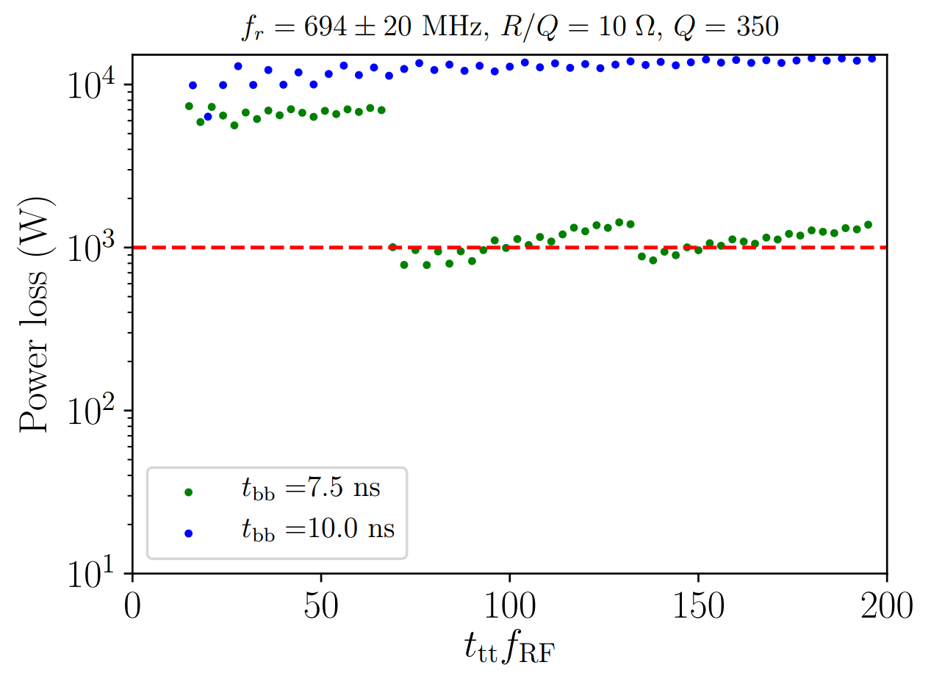
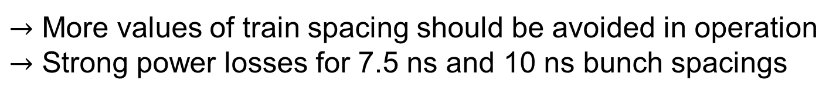
Power losses for new parameters
$→$ More values of train spacing should be avoided in operation
$→$ Strong power losses for 7.5 ns and 10 ns bunch spacings

Slide 14
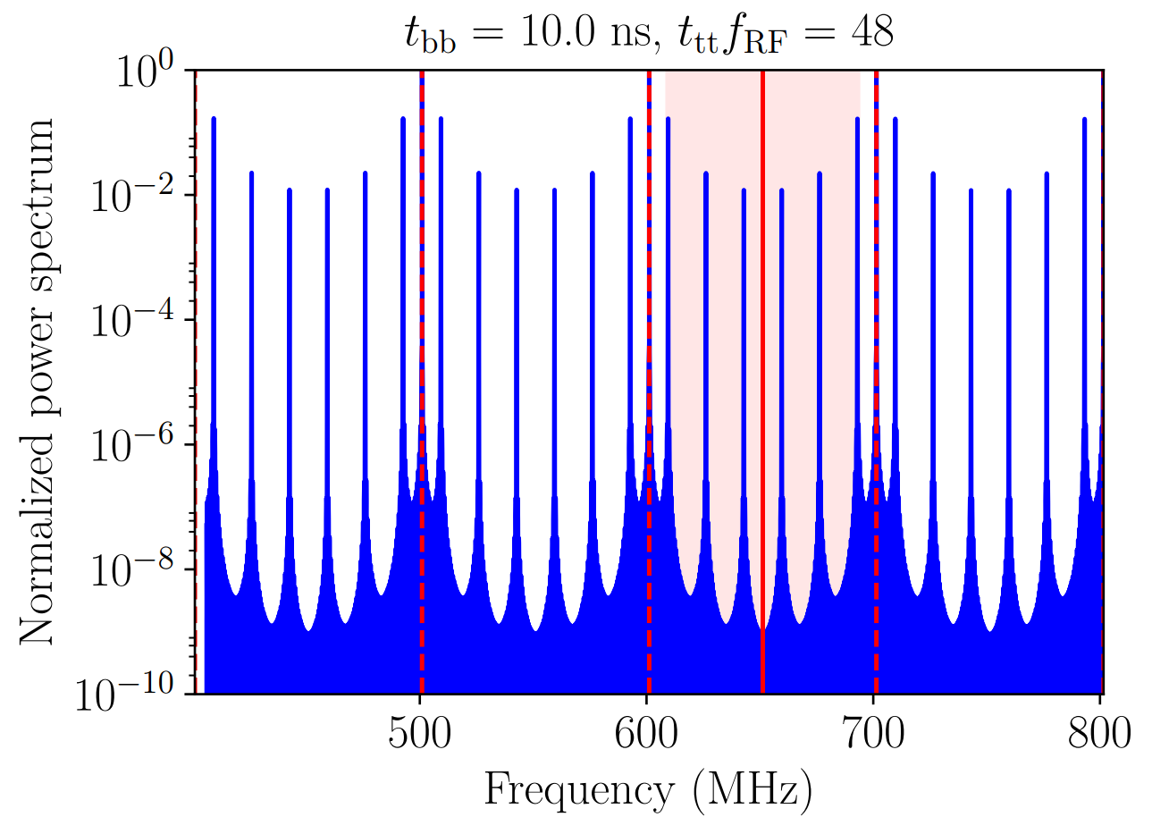
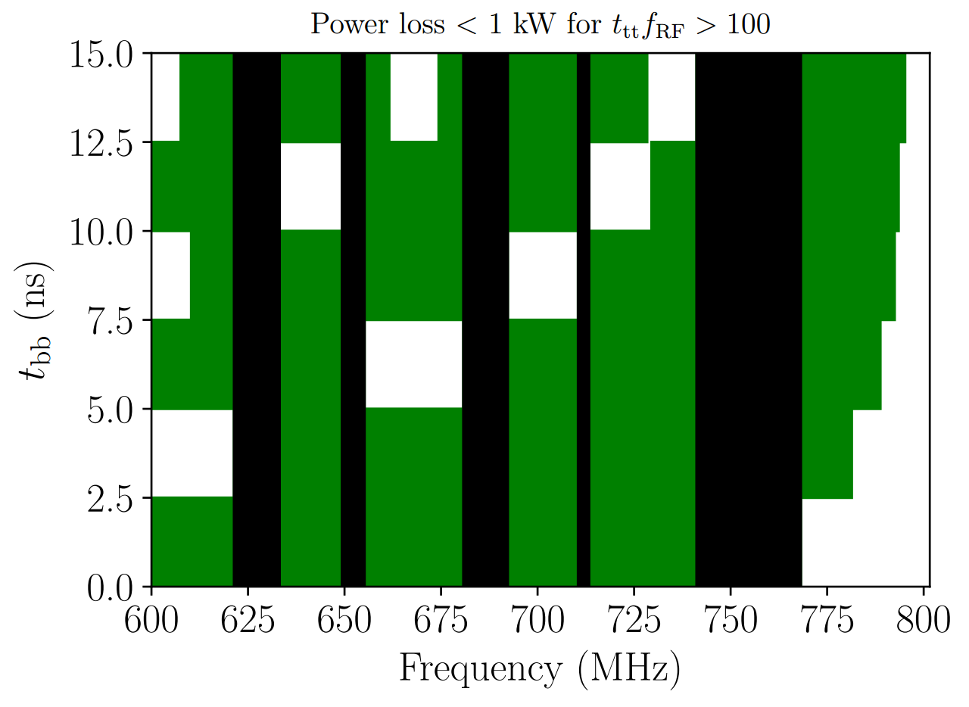
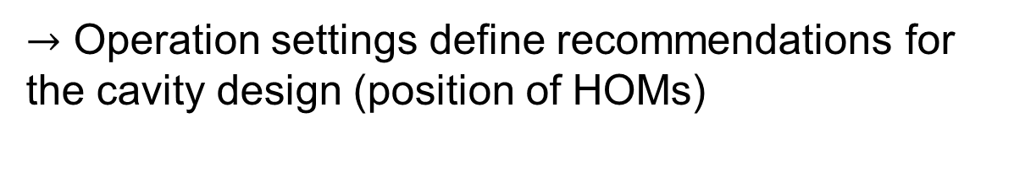


More “general” case
$$n/t_{bb}$$
$$f_{r}$$
Dangerous
Safe
Acceptable frequencies
$→$ Operation settings define recommendations for the cavity design (position of HOMs)

Slide 15
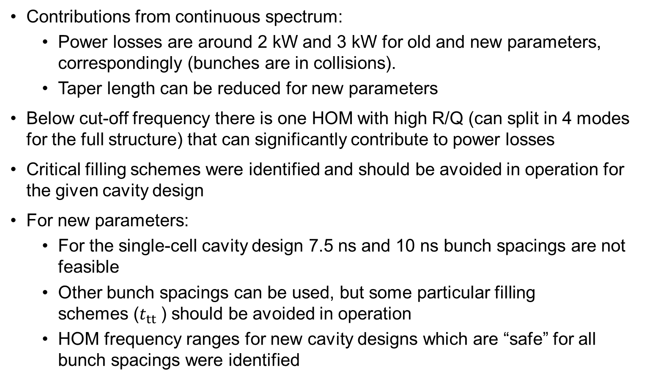
Summary of power loss for a single-cell cavity design for the Z machine
Contributions from continuous spectrum:
  Power losses are around 2 kW and 3 kW for old and new parameters, correspondingly (bunches are in collisions).
  Taper length can be reduced for new parameters
Below cut-off frequency there is one HOM with high R/Q (can split in 4 modes for the full structure) that can significantly contribute to power losses
Critical filling schemes were identified and should be avoided in operation for the given cavity design
For new parameters:
  For the single-cell cavity design 7.5 ns and 10 ns bunch spacings are not feasible
  Other bunch spacings can be used, but some particular filling
  schemes ($t_{tt}$) should be avoided in operation
  HOM frequency ranges for new cavity designs which are “safe” for all bunch spacings were identified

Slide 16
Thank you for your attention!

Slide 17
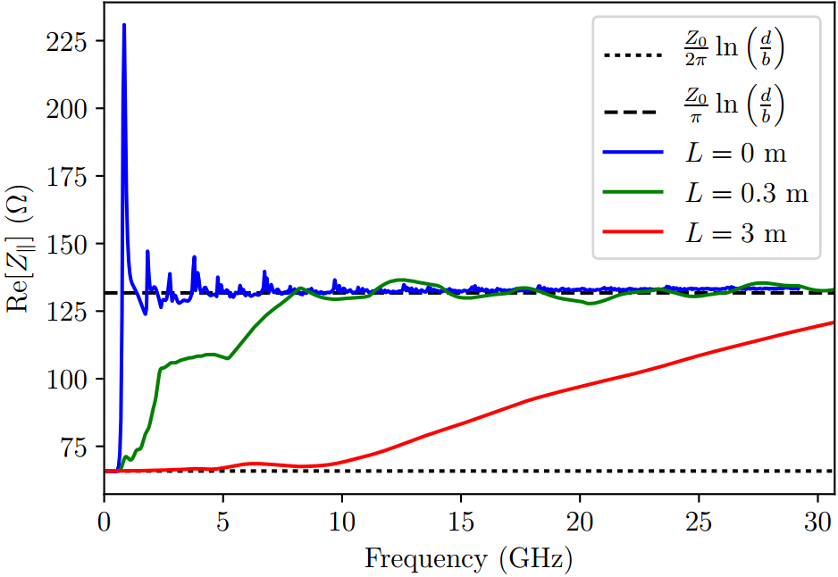
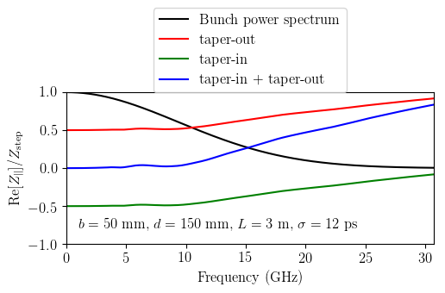
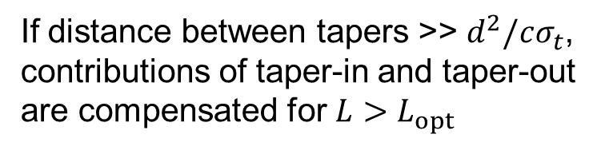
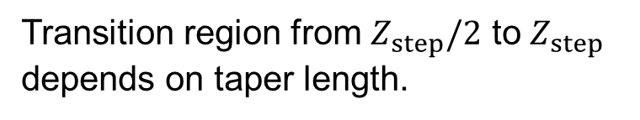
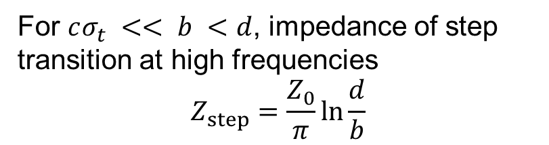

Contribution of tapers
For $cσ_{t} << b <d$, impedance of step transition at high frequencies
$$Z_{step}=\frac{Z_{0}}{π}\ln{\frac{d}{b}}$$
If distance between tapers >> $d^{2}/cσ_{t}$, contributions of taper-in and taper-out are compensated for $L>L_{opt}$
Transition region from $Z_{step}/2$ to $Z_{step}$ depends on taper length.
$$L_{opt}=\frac{{\left(d−b\right)}^{2}}{cσ_{t}}$$

Slide 18
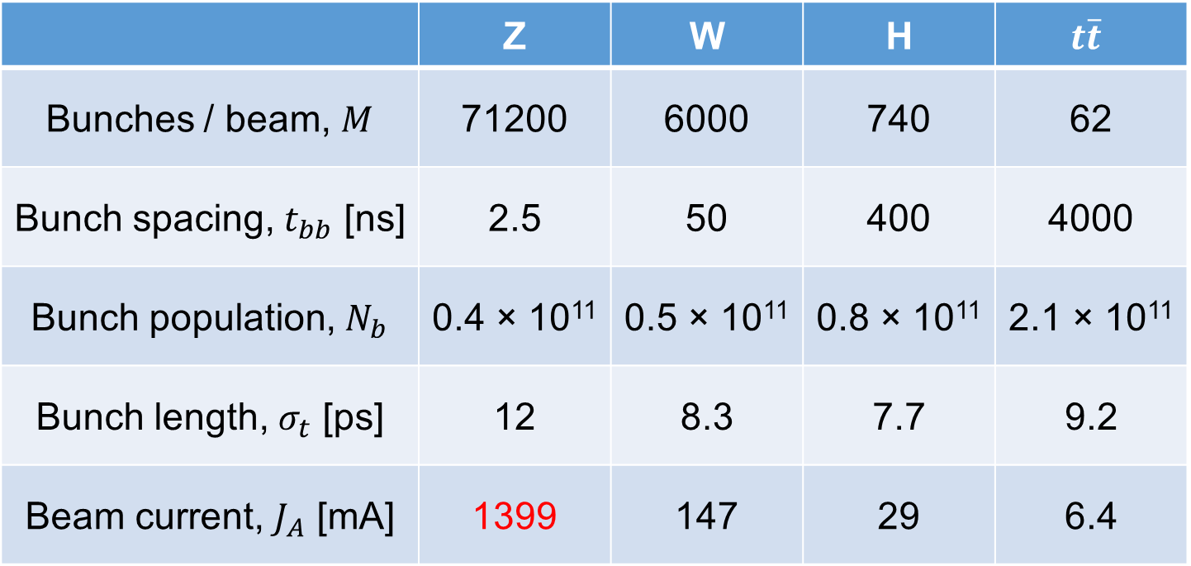
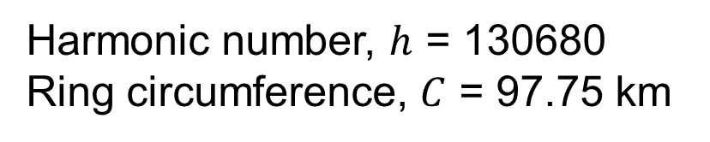
FCC-ee options
 | Z | W | H | $$t\overline{t}$$
Bunches / beam, $M$ | 71200 | 6000 | 740 | 62
Bunch spacing, $t_{bb}$ [ns] | 2.5 | 50 | 400 | 4000
Bunch population, $N_{b}$ | 0.4 × 10¹¹ | 0.5 × 10¹¹ | 0.8 × 10¹¹ | 2.1 × 10¹¹
Bunch length, $σ_{t}$ [ps] | 12 | 8.3 | 7.7 | 9.2
Beam current, $J_{A}$ [mA] | 1399 | 147 | 29 | 6.4
Harmonic number, $h$ = 130680
Ring circumference, $C$ = 97.75 km

