Slide 1
a-C coatings beyond the ITs
part 1: coat Q5R2 in YETS
P. Costa Pinto on behalf of (TE-VSC)
With contributions from B. Di Girolamo (ATS-DO), G. Ferlin and S. Claudet (TE-CRG) S. Le Naour (TE-MSC) and C. Adorisio (HSE-RP)
Outline:
Introduction
Why to coat Q5R2 in YETS
The technology is mature enough
Schedule & Resources
Risk assessment
Conclusions

Slide 2
1. Introduction
a-C coatings are in the HiLumi baseline to reduce heat load to the beam screens of the Inner Triplet magnets.
ITs for IP1 and IP5 have new design and the coating is integrated (deployed in the lab).
ITs for IP2 and IP8 have to be coated in-situ.
The in-situ coating technology is mature to go in the tunnel.
VSC proposes to coat Q5R2 during YETS. (with CRG support)

Slide 3
2. Why to coat Q5R2 in YETS
It’s a stepping stone before the large scale deployment of a-C in the Triplets in LS2 (16 magnets + 4 DFBX) :
it is the last opportunity before LS2;
allows to measure the heat load reduction;
disentangle photoelectron emission from electron multipacting.
The technology is mature enough.
Schedule & resources cope with YETS (CRG & VSC).

Slide 4
3. The technology is mature enough
Tested in the SPS
Coated e-cloud detector installed since 2008 maintains the initial performance (no e-cloud).
~ 300 meters of the SPS already coated. (Half coated in the laboratory during LS1 and half done in-situ during EYETS)
COLDEX confirms performance at low temperature
(no e-cloud, good vacuum behaviour)

Slide 5
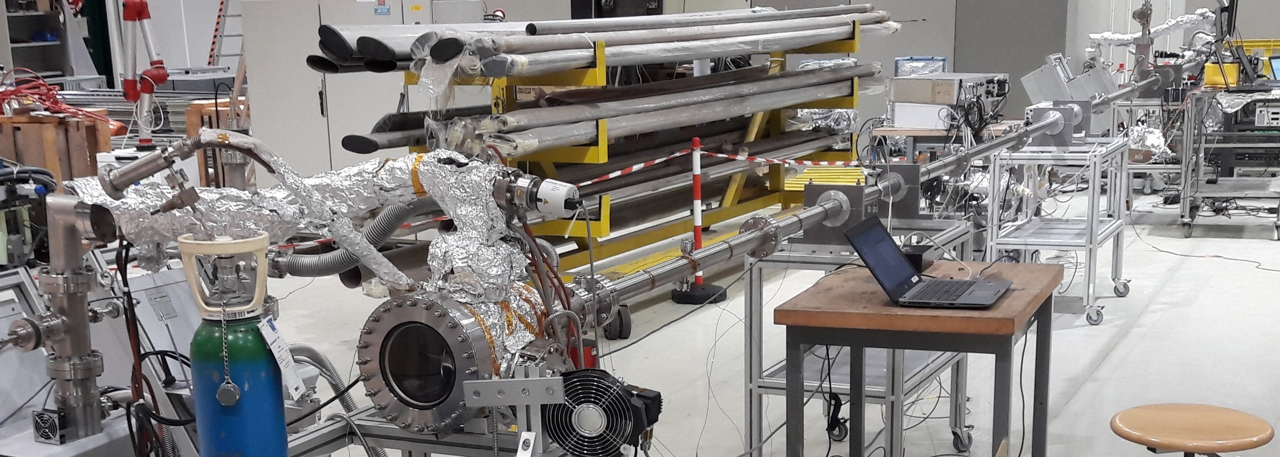
3. The technology is mature enough
Laboratory tests
Maximal SEY remains below 1.1 along 10 meters of BS

Slide 6
3. The technology is mature enough
Laboratory tests
Maximal SEY remains below 1.1 along 10 meters of BS
C ~90 nm
Ti ~500 nm

Slide 7
3. The technology is mature enough
Laboratory tests
Maximal SEY remains below 1.1 along 10 meters of BS
Good adhesion: peel-off never observed even after 10 thermal quenches from RT to 77K (dipping in LN2)
coating
Oxidized Cu
Yield strength of annealed copper ~50 MPa
10 x quench to 77K
Heavily contaminated
Glue dollies
Fresh
clean Cu
Passivated Cu
Cure 2h@150ºC
5 MPa =
50 Kgf/cm²
pull test

Slide 8
4. Schedule & Resources
Tasks
Remove He
6 days
Warm up
21 days
Open beam vac
1 day
Coating
10 days
Cool coated Mag to 20 K
7 days
Pumpdown
7 days
Close beam vac
1 day
Cool sector to 20 K
7 days
Cooldown to 1.9 K
14 days
ELQA tests
1 day
68 days
+ 9 contingency ~ 11 weeks

Slide 9
4. Schedule & Resources
Planning & resources
2017 | 2018
Dec | Jan | Feb | March
w50 | w51 | w52 | W1 | W2 | W3 | W4 | W5 | W6 | W7 | W9 | W10 | w11 | w12
1 | 2 | 3 | 4 | 5 | 6 | 7 | 8 | 9 | 10 | 11 | 12 | 13
Warmup
CRG+VSC
Coating
VSC
cool all 1.9K
CRG
Pump Mag
VSC
remove He
CRG
cool coated Mag 20K
CRG
Start hardware commissioning
ELQA
Working
during
Annual closure
cool sector 20K
CRG

Slide 10
4. Schedule & Resources
Planning & resources
2017 | 2018
Dec | Jan | Feb | March
w50 | w51 | w52 | W1 | W2 | W3 | W4 | W5 | W6 | W7 | W9 | W10 | w11 | w12
1 | 2 | 3 | 4 | 5 | 6 | 7 | 8 | 9 | 10 | 11 | 12 | 13
Warmup
CRG+VSC
Coating
VSC
cool all 1.9K
CRG
Pump Mag
VSC
remove He
CRG
CRG & VSC can ensure the required manpower
cool coated Mag 20K
CRG
Start hardware commissioning
ELQA
Working
during
Annual closure
cool sector 20K
CRG

Slide 11
5. Risk assessment
Bad SEY (>1.2): the coating will condition faster than the Cu surface.
V. Baglin
LHC report 471
CERN 2001
R. Larciprete
ECLOUD12
2012
Threshold for the IT
“bad SEY”
a-C

Slide 12
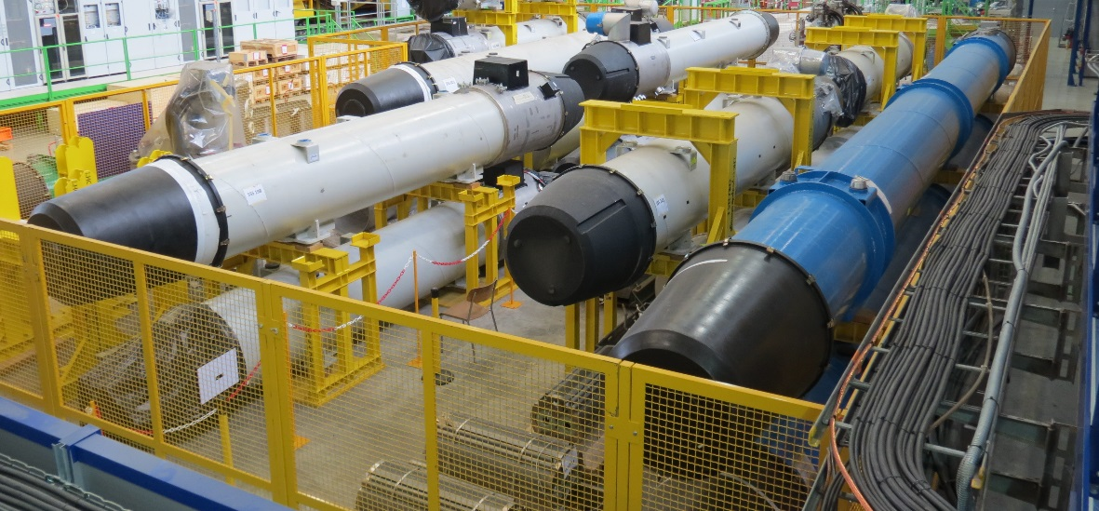
5. Risk assessment
Bad SEY (>1.2): the coating will condition faster than the Cu surface.
Real size deployment on a BS already exposed to the beam is scheduled for October 2017 (MB1007).
removed from LHC in LS1 and kept in air since then.
MB1007

Slide 13
5. Risk assessment
Bad SEY (>1.2): the coating will condition faster than the Cu surface.
Real size deployment on a BS already exposed to the beam is scheduled for October 2017 (MB1007).
21 days for warming up to be confirmed.
No concerns with the RF fingers.

Slide 14
6. Conclusions
To coat Q5R2 is an important stepping stone to go for the Triplets. (Do it in 1 before going for 20)
YETS 2018 is the last opportunity before LS2.
The technology is mature enough.
Mandatory tests before going to the tunnel: coat & test MB1007 and verify warmup in 21 days.
Still hard work ahead but we’re confident.

Slide 15

6. Conclusions
Still hard work ahead but we’re confident.

Slide 16
6. Conclusions
To coat Q5R2 is an important stepping stone to go for the Triplets. (Do it in 1 before going for 20)
YETS 2018 is the last opportunity before LS2.
The technology is mature enough.
Mandatory tests before going to the tunnel: coat & test MB1007 and verify warmup in 21 days.
Still hard work ahead but we’re confident.

Slide 18
Resistance to radiation

Slide 19
3. The technology is mature enough
Resistance to radiation & adhesion
Doses calculated by F. Cerutti (whole life of HiLumi):
1 GGy for triplets in IP1 and IP5
100 MGy for IP8 (and negligible for IP2)
At the time, a-C for LHC was not available => tests in SPS type a-C coating
a-C coating for SPS
C ~ 400nm
C / Cu oxidised
Copper

Slide 20
3. The technology is mature enough
Resistance to radiation & adhesion
Doses calculated by F. Cerutti (whole life of HiLumi):
1 GGy for triplets in IP1 and IP5
100 MGy for IP8 (and negligible for IP2)
At the time, a-C for LHC was not available => tests in SPS type a-C coating
Test 1 @ TRAD
IP8
5 MPa = 50 Kgf/cm²
Test 2 @
Uni Padova
200 MGy
IP1 & IP5
1GGy
1GGy

Slide 21
3. The technology is mature enough
Resistance to radiation & adhesion
Doses calculated by F. Cerutti (whole life of HiLumi):
1 GGy for triplets in IP1 and IP5
100 MGy for IP8 (and negligible for IP2)
What is different for LHC type a-C?
a-C coating for LHC
2 interfaces
C / Ti^{M}
Ti / Cu oxidised
Gradient of composition and carbide bonding:
Good adhesion and stable.
C ~ 50nm
Ti
~ 500nm
Ti mixes with Cu oxide: good.
Thinner is the Ti, lower the stresses, better the adhesion
Copper

Slide 22
SEY along 10 meters

Slide 23

3. The coating process
1 spool for mechanical cable
+
2 spools for electrical cables
1 spool for mechanical
cable
Cold bore + beam screen
Ar injection
1st step: Ti pre-coating
Turbo molecular
pump
10 meters

Slide 24
3. The coating process
1 spool for mechanical cable
+
2 spools for electrical cables
1 spool for mechanical
cable
Cold bore + beam screen
Ar injection
1st step: Ti pre-coating
Turbo molecular
pump
2st step: carbon coating ~90 nm (with Ti flashes)
10 meters

Slide 25
3. The coating process
Results from runs in 10 m BS
Required by HL-LHC
No bakeout: Ti 400 nm + 200 nm (flashes)
To Bake is excluded for YETS but under study for LS2
With bakeout: Ti 100 nm + 200 nm (flashes)

Slide 26
Particle generation

Slide 27
2- State of the art of the in-situ a-C coatings
Particle generation
Tests for the SPS: no difference between coated and uncoated beam pipes.
1 coated with carbon
Particle counter:
2 StSt tubes measured in clean-room
both measured again in clean-room
1 reference (in the lab. with plastic covers)
No increase after shaking and gentle hammering the chamber.
No increase for a chamber left in air for months. (flanges closed)
New particle counter setup and procedure being implemented: the goal is to measure in beam screens.

Slide 28
COLDEX

Slide 29
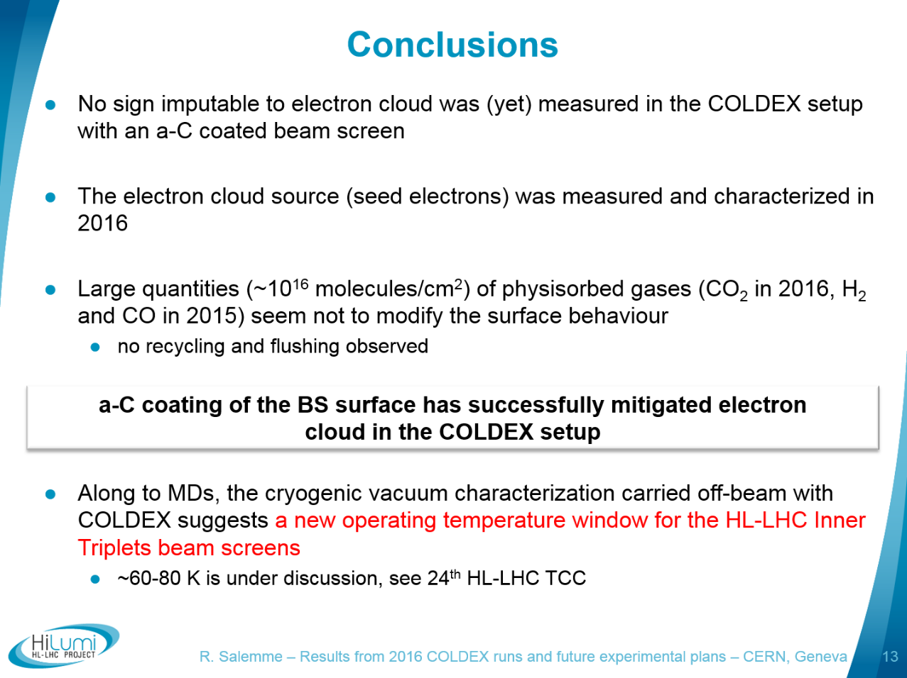
2- State of the art of the in-situ a-C coatings
a-C carbon tested in COLDEX
By R. Salemme

Slide 30
Sputtering source

Slide 31
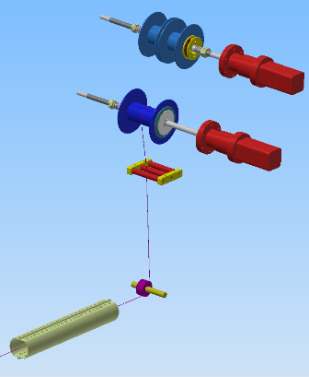
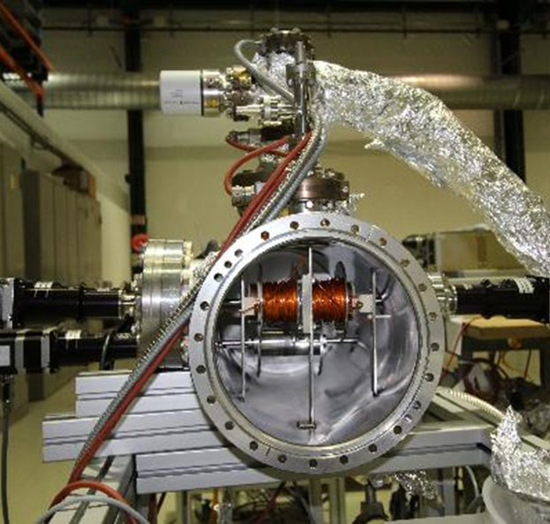
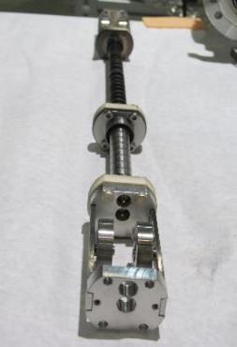
3. Application to accelerators: LHC
Development of the coating source
Displacement of the sputtering source.
Magnetron sputtering

Slide 32
Scenarios for LS2&LS3

Slide 33
4- Planning & resources
Coat BS already exposed to LHC beam (MB1007)
Not OK
Implement in-situ surface pre-processing
Ion etching
10/2017
UV lamps
OK
Possible to warmup Q2R2 in 21 days?
Are the 2 coating setups ready on time?
Coat Q5R2 (?)
YETS 2018
CRG
VSC
OK
CRG
MSC
VSC
25 weeks
(1 physicist + 1 technician + 2 coating setups)
ITs
LS2
or
LS3?
Beyond ITs
20 weeks
(1 physicist + 1 technician + 2 coating setups)
CRG
VSC

Slide 34
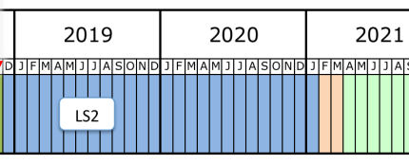
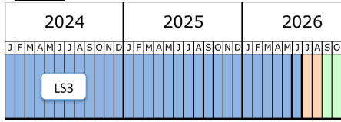
4- Planning & resources
LS2
LS3
1
BITs
ITs
1 team => 6 mSv
BITs
team 1 => 2 mSv
2
ITs
team 2 => 4 mSv
3
ITs
1 team => 4 mSv
BITs
1 team => 10 mSv
4
BITs
ITs
1 team => 30 mSv
BITs
team 1 => 10 mSv
5
ITs
team 2 => 20 mSv

Slide 35
Choice of the magnet

Slide 36
5. Choice of the magnet to coat
Outcome from VSC and CRG iterations
Advantages:
no opening of interconnects required;
degraded insulation vacuum can be repumped to avoid cold spots on QRL jumper vacuum barrier.
Standalone
(Q6 or Q5)
Advantage:
Can observe results in dipole and quad;
Doublet
(Q4/D2 pair)
Disadvantages:
requires opening of interconnect, cutting of PIM, addition of cryo instrumentation.
PIM welding & cryostat closure cannot be started until aC coating is compete;
more beam screens to coat (in series).

Slide 37
5. Choice of the magnet to coat
Outcome from VSC and CRG iterations
Standalone
(Q6 or Q5)
Sector 7-8 & 2-3 are targeted by CRG for heat load balancing strategy.
Q6L8, Q6R2 attached to arc cryostat so insulation vacuum cannot be degraded for cryo warmup.

Slide 38
5. Choice of the magnet to coat
Outcome from VSC and CRG iterations
Standalone
(Q6 or Q5)
Sector 7-8 & 2-3 are targeted by CRG for heat load balancing strategy.
Q6L8, Q6R2
Q6R7, Q6L3 difficult access.

Slide 39
5. Choice of the magnet to coat
Outcome from VSC and CRG iterations
Standalone
(Q6 or Q5)
Sector 7-8 & 2-3 are targeted by CRG for heat load balancing strategy.
Q6L8, Q6R2
Q6R7, Q6L3
Q5L8 has cryo instrumentation problem and a non-conformity with missing cryosorber on beamscreen.

Slide 40
5. Choice of the magnet to coat
Outcome from VSC and CRG iterations
Standalone
(Q6 or Q5)
Sector 7-8 & 2-3 are targeted by CRG for heat load balancing strategy.
Q6L8, Q6R2
Q6R7, Q6L3
Q5L8
Q5R2 chosen as baseline (for now… CRG still inquiring)

Slide 41
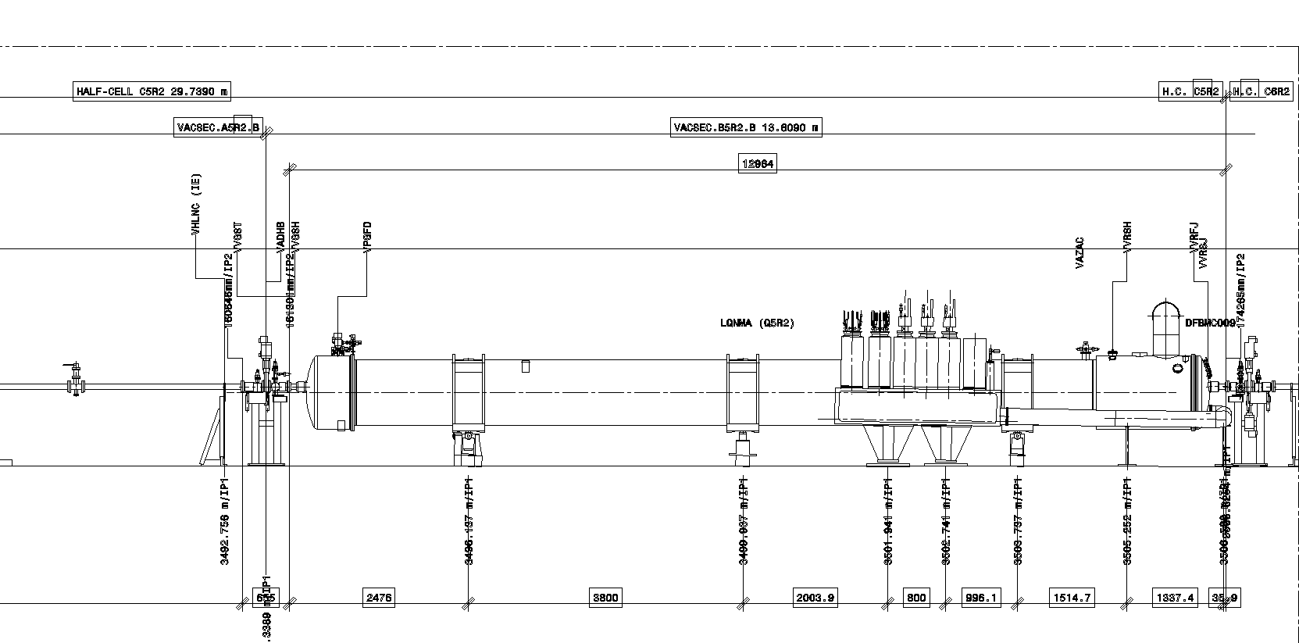
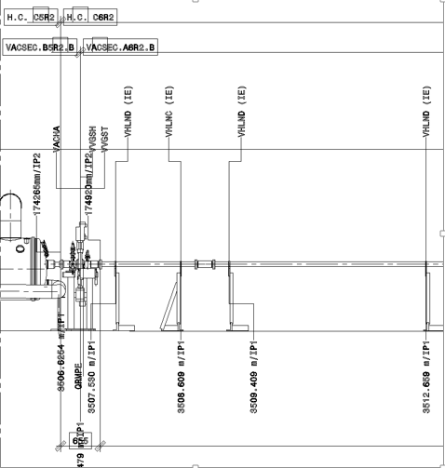
5. Choice of the magnet to coat
Outcome from VSC and CRG iterations
Q5R2 layout

Slide 42
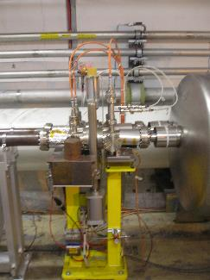
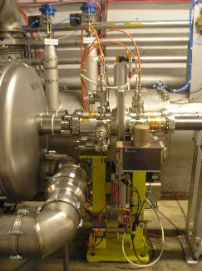
5. Choice of the magnet to coat
Outcome from VSC and CRG iterations
Q5R2 layout
320 mm
320 mm

