Slide 1
Cost & Schedule Review for the
Radiation to electronics Project
S. Claudet, identified as HL-LHC stakeholder
A.O.B at HL-TCC#37, 21Sept’17

Slide 2
Global overview
12-13 October 2017
From mitigation (Run1-LS1) to prevention, with qualification Run2-LS2 to prepare for Run3 and beyond
Evaluate organisation, staff, budget and schedule for the support group (central team for common parts & approaches) and equipment groups (specific hardware)

Slide 3
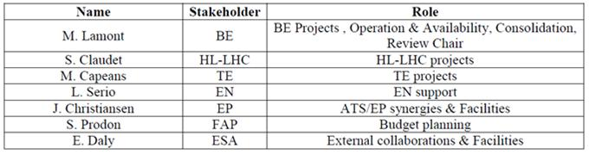
Panel Members

Slide 4
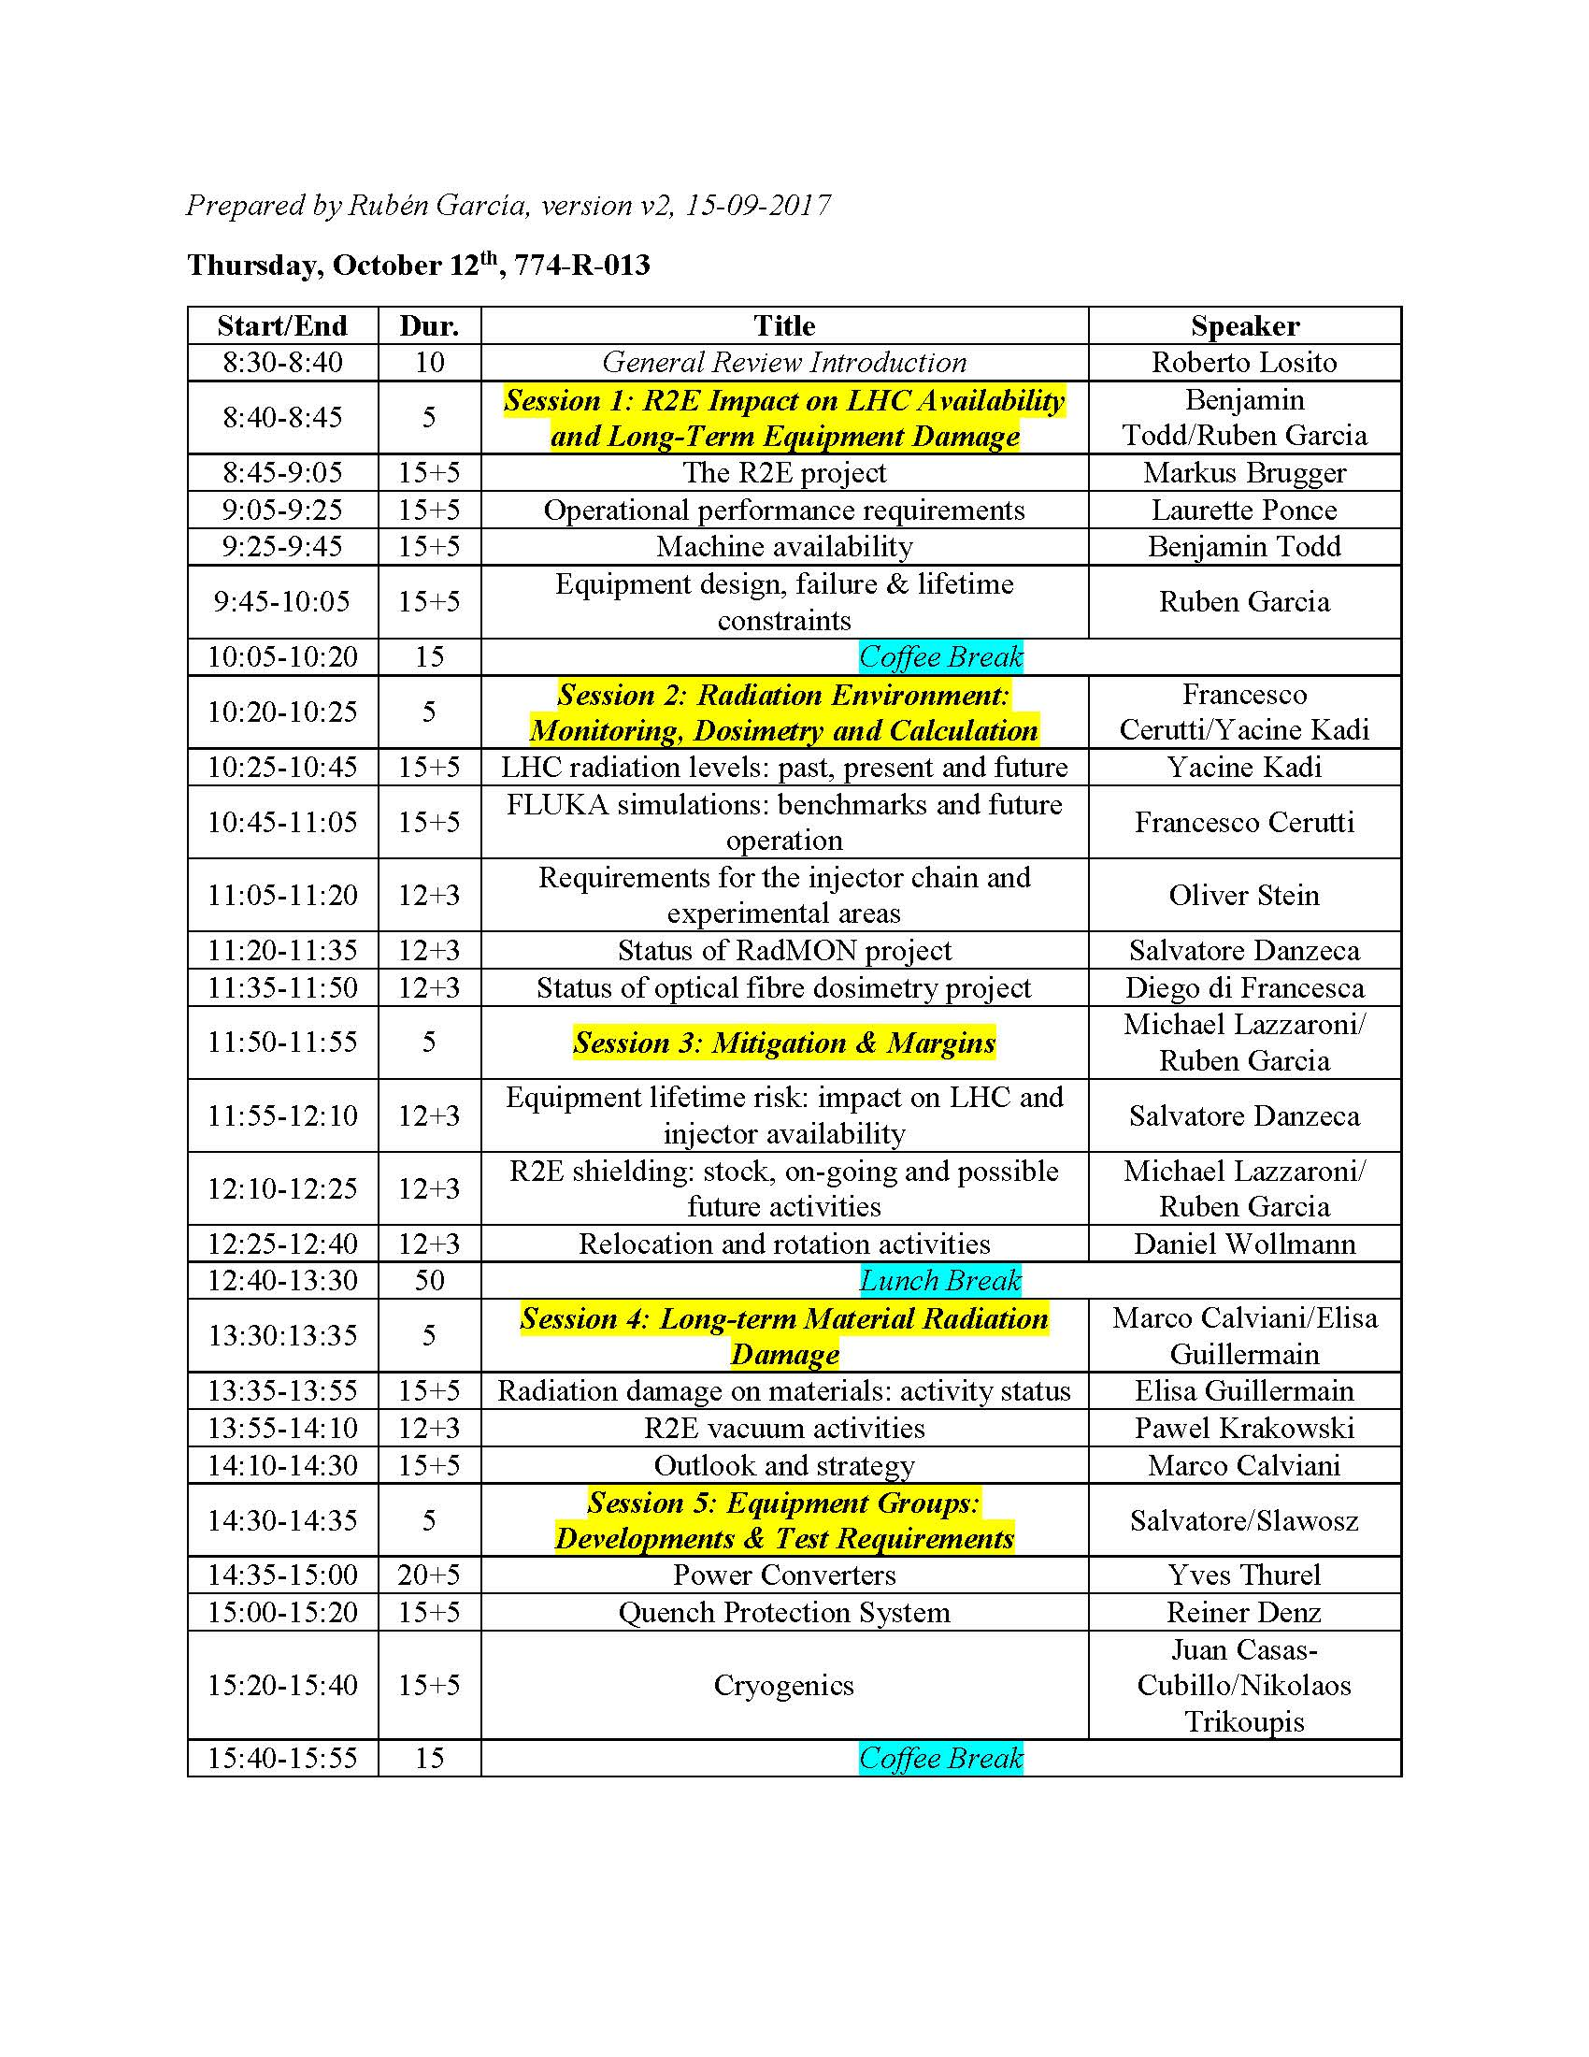

Slide 5
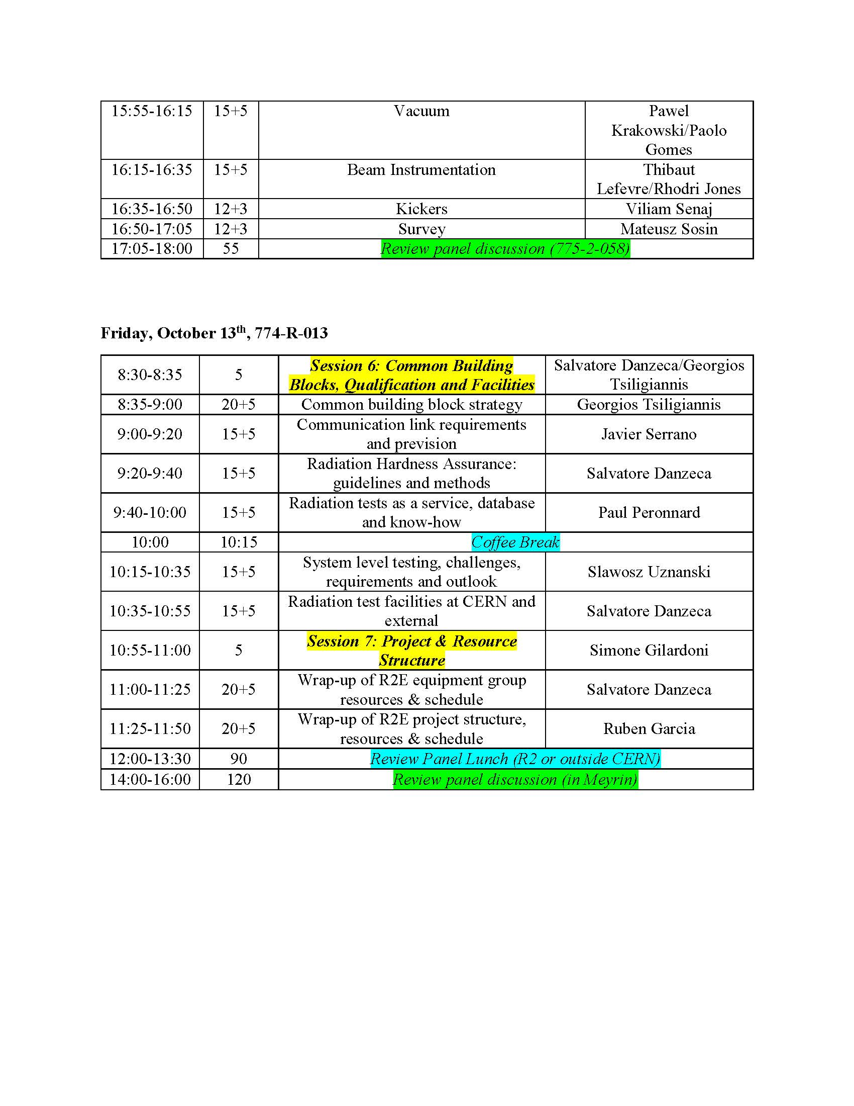

Slide 6
Help me to help you, your activities and the HiLumi project, in the most efficient way !!!
(relevant for your WP Y/N, level of involvement so far, specific views and suggestions)
The better prepared, the less risk to miss an important point

