Slide 2
EDMS folder for dependability studies
Miriam Blumenschein - RAS Working Group Meeting -
28.09.2017

Slide 3

EDMS folder for dependability studies
Purpose
  Prevent data loss, final report is not enough
  Sharing information
  Having quick access to information
  Overview of the performed studies and related literature
Public access: visible to everyone
Maintained by: Odei Rey Orozco, Miriam Blumenschein
EDMS: CERN Departments ► TE Department ► MPE ► Activities ► Dependability Studies
Once a dependability study is finished, send the final report, reliability software files, presentations and supporting documents to Odei or Miriam

Slide 4
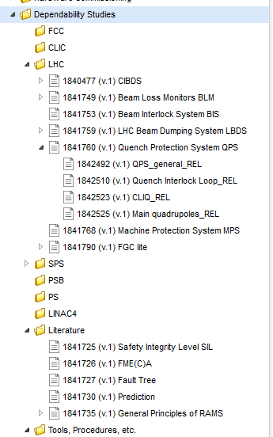
Structure
Performed dependability studies:
Standards, books, papers about dependability methodologies
Isograph report files, …
Accelerator
Subsystem
Dependability Study

Slide 5
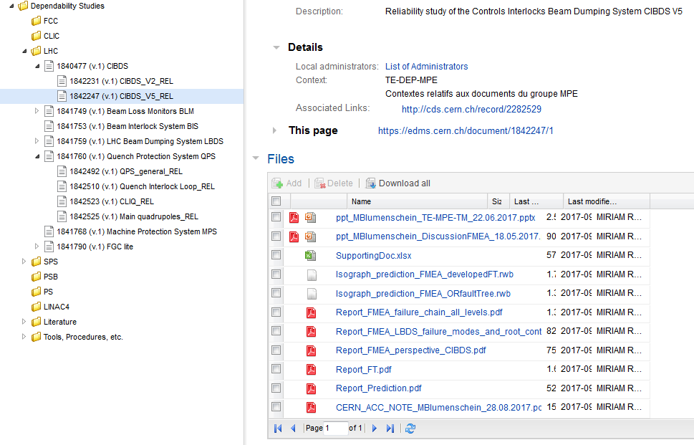
Files related to a study
Title
Link to CDS document
Files related to the dependability study
Final report
Isograph flies
Presentations
Supporting docs
Isograph reports

Slide 6
EDMS dependability folder in short
Collection
of CERN wide dependability studies
your dependability study to Odei or Miriam
Do you know about other dependability studies performed in your section or in your group?
Please send
Spread the word !

