Slide 1



10 Years
Gentner Programme
Before 2007
  very few German Doctoral Students at CERN (~2)
  early ideas how to increase number of Students discussed in various committees
    DAC Committee (representing Germans @ CERN)
    KET Committee (representing high energy physics community in Germany)
Conclusion
  need a German Doctoral Student Programme similar to Austrian Doctoral Student Programme
    Austrian Programme was introduced 1993/94
    very successful, about ¼ of former Austrian Students stayed at CERN
    fraction of staff = budget contribution (2.2%)

Slide 2
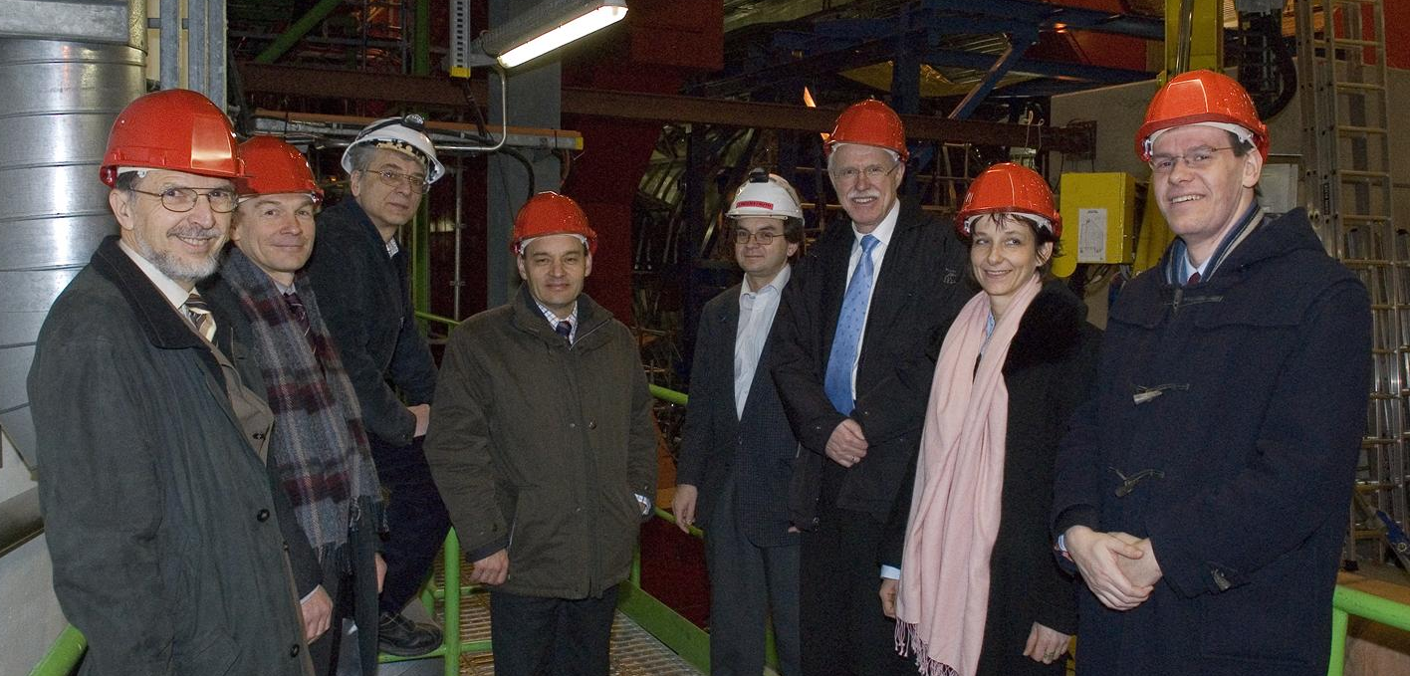
10 Years
Gentner Programme
Early 2007
  working groups formed at CERN and in Germany
  BMBF becomes interested
February 2007
  CERN visit of BMBF State Secretary Meyer-Krahmer
  important topic
    make better use of CERN by German Universities and Research Centres
  “Nutzungsinitiative” established (now the ball started rolling…)
    decision to create a German Doctoral Student Programme funded by BMBF (among other measures)

Slide 3
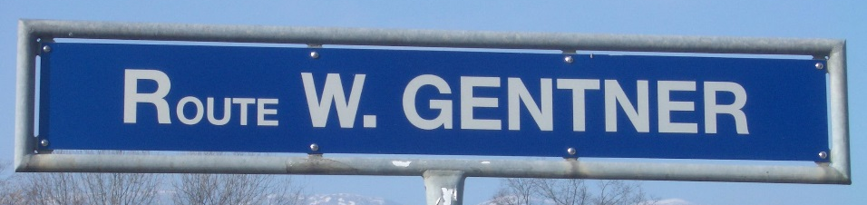
10 Years
Gentner Programme
Preparation phase
  how to organize
    meetings, discussions, documents…
  find a proper name
    → Wolfgang Gentner Programme
First Gentner Agreement signed September 2007
  3 parties involved: BMBF – CERN – DESY
    Programme Coordination by DESY (Manfred Fleischer)
      reporting to BMBF, administration, funding requests etc.
    Local Coordination at CERN (MH)
      interacting with CERN-HR + with Students, website, statistics etc.
First Gentner Student started 1 November 2007
CERN Prevessin

Slide 4
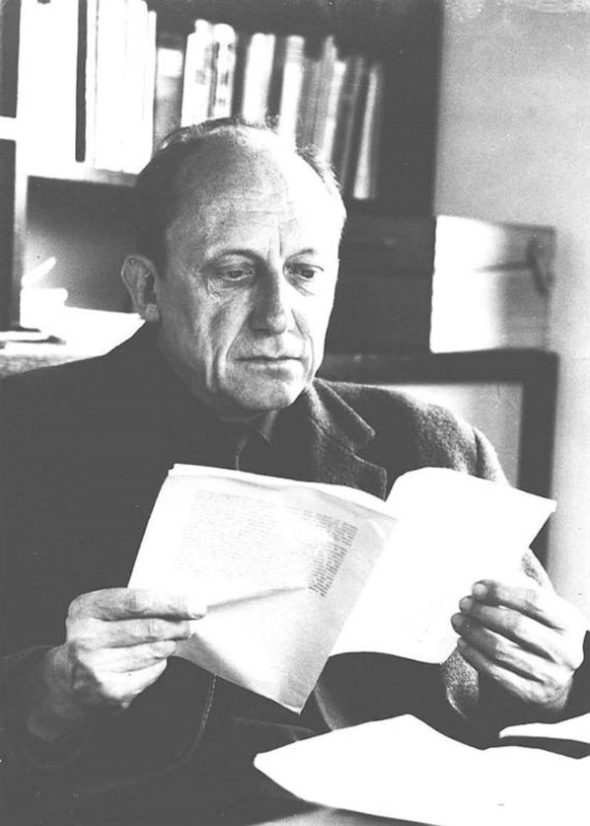
10 Years
Gentner Programme
Wolfgang Gentner (1906 – 1980)
  German nuclear scientist
    major research: nuclear photo effect, gamma rays, biophysics, archaeometry
  connected to CERN from the early days
    participating in negotiations leading to the foundation of CERN (together with Werner Heisenberg)
    director of the CERN synchrocyclotron and first CERN Research Director 1954 – 1959
    chair of CERN Scientific Policy Committee 1969 – 1971
  President of CERN Council 1972 – 1974
  appointed 1959 as first director of the new Max-Planck-Institute for Nuclear Physics in Heidelberg

Slide 5
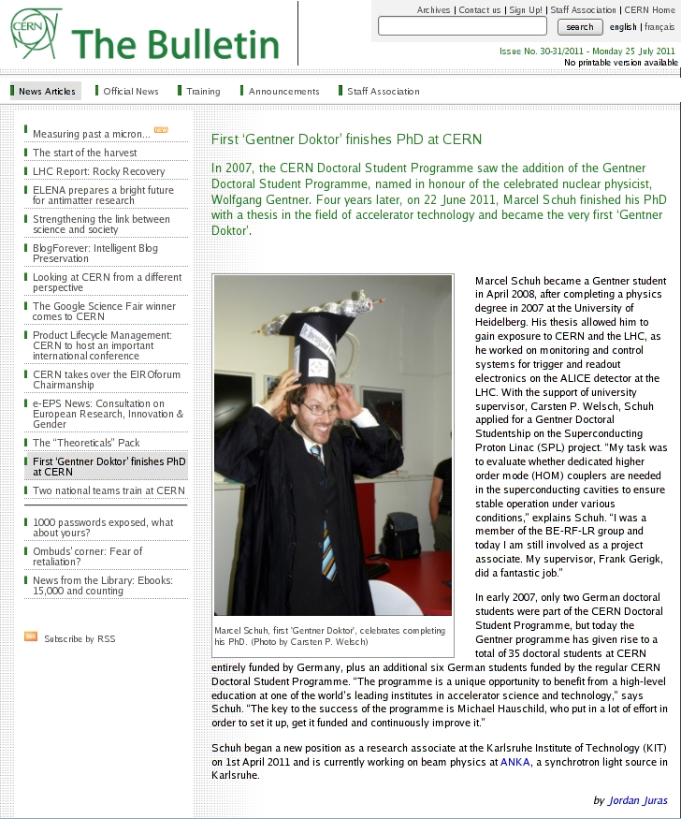
10 Years
Gentner Programme
First Gentner Day: 18 November 2009
  after ramp-up to ~25 Students
  annual Gentner Days until 2014
  since 2015 semi-annual
First ‘Gentner-Doktor’ made his PhD 22 June 2011
  Marcel Schuh
    now at Karlsruhe Institute of Technology (KIT)
Second Gentner Agreement signed September 2011
  valid from 2012 – 2017
    new: also EU nationals are eligible to become Gentner Students

Slide 6

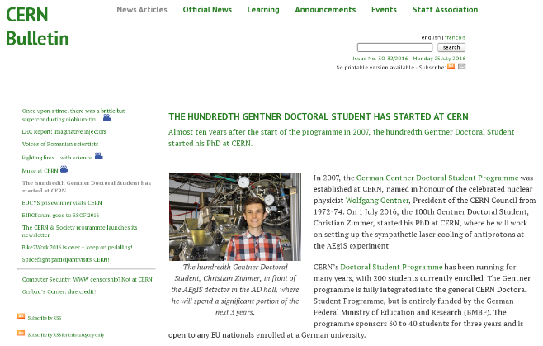
10 Years
Gentner Programme
2012/13
  brochures + new website (German/English)
January 2015
  drastic change of CHF – EUR exchange rate (-15%)
    consequence: less funding available, some reduction in number of Students
100th Gentner Student started 1 July 2016
  Christian Zimmer (Heidelberg)
Prolongation signed on 31 March 2017
  New agreement valid until 2023 (3 + 3x1 years)
  Funding increased to 1.95 M€/year
    sufficient for (on average) 39 Students as foreseen in initial Programme

Slide 7
Gentner Programme
Main Programme points
  special German Doctoral Student Programme
    in addition to the existing CERN Doctoral Student Programme
    (almost) identical conditions except funding (subsistence) by BMBF
    extra funds for Students’ travel to Germany and for Supervisors’ travel to CERN
    open to EU nationals from CERN Members (Member States + Associate Member States)
  mid- and long term goals
    better usage of CERN resources by Germany
    better connection between German Universities and CERN
    long-term: more German staff at CERN
      presently only ~6.7% German staff (175/2600), but 20.4% contribution of DE to CERN budget
      IT: 11.7% (10.6% contribution), GB: 8.1% (15.1% contribution), ES: 6.4% (7.2% contribution)

Slide 8
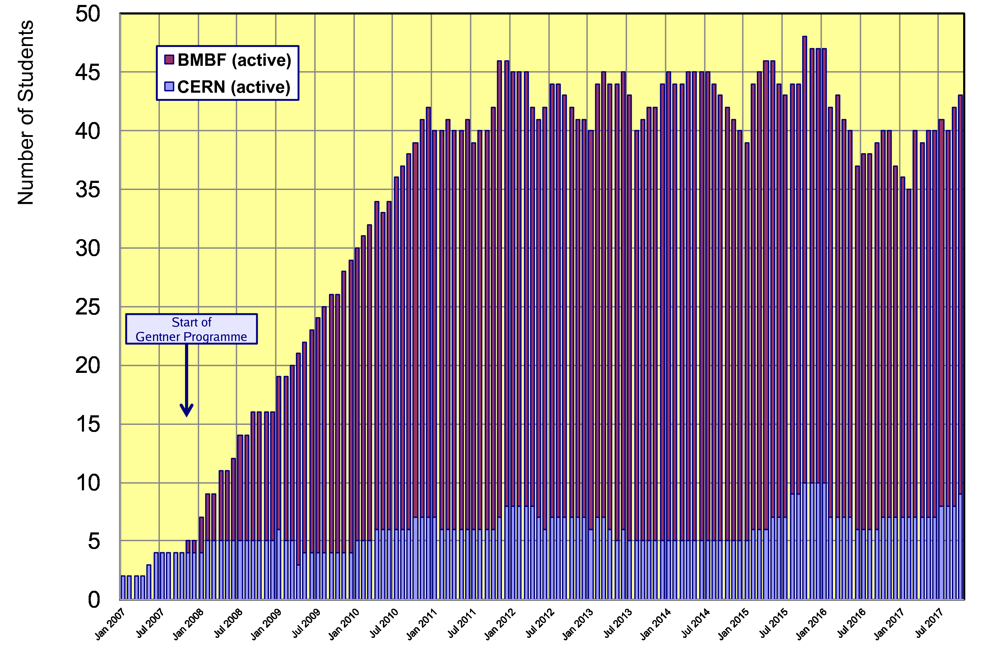
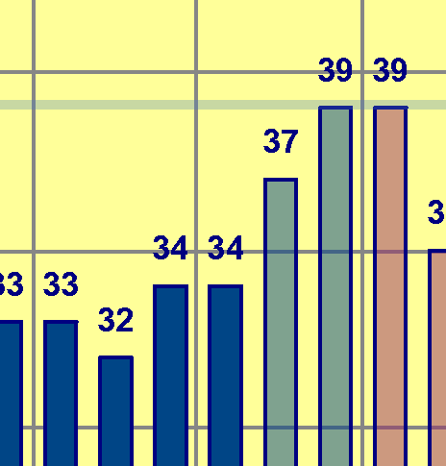
Status Gentner Programme
Presently 34 active Gentner Students (7 female = 21%)
    + 9 Germans in regular CERN Programme
  Expect to raise up to 39 Students in Dec 2017 / Jan 2018
Downward
trend!
Slight drop due to EUR/CHF exchange rate
Recovery in the next months
Oct 2017
Nov 2017
Jan 2018
Dec 2017

Slide 9
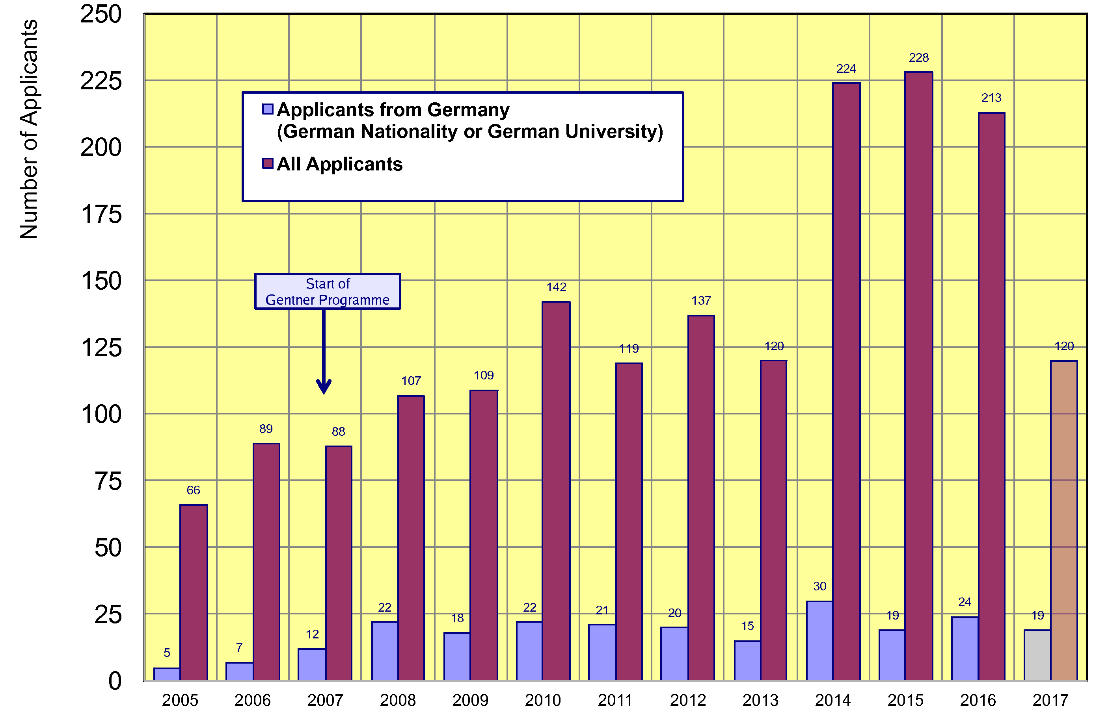
Doctoral Student Applications
Typically ~21 applicants/year from Germany (~stable since 2008)
    19 applications from DE in first selection round 2017 → new overall high
only one selection
board in 2017 so far
~21

Slide 10
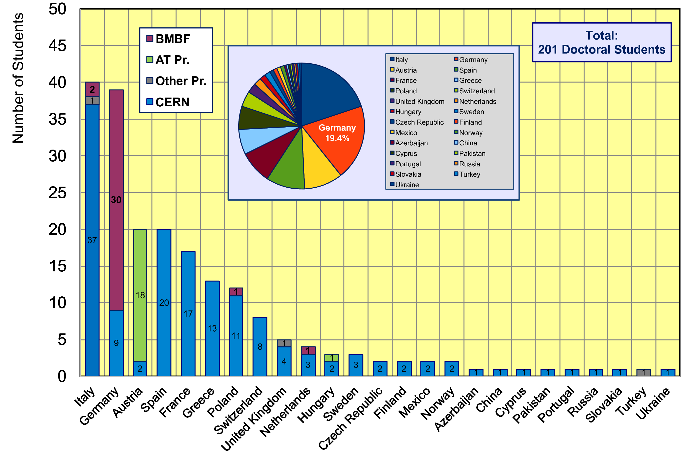
CERN Doctoral Students
Nationalities of all Doctoral Students at CERN
  Italians (40 Students) + Germans (39 Students) are leading

Slide 11
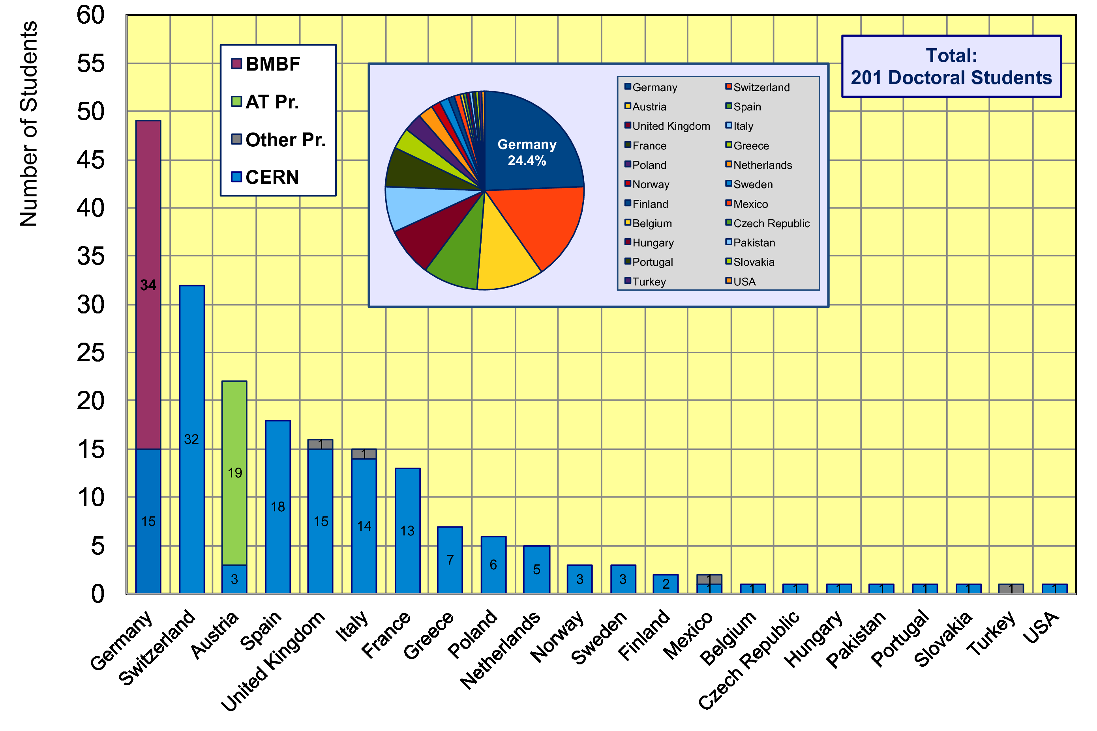
CERN Doctoral Students
Institute Country of all Doctoral Students
  49/201 Students enrolled at German Universities (24.4%)

Slide 12
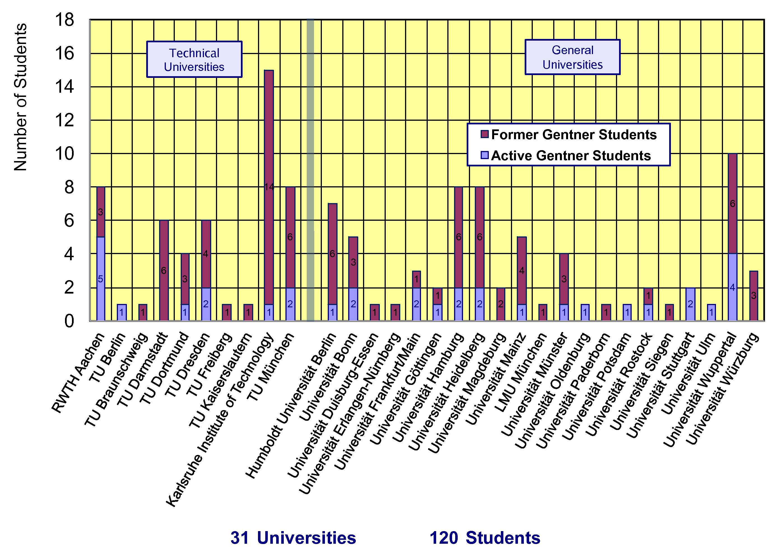
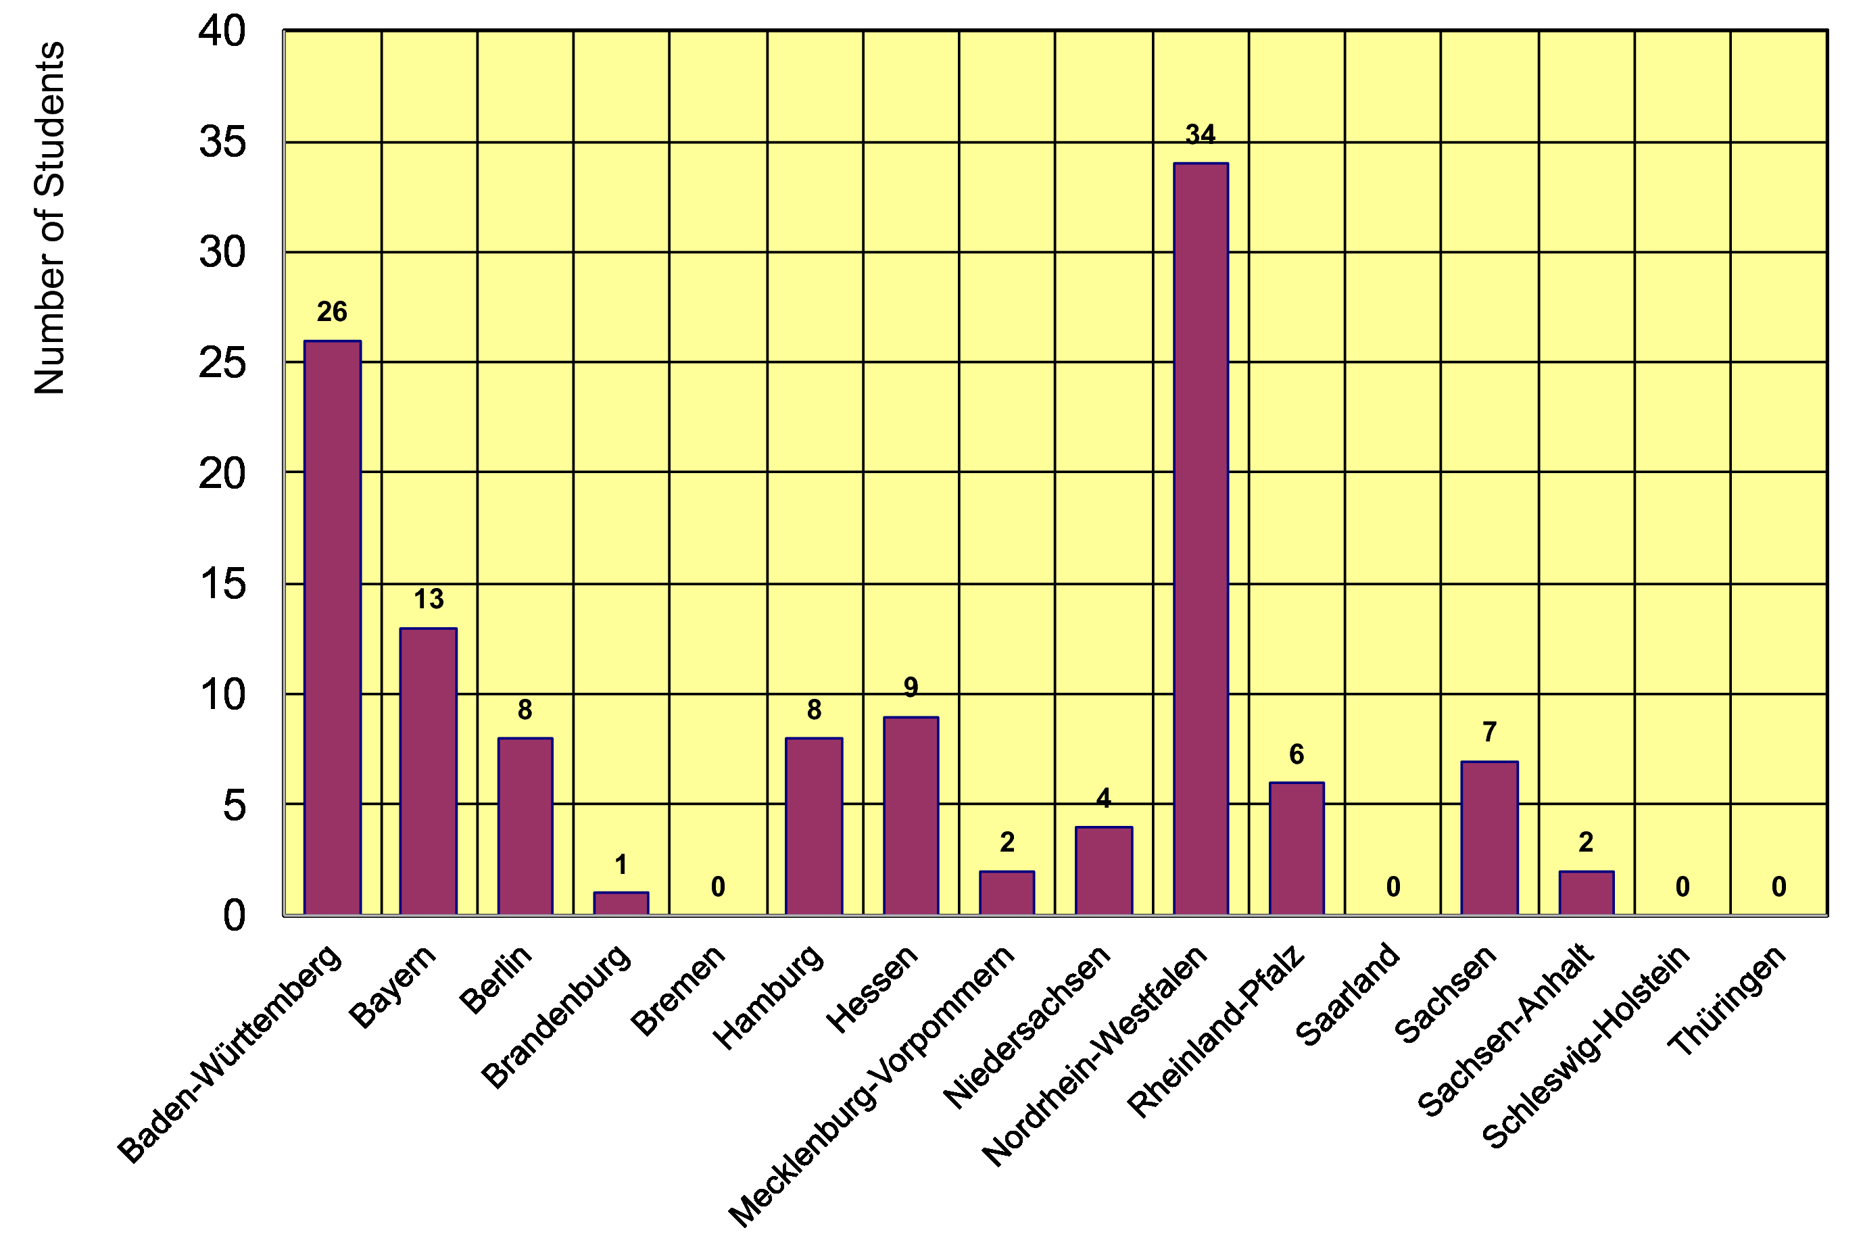
Gentner Students
  coming from 31 different Universities in DE
    also from university groups without or with little CERN contacts beforehand
  43% of Gentner Students from Technical Universities (stable since many years)
  12/16 German States
    NRW and BW are leading
    only a few small(er) States are missing

Slide 13
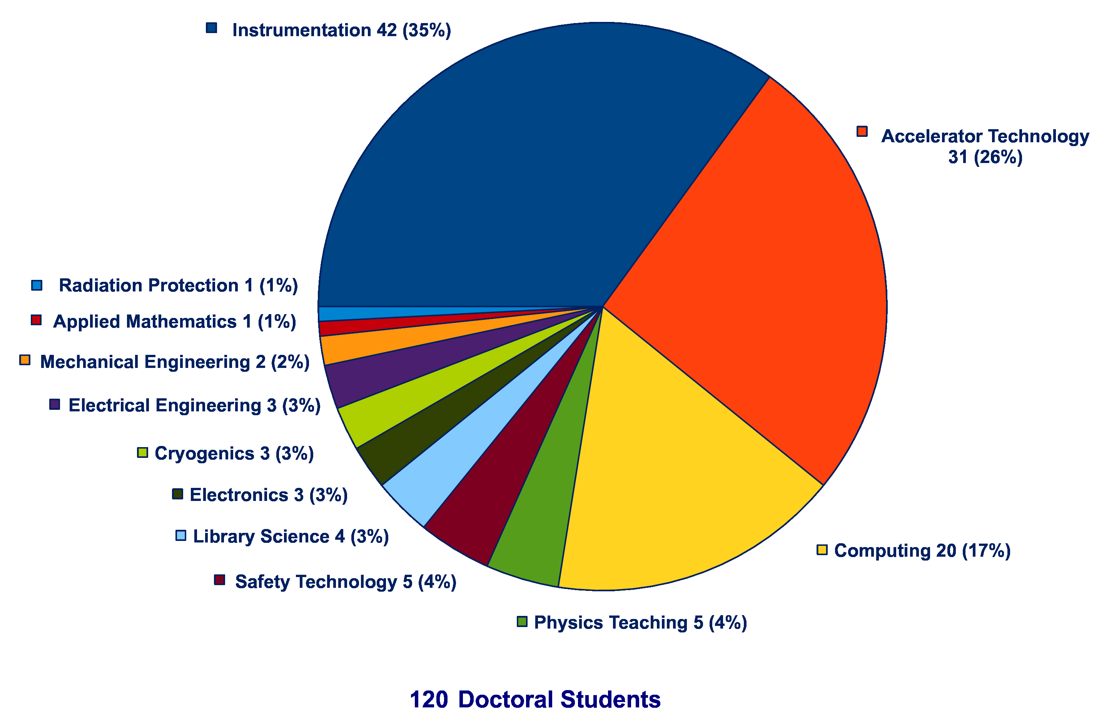
Thesis Topics of Gentner Students
(active + former)
Majority of topics in Instrumentation (35%), Accelerator Technology (26%), Computing (17%), all others = 23%

Slide 14
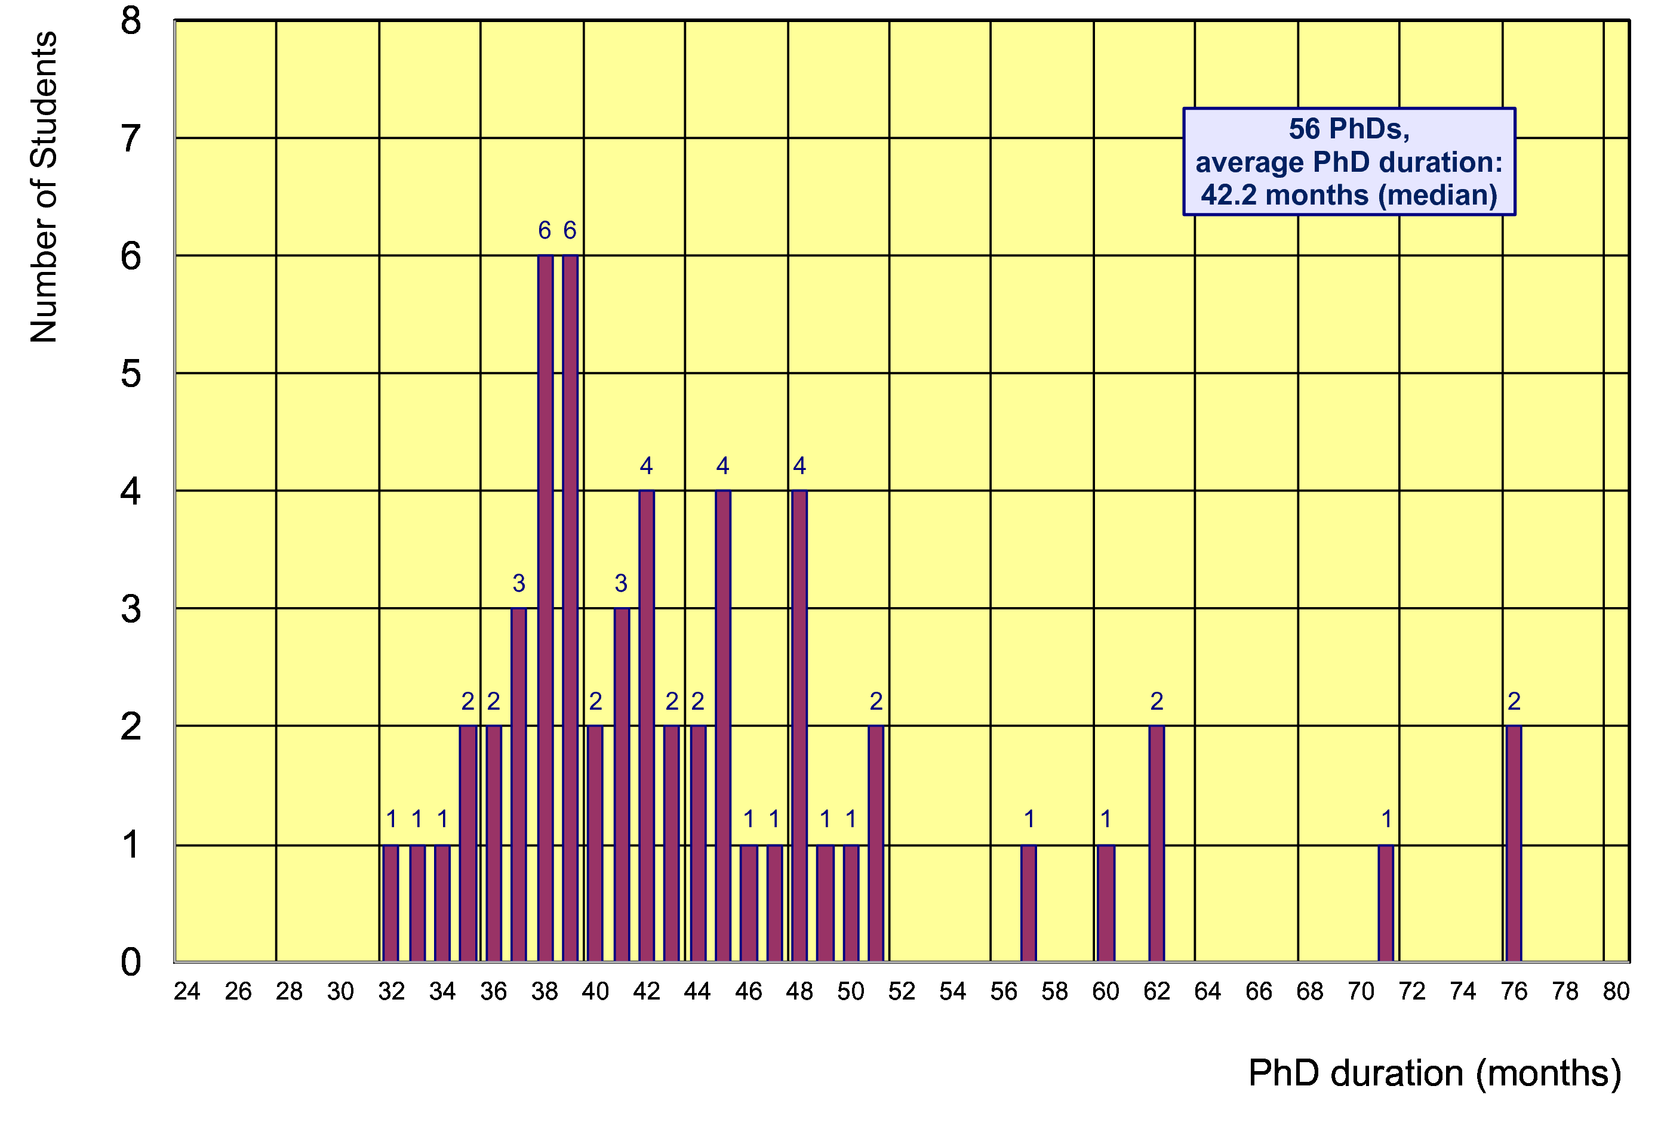
Former Gentner Students
56 PhDs so far (12 female = 21%), 7 Students have cancelled their PhD
    average age at PhD (defense): 30.5 years (median)
    average duration of PhD: 42.2 months (median) = 5.8 months after end of CERN 3-years contract
Physics PhDs in Germany (2016)
22% female PhDs students
30.7 years (median) at PhD
50.4 months (median) duration of PhD

Slide 15
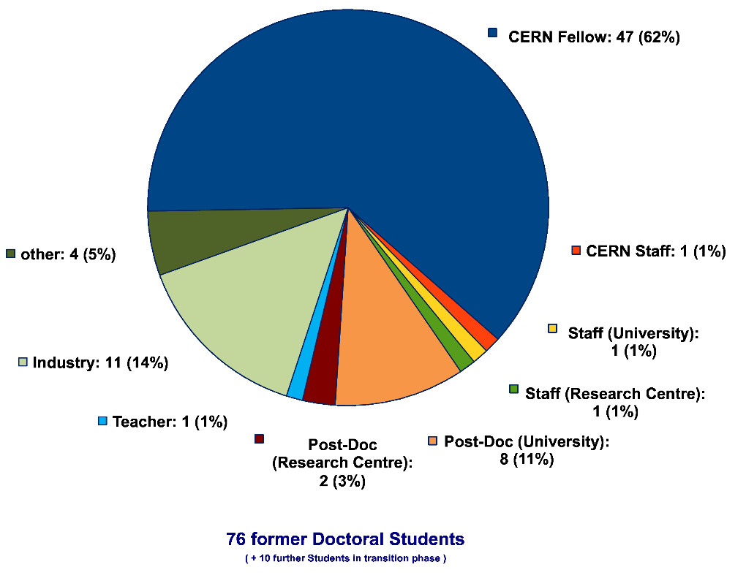
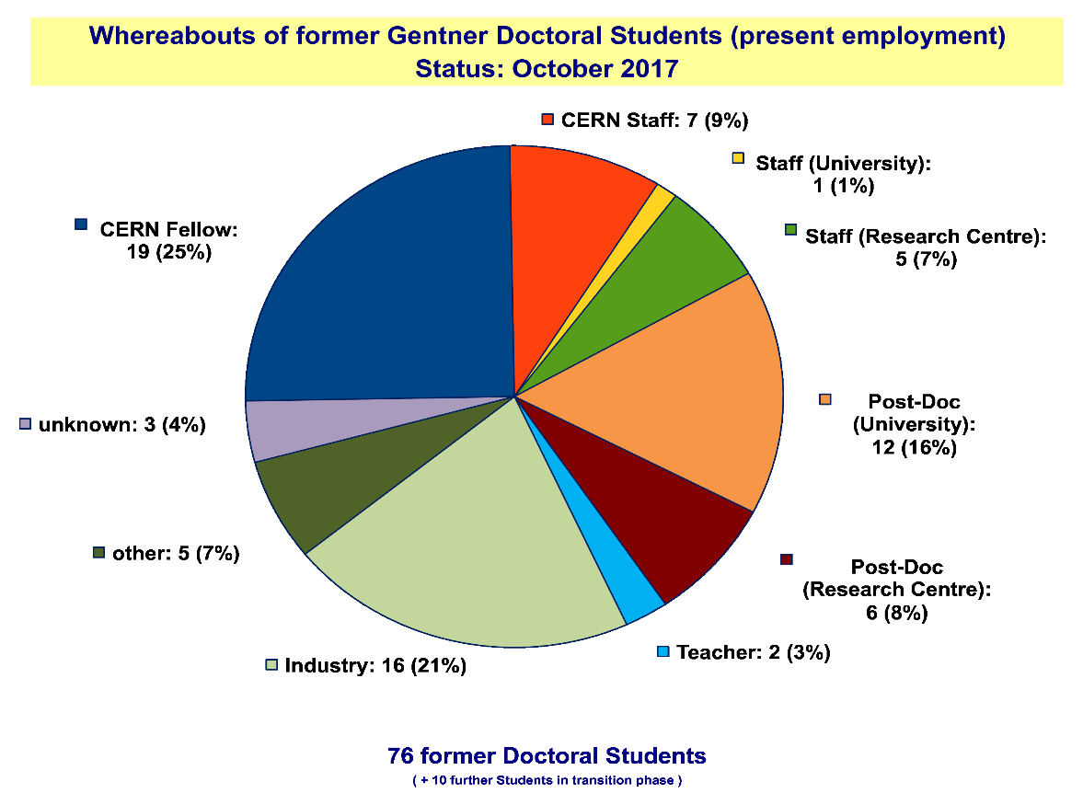
Whereabouts of Gentner Students
  first employment of >60% of the Gentner Students: CERN Fellow(!)
First Employment
Present Employment
presently 7 CERN Staff Members,
1 with indefinite contract (since 1 April 2016)
2 Staff now are supervising
Gentner students

Slide 16
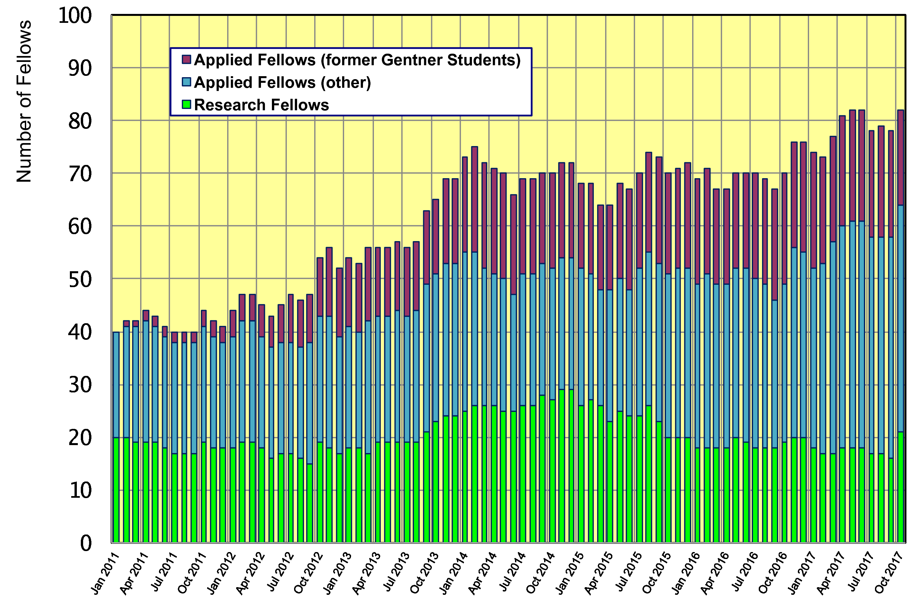
Gentner Students → Fellows
  significant increase of DE Fellows by former Gentner Students
    about 40% of German Applied Fellows are former Gentner Students

Slide 17
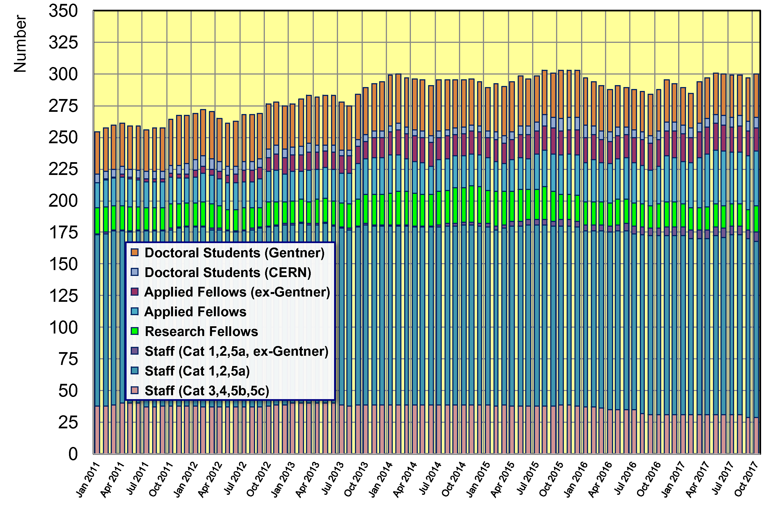
Gentner Students → Fellows, Staff
  300 German Doctoral Students, Fellows and Staff right now
    30 active + 25 former (German) Gentner Students at CERN (=18%)

Slide 18
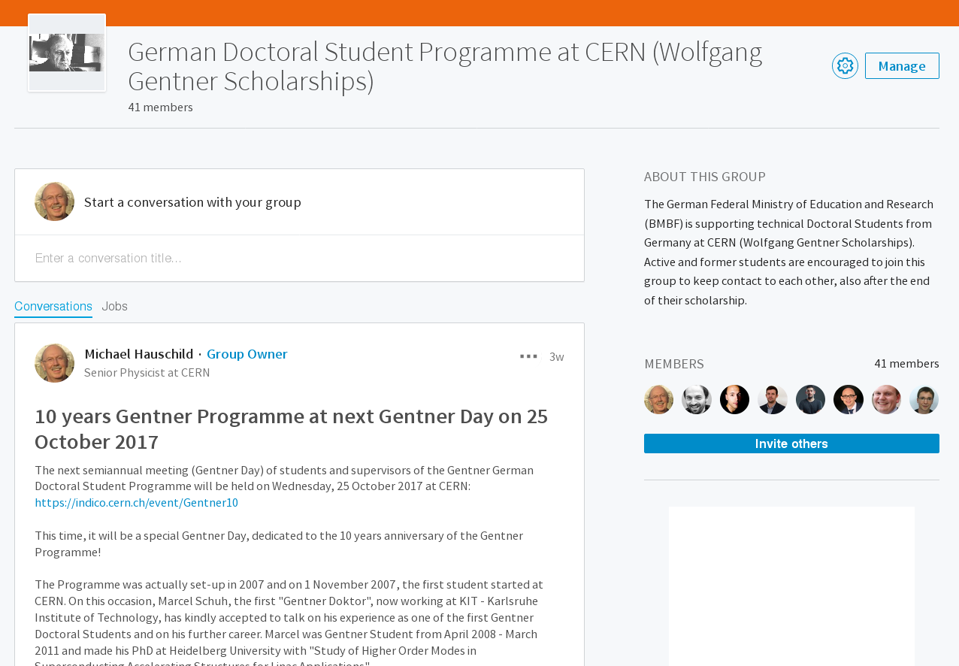
Gentner LinkedIn Group
Gentner Group @ LinkedIn (active + former Students)
  54 of 120 active + former Students are at LinkedIn professional network
    presently 40 Students in Gentner Group
    important to follow whereabouts of former Students (feedback to BMBF!)
    + good way to stay connected

Slide 19
General News and Remarks
Travel
  travel to home university constantly used (stable over years)
  trend since 2015:
    ~25% less travel to DPG Physical Society Spring Meetings + other national society meetings
    please make use of these opportunities, funding available and should be used!
Very important!!!
  when finishing → please keep me informed on your further whereabouts + upload your thesis to CDS
  key figures needed for BMBF indicating the Programme success!

Slide 20
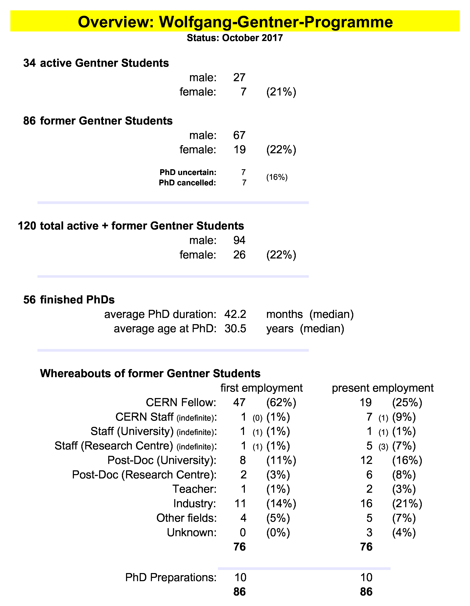
Summary Gentner Programme
  Prolongation of Gentner Programme signed in April 2017 by BMBF, CERN, DESY
  New agreement valid 3 years + 3x1 years → end of 2023
  Identical conditions (e.g. students to be enrolled in DE, EU citizenship)
  Funding increased to 1.95 M€/year (+13.4%) → sufficient for (on average) 39 Students as foreseen in initial Programme
Next Gentner Day:
25 April 2018 (tbc)

